Slide 1


Measurements of X-rays from kaonic lead with an HPGe detector at DAPHNE
Damir Bosnar
Department of Physics, University of Zagreb, Zagreb, Croatia
& SIDDHARTA-2 collaboration
Motivation
Preparations and measurements at DAɸNE during SIDDHARTA-2 run
Results and conclusion
Supported by
Croatian Science Foundation
Project IP-2022-10-3878
XGRADE 2026: Advances in X-ray & Gamma Ray Detectors and Applications, Palermo, 24.-26. 03. 2026

Slide 2
Motivation
Precise measurement of the charged kaon mass ;
Theoretical interest in precise measurements of X-ray transitions in heavy atoms
The accuracy of the determination of the charged kaon mass (m_{K}=493.677±0.016 MeV, 32 p.p.m.) is much less than the accuracy of the charged pion mass (m_{π}=139. 57061±0.00023 MeV, 1.6 p.p.m.), PDG2022.
Kaon mass has large influence on the K⁻N scattering lengths and through them on the kaon-nucleon sigma terms and eventually degree of chiral symmetry breaking.
Theoretical interest in precise measurements of X-ray transitions in heavy atoms
Kaonic atoms, charmed mesons, searches beyond standard model.

Slide 3
Measurements of kaon mass, history
Q value K⁻->π⁺+π⁻+π⁻
( W.H. Barkas, Annu. Rev. Nuclear Sci. 15 (1965) 67) m_{K}=493.75+0.16 MeV
Range measurements in emulsions
(A. Barbaro-Galtieri et al., Revs. Mod. Phys. 42 (1970) 87, m_{K}=493.7+0.3 MeV;
L.M. Barkov et al. Nucl. Phys. B148 (1979) 53 (ɸ->K+K-)) m_{K}=493.670+0.029 MeV
Energies of X-ray transitions in kaonic atoms, m_{K}=493.677 ± 0.016 MeV
all with energetic kaons (PDG2022)

Slide 4
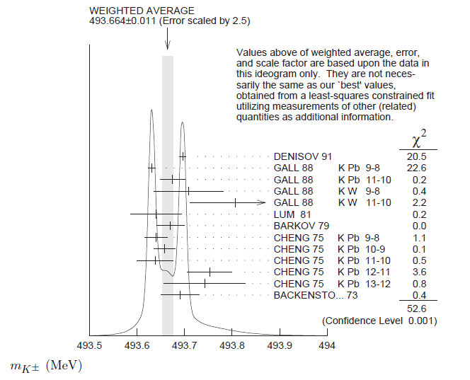
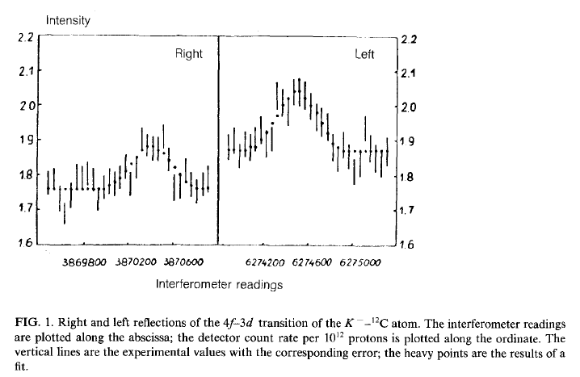
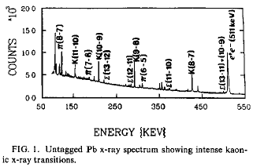
PDG:
The main disagreement is between the two most recent and precise measurements (x-ray energies from kaonic atoms):
m_{K}=493.696±0.007 MeV
A.S. Denisov et al. JEPT Lett. 54 (1991)558
K⁻ ¹²C, crystal diffraction spectrometer
(6.3 eV at 22.1 keV), 4f-3d
m_{K}=493.636±0.011 MeV
K.P. Gall et al. Phys. Rev. Lett. 60 (1988)186
K⁻ Pb, K⁻ W; HPGe detector (1 keV), K⁻Pb (9 -> 8),
K⁻Pb (11 -> 10), K⁻W (9 -> 8), K⁻W (11 -> 10),
m_{K}=493.677 ± 0.016 MeV
Average m_{K}=493.679 ± 0.006 MeV S=2.8

Slide 5
Previous measurements, motivation
PDG:
PDG conclusion:
” While we suspect that the GALL 88 K− Pb (9 ->8) measurements could be the problem, we are unable to find clear grounds for rejecting it. Therefore, we retain their measurement in the average and accept the large scale factor until further information can be obtained from new measurements and/or from reanalysis of GALL 88 and CHENG 75 data”.
It is sufficient that the new measurement has the same precision (10 keV) as the 2 previously mentioned measurements, which differ by 60 keV (PLB535 (2002)52):
-if the new result agrees with Denisov (and results from Gall are disregarded) the precision would be 5 keV (10 p.p.m)
-it the new results agrees with Gall, the precision would be 7 keV (14 p.p.m.)
-> substantial improvement in the precision

Slide 6
Principles of measurements of kaon mass in kaonic atoms
Measure X-ray energies in kaonic atoms for transitions not influenced by strong interactions.
In order to determine the kaon mass, measured energies have to be compared with the calculated energies obtained with a certain K-mass value (corrections: vacuum polarization, electron screening, non-circular trasitions)
Measurements with HPGe detectors and with crystal diffraction spectrometer, TES, …

Slide 7
Principles of measurements of kaon mass in kaonic atoms: X-ray energies in kaonic atoms
Measured energies have to be compared with the calculated energies obtained with a certain K-mass value (corrections: vacuum polarization, electron screening, non-circular…
K⁻
1) Kaon capture
^{e-}
X-ray
Interesting are X-rays from
the transitions in the middle
of cascading spectrum:
No influence from strong
interaction
avoid electron screening
of nuclei
->advantage – heavy atoms
2) Kaon cascade
3) Kaon absorption
Measurements with: HPGe detectors
crystal diffraction spectrometer, TES,…

Slide 8
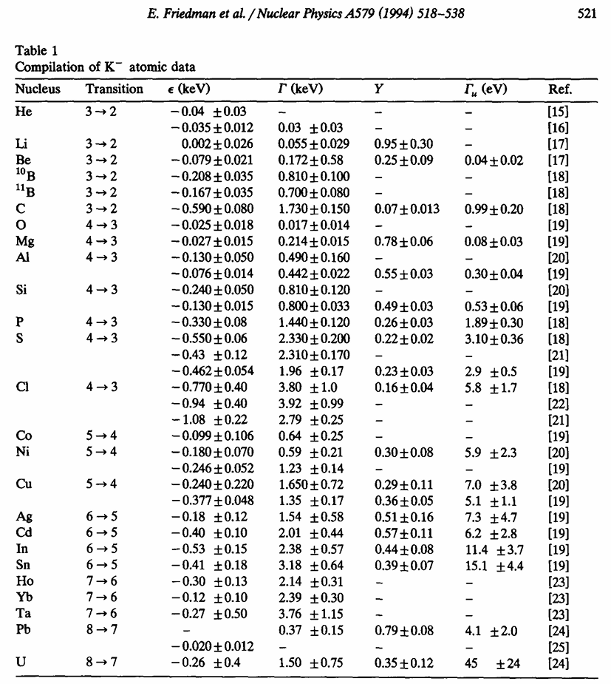
Motivation: Precise determination of transition lines in heavy kaonic atoms

Slide 9
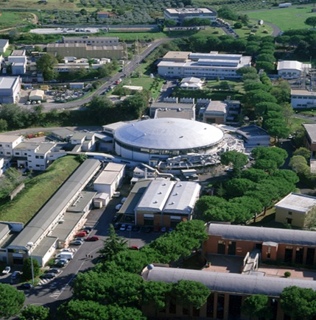
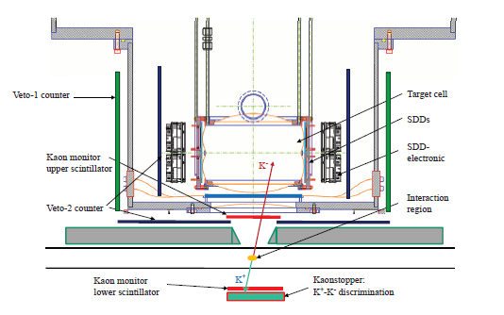
SIDDHARTA-2 at DAɸNE Silicon Drift Detector for Hadronic Atom Research by Timing Application
-> We performed a feasibility measurement with an HPGe detector during SIDDHARTA-2 run at DAɸNE - using the available space at the SIDDHARTA-2 interaction region and with a Pb target
DAɸNE:
e⁺+e⁻-- -> ɸ -> K⁺K⁻, E_{K} ≈ 16 MeV
SIDDHARTA-2 run: X-ray transitions in gaseous targets: deuterium, helium, …
Advantage: DAɸNE is producing low momenta kaon pairs – no need for degrader. No secondary hadronic particles in the beam.
Disadvantage: High background from the beam close to the interaction point (unknown –> one of the main goals of this feasibility study!).
In both cases: background originating from the kaons absorbed in nuclei, GEANT4 simulations indicate it is acceptable

Slide 10
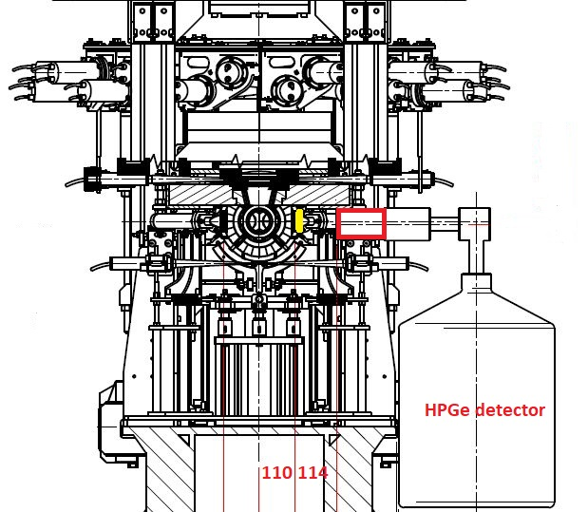
Measurement at DAɸNE with HPGe during SIDDHARTA-2 run
Signal from the luminometer
(80x40x2 mm³) as a trigger
for HPGe detector.
Interaction point
Positions of the target
and the HPGe detector
is restricted by
SIDDHARTA-2 setup
Measurement of transit times
of the particles from IP to the
scintillator.
¹³³Ba source for the calibration and monitoring of
the HPGe resolution.

Slide 11
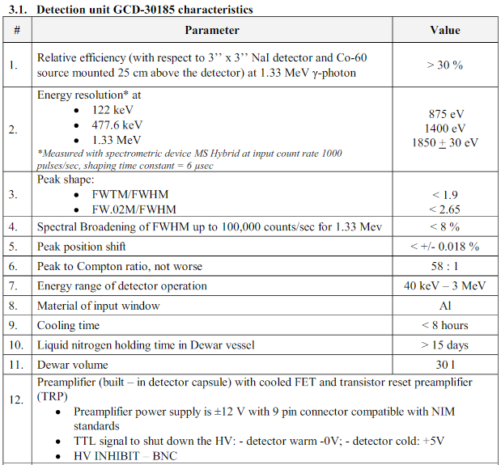
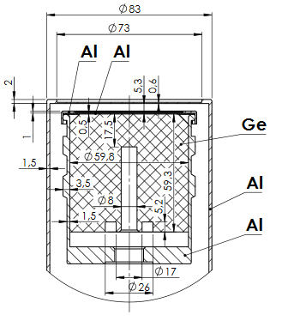
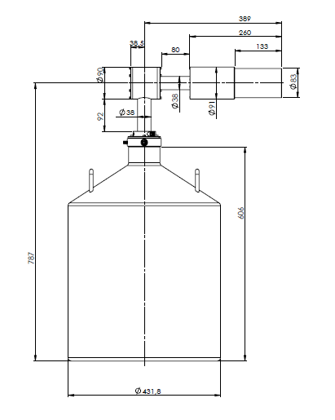
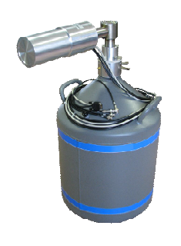
Measurement at DAɸNE with HPGe during SIDDHARTA-2
BSI HPGe detector with
transistor reset preamplifier (TRP)
HPGe active detector diameter ~60 mm, height ~60 mm.
(Analog electronics) and fast pulse digitizer.

Slide 12
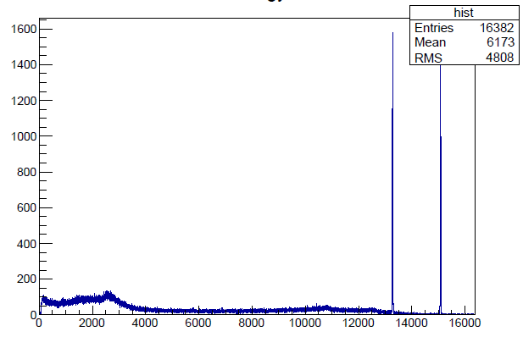
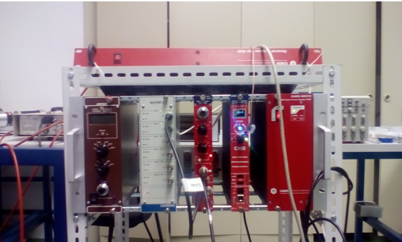
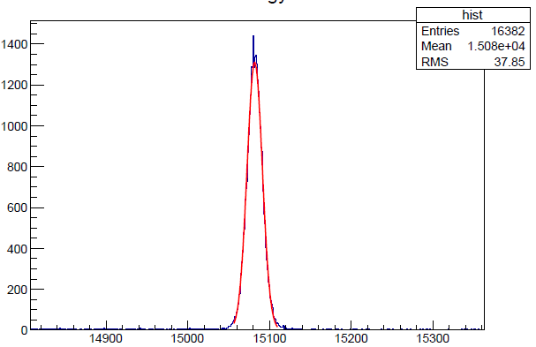
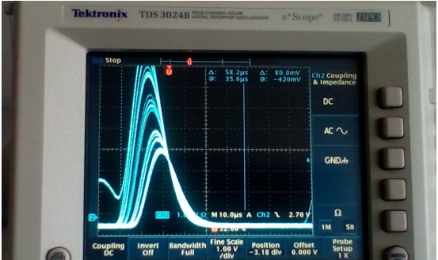
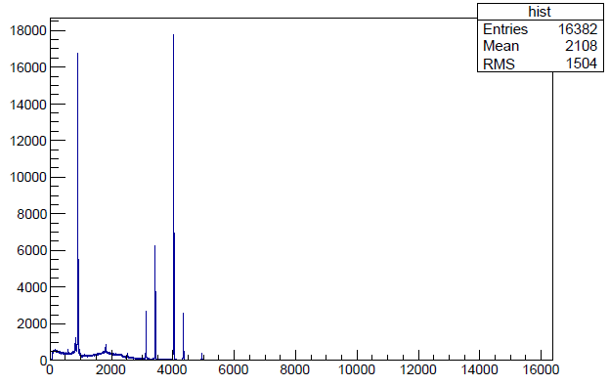
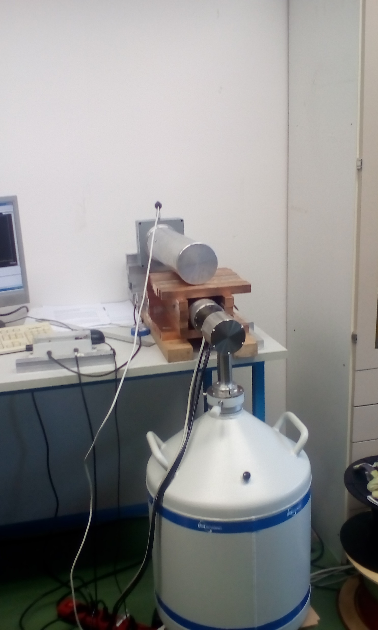
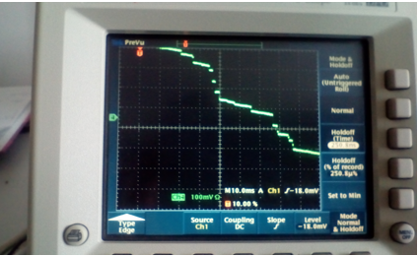
Laboratory tests of HPGe (BSI - TRP preamp) & analog electronics
Signal from spectroscopy amplifier
Signal from preamp of HPGe with TRP
Pb lines
Stability tests
⁶⁰Co, ¹³³Ba spectra,
resolutions: 0.870 keV at 81 keV
1.06 keV at 302.9 keV
1.11 keV at 356 keV
1.67 keV at 1330 keV
CAEN spectroscopy amplifier N968, Canberra
Multiport II, Canberra Genius DAQ + analysis

Slide 13

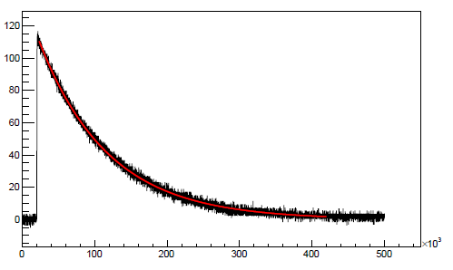
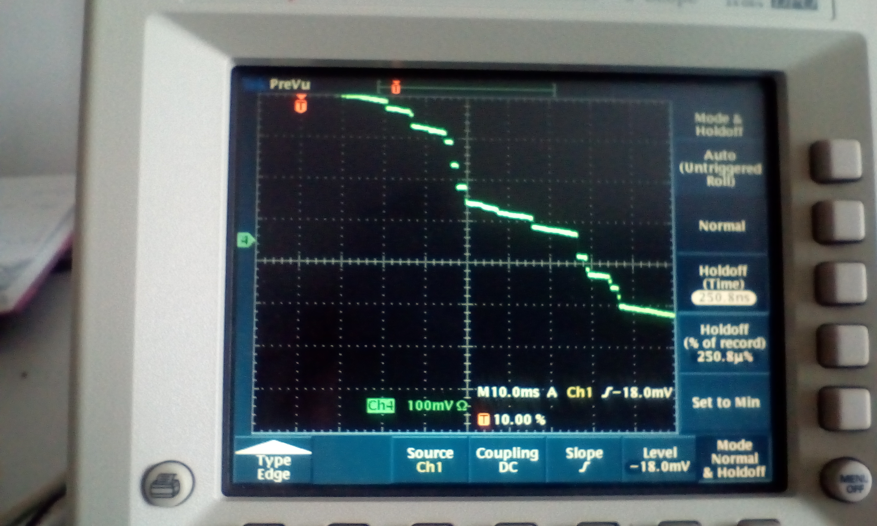
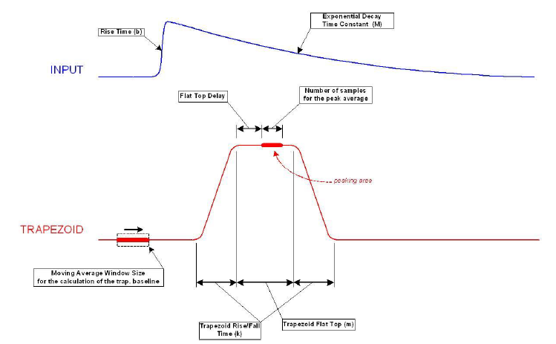
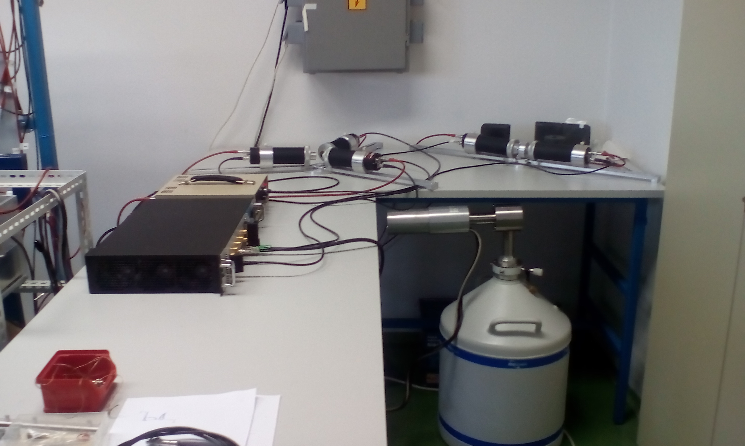
Laboratory tests of HPGe (BSI - TRP preamp) & fast pulse digitizer, CAEN DT5781 4 ch, 14 bit,
CAEN DT5781 4 ch, 14 bit, 10ns sampling time
Signal from spectroscopy amplifier ~20 μs (shaping time 6 μs),
restriction on the rate.
Digital Pulse Processing for Pulse Height Analysis firmware , based on
V.T. Jordanov et al. Nucl. Instr. Meth. A 353
(1994) 337
Signal from HPGe with RC preamp
Signal from preamp of HPGe with TRP
Possible rates up to 150 kHz, something worse resolution
Coincidences – HPGe + luminometer

Slide 14
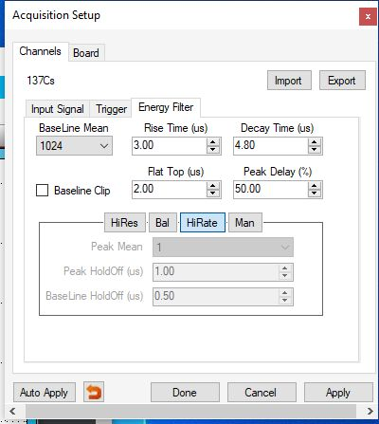
Adjustment of the parameters for energy reconstruction
V.T. Jordanov et al. Nucl. Instr. Meth. A 353 (1994) 337
Resolution 1.3 keV at 302.9 keV

Slide 15
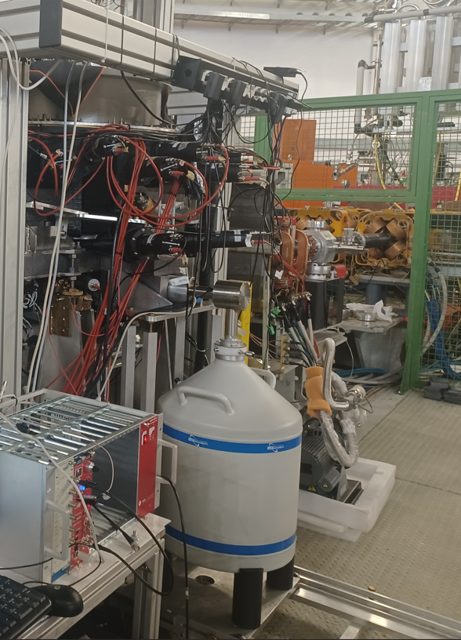
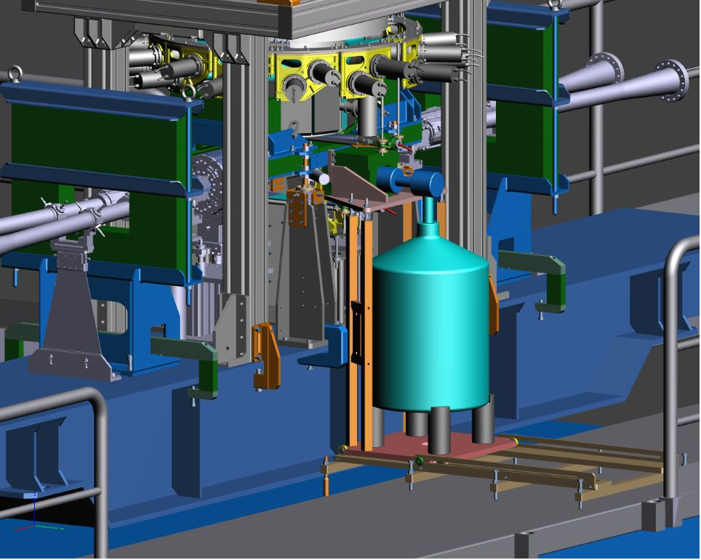
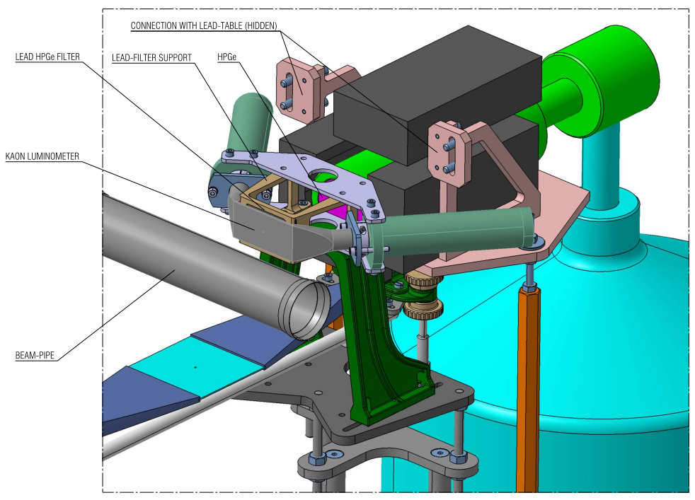
HPGe in the DAΦNE hall

Slide 16
Simulations – GEANT4
To estimate the thickness of the target, setup configuration and HPGe efficiency.
To estimate background – from the kaon absorption and to determine optimal position of the detector and target and shielding .
To estimate required time for the measurements.
Not all parameters are known: beam background !? – test measurements with the beam are required.

Slide 17
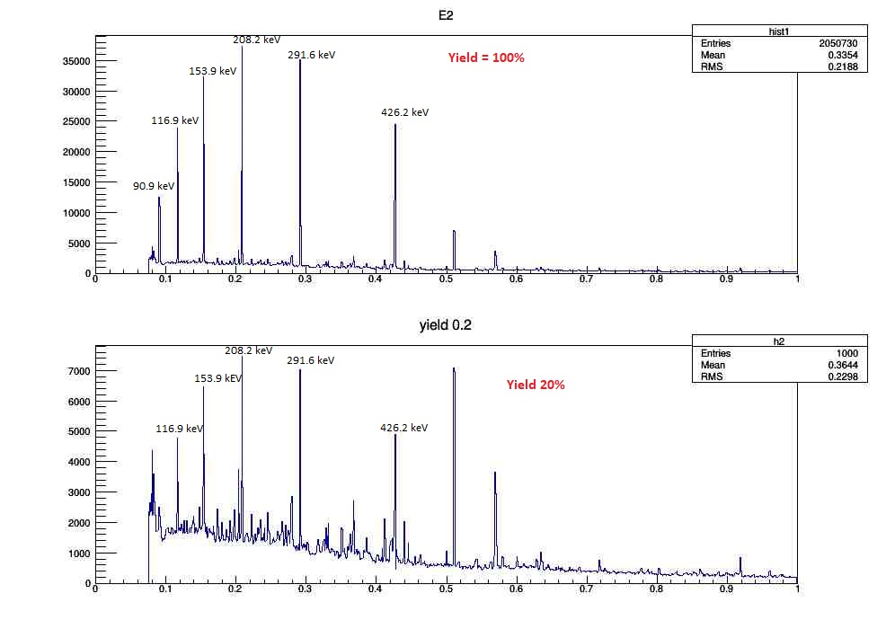
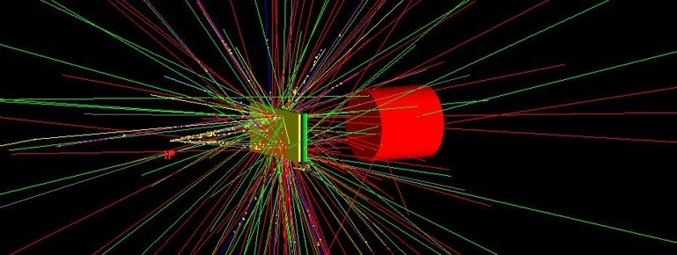
HPGe detector on d=110mm from the Pb target (closest position), 400 pb^-1
X-rays from Pb, in the peak at 291.6 keV there are approx 9.144 X-rays (yield 20%).
Approx. 9.000 X-rays in the 291.6 keV are needed for the required precisison
Only hadronic background, peaks are smeared with the detector resolution.

Slide 18
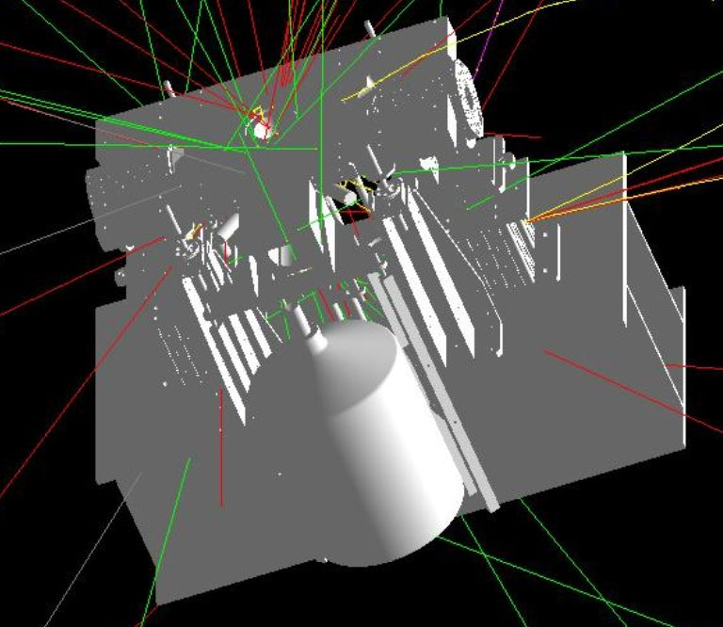
GEANT4 “full” simulation
Kaons are generated uniformly in 4π
Only hadronic background., no background from e+e- beams
CAD drawing
GEANT4 simulation
CAD files for selected objects are converted in GEANT4 gdml files for geometry description,
different materials are taken into account

Slide 19
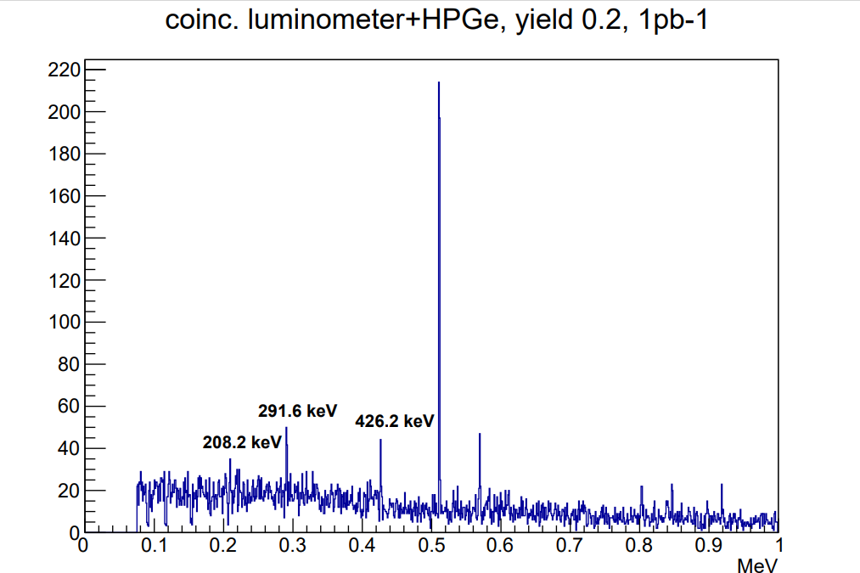
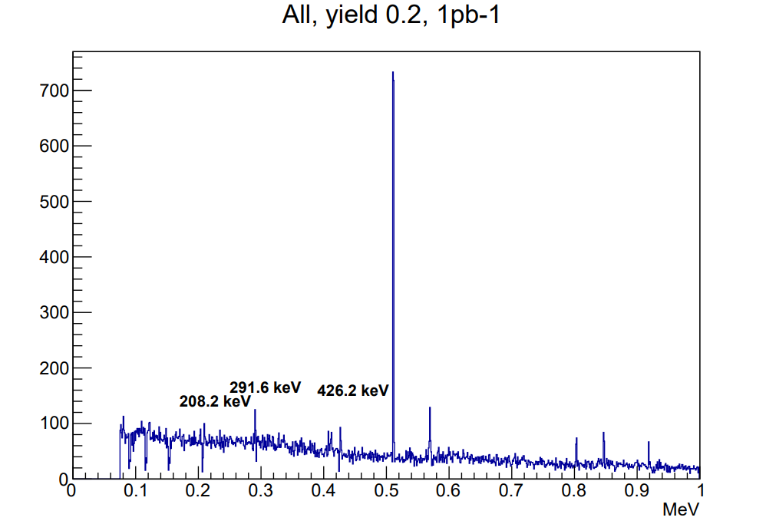
GEANT4 “full” simulation
Electromagnetic background ? -> Measurements in the hall
In principle, electromagnetic background should not have influence on this spectra
(coincidence luminometer + HPGe), but it can lead to pile-ups in the HPGe

Slide 20
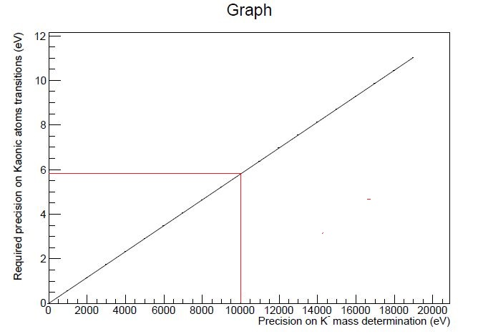
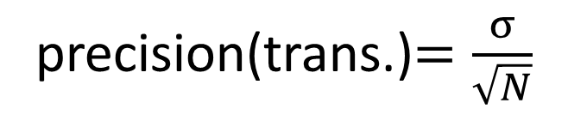
Estimation of the requested number of X-rays in the peak (Pb, 9->8 transition,291 keV)
precision(trans.)$=\frac{σ}{\sqrt{N}}$
FWHM(302.9 keV)=1.1 keV -1.3 keV (depending on the
rate)
N≈6.000-9.000 X-rays in the peak (291.6 kEV)
to reach the precision of previous
measurements (10 keV).
Estimation: A. Scordo

Slide 21
GEANT4 “full” simulation
Approx. 50 events (291.6 keV) / pb⁻¹,
10 pb⁻¹ /day -> approx. 500 events/day.
~9.000 events -> 10 keV precision (18 days)
~25.000 events-> 5 keV precision (50 days)

Slide 22
Measurement at DAɸNE with HPGe during SIDDHARTA-2 run, approx. 2 weeks
Signal from the luminometer
(80x40x2 mm³) as a trigger
for HPGe detector.
+
Transit times from IP to luminometer
Interaction point
Positions of the target
and the HPGe detector
is restricted by
SIDDHARTA-2 setup

Slide 23
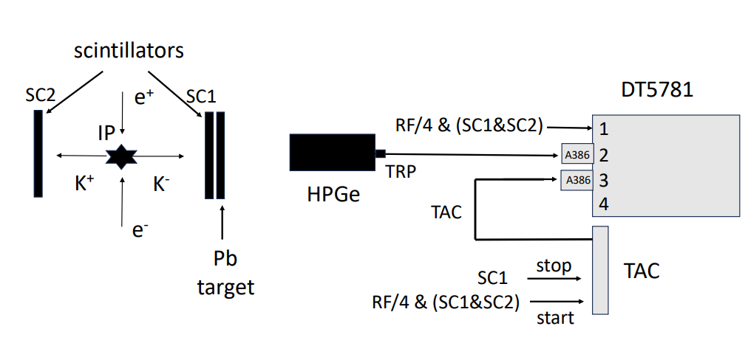
Schematic representation of electronics: -HPGe trigger -transit times from IP to SC1

Slide 24
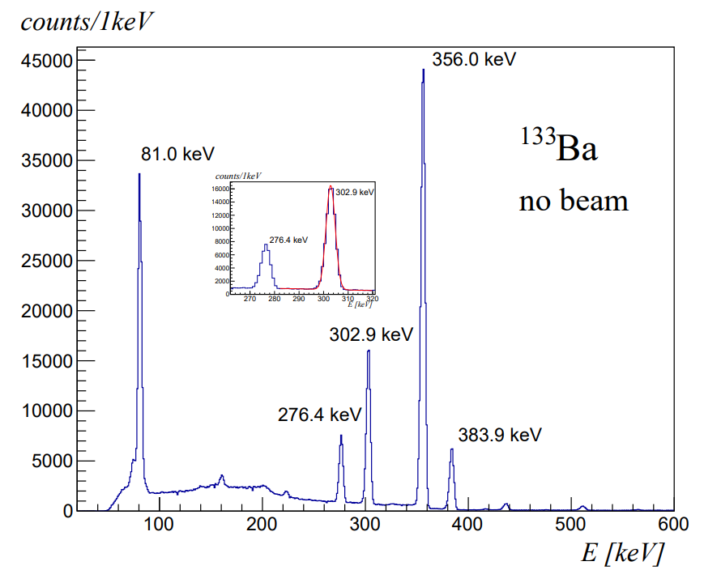
Spectrum of ¹³³Ba, without beam
Resolution at 302.9 keV = 4.39 keV
(close to (9->8) line in kaonic lead)

Slide 25
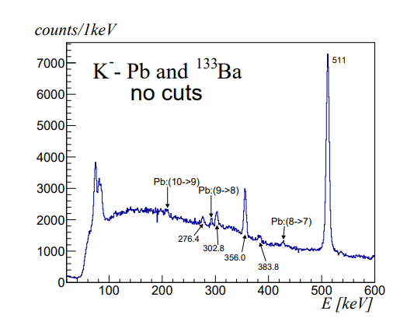
Coincidences: HPGe, Luminometer and RF
Integral luminosity ~39.4 pb⁻¹

Slide 26
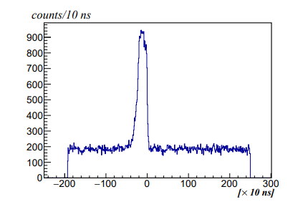
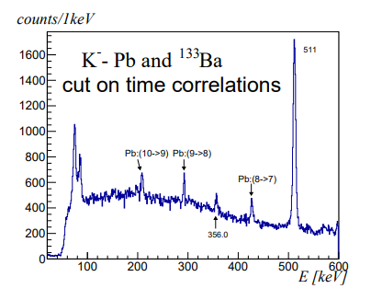
Cut on time correlations
Time correlation between signals in SC1 and HPGE
(time resolution of the digitizer is 10 ns)

Slide 27
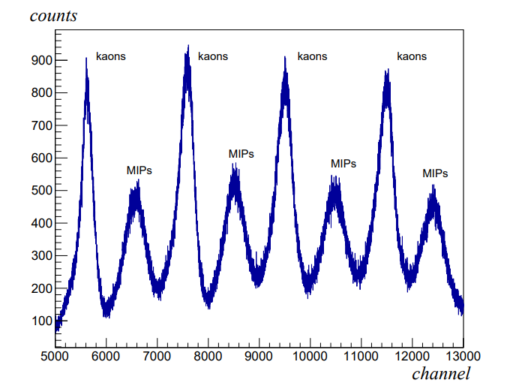
Transit times of particles from IP to the luminometer
2.7ns

Slide 28
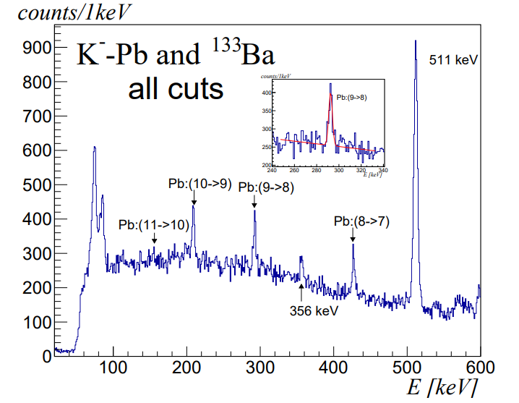
The spectrum in the HPGe – all cuts
Resolution at 292.47 keV – 3.92 keV (with ¹³³Ba at 302.8 keV without beam – 4.39 keV).
No worsening of the resolution in the full beam conditions!

Slide 29
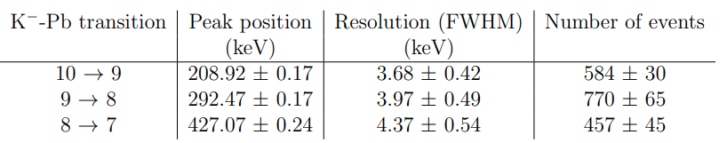
Estimation of the time of measurement for the desired accuracy of 10 keV
Integral luminosity ~39.4 pb⁻¹
Line (9->8): Integral luminosity 435 pb⁻¹ (assumed resolution of 1.3 keV)
Clearly visible lines (10->9) and (8->7) which can also be used to additionally improve
the accuracy of the charged kaon mass.

Slide 30
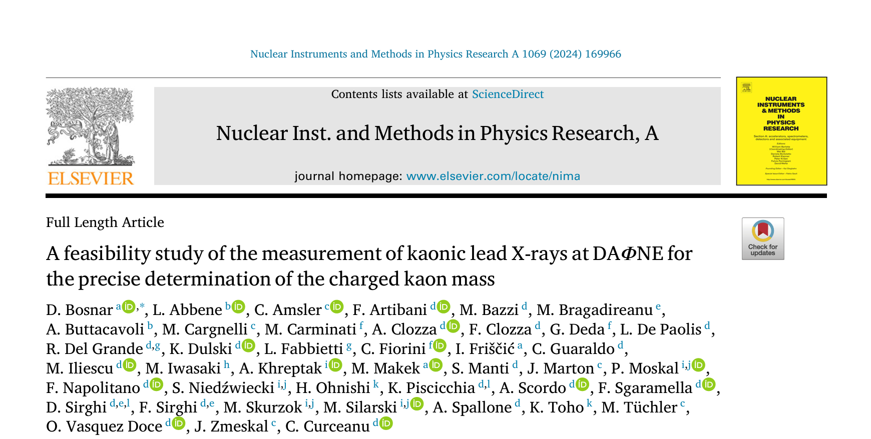

Slide 31
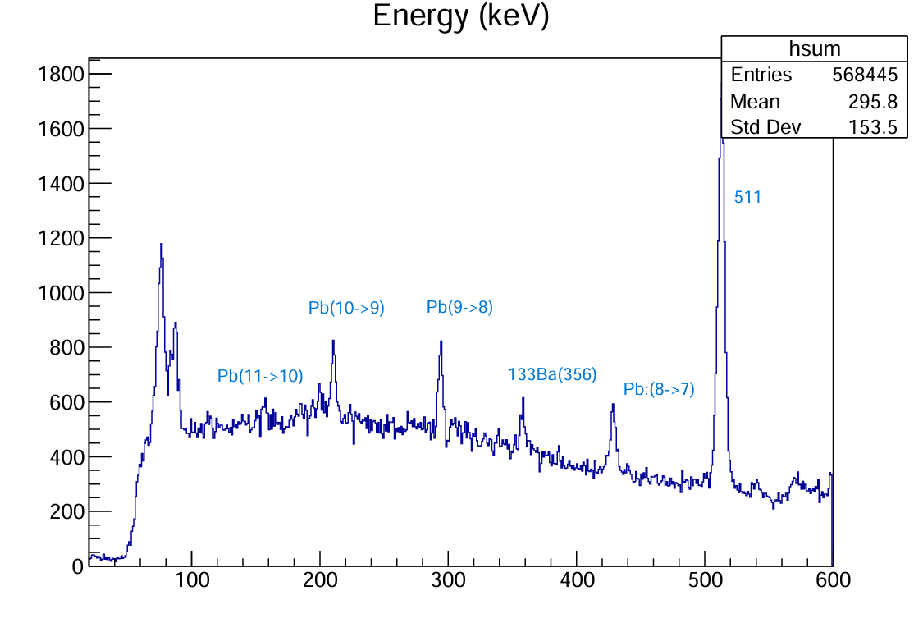
Complete analysis of all „good” data
NIM data
Precision worse than in published data
Problems with calibration
Additional analysis ongoing

Slide 32
Conclusions
We can successfully reduce the background (originating
from the beams).
There is no worsening of the HPGe resolution in the full
beam conditions.
The estimated time of the measurement to reach the
desired accuracy is realistic.
There can be measured some transitions (e.g. 8->7)
in kaonic lead with better precision.

Slide 33

Thank you for your attention !

Slide 34
Backup slides

