Slide 1
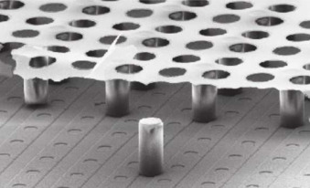
XGRADE 2026
CA24131-ENRICH
Advances in X-ray & Gamma Ray Detectors and Applications
GridPix Detector as an Advanced Alternative to IXPE GPD: Experimental Characterization and Validation with GEANT4 Simulations.
Presented by,
Saba Imtiaz , PHD Scholar, INAF-IAPS, Roma.
Co-Authors: Dr Paolo Soffitta, Dr Fabio Muleri, Dr Alessandro Di Marco, Dr Dawoon kim, Dr Markus Gruber, Dr Vladislavs Plesanovs
GridPix

Slide 2


INAF
ISTITUTO
NAZIONALE
DI ASTROFISICA
PRESENTATION ROADMAP
1
Introduction to IXPE
Overview of the IXPE Mission.
Scientific Motivation for X ray Polarimetry.
Gas pixel detector (GPD) Architecture.
How Gas Pixel Detector Work
Limitations of GPD ASIC
2
How Photoelectric Polarimeters Work
GridPix Detector Architecture and ASIC Integration.
Operational Principle of Detector.
Comparative Analysis: GridPix vs GPD.
3
The Gridpix Detector and the InGrid
Overview of Experimental Setup.
Results Obtained from Experimental Data.
Results Obtained from Simulated Data.
Comparative Analysis of Experimental and Simulated results.
4
Experimental Study and Results
5
Conclusions and Future Directions
Summary of Key Findings.
Potential Improvements and Future Research Directions.

Slide 3
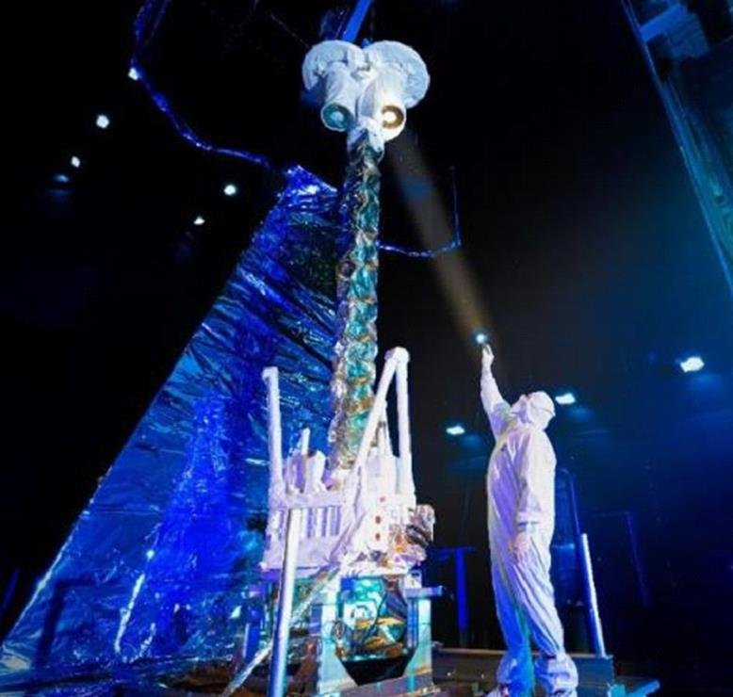
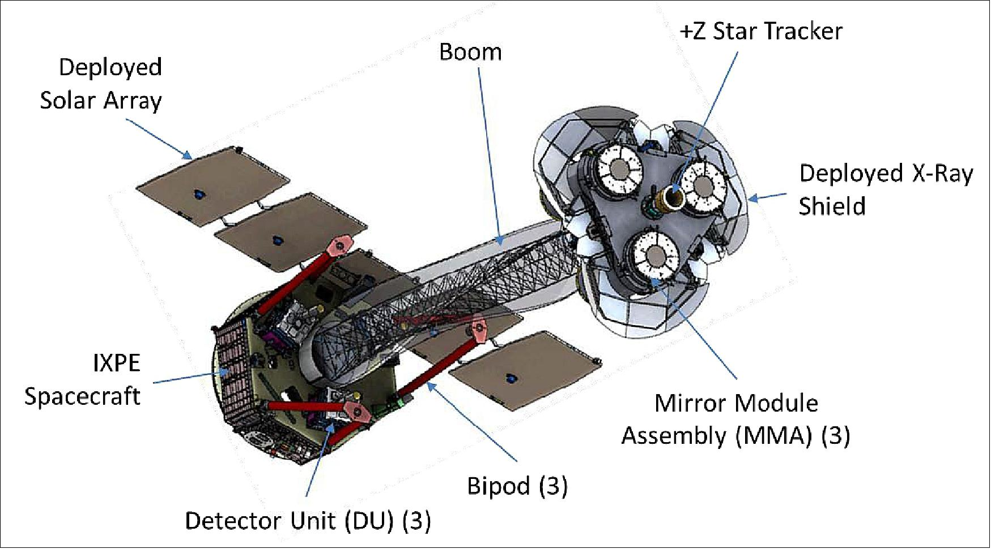
INAF
ISTITUTO
NAZIONALE
DI ASTROFISICA
INTRODUCTION
ABOUT SPACE OBSERVATORY...
The Imaging X-ray Polarimetry Explorer (IXPE), launched on 9 December 2021, carries three telescopes equipped with detectors capable of measuring the polarization of X-rays from astrophysical sources.
The detectors were developed by a team of INFN and INAF researchers.
Our Work
Weisskopf, M. C., Soffitta, P., Baldini, L., Ramsey, B. D., O’Dell, S. L., Romani, R. W., ... & Thomas, N. E. (2022).
IXPE during environmental testing
at Ball Aerospace
3

Slide 4
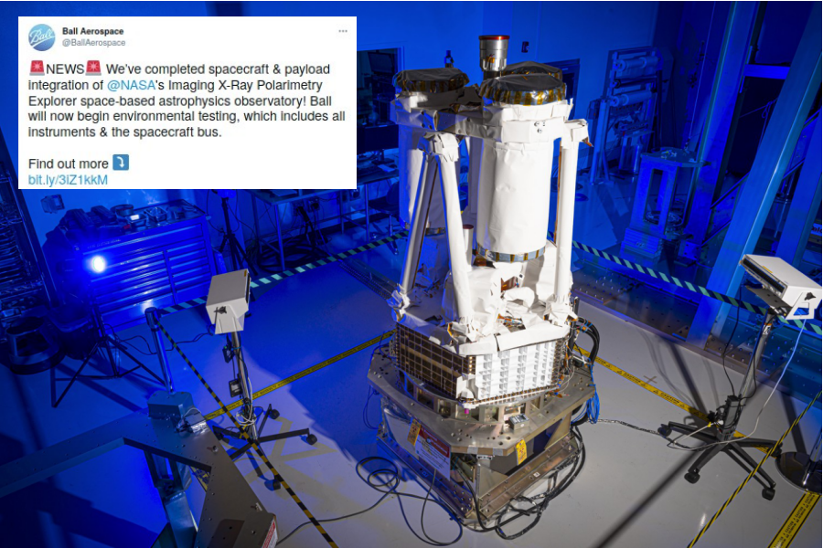
INAF
ISTITUTO
NAZIONALE
DI ASTROFISICA
INTRODUCTION
ABOUT SPACE OBSERVATORY...

Slide 5
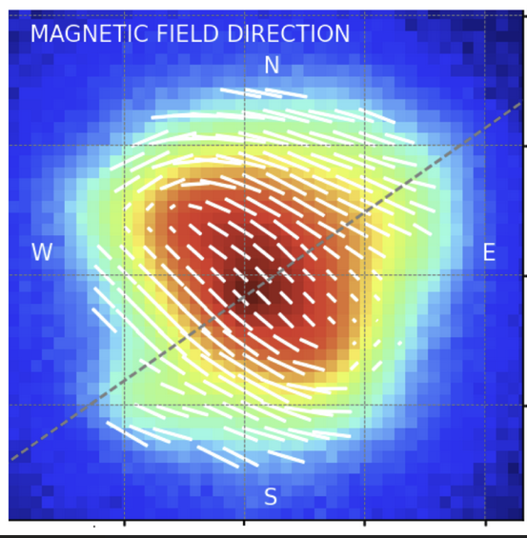
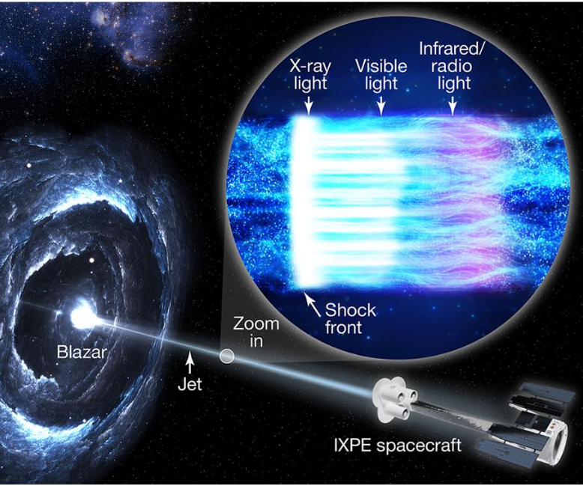
INAF
ISTITUTO
NAZIONALE
DI ASTROFISICA
Why We Do Polarimetry?
WHY POLARIMETRY?
EXAMPLE TARGETS STUDIED BY IXPE
X-ray polarimetry is performed to measure the polarization of X-rays emitted by astrophysical sources.
It provide unique information about the geometry, magnetic fields, and emission mechanisms in extreme environments such as black holes, neutron stars, and supernova remnants.
How are Particles accelerated in Blazar jets?
Magnetic Field Geometry, overlaid to the Intensity.
As Measured by IXPE for the Crab Nebula.
Bucciantini, N., Romani, R. W., Xie, F., & Wong, J. (2024).
Kirk, J. G., Rieger, F. M., & Mastichiadis, A. (1998). Particle acceleration and synchrotron emission in blazar jets. arXiv preprint astro-ph/9801265.

Slide 6
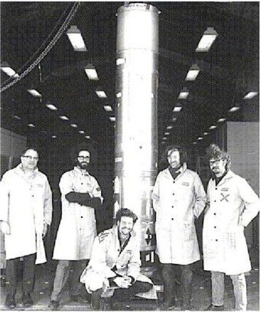
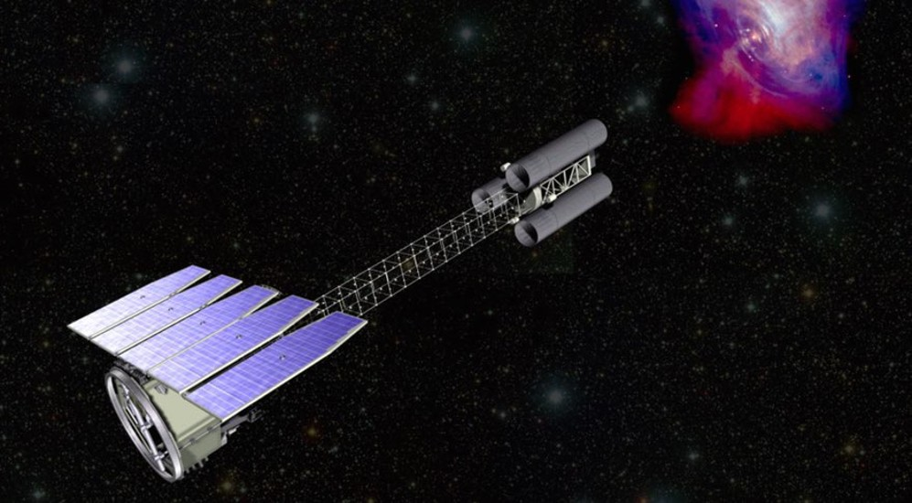
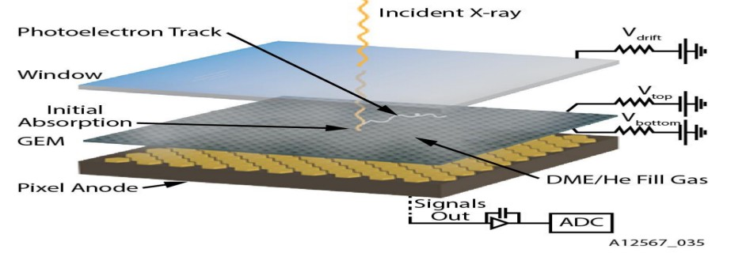
INAF
ISTITUTO
NAZIONALE
DI ASTROFISICA
INTRODUCTION of IXPE
HISTORY OF X-RAY POLARIMETRY
↑
Dark age: many X-ray polarimeters developed, none flown…
e.g. Kaaret et al. 1989
First X-ray polarimeters flown on sounding rockets.
Angel et al. 1969 Wolff et al. 1970
Novick 1970
Tindo et al. 1970
↑
Novick et al. 1972
↑
↑
↓
1969 - 1972 1976
...
2000’ 2017
2021
↓
↓
GPD
Costa et al. 2001 Bellazzini et al. 2006
OSO-8: First significative detection of X- ray polarization from the Crab Nebula.
Weisskopf et al. 1976 Weisskopf et al. 1978

Slide 7
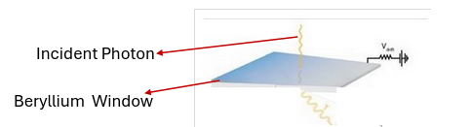
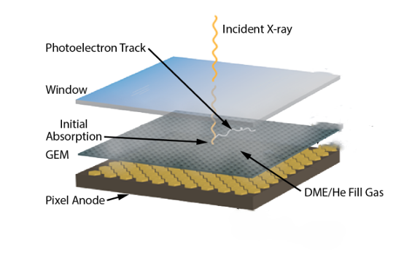
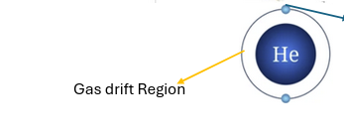

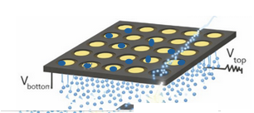
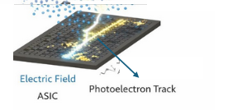
Why We Do Polarimetry?
INAF
ISTITUTO
NAZIONALE
DI ASTROFISICA
ONBOARD DETECTOR
THE GAS PIXEL DETECTOR (GPD)
The incident photon enters
in the gas cell through a
Berylium Window.
1
Primary Ionization
DME
Diffusion
Incident photon emit photoelectron in gas. These photoelectron travel in gas medium.
2
Electron Drift
Electrons reach out at GEM and then get multiplied.
3
Gas Electron Multiplier
At the end photoelectron track record at ASIC
4
Readout Chip
Concept from Costa et al. (2001)

Slide 8
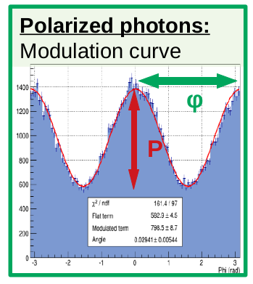
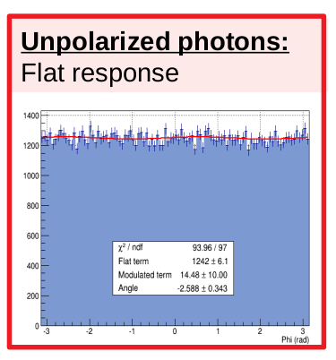
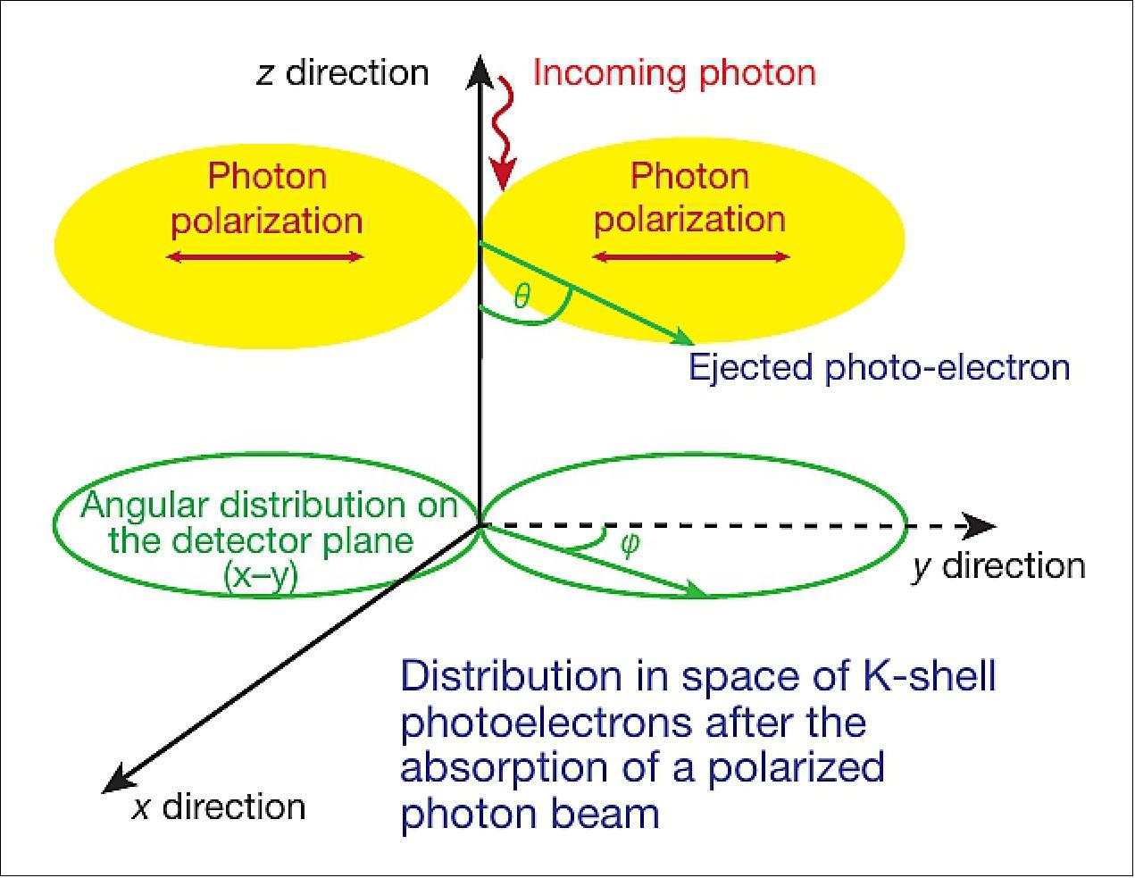
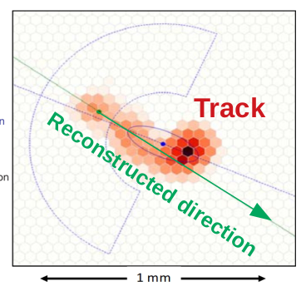
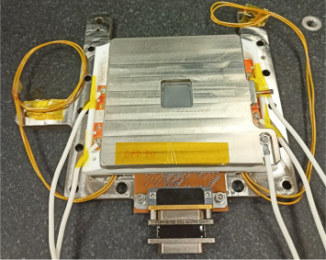
INAF
ISTITUTO
NAZIONALE
DI ASTROFISICA
Why We Do Polarimetry?
ONBOARD Detector
Principle of the Gas Pixel Detector (GPD)
Photoelectron Emission and Angular Distribution for Polarized X-rays
Photoelectron emission follows a cos(2φ) modulation, showing a clear anisotropic distribution for polarized photon.
Photoelectron emission is uniform (flat distribution) with no preferred direction for unpolarized photon.
GPD Assembly
Muleri, Fabio, et al.
A new design for the gas pixel detector." Space Telescopes and Instrumentation 2012: Ultraviolet to Gamma Ray. Vol. 8443. SPIE, 2012.

Slide 9
Why We Do Polarimetry?
INAF
ISTITUTO
NAZIONALE
DI ASTROFISICA
DETECTOR LIMITATIONS
Factors Affecting the Detector Performance
GPD operates effectively only in a limited X-ray energy range (2–8 keV).
Detector introduces dead time(1.1ms), reducing efficiency at high event rates.
The deposition of ions onto the dielectric GEM leads towards the decrease in gas gain.
The ASIC of Gass pixel detector offers two-dimensional photoelectron track.
Gas pixel detector has limited spatial resolution because of charge diffusion during drift.
GPD has relatively low energy resolution due to fluctuations in gas ionization and amplification process.
Its effective area is also limited because the gas absorption probability decreases with increasing photon energy.
Bellazzini, Ronaldo, et al. "Photoelectric X-ray polarimetry with gas pixel detectors." Nuclear Instruments and Methods in Physics Research Section A: Accelerators, Spectrometers, Detectors and Associated Equipment 720 (2013): 173-177.

Slide 10
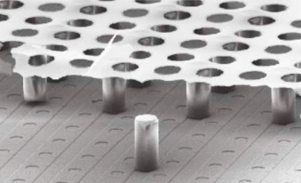
A
GRIDPIX
DETECTOR
Next-Generation
Approach
For
X-ray
Polarimetry

Slide 11
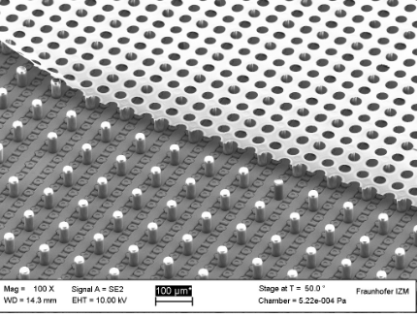
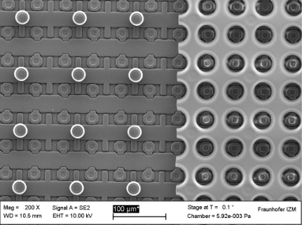
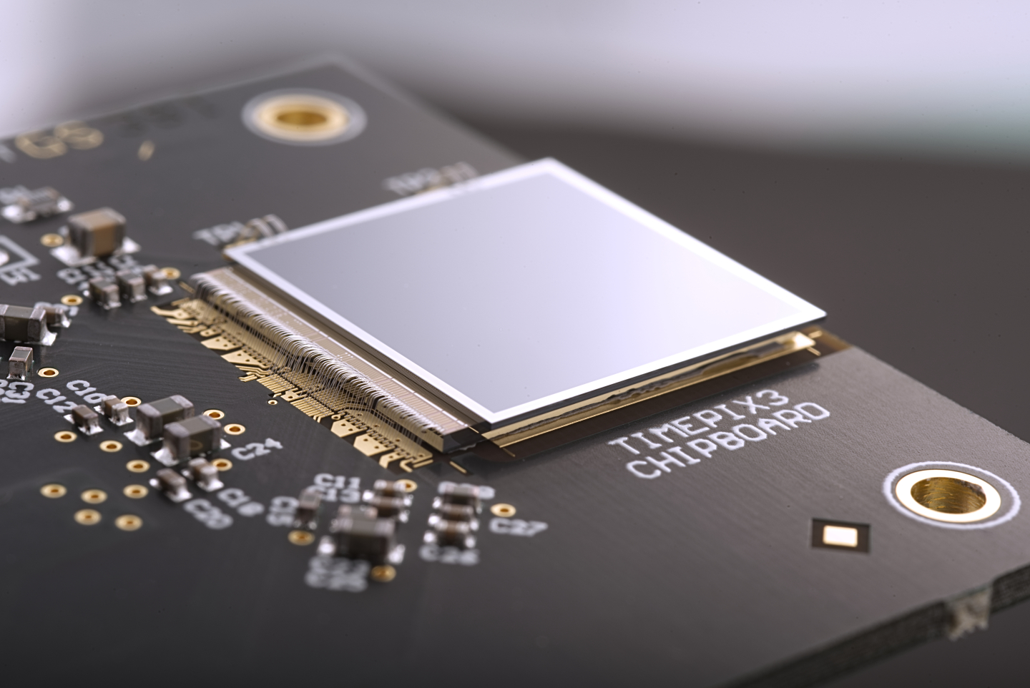
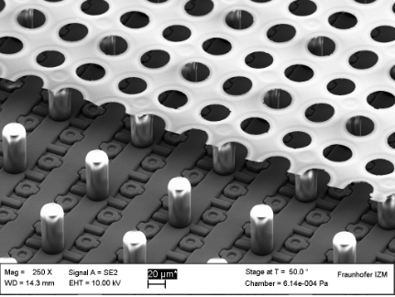
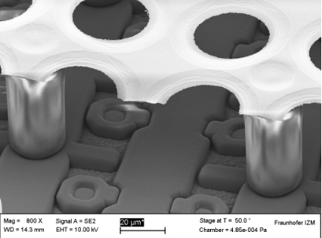
INAF
ISTITUTO
NAZIONALE
DI ASTROFISICA
Why We Do Polarimetry?
GRIDPIX DETECTOR
DETECTOR INTRODUCTION AND ITS ASIC
The GridPix detector combines a micromesh amplification grid with a Timepix3 pixel readout chip
SEM Images of GridPix Strcture:
Top images explain the pixel readout and micromesh Grid with zoom in.
Bottom Images show how the mesh is supported by pillars and aligned with the pixels.
Kaminski, J., et al. "GridPix detectors–introduction and applications." Nuclear Instruments and Methods in Physics Research Section A: Accelerators, Spectrometers, Detectors and Associated Equipment 845 (2017): 233-235.

Slide 12
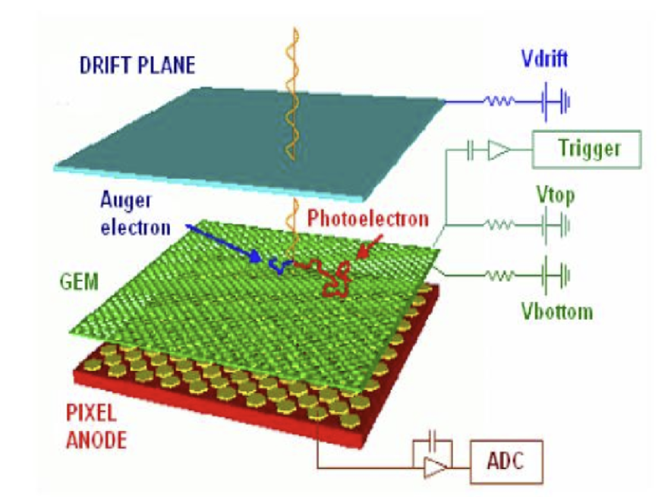
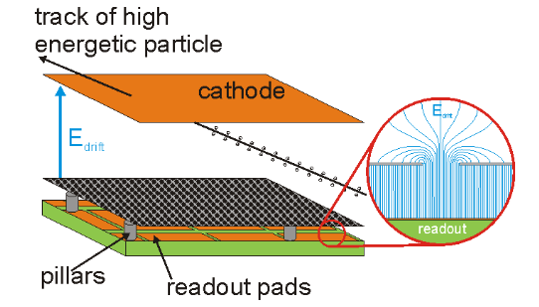
INAF
ISTITUTO
NAZIONALE
DI ASTROFISICA
GRIDPIX DETECTOR
Comparison of Detector Structures: GridPix vs GPD
Ionization electrons produced in the gas drift region move toward the micromesh under the applied electric field.
The drift field transports electrons while preserving the structure of the photoelectron track.
1.Cathode
The collected charge is then recorded pixel-by-pixel for precise track reconstruction.
The micromegas grid supported by pillars in the GridPix detector creates a very small and uniform amplification gap directly above each pixel, enabling precise single-electron detection and better spatial resolution compared to the GEM-based amplification in the Gas Pixel Detector.
2.Drift Region
1.
3.
4.Induction Gap
2.Drift Region
5.
6.TimePix
Gas Pixel Detector
4.
5.
3.Micromesh Grid
7.Anode
GridPix Detector
Ligtenberg, C., Heijhoff, K., Bilevych, Y., Desch, K., van der Graaf, H., Hartjes, F., ... & Timmermans, J. (2018). Performance of a GridPix detector based on the Timepix3 chip. Nuclear Instruments and Methods in Physics Research Section A: Accelerators, Spectrometers, Detectors and Associated Equipment, 908, 18-23.

Slide 13
INAF
ISTITUTO
NAZIONALE
DI ASTROFISICA
GRIDPIX DETECTOR
Comparison of Detector Readout ASICs: GridPix vs GPD
Dead time(1.1ms)
GridPix
Negligible dead time
GPD
Developed for X ray Polarimetry
Derived from Medipix
2D photoelectron Track
3D photoelectron Track
300 * 352 pixels
256*256 pixels
Self-Triggering Mode
Two mode of operation
15 * 15 mm² sensitive area
Heijhoff, K., et al. "Timing measurements with a 3D silicon sensor on Timepix3 in a 180 GeV/c hadron beam."
TOA
TOT
14.08 * 14.08 mm² sensitive area

Slide 14
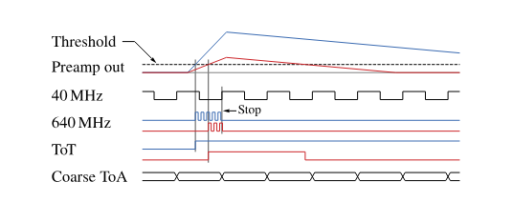
INAF
ISTITUTO
NAZIONALE
DI ASTROFISICA
GRIDPIX DETECTOR
Comparison of Detector Readout ASICs: GridPix vs GPD
Chip outputs analog information
GPD
Chip outputs digital information
GridPix
50 µm pitch
55 µm pitch
Diagram shows how the time of arrival (ToA) and time of threshold (ToT) measured by Timepix3 for two different signal Amplitude.
Each pixel integrates the collected charge from the GEM
Common clock 680 MHz & 40 MHz to measure TOA & TOT for each pixel.
Heijhoff, K., et al. "Timing measurements with a 3D silicon sensor on Timepix3 in a 180 GeV/c hadron beam."

Slide 15
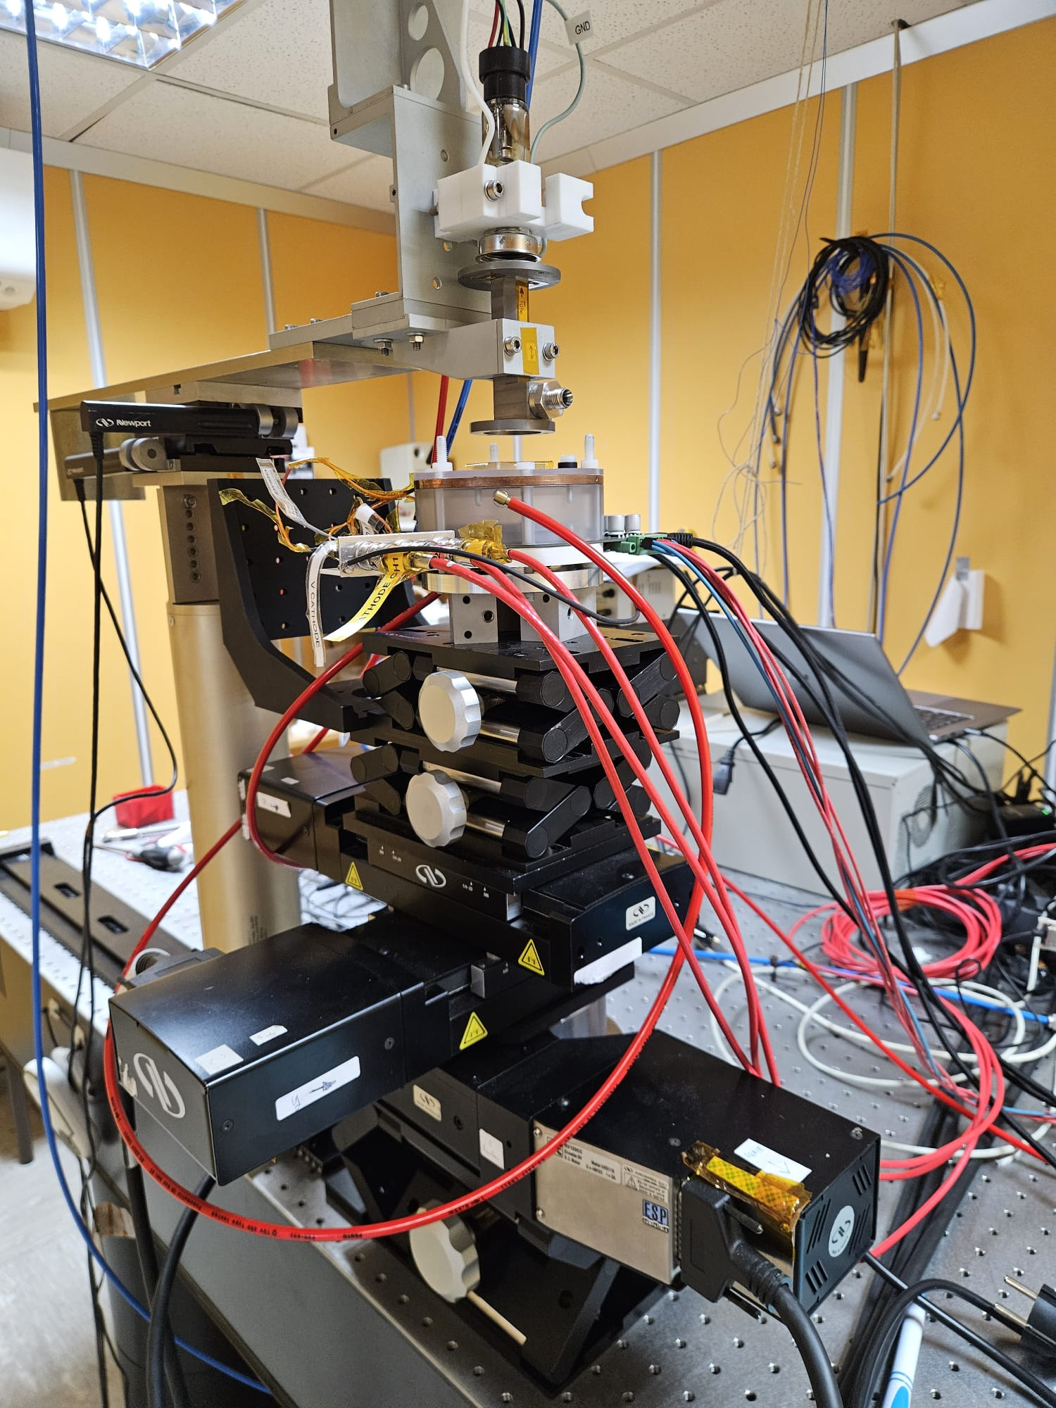
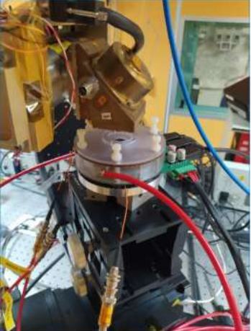
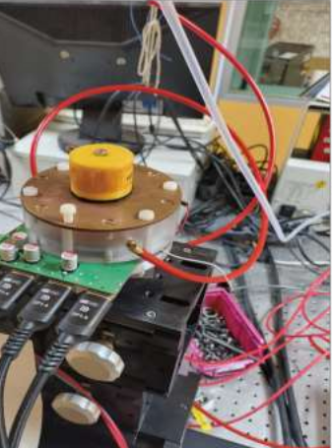
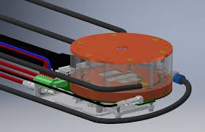
Why We Do Polarimetry?
INAF
ISTITUTO
NAZIONALE
DI ASTROFISICA
EXPERIMENTAL SETUP
With GRIDPIX DETECTOR
Prototype of GridPix Detector with Polarized X-ray Source at IAPS-INAF Calibration Facility.
Complete
Experimental
Setup
Its include X ray
Source, Detector
mounted stage, Positing stage, electronics
and cables
Close-up of detector housing:
- Entrance Window
- Gas Chamber
- Electrical Connection
This image shows detector mounted on the mechnaical satge beneath the polarized x ray source for measurement.
GridPix
Assembly

Slide 16
INAF
ISTITUTO
NAZIONALE
DI ASTROFISICA
EXPERIMENTAL SETUP
Key Experimental Parameters
Gas Mixture:
Argon(Ar): 80%
Dimethyl ether(C2H6O) : 20%
X ray Source:
Molybdenum(Mo) Target for both:
Polarized Source
Unpolarized Source
Photon Energy:
For Polarized Source : 8.7 KeV & 17.4 KeV
For Un-Polarized Source : 8.05 KeV
Pressure and Temprature:
Pressure: 1.05 bar
Temperature: at Room Temprature
Detector Position:
ε = 0
ε= 90
Drift Values:
Edrift : 280 V/cm
Vgrid : 340 V
Data Format & Analyzed:
Data Format: HDF5
Analyzed using Python based Software.
Run Duration:
Run duration: 30 mins
Number of triggers per run:

Slide 17
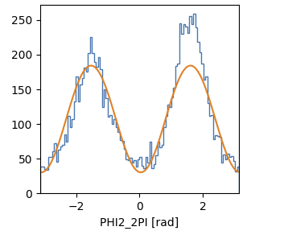
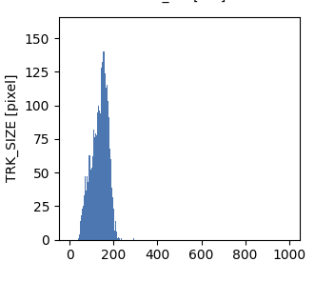
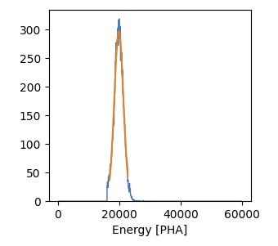
INAF
ISTITUTO
NAZIONALE
DI ASTROFISICA
EXPERIMENT RESULTS
Real Data Results
For 8.7 KeV
2.
Modulation Curve
3.TRK_Size
3. TRK_SIZE
1.
Energy Spectrum
R = 17.5%
This plot shows the azimuthal angle distribution of reconstructed photoelectron tracks, which is used to measure X-ray polarization.
Blue histogram
Represent the measured distribution of emission angles from the detector.
Orange curve
A cos² modulation fit applied to the data.
This histogram shows the distribution of reconstructed photoelectron track sizes in pixels.
with most tracks occupying around 170 pixels, reflecting the typical charge spread of photoelectron tracks.
PHA: Pulse height amplitude . PHA is proportional to charge collected event by event in detector.
Blue curve: Measured energy distribution.
Orange curve: Fitted distribution with Gaussian fit to determine the peak position and resolution.

Slide 18
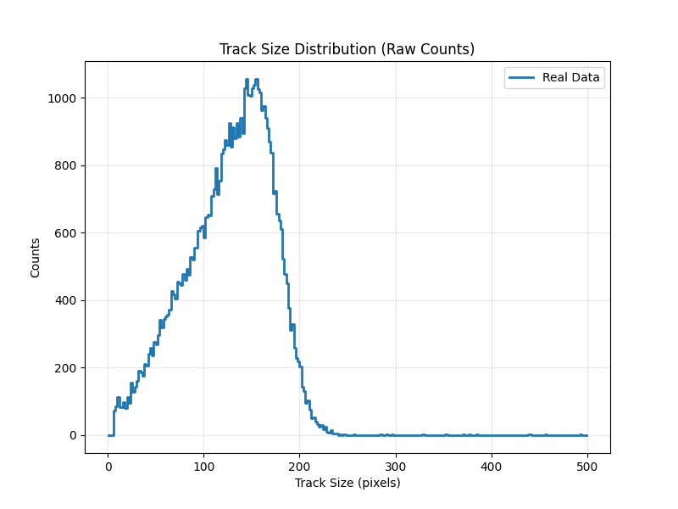
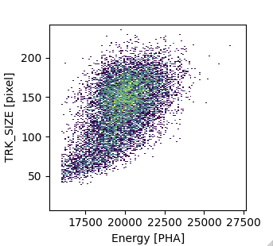
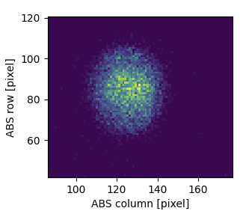
INAF
ISTITUTO
NAZIONALE
DI ASTROFISICA
EXPERIMENTAL RESULTS
Real Data Results
For 8.7 KeV
Normalized Track Size Distribution
6.
4.
This is a 2D correlation plot between deposited energy and track size in the detector.
The bright yellow region represent the most events. corresponding to the main energy peak of the source
5.
This plot shows the spatial distribution of reconstructed events on the detector plane.
Yellow → many events
Purple → fewer events
This histogram shows the distribution of reconstructed photoelectron track sizes, with most tracks have about 150 pixels, corresponding to the typical charge spread of photoelectron tracks in the detector.

Slide 19
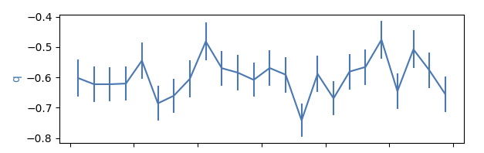
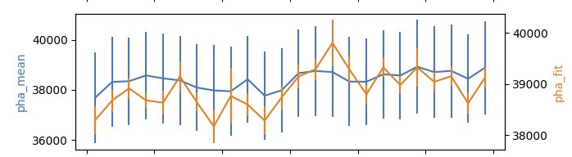
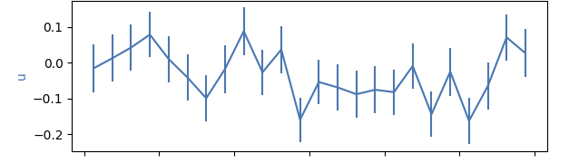
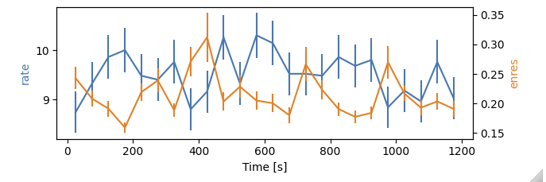
INAF
ISTITUTO
NAZIONALE
DI ASTROFISICA
EXPERIMENT RESULTS
Real Data Results
Time Trend Plots for 8.7 KeV
These plots show the stability of detector and polarization parameters as a function of time.

Slide 20
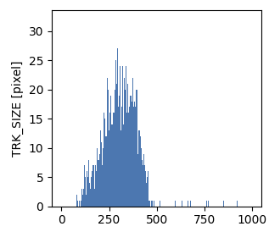
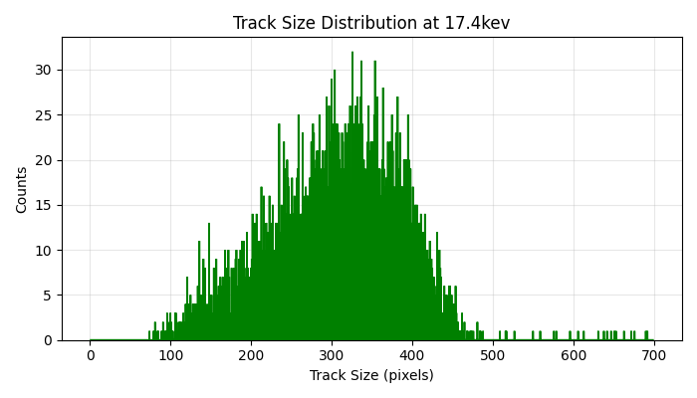
INAF
ISTITUTO
NAZIONALE
DI ASTROFISICA
EXPERIMENT RESULTS
Real Data Results
For 17.4 KeV
Top-Left: Track size distribution
Top-Right: Spatial event distribution
Bottom-Left: Azimuthal angle (polarization) distribution
Bottom-Middle: Full track size spectrum
Bottom-Right: Energy vs track size correlation

Slide 21
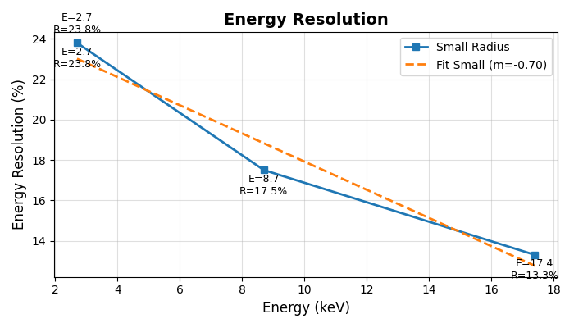
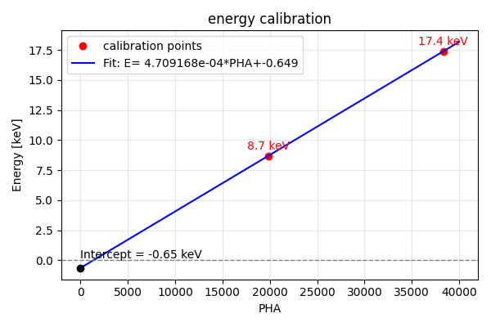
INAF
ISTITUTO
NAZIONALE
DI ASTROFISICA
EXPERIMENT RESULTS
Real Data Results
Energy Calibration Results:
Energy Resolution Results:
Shows the linear relationship between PHA and photon energy, with small offset.
Shows how the energy resolution improves with increasing photon energy, better detector performance at higher Energies.

Slide 22
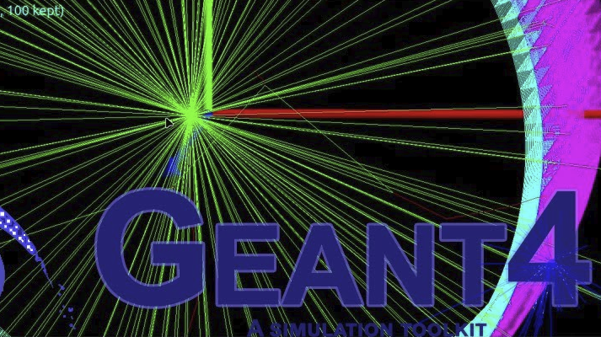

Slide 23
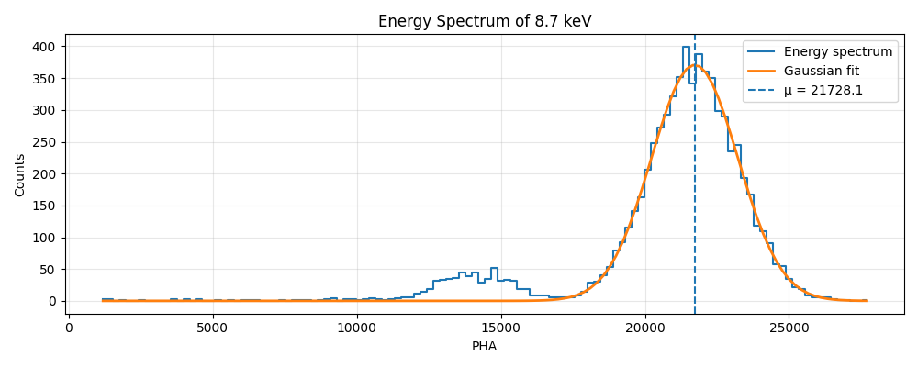
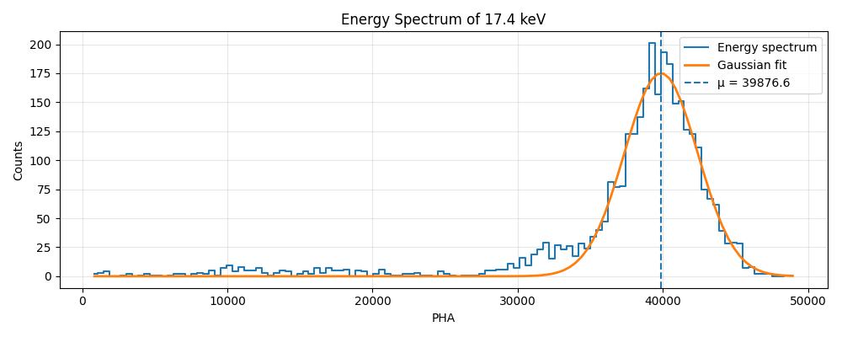
INAF
ISTITUTO
NAZIONALE
DI ASTROFISICA
SIMULATION RESULTS
Energy Spectrum & Resolution
Energy Spectrum of 17.4 KeV
EnRes = 16.26 ± 0.26 % (FWHM/mu)
EnRes = 14.92 ± 0.30 % (FWHM/mu)
Energy Spectrum of 8.7 KeV

Slide 24
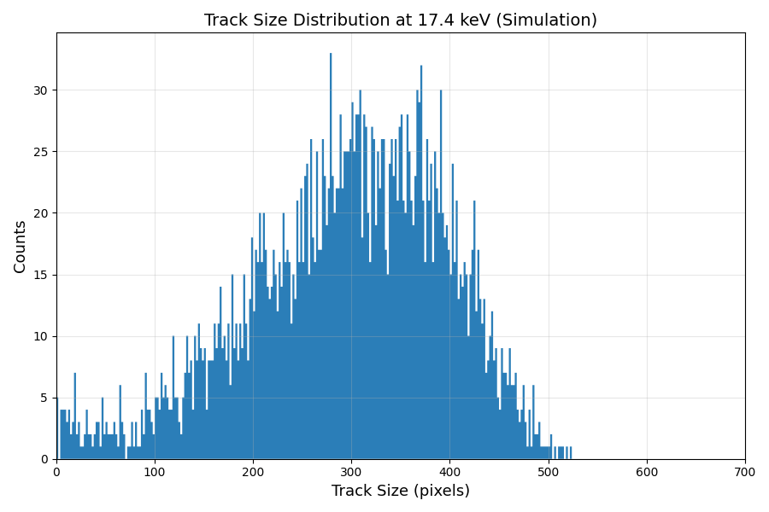


INAF
ISTITUTO
NAZIONALE
DI ASTROFISICA
SIMULATION RESULTS
Energy Calibration & Track Size Distribution

Slide 25

Comparison of Real and Simulated Data
Comparison of Real Data And Simulation

Slide 26


INAF
ISTITUTO
NAZIONALE
DI ASTROFISICA
COMPARISON RESULTS
Real Data Vs Simulation
Track Size Distribution Comparison Between Experimental and Simulated Data

Slide 27


INAF
ISTITUTO
NAZIONALE
DI ASTROFISICA
COMPARISON RESULTS
Energy Calibration and Resolution
Validation of Energy Calibration and Resolution Using Simulated and Experimental Data

Slide 28

INAF
ISTITUTO
NAZIONALE
DI ASTROFISICA
Conclusion

Slide 29


