Slide 1
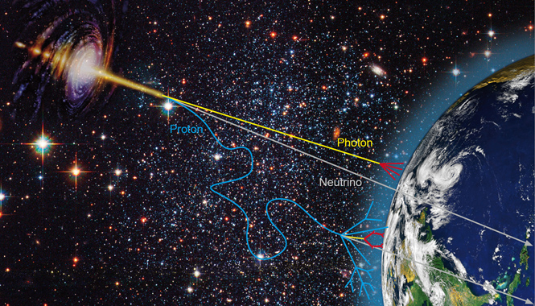
Welcome to the
“Arthur B. McDonald Canadian Astroparticle Physics Research Institute”
(the McDonald Institute)
Tony Noble
Scientific Director
Queen’s University
Notes:
Astroparticle Physics What’s that, the role of MI, why were we interested in commissioning an indigenous Art Piece

Slide 2
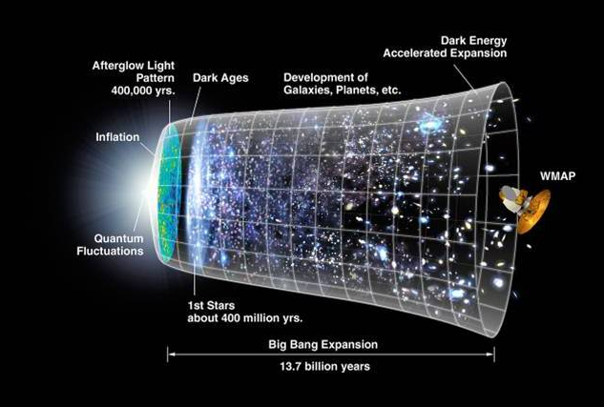
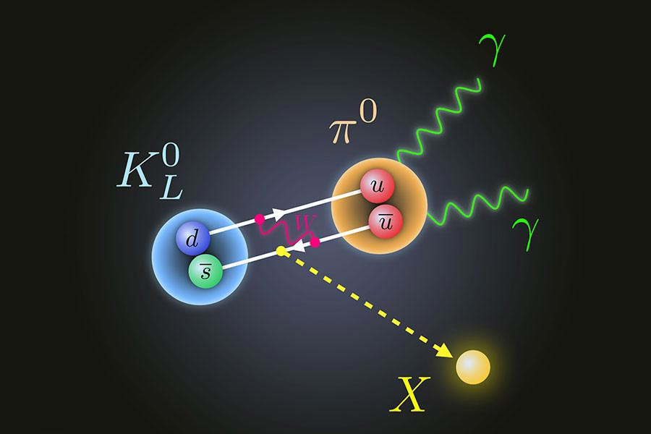
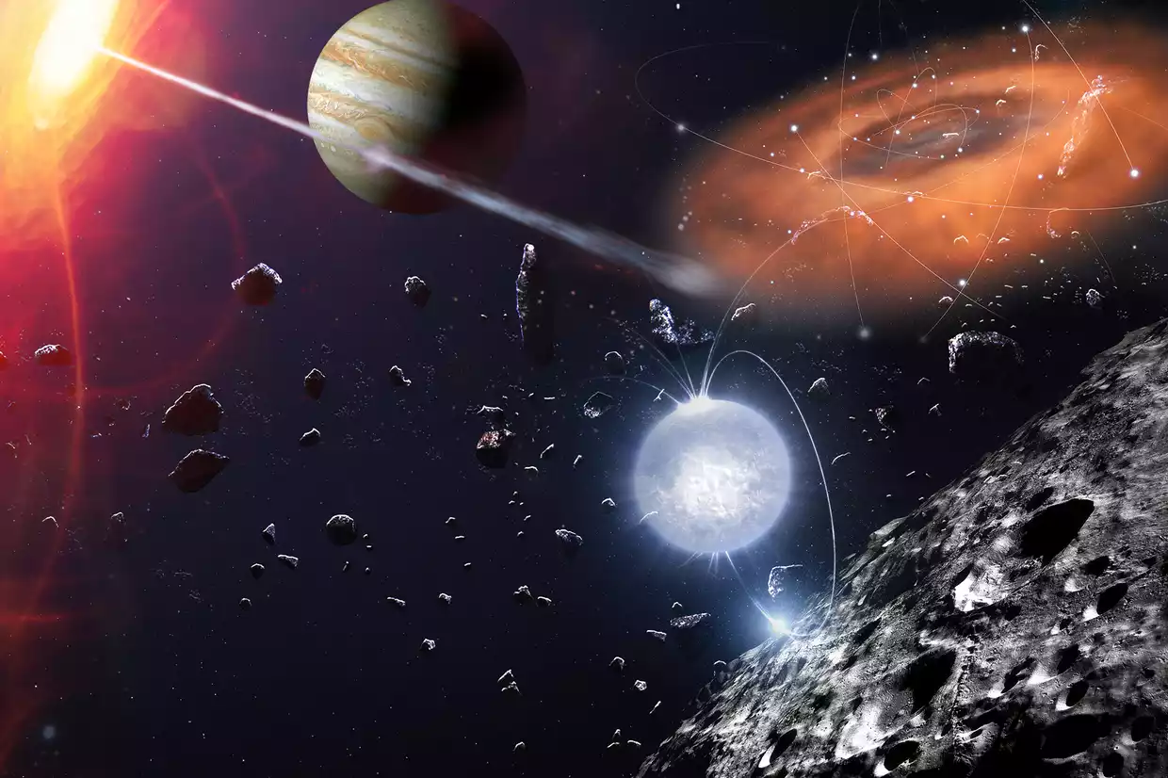
The McDonald Institute:
supports fundamental research in astroparticle physics at 11 Universities and 6 research institutes all across Canada,
supports a highly networked community of scientists, engineers, students and admin team members.
Astroparticle Physics lies at the intersection of particle physics, astronomy, and cosmology.
Particle Physics:
Properties of the fundamental particles that constitute nature.
Credit: Florida State University
Astronomy:
Physics and properties of celestial objects
Credit: BBC Sky at Night
Cosmology:
Origin and evolution of the Universe.
Credit: UniverseToday.com
Notes:
The smallest of things to the largest of things…. Exploring the nature of dark matter, neutrinos, the origin of the matter-antimatter asymmetry, how the universe evolves….

Slide 3
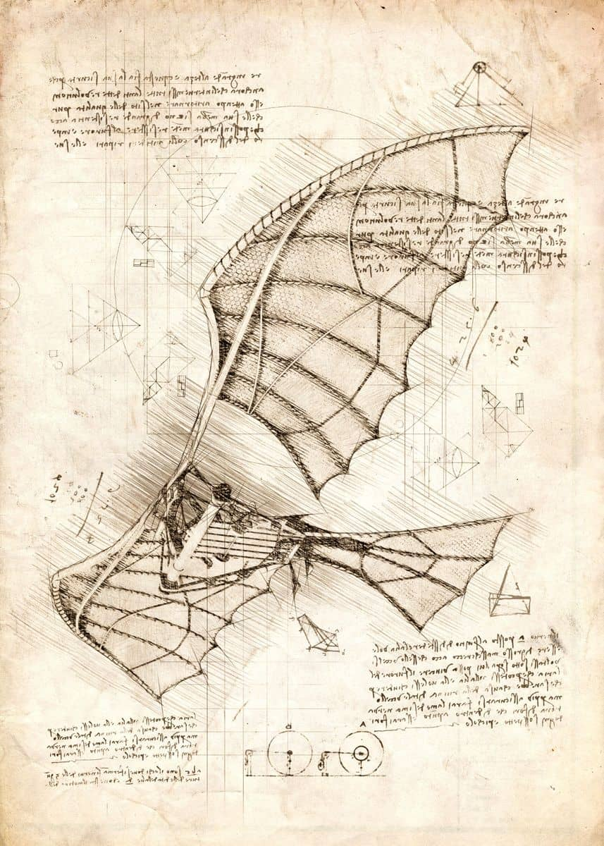
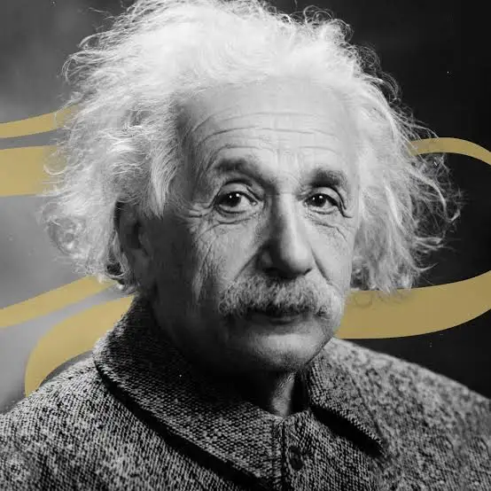
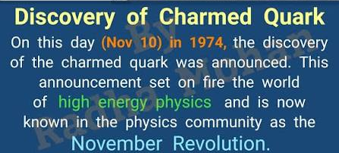
There is a deep-rooted connection between art and science
In both we are driven to explore relevant questions through creativity and curiosity, using the power of observation as our primary tool.
Leonardo Da Vinci: Artist, scientist and inventor
Einstein:
Strived to find beauty and symmetry in his physical theories.
The Charm Quark:
Predicted in 1964 and discovered in 1974. Named “Charm” for the elegant symmetry it was expected to bring to the particle theories of the day.
Notes:
From chaos arises art and order

Slide 4
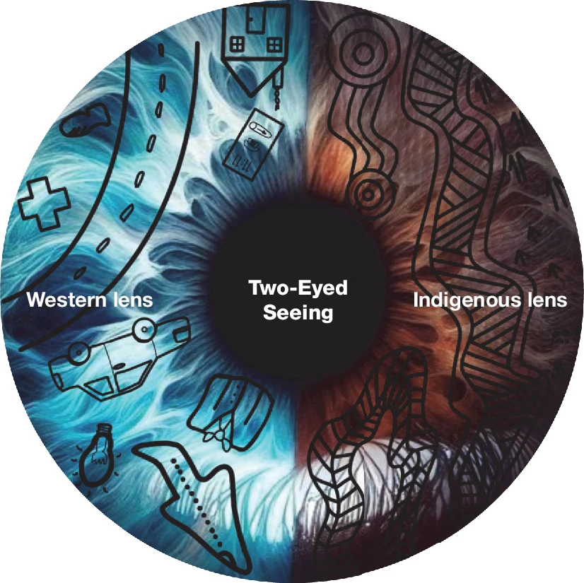
Indigenous connection:
I am intrigued by the potential to benefit from both the indigenous and western ways of knowing, through two different lenses, and to intentionally shift one’s perspective according to the situation at hand.
For example, in indigenous world-views living and non-living entities are deeply connected through reciprocal relationships, mirroring the western treatment of quantum entanglement and observer influence.
The space:
I am particularly pleased with this fantastic artwork being on the wall of the McDonald Institute, within Physics and Queen’s. This space is normally a hub of learning, teaming with students, who can enjoy the art and reflect on the messages being evoked.
Credit: Nature 638, 58–68 (2025).
Notes:
Two-eyed seeing introduced by Mi'kmaw Elder Albert Marshall

