Slide 1


Status of the McDonald Institute and its future role in the Canadian Astroparticle Physics Landscape
MI National Meeting
Queen’s University
July 28th/2026
By Tony Noble
tony.noble@mcdonaldinstitute.ca

Slide 2
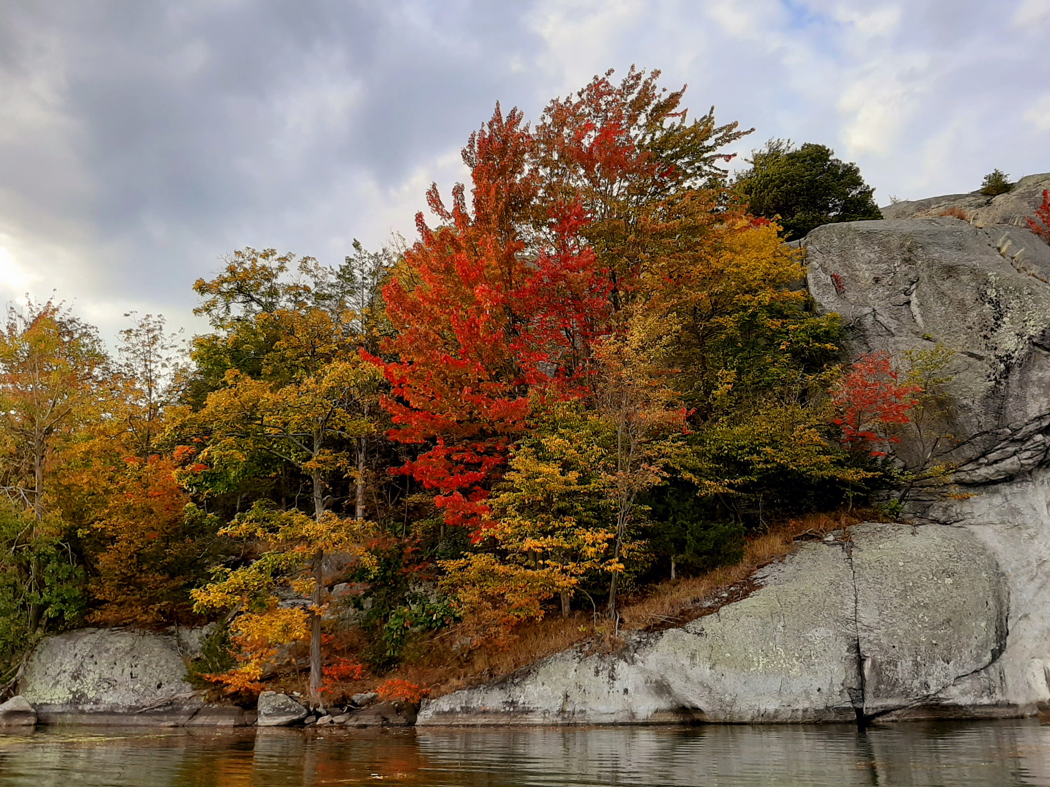
Notes:
Before we start, let me begin by recognizing that we are meeting today on the traditional lands of the Anishinaabe (Ah- nish-in-ah-bay) and Haudenosaunee (Ho-den-o-show-nee) peoples. We are extremely grateful to be able to live, learn and play on these lands. This is a picture from just North of Kingston, one of my favorite places.
When I walk on this land I am acutely aware that this land has existed in this way for millions of years, and I recognize that many peoples have enjoyed this wonderful space and cared for this land. I feel a great connection to the land when I am here, and the sense of responsibility I have to steward the land in a responsible way. I encourage all of you to be thinking in this way about the lands you visit, and the lands you might occupy.

Slide 3
Outline
Introduction to MI
The ‘now completed’ CFREF award
  Status
  Accomplishments
  Criticisms
The ‘current’ “NSERC-MRS” award
  Funding Status
  Current Mission
  Thoughts on the Collaboration with NSERC/CFI and alignment with SAP LRP
  Transition to priority driven support

Slide 4














The role of the McDonald Institute over past 10 years of CFREF funding
Originally a partnership of 8 Universities and 5 institutes, the Institute was funded in 2016 for 63.7 M$ over an initial 7 years
The McDonald Institute connects and supports astroparticle physics research all across Canada with a focus on R&D efforts at Universities.
The Institute also provides the community with professional and administrative support with expertise in education/outreach, communications, hqp recruitment, retention and training, EDII best practices etc …. All important aspects of big science that are difficult to include at the individual project level.

Slide 5




Now a partnership of 11 Universities and 6 institutes with funds flowing through NSERC
New

Slide 6
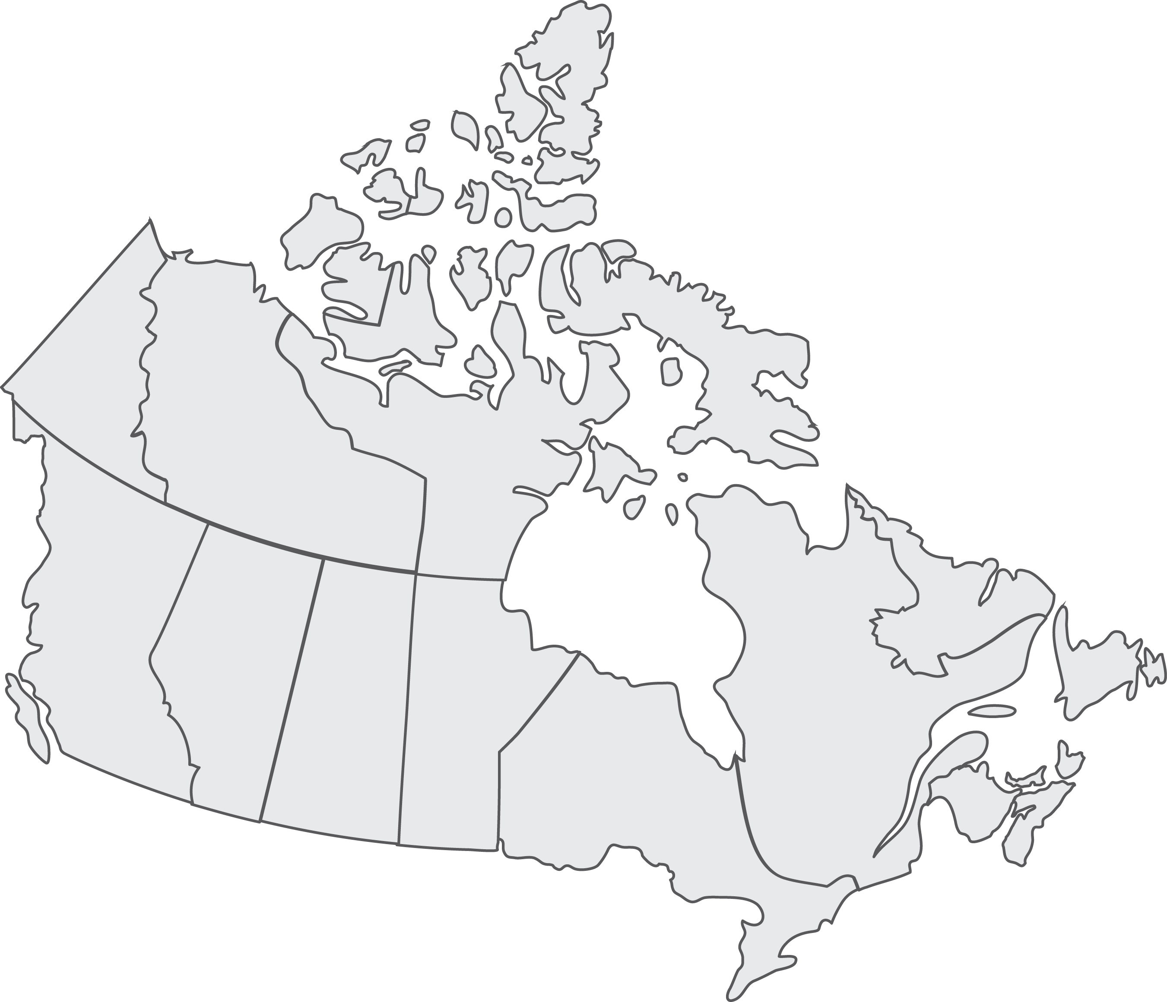
A Canadian Partnership
Hosted at Queen’s:
Canada-wide scientific effort leveraging world-class facilities
SNOLAB – Premier underground facility in the world
11 Universities
Alberta
Carleton
Laurentian
McGill
Montreal
Queen’s
Sherbrook
Simon Fraser
Toronto
UBC
Victoria
6 Institutes
CIFAR
CITA
IPP
PI
SNOLAB
TRIUMF
Collaborators
McMaster
Regina
Saskatchewan
Waterloo
Winnipeg
York
Dalhousie
SNOLAB
Queen’s
Notes:
SNOLAB is considered the premier facility in the world by virtue of the lowest backgrounds
We involve all institutions in Canada, and the only such institution known with a national agenda
Large international collaborations

Slide 7
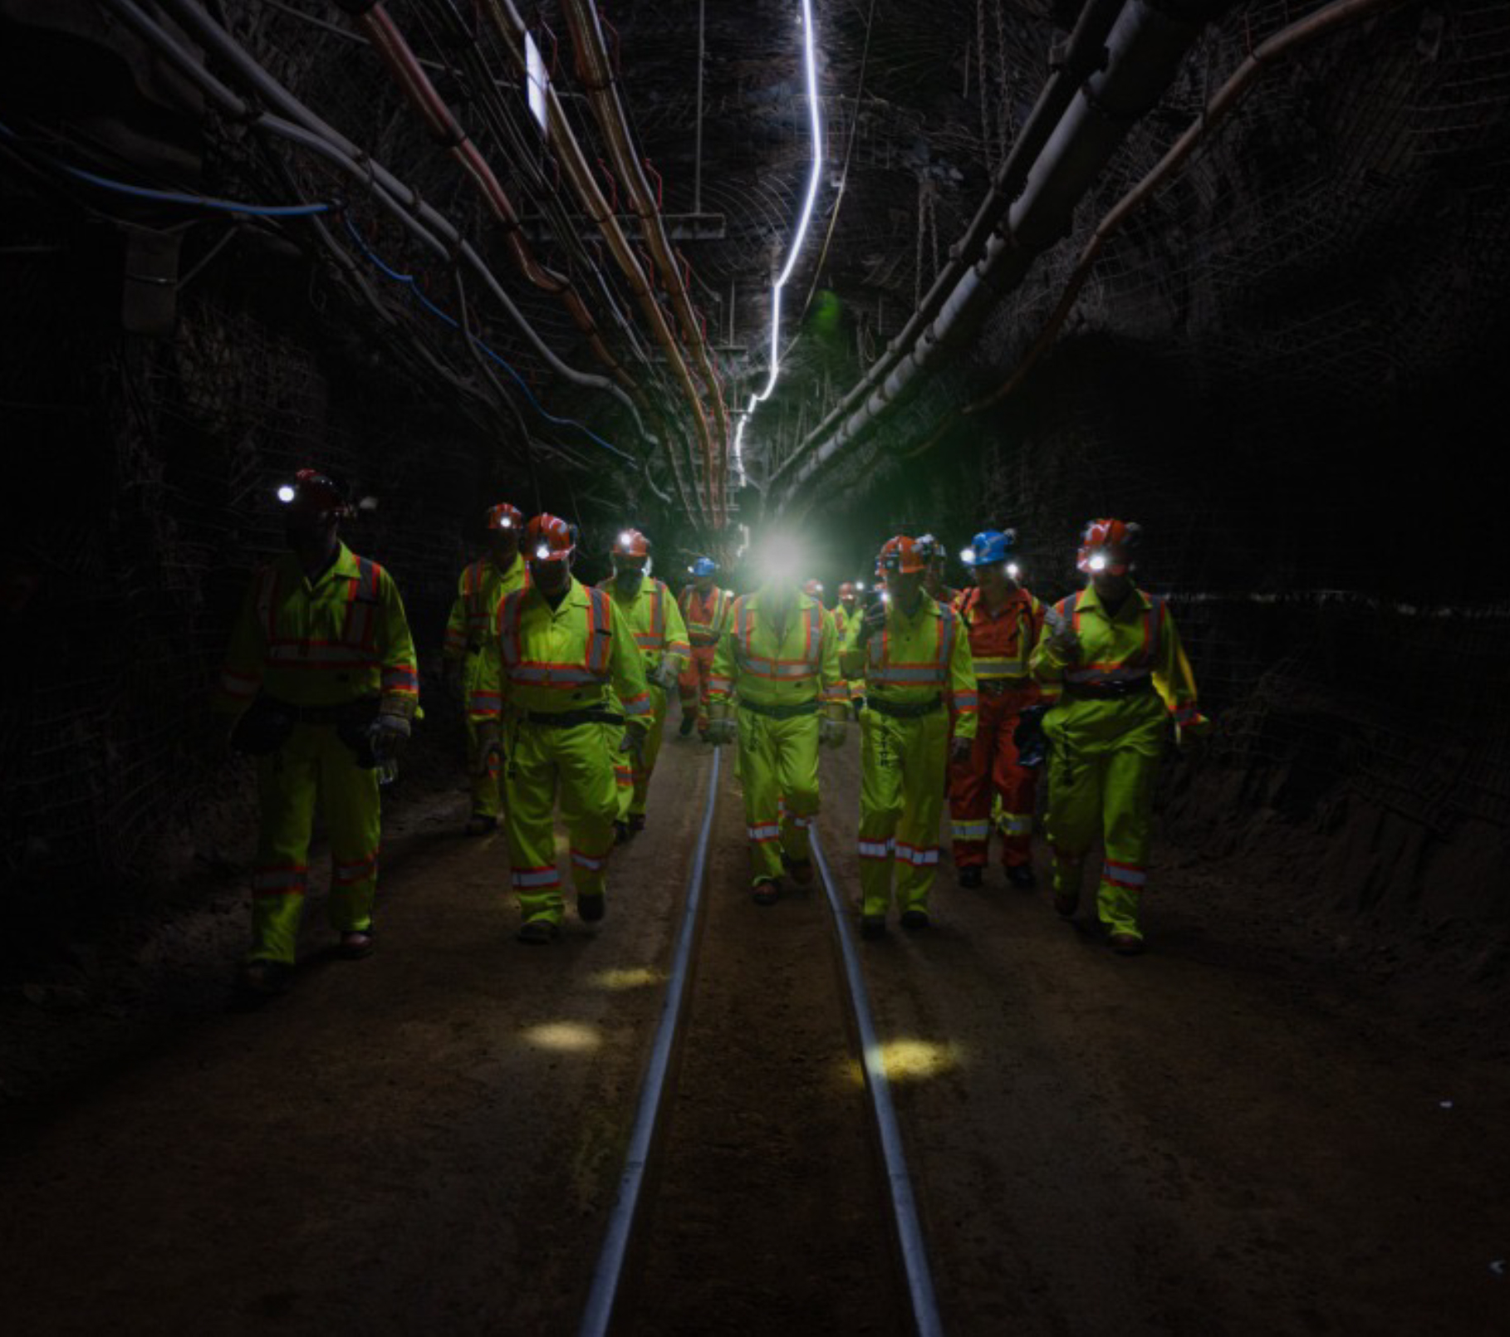
Focus: The Institute was initially created with a focus on ensuring Canadian scientists were leading in the science that benefits from having the premier underground facility, SNOLAB, in their backyard.
Physics objectives focus on:
  Dark Matter
  Fundamental Properties of neutrinos
  Neutrinoless double beta decay
  Multi-messenger Physics
In addition to SNOLAB we also now benefit from the underwater facilities at Ocean Networks Canada.

Slide 8
CFREF main project dates:
January 2015 Initial Idea, to create a center focused on supporting Canadian participation on SNOLAB physics
September 2016 Launch of CFREF – Known as CPARC for 1st few years. 63.7 M$
May 2018 Re-branded as McDonald Institute
September 2023 Original end date from CFREF. All funds received.
Then we received: - One year extra for “spend down”
                - 18 month “Covid Extension”.
September 2025 Our Targeted end-date for all spending (gave us a 6 month buffer)
September 2026 Last annual report due

Slide 9
CFREF Funding Status
100 % of all funds spent.
Financial reports audited and approved.
After 63.7 M$ in funding, reconciliation against all invoices and bills agrees to about 1$
Finance and audit committee commends the MI financial team, along with Queen’s and our partners on the robustness, clarity, and transparency of our financial reporting.
Exit survey with CFREF completed in June 2026.
Last step is to submit final annual report (thanks to everybody that filled the survey out to help collate the data we need for reporting).

Slide 10
CFREF Highlight: Capacity Building:
15 new Faculty in cross-disciplinary positions hired directly by McDonald Institute.
This spawned about 14 more faculty positions to build on these groups.
There has been a significant shift of researchers, previously in more adjacent fields, more directly into astroparticle physics. Over 80 faculty members across Canada have had significant engagement with MI during the CFREF period.
Initiated substantial growth in astroparticle physics theory
Many hundreds of HQP supported across Canada
We supported (with SNOLAB) 5 faculty members at Laurentian when LU became insolvent.
New arrivals: Ana Botti (UdeM)
Kyle Leach (Queen’s)
One CERC already established (SFU) and another pending results (Queen’s)

Slide 11
Example of growth in field
SuperCDMS
  Research Faculty originally supported completely by MI:
    Miriam Diamond (Toronto)*
    Alan Robinson (Montreal)
    Wolfgang Rau (TRIUMF)
Plus at Toronto*:
Pekka Sinervo
Ziqing Hong
Support for SuperCDMS at UBC, TRIUMF, Toronto, Montreal, Queen’s. This has been very important as with the current geo-political situation, the Canadian teams were taking on a disproportionate share of the infrastructure installation at SNOLAB.
*New Group in Astroparticle Physics at University of Toronto enabled by CFREF

Slide 12
Advancing the science:
Funds from MI are used to accelerate/amplify the impact of NSERC supported research programs, mainly by supporting personnel to work on these projects. Engineers, pdfs, students, project managers….
 | 2016 | 2026
Deap | Started cooling | Main Science complete. Completed upgrades. In operation again
SuperCDMS | Completed run in Soudan. Planning to relocate to SNOLAB | In commissioning phase. Base temperatures acheived
News-G | A concept. Exploring approval with SNOLAB | In Operation
PICO | Running with PICO 60 | Running with PICO 40 RSU and main components of PICO-500 assembled
SNO+ | Cavity fill just starting | In Phase 2 of operations (water,scintillator). Te purification testing underway for phase 3
nEXO | Running at WIPP with EXO-200, thinking about nEXO | Original design essentially complete. Merging with XLZD for dark matter (and 0vBB if possible)
Halo | Running already by 2012 | Launched SNEWS. Still running well
Not part of the APP in Canada scope, or some not even a concept, in 2016 but on the agenda now:
SBC, P-ONE, Darkside, ARGO, Ricochet, CUTE, HyperKamiokande, GW (LIGO/LISA) …

Slide 13
Criticisms:
As the MI has evolved from a grass roots idea, we have a better sense of what technologies are most likely to succeed at probing new physics sensitivities, and a better sense of community priorities. In the original CFREF days there was a lot of discretionary funding support flowing to the partners. Criticisms leveled at MI included:
Just another funding agency. Too much discretionary funding, not enough direction.
This also made it hard to work with NSERC and CFI in terms of providing them with details on which programs were going to be supported.
We are slowly changing this through a more top-down approach, well defined priorities, and allocation of resources predominantly in support of the priority program.
My vision is to have MI move towards a model wherein the Institute adopts and supports key priority programs at levels commensurate with their established priority.
We are collecting the data we need to share with NSERC on program support levels, and are thinking about ways to help support priority applications requesting major CFI infrastructure .

Slide 14
The McDonald Institute Relaunched.
To compete with international peers, we need to have the resources to be able to step up and accept major responsibility for the creation of significant elements of the experimental program.
MI will enable scientists (largely at the Universities) to take leading roles on major international programs with the support required to:
  to do the necessary R&D to develop detector concepts,
  to engineer, build, commission and test demonstrator modules,
  fabricate final detector components for delivery to experimental site,
  liaise with engineering teams at host facilities to help ensure smooth integration and safe installation/operation

Slide 15
Relaunched McDonald Institute NSERC-MRS Scope:
Significant new element. Integrated Project Delivery Centre (IPDC). The distributed engineering and technical staff (17 FTE spread across hubs in Montreal, Kingston, Ottawa, Edmonton, Vancouver/Victoria) which support the major R&D efforts. Resources are allocated on priority basis on advice from allocation committee. (See talk by Koby)
Pooled Funding: Available on competitive basis to support HQP (postdocs, graduate students, summer students) and new initiatives. Several application rounds already completed:
  47 HQP supported through pooled funding program so far. New competitions on the way.
Regular funding through inter-institutional agreements
  75 HQP supported through funds to partner Institutions. (SNAP shot of Q4 Jan – March 2026)
  Plus 4 HQP working on astroparticle physics related STEM curriculum development in Faculty of education at Queen’s.
Special programs
  Engineer in training program
  Early career researcher support. Visitor exchanges
  EDII special initiatives, recruitment strategies
Education in STEM
Education and Outreach
Tech development:

Slide 16

NSERC-MRS Funding Status. 45.5 M$ award
NSERC treating as two separate entities due to the way they received the funding notices from ISED.
  First two years (18.2 M$) received. Nominally April 2024 – March 2026 but with extra year spend down at NSERC we are budgeting this April 2024 – March 2027
  Final three years (27.3 M$) has also been reviewed, approved and received. Budgetted ~ April 2027 – March 2030 including the one year spend down.
  NSERC formally expects us to budget 9.1 M$/a but we will be ramping up over the entire period.
 | 2024-25 | 2025-26 | 2026-27 | 2027-28 | 2028-29 | 2029-30
First 2 years | 0 | 9.1 | 9.1
Final 3 years |  |  |  | 9.1 | 9.1 | 9.1
Notes:
`

Slide 17
Basic Program support (snapshot from Q4 Jan – Mar 2026)
Program | UG | MSc | PhD | PDF | RS | Eng/tech | EIT | Admin | Total
Theory | 2 | 2 |  | 1 |  |  |  |  | 5
PICO |  |  |  | 1 |  |  |  |  | 1
HK |  |  | 1 |  |  |  |  |  | 1
SuperCDMS |  | 1 |  | 7.7 | .75 |  |  |  | 9.45
Tech Dev |  |  |  | 1 |  | 4 |  |  | 5
IPDC |  |  |  |  |  | 22 |  |  | 22
LAr | 1 |  | 1 | 1 | 2 | 5.7 |  | 2 | 12.7
SBC |  |  |  | 1 |  | .5 |  |  | 1.5
P-ONE |  |  |  |  |  | .5 |  |  | 0.5
SNO+ |  |  |  |  |  | .3 | 2 |  | 2.3
Sensei |  | 1 |  |  |  |  |  |  | 1
XLZD | 1 |  | 3 |  |  |  |  |  | 4
CUTE |  |  |  |  | .25 |  |  |  | .25
Ricochet | 2 |  |  |  |  |  |  |  | 2
LIGO |  |  |  | 1 |  |  |  |  | 1
Mathusla |  |  |  | .3 |  |  |  |  | .3
Other |  |  |  |  |  | 2 |  | 4 | 6
Total | 6 | 4 | 5 | 14 | 3 | 35 | 2 | 6 | 75
Notes:
`

Slide 18
Integrated Project Delivery Centre
A well identified gap in the Canadian astroparticle physics ecosystem is the lack of engineering and technical resources at the Universities. Such a resource:
Will enable Canadian researchers to take on major leadership responsibilities within large international collaborations to deliver significant components of those projects. Hence elevating the stature of the Canadian contributions.
Will provide a blend of technical skills accessible to the entire community where having all those skills locally would be impossible.
Allows the community to retain the expertise in underground physics while the various projects move through the typical life cycles of design, fabrication, and commissioning where significant engineering resources are most needed.

Slide 19
Engineering and Technical Staff in the IPDC
Queen’s Koby Dering P.ENG Mechanical, Structural, Process, PM, Technical Director
Jonathan Corbett P.ENG Cryogenic, Mechanical
Mackenzie Dean Mechanical
Armin Mir Mechanical
Nicholas Moss Mechanical
Jeff Kingma Machinist
Robert Gagnon Research Technologist
Carleton Farrokh Rad P.ENG Project Management
Ryan Crampton P.ENG Design Engineer
John Sosiak Lab Management
Alberta Michael Rangen Electronics Technologist
Steve Perricone Mechanical
McGill Naman Walia Mechanical, Cryogenic
Montreal Mathieu Lauren ++ Research Scientist
UVIC Sam de Jong Detector Technologist
SFU Chris Ng Mechanical
TRIUMF++ Leanne Beet Facility Manager
Roger Brammall Electronics Engineer in Training
Benjamin Smithers Detector Scientist
James Nikkel Research Scientist

Slide 20
Managing the IPDC
Relevant proposals are first reviewed by a “Project Feasibility Committee” with appropriate engineering and technical expertise to evaluate the technical feasibility of the request. This may involve some iteration with the proponents.
The “Resource Allocation Committee” evaluates the scientific merit and alignment of feasible proposals and makes a recommendation on the appropriate level of support.
First round of applications has been received, (with some notable absences).
  PFC has completed their review.
  The RAC has met once and will meet again in early to mid August to finalize.
Notes:
`

Slide 21
Highest MI Priorities (in no particular order)
XLZD/nEXO2.0 amalgamation.
  Potentially best of both worlds if 0νββ comes together with dark matter. New ideas emerging daily.
  Excellent potential home at SNOLAB. (But other labs are interested too)
  Ready made second phase with xenon enrichment.
  Capturing imagination of scientists, and agencies are willing to explore.
SNO+
  Must load with Te to 0.5%. (The main focus of MI support for SNO+ along with recent engineering effort to fix leak). Still very competitive.
SuperCDMS
  In the process of commissioning. Reached temperature. Chasing usual sources of noise, thermal leaks….
  After decades of effort, on the verge of exciting new physics results. A must complete
Darkside 20
  Need to complete: Enormous Canadian investment to construction phase. Follows from successful DEAP program in Canada. Excellent PSD demonstrated.
Theory
  Modest amounts of support leads to big impact, connected vibrant community.

Slide 22
Near top MI Priorities
P-ONE
  Great enthusiasm for neutrino telescope in Canada using Ocean Networks Canada site and infrastructure
  Adds to the global community, overall sensitivity, complementary sky coverage
  The collaboration argues it is important to have P-ONE and KM3Net for multi-messenger astronomy with transient events where opacity of earth to high energy neutrinos can be a limitation.
  Technology is generally understood (to be refined and optimized based on pathfinder strings).
  MI support generally focused on support for getting first strings built and deployed.
  Less well aligned to MI mandate. (Originally focused on the connection to SNOLAB)
  No clear path yet to fully funded km³ array.

Slide 23
Breadth
Experiments which are at the smaller/earlier stage. Important, but feasibility or ability to implement a next step needs to be demonstrated. MI willing to provide modest support in the short term. Next phase to be determined based on success at this level. Otherwise, these projects may be sun-set in the eyes of MI.
PICO
  Imperative that PICO 500 is completed. At this stage construction in nearly complete. Only operational support required.
  No clear next generation scaleup
  Possible interest in swapping fluids to push to lower mass WIMP
SBC
  Small scale demonstrator needs to run its course
  Possible coalescence of community (PICO/SBC merger) if promise of SBC can be demonstrated.
NewsG
  Needs to finish operations at SNOLAB. Next phase is 3-m SPC at Boulby. Less connected to MI
Super Fluid Helium: Some interesting developments in using superfluid He as low mass DM detector should be explored

Slide 24
Lower Priorities
Experiments which have limited footprint in Canada, are less well aligned with MI, or not really needing the sorts of resources available from MI. These currently get limited or no funding from MI
Legend: Small footprint in Canada. LNGS siting. SNO+ then Xe based 0νββ are priorities.
Halo: Minimal resources needed.
DEAP 3600: Important to finish but completion of DEAP has minimal or no resource cost to MI
KDK+: Fundamental measurement of K decay, but not requiring SNOLAB, underground resources.
DUNE: Longer time scale than HK, less Canadian footprint, not so well aligned with MI
Skipper CCDs: Very interesting project, but small footprint in Canada as yet.
Mathusla: Not well aligned with MI for deep underground low background expt. No clear path to funding required. Limited existing support internationally.

Slide 25
Other Priorities
Experiments which have a high scientific impact but are less well aligned with MI and are not using Canadian facilities will be supported strategically to boost Canadian opportunities to lead on some of the scientific output.
Hyper-Kamiokande: A very exciting, accelerator based, neutrino oscillation experiment in Japan. Very likely to be operation in the next couple of years and with Juno should make defining measurements of neutrino/PMNS matrix parameters, (mass hierarchy, CP phases, precision mixing angles….). Very strong Canadian contributions. Should be a key element of the SAP LRP but not so well aligned to MI mandate. A natural follow on from SNO, T2K etc. Modest support to help maintain Canadian Ledership.
LIGO/LISA GW: Interesting to MI (not of relevance to SAP LRP) as a global success story with connections to multi-messenger physics. Very modest support to amplify Canadian contributions

Slide 26
A word on Sustainability
The conversation around the Major Research Framework (MRF) has gone a little quiet, although we know CFI is in conversation with ISED.
In my view, a complete MRF in support of astroparticle physics in Canada requires cradle to grave oversight with funding outside the standard funding agency programs, and would include:
  Support for facilities (like SNOLAB and TRIUMF)
  Support for institutes supporting the Research and Development of projects destined for said facilities where support required for Canadian participation and leadership is at a level well beyond the capacity of standard funding streams. This would include the McDonald Institute
  Support for project infrastructure at a scale that exceeds the capacity of CFI and NSERC. (>100 M$ price tags)
  Flexibility in the look and feel of MRF for each. One size does not fit all. Matching programs should not be required. CFI with current rules is not a good fit for many facilities.
We need to think about a new campaign already, pushing for support through the MRF, applying for a next round of CFREF, NFRF, philanthropy….

Slide 27

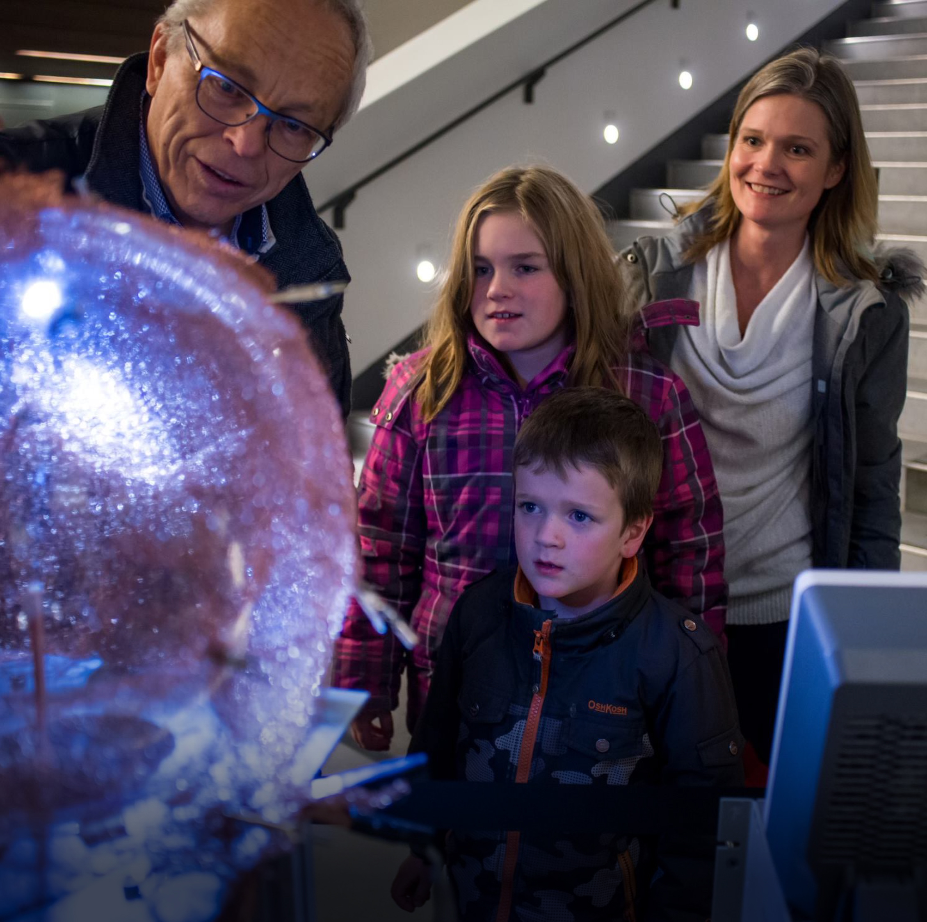

Thank-You tony.noble@mcdonaldinstitute.ca
Thank You

