Slide 1
Toward Two-Photon Absorption Characterization for Silicon Photomultipliers for Dark Matter Detectors
Uday Madaan, Kurtis Raymond, Harry Lewis, Fabrice Retière, Boris Stoeber
Master’s Student in Astroparticle Physics Group @TRIUMF

Slide 2
30s Stretch Break
“Since the dawn of time, mankind dreamt of better SiPMs for VUV detection”
  – fabrice (probably)

Slide 3
Motivation – Pe & Ph for BSI and Dark Matter Detector Improvement
blocked by routing
reaches silicon
Front-Side Illumination
Back-Side Illumination
Legend
- Electron
- Hole
Notes:
[1509.02286] Characterization and modeling of crosstalk and afterpulsing in Hamamatsu silicon photomultipliers
Explain what’s going on (will explain TPA later)
Explain what electron and hole avalanches are and mention they have diff. probs.
Explain why Ph matters for correlated noise
Explain BSI and this benefits it and why this all is beneficial for Astroparticle detectors
BSI PDE good for VUV making it optimal for astroparticle
What’s going on?
Measure (both!) Pe & Ph in SiPMs using two-photon absorption
Correlated noise (cross-talk and afterpulsing) limits SiPM sensitivity in Astroparticle detectors
Holes drive this (Rosado & Hidalgo, JINST 2015)
BSI is the next gen. SPAD for VUV

Slide 4
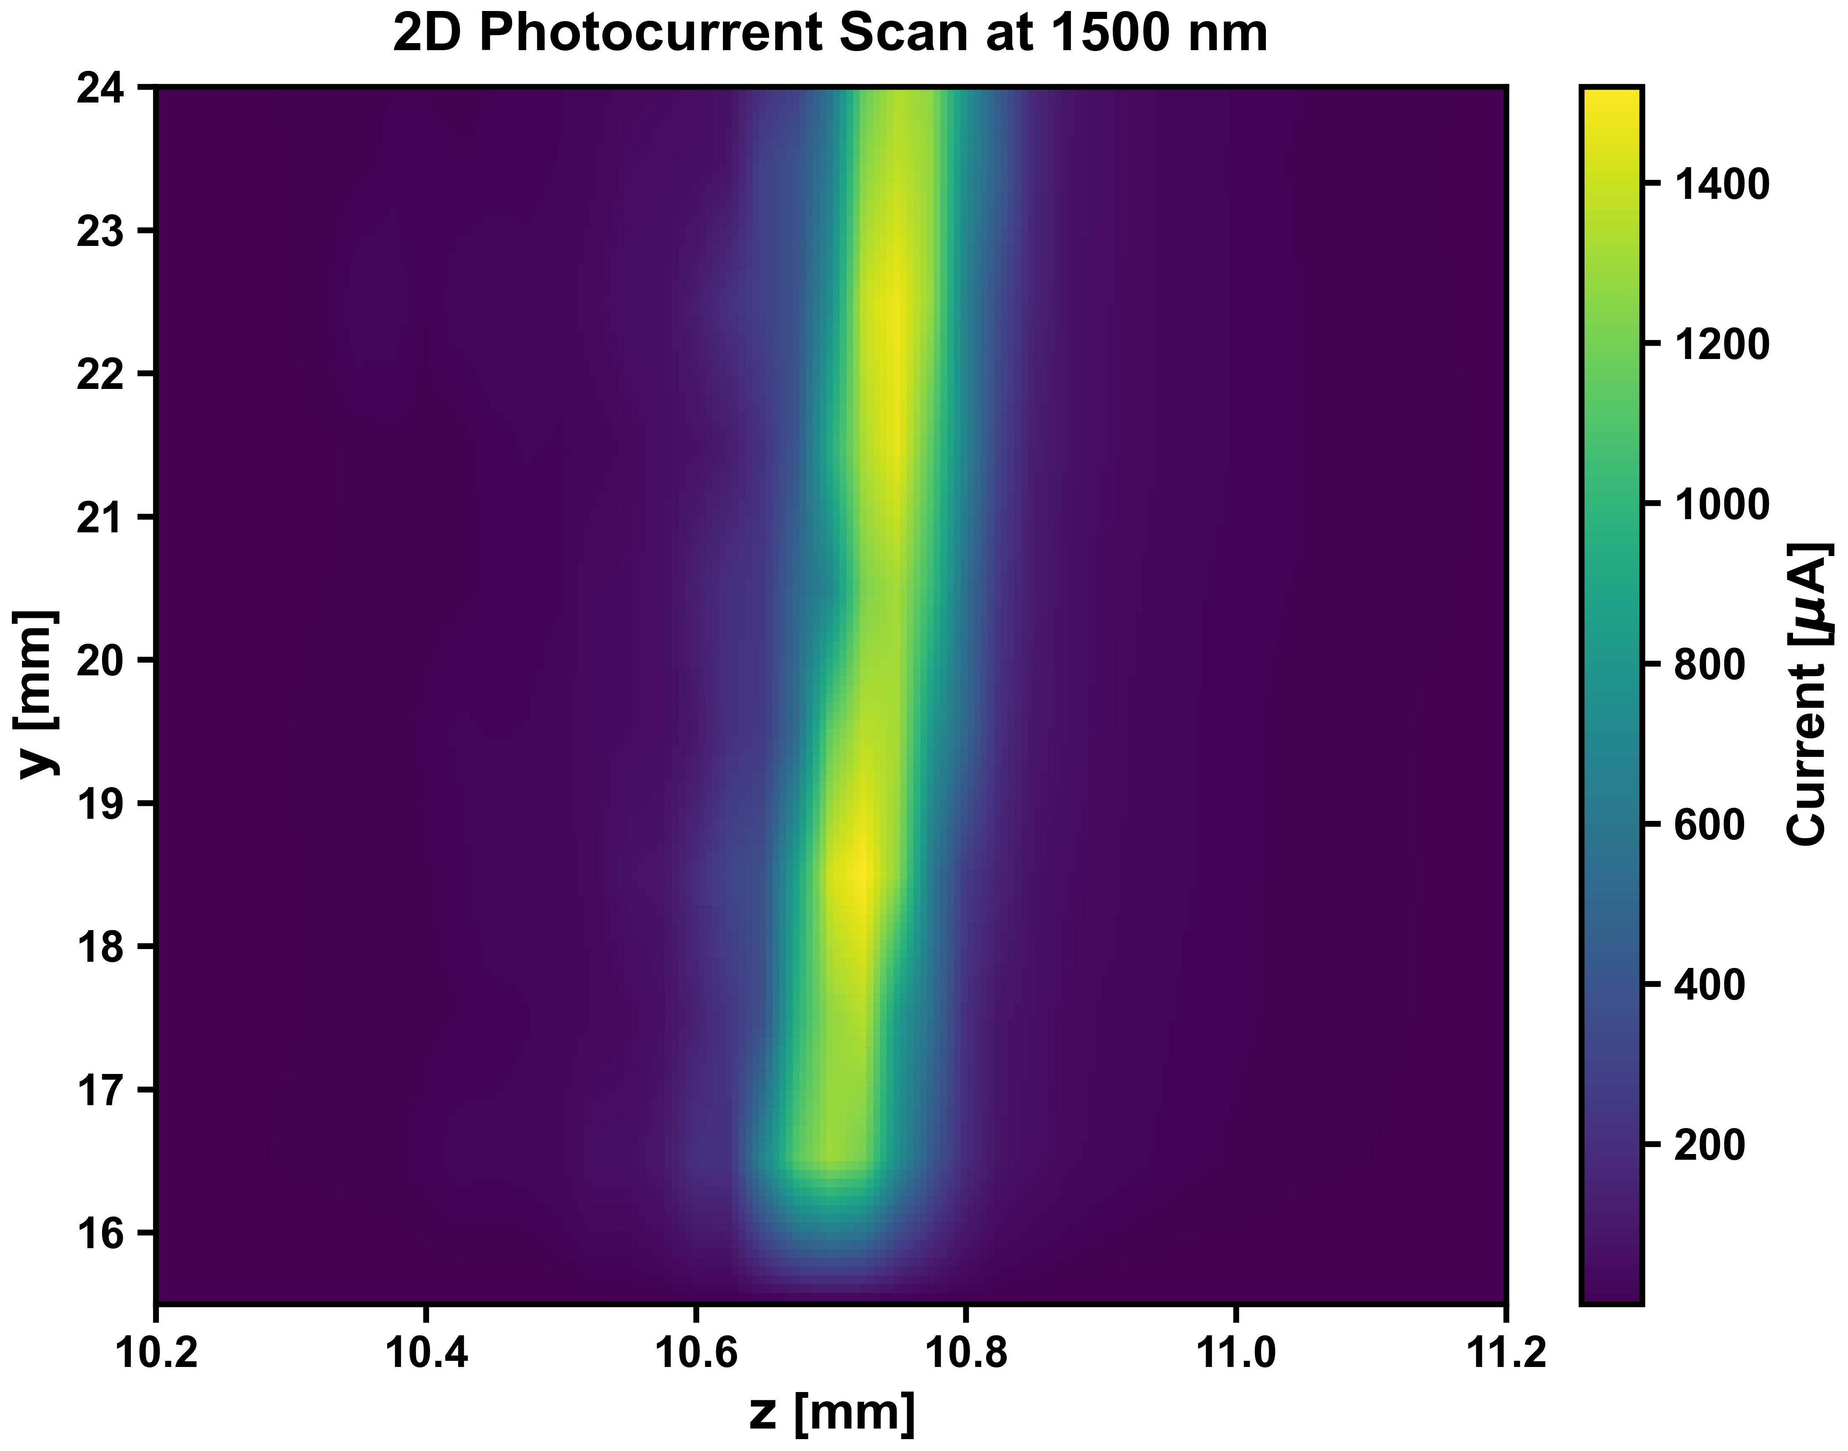
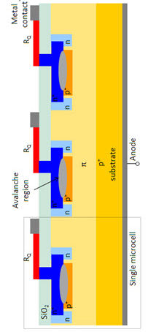
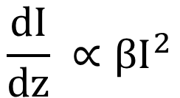
Two Photon Absorption (TPA) - TCT Concept + Results
$$\frac{dI}{dz} ∝βI^{2}$$
Si Photodiode* TPA 2D Scan
Notes:
TCT: a focused laser generates charge at a chosen position; the induced current reveals field and light collection efficiency there
1. Explain TPA mechanism (including quadratic relationship)
2. Explain how TPA allows us to do single carrier to measure Pe and Ph

Slide 5
Setup & Results FBK-VUV-HD3
Preliminary
Notes:
Explain setup
Explain what’s happening in plot
Highlight
The baseline is quite high
The dip in the peak

Slide 6
Interpretation and Outlook
Outlook
Achieve 2D/3D scan methodology
Deconvolve with beam shape and extract Pe & Ph + β
Understand parameter space of TPA with wavelength, intensity, device, etc
Notes:
Interpretation
Too might light (non-single carrier due to high baseline
Slightly off SPAD potentially causing dip
Outlook
Deconvolve
Scan 2D/3D
Understand parameter space of single carrier TPA

Slide 7


Slide 8
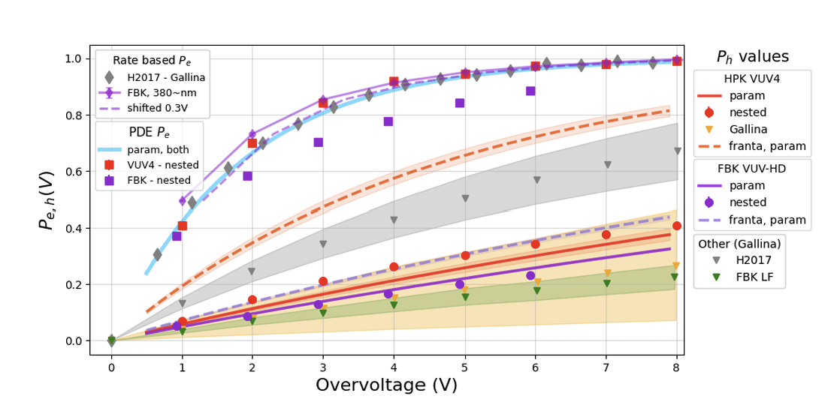
Demonstrating a broadband Photon Detection Efficiency model on VUV sensitive Silicon Photomultipliers – Austin de St. Croix, et al

