Slide 1


Radon assaying facility at University of Windsor for rare physics searches
AboBakr Emara (PhD candidate)
Supervisor: Dr. Caio Licciardi
29th of July 2026
2026 Canadian Astroparticle Physics Community Meeting

Slide 2
How to build the most sensitive detector?

Slide 3
How to build the most sensitive detector?
To do what?

Slide 4
How to build the most sensitive detector?
Neutrinos!
Dark matter!
To do what?
Supernova!
Rare decay!

Slide 5
How to build the most sensitive detector?
Massive target volume?
Cryogenic?
Extreme radio-purity?
Neutrinos!
Dark matter!
To do what?
Supernova!
Rare decay!
Noble gas?
Go underground?

Slide 6
The recipe for a sensitive detector for rare physics searches

Slide 7
The recipe for a sensitive detector for rare physics searches
Go underground (suppress muons, cosmogenic activation)

Slide 8
The recipe for a sensitive detector for rare physics searches
Go underground (suppress muons, cosmogenic activation)
Large target volumes (xenon, water, crystals)

Slide 9
The recipe for a sensitive detector for rare physics searches
Go underground (suppress muons, cosmogenic activation)
Large target volumes (xenon, water, crystals)
Extreme radio purity (suppression of natural backgrounds)

Slide 10
The recipe for a sensitive detector for rare physics searches
Go Underground (eliminate mouns, cosmogenic activation)
Large target volumes (xenon, water, crystals)
Extreme radio purity (background suppression)
Cryogenic (maybe!)
Noble elements (could be!)
Dual-phase (why not!)

Slide 11

The recipe for a sensitive detector for rare physics searches
Go Underground (eliminate mouns, cosmogenic activation)
Large target volumes (xenon, water, crystals)
Extreme radio purity (background suppression)
Cryogenic (maybe!)
Noble elements (could be!)
Dual-phase (why not!)

Slide 12
How to get extreme radio purity
Every piece of material used to build detectors from the metal housing to the photomultiplier tubes (PMTs) must be painstakingly screened for trace amounts of natural radioactivity (like uranium or thorium) to prevent false triggers
To build a very sensitive detector you need to start with a very clean detector
To start with a very clean detector you need a very sensitive detector to measure how clean are your future detector can be! Deadlock!

Slide 13

How to get extreme radio purity

Slide 14
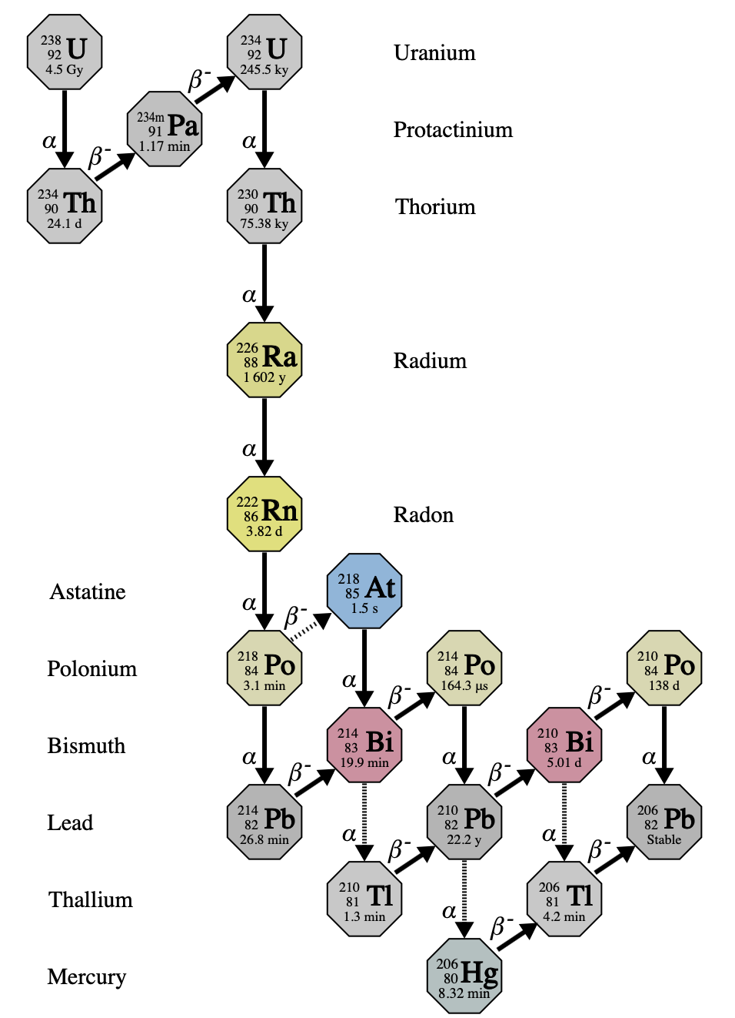
Measuring decay chain of (eg.U²³⁸)
We have different techniques for different decay product and different energies
Upper chain
  ICP-MS, NAA
Medium chain
  HPGe γ-spectroscopy
  Radon emanation
Lower chain
  Ultra-sensitive α counting
  Low-energy HPGe
  Ultra-sensitive β counting
Each techniques has a different sensitivity
Credit: “Radioassay for Future Low Background Experiments” Isaac Arnquist

Slide 15
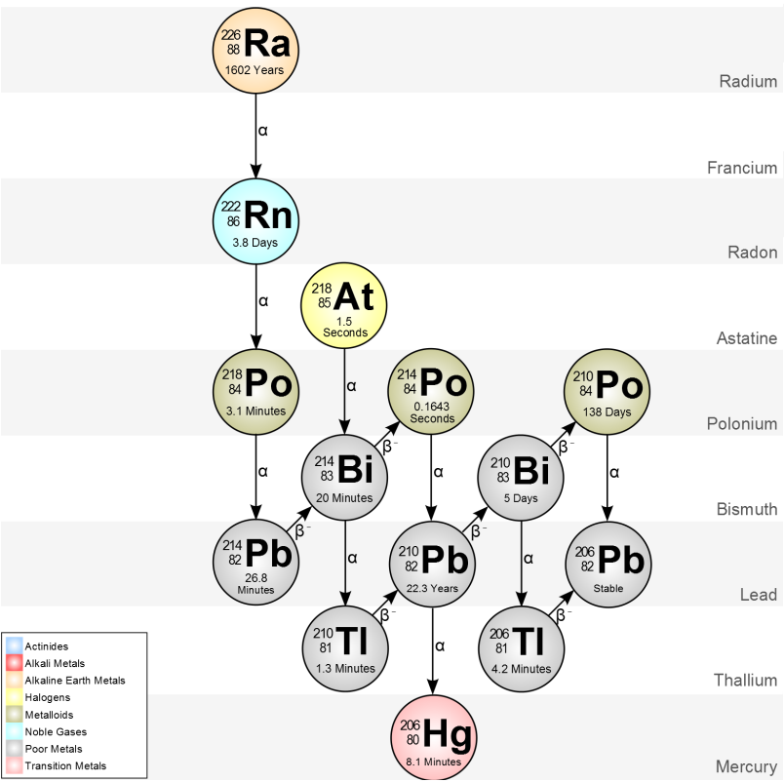
Why do we care about Radon?
Radium is long lived (T_{1/2}=1602 y)
Radon is noble gas, xenon purification via noble gas
Mobility
Q-value of 0νββ for ¹³⁶Xe coincide with ²¹⁴Bi gamma
Alpha-n (𝝰-n) reaction may produce n-capture ¹³⁷Xe (β)
𝛾 (2.44 MeV)

Slide 16
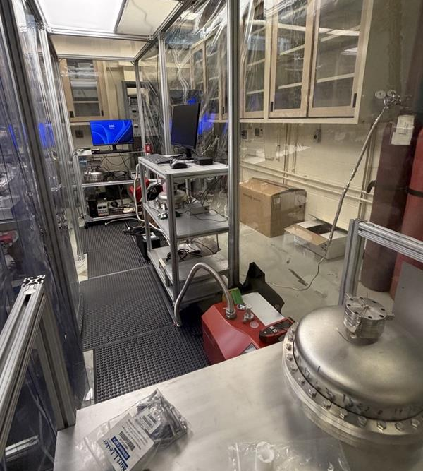
Radon assay facility at University of Windsor
Building three electrostatic counter for radon assay
ESC does alpha spectrometry of radon progeny
ESC is state of the art technology, sensitive to 10s of µBq, recirculation system

Slide 17
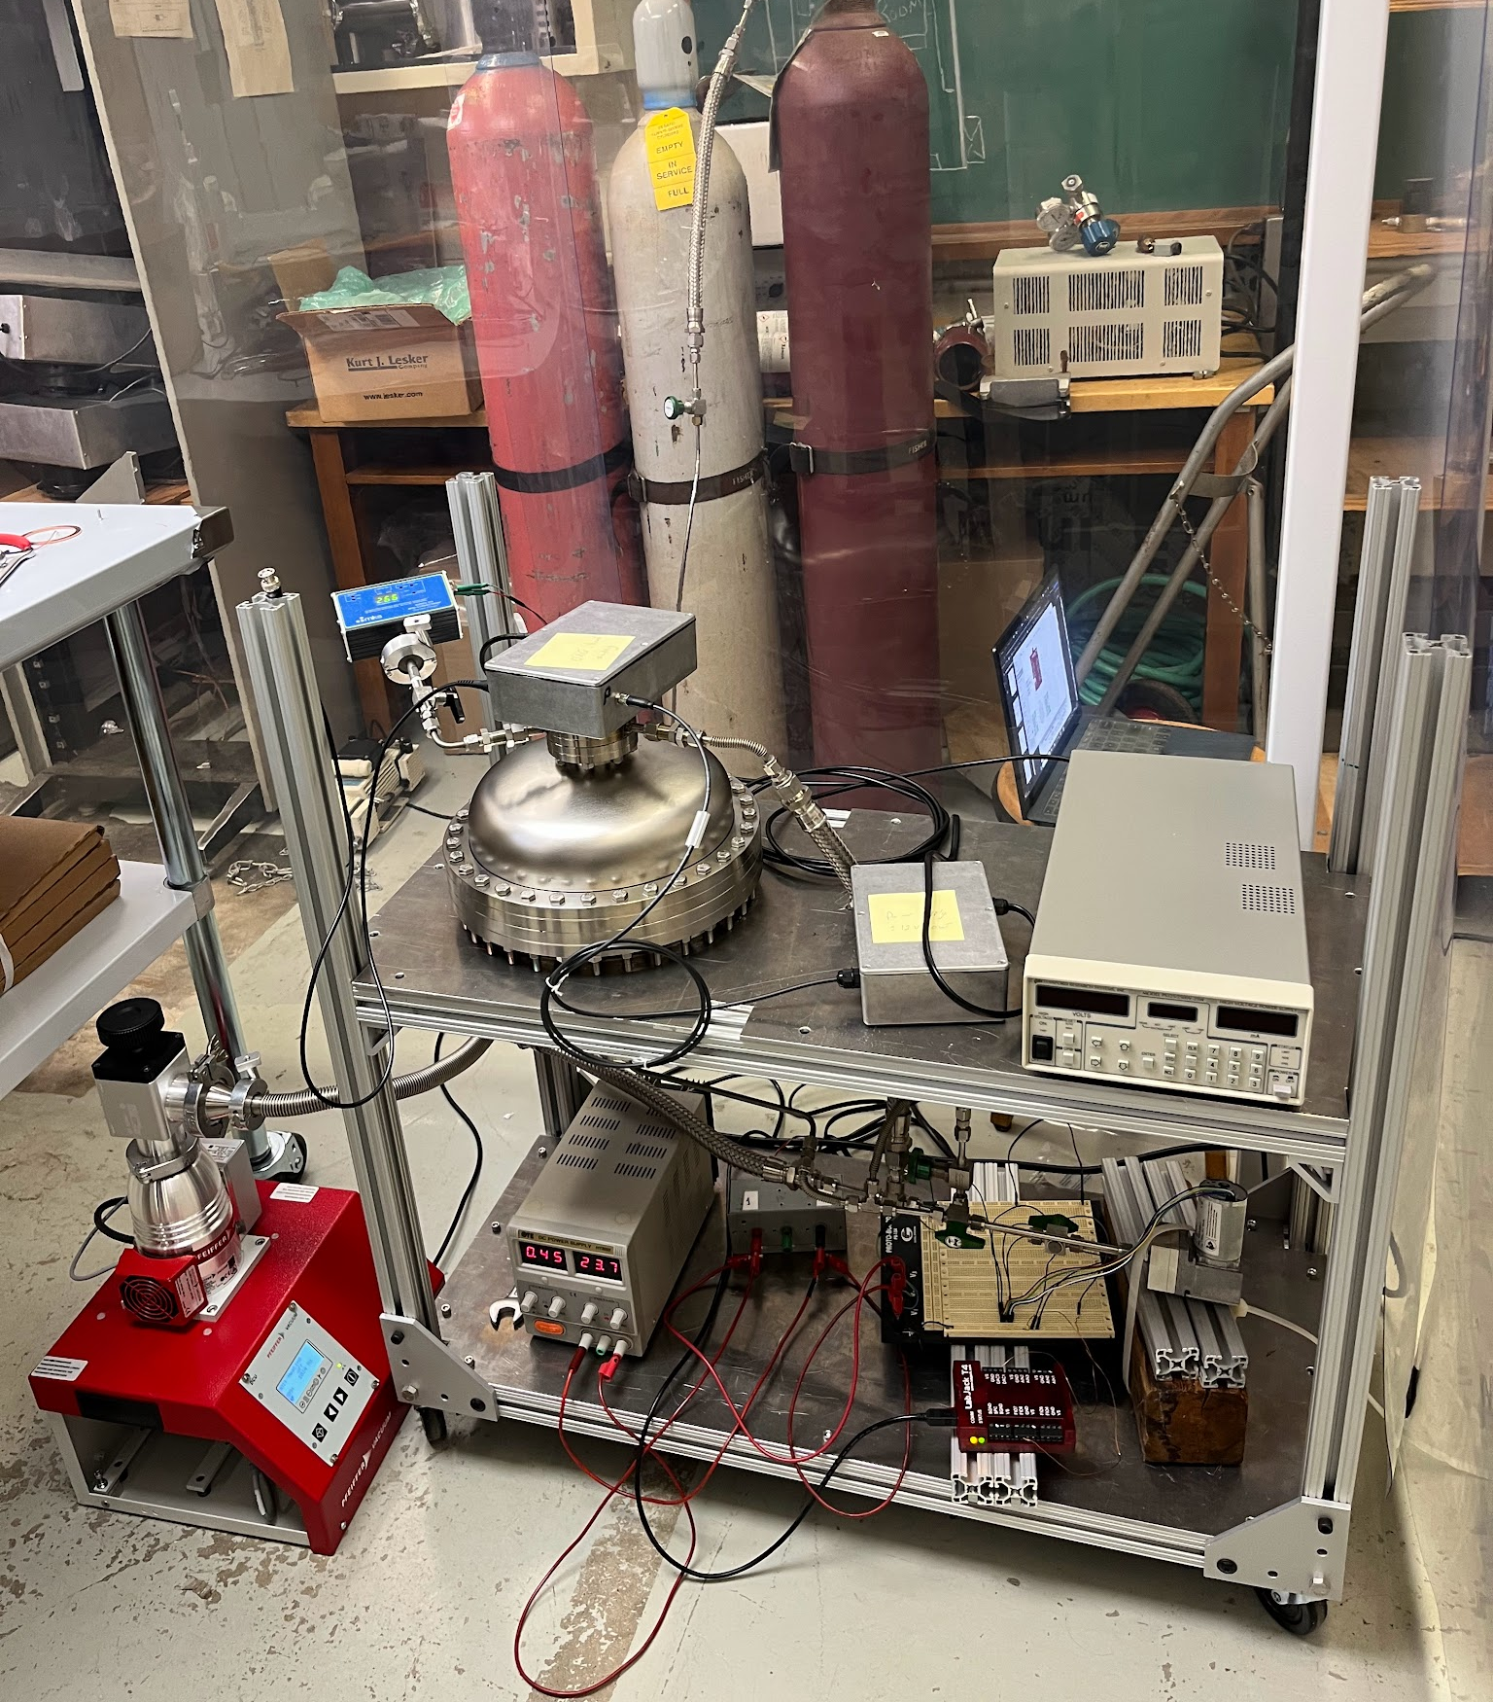
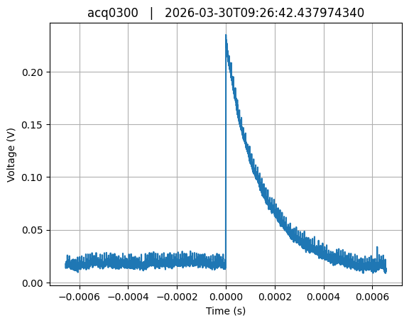
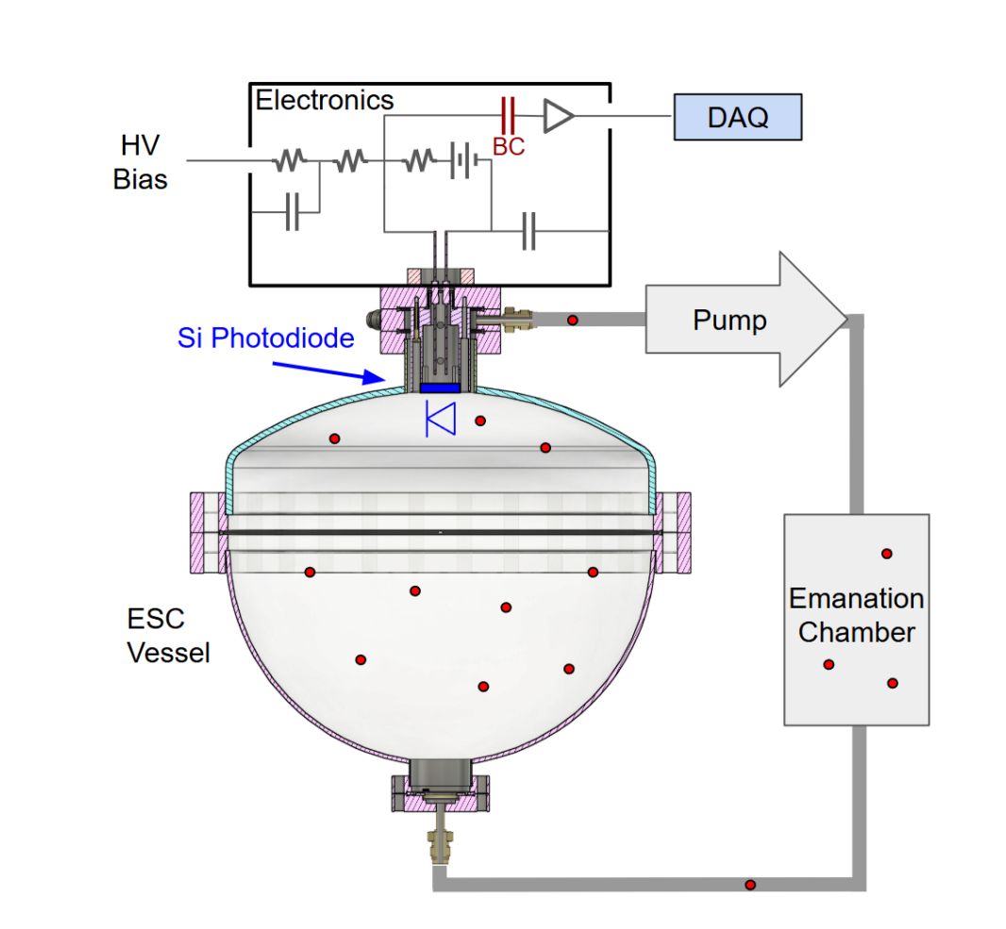
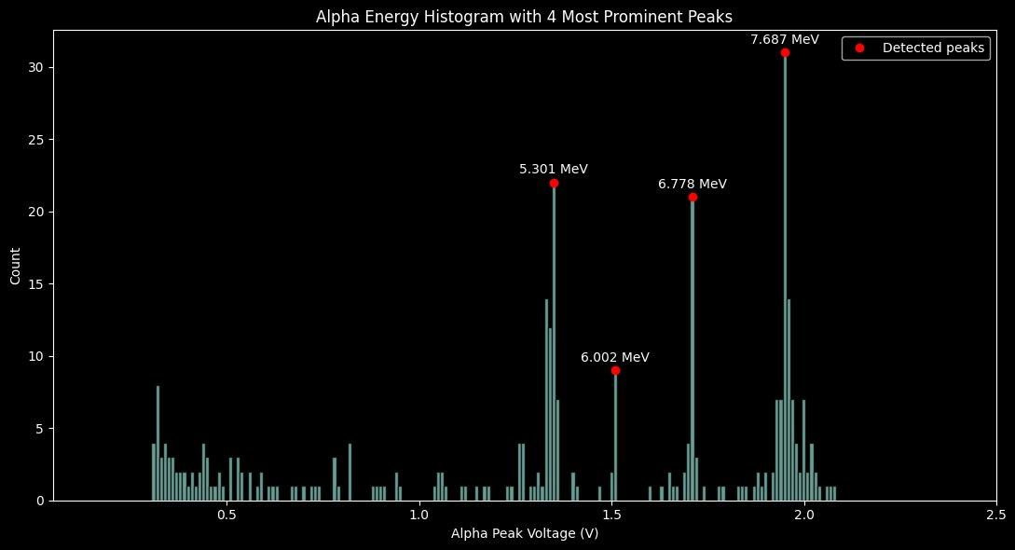
How does an electrostatic counter work?
DAQ
Pressure gauge
HV power supply
Drift chamber
Recirculation pump
Vacuum pump

Slide 18
Background preliminary results
We ran different background runs for both custom-spherical and hemispherical ESCs (commissioning)
We are reaching background runs at <400μBq
Comparable to literature 197μBq (DOI:2504.15464)

Slide 19
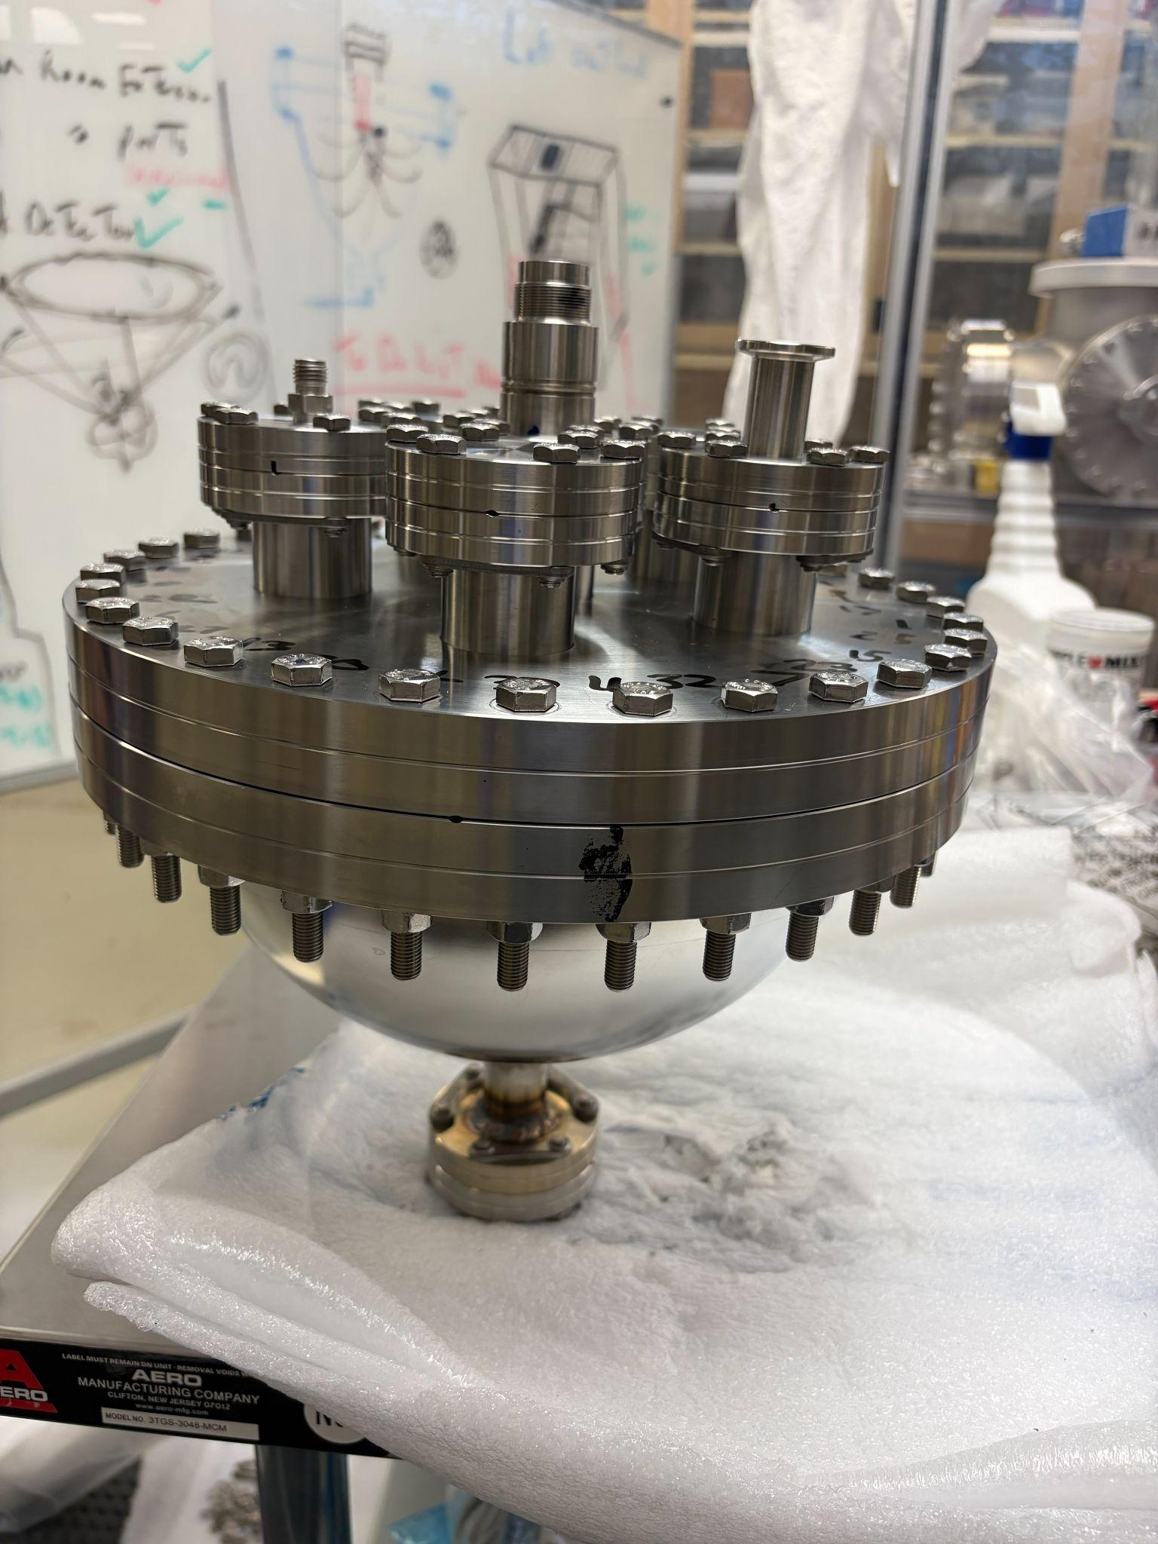
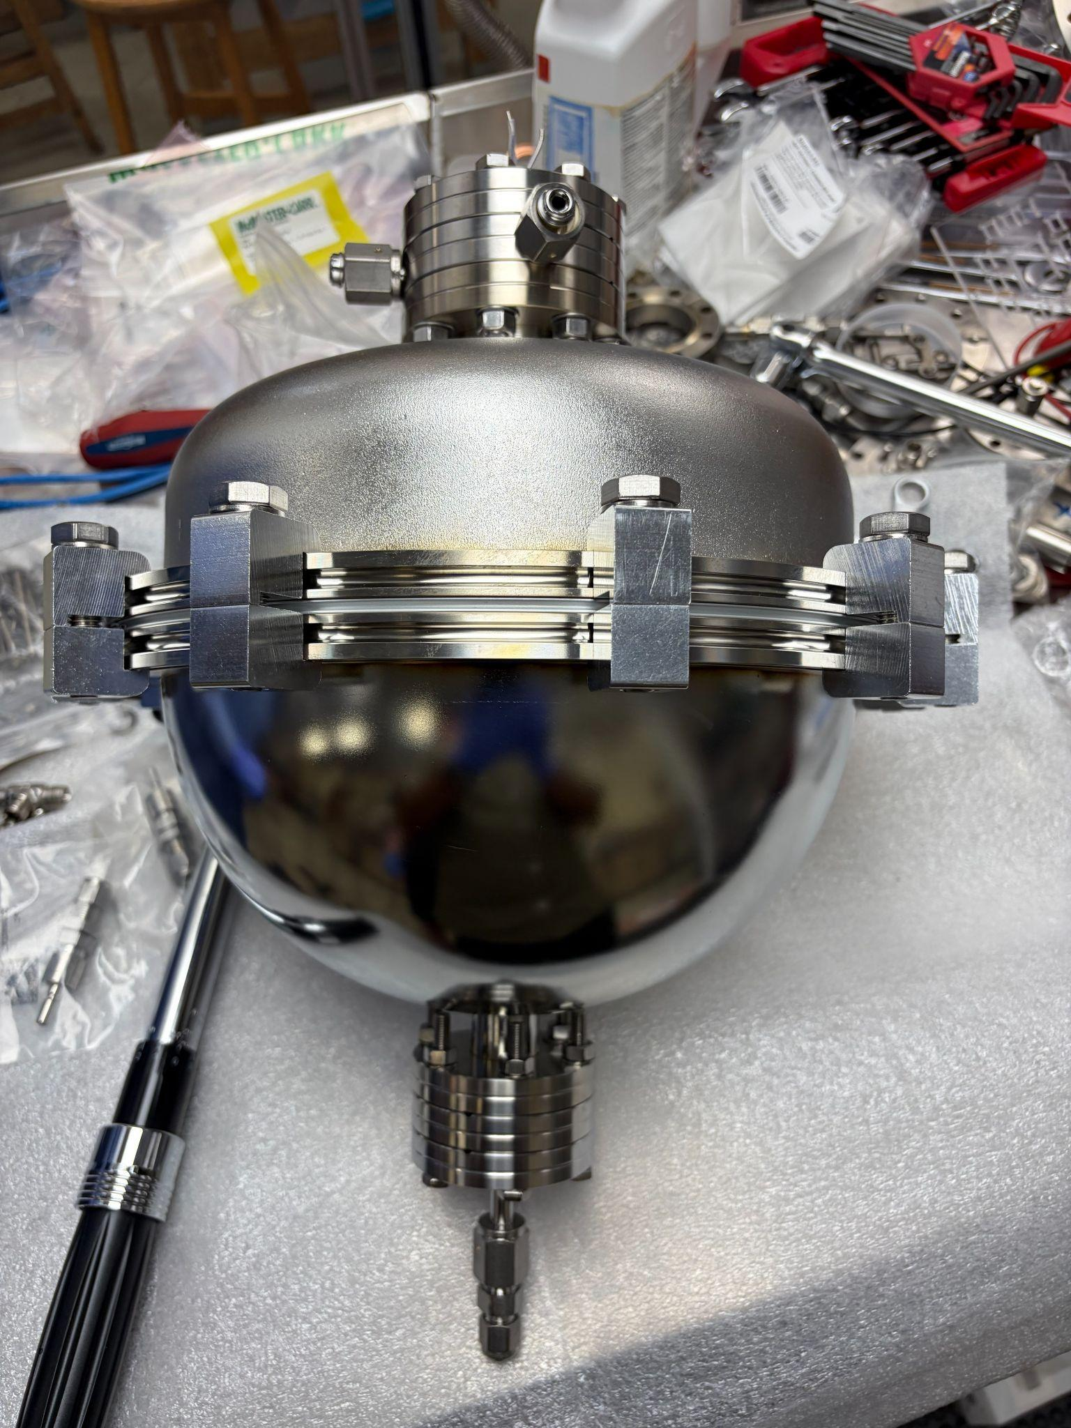
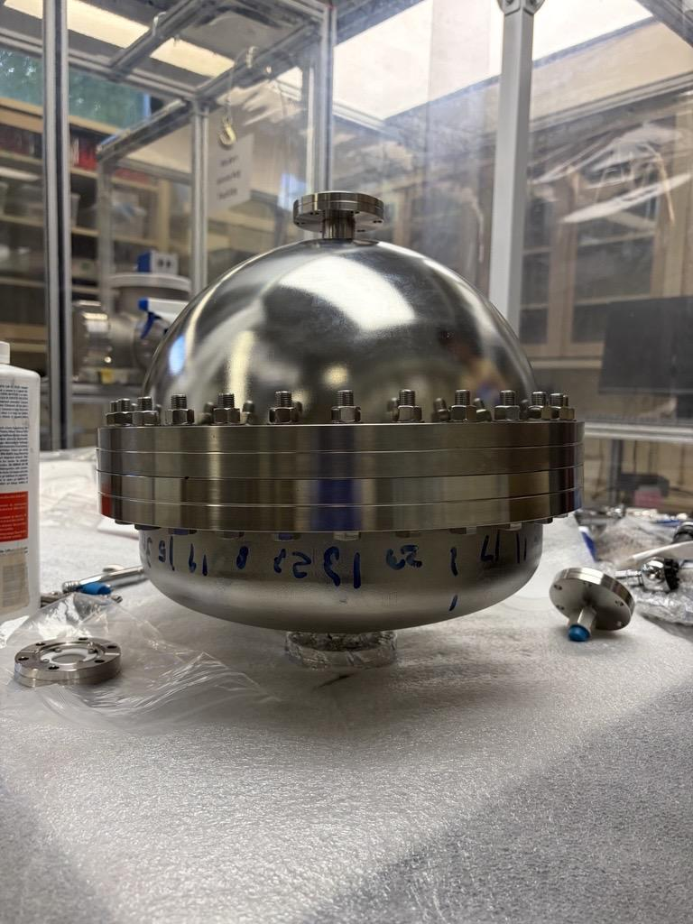
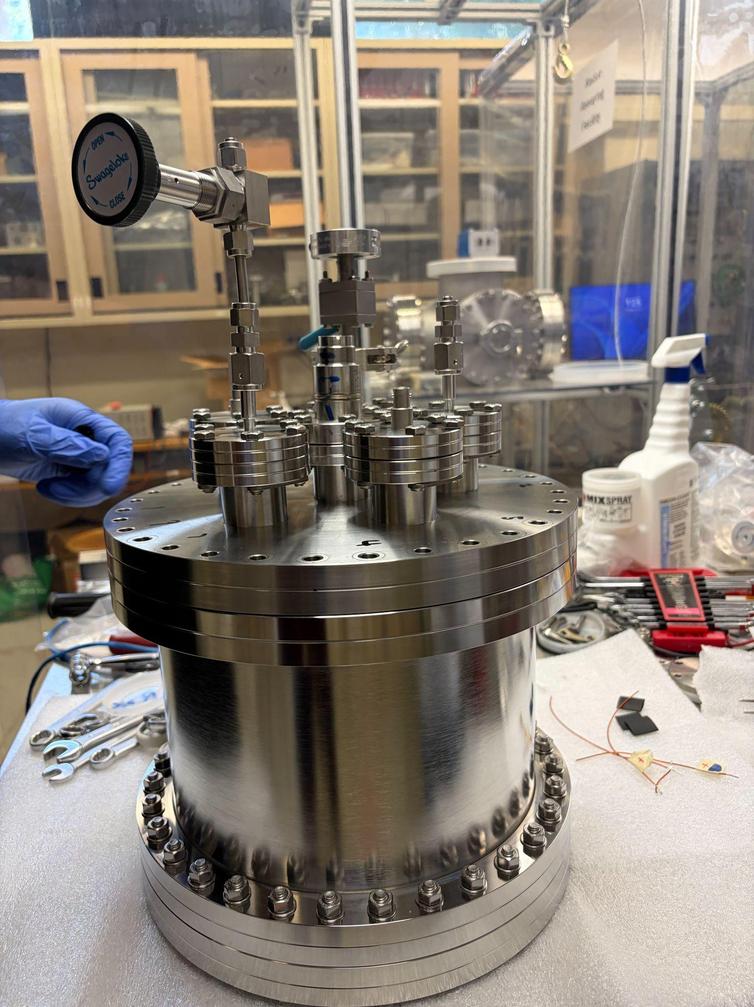
ESC detection efficiency
ε_{Detection​}=f_{α​}×f_{S}×f_{E} ×f_{V}
Due to volume sharing
Ion collection eff. ​
Due to electric field intensity and uniformity
88% ion in air​
From Rn decay
Isotopic decay solid angle 50%​

Slide 20
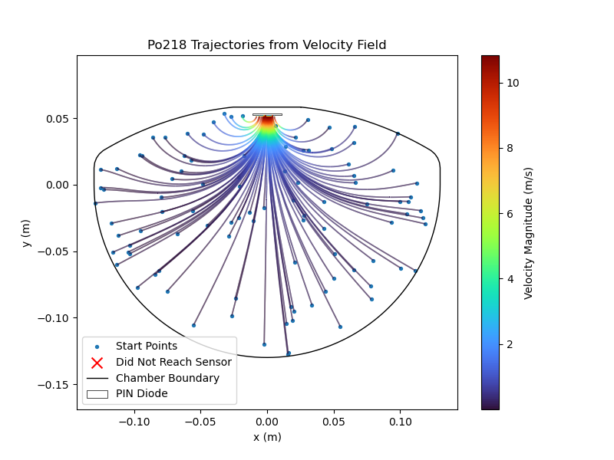
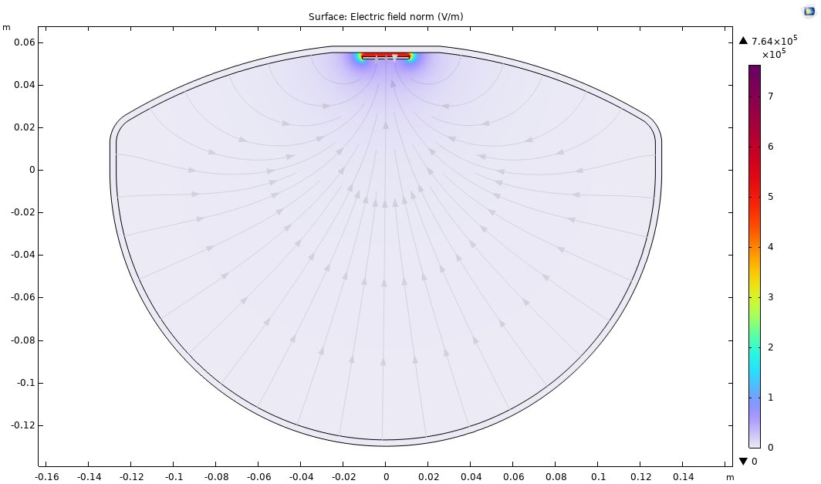
Comsol particles trajectories simulations (f_{E})
Simulation credits: Akira Lee

Slide 21
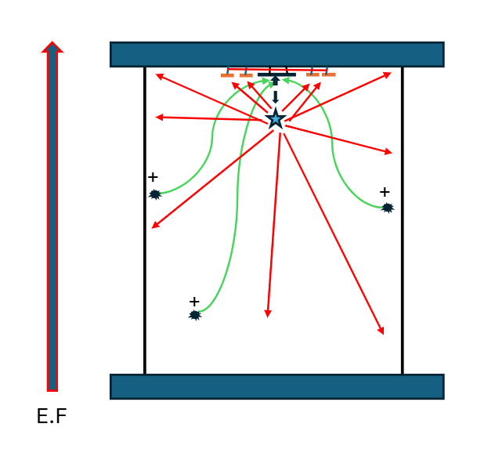
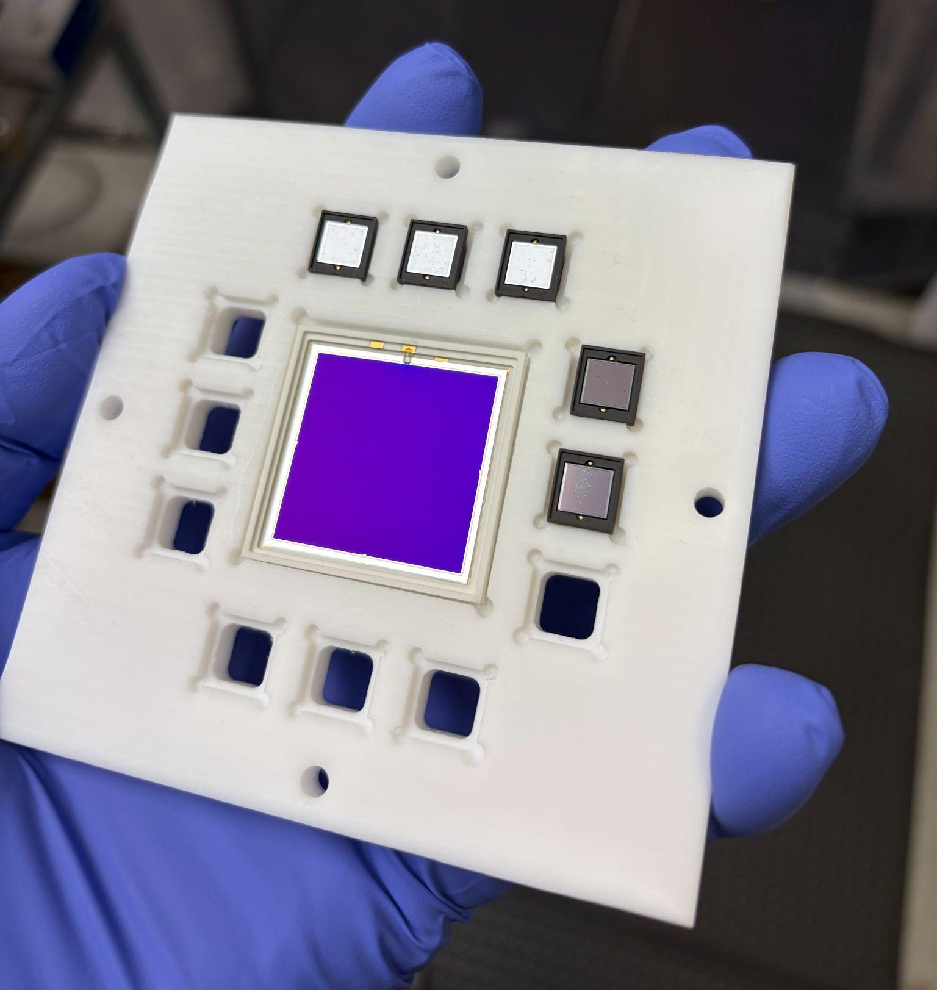
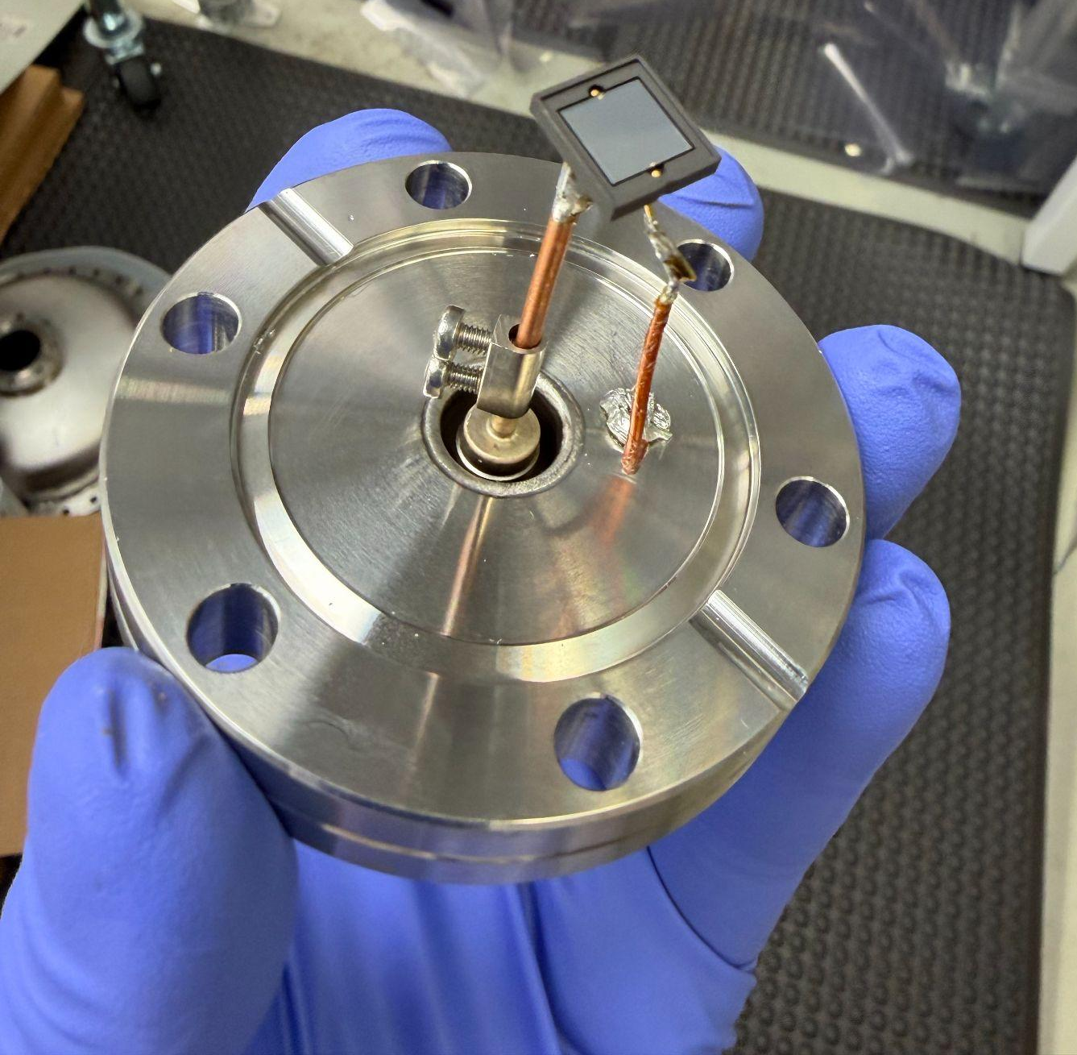
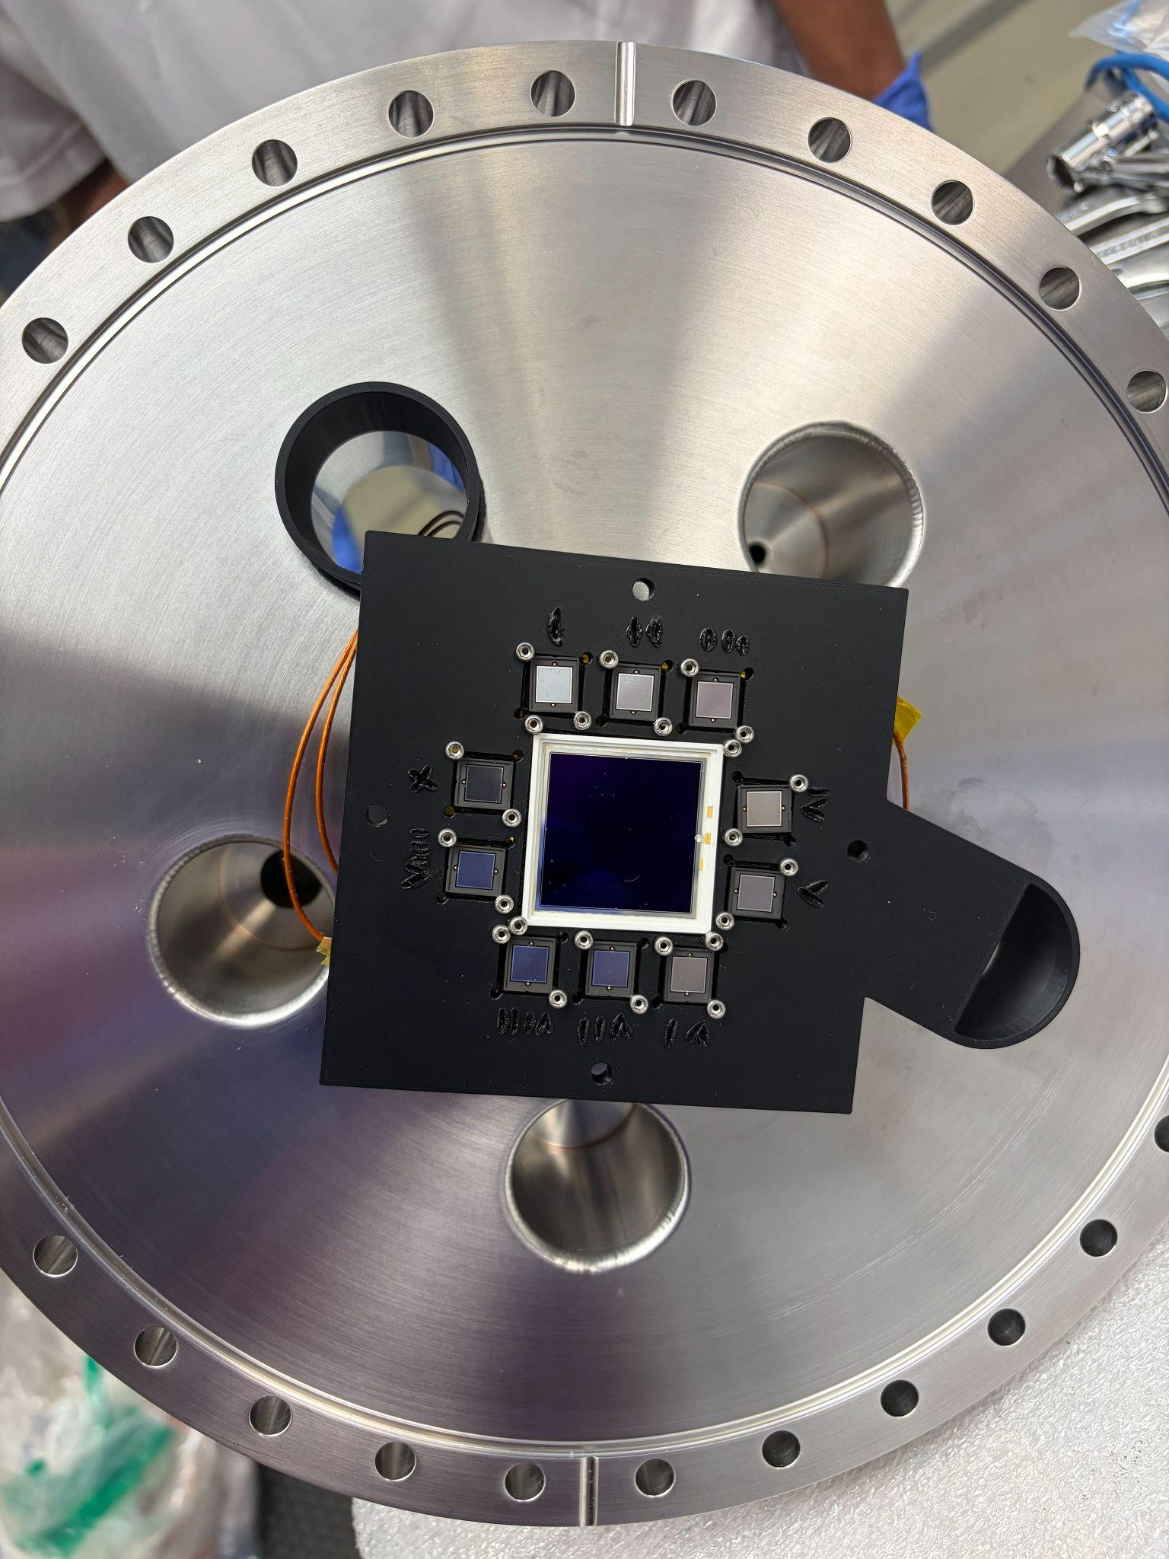
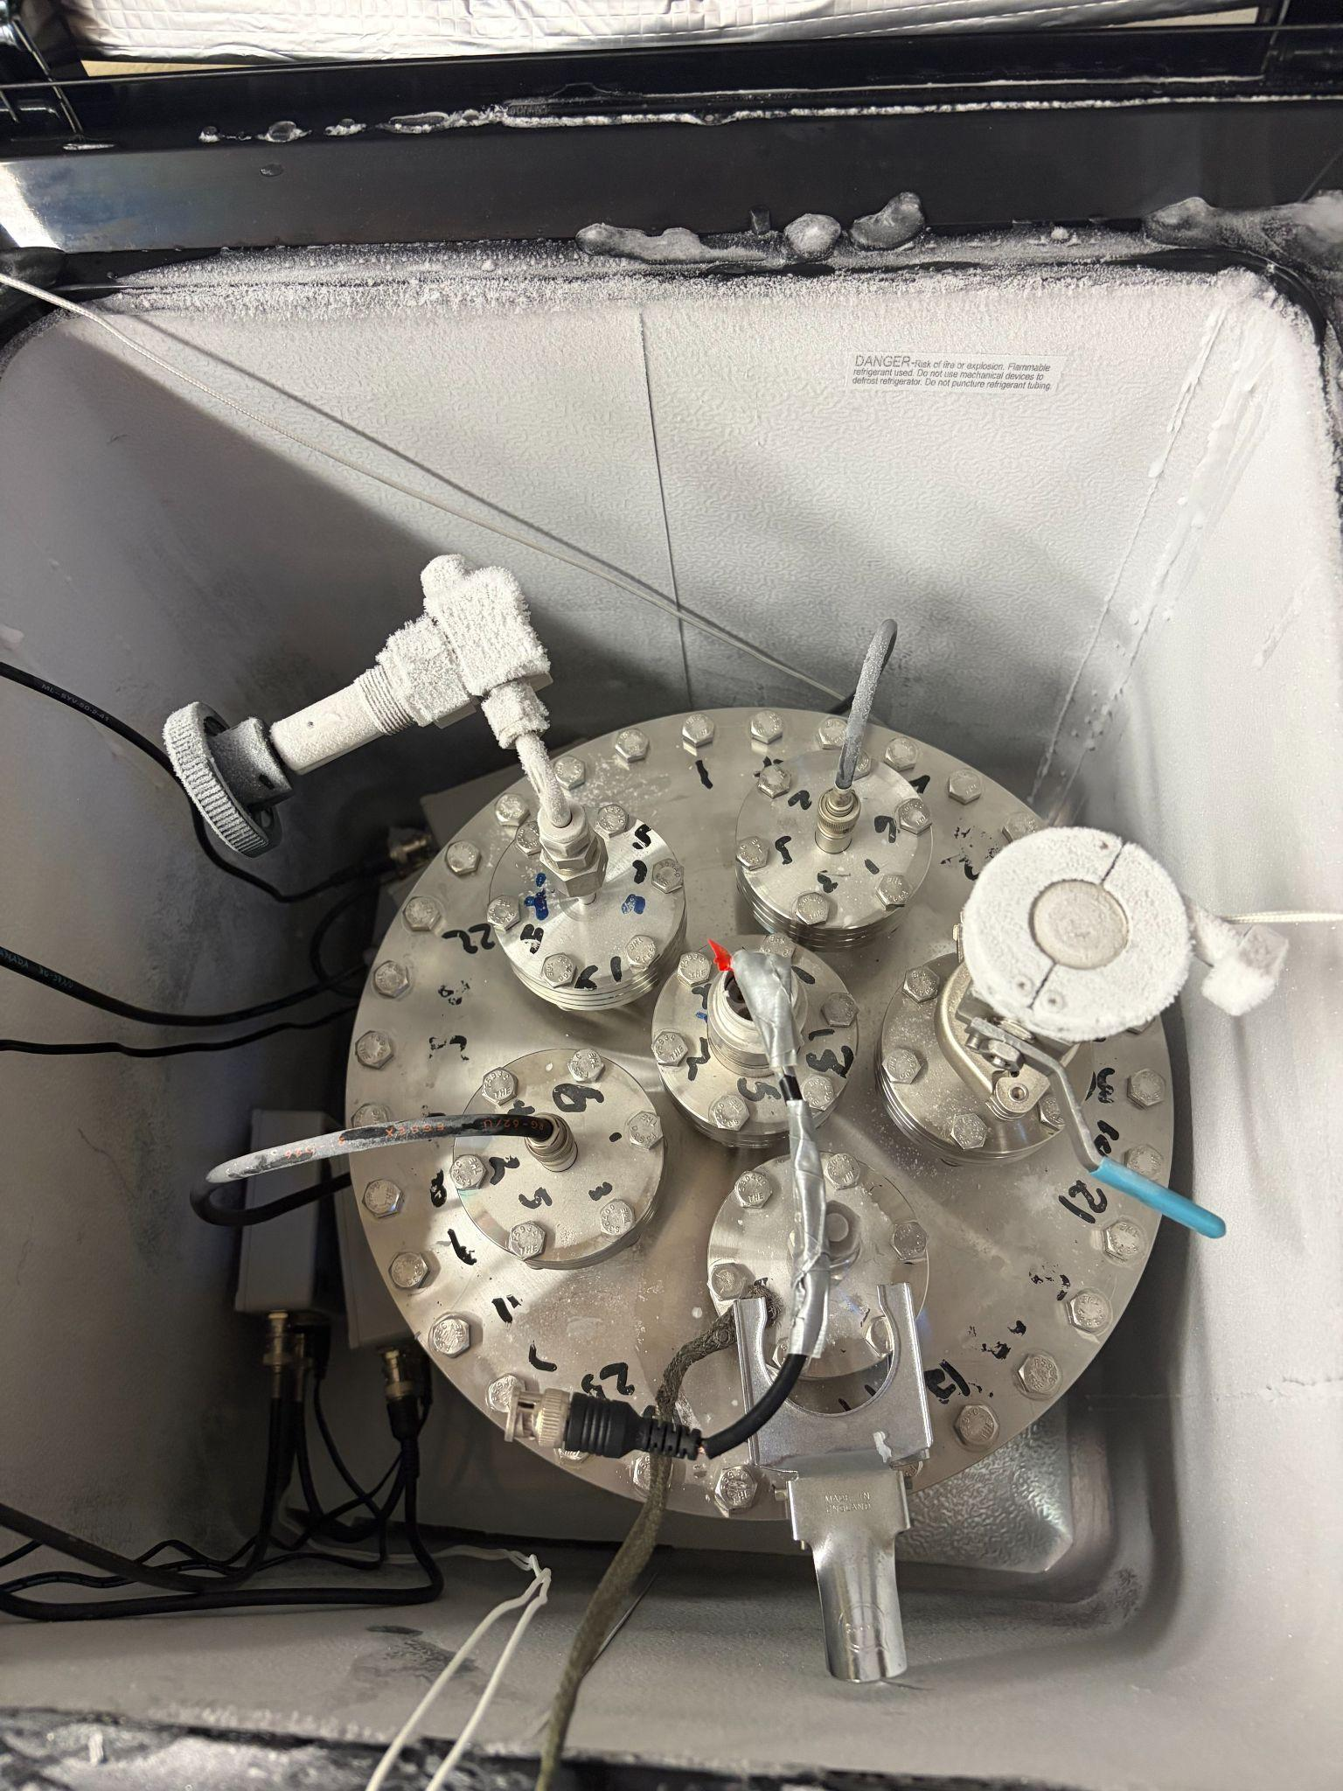
R&D cylindrical vessel with SiPMs (f_{S})
Hamamatsu VUV-4 MPPC
Diagram of the new ESC design with SiPM
-40° C freezer (reduce dark counts)

Slide 22
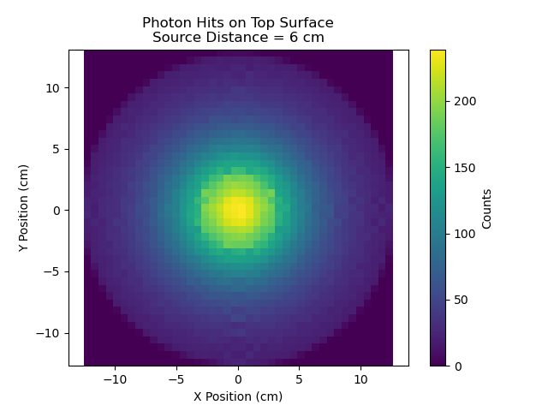
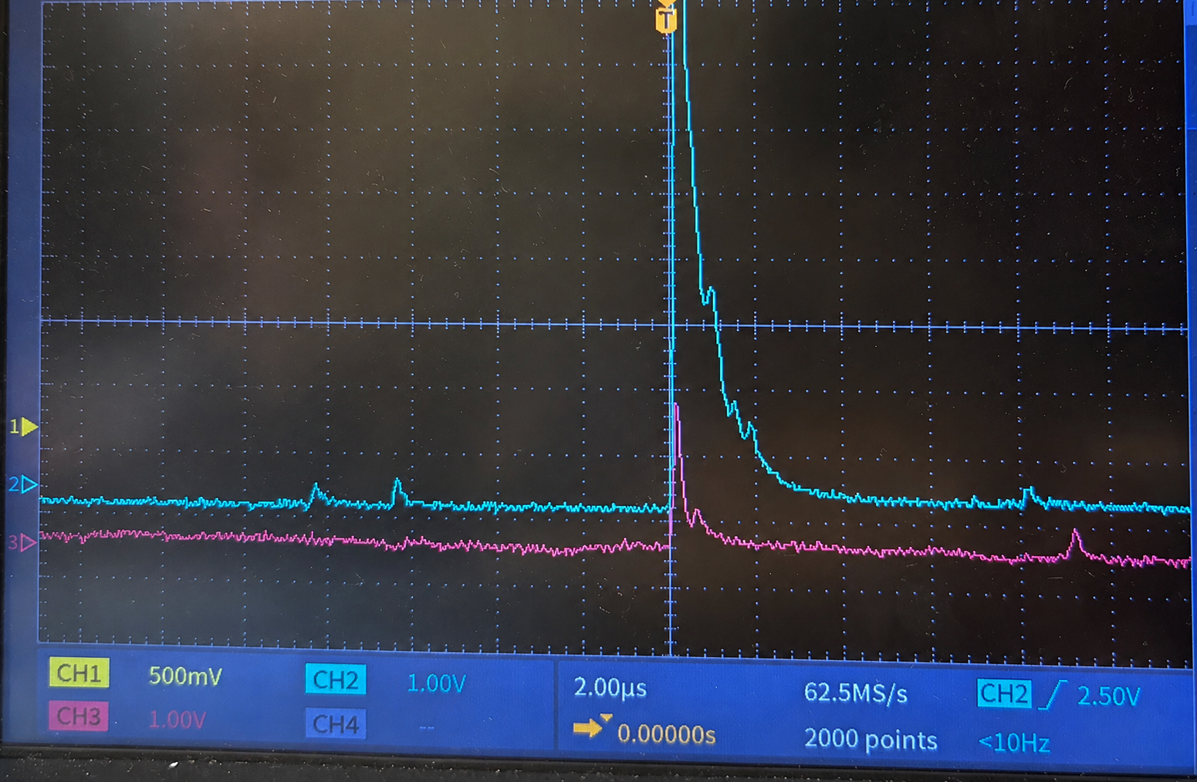
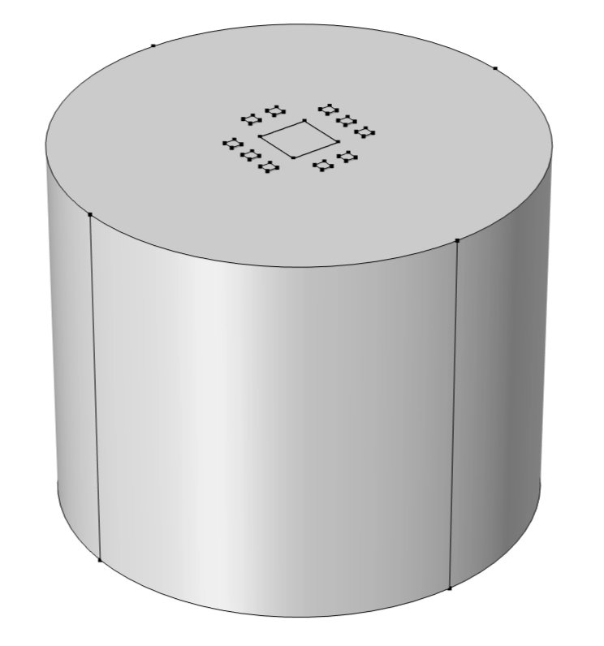
R&D cylindrical vessel with SiPMs (f_{S})
Simulated light signal
Measured light signal on two SiPM channels
Measuring both alpha particles energies
And scintillation photons in argon gas
Would improve our understanding of the decay physics
Improve the total efficiency of ESC
Simulation credits: Simon Bottrill
Measured alpha signal on center PIN diode

Slide 23
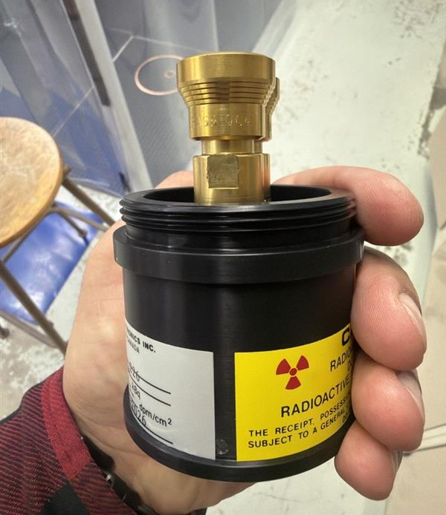
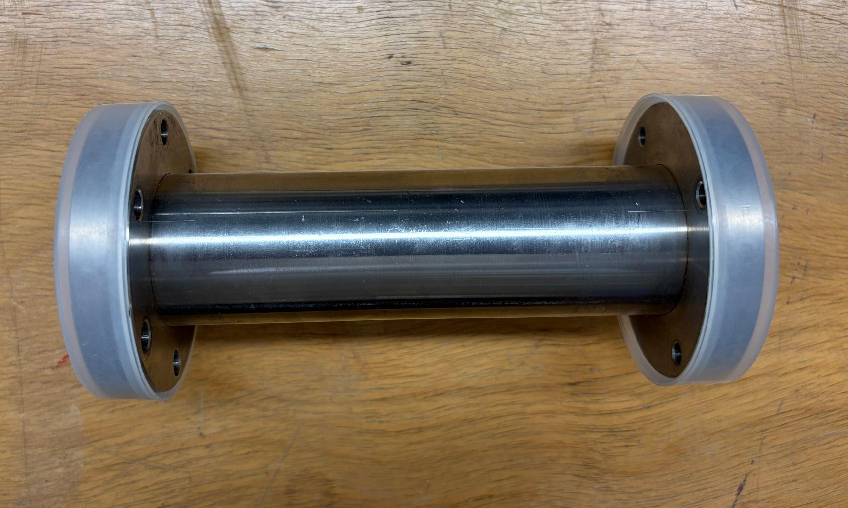
Future work radon source calibration (f_{α​}),(f_{V​})
Radon source calibration (Dr. Shetty-postdoc)
ESC background measurement (Dr. Rahman-RA)
R&D to measure the ionization fraction of radon in gases (Bakr-PhD, Mathew, Simon and Akira-undergrads) (f_{α​})
²²²Rn calibration source (ε_{Detection})​
Emanation chamber (f_{V​})

Slide 24
Summary
It is important to understand radon contamination in low-background searches
We are commissioning ultra-sensitive radon detectors at the University of Windsor, promising initial results
On going work on calibration procedures and R&D for increase detection efficiency
The radon assay facility at the University of Windsor is intended to serve as a central radon assay hub in Canada

Slide 25
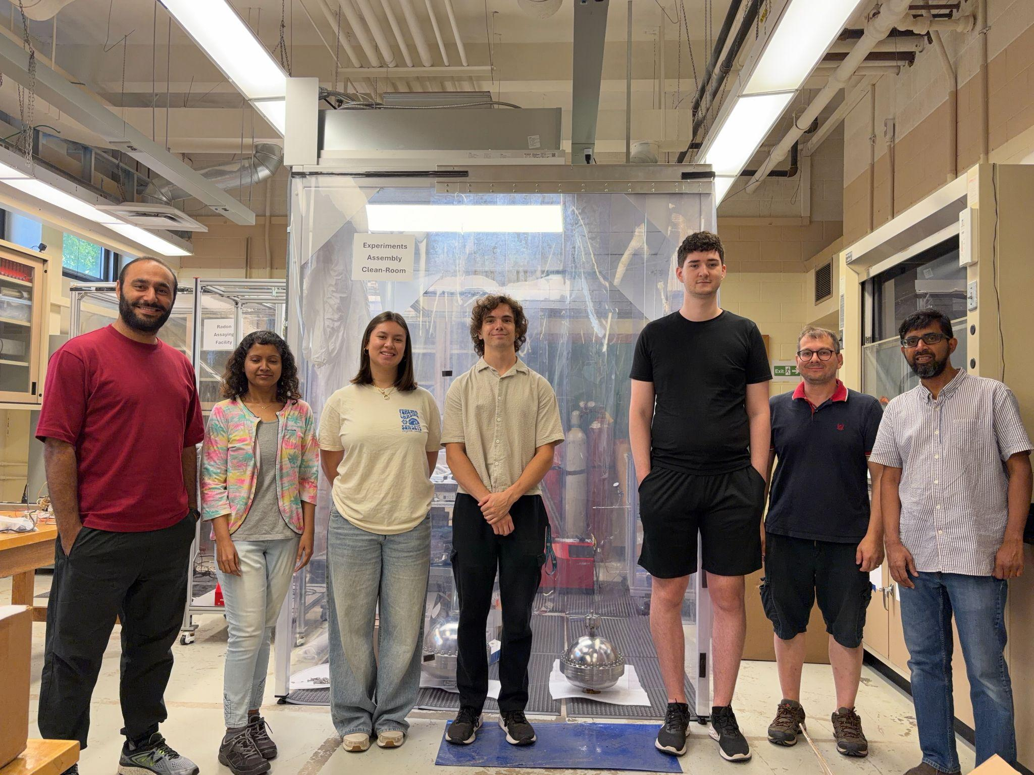
Licciardi Group
Bakr Emara - PhD Student
Dr. Trilochana Shetty - postdoc
Akira Lee -undergrad
Simon Bottrill - undergrad
Matthew Beemer - undergrad
Dr. Caio Licciardi - PI
Dr. Saydur Rahman - RA

Slide 26

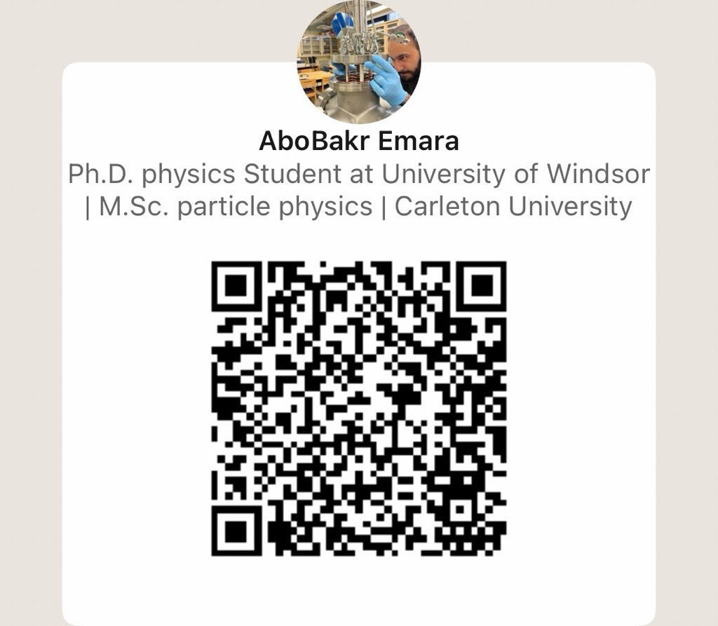
For any ideas, collaboration or future postdoc positions :) please reach out to me on LinkedIn
Meow-estions?

Slide 27
Extra Slides

Slide 28
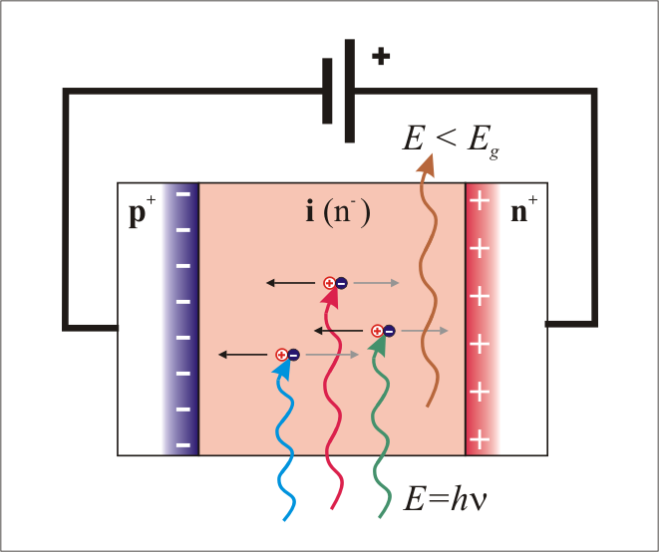
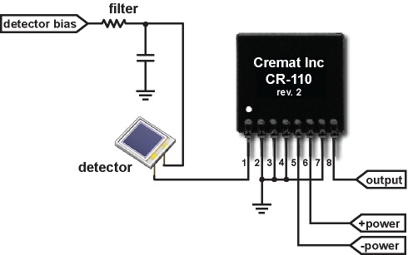
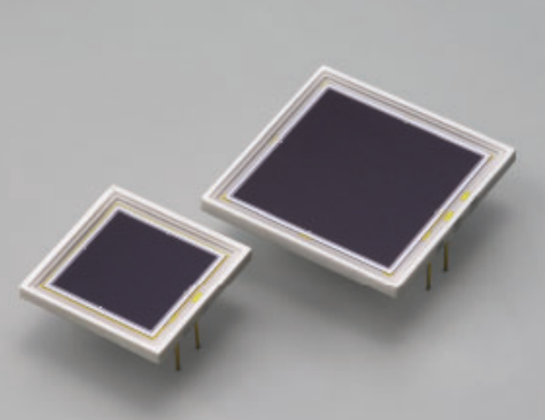
PIN Diode
A PIN diode has a P-type region, a thick intrinsic (I) layer , and an N-type region
When charged particles create electron-hole pairs, causing a current pulse
This pulse is fed into a charge-sensitive preamplifier for energy measurement

Slide 29
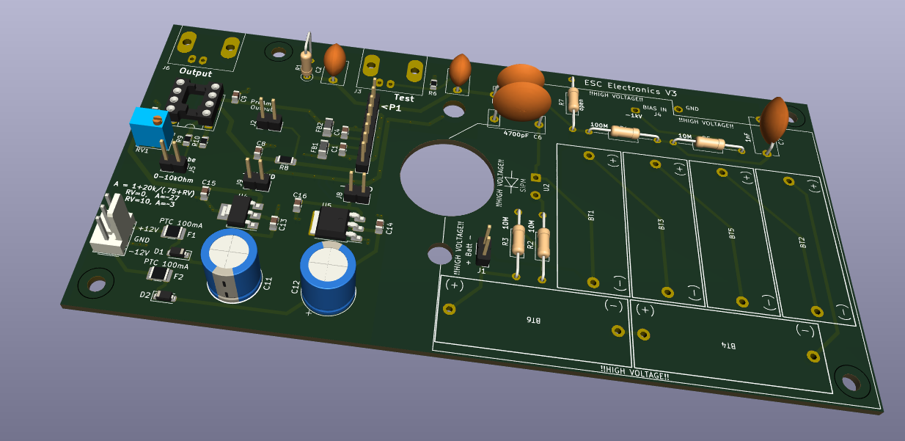
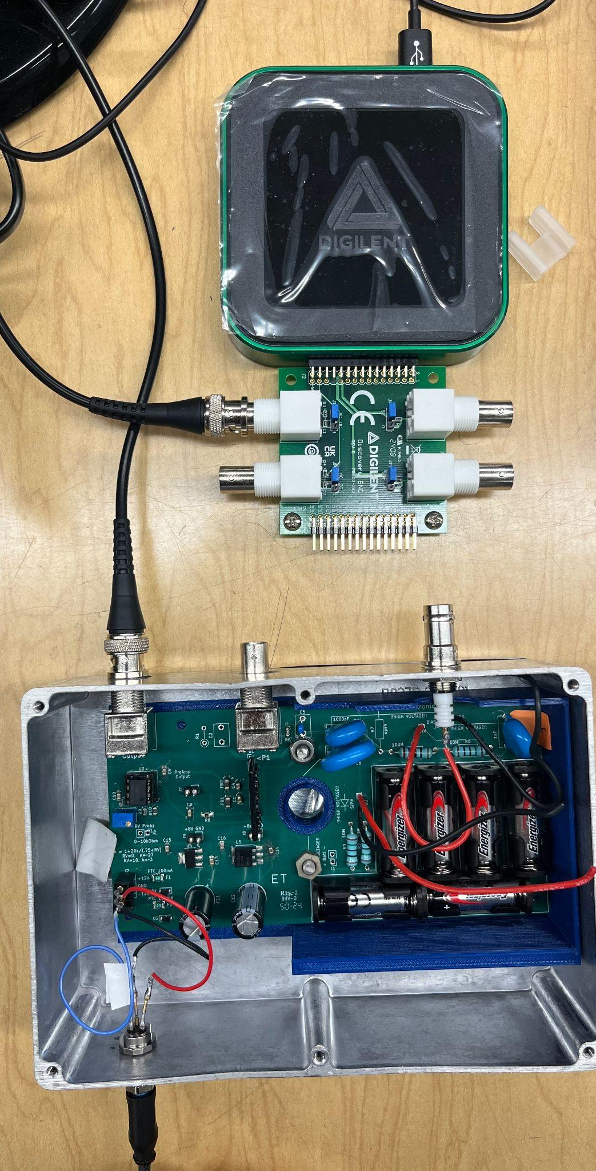
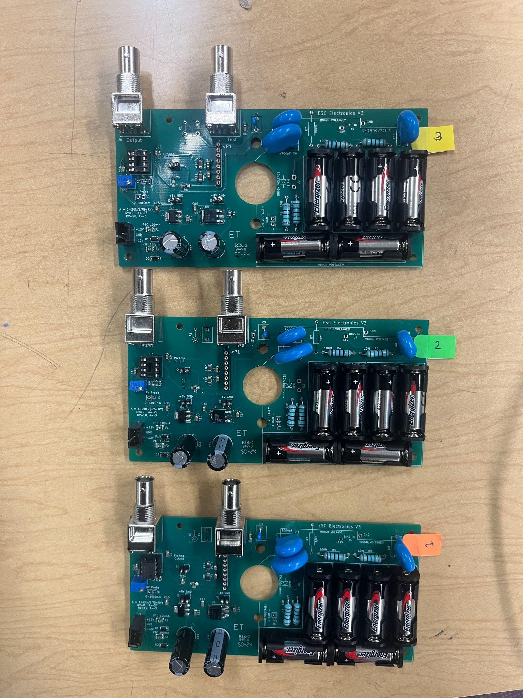
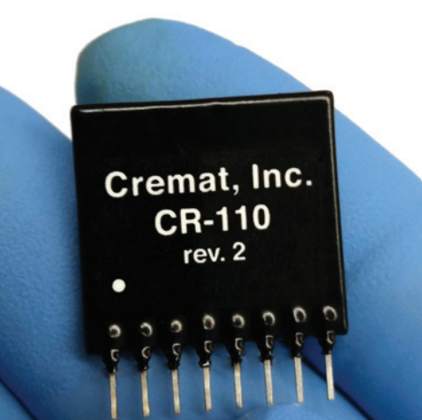
Data acquisition system (DAQ)
Custom charge electronics board amplifies signal to ~0.3 V/MeV
Signal is digitized using Digilent Analog Discovery 3: 125 MS/s USB Oscilloscope
High voltage power supply for ion drifting inside the chamber

Slide 30
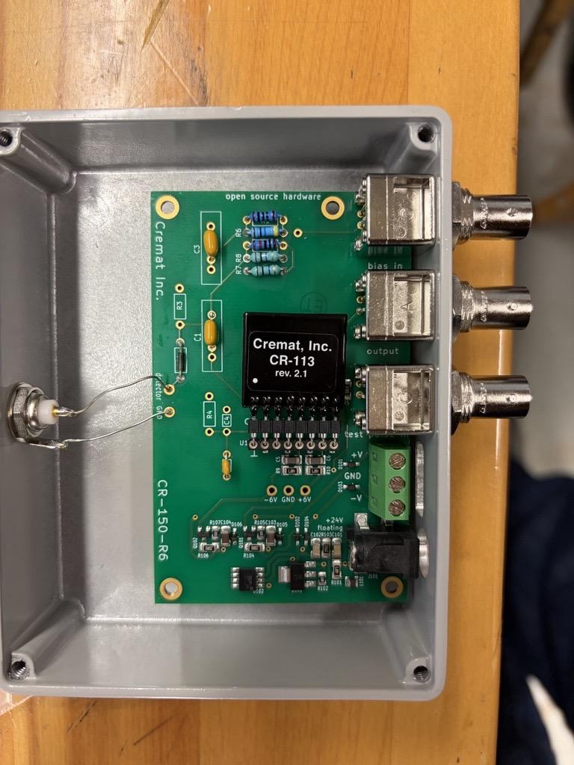
Data acquisition system (DAQ)
Using cremat board for preamp and shaping
Signal is digitized using Digilent Analog Discovery 3: 125 MS/s USB Oscilloscope
High voltage power supply for MPPC bais

Slide 31
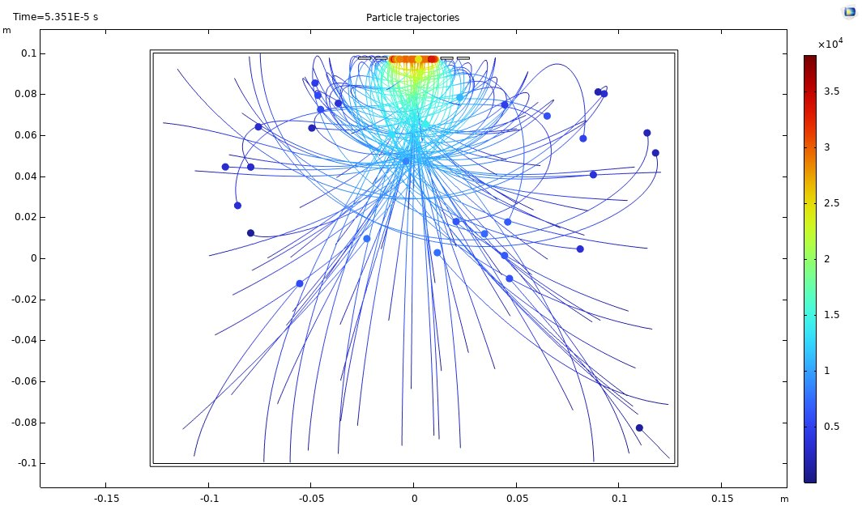
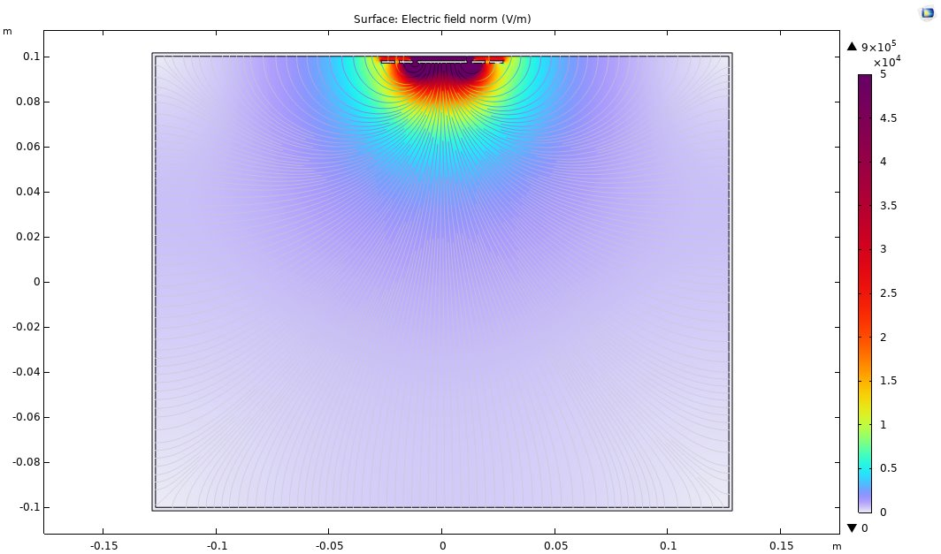
Electric field simulation inside ESC

