Slide 1
2026/07/29
Characterizing qubits at SNOLAB
Vijay Iyer
Research Scientist (SNOLAB)
McDonald Institute Annual Community Meeting 2026

Slide 2
Land acknowledgement
SNOLAB is located on the traditional territory of the Robinson-Huron Treaty of 1850, shared by the Indigenous people of the surrounding Atikameksheng Anishnawbek First Nation as part of the larger Anishinabek Nation.​​
​​
We acknowledge those who came before us and honour those who are the caretakers of the land and the waters.
2

Slide 3
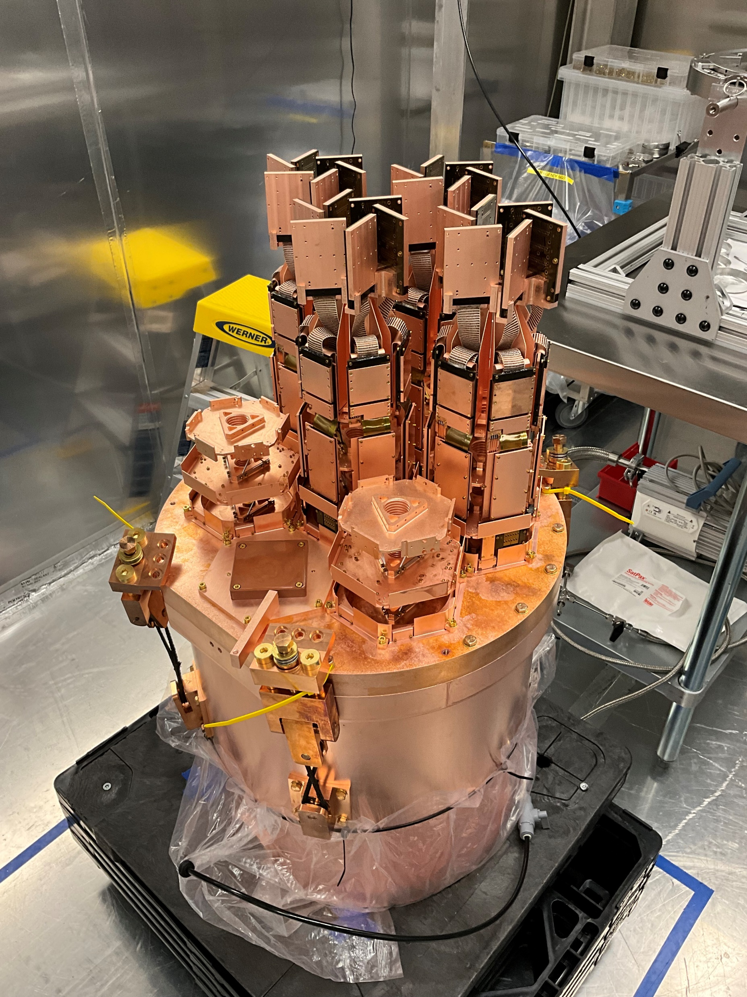
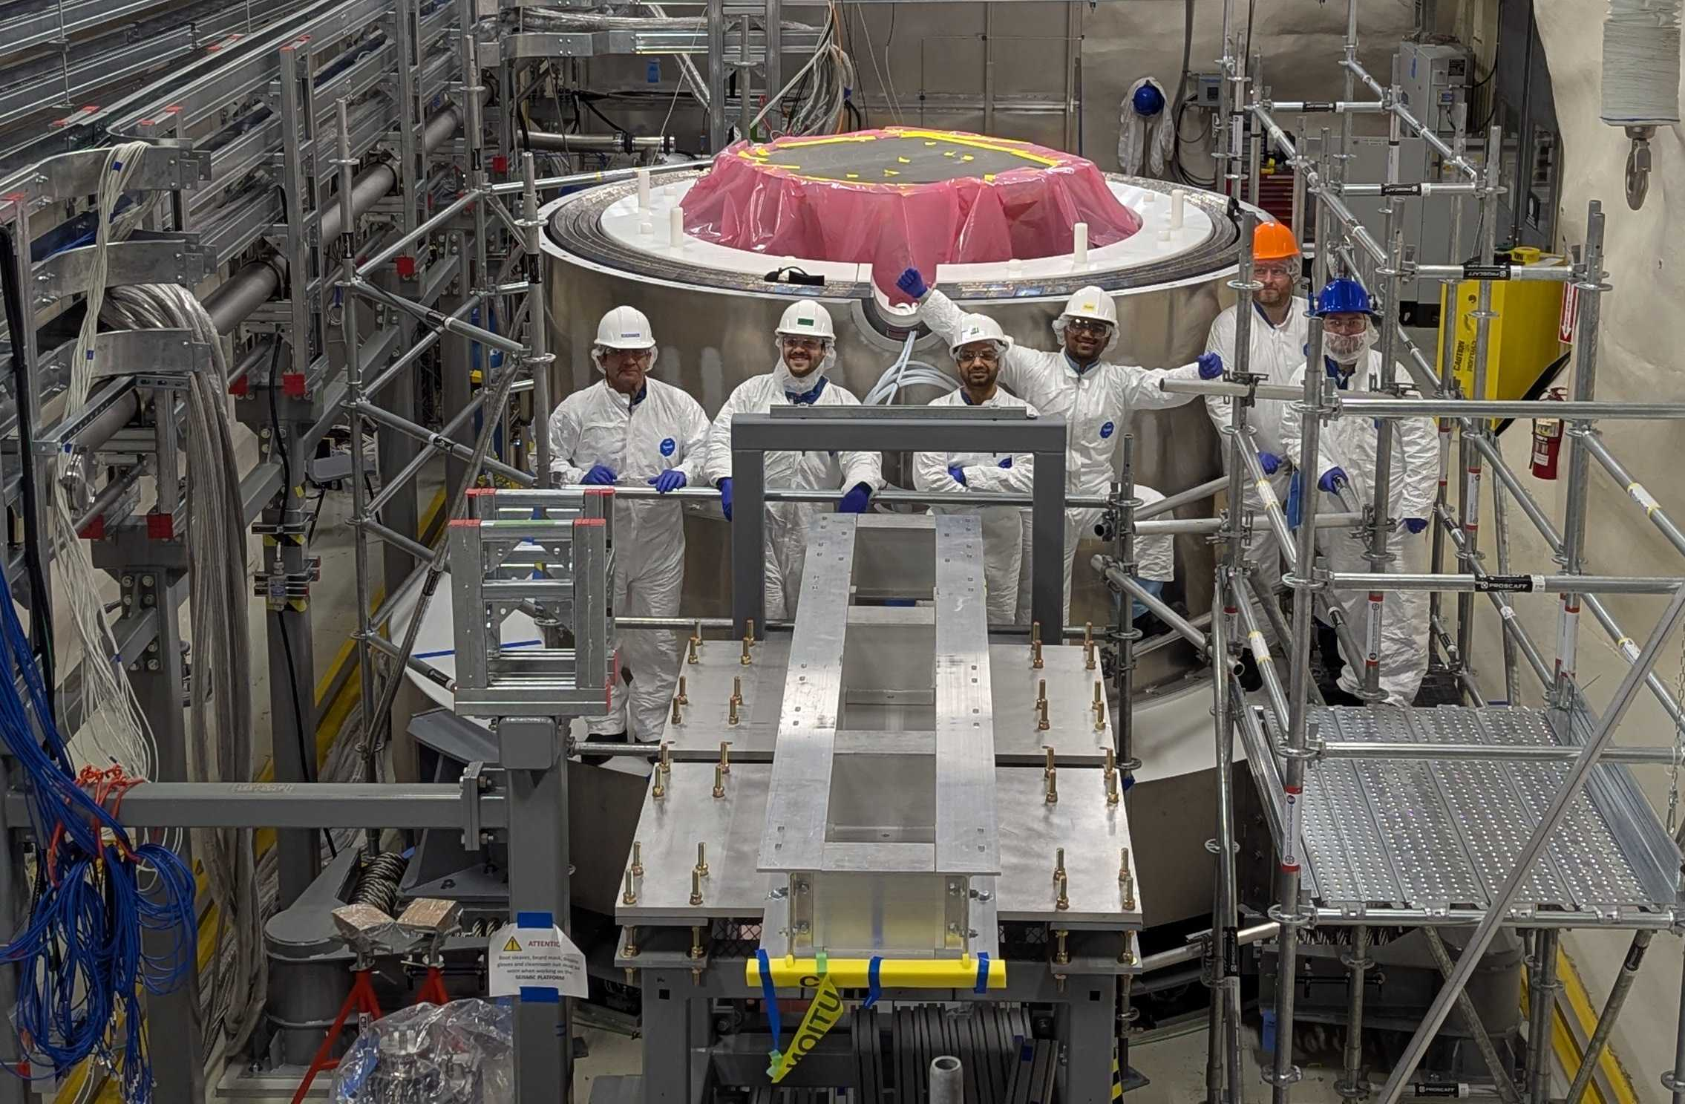

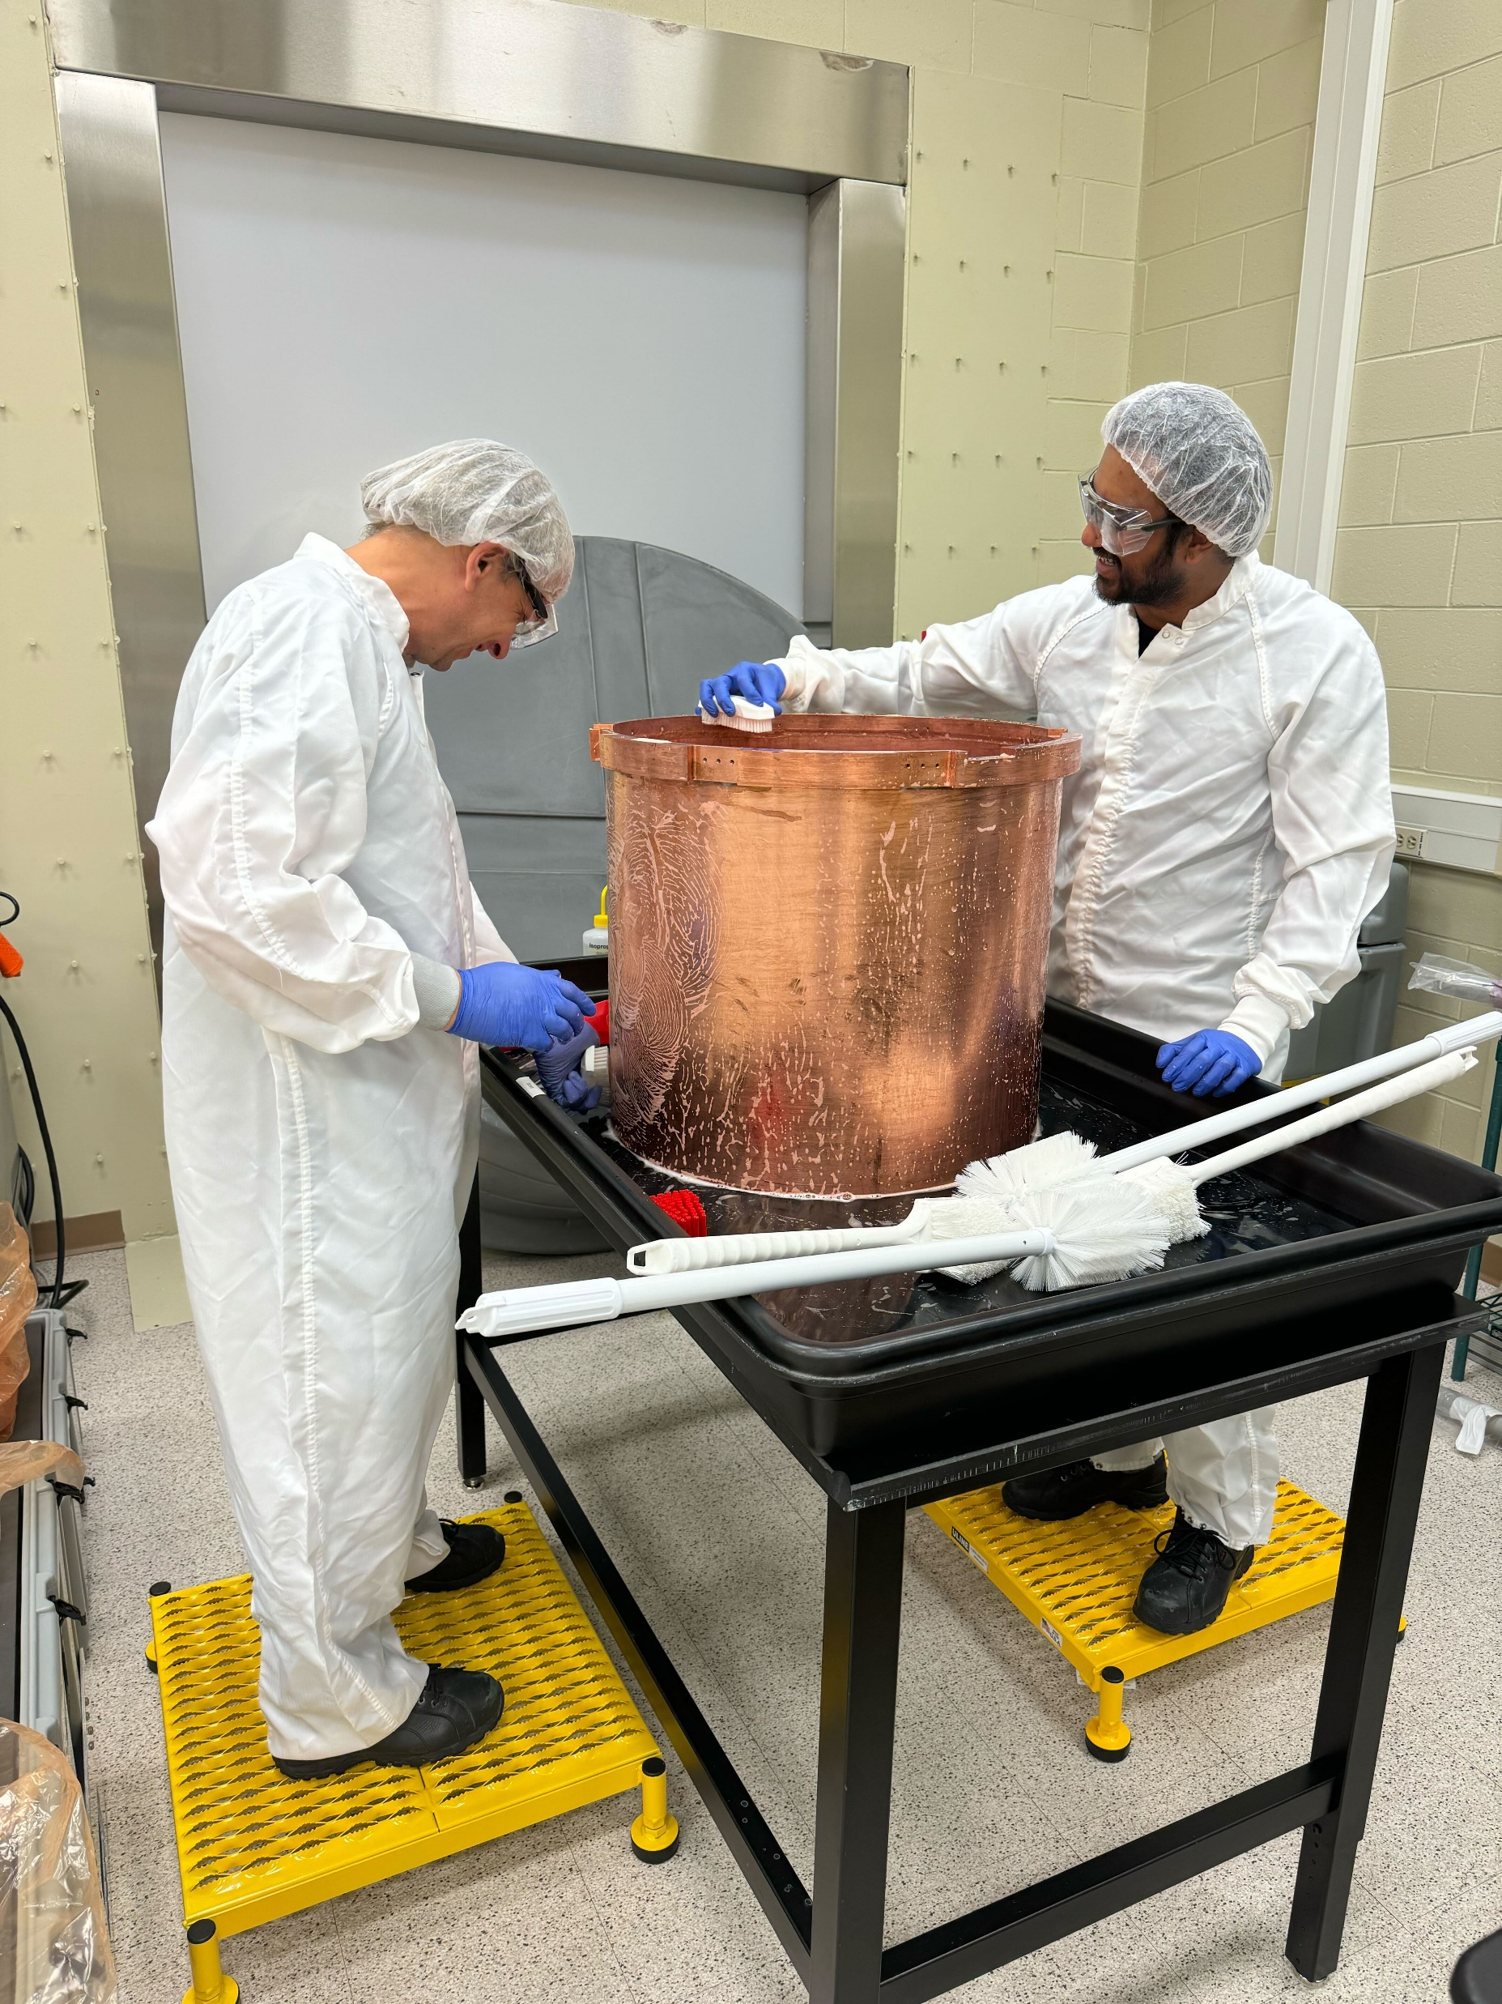
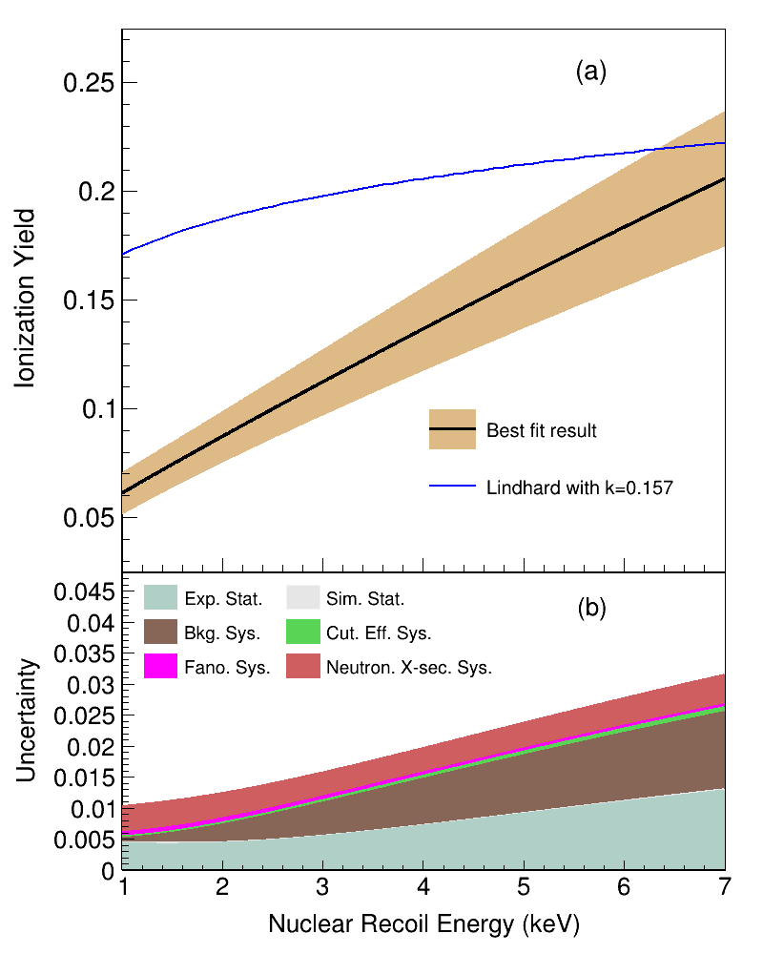
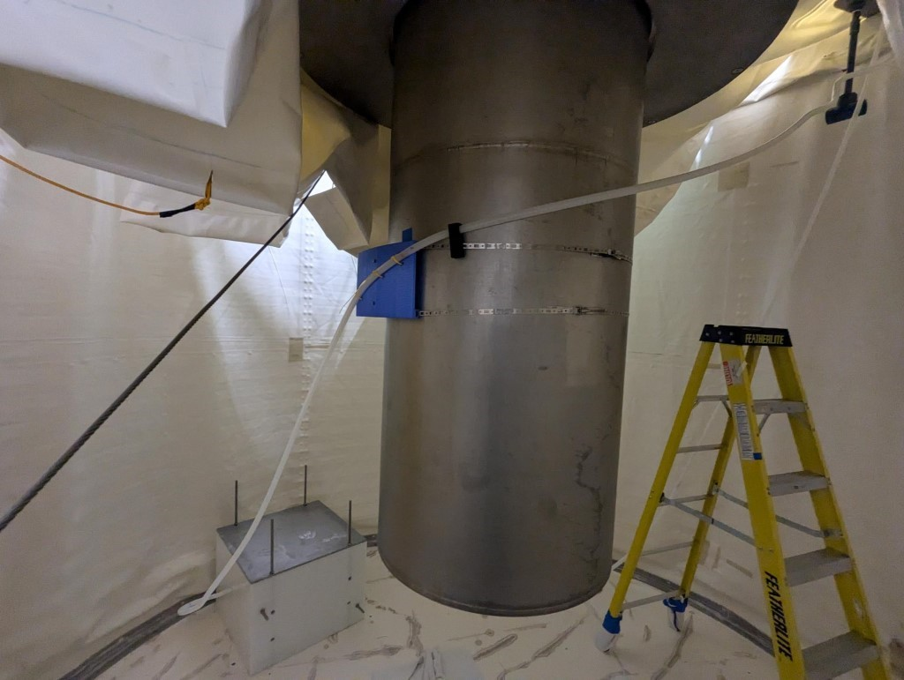


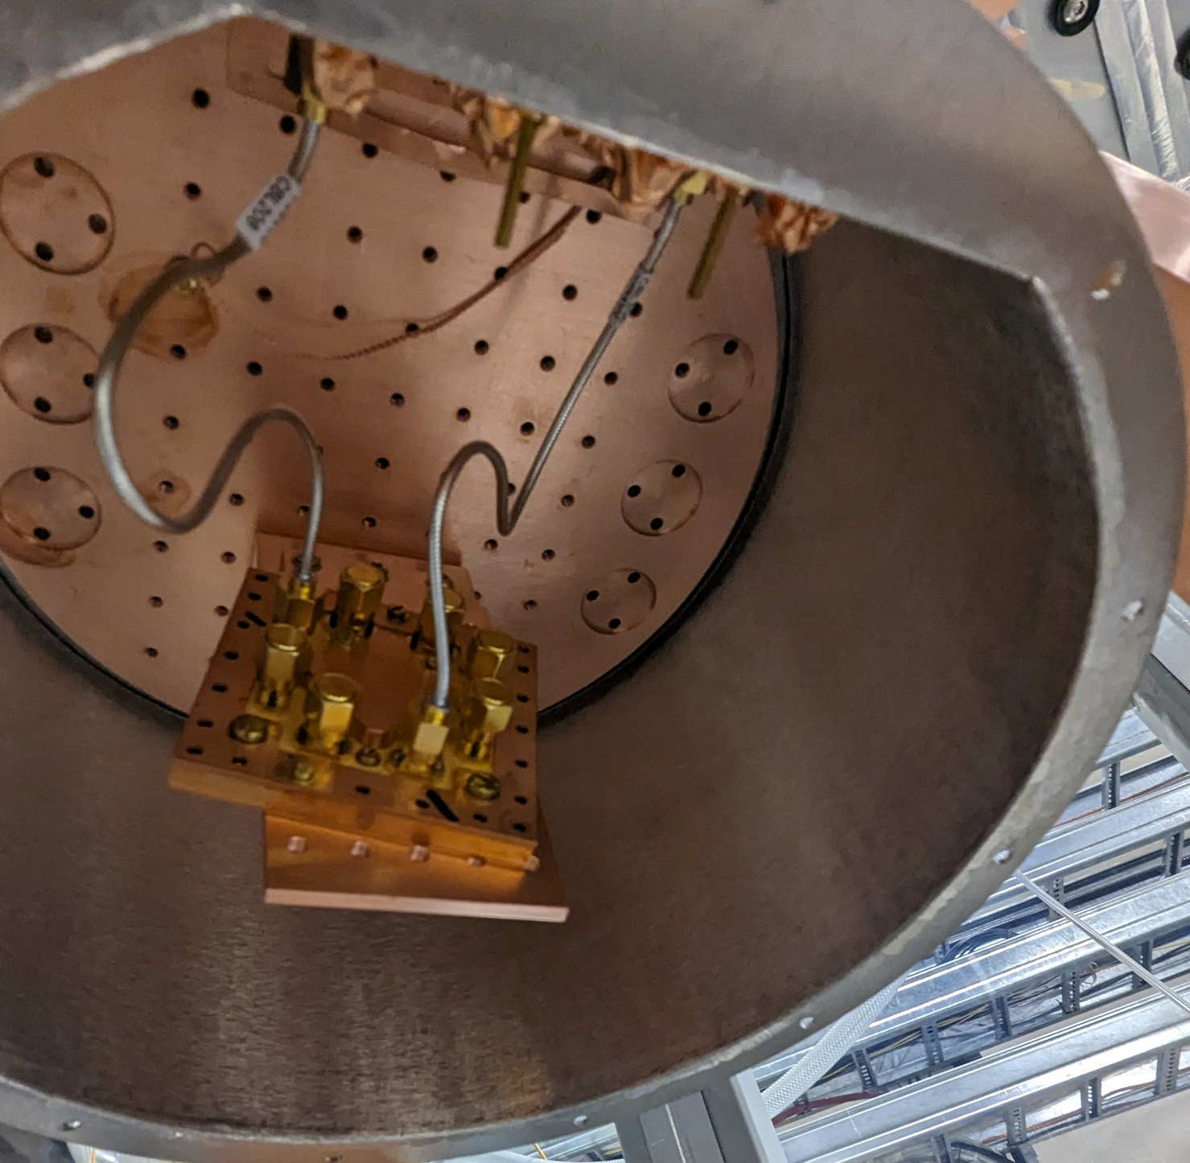

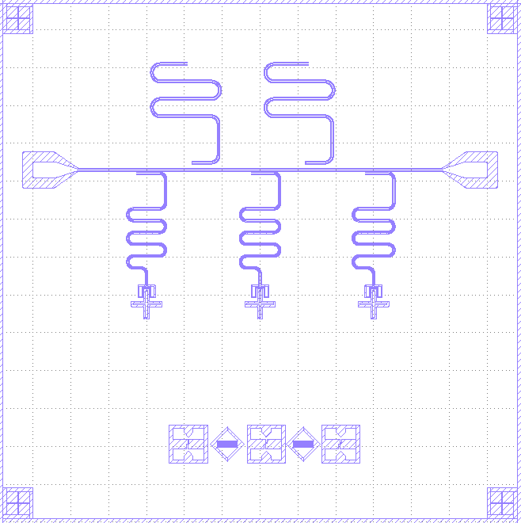
My Background
Credit: SuperCDMS
PRD 105, 122002 (2022)
Qutebits
3

Slide 4
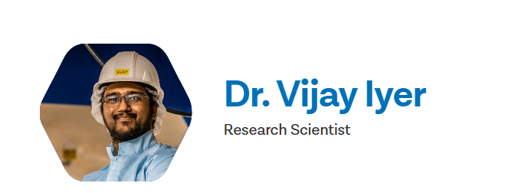



Role at SNOLAB
Develop programs in quantum science that align with CANADA’s National Quantum Strategy
Utilize the Cryogenic Underground TEst (CUTE) facility at SNOLAB for applicable projects.
Current primary project: Advanced characterization and mitigation of qubit decoherence in a deep underground environment.
Goals:
Effect of radiation on qubit decoherence.
Mechanisms that cause decoherence.
Mitigation techniques.
Final goal: Develop recommendations on the requirements for a quantum computer system design that would be largely unaffected by ionizing radiation
Qutebits
4

Slide 5
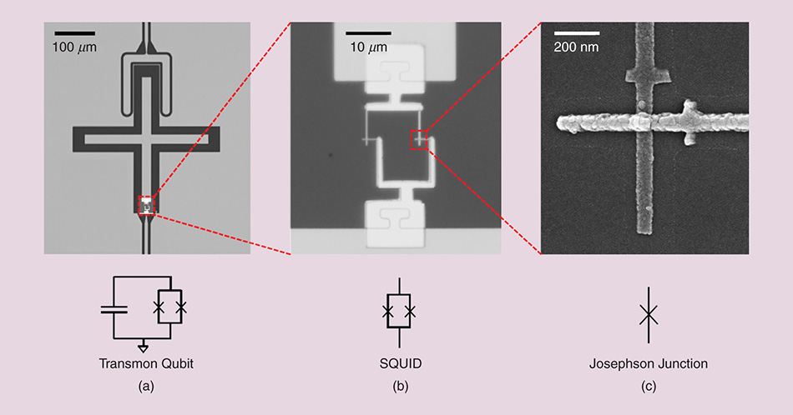
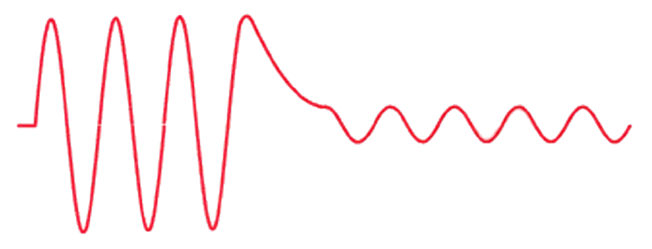
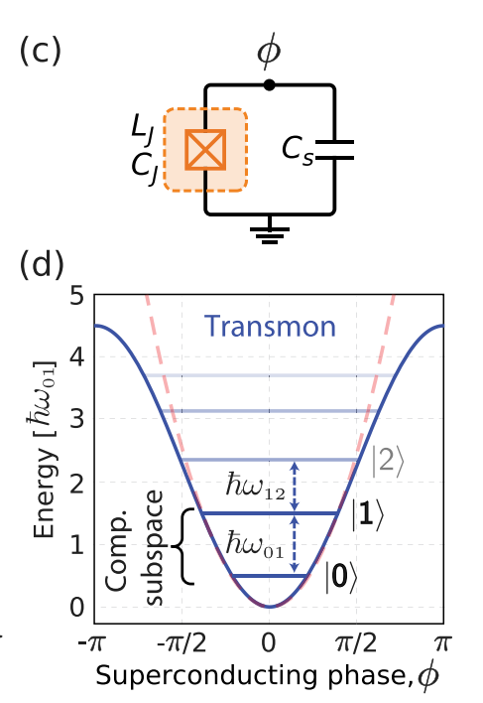

DOI: 10.1109/MAP.2023.3251261
Superconducting qubits
Josephson Junction
Cooper pair
Superconductor
Insulator
Superconductor
Introduces non-linearity in the inductance
C
L
A macroscopic quantum circuit that acts as an artificial atom whose energy spectrum can be configured by us.
Use a Josephson junction to bring the anharmonicity in the energy level spacing for the system.
Appl. Phys. Rev. 6, 021318 (2019)
5

Slide 6

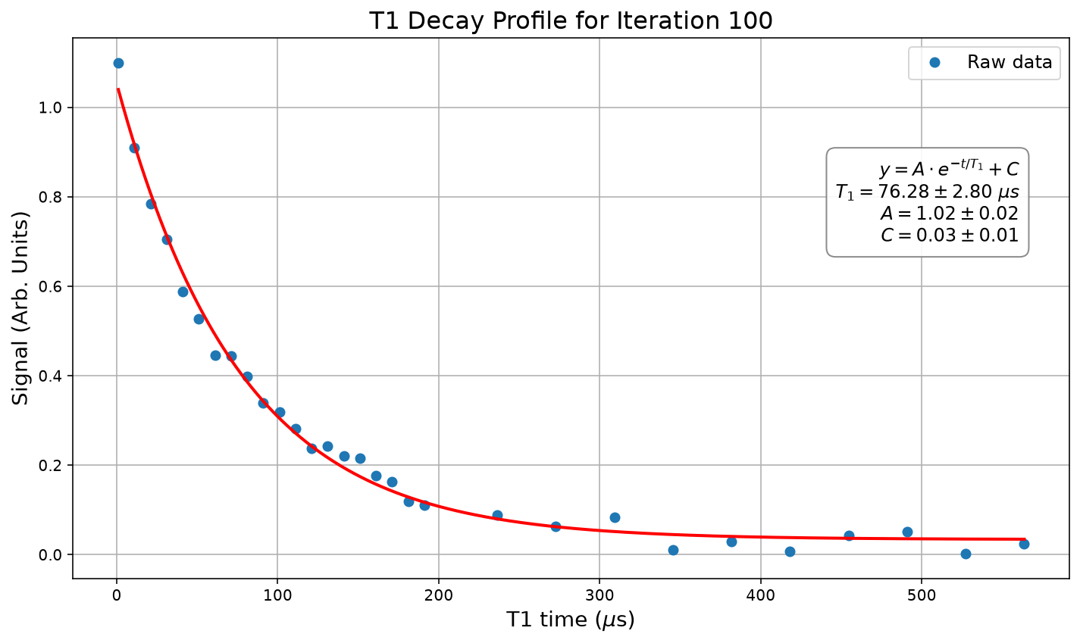
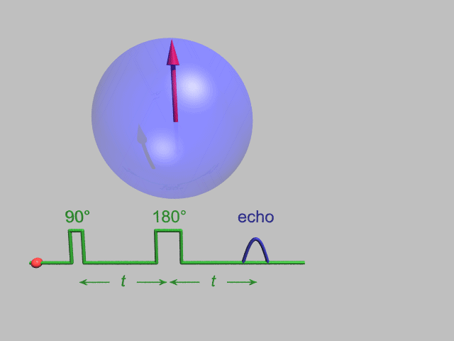
Qubit parameters
T₁ time –
  How long before system returns to ground state from an excited state.
  Rate at which the system dissipates energy back to the environment.
T₂ time –
  Dephasing time.
  How long before the phase relationship (ϕ) between the population in the ground state and the excited state last before interactions with the environment randomizes it.
T₁ relaxation time
T_{2echo} (Hahn Echo time)
Credit: Gavin Morley/Wikipedia
Errors – T₁ controls bit flip errors, and T₂ controls phase flip errors during various gate operations in algorithms.
The goal is to keep the system in a superposition state, as well as maintain its phase relationship for as long as possible to execute quantum algorithms.
6

Slide 7
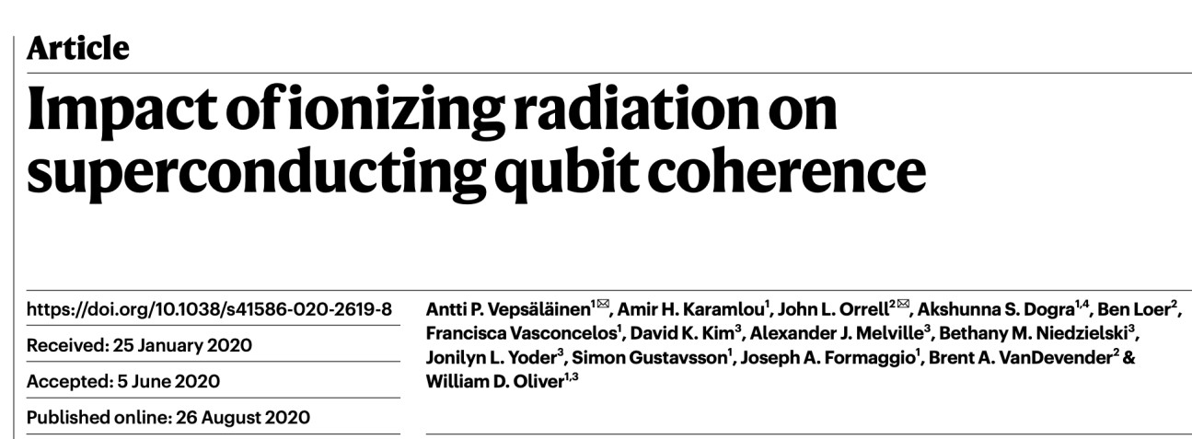
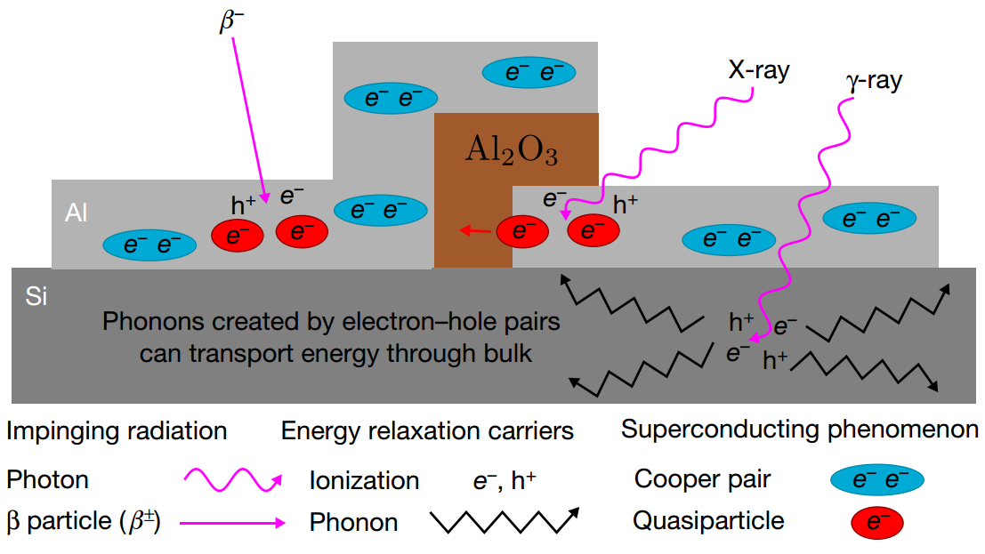
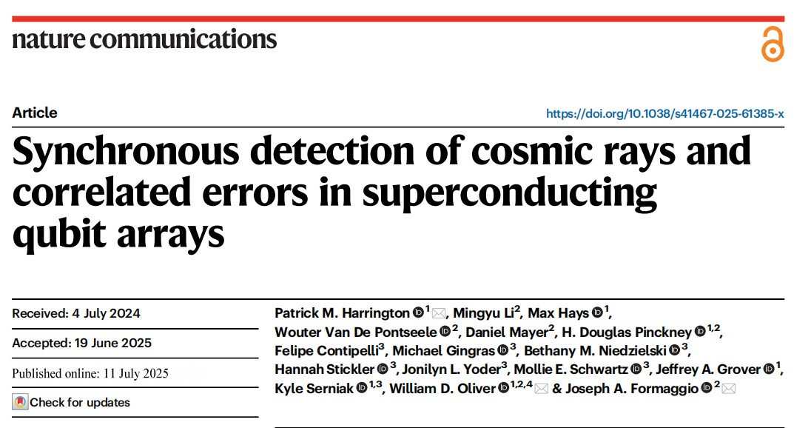
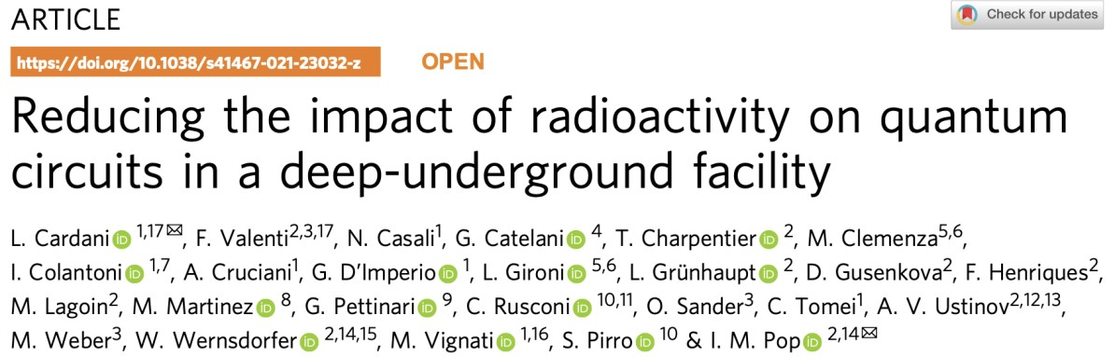
Motivation
Implementing a 10-cm-thick lead brick around the cryostat reduced the external radiation flux
Measurably improved the qubits' energy relaxation times.
7

Slide 8
Motivation
Correlated cosmic ray detection events with changes of the energy relaxation rates in a 10 transmon qubit array.
All cosmic rays incident on the qubit array resulted in detectable correlated error events.
8

Slide 9
Motivation
Environmental radioactivity identified as a major source of non-equilibrium quasiparticles and time correlated energy bursts in superconducting quantum circuits.
Material selection and replacing radioactive components successfully contributed to suppressing spurious background bursts.
9

Slide 10
Motivation
Key takeaways:
Ionizing radiation imposes limitations on T₁ and T₂ times; introduces correlated errors through quasiparticle generation.
Shielding cosmic rays requires deep underground facilities.
10

Slide 11
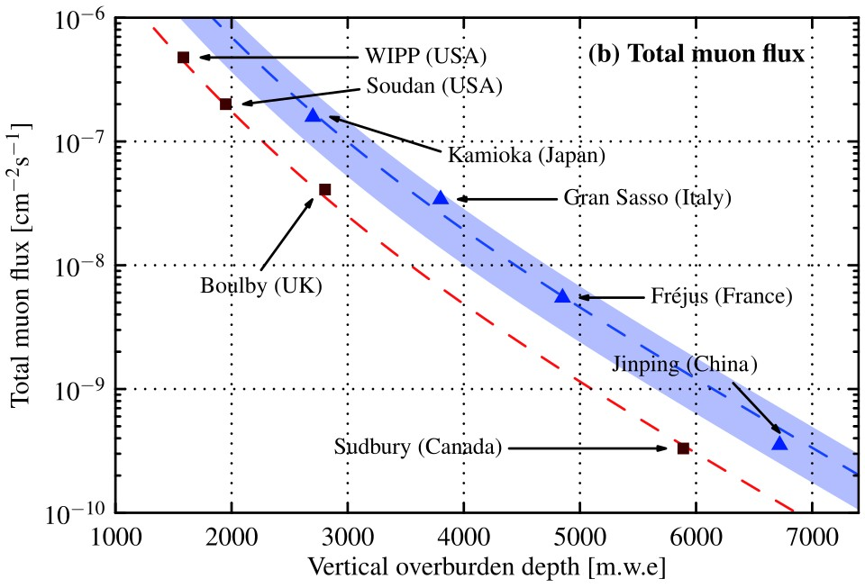
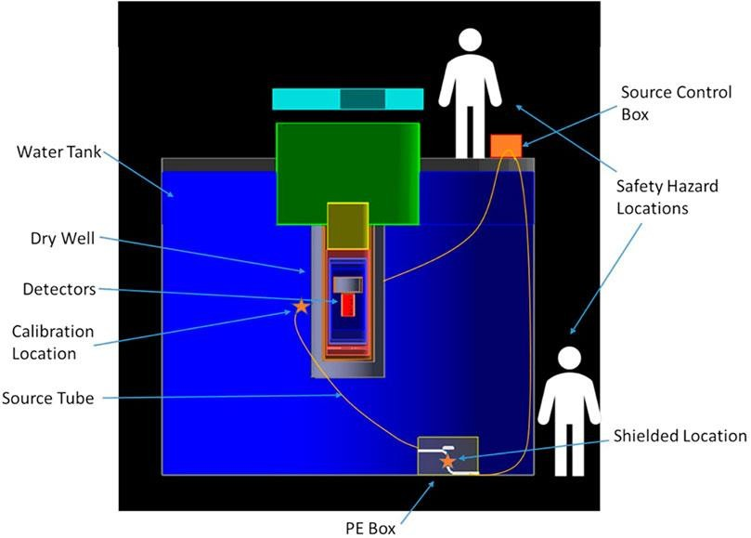
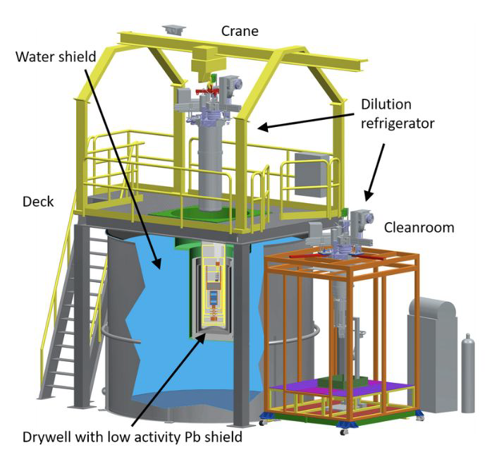
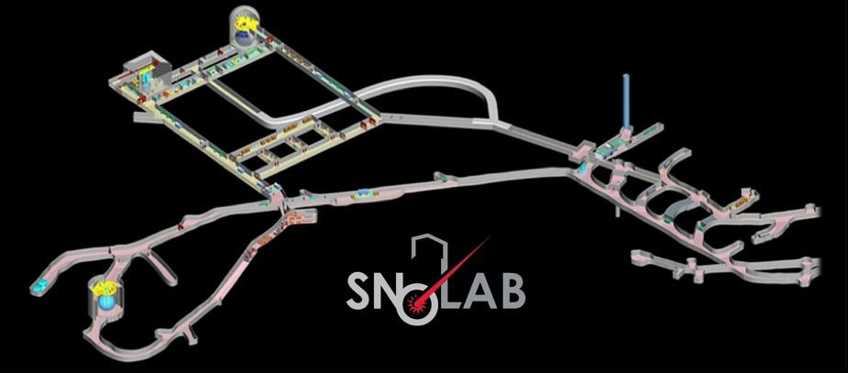
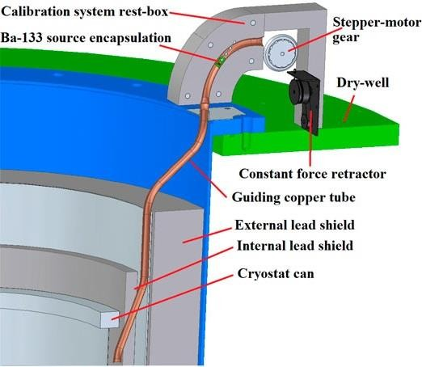
CUTE @ SNOLAB
Cryogenic Underground Test facility (CUTE).
A dilution refrigerator well shielded from environment backgrounds.
Dedicated class-200 low radon cleanroom.
Can deploy and expose detectors to a gamma, and/or neutron source.
Z. Guo et al., Chinese Phys. C 45 025001, (2021)
2 km underground.
Shielding from cosmic rays.
Class 2000 cleanroom
Cf-252 source
11

Slide 12
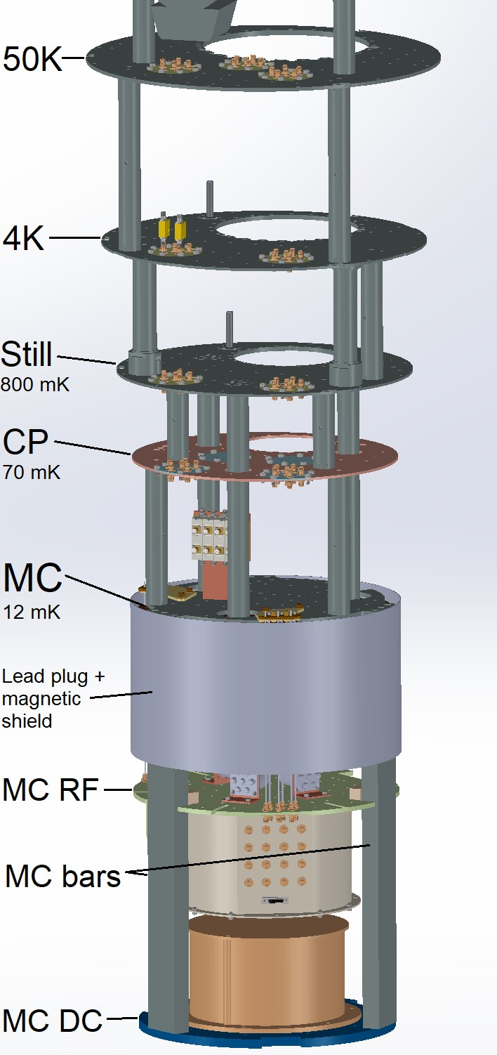
Facility upgrades for quantum science
Facility originally designed for SuperCDMS.
  Originally meant for “DC” payloads (such as transition edge sensor calorimeters).
  Fridge can reach a base temperature ~12 mK.
  Has a Pb shield/plug just above the detectors.
In 2025, facility underwent upgrades to accommodate qubit measurements.
  Can support up to 12 RF lines with rigid coax cables.
  Has a new MC sample plate underneath the Pb.
  Low activity magnetic shield for qubit devices.
  Qubit control and readout modules. A dedicated measurement PC.
  Can simultaneously run RF and DC payloads.
  Screen every component that goes on the fridge.
12

Slide 13
Project flow
Start with a standard Qubit design.
Take measurements on surface at IQC.
Take measurements underground at SNOLAB.
One Chip
  Three qubits with 3 corresponding resonators.
Based on 2025 measurements at IQC:
  E_{j}/E_{c}=28.29
  f₀₁=3.371 GHz
Underground measurements at SNOLAB taken in July 2025.
  More on-going right now.
Surface measurements at IQC taken between September 2025 and January 2026.
Analyze and compare the datasets
Use that information to design new qubit layout that could mitigate the effect of radiation on qubit T₁ and T₂ times.
Make a practical quantum processor
13

Slide 14
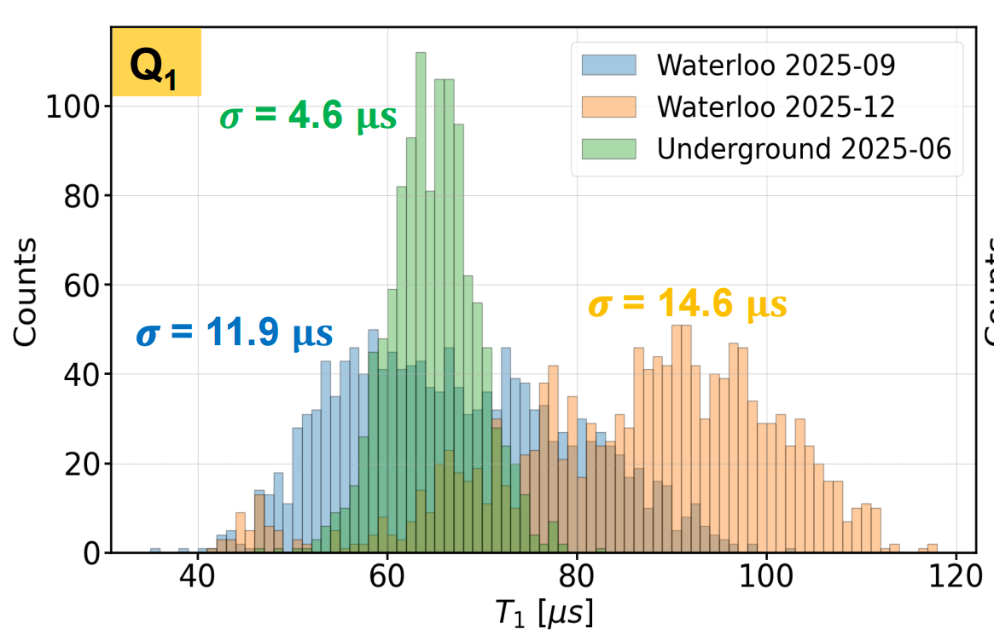
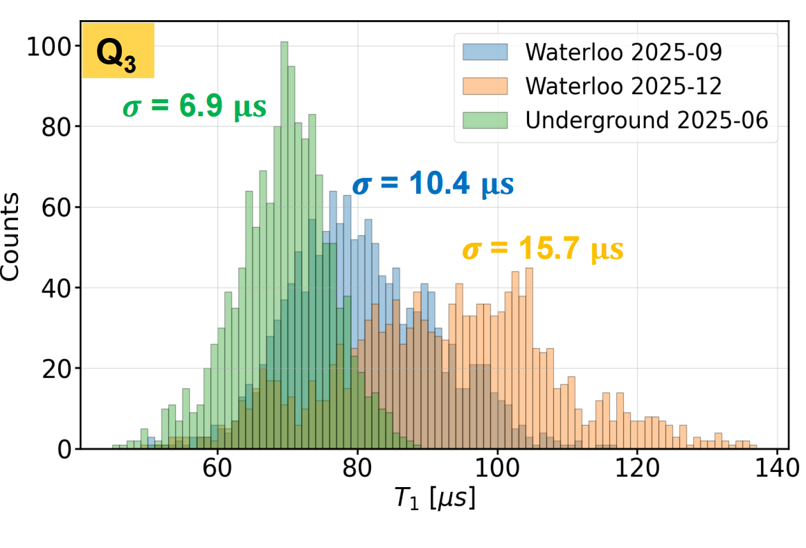
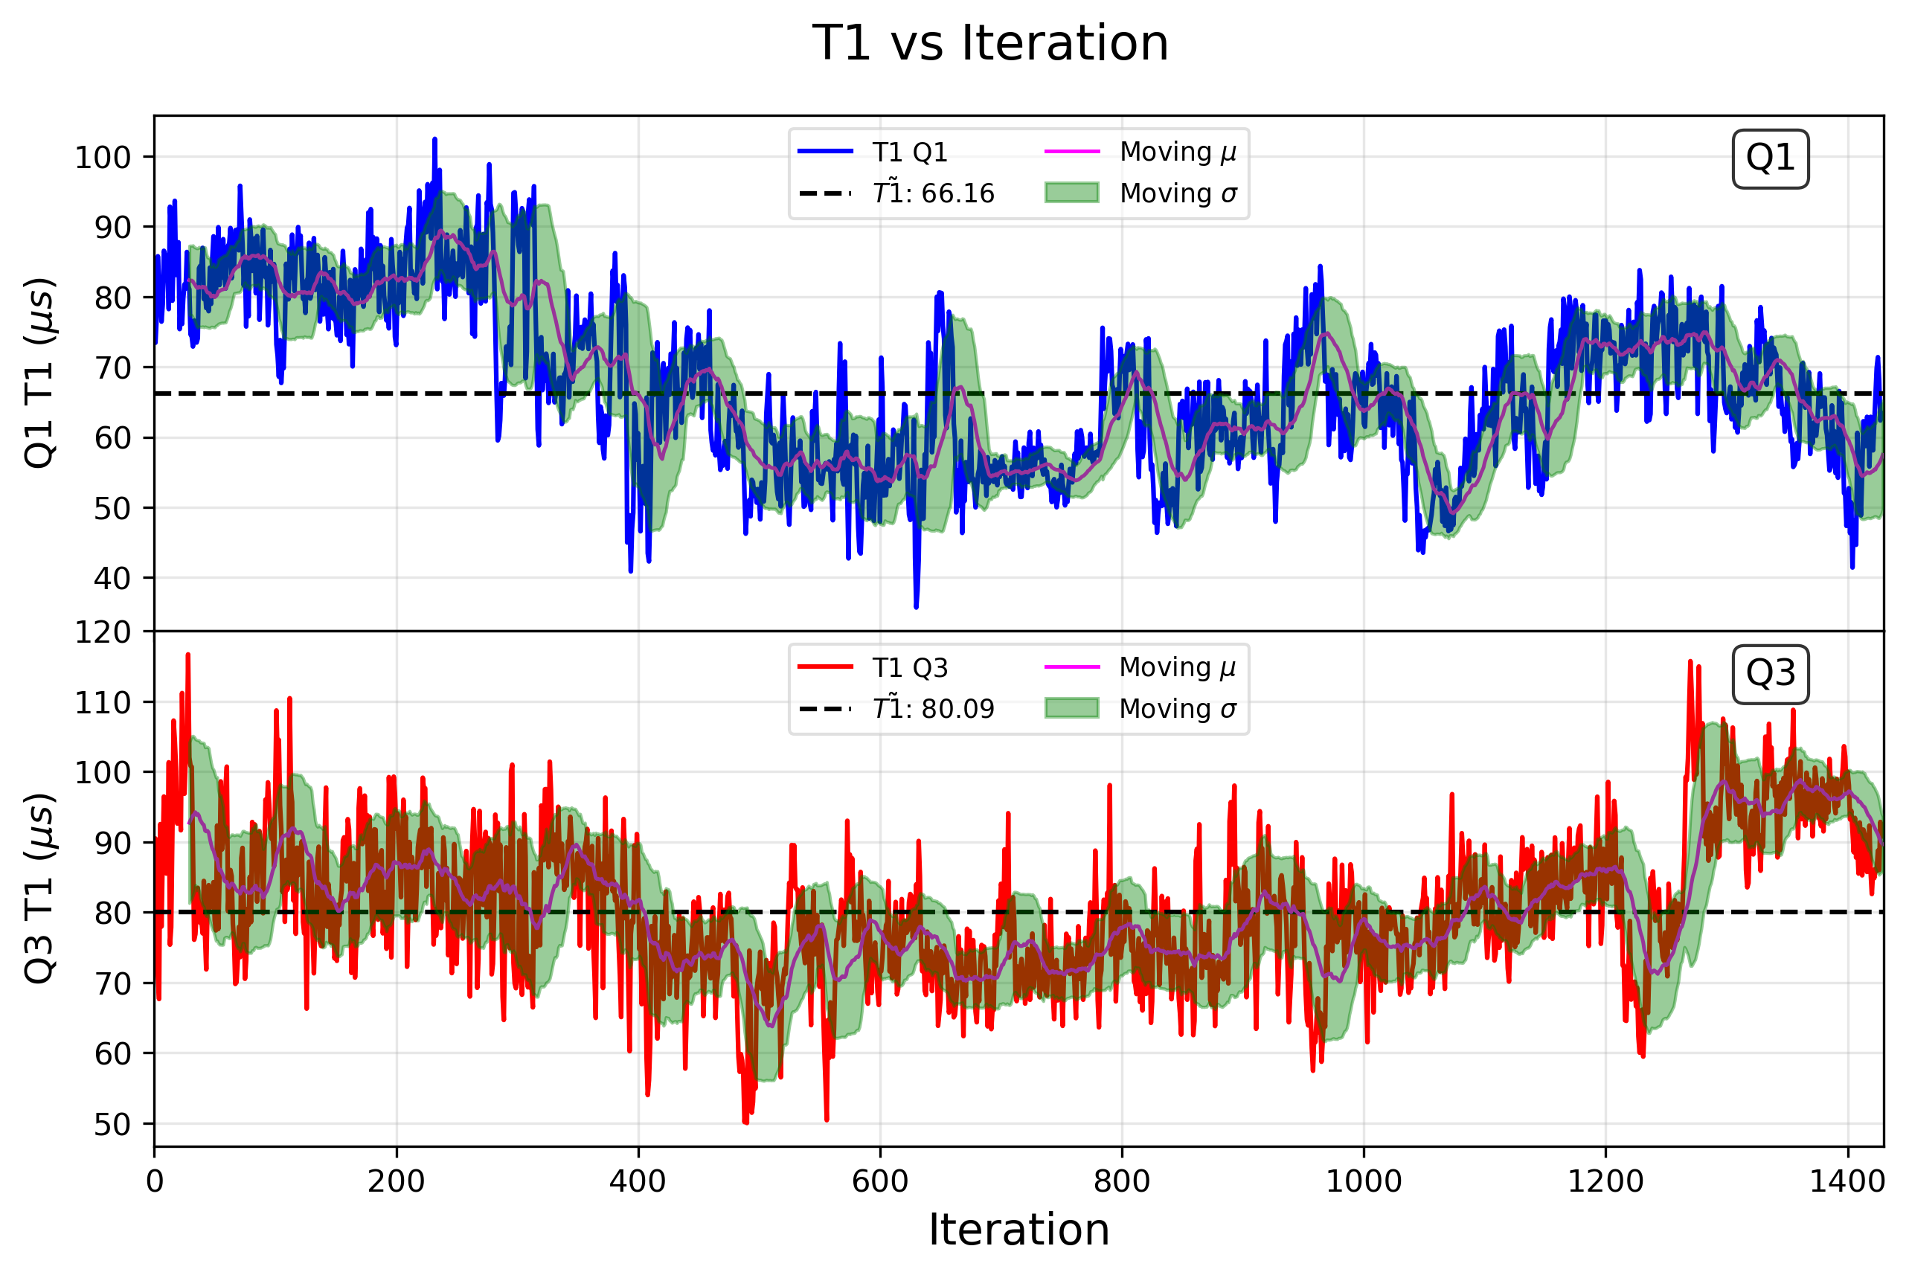
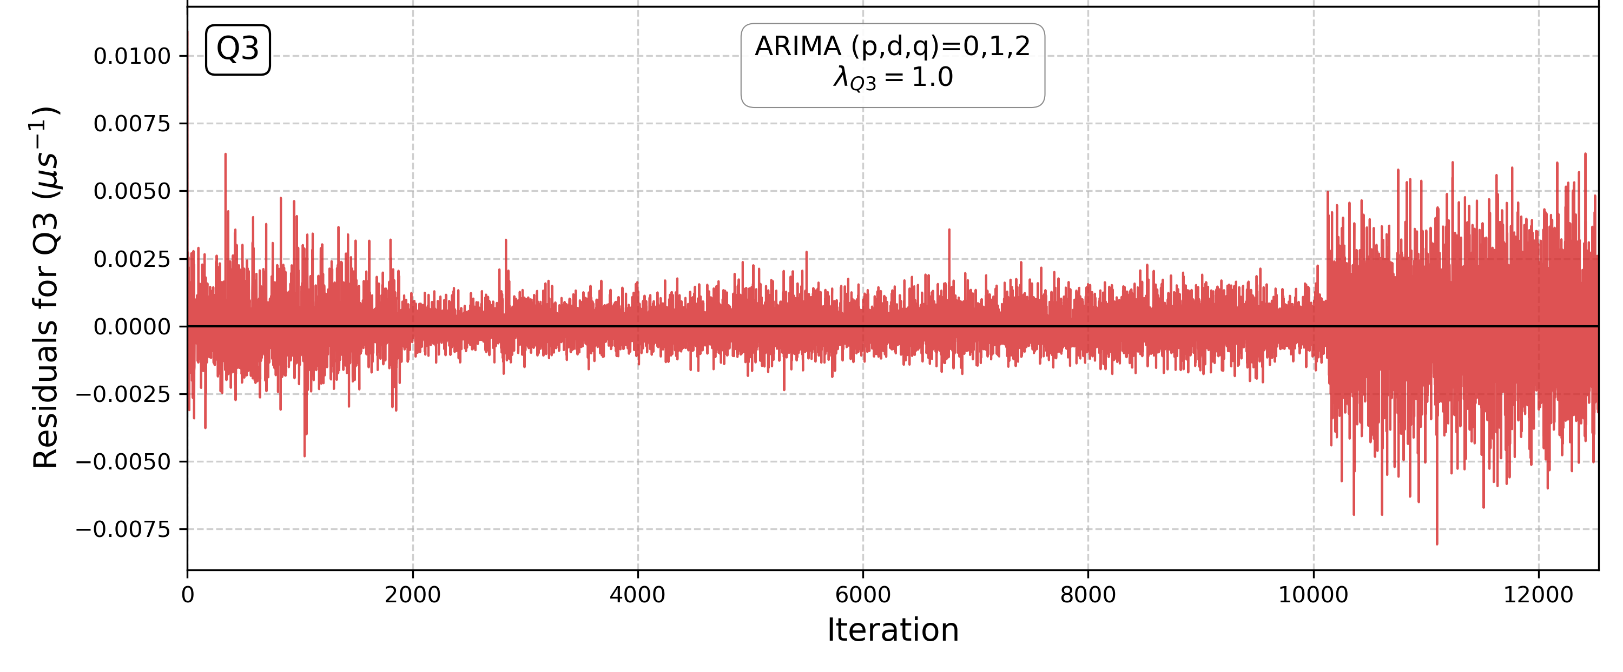
The data
Pursuing techniques like time series analysis to:
Mitigate the non-stationarity in T1 and T2 data.
Determine outlier events in datasets that could be indicative of the controlled radiation exposure.
Vector analysis to check correlation between parameters across different qubits.
Interpreting physical meaning of the memory coefficients (θ) determined from time series analysis.
Consistently observed a smaller standard deviation for the underground results.
T₁ rate vs time
Residual after a likelihood fit to ARIMA (0,1,2)
θ | Coeff
θ₁ | -0.41 ± 0.02
θ₂ | -0.27± 0.03
Change point in behaviour ?
Non-stationary dynamics observed.
14

Slide 15
Outlook for Qutebits
Currently taking another set of underground data.
Take measurements that provide charge control, and can help determine quasiparticle poisoning.
Continue data analysis efforts towards understanding effects of radiation on qubit performance, determine quasiparticle density on the chip.
Design and fabricate new qubit chips that would help narrow down on hypothesis from data analysis.
15

Slide 16
Outlook for quantum science @CUTE
Upgrade the facility with additional RF line installations.
Infrared absorbers have shown to improve T1 times. Look for better IR coatings around the qubit mount.
Collaborate with more such interesting projects to slowly develop a quantum science program at SNOLAB.
Contact me (vijayiyer@snolab.ca) if you have any ideas that might benefit from being at CUTE.
Thank you
16

