Slide 1


Pushing into the Ultra-Heavy Mass Frontier
Andrew Buchanan

Slide 2
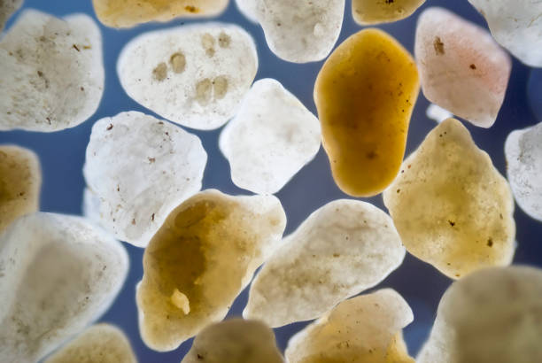
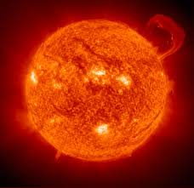

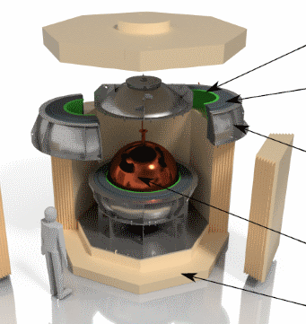
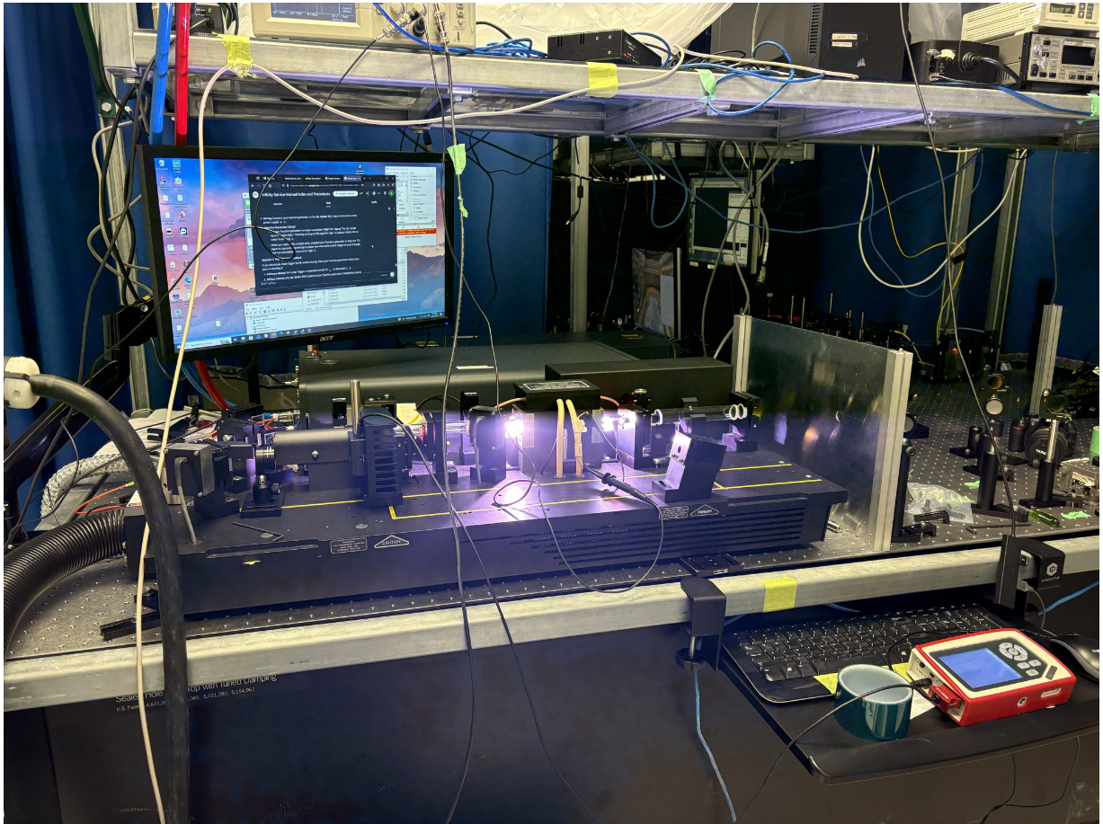
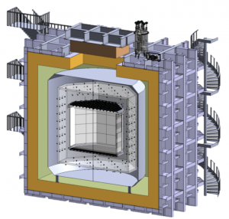
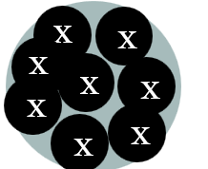
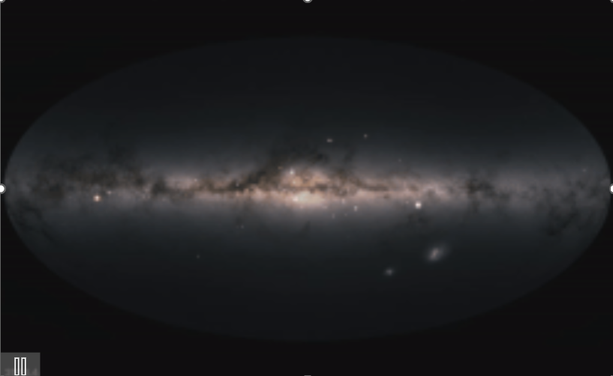






What is (Ultra)-Heavy Dark Matter?
$${10}^{−22 } eV$$
$$keV$$
$$GeV$$
$$100TeV$$
$$M_{pl}$$
$$10M_{⊙}$$
“ultralight” dark matter
“light” dark matter
“heavy” dark matter
“ultraheavy” dark matter
compact objects
CATCHY
NEWS-G
DarkSide-40k

Slide 3
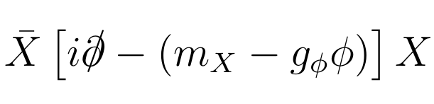
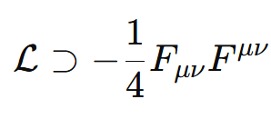
Models of Composite Dark Matter
Fermion nuggets
  Dirac fermion held together with a light scalar
  Easy to analyze
  Dirac fermions -> ‘Asymmetric Composite Dark Matter’

Slide 4
Models of Composite Dark Matter
Fermion nuggets
Dark QCD
  Dirac fermion held together with a light scalar
  Easy to analyze
  Dirac fermions -> ‘Asymmetric Composite Dark Matter’
  Dark analogue of QCD
  Quarks combine to make nucleons
  Nucleons combine to make nuclei
  No EM force to cause fission

Slide 5
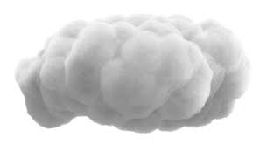
Heavy DM Interactions with Nuclei
Per-Nucleon (fluffy cloud)
  Realistic for large loosely-bound composite DM
  Each DM constituent interacts coherently with whole nucleus

Slide 6
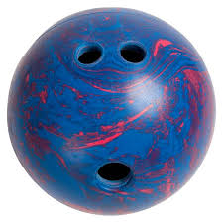
Heavy DM Interactions with Nuclei
Per-Nucleon (fluffy cloud)
Contact (bowling ball)
  Realistic for large loosely-bound composite DM
  Each DM constituent interacts coherently with whole nucleus
  Realistic for tightly-bound composite DM
  DM interacts with each nuclei with the same strength

Slide 7
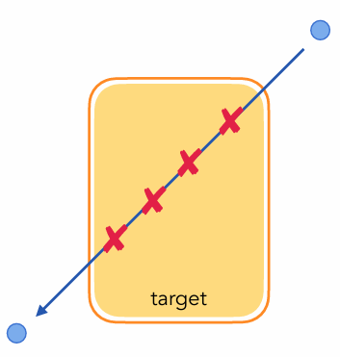
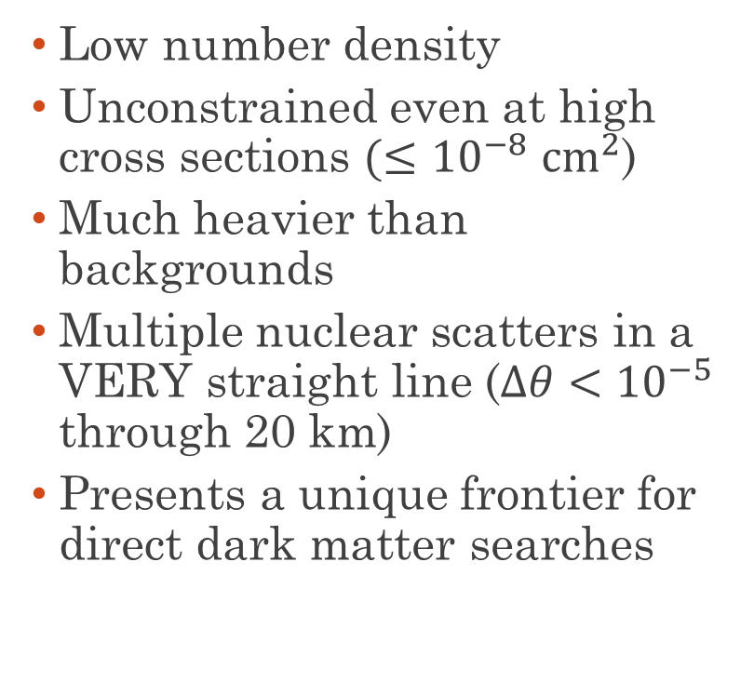
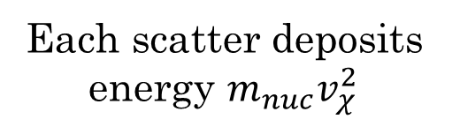
Aspects of Heavy Dark Matter Searches
  Low number density
  Unconstrained even at high cross sections $(≤{10}^{−8}$ ${cm}^{2}$)
  Much heavier than backgrounds
  Multiple nuclear scatters in a VERY straight line ($Δθ<{10}^{−5}$ through 20 km)
  Presents a unique frontier for direct dark matter searches
Each scatter deposits energy $m_{nuc}v_{χ}^{2}$

Slide 8
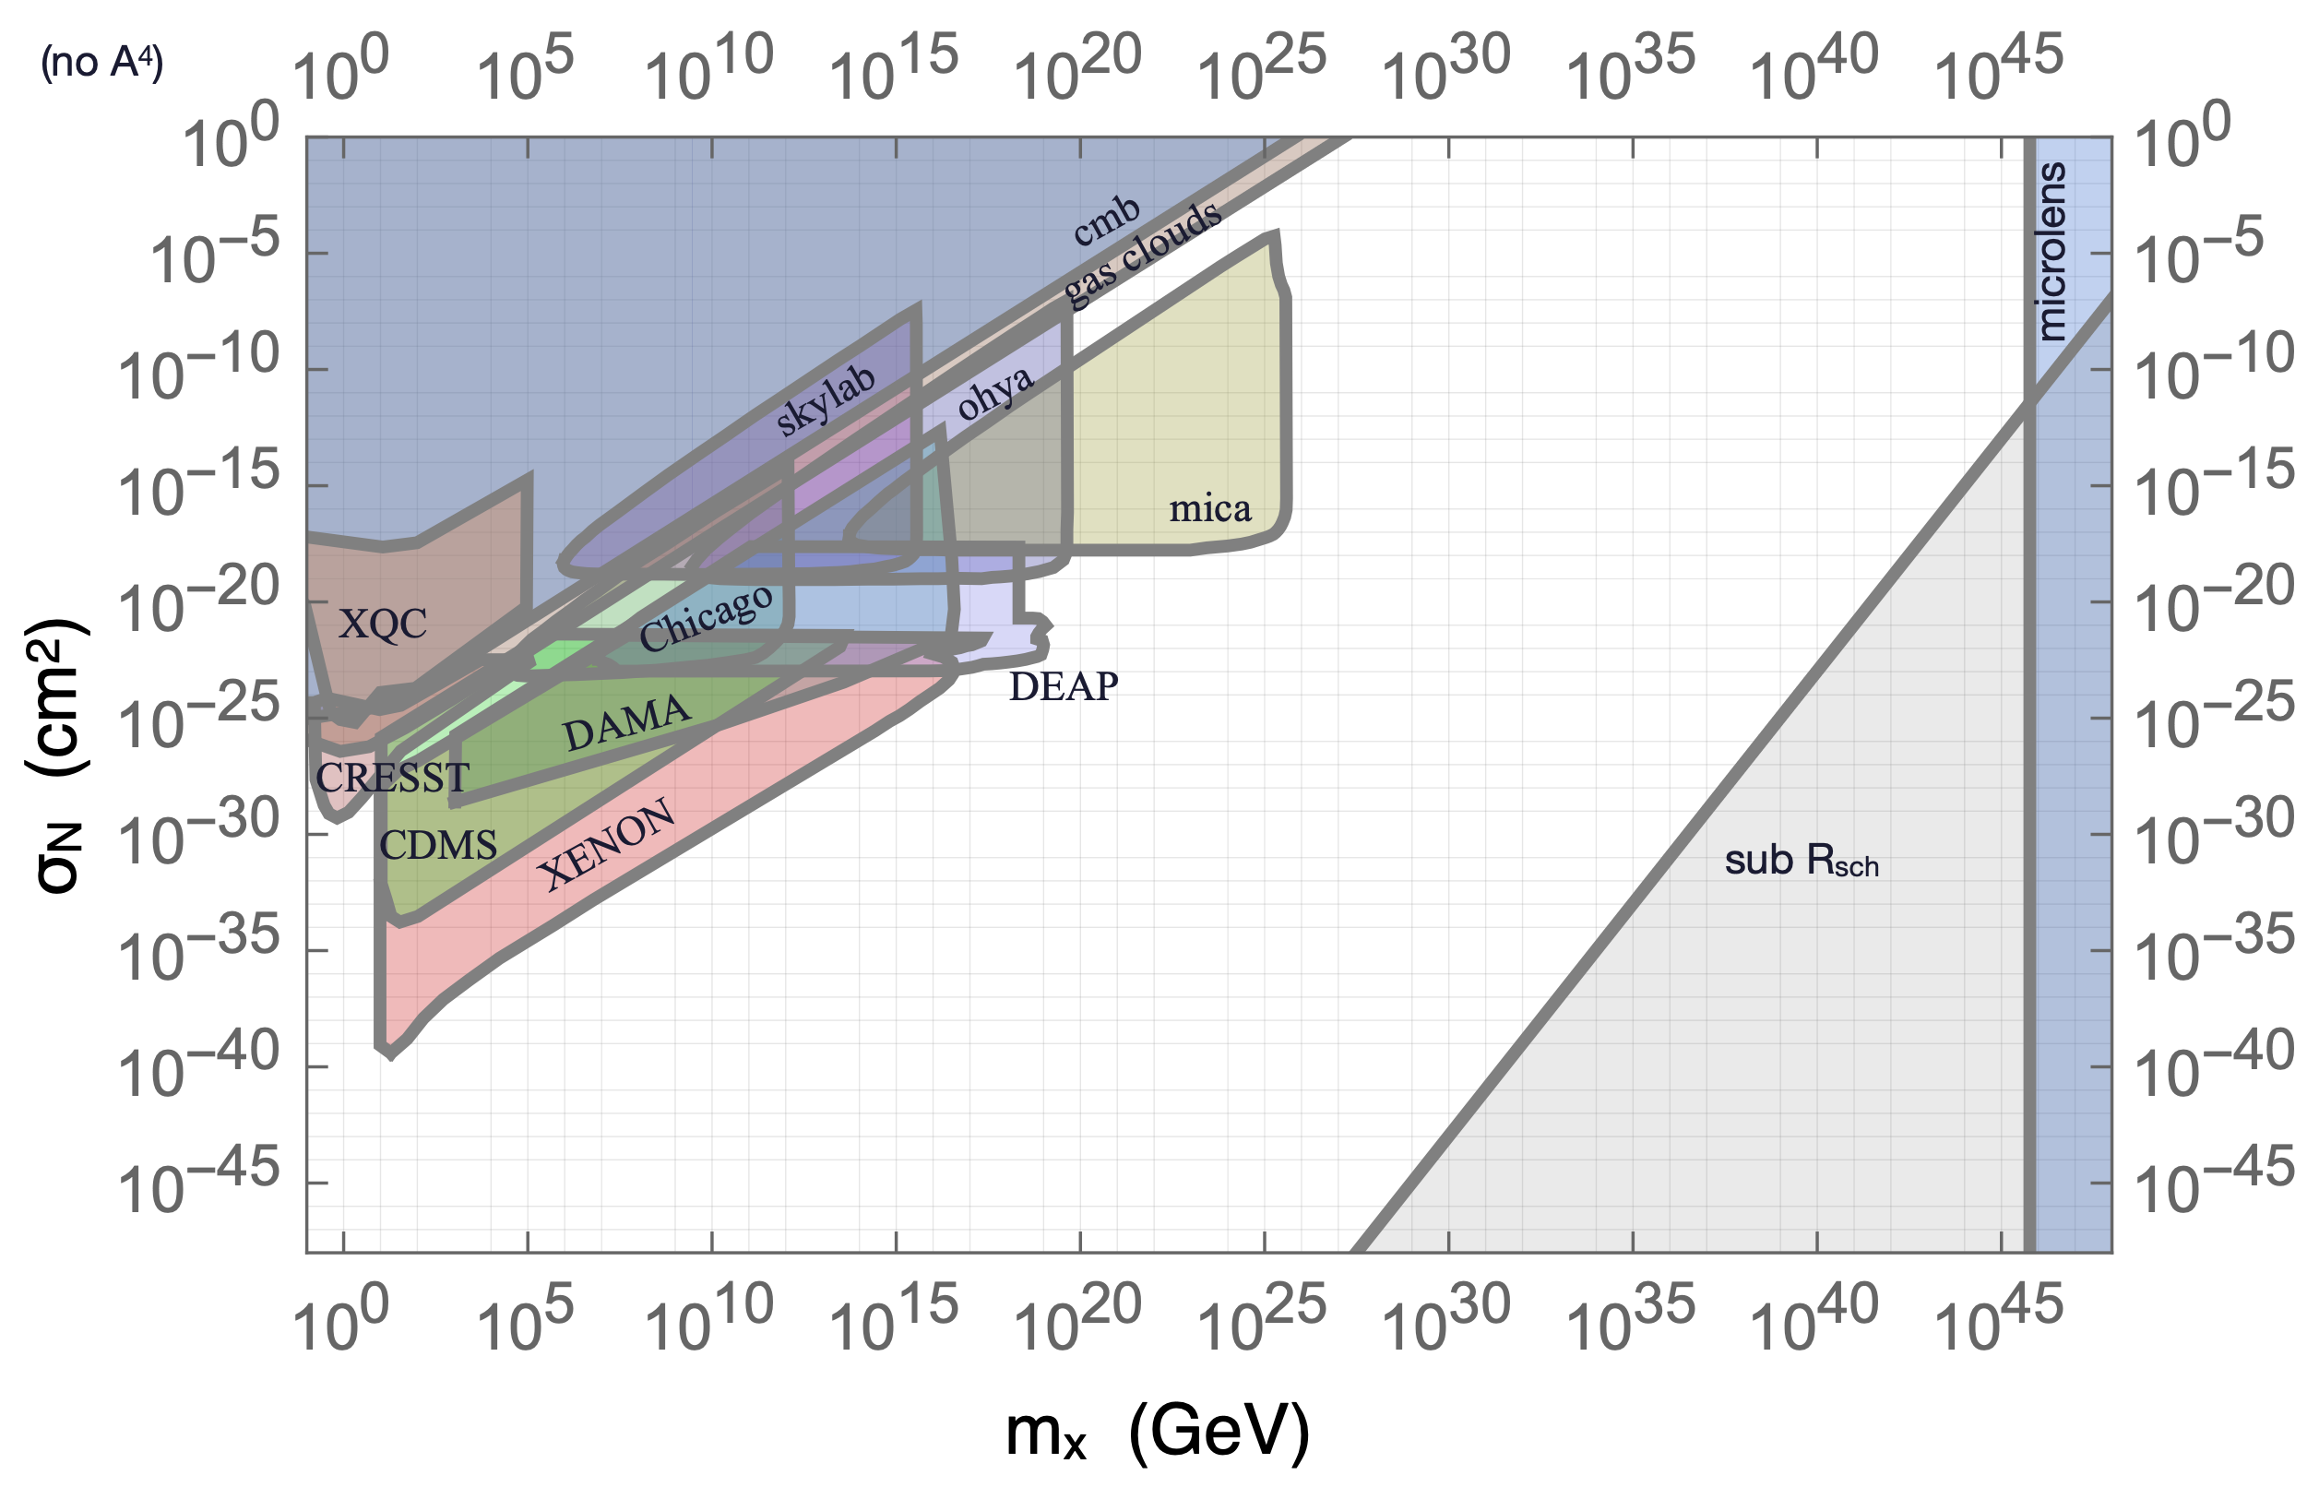
The High Mass Frontier
Indirect Detection
Multi-Scatter
Gravity
Single Scatter

Slide 9



DM Mass Flux on Human Scales
  How much dark matter passes through your body each year?
  Sets a soft limit on human scale experiments

Slide 10
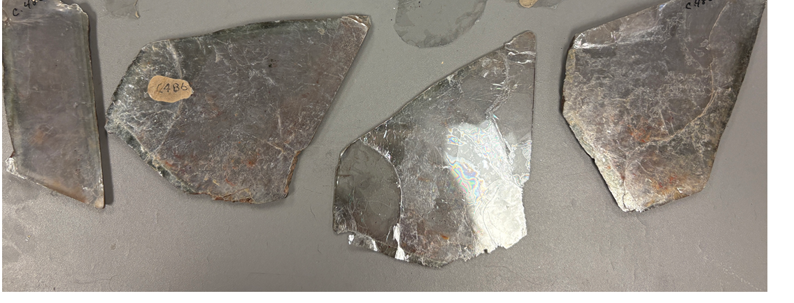
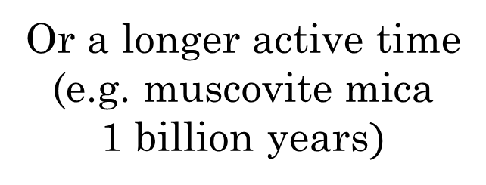
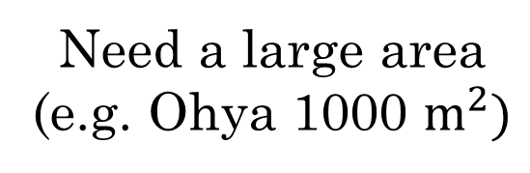
Getting To The High Mass Gap
Need a large area
(e.g. Ohya 1000 $m^{2})$
Or a longer active time
(e.g. muscovite mica
1 billion years$)$
Direct
Detection

Slide 11
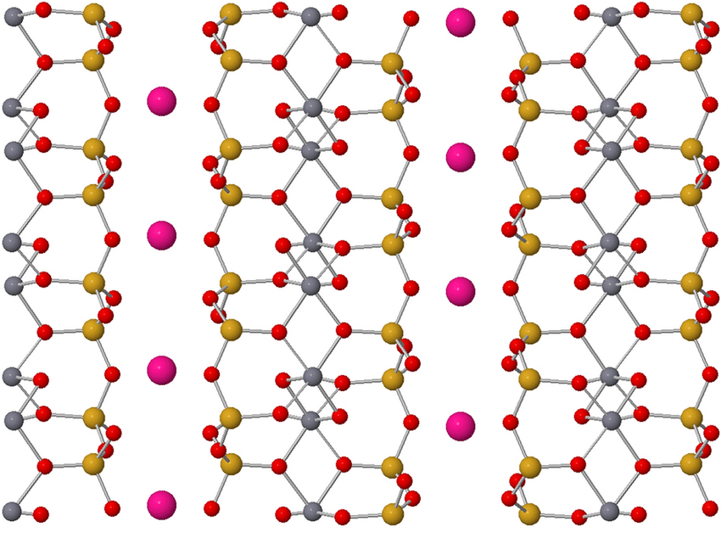
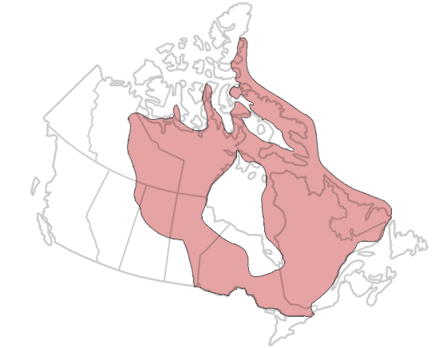
Why Muscovite Mica?
  Mineral with layered molecular structure
  Weak bonds between layers
  Can be easily cleaved into large (10² – 10³ cm² ) flat sheets
  Is plentiful in geologically stable sections of crust (“cratons”)
  DM damage will not anneal or melt away over one billion years
  Geological stability verifiable with observable fission tracks
Canadian
Shield Craton
Notes:
More on this later

Slide 12
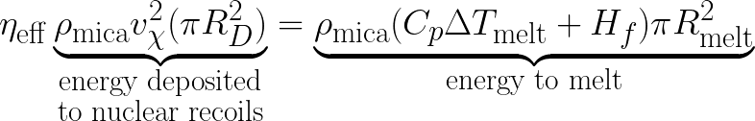
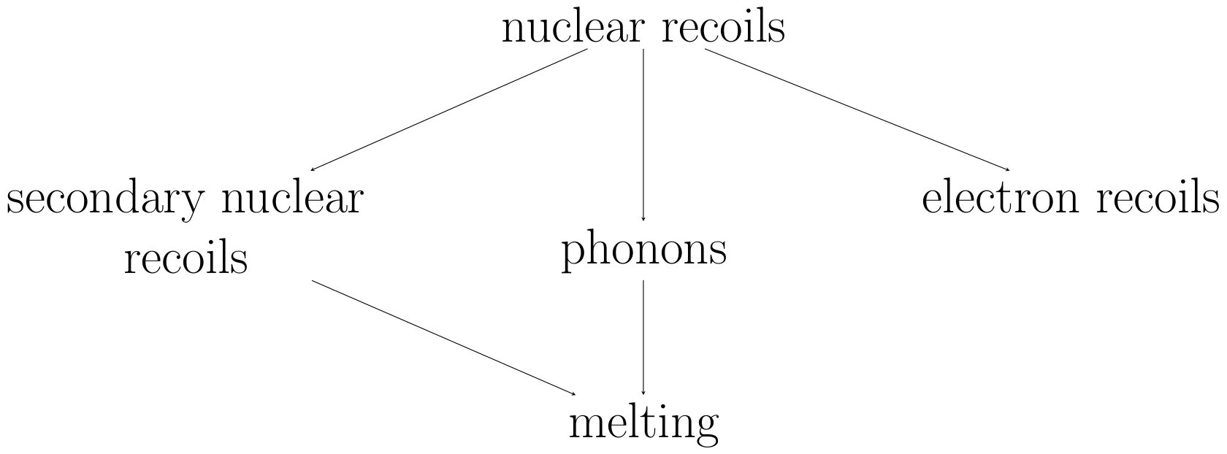

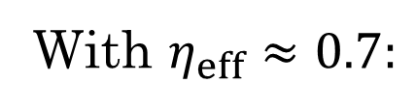
New Bounds: Searching for Melt Tracks
  Large enough DM can make ‘melt tracks’
  Energy from nuclear recoils melts surrounding mica
  Produces a straight track of vitrified mica
  Ongoing experimental program at Queen’s University to search for melt tracks from DM
With $η_{eff}≈0.7:$

Slide 13
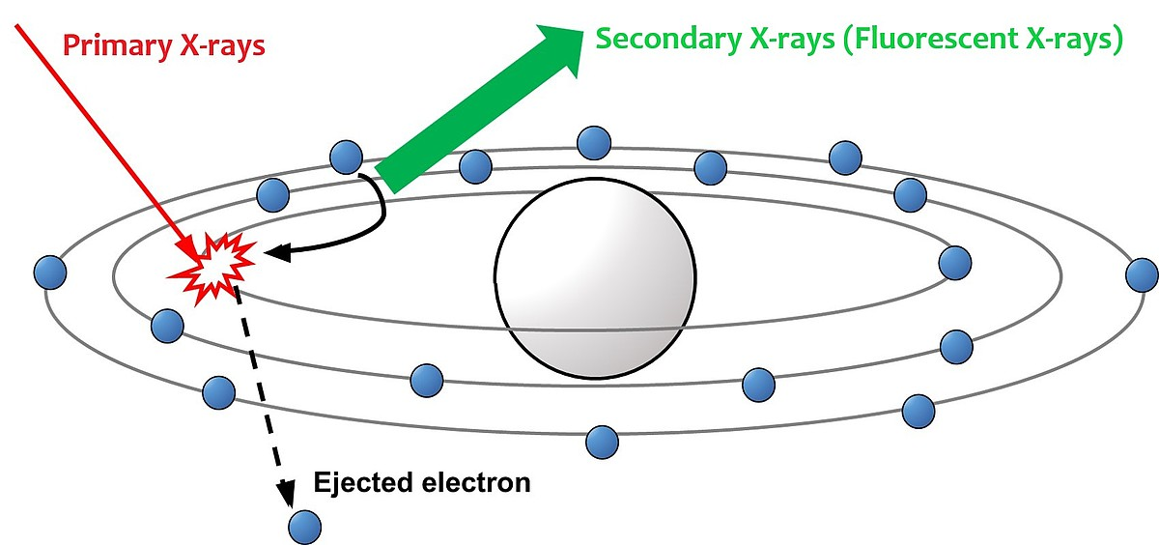
X-Ray Fluorescence
  Non-destructive imaging technique
  Irradiate a sample with X-rays
  Spectrum of subsequent deexcitations are unique to each element
  Provides a spatial map of elemental abundance

Slide 14
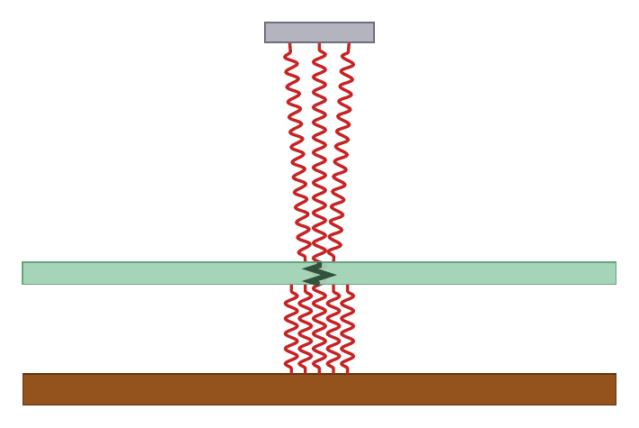

Schematic of Imaging Technique
Detector
Why copper?
Not present in mica;
no background Cu
Strong characteristic
emissions:
2p → 1s (8.0 keV)
3p → 1s (8.9 keV)
Light is scattered/
attenuated
Defect
Mica
Fluorescent
X-Rays
Irradiated
Copper

Slide 15
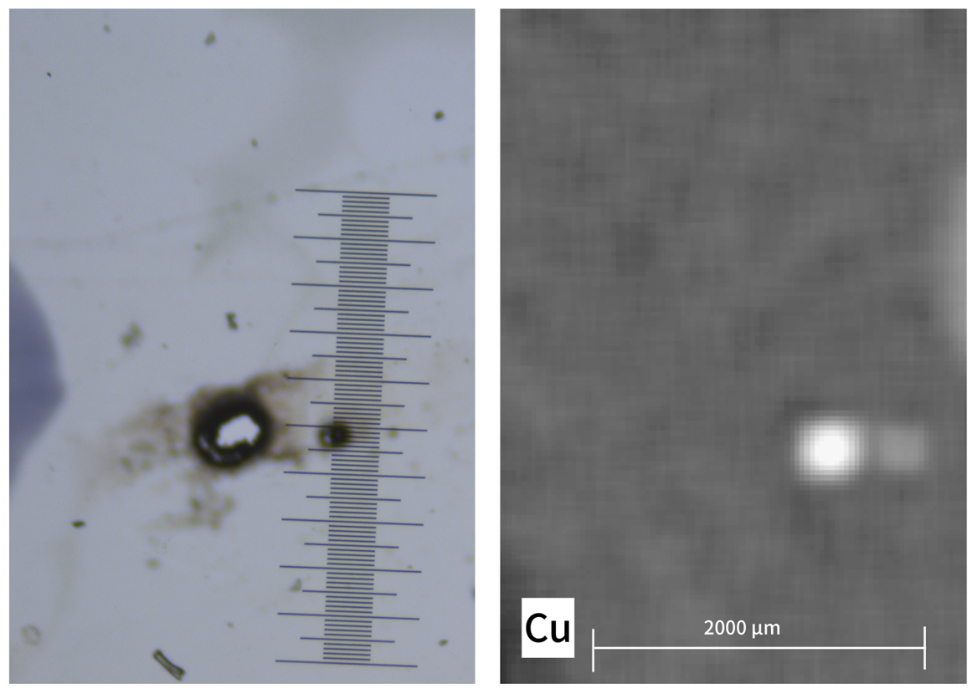
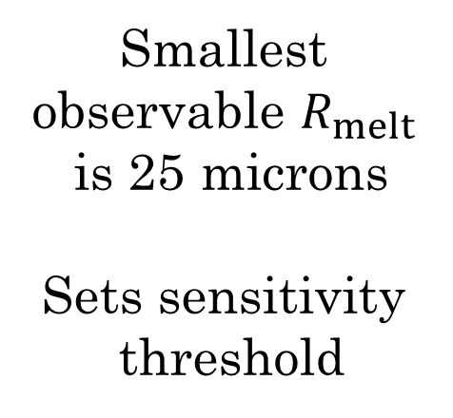


Preliminary Size Calibration with Laser-Damaged Mica
Optical
XRF
$$R_{melt}=75 μm$$
Smallest
observable $R_{melt}$
is 25 microns
Sets sensitivity
threshold
$$R_{melt}=25 μm$$
Notes:
75 micron laser ablated region
25 micron melt defect

Slide 16
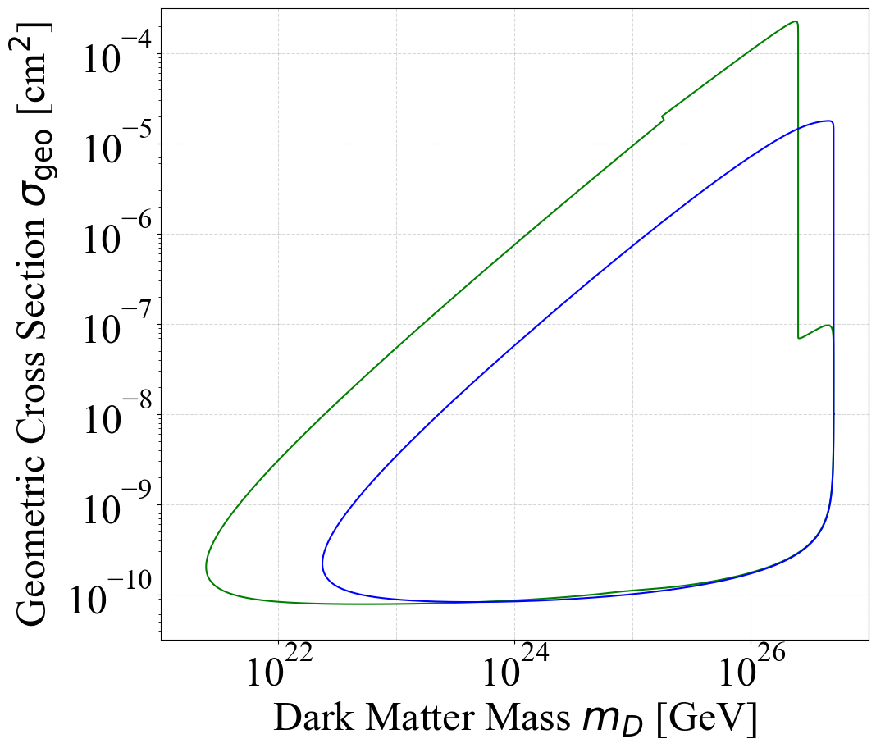
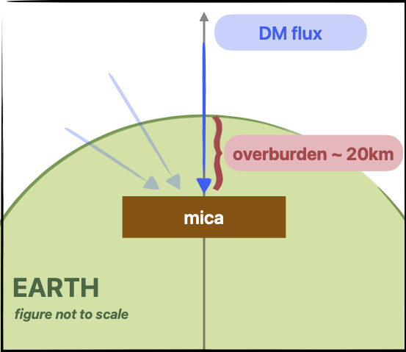
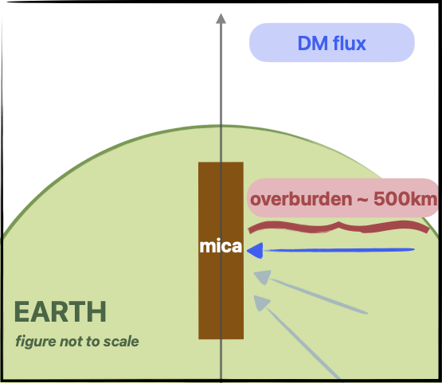



Projected Sensitivity
two-sided
flux
Mica is parallel
to Earth surface
Mica is perpendicular
to Earth surface
one-sided
flux
20 km
overburden
500 km
overburden
6000 km
overburden
$$R_{melt}=25 μm$$
$$A_{mica}=1{ m}^{2}$$
$$T_{mica}=1 Gyr$$

Slide 17
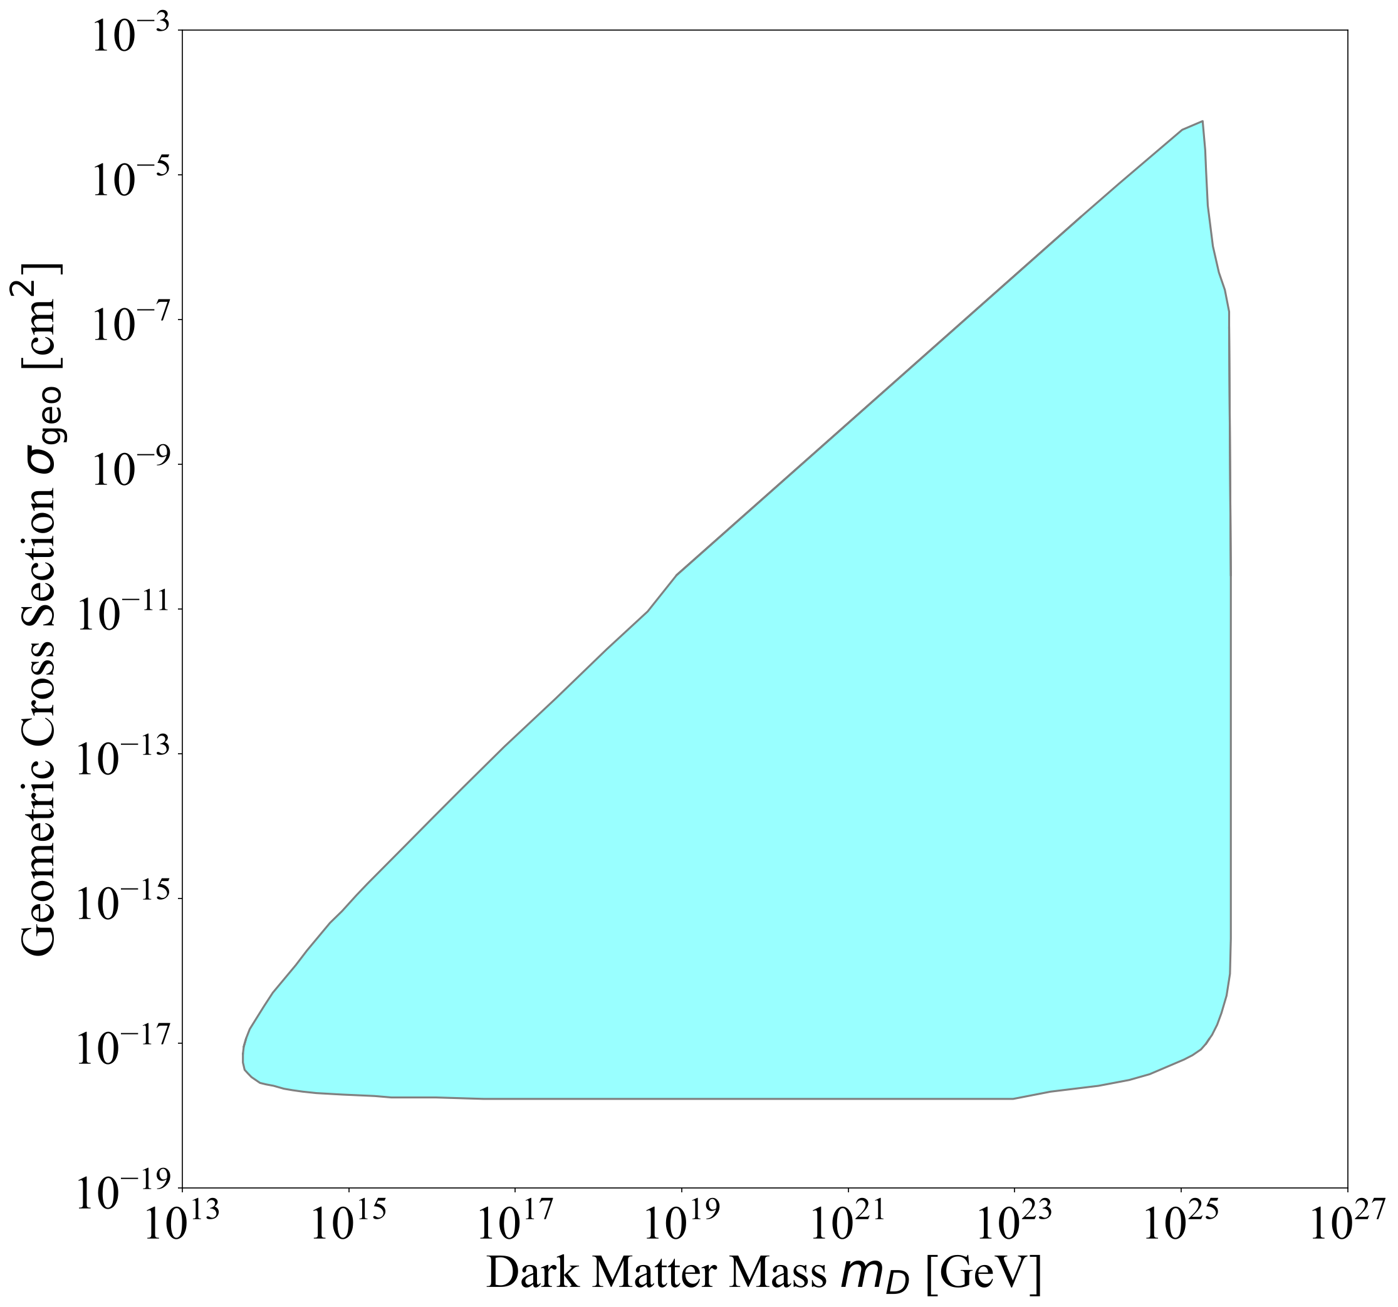
Refinements to Previous Bounds
  Recast bounds from magnetic monopole search in mica (Price and Solomon 1986)
  Finds tracks with acid etching, like Skylab and Ohya
  Less parameter space is excluded than initially thought
Notes:
These are dark matter bounds!

Slide 18
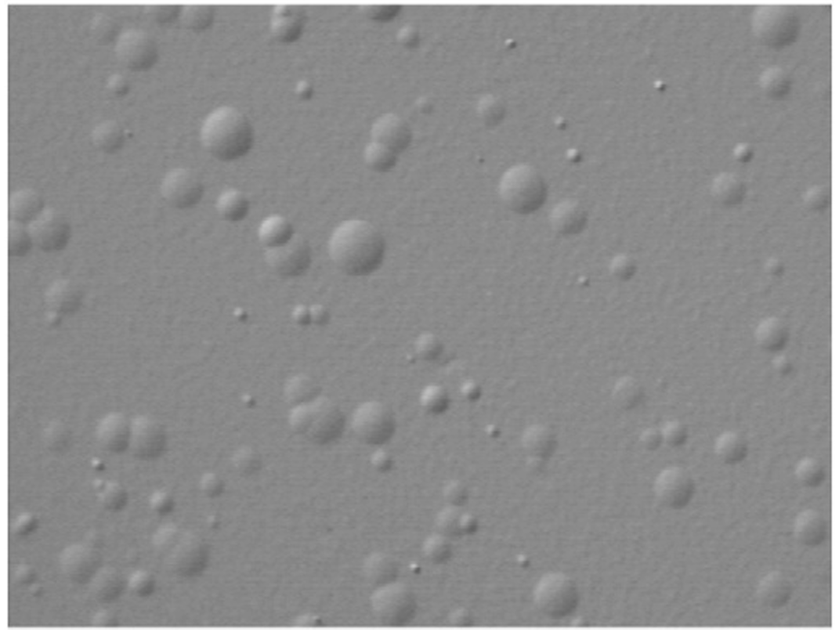

Refinements: Annealing
  Monopole search and DM recast used etching threshold based on alpha bombardment
  Studies suggest damage from alphas anneal over million-year timescales (Yuan et al 2009)
  Likely small DM tracks would also anneal
Alpha Tracks
Notes:
They said ‘we expect monopole tracks to be larger than alpha tracks, so let’s look for tracks larger than alpha tracks’ -> DM bounds

Slide 19
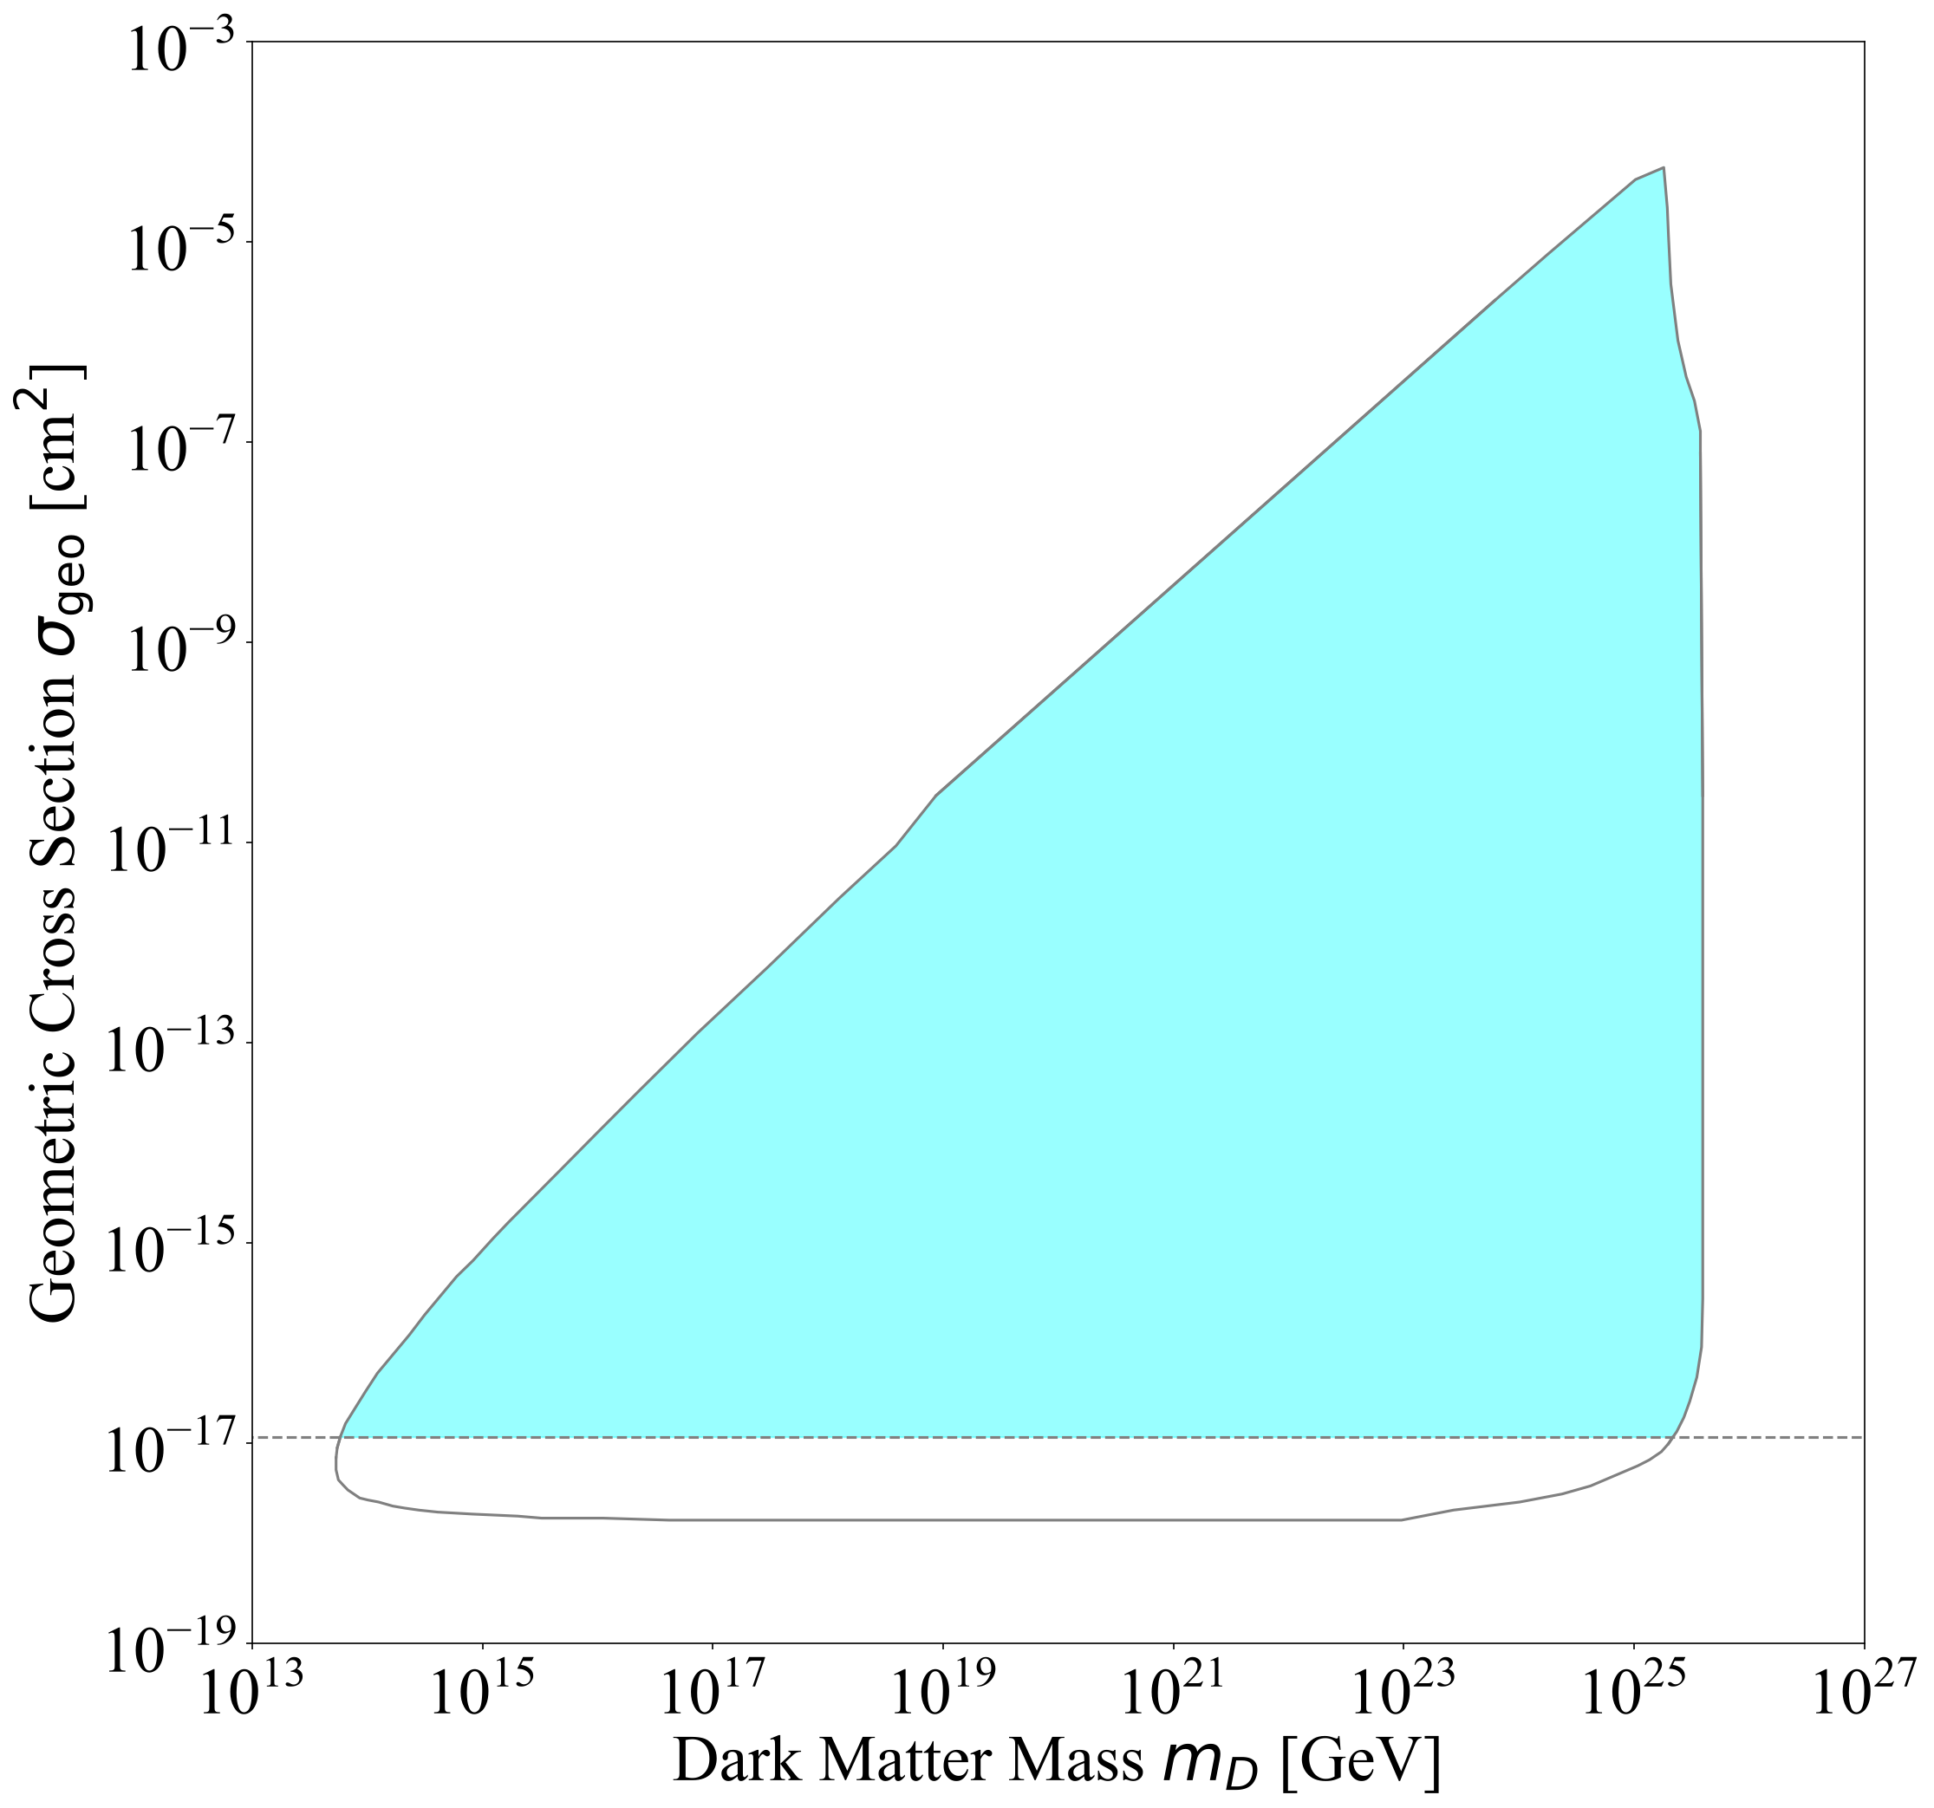

Refinements: Fission Track Validation
  Spontaneous fission tracks are directly observable
  Occurs over actual lifetime of rock; verifying mica was never hot enough to anneal
  Sets a new threshold for no annealing:
Fission Tracks

Slide 20
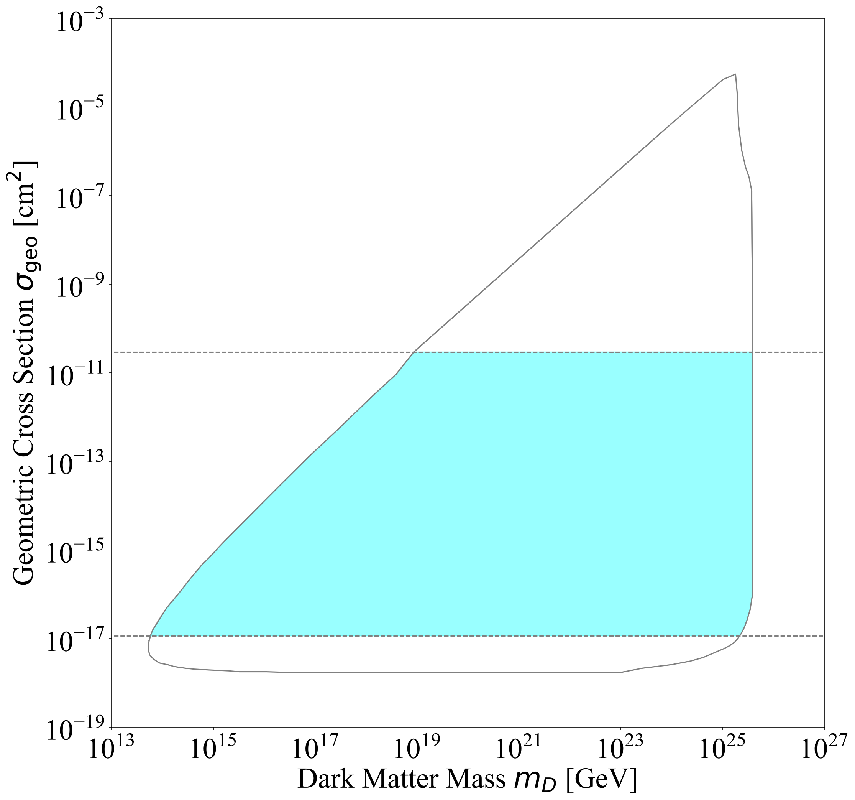
Refinements: Selection Cuts
  If DM is too big, its damage would be visible to naked eye
  DM-damaged mica could have been excluded by quality cuts in original monopole search
  Set an upper limit on excluded cross sections by imposing a max melt radius of 10 microns
Optical
Damage
Fission Tracks

Slide 21
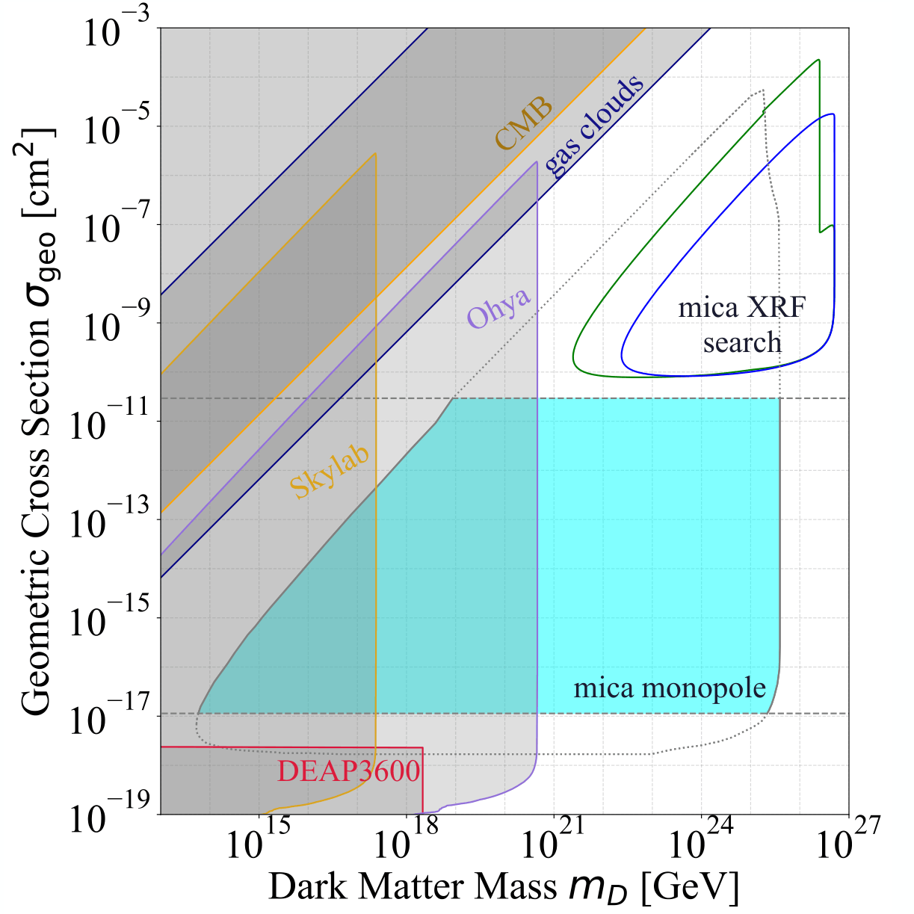
Full Mica Sensitivities
2606.02579

Slide 22
Conclusion
  Mineral searches can reach into parameter space with extremely large masses
  Ongoing search at Queen’s looking for melt tracks in muscovite mica
  Preliminary paper out; onto calibration, measurement and more theory work to find final bounds
  Also re-examined old bounds from monopole searches in mica; less parameter space than originally though

Slide 23
Thank you!

Slide 24
Backup Slides

Slide 25
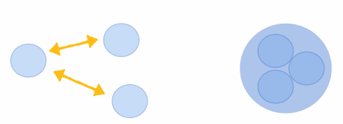
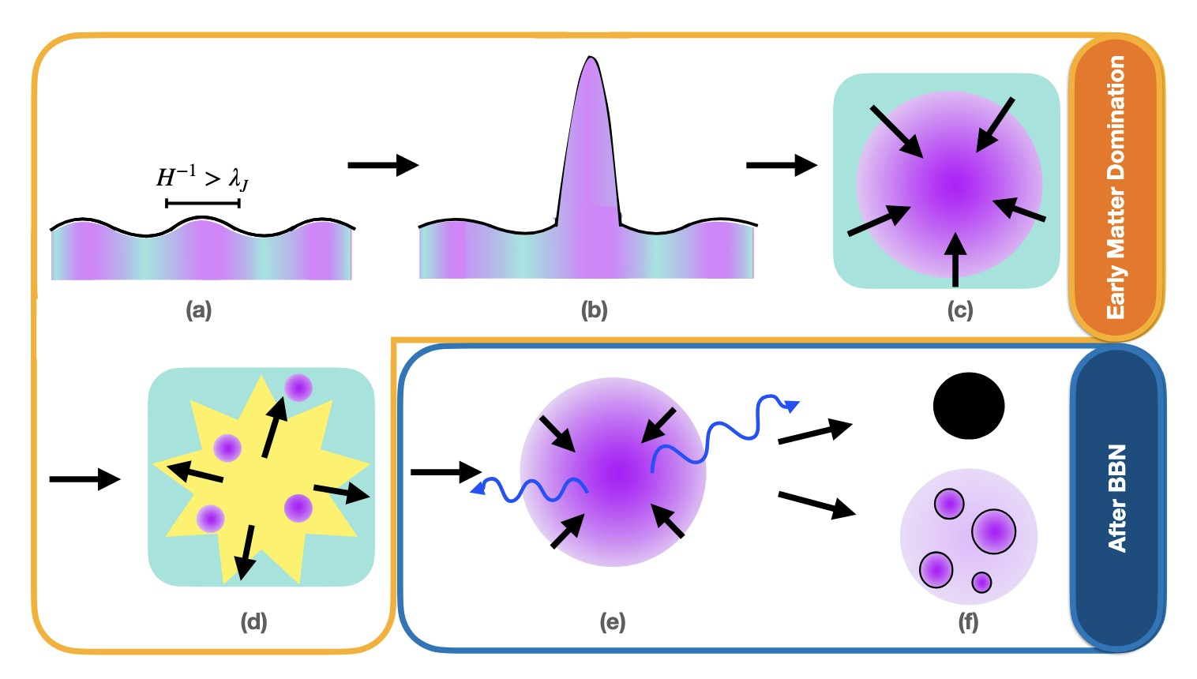
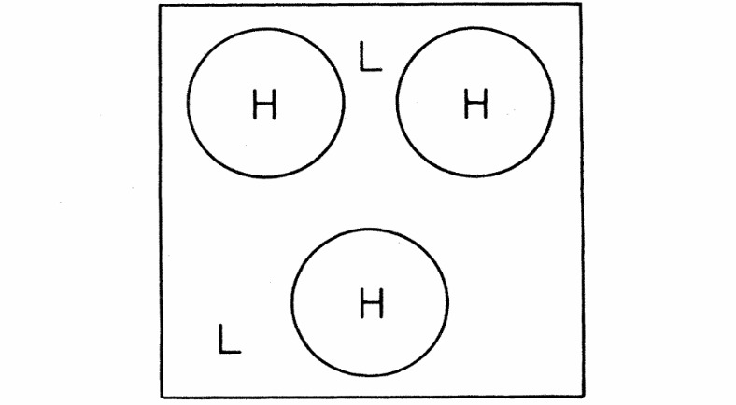
How Can Heavy Dark Matter Form?
Production from False Vacuum Bubbles
Dark Nucleosynthesis
Dissipative Processes
E.g. Witten
PhysRevD.30.272
E.g. Sigurdson and Krnjaic 1406.1171
E.g. Bramante, Cappiello, Diamond, Kim, Liu, Vincent
2405.04575

Slide 26
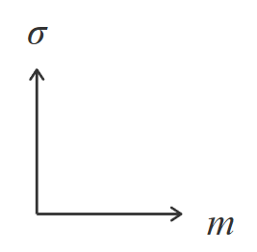


Single Scatter Bounds
Multi-Scattering Regime
Sensitivity
Flux

Slide 27



Multi-Scatter Bounds
Overburden
Flux
Sensitivity

Slide 28
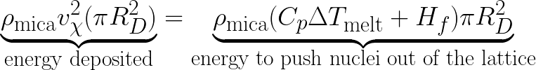
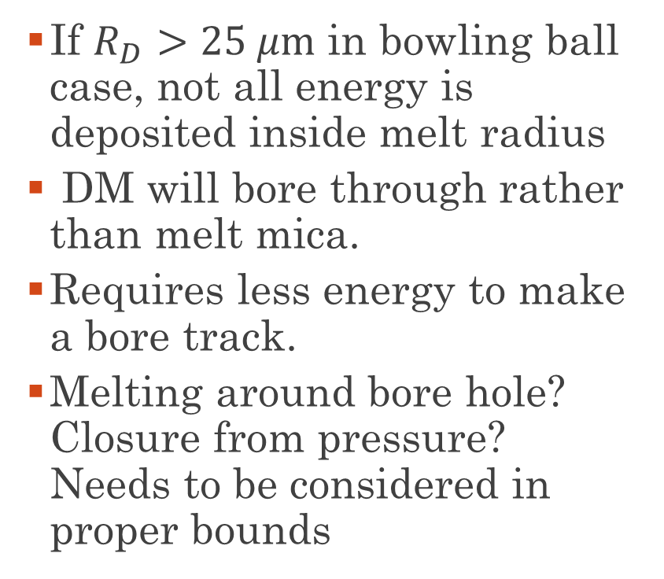
Extra Large DM: Boring Bowling Balls
  If $R_{D}>25 μm$ in bowling ball case, not all energy is deposited inside melt radius
  DM will bore through rather than melt mica.
  Requires less energy to make a bore track.
  Melting around bore hole? Closure from pressure? Needs to be considered in proper bounds
Boring
Melting

Slide 29
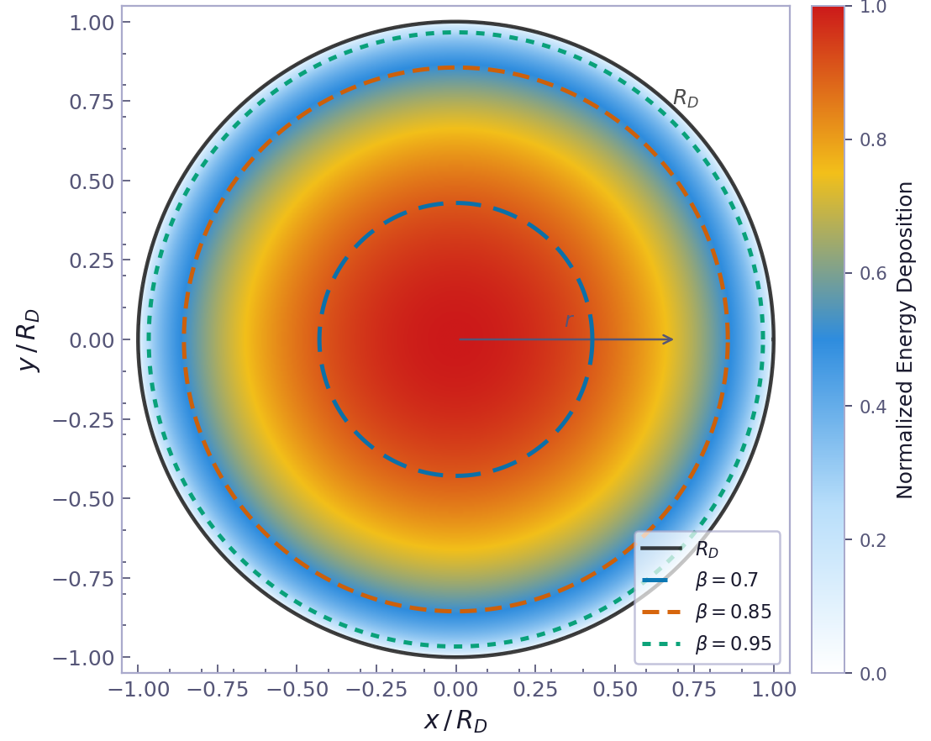
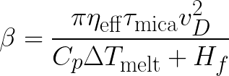

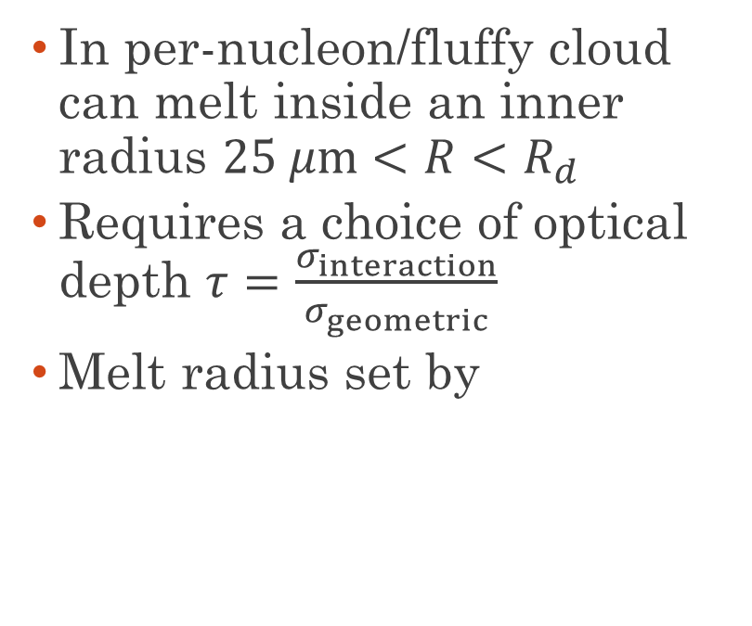
Extra Large DM: Fluffy Cloud
  In per-nucleon/fluffy cloud can melt inside an inner radius $25 μm<R<R_{d}$
  Requires a choice of optical depth $τ=\frac{σ_{interaction}}{σ_{geometric}}$
  Melt radius set by

Slide 30
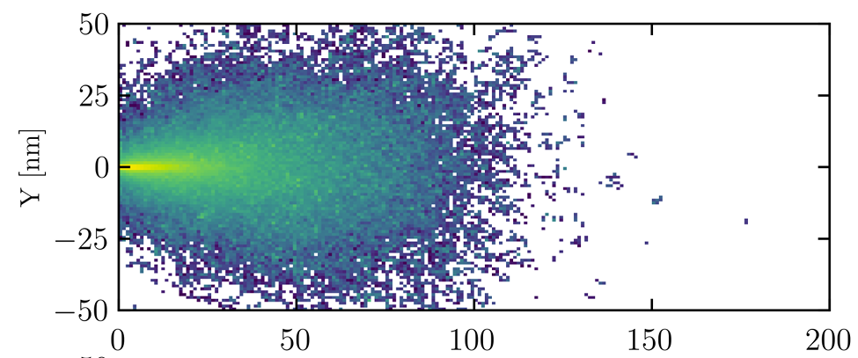
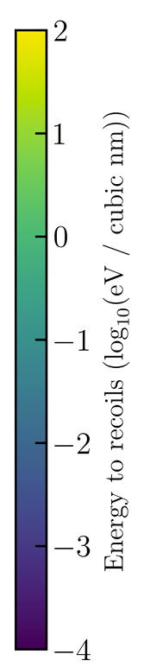
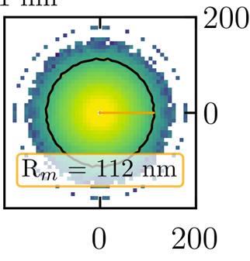
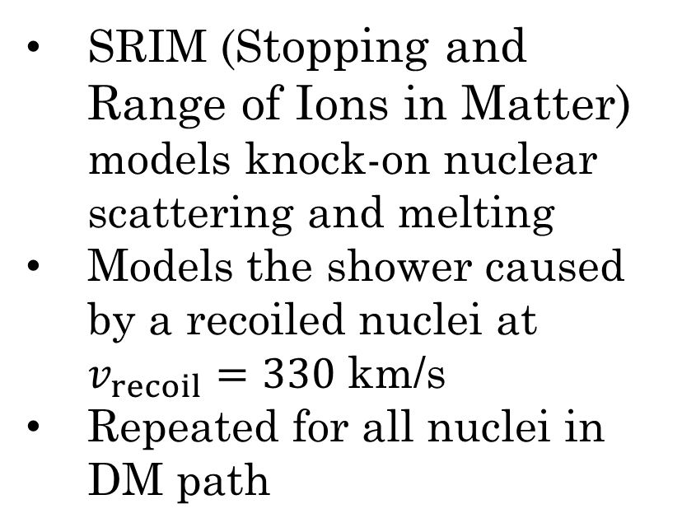
Modeling With SRIM
SRIM (Stopping and Range of Ions in Matter) models knock-on nuclear scattering and melting
Models the shower caused by a recoiled nuclei at $v_{recoil}=330$ km/s
Repeated for all nuclei in DM path
Notes:
Models secondary shower of scatter after one collision
Repeat many times
Models the blast wave of the DM moving through mica

Slide 31
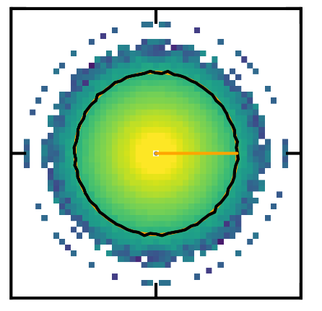
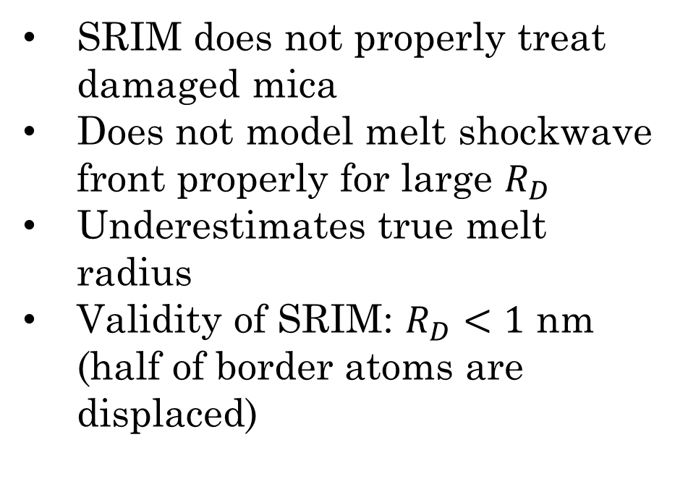


Modeling With SRIM
# Border Atoms ~ $R_{D}^{2}$
SRIM does not properly treat damaged mica
Does not model melt shockwave front properly for large $R_{D}$
Underestimates true melt radius
Validity of SRIM: $R_{D}<1$ nm
(half of border atoms are displaced)
# Recoiled Atoms ~ $R_{D}^{2}$

Slide 32

Modeling With SRIM
Not enough
recoils for
continuous defect
SRIM
invalid
SRIM seems to validate
our melt radius estimate

Slide 33




DM is Very Fast in Most of Parameter Space
Schematic plot of
fraction of DM
initial speed left
when DM hits mica
$$\log_{10}(σ_{geo}/ 1 {cm}^{2})$$
Assumes constant
$20$ km overburden
$$\log_{10}(m_{χ}/ 1 GeV)$$

Slide 34


Mica Sensitivities in Per-Nucleon Case

Slide 35
Astrophysics is Complicated
  Like Skylab/Ohya, direction of the detector matters
      Daily rotation of Earth
      Axial procession of Earth
      Oscillation of Sun through galactic plane
      Angle between sun orbit and solar system plane
      Plate tectonics changing the mica’s latitude
      Just average like Skylab!
Has the DM speed distribution changed over the last 1 Gyr?
        LMC + MW dynamics
        Changing solar distance from galactic centre
Full treatment should include a simulation of velocity distribution.
Preliminary results use unchanging modern values

