Slide 1


Bubble Chamber Sensitivity to Composite Dark Matter
Alex Hayes

Slide 2
Outline
Part I: Dark Matter
Part II: Bubble Chambers
Part III: Analysis & Results

Slide 3
Part I: Dark Matter

Slide 4
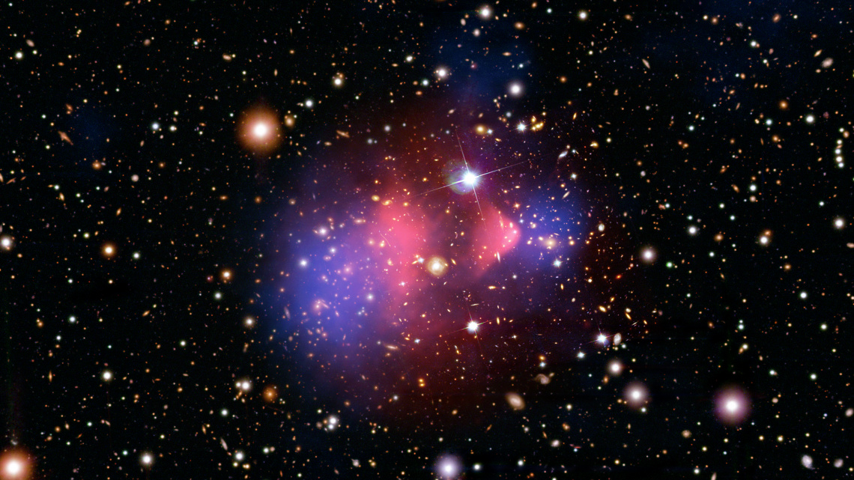
Part I – Dark Matter
New form of matter
Motivated by various astrophysical phenomena
Particle nature unknown
Credit: NASA

Slide 5
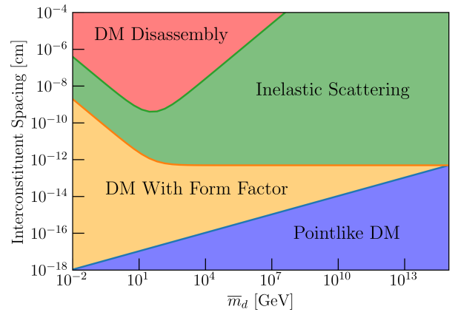
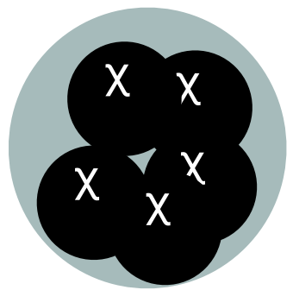

Part I – Composite Dark Matter
Models with a binding force
Clump into large composite states
Can be very heavy, $𝒪(1−{10}^{45})$ GeV
Credit: Joe Bramante
Notes:
Mass range depends on the specific sub-model (dark quark nuggets, dark glueballs, etc.) which we are agnostic to in this study (up to the requirement that they be loosely bound)

Slide 6
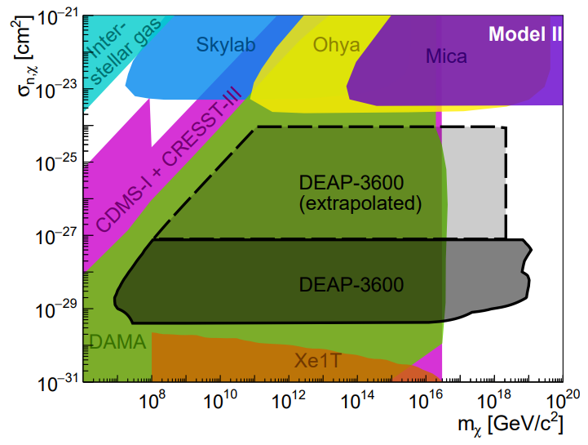
Part I – DEAP-3600 Multi-scatter
Used DEAP-3600’s lack of multiple-scatter events
Provided new limits on heavy dark matter
Credit: DEAP Collaboration
Notes:
Motivation to try similar analysis with other detectors

Slide 7
Part I – Summary
Invisible, new type of matter
Models with binding forces
  Create large “composites”
Direct detection can provide new limits

Slide 8
Part II: Bubble Chambers

Slide 9
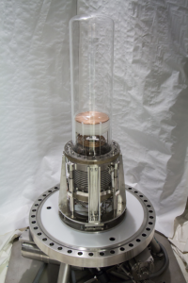
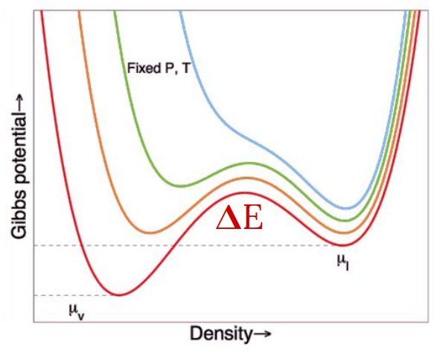
Part II – Bubble Chambers
Credit: Ben Broerman, SBC
Credit: PICO Experiment
Notes:
Superheated fluid
octafluoropropane

Slide 10
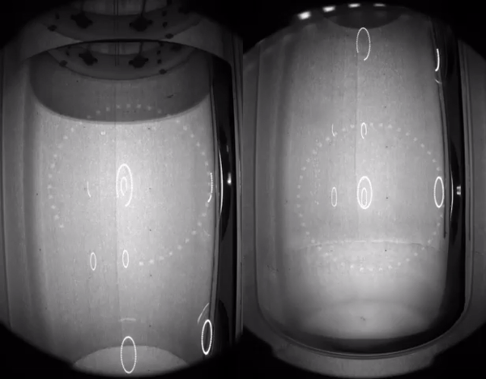
Part II – Bubble Chambers
Credit: McDonald Institute

Slide 11
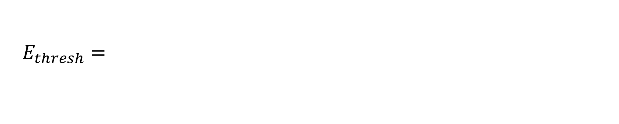

Part II – Energy Threshold
$$r_{c}$$
$$E_{thresh}=4π\left(σ−T\frac{∂σ}{∂T}\right)r_{c}^{2}+\frac{4π}{3}ρ_{b}\left(h_{b}−h_{l}\right)r_{c}^{3}−\frac{4π}{3}\left(P_{b}−P_{l}\right)r_{c}^{3}$$
Notes:
Using thermodynamic arguments, one can derive this equation for the threshold energy of a single recoil, parameterized as a “critical radius” i.e. the smallest radius bubble that will grow by itself.

Slide 12
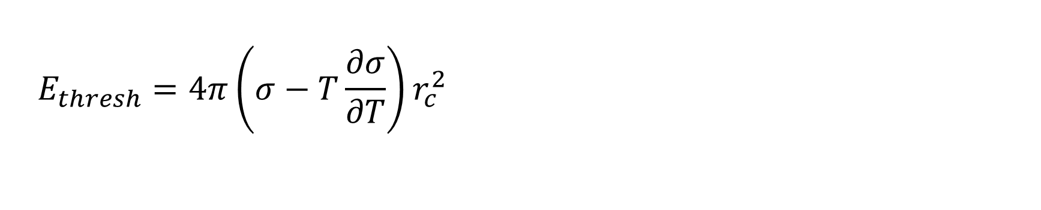
Part II – Energy Threshold
$$r_{c}$$
$$E_{thresh}=4π\left(σ−T\frac{∂σ}{∂T}\right)r_{c}^{2}+\frac{4π}{3}ρ_{b}\left(h_{b}−h_{l}\right)r_{c}^{3}−\frac{4π}{3}\left(P_{b}−P_{l}\right)r_{c}^{3}$$
Surface tension
Notes:
Using thermodynamic arguments, one can derive this equation for the threshold energy of a single recoil, parameterized as a “critical radius” i.e. the smallest radius bubble that will grow by itself.

Slide 13
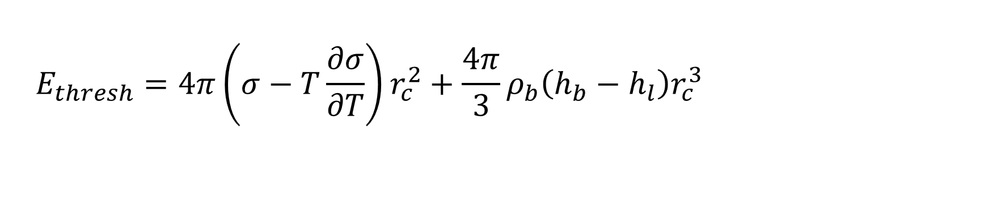
Part II – Energy Threshold
$$r_{c}$$
$$E_{thresh}=4π\left(σ−T\frac{∂σ}{∂T}\right)r_{c}^{2}+\frac{4π}{3}ρ_{b}\left(h_{b}−h_{l}\right)r_{c}^{3}−\frac{4π}{3}\left(P_{b}−P_{l}\right)r_{c}^{3}$$
Surface tension
Enthalpy
Notes:
Using thermodynamic arguments, one can derive this equation for the threshold energy of a single recoil, parameterized as a “critical radius” i.e. the smallest radius bubble that will grow by itself.

Slide 14
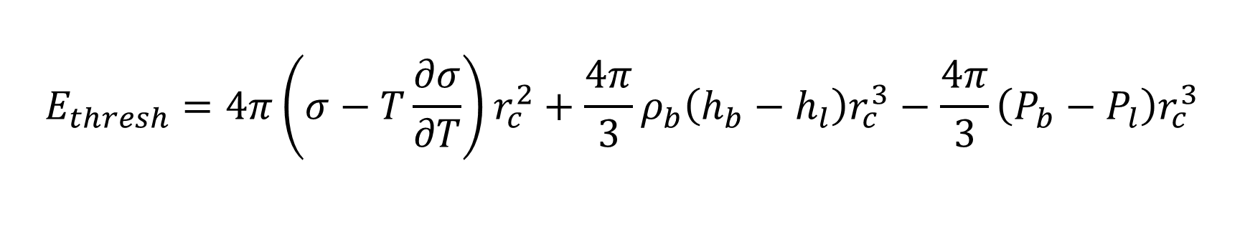
Part II – Energy Threshold
$$r_{c}$$
$$E_{thresh}=4π\left(σ−T\frac{∂σ}{∂T}\right)r_{c}^{2}+\frac{4π}{3}ρ_{b}\left(h_{b}−h_{l}\right)r_{c}^{3}−\frac{4π}{3}\left(P_{b}−P_{l}\right)r_{c}^{3}$$
Surface tension
Enthalpy
Pressure
Notes:
Using thermodynamic arguments, one can derive this equation for the threshold energy of a single recoil, parameterized as a “critical radius” i.e. the smallest radius bubble that will grow by itself.

Slide 15
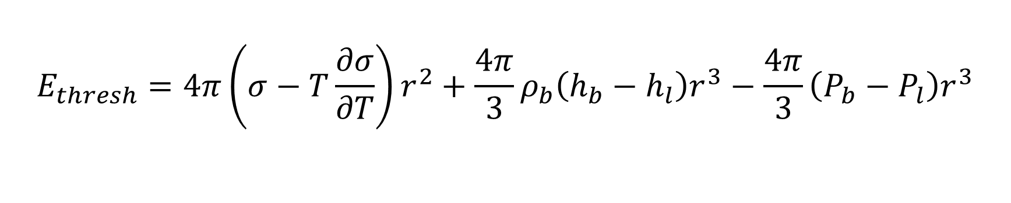
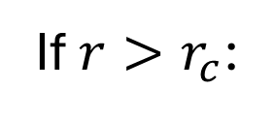
Part II – Energy Threshold
If $r>r_{c}$:
$$E_{thresh}=4π\left(σ−T\frac{∂σ}{∂T}\right)r^{2}+\frac{4π}{3}ρ_{b}\left(h_{b}−h_{l}\right)r^{3}−\frac{4π}{3}\left(P_{b}−P_{l}\right)r^{3}$$
Surface tension
Enthalpy
Pressure
Notes:
If you deposit energy in a region bigger than the critical volume, the thermodynamics are identical but now at a larger r.

Slide 16
Part II – Summary
Macroscopic signal region
Uniquely sensitive to composite interactions!

Slide 17
Part III: Analysis & Results

Slide 18

Part III – Velocity
Flux:
$$Φ=\frac{ρ_{D}}{M_{D}}v_{avg}Af_{g}$$
Number of events:
$$N=Φt\int_{v_{i}}^{∞}{f\left(v\right)dv}$$
This gives us $v_{i}$
Notes:
Rho_D: 3x10^5 GeV / m^3
Mass: 10^16 GeV
f_g = ¼ “acceptance factor”
Area: ~0.5 square meters
v_i: minimum velocity for N events
t: ~100 days exposure time

Slide 19

Part III – Velocity
Flux:
$$Φ=\frac{ρ_{D}}{M_{D}}v_{avg}Af_{g}$$
Number of events:
$$N=Φt\int_{v_{i}}^{∞}{f\left(v\right)dv}$$
This gives us $v_{i}$
Notes:
Rho_D: 3x10^5 GeV / m^3
Mass: 10^16 GeV
f_g = ¼ “acceptance factor”
Area: ~0.5 square meters
v_i: minimum velocity for N events
t: ~100 days exposure time

Slide 20
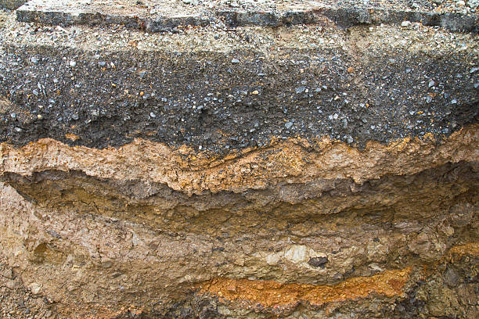
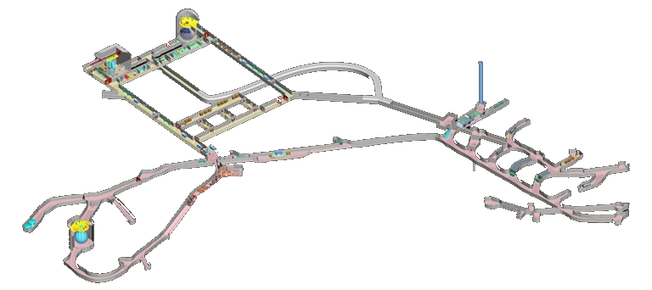

Part III – Overburden
Overburden slowdown:
$\frac{v_{f}}{v_{i}} \sim \text{exp}\left(−σ_{nd}ℓ\sum{μ_{Nd}^{4}n_{N}}\right)$
Composite disassembly?
Notes:
2km of rock reduces cosmic radiation by a factor of ~50 million (snolab)
Composite of radius r
Impose the constraint that less than 50% of the constituents ever scatter in the overburden

Slide 21


Part III – Total Energy Deposit
Total energy deposited:
$E_{dep} \sim rNσ_{nd}v_{f}^{2}\sum{μ_{Nd}^{4}n_{N}}$
Continuous bubble formation
$$r$$
Notes:
Composite of radius r, E_dep calculated by determining energy deposited per scatter and integrating over the sphere

Slide 22

Part III – Summary so far
Find $v$ to give enough events
Calculate energy lost in overburden
Bubbles when $E_{dep}>E_{thresh}$

Slide 23
Part III – Results (Preliminary) – PICO-40L
PICO-40L sensitivity at SNOLAB
Notes:
Note the sub-GeV sensitivity!

Slide 24
Part III – Results (Preliminary) – PICO-40L
Loses too much energy in overburden
PICO-40L sensitivity at SNOLAB
Notes:
Note the sub-GeV sensitivity!

Slide 25
Part III – Results (Preliminary) – PICO-40L
Loses too much energy in overburden
Doesn’t deposit enough energy
PICO-40L sensitivity at SNOLAB
Notes:
Note the sub-GeV sensitivity!

Slide 26
Part III – Results (Preliminary) – PICO-40L
Loses too much energy in overburden
Doesn’t deposit enough energy
Bubbles!
PICO-40L sensitivity at SNOLAB
Notes:
Note the sub-GeV sensitivity!

Slide 27
Part III – Results (Preliminary) – PICO-40L
Loses too much energy in overburden
Doesn’t deposit enough energy
Bubbles!
PICO-40L sensitivity at SNOLAB
Notes:
Note the sub-GeV sensitivity!

Slide 28
Part III – Results (Preliminary) – PICO-40L
Loses too much energy in overburden
Doesn’t deposit enough energy
Bubbles!
PICO-40L sensitivity at SNOLAB
Notes:
Note the sub-GeV sensitivity!

Slide 29
Part III – Results (Preliminary) – PICO-500
PICO-500 sensitivity in SNOLAB
Notes:
Note the nearly sub-GeV sensitivity!
~0.3m radius, ~1m tall detector

Slide 30
Part III – Results (Preliminary) – PICO-500
PICO-500 sensitivity in SNOLAB
Notes:
Note the nearly sub-GeV sensitivity!
~0.3m radius, ~1m tall detector

Slide 31

Part III – Summary
Analyzed velocity distribution, overburden effects, and energy deposited by composite dark matter
Calculated composite dark matter limits for PICO-40L and PICO-500
Paper in the works! Stay tuned for more bubbles
Thank you!

