Slide 1


Searching for Dark Matter with Two-Stage Atomic Transitions
Andrew Buchanan

Slide 2
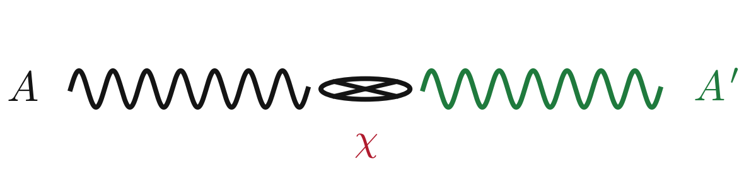
Dark Photon Searches

Slide 3
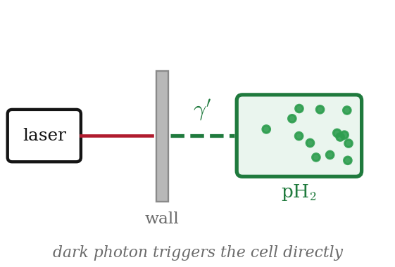
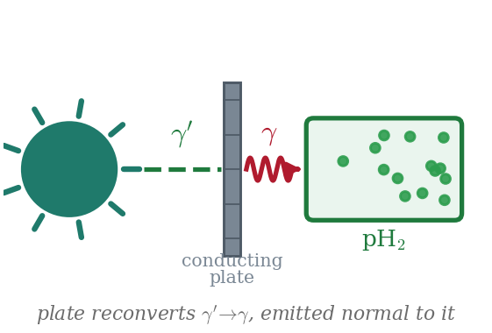
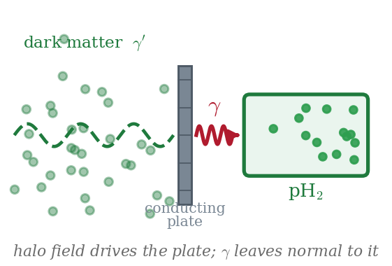
Dark Photon Searches
New detection method
Shining Through a Wall
From the Sun
From the Halo

Slide 4


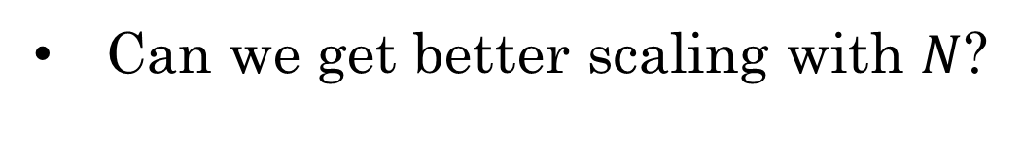

Quantum Detection
$$Signal=NΓt$$
$$Γ≈n_{x}v_{x}A^{4}σ_{nx}$$
$$N=\#Argon,Xenon$$
Can we get better scaling with $N$?

Slide 5
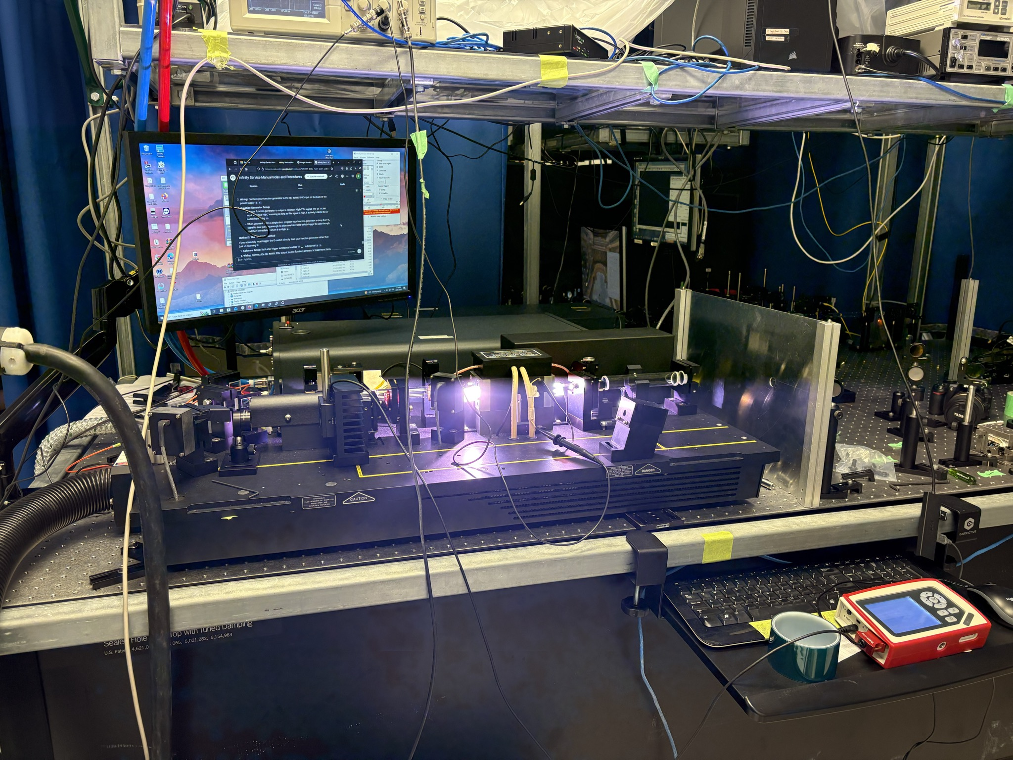
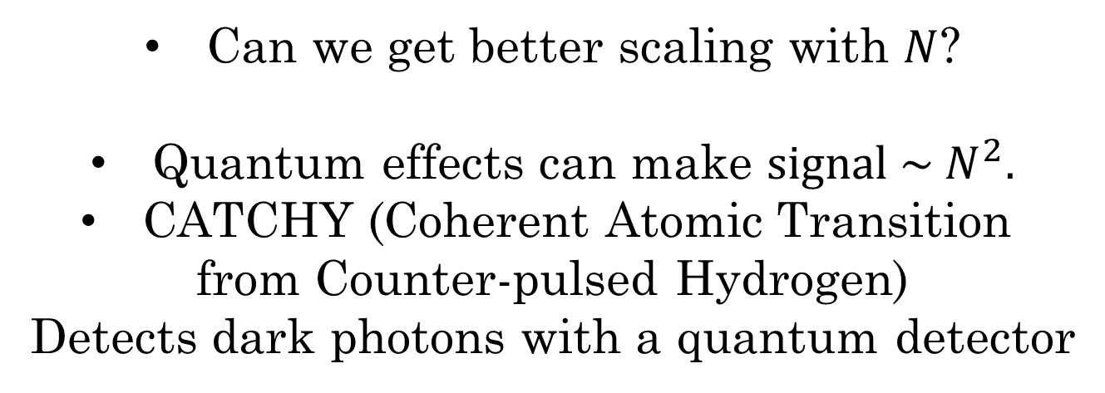
Quantum Detection
$$Signal=NΓt$$
$$Γ≈n_{x}v_{x}A^{4}σ_{nx}$$
$$N=\#Argon,Xenon$$
Can we get better scaling with $N$?
Quantum effects can make ${signal \sim N}^{2}.$
CATCHY (Coherent Atomic Transition
from Counter-pulsed Hydrogen)
Detects dark photons with a quantum detector

Slide 6
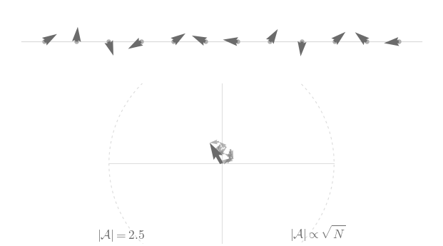
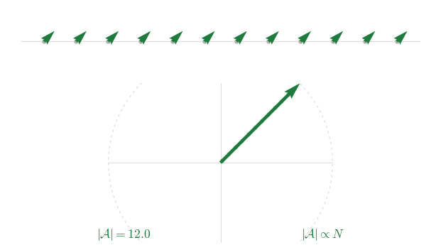
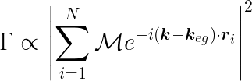

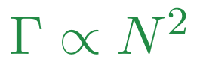
Coherent Atomic Emission
RANDOM PHASES
LOCKED PHASES
Emission triggered by an
incoming dark photon
5

Slide 7
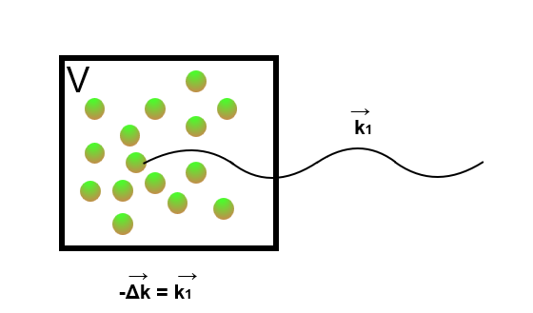

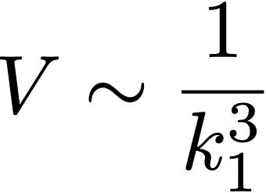
One-Photon Emission
Number of atoms is limited by
wavelength of emitted light.

Slide 8
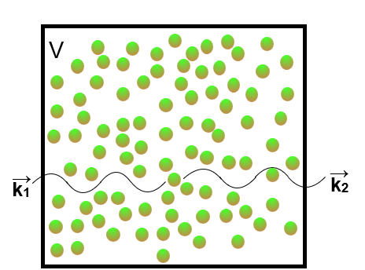
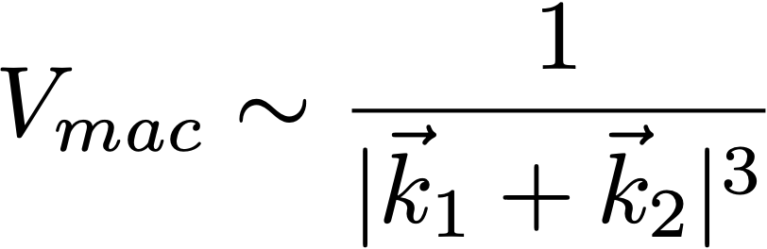
Two-Photon Emission
Number of atoms
is not limited
by wavelength.

Slide 9

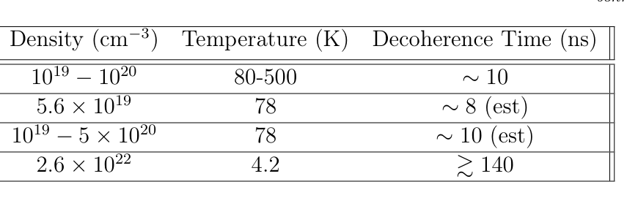
Two-Photon Emission
Response is instead limited by
collisional desyncing
Number of atoms
is not limited
by wavelength.
CATCHY = 30 cm

Slide 10
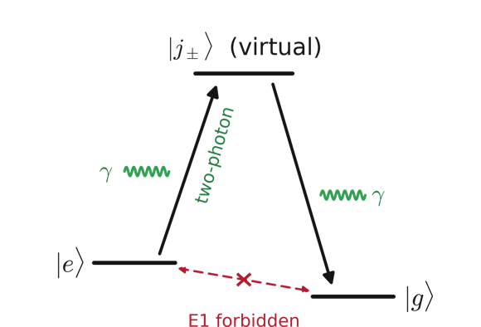

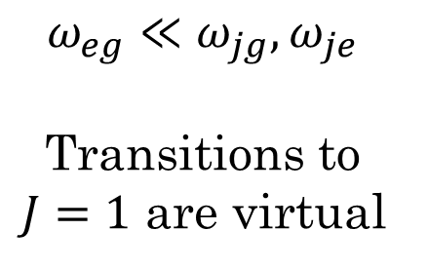


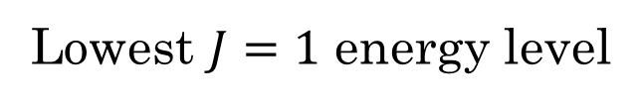
Two-Stage Transitions
Lowest $J=1$ energy level
At leading order:
$ω_{eg}≪ω_{jg},ω_{je}$
Transitions to
$J=1$ are virtual
Wigner-Eckhart
+ parity
$$\left|J_{f}−J_{i}\right|=1$$
$$J=0$$
E1 transition
Every deexcitation
releases two photons!

Slide 11
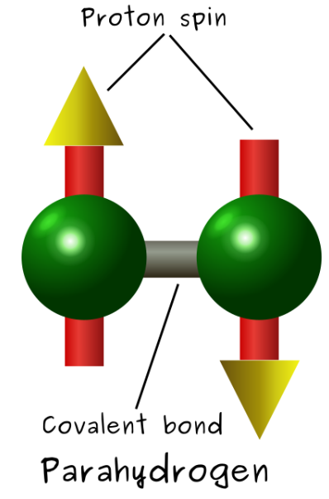
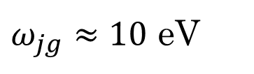
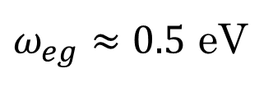
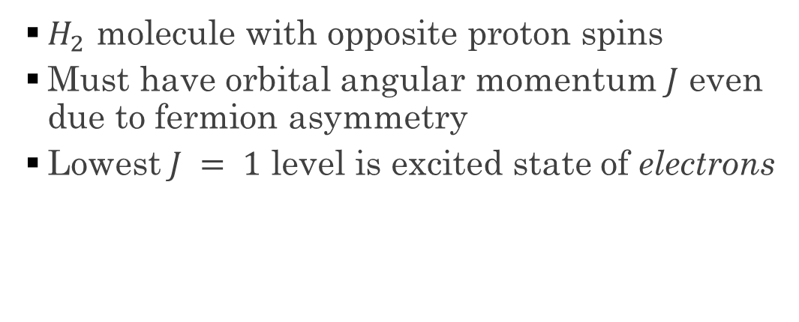
A Candidate: Parahydrogen
  $H_{2}$ molecule with opposite proton spins
  Must have orbital angular momentum $J$ even due to fermion asymmetry
  Lowest$J = 1$ level is excited state of electrons
$ω_{jg}≈10$ eV
$ω_{eg}≈0.5$ eV

Slide 12



The Protocol
(a) Pump Phase — two counter-propagating lasers phase-lock the sample
pump
$2.5\frac{MW}{{cm}^{2}}$.
$2.5\frac{MW}{{cm}^{2}}$.
pump
R
L
signal
(b) Trigger Phase — a trigger laser deexcites the sample
R
signal
L
L
trigger
$0.25\frac{MW}{{cm}^{2}}$ in pilot run
All light is circularly polarized has $ω=\frac{E_{e}−E_{g}}{2ℏ}=0.26 eV$ and $4.8 μ$m.

Slide 13
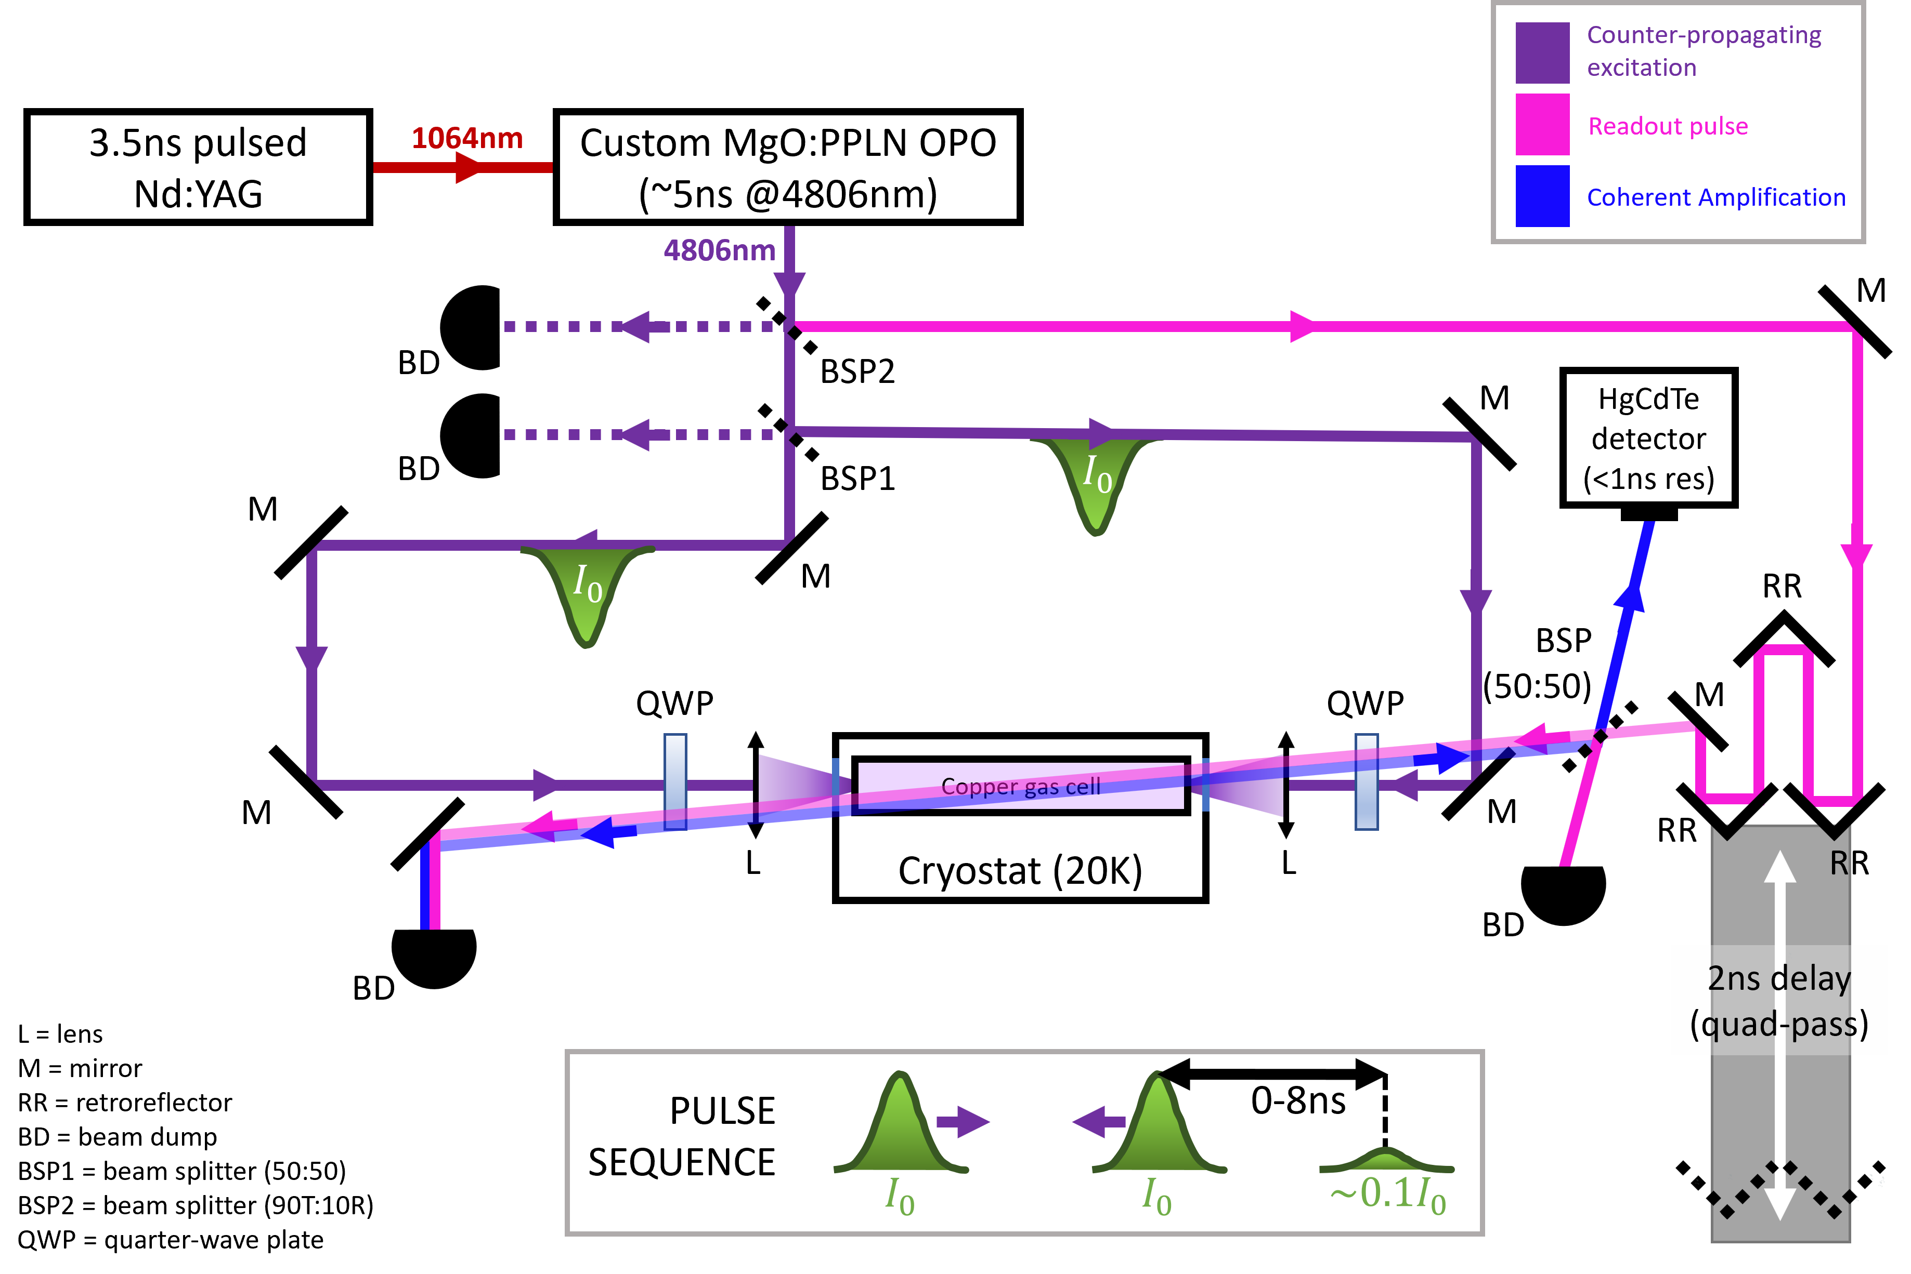
Experimental Setup
https://www.proquest.com/docview/3161889593
pump
detector
trigger

Slide 14
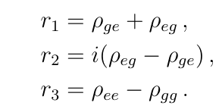
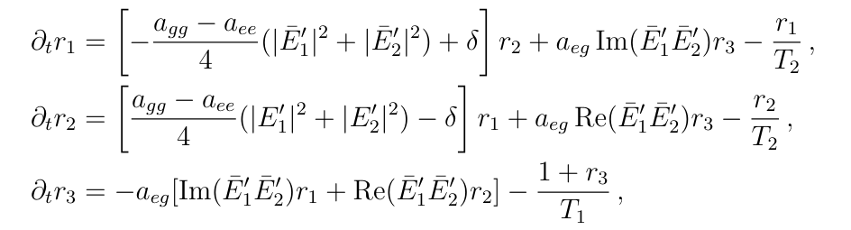
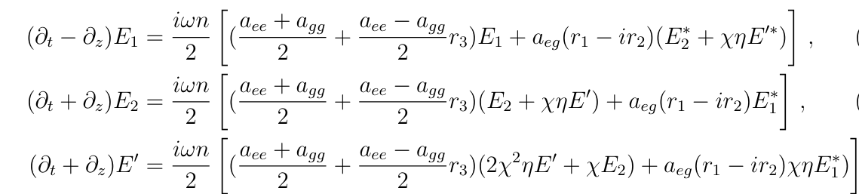
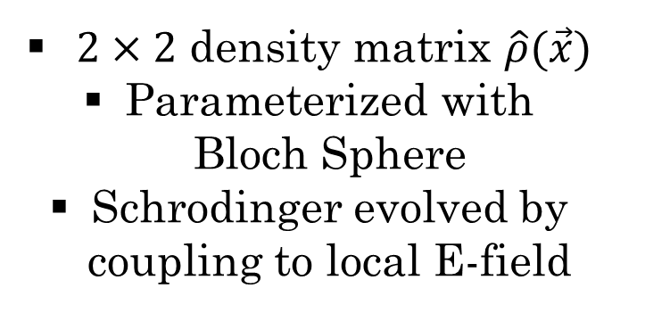
Maxwell-Bloch Equations
Atoms
Fields
$2×2$ density matrix $\hat{ρ}(\vec{x})$
Parameterized with Bloch Sphere
Schrodinger evolved by coupling to local E-field
Atoms induce a polarization
Acts as a source for E-fields

Slide 15
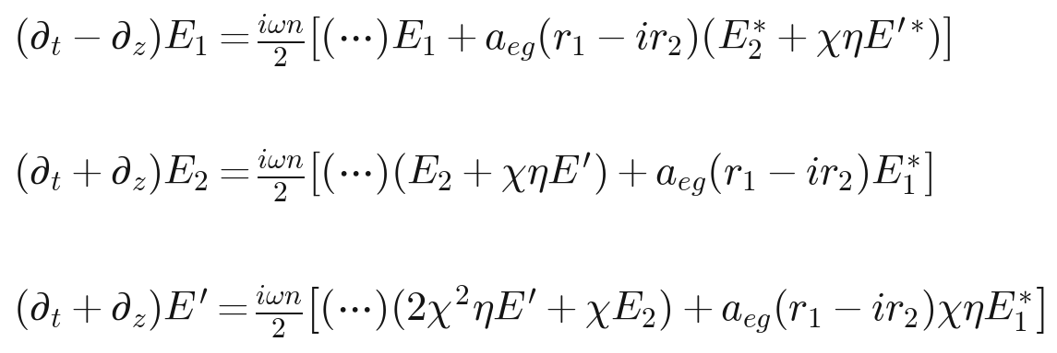
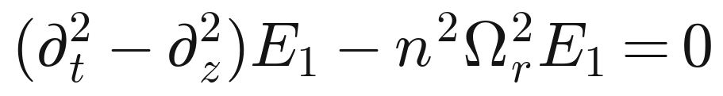
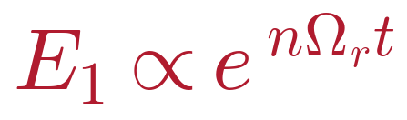
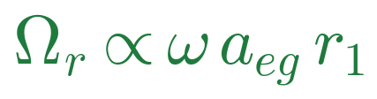
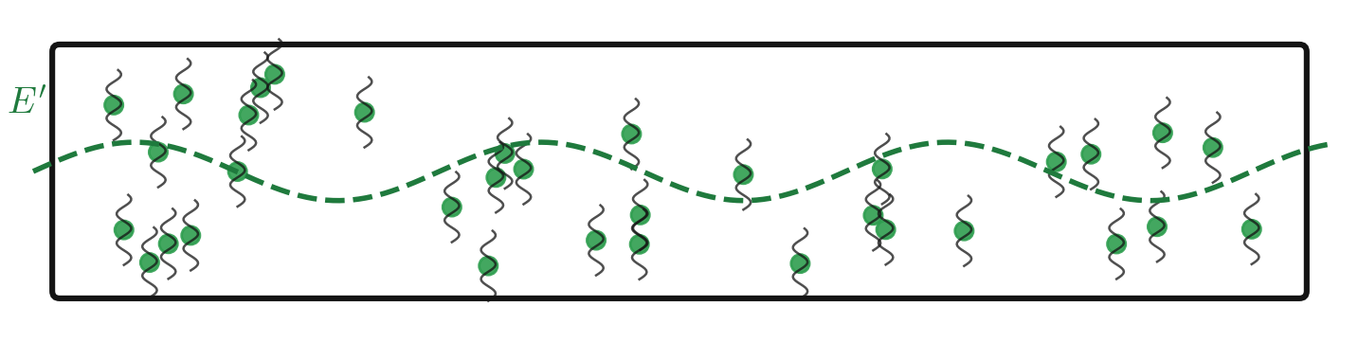
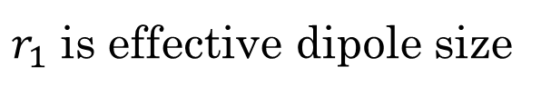
Photon Avalanche
condense field equations,
drop z, r₂, fix r₁
$r_{1}$ is effective dipole size

Slide 16
Photon Avalanche
condense field equations,
drop z, r₂, fix r₁
$r_{1}$ is effective dipole size

Slide 17
Photon Avalanche
condense field equations,
drop z, r₂, fix r₁
$r_{1}$ is effective dipole size

Slide 18
Photon Avalanche
condense field equations,
drop z, r₂, fix r₁
$r_{1}$ is effective dipole size

Slide 19
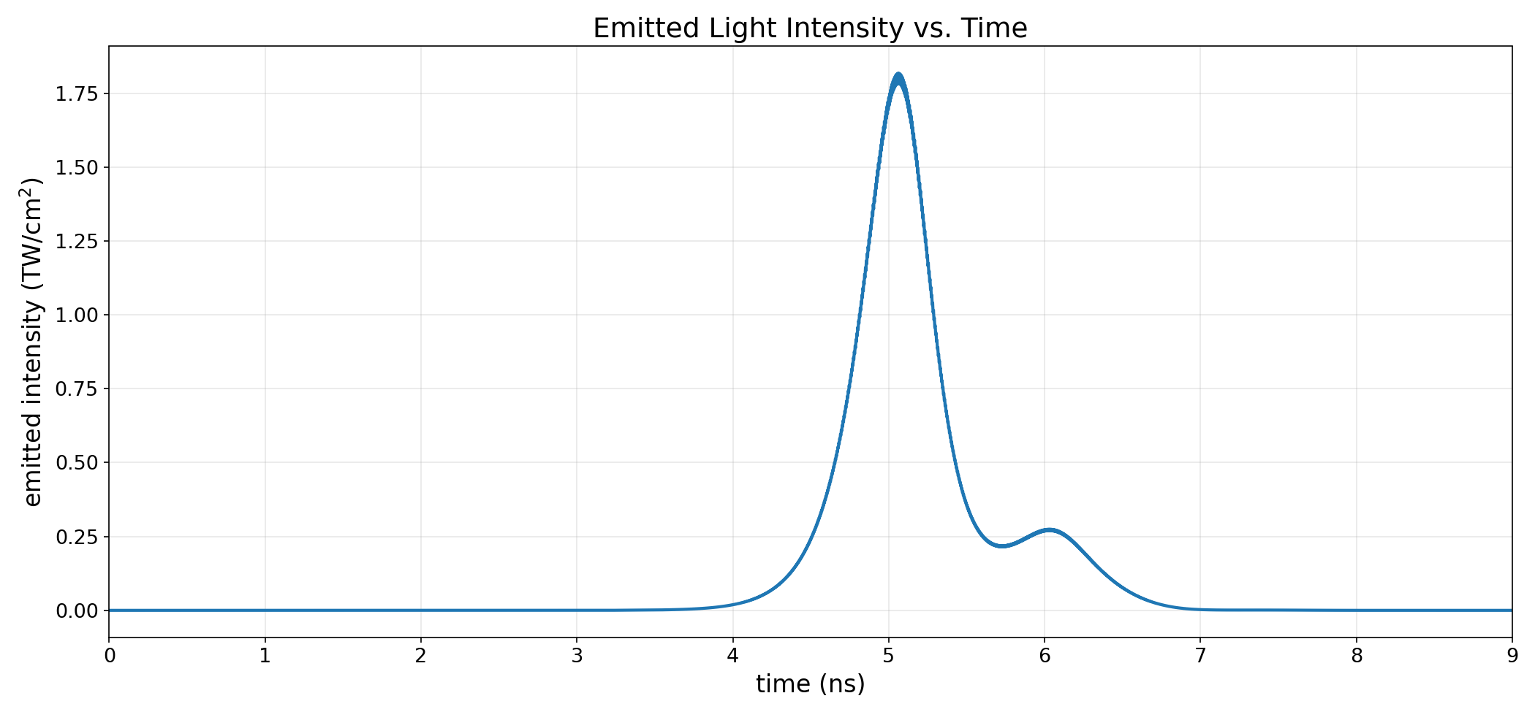
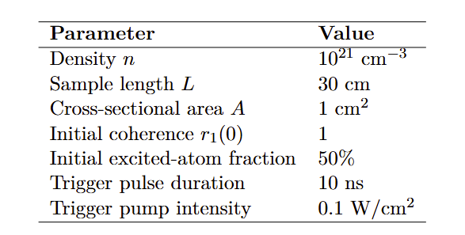
The Intensity Spike

Slide 20
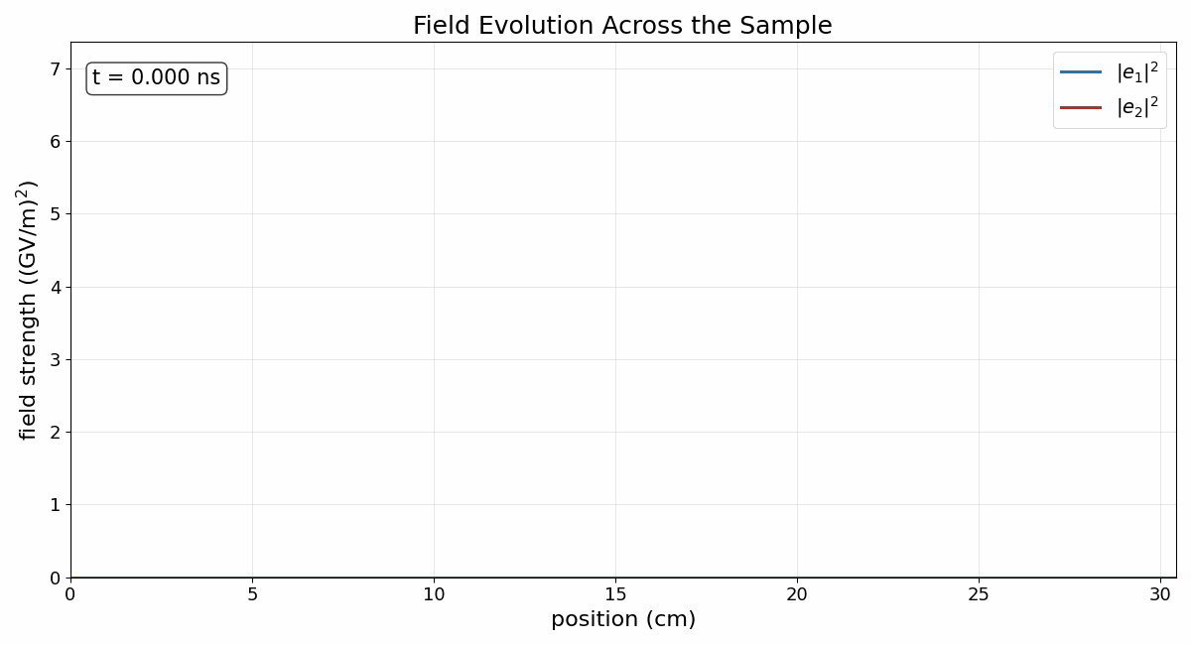
Evolution of the Electric Field

Slide 21
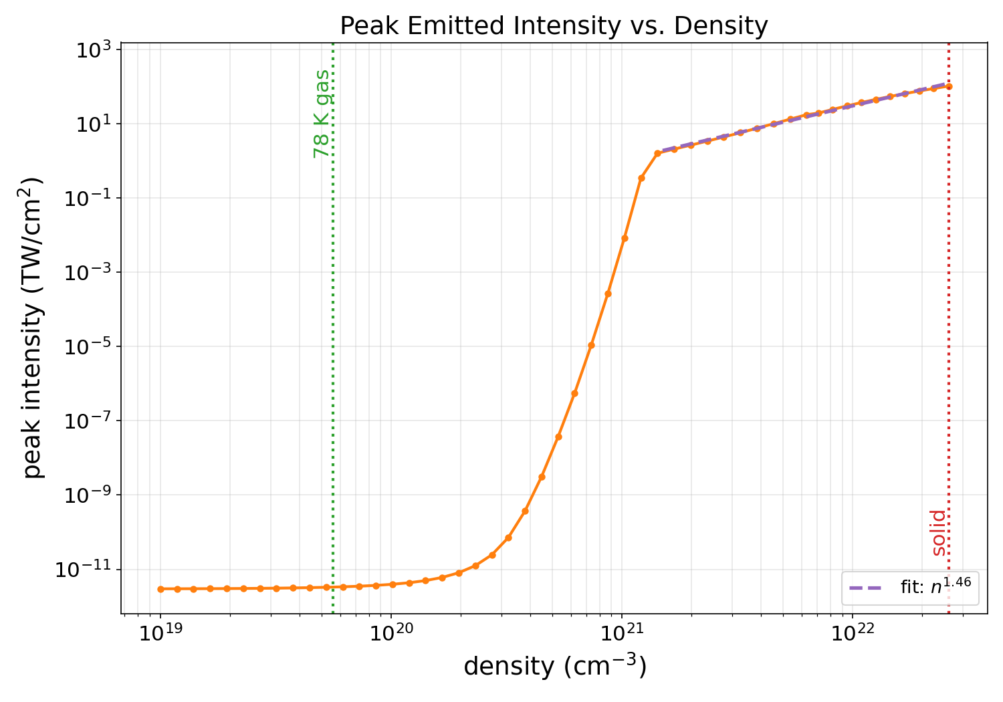
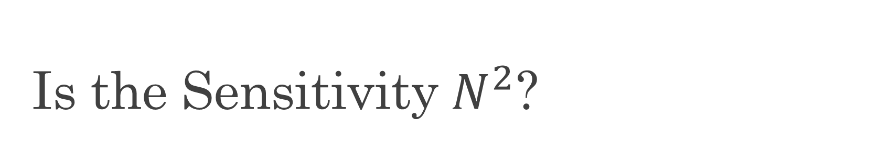
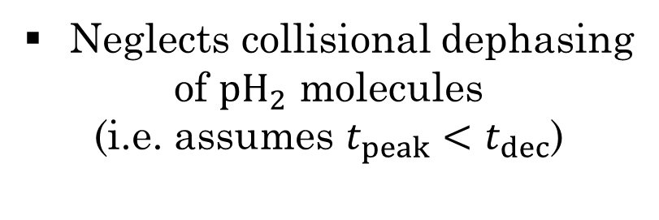
Is the Sensitivity $N^{2}$?
Max intensity is super-linear
for fixed length
Reminiscent of other quantum
coherent processes
(e.g. Dicke Superadiance)
Neglects collisional dephasing
of ${pH}_{2}$ molecules
(i.e. assumes $t_{peak}<t_{dec}$)

Slide 22
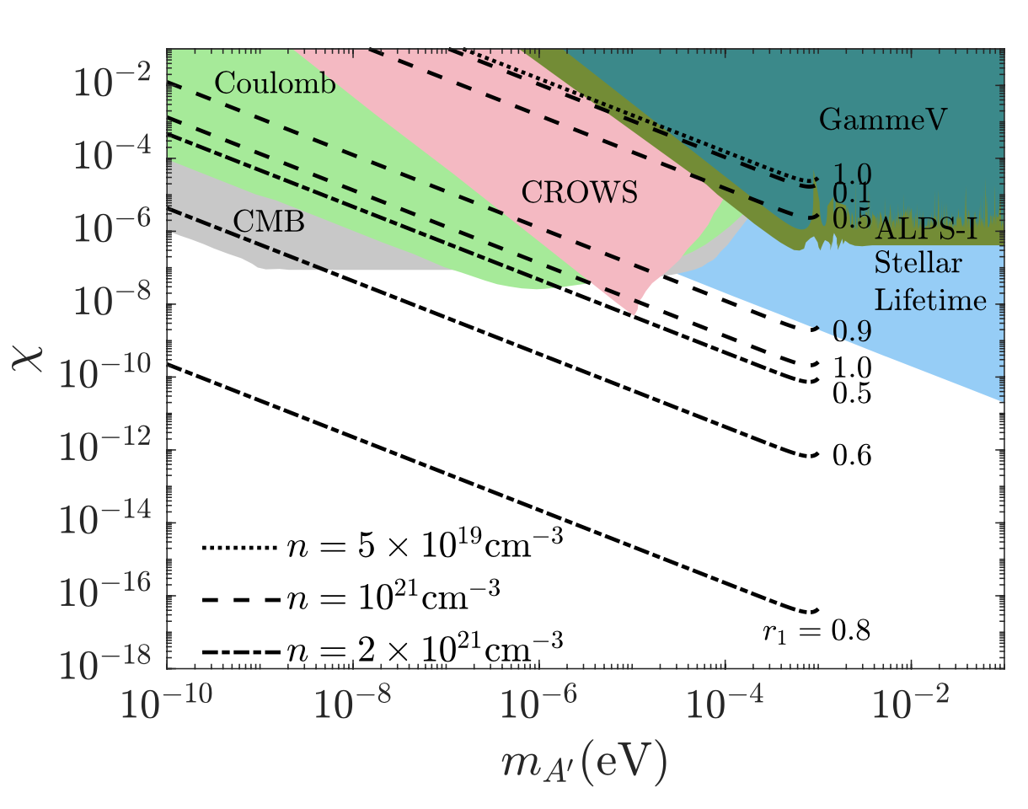
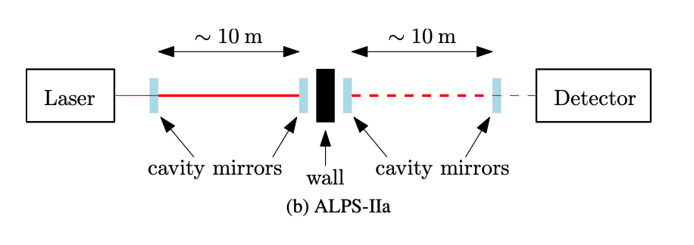
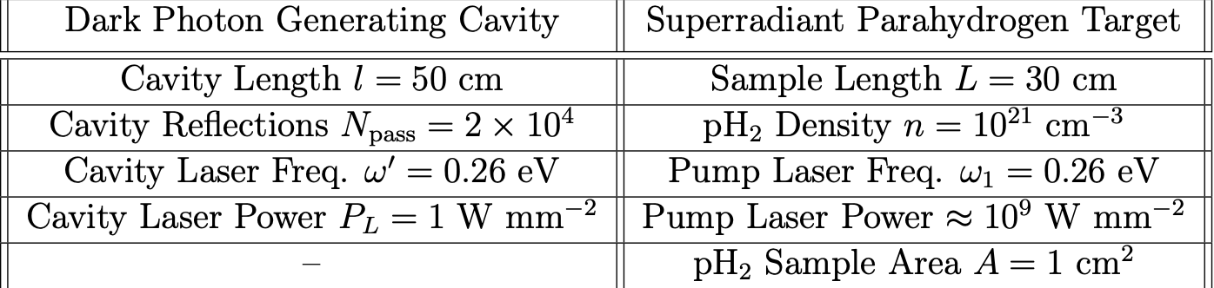
Prospective LSW Sensitivity
Improved reach as the
number density of pH2
or initial coherence r1 increases.

Slide 23
Conclusion
  CATCHY: ongoing project for a new kind of quantum detection at Queen’s University
  Search for dark photons with coherently prepared parahydrogen
  An incoming dark photon produces a cascade of two-photon emissions, producing an observable spike in intensity
  Sensitivity limits scales super-linearly with number density

Slide 24
EXTRA SLIDES

Slide 25
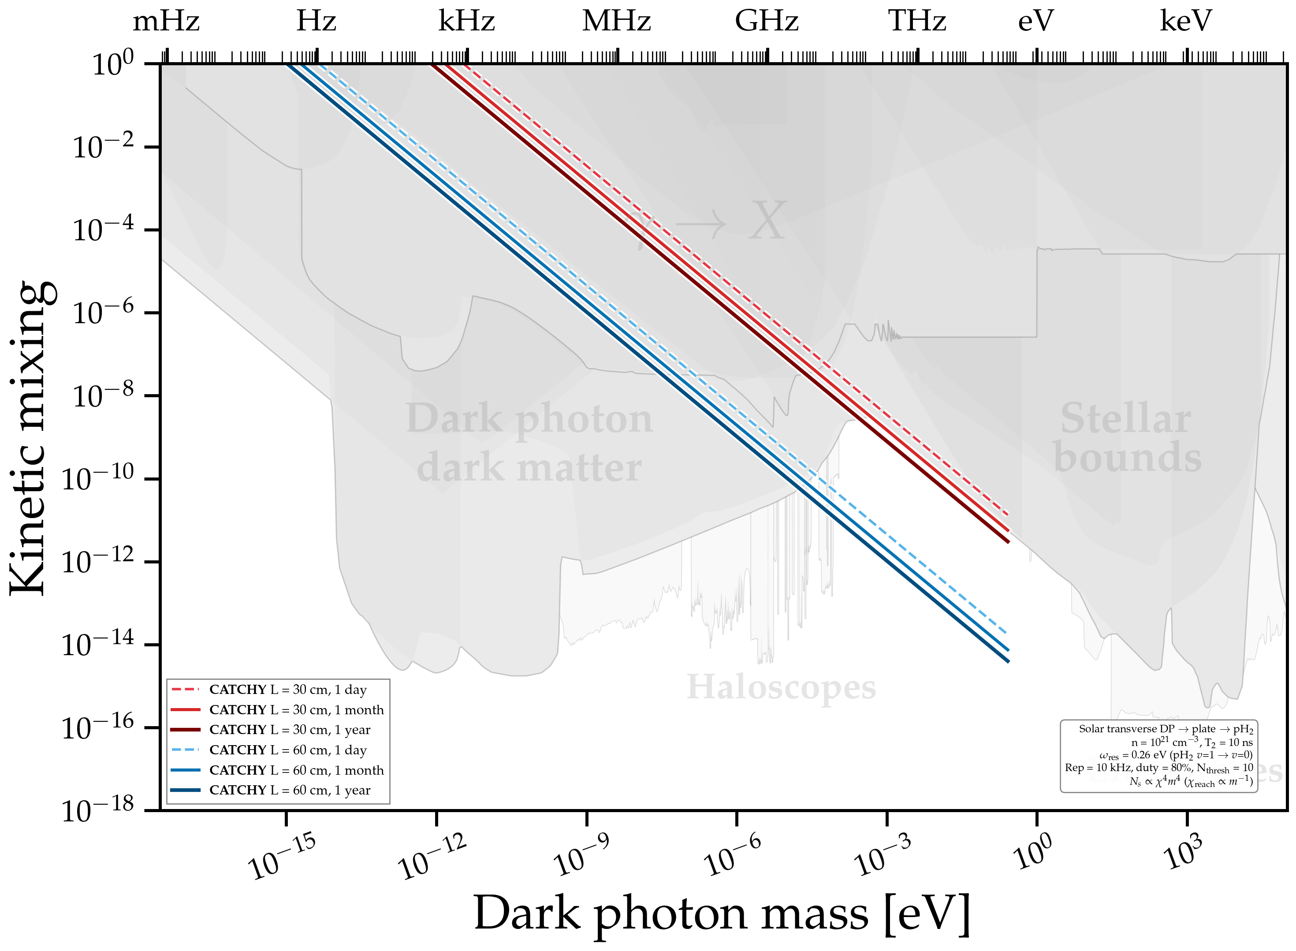
CATCHY as a Helioscope

Slide 26
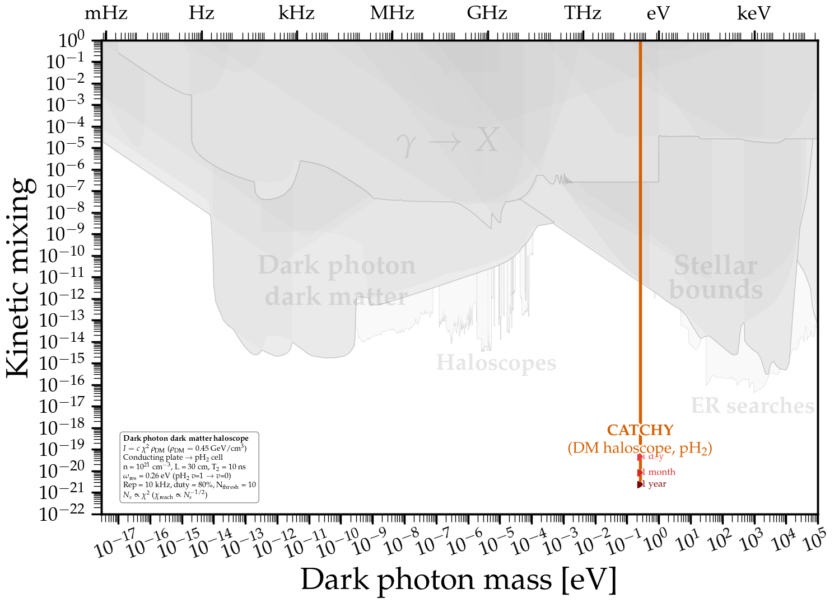
CATCHY as a Haloscope

Slide 27
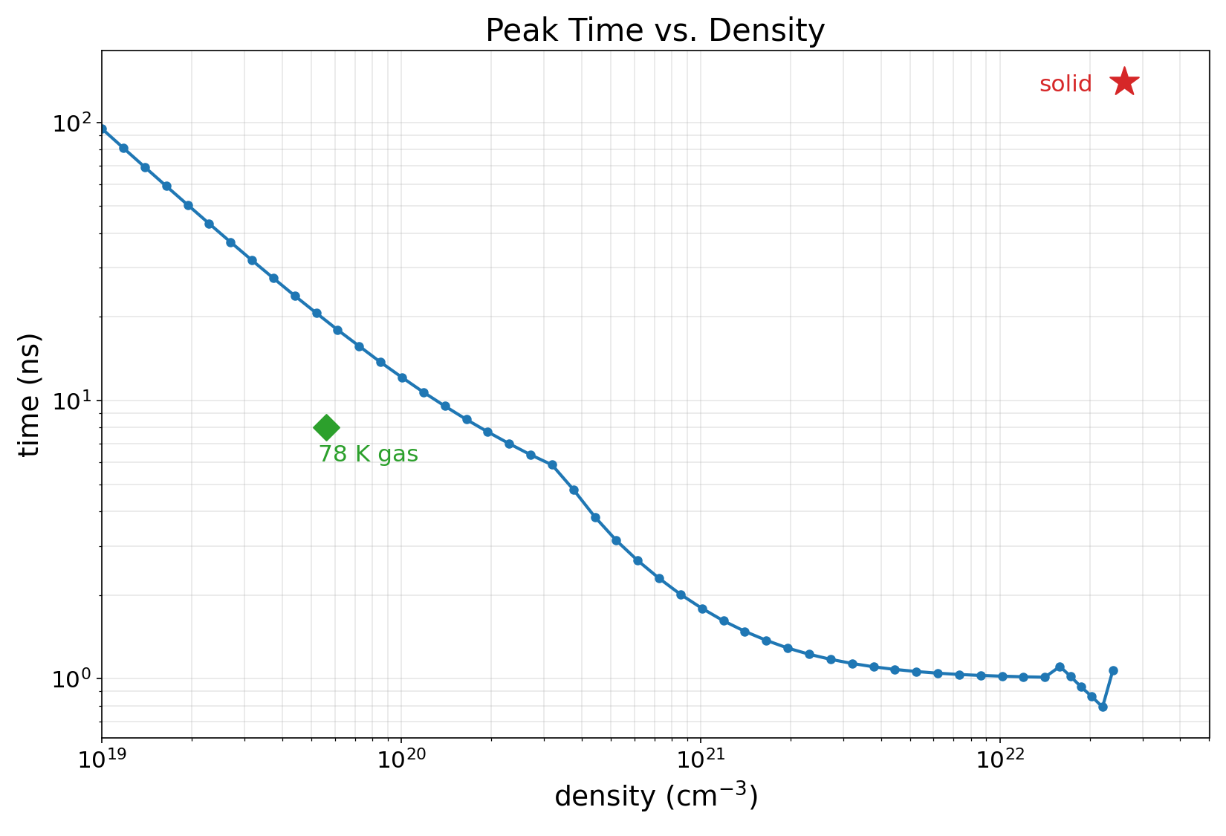
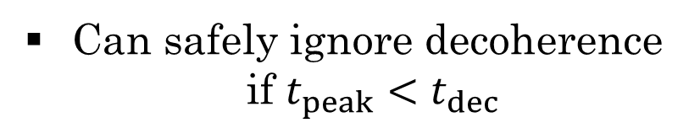
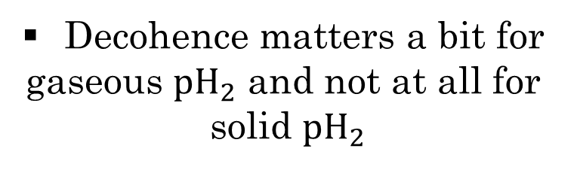
Peak Times vs. Density
Time of peak intensity vs
density (idealized no decoherence)
Can safely ignore decoherence
if $t_{peak}<t_{dec}$
Decohence matters a bit for
gaseous ${pH}_{2}$ and not at all for
solid ${pH}_{2}$

Slide 28



Quantum Noise
Random vacuum fluctuations may trigger detector spontaneously
Likely dominant background
May be circumvented by using a stronger laser
$$1 W/{mm}^{2}$$
$${10}^{4} W/{mm}^{2}$$
$${10}^{8} W/{mm}^{2}$$

Slide 29
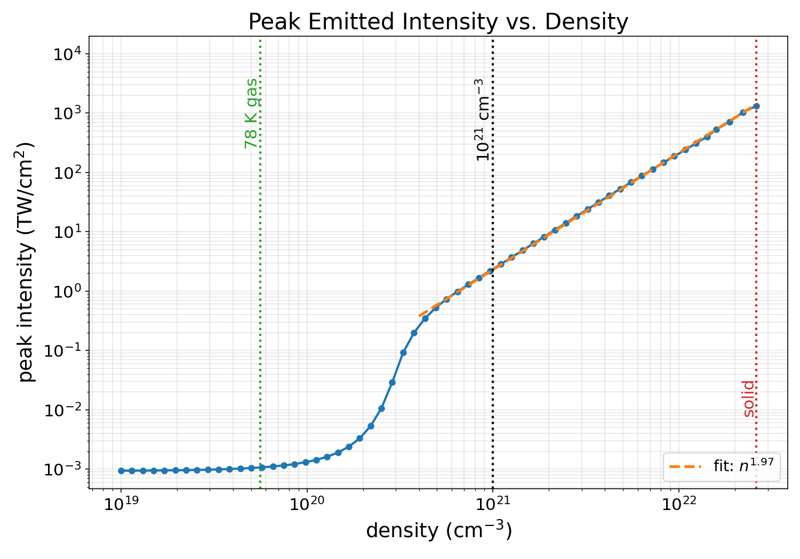



The Power Law Depends on Trigger Strength
$n^{1.97}$ for strong field vs. $n^{1.46}$ for weak field

Slide 30



Dependence on Signal on Constant Phase
More aligned
dipoles give
stronger signal
Random dipoles
completely destroy
signal

