Slide 1
Dark Matter–Induced UV Radiation and the Formation of Supermassive Black Hole Seeds
Light Dark World 2026
Han Wu, Aaron Vincent, Sarah Schoen
July 30, 2026

Slide 2
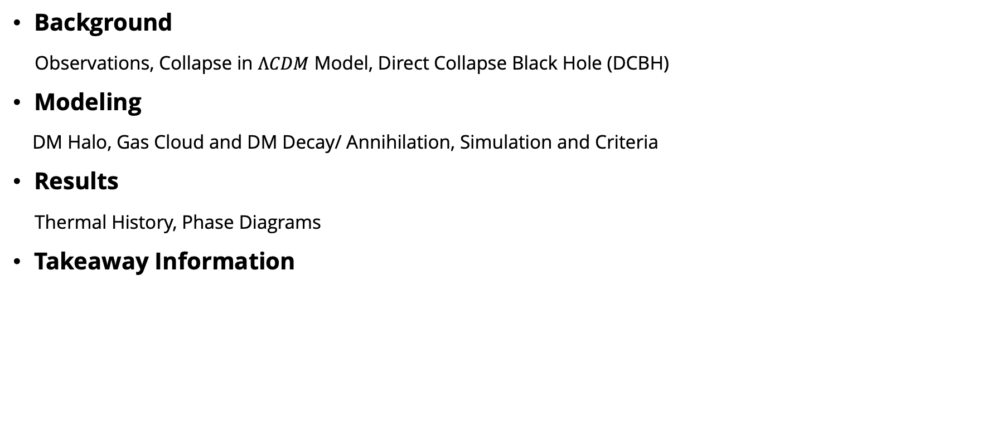
Outline
Background
Observations, Collapse in $ΛCDM$ Model, Direct Collapse Black Hole (DCBH)
Modeling
DM Halo, Gas Cloud and DM Decay/ Annihilation, Simulation and Criteria
Results
Thermal History, Phase Diagrams
Takeaway Information

Slide 3
Timeline of the Evolution of the Universe
https://www.eso.org/public/images/eso1620a/
Page 1 of 16

Slide 4
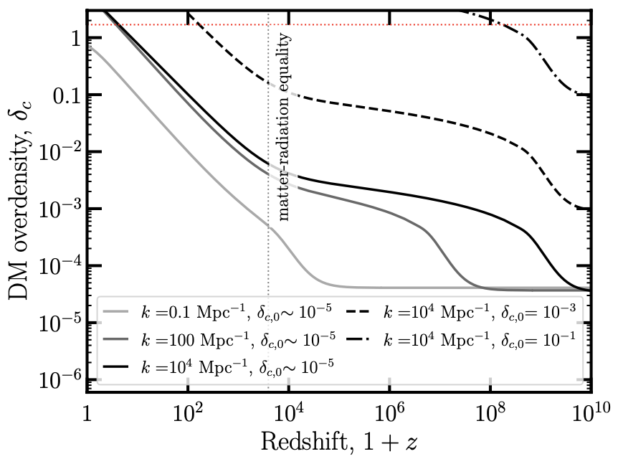
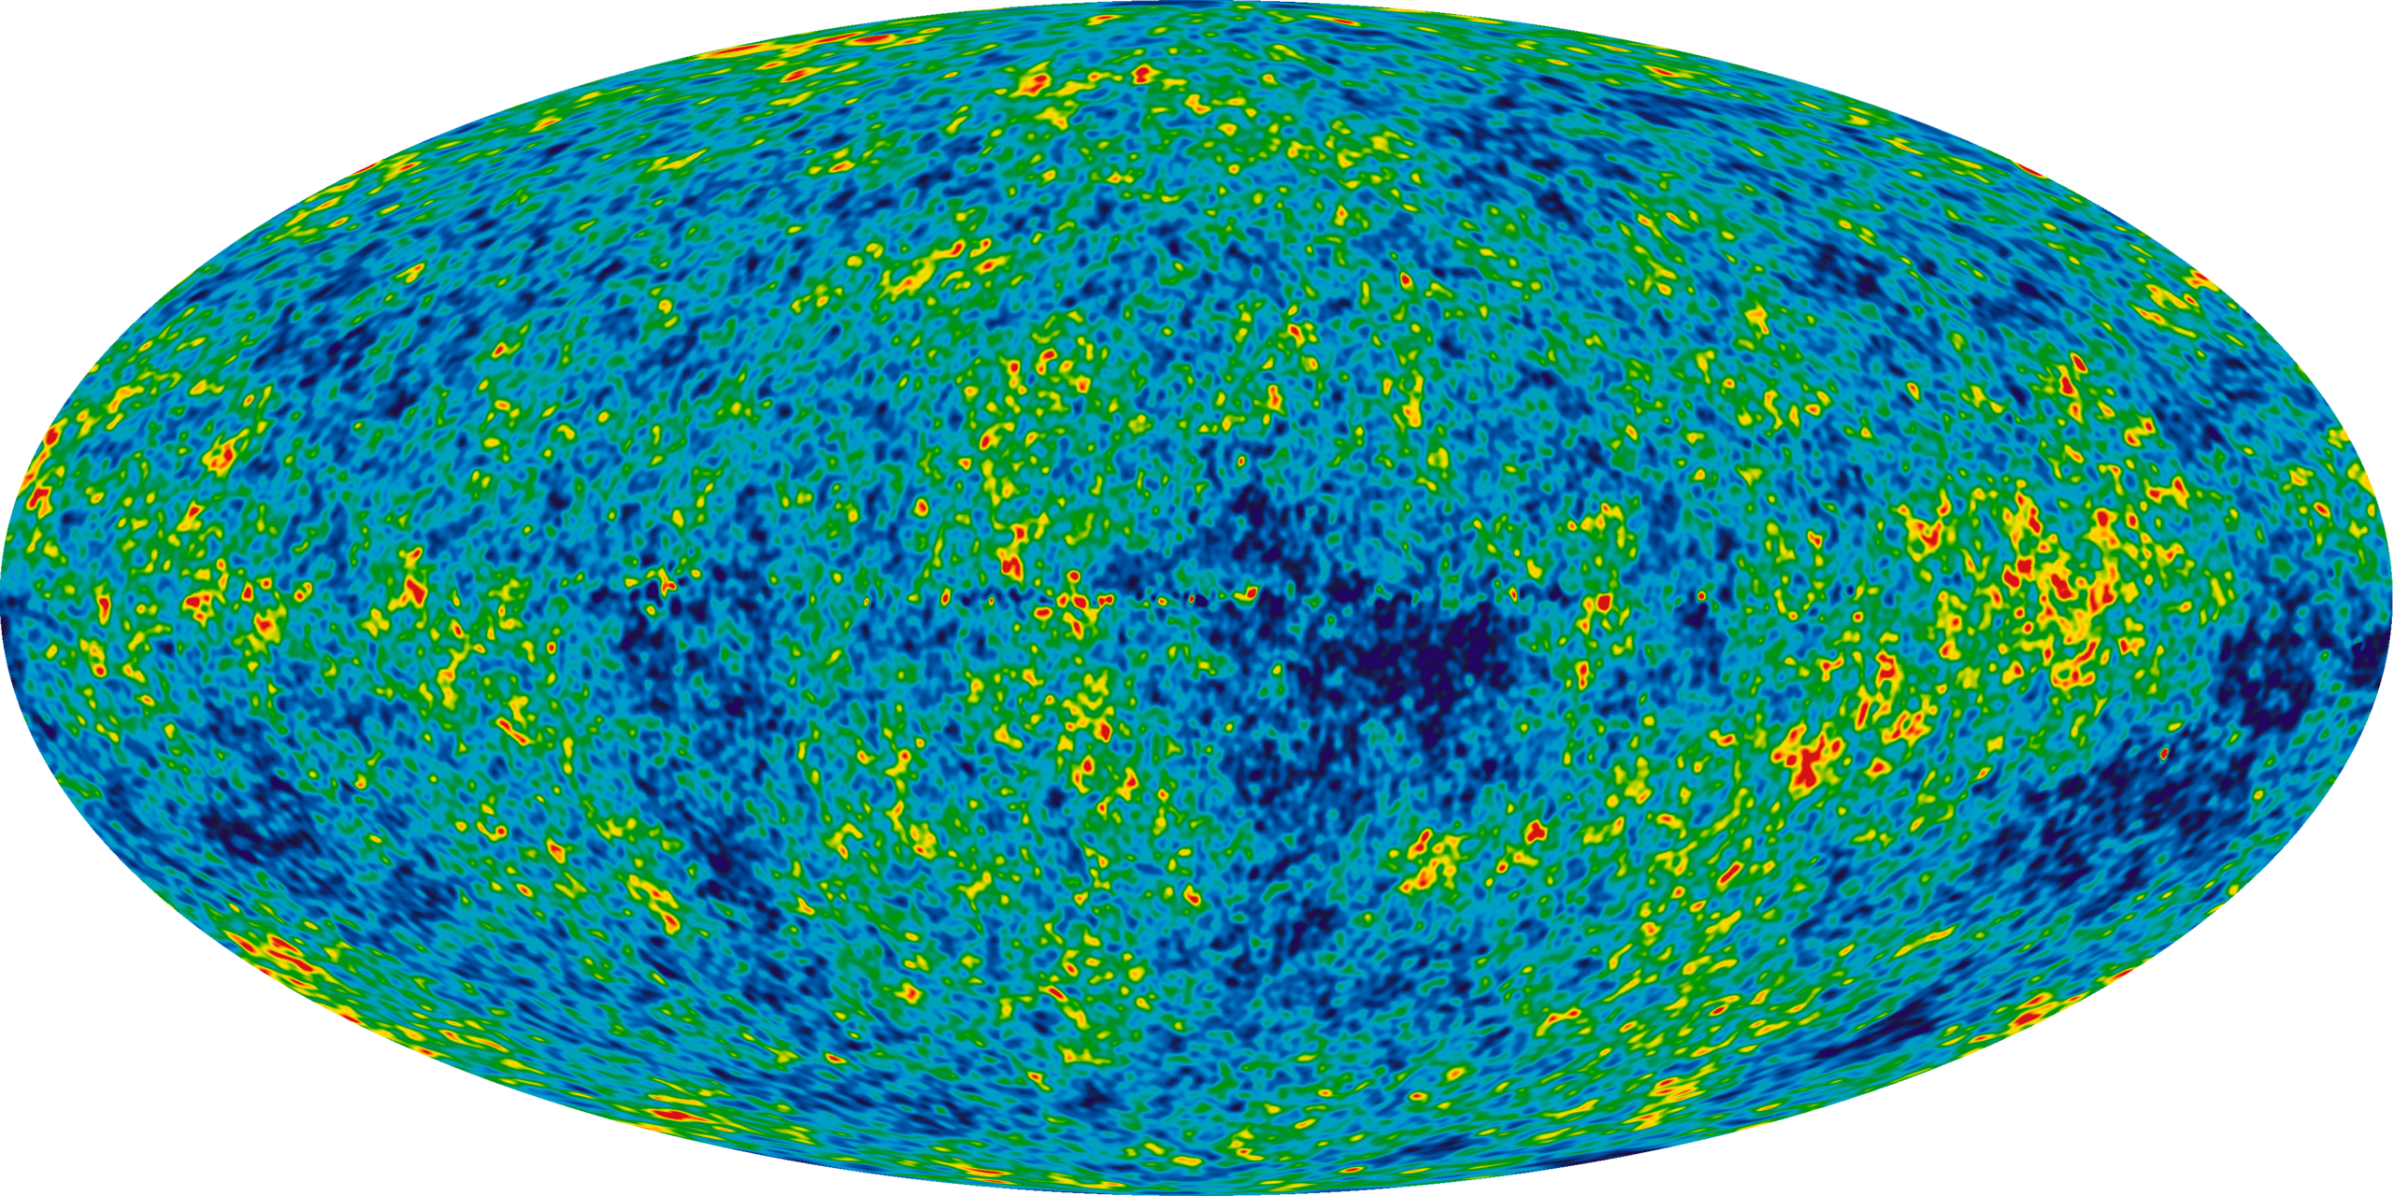
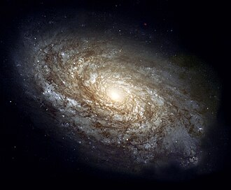

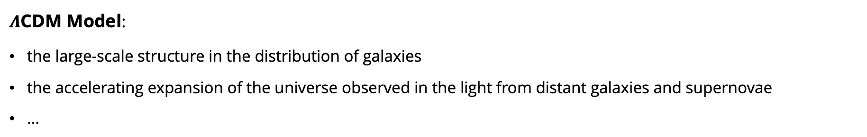
Structure Collapse in $Λ$CDM Model
https://arxiv.org/pdf/2506.13858
~6 billion yrs
~0.01 s
Collapse
https://science.nasa.gov/mission/wmap/wmap-overview/
Initial Density Fluctuation $δ=\frac{ρ−\overline{ρ}}{\overline{ρ}}\sim {10}^{−5}$
$Λ$CDM Model:
the large-scale structure in the distribution of galaxies
the accelerating expansion of the universe observed in the light from distant galaxies and supernovae
…
$$δ≫1$$
The Hubble Heritage Team (AURA/STScI/NASA)
Page 2 of 16

Slide 5
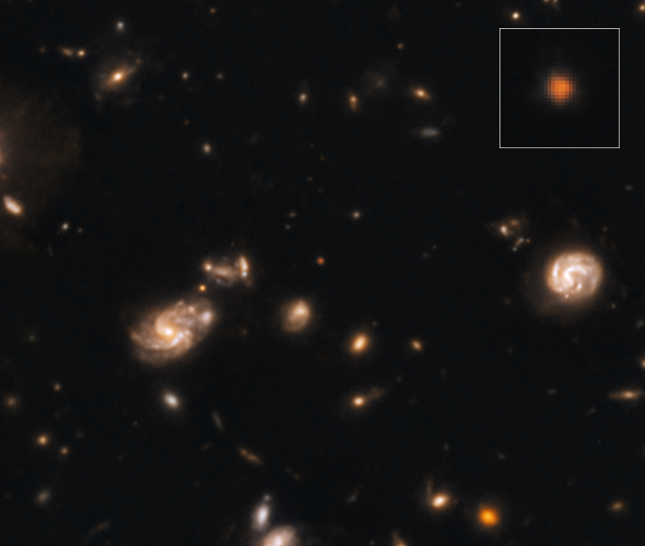
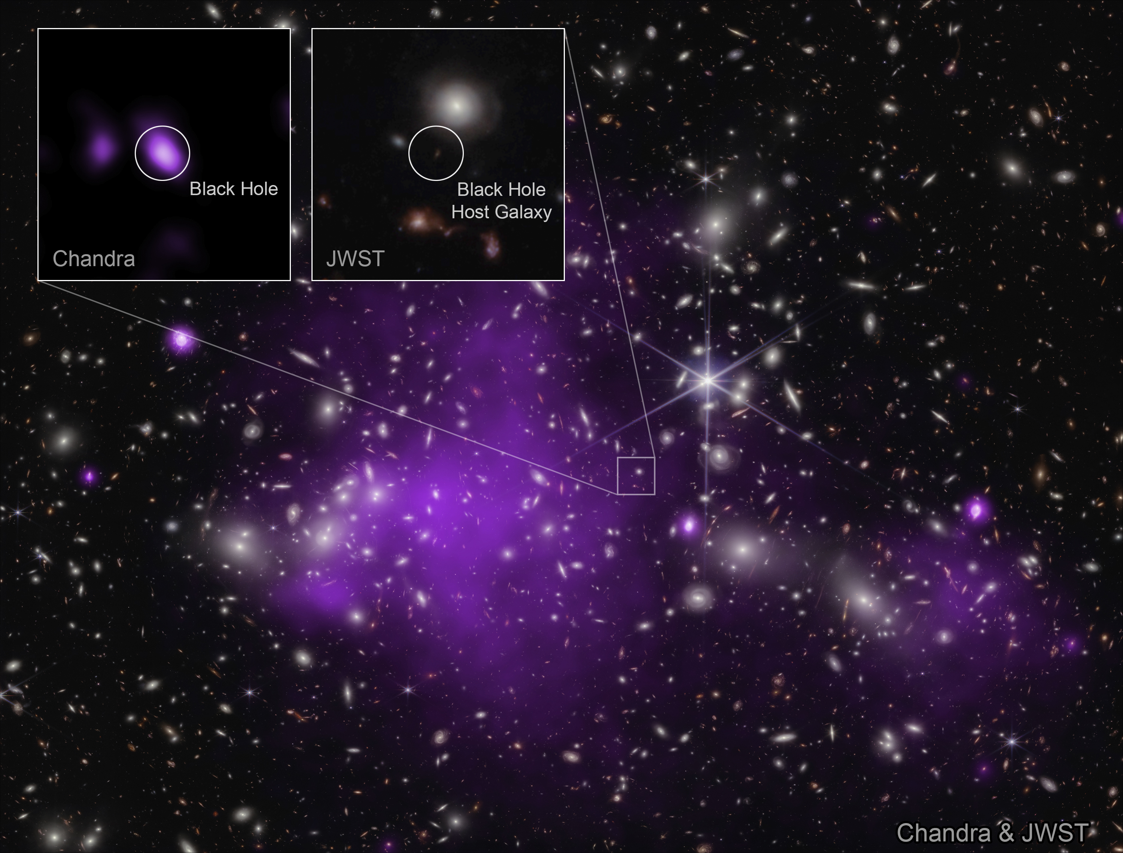
Observations
Little red dots (LRDs)
The original reports identified LRDs as a type of early active galactic nucleus (AGN)
The current leading theory is that the LRDs are a form of primordial galaxy
Early galaxies as result of very slowly spinning dark matter halos
…
https://science.nasa.gov/asset/
webb/little-red-dots-nircam-image/
Type | Redshift
Little red dots | 4.75 < z < 8.92
Galaxy candidates | z > 10
Accreting black holes | z >17
https://en.wikipedia.org/wiki/Capotauro
https://chandra.si.edu/blog/node/861
Page 3 of 16

Slide 6
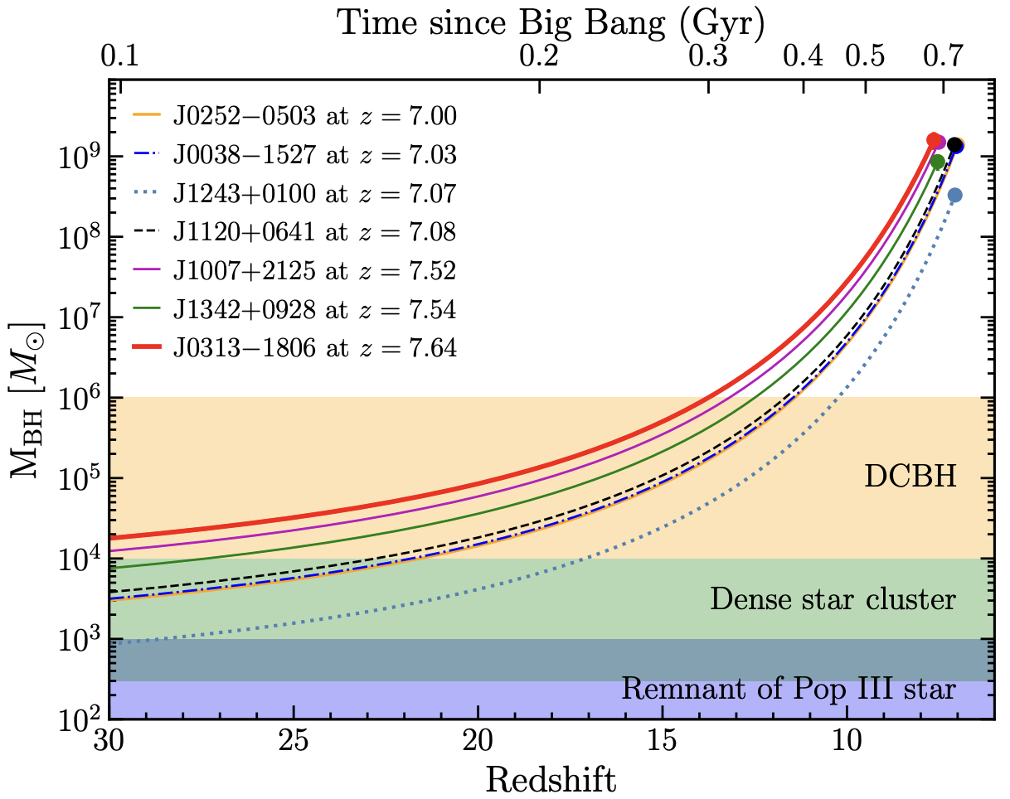

Observations
https://science.nasa.gov/asset/
webb/little-red-dots-nircam-image/
https://arxiv.org/pdf/2101.03179
Type | Redshift
Little red dots | 4.75 < z < 8.92
Galaxy candidates | z > 10
Accreting black holes | z >17
https://en.wikipedia.org/wiki/Capotauro
https://chandra.si.edu/blog/node/861
Page 3 of 16

Slide 7
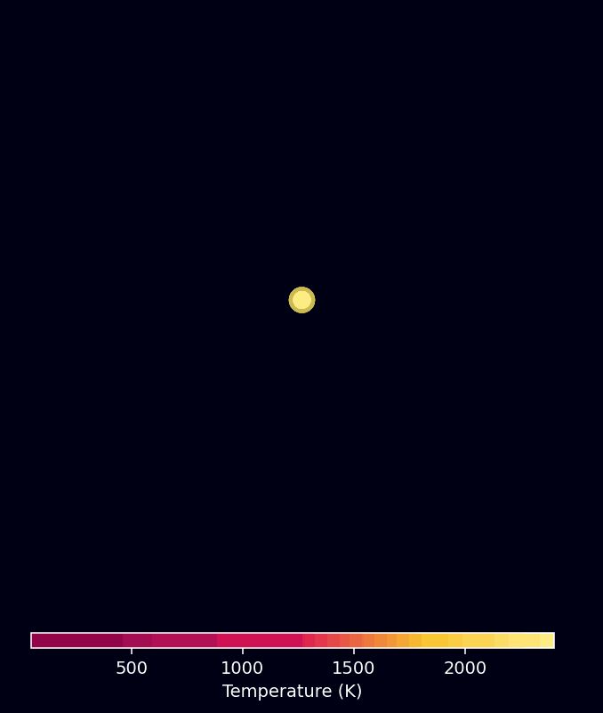


Direct Collapse Scenario
Star Formation
(Standard Scenario)
Rapid Cooling
Moderate Cooling
SMBH Formation
Therefore, a moderate cooling rate is required to form a SMBH in the direct collapse black hole scenario.
Page 4 of 16

Slide 8
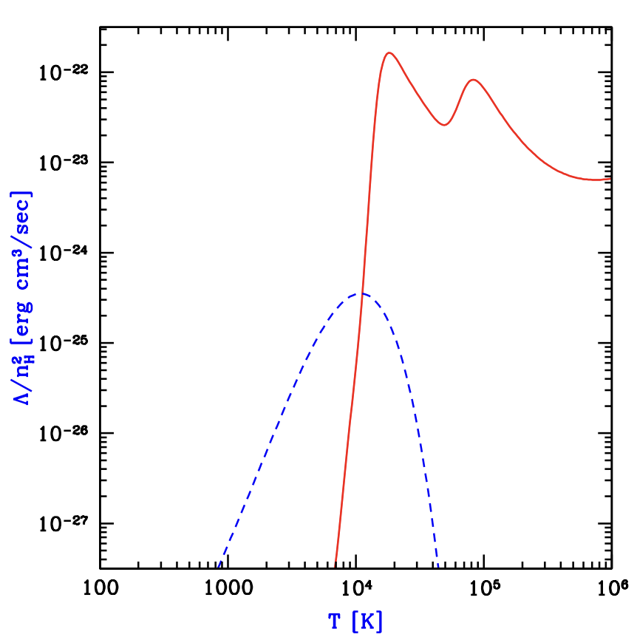

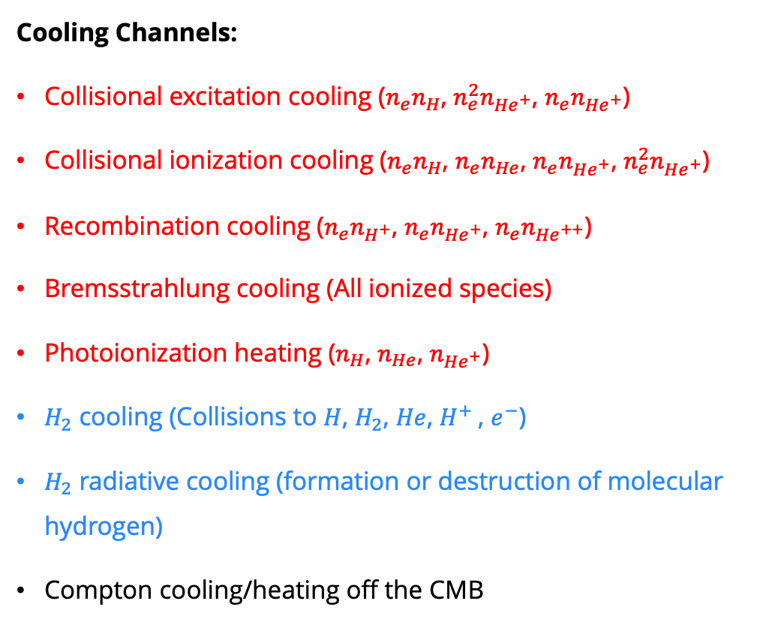


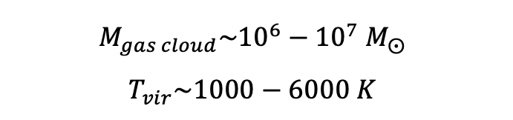
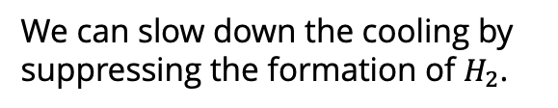

Let’s slow down the cooling
Below ${10}^{4}$ K
Cooling Channels:
Collisional excitation cooling ($n_{e}n_{H}$, $n_{e}^{2}n_{He^{+}}$, $n_{e}n_{He^{+}}$)
Collisional ionization cooling ($n_{e}n_{H}$, $n_{e}n_{He}$, $n_{e}n_{He^{+}}$, $n_{e}^{2}n_{He^{+}}$)
Recombination cooling ($n_{e}n_{H^{+}}$, $n_{e}n_{He^{+}}$, $n_{e}n_{He^{++}}$)
Bremsstrahlung cooling (All ionized species)
Photoionization heating ($n_{H}$, $n_{He}$, $n_{He^{+}}$)
$H_{2}$ cooling (Collisions to $H$, $H_{2}$, $He$, $H^{+}$, $e^{−}$)
$H_{2}$ radiative cooling (formation or destruction of molecular hydrogen)
Compton cooling/heating off the CMB
Above ${10}^{4}$ K
H, He atoms
$$H_{2}$$
https://arxiv.org/pdf/astro-ph/0010468
Below ${10}^{4}$ K
We can slow down the cooling by suppressing the formation of $H_{2}$.
$$M_{gas cloud}\sim {10}^{6}−{10}^{7} M_{⨀}$$
$$T_{vir}\sim 1000−6000 K$$
Page 5 of 16
Notes:
DM may play an important role in this task

Slide 9














Overview of the Model
Cosmic Background
CMB
$$χχ→2γ$$
DM Halo
$H_{2}$ Formation:
One zone Model + NFW Profile
$$H+e^{−}→H^{−}+γ$$
Photodissociation
(11.2-13.6 eV, LW Band)
$$H^{−}+H→H_{2}+e^{−}$$
Gas Cloud
One-zone Model
$$χχ→2γ$$
Self-Shielding
$$H+γ→H^{+}+e^{−}$$
$$H_{2}+γ→H+H$$
$$He+γ→{He}^{+}+e^{−}$$
$$H^{−}+γ→H+e^{−}$$
Photodetachment
(0.76-13.6 eV)
$${He}^{+}+γ→{He}^{++}+e^{−}$$
…
$$H_{2}^{+}+γ→H+H^{+}$$
$$H_{2}+γ→H_{2}^{+}+e^{−}$$
$$H_{2}^{+}+γ→H^{+}+H^{+}+e^{−}$$
Chemical Network and Cooling Library: Grackle
Page 6 of 16

Slide 10

Results: Thermal History
DM Parameter:
Star Formation:
Present
Past
$$m_{χ}=47.1 eV, τ=7.74×{10}^{30} s$$
Page 7 of 16

Slide 11

Results: Thermal History
DM Parameter:
Star Formation:
Supermassive Black Hole (SMBH) Formation:
Present
Past
$$m_{χ}=47.1 eV, τ=7.74×{10}^{30} s$$
$$m_{χ}=47.1 eV, τ=1×{10}^{30} s$$
Page 7 of 16

Slide 12

Results: Thermal History
DM Parameter:
Star Formation:
Supermassive Black Hole (SMBH) Formation:
Present
Past
High Temperature Cloud (HTC) Formation:
$$m_{χ}=47.1 eV, τ=7.74×{10}^{30} s$$
$$m_{χ}=22.86 eV, τ=2.78×{10}^{26} s$$
$$m_{χ}=47.1 eV, τ=1×{10}^{30} s$$
Page 7 of 16

Slide 13

Results: Thermal History
Evaporation
DM Parameter:
Star Formation:
Supermassive Black Hole (SMBH) Formation:
Present
Past
High Temperature Cloud (HTC) Formation:
Evaporation Formation:
$$m_{χ}=47.1 eV, τ=7.74×{10}^{30} s$$
$$m_{χ}=22.86 eV, τ=2.78×{10}^{26} s$$
$$m_{χ}=47.1 eV, τ=1×{10}^{30} s$$
Page 7 of 16
$$m_{χ}=47.1 eV, τ=1×{10}^{22} s$$

Slide 14
Phase Diagram: Decaying DM with Box Spectrum
Without Self-Shielding
With Self-Shielding
Lifetime [s]
Lifetime [s]
Evaporation
Page 8 of 16

Slide 15
Phase Diagram: Decaying DM with Parabola Spectrum
Without Self-Shielding
With Self-Shielding
Lifetime [s]
Lifetime [s]
Evaporation
Page 9 of 16

Slide 16
Phase Diagram: Annihilating DM
Without Self-Shielding
With Self-Shielding
Evaporation
Page 10 of 16

Slide 17
Star Formation Time: Decaying DM with Box Spectrum
Early Star Formation
Standard Star Formation
Late Star Formation
Page 11 of 16

Slide 18
Star Formation Time: Decaying DM with Parabola Spectrum
Early Star Formation
Standard Star Formation
Late Star Formation
Page 12 of 16

Slide 19
Star Formation Time: Annihilating DM
Early Star Formation
Standard Star Formation
No Star Formation
No Star Formation
Late Star Formation
Page 13 of 16

Slide 20





Star Formation: Gas Cloud Mass Critical Curves
Star Formation
Star Formation
Lifetime [s]
Lifetime [s]
No Star Formation
No Star Formation
$$M_{cloud }\left[M_{⊙}\right]$$
$$J_{decay}∝{\left(τm_{χ}\right)}^{−1}$$
No Star Formation
$\left\langle σv\right\rangle \left[{cm}^{3}/s\right]$
$$J_{ann}∝\left\langle σv\right\rangle m_{χ}^{−2}$$
Star Formation
$$M_{cloud }\left[M_{⊙}\right]$$
Page 14 of 16

Slide 21
Star Formation: Gas Cloud Mass Critical Curves
Star Formation
Star Formation
Lifetime [s]
Lifetime [s]
No Star Formation
No Star Formation
$$M_{cloud }\left[M_{⊙}\right]$$
$$J_{decay}∝{\left(τm_{χ}\right)}^{−1}$$
No Star Formation
$\left\langle σv\right\rangle \left[{cm}^{3}/s\right]$
$$J_{ann}∝\left\langle σv\right\rangle m_{χ}^{−2}$$
Star Formation
$$M_{cloud }\left[M_{⊙}\right]$$
Page 14 of 16

Slide 22
Star Formation: Gas Cloud Mass Critical Curves
Star Formation
Star Formation
Lifetime [s]
Lifetime [s]
No Star Formation
No Star Formation
$$M_{cloud }\left[M_{⊙}\right]$$
$$J_{decay}∝{\left(τm_{χ}\right)}^{−1}$$
No Star Formation
$\left\langle σv\right\rangle \left[{cm}^{3}/s\right]$
$$J_{ann}∝\left\langle σv\right\rangle m_{χ}^{−2}$$
Star Formation
$$M_{cloud }\left[M_{⊙}\right]$$
Page 14 of 16

Slide 23
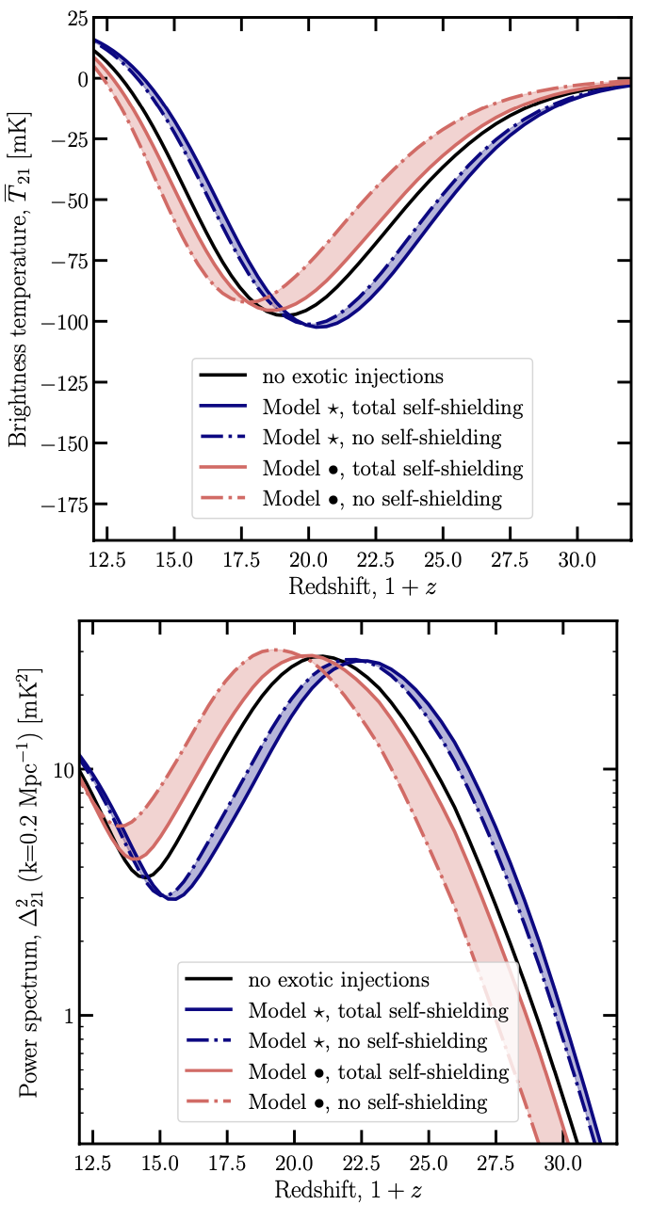
Ongoing Work
Next Step:
  How about WIMPs?
  Cascade: As propagating through the gas cloud, high-energy photons from heavier DM decay/ annihilation gradually lose energy via interactions with the ambient medium.
  Observation Signals: 21 cm signal, JWST
Ambitions:
  1-D hydrodynamic simulation
  3-D hydrodynamic simulation
Page 15 of 16
https://arxiv.org/abs/2308.12992

Slide 24
Takeaway Information
Dark matter with different parameter values can alter the evolution of a gas cloud, leading to the formation of the first stars, SMBHs, a high temperature cloud, or simply a cold overdensity region in the universe.
In the direct-collapse black hole scenario, photons produced by DM decay or annihilation can suppress H₂ formation and slow cooling, promoting SMBH formation.
In the first-star formation scenario, these photons can either delay or accelerate star formation.
When self-shielding is included, higher-mass DM can further contribute to H₂ destruction, thereby affecting the thermal and ionization history of the gas cloud.
Page 16 of 16

Slide 25
Thank You!

Slide 26
Takeaway Information
Dark matter with different parameter values can alter the evolution of a gas cloud, leading to the formation of the first stars, SMBHs, a high temperature cloud, or simply a cold overdensity region in the universe.
In the direct-collapse black hole scenario, photons produced by DM decay or annihilation can suppress H₂ formation and slow cooling, promoting SMBH formation.
In the first-star formation scenario, these photons can either delay or accelerate star formation.
When self-shielding is included, higher-mass DM can further contribute to H₂ destruction, thereby affecting the thermal and ionization history of the gas cloud.

Slide 27
Backup

Slide 28
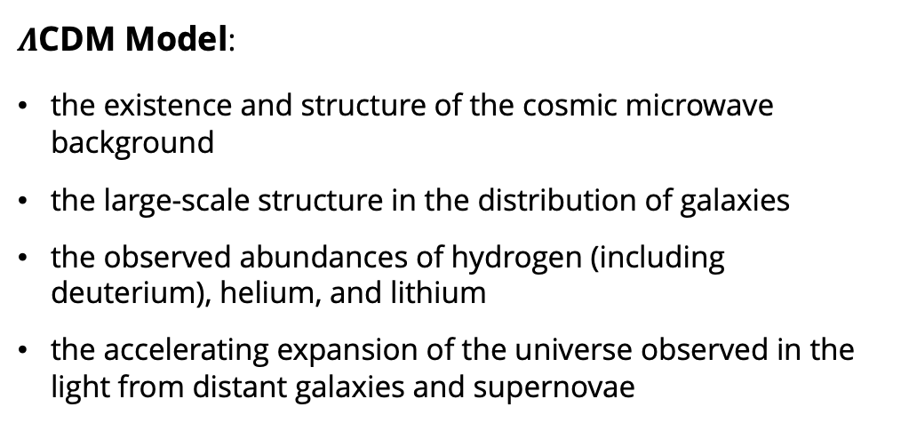
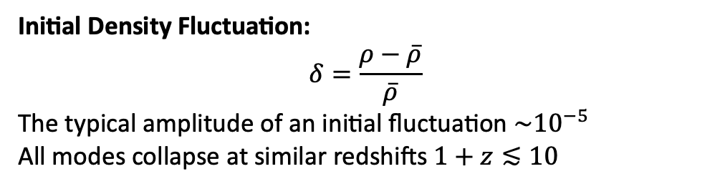
Structure Collapse in $Λ$CDM Model
$Λ$CDM Model:
the existence and structure of the cosmic microwave background
the large-scale structure in the distribution of galaxies
the observed abundances of hydrogen (including deuterium), helium, and lithium
the accelerating expansion of the universe observed in the light from distant galaxies and supernovae
Collapse
https://arxiv.org/pdf/2506.13858
Initial Density Fluctuation:
$$δ=\frac{ρ−\overline{ρ}}{\overline{ρ}}$$
The typical amplitude of an initial fluctuation $\sim {10}^{−5}$
All modes collapse at similar redshifts $1+z≲10$
https://science.nasa.gov/mission/wmap/wmap-overview/
Page 2 of 16

Slide 29


Backup: Mass Accretion Histories (MAH)
Questions about the fixed mass modeling:
Bullock et al.(2000) found that the halo concentration (at fixed mass) is systematically lower at higher redshift
haloes of fixed mass have significant scatter in their $c$ values (Jing 2000), although there is a mean trend of $c$ with $M_{h}$
$c∝{\left(1+z\right)}^{−1}$ corresponds to the scaling of the virial radius for an object whose mass did not increase with redshift, that is for an isolated system surrounded by a void. Haloes never exist in complete isolation, however; as the virial radius increases, it will enclose more matter, increasing both the total mass and the virial radius further.
Bullock et al. (2000)
Eke et al. (2001)
Wechsler et al. (2002)
van den Bosch
(2002)
Zhao et al. (2003)
$$c∝\frac{{\left(M/M_{⋆}\right)}^{−0.13}}{(1+z)}$$
the average MAH of CDM halos follows a simple universal function with two scaling variables.
the MAH of a halo in general consists of two distinct phases
halos which are still in
the fast growth regime should all have a similar concentration
Page 9 of 16
Notes:
M⋆ being the mass at which the rms of the linear density field is ∼1 weishler Bosh

Slide 30
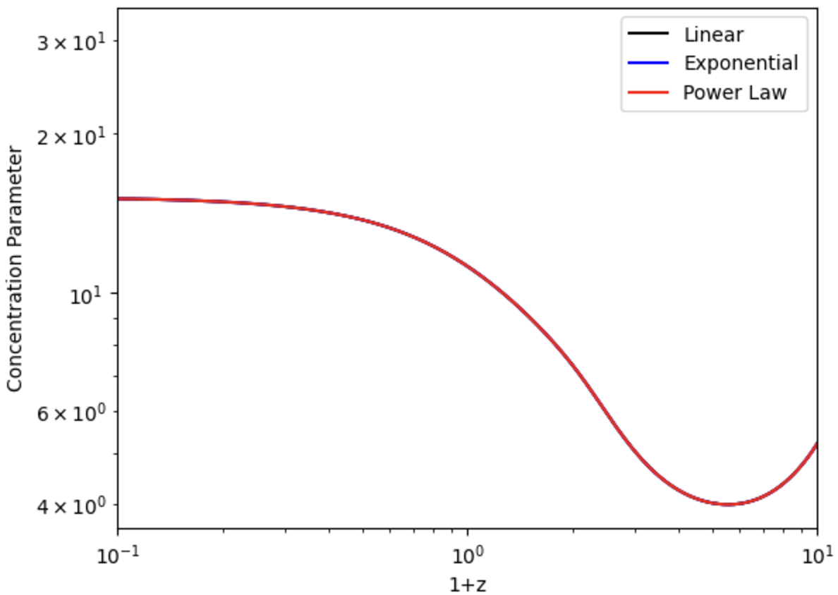
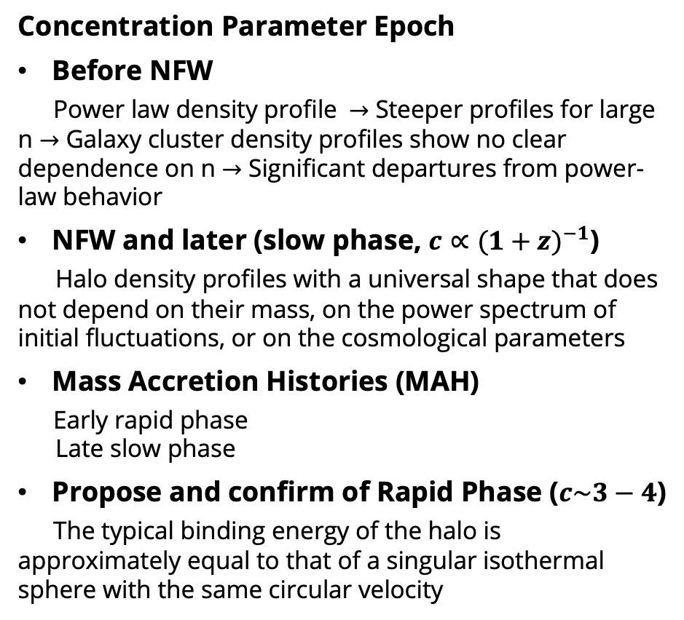
Backup: Concentration Parameter
Concentration Parameter Epoch
Before NFW
Power law density profile $→$ Steeper profiles for large n $→$ Galaxy cluster density profiles show no clear dependence on n $→$ Significant departures from power-law behavior
NFW and later (slow phase, $c∝{(1+z)}^{−1}$)
Halo density profiles with a universal shape that does not depend on their mass, on the power spectrum of initial fluctuations, or on the cosmological parameters
Mass Accretion Histories (MAH)
Early rapid phase
Late slow phase
Propose and confirm of Rapid Phase ($c\sim 3−4$)
The typical binding energy of the halo is approximately equal to that of a singular isothermal sphere with the same circular velocity
Schmidt & Allen (2007)
Chandra observation
Bullock et al.
(2000)
Eke et al.
(2001)
Zhao et al.
(2003)
Gao et al. (2008)
Wechsler et al. (2002)
Maccio ́ et al. (2008)
Agree
Disagree
MAH

Slide 31
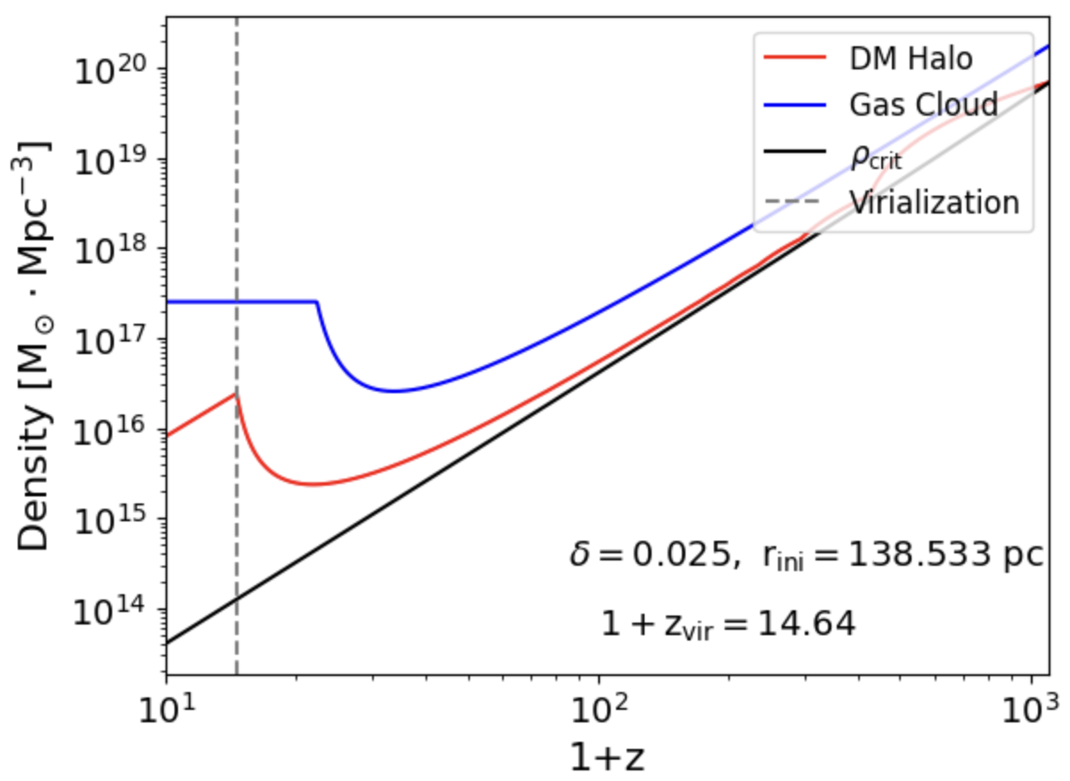
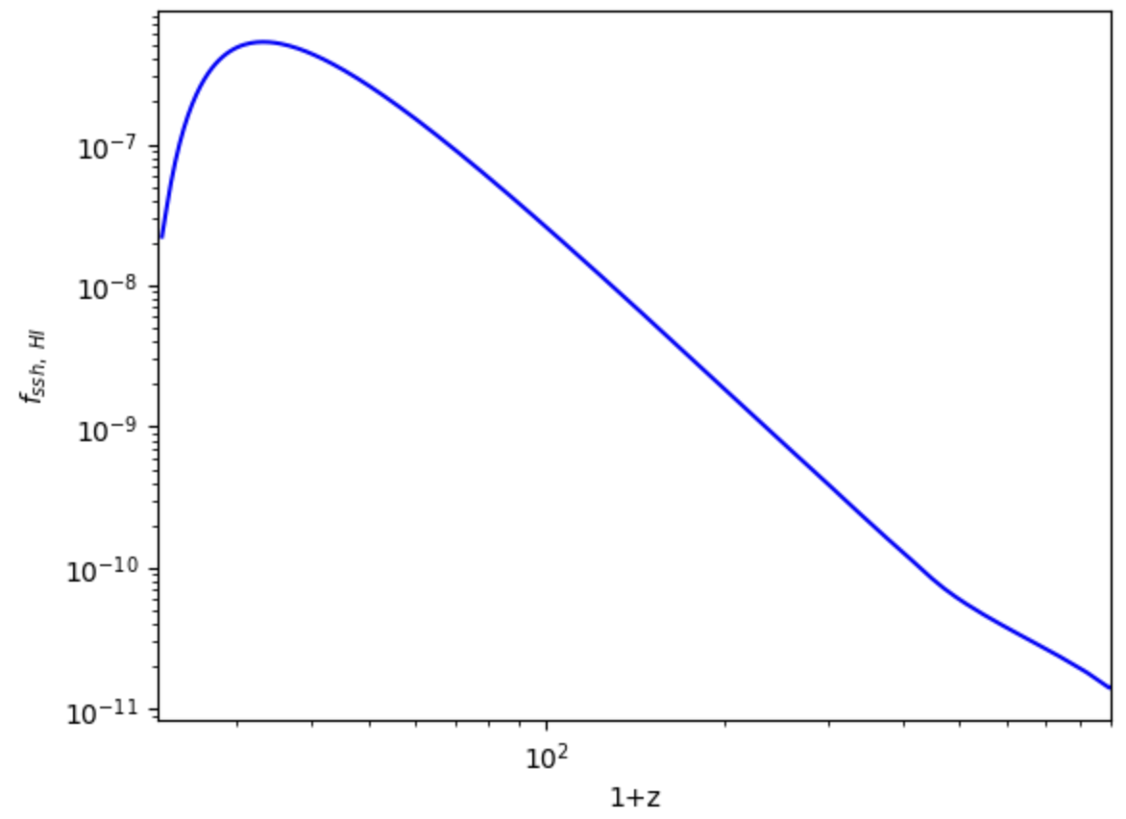
Modeling
Gas Cloud and DM Halo
One-Zone model, NFW Profile
DM Decay/ Annihilation
Photon Spectrum, Photon source
Chemical Reaction Rate
Photodissociation, Photodetachment, Photoionization, Photoheating
Thermal and Ionized History Simulation
Initial Conditions (CLASS), Grackle
Criteria
Star, SMBH, High Temperature Cloud Formation and Evaporation
Self-Shielding
Fitting Formula from IGM Studies
Page 7 of 28

Slide 32
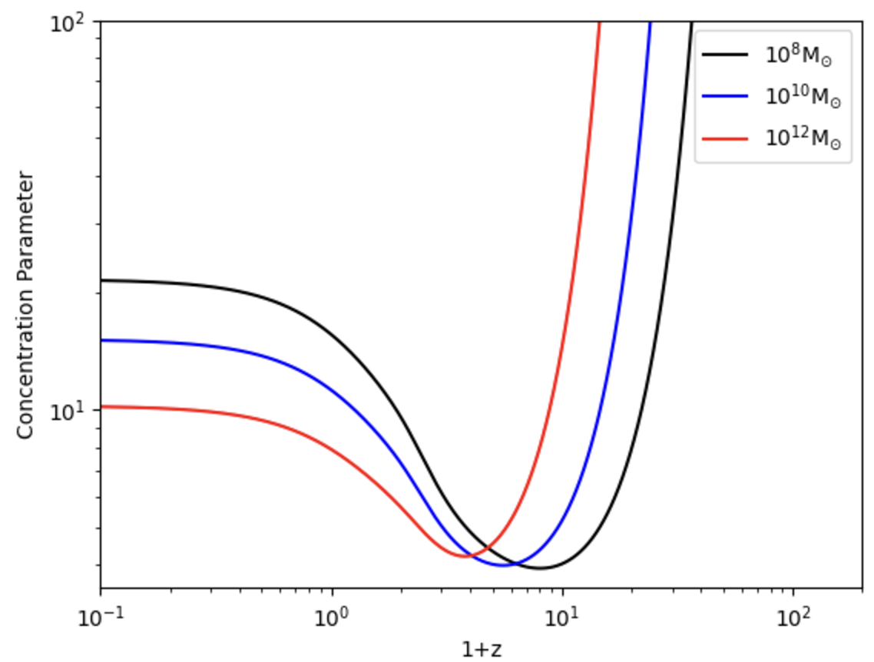
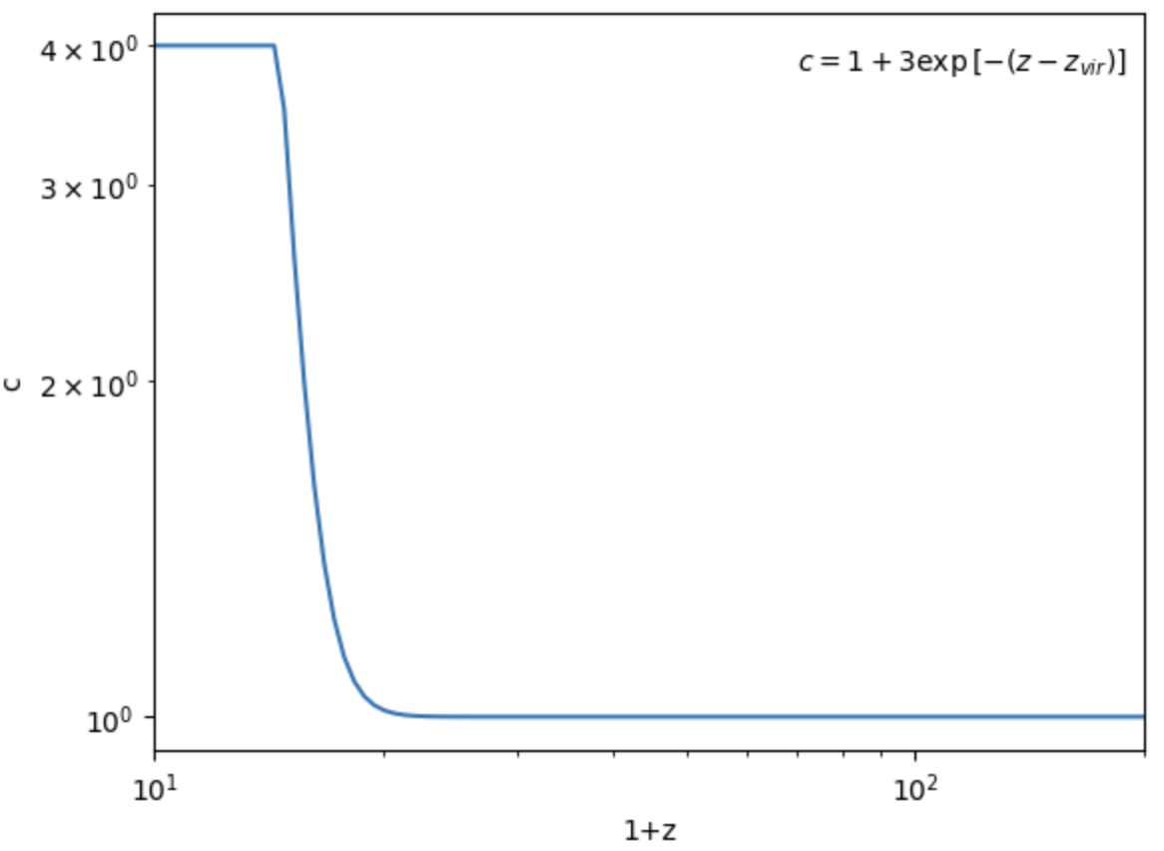
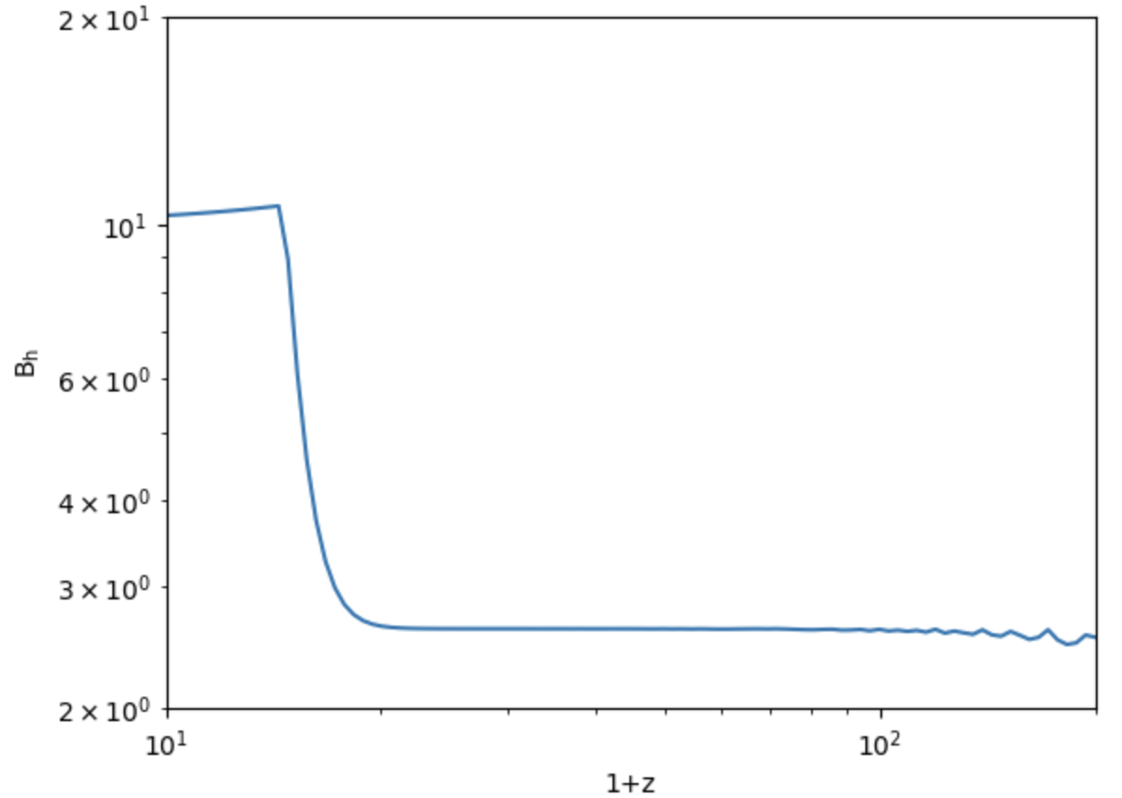



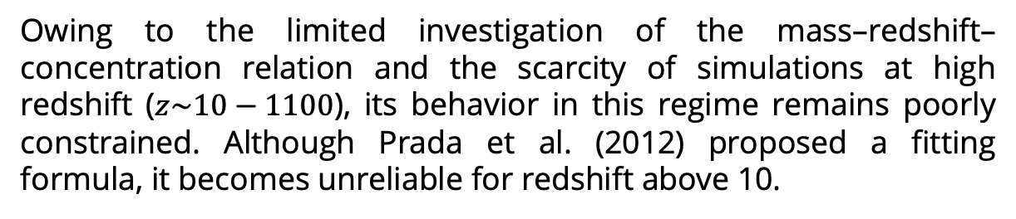
Backup: B-Factor
Owing to the limited investigation of the mass–redshift–concentration relation and the scarcity of simulations at high redshift ($z\sim 10−1100$), its behavior in this regime remains poorly constrained. Although Prada et al. (2012) proposed a fitting formula, it becomes unreliable for redshift above 10.
DM Halo
Solving ODE with initial conditions:
Using an artificial mass–redshift–concentration relation function, fit the NFW profile
After halo reaches virialization, fix $c=4$, fit the NFW profile
  $$\frac{d^{2}r}{dt^{2}}=−\frac{GM_{halo}}{r^{2}}$$
$$c=1+e^{−\left(z−z_{vir}\right)}$$

Slide 33

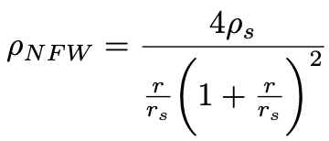
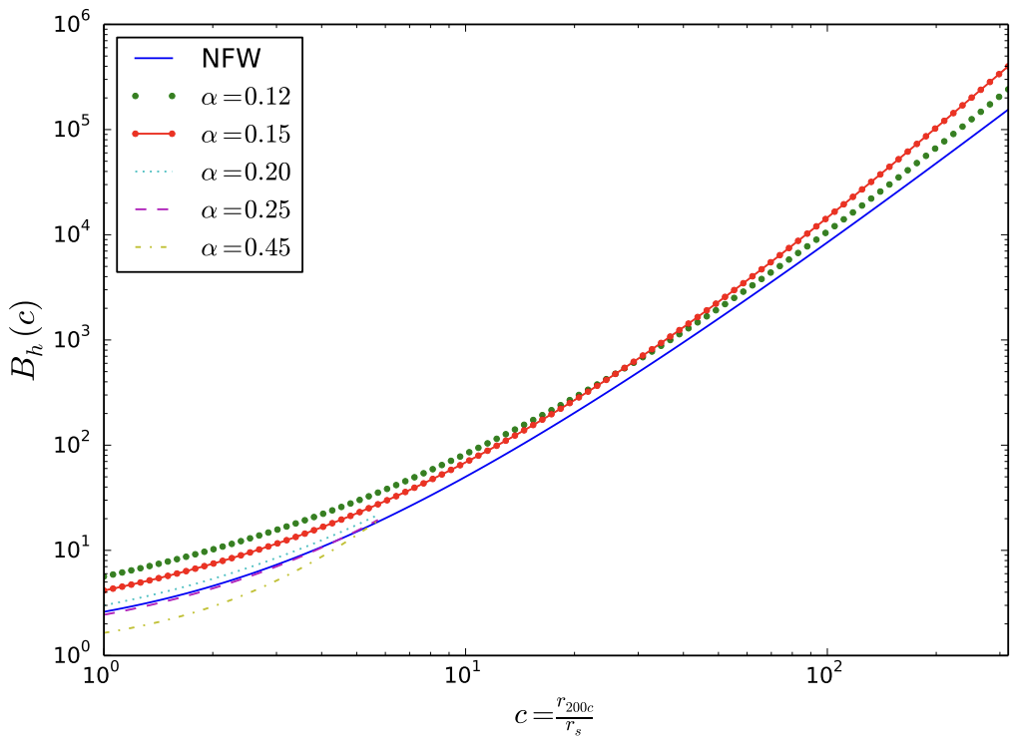
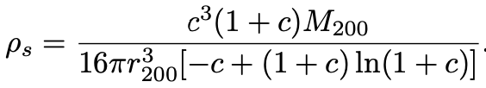


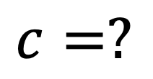

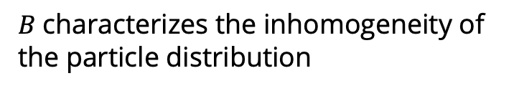



Modeling: Gas Cloud and DM Halo
Gas Cloud
DM Halo
DM Decay
Annihilation
Chemical
Reactions
Simulation
Criteria
DM Halo
  NFW Profile:
  Halo Radius
  Halo Density
  Concentration parameter
Halo Boost Factor
$$r_{200}$$
  $$\frac{d^{2}r}{dt^{2}}=−\frac{GM_{halo}}{r^{2}}$$
$$ρ_{200}$$
$$c$$
$$c≡\frac{r_{200}}{r_{s}}, c=\frac{v_{peak}}{v_{vir}}$$
https://arxiv.org/pdf/1711.05271
A measure of the size or density of the central region relative to the size or density of the whole halo.
$B$characterizes the inhomogeneity of the particle distribution
$$c=?$$
Page 8 of 28

Slide 34
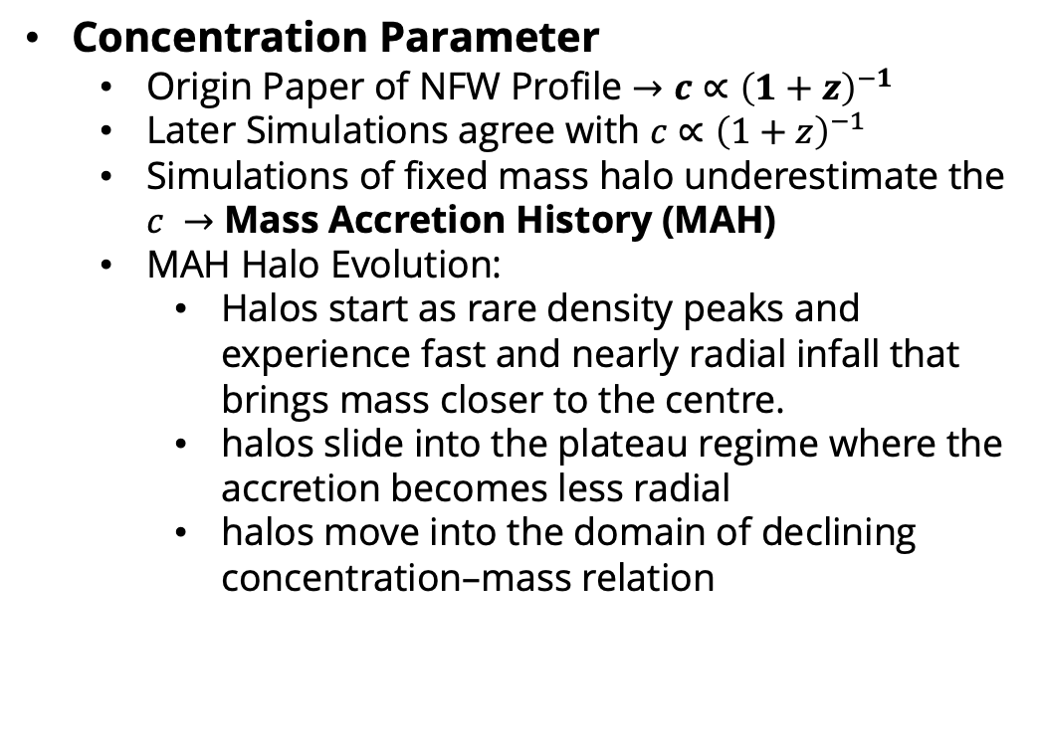
Modeling: Gas Cloud and DM Halo
Gas Cloud
DM Halo
DM Decay
Annihilation
Chemical
Reactions
Simulation
Criteria
?
Concentration Parameter
  Origin Paper of NFW Profile $→c∝{\left(1+z\right)}^{−1}$
  Later Simulations agree with $c∝{\left(1+z\right)}^{−1}$
  Simulations of fixed mass halo underestimate the $c →$ Mass Accretion History (MAH)
  MAH Halo Evolution:
    Halos start as rare density peaks and experience fast and nearly radial infall that brings mass closer to the centre.
    halos slide into the plateau regime where the accretion becomes less radial
    halos move into the domain of declining concentration–mass relation
Rapid Phase
Slow Phase
How long it will take?
Rapid Phase
Slow Phase
Page 9 of 28

Slide 35
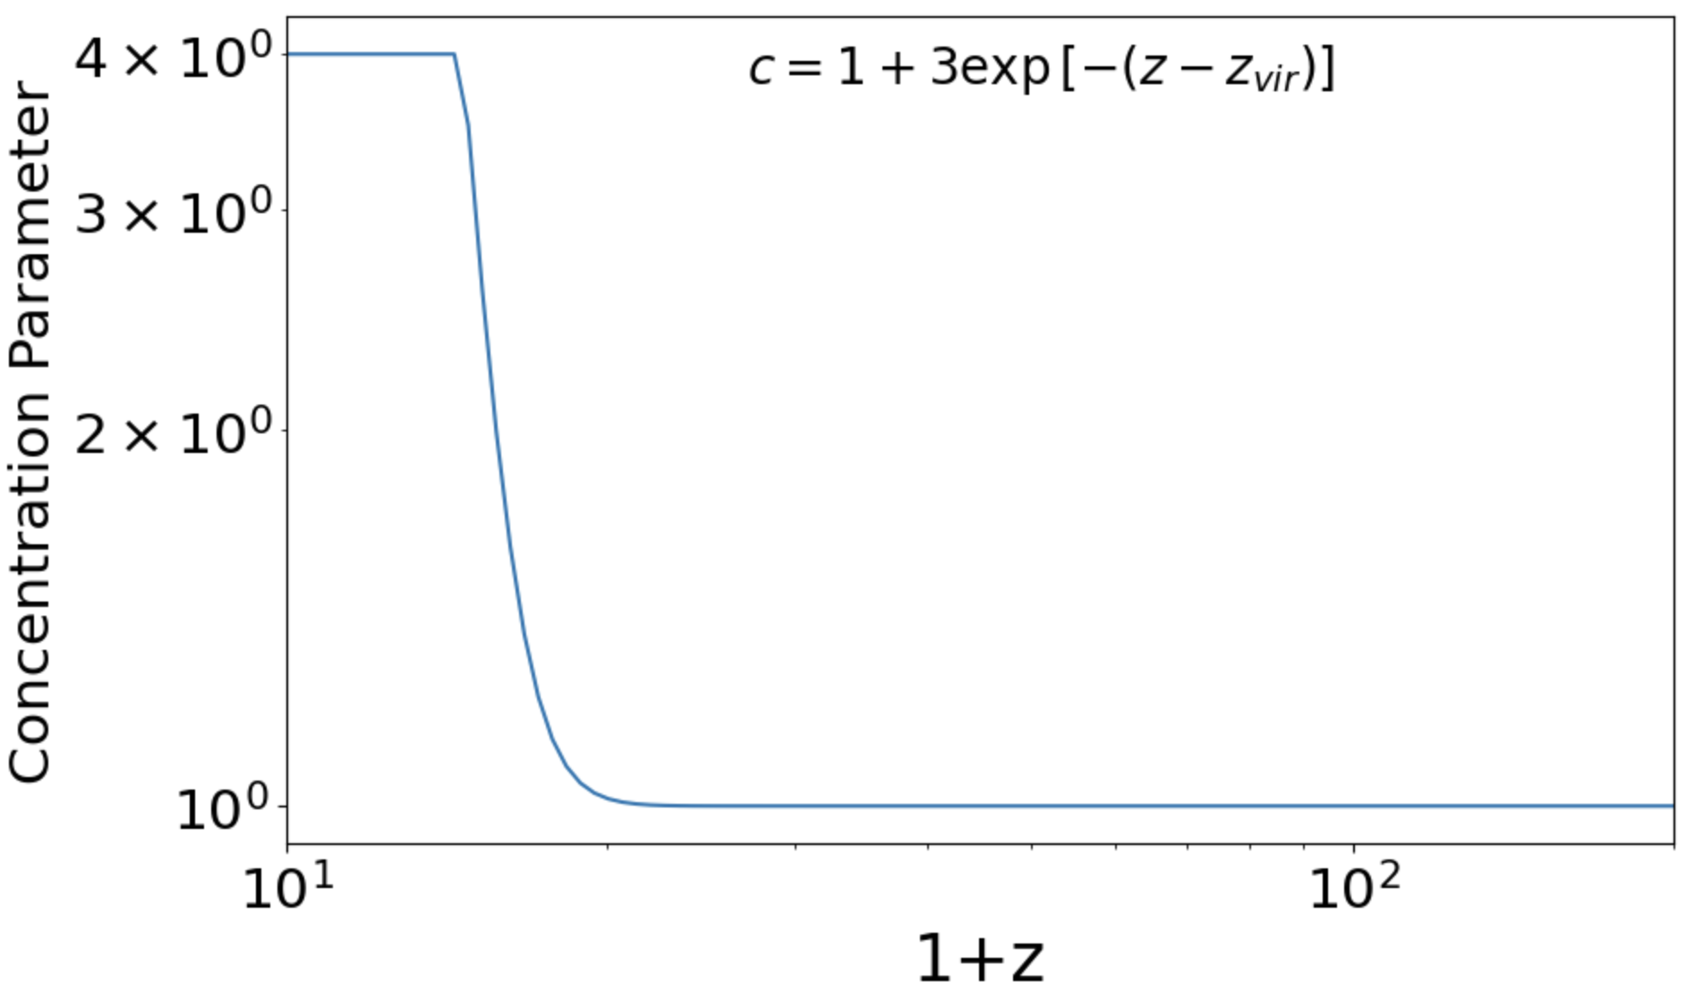
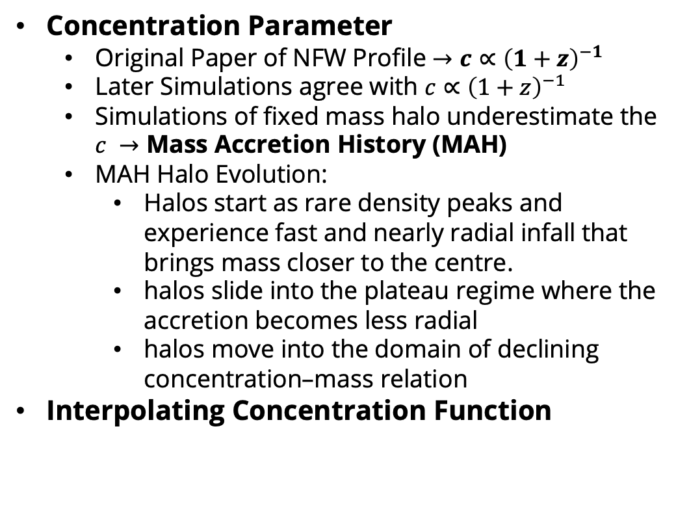
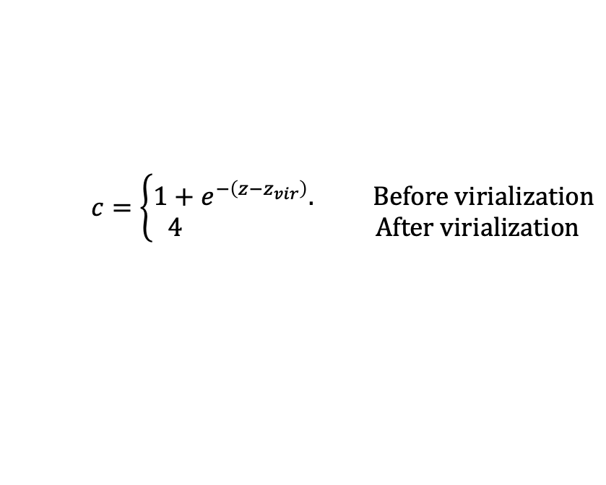
Modeling: Gas Cloud and DM Halo
Gas Cloud
DM Halo
DM Decay
Annihilation
Chemical
Reactions
Simulation
Criteria
?
Concentration Parameter
  Original Paper of NFW Profile $→c∝{\left(1+z\right)}^{−1}$
  Later Simulations agree with $c∝{\left(1+z\right)}^{−1}$
  Simulations of fixed mass halo underestimate the $c →$ Mass Accretion History (MAH)
  MAH Halo Evolution:
    Halos start as rare density peaks and experience fast and nearly radial infall that brings mass closer to the centre.
    halos slide into the plateau regime where the accretion becomes less radial
    halos move into the domain of declining concentration–mass relation
Interpolating Concentration Function
Rapid Phase
Slow Phase
How long it will take?
Rapid Phase
Slow Phase
Julio F. Navarro (1996)
Ewa L. Lokas (1999)
Bullock et al.(2000)
Zhao et al. (2003)
Gao et al. (2008)
$$c=\left\{\begin{aligned}1+e^{−\left(z−z_{vir}\right)}. Before virialization \\ 4 After virialization\end{aligned}\right.$$
Page 9 of 28

Slide 36
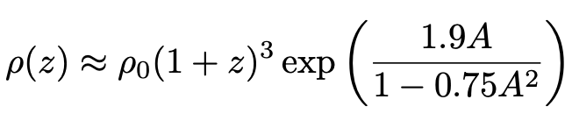
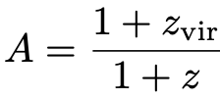


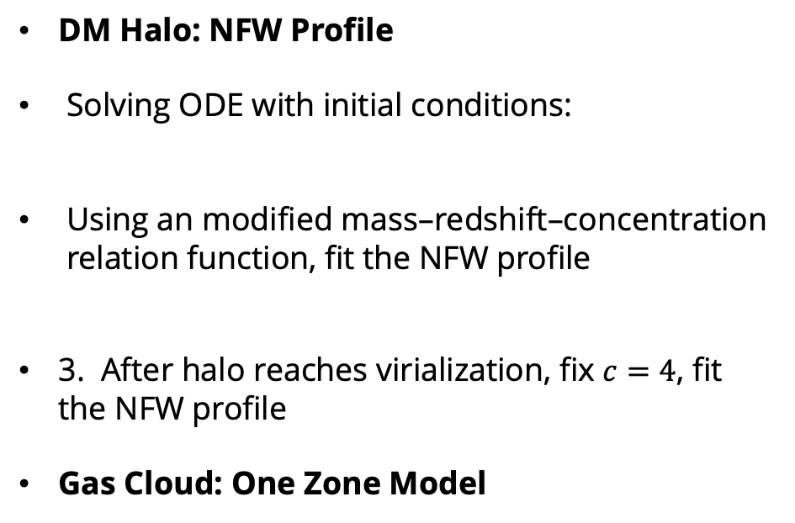



Modeling: Gas Cloud and DM Halo
Gas Cloud
DM Halo
DM Decay
Annihilation
Chemical
Reactions
Simulation
Criteria
DM Halo: NFW Profile
Solving ODE with initial conditions:
Using an modified mass–redshift–concentration relation function, fit the NFW profile
3. After halo reaches virialization, fix $c=4$, fit the NFW profile
Gas Cloud: One Zone Model
  $$\frac{d^{2}r}{dt^{2}}=−\frac{GM_{halo}}{r^{2}}$$
$$c=1+3e^{−\left(z−z_{vir}\right)}$$
$$z_{vir}=20$$
$$M_{halo}=M_{cloud}/f_{b}$$
$$f_{b}=Ω_{baryon}/Ω_{m}$$
Page 10 of 28

Slide 37
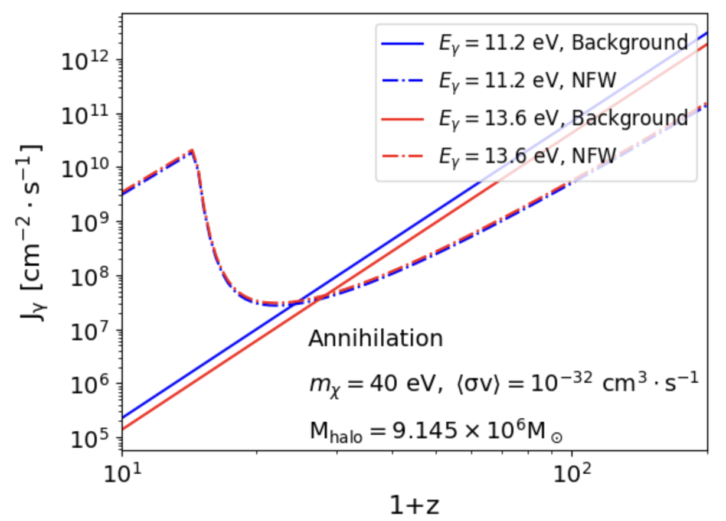
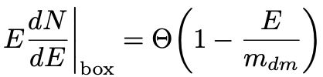
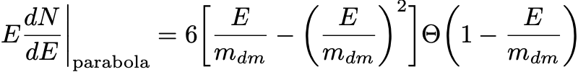
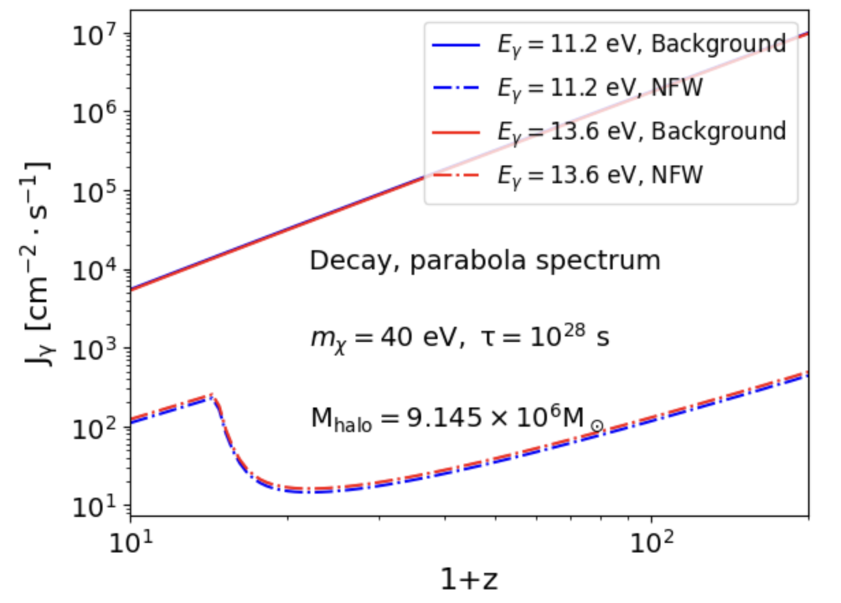

Modeling: DM Decay/ Annihilation and Source of Photon
Gas Cloud
DM Halo
DM Decay
Annihilation
Chemical
Reactions
Simulation
Criteria
DM Decay ($χ→γγ…$)
  Box Spectrum
  Parabola Spectrum
DM Annihilation ($χχ→2γ$)
UV Photon Source
CMB (high redshift)
Background DM
DM Halo
Page 11 of 28
Notes:
Suppose that dark matter self-annihilates into a pair of scalars φ that in turn decay into a pair of photons

Slide 38
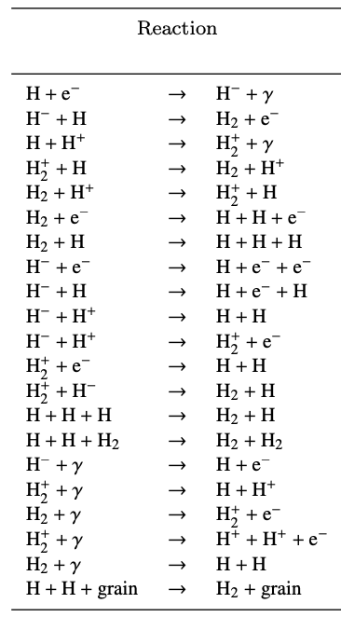
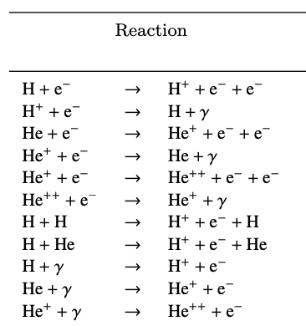
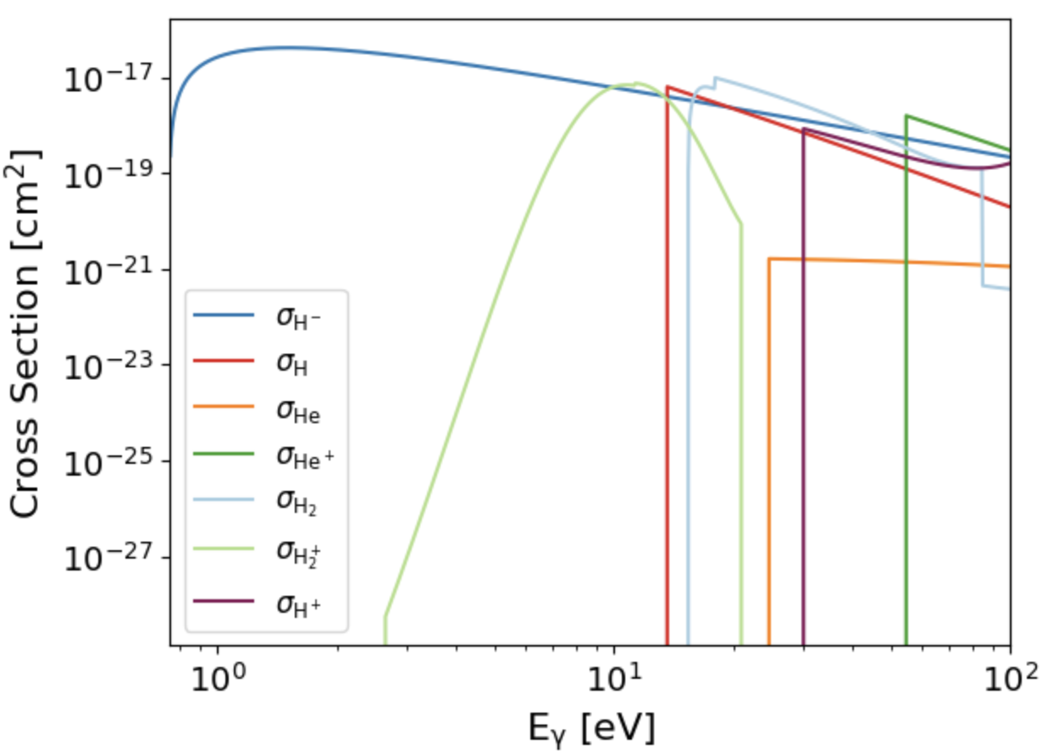
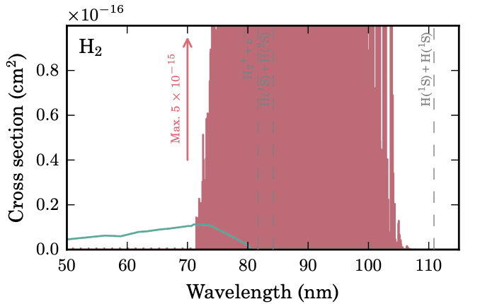
Modeling: Chemical Reaction Rate
Gas Cloud
DM Halo
Chemical
Reactions
Simulation
Criteria
DM Decay
Annihilation
Neutralization
Photodetachment (0.76– 13.6 eV)
Photodissociation (11.2 – 13.6 eV)
31 reactions; 8 require manual input.
Page 12 of 28
https://arxiv.org/pdf/1701.04459

Slide 39




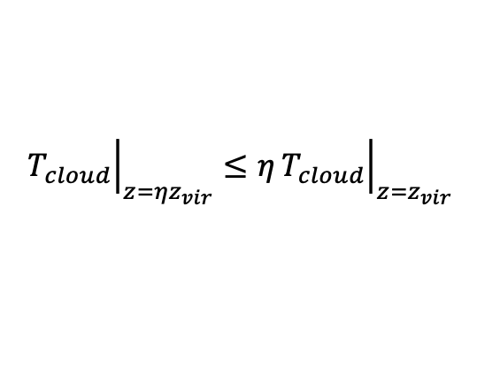
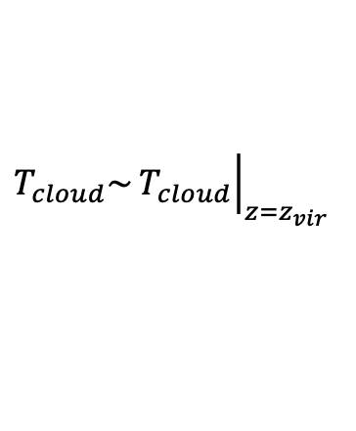




Modeling: Thermal and Ionized Simulation and Criteria
Gas Cloud
DM Halo
DM Decay
Annihilation
Chemical
Reactions
Simulation
Criteria
Initial Conditions (Temperature, $f_{X}$, $x_{e}$…)
CLASS (http://class-code.net/)
(the Cosmic Linear Anisotropy Solving System)
Chemistry and Cooling Library for Astrophysics
Grackle (https://github.com/grackle-project/grackle)
Criteria:
Star Formation
SMBH Formation
High Temperature Cloud (HTC) Formation
Evaporation
Gas cloud becomes too cold as high redshift
$${\left.T_{cloud}\right|}_{z={ηz}_{vir}}≤η{\left.T_{cloud}\right|}_{z=z_{vir}}$$
Rapid Cooling
$${\left.T_{cloud}\right|}_{z={ηz}_{vir}}>η{\left.T_{cloud}\right|}_{z=z_{vir}}$$
Moderate Cooling
$$M_{cloud}>M_{Jeans}$$
$$M_{cloud}>M_{Jeans}$$
$$T_{cloud}\sim {\left.T_{cloud}\right|}_{z=z_{vir}}$$
Very slow Cooling
Page 13 of 28

Slide 40
Phase Diagram: DM Decay
Evaporation
Page 15 of 28

Slide 41
Phase Diagram: Non-Thermal DM Annihilation
Evaporation
DC
Page 17 of 28

Slide 42



Self-Shielding
Distance
Optical Depth
IGM
DM Halo
Photons from DM Decay/ Annihilation in the DM Halo
Photons from Background DM Decay/ Annihilation
Gas Cloud
Page 18 of 28

Slide 43





Self-Shielding Fitting Formula
$H_{2}$ Self-Shielding Fraction
HI Self-Shielding Fraction
https://arxiv.org/abs/1210.7808
Page 19 of 28

Slide 44


Backup: Ionized History

Slide 45


Backup: Accretion and Number Density of the Halo

Slide 46







Backup: CMB and Photon Flux
Decay DM
Annihilation DM
$$\frac{dΦ_{γ}}{dE_{γ}}=\frac{1}{4π}\frac{f_{γ}f_{χ}Ω_{DM}ρ_{c}}{τm_{χ}}\int_{z_{step}}^{∞}{\frac{1}{H(z)}\frac{2}{E_{γ}}δ\left(\frac{m_{χ}}{E_{γ}}−\frac{1+z}{1+z_{step}}\right)dz}$$

Slide 47

Backup: DM Halo Modeling

Slide 48


Backup: DM Halo Modeling

Slide 49


Backup: Gas Cloud Mass

