Slide 1

Adaptive quantum sensing
for wave-like dark matter searches
arXiv: [2608.xxxxx]
In collaboration with
So Chigusa (Postdoctoral Fellow)
Light Dark World 2026 @ Carleton (7/28/2026)
Notes:
何を示すトークか
Today I will show when adaptive readout improves wave-like dark-matter searches, and why the answer matters for experimental design.

Slide 2




Wave dark matter signals at direct detection
Coherent oscillation of classical wave dark matter (DM)
$$a\left(t\right)=a_{0}\sin\left(m_{DM}t−m_{DM}{\vec{v}}_{DM}⋅\vec{x}+δ\right)$$
Unknown properties of DM signals
  Frequency $=m_{DM}$
  Amplitude $∝a_{0}$
  Oscillation phase $=δ$
  Direction
  ex) Dark photon polarization
  Axion-induced ${\vec{B}}_{eff}$
Resonant drive
  as example of quantum sensing
  DM signal
  $$m_{DM}≃ω_{qubit}$$
$$\left|↑\right\rangle$$
Example: “Detection of hidden photon dark matter using the direct excitation of transmon qubits”
[Chen, et al. PRL ’23]
$$\left|↓\right\rangle$$

Slide 3
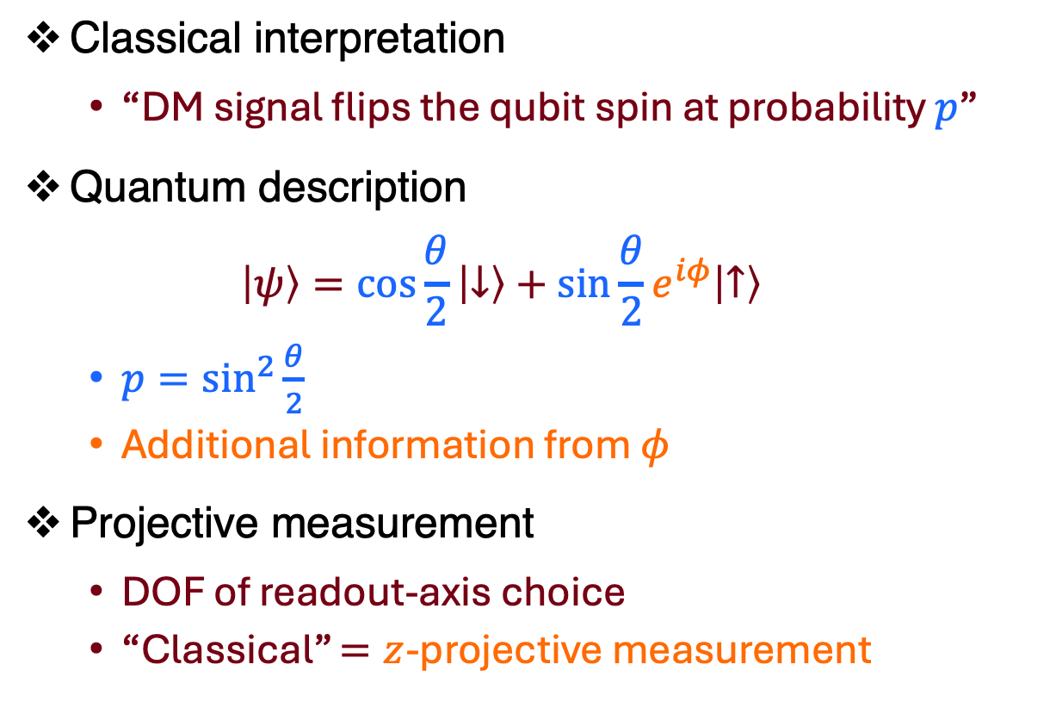
Classical interpretation and projective measurements
Classical interpretation
  “DM signal flips the qubit spin at probability $p$”
Quantum description
  $$\left|ψ\right\rangle =\cos{\frac{θ}{2}}\left|↓\right\rangle +\sin{\frac{θ}{2}}e^{iφ}\left|↑\right\rangle$$
  $p=\sin^{2}{\frac{θ}{2}}$
  Additional information from $φ$
Projective measurement
  DOF of readout-axis choice
  “Classical” $=z$-projective measurement
Notes:
このページで必要な結論は「population readoutは位相情報を捨てる」「readout axisがadaptiveに選ぶ自由度」の2点です。
Bloch 球の説明は、「この量子状態は表せる Bloch ベクターとしても that gives いわゆるBloch球内部の点」くらい
「この（projective measurementの）自由度が、adaptive戦略でtuneしたい自由度」

Slide 4



Longitudinal vs transverse readout
$z$-readout
  Insensitive to unknown phase $φ$
  Quadratic response $2\sin^{2}{(θ/2)}∝θ^{2}$
Transverse oracle $φ$-readout
  Linear response $∝θ$
  Need to know $φ$
$φ$is determined by signal direction
  For ${\vec{E}}_{sig}=cos{φ}\hat{x}+\sin{φ}\hat{y}$
  $φ=φ+π/2$ is unknown $⟹$ learn it!
Notes:
「なぜ位相を学ぶ価値があるか」
ダイナミクスの説明は不要
Longitudinal readout is robust to the unknown phase, but its weak-signal response is quadratic.
A phase-aligned transverse readout gives a linear response, but requires the phase.

Slide 5

Adaptive strategy
During repeated measurements with $n_{shots}$ total shots,
Resilient to fake positives/look-elsewhere effects
Start with $z$-readout
Start with z-readout
Phase-insensitive signal search
Phase learning
Insert trial shots (information gain) to learn the signal phase $φ$
Insert trial shots (information gain) to learn the signal phase 𝜑
Converge to transverse oracle
The optimal $φ$-readout for signal detection
The optimal 𝜙-readout for signal detection
Notes:
「adaptive strategyとは何をするのか」

Slide 6

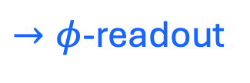

Adaptive trajectory
Noisy environment simulation: Relaxation ($T_{1},T_{2}$), Readout contrast & error
Bayesian analysis tracking prior/posterior distribution of nuisance parameters
$→φ$-readout
Information gain
$z$-readout
Notes:
「実際に学習・収束するか」
軸の説明は適宜省略
左プロットの説明は、「実際に前スライドの3段階の推移が見える」程度

Slide 7

Sensitivities
Statistical formulation
  Composite hypothesis test
  Noise only vs Noise+DM
  Asymmetric testing
  Keep false-positive rate $<5 \%$
Best strategy for increasing $n_{shots}$
  $z$-readout for small $n_{shots}$
  Adaptive for large $n_{shots}$
Notes:
「少数shotでは何が最適か」
Formulation の説明は一文で簡潔にまとめる
Composite hypothesis test
Maximize detection power while keeping FP < 5%
黒線には触れない。単に「色付き線が attainable なセットアップの感度曲線」
15分版では、fixed x, x/y に関する mention は省いて良い

Slide 8

Sensitivities
Statistical formulation
  Composite hypothesis test
  Noise only vs Noise+DM
  Asymmetric testing
  Keep false-positive rate $<5 \%$
Best strategy for increasing $n_{shots}$
  $z$-readout for small $n_{shots}$
  Adaptive for large $n_{shots}$
Notes:
「多数shotでは何が最適か」

Slide 9

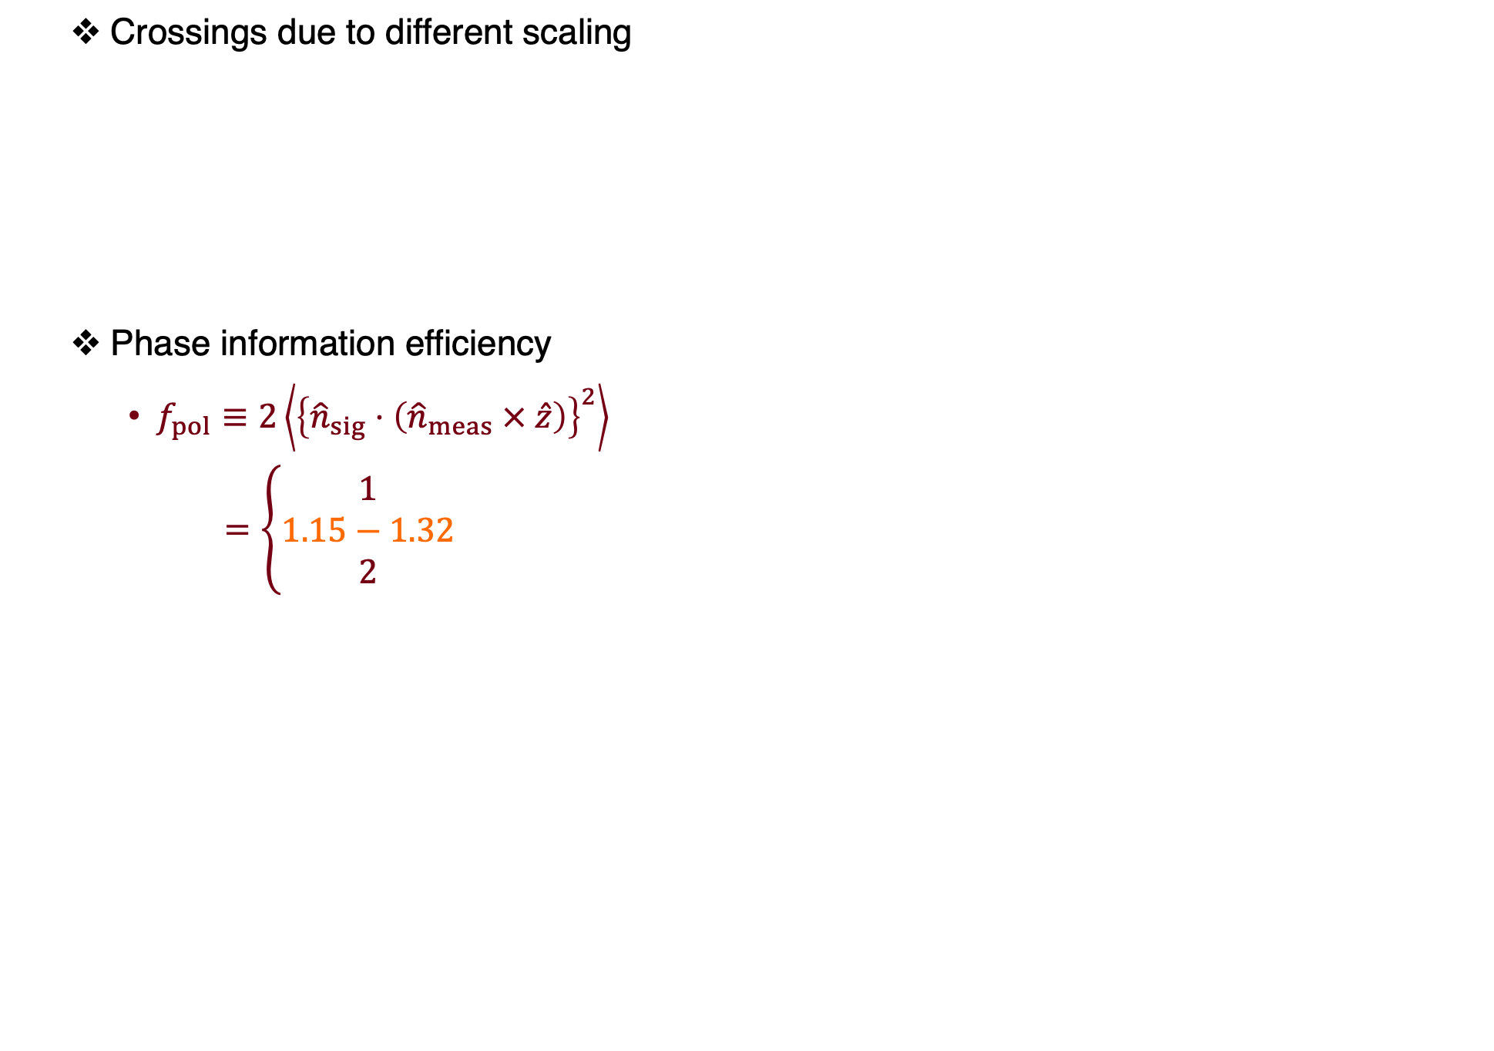

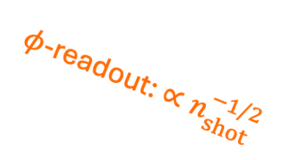
Sensitivity scaling and comparison
Crossings due to different scaling
Phase information efficiency
  $f_{pol}≡2\left\langle {\left\{{\hat{n}}_{sig}⋅\left({\hat{n}}_{meas} × \hat{z}\right)\right\}}^{2}\right\rangle$
  $$=\left\{\begin{aligned}1 \\ 1.15−1.32 \\ 2\end{aligned}\right.$$
$φ$-readout: $∝n_{shot}^{−1/2}$
$z$-readout: $∝n_{shot}^{−1/4}$
$$n_{z:adapt}$$
(fixed x/y)
(adaptive)
(oracle)
Notes:
「切替点はどこか」
【冒頭】 The reason why the best strategy changes with n_shots is the different sensitivity scaling.
For \phi-readout with linear signal response, …
f_pol に触れる時間はない

Slide 10
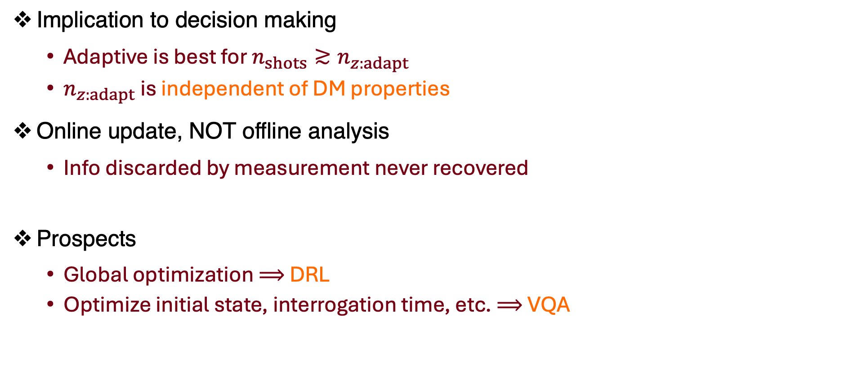
Takeaways and discussions
Implication to decision making
  Adaptive is best for $n_{shots}≳n_{z:adapt}$
  $n_{z:adapt}$ is independent of DM properties
Online update, NOT offline analysis
  Info discarded by measurement never recovered
Prospects
  Global optimization $⟹$ DRL
  Optimize initial state, interrogation time, etc. $⟹$ VQA
“Realizing a deep reinforcement learning agent discovering real-time
feedback control strategies for a quantum system”
[Reuer, et al. Nat. Comm. ’23]
Notes:
“crossing”
Information for Q&A
$kHz−MHz$ rate (cf: $20 MHz$ @ L1 trigger, CMS)

Slide 11
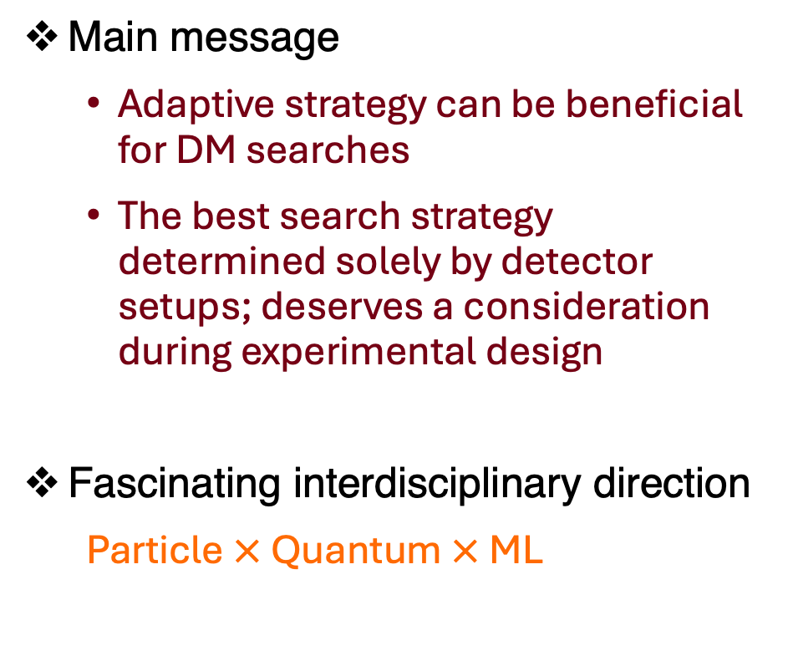
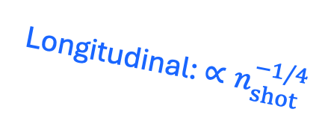
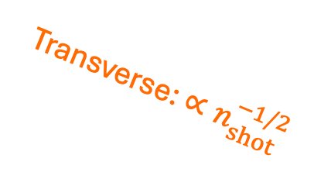
Conclusion
Main message
  Adaptive strategy can be beneficial for DM searches
  The best search strategy determined solely by detector setups; deserves a consideration during experimental design
Fascinating interdisciplinary direction
  Particle $×$ Quantum $×$ ML
Transverse: $∝n_{shot}^{−1/2}$
Longitudinal: $∝n_{shot}^{−1/4}$
$$n_{z:adapt}$$

Slide 12
Backup slides

Slide 13

Detuning effects
Detuning $∆$ makes optimal readout time-dependent: $φ(t)=φ+π/2+∆ t$

Slide 14
Visualizing look-elsewhere effects
No signal simulation
Fake signal
Phase id.
Resolve

Slide 15

Repeated local optimization $≠$ global optimization
Fixed-$z$ is the best with unknown phase $⟺$ No phase information is learned

Slide 16
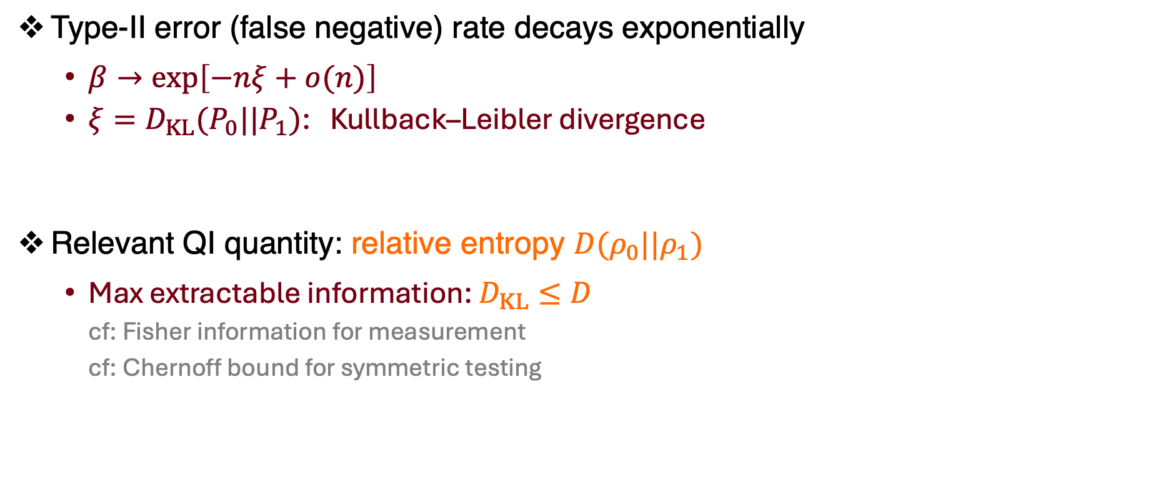
Information theory for hypothesis test
Type-II error (false negative) rate decays exponentially
  $β→exp\left[−nξ+o(n)\right]$
  $ξ=D_{KL}(P_{0}||P_{1})$: Kullback–Leibler divergence
Relevant QI quantity: relative entropy $D(ρ_{0}||ρ_{1})$
  Max extractable information: $D_{KL}≤D$
  cf: Fisher information for measurement
  cf: Chernoff bound for symmetric testing

Slide 17
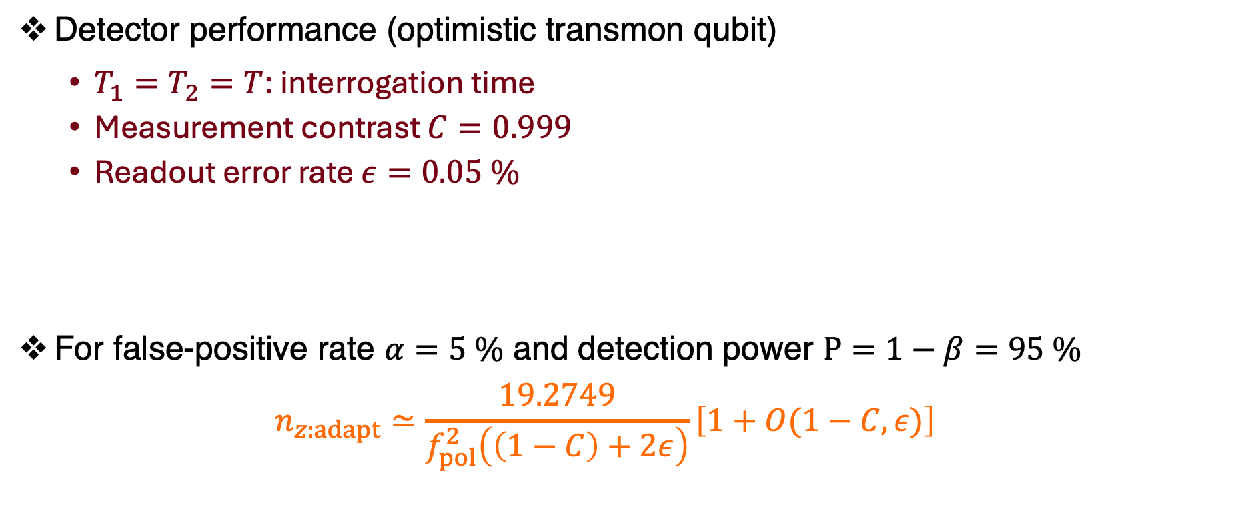
Assumed experimental setups
Detector performance (optimistic transmon qubit)
  $T_{1}=T_{2}=T$: interrogation time
  Measurement contrast $C=0.999$
  Readout error rate $ε=0.05 \%$
For false-positive rate $α=5 \%$ and detection power $P=1−β=95 \%$
  $$n_{z:adapt}≃\frac{19.2749}{f_{pol}^{2}\left(\left(1−C\right)+2ε\right)}\left[1+O(1−C,ε)\right]$$

