Slide 1
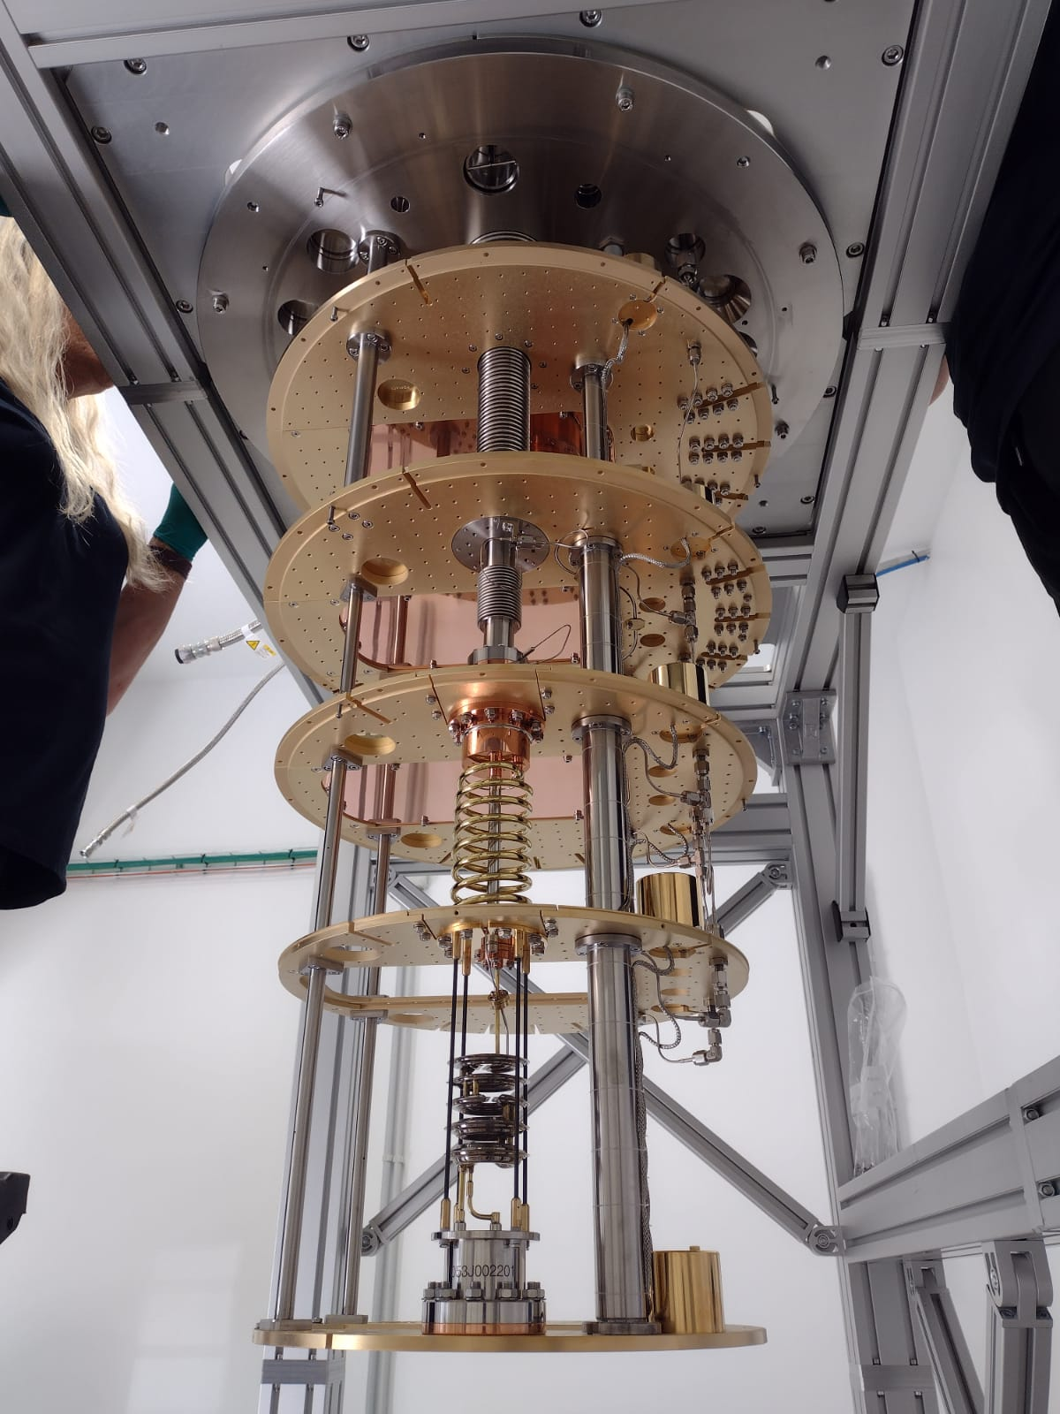

Quantum sensing for ultra-light dark matter at IFCA
CNID WG5, Kick-off meeting
Iván Vila Álvarez
Instituto de Física de Cantabria (CSIC-UC)

Slide 2
Outline
A brief history of our interest and history so far.
QET sensors for particle-like DM detection.
CADEx experiment for QCD axion detection.
A plan sketch for future short-term development.

Slide 3
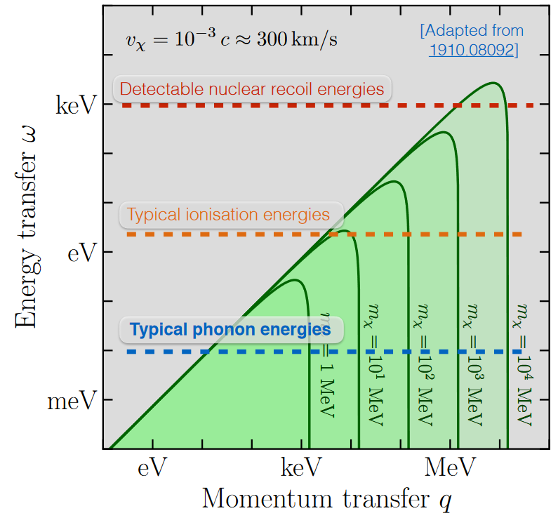
What is ultra-light matter (at least for this talk) ?
Nuclear recoils – can probe energies down to eV, but realistically can only measure recoil energies down to ~keV → mχ ≳ GeV
Electron ionisation – possible for ω > Δ ~ eV → mχ ≳ MeV
Phonon interactions – possible for sufficiently small q, with ω_ph ~ O(10s) meV → mχ ~ keV – 50 MeV
BCS quasiparticle creation – possible when the deposited energy exceeds the superconducting gap, ω ≳ 2Δ_SC, with Δ_SC ~ O(1–5)·k_B·T_c ~ O(0.1–1) meV → mχ ~ eV – keV
Note: For scattering, the detectable energy is set by recoil kinematics and thresholds; for absorption, the deposited energy is ∼ mχ, extending sensitivity to much lower dark-matter masses.

Slide 4
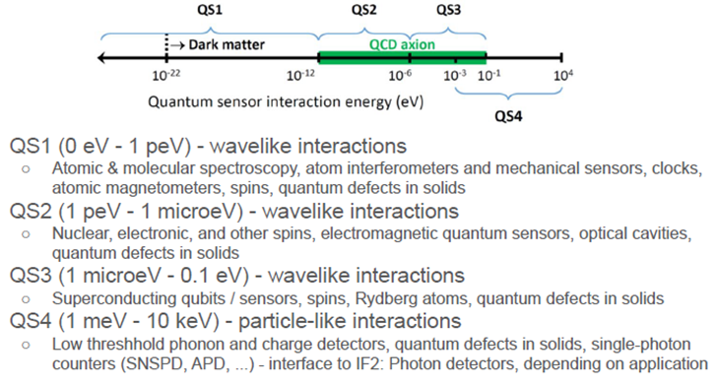
What is ultra-light matter (at least for this talk) ?

Slide 5
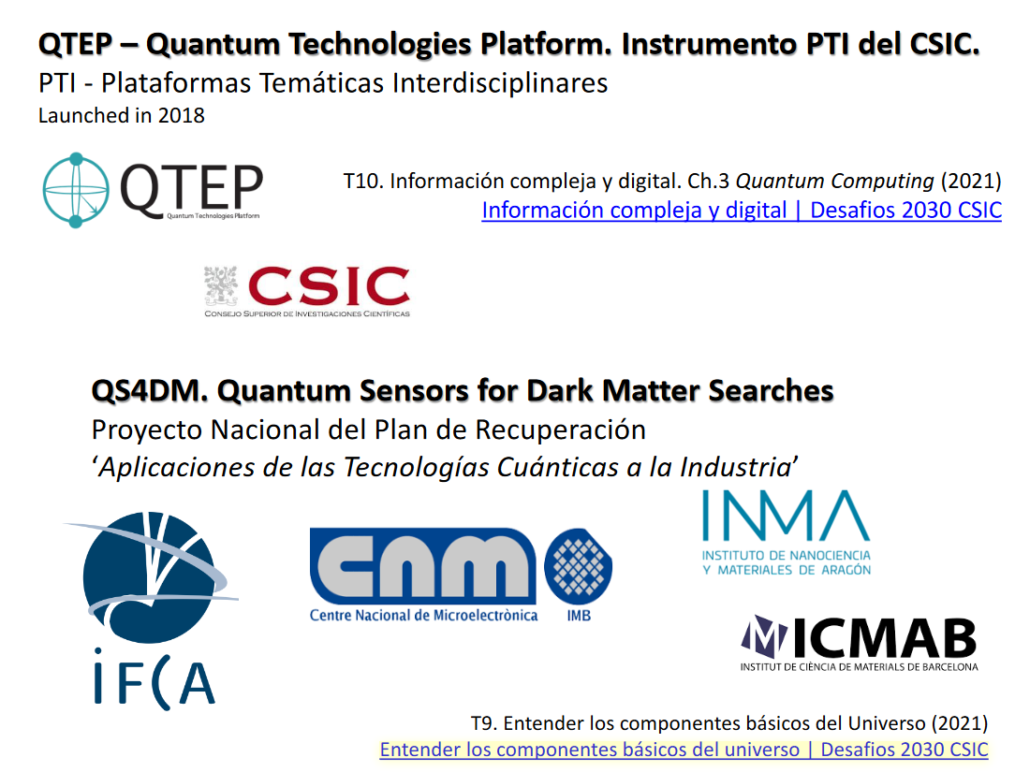
A first opportunity: Initial prospective study
Development of quantum sensing tecnologies with improved energy resolution and lower energy detection thresholds for Dark Matter detection in the 1meV to 10eV energy range.
Creation of a interdisciplinary team with expertise in superconducting technologies, condensed matter physics, materials science and elementary particle physics

Slide 6
Ultralight Dark matter detection with quantum sensors: lines of action.
Phonon Sensors
Phonon-assisted detection with directional sensitivity and very low threshold (meV).
Goal: Prof-of-concept demonstrator of detecting element.
Transversal actions
Setting up and commissioning of cryogenic laboratory at IFCA (synergy with microwave cosmology group at IFCA)
Modeling of phonon transport in polar materials (dark matter excitation with anisotropic response). Connection with material theorists at ICMAB.
Development of superconducting quantum sensors (QET) for phonon-mediated meV scale Dark matter detection using polar semiconductors as targets.
Synergy with Cosmology group at IFCA

Slide 7
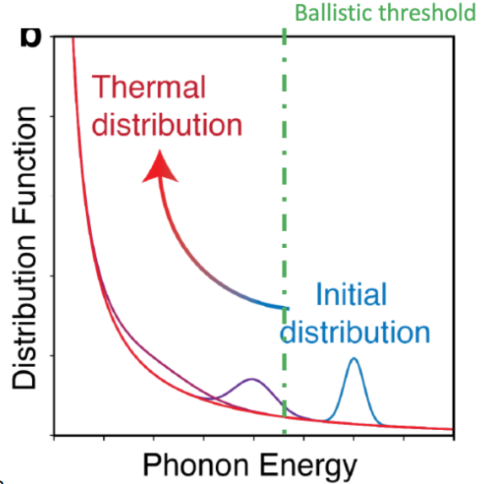
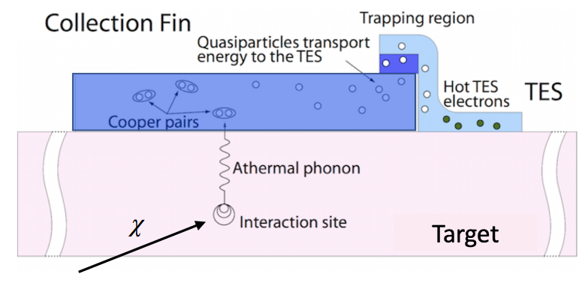
Our choice: A Detector of sub-eV athermal phonons: QET (Quasiparticle-trap-assisted Eectrothermal-feedback Transition Edge Sensors)

Slide 8

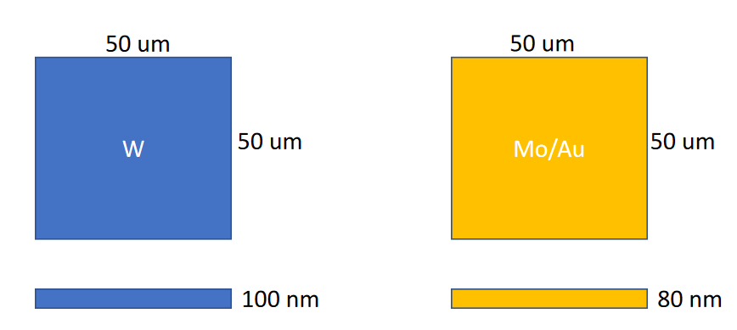

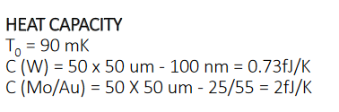
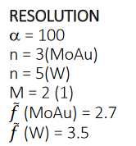

Would it work? A back-of-the-envelop calculation
Yes!

Slide 9

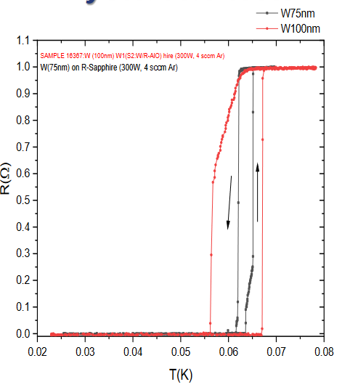
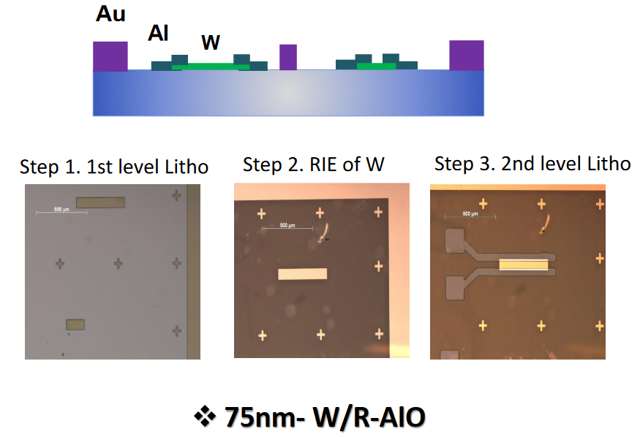
Manufacturing and characterization of first test structures

Slide 10

A second Line of action/oportunity:
Proposed axion haloscope experiment to search for QCD axion Dark Matter (DM) in the W-band (80-110 GHz) - well-motivated but so far unexplored region of parameter space (m_{a} = 330-460 μeV)
Spanish collaboration with experiment to eventually be hosted at Canfranc Underground Lab (LSC)
Synergetic activity within IFCA - participation from both Particle Physics and Cosmology groups and with other groups from the Plan Complementario (CAB @ Madrid).
IFCA leads the Science Working Group
IFCA equipping a laboratory CRYOLAB to demonstrate the integration of the core technologies: Cryostat acquisition, installation and operation. Demonstration of key technology (magnet haloscope, detectors,…)
Dilution
Refrigerator
at Cryolab (IFCA) operational since 12/25
10

Slide 11
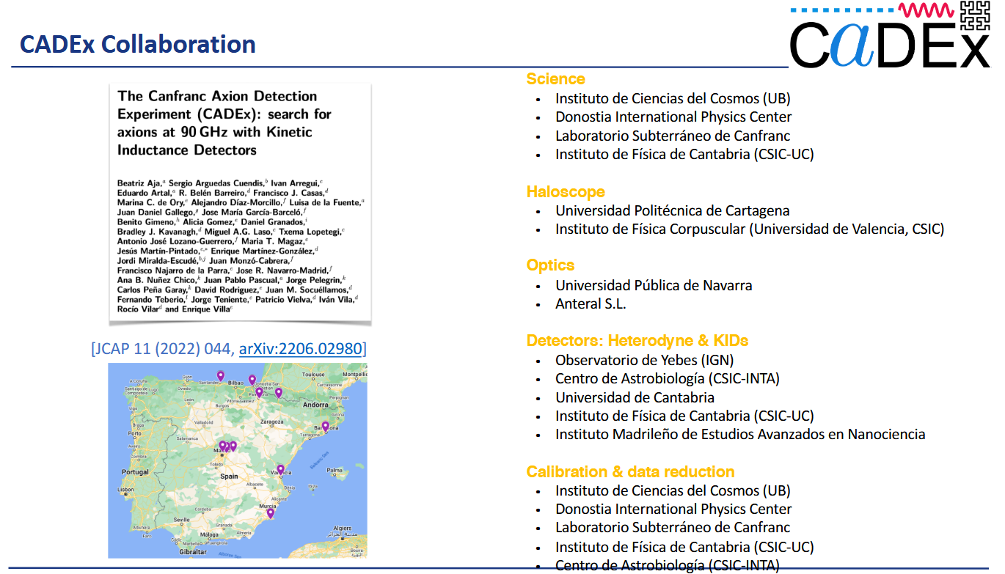

Slide 12
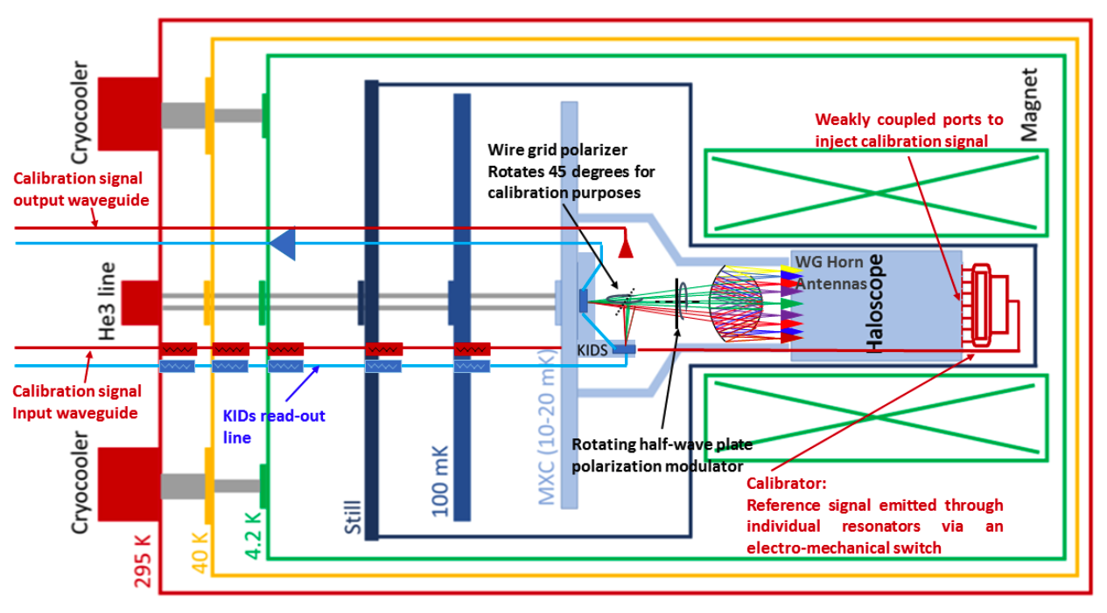
Conceptual Design

Slide 13
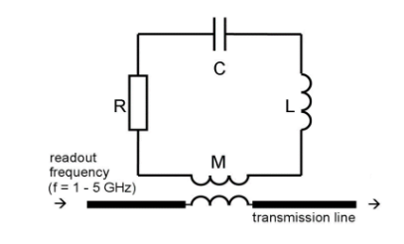

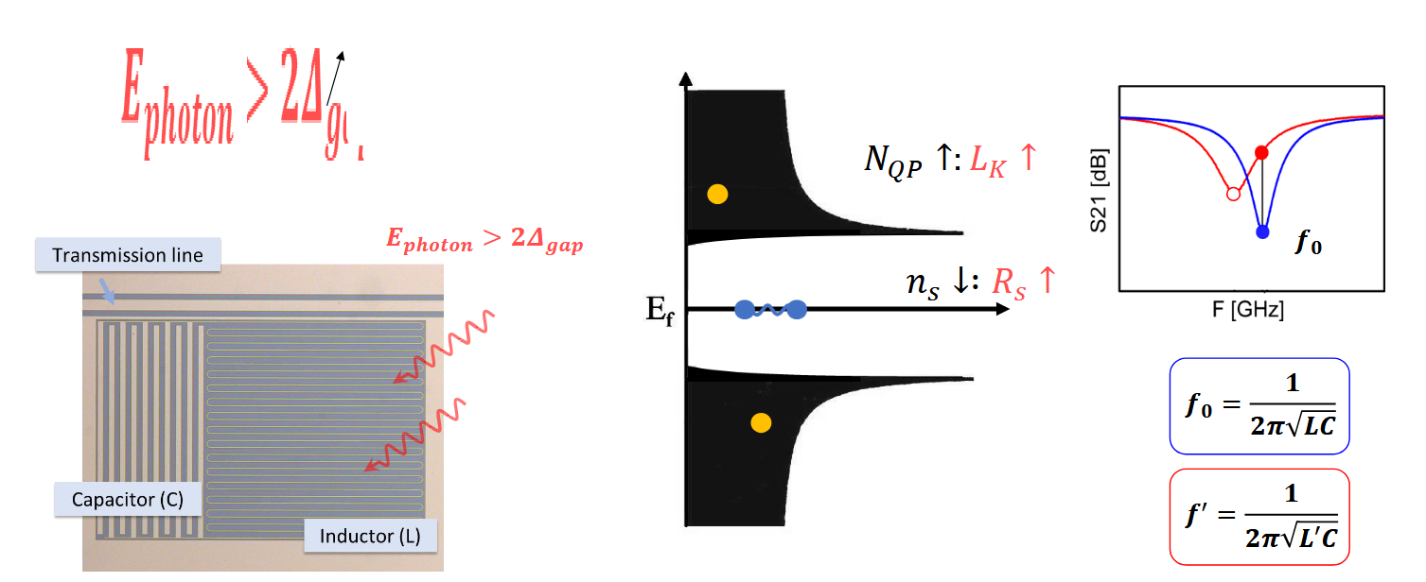
Sensor concept: Kinetic Inductance Sensors

Slide 14
Summary
Physics goal: Access ultra-light dark matter (eV–GeV) using quantum sensors sensitive to sub-eV energy depositions, beyond conventional nuclear-recoil or electron-recoil detection.
Primary R&D line (QET/TES): Development of superconducting quantum sensors for detection of athermal phonons and quasiparticles, with demonstrated feasibility and first test structures already manufactured and characterized.
• Flagship experimental driver (CADEx): Axion haloscope experiment targeting QCD axion dark matter in the W-band (80–110 GHz).

Slide 15
…and short term plans
Infrastructure consolidation:
A superconducting solenoid for the dilution refrigerator, replicating CADEx operating conditions
Dedicated TES and KIDs readout systems, enabling realistic detector operation and system-level testing
Strategic vision:
Reinforce collaborations with sensor manufacturing and characteriation centers (CNM, INMA, CAB,…) to establish a permanent superconducting sensor testing facility at IFCA (CRYOLAB), extending beyond the specific needs of CADEx and exploit synergies with other experiments that employ quantum-sensor applications.
Outlook: Technology validation under realistic conditions, and positioning IFCA as a node for demonstrating quantum sensing in ultra-light dark-matter searches.

Slide 16
BACK-UP

Slide 17
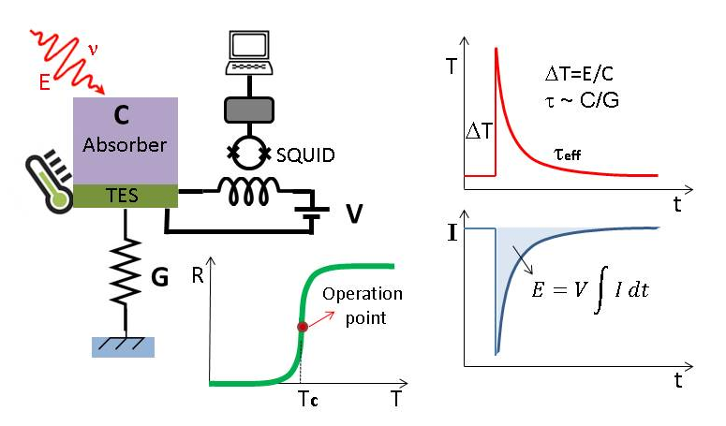
Transition Edge Sensors 101

Slide 18
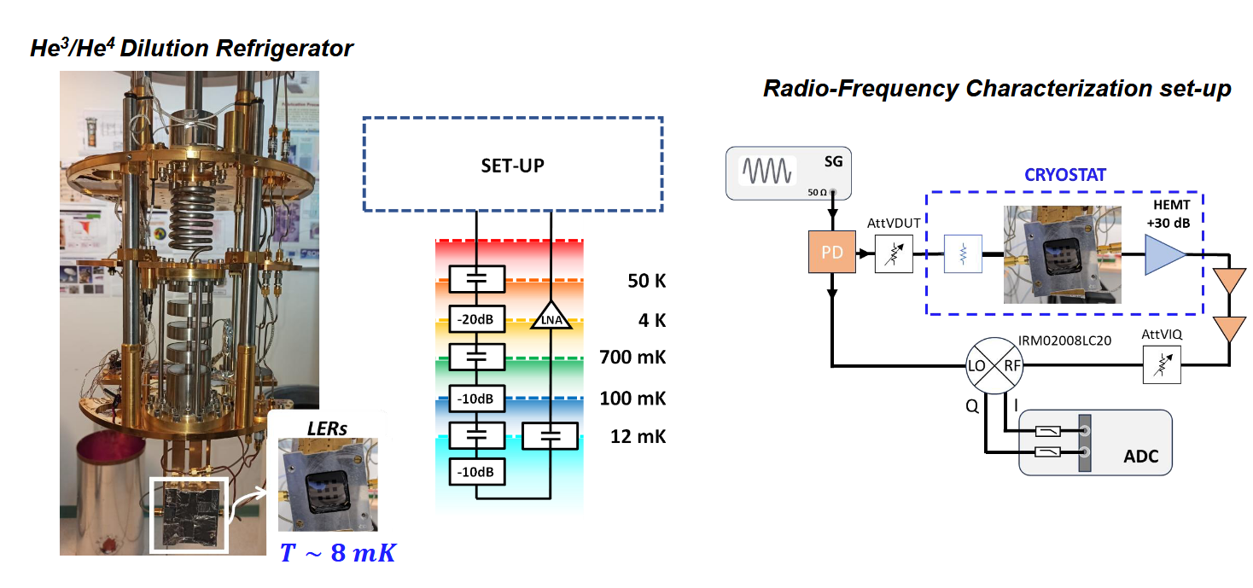
KIDs experimental setup

