Slide 1


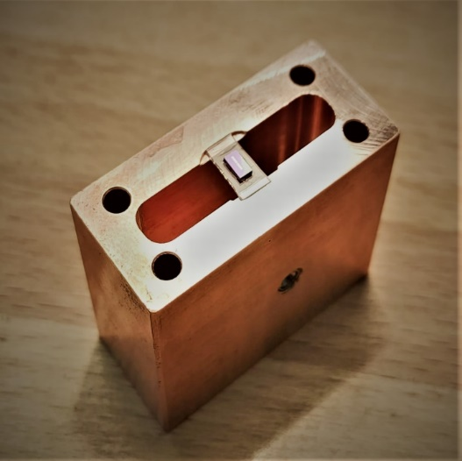
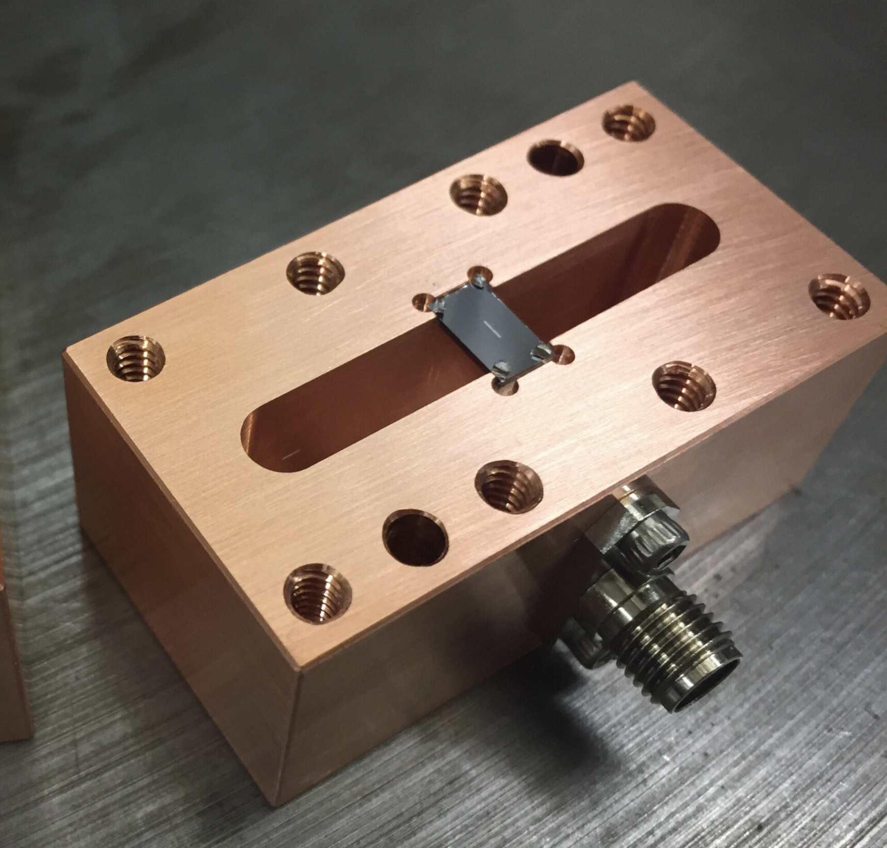
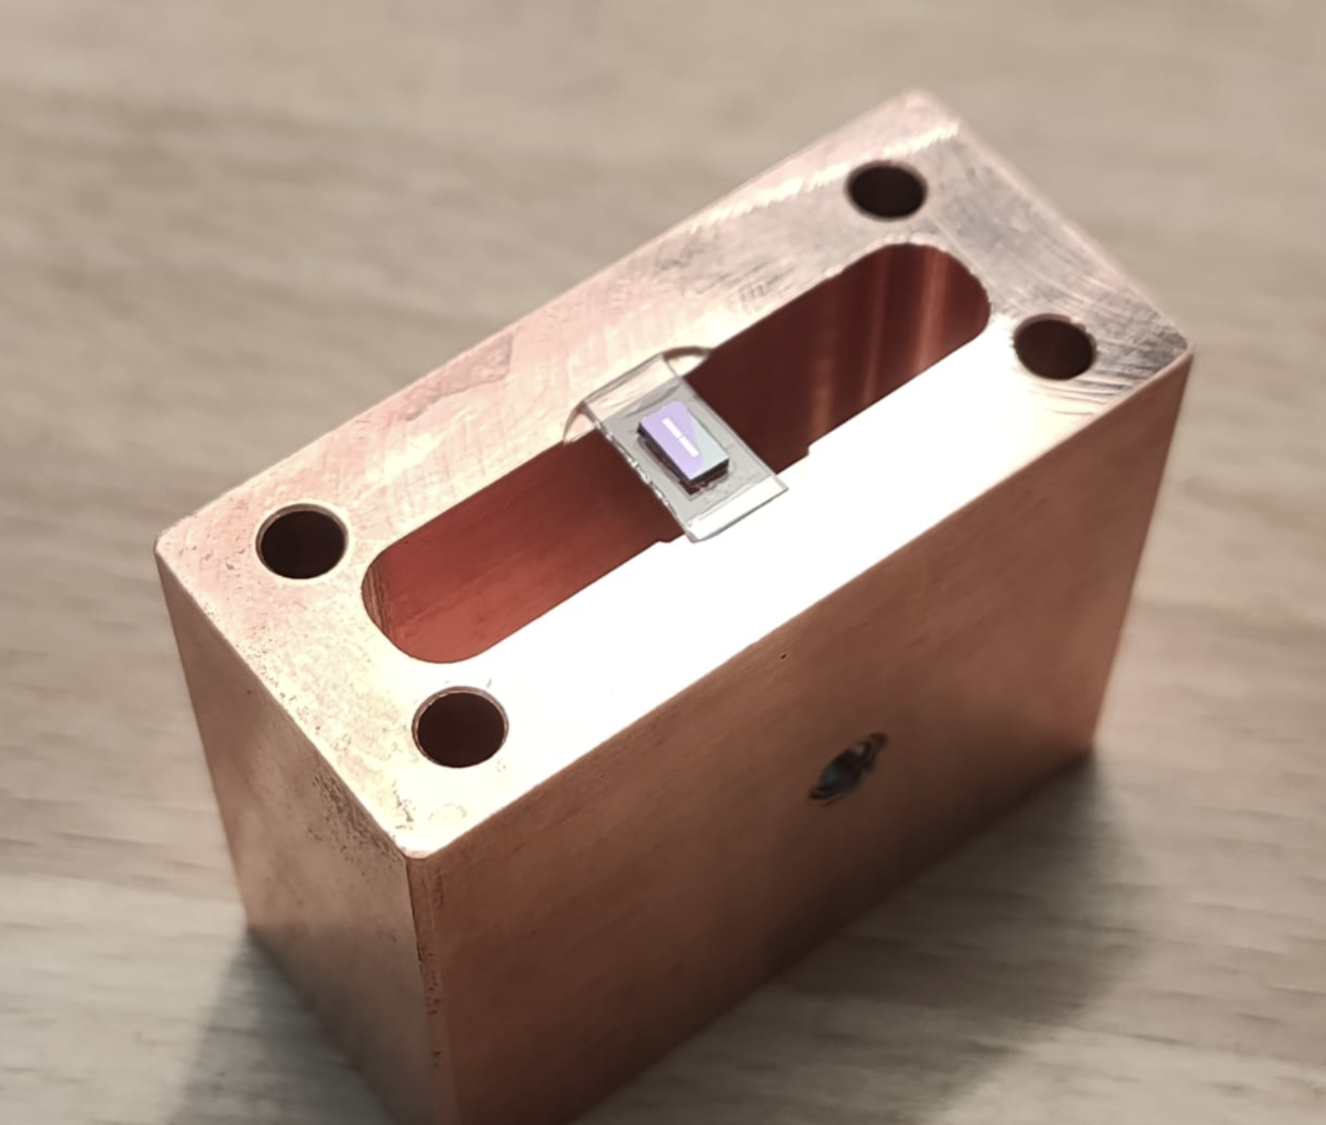
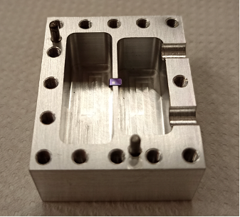
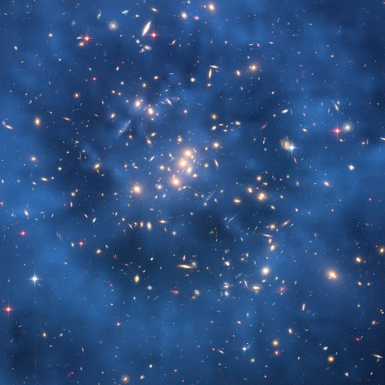


DarkQuantum
Quantum sensing for the detection of axion dark matter: the DarkQuantum project
Igor G. Irastorza (CAPA/UNIZAR)
CNID WG5 Meeting
19-01-26

Slide 2
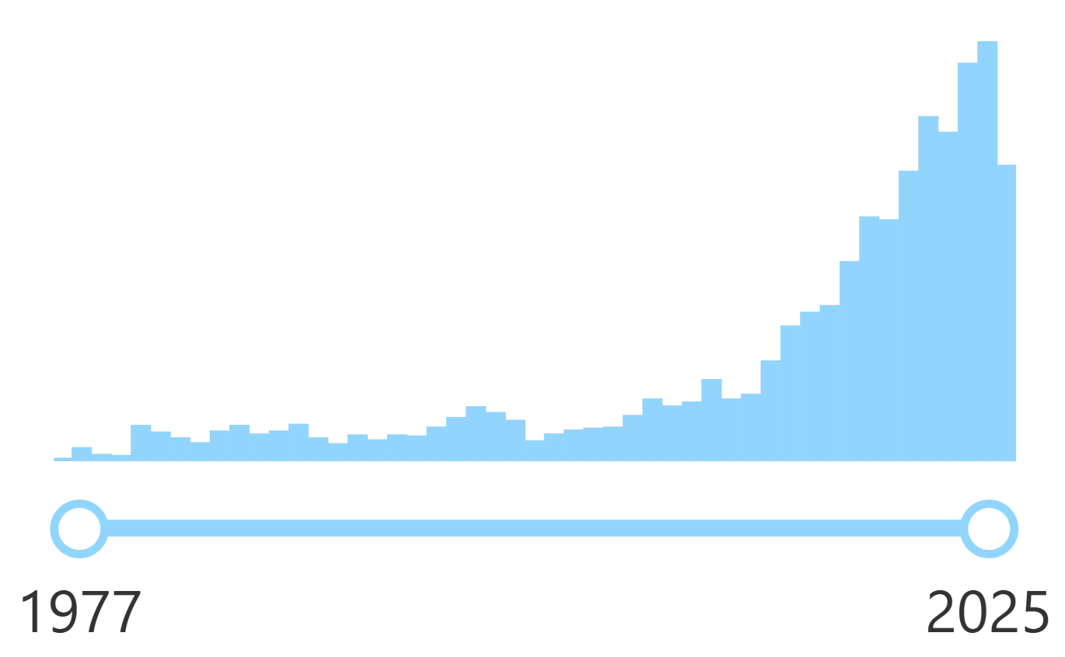
Axion DM and its detection
Nature of dark matter unknow (>80% of the matter of the Universe).
Axions very compelling DM candidates. Proposed as solution to the Strong CP problem of the SM.
Relevant axion models are not far from current experimental bounds. Rapidly increasing interest & experimental efforts devoted to axions
Axions can be detected fully in the laboratory, in axion helioscopes and axion haloscopes.
Detection principle relies on the axion-to-photon conversion in presence of magnetic field.
Papers with “axion” in title
Source: INSPIRE-HEP
N=4570 [1977-2025]

Slide 3
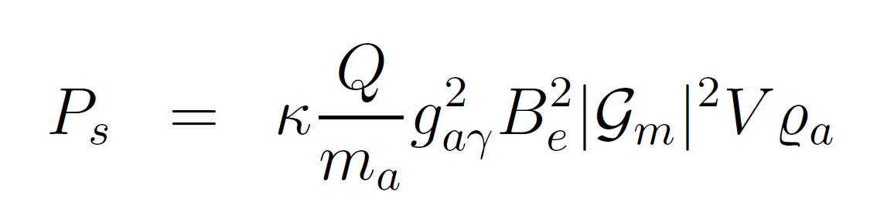
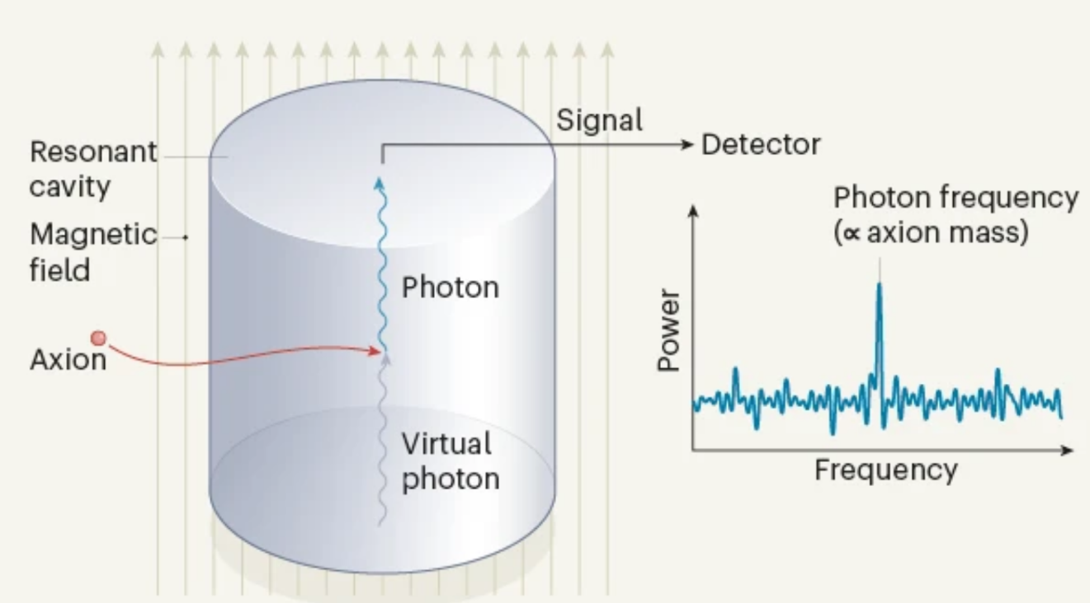

Detecting DM axions: “axion haloscopes”
Assumption: DM is mostly axions
Resonant cavities (Sikivie,1983)
  Primakoff conversion inside a “tunable” resonant cavity
  Energy of photon = $mac2+O(β2)$
Cavity dimensions smaller than de Broglie wavelength of axions
Axion DM field
Non-relativistic
Frequency ← axion mass
Primakoff conversion of DM axions into microwave photons inside cavity
If cavity tuned to the axion frequency, conversion is “boosted” by resonant factor
(Q quality factor)

Slide 4
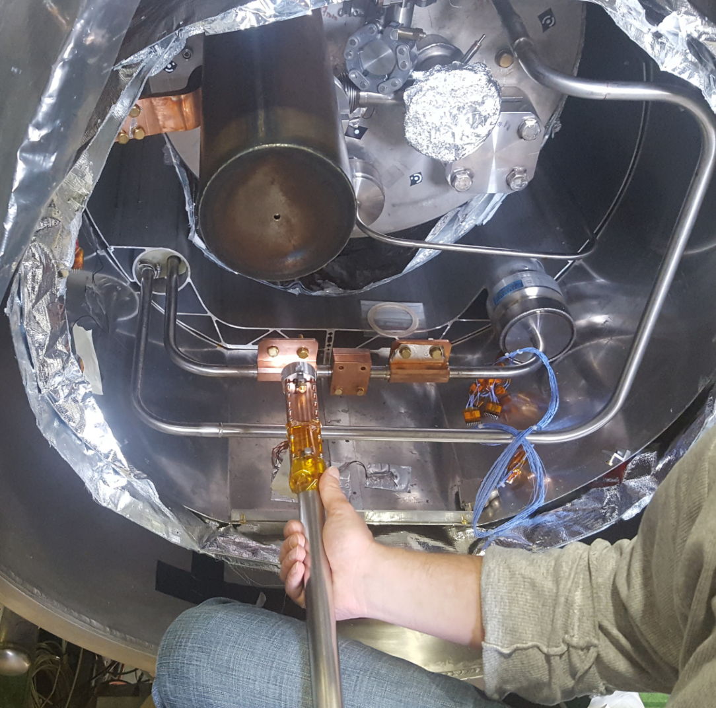
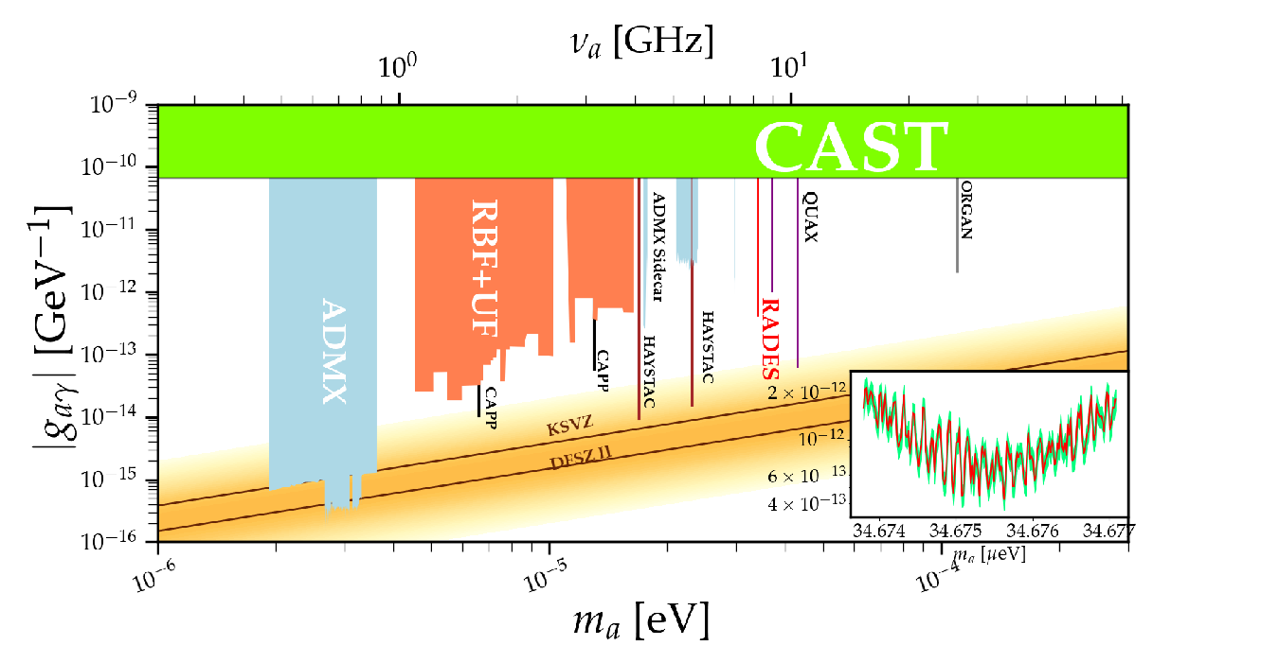
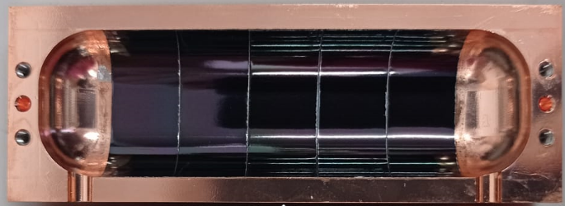
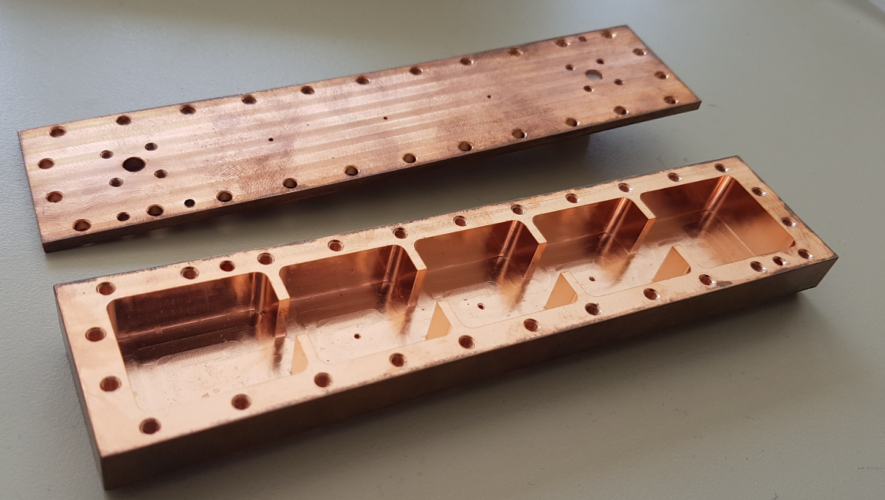
RADES
Exploratory project emerged at a later stage of CAST: use of “helioscope” magnets for “haloscope” searches
Creation and build-up “axion haloscope” community in Europe
Strong boost by ERC-StG (B. Dobrich) in 2018
Very interesting results so far:
Now ultra-cryogenic setup being built at MPP-Munich
Physics result at single f point (34.7 μeV) in the CAST magnet
Inner HTS coatings to improve Q factor
New geometry concepts to scale in V but keeping high resonant f
JCAP 05 (2018) 040
JHEP 07 (2020) 084
IEEE Trans. Appl. Supercond. 32 (2022) 45
JHEP 21 (2020) 075

Slide 5
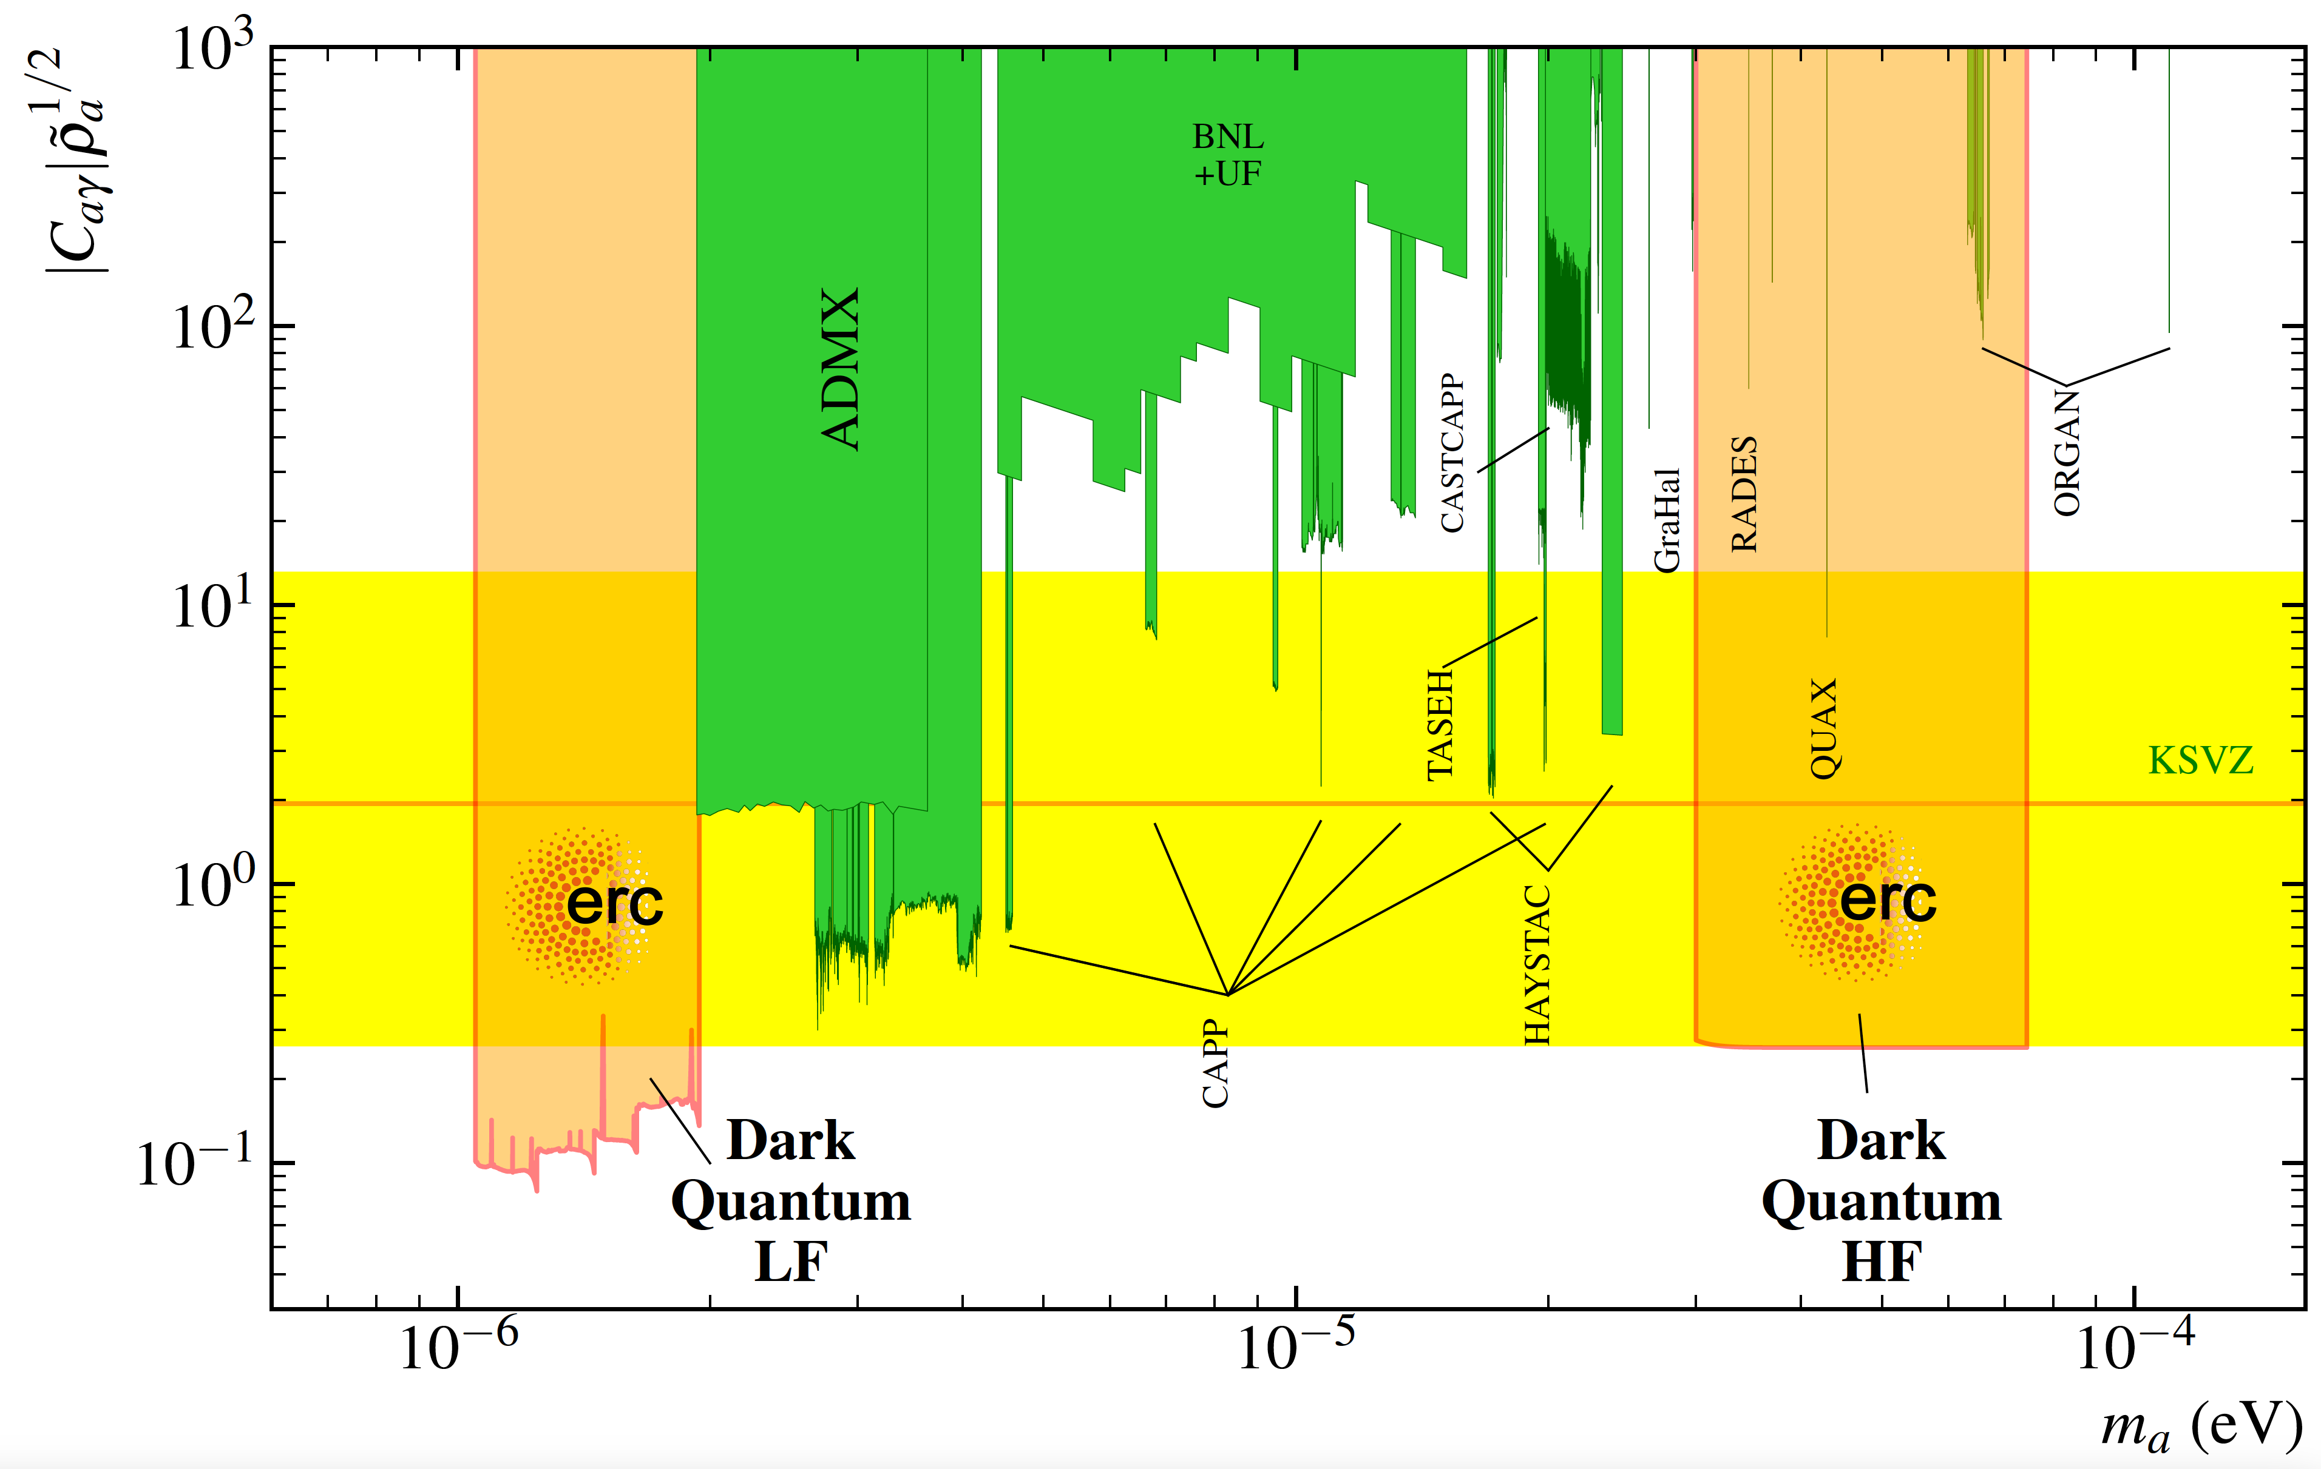
DarkQuantum : quantum-enhancing RADES
Well defined roadmap of technical and physics outcome (→ impact)
A number of secondary exploratory line with great potential:
  HTS for increasing Q
  Low radioactive techniques / underground
  Machine learning
  Magnonics for tuning
Very novel synergies: remain open for new ideas, unforeseen byproducts, etc…
DQ
LF
DQ
HF

Slide 6
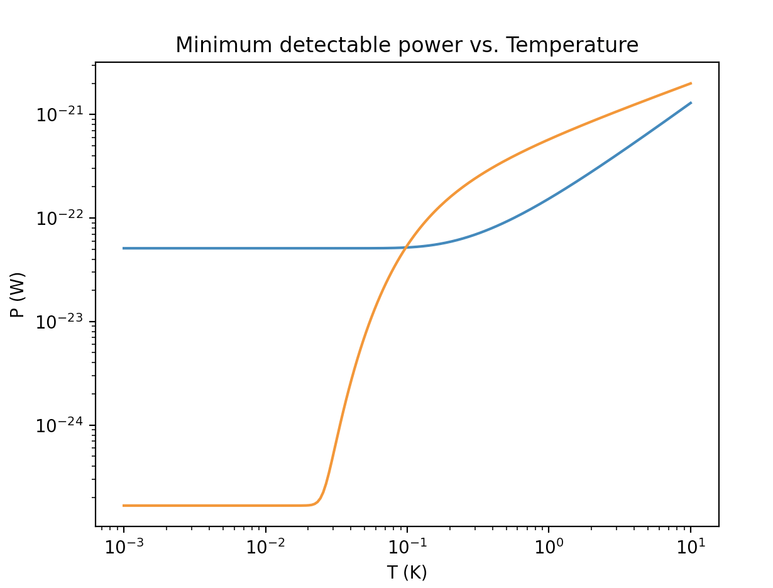
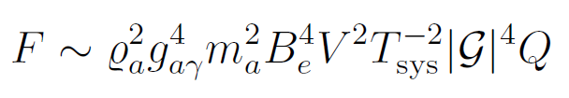
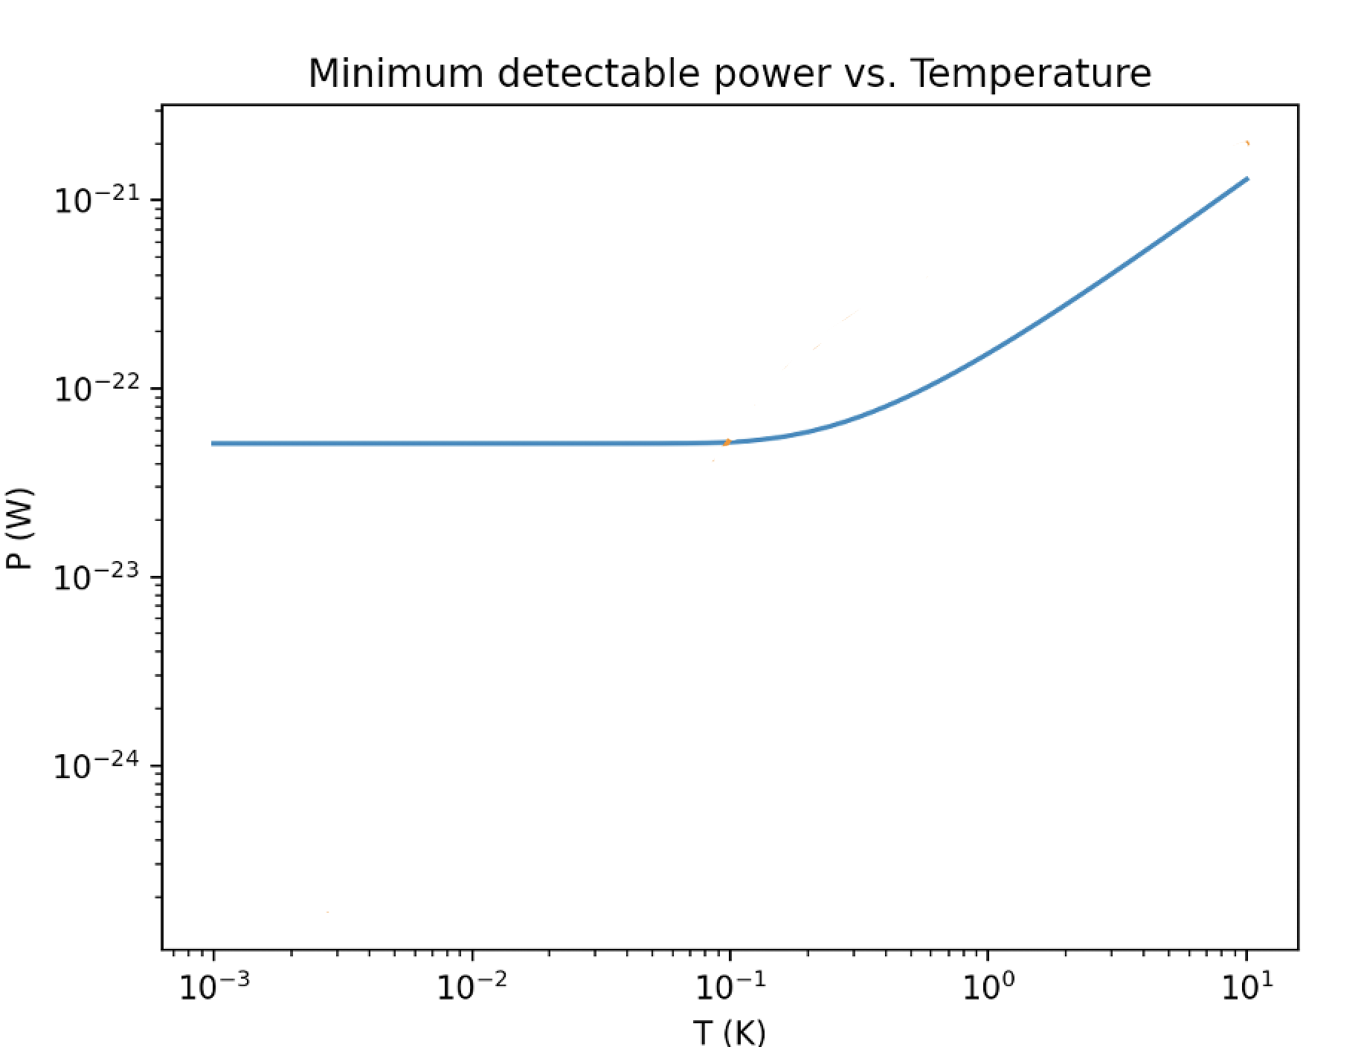
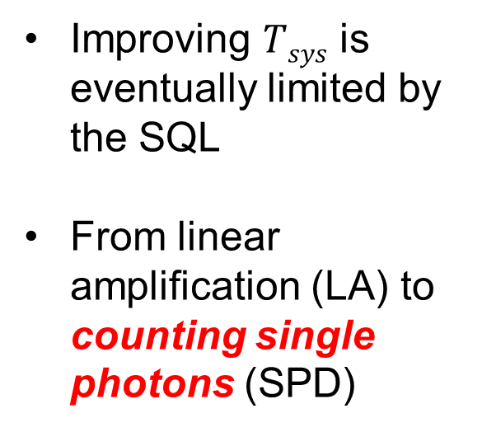
Haloscopes & quantum technologies
SPD
Improving $Tsys$ is eventually limited by the SQL
From linear amplification (LA) to counting single photons (SPD)
LA
SQL
Several orders of magnitude SNR improvement available !!!
Noise counts exponentially suppressed at low T !!!
Shot noise
DQ change of paradigm → Number-Phase conjugates evade the SQL
Single-photon detector (SPD)
vs Linear Amplifier (LA)
6

Slide 7
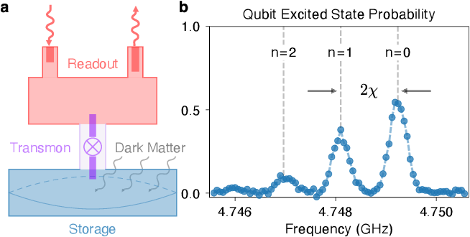
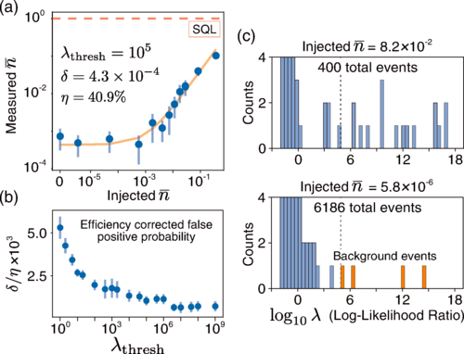
Qubit-based Single Photon Detector (SPD)
Dixit et al. Searching for dark matter with a superconducting qubit, Phys. Rev. Lett. 126
Other SC devices/layouts possible (*)
Problem: transmons are supersensitive to B-fields!
7

Slide 8
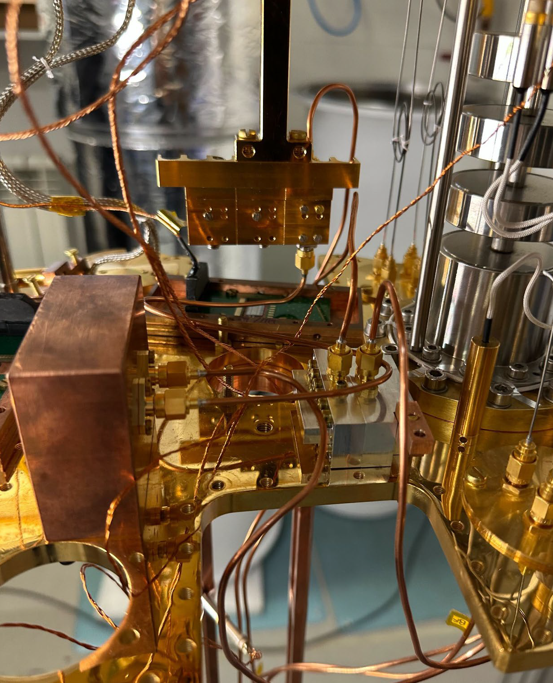
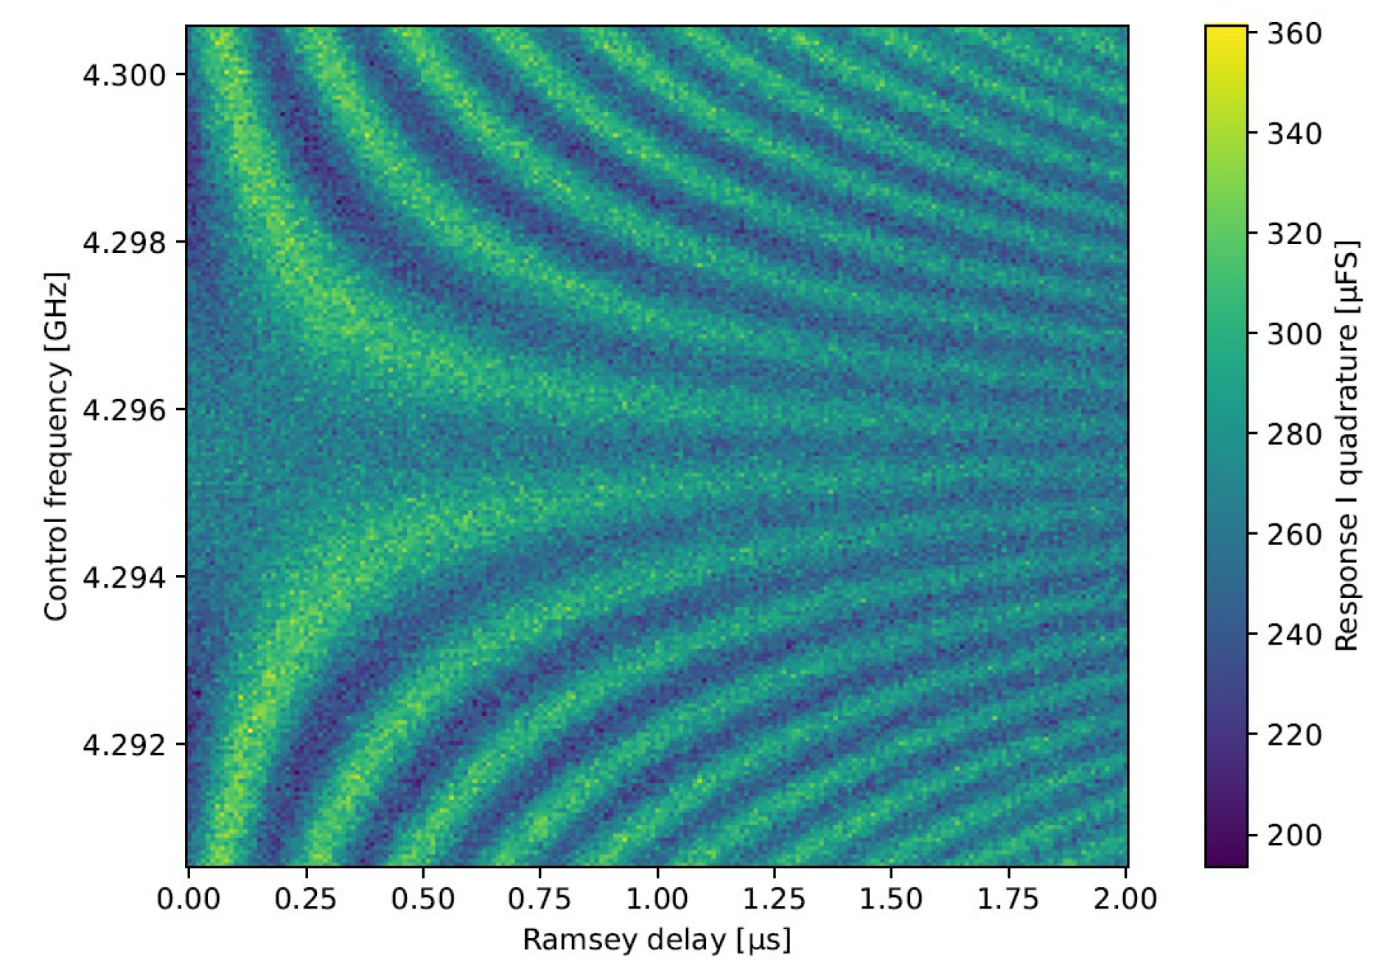
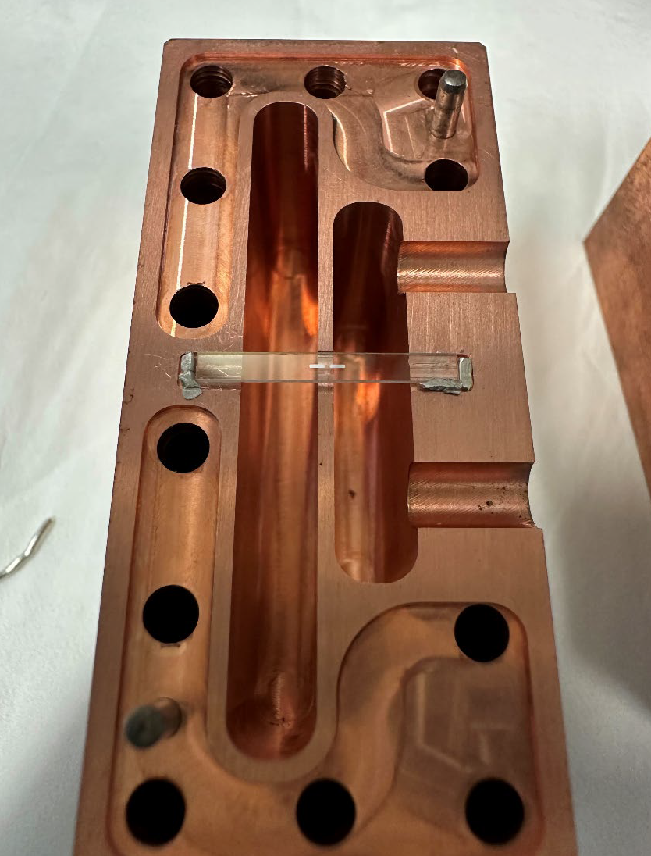
Qubit-based Single Photon Detector (SPD)
First results at CAPA!
First DarkQuantum transmon characterized
Test cavity installed in fridge.
Thanks to Pepa Martínez & QMAD group
(work in PhD thesis of D. Díez + Y. Gu + L. Segui + …)

Slide 9
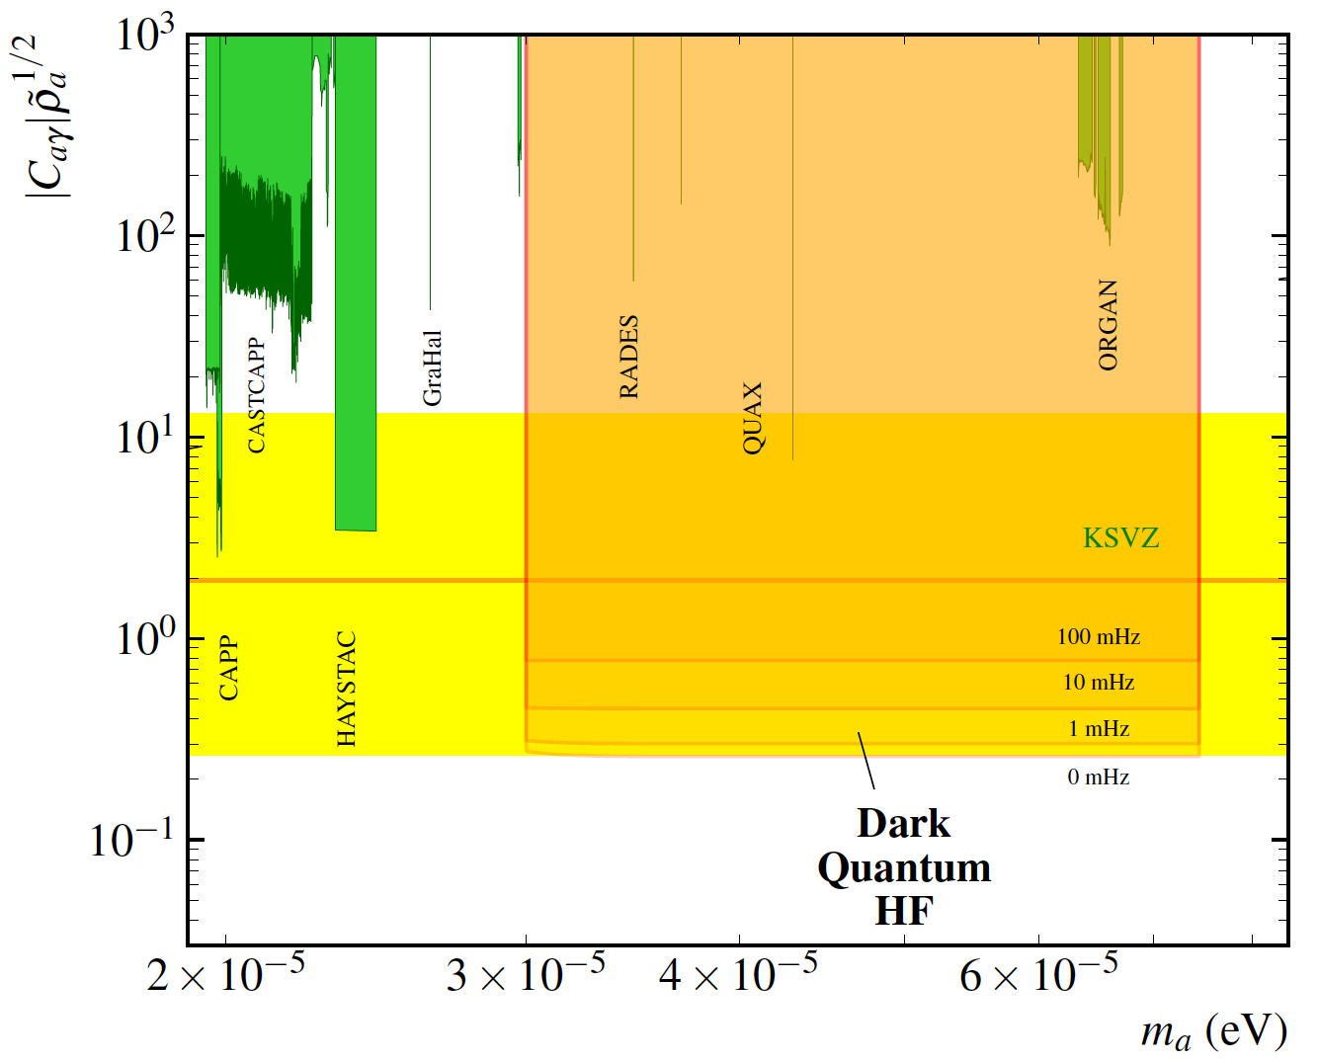



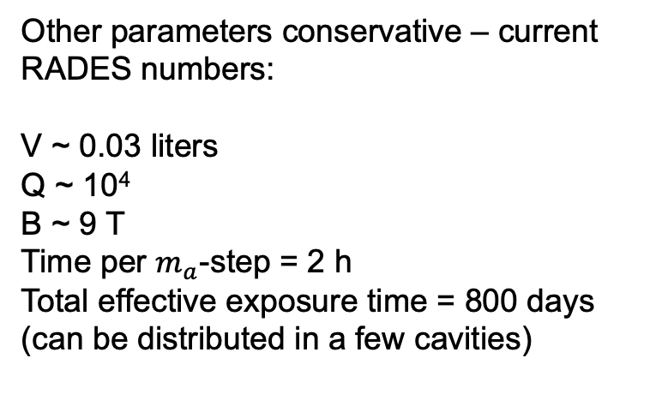
Potential impact in high-freq RADES setup
$$f ∈ (8,18) \text{GHz}$$
+ single-photon counter
+ reasonable tunability
DQ
${\text{axion}\text{−}\text{photon} \text{coupling} C}_{aγ}∝ g_{aγ}/m_{a}$
Other parameters conservative – current RADES numbers:
V ~ 0.03 liters
Q ~ 10⁴
B ~ 9 T
Time per $m_{a}$-step = 2 h
Total effective exposure time = 800 days (can be distributed in a few cavities)
SPD
dark count rate
$${\text{axion} \text{mass} m}_{a} \text{(}\text{eV}\text{)}$$
9

Slide 10
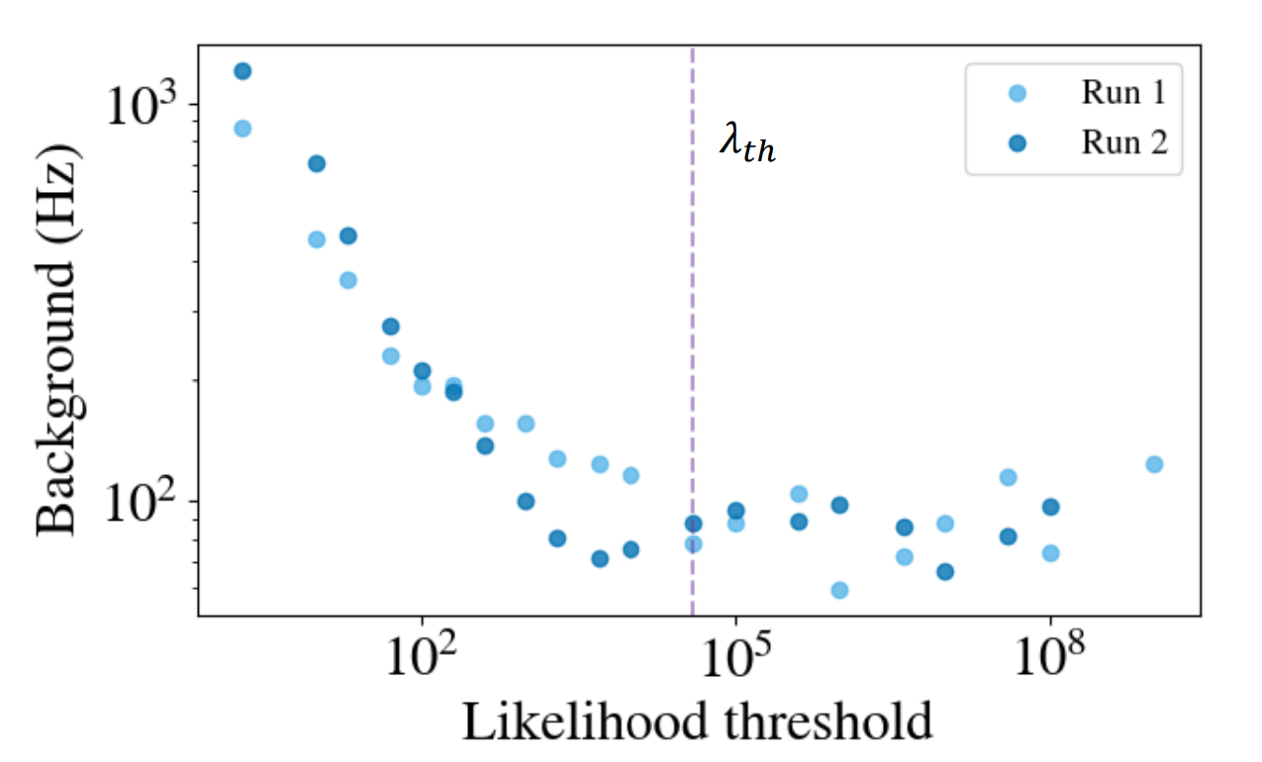
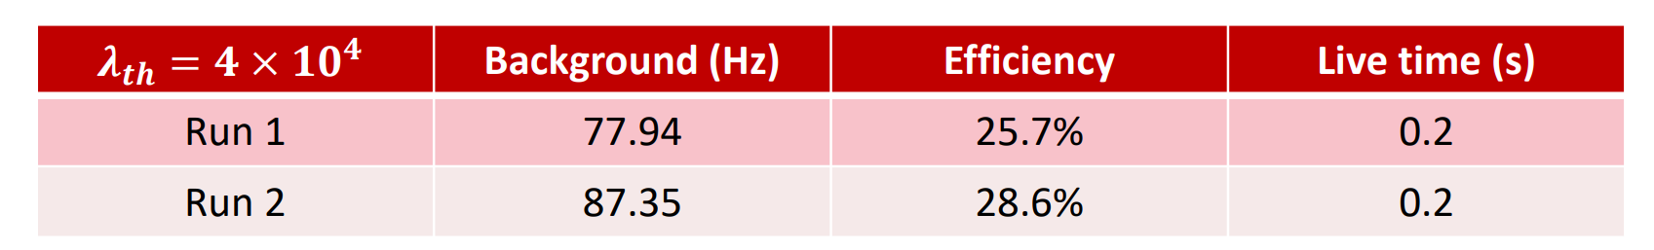
“quantum” collaborations
QRADES (Quantera) & DarkQuantum (ERC)
  → IFAE (common QSPC setup planned)
  → Aalto (QSPC in operation) →
  → KIT & ENS-Paris
  → MPP-Munich
Participation in DRD5
Of course WG5-CNID

Slide 11
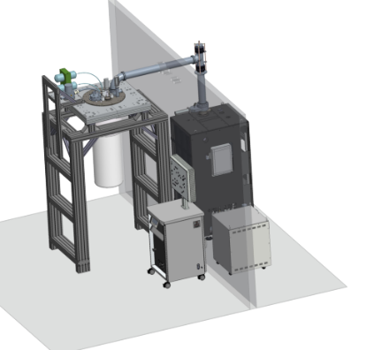
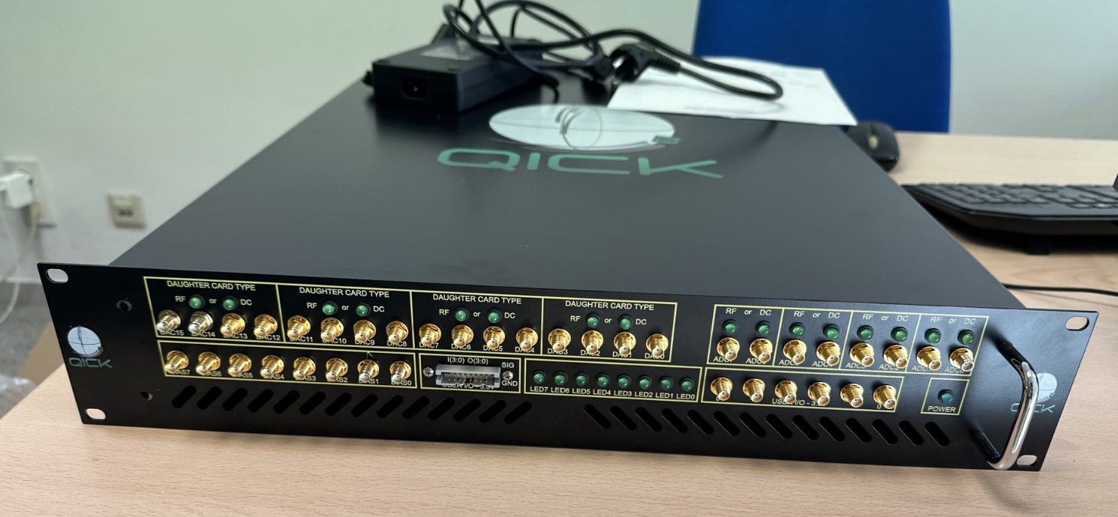
QS at CAPA
DarkQuantum & axions is main motivation, but CAPA aims to stablish QS in general as strategic → expansion to other applications
Buildign know-how & infrastrcutures:
  Dilution fridge as general CAPA infrastructure purchased (to be received in april) + antivibration platform
  A second dilfrige (DarkQuantum) to follow
  Good portfolio of generic RF electronics
  New QICK electronics for qubit control

Slide 12


Acknowledgements
The work presented in this seminar is part of the work carried out in collaborations (IAXO & RADES), and funded by many agencies. But in particular I want to personally acknowledge support from:
The European Union’s Horizon 2020 research and innovation programme under the European Research Council (ERC) grant agreement ERC-2017-AdG788781 (IAXO+).
The European Union’s Horizon 2020 research and innovation programme under the European Research Council (ERC) grant agreement ERC-2023-SyG 101118911 (DarkQuantum).
The Spanish Agencia Estatal de Investigación (AEI) under grant PID2019-108122GB-C31 funded by MCIN/AEI/10.13039/501100011033.
The “European Union NextGenerationEU/PRTR” (Planes complementarios, Programa de Astrofísica y Física de Altas Energías), co-funded by Gobierno de Aragón
Funded by the European Union. Views and opinions expressed are however those of the author(s) only and do not necessarily reflect those of the European Union. Neither the European Union nor the granting authority can be held responsible
for them.

Slide 13
DQ
Thank you for your attention
→ Backup slides

