Slide 1
What do Ted and Matt actually do?
04/02/2026

Slide 2
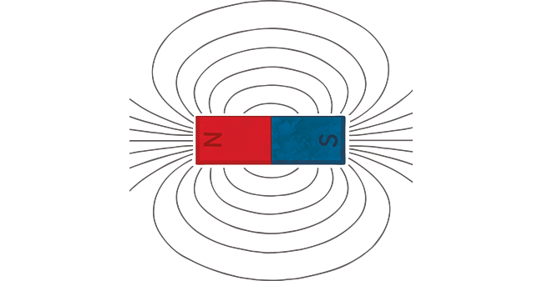
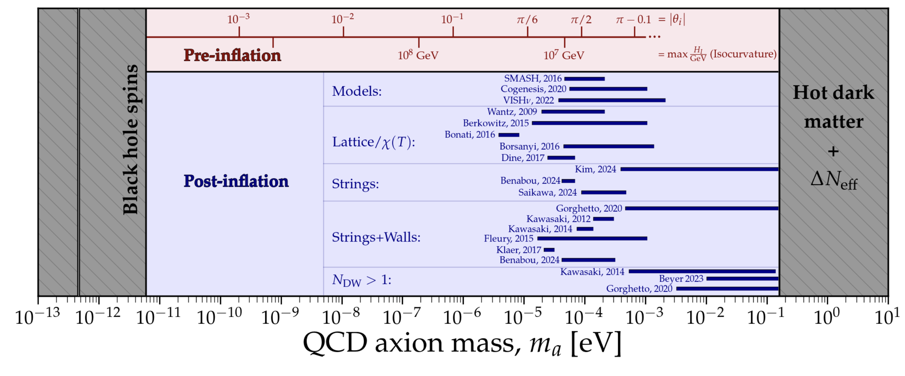
Axions
Axions are a proposed dark matter particle.
In strong B fields they interact, via the inverse Primakoff effect, to produce photons.
These photons are strongly motivated to be around microwave frequencies.
We are building a haloscope to detect these microwave photons.
Axions
Photons

Slide 3
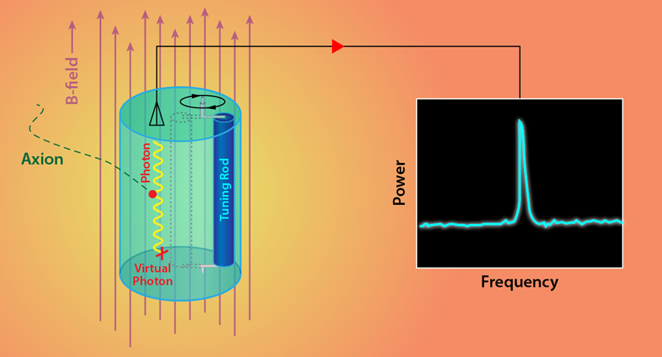
The Detector
A haloscope is a microwave resonant cavity in a strong magnetic field.
If a photon with frequency matching the resonance of the cavity is present, we see an increase in output power.
The photon frequency is related to the axion mass.

Slide 4

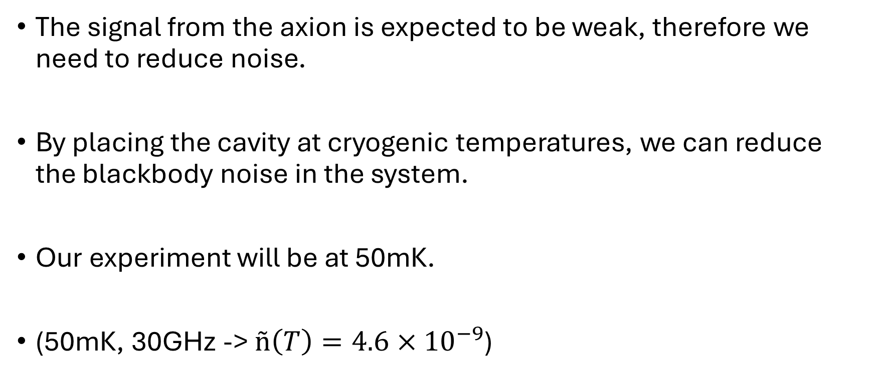
Cryogenics
The signal from the axion is expected to be weak, therefore we need to reduce noise.
By placing the cavity at cryogenic temperatures, we can reduce the blackbody noise in the system.
Our experiment will be at 50mK.
(50mK, 30GHz -> $ñ\left(T\right)=4.6×{10}^{−9}$)
$$ñ\left(T\right)= \frac{1}{e^{{hf}/{k_{B}T}}−1}$$

Slide 5
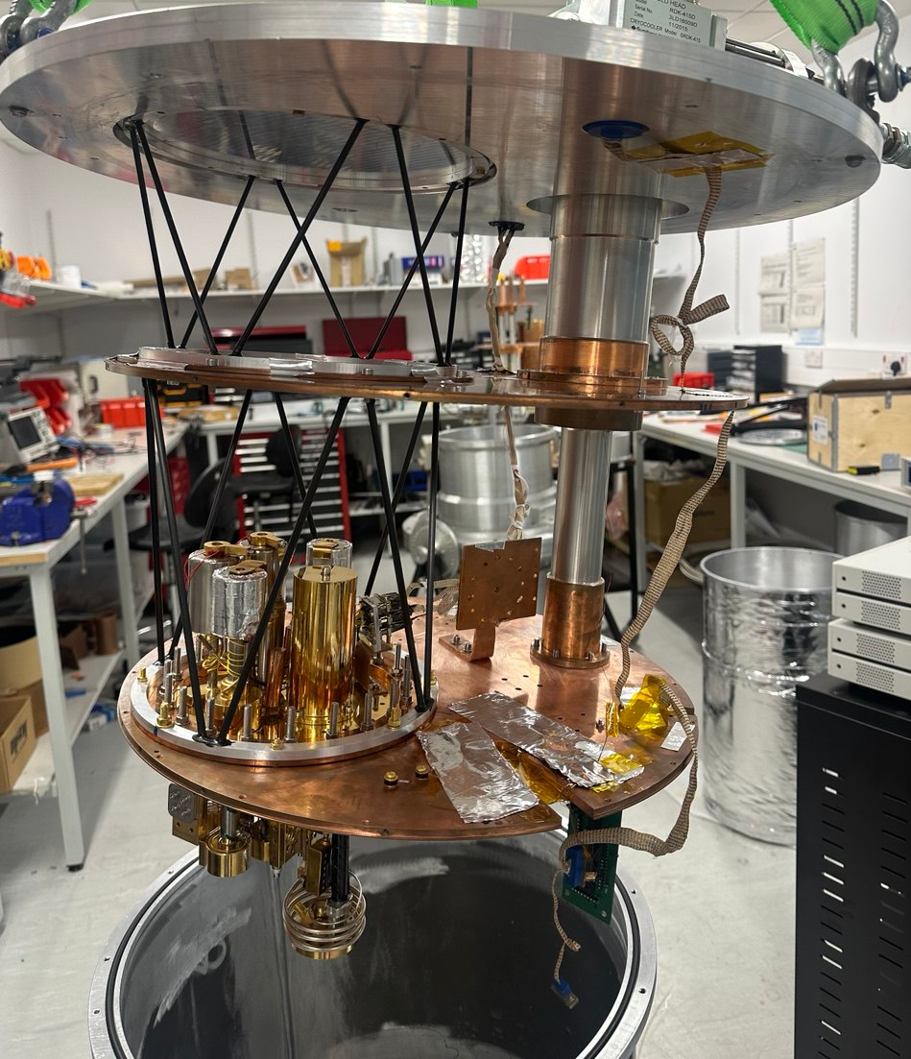
Cryogenics
We get to 50mK using a mini dilution refrigerator.
These dissolve liquid helium-3 into superfluid helium-4, which produces large sub-kelvin cooling power.
We pre-cool the mixture using sorption coolers.

Slide 6
Sorption Coolers
Charcoal Pump
Heat Switch
A pot of liquid Helium lies below a charcoal pump, with a condenser (mechanically cooled to 4K) between them.
The charcoal pump, when cooled using a heat switch, adsorbs evaporated Helium from the pot.
This adsorption of vapour cools the liquid Helium in the pot.
This cools He-4 to 1K. A He-4 cooler can act as the condenser to a He-3 system which can reach 300mK.
Condenser Flange
He Vapour
Pot
Liquid He
A diagram of a single stage sorption cooler. When the charcoal pump is heated, Helium flows as the red arrows. When cooled, Helium flows as the blue arrows.

Slide 7
Dilution Refrigerators
Below 0.85K, a phase separation between liquid He-3 and superfluid He-4 occurs.
Concentrated He-3 sits above diluted He-3 in He-4 (at a constant conc.).
There is an enthalpy change when He-3 is diluted with He-4. Heat is absorbed from the surroundings when this occurs.
We can circulate He-3 through He-4 to continuously cool.
He-3
He-3 + He-4
Mixing chamber
An illustration of how He-3 and He-4 occupy the mixing chamber.

Slide 8
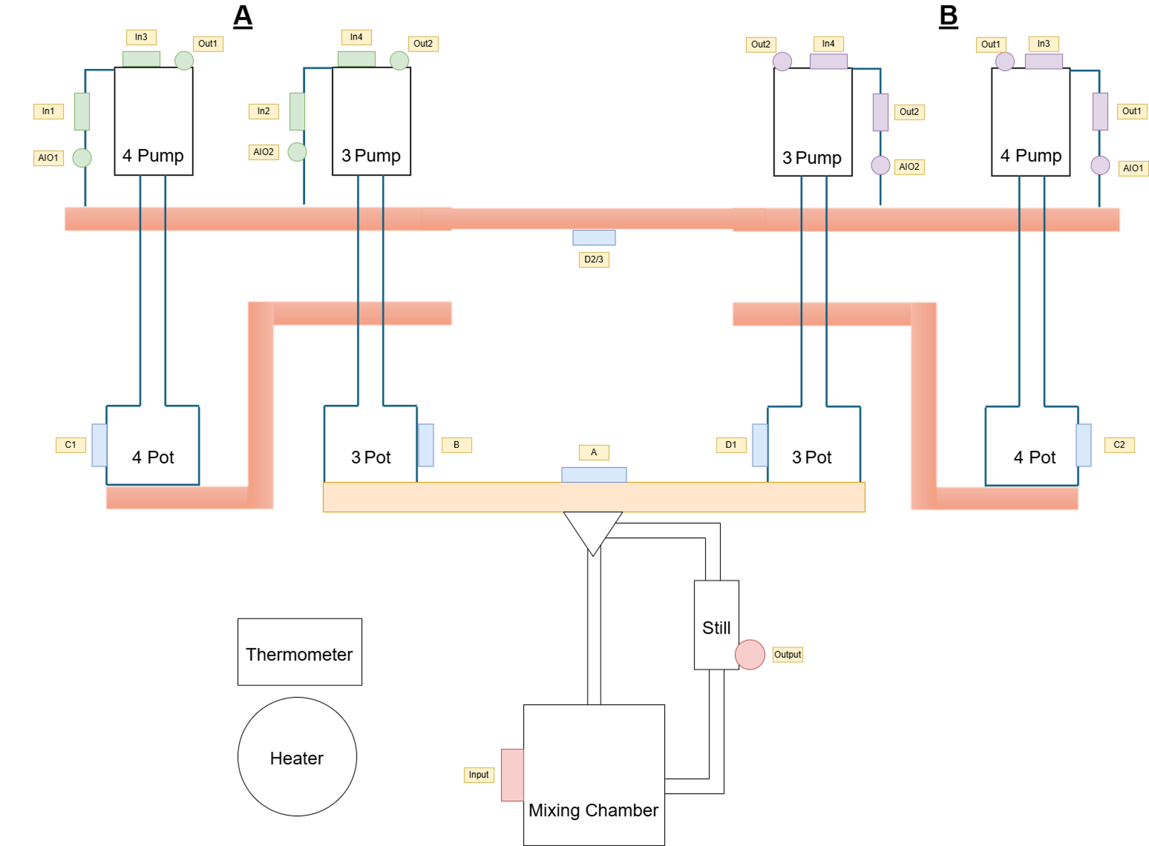
Dilution Refrigeration
We circulate He-3 in the mixing chamber by heating the still.
We have two coupled sorption systems acting as the condenser for the dilution system.
We can alternately cool these systems to keep the condenser at a constant 300mK.
Condenser @ 300mK
50mK

Slide 9
Thermometry + Heating
We need to monitor the temperatures of each stage of the fridge.
Above 4K we use diodes, below 4K we use resistors.
Resistance bridges measure the temperature of these thermometers and output them via USB to ARCTIC-FOX.
We also use heaters in the cryostats to control the sorption pumps and to circulate the He-3 through the DR.
Heaters are controlled by CTCs + ARCTIC-FOX.

Slide 10
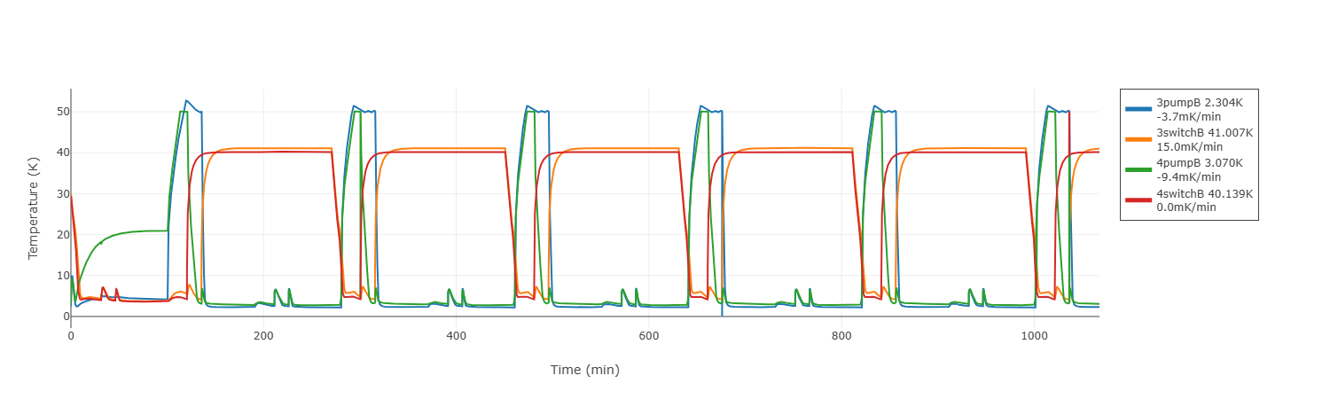
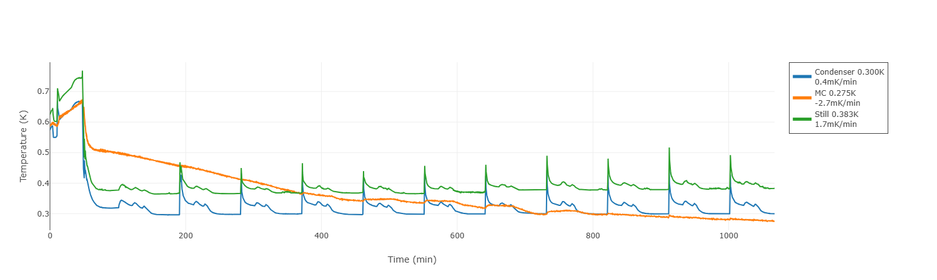
ARCTIC-FOX
Active Regulation & Control of Thermal Interfaces for Cryogenic Fridge Operation eXperiments
A software which allows us to monitor and control the temperatures inside the cryostat.
It also contains an algorithm for cycling the sorption systems for automatic continuous cooling.

Slide 11
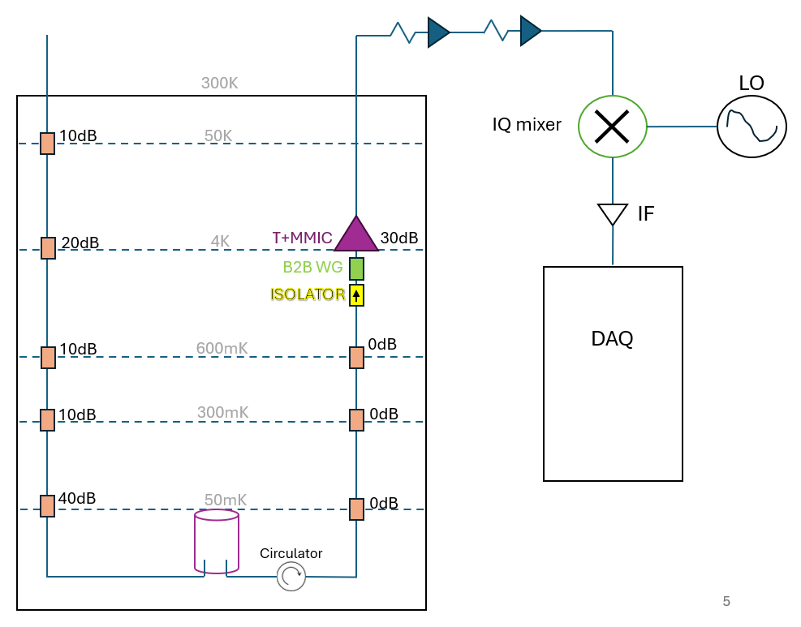
Axion Signals
Now we have reached sub-K, we can construct the readout chain.
The cavity is weakly coupled to a coaxial cable where the resonant signal can be read out.

Slide 12
Axion Signals
Input
There is also an input line, this is for characterising the readout chain.
We can inject simulated axions via this line also.
Attenuators are placed at each thermal stage to reduce blackbody noise travelling down the input line.

Slide 13
Axion Signals
Input
The circulator stops reflections down the output chain.
The 0dB attenuators thermalise the chain to reduce heating to the 50mK stage.
The back-to-back waveguides act as a frequency filter to reduce noise.
The signal is amplified by an LNA at 4K.
Outside the cryostat, the signal is downmixed at the IQ mixer from 30GHz to 10MHz to make data processing easier.

Slide 14
Axion Signals
Input
The DAQ receives voltages as a series in time.
An FFT turns this into frequency vs “counts”.
If an axion signal appears, we will see a peak at the axion frequency.

