Slide 1
Exploring Color Flows in TMDs:
Disconnected Wilson Loops on the Lattice
Jyn Peyton

Slide 2
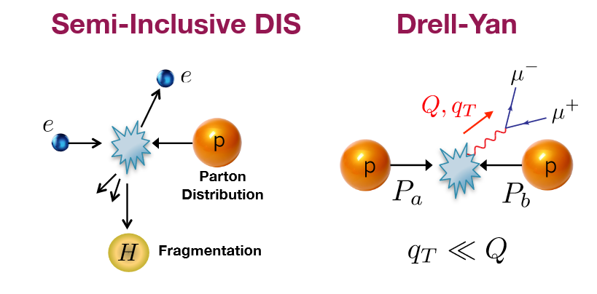
Motivation
Fig 1.9 from 2023 TMD Handbook
Notes:
Processes capable of being simulated perturbatively and non-perturbatively, describes many kinds of collisions in particle accelerators
TMDs on the lattice
Semi-Inclusive Deep Inelastic Scattering
Drell-Yan: Hadron-Hadron production of lepton pairs
Standard TMDs that can be used to describe SIDIS and Drell-Yan processes can be calculated on the lattice.
There are new kinds of TMDs calculated on the lattice, that could be used to describe hadron to hadron interactions and results from the eic

Slide 3
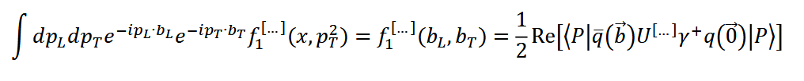
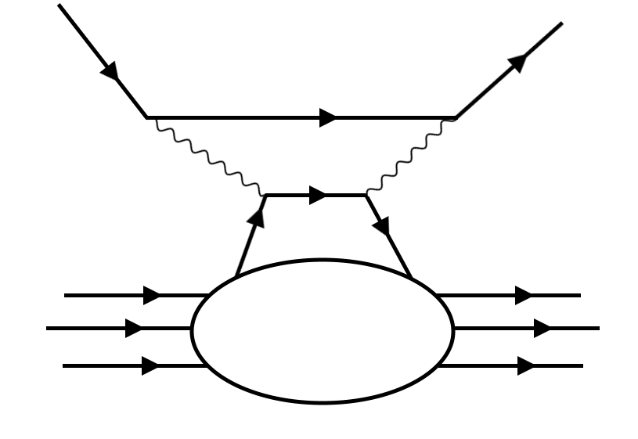
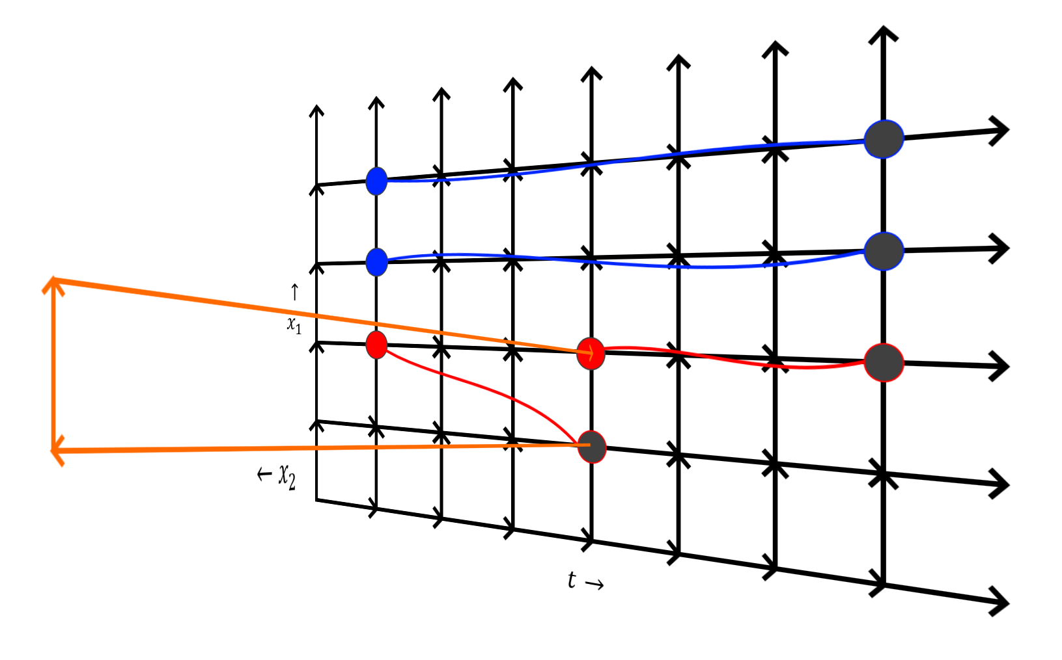
Motivation
Notes:
How can lattice qcd calculate TMD’s anyway?
In a particle collider, we have some hadron traveling with some momentum, and a quark is ejected. That is exactly what happens on the lattice.
We only focus on the qcd component, we don’t care about the electrons/photons at all
The ‘blob/bulk’ is the TMD Matrix Component that we calculate on the lattice
Compare dis handbag diagram to Lattice diagram
We are calculating fourier transformed TMDs, in Position Space not Momentum Space
How to get from phenomenology view to lattice view?
3 Things:
-Fourier transform from momentum to position
-Remove all non-qcd elements from the interaction
-Wick rotate from minkowski time to euclidean time
-Simulate the blob/bulk of the hadron with the conditions imposed
All the infinite interactions that can happen inside that blob are ‘discretized’ on the lattice and become countable and calculable.
TMD Matrix Element

Slide 4
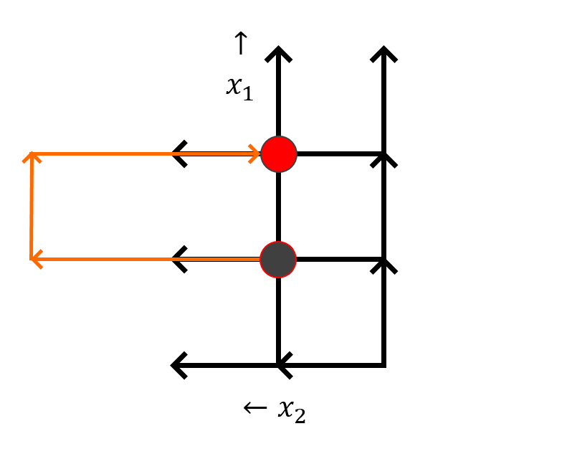
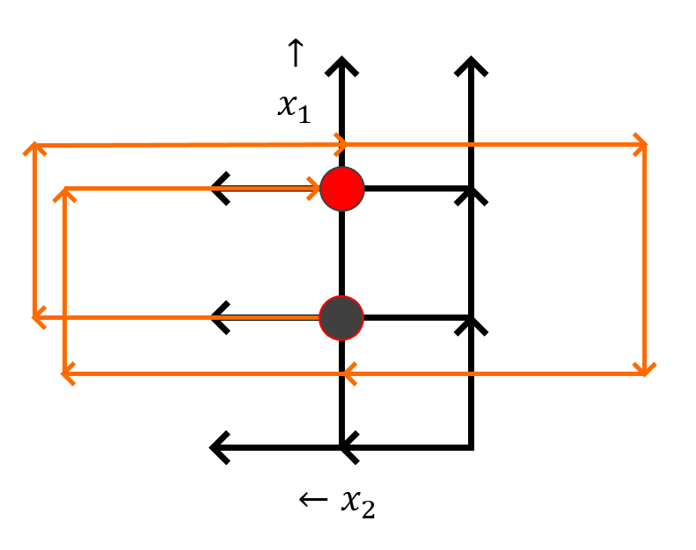
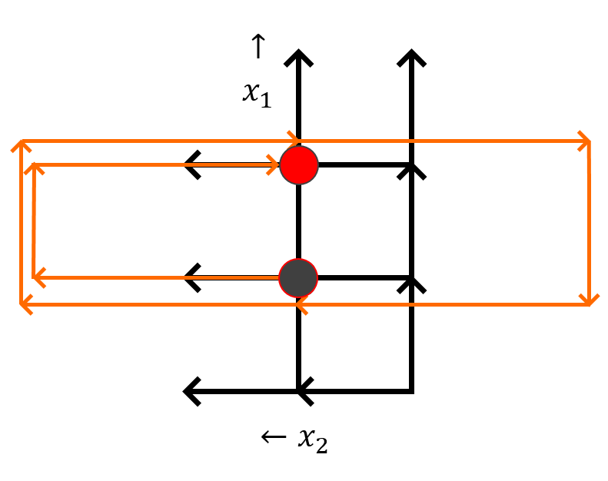

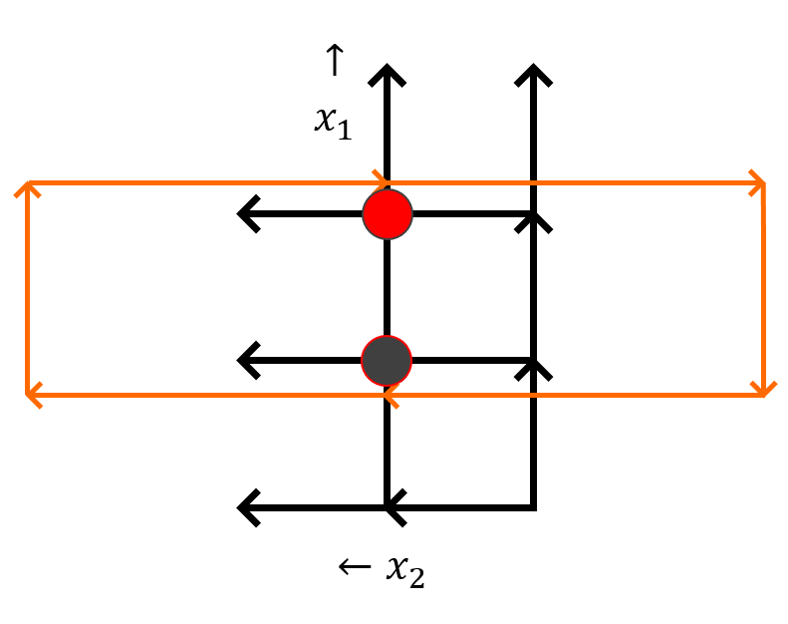
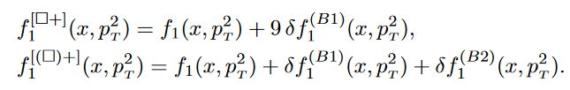
Motivation
Boer et al, 2015 arXiv: 1503.03760v2
Notes:
New kinds of TMDS.
Dependance on pt^2.
Gauge link dependence of TMDS.
Measuring Non-universality of TMDs.
Spiral closely matches figure 1e, Leading Order 2->2 Processes
Disconnected closely matches figures 1f,1g,1h, Non Leading Order 2->2 Processes
TMD functions made from original staple function (f1)
F1 describes an unpolarized quark in an unpolarized hadron with some longitudinal and transverse momentum

Slide 5
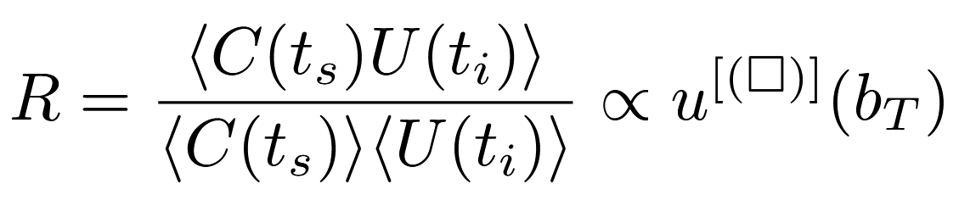
Motivation
Boer et al, 2015 arXiv: 1503.03760v2
Notes:
New kinds of TMDS.
Dependance on pt^2.
Gauge link dependence of TMDS.
Measuring Non-universality of TMDs.
Spiral closely matches figure 1e, Leading Order 2->2 Processes
Disconnected closely matches figures 1f,1g,1h, Non Leading Order 2->2 Processes
TMD functions made from original staple function (f1)
F1 describes an unpolarized quark in an unpolarized hadron with some longitudinal and transverse momentum

Slide 6
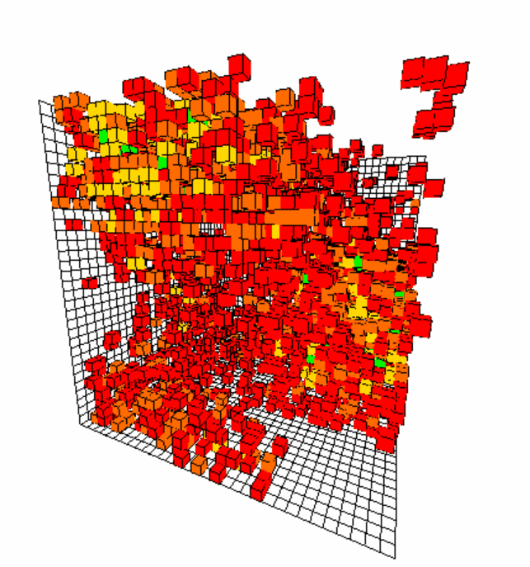
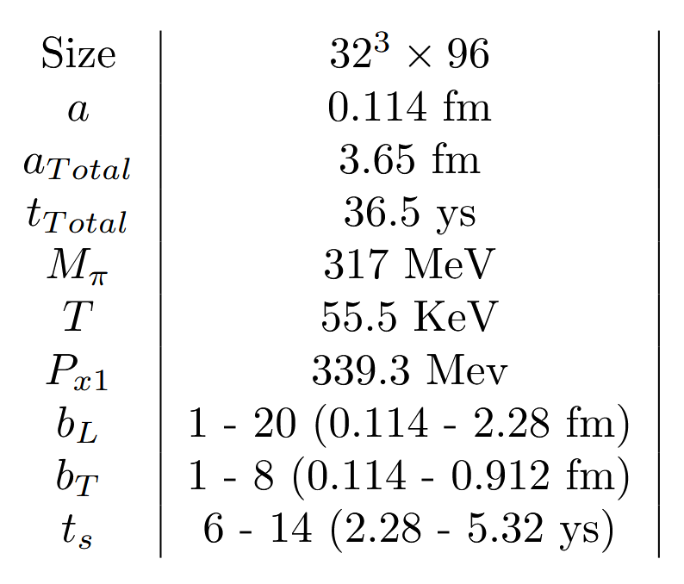
Methodology
Notes:
Details of the lattice:
-Size, Duration, Pion Mass, Vacuum Energy
Lasts roughly one one-hundred-thousandth of an attosecond, absurdly fast (10^-24 sec)
Wilson Loop sizes
Two-point function momentum, lowest possible on the lattice due to harmonics
Two-point function source locations
4-distance of 32 or higher away from other sources
Prevents re-using the same portions of the lattice
12 sources per configuration, each sources produces 32*32*32*96 proton/pion correlator results.
Like in real life, a proton source on the lattice doesn't just make one proton.
Non-imaginary time, hadrons decay exponentially from sources
The lattice calculates every possible two point function with a given source.
12 Sources in a cubic array.
Protons being generated at multiple points and propagating in all directions, including backward in time
Euclidean Proton Propagation animation
Visualization of the raw data
Always average all correlators over all space and just have a function in terms of time
Averaging over middle time slices.
As Hamiltonian is exaggerated near the source point,
And uncertainties become comparatively larger as we approach t_s=16 and the amplitude continues to decay.

Slide 7
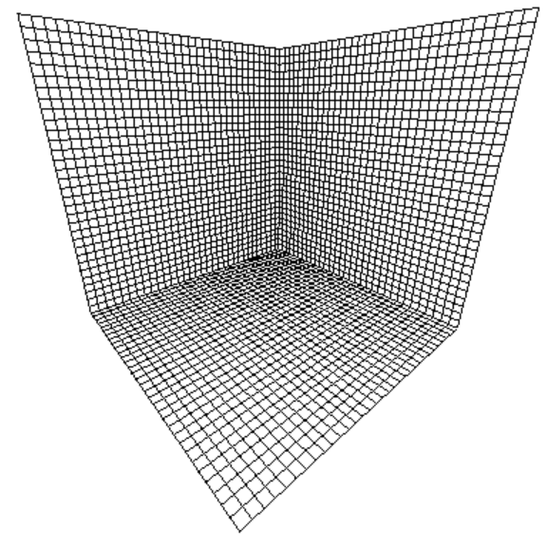
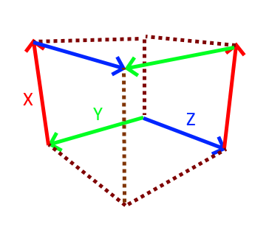
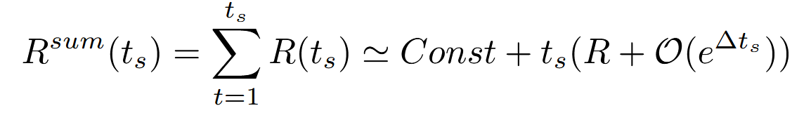
Methodology
Correlated Over 12 2pt Sources
Summation Method over Source-Sink Separation
Jackknife Resampling over 968 Configurations for Uncertainty
Linear Fit over Longitudinal Distance

Slide 8
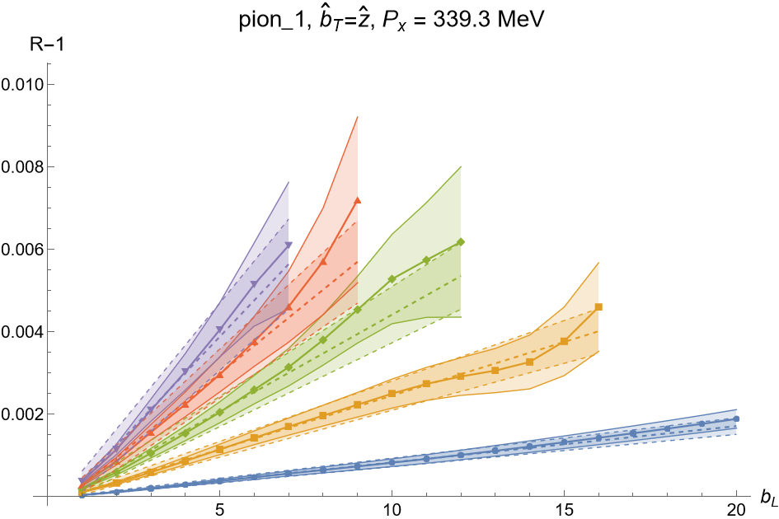
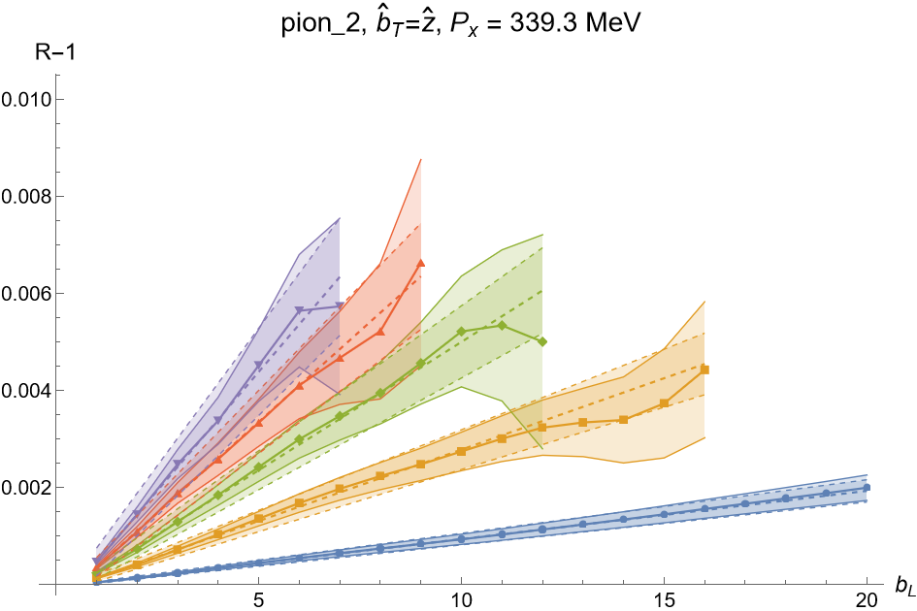
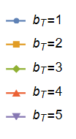
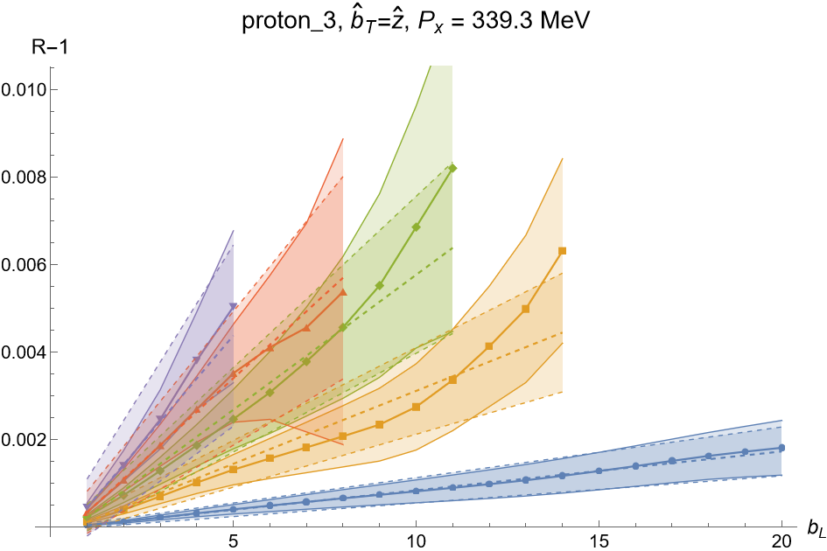
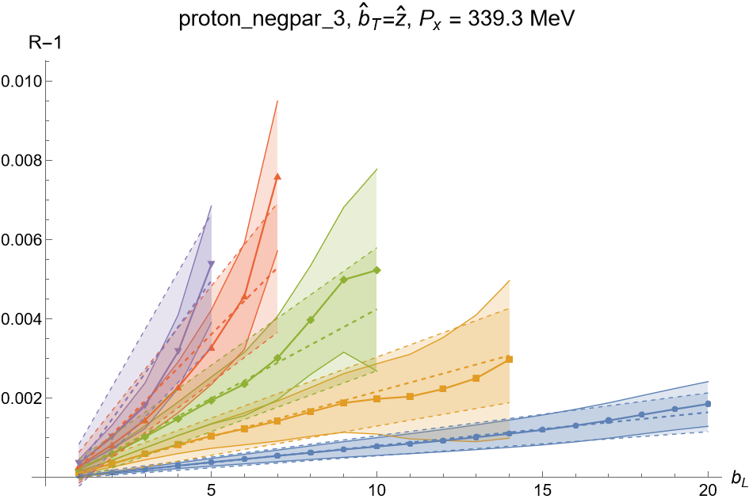
Results

Slide 9
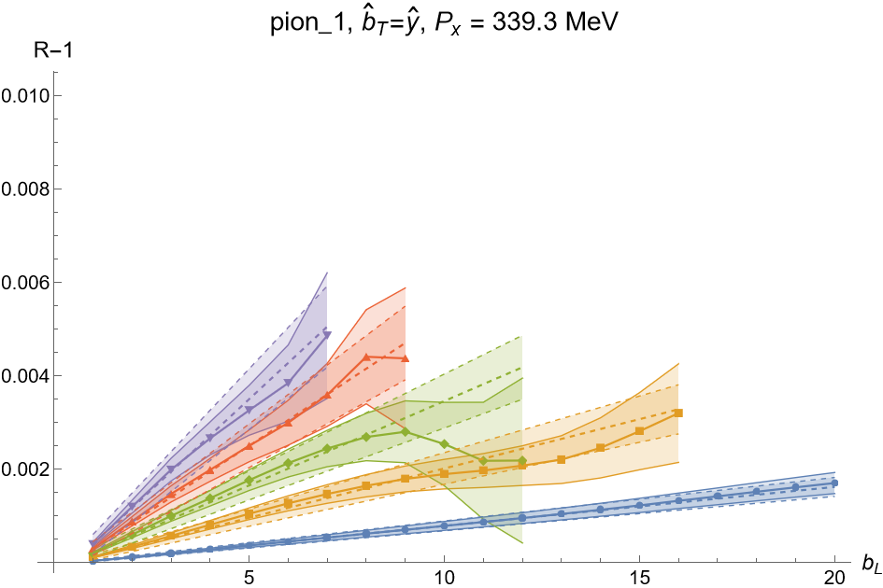
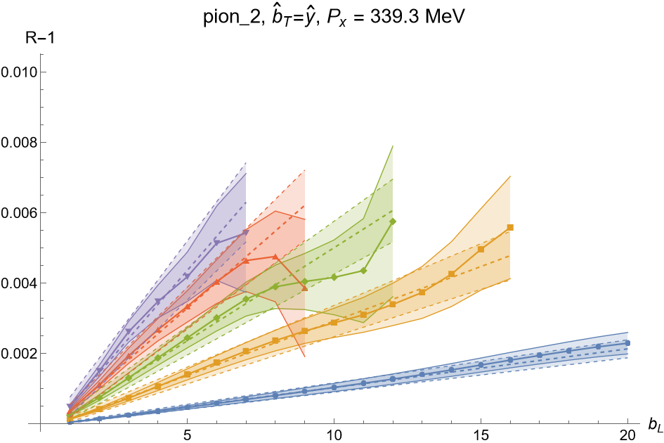
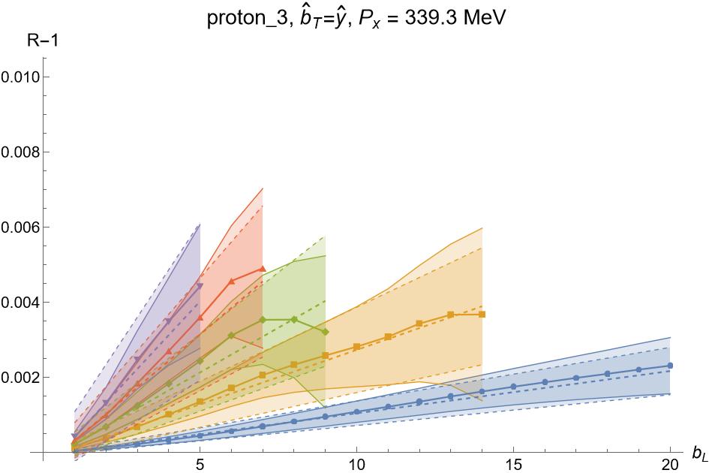
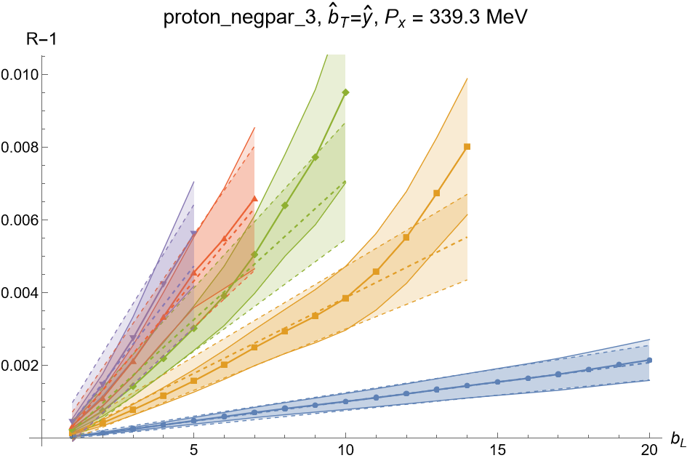
Results

Slide 10
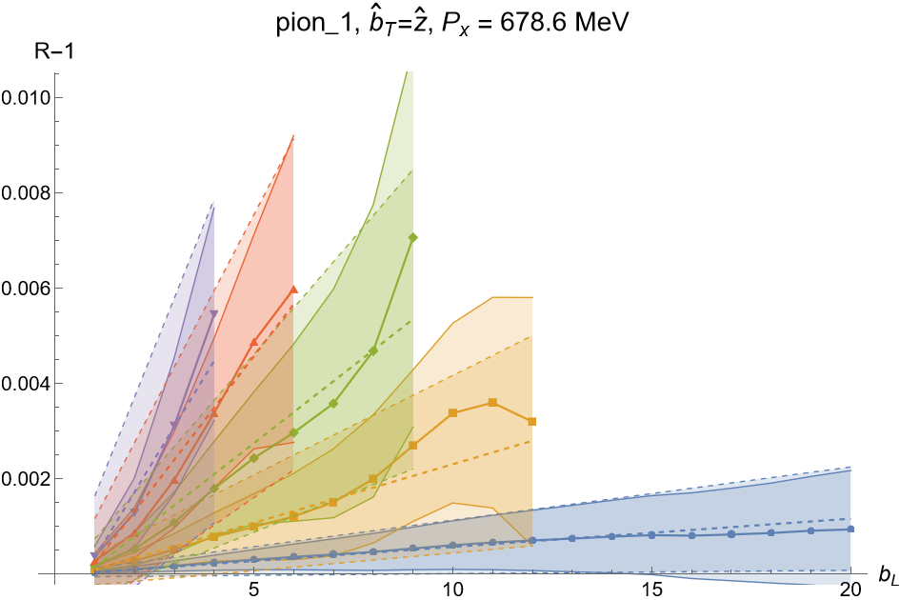
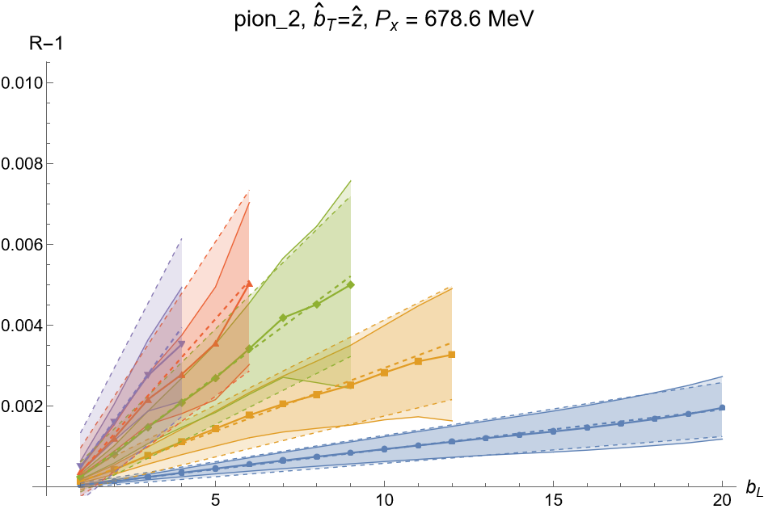
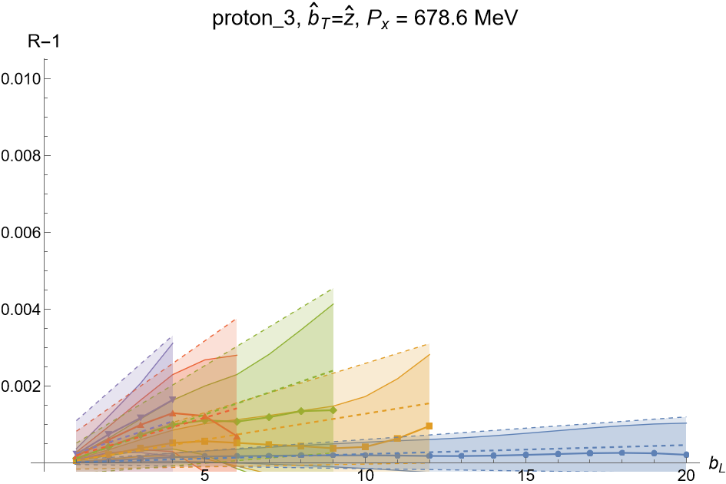
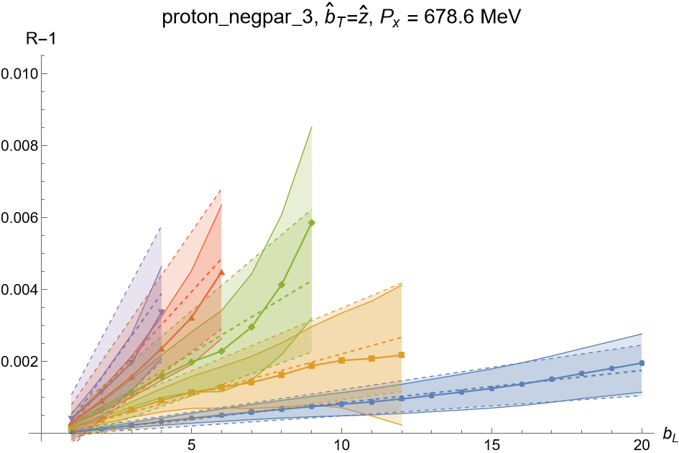
Results

Slide 11
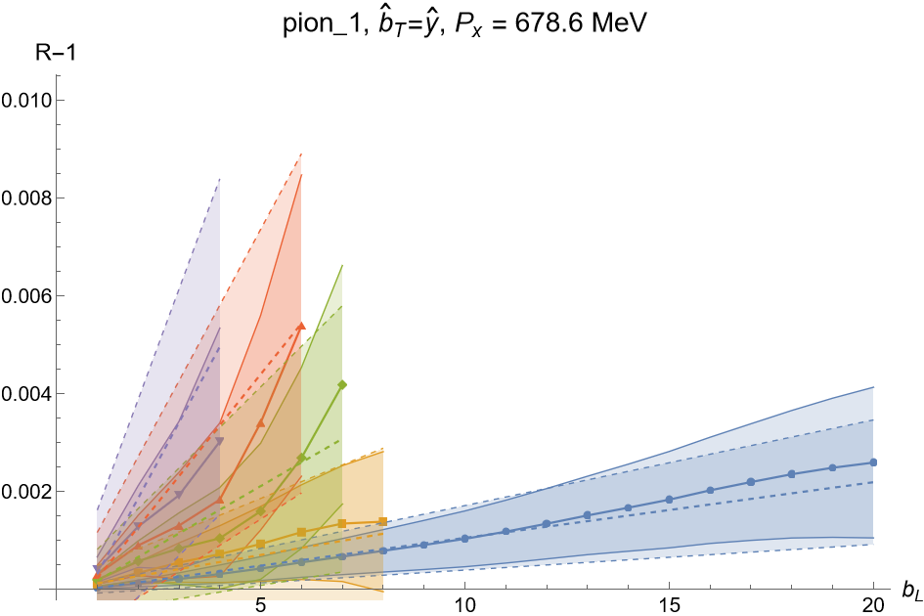
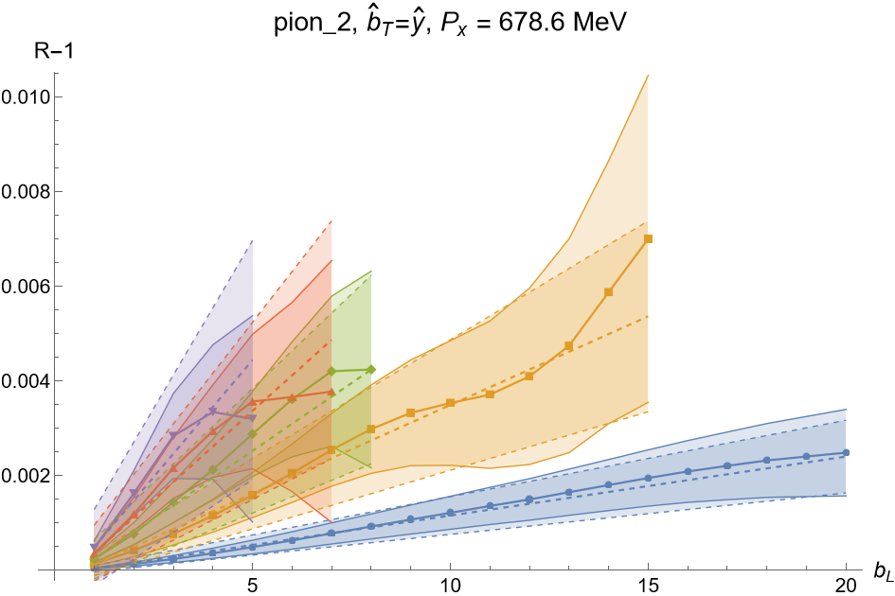
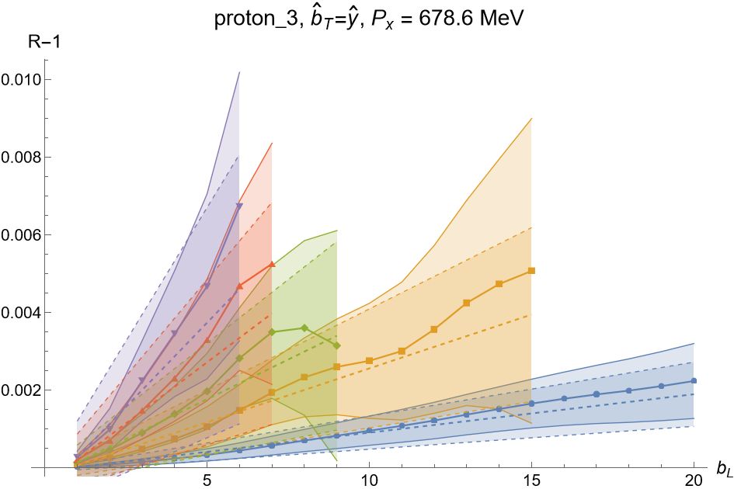
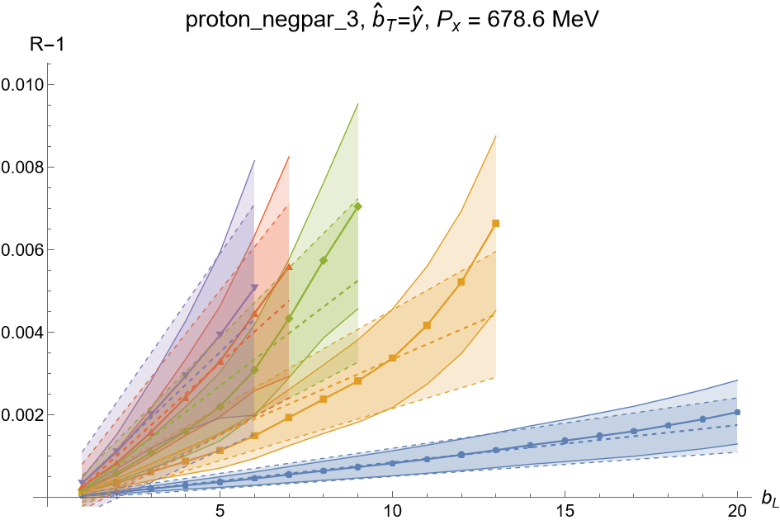
Results

Slide 12
Conclusions
Boer et al proposed new TMD operators
Could Describe 2->2 Processes
A Disconnected 3-Point Function was Calculated
Signal for b_{T} = 1 - 5, for all Four Hadrons tested, and for First Two Momenta
Funded via DOE Grant: DE-FG02-96ER40965

Slide 13
Remaining Work
Repeating calculation for even higher momenta
Fit over b_{T} and P_{X}
Fourier to p_{T}
Calculate new Fully-Connected 3-Point Functions
Define relations between new TMDs and potential EIC processes
Funded via DOE Grant: DE-FG02-96ER40965
Notes:
Gauge links describe the ejected quark,
In phem frame, gauge links are W_kb for the ejected quark
Non-universality - “process dependant”

Slide 14
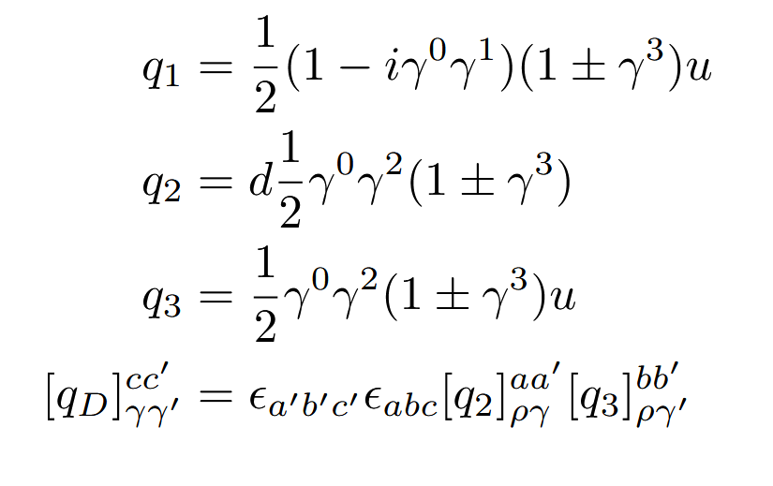
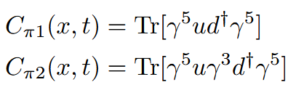
Methodology

