Slide 1

Baryon-baryon interactions in the S = -1 channel and inelastic contaminations in physical-point lattice QCD
Koichi Murase^{A}, Takumi Doi^{B}, Takahiro M. Doi^{C}
^{A}The University of Osaka,
^{B}iTHEMS, RIKEN,
^{C}Kyoto Univ.
for HAL QCD Collaboration
Lattice 2026, 2026-07-31, University of Maryland, US

Slide 2
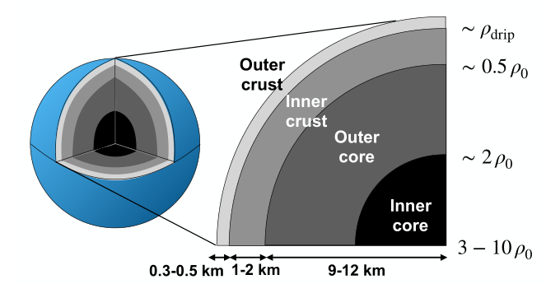
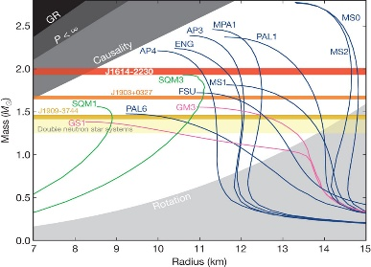
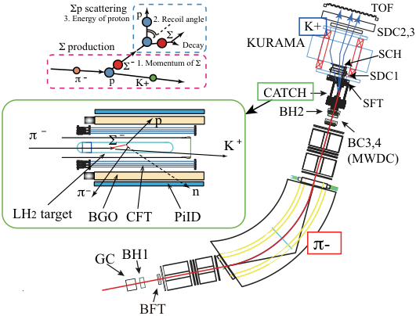
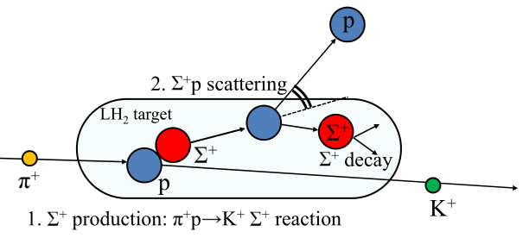
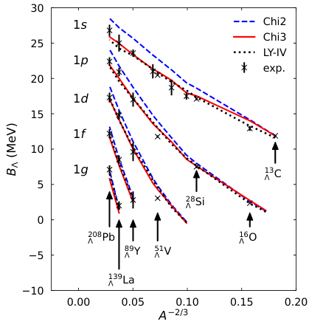
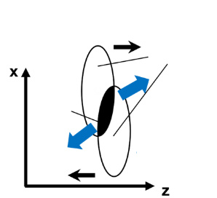
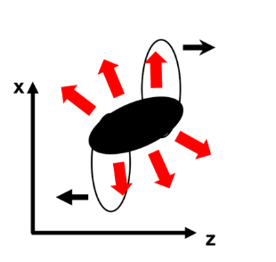
Background for S = -1 interaction
S = -1: Systems of minimum number of strangeness
→ Most common/accessible non-nucleonic systems
Present study
YN (2-body, S = -1) w/
the HAL QCD method
Examples
Scattering exp. Σp, Λp
Neutron star EoS
M-R relation
Cross section、phase shift、cusp、etc.
Mass (M☉)
Nanamura et al. [J-PARC E40] (2022)
Massive neutron stars
Radius (km)
Miwa et al. [J-PARC E40] (2021)
Hyperon puzzle
Demorest et al. (2010)
Hypernuclear spectroscopy
High energy heavy-ion collisions
Femtoscopy
Single-particle potential
→ Collective flow in RQMD
Fireball created in high-energy collisions
p₁
Initial stage
later stage
Λ binding energy
p₂
Jinno, KM, Nara, Ohnishi
PRC 108 (2023)
Figures: Jinno (2023)
Nara, Jinno, KM, Ohnishi
PRC (2023)
Notes:
B02

Slide 3
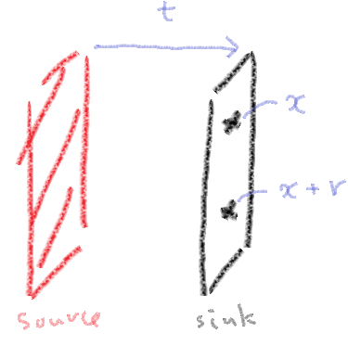
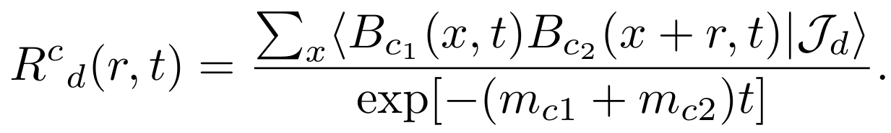
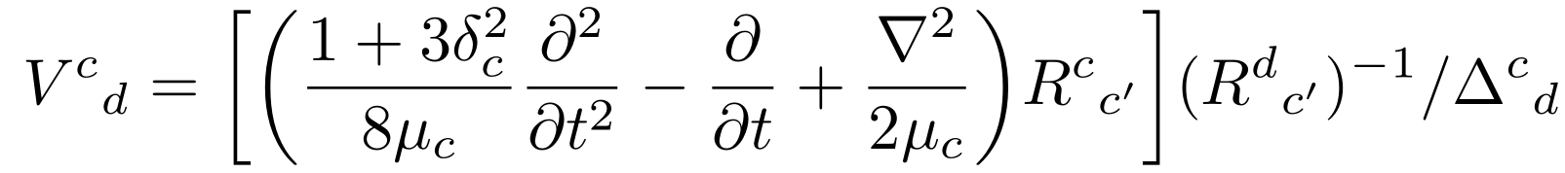
Time-dependent HAL QCD method
N. Ishii et al [HAL], PLB 712 (2012), 437
wall source J
sink
B†B†
BB
(1) R(r, t): measure the normalized 4pt functions
(2) Consider time-dependent Schroedinger eq. for R
Relativistic correction
Potential
(3) Assume “U(r, r’) ～ δ(r-r’) V(r) + (derivative expansion)” to solve V(r)
~ neglected (for small p)

Slide 4
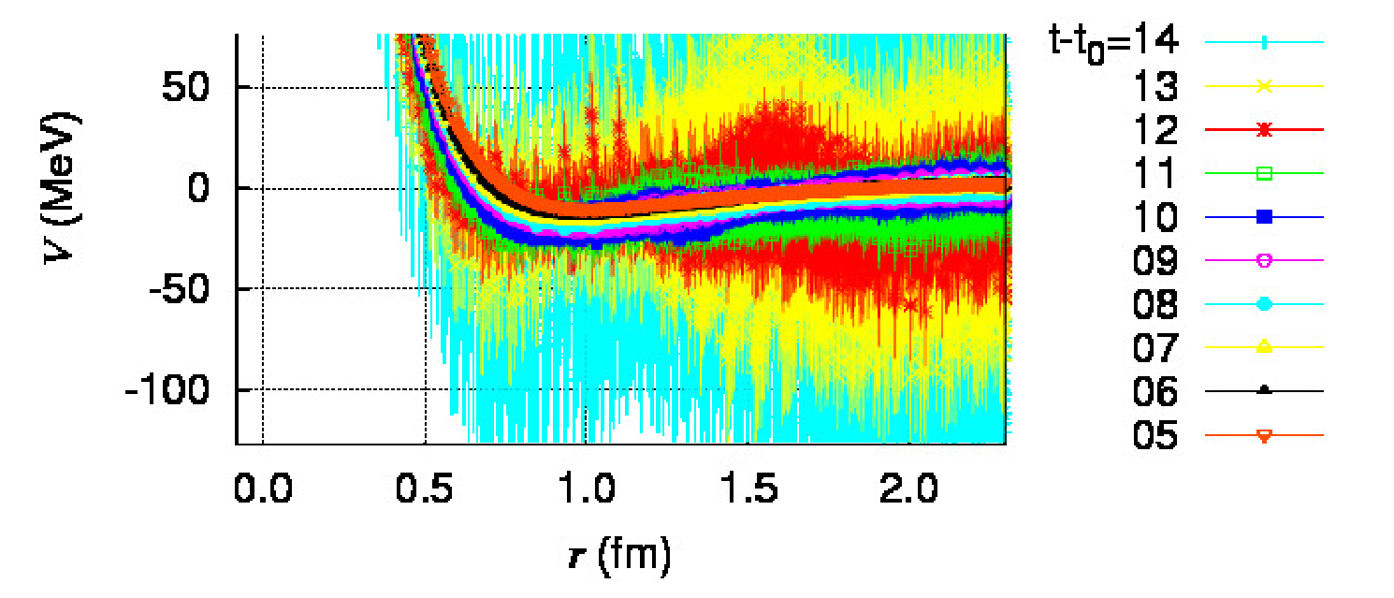
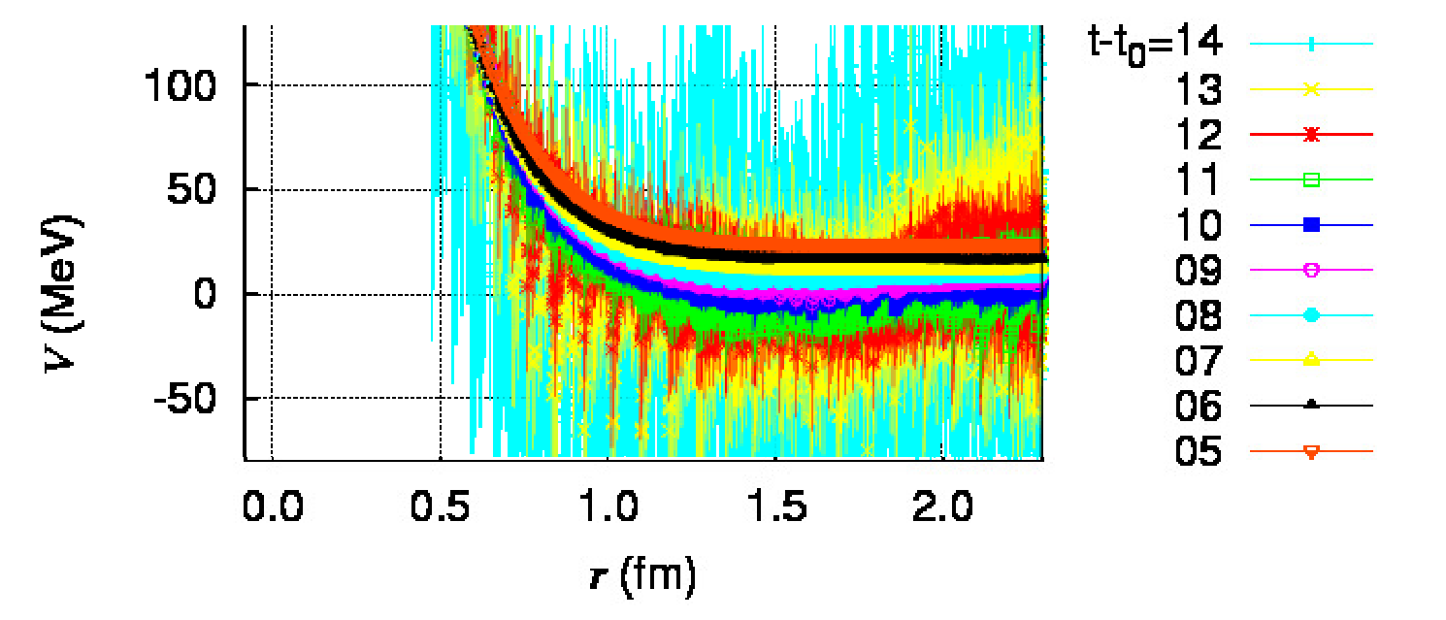
Gauge configurations at physical point
K-conf
N_{f} = 2+1, almost physical point (m_{π}, m_{K}) = (146, 525) MeV on K supercomputer
size 96⁴, a = 0.085 fm, ～400 configurations
existing S = -1 analysis: H. Nemura, AIP Conf. Proc. 2130 (2019) 1, 040005 [HYP2018], H. Nemura, PoS LATTICE2021 (2022) 272, etc.
NΣ(I=3/2) ¹S₀
NΣ(I=3/2) ³S₁
F-conf (HAL-conf-2023) Aoyama et al, PRD110 (2024) 9, 094502.
N_{f} = 2+1, physical point (m_{π}, m_{K}) = (137, 502) MeV at Fugaku computer
size 96⁴, a = 0.084372(54) fm, 1600 configs
→ Potential analysis based on F-conf
Notes:
Aoyama:2024cko

Slide 5
S = -1 Baryon-Baryon (S-wave)
Note: ³D₁ & tensor forces are not considered for now
27, 10, 8_{s} etc.: SU(3)_{f} rep.
I = 1/2
I = 3/2
Pauli forbidden,
repulsive
¹S₀
³S₁
¹S₀
³S₁
NΣ
m_{N}+m_{Σ} ~ 2132 MeV
8_{s}, 27
27
10
10*, 8_{a}
Pauli forbidden,
repulsive
NΛ
m_{N}+m_{Λ} ~ 2054 MeV
27, 8_{s}
10*, 8_{a}
Inelastic state contamination
NΛ effective single-channel potential
NΛ-NΣ coupled-channel potential
S = -1 has particularly bad S/N.
Removing inelastic contamination becomes important

Slide 6
Results

Slide 7
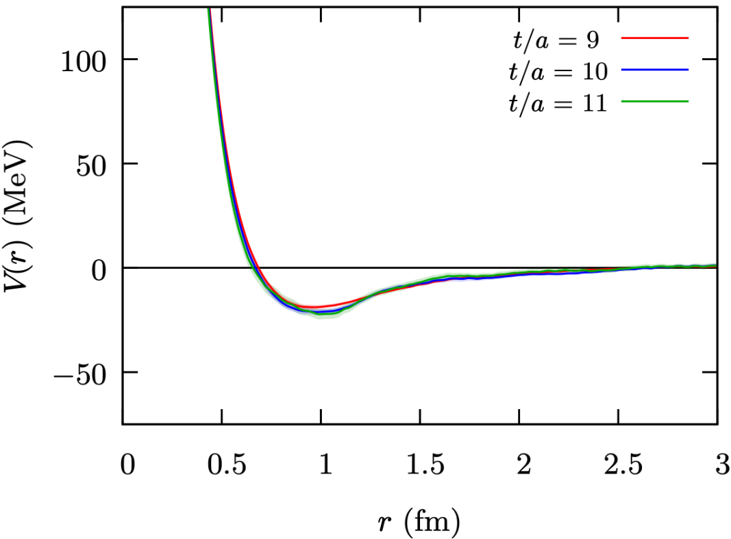
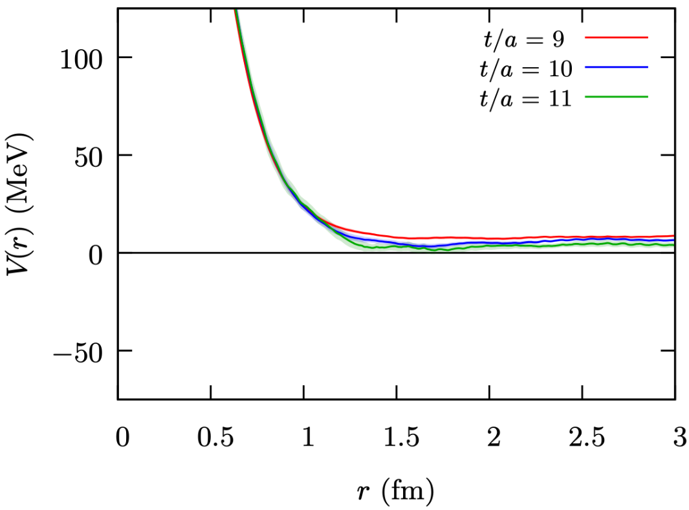
Results: NΣ(I=3/2) potentials
¹S₀
³S₁
Preliminary
Preliminary
Misner method (S-wave)
Misner method (S-wave)
~ SU(3) 27
~ SU(3) 10
Constant-offset
coming from
inelastic contamination
~ NN(I=1)
~ Pauli forbidden, repulsive
Misner method: Extract partial wave and average in [r-a, r+a]

Slide 8
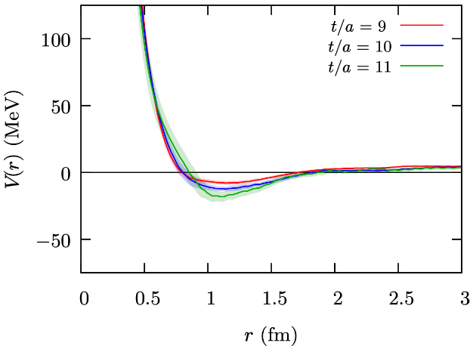
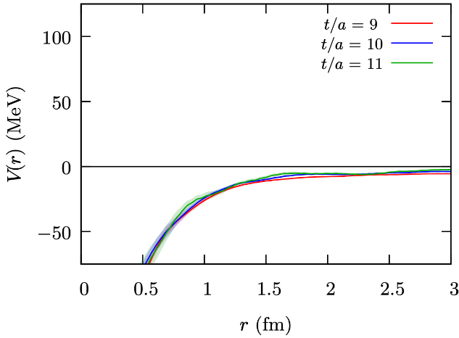
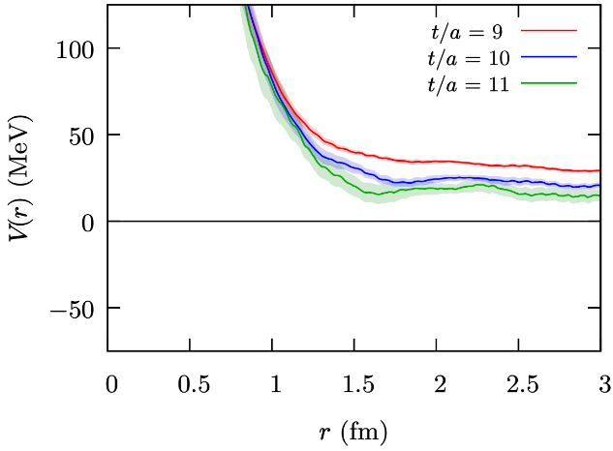
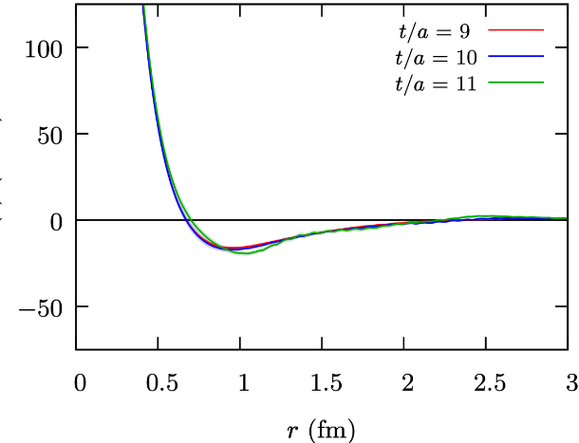
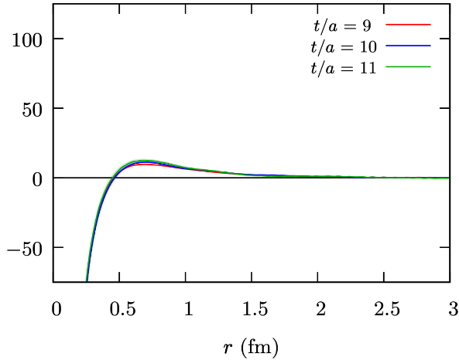
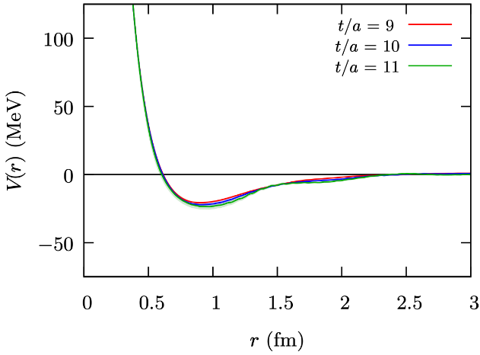
Results: NΛ-NΣ coupled-channel (I=1/2)
Other channelsalso suffer from
constant offsets
2x2 NΛ-NΣ coupled-channel potential (¹S₀)
Preliminary
Preliminary
Preliminary
~ 27
~ 8_{s}
NΛ-NΛ (¹S₀)
NΣ-NΛ (¹S₀)
NΣ-NΣ (¹S₀)
2x2 NΛ-NΣ coupled-channel potential (³S₁)
Preliminary
Preliminary
Preliminary
NΛ-NΛ (³S₁)
NΣ-NΛ (³S₁)
NΣ-NΣ (³S₁)

Slide 9
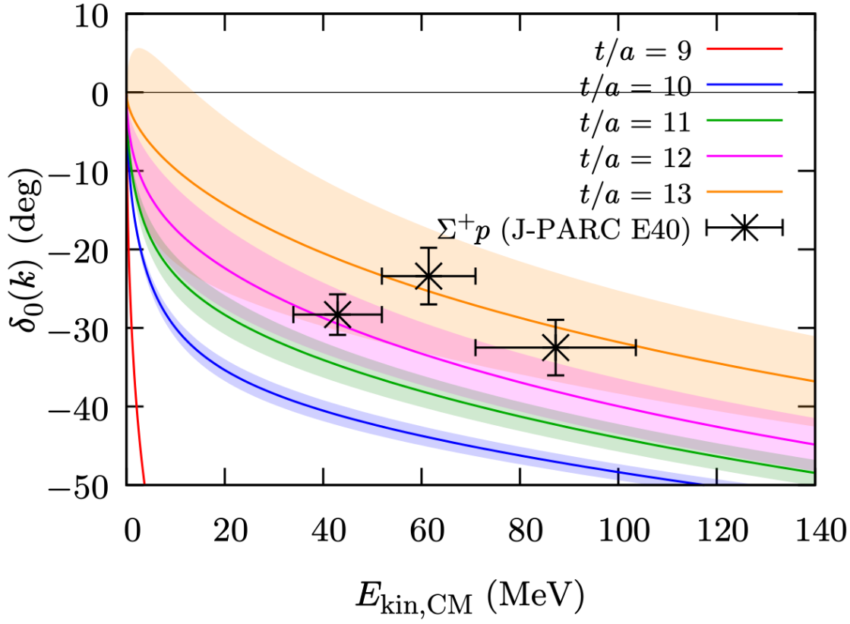
NΣ(I=3/2) ³S₁ phase shift
Experimental data:
Σ⁺p elastic scattering [J-PARC E40]
to determine the size of repulsion
Preliminary
Nanamura et al. [J-PARC E40] PTEP 2022 (2022) 9, 093D01
potential fit: 2 Gauss + Yukawa
t/a ≦ 11 : large contamination from inelastic excited states
t/a ≧ 12 : larger noise

Slide 10
Exponential extrapolation to t/a → ∞

Slide 11

Contribution from inelastic state
Inelastic contributions enter the R correlator in the form of
the sum of the exponentials exp(-bt)
Elastic part (NΣ)
Inelastic state contamination
N + Σ
N+π + Σ
t → ∞
Δ + Σ
N + Σ
N + Σ*
etc…
Too small t/a → Large inelastic contamination
Too large t/a → Signal (elastic states) becomes too small.
Large relative noise
Mass difference of inelastic state
remains at large r → constant shift
Notes:
r→∞ で非弾性状態の mass 増分だけ constant に増える

Slide 12


Extrapolation of V(r) to t/a → ∞
Naively, inelastic state contamination enter
the R correlator in a sum of exponential forms exp(-bt):
Elastic part
Inelastic contamination...
Assumption for extracted potential: V = (1/R) (－ H₀ － ∂/∂t) R
we want this
contamination (leading)
Steps to get V(r)
Determine b (> 0) at a large r of V(r, t)
Fit V_{el} and V_{inel} at each r. → Pick only V_{el} (Extrapolation for t/a → ∞)

Slide 13
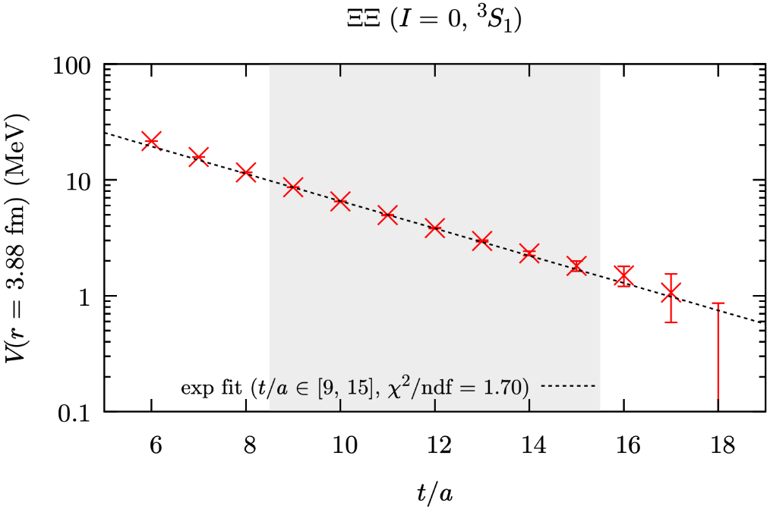
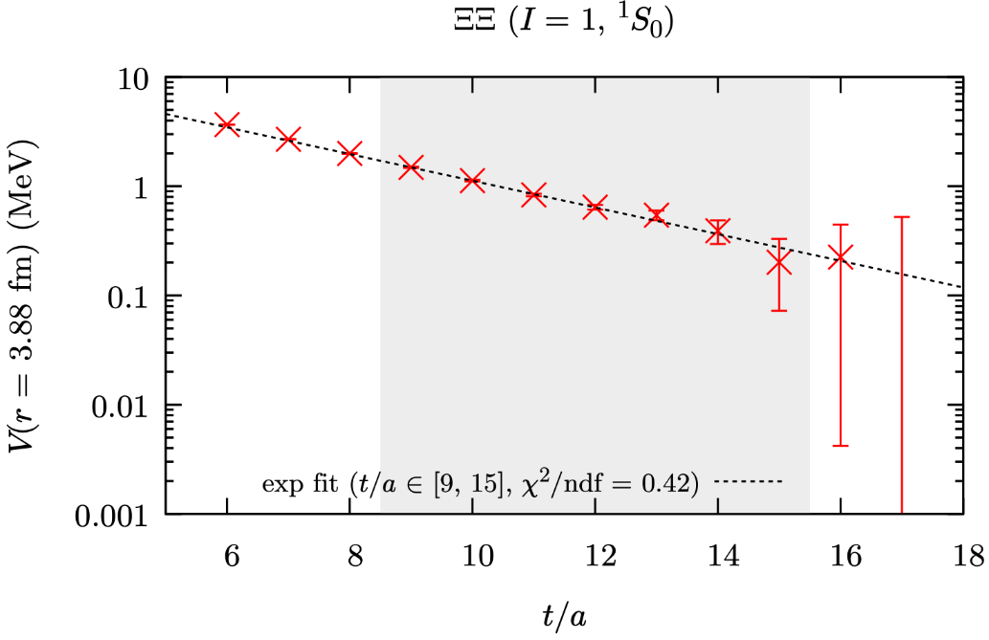
Inelastic contamination in ΞΞ
Small noise in ΞΞ → We can check the contamination behavior for a wide t/a range
Exponential slope
b = 676 ± 25 MeV
Exponential slope
b = 656 ± 6.8 MeV
points: calculated potential values
line: exponential fit by a exp(-bt)
shaded region: fitting range
Contamination is well described by a single exponential form
at large r (i.e., constant offsets)
in ΞΞ (where the contamination is small)

Slide 14
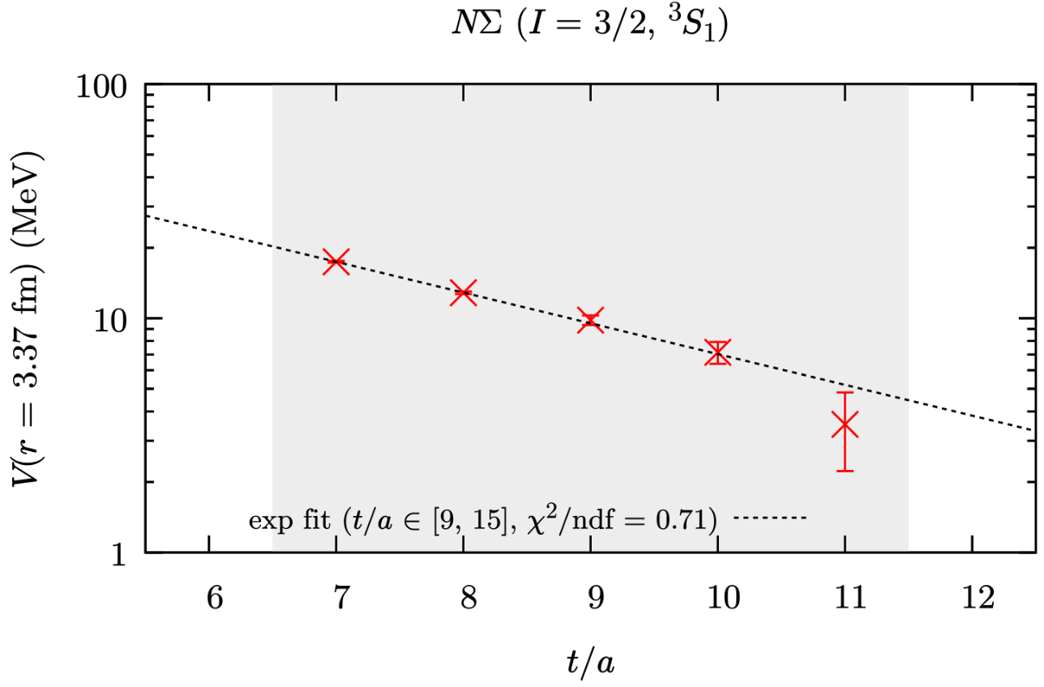
Inelastic contamination in NΣ (I=3/2, ³S₁)
NΣ is noisier … We need to fit to fewer data points
Exponential slope
b = 670 ± 25 MeV
The constant offset of NΣ also behaves in a single exponential decay

Slide 15
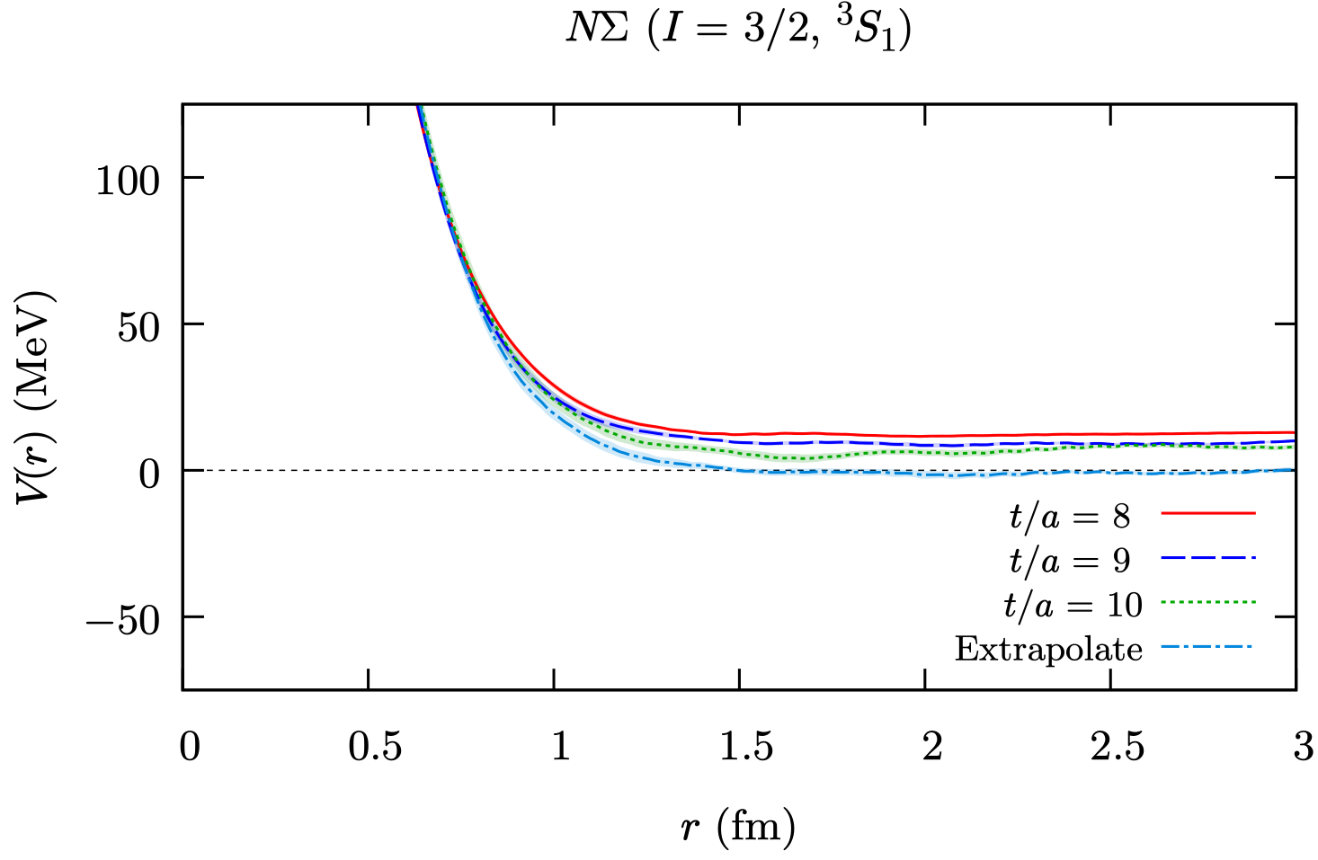
Extrapolated potential V_{NΣ}(r) (I = 3/2, ³S₁)
Result of the extrapolation to t/a → ∞
b = 0.2947(7) = 690 MeV
fitted to r = 3-3.38 fm
Preliminary
Modification by the extrapolation is small at r < 1
This is not actually constant subtraction.
Notes:
b = 0.2947(7)

Slide 16
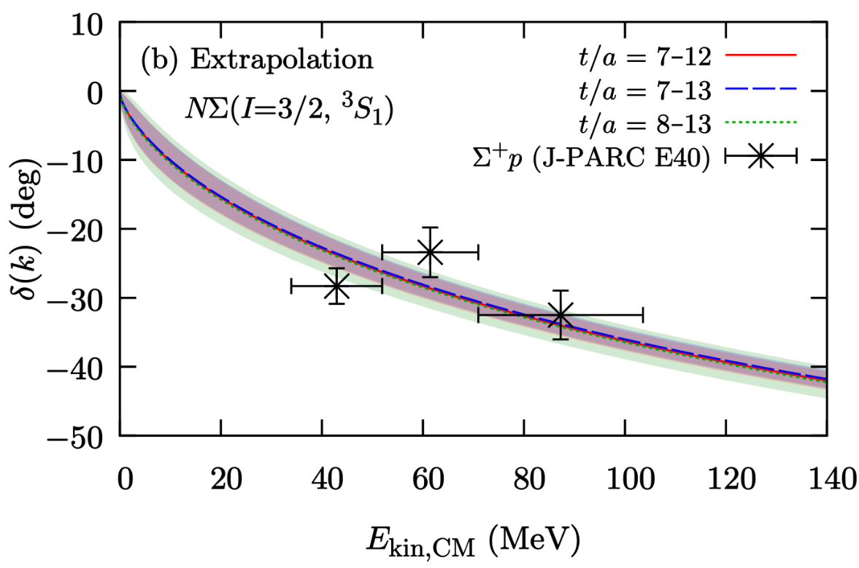
Phase shift with extrapolated potentials
Preliminary
Experimental data:
Σ⁺p elastic scattering [J-PARC E40]
to determine the size of repulsion
Nanamura et al. [J-PARC E40] PTEP 2022 (2022) 9, 093D01
potential fit: 2 Gauss + Yukawa
The phase shift seems stable for slight change of the time range to fit.
Note: The potential difference at short range (r < 1) does not affect δ₀ much.

Slide 17
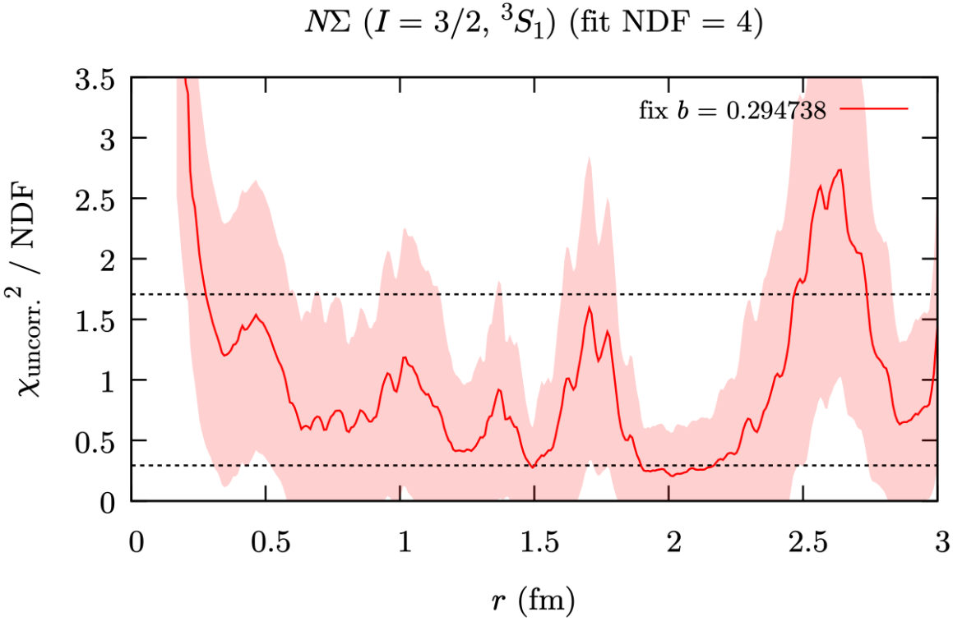
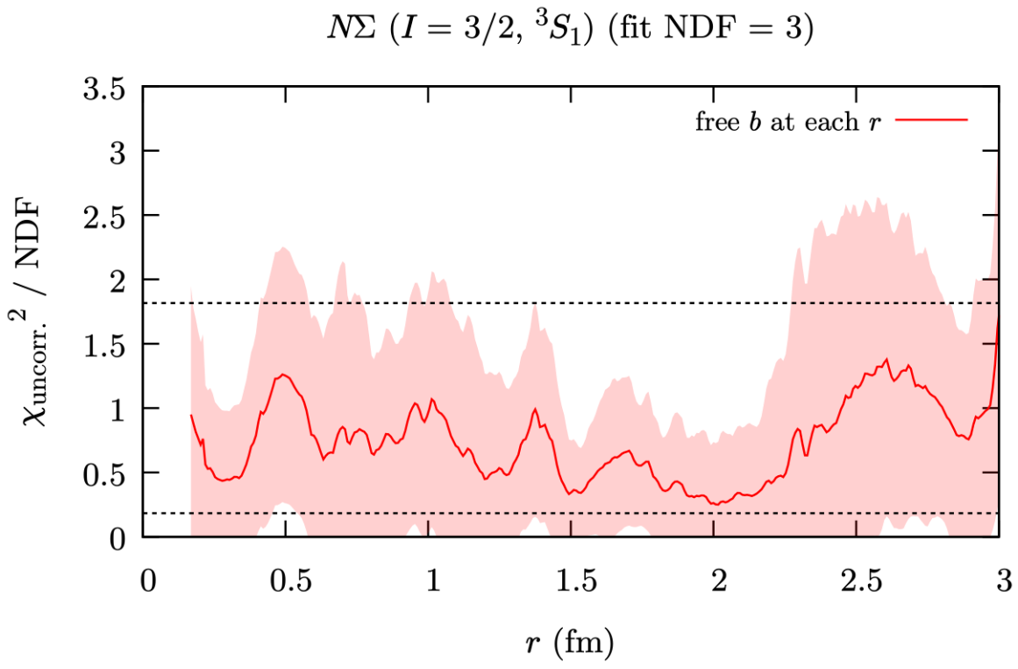
Discussion: χ² vs r
We determined b at large r.
Does it work for small r?
Common b
By default, b is determined at large r, and only V and V_{inel} are fitted for each r
V(r,t) = V(r) + V_{inel}(r) exp[-bt].
Another variation of the fitting form: b(r) is determined for each r:
V(r,t) = V(r) + V_{offset}(r) exp[-b(r)t].
cf. b(r) at each r
Both cases seem to produce consistent results
Notes:
b = 0.2947(7)

Slide 18
Discussion: b ~ 700 MeV
b: The “mass” for the inelastic contribution
V_{inel}(r,t) ∝ exp(-bt),
naively associated with the gap for the lowest inelastic state.
b for large r is identified to be 0.286(11)/a = 670(25) MeV
for NΣ(I=3/2, ³S₁).
Too large?
Possibilities:
Cancellation in R = (4pt)/(2pt)²
(contaminations in denominator vs numerator)?
→ Unlikely? The gap doesn’t change much even with R = (4pt)/exp[-(m₁+m₂)t]
“Single exponential” is a bad assumption?
→ There is the dependencies on the time range to fit
We need to checks with multi exponential fitting (with ΞΞ).
Smaller overlap with the source for lower inelastic states such as Nπ-Σ?
etc.
Notes:
b = 0.2947(7)

Slide 19
Summary
Analyses ongoing for NΛ & NΣ potentials at the physical pt.
using HAL QCD method for F-conf (HAL-conf-2023)
Repulsive channels, NΣ(I=1/2) ¹S₀ & NΣ(I=3/2) ³S₁, receive
constant offsets in the potential from inelastic contamination:
(Large offset at small t/a) vs (Large noise at large t/a)
  Extrapolation from smaller t/a is consistent (assuming ΔV ~ e^{-bt})
Comparison
  I=3/2 δ(³S₁) consistent with J-PARC E40 Σ⁺p scattering?
  I=3/2 a(¹S₀) and a(³S₁) [~ ALICE femtoscopy] large uncertainty
Outlook
Systematic validation of extrapolation method
Detailed analysis on the fitting-form dependence
³D₁ and tensor forces

Slide 20
backup

Slide 21
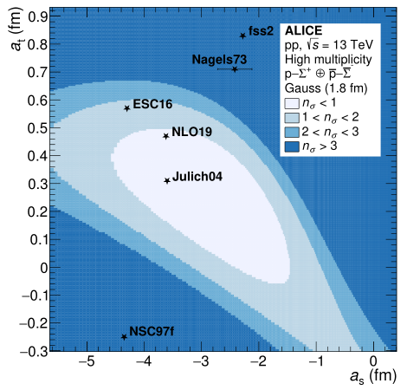
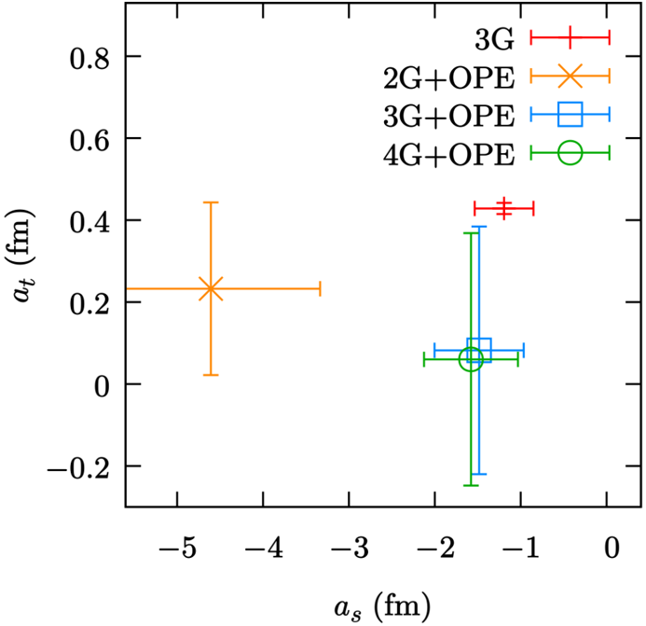
Femtoscopy of pΣ⁺ (ALICE)
Legend (fitting function):
G = Gauss,
OPE = Yukawqa with m_{π}
(Coulomb Unmodified) Scattering length
from HAL-conf-2023
in the same plotting range
ALICE, arXiv:2510.14448v1 [nucl-ex] (2025)
(a_{s}, a_{t}) for Gaussian potential (1.8 fm)
³S₁ scattering length →
Preliminary
t = 12
¹S₀ scattering length →
Fitting function dependence & time dependence are large.

Slide 22
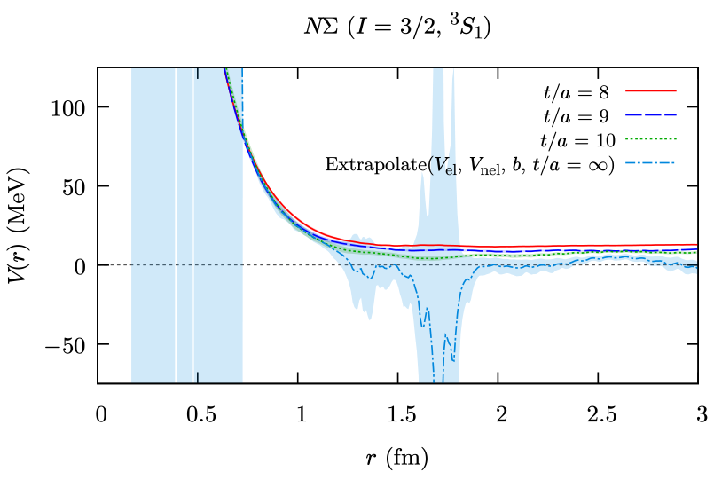
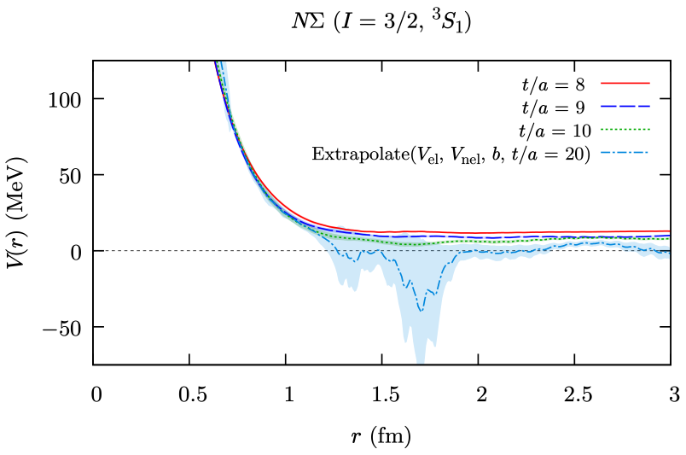
Extrapolation methods
When b is also varied for each r
t/a = ∞
t/a = 20
Notes:
b = 0.2947(7)

Slide 23
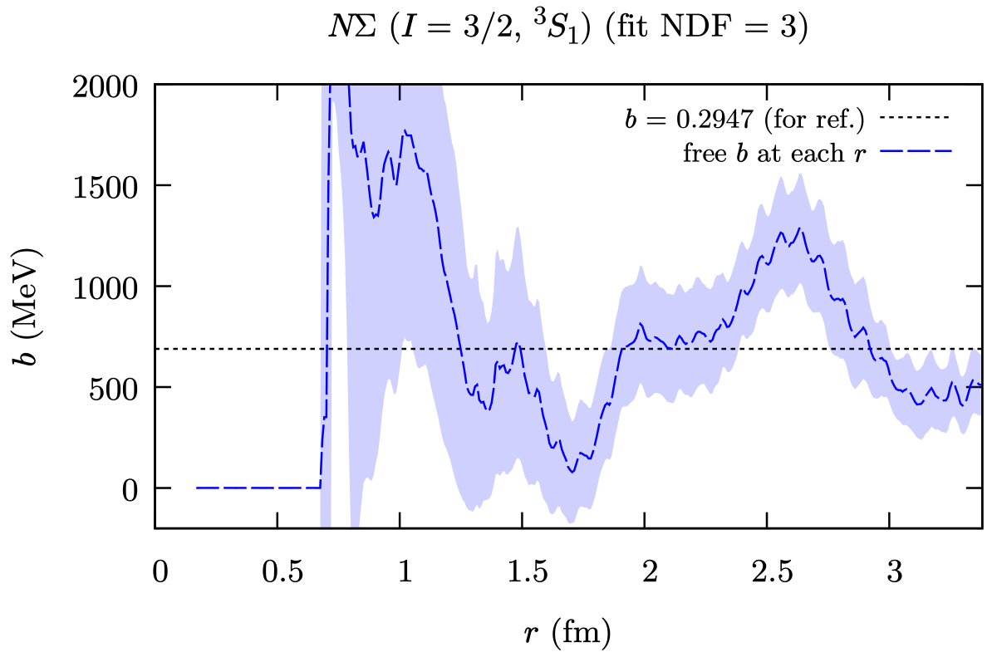
Extrapolation methods
b(r) is for fitting V(r,t) = V_{el}(r) + V_{inel}(r) exp[-b(r)t]
b tends to be large at the entire r region
Note: b = 0.2947(7) in the other extrapolation method
was obtained for a different fitting form
V(r,t) = V_{offset}(r) exp[-b(r)t], so is systematically different.
Notes:
b = 0.2947(7)

Slide 24
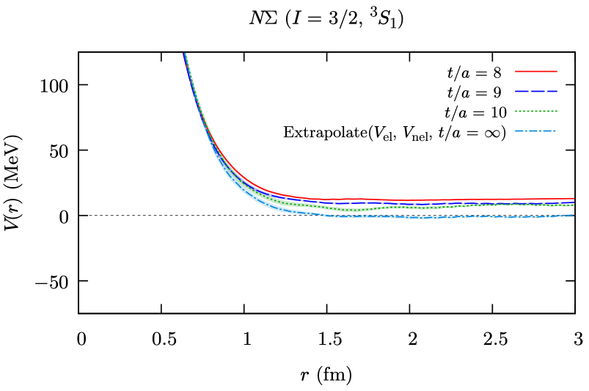
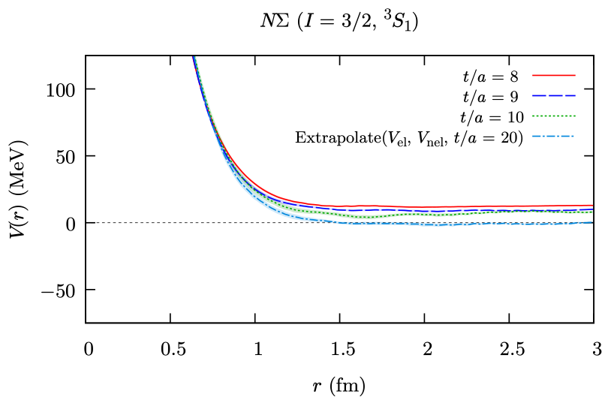
Extrapolation methods
When b = 0.2947 is determined at
r = 3.0 … 3.38
for V ∝ exp(-bt)
t/a = ∞
Modification by the extrapolation is small at r < 1
This is not actually constant subtraction.
t/a = 20
Notes:
b = 0.2947(7)

Slide 25
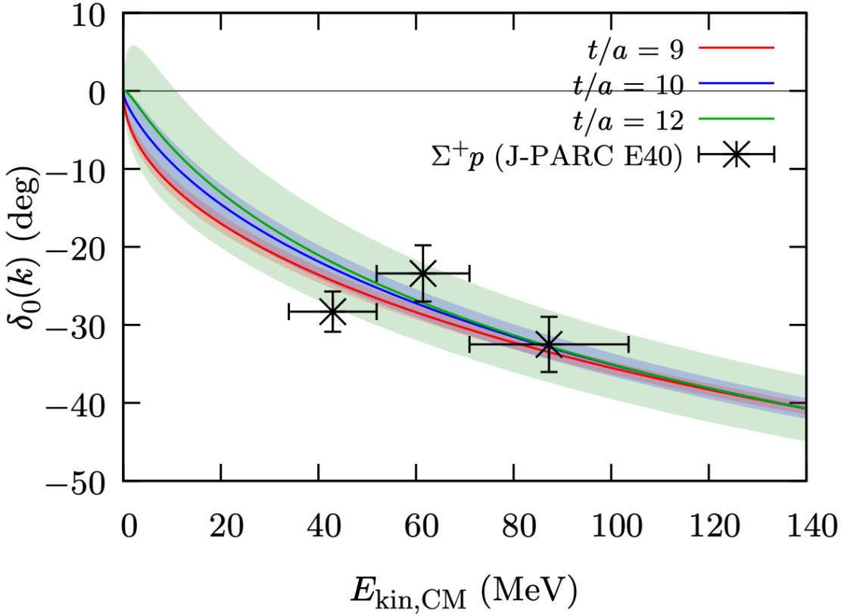
NΣ(I=3/2) ³S₁ phase shift
Experimental data:
Σ⁺p elastic scattering [J-PARC E40]
to determine the size of repulsion
Preliminary
Nanamura et al. [J-PARC E40] PTEP 2022 (2022) 9, 093D01
potential fit: 2 Gauss + Yukawa (+ const)
With the constant offset of the potential subtracted in fitting,
the result becomes stable for a larger t/a range.
→ Consistent with experimental estimation of phase shifts (with δ < 0 assumed)

Slide 26
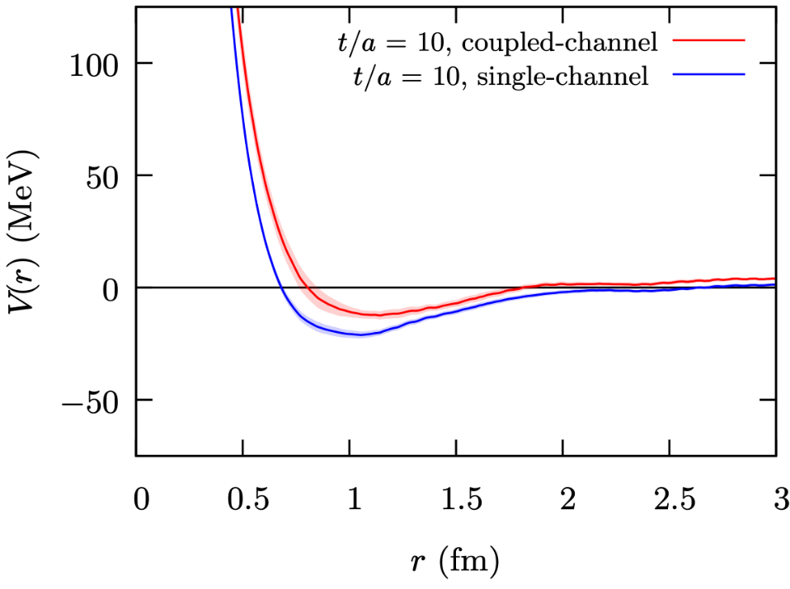
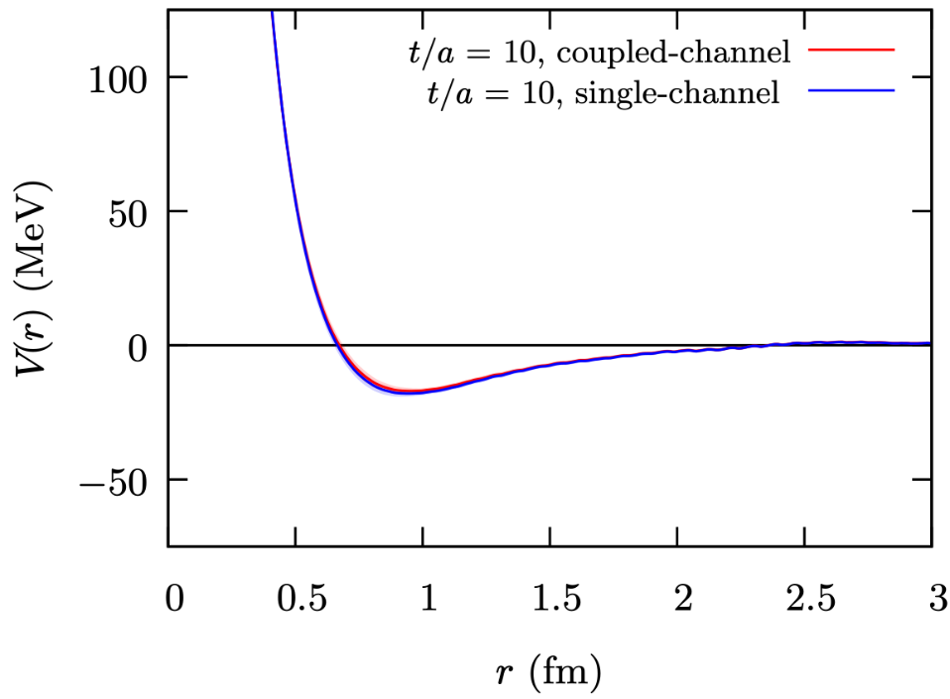
NΛ(I=1/2) Effective single-channel pot.
Analysis ongoing…
2x2 NΛ-NΣ coupled-channel potential
vs NΛ effective single-channel potential
¹S₀
³S₁
Preliminary
Preliminary

Slide 27
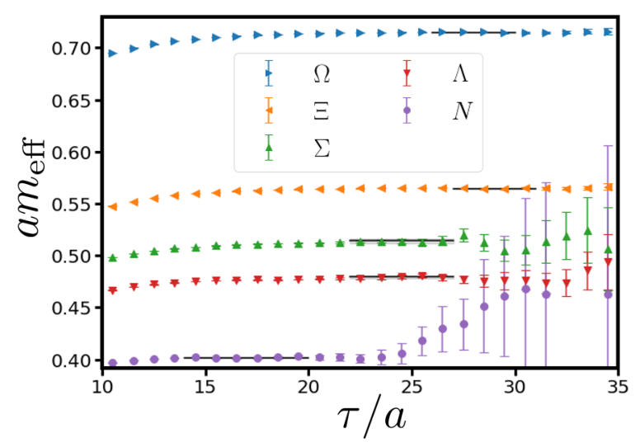
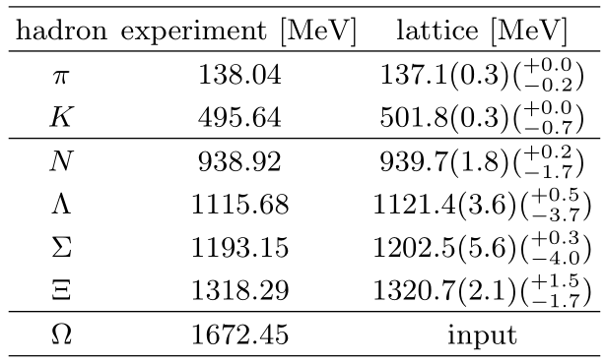
Baryon masses
Aoyama et al [HAL QCD], PRD110 (2024)

Slide 28
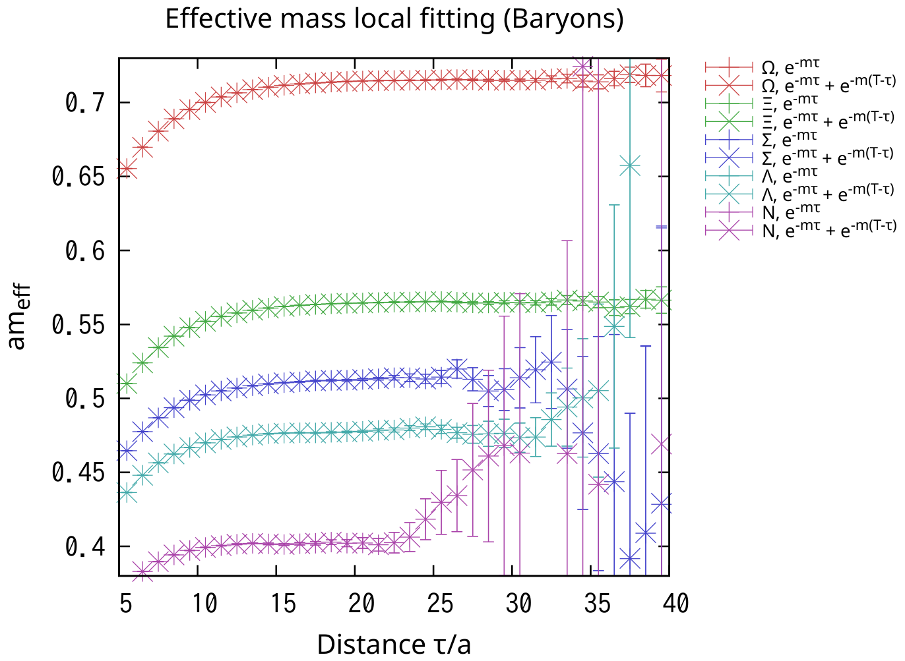
Baryon effective masses

