Slide 1
Neural Wavefunctions in
Quantum Field Theory
Suryansh Rajawat
Paulo F. Bedaque, Hersh Kumar, Gregory Ridgway
University of Maryland, College Park
Lattice 2026 · arXiv:2606.20791

Slide 2

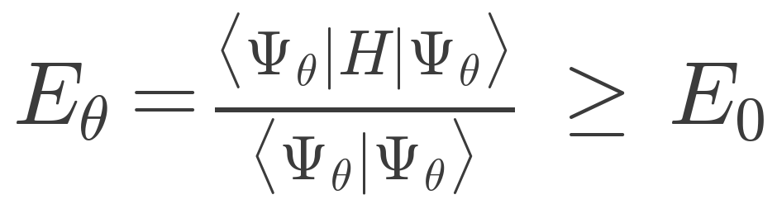
Variational Monte Carlo
Variational principle: Trial wavefunction has minimum energy at the ground state

Slide 3
Variational Monte Carlo
Variational principle: Trial wavefunction has minimum energy at the ground state
Write as a neural network

Slide 4


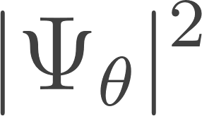
Variational Monte Carlo
Variational principle: Trial wavefunction has minimum energy at the ground state
Write as a neural network
Estimate and with Monte Carlo samples from

Slide 5
Variational Monte Carlo
Variational principle: Trial wavefunction has minimum energy at the ground state
Write as a neural network
Estimate and with Monte Carlo samples from
Minimize with gradient descent

Slide 6

VMC for lattice field theories
Parameterize the wavefunctional on a spatial lattice

Slide 7
VMC for lattice field theories
Parameterize the wavefunctional on a spatial lattice
Minimize energy given by lattice hamiltonian

Slide 8
VMC for lattice field theories
Parameterize the wavefunctional on a spatial lattice
Minimize energy given by lattice hamiltonian
But energy is unphysical

Slide 9

VMC for lattice field theories
Parameterize the wavefunctional on a spatial lattice
Minimize energy given by lattice hamiltonian
But energy is unphysical
UV finite
IR finite
UV divergent
IR divergent

Slide 10
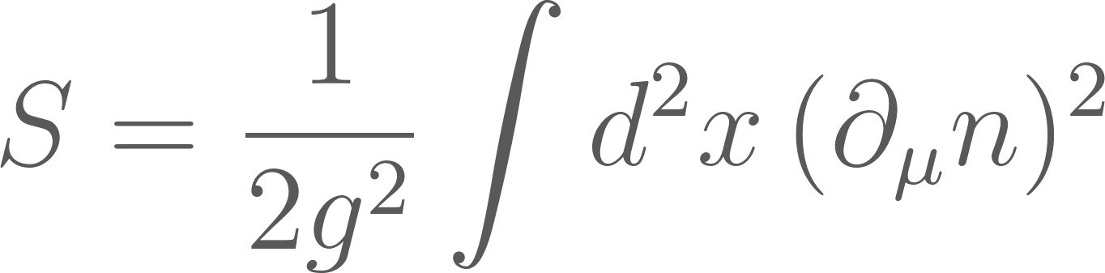
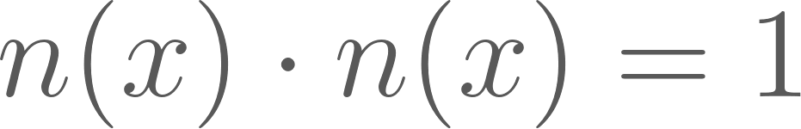
Nonlinear sigma model
The 1+1d nonlinear O(3) sigma model is defined by

Slide 11
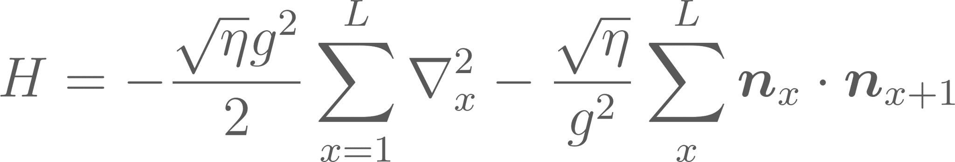
Nonlinear sigma model
The 1+1d nonlinear O(3) sigma model is defined by
We use the discretized Hamiltonian on a 1d spatial lattice with PBCs

Slide 12
Nonlinear sigma model
The 1+1d nonlinear O(3) sigma model is defined by
We use the discretized Hamiltonian on a 1d spatial lattice with PBCs
Asymptotically free, with the continuum limit at g² → 0

Slide 13
Variational Ansatz – Ground state
Vacuum wavefunction is zero-momentum and isospin singlet

Slide 14
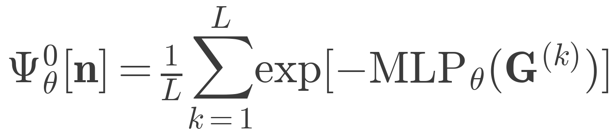
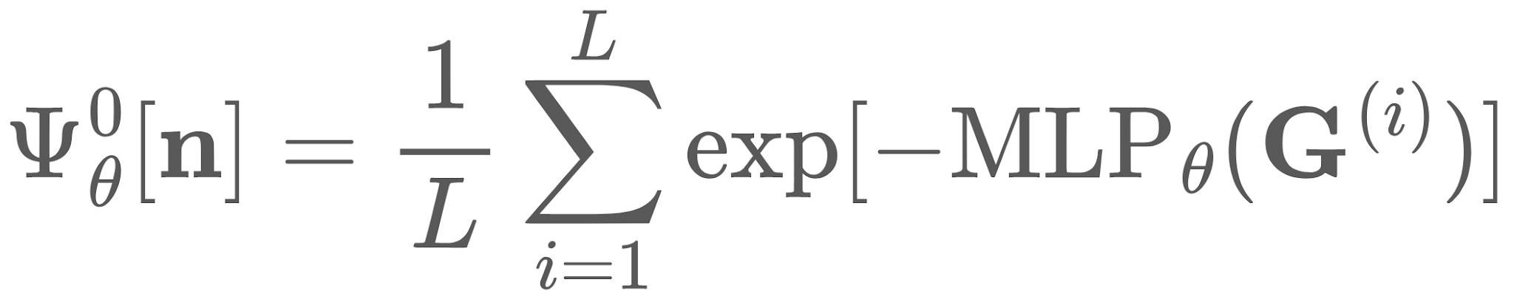
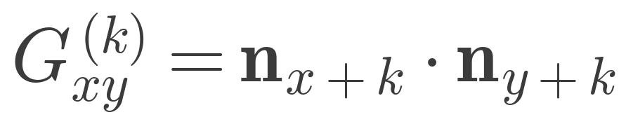
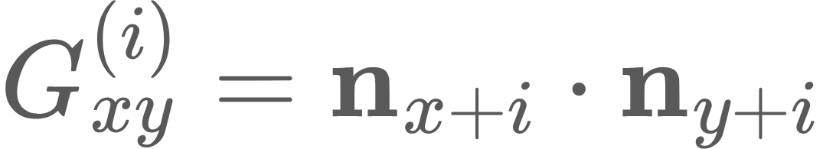
Variational Ansatz – Ground state
Vacuum wavefunction is zero-momentum and isospin singlet

Slide 15
Variational Ansatz – Ground state
Vacuum wavefunction is zero-momentum and isospin singlet
Translational invariance
O(3) invariance

Slide 16
Variational Ansatz – Ground state
Vacuum wavefunction is zero-momentum and isospin singlet
Translational invariance
O(3) invariance
Universal ansatz for vacuum wavefunction

Slide 17
Variational Ansatz – Excited State
Excited state has zero-momentum and is an isospin triplet and has Iᙆ = 0

Slide 18

Variational Ansatz – Excited State
Excited state has zero-momentum and is an isospin triplet and has Iᙆ = 0
Has k=0, I=1, Iᙆ=0 quantum numbers

Slide 19
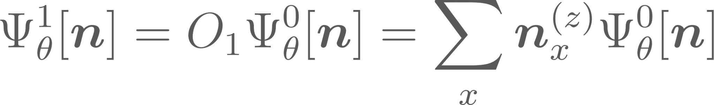
Variational Ansatz – Excited State
Excited state has zero-momentum and is an isospin triplet and has Iᙆ = 0
Gets 99% of the energy right but is not universal!

Slide 20
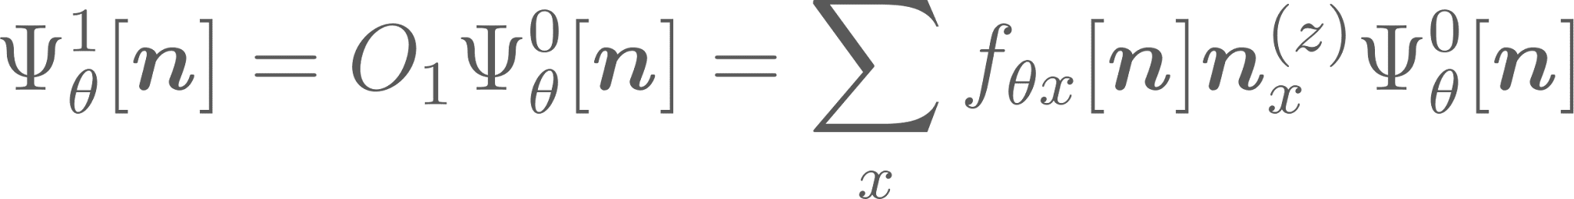
Variational Ansatz – Excited State
Excited state has zero-momentum and is an isospin triplet and has Iᙆ = 0
Arbitrary function of the fields, has site index

Slide 21

Variational Ansatz – Excited State
Excited state has zero-momentum and is an isospin triplet and has Iᙆ = 0
For translational invariance

Slide 22
Variational Ansatz – Excited State
Excited state has zero-momentum and is an isospin triplet and has Iᙆ = 0
Shifted matrix of pair products of fields

Slide 23
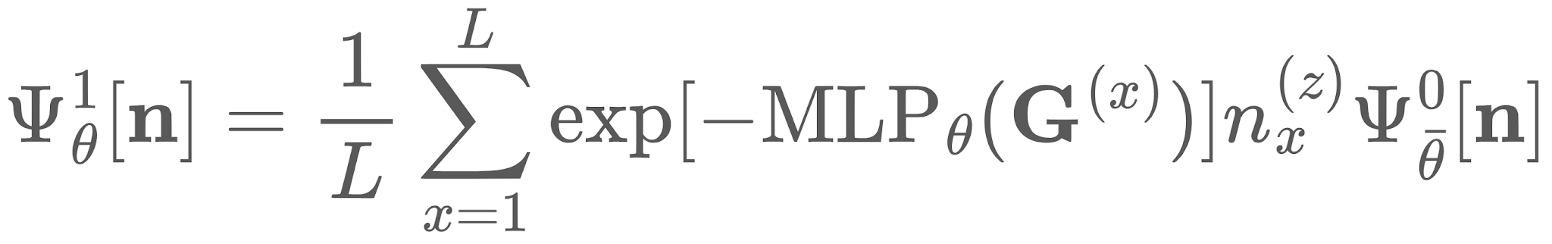
Variational Ansatz – Excited State
Excited state has zero-momentum and is an isospin triplet and has Iᙆ = 0
Fix the parameters of this wavefunction

Slide 24
Variational Ansatz – Excited State
Excited state has zero-momentum and is an isospin triplet and has Iᙆ = 0
Fix the parameters of this wavefunction
Shared UV systematic error cancels in E₁ − E₀
Compute E₀ and E₁ with reweighting

Slide 25
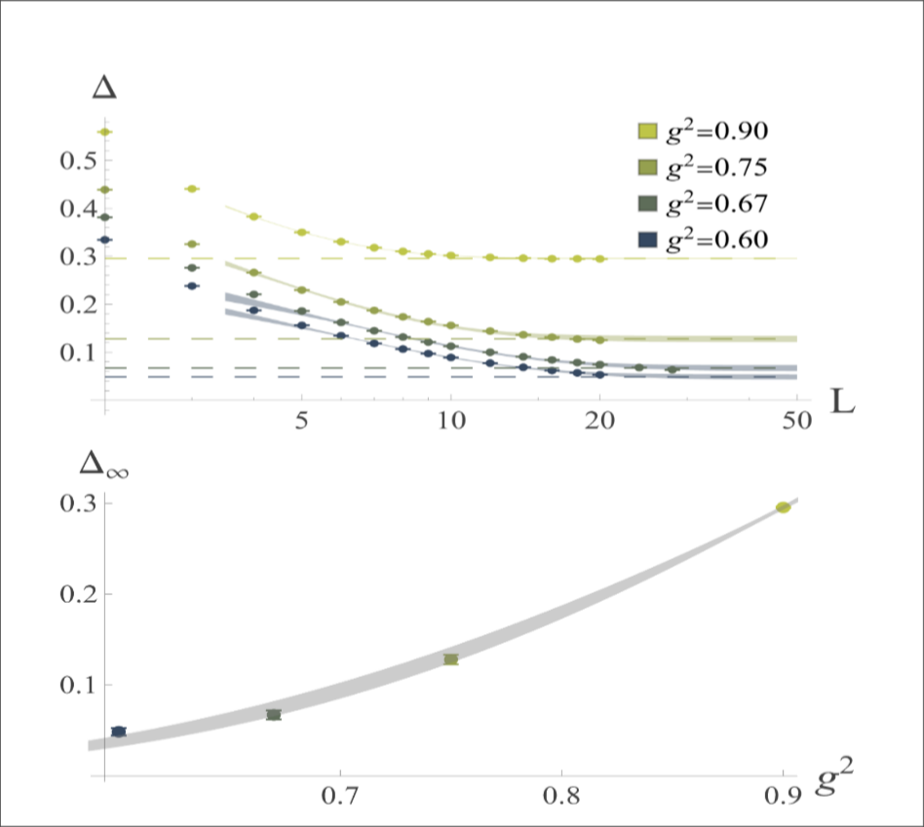
Computing the gap
Infinite volume + continuum extrapolation of the gap

Slide 26
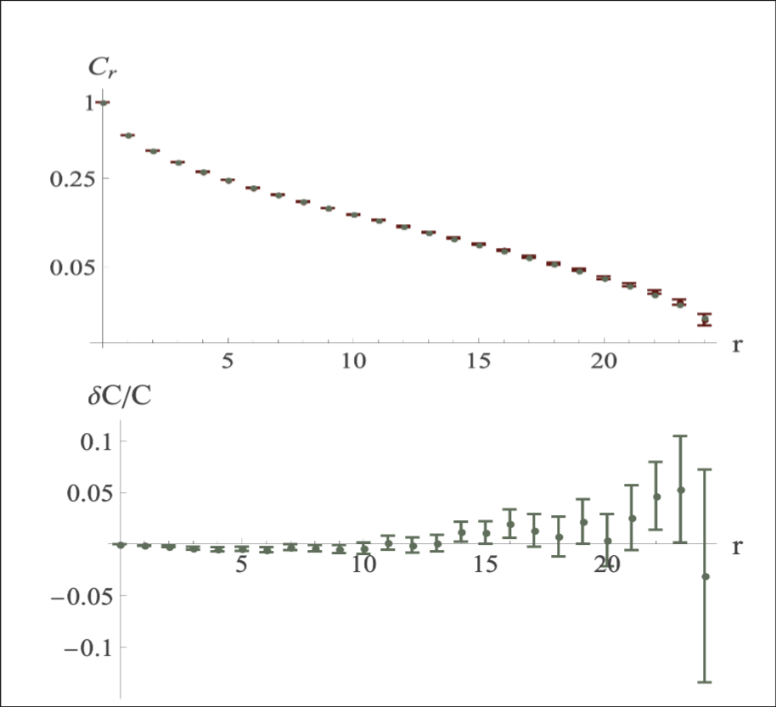
Computing correlators
Comparison with MPS of spatial correlators

Slide 27
Computing correlators
Comparison with MPS of spatial correlators
Long distance behavior is also captured

Slide 28
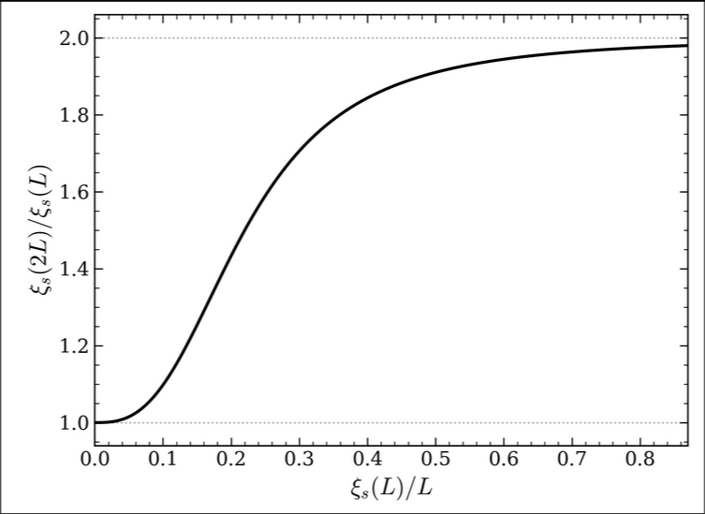
Step-scaling curve
Plot of ξₛ(2L)/ξₛ(L) vs ξₛ(L)/L

Slide 29
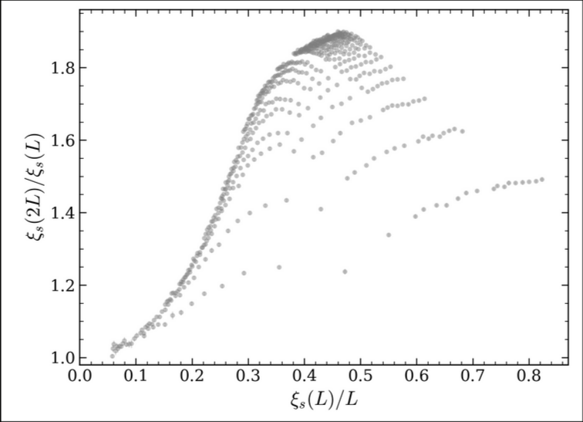
Step-scaling curve
Plot of ξₛ(2L)/ξₛ(L) vs ξₛ(L)/L
Euclidean lattice data in gray

Slide 30
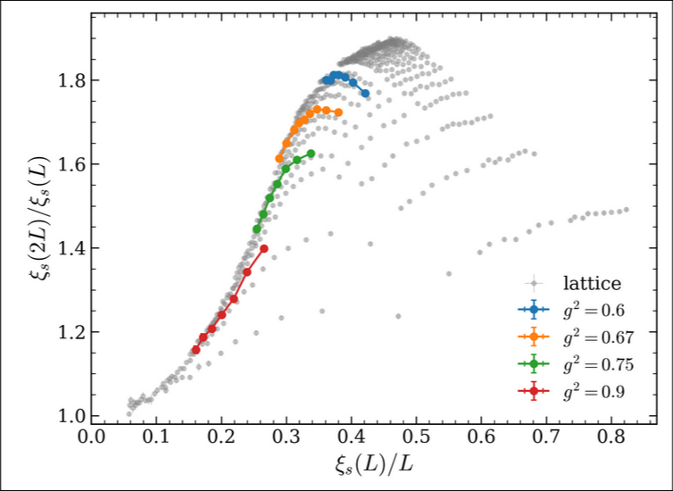
Step-scaling curve
Plot of ξₛ(2L)/ξₛ(L) vs ξₛ(L)/L
Euclidean lattice data in gray
VMC data in color

Slide 31
Conclusion
Variational calculations are feasible in field theory
Generalizable to finite density by fixing charge sectors in the ansatz
Real-time evolution possible through time dependent variational Monte Carlo

Slide 32
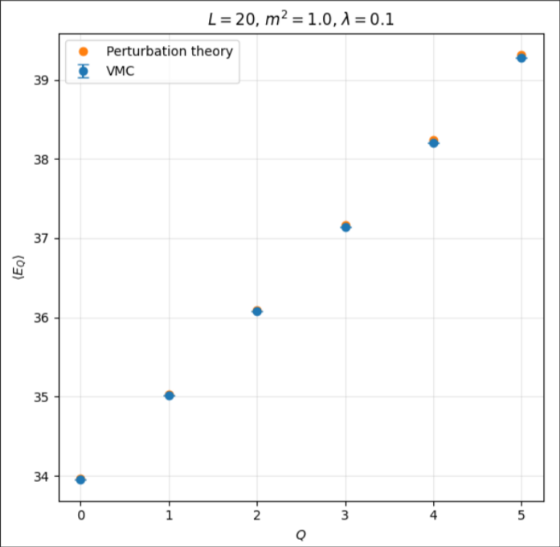
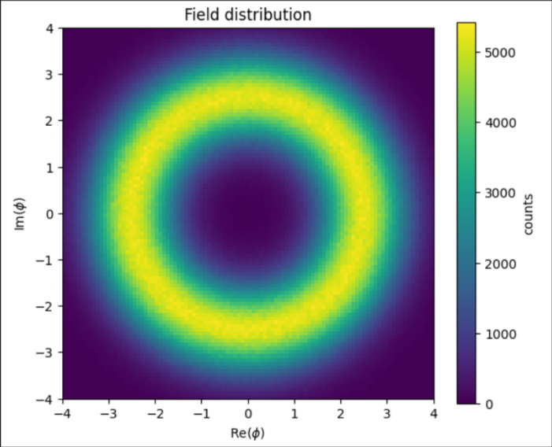
Preliminary – Finite Density

Slide 33
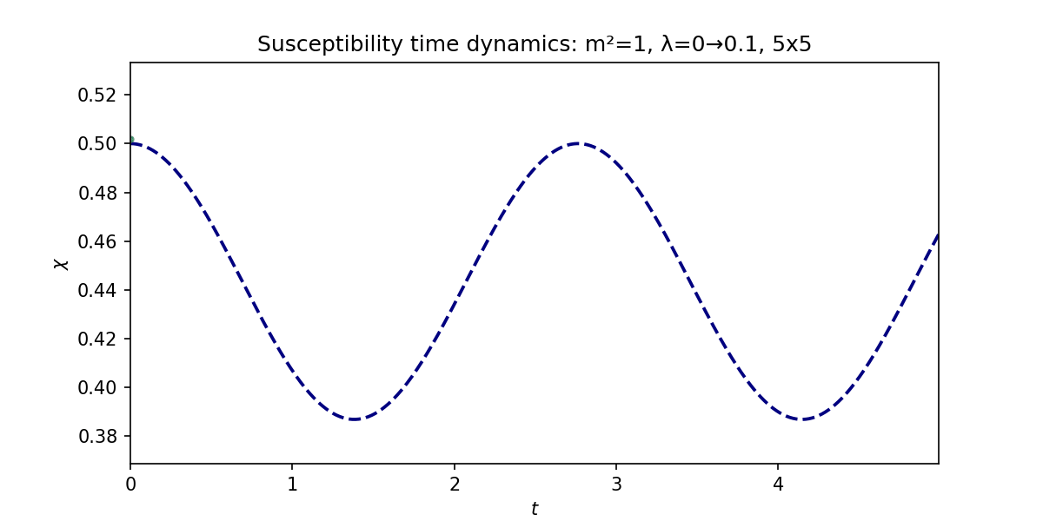
Preliminary – Realtime

Slide 34
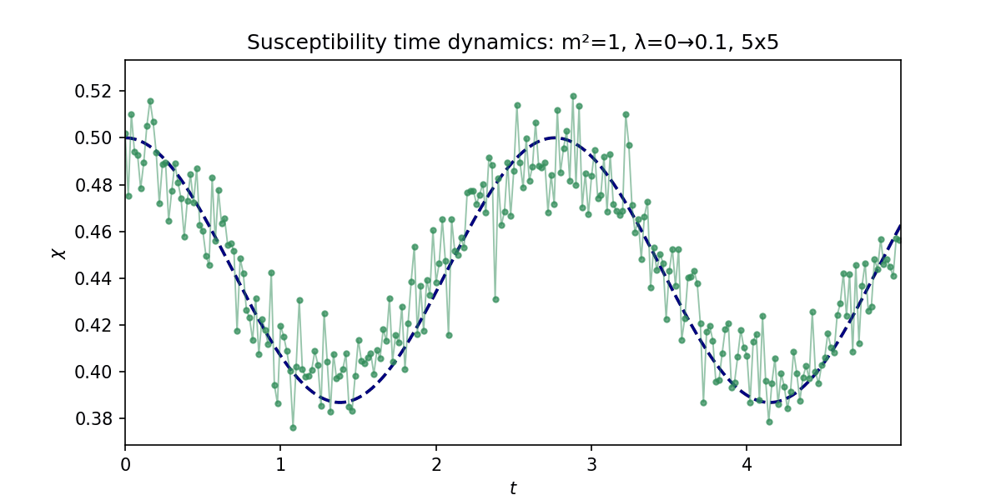
Preliminary – Realtime (in case gif doesn’t work)

Slide 35
Thank you
Questions?

