Slide 1



Pion and kaon quark GPDs via LaMET and SDF
Joseph Torsiello
Temple University, Philadelphia, PA, US
In collaboration with
Minhuan Chuª, Krzysztof Cichyª, Martha Constantinou^{b}, Joshua Miller^{b}
ª Adam Mickiewicz University, ^{b} Temple University

Slide 2
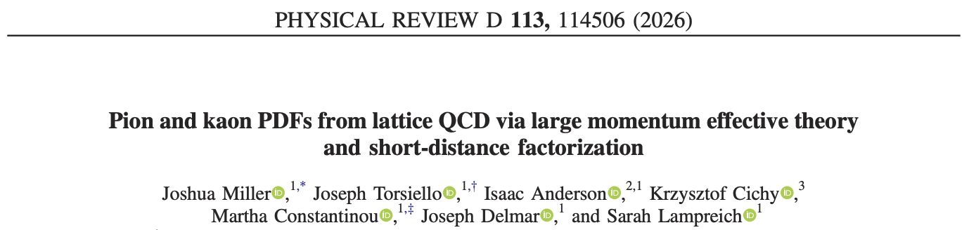
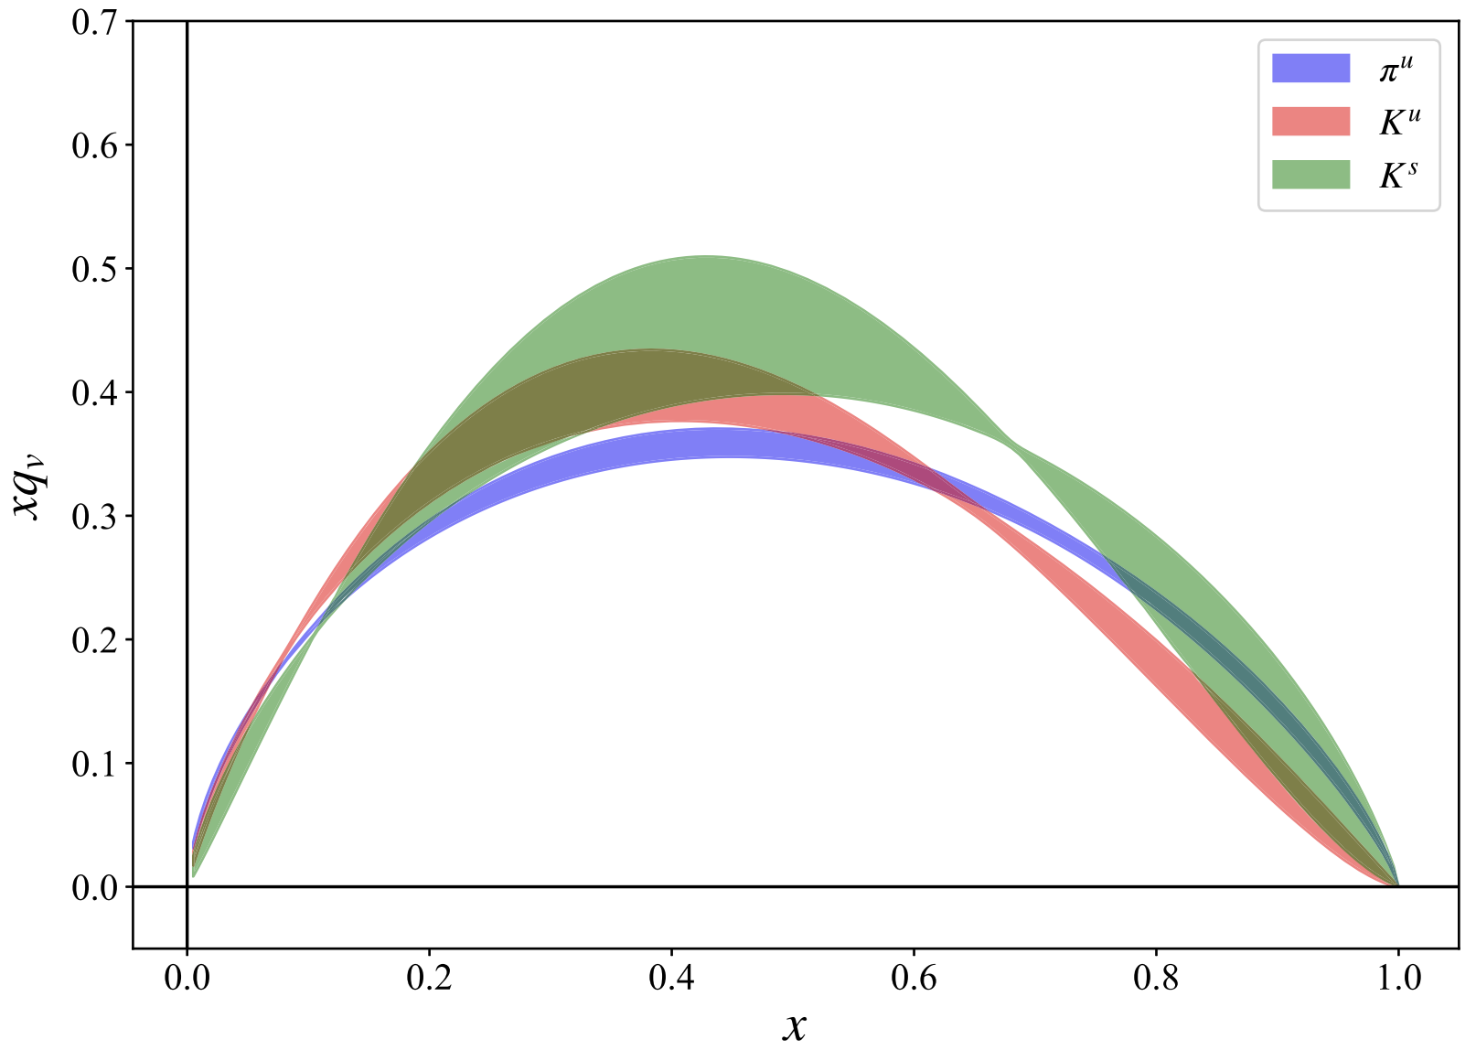
Outline
Motivation and x-dependent GPDs from LQCD
Methodology: LaMET
  Asymmetric Frame
  Analysis of Approach
  Pion and Kaon Hybrid Renormalization
  Large z-extrapolation
Results
  Matrix elements
  Amplitudes
  Quasi-GPDs
  Light Cone GPDs
Summary and Future Work
Extension of PDFs calculation
2

Slide 3
Motivation and x-dependent GPDs from LQCD

Slide 4
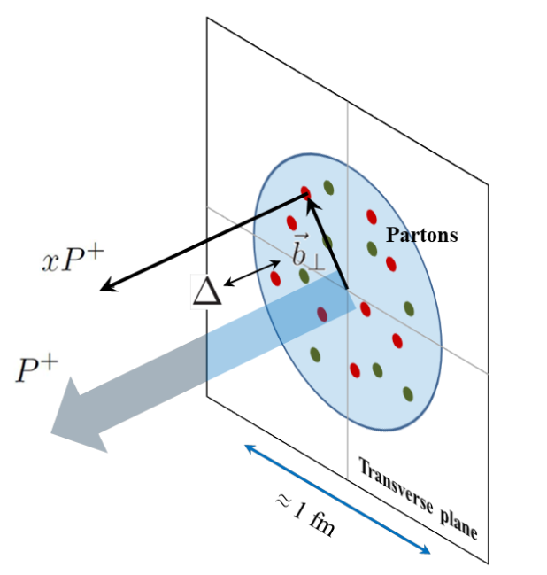



Motivation
Why GPDs?
- Correlate longitudinal momentum and transverse position
- Unify information from PDFs, form factors (ffs), and generalized ffs
- 3D tomography of hadrons (together with TMDs)
- Central goal of the EIC and Jefferson Lab science programs
- Lattice results can constrain global analyses and GPD parametrizations
Image Credit: Cédric Lorcé
https://qgtcollab.github.io/
Why the pion and kaon?
- Laboratories for understanding emergent hadron mass
- Pion: special role as a pseudo-Goldstone boson
- Kaon: interplay of a light quark and a heavier strange quark
- Direct probe of SU(3)-flavor-symmetry breaking
4

Slide 5
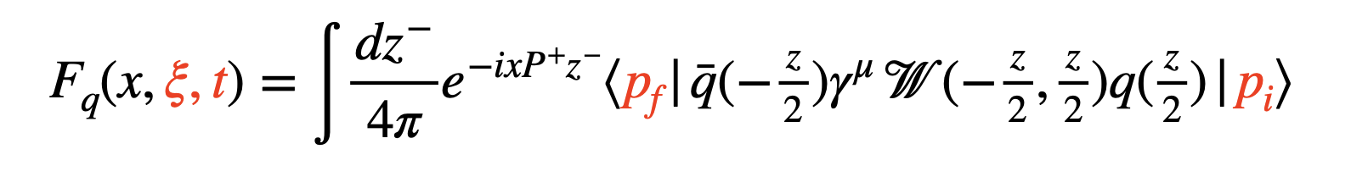
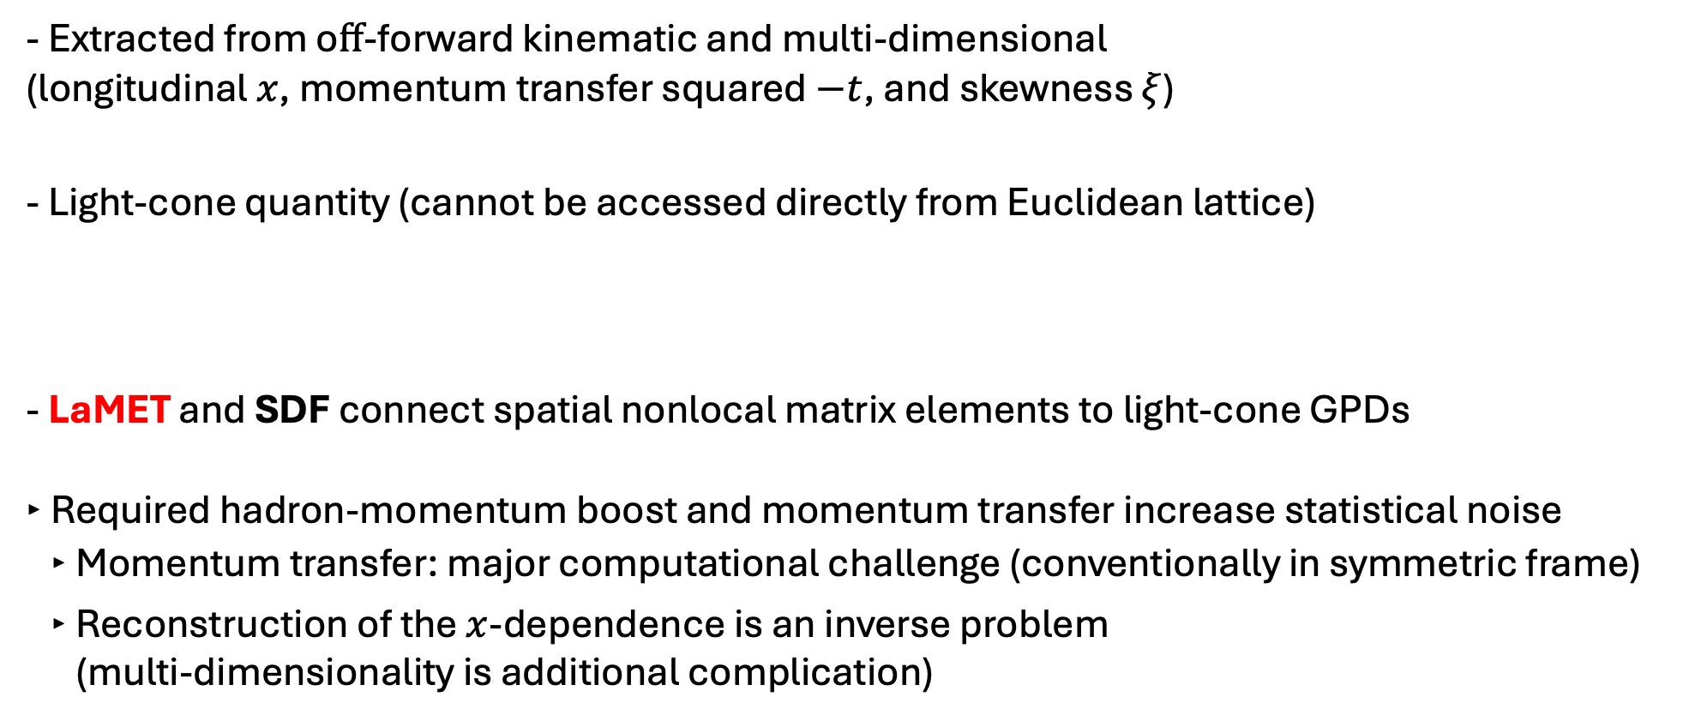
x-dependent GPDs from lattice QCD
- Extracted from oﬀ-forward kinematic and multi-dimensional
(longitudinal $x$, momentum transfer squared $−t$, and skewness $ξ$)
- Light-cone quantity (cannot be accessed directly from Euclidean lattice)
- LaMET and SDF connect spatial nonlocal matrix elements to light-cone GPDs
‣ Required hadron-momentum boost and momentum transfer increase statistical noise
‣ Momentum transfer: major computational challenge (conventionally in symmetric frame)
‣ Reconstruction of the $x$-dependence is an inverse problem
(multi-dimensionality is additional complication)
Image Credit: Cédric Lorcé
[X. Ji, PRL 110 (2013) 262002; Sci. China Phys. M.A. 57 (2014) 1407]
[A. Radyushkin, PRD 96, 034025 (2017)]
LaMET focus of this talk
5

Slide 6
Lattice Methodology for GPDs:
LaMET (quasi-GPDs approach )

Slide 7



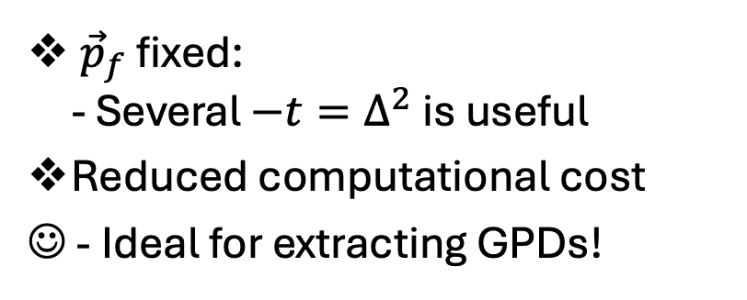

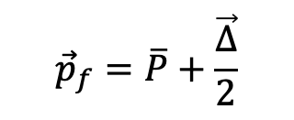

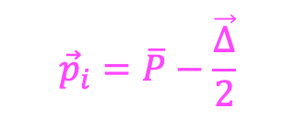



Kinematic setup
Traditional Briet Frame (Symmetric)
Asymmetric Frame
(alternative parametrization)
[S. Bhattacharya et al., PRD 106 (2022) 11, 114512 ]
$$\overline{q}$$
$$\overline{q}$$
$$z$$
$$z$$
$$q$$
$$q$$
$${\vec{p}}_{f}=\overline{P}+\frac{\vec{∆}}{2}$$
$${\vec{p}}_{i}=\overline{P}−\frac{\vec{∆}}{2}$$
$${\vec{p}}_{f}=\left(0,0,P_{z}\right)$$
$${\vec{p}}_{i}={\vec{p}}_{f}−\vec{∆}$$
Method of choice
${\vec{p}}_{f}$ fixed
- Only one $−t=∆^{2}$ is useful
Huge computational cost
☹ Impractical for GPDs
${\vec{p}}_{f}$ fixed:
- Several $−t=∆^{2}$is useful
Reduced computational cost
☺ - Ideal for extracting GPDs!
7

Slide 8
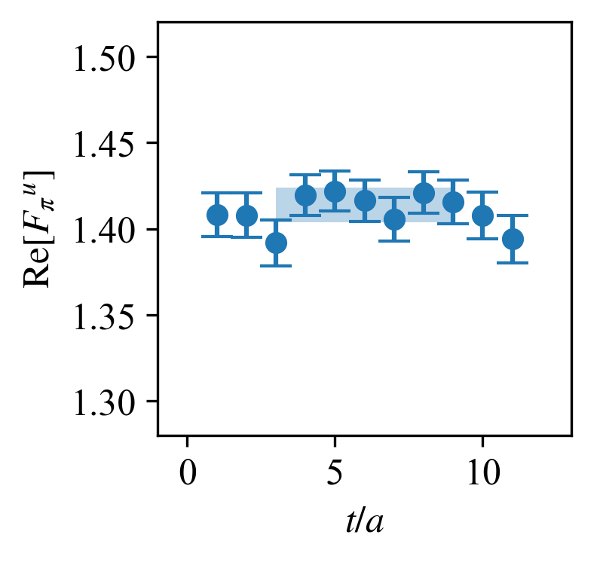
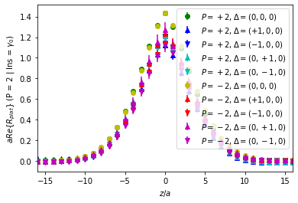



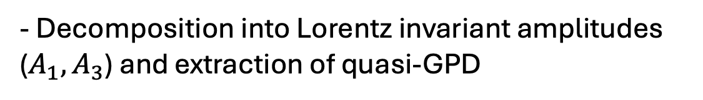

Analysis of Method
- Calculation in asymmetric frame for vector operators: $γ^{μ}$ ($μ=0,1,2$)
$$M_{μ}^{f}=\left\langle p_{f} | \overline{q}(z)γ^{μ}𝒲(z,0)q(z) | p_{f}−Δ\right\rangle$$
- Extraction of matrix element through a plateau fit $Π_{μ}^{f}$
$$R_{M}(z,p_{i},p_{f};t,t_{s})=\frac{C_{M}^{3pt}(z,p_{i},p_{f},t_{s},t)}{C_{M}^{2pt}(p_{f}, t_{s})}\sqrt{\frac{C_{M}^{2pt}(p_{i},t_{s}−t)C_{M}^{2pt}(p_{f}, t)C_{M}^{2pt}(p_{f},t_{s})}{C_{M}^{2pt}(p_{f}, t_{s}−t)C_{M}^{2pt}(p_{i},t)C_{M}^{2pt}(p_{i}, t_{s})}}$$
$$t_{s}−t≫a$$
$$Π_{μ}^{f}(z,p_{i},p_{f};t_{s})$$
$$t≫a$$
- Decomposition into Lorentz invariant amplitudes
($A_{1}, A_{3}$) and extraction of quasi-GPD
- Hybrid renormalization and exploration of large-z behavior
- x-dependence reconstruction (Backus-Gilbert and Neural Networks)
- Extraction of light-cone GPDs via a 1-loop matching kernel for hybrid
8

Slide 9
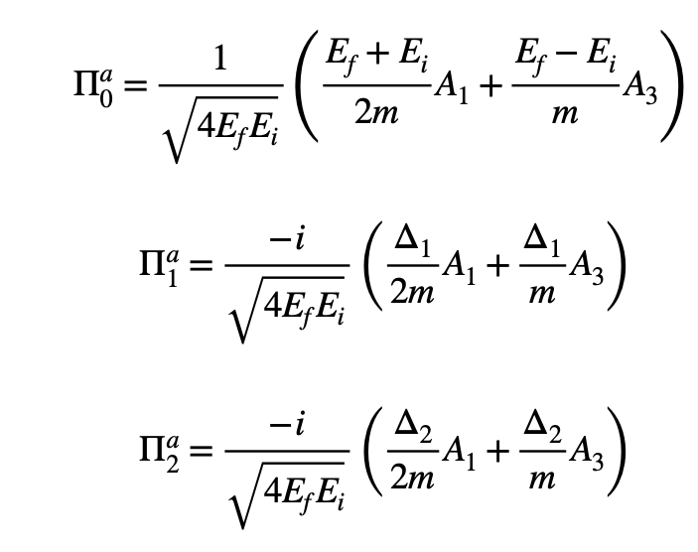
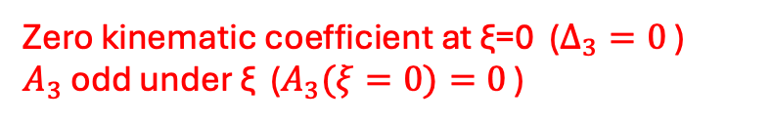
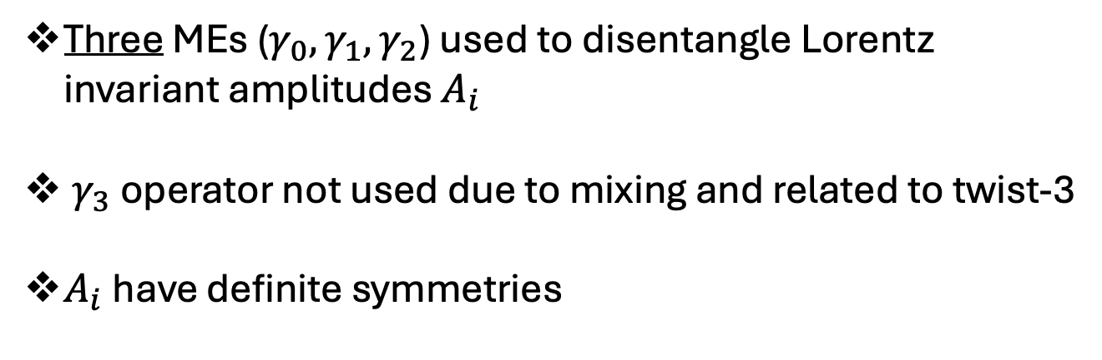
Extracting Amplitudes
[S. Bhattacharya et al., PRD 106 (2022) 11, 114512 ]
Three MEs ($γ_{0},γ_{1},γ_{2}$) used to disentangle Lorentz invariant amplitudes $A_{i}$
$γ_{3}$ operator not used due to mixing and related to twist-3
$A_{i}$have definite symmetries
Quasi H-GPD related to $A_{i}$ (definition not unique for quasi-GPDs)
Zero kinematic coefficient at ξ=0 ($Δ_{3}=0$ )
$A_{3}$ odd under ξ ($A_{3}(ξ=0)=0$ )
9

Slide 10
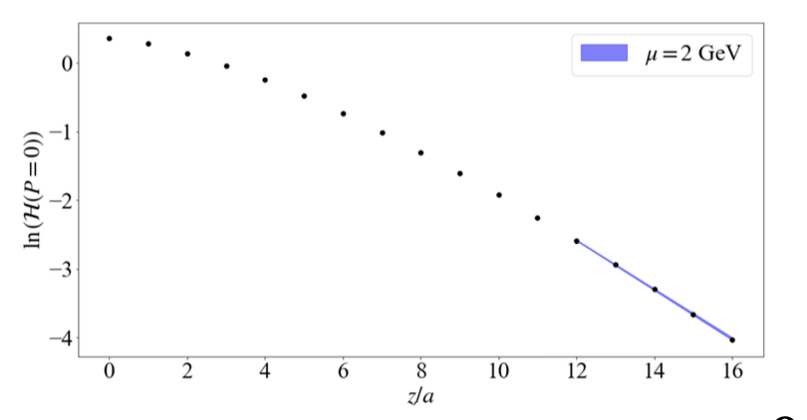
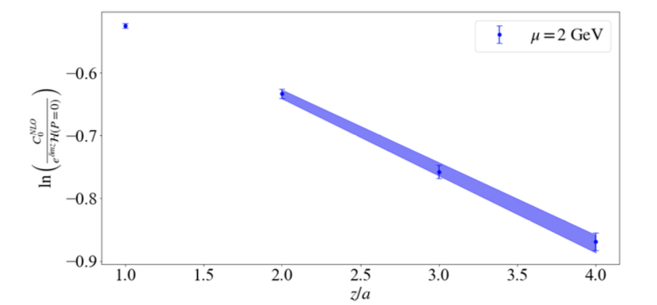
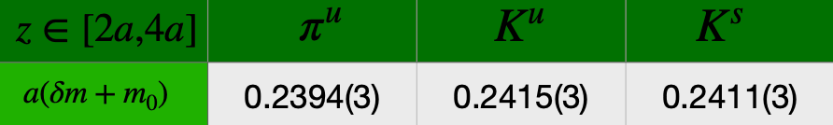

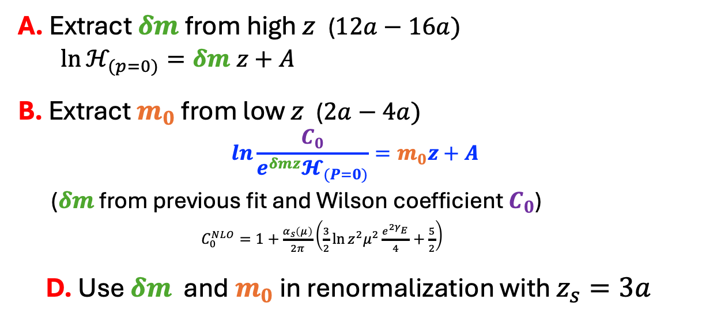
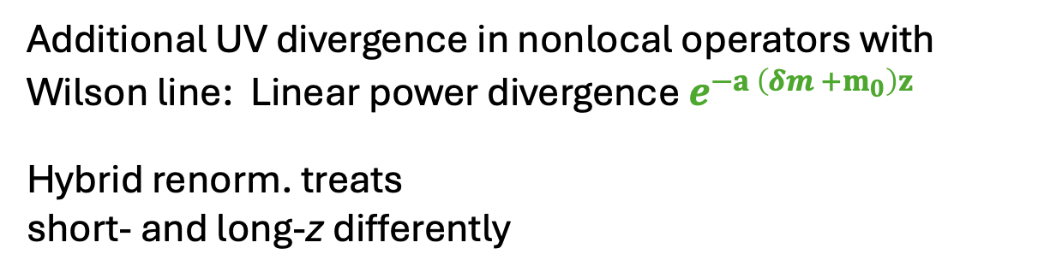

Hybrid Renormalization
[X. Ji et al., NPB 964 (2021) 115311]
A.
Additional UV divergence in nonlocal operators with Wilson line: Linear power divergence $e^{−a \left(δm +m_{0}\right)z}$
Hybrid renorm. treats
short- and long-z differently
$$ℋ_{R}=\left\{\begin{aligned}\frac{ℋ_{B}(z,P_{z},\vec{∆})}{ℋ_{B}(z,0,0)} z≤z_{s} \\ \frac{ℋ_{B}(z,P_{z},\vec{∆})}{ℋ_{B}(z_{s},0,0)}e^{(δm+m_{0})(z−z_{s})} z≥z_{s}\end{aligned}\right.$$
Approach: Fit bare quasi PDF $ℋ_{(P=0)}$ in two regions
A. Extract $δm$ from high $z$ ($12a−16a)$
$\ln{ℋ_{(p=0)}}=δm z+A$
B. Extract $m_{0}$ from low $z$ ($2a−4a)$
$$\ln{\frac{C_{0}}{e^{δmz}𝓗_{(P=0)}}=m_{0}z+A}$$
($δm$ from previous fit and Wilson coefficient $C_{0}$)
$C_{0}^{NLO}=1+\frac{α_{s}\left(μ\right)}{2π}\left(\frac{3}{2}\ln{z^{2}μ^{2}\frac{e^{2γ_{E}^{}}}{4}+\frac{5}{2}}\right)$
D. Use $δm$ and$m_{0}$ in renormalization with $z_{s}=3a$
B.
$μ=2$ GeV
C.
10

Slide 11
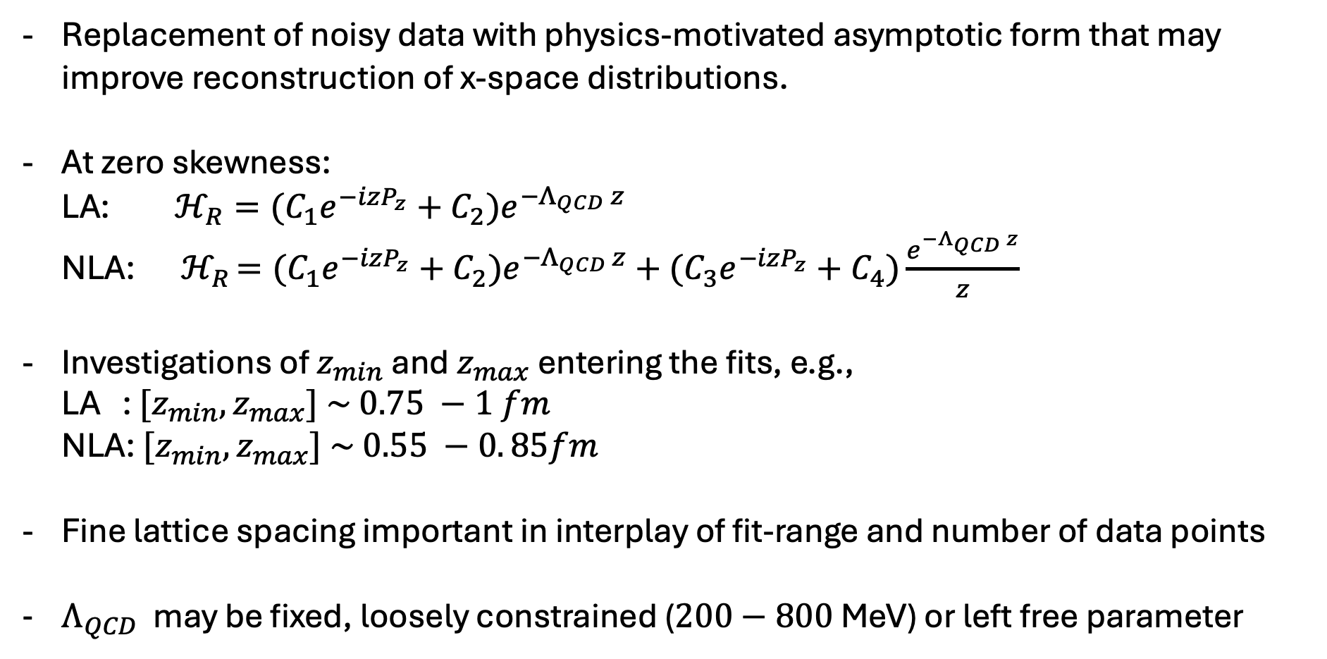
Large z-extrapolation
[X. Ji et al., arXiv:2601.12189]
Replacement of noisy data with physics-motivated asymptotic form that may improve reconstruction of x-space distributions.
At zero skewness:
LA: $ℋ_{R}={(C}_{1}e^{−izP_{z}}+C_{2})e^{−Λ_{QCD} z}$
NLA: ${ ℋ}_{R }={(C}_{1}e^{−izP_{z}}+C_{2})e^{−Λ_{QCD }z}+{(C}_{3}e^{−izP_{z}}+C_{4})\frac{e^{−Λ_{QCD} z}}{z}$
Investigations of $z_{min}$ and $z_{max}$ entering the fits, e.g.,
LA : ${[z}_{min},z_{max}] \sim 0.75 −1 fm$
NLA: ${[z}_{min},z_{max}] \sim 0.55 −0. 85fm$
Fine lattice spacing important in interplay of fit-range and number of data points
$Λ_{QCD}$ may be fixed, loosely constrained ($200−800$ MeV) or left free parameter
11

Slide 12
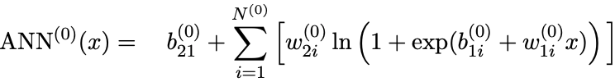

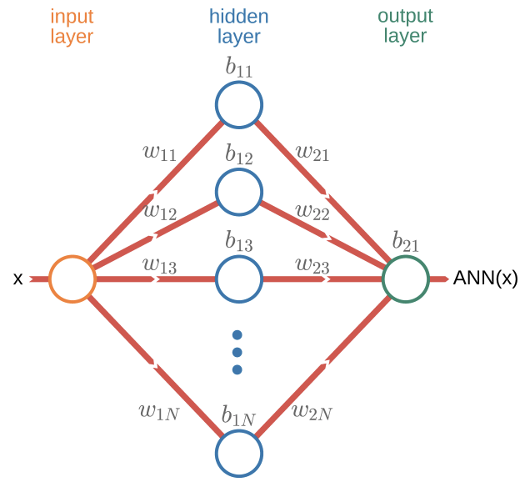
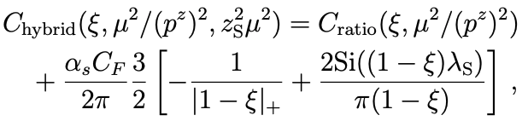

Reconstructing x-space and matching
x-dependence reconstruction
ANN single neural network
[M.-H. Chu et al., JHEP 05 (2026) 210]
Target parametrization:
Parameters $δ, ρ, b, w$: fitted to lattice data
ANN replaces a low-parameter Ansatz and provides a flexible continuous parametrization of the distribution
Light-cone PDF parametrized with an ANN and fitted through: inverse matching, Fourier transformation, and comparison with the lattice matrix elements.
Comparison with Backus-Gilbert
[G. Backus et al., Geophysical Journal International 16 (2) 169]
Matching formalism
One-loop accuracy:
$C_{ratio}$ from:
[T. Izibuchi et al, PRD98 056004 (2018)]
[X. Ji et al., NPB 964 (2021) 115311]
12

Slide 13
Results

Slide 14

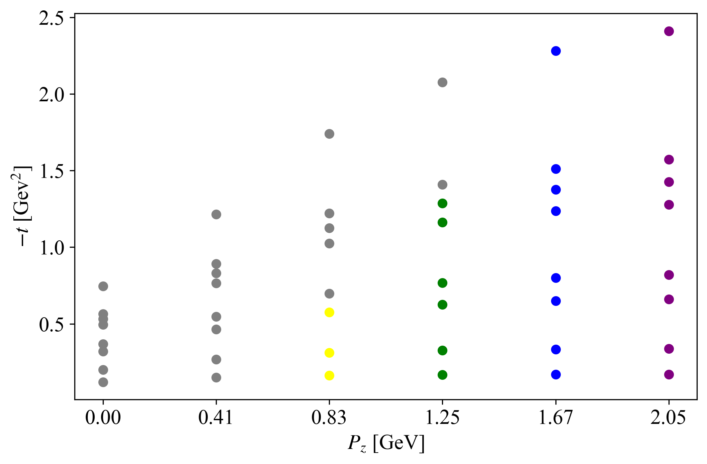
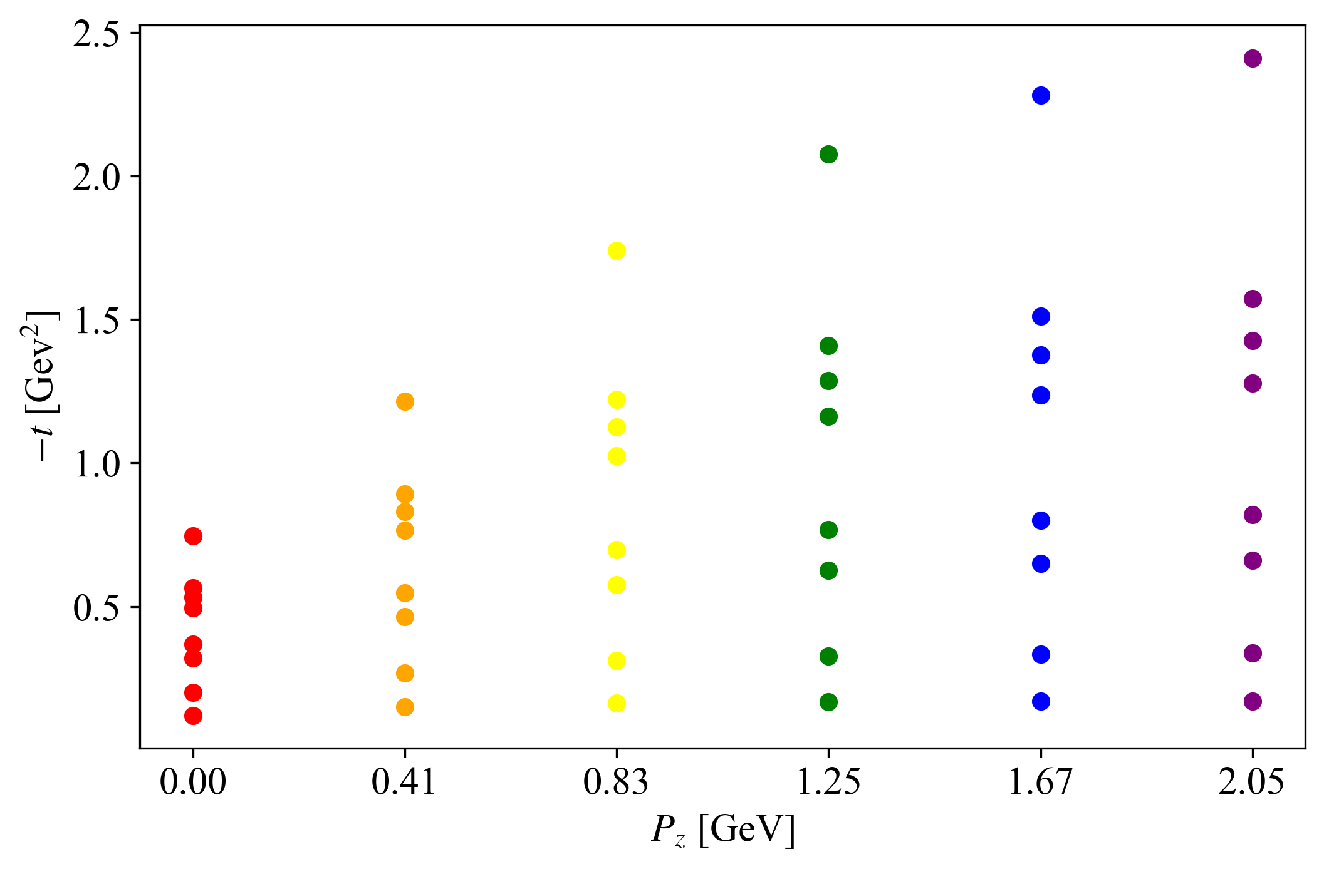
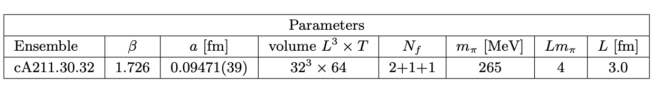
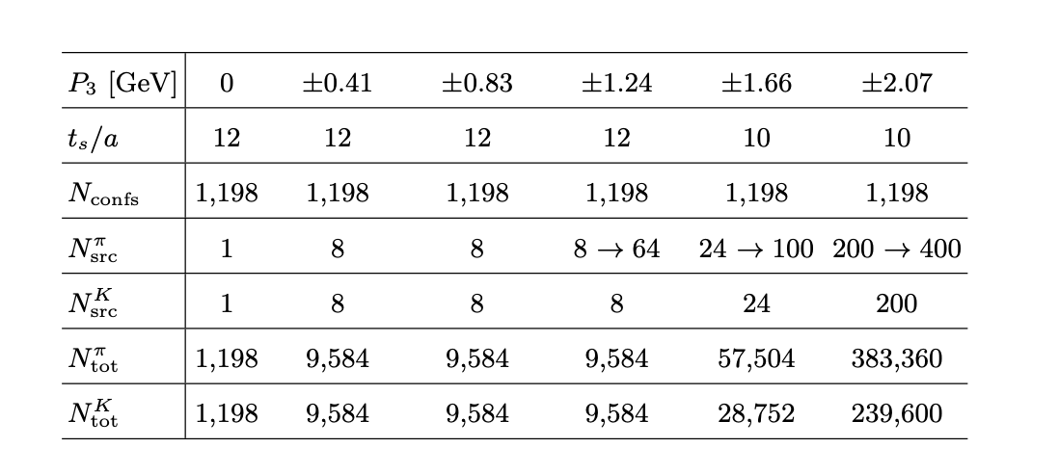
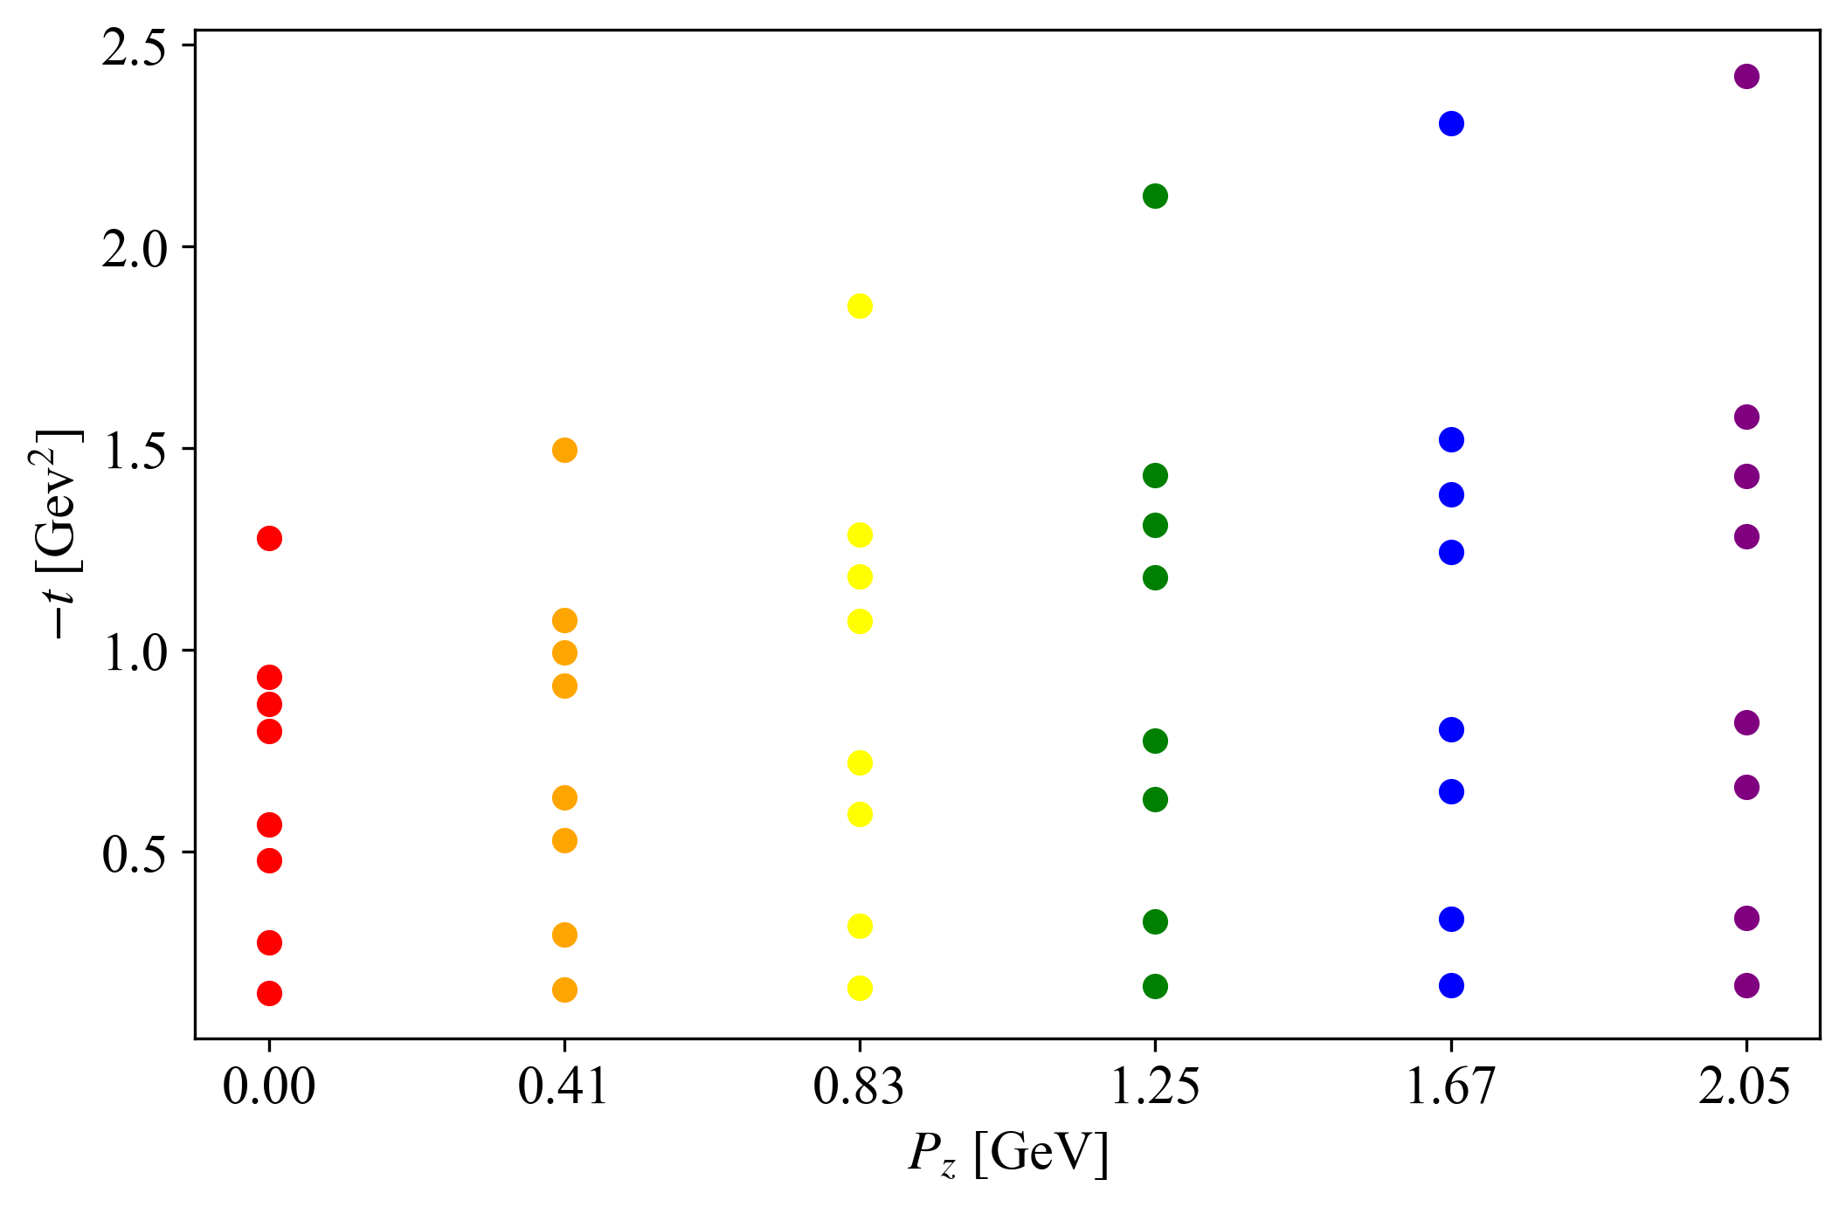
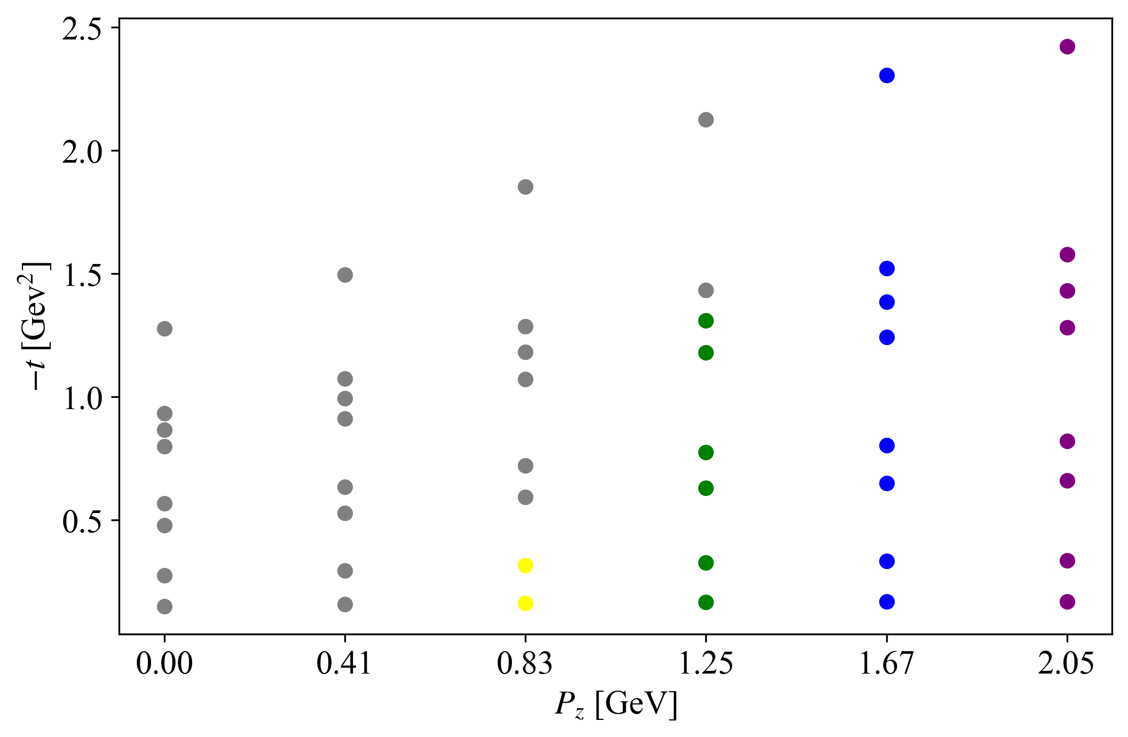
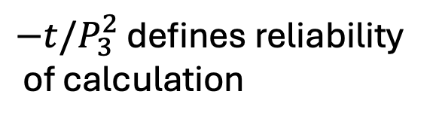
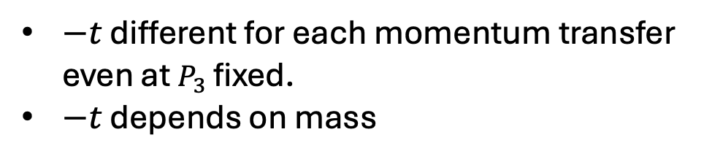
Lattice Setup
ξ=0 calculations
Increased statistics compared to PDFs
$−t$ different for each momentum transfer
even at $P_{3}$ fixed.
$−t$ depends on mass
$−t/P_{3}^{2}$ defines reliability
of calculation
14

Slide 15
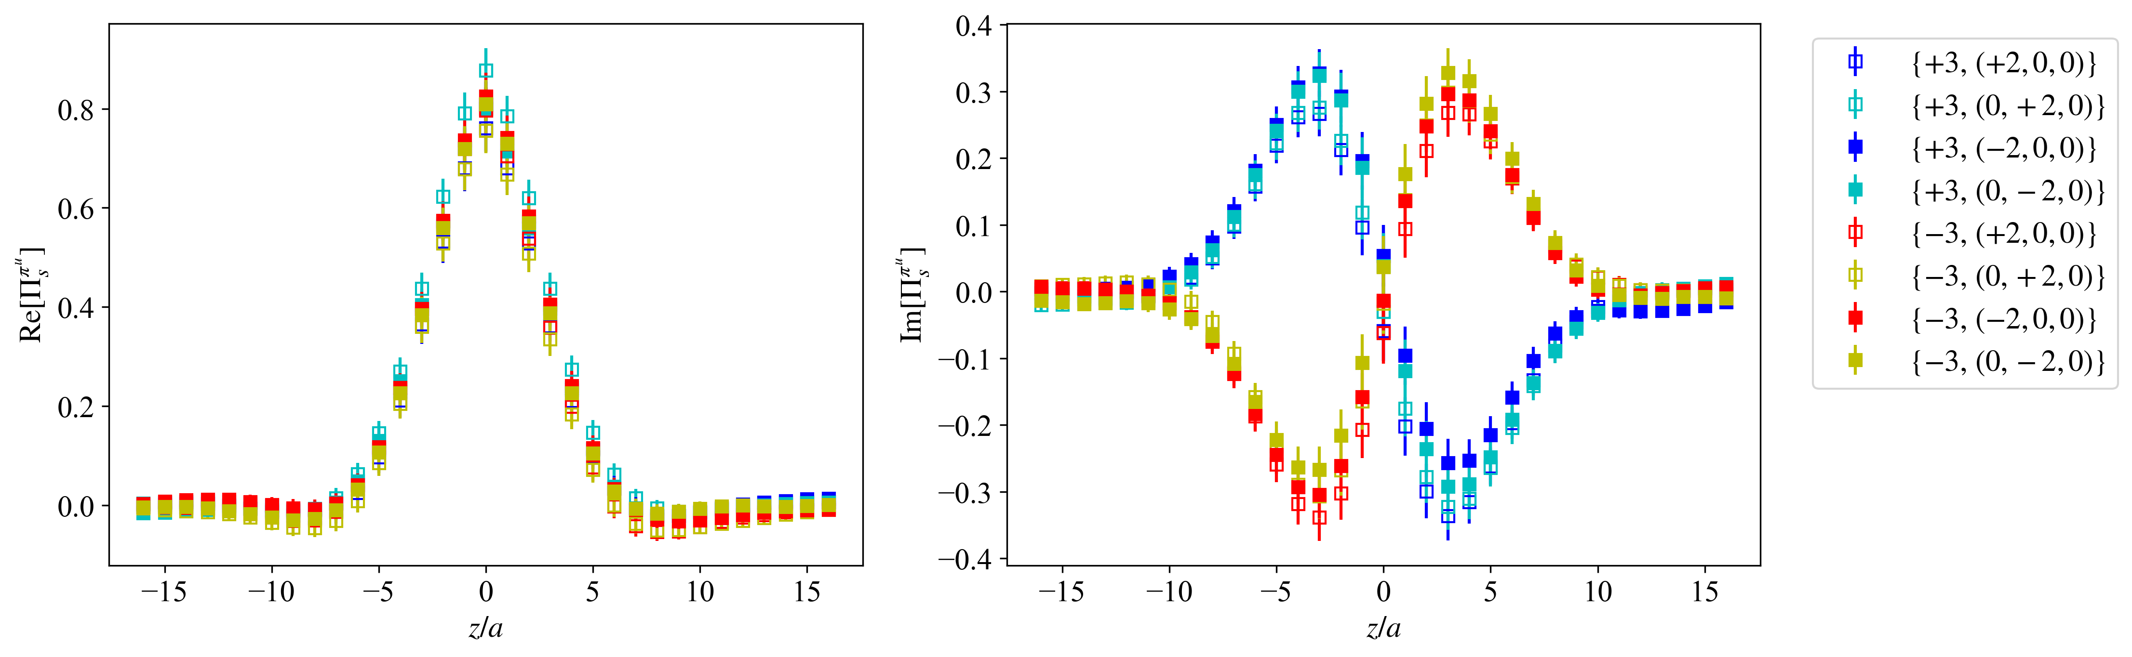
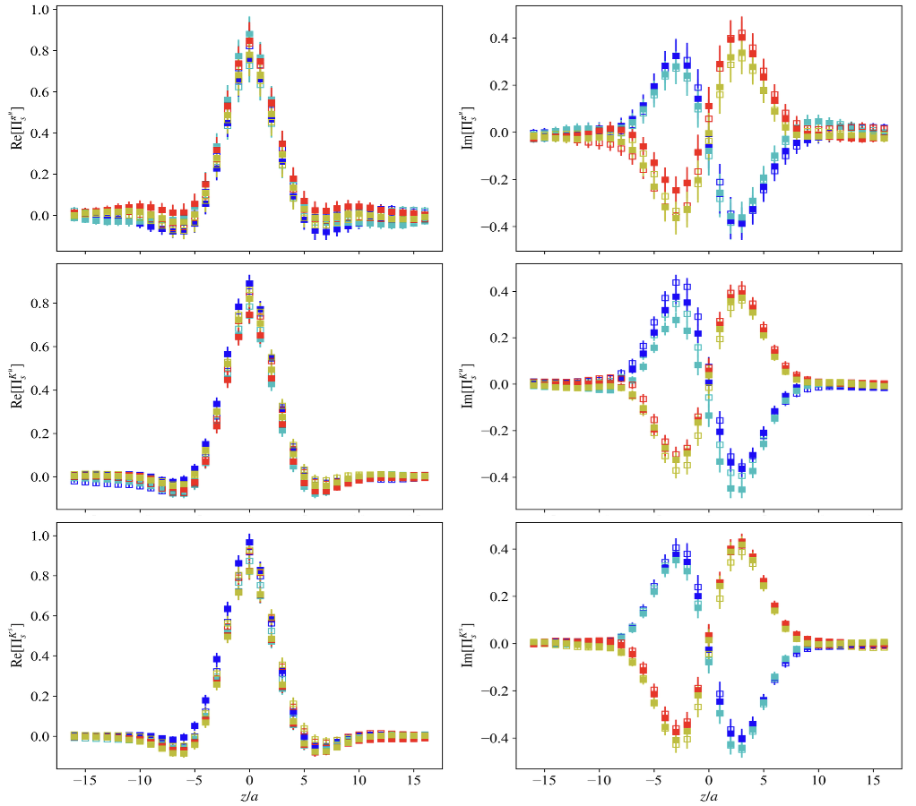
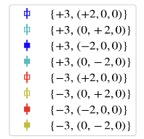

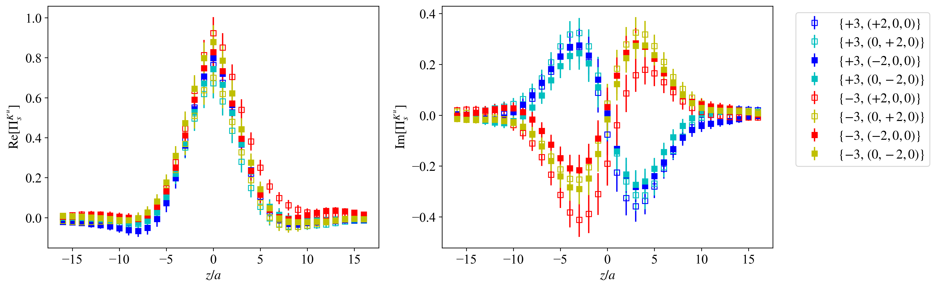
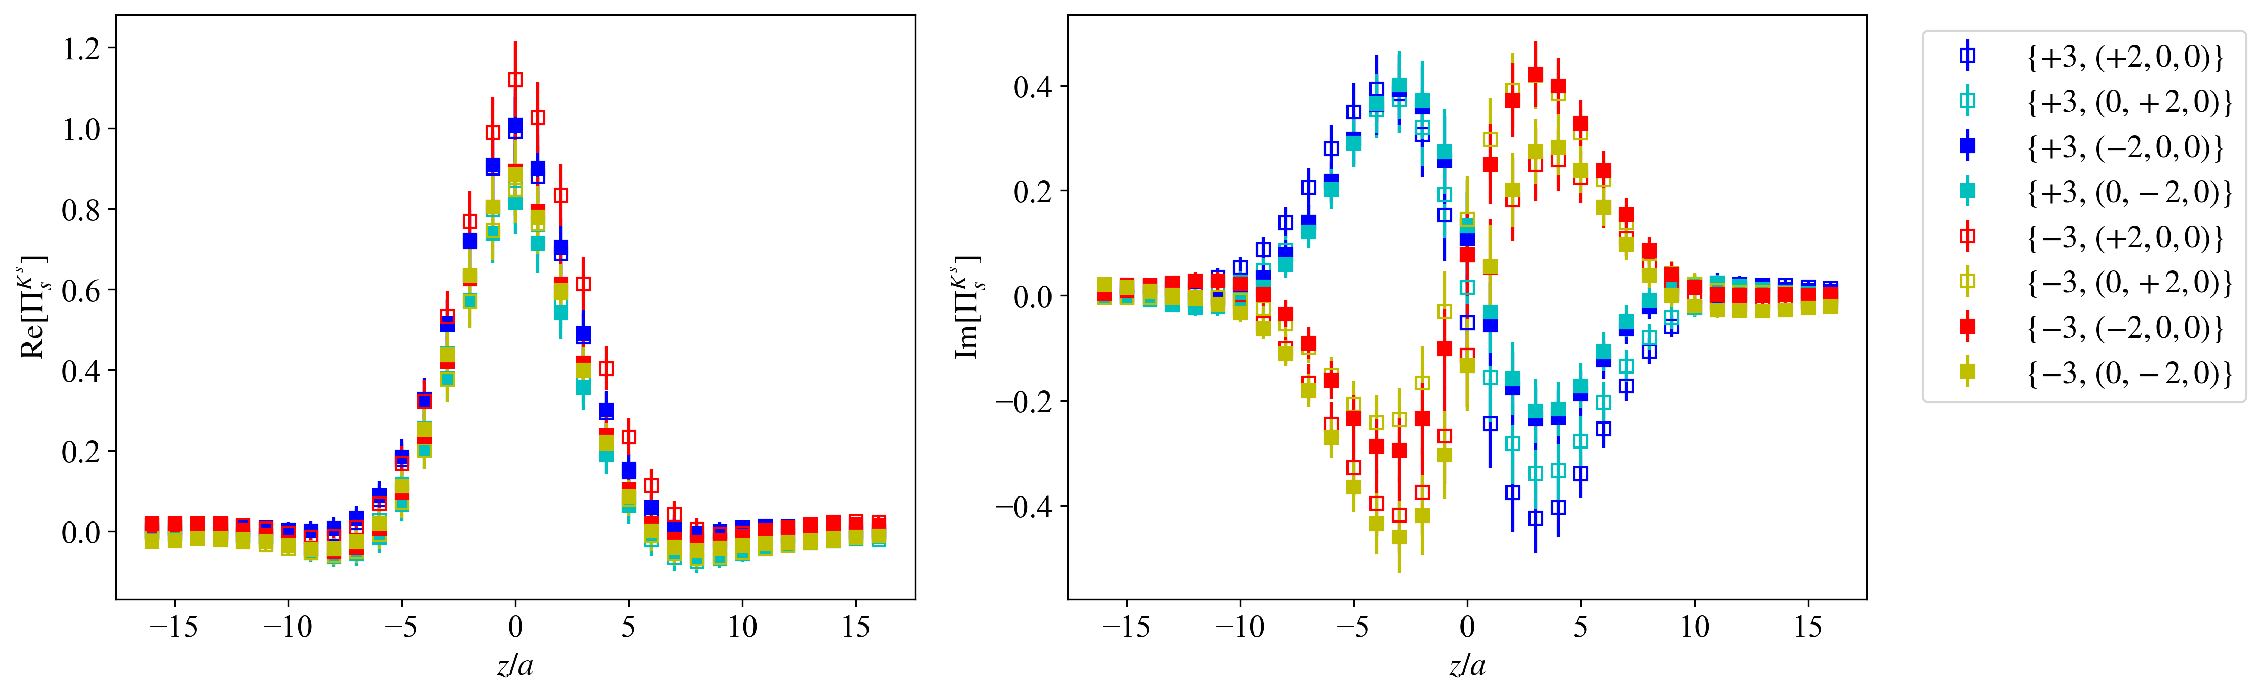



(Selected) Matrix Elements for $γ_{0}$
Statistics:
Pion=57,504
Kaon=28,752
$$P_{3}=1.25 GeV$$
Statistics:9,584
$$P_{3}=1.67 GeV$$
Pion (u)
Pion (u)
Kaon (u)
Kaon (u)
Kaon (s)
Kaon (s)
15
Notes:
Why is signal not getting better for Kaon?

Slide 16
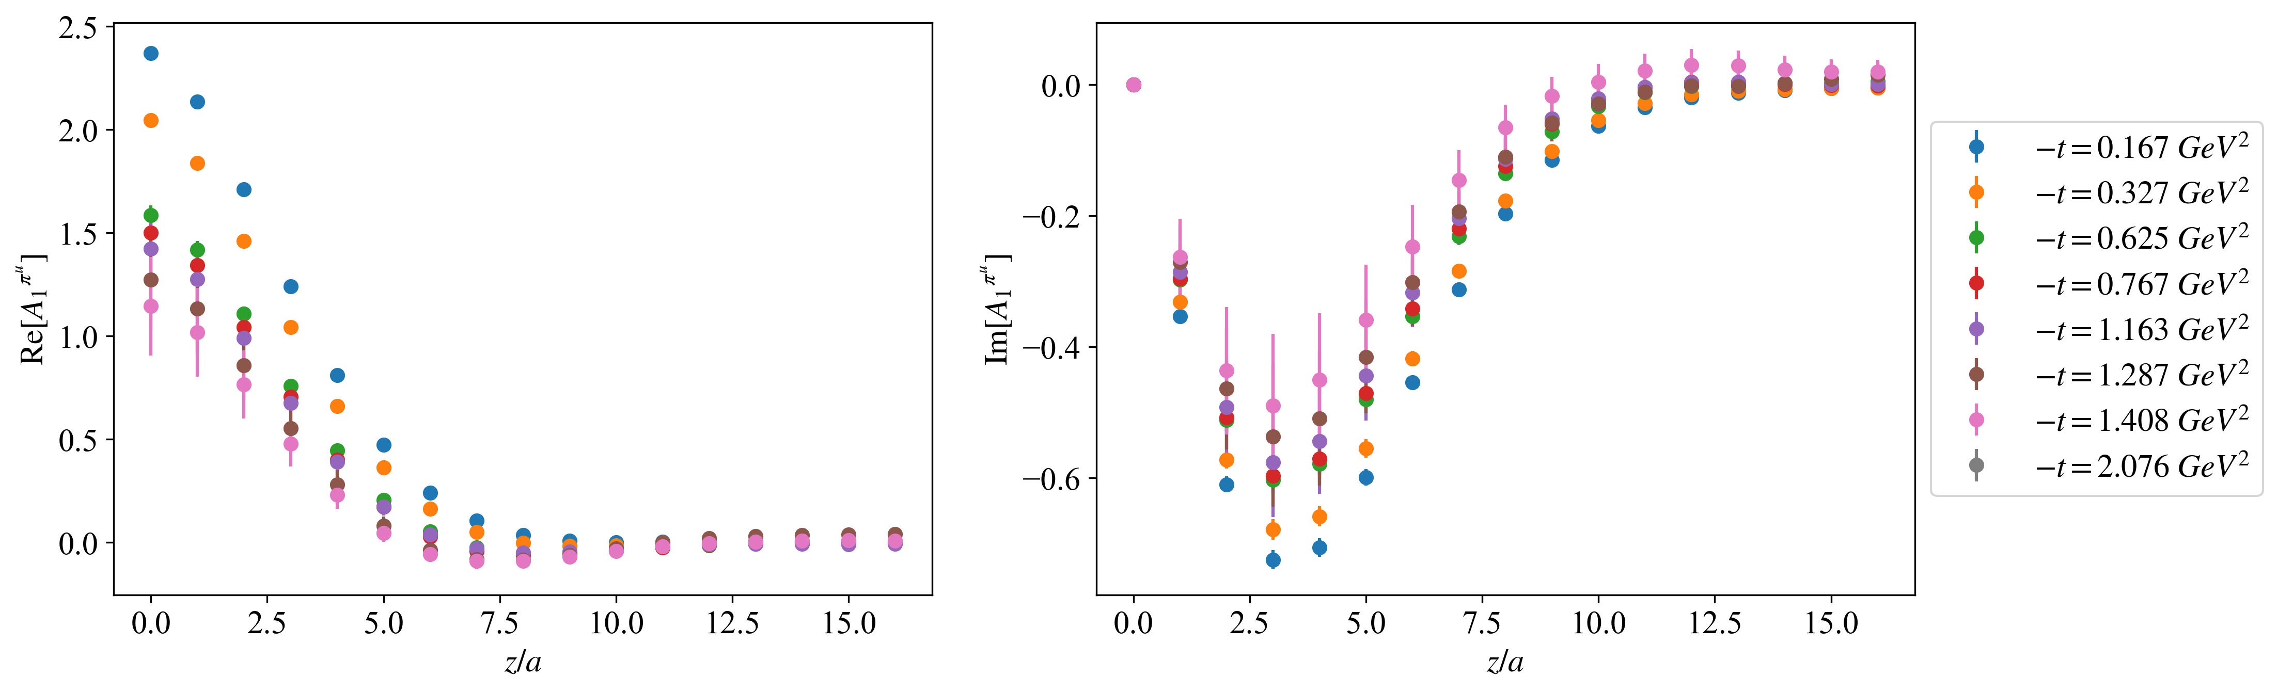
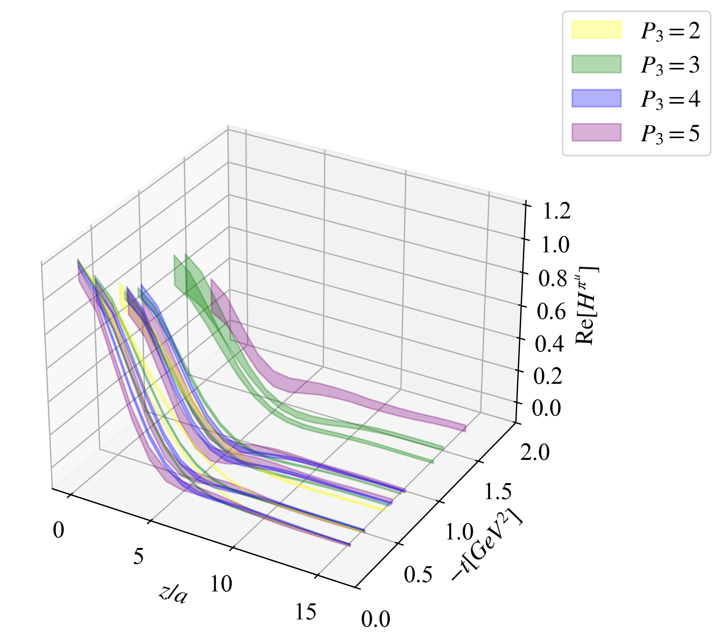
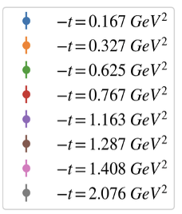
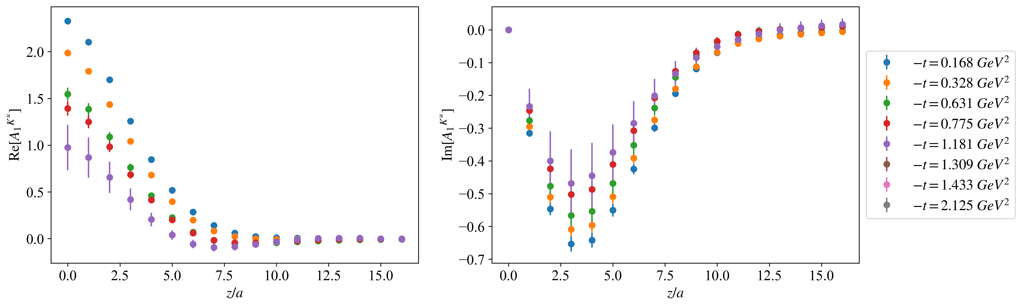
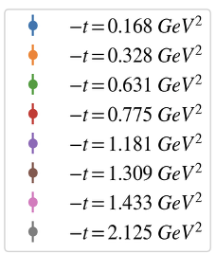
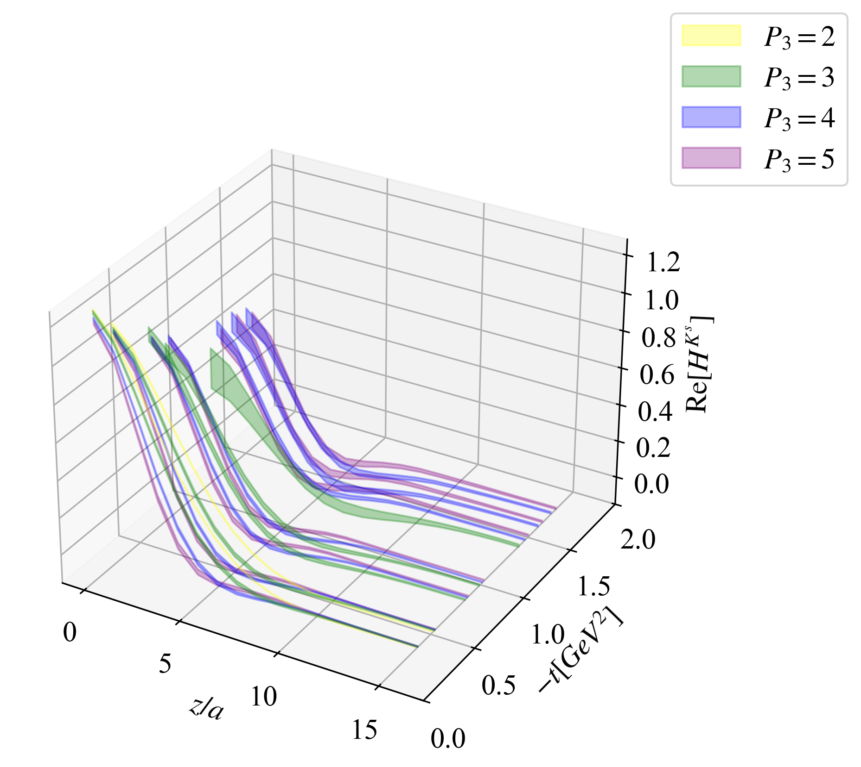
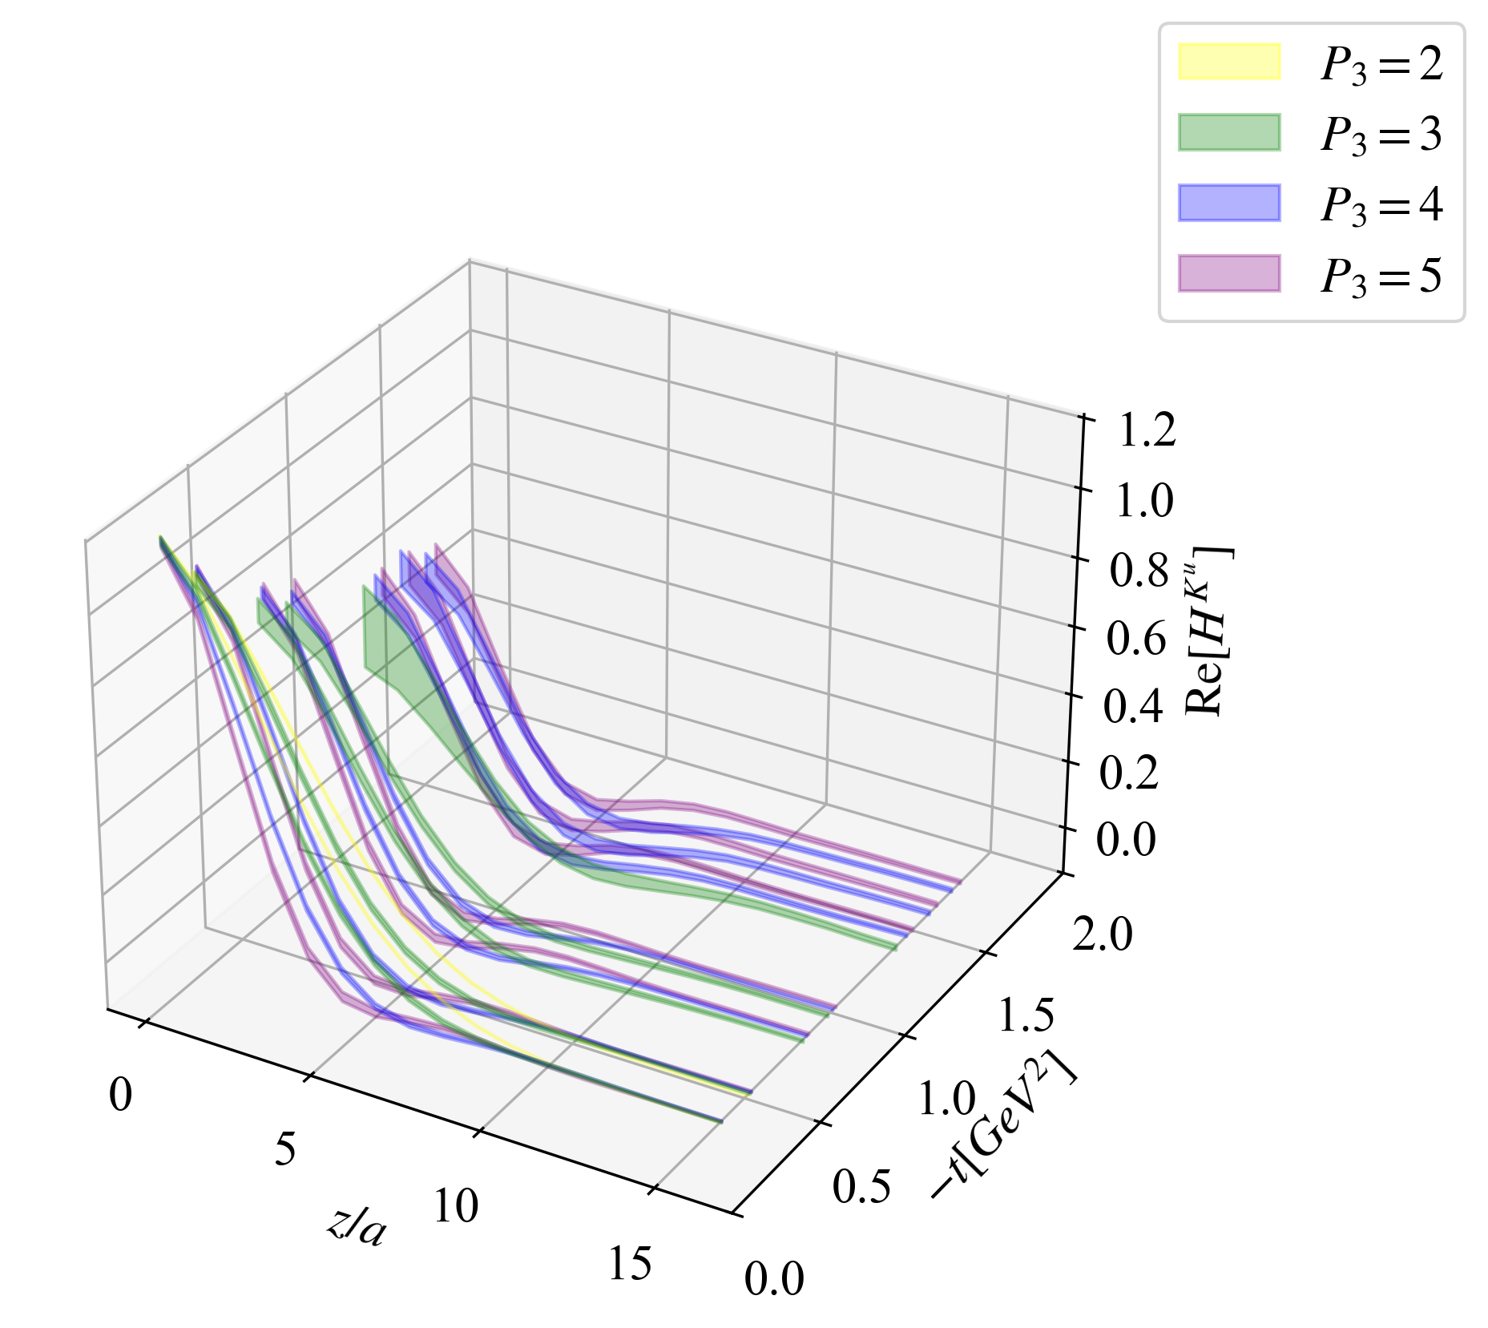
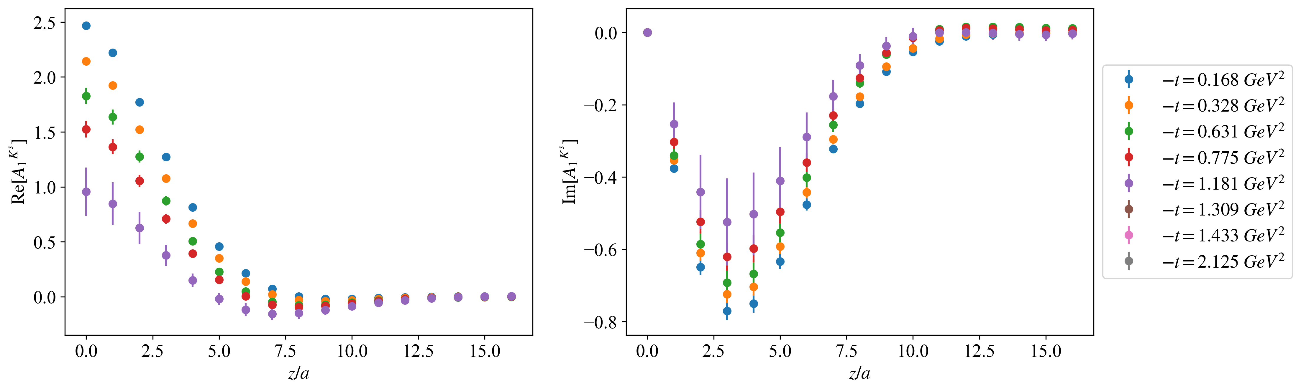
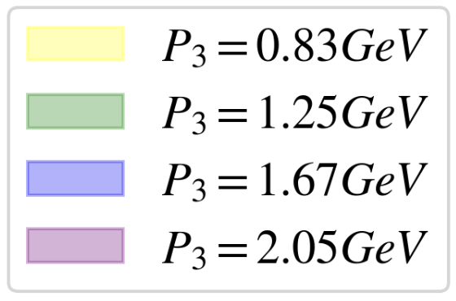
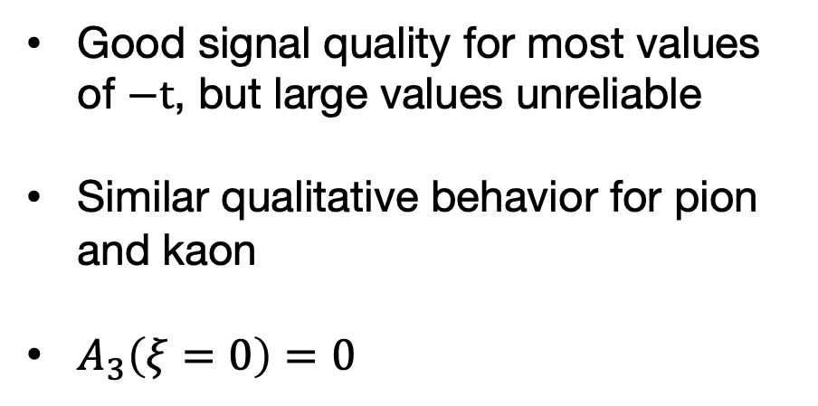

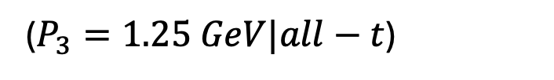
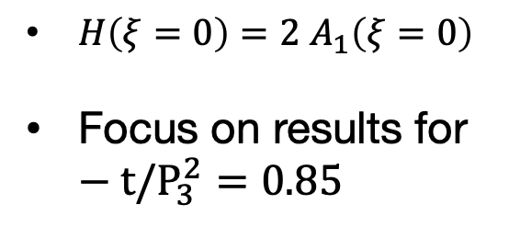
Bare Amplitude $A_{1}$
Good signal quality for most values of $−t$, but large values unreliable
Similar qualitative behavior for pion and kaon
$A_{3}\left(ξ=0\right)=0$
($P_{3}=1.25 GeV|all−t$)
Pion (u)
Kaon (u)
$H\left(ξ=0\right)=2 A_{1}\left(ξ=0\right)$
Focus on results for $−t/P_{3}^{2}=0.85$
Kaon (s)
16

Slide 17










Quasi-GPDs in x-space
Same trend for other $−t, P_{3}$ combinations
BG and ANN share similarities in intermediate-x region
Reconstruction method has impact to the light-cone distribution
17

Slide 18









Light-cone GPDs
BG and ANN differences in quasi-GPDs appear as small differences in intermediate-x region
Anti-quark region not reliable
Small- and large-x suffer from increased uncertainties
18

Slide 19
Summary and Future Work

Slide 20


Summary and Future Work
Extracting pion and kaon GPDs for a wide kinematic range is possible due to
Lorentz-invariant parametrization utilizing asymmetric kinematic frames.
This opens a practical path toward pion and kaon tomography from lattice QCD
Improvements in renormalization (hybrid) and x-space reconstruction
(neural networks), and exploration of large-z behavior
Follow-up work
Parametrization of –t dependence and impact-parameter
space distributions
GPDs from Short Distance Factorization on existing data
Nonzero skewness
Twist-3 GPDs
Mellin momens via OPE on these nonlocal operators
[Miller et al., arXiv:2606.28102], also slides of J. Miller
20

Slide 21





Thank you!
Please let me know if you have any questions
Collaborators: Minhuan Chu, Krzysztof Cichy, Martha Constantinou, and Joshua Miller
Acknowledgements:
ASCR Leadership Computing Challenge (ALCC)
DOE CSGF
NERSC
QGT Collaboration
Temple University

Slide 22
Backup

Slide 23

Conversion from lattice units to physical

Slide 24





LA and NLA Fits: $P_{3}=3|−t=4$ (Pion)
LA:
NLA:

Slide 25





LA and NLA Fits: $P_{3}=4|−t=4$ (Pion)
LA:
NLA:
NLA:

