Slide 1









Observation of quantum-field theory dynamics on a spin-boson quantum computer
Lattice 2026
Anton Than, Saurabh Kadam, Vinay Vikramaditya, Nhung Nguyen, Xingxin Liu, Zohreh Davoudi, Alaina Green, and Norbert Linke
University of Maryland, College Park
arxiv.org/pdf/2509.11477
(Accepted in Nature Physics)
Notes:
Hello everyone, today I'm here to talk about our work on simulating quantum field theory dynamics on a spin-boson quantum computer. Anton led the experimental work along with Nhung and Xingxin supervised by Alaina and Norbert. Saurabh and I worked on the theory with Prof. Zohreh Davoudi.

Slide 2
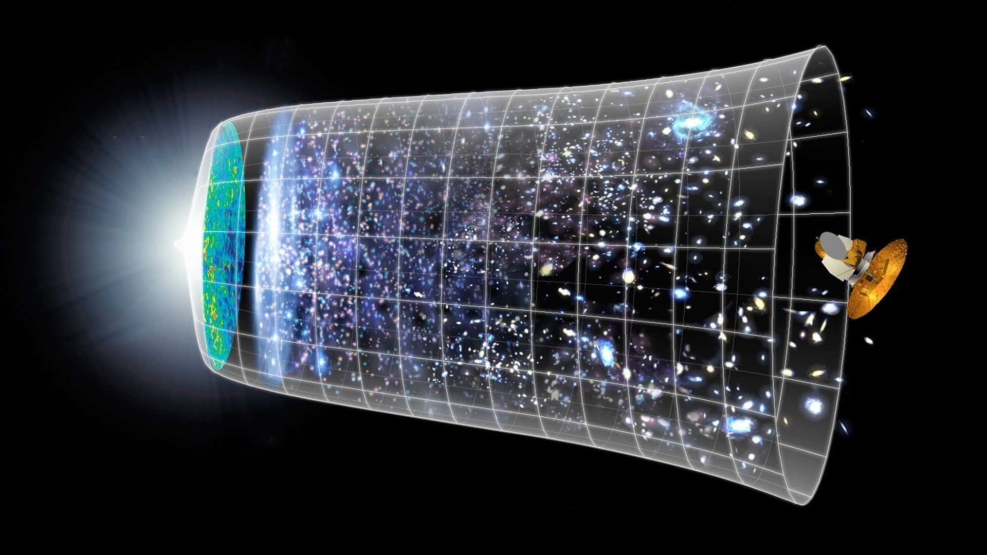
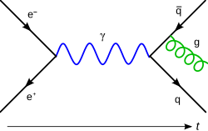
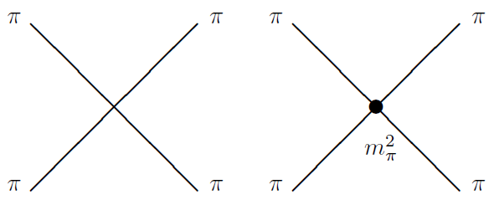
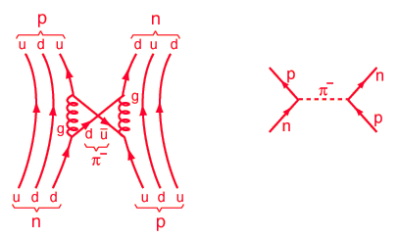
Bosons in QFTs
Scalar field theories
Cosmic Inflation
Hadronic interactions (Pion EFTs, …)
Fermion-Boson theories
Gauge theories (QED, QCD, …)
Yukawa model (Higgs coupling, nuclear interactions)
Notes:
Simulating out-of-equilibrium dynamics of bosonic and interacting fermion-boson theories is crucial to understand hadronic interactions, early universe, gauge theories etc.

Slide 3
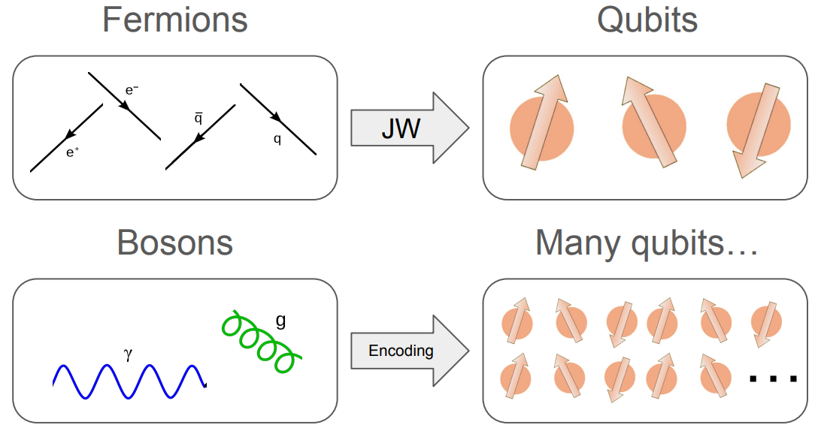
Simulation Methods
Digital
Bosonic Hilbert space is truncated and mapped to a finite number of qubits.
Bosonic operations map to complex qubit-based circuits.
Error correction can be performed.
Notes:
This task is challenging with classical methods when dealing with real-time dynamics or finite-density systems. Quantum simulation is a promising alternative.
In digital quantum simulation, the infinite dimensional Hilbert space of a boson is truncated and mapped to a finite number of qubits. However, truncation errors grow with energy and time and keeping this under control requires large qubit and gate costs.

Slide 4
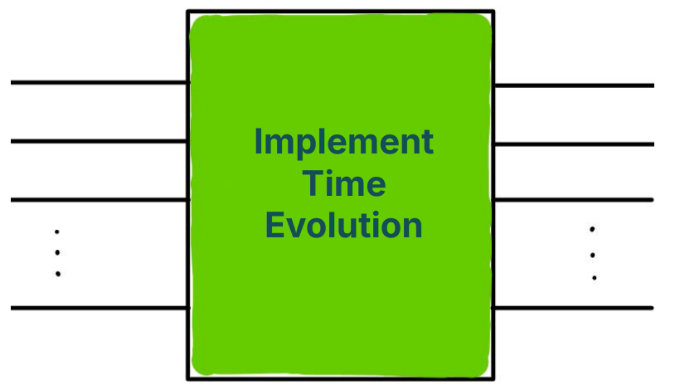
Simulation Methods
Digital
Analog
Bosonic Hilbert space is truncated and mapped to a finite number of qubits.
Intrinsic d.o.f. and interactions are used to engineer target Hamiltonian.
Bosonic operations map to complex qubit-based circuits.
Limited by tunability of platform parameters.
Error correction can be performed.
Notes:
Analog simulation, on the other hand, uses the intrinsic bosonic d.o.f. to directly simulate the target Hamiltonian, bypassing the need for truncation. However, this approach is limited by the tunability of intrinsic interactions.

Slide 5
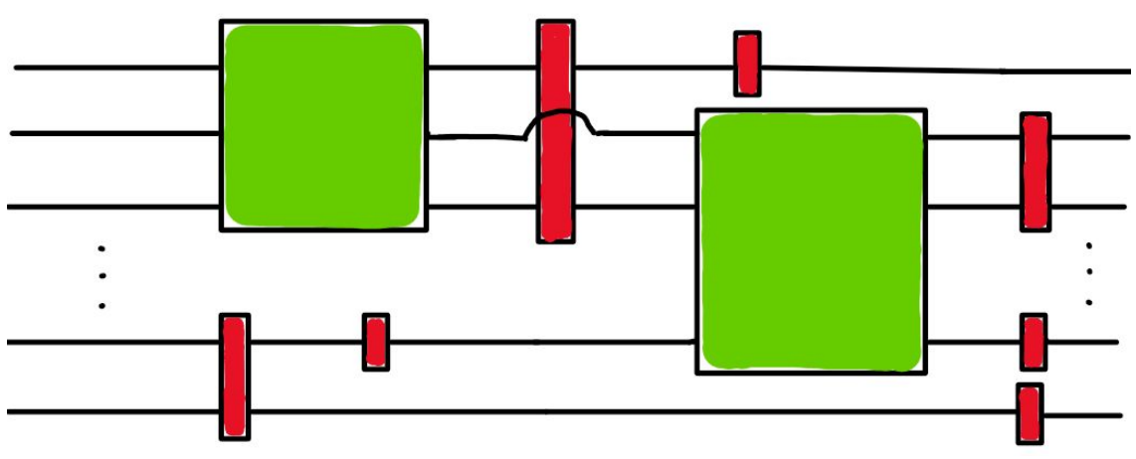
Simulation Methods
Digital
Hybrid
Analog
Bosonic Hilbert space is truncated and mapped to a finite number of qubits.
Efficiency → Uses intrinsic d.o.f.
Flexibility → Digitizes time evolution using hybrid gates designed to operate on these intrinsic d.o.f.
Intrinsic d.o.f. and interactions are used to engineer target Hamiltonian.
Bosonic operations map to complex qubit-based circuits.
Limited by tunability of platform parameters.
Error correction can be performed.
Notes:
We use a hybrid method which combines the efficiency of analog simulation with the flexibility of digital simulation by implementing time evolution using hybrid gates designed to operate on these intrisic d.o.f.

Slide 6
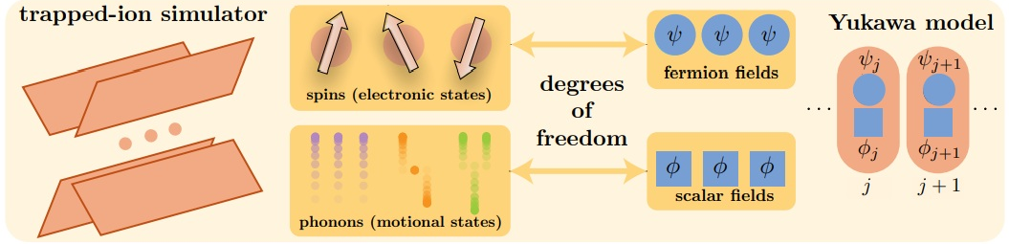
Trapped-ion quantum simulator
A. Than et al. arXiv:2509.11477
Notes:
The trapped ion platform hosts both qubit d.o.f., encoded in the internal levels of the ions, and bosonic d.o.f., encoded in the motional modes of the ions. This makes it a good candidate to simulate spin-boson Hamiltonians like the Yukawa model.

Slide 7
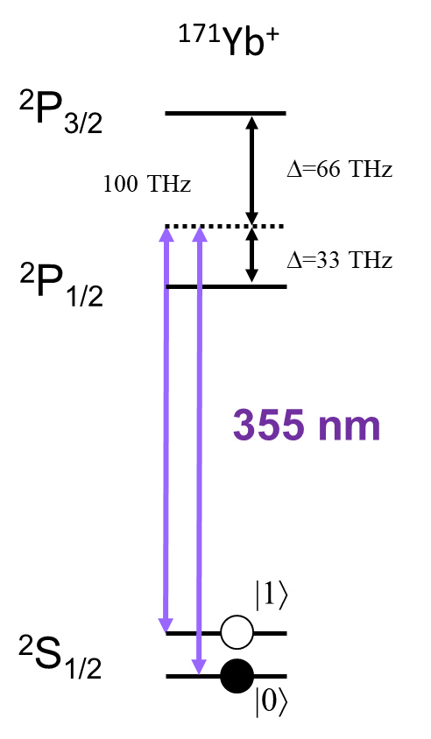
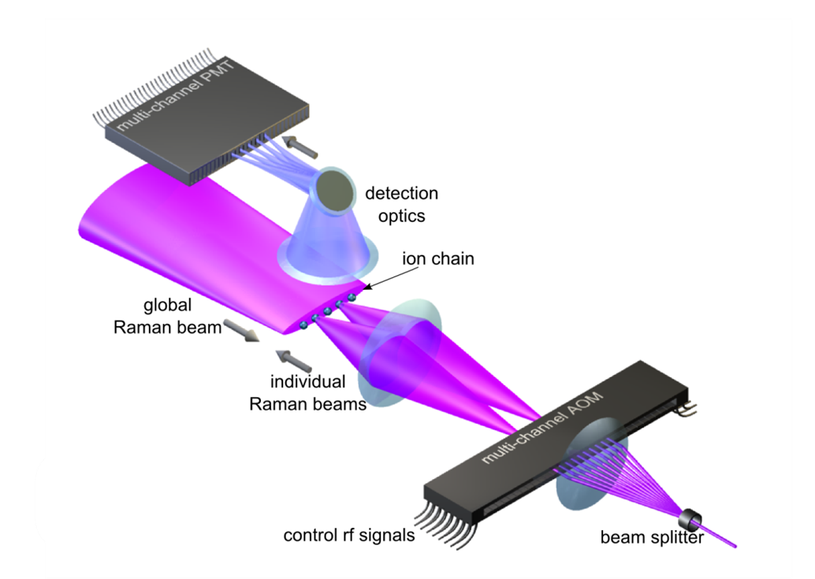

Our system
Debnath et al. Nature 536 (2016)
Notes:
In our setup, we use the internal levels of the Ytterbium ion as our qubit degree of freedom. These ions are addressed by laser beams to perform coherent operations.

Slide 8
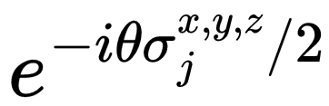



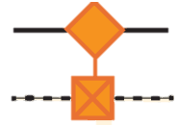
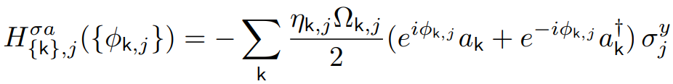
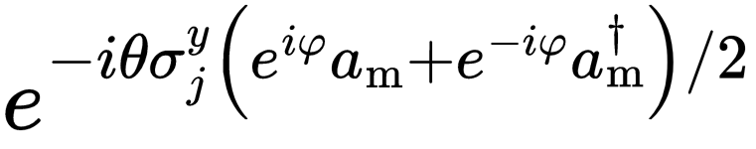

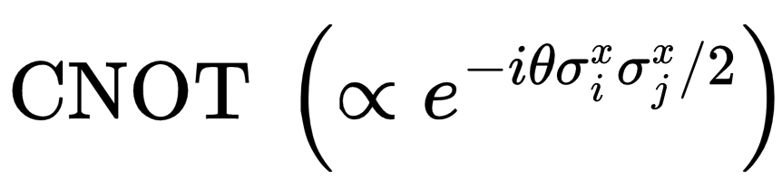
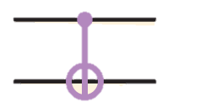
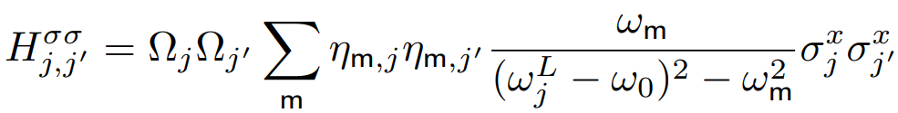

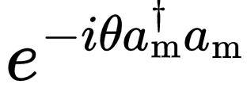

Trapped-ion Gates
A. Than et al. arXiv:2509.11477
Z. Davoudi et al. PhysRevResearch.3.043072
Notes:
These are operations that can be performed in the trapped-ion platform. The single and 2 qubit gates are well known and used in digital quantum computation. z-rotations and the bosonic phase can be implemented classically at no cost. The non-trivial hybrid gate is the spin-phonon gate.
Eta is the Lambe Dicke parameter which is small. So, the higher order operations take longer to implement. This makes the 2-qubit gates the slowest among these.

Slide 9
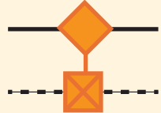
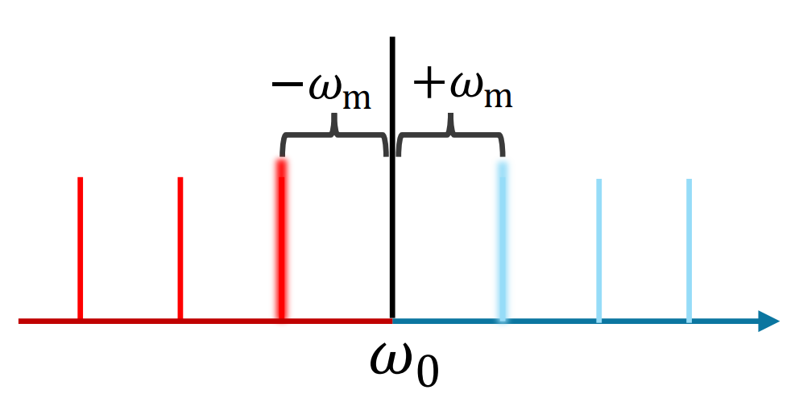



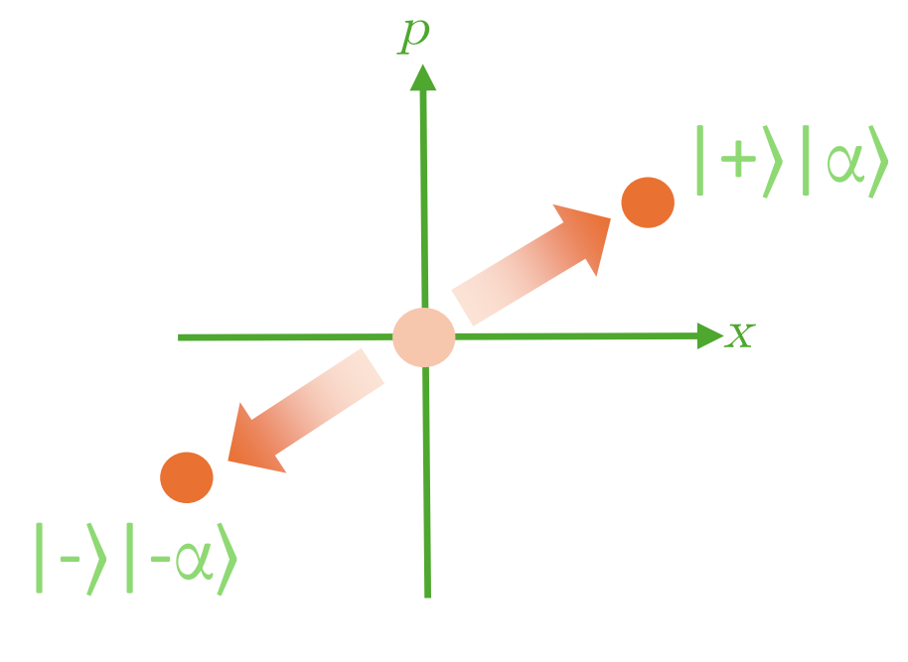
Spin-dependent displacement
Phase control on laser allows for selectable phase for each operator
A. Than et al. arXiv:2509.11477
Notes:
The spin--phonon gates are performed by applying a simultaneous red and blue sideband operation that gives us the following operator with arbitrary phases.

Slide 10
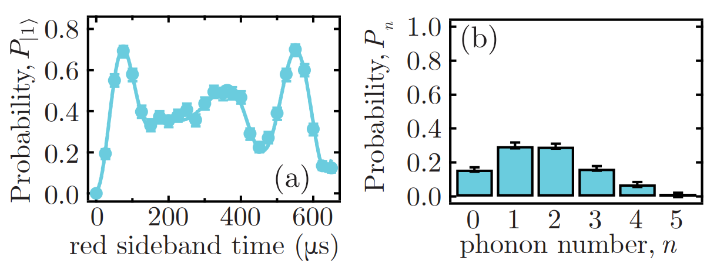
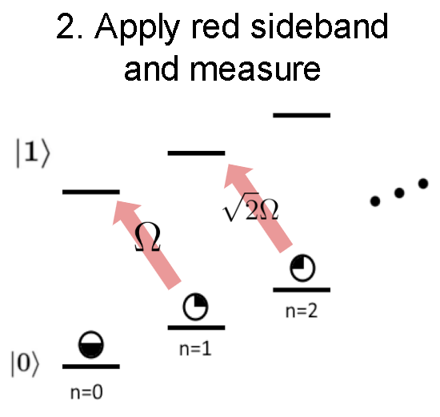
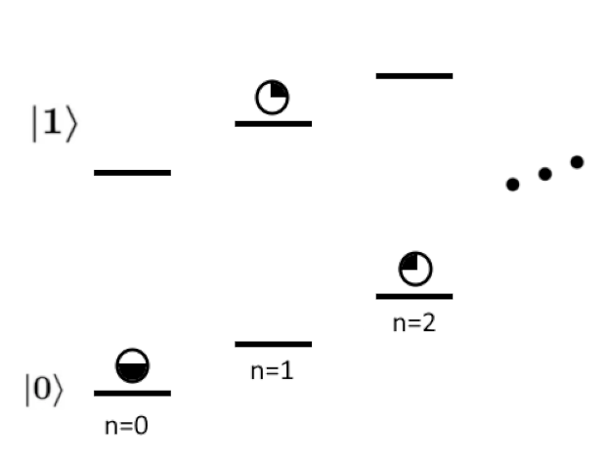
Phonon measurement
1. Pump to |0〉
Meekhof et al, PRL 76, 1796 (1996)
A. Than et al. arXiv:2509.11477
Notes:
Phonon occupations are measured by driving transitions in a coupled spin-phonon state. The spin state is first reset to 0. The Rabi frequencies go as square root of the phonon occupation number, and therefore performing a fitting procedure on the spin flip probability can give us the phonon occupation probabilities.

Slide 11
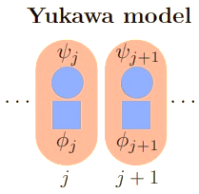


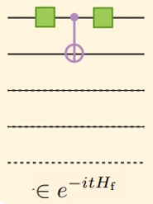

Yukawa model in (1+1)D
A. Than et al. arXiv:2509.11477
Notes:
Now, I'll discuss the lattice Yukawa model in 1+1 D. We use the staggered fermion formulation where the electron d.o.f. are mapped to even sites (in green) and positron d.o.f. to odd sites (in blue). The dotted ones represent empty sites and colored ones occupied.
The fermionic fields (psi) are mapped to spins via Jordan-Wigner transformation. The free fermionic Hamiltonian contains nearest neighbour hopping, including hopping across the periodic boundary, and the staggered mass term. This term can be implemented using single and 2 qubit gates.

Slide 12
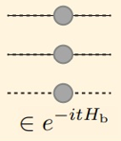

Yukawa model in (1+1)D
A. Than et al. arXiv:2509.11477
Notes:
The bosonic fields (phi) can be written as a momentum mode expansion and the free bosonic term is just the harmonic oscillator Hamiltonian summed over the N modes. They can be implemented using bosonic phase gates at no cost.

Slide 13
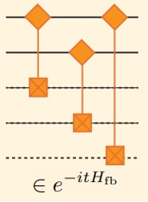


Yukawa model in (1+1)D
A. Than et al. arXiv:2509.11477
Notes:
The Yukawa interaction term takes the following form where the fermionic number operator maps to 1+sigmaz/2 and phi is replaced by the mode expansion. This can be implemented using the spin-phonon gates.

Slide 14
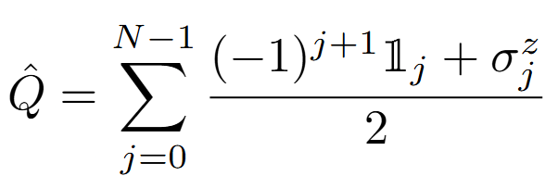
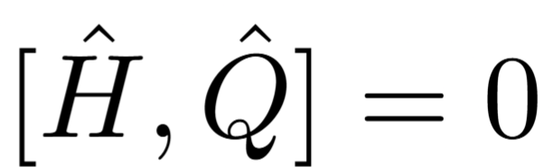
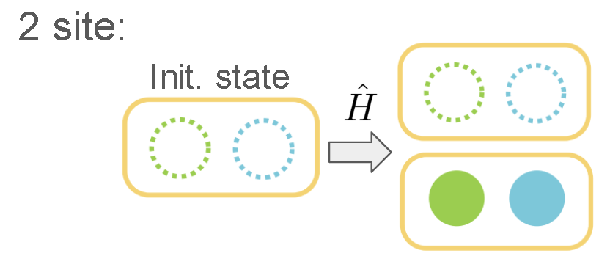
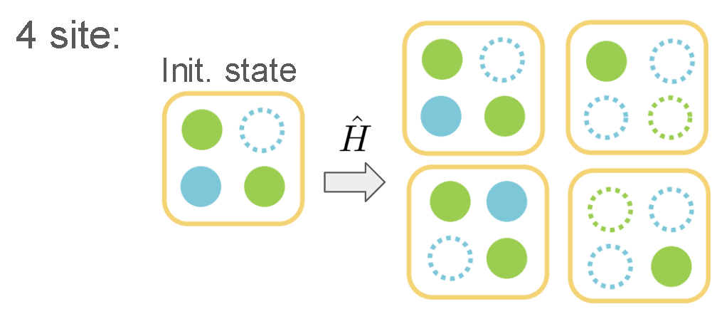
Model Simplification
Q=0
Q=-1
A. Than et al. arXiv:2509.11477
Notes:
The staggered charge operator, Q, measures the number of positrons minus number of electrons and is a conserved quantity.
Our experimental setup has a limited bosonic coherence time, which limits the number of 2 qubit gates we can use. So, we restrict our simulation to certain charge subsectors.
The 2 site theory has 2 states with Q=0 which can be mapped to a single qubit and the 4 site theory has 4 states with Q=-1 which can be mapped to 2 qubits.

Slide 15
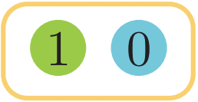
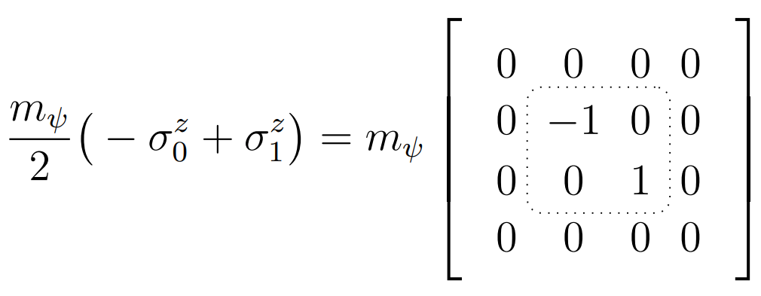

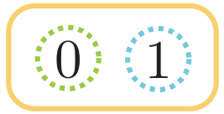
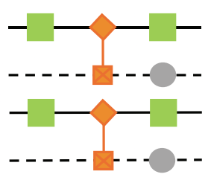

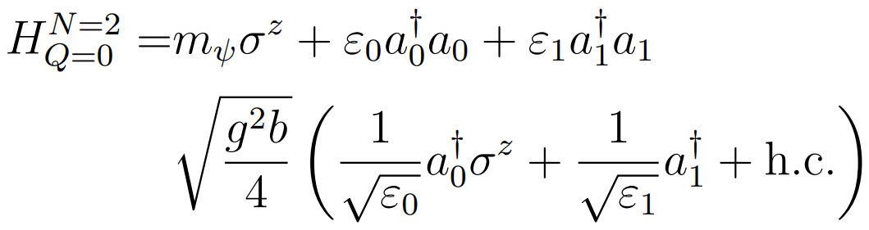



N=2, Q=0
A. Than et al. arXiv:2509.11477
Notes:
For the 2 site case, we map the charge 0 states to a single qubit as follows and then Pauli decompose the subsector Hamiltonian.
This Hamiltonian is then translated to a quantum circuit using an ancilla qubit.

Slide 16
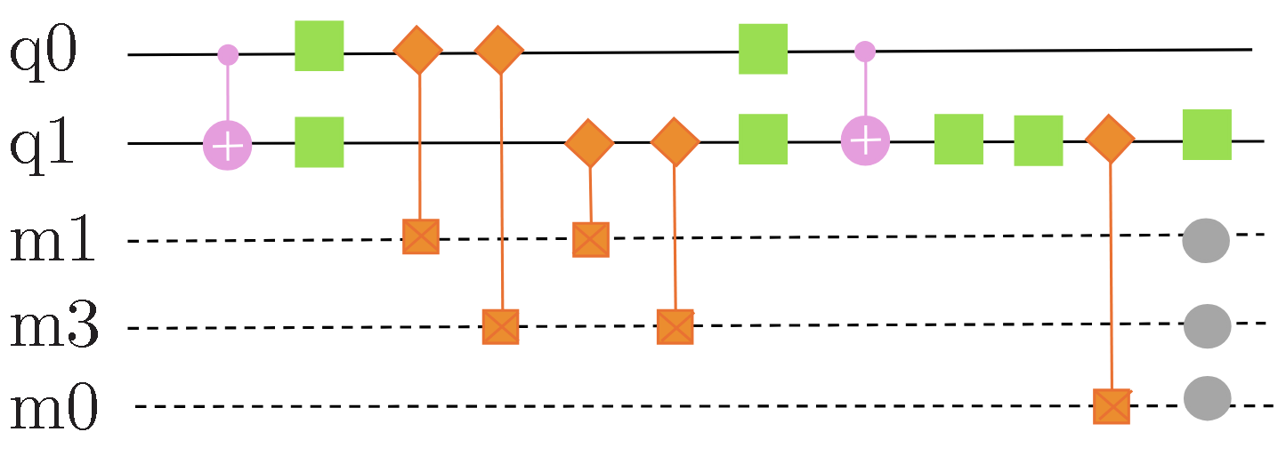
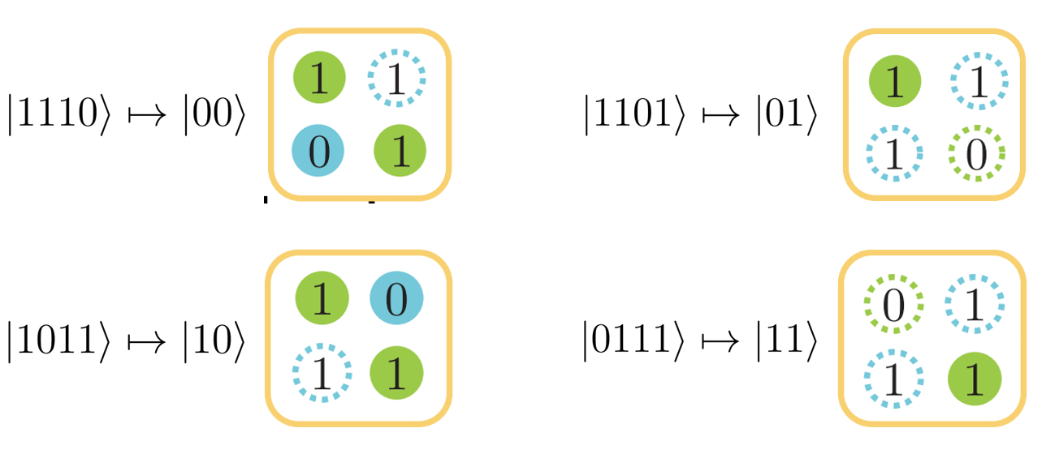
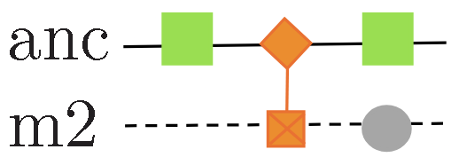
N=4, Q=-1
Only 2 CNOTs per Trotter step
A. Than et al. arXiv:2509.11477
Notes:
In the 4 site case, we map the 4 states to 2 qubits and a similar procedure gives us this circuit.
Note that we have only 2 2-qubit gates per Trotter step which was helpful in obtaining non-trivial dynamics before bosonic decoherence kicks in.

Slide 17
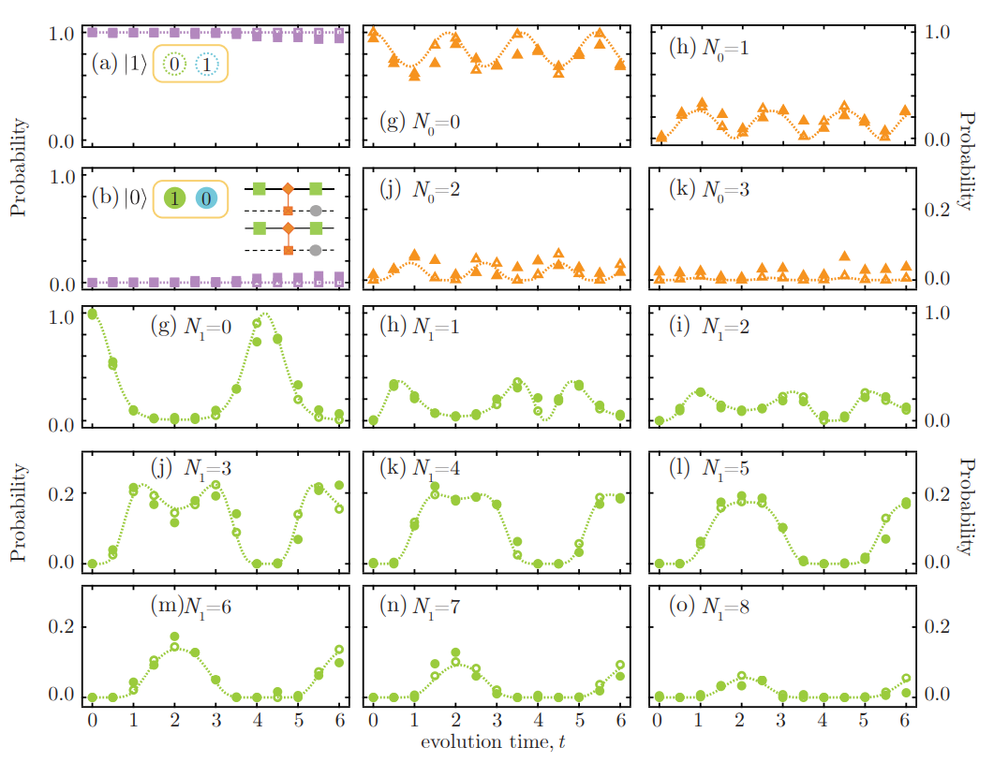
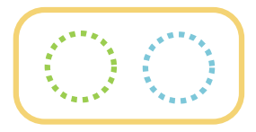


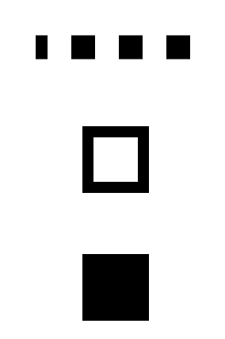
Results: 2-site theory
Fock state measurement for mode 0
Fermion occupation
Init. state:
Exact diag.
Trotter sim.
Experiment
Fock state measurement for mode 1
A. Than et al. arXiv:2509.11477
Notes:
We start with this initial state with no phonon excitations and here are the results for the 2-site theory. The spin dynamics are trivial.
The dotted lines correspond to classical simulations. The hollow dots denote the exact dynamics of the quantum circuit in the absence of experimental errors. The solid dots are the experimental data points.
The hybrid simulation was able to capture the dynamics for phonon occupations of upto 8 for the strongly coupled mode.

Slide 18
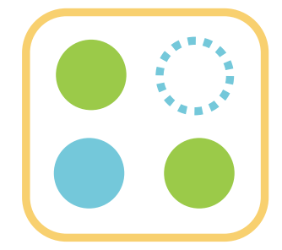
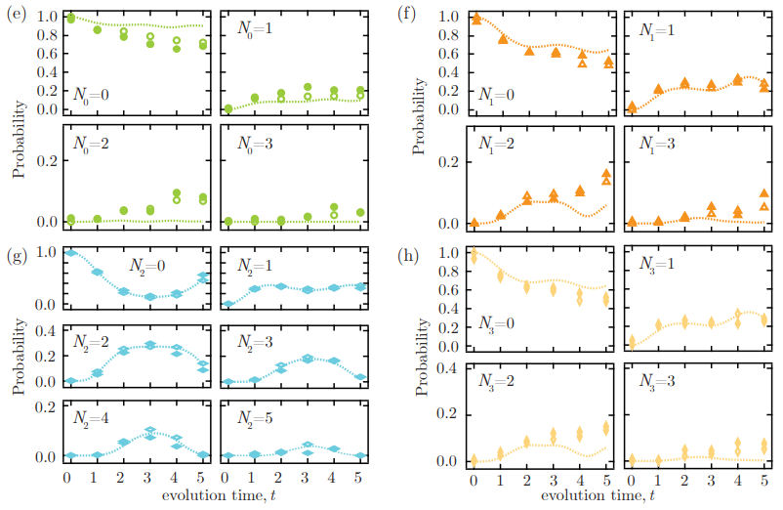
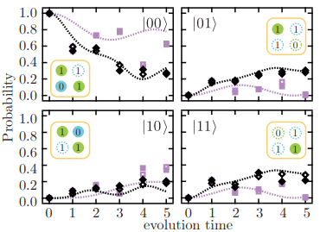
Results: 4-site theory
Init. state:
Bosonic occupations for all 4 modes
Fermion occupation
A. Than et al. arXiv:2509.11477

Slide 19
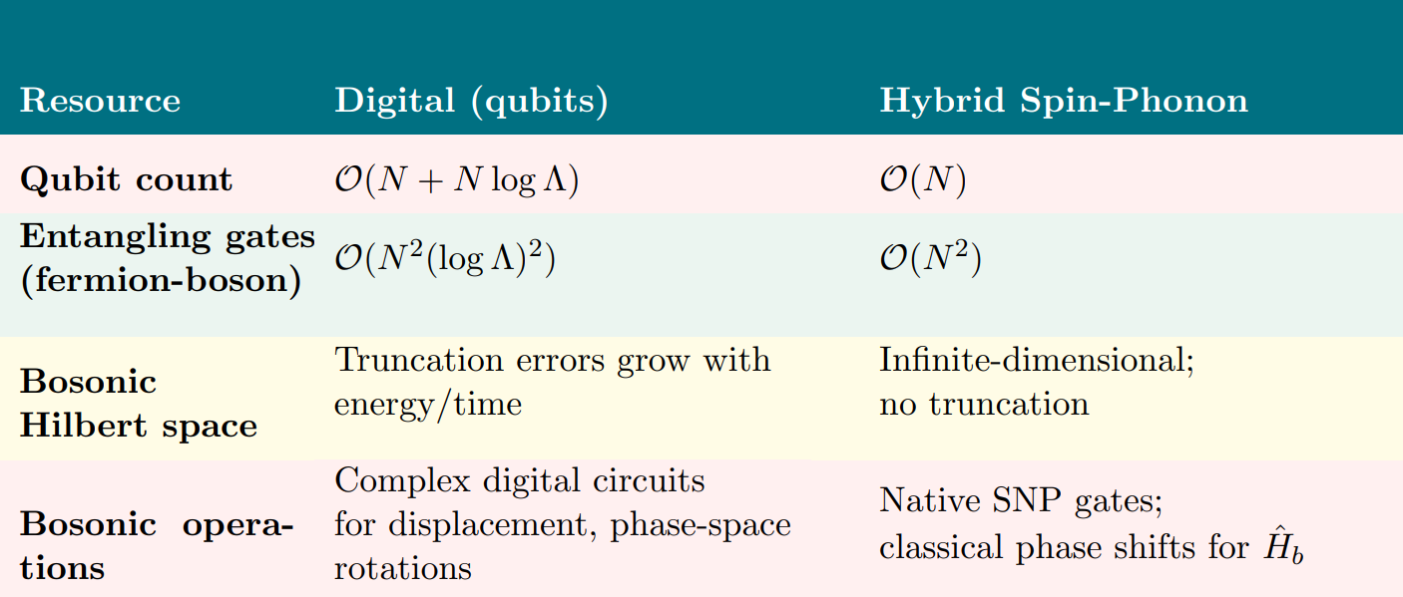
Cost Comparison
Notes:
Here is a comparision table. The N log Lambda extra qubits required to binary encode a bosonic mode truncated at Lambda are replaced by the N motional modes already present in the simulator.
Entangling gate costs are reduced by a factor of log Lamba squared. There is no cutoff dependence in the hybrid case and bosonic operations are more naturally implemented.

Slide 20
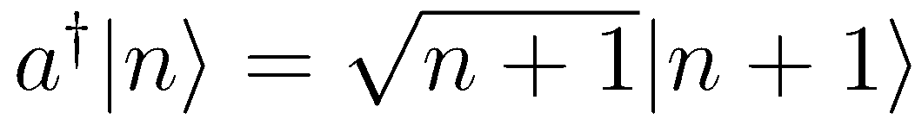
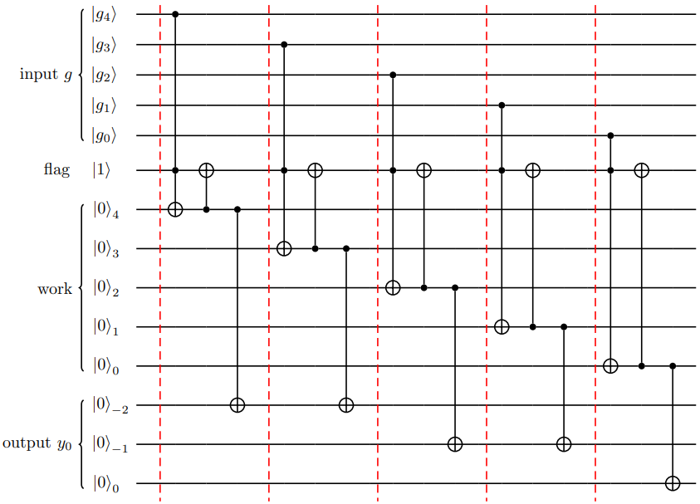
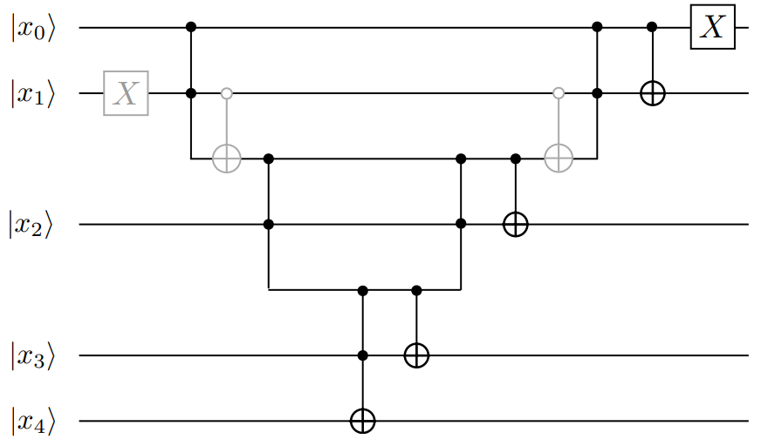
Cost Comparison
PC: Z. Davoudi et al. Quantum 7, 1213 (2023)
Notes:
These are digital circuits for calculating square roots and applying incremental operations on a binary encoding of bosons to qubits. Native hybrid gates are able to reduce gate depths by avoiding this.

Slide 21

Cost Comparison
Reduced Hilbert Space (N=4, Q=-1)
Notes:
For classical simulations, exact diagonalization was used and for the 4 site theory, the Hilbert space grows rapidly with cutoff.

Slide 22










Future Directions
Lattice Schwinger Model
Gauge theory →
Gauge algebra differs from harmonic oscillator algebra:
Z. Davoudi et al. PhysRevResearch.3.043072
Ale, V., Rainaldi, T et al. JHEP04(2026)122
Conditional squeezing
Conditional beamsplitter
Need gates that implement higher order phonon-phonon interactions:
Notes:
Our next goal would be to implement gauge theories. A good starting point would be the lattice Schwinger model in 1+1 dimension.
The gauge theory algebra is different from that of the harmonic oscillator. This can be managed by using approximations or with continuous variable mappings which will be discussed in the following talk.
These methods require implementing phonon-phonon interactions. Adding these to the gate-set gives us a universal hybrid gate-set for spin-boson quantum computing.

Slide 23
Future Directions
In this work, motional coherence time was limited to about 2ms. Improvements have been made to allow for longer circuits.
Advanced pulse shaping can help mitigate errors caused by crosstalk and large phonon excitations.
Phase sensitive measurements give access to correlations, which can be used to study the entanglement structure.
Adding conditional squeezing and beam-splitter operations to the gate-set used gives us a universal hybrid gate-set for continuous variable spin-boson quantum computation.
Notes:
To achieve this, we are working towards improving our motional coherence time to allow running longer circuits.
Advanced pulse shaping techniques can help mitigating errors.
We would also like to access observables like correlations by using phase sensitive measurements to help study entanglement structure of the final states.

Slide 24
Thank you!
arxiv.org/pdf/2509.11477
Notes:
Thank you for listening.

