Slide 1
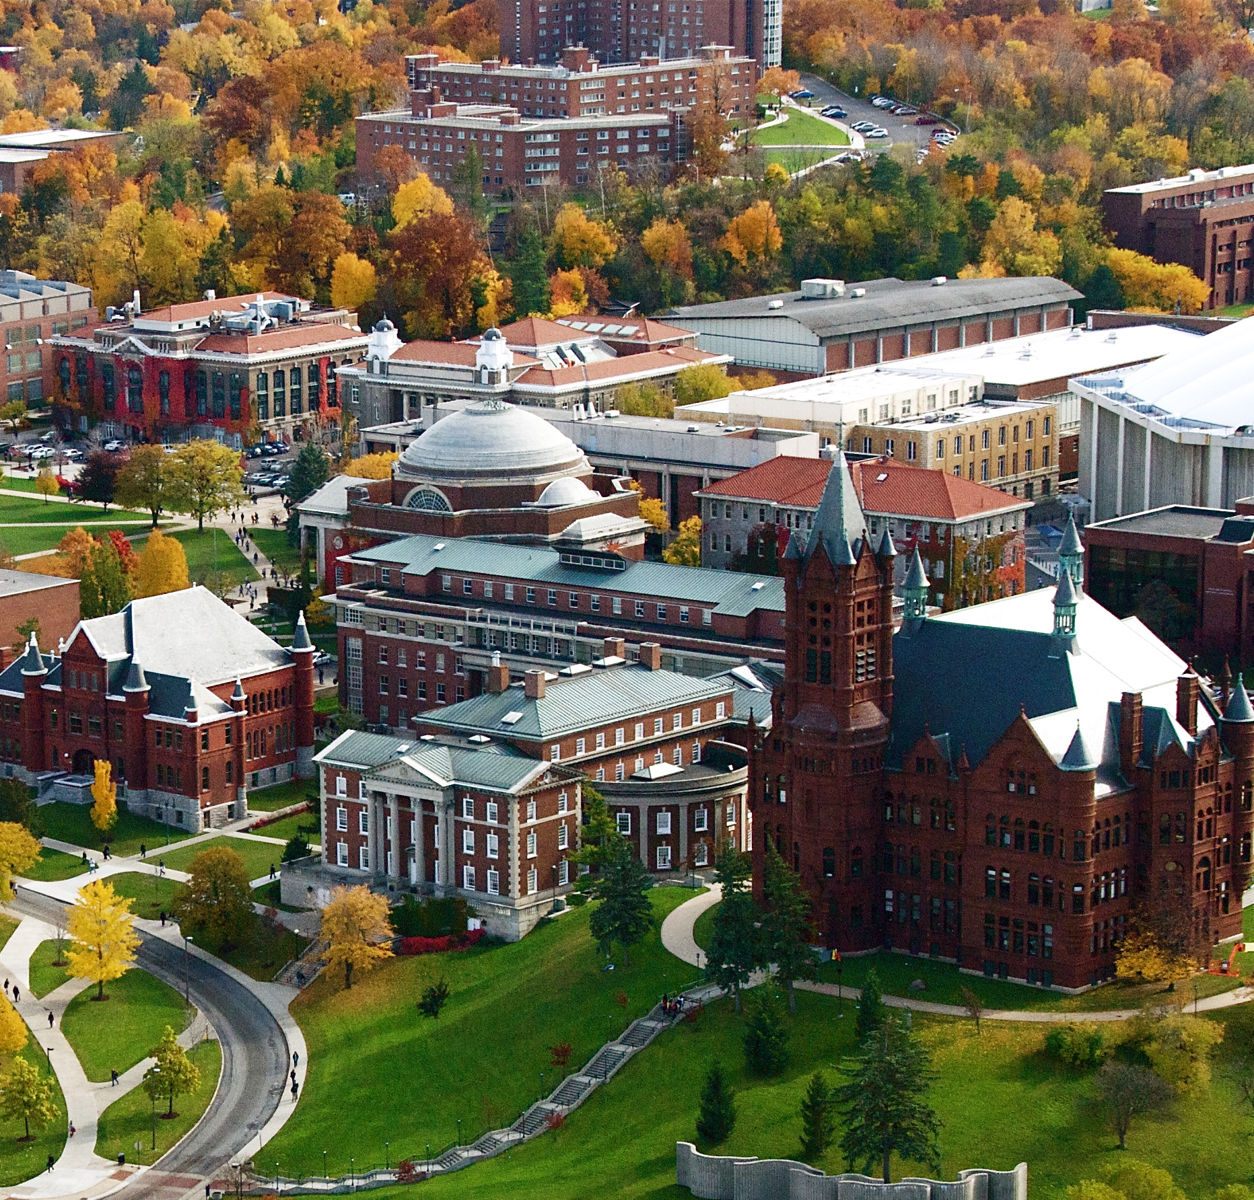
SOCS
Spins on Curved Surfaces
Abhishek Samlodia
Department of Physics, Syracuse University
asamlodi@syr.edu

Slide 2
Main objective
Study:
  discrete quantum spin systems on curved geometries
Investigate:
  Thermodynamic behavior
  Scaling laws
  Information scrambling
  Out of Time Ordered Correlators (OTOCs)
Using:
  Density Matrix Renormalization Group (DMRG) – Matrix Product State (MPS)

Slide 3
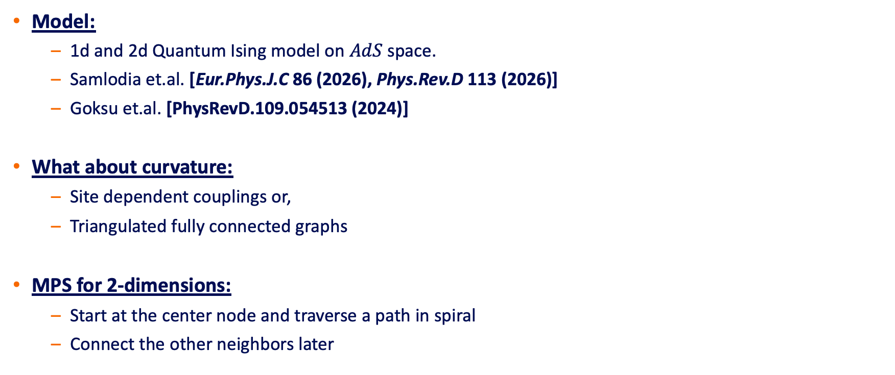
What Path?
Model:
  1d and 2d Quantum Ising model on $AdS$ space.
  Samlodia et.al. [Eur.Phys.J.C 86 (2026), Phys.Rev.D 113 (2026)]
  Goksu et.al. [PhysRevD.109.054513 (2024)]
What about curvature:
  Site dependent couplings or,
  Triangulated fully connected graphs
MPS for 2-dimensions:
  Start at the center node and traverse a path in spiral
  Connect the other neighbors later

Slide 4
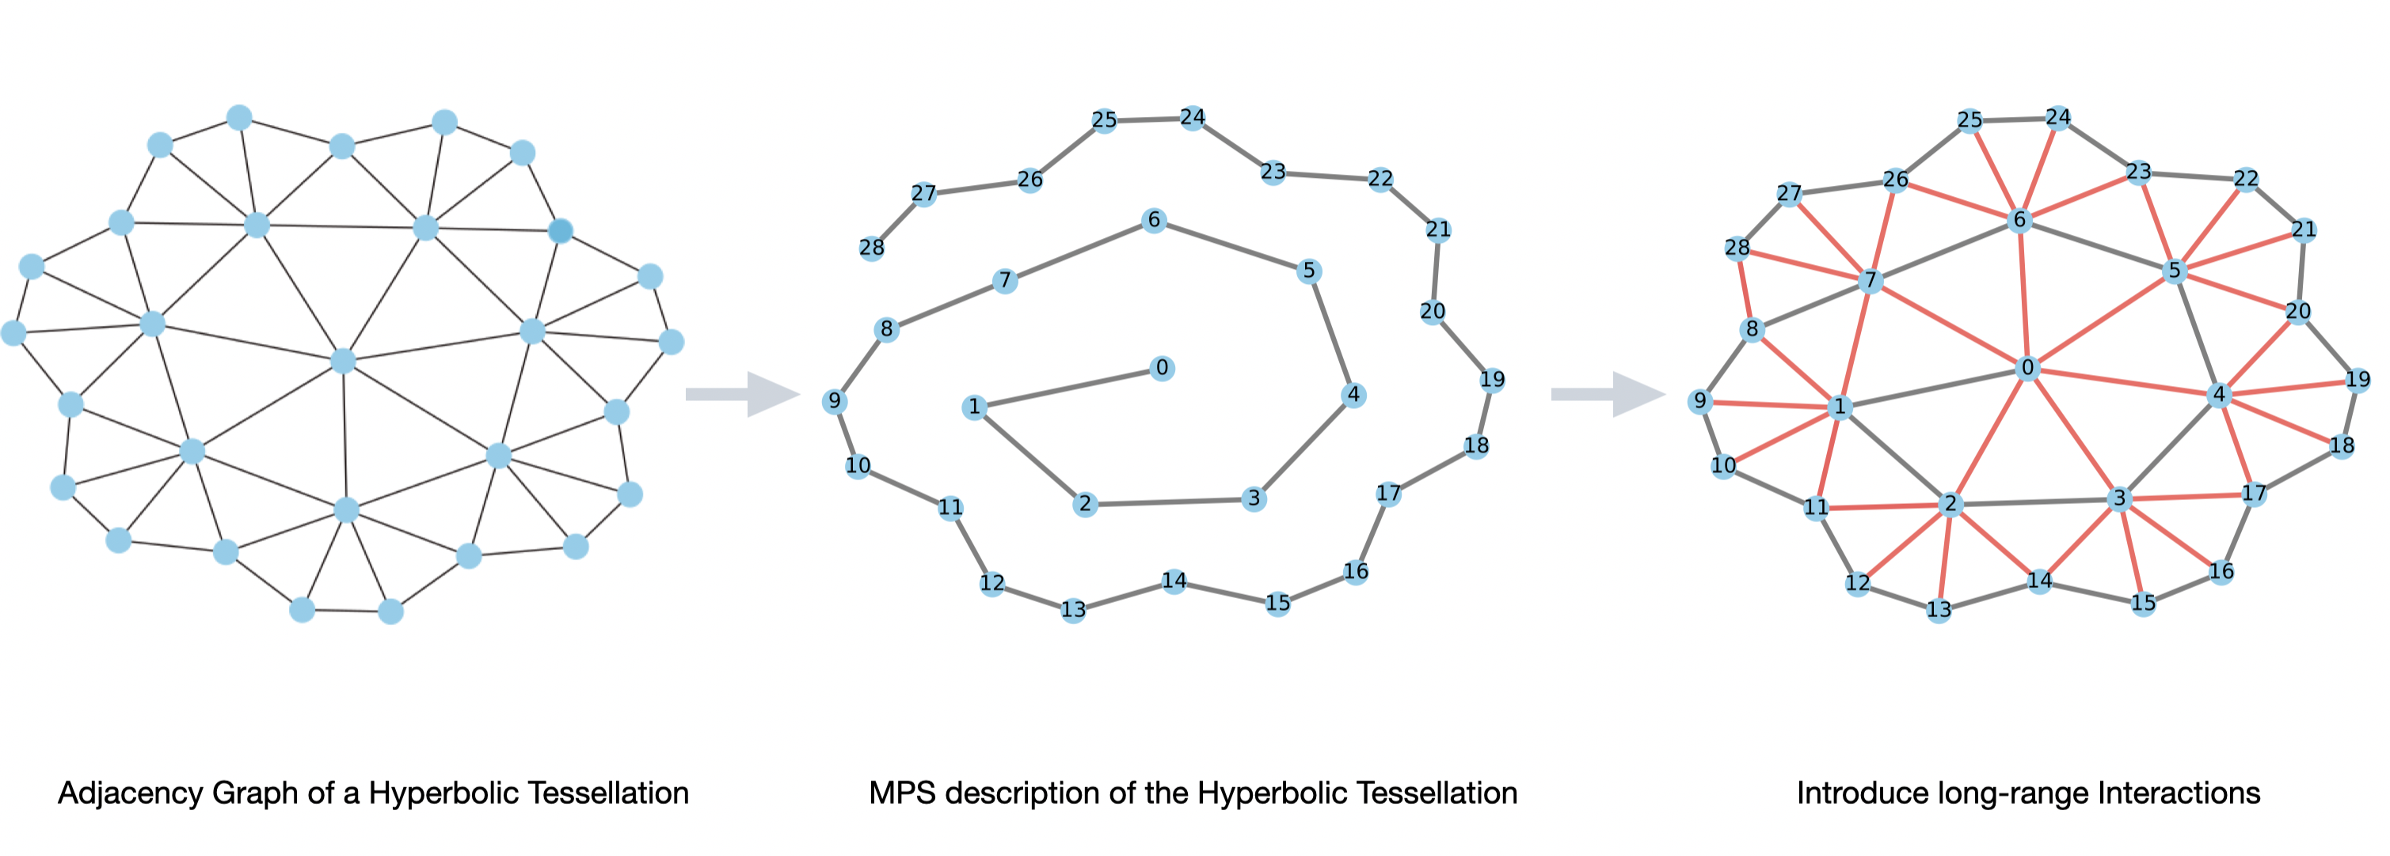
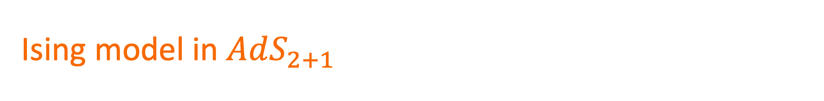
Ising model in $AdS_{2+1 }$
{3,7} Tessellation

Slide 5
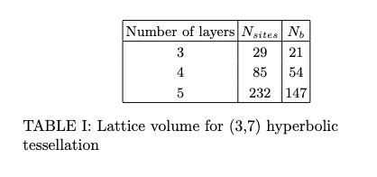
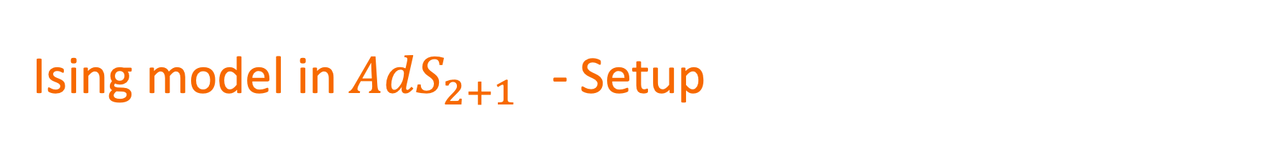
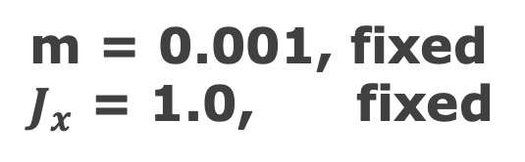
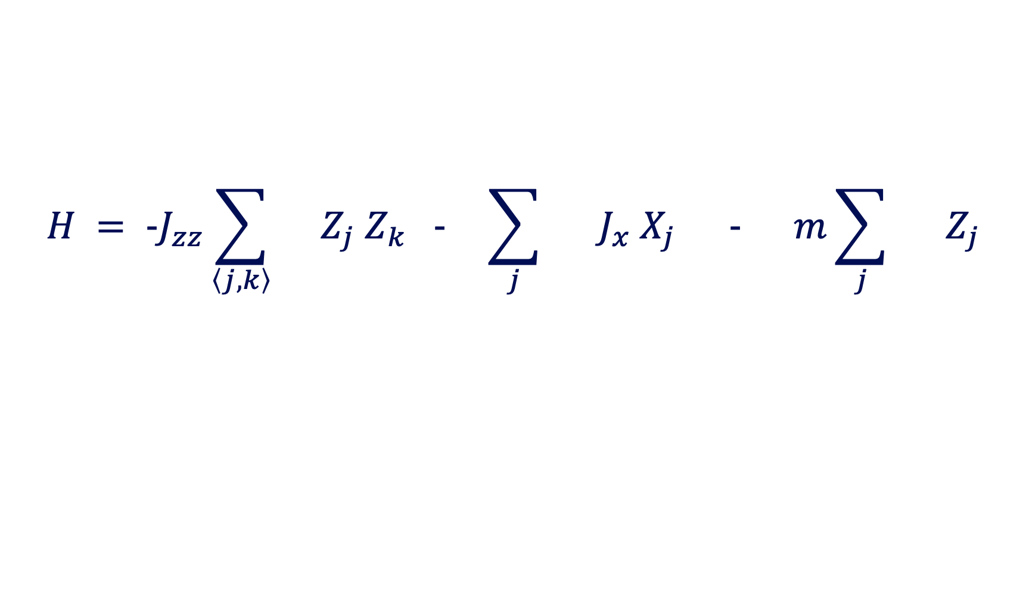
Ising model in $AdS_{2+1 }$ - Setup
$$H = −J_{zz}\sum_{\left\langle j,k\right\rangle }{}Z_{j} Z_{k} − \sum_{j}{} J_{x} X_{j} − m\sum_{j}{} Z_{j}$$
m = 0.001, fixed
$J_{x}$ = 1.0, fixed

Slide 6

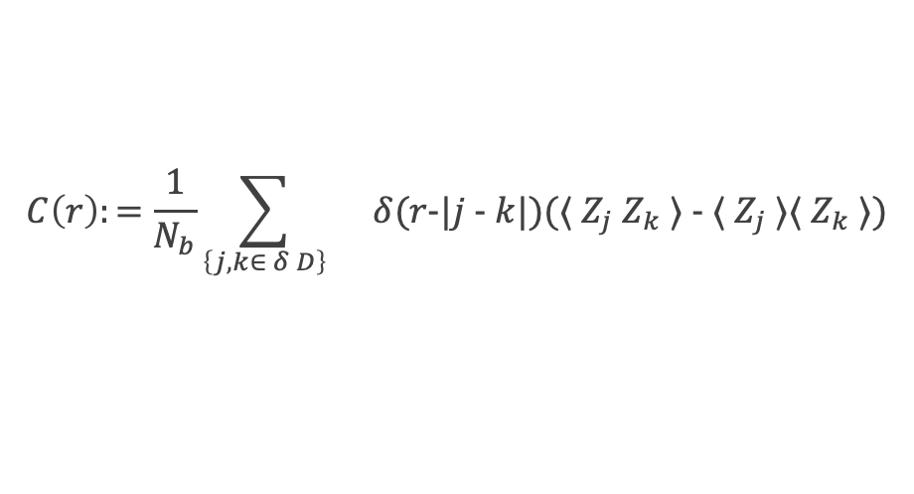
Ising model in $AdS_{2+1 }$- Magnetization & Correlators
$$C\left(r\right):=\frac{1}{N_{b}}\sum_{\left\{j,k∈ δ D\right\}}{}δ(r−|j − k|)(⟨ Z_{j} Z_{k} ⟩ − ⟨ Z_{j} ⟩⟨ Z_{k} ⟩)$$

Slide 7

Ising model in $AdS_{2+1 }$- Boundary Entanglement Entropy
Critical Point – Logarithmic
3-layers
Away from Criticality – Linear
3-layers

Slide 8
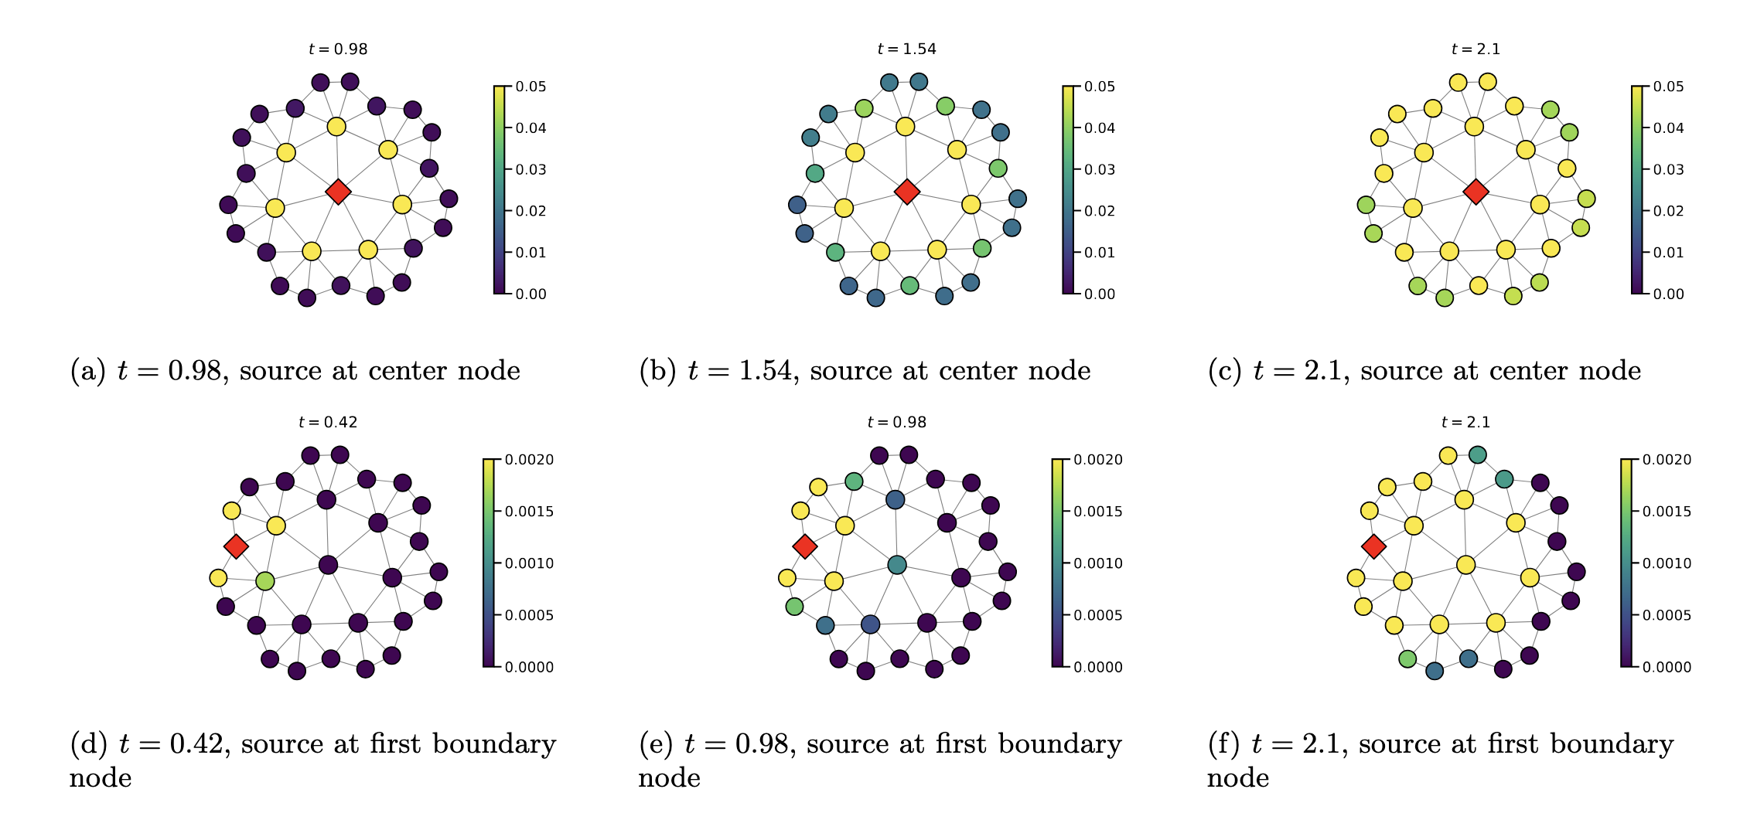
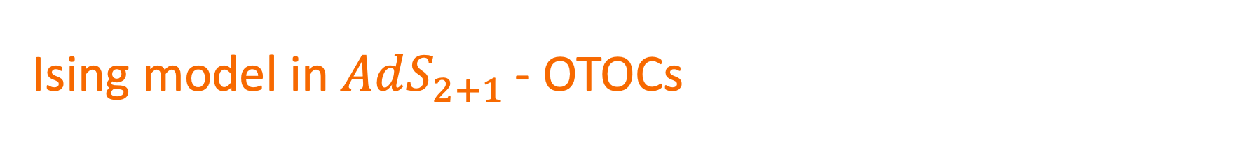
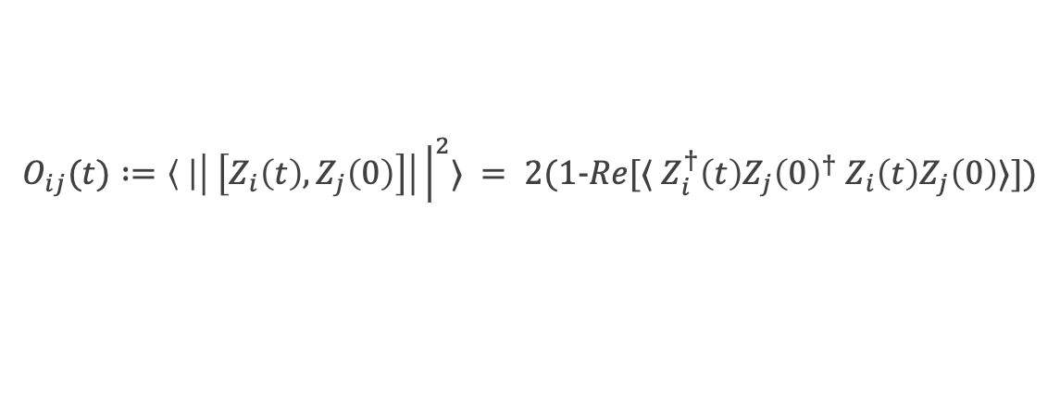
Ising model in $AdS_{2+1 }$- OTOCs
$$O_{ij}(t) :=\left\langle \right|\left| \left[Z_{i}\left(t\right), Z_{j}\left(0\right)\right]\right|{\left.​\right|}^{2}⟩ = 2(1−Re[⟨ Z_{i}^{†}\left(t\right)Z_{j}{\left(0\right)}^{†} Z_{i}\left(t\right)Z_{j}\left(0\right)⟩])$$

Slide 9
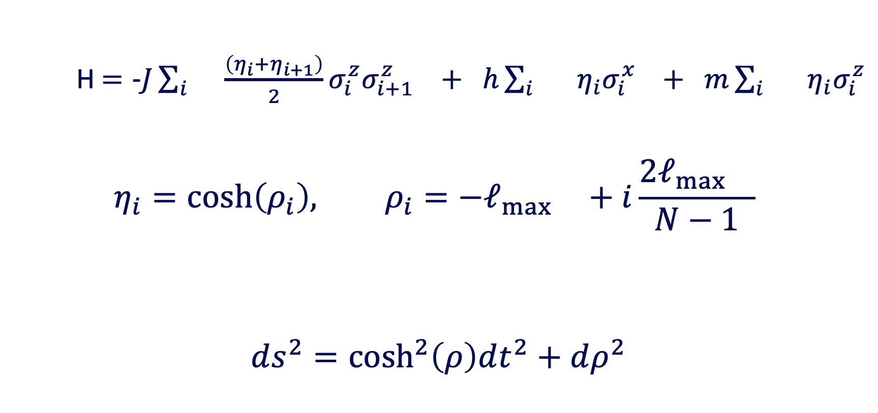
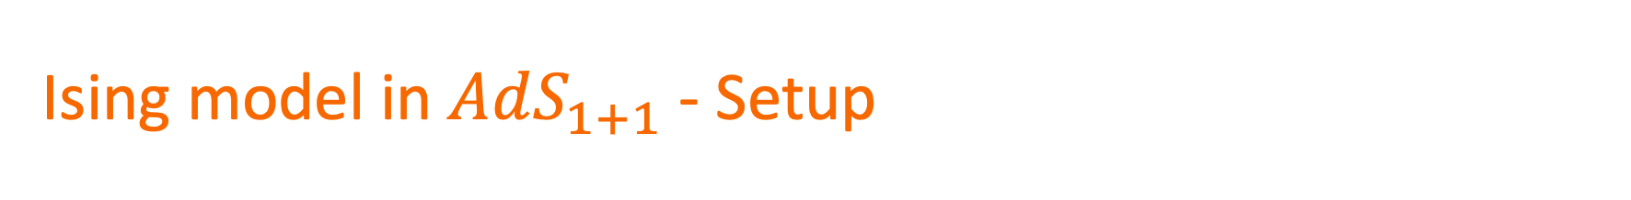
Ising model in $AdS_{1+1}$ - Setup
    H $=−J\sum_{i}{}\frac{\left(η_{i}+η_{i+1}\right)}{2}σ_{i}^{z}σ_{i+1}^{z} + h\sum_{i}{} η_{i}σ_{i}^{x} + m\sum_{i}{} η_{i}σ_{i}^{z}$
$$η_{i}=\cosh\left(ρ_{i}\right), ρ_{i}=−ℓ_{\max{}}+i\frac{2ℓ_{\max{}}}{N−1}$$
$$ds^{2}=\cosh^{2}\left(ρ\right)dt^{2}+dρ^{2}$$
Controls curvature
Critical Point at J/h = 1

Slide 10
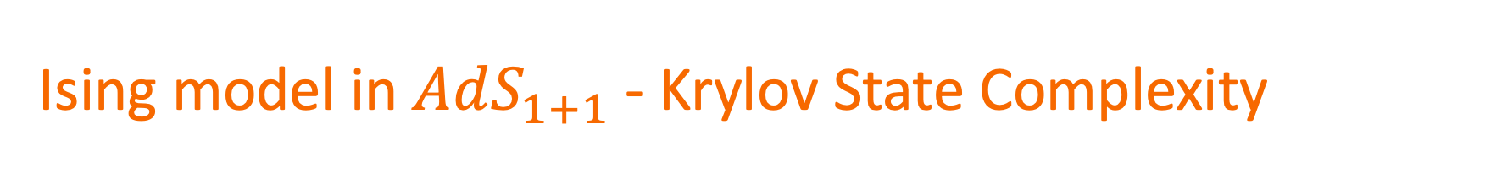
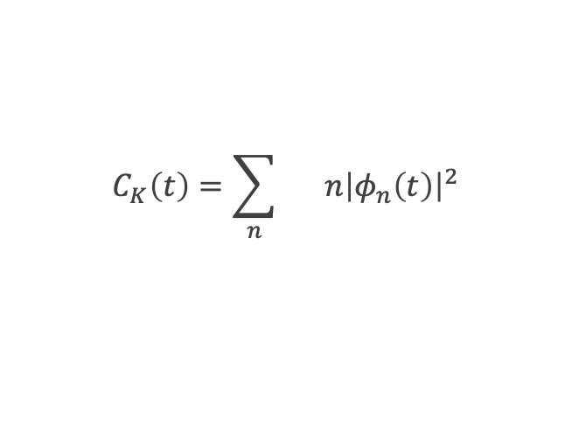
Ising model in $AdS_{1+1}$ - Krylov State Complexity
$$C_{K}\left(t\right)=\sum_{n}{} n{\left|φ_{n}\left(t\right)\right|}^{2}$$
Krylov Basis Functions
n = 0,1,2…,K-1
N = 11, J/h = 1.0, m = 0.25
Initial state
$${|Ψ}_{0}⟩= \left|+^{y}\right\rangle ⊗\left|1\right\rangle ⊗\left|+^{y}\right\rangle ⊗\left|1\right\rangle …⊗\left|+^{y}\right\rangle ⊗|1⟩$$

Slide 11
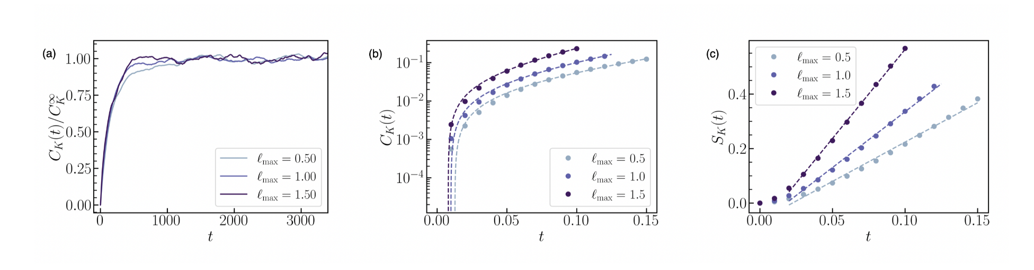

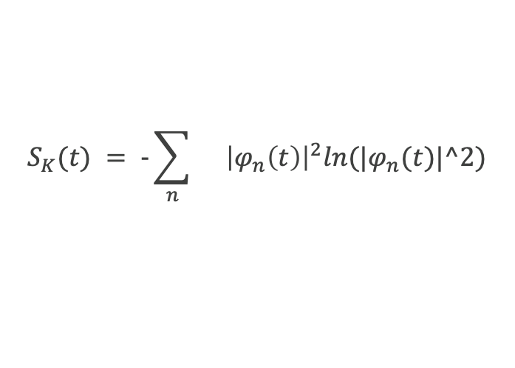
Ising model in $AdS_{1+1}$ - Krylov Operator Complexity
$$S_{K}(t) = −\sum_{n}{}{\left|φ_{n}\left(t\right)\right|}^{2}ln(|φ_{n}(t)|^2)$$
1. Exponential Fit to Complexity
2. Linear Fit to Entropy

Slide 12
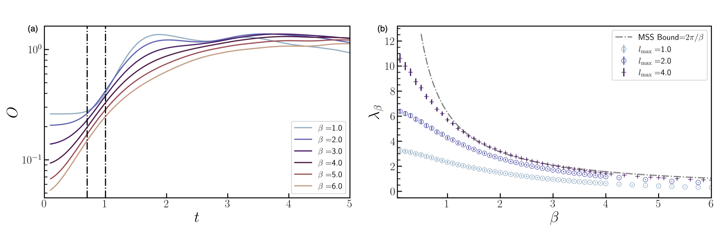

Ising model in $AdS_{1+1}$ - Lyapunov Exponent from OTOCs
Fit exponentials to OTOCs – Lyapunov Exponent
N = 13, J/h = 1.0, m = 0.05

Slide 13
Thank You
Abhishek Samlodia
Graduate Student
asamlodi@syr.edu

