Slide 1

Real Time GEVP on Quantum Hardware
Valery Simonyan
Paulo Bedaque, Gregory Ridgeway
University of Maryland, College Park

Slide 2
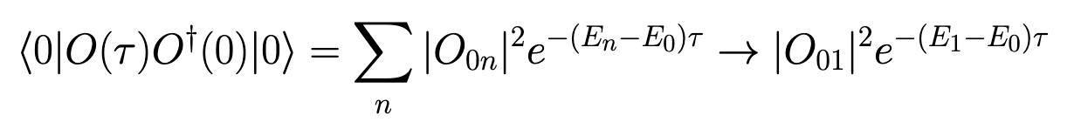
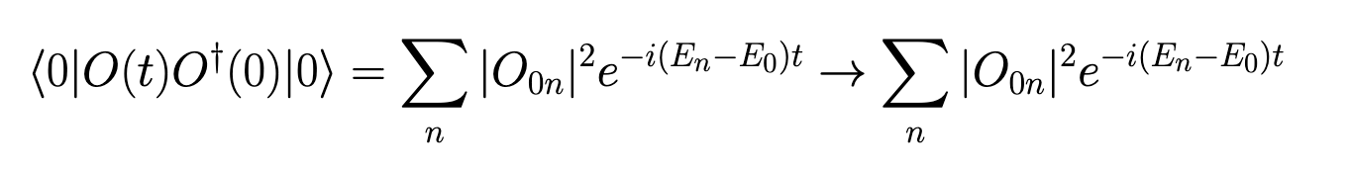
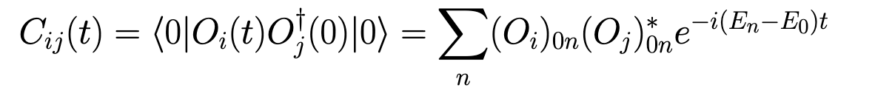
MOTIVATION
Extracting low-lying spectra in real time
Want to know the gap? In Euclidean time just evolve to isolate
In real time (on a quantum computer) however…
The solution:

Slide 3
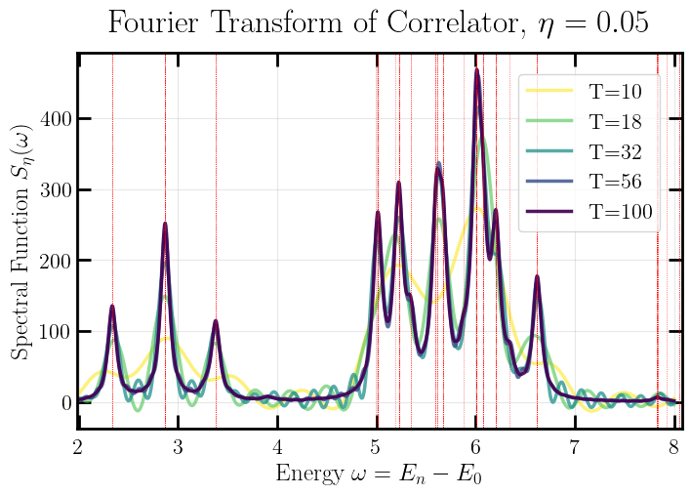
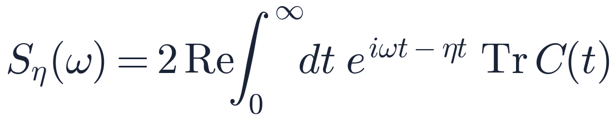
COMPARISON
Why don’t you just Fourier transform?
Long time to resolve the peaks
Noise will destroy the signal
Deeper circuits are expensive and sensitive to noise
~18x longer time evolution to recover same results that will be shown in a couple minutes, more for larger volume

Slide 4
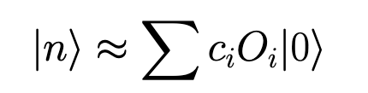
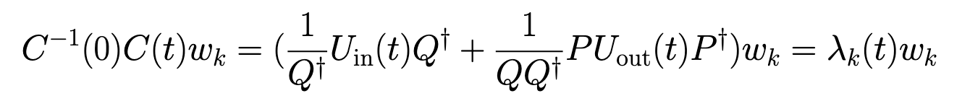
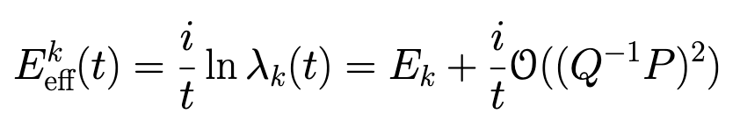
METHOD
How to do GEVP (Lüscher-Wolff) in Real Time
Choose operator set with overlap onto desired state
Evaluate matrix from last slide, find eigenvalues
Get energy, errors die off with 1/t and from dephasing

Slide 5
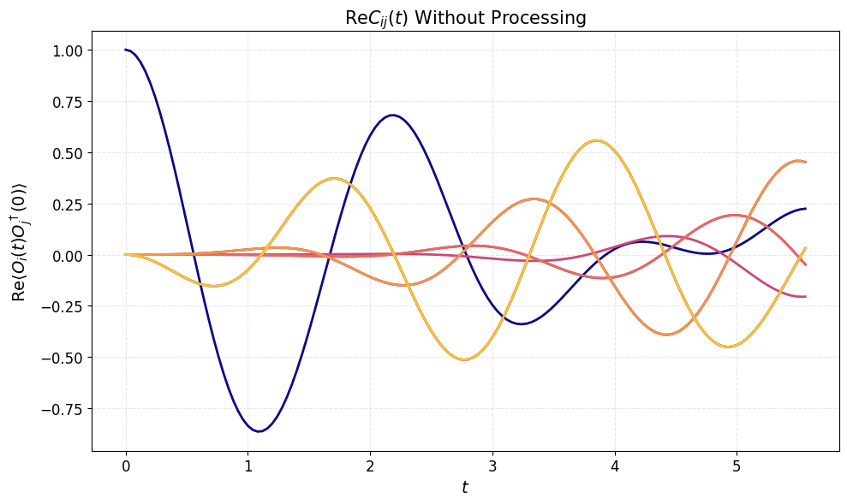
METHOD
Before Applying Lüscher-Wolff
Each correlator contains a superposition of signals
Lots of interference
Energy levels are not cleanly separated

Slide 6
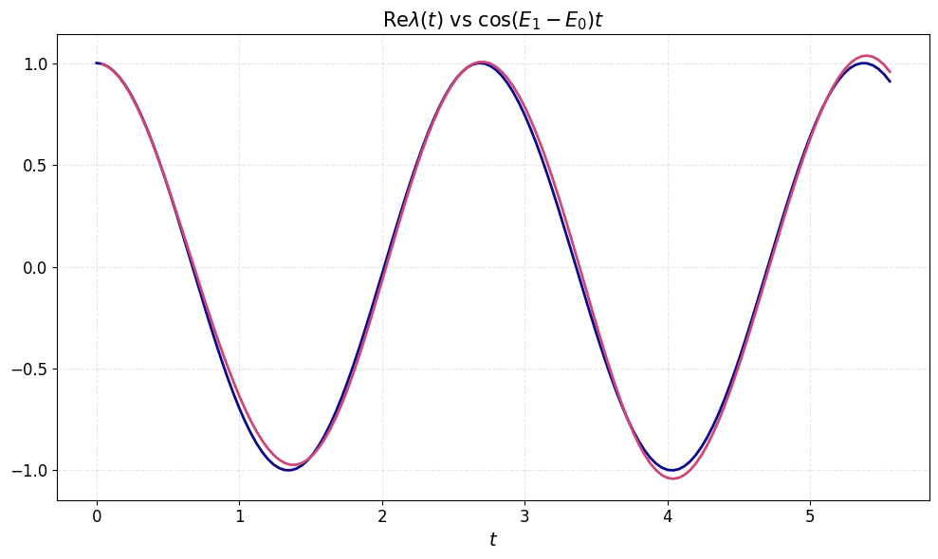
METHOD
After Applying Lüscher-Wolff
GEVP takes linear combination of operators isolating individual states
Get single frequency oscillation, energy can be extracted

Slide 7
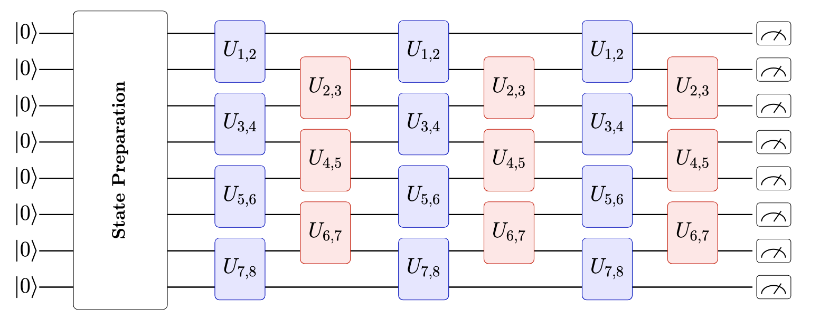
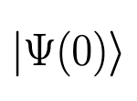
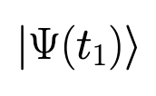

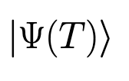
MOTIVATION
Quantum Computing 101
Encode your system into qubits
Prepare a state
Evolve it
Measure the expectation value of an operator

Slide 8
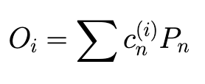

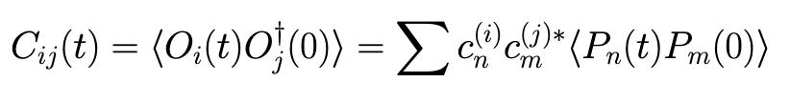
METHOD
Changes on a Quantum Computer
Only act on qubits with a unitary operation
We decompose our operator basis into Pauli strings:
Directly measure Pauli string correlators:
Take linear combinations getting correlator matrix:

Slide 9
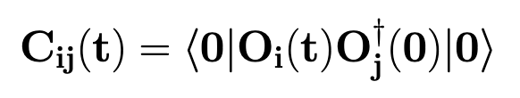
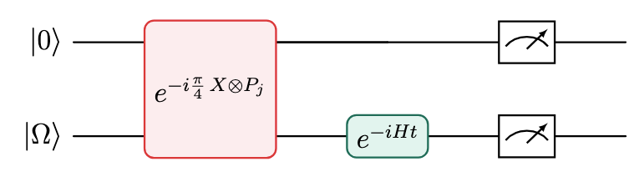
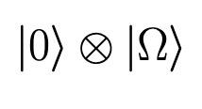
METHOD
How do you measure aaaaa a ?

Slide 10
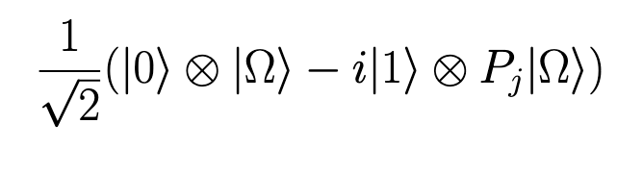
METHOD
How do you measure aaaaa a ?

Slide 11
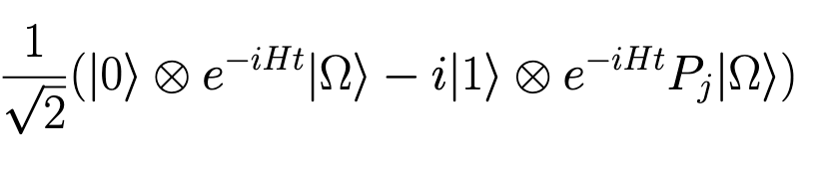
METHOD
How do you measure aaaaa a ?

Slide 12
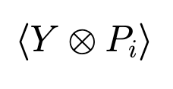

METHOD
How do you measure aaaaa a ?
Measure interference terms for real and imaginary part of C(t):

Slide 13
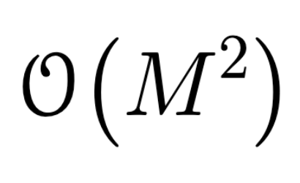
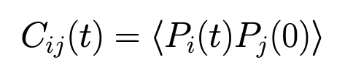
METHOD
Quantum Algorithm Details
Naively if we take operator set size M must measure circuits
However may measure multiple simultaneously if are qubit wise commuting
Utilizing symmetries of Hamiltonian being studied significantly reduce circuit count further
Partially trade off long simulation times in Fourier transform with more circuits

Slide 14
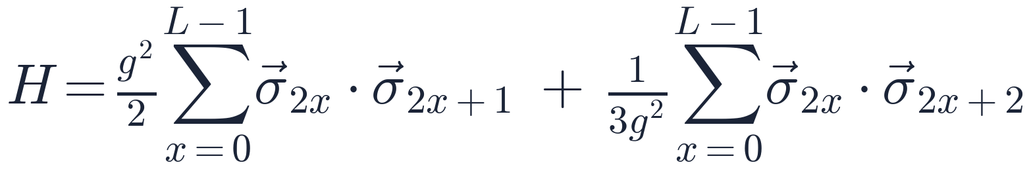
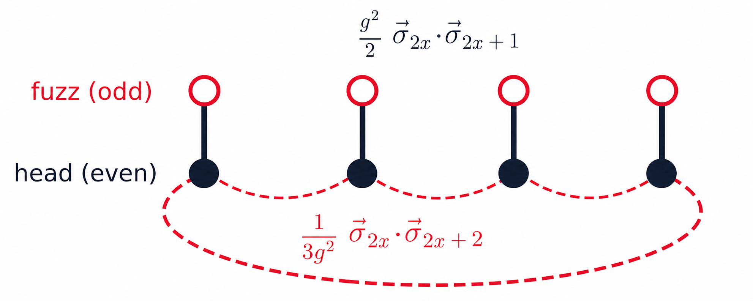
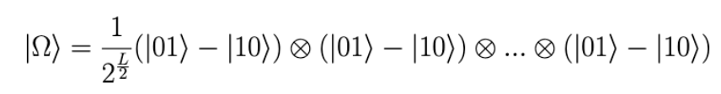
TEST CASE
A case study: the fuzzy σ-model
Small g limit = antiferromagnetic Heisenberg chain
Large g limit = factorizable antiferromagnetic spin pairs
Use large g limit, ground state prep is cheaper
O(3), translation invariance significantly reduce circuit count

Slide 15

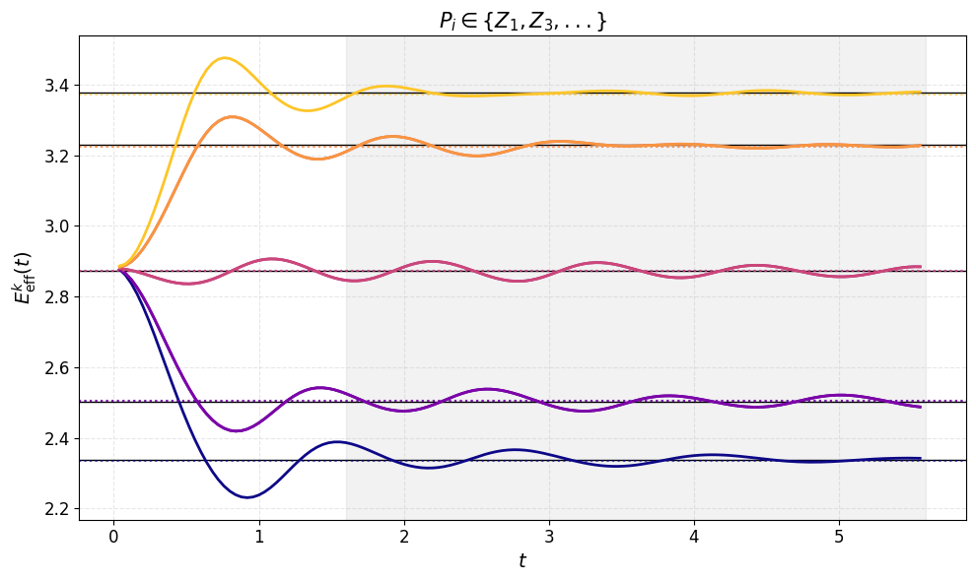
RESULTS · NOISELESS, L = 8
Classical Exact Simulation - L=8 -
8 operators, plateau at correct energy levels within 0.1 % of exact diagonalization

Slide 16
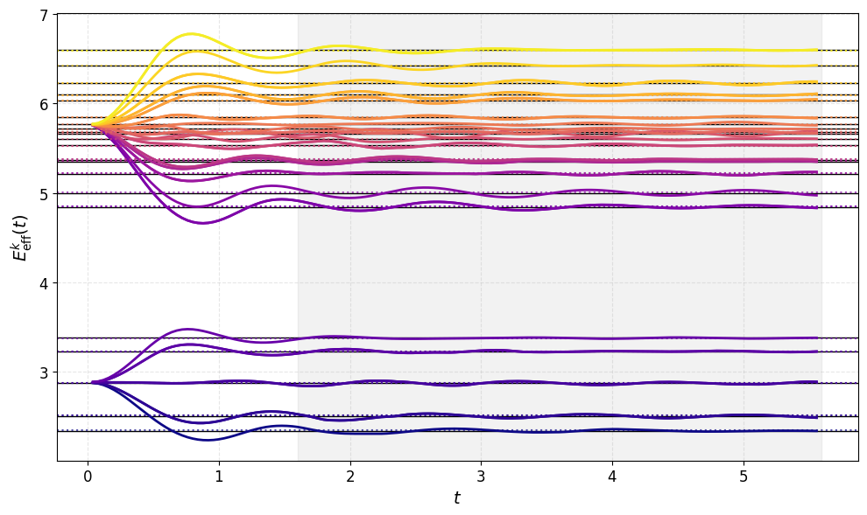
RESULTS · NOISELESS, L = 8
Classical Exact Simulation - Linear combinations of 1 and 2 Pauli with l = 1, m = 0
36 operators, plateau at correct energy levels within 0.3 % of exact diagonalization

Slide 17
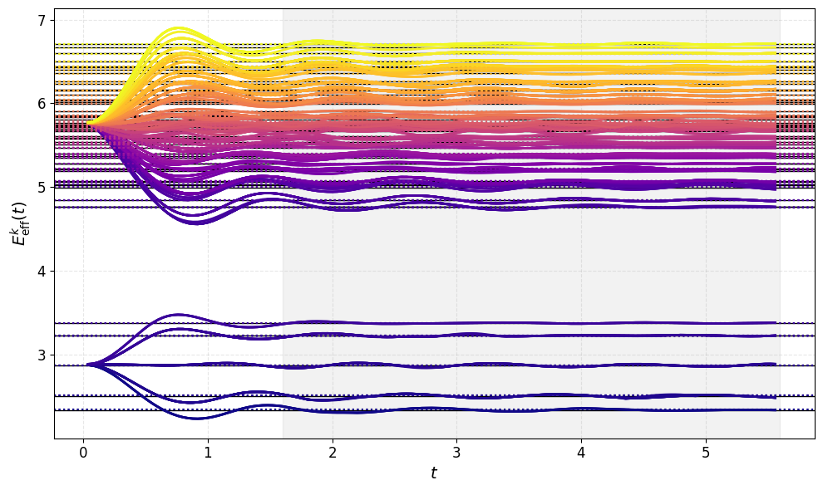
RESULTS · NOISELESS, L = 8
Classical Exact Simulation - All 1 and 2 Pauli
276 operators, plateau at correct energy levels within 0.5 % of exact diagonalization

Slide 18
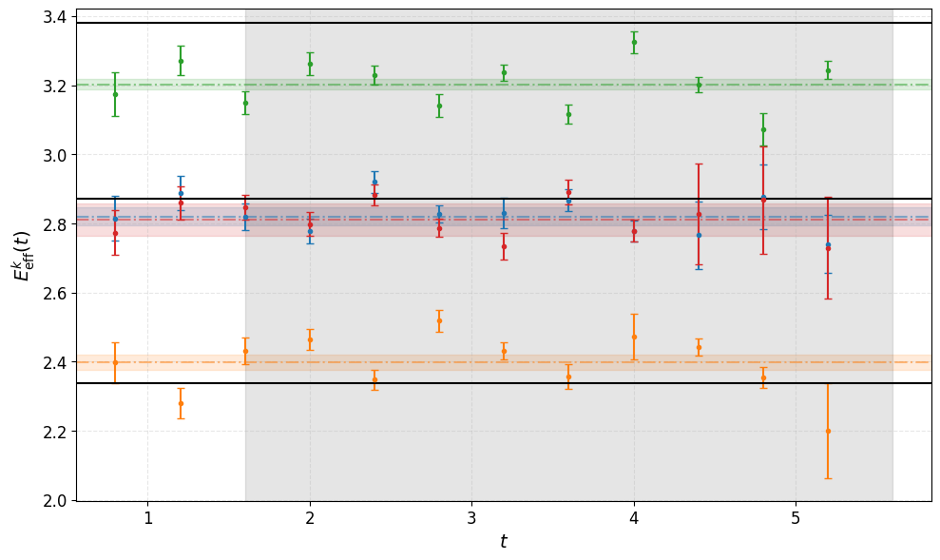
RESULTS · QUANTUM HARDWARE, L = 4
IonQ Forte Enterprise - L=4 -
14 time steps, dt =0.4
Estimate fit uncertainties with bootstrap (shaded regions)
Results within 5.2% of exact diagonalization
Systematic error from noise and trotterization

Slide 19
SUMMARY & OUTLOOK
In summary
Systematic improvement in spectrum resolution with operator basis size
No noise can recover the low-lying spectrum with a truncated operator basis within sub-percent precision.
Current NISQ hardware can recover low-lying spectra within a couple percent on sufficiently small systems.

Slide 20
BACKUP
Hardware numbers (L = 4, Z basis)
state | E (GEVP) | E (exact) | δ (%) | |Δ|/σ
k = π (single) | 2.399(21) | 2.337 | +2.6 | 2.9
k = ±π/2 (double) | 2.820(26) | 2.870 | −1.7 | 1.9
k = ±π/2 (double) | 2.810(46) | 2.870 | −2.1 | 1.3
k = 0 (single) | 3.203(14) | 3.380 | −5.2 | 12.6
Same signed pattern as the noise model — bottom pulled up, top pulled down: the compression signature reproduces on hardware.
k = 0: smallest statistical error of the four, largest deviation → a systematic, not shot noise. Trotter (Δt = 0.4) + coherent gate error.

