Slide 1
Quantum Simulation of Lattice QCD in the Representation Basis
Luis Hidalgo
University of Illinois
Advisor: Patrick Draper
Coming soon!

Slide 2

Lattice QCD Needs Quantum Computing
Euclidean Lattice QCD
  Pro: This conference
  Con: Sign problems for real time, theta angle
$$𝒵=∫𝒟\overline{ψ} 𝒟ψ 𝒟A e^{−S_{E}}$$

Slide 3

Lattice QCD Needs Quantum Computing
Euclidean Lattice QCD
  Pro: This conference
  Con: Sign problems for real time, theta angle
Hamiltonian Lattice QCD
  Pro: No inherent sign problem
  Con: Big Hamiltonian (Quantum computers can help)
$$𝒵=∫𝒟\overline{ψ} 𝒟ψ 𝒟A e^{−S_{E}}$$
$$\left|ψ\left(t\right)\right\rangle =e^{−iHt}|ψ\left(0\right)⟩$$

Slide 4
Lattice QCD Needs Quantum Computing
Euclidean Lattice QCD
  Pro: This conference
  Con: Sign problems for real time, theta angle
Hamiltonian Lattice QCD
  Pro: No inherent sign problem
  Con: Big Hamiltonian (Quantum computers can help)
Lots of work on pure SU(3) lattice gauge theory
  This talk: formulating full lattice QCD in 2+1 and 3+1 dimensions with Wilson and staggered fermions for quantum simulation
$$𝒵=∫𝒟\overline{ψ} 𝒟ψ 𝒟A e^{−S_{E}}$$
$$\left|ψ\left(t\right)\right\rangle =e^{−iHt}|ψ\left(0\right)⟩$$
Ciavarella, Klco, Savage, PRD 103, 094501 (2021)
Balaji et al., PRD 112, 054511 (2025)

Slide 5
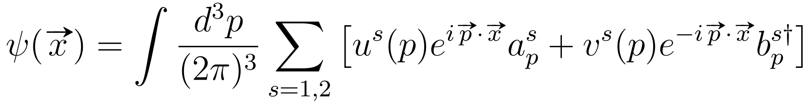
Dirac Fermions

Slide 6
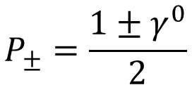
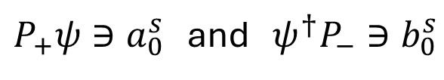
Dirac Fermions
$P_{+}ψ∋a_{0}^{s}$ and $ψ^{†}P_{−}∋b_{0}^{s}$
$$P_{±}=\frac{1±γ^{0}}{2}$$

Slide 7
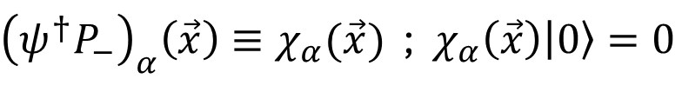
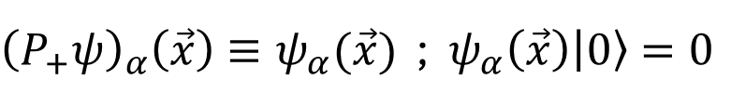
Dirac Fermions
$P_{+}ψ∋a_{0}^{s}$ and $ψ^{†}P_{−}∋b_{0}^{s}$
${\left(P_{+}ψ\right)}_{α}\left(\vec{x}\right)≡ψ_{α}(\vec{x})$ ; $ψ_{α}\left(\vec{x}\right)\left|0\right\rangle =0$
$$P_{±}=\frac{1±γ^{0}}{2}$$
Use to define “particle” and “antiparticle” states
${\left({ψ^{†}P}_{−}\right)}_{α}\left(\vec{x}\right)≡χ_{α}(\vec{x})$ ; $χ_{α}\left(\vec{x}\right)\left|0\right\rangle =0$

Slide 8

Lattice Fermions
Naively discretizing Dirac fermions $→$ fermion doubling

Slide 9

Lattice Fermions
Naively discretizing Dirac fermions $→$ fermion doubling
Staggered fermions
  Stagger Dirac spinor components among sites
  Leaves two tastes in 2+1D and 3+1D

Slide 10
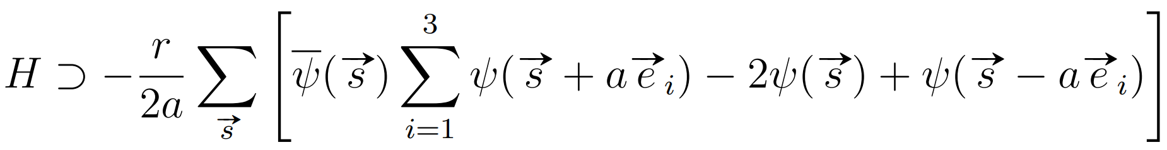
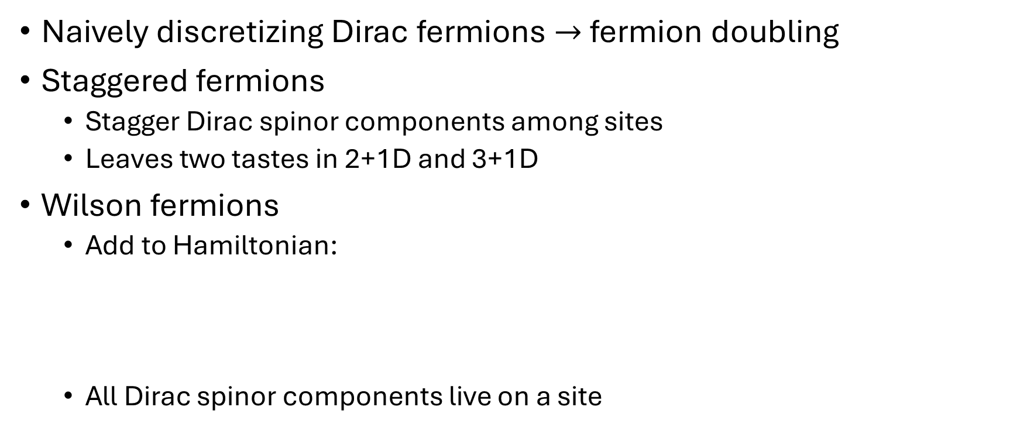
Lattice Fermions
Naively discretizing Dirac fermions $→$ fermion doubling
Staggered fermions
  Stagger Dirac spinor components among sites
  Leaves two tastes in 2+1D and 3+1D
Wilson fermions
  Add to Hamiltonian:
  All Dirac spinor components live on a site

Slide 11
















Lattice Fermions
$$ψ_{2}$$
$$χ_{3}$$
$$ψ_{1},…,χ_{4}$$
$$ψ_{1},…,χ_{4}$$
$$χ_{3}$$
$$ψ_{2}$$
$$ψ_{1},…,χ_{4}$$
$$ψ_{1},…,χ_{4}$$
$$χ_{4}$$
$$ψ_{1},…,χ_{4}$$
$$ψ_{1},…,χ_{4}$$
$$ψ_{1}$$
$$ψ_{1}$$
$$χ_{4}$$
$$ψ_{1},ψ_{2},χ_{3},χ_{4}$$
$$ψ_{1},…,χ_{4}$$
Staggered Fermions
Wilson Fermions

Slide 12
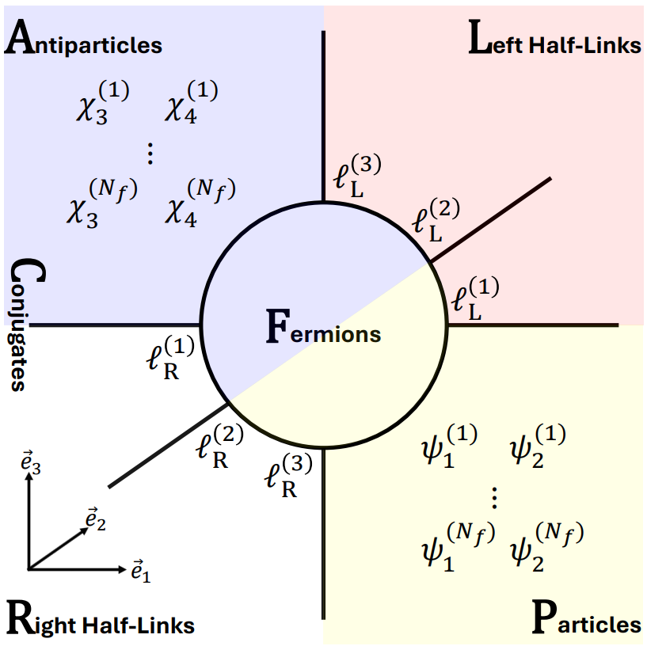
Lattice Degrees of Freedom

Slide 13
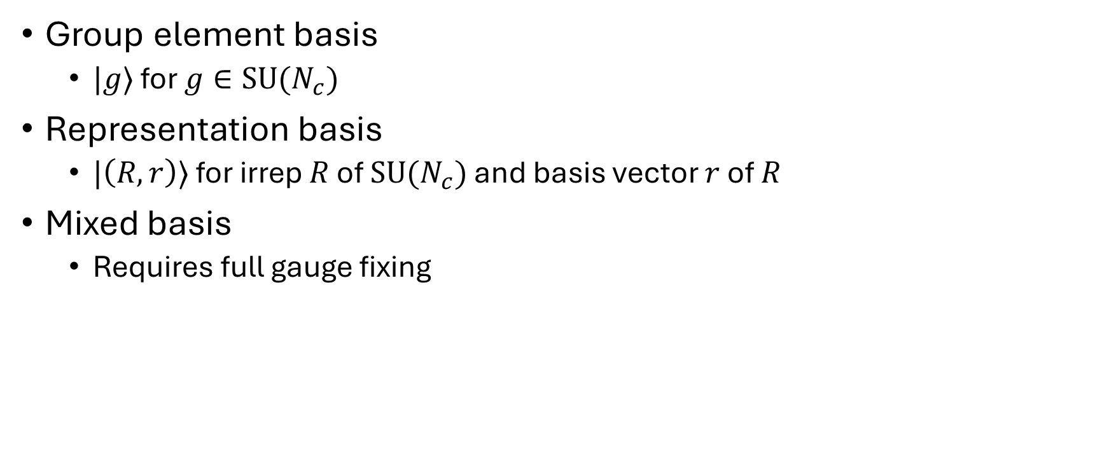
Different Bases for Gauge Link States
Group element basis
  $|g⟩$ for $g∈\text{SU}(N_{c})$
Representation basis
  $|\left(R,r\right)⟩$ for irrep $R$ of $\text{SU}(N_{c})$ and basis vector $r$ of $R$
Mixed basis
  Requires full gauge fixing

Slide 14
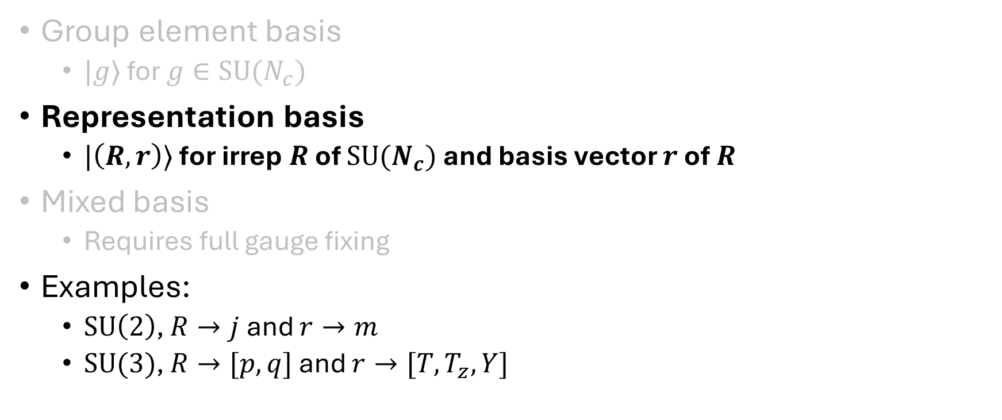
Different Bases for Gauge Link States
Group element basis
  $|g⟩$ for $g∈\text{SU}(N_{c})$
Representation basis
  $|\left(R,r\right)⟩$ for irrep $R$ of $\text{SU}(N_{c})$ and basis vector $r$ of $R$
Mixed basis
  Requires full gauge fixing
Examples:
  $\text{SU}\left(2\right)$, $R→j$ and $r→m$
  $\text{SU}(3)$, $R→[p,q]$ and $r→[T,T_{z},Y]$

Slide 15
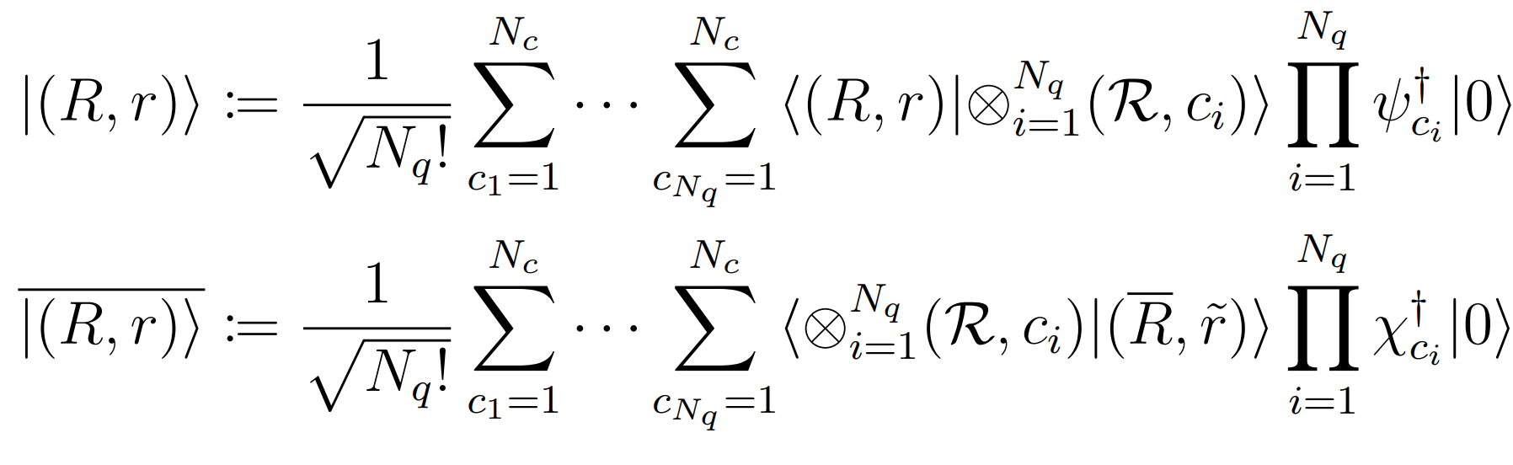
Fermionic Representation Basis
(for particles)
(for antiparticles)

Slide 16
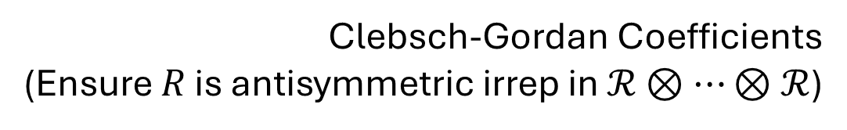
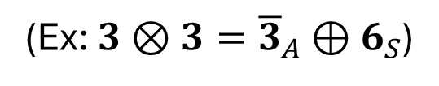
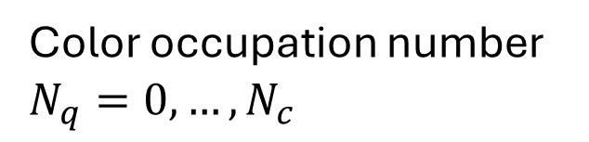
Fermionic Representation Basis
(for particles)
(for antiparticles)
Color occupation number
$$N_{q}=0,…,N_{c}$$
Clebsch-Gordan Coefficients
(Ensure $R$ is antisymmetric irrep in $ℛ⊗⋯⊗ℛ$)
(Ex: $3⊗3={\overline{3}}_{A}⊕6_{S}$)

Slide 17
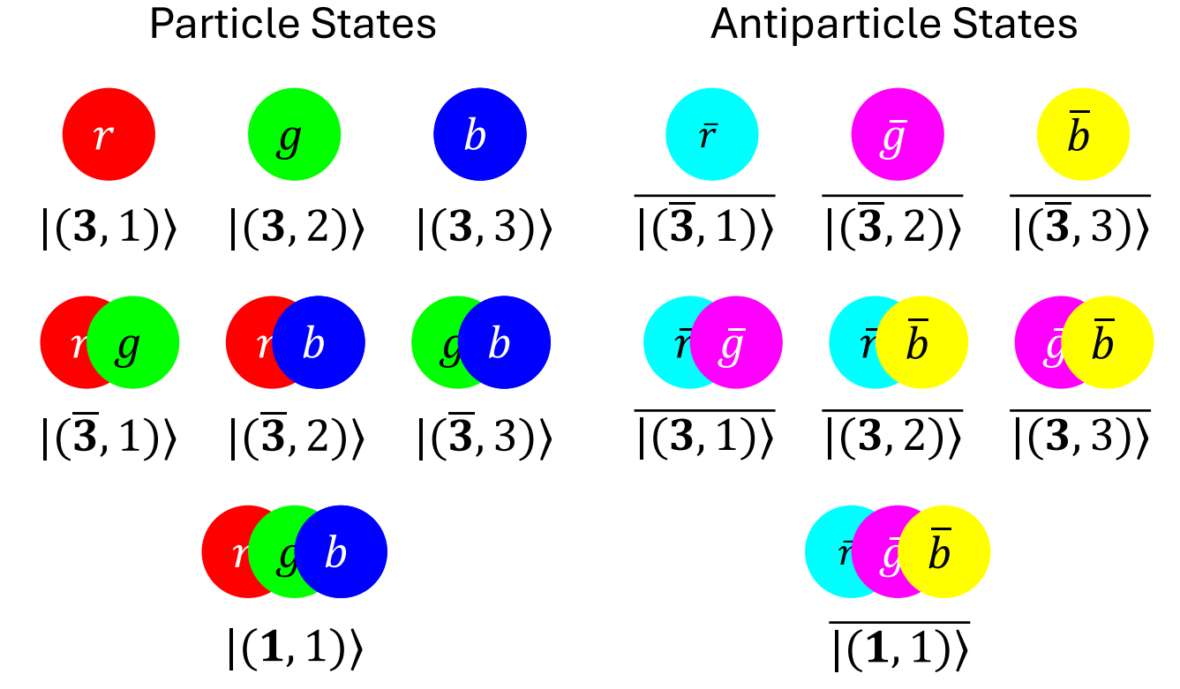
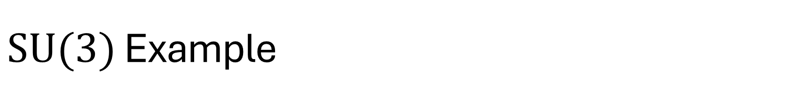
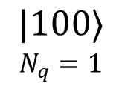
$\text{SU}(3)$ Example
$$|100⟩$$
$$N_{q}=1$$

Slide 18
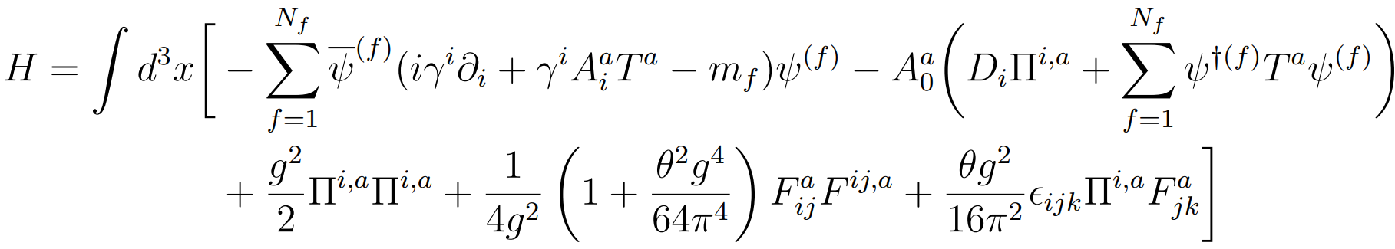
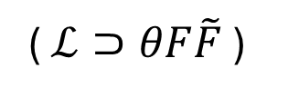

Hamiltonian
( $ℒ⊃θF\tilde{F}$ )
Gauss Operator $G^{a}(\vec{x})$
Kinetic Term
Mass Term
Electric Term
Magnetic Term
Theta Term

Slide 19
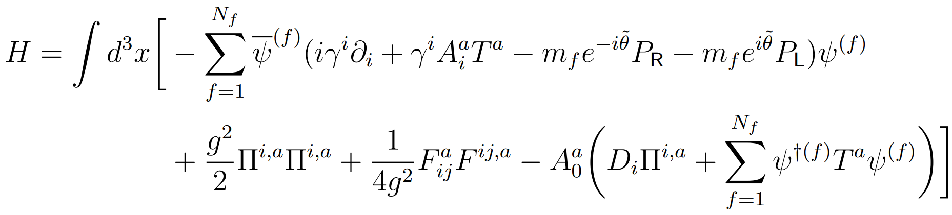
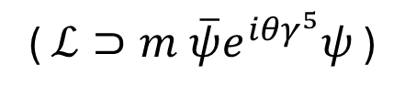


Hamiltonian(s)
( $ℒ⊃m \overline{ψ}e^{i{θγ}^{5}}ψ$ )
$$P_{R,L}=\frac{1±γ^{5}}{2}$$
Kinetic Term
Complex Mass Term
Electric Term
Magnetic Term
Gauss Operator $G^{a}(\vec{x})$

Slide 20

Solving Gauss’s Law
Solve $e^{iφ_{Ω}^{a}G^{a}(\vec{s})}\left|\text{phys}\right\rangle =|\text{phys}⟩$
Singlet multiplicity label
Irrep basis vectors are summed over
Irreps on site dof are fixed

Slide 21
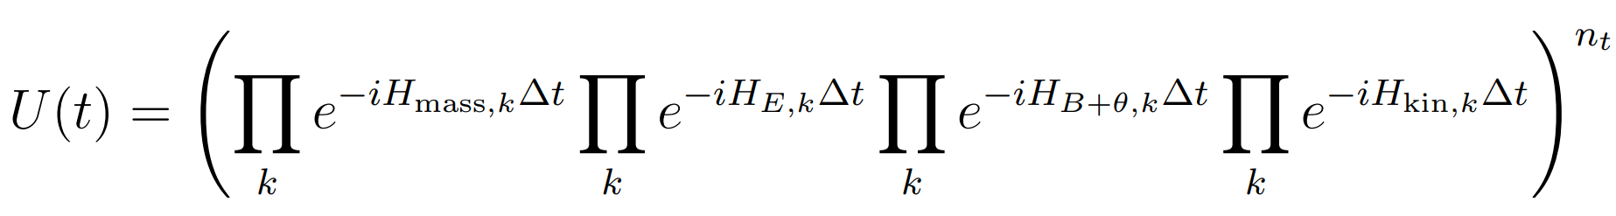
Quantum Circuits for Trotterization

Slide 22
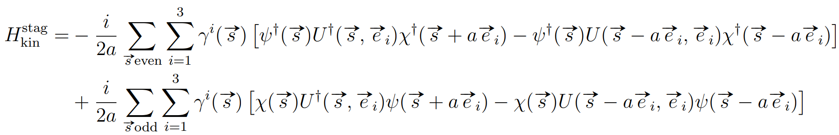
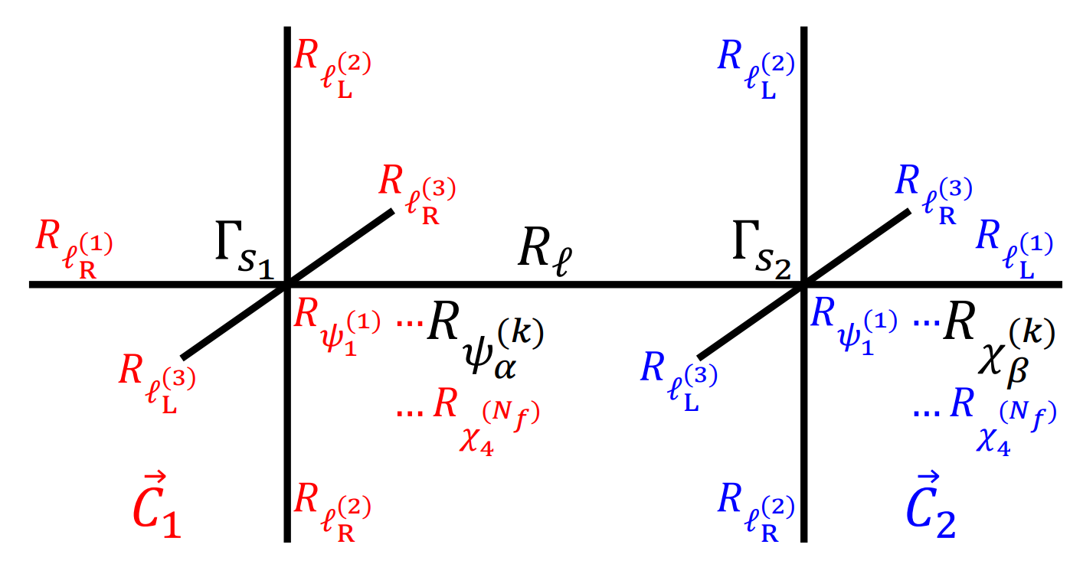
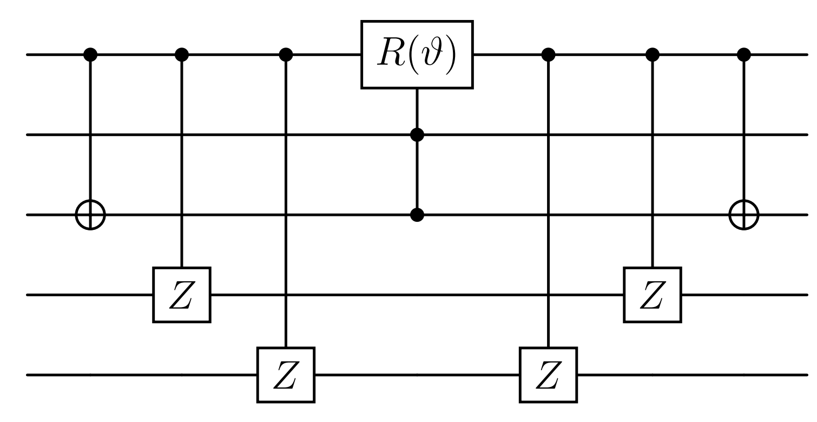
Quantum Circuits for Trotterization

Slide 23
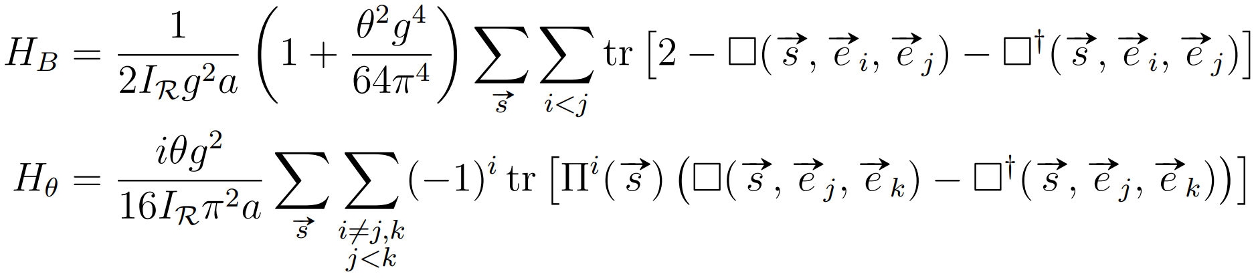
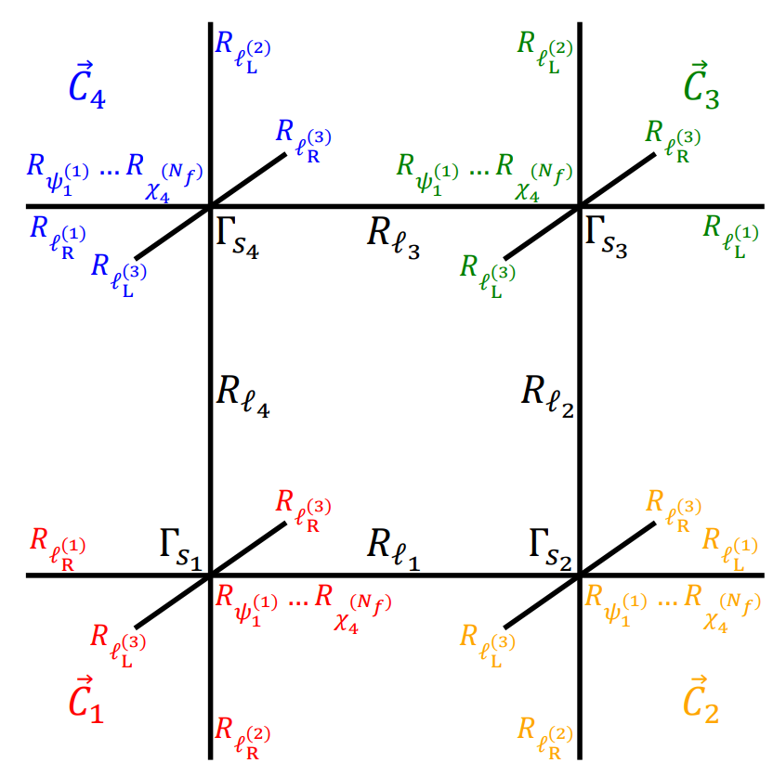
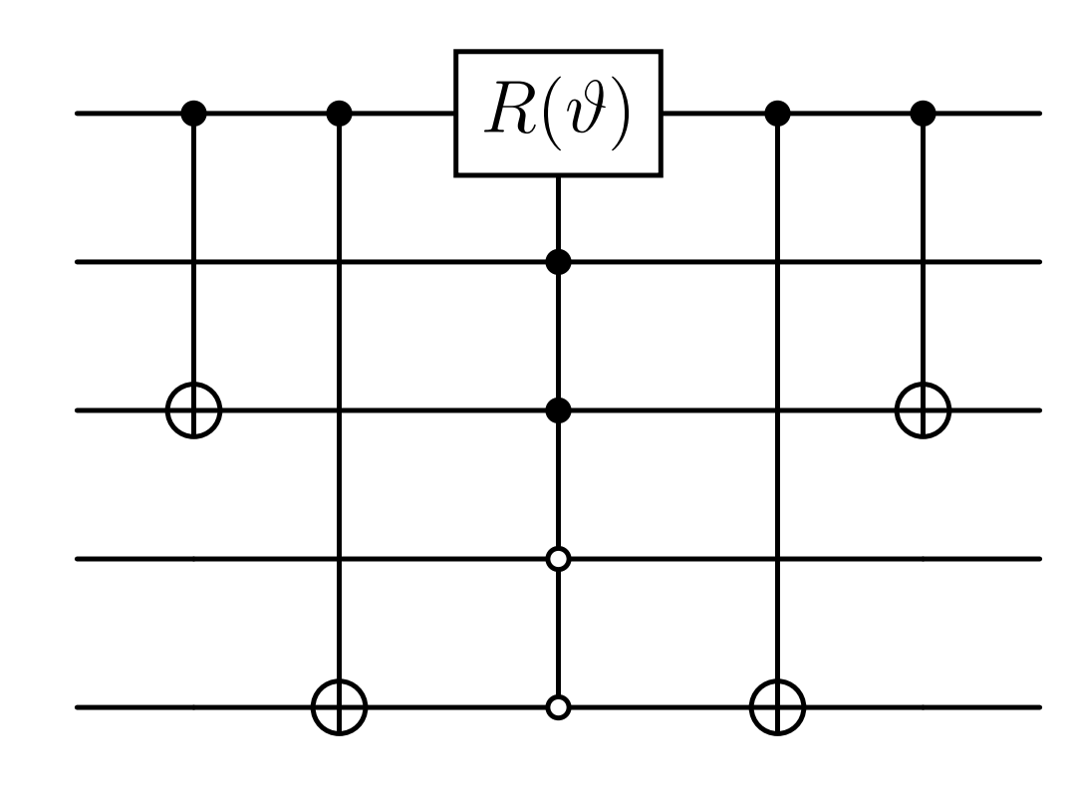
Quantum Circuits for Trotterization

Slide 24
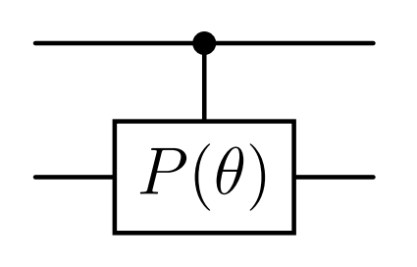
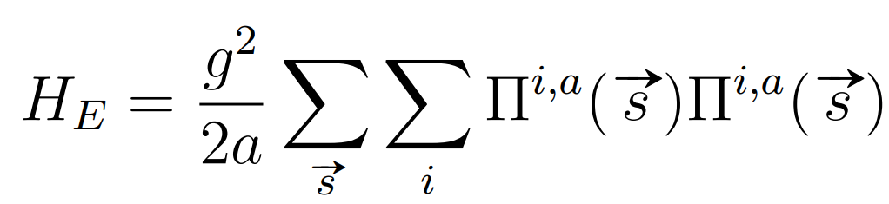
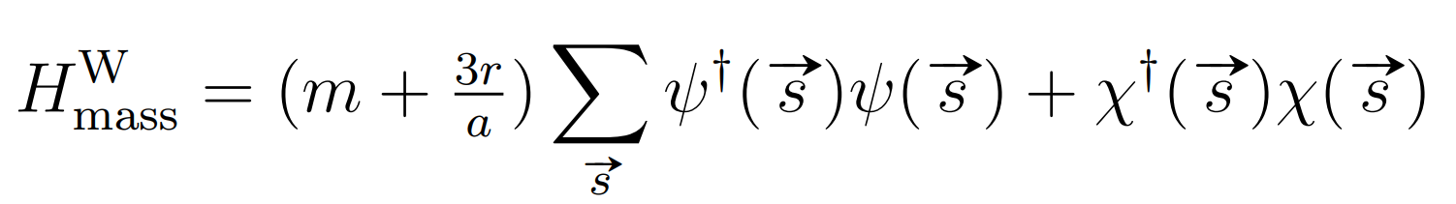
Quantum Circuits for Trotterization

Slide 25
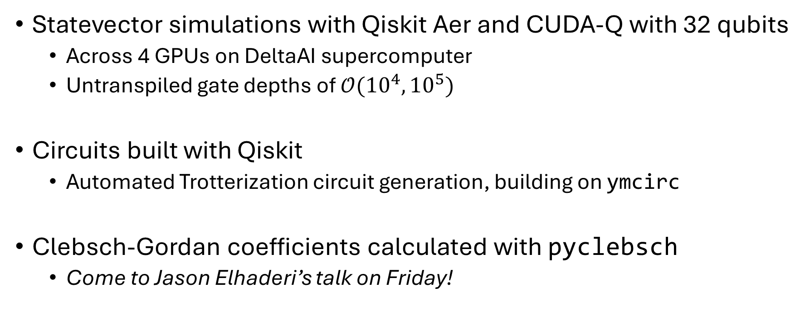
Quantum Simulators
Statevector simulations with Qiskit Aer and CUDA-Q with 32 qubits
  Across 4 GPUs on DeltaAI supercomputer
  Untranspiled gate depths of $𝒪({10}^{4},{10}^{5})$
Circuits built with Qiskit
  Automated Trotterization circuit generation, building on ymcirc
Clebsch-Gordan coefficients calculated with pyclebsch
  Come to Jason Elhaderi’s talk on Friday!

Slide 26
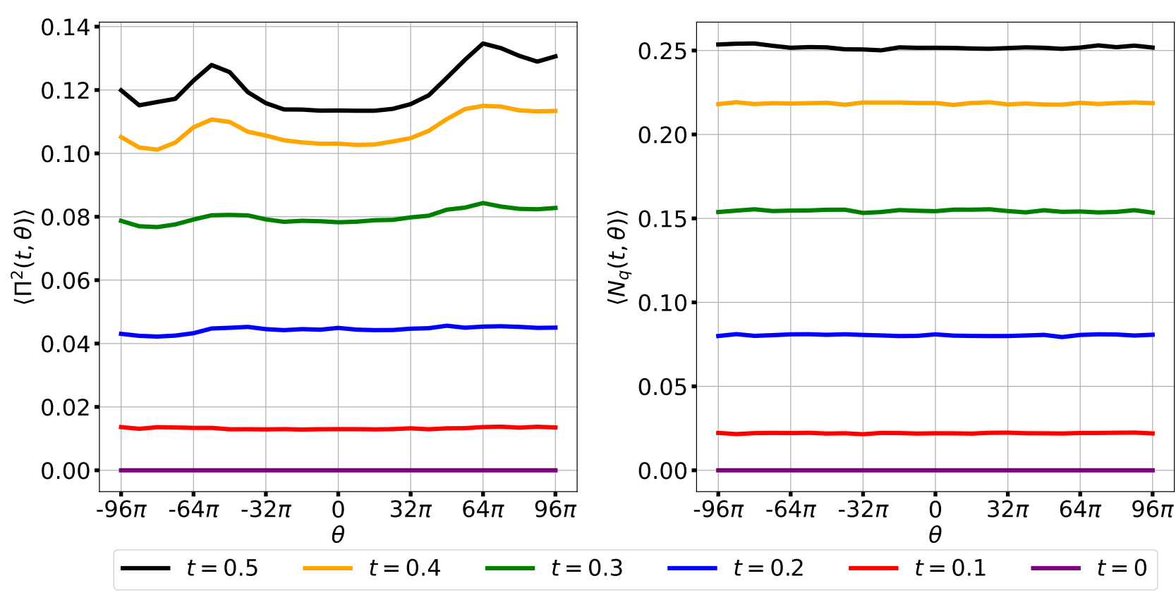
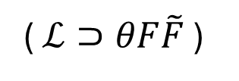





The Theta Angle
( $ℒ⊃θF\tilde{F}$ )
$$3$$
$$g=2, a=1,m=1$$
(staggered fermions)
$$1$$
$$3$$
$$3$$

Slide 27
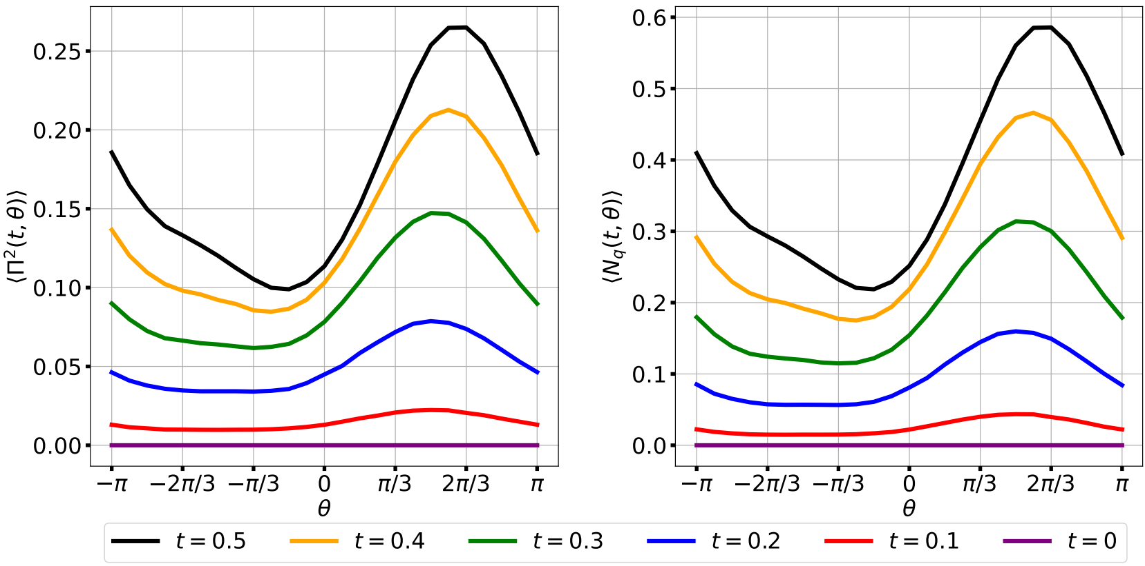
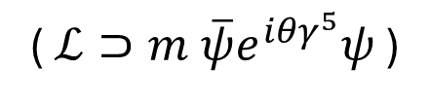
The Theta Angle
( $ℒ⊃m \overline{ψ}e^{i{θγ}^{5}}ψ$ )
$$3$$
$$g=2, a=1,m=1$$
(staggered fermions)
$$1$$
$$3$$
$$3$$

Slide 28
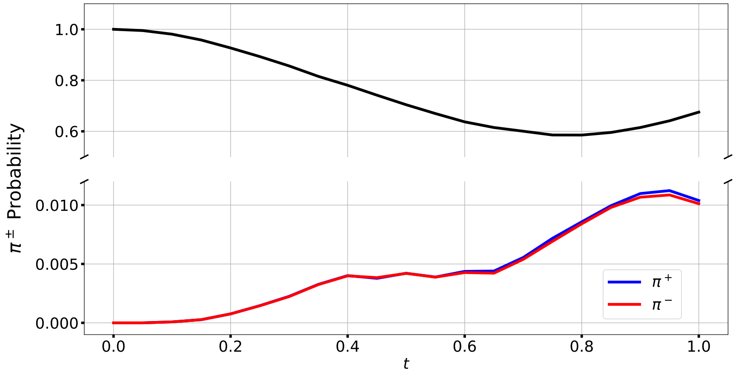

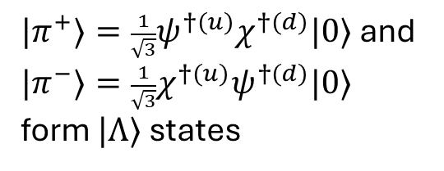





Hadronic States
$$1$$
$|π^{+}⟩=\frac{1}{\sqrt{3}}ψ^{†(u)}χ^{†(d)}|0⟩$ and $|π^{−}⟩=\frac{1}{\sqrt{3}}χ^{†(u)}ψ^{†(d)}|0⟩$ form $|Λ⟩$ states
$$1$$
$$3$$
$$3^{\left(u\right)},1^{\left(\overline{u}\right)},3^{\left(d\right)},1^{(\overline{d})}$$
$$|π^{+}⟩$$
$$1$$
$$g=2, a=1,m_{u}=m_{d}=1,r=1$$
(Wilson fermions)
($π^{+}$ at site (0,0))
(at other three sites)

Slide 29
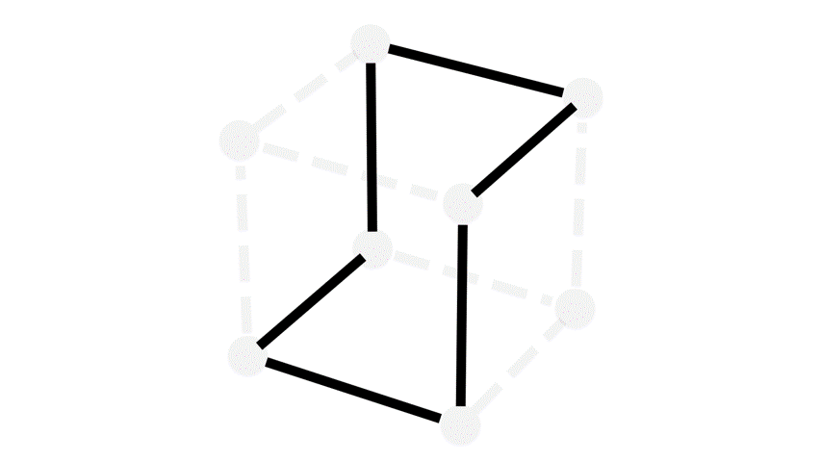
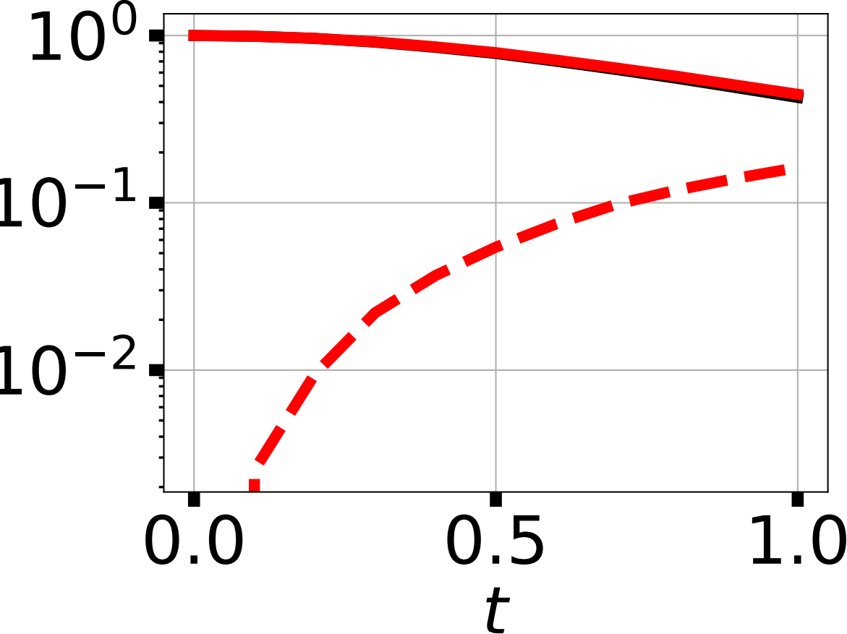
String Dynamics
$$3$$
$$g=2, a=1,m=1$$
(staggered fermions)
$$1$$
$$3$$
$$3$$
Unbroken String
Probability
Broken String

Slide 30
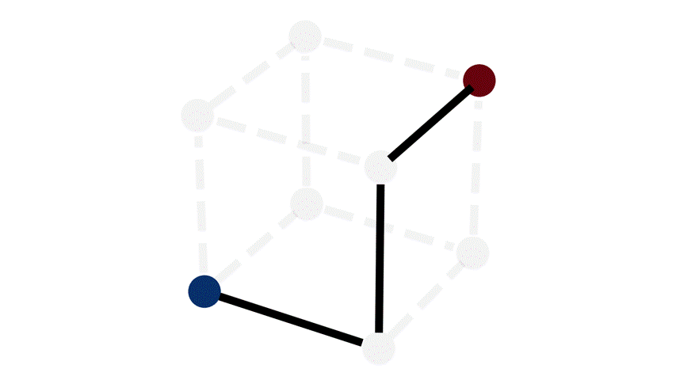
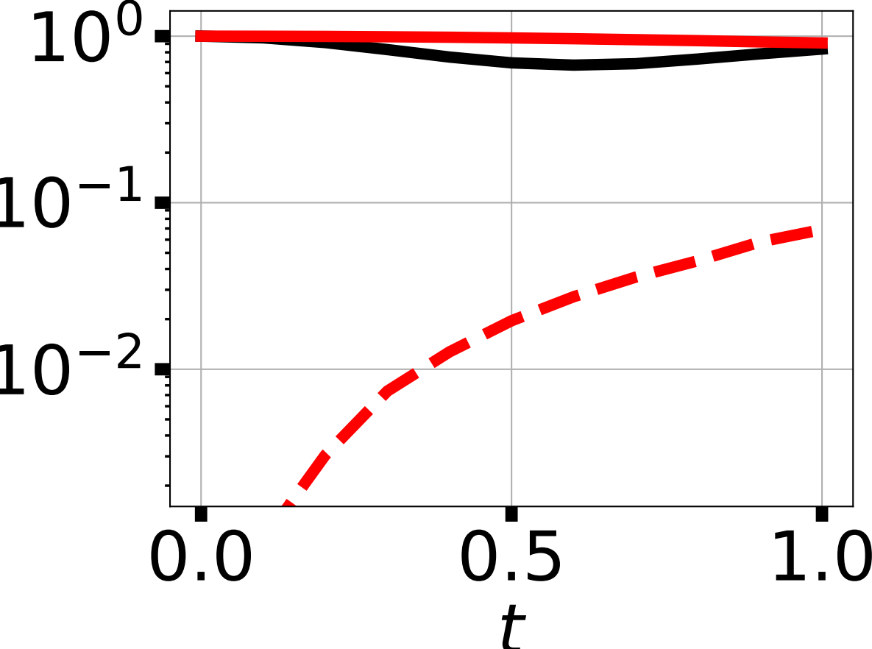
String Dynamics
$$3$$
$$g=2, a=1,m=1$$
(staggered fermions)
$$1$$
$$3$$
$$3$$
Unbroken String
Probability
Broken String

Slide 31
Future Directions
Hamiltonian simulation with alternatives to Trotterization
Alternatives to the Jordan-Wigner transformation
Analyzing Hilbert space truncation errors
State preparation algorithms
Improved Hamiltonians and/or counterterms
Adding the U(1) gauge field

