Slide 1

Quantum Simulation of Gluon Spin-Orbit Correlations in Single- and Multi-Gluon Systems
Juan Antonio Gil Fraile
T. Chowdhury (IonQ)
T. Izubuchi (BNL)
R. Sufian (NMSU/BNL)
K. Yu (BNL CSI)

Slide 2
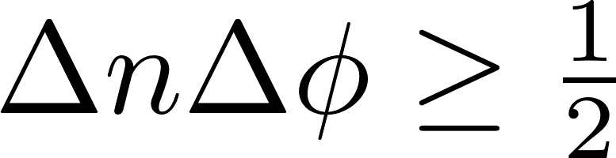





Parton Model and Quantum Mechanics
The Parton Model treats the DIS cross-section as the incoherent sum of the individual cross-sections of each parton.
However, Quantum Mechanics tells us that the wave functions of each parton should interfere with one another.
Because DIS interactions are so fast, information about the quantum phase of the hadron is lost (unobservable), and interference terms disappear.
$$I$$
$$I$$
$$γ^{∗}$$
$$p_{n}$$
$$p_{n}$$
p
Kharzeev et. al. (Phys. Rev. D 2017)

Slide 3
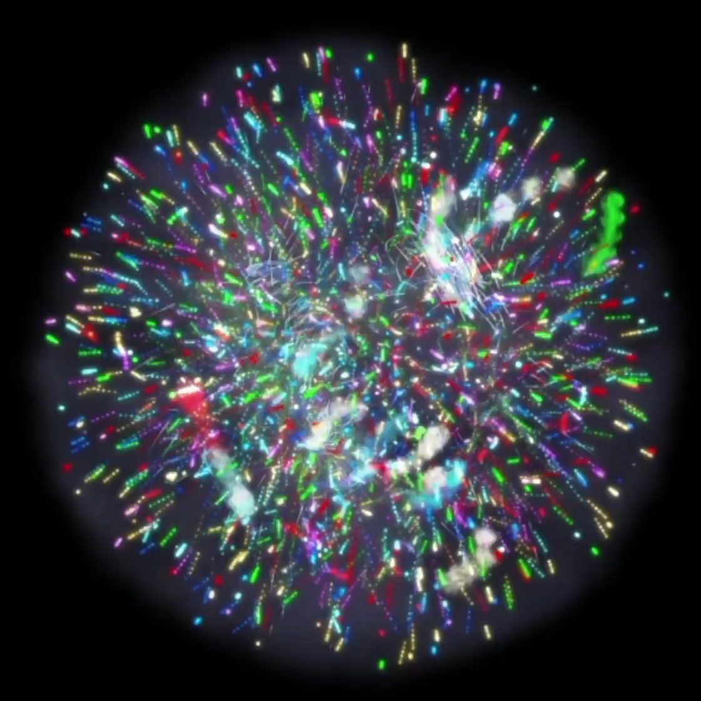
Entanglement Entropy as a Driver of Parton Distributions
We attempt to look at the flow of quantum information between gluons by exploring the entanglement entropy of the system.
The small-x regime in relation to gluon saturation is one of the pillars of the EIC science.
Grieninger et. al. (Phys. Rev. D 2026)
Maximal entanglement in the small x regime leads to interpreting gluons losing all information independence and forming an interconnected quantum information network.
Snowmass 2021 White Paper
“Gluon saturation is an extremely important part of the heavy ion collision program… It is the key ingredient of our current theoretical understanding of the initial stage of the collision process, describing the production and equilibration of the matter that evolves to a quark-gluon plasma”

Slide 4
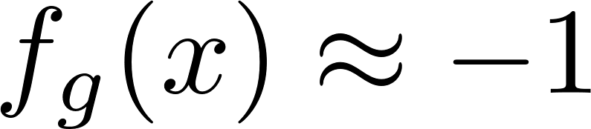
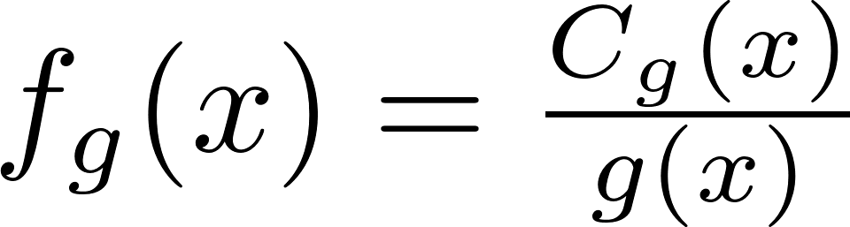
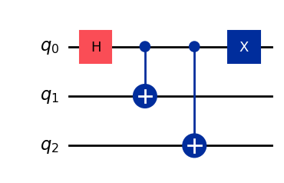
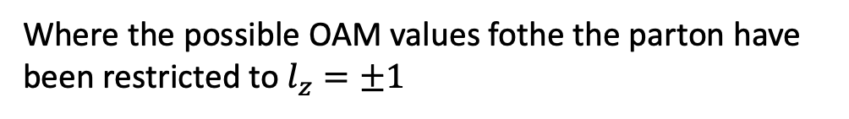
Theoretical Framework and Assumptions
We consider an unpolarized hadron such that:
Hatta, et. al (Phys. Rev. D 2025)
Recent observations have shown:
where
At small-x we can approximate their wave function as:
Where the possible OAM values fothe the parton have been restricted to $l_{z}=±1$

Slide 5
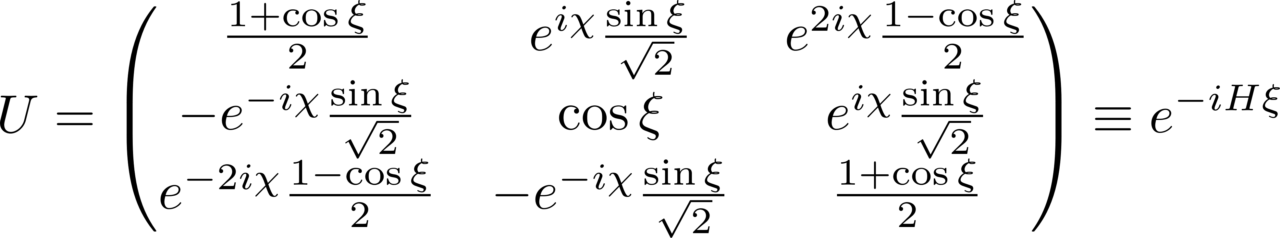
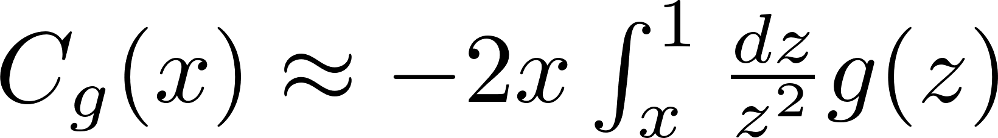
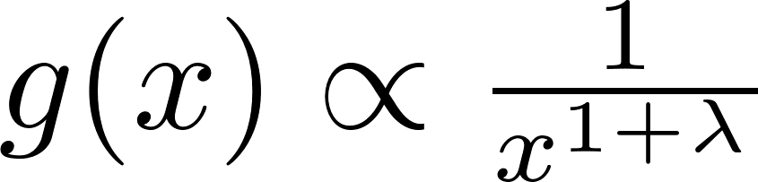
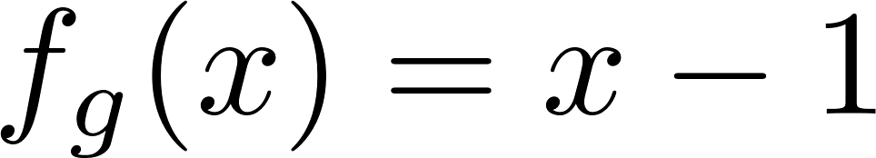

Defining x Evolution for the Gluon OAM
The unitary evolution operator that will control the single gluon x-dependent quantum evolution is:
Hatta, et. al. (Phys. Rev. D 2025)
Here the x-dependence comes from $ξ$, which we define as:
$$ξ≡\cos^{−1}(−f_{g}\left(x\right))$$
The spin-orbit correlation is approximated as:
Hatta et. al. (J. High Energ. Phys. 2024)
For $x≪1$, the unpolarized PDF will contain the follow:
For a light cone distance $λ≪1$, the resulting function for a single gluon is:

Slide 6
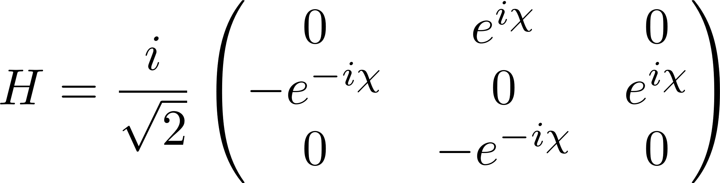
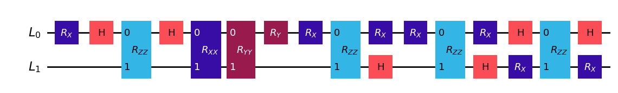

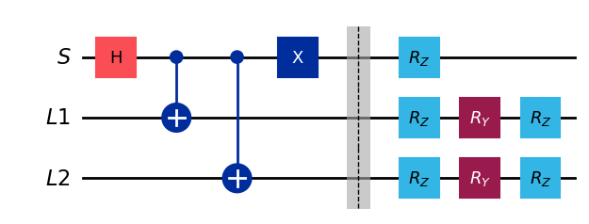
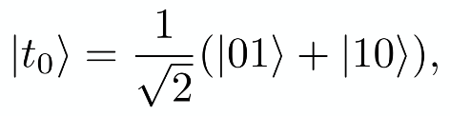

Quantum Evolution of a Single Gluon (New Developments)
The corresponding Hamiltonian from the unitary evolution operator:
We decompose the Hamiltonian in the computational basis into double-gate operations leads to:
We instead can instead project the Hamiltonian into the Dicke states to simplify the circuit:

Slide 7
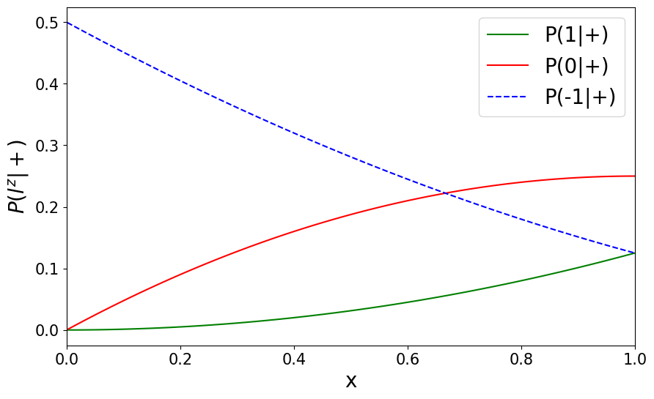
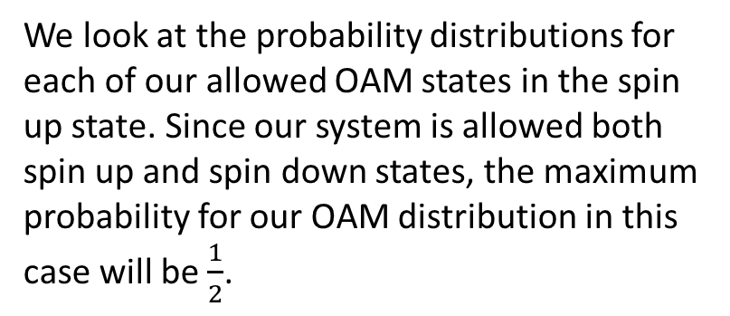
Spin up Conditional Probability Distribution of Gluon OAM States
We look at the probability distributions for each of our allowed OAM states in the spin up state. Since our system is allowed both spin up and spin down states, the maximum probability for our OAM distribution in this case will be $\frac{1}{2}$.

Slide 8
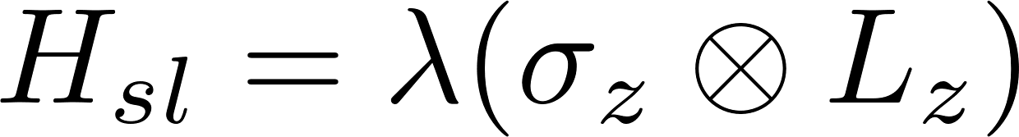
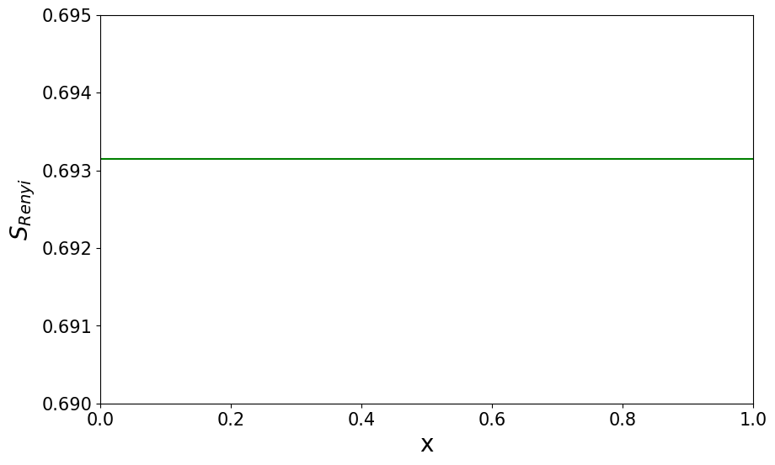
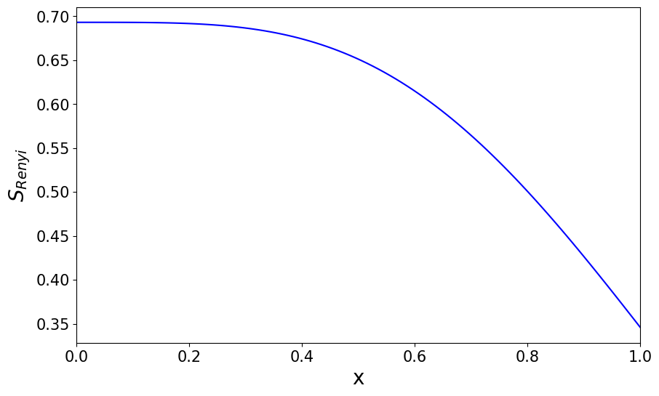
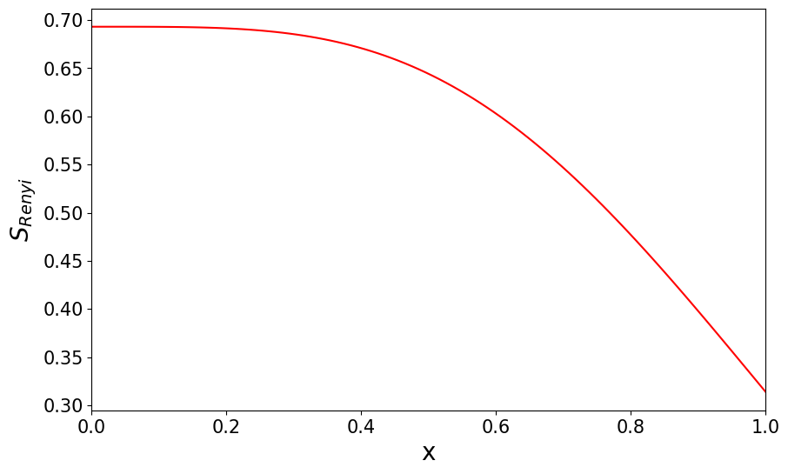
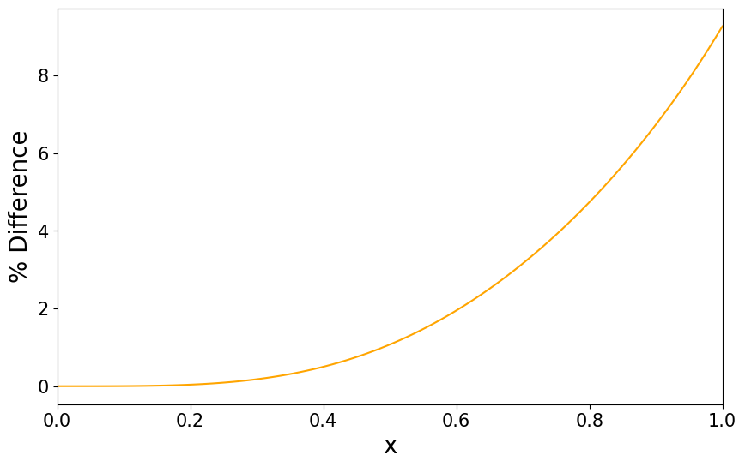

Entanglement Entropy for a Single Gluon
We look at the entanglement entropy as we evolve the system over x:
Now we introduce spin-orbit coupling into our Hamiltonian with an additional term:
$$S_{Renyi}=ln⁡(2)$$
Simulator
Exact
We observe constant maximum entropy throughout the evolution
Trotter error will cause slight disagreement between simulation and exact results:

Slide 9
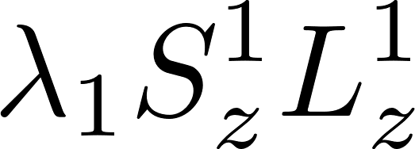
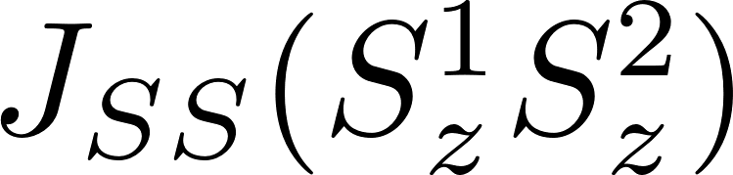
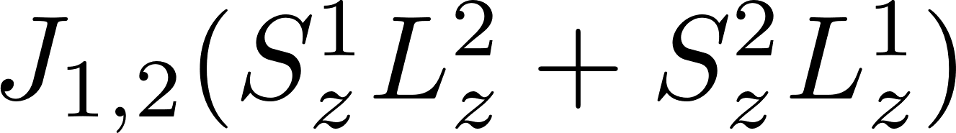
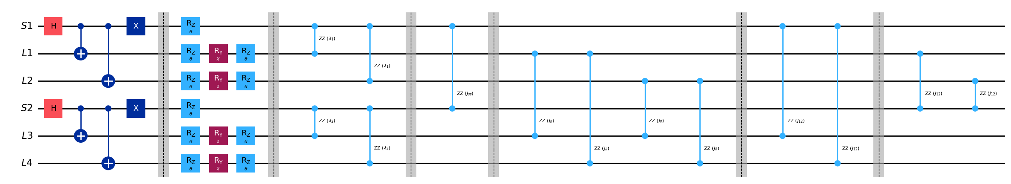
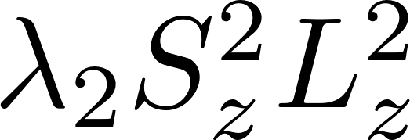
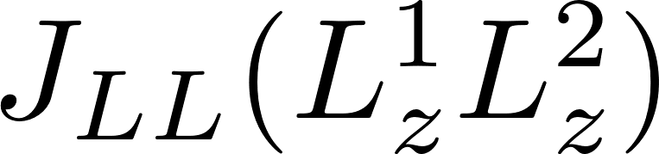
Simulating an Interacting Gluon Pair

Slide 10
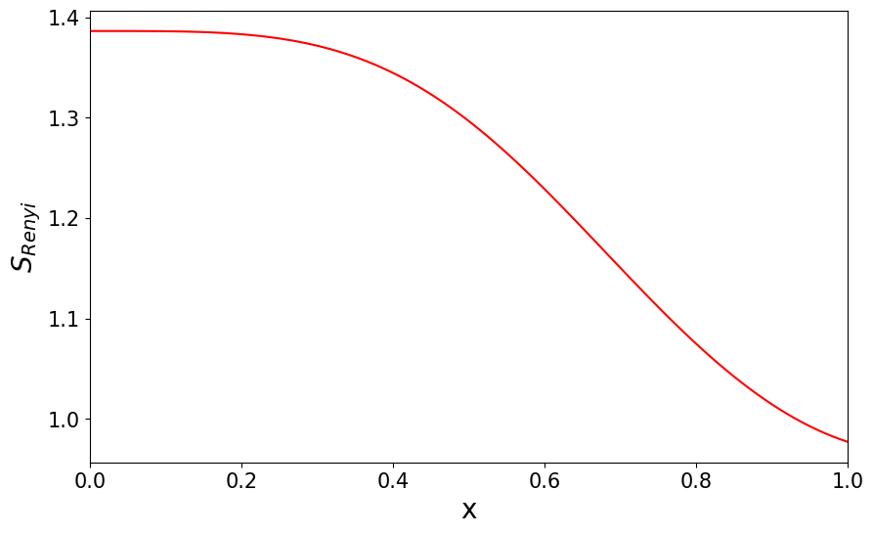
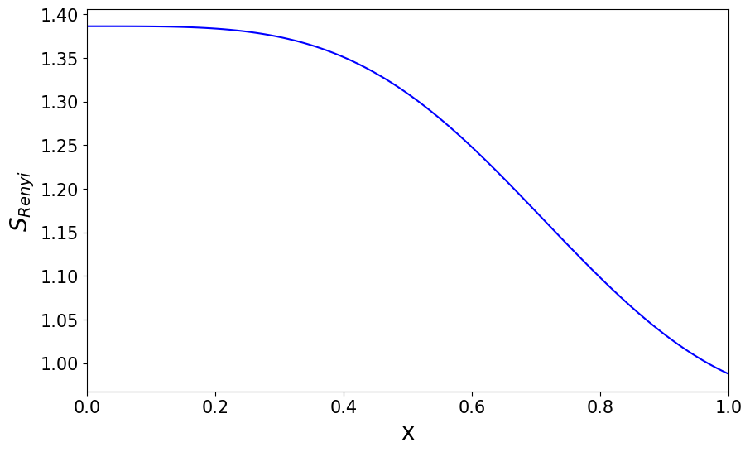
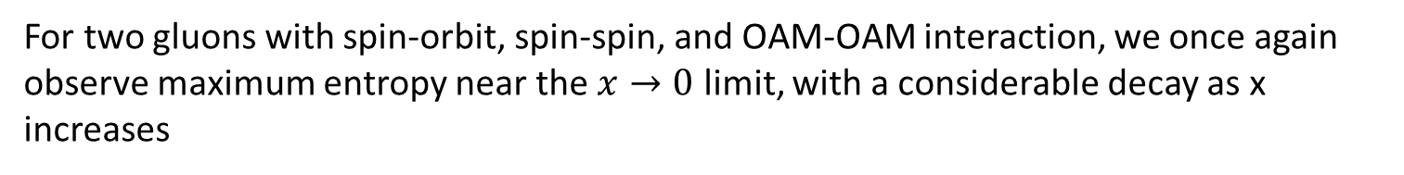
Entanglement Entropy for Two Interacting Gluons
$$S_{Renyi}=2ln⁡(2)$$
Simulator
Exact
For two gluons with spin-orbit, spin-spin, and OAM-OAM interaction, we once again observe maximum entropy near the $x→0$ limit, with a considerable decay as x increases

Slide 11
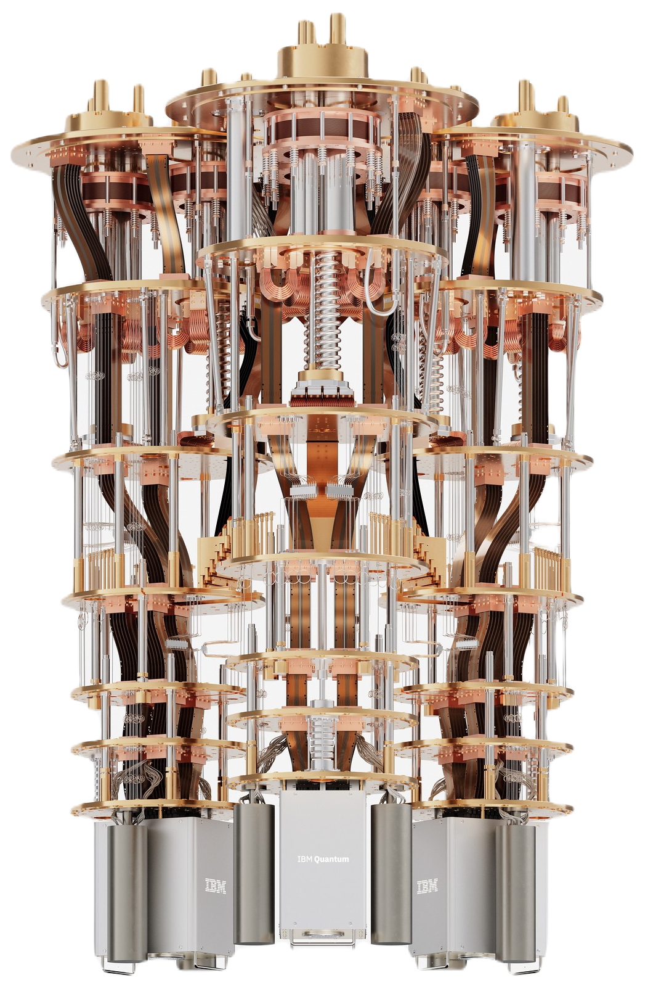

Future Work
With a good foundation of the quantum evolution of flow of quantum information between gluons, our next step is to run these circuits on a real device.
For a more adequate definition of the system, a better understanding of the different interaction strengths is needed. We are currently looking into more empirically motivated values.
We will work on implementing physics informed neural networks to assist with future state preparation and circuit optimization.
Note: Extracting Rényi entropy from a real device requires performing an algorithm known as the swap test, which will require alteration of the circuits discussed in this presentation.
“Enhancing quantum utility: Simulating large-scale quantum spin chains on superconducting quantum computers”
Chowdhury, Yu, Sufian, et. al. (Phys. Rev. Res 2024)
“Capturing the Page curve and entanglement dynamics of black holes in quantum computers”
Chowdhury, Yu, Asaduzzaman, Sufian
(Nucl. Phys. B 2025)
“Probing entanglement dynamics in the SYK model using quantum computers”
Chowdhury, Yu, Sufian
(Res. Phys. 2025)

Slide 12
Outlook
We can’t use standard cross-sections to learn about the quantum nature of the proton, which is why the entanglement entropy is a prime candidate for understanding how quantum information flows between partons
We have designed quantum circuits capable of exploring the quantum evolution of gluons and the quantum information flow due to their interactions
We can appreciate maximal entanglement entropy in the small x regime, as well as its decay when introducing spin-orbit interactions
Our next steps are to run these circuits on a real quantum computer to observe real quantum interactions at play, while at the same time exploring fault tolerance of our system. We will integrate AI into future projects to overcome system size constraints, as well as reduce error and noise accumulation.

Slide 13


Thank you!

Slide 14

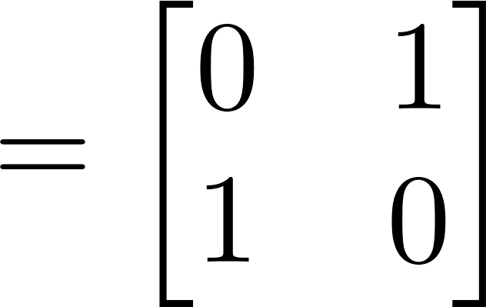
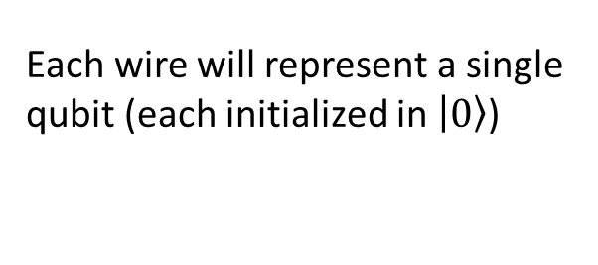
Components of a Quantum Circuit
Each wire will represent a single qubit (each initialized in $\left.\left|0\right.\right\rangle$)
Rotation gates represent logical operations that a quantum computer can perform on quantum data. These have unique matrix representations:
Single qubit gates such as the Hadamard “H” gate evolve a single qubit at the time
Two-qubit gates such as the controlled NOT “CNOT” gate act on two qubits at the time.

Slide 15
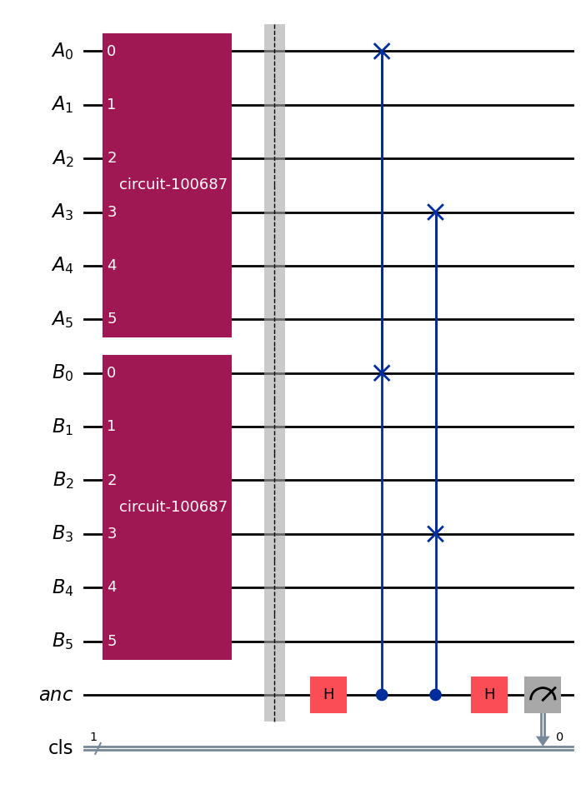
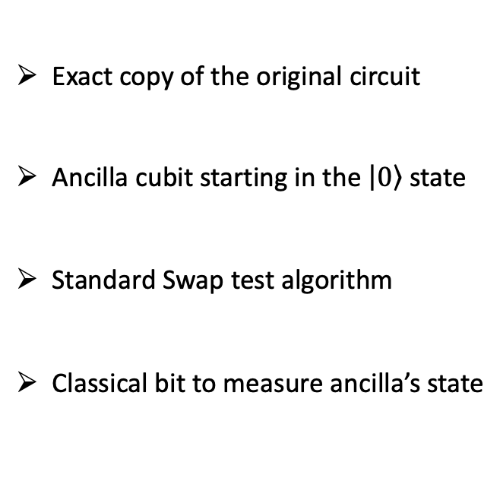
Future Work
Swap test to extract the Rényi entropy from a real device
Exact copy of the original circuit
Ancilla cubit starting in the $\left|\left.0\right\rangle \right.$ state
Standard Swap test algorithm
Classical bit to measure ancilla’s state

