Slide 1





Arbitrary-Distance Quantum Error Correction with Gauss’s Law for Lattice Gauge Theories
Neel S. Modi, Lento Nagano, Masazumi Honda, Nobuyuki Yoshioka, Christian W. Bauer
(arXiv-submitted + upcoming)

Slide 2
Now is the time to get involved with QEC
1994
2012
QEC “discovered” as a feature of QM
(Calderbank-Shor, ‘96), (Steane, ‘96), (Gottesman, ‘97)
1996
2014
Lattice surgery introduced for
surface codes
(Horsman-Fowler-Devitt-Meter, ‘11)
Threshold theorem proven, threshold
rate ~99.9999%
(Laflamme-Knill-Zurek, ‘98), (Aharonov-Ben-Or, ‘99)
1998
2016
~99.9% 2-qubit gate fidelity,
~99.99% 1-qubit gate fidelity,
reported for a pair of trapped ions
(Ballance-Harty-Linke-Sepiol-Lucas, ‘16)
2000
Planar surface codes introduced
(Bravyi-Kitaev, ‘98), (Freedman-Meyer, ‘98)
2018
2002
Surface code threshold rate estimated
to be ~99.98%
(Dennis-Kitaev-Landahl-Preskill, ‘01)
2020
Discovery of “good” qLDPC codes,
i.e., k = Θ(n) and d = Θ(n)
(Panteleev-Kalachev, ‘21)
2004
2022
Modern starting point for qLDPC codes
(sparse-graph codes)
(MacKay-Mitchison-McFadden, ‘04)
Linear-time decoders for “good”
qLDPC codes
(Dinur-Hsieh-Lin-Vidick, ‘22)
2006
2024
~99% fidelity reported for entangling a pair of trapped ions
(Benhelm et al., ‘08)
Google, QuEra, and Quantinuum experimentally demonstrate QEC
below the FT threshold
(Google, ‘24), (QuEra, ‘25), (Quantinuum, ‘26)
2008
2026
2010
Hypergraph-product codes introduced
(prototypical qLDPC family)
(Tillich-Zemor, ‘09)
2028
Your hardware demonstration here

Slide 3
General-Purpose QEC (Stabilizer Codes)
A quantum error-correcting code (QECC) is a subspace H_{C} within n-qubit states.
H_{C} is called the code space.
Stabilizer codes choose H_{C} as invariant states of (Pauli) “stabilizer” operators.
Example: S₁ = Z Z I and S₂ = I Z Z gives H_{C} = span{|000⟩, |111⟩}.
Syndrome of a Pauli error E answers: “Does E commute with S_{i}?”
No → S_{i} detects E.
Yes → S_{i} does not detect E.
Code distance d = minimum weight of completely undetectable Pauli error.
Example: d = 1 due to E = Z I I.
Distance d = 2t + 1 code can correct arbitrary t-qubit errors.

Slide 4
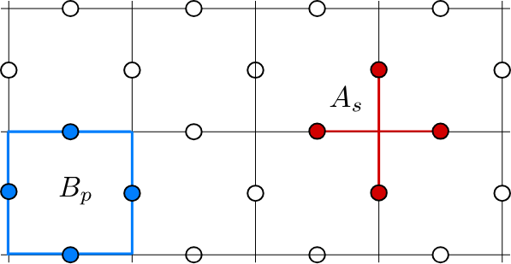
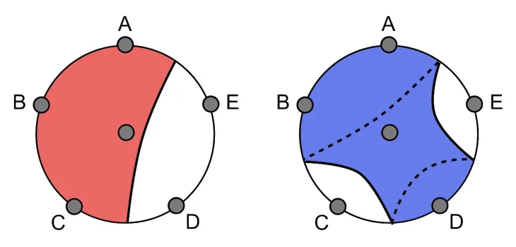
We’ve seen QEC before in HEP
Toric code as a ℤ₂ lattice gauge theory
Arbitrary code distance (technically qLDPC)
Gauss’s law and ground state degeneracy
(Bravyi-Kitaev, ‘98)
Entanglement-wedge reconstruction in AdS/CFT
Operator-algebra variant of QEC
Not simply conformal invariance (requires bulk)
(Dong-Harlow-Wall, ‘16)

Slide 5
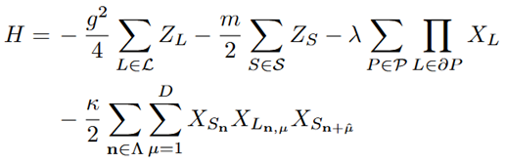
Simulating Hamiltonian LGTs using their nature-given QECC
First attempt: take any ℤ₂ lattice gauge theory, e.g.,
The gauge-invariant subspace ℋ_{G} ⊆ ℋ is automatically an n-qubit QECC!*
L_{i}
S_{i}
L_{i+1}
L_{i} + S_{i} + L_{i+1} = 0
OR
G_{i} = Z_{Li} Z_{Si} Z_{Li+1}
*But not a very good one… (d = 1)

Slide 6
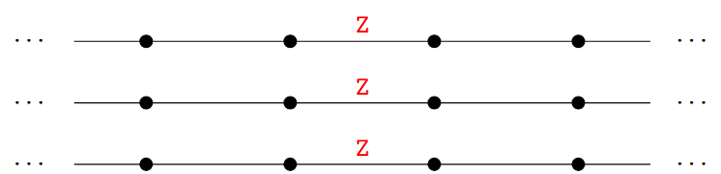
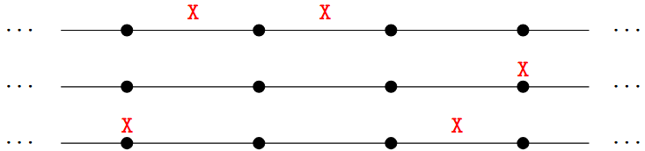
Rajput, Roggero, and Wiebe’s solution: concatenation
(Rajput-Roggero-Wiebe, ‘23)
By adding to Gauss’s law, RRW achieves QECC with distance d = 3.
Keep all G_{i} = Z_{Li} Z_{Si} Z_{Li+1}
Expand with S₁ = X X I and S₂ = I X X
Then Z = Z Z Z, so G = Z ^{⊗9}
{Z Z Z} ⊙ {X X I, I X X}
Z Z Z | Z Z Z | Z Z Z
X X I | I I I | I I I
I X X | I I I | I I I
I I I | X X I | I I I
I I I | I X X | I I I
I I I | I I I | X X I
I I I | I I I | I X X

Slide 7
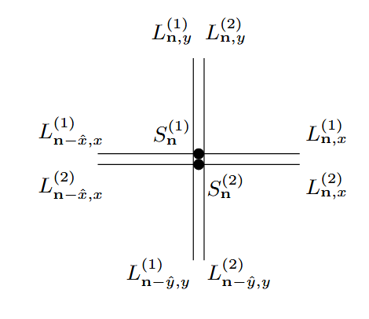
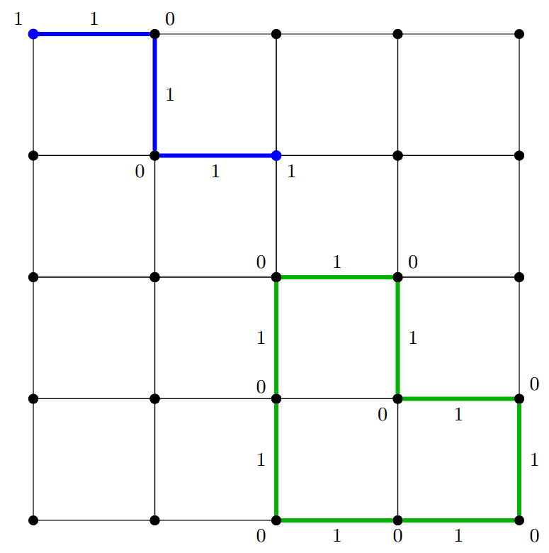
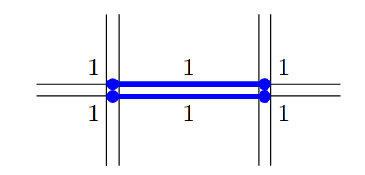
Generalization to arbitrary distance
Observation 1:
Codewords are
flux strings, in any
spatial dimension!
Observation 2:
Duplication thus
increases code
distance

Slide 8
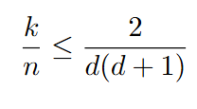
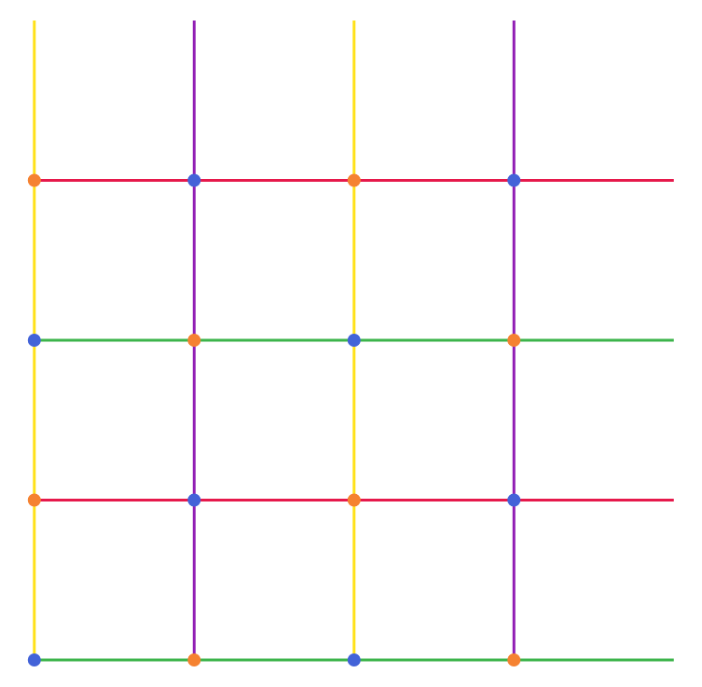
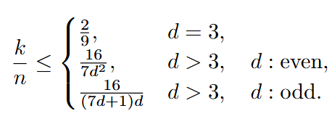
Optimal encoding rate
1D:
2D:
Stabilizer weights are O(1), so this is qLDPC
But d = Θ(√n), so not the “good” kind
More like a surface code; has locality

Slide 9
Compare against most efficient single-qubit codes
cf. (Spagnoli-Roggero-Wiebe ‘24) and (Pato-Klco, ‘26)
Take d = 2t + 1 and N-site lattice
 | Optimal GLC | Efficient single-qubit code* | GLC is better for
Total number of physical qubits (1D) | (2t + 1)(t + 1)N | 2(6t – 1)N | t ≤ 4 or d ≤ 9
Total number of physical qubits (2D) | ¼ (7t + 4)(2t + 1)N | 3(6t – 1)N | t ≤ 3 or d ≤ 7
Encoded Hamiltonian Pauli weight (1D)** | 2t + 1 | 6t + 3 | All t or d; all N
Encoded Hamiltonian Pauli weight (2D)** | 2t + 1 | 8t + 4 | All t or d; all N
*Conjectured
**Assuming hard-core boson interaction

Slide 10
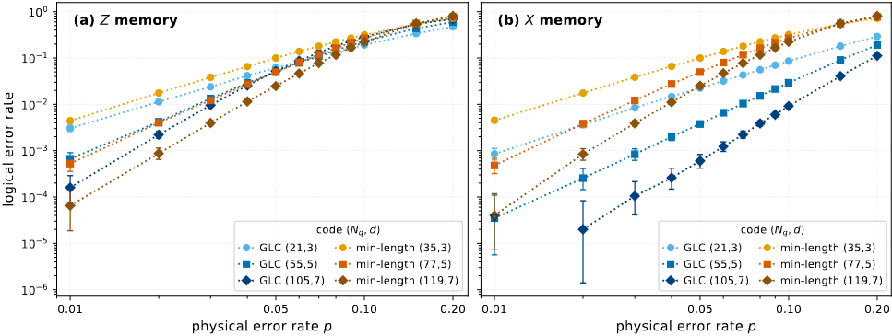
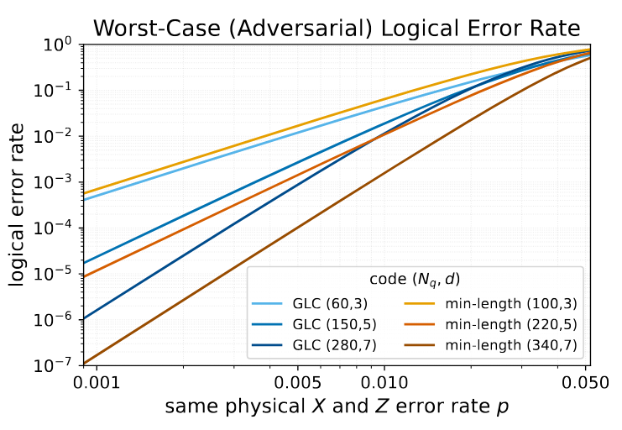
Comparison with code capacity simulations
cf. (Pato-Klco, ‘26)

Slide 11
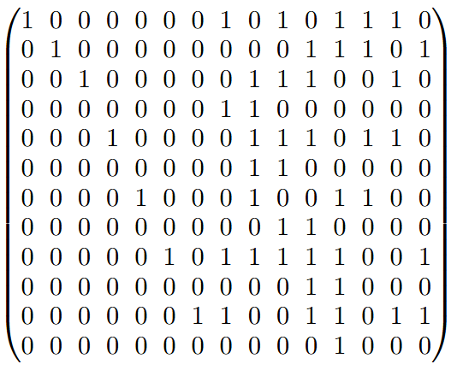

Can we do better?
Observation: we effectively encoded each site and link, then imposed Gauss’s law
What if we encode blocks of the lattice, instead of individual sites and links?
Can we go beyond repetition code?
G_{ij}
[15, 12, 1] + Gauss’s law = [15, 7, 5] BCH code
Concat. with [5, 1, 5] yields [[12.5N, N, 5]]*
*Requires gluing all N / 6 pairs of dangling ends
Surpasses our original efficiency bound (n ≥ 15N, but n = 12.5N)

Slide 12
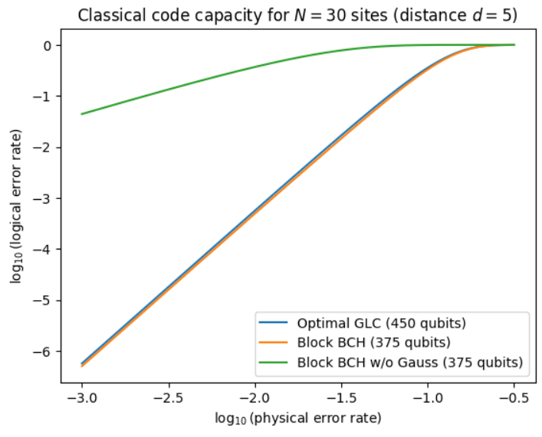
Compare “block BCH” against optimal GLC (preliminary)
Benefits:
Lower physical qubit cost
Reasonable logical error rate
Efficient decoders are known
Caveats:
Higher weight stabilizers
Higher weight interaction terms
In 1D, solving Gauss’s law yields a simple model anyway

Slide 13
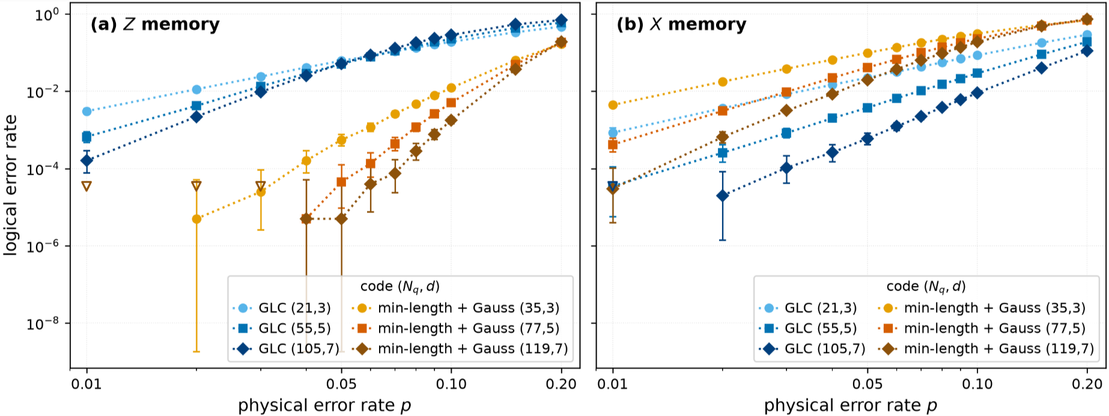
New framework for the concept of “utilizing Gauss’s law”
Take any Hamiltonian LGT with Hilbert space ℋ
Equip any QECC with physical qubits (or otherwise), so that ℋ ⊆ ℋ_{P}
Let ℋ_{G} ⊆ ℋ be the gauge-invariant subspace
Then upgrade the QECC from ℋ ⊆ ℋ_{P} to ℋ_{G} ⊆ ℋ_{P}

Slide 14
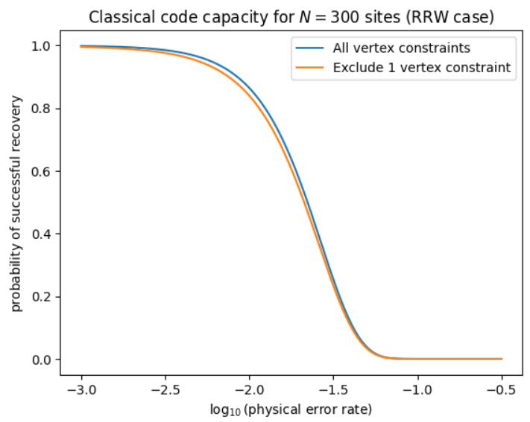
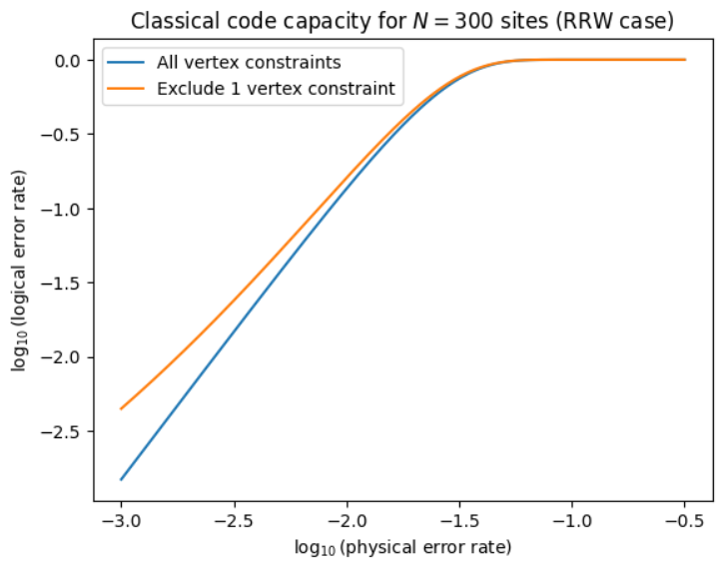
What about the non-Abelian case?
Immediate problem: the upgraded QECC is not a stabilizer code!
Resolution: upgrade the QECC only partially (enough to make a stabilizer code)
Find a convenient ℋ_{G} ⊆ ℋ_{G’} ⊆ ℋ
Upgrade the QECC from ℋ ⊆ ℋ_{P} only to ℋ_{G’} ⊆ ℋ_{P}
Needs investigation: how bad is it to disregard some amount of Gauss’s law?

Slide 15
Future directions
How much can domain-agnostic codes be improved by Gauss’s law?
  Surface codes, bicycle codes, perfect codes, good qLDPC codes, etc.
Explore non-Abelian case
  Select ℋ_{G’} to be the subspace where net color charge is balanced
    Truncated Kogut-Susskind Hamiltonian in the basis |1⟩, |3⟩, |3⟩
    Qudit stabilizer codes (cf. Spagnoli-Roggero-Wiebe ‘26)
  Encode first to qubits, then choose ℋ_{G’} to make a stabilizer code from there
Consider circuit-level noise models
  What is the threshold rate?
  Can Gauss’s law improve over domain-agnostic case?
Investigate fault-tolerant Hamiltonian simulation
  How does complexity of FT Hamiltonian simulation change with different codes?
Hardware test?

Slide 16
Thank you!

