Slide 1
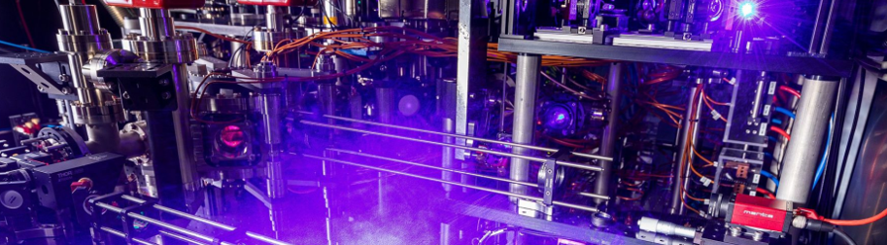
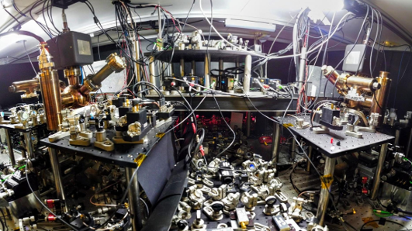
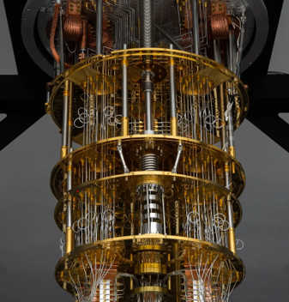

Lattice Field Theory Meets Quantum Computers
atoms
“best use” of quantum computers
ions
SC circuits
LF Theorists
confidence in the future
Alaina Green
International Symposium on Lattice Field Theory
July 30th 2026
Notes:
Discuss the dynamics of collisions between hardware experimentalists like myself and highly qualified and engaged end users
While utility is the goal…in the short terms

Slide 2
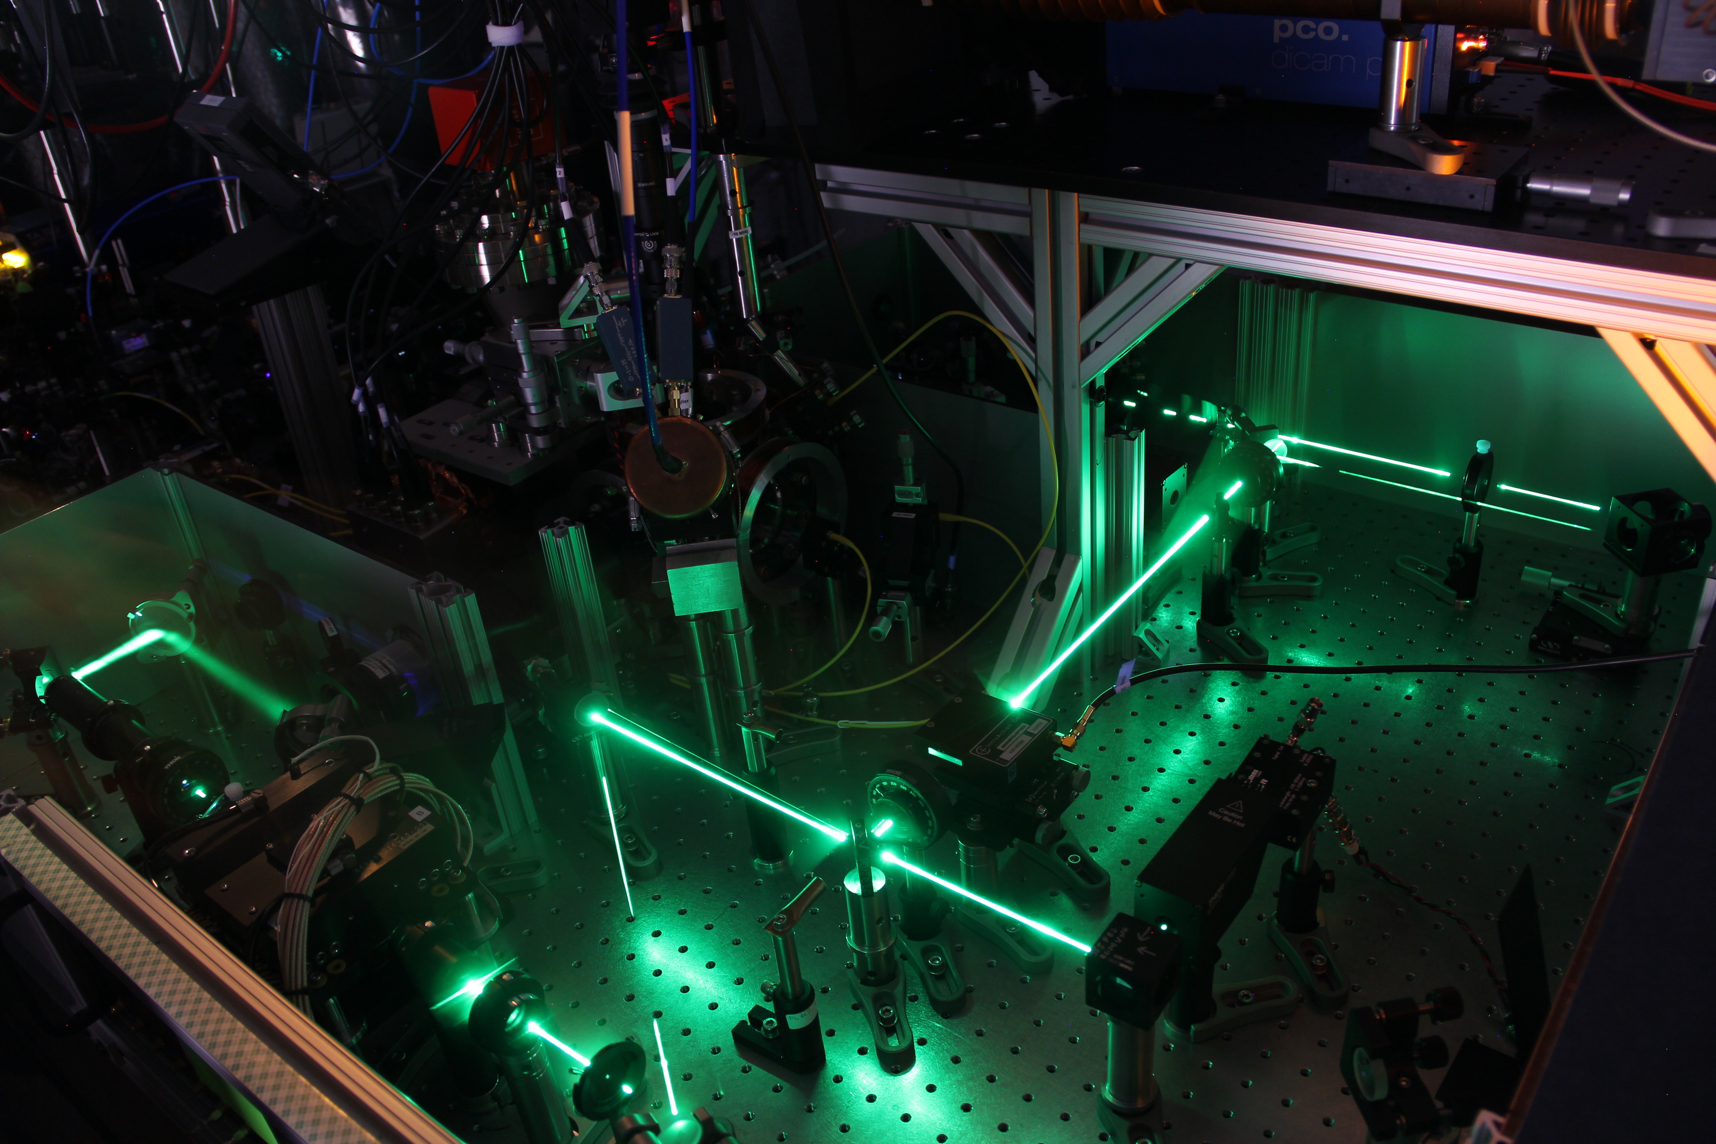
Green/Linke Lab: Quantum Computing with Ions
Quantum algorithms
New Gates/
Architectures
PRR 4,3 (2022)
Q. Sci. and Technol. 8,1 (‘22)
PRA 111, 2 (2025)
arXiv:2509.11477 (Nat Phys.)
Adv. Q. Technol. 6,11 (2023)
PRL126, 220503 (2021)
Quantum simulation
arXiv:2509.11477 (Nat Phys.)
Nat. Comms.16, 1 (2025)
Sci. Rep.15, 141498 (2025)
PRX Quantum 3, 2 (2022)
PRL128,14 (2022)
Benchmarking/
tomography
PRL137, 040601(2026)
arXiv:2504.12575
arXiv:2501.05355

Slide 3
The Quantum Computing Stack
real time dynamic simulation
APPLICATION
trotterized time evolution
ALGORITHM
CNOT, H, T, etc.
QUANTUM CIRCUIT
XX, ZZ, ECR (ZX), etc.
NATIVE GATES
lasers, microwaves
GATE PULSES
DETECTION
trapped ions, neutral atoms, superconducting qubits, etc.
QUBITS
Notes:
alternate way to describe what I do: full stack
abstract concept designed for classical computers

Slide 4
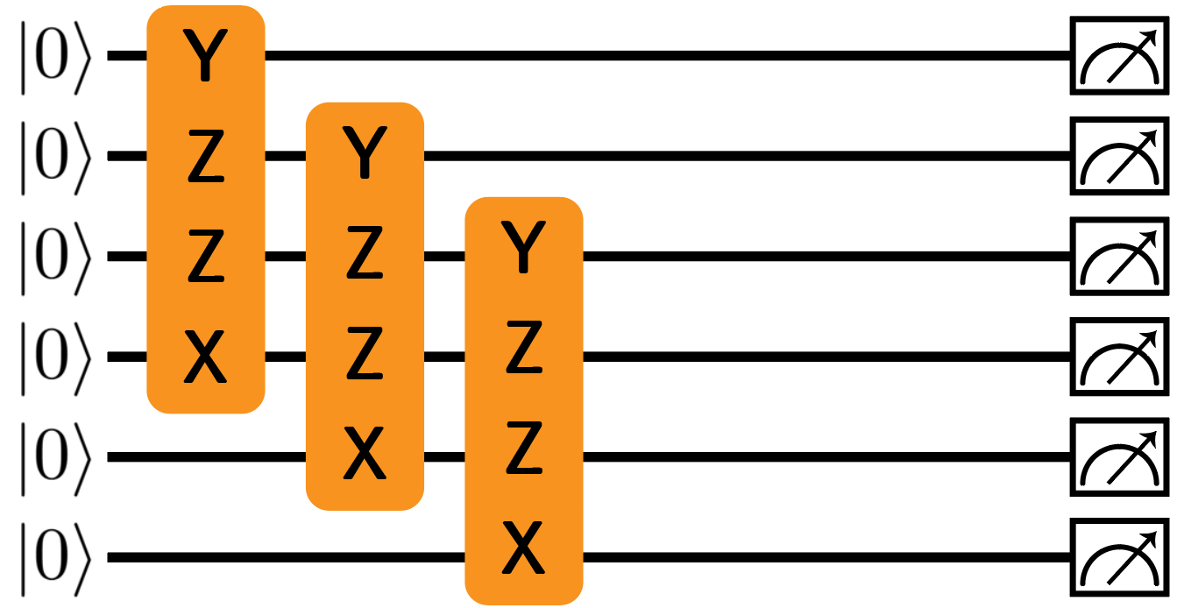
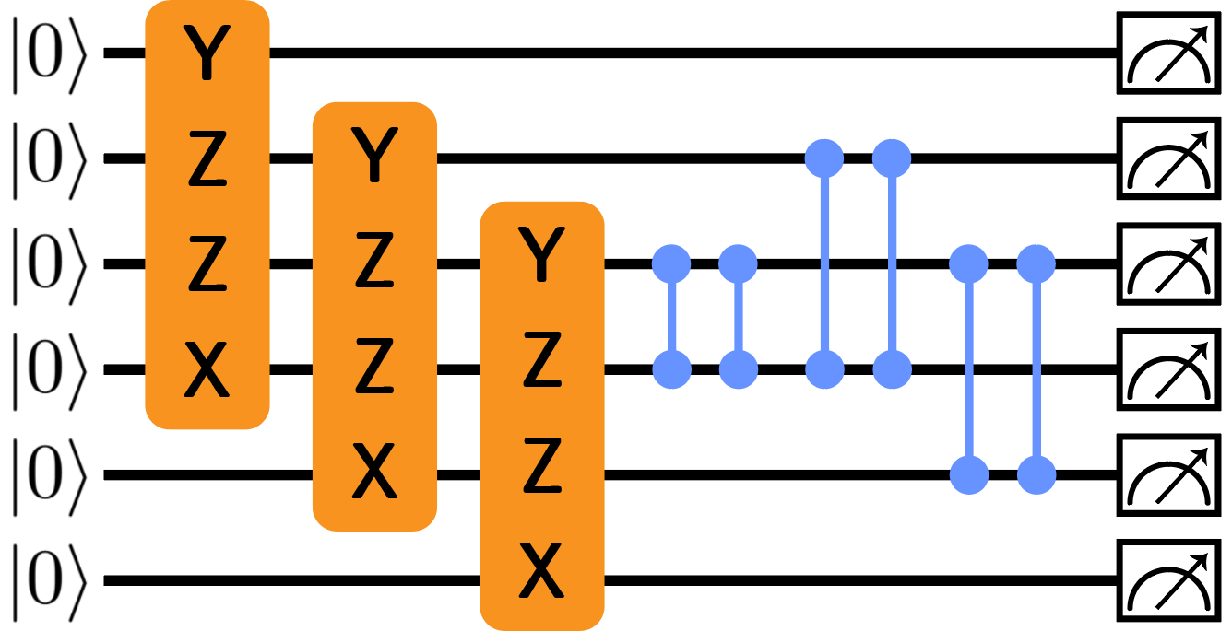
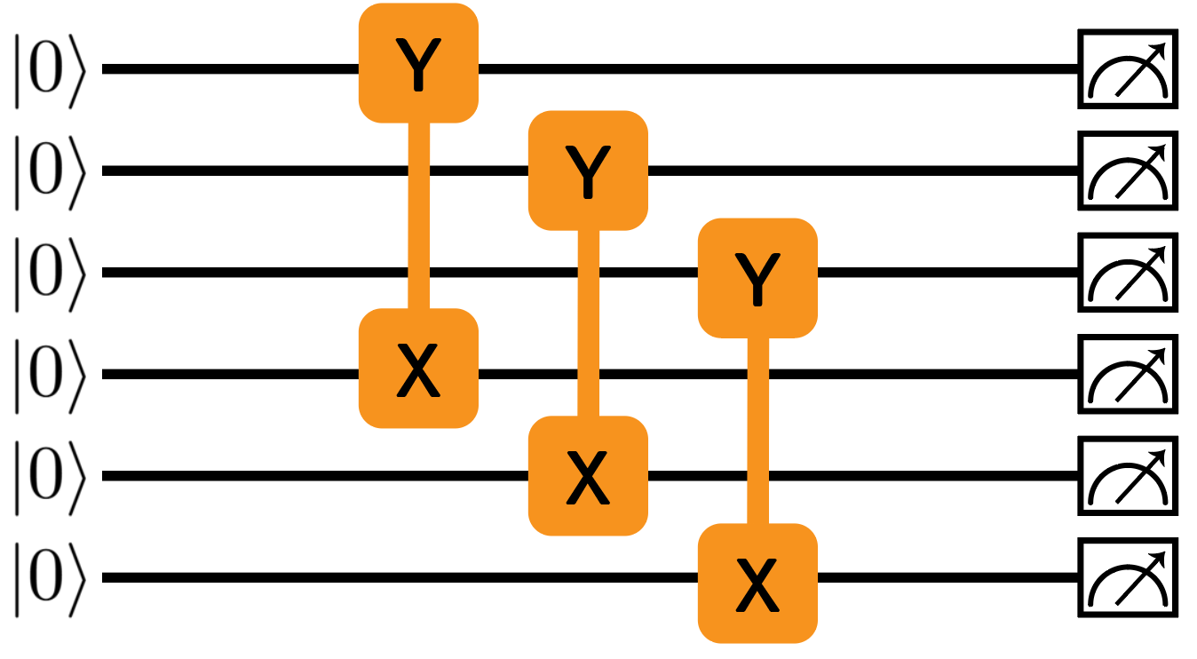
Quantum Computing Co-design
APPLICATION
ALGORITHM
QUANTUM CIRCUIT
NATIVE GATES
GATE PULSES
DETECTION
QUBITS

Slide 5
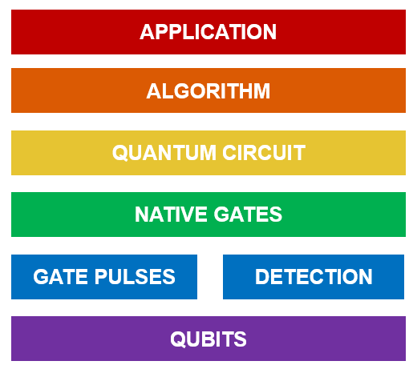


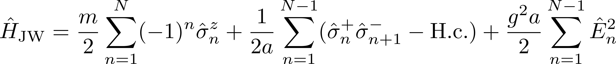
Quantum Computing Co-design
. . .
OPTION B: Integrate gauge fields out, pick up long-range entanglement
OPTION A: map gauge fields to qubits
fewer qubits, more long-range entanglement
more qubits, less long-range entanglement
Nguyen et al. PRX Quantum 3, 2 (2022)
Muschik et al. NJP 19, 10 (2017)

Slide 6
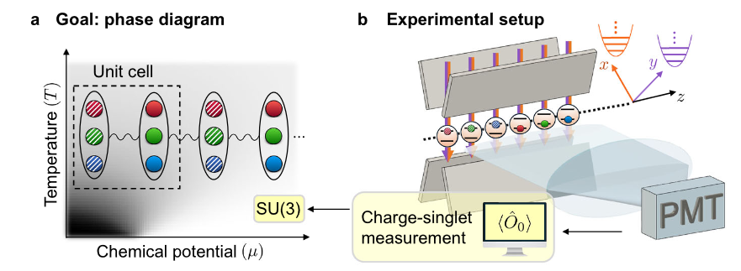
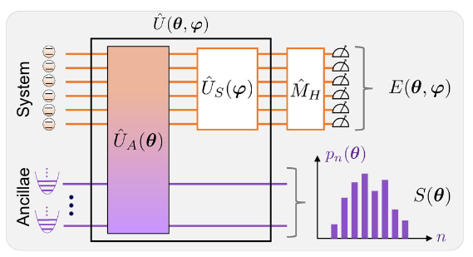
Quantum Computing Co-design
APPLICATION
ALGORITHM
QUANTUM CIRCUIT
NATIVE GATES
GATE PULSES
DETECTION
QUBITS
+QUMODES
Than et al. Nat. Comms. 16, 1 (2025)

Slide 7
Benchmarking Quantum Computers is Hard
less information
more information
randomized benchmarking +
everyone choose the metric that makes them look good
state / process tomography
volumetric benchmarks (QV, CLOPS)
application suites
cheap
expensive
Hashim et al. PRX Quantum 6, 3 (2025)

Slide 8
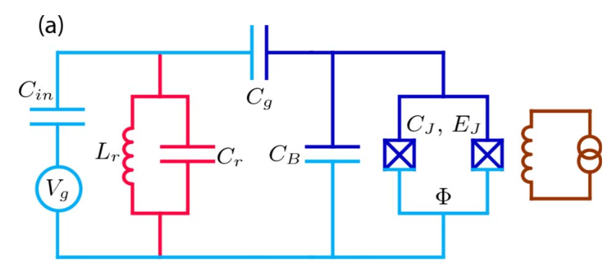

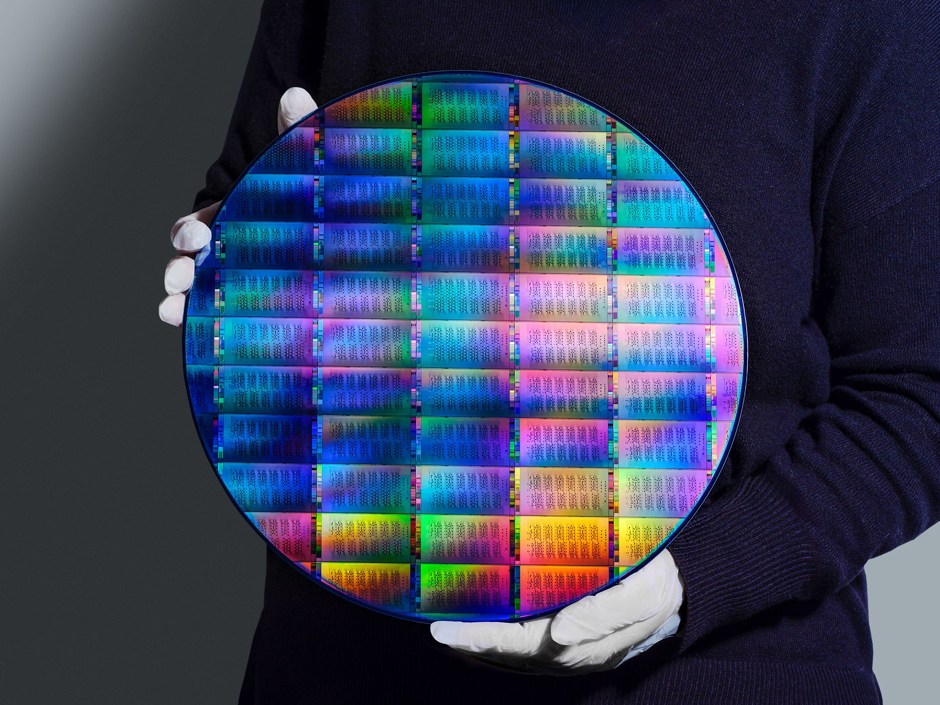
Superconducting Circuits
IBM Heron Class
Qubits 156
F_{2Q} 1 – 2e-3
F_{1Q} 1 – 1e-4
F_{meas} 1 – 7E-3
Helium-3
T1 240 μs
T2 280 μs
t_{2Q} 70 ns
t_{1Q} 32 ns
t_{meas} 2.2 μs
1
|
〉
0
|
〉
photo: https://www.nytimes.com/2023/06/14/science/ibm-quantum-computing.html
specs: IBM Quantum Experience, accessed July 2026
figure: Koch et al. PRA 76, 4 (2007)
photo: https://www.ibm.com/quantum/blog/300mm-fab

Slide 9
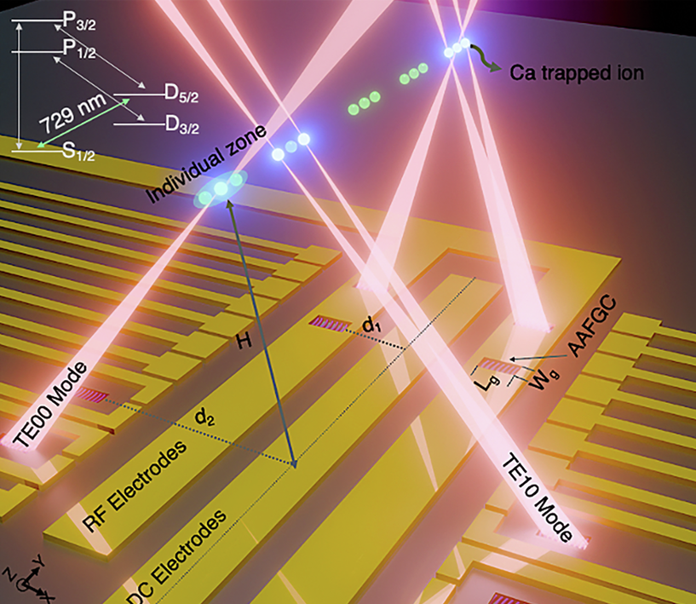

Trapped Ions
Quantinuum Helios
Qubits 98
F_{2Q} 1 – 3.5e-3
F_{1Q} 1 – 3.3e-3
F_{meas} 1 – 3.3e-4
T1 ~ s or yrs
T2 ~ 100 ms
t_{2Q} 70 μs
t_{1Q} ≈ 5 μs
t_{meas} ≈ 200 μs
t_{move} ~ 10 μs
He-4/N₂
Ransford et al. Nature (2026)
Delaney et al. Physical Review X 14,4 (2024)
Debnath et al. Nature 536 (2016)
photo: Oxford quantum networking group
figure: Momenzadeh et al npj Nanophotonics 3 (2026)

Slide 10

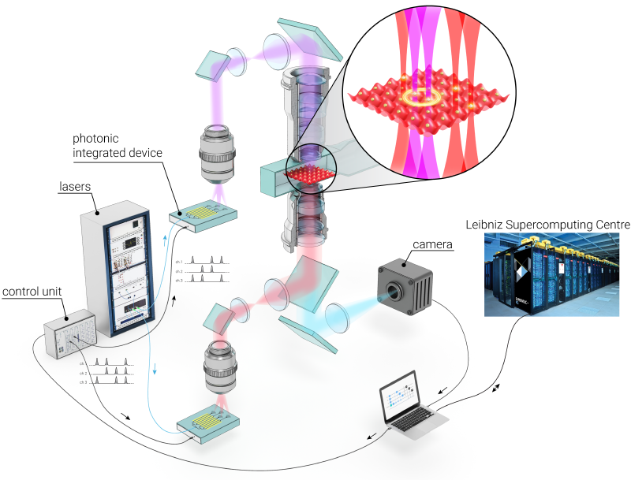
Trapped Neutral Atoms
Atom Computing
Qubits 256
F_{2Q} 1 – 3e-3
F_{1Q} 1 – 2.7e-4
F_{meas} 1 – 2e-4
T1 ≈ 10 s
T2 ≈ 10 ms
t_{2Q} ≈ 300 ns
t_{1Q} ~ 1 μs
t_{meas} 5 ms
t_{move} ~ 100 μs
Muniz et al. PRX Quantum 6 (2025)
Manetsch et al. Natures 647 (2025)
Bluvstein et al. Nature 694 (2026)
Bluvstein et al. Nature 604 (2022)
figure & photo: Munich Quantum Valley

Slide 11
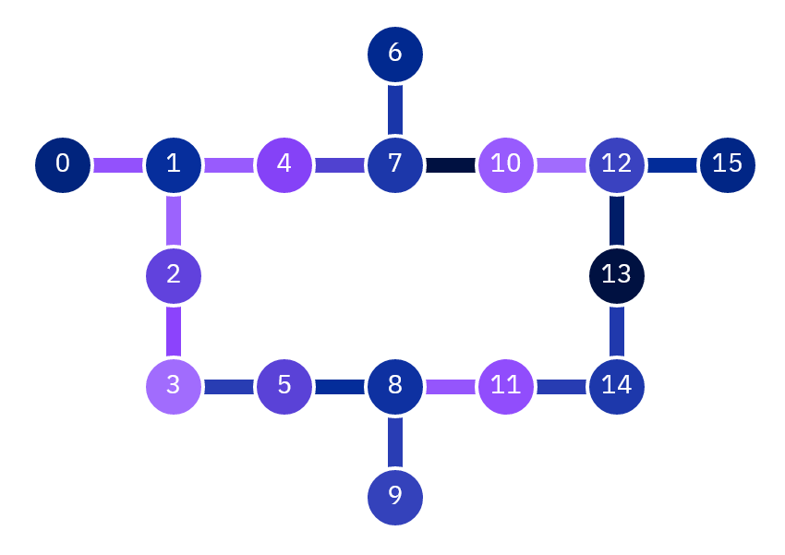
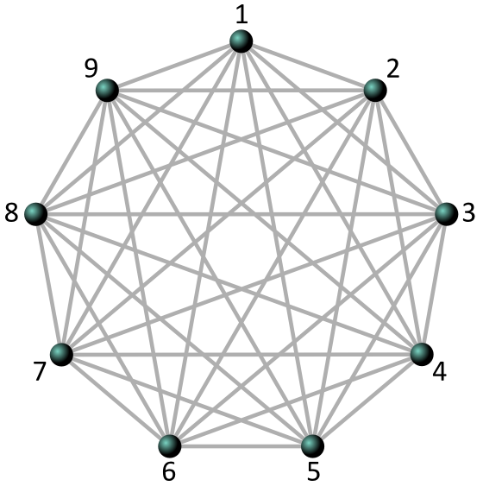
Comparison
IBM Heron Class
Atom Computing
Quantinuum Helios
Qubits 156
Qubits 256
Qubits 98
F_{2Q} 1 – 2e-3
F_{1Q} 1 – 1e-4
F_{meas} 1 – 7E-3
F_{2Q} 1 – 3e-3
F_{1Q} 1 – 2.7e-4
F_{meas} 1 – 2e-4
F_{2Q} 1 – 7.9e-4
F_{1Q} 1 – 2.5e-5
F_{meas} 1 – 3.3e-4
T1 240 μs
T2 280 μs
t_{2Q} 70 ns
t_{1Q} 32 ns
t_{meas} 2.2 μs
T1 ≈ 10 s
T2 ≈ 10 ms
t_{2Q} ≈ 300 ns
t_{1Q} ~ 1 μs
t_{meas} 5 ms
t_{move} ~ 100 μs
T1 ~ s or yrs
T2 ~ 100 ms
t_{2Q} 70 μs
t_{1Q} ≈ 5 μs
t_{meas} ≈ 200 μs
t_{move} ~ 10 μs
fig: Zhu et al., PNAS 117, 41 (2020)
fig: https://quantum-computing.ibm.com/services

Slide 12
SUPERCONDUCTING
ATOMS
IONS
non-uniform qubits
relies on laser fields
relies on laser fields
CONS
intense cryogenic demands
slow measurement speed
difficult to trap
short coherence times
high qubit loss rates
slow operations
fast operations
long coherence times
long coherence times
PROS
industrially backed
all-to-all connectivity
all-to-all connectivity
relies on microwave fields
highest fidelity
largest qubit numbers
highly uniform qubits

Slide 13
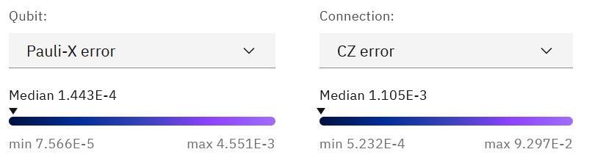
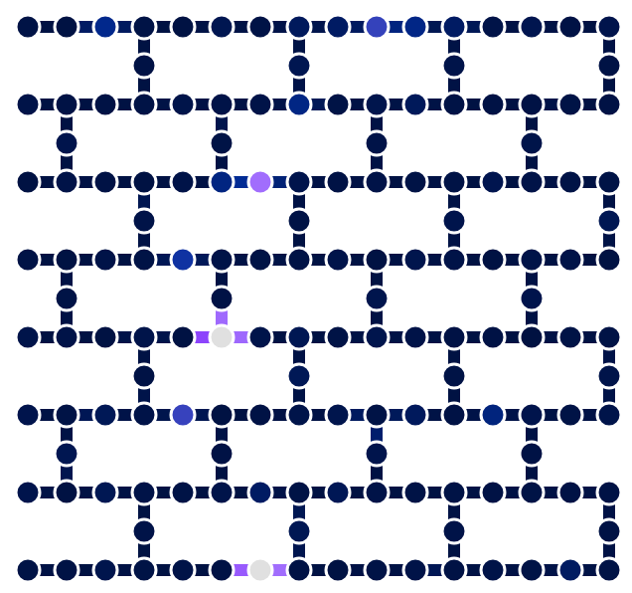
Qubit Uniformity
IBM_Boston
IBM Quantum Experience

Slide 14
IONS
ATOMS
SUPERCONDUCTING
relies on laser fields
relies on laser fields
non-uniform qubits
CONS
slow measurement speed
intense cryogenic demands
difficult to trap
short coherence times
slow gates
high qubit loss rates
fast operations
long coherence times
long coherence times
PROS
all-to-all connectivity
all-to-all connectivity
industrially backed
highest fidelity
relies on microwave fields
largest qubit numbers
highly uniform qubits

Slide 15
The Quantum Computing Stack
v
Error-Corrected
APPLICATION
ALGORITHM
QUANTUM CIRCUIT
NATIVE GATES
SCHEDULING
GATE PULSES
DETECTION
QUBITS

Slide 16
Scaling Trajectories*
* commercially available, in US
https://www.research.ibm.com/ibm-q/technology/devices/ accessed July 2019
https://quantumai.google/hardware/datasheet/weber.pdf
https://www.ibm.com/quantum/blog/quantum-roadmap-2033
Ransford et al. Nature 655 (2026)
https://www.quantinuum.com/products-solutions

Slide 17
Scaling Trajectories
* academic systems
Infleqtion: in “private beta”, 100+ qubits
Quera: pilot program, 260 qubits
Atom Computing: no cloud access planned?

Slide 18
Scaling Trajectories
*
* academic systems
Infleqtion: in “private beta”, 100+ qubits
Quera: pilot program, 260 qubits
Atom Computing: no cloud access planned?
https://www.research.ibm.com/ibm-q/technology/devices/ accessed July 2019
https://quantumai.google/hardware/datasheet/weber.pdf
https://www.ibm.com/quantum/blog/quantum-roadmap-2033
Ransford et al. Nature 655 (2026)
https://www.quantinuum.com/products-solutions
Bluvstein et al. Nature 694 (2026)
https://atom-computing.com/ac1000/

Slide 19
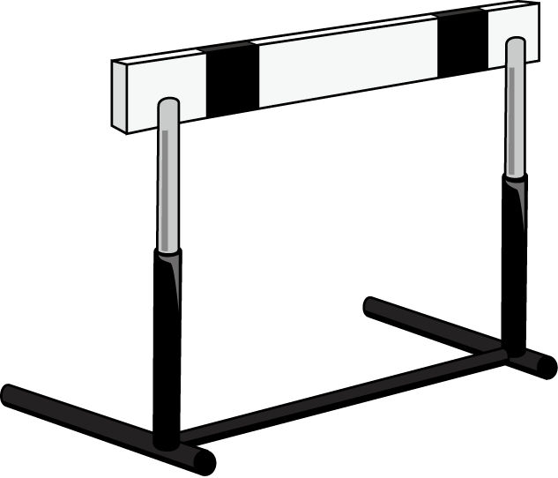

Hurdles for Scalability
degradation that come with scaling
Croot et al arXiv:2512.15001
Brown et al. Nat. Rev. Mat. 6 (2021)
Brown et al. arXiv:2403.08780
Menssen et al. arXiv:2607.21554

Slide 20
Hurdles for Scalability
fast, high-fidelity, remote entanglement by flying qubits
…
…
…
…
first algorithm on distributed quantum computer
ions: Main et al. 638 (2025)
remote entanglement SoTA
ions: ~98% fidelity ~100 Hz entanglement rate (Saha et al. Nat Comms. 16 (2025))
atoms: ~99% fidelity ~0.01 Hz (Ritter et al Nature 484 (2012))
superconducting: no photonic links out of cryo
Monroe and Kim. Science 339 (2013)
Awschalom et al. PRX Quantum 2 (2021)

Slide 21

Hurdles for Scalability
IONS
ATOMS
SUPER-CONDUCTING

Slide 22
Hurdles for Scalability
IONS
ATOMS
SUPERCONDUCTING
designing larger traps
reducing atom loss
longer coherence times
Ganjam et al. Nat. Comms. 15 (2024)
Sterk et al. AVS Q. Sci. 8, 2 (2026)
Jin et al. PRX Quantum 7, 3 (2026)
more uniform qubits/inter-chip links
scalable laser delivery/ microwave architecture
scalable laser delivery
Almanakly et al. Nat. Phys 21 (2025)
Mehta et al. Nature 586 (2020)
Löschnauer et al PRX Quantum 6, 4 (2025)
reducing cryogenic requirements
faster measurements
faster gates
Deist et al. PRL 129, 20 (2022)
flexible connectivity
Savill-Brown et al. PRL 136 (2026)
O’Brien et al. PRX Quantum 7 (2026)

Slide 23
Logical Qubit Performance
IONS
ATOMS
SUPERCONDUCTING

Slide 24
New Frontiers: Qudits
¹⁷¹Yb⁺ ions
superconducting qubits
²D_{5/2}
9
|
〉
²D_{3/2}
1
|
〉
|
2
〉
²F_{7/2}
|
1
〉
|
2
0
〉
1
|
〉
|
〉
|
²S_{1/2}
0
〉
*energies not to scale

Slide 25
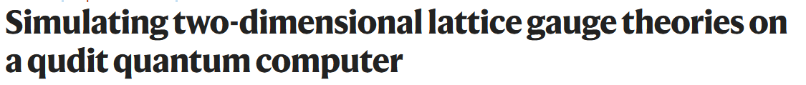
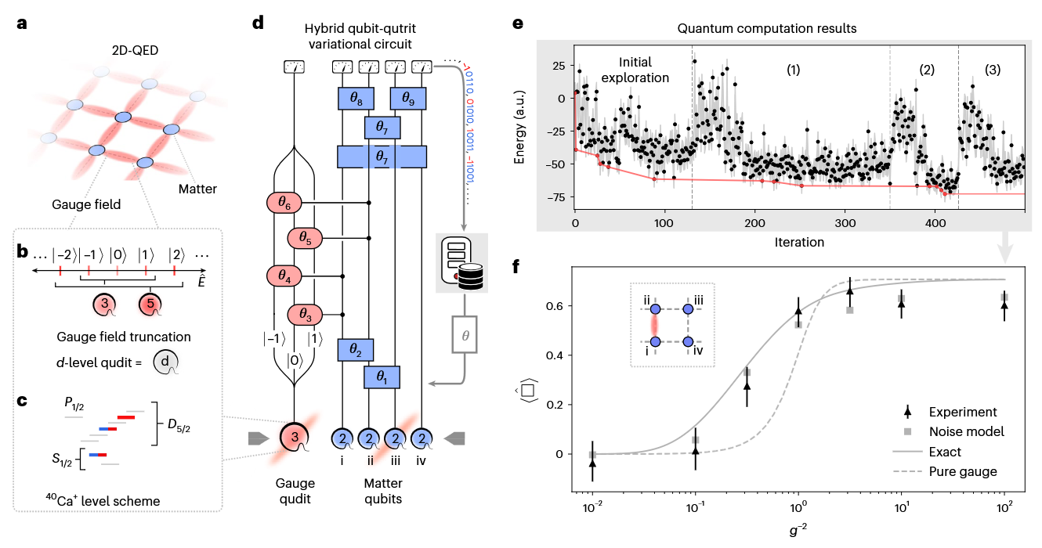
New Frontiers: Qudits
hardware state-of-the-art:
13 levels (ions)
6 levels (atoms)
Low et al. npj Quantum Info. 11, 1 (2025)
Ringbauer et al. Nat. Phys. 18, 9 (2022)
Krondofer et al. arXiv:2605.09715
fig: Meth et al. Nat. Phys. 21 (2025) (reproduced with permission)

Slide 26
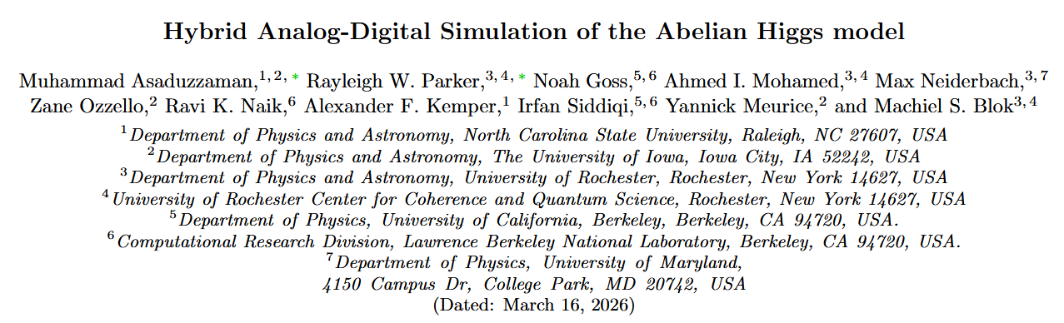
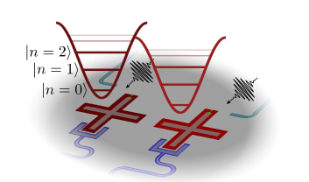
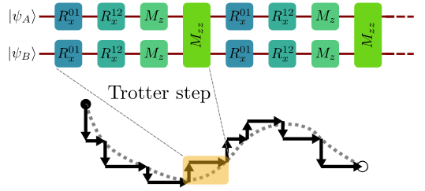
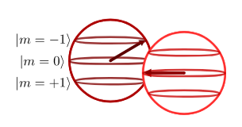
New Frontiers: Qudits
hardware state-of-the-art: 12 levels
Asaduzzaman et al. arXiv:2603 (reproduced with permission)
Wang et al. PR Applied 23, 3 (2025)

Slide 27
New Frontiers: Spin-Boson Quantum Computing
p
p
p
x
x
x
Notes:
word salad title
real title

Slide 28
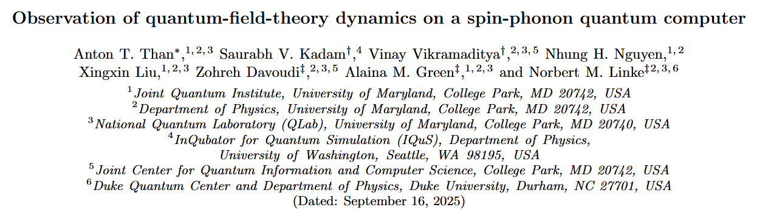
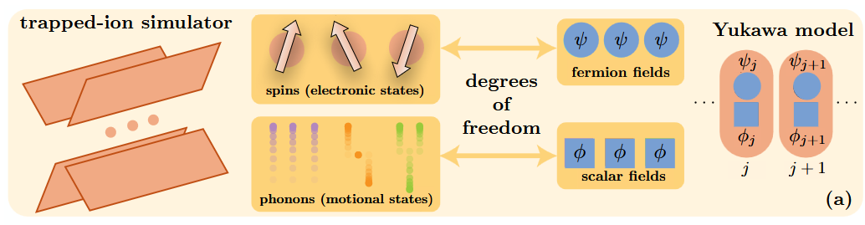
New Frontiers: Spin-Boson Quantum Computing
IN PRINCIPLE AVAILABLE IN OTHER PLATFORMS!
Y Liu et al. PRX Quantum 7, 1 (2026)
Than et al. arXiv:2509.11477 (to appear Nat. Phys.)
Saner et al. arXiv:2507.19588 (to appear Nat. Phys.)
spin only
spin-boson

Slide 29
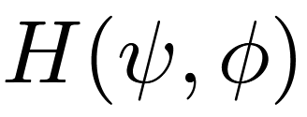
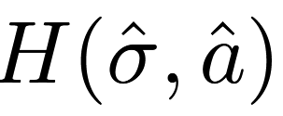
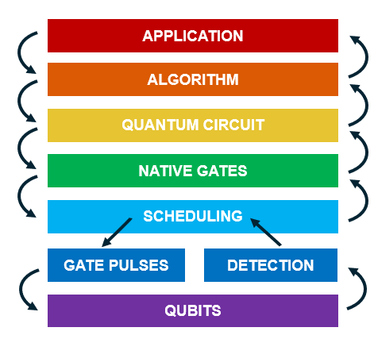
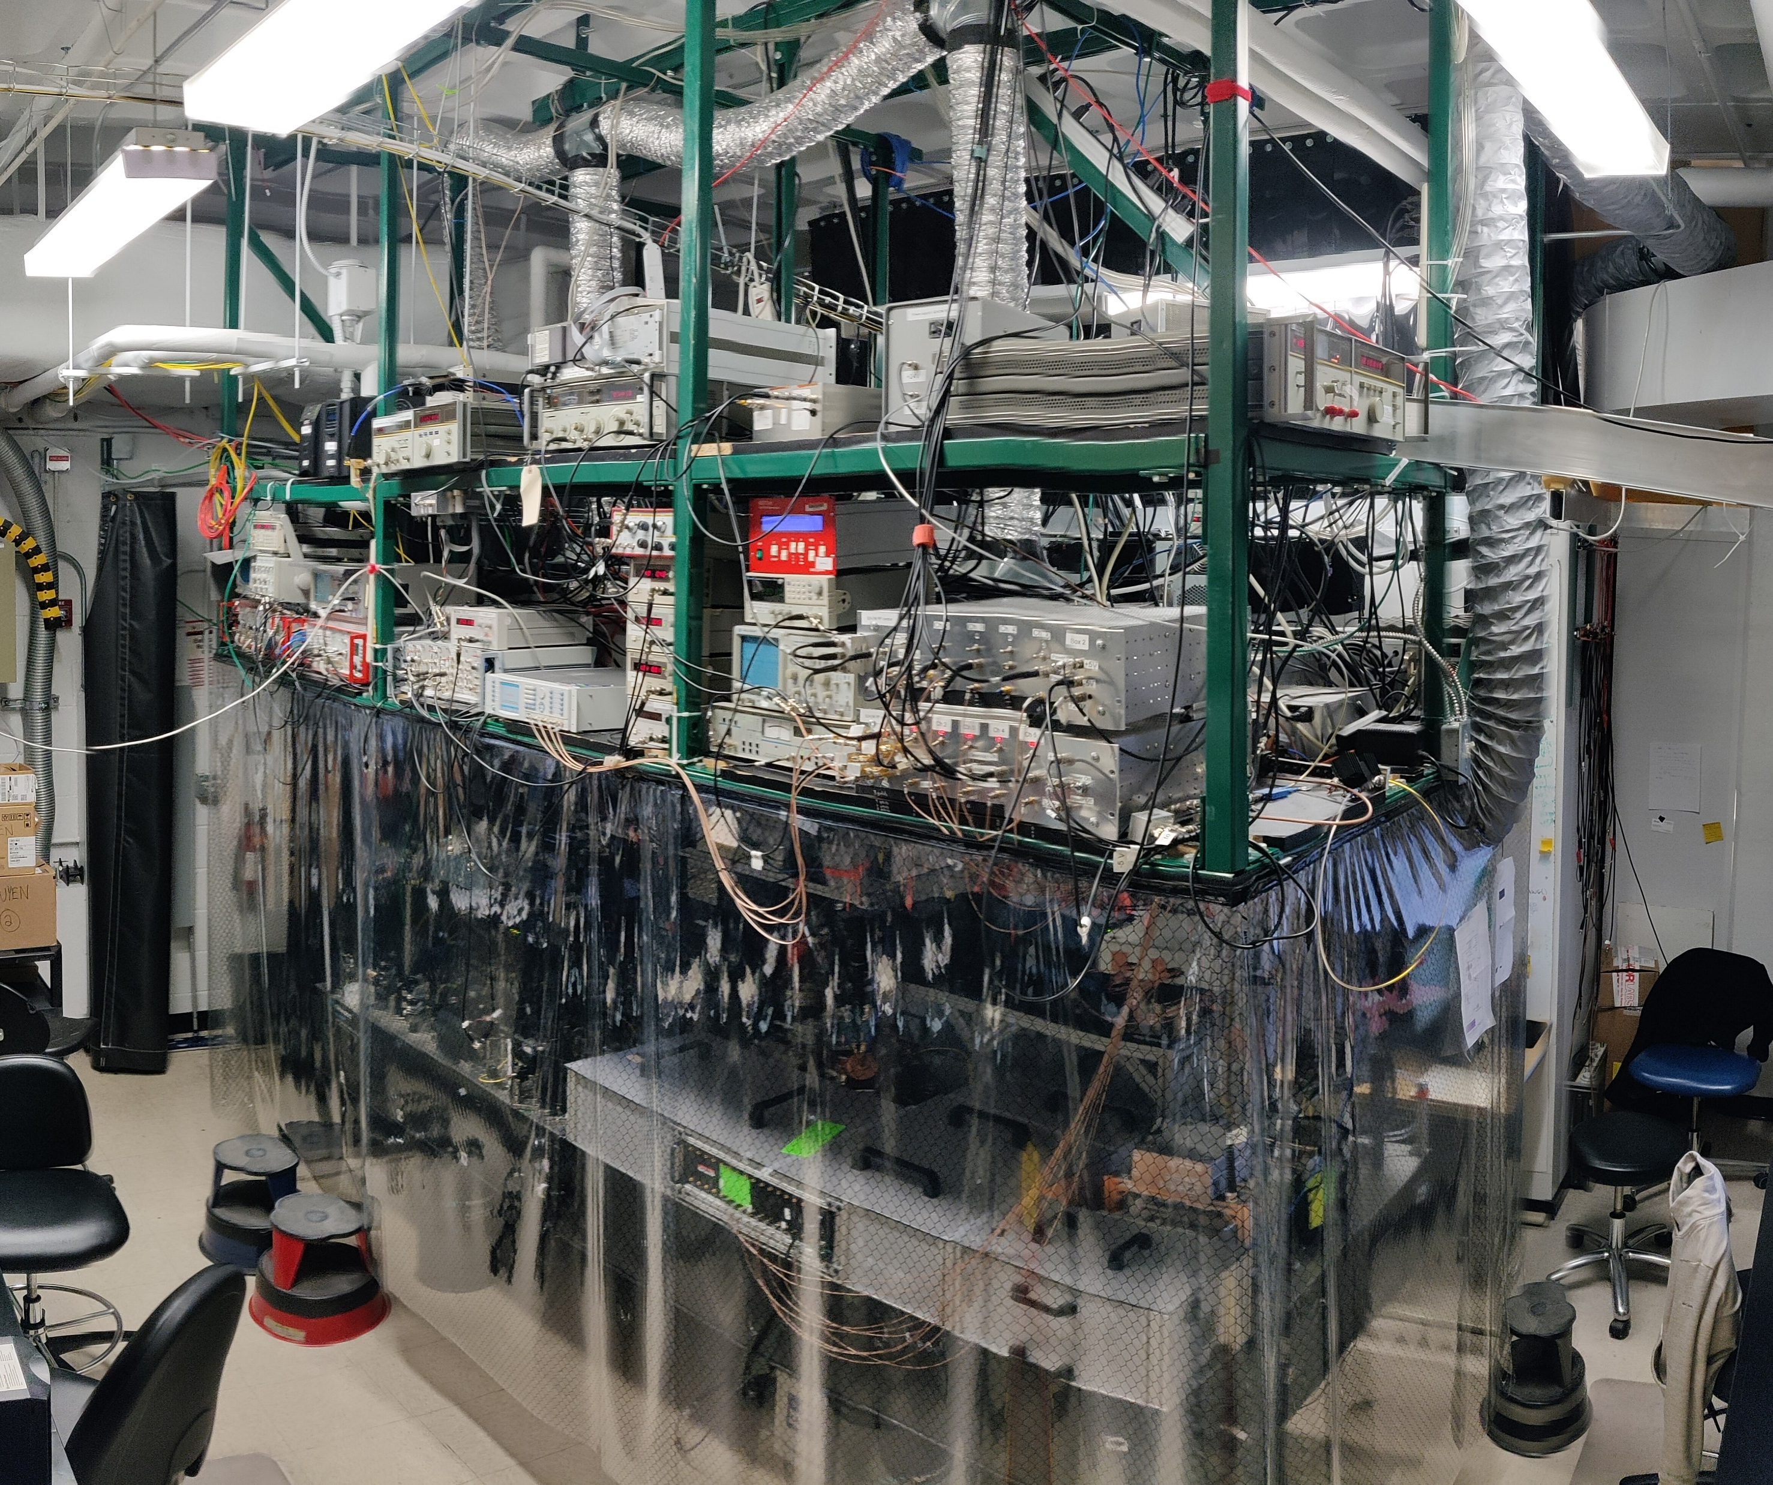
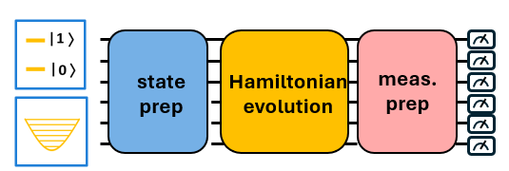
Theory-Experiment Challenges

Slide 30
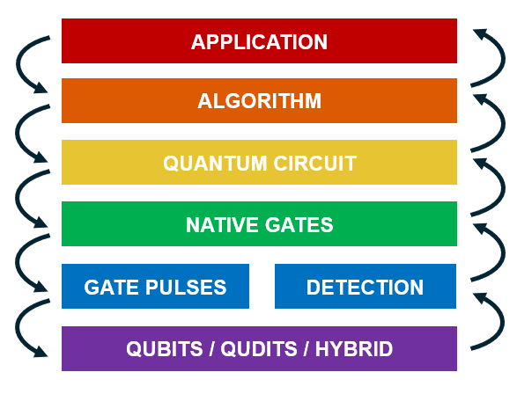
Theory-Experiment Challenges
Spagnoli et al. arXiv:2503
Bell et al. PRX Quantum 6, 4 (2025)
Ale et al. arXiv:2511
Limiting Errors (and understanding them)
circuit depth
experimental error
algorithmic error
gauge variance
finite size error
truncation error
trotter error
Circuit Compilation for Novel Platforms
p
x
CV/DV
Y Liu et al. PRX Quantum 7, 1 (2026)
X. Liu et al. in prep.

Slide 31

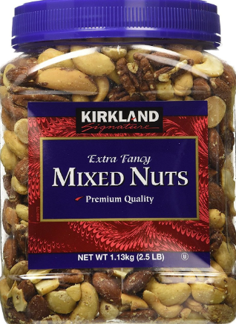
Theory-Experiment Challenges
Ding et al. arXiv:2508.05703
Farrel et al. arXiv:2605
Zhang et al PRL 127 (2021)
Thermal
State Preparation
U
U
U
U
U
U
U
U
U
U
U
U
U
U
U
U
U
U
U
U
U
U
U
U
U
U
U
U
U
U
p
U
x
U
0
|
0
0
〉
|
|
〉
〉
Accessing Relevant Observables
?
just measure in every basis
tomography
QPE
me
theory friend
me
meas. bases
circuit depth
Mueller et al. Nat. Comms. 16, 1 (2025)
Jeon et al. arXiv:2506.12628

Slide 32
atoms
“best use” of quantum computers
ions
SC circuits
LF Theorists
confidence in the future
Notes:
with that, I hope I’ve both motivated an at least sketched a foundation upon which further collaboration can be built
this community has a rich tradition of using cutting edge computing technology and I’m sure you’re up to the challenge of diving into the details of experimental hardware

Slide 33
atoms
“best use” of quantum computers
ions
SC circuits
LF Theorists
confidence in the future

Slide 34
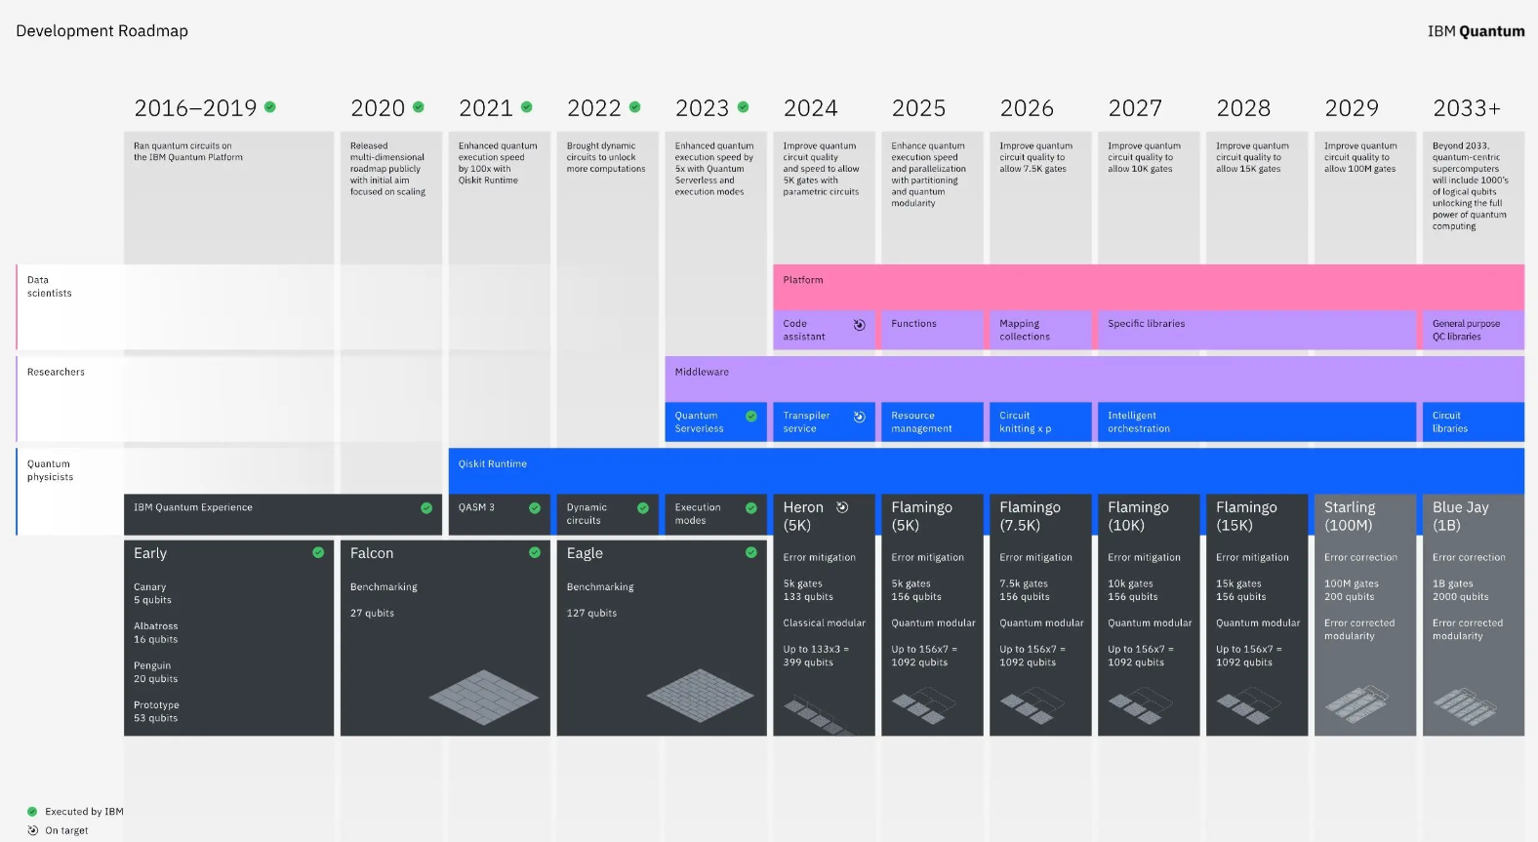
2022

