Slide 1
Timing system
Yoshinari Hayato for FD4

Slide 2
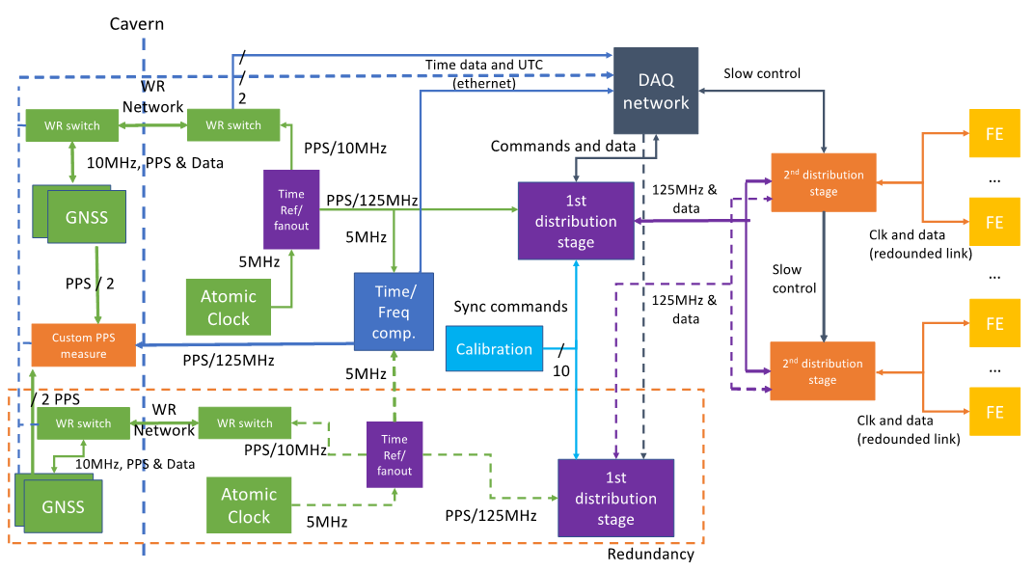
Equipment in the central hut
Rack plan
Atomic (Cs) clock, 1pps receivers (WR switches), and 1st stage clock distributors (FSCD), are installed in the central hut.
External triggers and control signals are fed to the 1st stage distributor.
Central hut
1st stage clock distributor (FSCD)
External triggers

Slide 3
Equipment in each quadrant hut
Rack plan
2nd stage timing distributors (TDM) are installed in each hut. There are 20 TDMs in each hut.
Each TDM is connected to the FSCD via 8 single-mode fibers (2 fibers x 4 sets).
In total 160 single-mode fibers are coming from the central hut.
Quadrant
hut
2nd stage timing distributor (TDM)

Slide 4
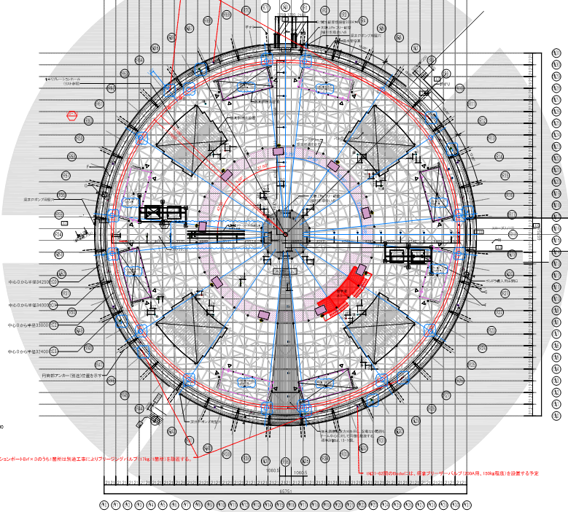
Fibers between electronics huts
From the central hut to each quadrant hut
640 fibers (OS2)
(=160 fibers/hut)
Need to install the fibers before the other components (DAQ) are installed.
(By June 2027 is fine.)
We are planning to ask a company to run the fibers.
160 fibers
2
160 fibers
1
160 fibers
3
C
4
160 fibers

Slide 6
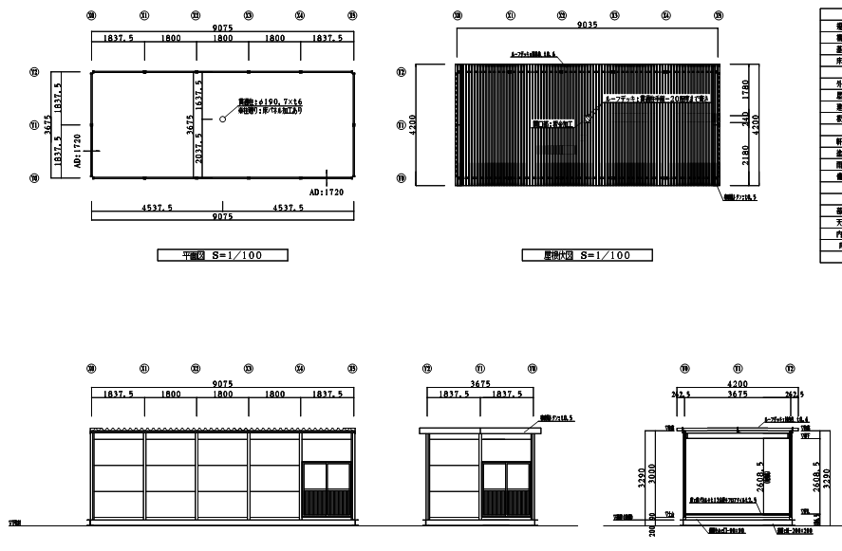
Electronics hut dimension
Dimensions
W 9m x D 3.6m x H 2.6m

