Slide 1

Open Data – Requirements and How-to
Juuso Marttila, juuso.h.marttila@jyu.fi, Data Management Expert
Research Data Services, Open Science Centre, University of Jyväskylä

Slide 2
What is data?
Starting point
All material leading to results =
DATA
Results
Research process
Data includes:
  Measurements, raw data
  Refined/filtered/analysed data
  Code related to the production/analyzation of the data
  Lab books, codebooks, other documentation

Slide 3

Funder requirements on Open Data
For Research Council of Finland and EU participation in Open Science is not an option, it is a default
  Most foundations do not have specific stipulations on Open Data, BUT your university or research infracstructure often does
This means that your data must be available as openly and as soon as possible and to follow FAIR principles
  at least metadata must be published for all data from the project
Data should be opened as soon as possible
Your data management plan outlines your promises on research data
  Be credible, be realistic, follow your plan

Slide 4

Example: Horizon project agreement on research data
29.3 Open access to research data
Regarding the digital research data generated in the action (‘data’), the beneficiaries must:
(a) deposit in a research data repository and take measures to make it possible for third parties to access, mine, exploit, reproduce and disseminate — free of charge for any user — the following:
(i) the data, including associated metadata, needed to validate the results presented in scientific publications, as soon as possible;
(ii) other data, including associated metadata, as specified and within the deadlines laid down in the ‘data management plan’;
(b) provide information — via the repository — about tools and instruments at the disposal of the beneficiaries and necessary for validating the results (and — where possible — provide the tools and instruments themselves).

Slide 5
Rerporting data to funder
Research data and its availability will be reported in end reports for EU and RCF
  Also note that EU projects are often lump sum fundings of which part can be revoked if promised deliverables (published datasets) are not produced
RCF asks you to list all used and created research datasets, how they have been managed and how re-use of dataset has been made possible
  Also list of all datasets suitable for re-use and where they can be downloaded (PID)
  If only metadata is available, list metadata landing pages with their PIDs
  If dataset is not openly available, you must explain why

Slide 6
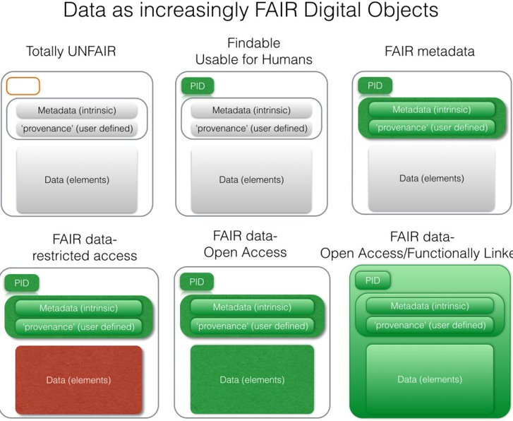
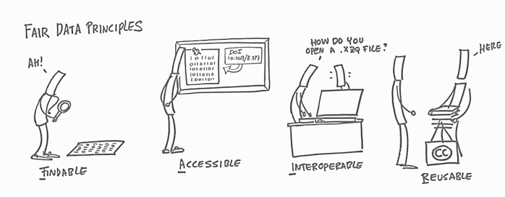
FAIR principles in the core of Open Science
  Data cannot always be open, but it can always be as FAIR as possible

Slide 7

As open as possible, as closed as necessary – acceptable reasons for not publishing data openly
Never publish/open
  Data containing personal information
  Data on which a third party holds IPR rights
Use a reasonable embargo for
  Data necessary for patents in progress
  Data for your own upcoming publications
  Data that you’re going to exploit yourself in forseeable future
No need to disclose data unsuitable for any reasonable reuse
  BUT also, remember the possibility to show your zero results by publishing data when paper cannot be done due to lack of results
Remember that some data can have restricted (e.g. only for research purposes) access, if that makes publishing it easier

Slide 8
Funder requirements for open data in practice
Not sufficient
Sufficient
Witholding data without justified cause
Publishing files on your own web page (no PID = no open data)
  PID = persistent identifier, e.g. DOI, URN
Publishing without valid open licence
Publish data in open, proper data repository that gives PID and licence to the dataset, OR
Publish metadata in proper data repository/catalogue AND
  Argue in DMP/report on why whole dataset could not be opened
  Bare minimum for ALL datasets!

Slide 9
Open Data – What, where, when…

Slide 10
What data you should make openly available?
All data or just parts needed as supplements for publications?
  Is the data only for validation of your results or are there some possible re-use?
  All at once (in the end) or in smaller bits per publication?
    Remember that funders are interested in all data, not just those that supplement publications
  Remember possibility to make linkages between multiple datasets
Raw data or analyzed/filtered data?
  Is raw data usable/understandable as such?
Remember, whatever you publish, it must be well-organized and well-documented and usable as such

Slide 11
Different data repositories for opening data
Discipline specific repositories are the golden standard
  E.g. HEPData (Repository for publication-related High-Energy Physics Data), Cambridge Crystallographic Data Centre (CCDC)
Some journals have their own repositories for supplementary data
Institutions may have their own repositories (JYX for JYU, Datapankki for HY
  You can also use CSC’s IDA storage + ETSIN publishing platform via your institutions
  Datapankki and IDA are for especially large datasets
There are also generic repositories (e.g. Zenodo, Figshare, Open Science Framework), but most of these are not curated
If you’re publishing only metadata, you can use JYX in JYU or Data Catalogue in HY. Qvain and Zenodo also make this possible.

Slide 12
Publishing code
Code should always be maintained in some version control environment, e.g. Github or (institutional) Gitlab
  Remember sufficient documentation, code-specific licences etc. alongside the code
Github has an export option to Zenodo
From institutional Gitlab you can take a snapshot (zip) of the code repository and publish that in institutional or any other repository.
If you want to point a live repository, you can make a metadata publication that points to the Gitlab repository
Also remember that MATLAB and R have own communities for publishing code as standalone sets: The Comprehensive R Archive Network, rOpenSci, MATLAB File Exchange

Slide 13
Checklist for opening data
Take opening into account when planning data management
  Extra important to agree on ownership, use rights and opening data
    Any third party rights must be considered
  Plan what is appropriate timing for opening the data
Create dataset with sufficient documentation and arrangement so that others may understand and use it (file naming, readme-files, lab diaries etc.)
Choose appropriate repository and level of openness
Choose and give appropriate licence for the data (e.g. Creative Commons licences). It tells recipient on how the data may be used and safeguards your rights to be cited when data is used.

Slide 14
More information and help
JYU: https://www.jyu.fi/en/research/research-data-management/guide/opening-research-data
  researchsupport-osc@jyu.fi
HY: Checklist for providing open access to research data (1.0). University of Helsinki. https://doi.org/10.5281/zenodo.17698438 (FI, EN, SV)
  datasupport@helsinki.fi

