Slide 1
Progress on the P2 Basket
Wednesday, 07 January 2026
P2 Collaboration Meeting
${\text{Alexandra} \text{Kallitsopoulou}}^{(1)}$, on behalf of the CEA/IRFU/P2 Basket Group
(1)CEA/IRFU/Université Paris – Saclay

Slide 2
The P2 Basket Group
DEDIP (Département d'Électronique des Détecteurs et d'Informatique pour la Physique):
S. Anvar, E. Casalotti, A. Demonti, M.-M. Diop, A. Gairot (Internship student), C. Goblin, M. Kebbiri, I. Mandjavidze, P. Mas, B. Moreno, F. Prunes, B. Rapp, N. Salse, M. Vandenbroucke, H. Le Provost
DPhP (Département de Physique des Particules) :
M. Boonekamp, L. Chevalier, M. Gailliard (PhD Student), P.-F. Giraud, A. Kallitsopoulou (Post-Doc)
DIS (Département d’Ingénierie Systèmes) : S. Cazaux, P. Charon, T. Lebrun

Slide 3
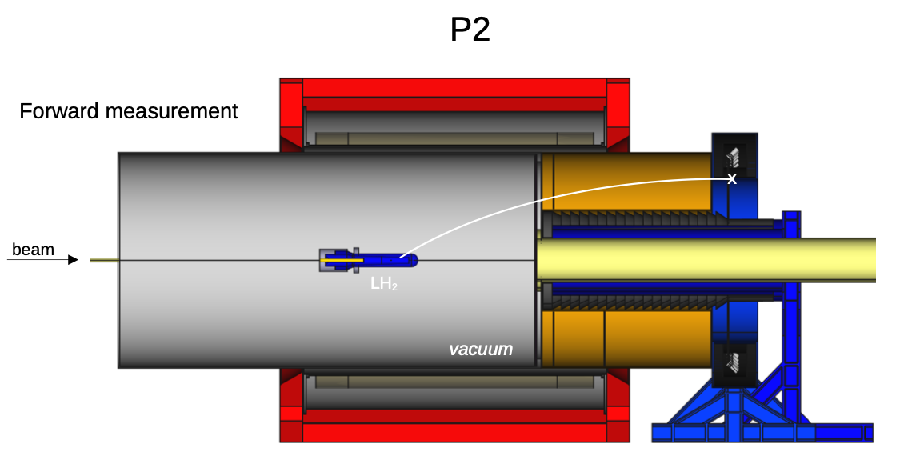
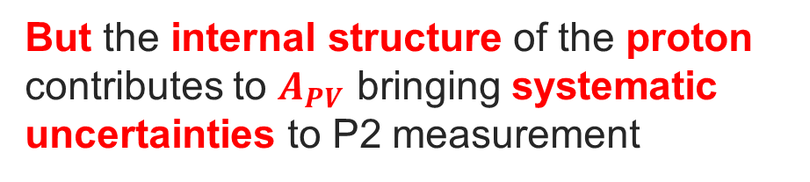
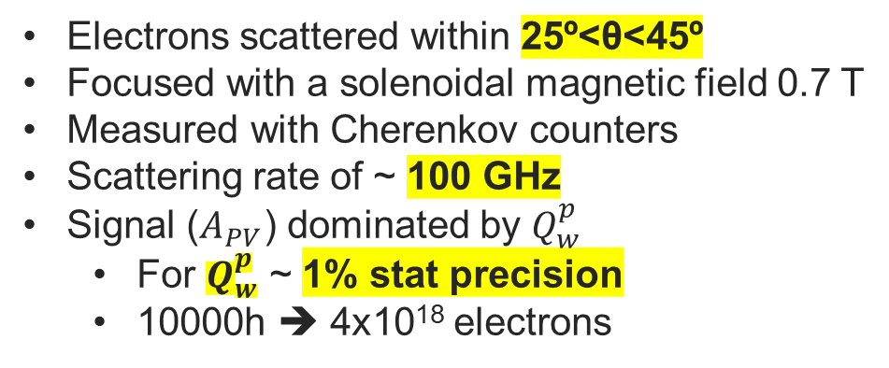
P2 @ Mainz - Recap
P2 Forward angle measurement
Beam energy 50 -150 MeV
Electrons scattered within 25º<θ<45º
Focused with a solenoidal magnetic field 0.7 T
Measured with Cherenkov counters
Scattering rate of ~ 100 GHz
Signal ($A_{PV}$) dominated by $Q_{w}^{p}$
For $Q_{w}^{p}$ ~ 1% stat precision
10000h ➔ 4x10¹⁸ electrons
But the internal structure of the proton contributes to $A_{PV}$ bringing systematic uncertainties to P2 measurement
Notes:
The parity-violating scattering cross section asymmetry, APV, dominated by the weak charge of the proton, 𝑄𝑊𝑝=1−4sin2 θ𝑊.
Given the scattering rates mentioned above, a measurement of 𝑄𝑊𝑝with ~1% relative statistical precision can be achieved in 10000 hours

Slide 4
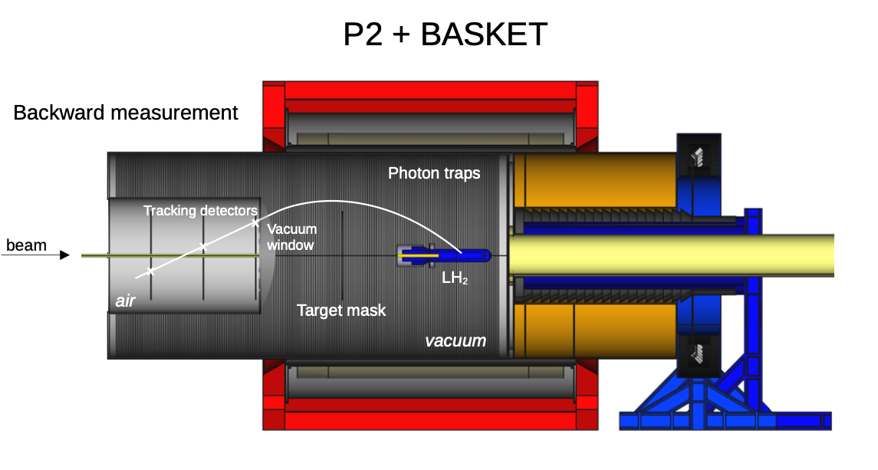
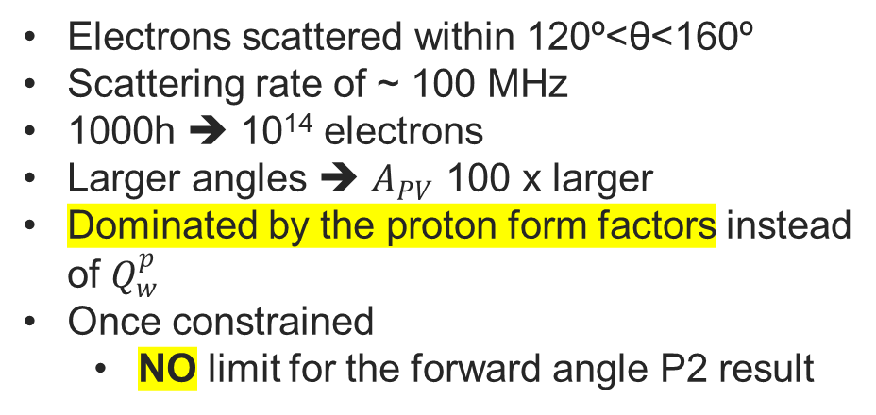
P2 @ Mainz - Recap
P2 + BASKET
P2 Backward angle measurement
Electrons scattered within 120º<θ<160º
Scattering rate of ~ 100 MHz
1000h ➔ 10¹⁴ electrons
Larger angles ➔ $A_{PV}$ 100 x larger
Dominated by the proton form factors instead of $Q_{w}^{p}$
Once constrained
NO limit for the forward angle P2 result
Not “extra physics” — it is essential to unlock the full precision of P2
Notes:
The parity-violating scattering cross section asymmetry, APV, is about 5x10-8 in this configuration, and dominated by the weak charge of the proton, 𝑄𝑊𝑝=1−4sin2 θ𝑊.
Given the scattering rates mentioned above, a measurement of 𝑄𝑊𝑝with ~1% relative statistical precision can be achieved in 10000 hours, and yields a precision in the weak mixing angle of δsin2θW ~ 0.0003, which competes with that of the best e+e- measurement results from LEP and SLC.

Slide 5
P2 @ Mainz - Recap
P2 + BASKET
Experimental advantages
Manageable event rate
Allows event-by-event tracking (unlike forward P2 in integrating mode)
Reconstruct: scattering angle momentum, vertex position
Validate: Energy loss models in LH₂ target, radiative corrections, background and acceptance effects
P2 Backward angle measurement
Notes:
Impact on systematics
Reduces uncertainty from axial/strange form factors by factor 5–10
Lowers their contribution to Qᵂᵖ uncertainty to ~0.2%
Ensures P2 reaches its precision goal on sin²θ₍W₎

Slide 6
Toward the P2-Basket Implementation
1. Mechanics (IRFU/DIS)
Chapeau
Target Mask
Vacuum Shielding (in collaboration with DEDIP)
Detector Support
3. Detectors(IRFU/DEDIP/DPhP)
Bulk Micromegas
Frame and Drift electrode
HV and Gas circulation
2. Physics(IRFU/DPhP)
Simulation
Signal acceptance
Background
Online Tracking
Reconstruction
4. Electronics (IRFU/DEDIP)
Frond-end
Back-end (Supervisor/Software)
Service (BT/Interlock)
Low voltage

Slide 7
Mechanics

Slide 8
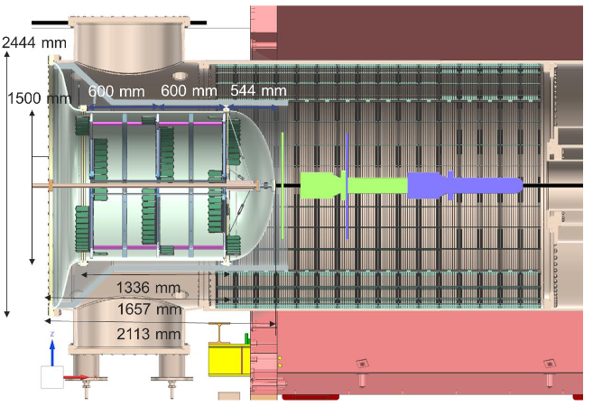
Mechanics – 2025 Design
Chapeau
Chapeau
Includes membrane and beam tube extension
Challenges on the design:
Main flange and membrane difficult to shape and solder
Difficult integration (little margin)
fwd. meas^{t} bkwd. meas^{t}

Slide 9
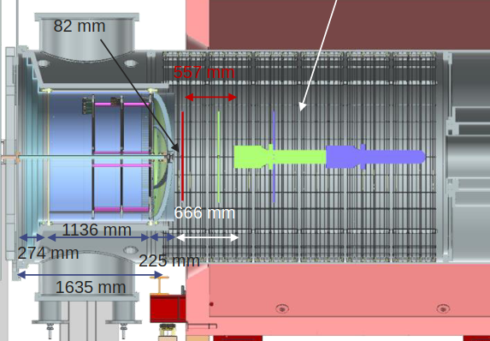
Mechanics – 2025 Design
Chapeau
Chapeau (Finalized)
Change on the shape of the main flange (“stairs”)
Shorter cylinder
Simulation studies (M. Gailliard) shown better acceptance with closer detector planes
Shorter membrane
Carbon fiber
Can be purchased separately
Simplifies integration
Facilitates the Target/Mask design
fwd. meas^{t} bkwd. meas^{t}

Slide 10
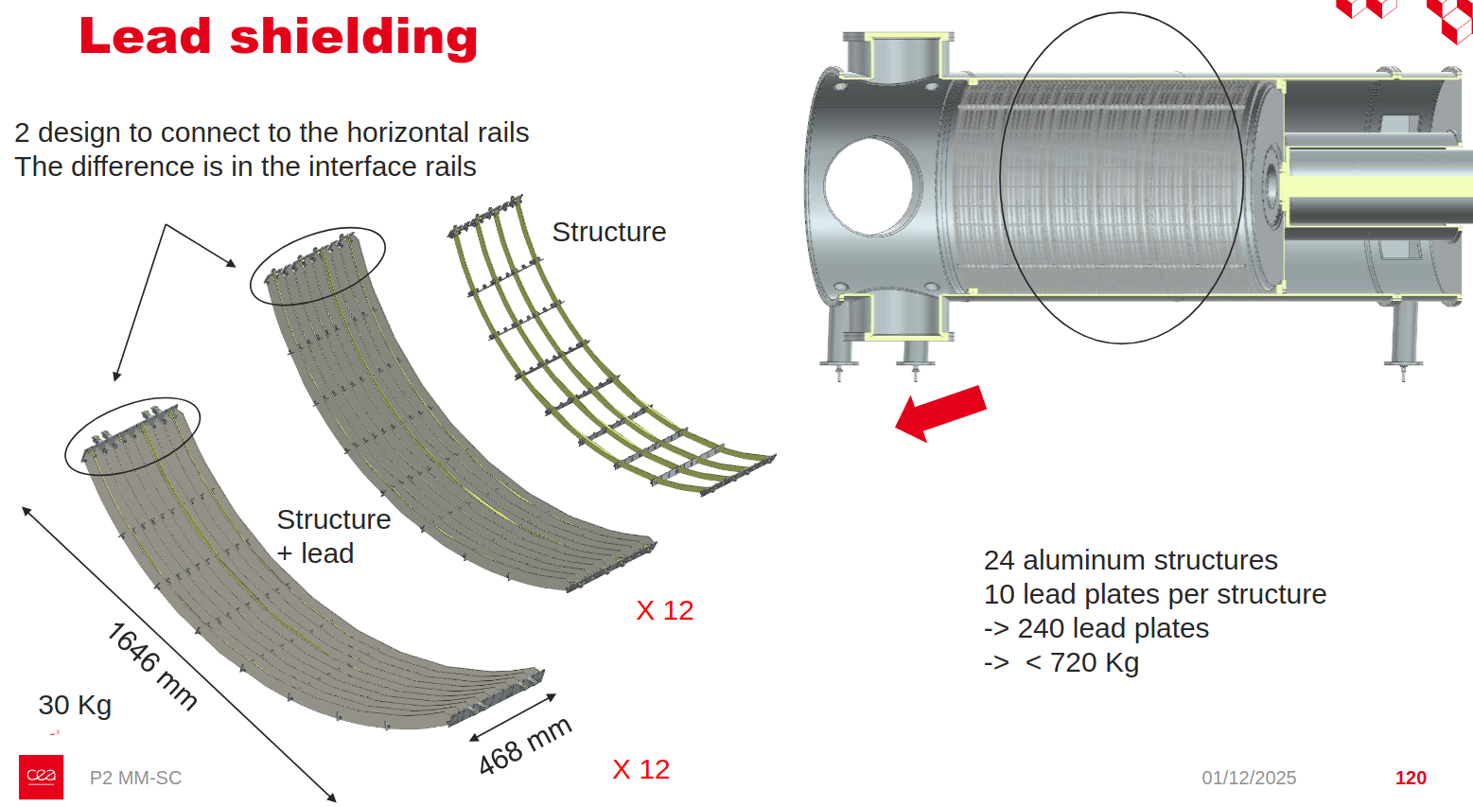
Mechanics – 2025 Design
Shieldings
Vacuum shielding (Finalized)
Two designs to connect to the rails
24 aluminum frames; 10 lead sheets/frame
Total weight ~ 700kg including screws
fwd. meas^{t} bkwd. meas^{t}
Integration strategy
Purchase material + water-jet cutting of basic elements
Assembly on site (Saclay and/or Mainz)
Notes:
Why do we need the water-jet cutting approach?

Slide 11
Mechanics – 2025 Design
Target & Target mask
Target Mask & Target (Not Started)
Complex interface with target support
Depended on the chapeau design (due to limited available space)
With the updated design of the Chapeau the objects can now move as a single system!
Challenge: Interface and hooks still need to be defined
fwd. meas^{t} bkwd. meas^{t}
Latest design step files can be found here : https://seafile.rlp.net/library/16a6740c-1a99-4435-acd7-2c98f5eea8bf/P2/
Notes:
Is the plan to move the target for the forward and backward measurements? Will they be taken place separately?

Slide 12
Planning 2026
Strategy: separate contracts for the different elements
Chapeau : T4 2026 - T2 2027
Timeline: Call for tender end Feb → contract early summer 2026 → construction few months (TBC) → updated design review with NTG needed
Membrane : T3 2026
Design finalized, company identified, quote available
Vacuum chamber shielding : T3 2026 (installed first)
Design finalized, contacts established, quote available
Target mask : T4 2026 (installed second)
Simple design, interface with target support to be defined (maybe dedicated meeting soon?)
Beam tube extension : T3 2026
Standard beam tube & flanges + bellows to absorb the small movements (Coordination with MESA foreseen)
Notes:
What Is NTG

Slide 13
Physics

Slide 14
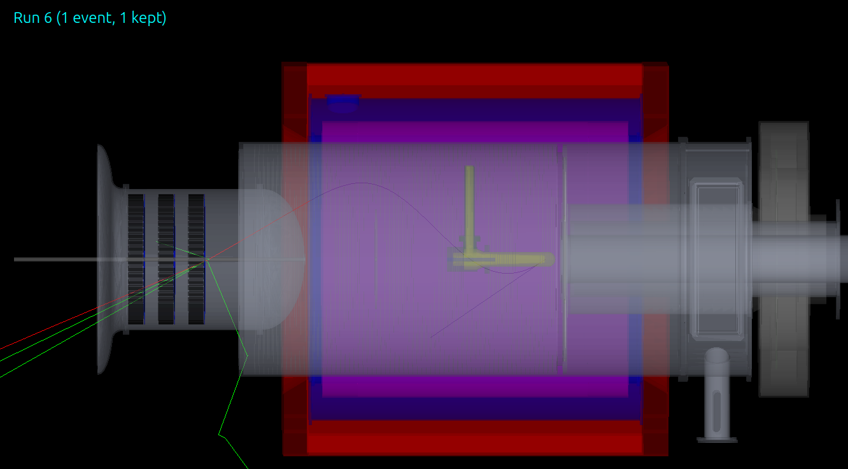
Optimization of the signal acceptance
3 parameters to optimize
Distance between detectors
Position of closest to target detector
Magnetic field scaling ( 0.7 T is the max value)
Observables
Fraction of elastic electrons that produce a 3-plane track (3Hits coincidence)
Combinatorial background events included in the total number of events on this analysis
det2 det1 det0
Target
z=500mm
300mm
zDet0=-2500mm
Work done by M. Gaulliard
Notes:
Why the chapeau is outside? Is it really? Is only the membrane in vacuum and the rest is supported outside? Target (slide 2 on the google slides, it seems to me that its all inside a vaccume chamber)
In the simulation is it one detector per plain? Do we include the detector per pad response? And how does the optimization goes
Instead of absolute rate(number of 3-hit events per second), we maximize:
(3-hit elastic e⁻ rate) / (total e⁻ rate)
This:
suppresses background sensitivity
isolates geometrical and magnetic effects
is robust against luminosity assumptions

Slide 15
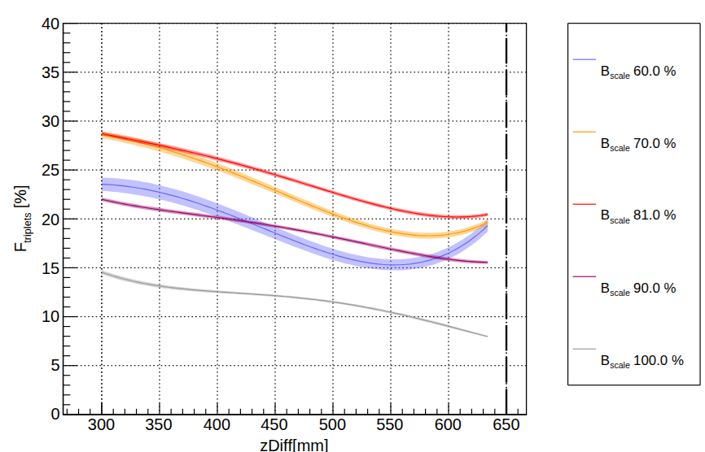
Optimization of the signal acceptance
3 parameters to optimize
Distance between detectors
Position of closest to target detector
Magnetic field scaling ( 0.7 T is the max value ➔ 100%)
Observables
Fraction of elastic electrons that produce a 3-plane track (3Hits coincidence)
Combinatorial background events included in the total number of events on this analysis
Work done by M. Gaulliard

Slide 16
Optimization of the signal acceptance
3 parameters to optimize
Distance between detectors
Position of closest to target detector
Magnetic field scaling ( 0.7 T is the max value ➔ 100%)
300mm ➔ Hardware limit
Observables
Fraction of elastic electrons that produce a 3-plane track (3Hits coincidence)
Combinatorial background events included in the total number of events on this analysis
The smallest possible distance between the det planes gives the best efficiency for any B field
Work done by M. Gaulliard
Notes:
Instead of absolute rate, we maximize:
(3-hit elastic e⁻ rate) / (total e⁻ rate)
This:
suppresses background sensitivity
isolates geometrical and magnetic effects
is robust against luminosity assumptions

Slide 17
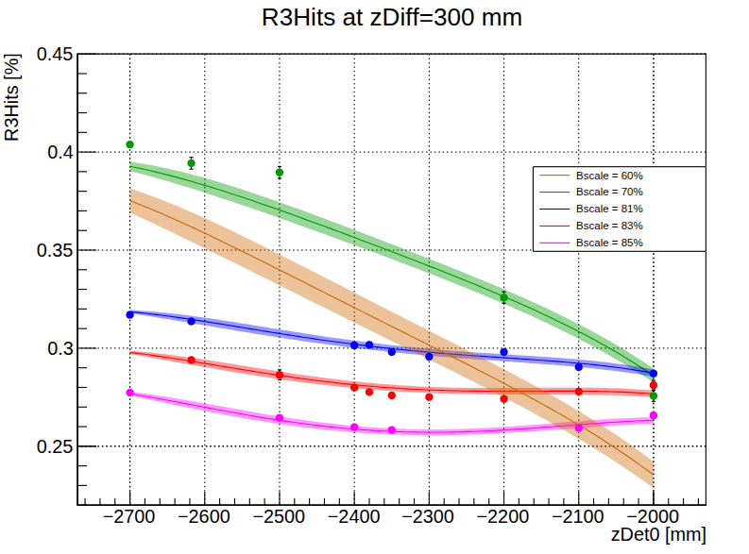
Optimization of the signal acceptance
3 parameters to optimize
Distance between detectors
Position of closest to target detector
Magnetic field scaling ( 0.7 T is the max value ➔ 100%)
Observables
Fraction of elastic electrons that produce a 3-plane track (3Hits coincidence)
Combinatorial background events included in the total number of events on this analysis
Output of Simulation
Distance between detectors ➔ 300 mm
Distance closer to target ➔ -2700 mm
Further backward from the target @ 70% of B the best det. efficiency
Work done by M. Gaulliard
Notes:
→ zDet0 = -2700m, B 70% (further backward) best relative 3hits rate
→intermediate config. can still be interesting (more stats, different scattering angle distrib.)

Slide 18
Optimization of the signal acceptance
3 parameters to optimize
Distance between detectors
Position of closest to target detector
Magnetic field scaling ( 0.7 T is the max value ➔ 100%)
Resolution estimation
Scattering angle ➔ σ_{θ} = 4 degrees
Z vertex ➔ σ_{z} = 133 mm
Observables
Fraction of elastic electrons that produce a 3-plane track (3Hits coincidence)
Combinatorial background events included in the total number of events on this analysis
Output of Simulation
Distance between detectors ➔ 300 mm
Distance closer to target ➔ -2700 mm
Further backward from the target @ 70% of B the best det. efficiency
Work done by M. Gaulliard
Notes:
→ zDet0 = -2700m, B 70% (further backward) best relative 3hits rate
→intermediate config. can still be interesting (more stats, different scattering angle distrib.)
Here we focus on the 3-hit fraction as a purity-driven metric; optimizing the absolute rate favors different configurations and provides complementary acceptance, which will be addressed in follow-up studies
Optimizing for clean track fraction and optimizing for total statistics lead to different preferred detector configurations. By shifting the detector position and magnetic field within the allowed range, we can access complementary acceptances, which is interesting from a physics point of view.

Slide 19
Detectors

Slide 20
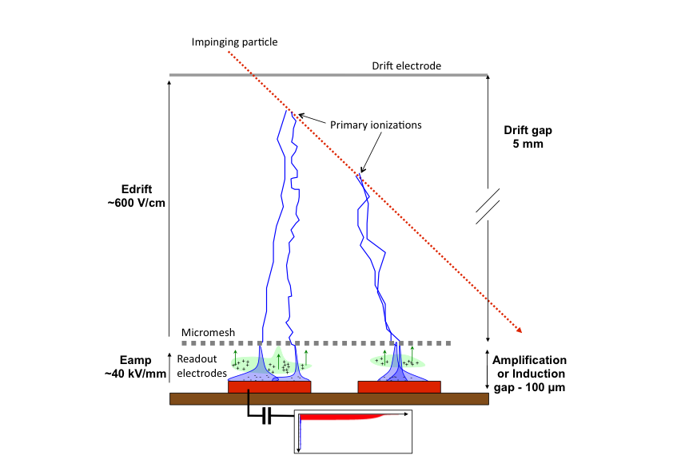
Minimization of X-ray background
Detector technology
Micromegas detectors
Suitable for low material budget applications
Large area coverage
Radiation hard
Good spatial/energy resolution ~ 150 μm / 15%
[Giomataris et al., NIM A 376 (1996) 29]
Geant4 simulation
X-ray beam generated in an Ar/C4H10 gas envelope with a MM detector included
Drift electrode → Drift Gap (3.25 mm) Ar/C4H10(90:10) → Mesh → Ampl. Gap(128um) Ar/C4H10(90:10) → Cu (50um) → FR4(150um) → Cu 50um
Mylar
Readout Kapton
Mesh
Mylar
Drift
Notes:
→ zDet0 = -2700m, B 70% (further backward) best relative 3hits rate
→intermediate config. can still be interesting (more stats, different scattering angle distrib.)

Slide 21
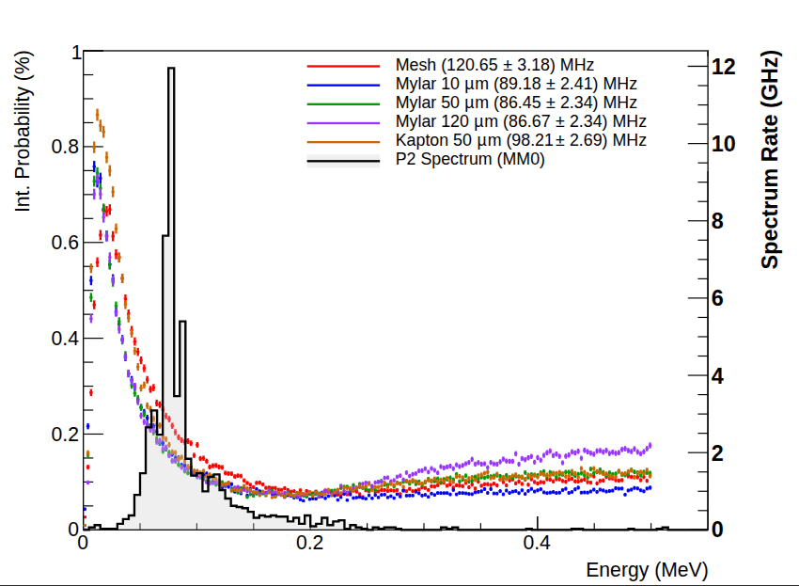
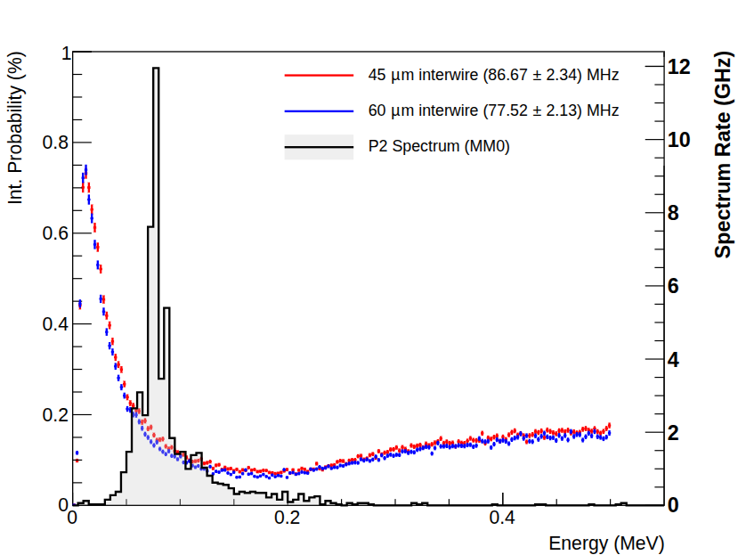
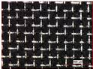
Minimization of X-ray background
Work done by M. Gaulliard
Detector in P2 and in the simulation
Metallic Micromegas with readout pad structure
Readout structure of 1 cm □ pads
(corresponding to 1280 per module)
120 µm Mylar drift electrode
Construction material can affect the background
Drift electrode material effect
Mesh Geometry effect
60 µm mesh interwire
offers 11% reduction
Condition: at least 1 e- is produced & reach an active gas region
Notes:
→ zDet0 = -2700m, B 70% (further backward) best relative 3hits rate
→intermediate config. can still be interesting (more stats, different scattering angle distrib.)

Slide 22
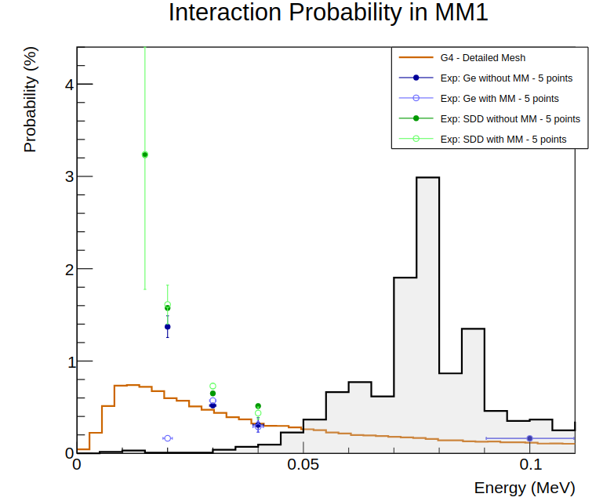
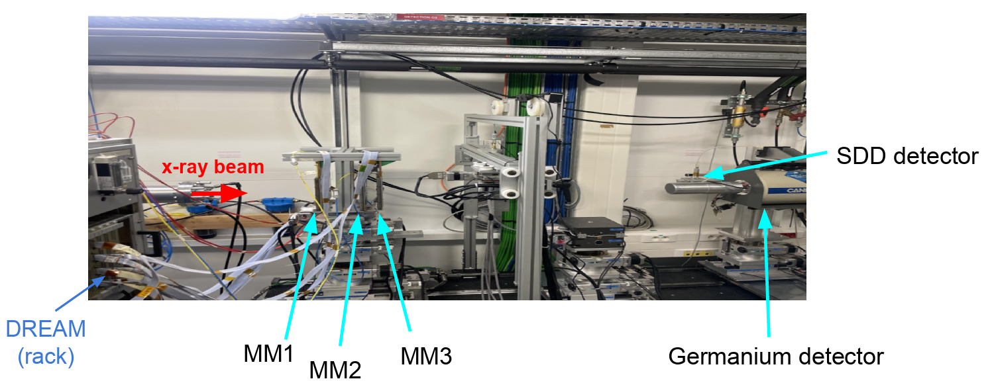
Comparison with Experimental data
X-ray Beam Measurements
Soft x-ray beam of 15-100 keV energy range
SOLEIL synchrotron @ Ormes de Merisiers (France)
Two 10x10 cm² detector prototypes
Germanium / Silicon Drift ➔ Detector reference measurement for energy calibration
spectrum of xray in full P2 simulation, received by closest-to-target Micromegas
Good agreement @ 30, 40, 100 keV (already satisfactory for the P2 energy range)
Work done by M. Gaulliard

Slide 23
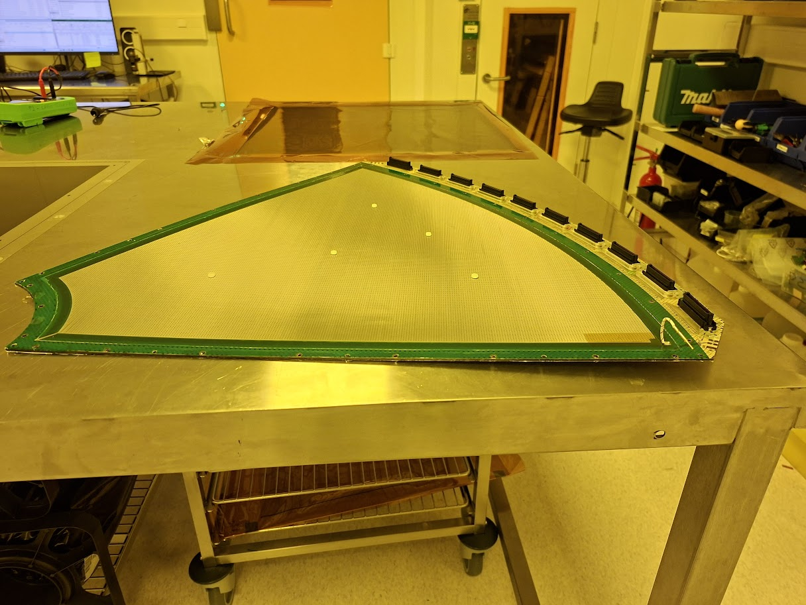
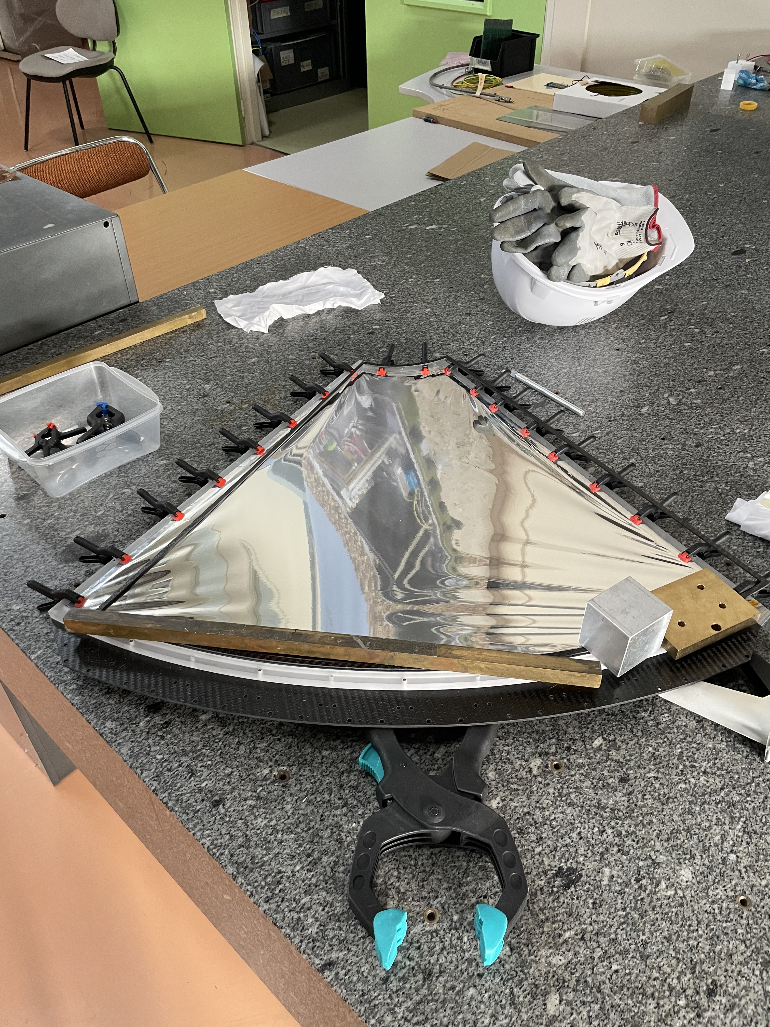
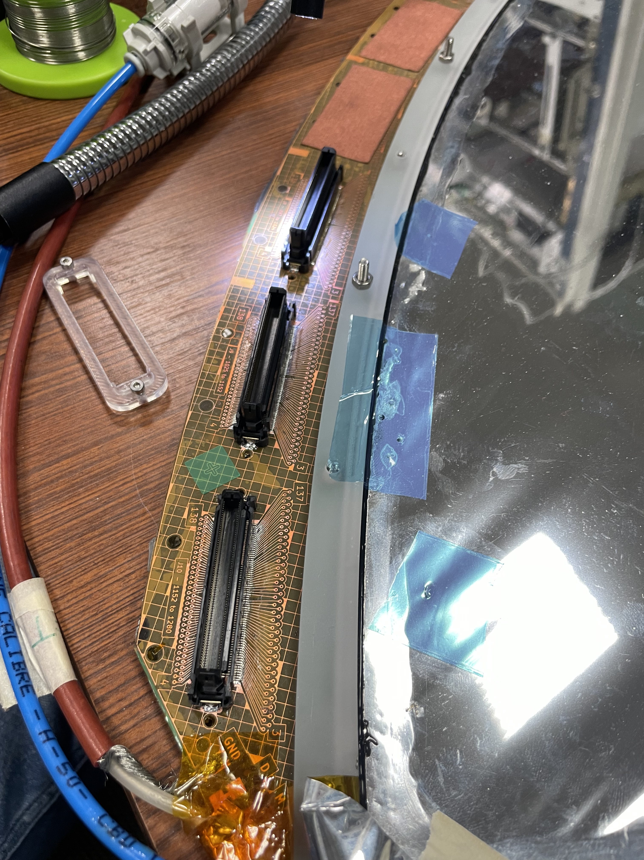
Detector Production (Size 1 Prototypes)
Production on site
Challenges in the bulking process:
Max size with respect to the machine size
Change in the photoresist material available (needed for the bulking process)
Bulking process and degradation of the raw PCB material
Key challenges identified; mitigation strategies in progress
Connector soldering
Bulking process
Drift electrode assembly

Slide 24
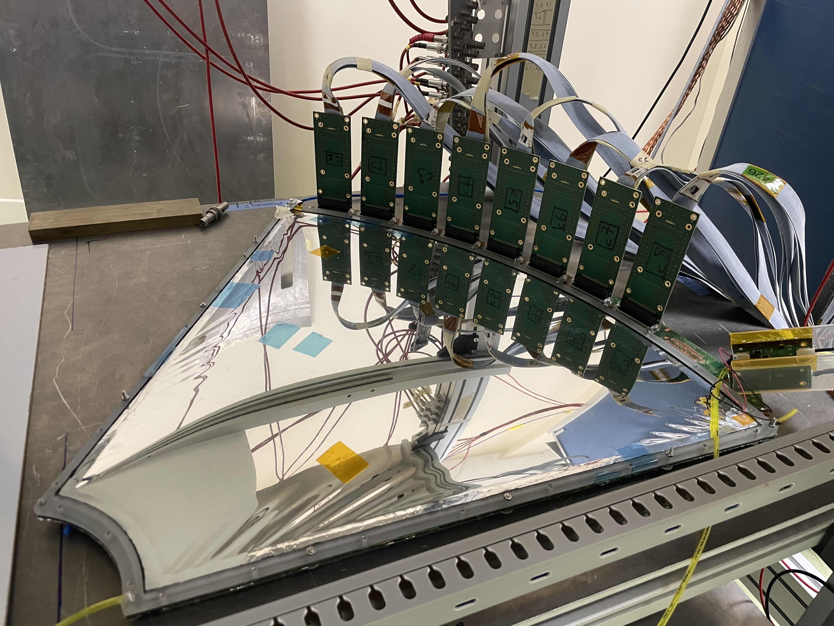
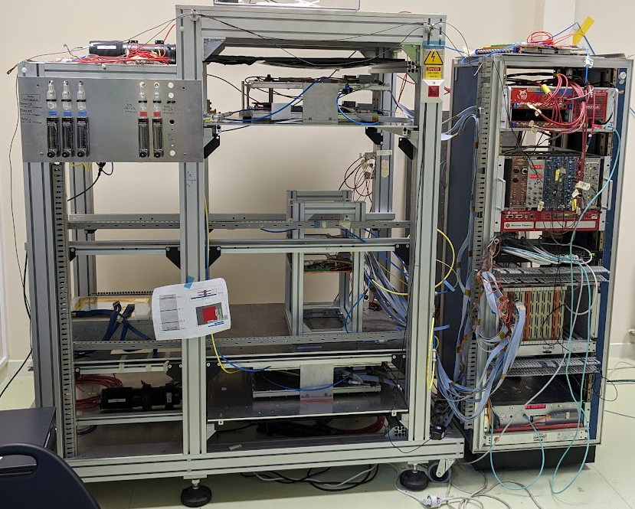
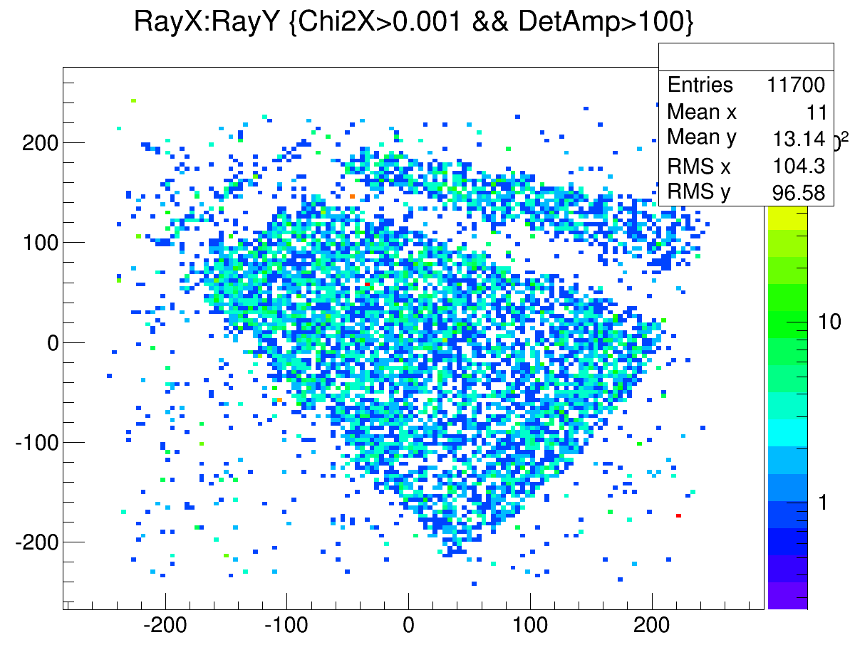
Detector Testing
Cosmic Bench in Saclay
Two outer 60x60 cm² scintillator with four 50x50 cm² Micromegas trackers
Characterization of prototypes in low muon rate environments
Efficiency measurements / Homogeneity of response
Work done by G. G. Veyrac & A. Gairot

Slide 25
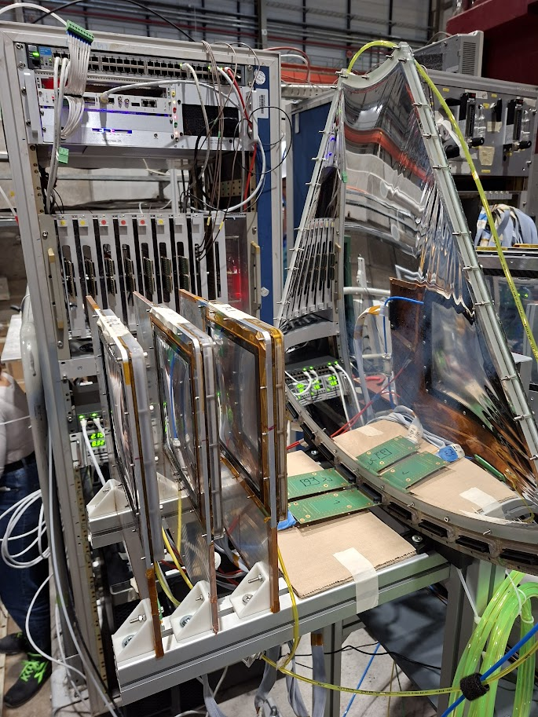
Detector Testing
Particle Beams @ CERN SPS H4 Beamline
Highly energetic muons (80-150GeV) and pions of 80 GeV
Shared TB campaign with EIC group of CEA
Three 10x10 cm² small scale prototypes
One Size one prototype
Gas Mixture : Ar/CO2/Iso (95:3:2) (non-flammable)
Detector characterization measurements using different particle types
Rate performances evaluated, mainly for the electronics
P2_3
P2_3
P2_1
P2_G
beam direction
banco ref tracker

Slide 26
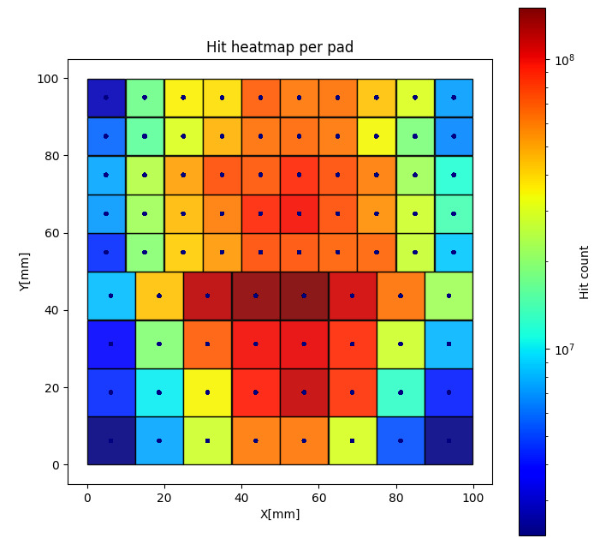
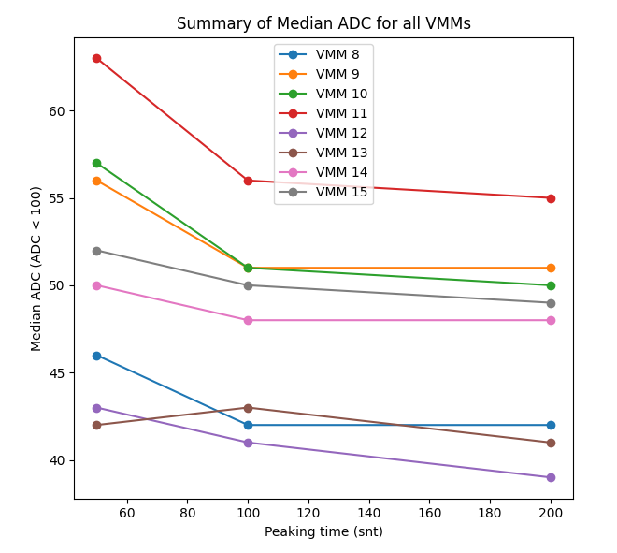
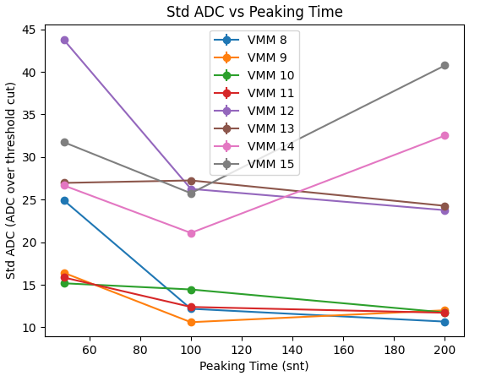
Highlighted Results (Analysis ongoing)
Stable detector performance in a range of rates from few kHz up to 2MHz with muons and pions
Stable operation also of the dedicated frond end /back end electronics tested with different protection boards

Slide 27
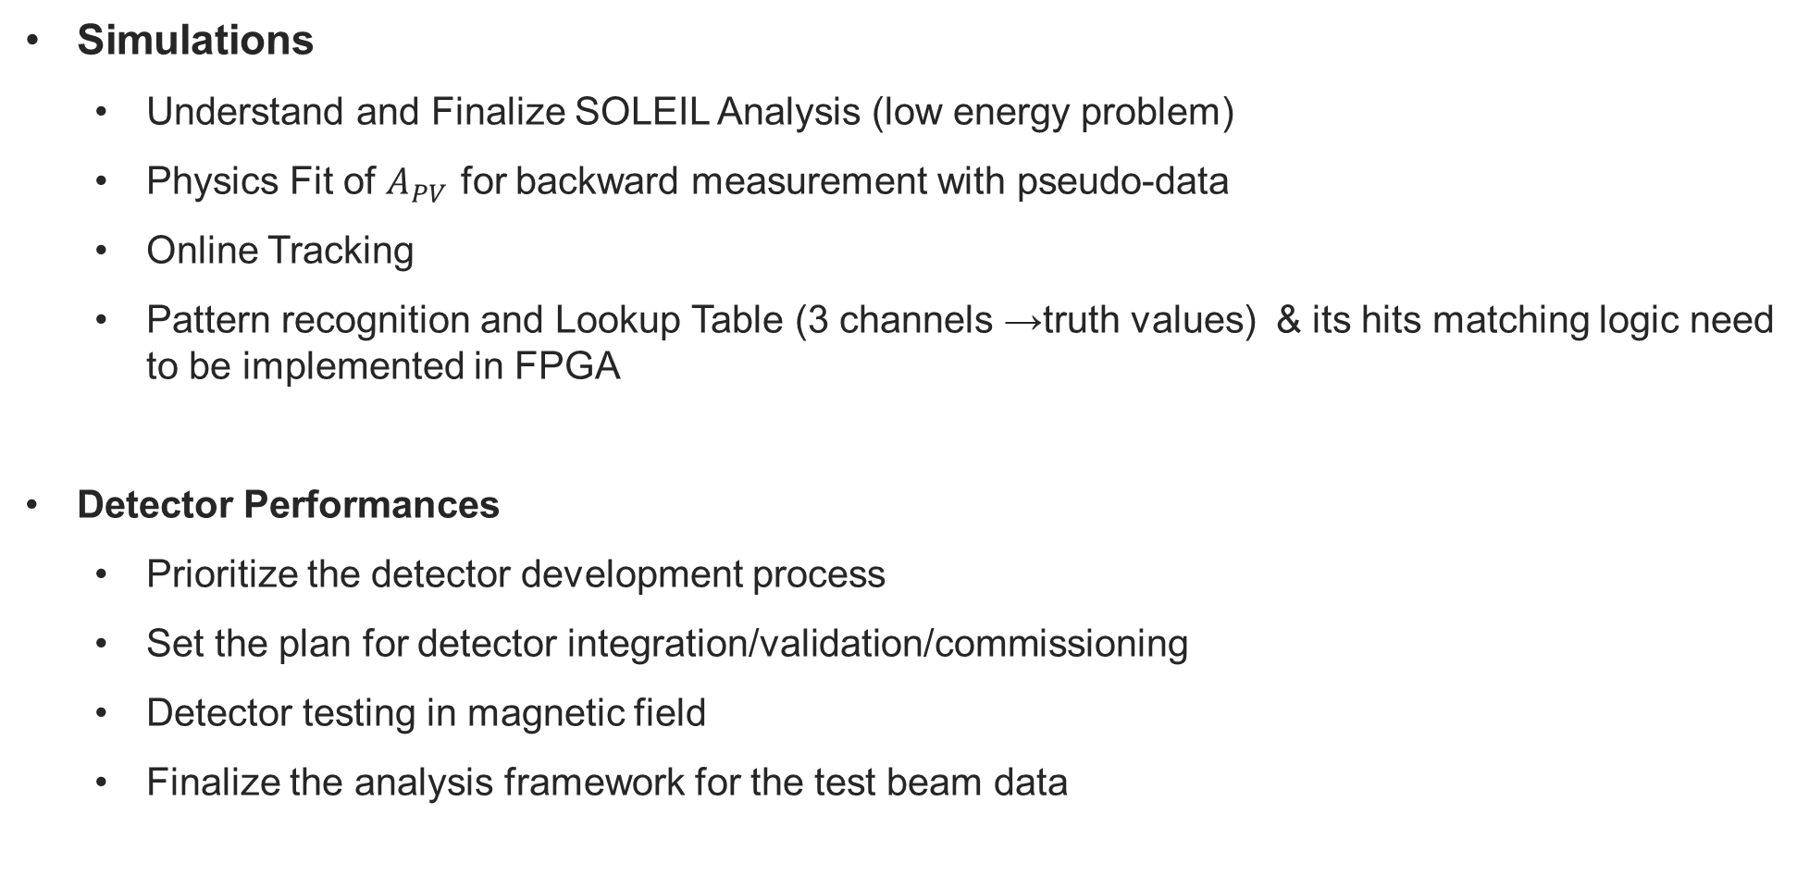
Planning 2026
Simulations
Understand and Finalize SOLEIL Analysis (low energy problem)
Physics Fit of $A_{PV}$ for backward measurement with pseudo-data
Online Tracking
Pattern recognition and Lookup Table (3 channels →truth values) & its hits matching logic need to be implemented in FPGA
Detector Performances
Prioritize the detector development process
Set the plan for detector integration/validation/commissioning
Detector testing in magnetic field
Finalize the analysis framework for the test beam data
Notes:
I don’t really understand the two last objectives of the simulation part

Slide 28
Electronics

Slide 29
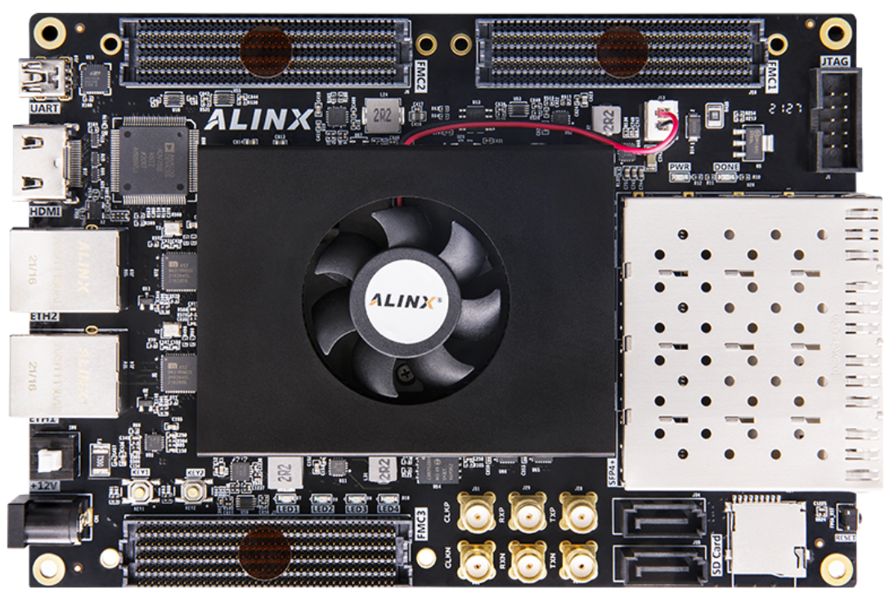
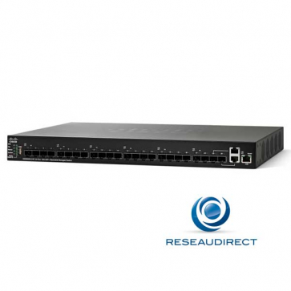
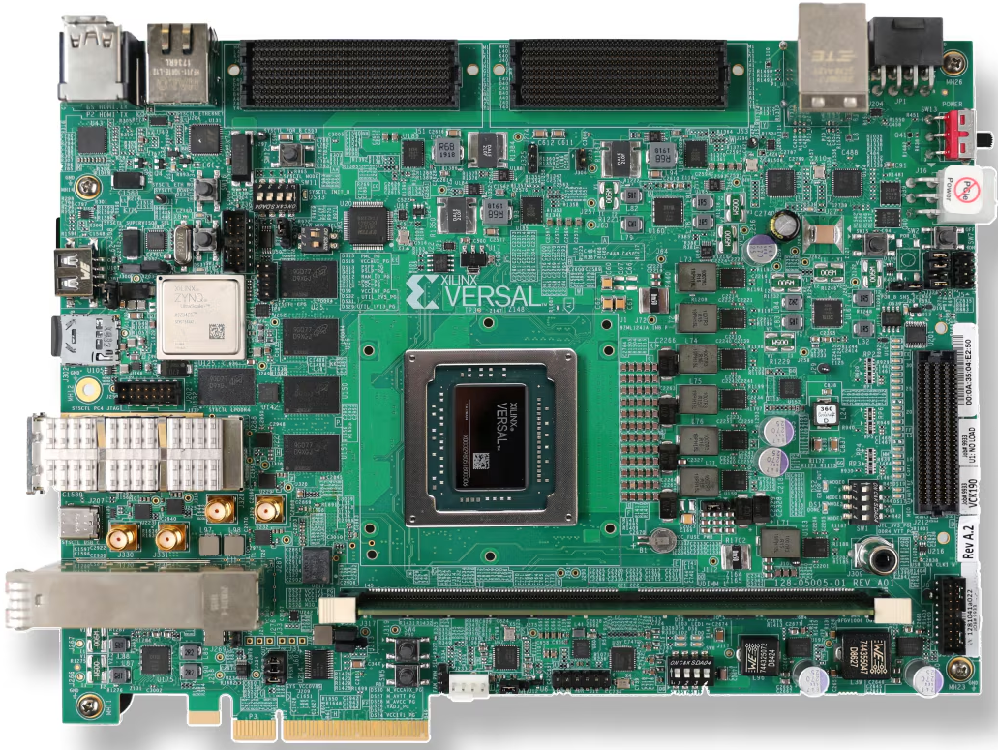

Readout architecture
Frontend on detector
180 VMM Hybrids ➔ 60 per plane
5m
Electrical : data & control
Backend in cavern
12 AXKU040 boards
15 hybrids per backend
100m
High-speed optical Data & control
10 GE optical
Ethernet network
Supervisor in control room
e.g. EK-VCK190 board
PC cluster
Data & control
Machine interface Clock, synchro

Slide 30
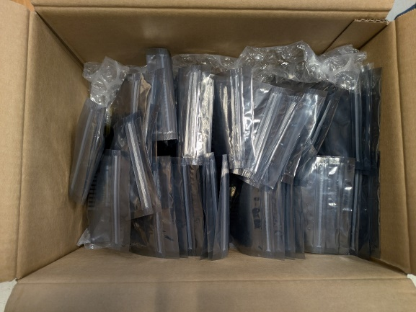

Frontend Status
Frontend production
200 VMM Hybrids delivered and validated in-house on Irfu test-bench
196 accepted with not more than 2 bad channels per 128-channel hybrid
4 hybrids replaced by SRS Technology
Hybrid classification data base under construction
ID, malfunctioning channels, best performance configuration parameters …
Frontend protection circuit studies
Goal: Improve deadtime after detector discharges and achieve robust channel protection
2 add-on schemes devised standing 600 V sparks
bulky (higher safety margin)
compact (lower safety margin)
Both degrade S/N by ~15%
Both improve deadtime ~4 times
Enough knowledge to design frontend adaptation board
ProtStage AC
ProtStage DC
VMM Hybrid
470p
TP
470p
VMM 0
10
Chan X
1M
1M
BAV99
BAV99
NUP4114

Slide 31
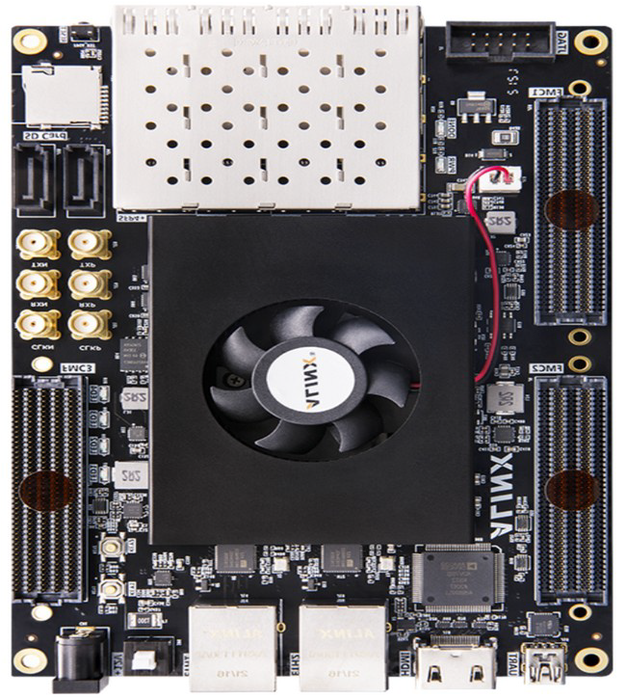
Backend Status
Backend
FW and SW of the commercial AXKU040 board extended to support
16 frontends
Separate data and control Ethernet networks
10G Ethernet for data links
Prototype backend-frontend interface board developed
Slow-control software
Main functions for scripting hardware configuration and running data acquisition ready
Data model extended to support 8 sub-networks of 16 Fec boards each containing 16 hybrids (full system: 262K channels)

Slide 32
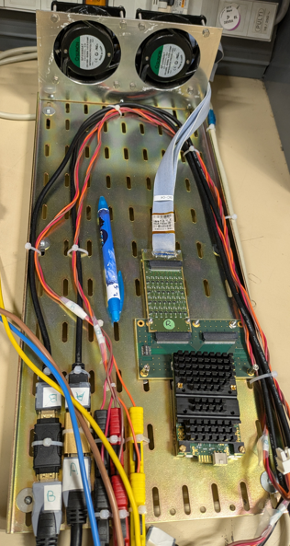
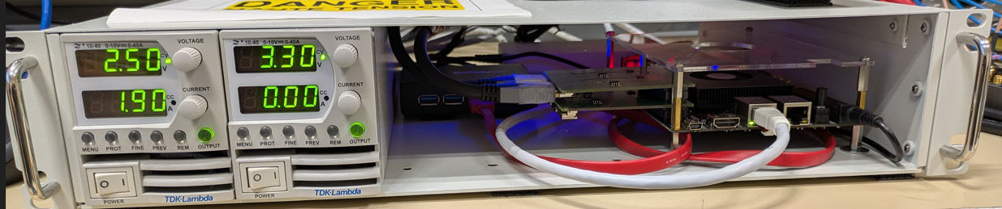
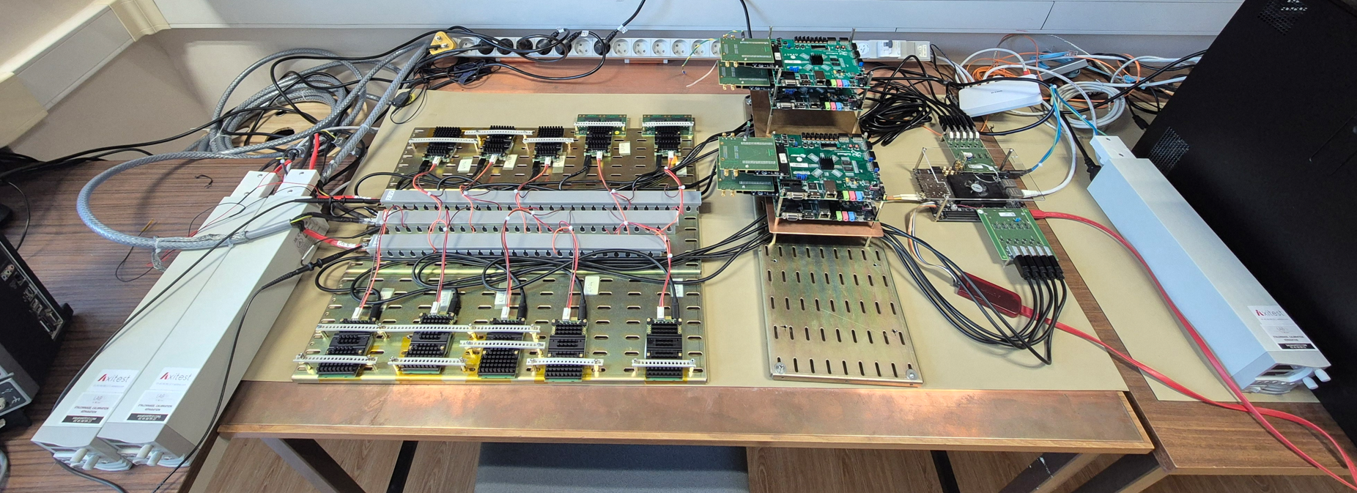
Low voltage powering
Low voltage power distribution
TDK Lambda LV power modules for frontend and backend electronics
6 m cable harness devised based on commercial shielded cables
Performance validated with the nominal load of 10 frontends
Power-up sequence tested – final-scale scheme under elaboration
Hybrids
Backend
LV power supply
LV power supply
Portable test bench with backend, PS, switch and frontend for radiation tolerance assessment

Slide 33
Irradiation Tests
Radiation tolerance studies
Expected radiation doses after 3 months of operation
Frontend : ~40 krad and 6x10¹¹ 1 MeV neq / cm² – space-grade
Backend : ~4 krad and 3x10¹¹ 1 MeV neq / cm² – high neutron flux
Irradiation tests in A1 hall @ MAMI
Overwhelmingly intensive : beam current (20 mA?)
Frontend and backend installed on beam pipe close to beam dump
Including neutron flux monitoring nBLM detectors
Controlling electronics installed in “safe” area behind shielding blocks
Estimated received dose : ~1 Mrad
Parts of acquisition started to become inaccessible
Even in the “safe” zone
Neutron fluence to be understood from simulations
Unfortunately nBLM acquisition failed
Damage level to be evaluated when access to hardware be possible

Slide 34
Planning 2026
Validate system readout on 1/6 of the tracker
2027 : production, construction, validation, commissioning
Frontend
Develop, validate and produce 50 detector interface boards with protection circuits
Backend
Enrich firmware with cross-backend and supervisor isochronous communication links
Produce backend-frontend interface boards
Supervisor
Make supervisor board choice
Develop supervisor-machine interface board
Develop run-control part of the supervisor firmware

Slide 35
Planning 2026
System
Understand radiation and magnetic field related issues
May have important consequences for backend electronics whereabouts
Finalize LV distribution system
Devise and validate frontend cooling
Developpe software and firmware versions of on-line track-finding algorithms
Software
Pursue run-control framework development
Simplified GUI for operating the system
Monitoring visualizations
Run management including run conditions

Slide 36
Thank you
CEA SACLAY
91191 Gif-sur-Yvette Cedex
France
alexandra.kallitsopoulou@cea.fr

Slide 37
Back up

Slide 38
Optimization of the signal acceptance
Work done by M. Gaulliard
Observables
Fraction of elastic electrons that produce a 3-plane track (3Hits coincidence)
Combinatorial background events included in the total number of events on this analysis
Output of Simulation
Distance between detectors ➔ 300 mm
Distance closer to target ➔ -2700 mm
Resolution estimation
Scattering angle ➔ σ_{θ} = 4 degrees
Z vertex ➔ σ_{z} = 133 mm
Notes:
→ zDet0 = -2700m, B 70% (further backward) best relative 3hits rate
→intermediate config. can still be interesting (more stats, different scattering angle distrib.)

Slide 39
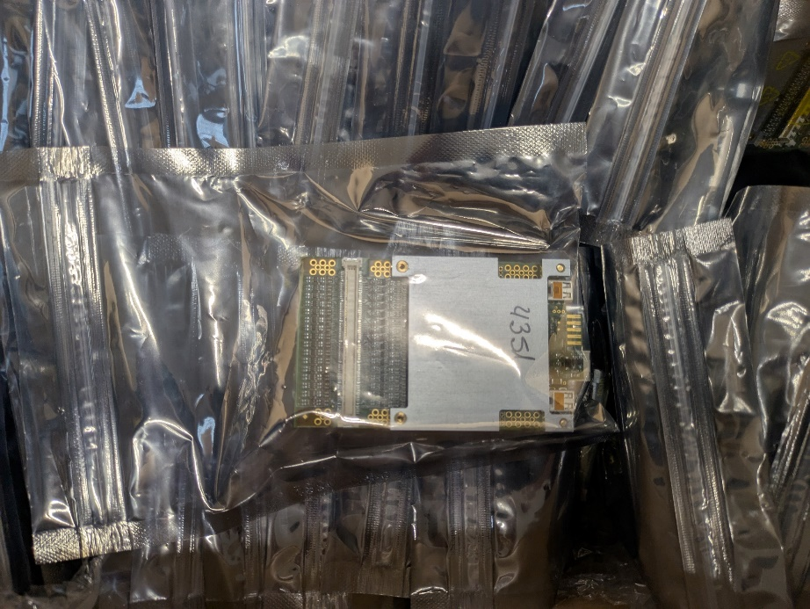
Frontend production
200 VMM hybrids have been received on 7/Feb/2025
In-house production validation on Saclay test-bench (next page)
Acceptance criteria
Not more than 2 bad channels per 128-channel Hybrid
“Bad” hybrids to be replaced by SRS Technology
Outcome
196 accepted VMM hybrids
4 hybrids replaced by SRS Technology
To be tested on Saclay test-bench
Frontends classified
Number of channels, “best-performance” configuration parameters
On-going : excel sheet to be replaced by a data base

Slide 40
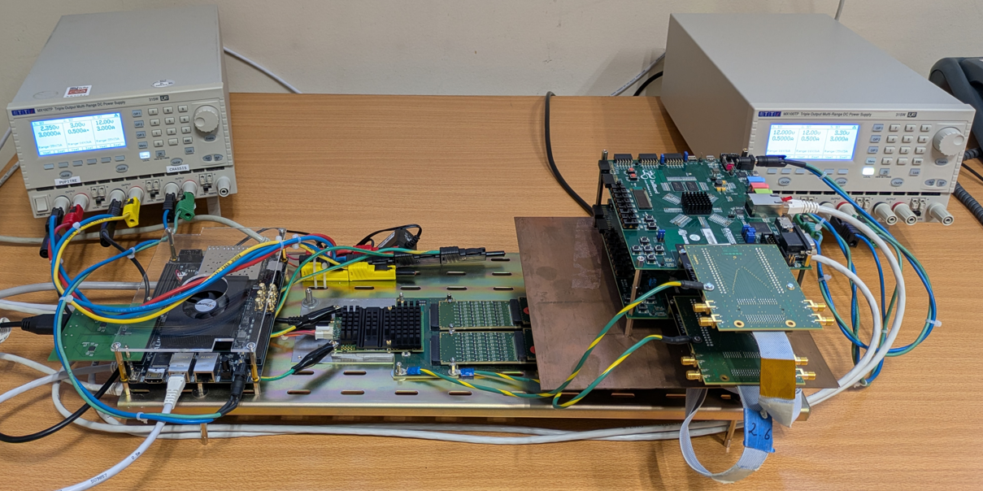
Saclay production validation test bench
LV power for
Hybrid and Backend
LV power for
charge injector
Charge injector
Protections
Backend
Hybrid

Slide 41
Frontend protection

Slide 42
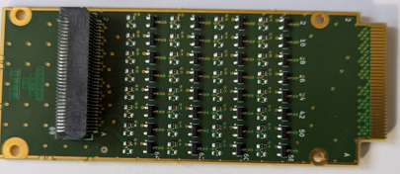
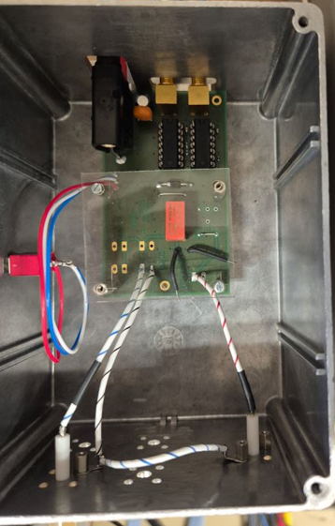
Frontend protection studies
ProtStage board
VMM hybrids feature on-board per-channel protection circuit
Overvoltage diodes followed by an AC coupling capacitor
Non-optimal to recover metallic detector efficiency after discharge
Requires an extra protection circuit to be robustly safe
Study add-on protections to overcome the weakness
Exercise with dedicated “killer” circuit and real detectors
Check S/N degradation
Check deadtime decrease
Develop a flexible cascade-able board to check different protection types
Make the choice for detector-frontend adaptation board design
Robust, compact, acceptable S/N degradation
“Killer”
A test configuration example with cascaded ProtStages and Killer
Killer
ProtStage AC
ProtStage DC
VMM Hybrid
470p
TP
470p
VMM 0
HV
10
Chan X
1n
1M
1M
From -1V to -600V
BAV99
BAV99
NUP4114

Slide 43
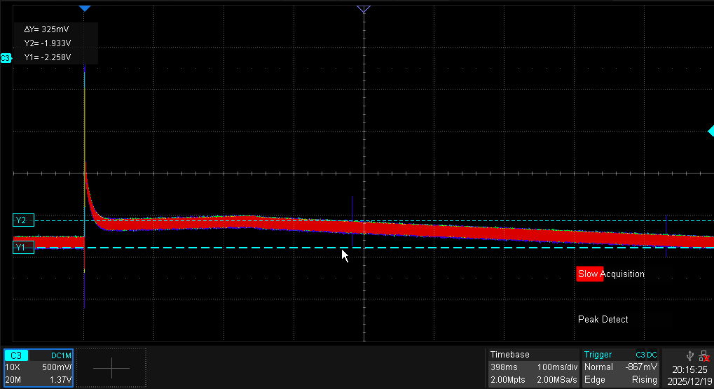
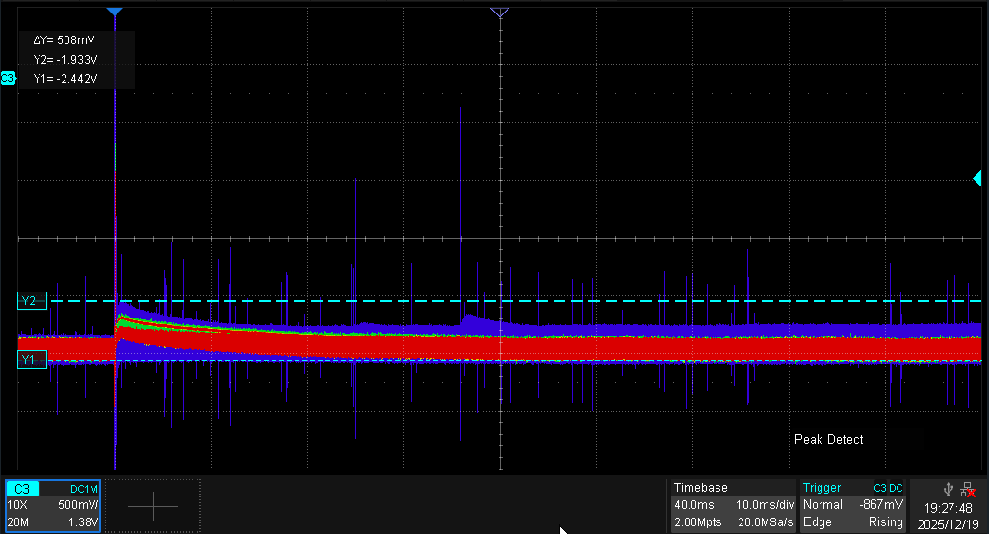
Frontend protection studies
2 possible add-on circuits identified
Bulky : less than ± 6V peak residual voltage at the entry of the VMM Hybrid
Compact : less than -20 V / +10 V residual voltage at the entry of the VMM Hybrid
Both survive 600 V discharges
Both degrade S/N by ~15%
Both improve deadtime ~4 times
Frontend adaptation board with “bulky” circuits if space limitation permits
Coherent
Killer & detector
measurements
Expected
Detector measurements coherent with simulation
Mesh potential : on-board protections only
Mesh potential : with additional protections
600 ms
60 ms

Slide 44
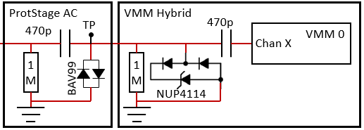
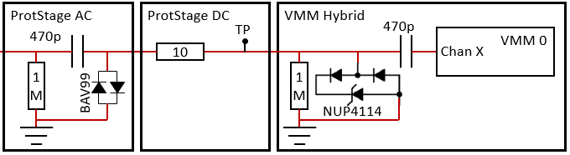
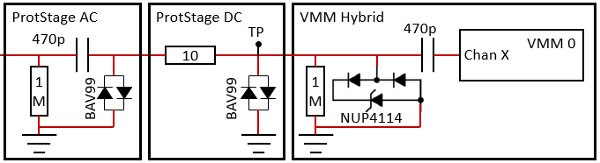
Protection studies
1 additional AC-coupled BAV99 diode stage
Asymmetric excursions exceeding -20 and +10V
All 4 tested channels died under -600V discharges
1 additional BAV99 diode stage + 10Ω resistor
Asymmetric excursions lower than -20 and +10V
All 7 tested channels survived -600V discharges
2 additional BAV99 diode stages
Symmetric +/- excursions < 5V
All 7 tested channels survived -600V discharges
All killed
All killed

Slide 45
Radiation immunity

Slide 46
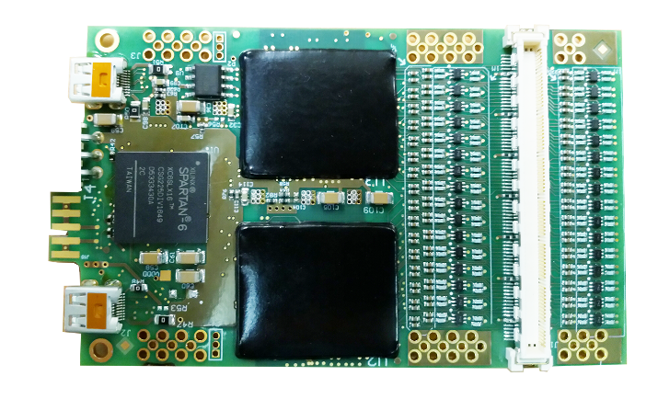
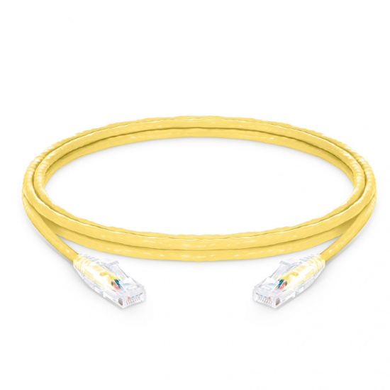
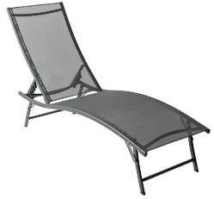


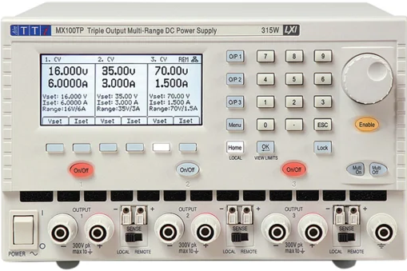
Frontend test configuration
Adapted radiation area in the hall
Negligible radiation area in the hall
20 m
Time | TID (krad) | Grade
Hour | 0.02 | Commercial
Day | 0.5
Month | 14
1 000 h | 20 | Rad tolerant (space)
3 months | 43
6 months | 86
9 months | 130
Year | 173
10 000 h | 200 | Rad hard
Counting room
Dose estimate for ±0.5m around the beam : 20 rad /h
Dose monitor to be installed on the frontend

Slide 47

Backend test configuration
Negligible radiation area in the hall
Adapted radiation area in the hall
20 m
Time | TID (krad) | Grade
Hour | 0 | Commercial
Day | 0.1
Month | 1.4
1 000 h | 2
3 months | 4
6 months | 9
9 months | 13
Year | 17
10 000 h | 20 | Rad tolerant
Counting room
Dose estimates at 50 cm to 1m from ground : 2 rad / h
Dose monitor to be installed on the backend

Slide 48
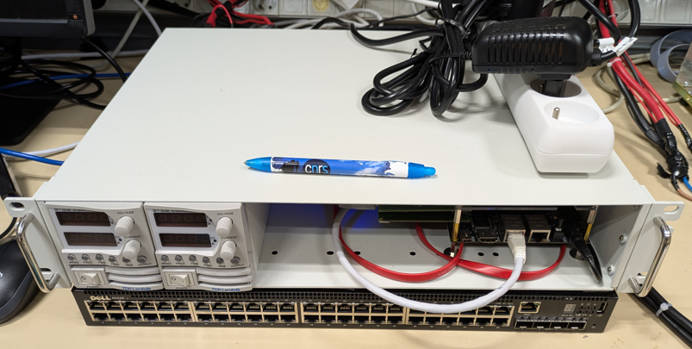
The objects to irradiate
Integrated frontend
20-40 krad < 100 krad
~10¹¹ 1MeV neq / cm²
Integrated backend
2-4 krad < 10 krad
~10¹¹ 1MeV neq / cm²
120
360
490
460
120
Each require a single 220V mains outlet
Dimensions of nBLM neutron detectors to be taken into account when placing the objects in the hall
220

Slide 49

The objects in the safe area
380
Integrated setup with
Backend for irradiated frontend
Frontend for irradiated backend
380
200
300
Frontend
Backend
700
200
To be added :
Scope and HV PS for nBLM detectors
A PC + screen

Slide 50
Low Voltage Power Supply testbench with 10VMM
Configuration:
Z10-40 -> 2,2 V IP: 192.168.0.50
Z10-40 -> 3,3V IP: 192.168.0.51
Z20-40 -> 12V IP: 192.168.0.70
Voltage measurement:
Power suppy TDK output:
[2,2V]: 2,64V /13,53A
[3,3V]: 3,30V /1,35A
Power suppy bus bars:
[2,2V]: 2,17V
[3,3V]: 3,26V
When Alinx power ON, voltage@TDK output:
[2,2V]: 2,17V / 12,65A
[3,3V]: 3,3V / 2,43A

Slide 51



LVPS Testbench: Power supply 10 VMM Ref power supply: TDK Lambda Z10-40
Number | VMM | Current for 2,2V | Current for 3,3V
1 | 4529 | 1,48 A | 0,13A
2 | 4389 | 1,47A | 0,13A
3 | 4360 | 1,49A | 0,12A
4 | 4015 | 1,64A | 0,13A
5 | 4096 | 1,31A | 0,13A
6 | 4321 | 1,19A | 0,12A
7 | 4342 | 1,51A | 0,12A
8 | 4346 | 1,49A | 0,12A
9 | 4024 | 1,75A | 0,13A
10 | 4021 | 1,37A | 0,12A
 | Total | 14,84A | 1,23A
Shut off control
2,2V
3,3V
2,2V
GND
Bus Bars
3,3V

Slide 52

LVPS Testbench – Rise time measurement with 10 VMM
Rise time for 2,2V: 965,7 µs
Rise time for 3,3V: 536,9 µs

Slide 53

LVPS Testbench – No glitch !
Rise time for 2,2V: 965,1 µs
Rise time for 3,3V: 555,4 µs

Slide 54

SNR Testbench: Rise time measurement with VMM Hybrid Ref power supply: TDK Lambda Z10-40
HDMI 1m cable, 25 times measurements
Voltage C1: 3,31V, time rise : 1,78 ms and no glitch with 200ms timebase
Voltage C2: 2,3 V, time rise 808,87 µs and no glitch with 200ms timebase

Slide 55

SNR Testbench: Rise time measurement with VMM Hybrid without sense Ref power supply: TDK Lambda Z10-40
HDMI 1m cable, 25 times measurements
Voltage C1: 3,31V on power supply
Voltage C2: 2,7 V on power supply

Slide 56

SNR Testbench: Rise time measurement with VMM Hybrid with sense Ref power supply: TDK Lambda Z10-40
HDMI 1m cable, 25 times measurements
Voltage C1: 3,31V on power supply
Voltage C2: 2,2 V on power supply

