Slide 1


Lecture II : Modeling neutrino-nucleus interactions
department of Physics and Astronomy
Natalie Jachowicz

Slide 2
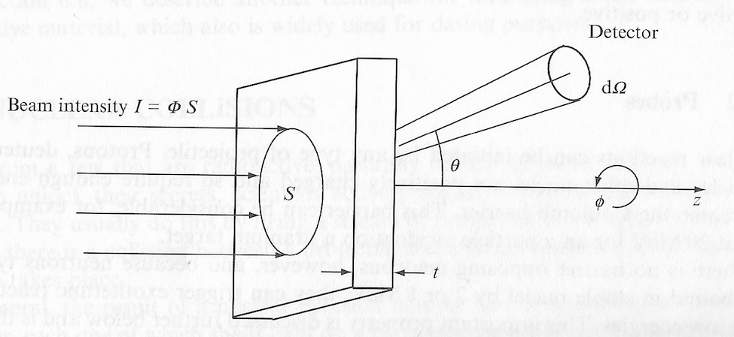
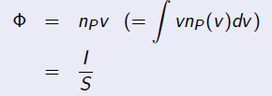
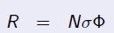
Cross section and reaction rate
Flux=#particles/unit area/unit time
Number density of projectile particles in the beam
Cross section σ = measure of the interaction probability per collision
= # events R / # target nuclei N/incident flux
Notes:
Very formal / anonymous particles no identity / impeding perpendicular to the surface
Same as how strong the water jet is that is coming out of the tap

Slide 3
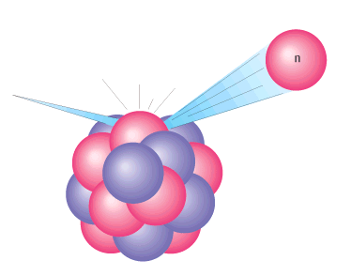
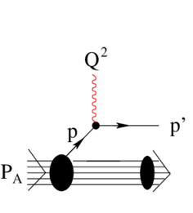

(Quasi)scattering off a nucleus vs scattering off a nucleon
Impulse approximation : a very important concept !
The interaction between the projectile and bound target nucleons has essentially the same form as the interaction between two particles in free space
Often the scattering is dominated by single-collision processes : the lepton most often couples to a single nucleon in the nucleus
Description assumes that the interaction takes place with 1 nucleon in the nucleus,
Total cross section is the sum of these lepton-nucleon interactions
Extra corrections and correlations can be added
Approach is valid when the momentum transfer is high enough, since then the resolution of the probe is small
Sum over all nucleons !
Insert bound nucleons wave functions for the initial nucleon states

Slide 4
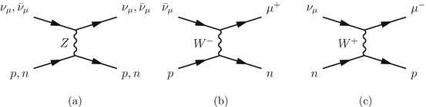
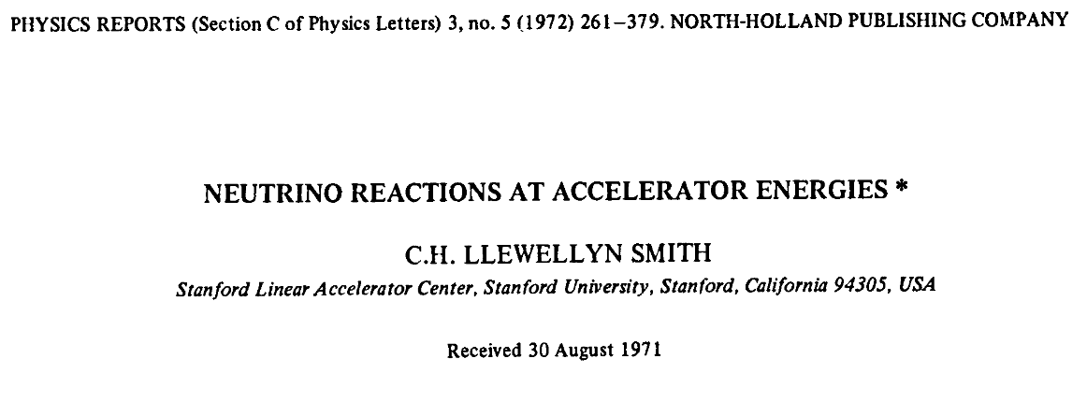



The basic ingredient : Scattering off a nucleon
Several options
Neutral current
Charged current
Neutrinos or antineutrinos
Electron, mu or tauneutrinos …
Ingredient for quasi-elastic scattering in most generators

Slide 5
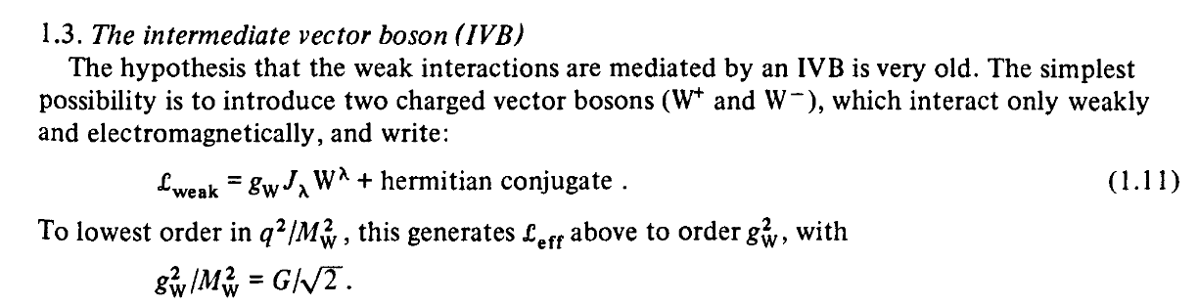
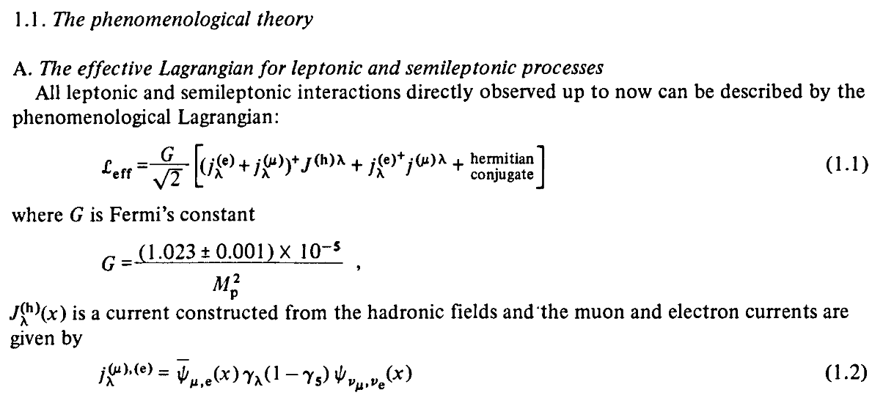
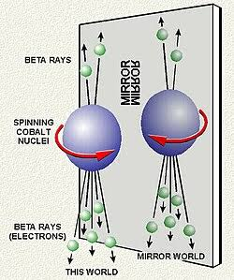

The basic ingredient : Scattering off a nucleon
Lepton x hadron current
V-A structure for the lepton current
Leptons : point particles
Weak interaction : maximal parity violation
Notes:
WZ mass~90GeV

Slide 6
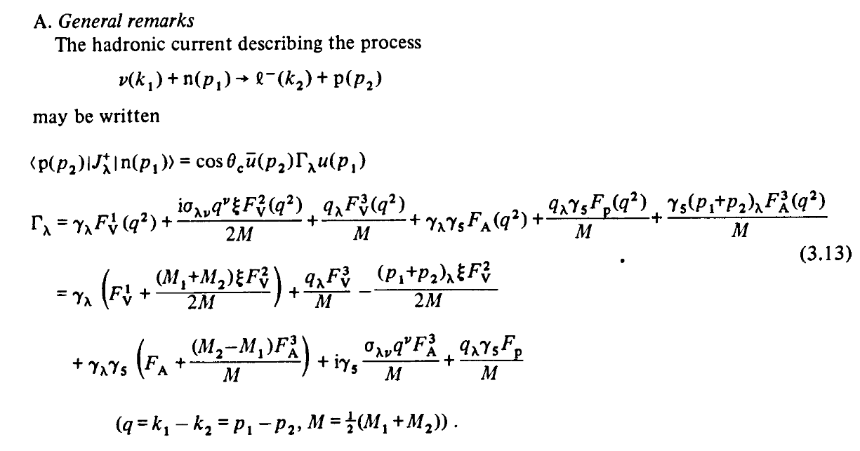
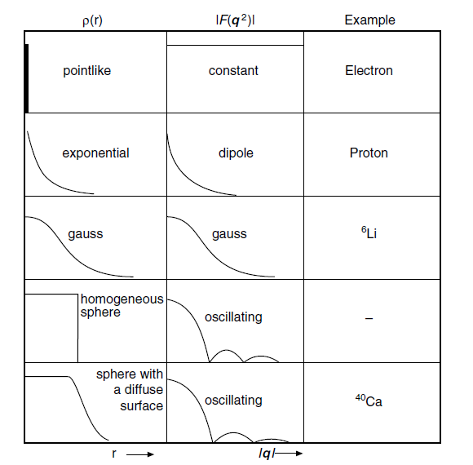
The basic ingredient : Scattering off a nucleon
Hadron currents can be constructed from
Four vectors of incoming and outgoing particles
Lorentz invariance
Form factors to take into account the structure and extension of the nucleon (we are not dealing with a quark current !)
Essentially : Fourier transform of density distribution

Slide 7
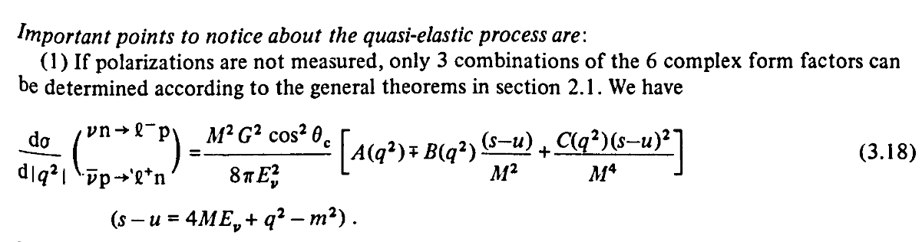
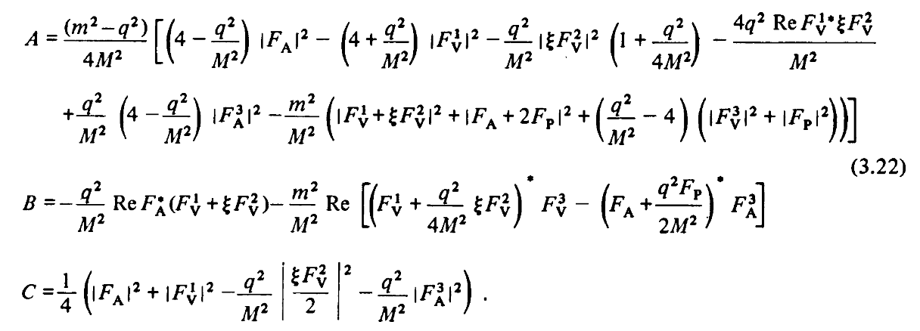
The basic ingredient : Scattering off a nucleon

Slide 8

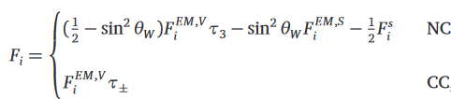


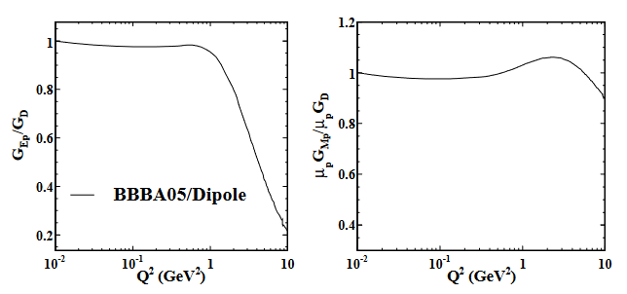


Nucleon Form Factors
Information about the structure of the nucleon is encoded in form factors
Neutrino-nucleon form factors constitute a major source of uncertainty in neutrino scattering modeling
Weak vector form factors are well constrained by electron scattering experiments by CVC
G :electric and magnetic Sachs form factors
Q² dependence Form factor parameterizations !
Traditional : Dipole :
Galster parameterization
Notes:
Neutron ff less well constrained by data, galster parameterization reproduces well elastic electron-deuteron scatterin data

Slide 9
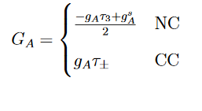
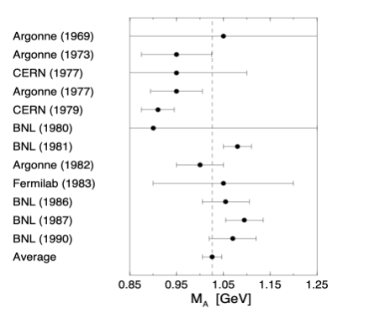


Nucleon Form Factors
Neutrino-nucleon form factors constitute a major source of uncertainty in neutrino scattering modeling
Weak vector form factors are well constrained by electron scattering experiments
Q² evolution of the axial form factor is not well-known, mainly based on old bubble chamber data (ANL, BNL, FNAL)
Axial form factors Q² evolution subject to uncertainties
Tension with MiniBooNE data : needed higher value to explain data
Notes:
MiniBooNE CCQE-like/CC 0pi (1 muon and no pion in the
final state) measurement showed that using the world-
average axial mass in a dipole form underestimated both
total and differential cross sections
• While a higher, effective = 1.35 ± 0.17 can explain the
data.
• Subsequent studies indicated that additional nuclear
effects, particularly 2p--2h contributions, explains the
observed deficit without requiring an artificially
enhancement.
MA
MA

Slide 10
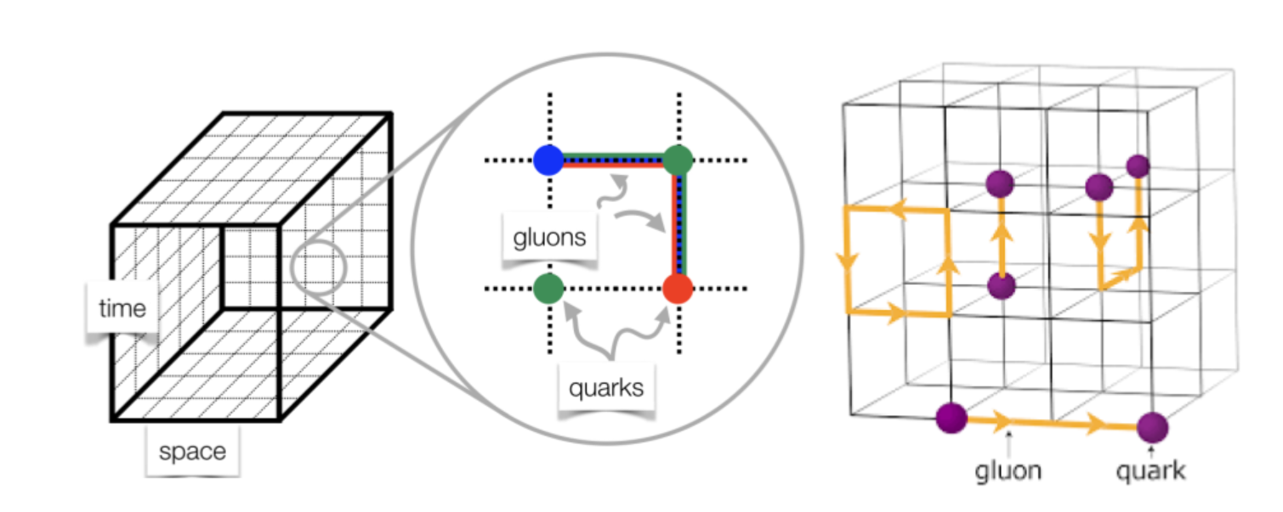
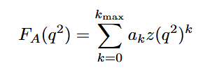
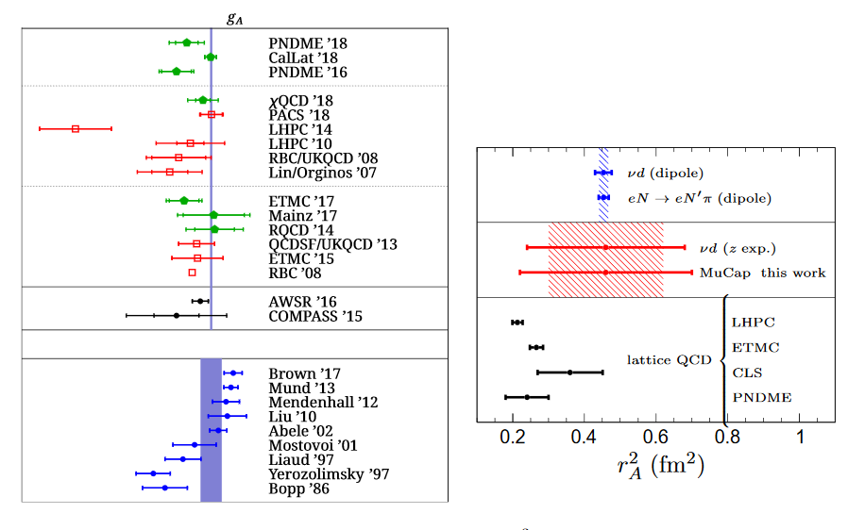

Nucleon Form Factors
More recent parameterizations :
Lattice QCD efforts : Improved LQCD prediction owing to better control of excited state contamination
Z-expansion (Meyer et al. PRD84(2011)) :
Allows for a better quantization of uncertainties
Notes:
Ri is slope, related to the axial massZ kinematic variable Ma is an effective parameter, effects form eg multinucleon
Ak dimensionloess parameters containing the information about the nucleon structure

Slide 11
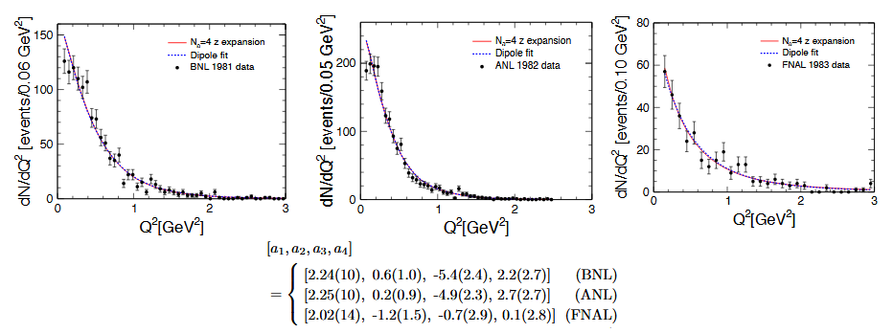
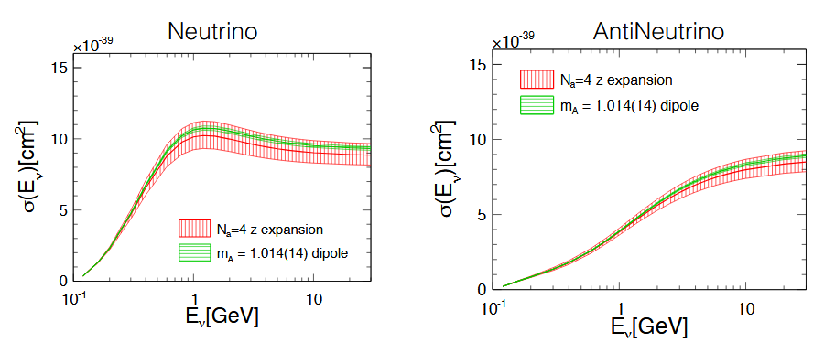
Nucleon Form Factors
Models obtain similar values
for F_{A}(Q²)
But with different error bars
Dipole is likely to underestimate errors
Uncertainty !
Notes:
Compared to 1.35 best fit in MiniBooNe
Meausrement CCQE
Uncertainty of the order of 10%

Slide 12
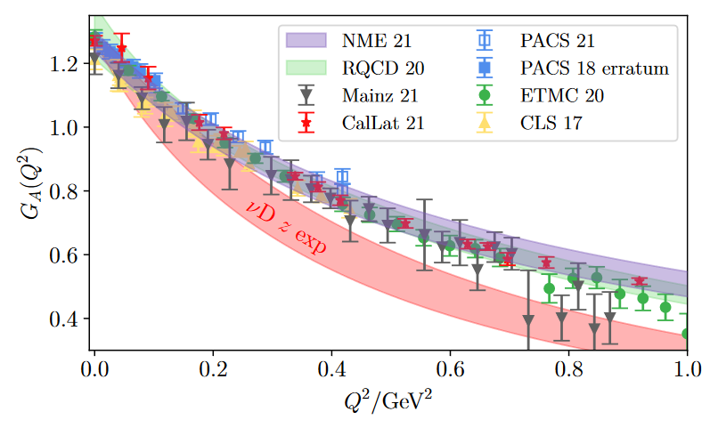
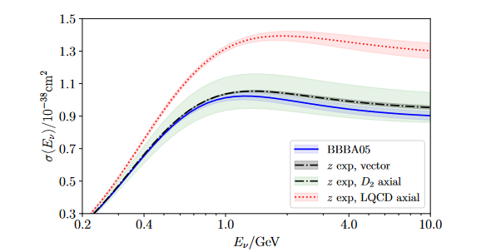
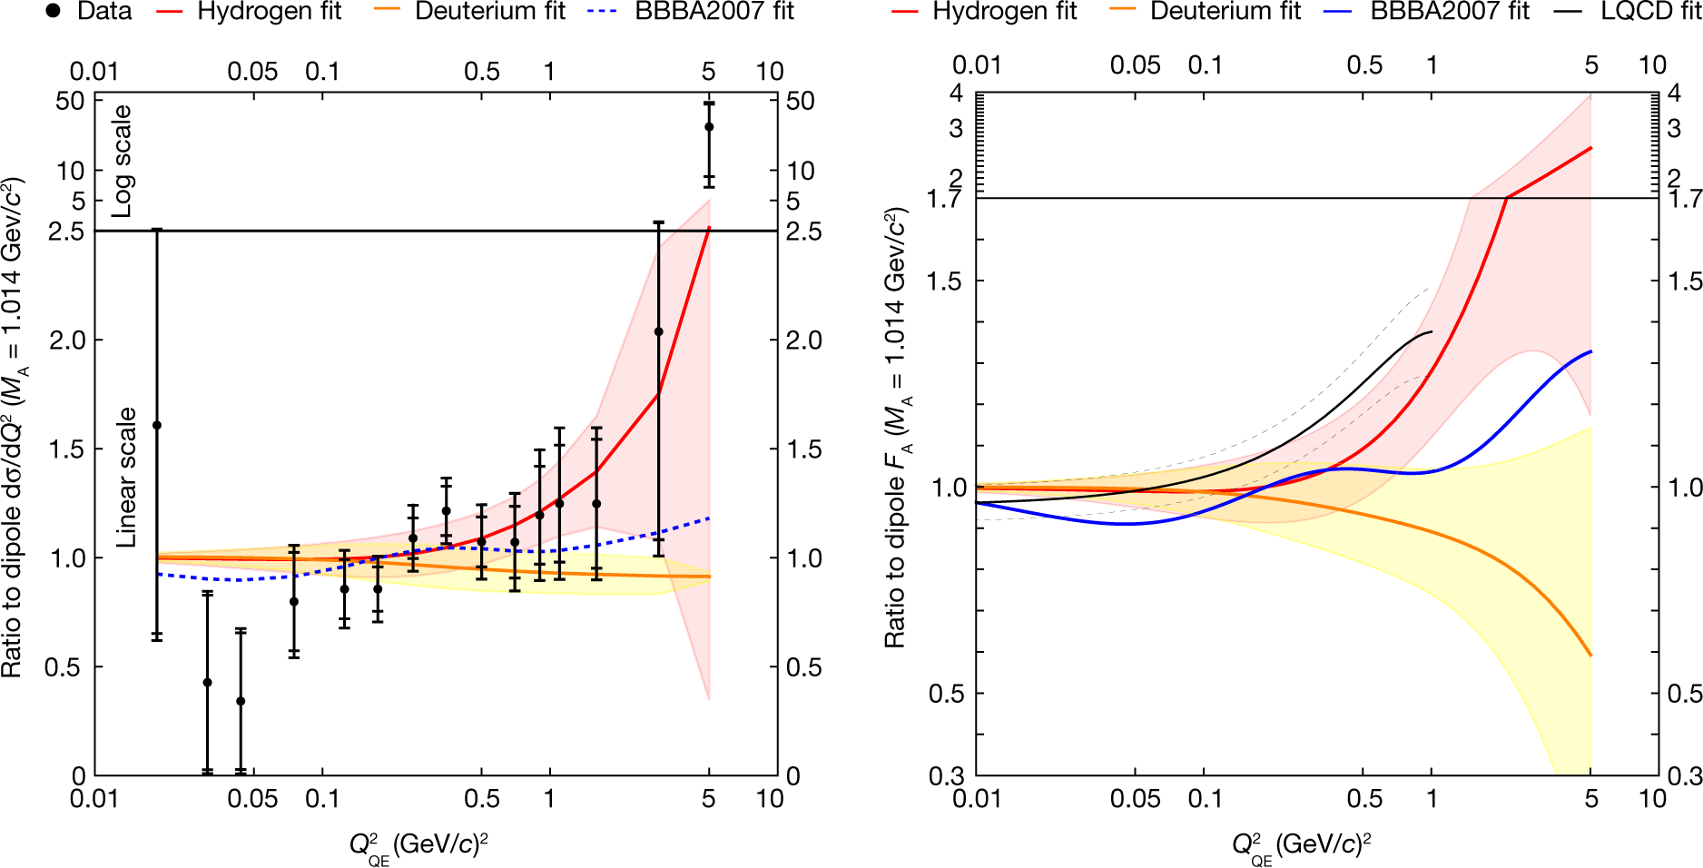
Nucleon Form Factors
Softer slope of the axial form factor’s Q² dependence in LQCD results leads to enhanced cross section on the nucleon
A. Meyer et al arXiv:2201.01839
MINERvA, Nature volume 614, pages 48–53 (2023)
New form factor measurement
Notes:
attice QCD (LQCD) calculates the numerical values of hadronic form factors from first principles. However, this method can only accurately compute them at specific, discrete momentum transfers (usually at low recoil). The z-expansion is a mathematical parametrization used to extrapolate LQCD data across the entire kinematically allowed range of momentum transfer. [1, 2, 3]
In short: LQCD is the non-perturbative computational method, while the z-expansion is the extrapolation tool used to connect LQCD data with experimental measurements. [1, 2]

Slide 13
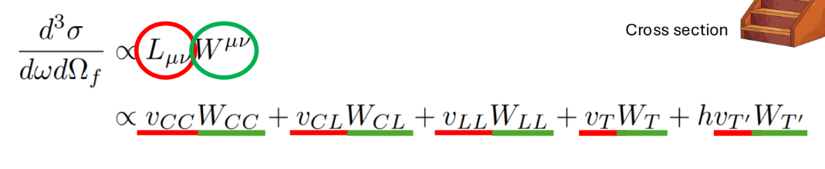
From scattering off the nucleon to scattering off the nucleus
If the nucleon is bound in a nucleus :
Impulse approximation :
the interaction between the projectile and target nucleons has essentially the same form as the interaction between two particles in free space
scattering is dominated by single-collision processes
the lepton couples to a single nucleon in the nucleus
Sum over all nucleons !
Insert wave functions for nucleons feeling the nuclear potentialfor the nucleon states

Slide 14
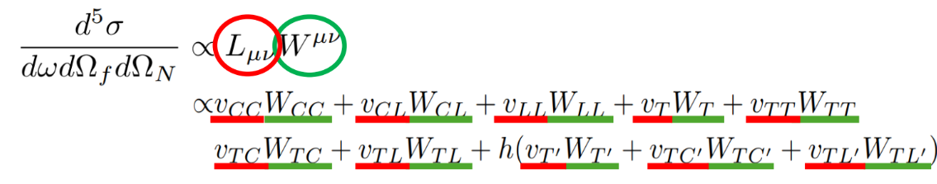
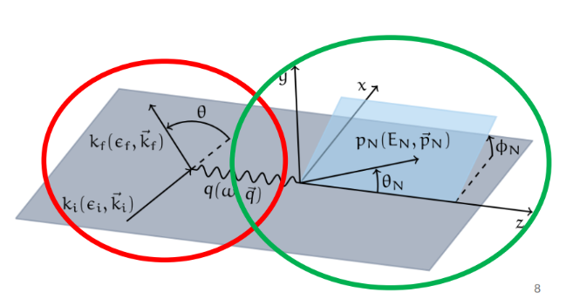
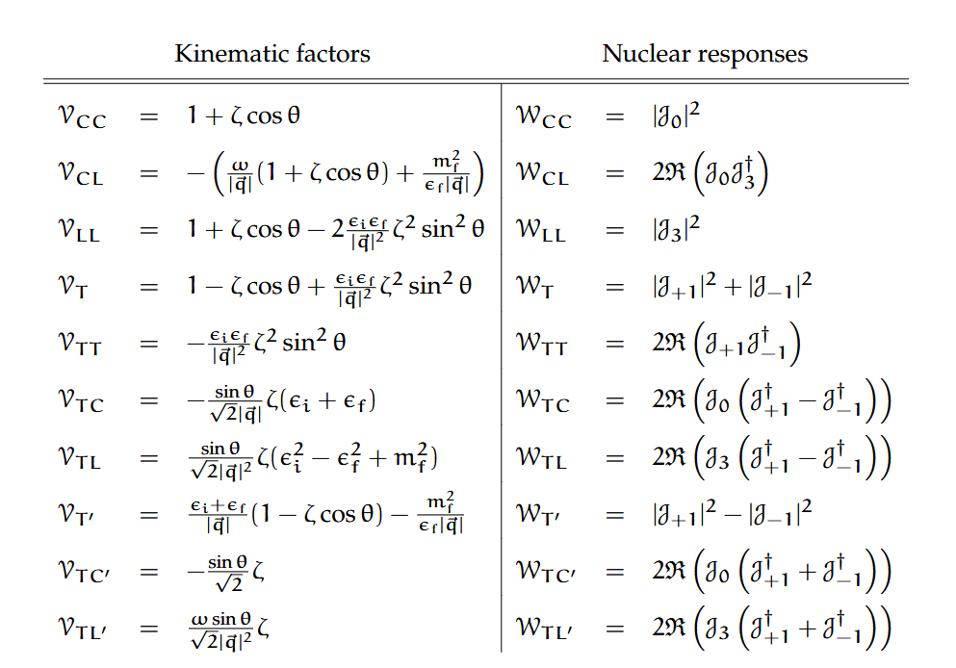
More important things you should know about neutrino-nucleus scattering : inclusive vs exclusive
Exclusive cross sections, where also the final nucleon is detected (and has to be described) are a bit more involved :
leptons
Theoretical extensions needed for exclusive:
Extra response functions
Appropriate description of the outgoing nucleon wave function in the nuclear medium
Contributes to more accurate reconstruction of the neutrino energy
Hadronic tensor

Slide 15
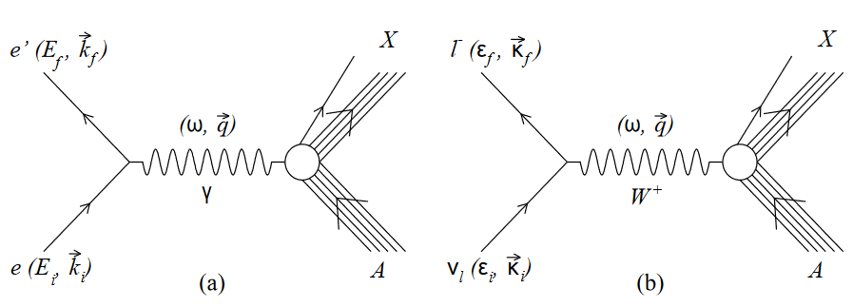
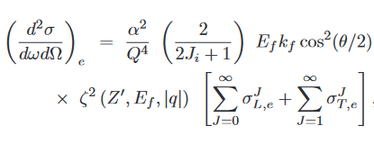
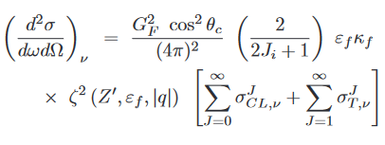
Electron versus neutrino scattering
More important things you should know about neutrino-nucleus scattering
Electron versus neutrino scattering
Notes:
Focus on QE scattering, In born approximation

Slide 16
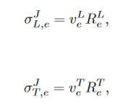
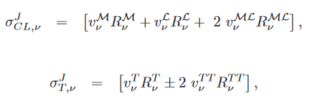
Electron versus neutrino scattering
Notes:
In born approximation

Slide 17
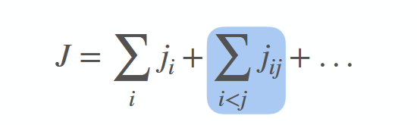
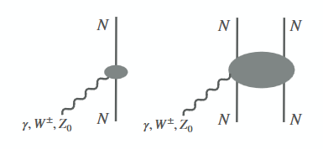
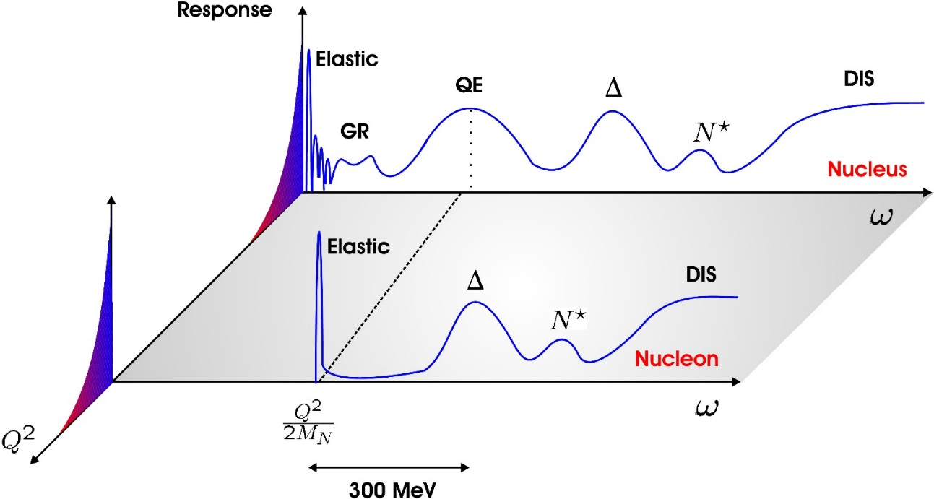
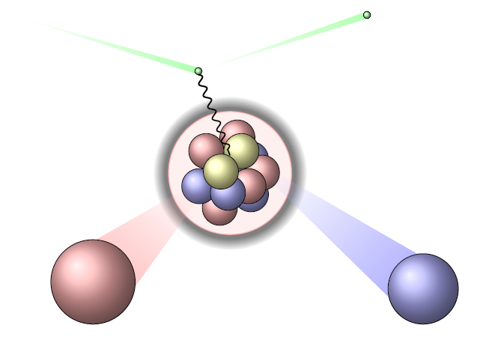
Quasi elastic versus multinucleon knockout processes
Multi-nucleon effects
  affect 1-nucleon knockout processes
  Cause multi-nucleon knockout processes, filling the dip region between the QE and the Delta peak

Slide 18
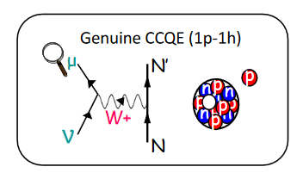
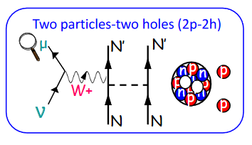
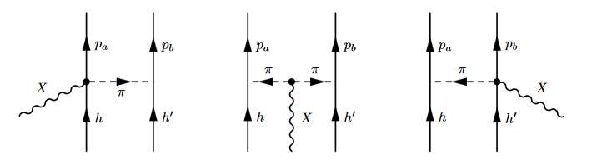
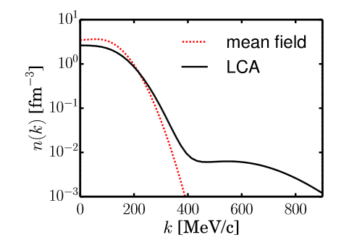
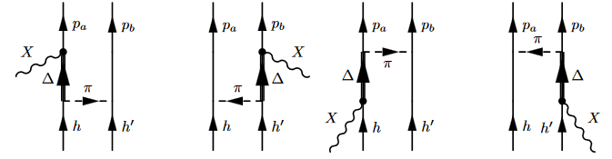
Quasi elastic versus multinucleon knockout processes
When an electroweak boson interacts with a pair of nucleons which are correlated through short-range correlation or through the exchange of a meson, this will cause the knockout of one or both of the particles from the nucleus. The boson was interacting with a current consisting of two nucleons, a two-body current, called a MEC
Meson-exchange currents
IPM single-particle orbitals are depleted by short range correlations and higher momentum states are populated
Seagull
Pion in flight
Delta currents

Slide 19
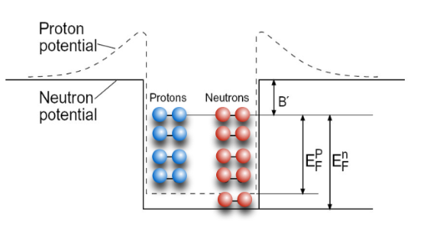
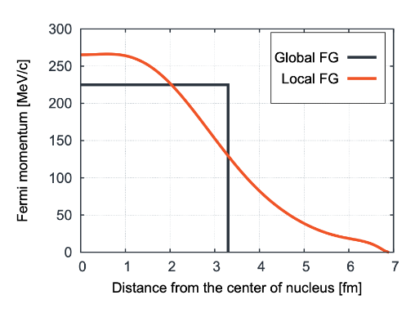
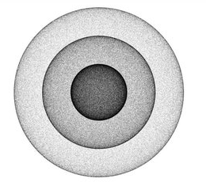
Models you often hear about when working in neutrino physics : Fermi Gas
Nucleons are not interacting, constant average binding energy
Global Fermi gas :
  same Fermi momentum for the whole nucleus = uniform density
Local Fermi gas
  Density dependent Fermi momentum p_{F} ~ ρ(r)^{1/3} adjusted to the local density in the nuclear medium
Extra nuclear effects can be added, often labeled FG+RPA e.g. Nieves model (Valencia), Martini model (Saclay Lyon)

Slide 20
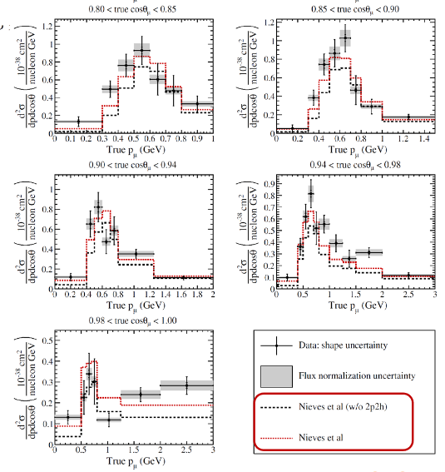
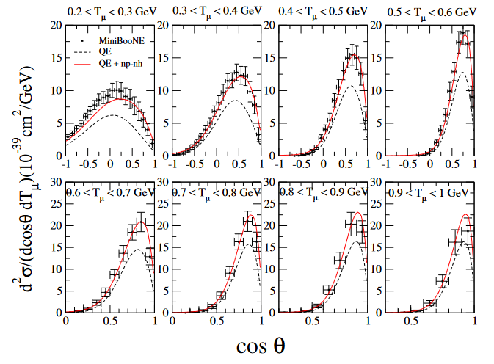
Models you often hear about when working in neutrino physics : Fermi Gas
Fermi gas approaches
  Efficient description of inclusive processes in QE peak region
  Can include extra correlations
  Including np-nh contributions
  often used in generators
  satisfactory agreement with inclusive data
M. Martini et al, PRC84, 055502
Valencia model T2K

Slide 21
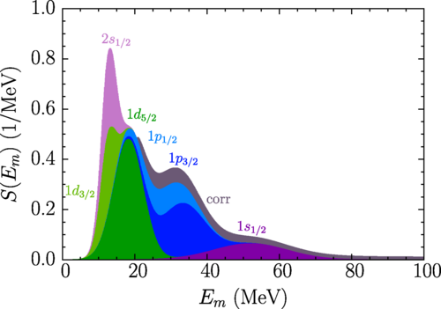


Models you often hear about when working in neutrino physics : Spectral function
Based on the impulse approximation
Cross section is factorized : σ_{nucleus}=σ_{nucleon} x P(p_{m},E_{m})
The spectral function P(p_{m},E_{m}) provides a probability distribution for removing a nucleon with momentum p_{m(issing)} from the initial nuclear ground state, leaving the final residual nucleus in a state with energy E_{m}
The spectral function can be extracted from (electron) scattering data or calculated using a model
PRC91, 034607 (2015)
PRD105, 11 2002 (2022)
Determination of the argon spectral function from (𝑒,𝑒′⁢𝑝) data
Notes:
Artifacts near threshold, still factorized !

Slide 22


Spectral function
Spectral function calculations
  Factorized approach
  Nuclear medium influence taken into account by spectral function
  Can be extended two 2p2h processes
M. Ivanov et al. PRC91,034607
¹²C
CBF spectral function
N. Rocco, Front. Phys 8 (2020)
Notes:
The hole-spectral function P_{h}(k, E) provides the probability distribution of removing a nucleon with momentum k from the target nucleus, leaving the residual (A − 1)-nucleon system with an excitation energy E.

Slide 23


Models you often hear about when working in neutrino physics : (Super)Scaling
Day et al., Annu. Rev. Nucl. Part. Sci. (1990)
Based on factorization : separates the QE cross section in an averaged single-nucleon factor and a scaling function encoding the influence of nuclear dynamics
→ Scaling of the first kind = independence on q
Scaling variable y ~ minimal longitudinal momentum the bound nucleon had before the interaction
Notes:
Scaling variables : chosen in a smart way, most variables dimensionless (or easy to make dimensionless)
Extracted from energy momentum conservation -> related to fermi motion distribution
negative : below the close to QE peak, moving further away other mechanisms (2nucleon etc become important
Scaling function f(y) is fundamentally related to the fermi distribution, if normalized properly that is universal. Negative y= below QEP
Not a neDe variabele y representeert natuurkundig gezien de minimale initiële impuls (momentum)
die het getroffen nucleon parallel aan de richting van de virtuele foton-overdracht moet hebben gehad om aan de kinematische voorwaarden te voldoen. [1]
Onafhankelijkheid: Wanneer y-scaling perfect opgaat, betekent dit dat de schaalffunctie F(y) onafhankelijk is geworden van de totale momentumoverdracht (q). Dit bewijst dat het elektron daadwerkelijk interageert met losse bouwstenen (incoherente verstrooiing) en niet met de kern als één collectief object. [1, 2, 3]
Waarom is het werk van Donnelly hierin belangrijk?
Professor T.W. Donnelly heeft, vaak in samenwerking met fysicus Ingo Sick, baanbrekend werk verricht door:
Relativistische effecten te integreren: Te beschrijven hoe y-scaling zich gedraagt binnen het Relativistic Fermi Gas (RFG) model, waarbij rekening wordt gehouden met de enorme snelheden van nucleonen in de kern. [1, 2]
Longitudinale en transversale scheiding: Aan te tonen hoe de schaalvariabele apart moet worden toegepast op de elektrische (longitudinale) en magnetische (transversale) responsfuncties van de atoomkern. [1, 2]
Superscaling: Dit concept later uit te breiden naar superscaling (meestal aangeduid met de variabele ψ'), waarmee niet alleen de afhankelijkheid van de energieuitwisseling wordt weggeschaald, maar ook de afhankelijkheid van het massagetal (A) van de specifieke atoomkern (zoals Helium, Koolstof of IJzer). [1, 2]
Toepassing
Dit theoretische kader van Donnelly wordt tot op de dag van vandaag intensief gebruikt in nucleaire onderzoekscentra (zoals Jefferson Lab) om de interne impulsdistributie van nucleonen te bepalen en om voorspellingen te doen voor neutrino-atoomkernreacties in moderne deeltjesfysica-experimenten. [1, 2, 3]
Bent u bezig met een specifieke kinematische berekening binnen de kernfysica, of zocht u naar de formule achter de y-schaalvariabele? Laat het gerust weten zodat we hier dieper op in kunnen gaan! [1]
AI-reacties kunnen fouten bevatten. Meer informatie
12 sites
Scaling in electron scattering from a relativistic Fermi gas | Phys. Rev ...
1 okt 1988 — Abstract. Within the context of the relativistic Fermi gas model, the concept of ''y scaling'' for inclusive electron scattering f...
APS Journals
Mesonic y scaling | Phys. Rev. C - APS Journals
17 apr 2002 — Abstract. The concept of y scaling has been demonstrated in the scattering of high-energy electrons to the nuclear continuum, demo...
APS Journals
Superscaling and neutral current quasielastic
w idea

Slide 24



(Super)Scaling
Donnelly and Sick, PRL82 (1999)
Scaling variable Ψ’ ~ ratio of threshold nucleon knockout energy to the momentum transfer
→Scaling function independent of A (k_{F}) = Scaling of second kind
Notes:
Longitudinal and transverse separated Below the peak (ψ' < 0): At high momentum transfers, scaling of the second kind is excellent. The scaling functions extracted from completely different nuclei (such as carbon-12, oxygen-16, and calcium-40) collapse onto a single universal curve.Above the peak (ψ' > 0): Scaling of the second kind is broken to a moderate degree. This happens because other distinct physical processes besides simple nucleon knockout—such as meson-exchange currents (2p-2h excitations) and delta resonance production—begin to dominate the energy spectrum. [1, 2, 3, 4, 5, 6]

Slide 25


Models you often hear about when working in neutrino physics : (Super)Scaling
Day et al., Annu. Rev. Nucl. Part. Sci. (1990)
Scaling of the first kind
+
Scaling of the second kind
=
SuperScaling
Separating longitudinal and transverse contributions :
Allows for a more sophisticated and accurate description
Shows that transverse channels violate scaling beyond the quasi-elastic peak : multinucleon effects
→ use RMF calculations to determine the scaling functions = SuSAv2
R. Gonzalez-Jimenez PRC90, 035501(2014)
Notes:
Can be extended to higher energies ...recipe : extract scaling function from e-scattering data and use it in neutrino-nucleus calculations. Techniquehas bee refined including RMF calculations

Slide 26


SuSA
Superscaling approach
  SuSAv2 based on RMF calculations
  Strong predictive power for inclusive processes
  Including inelastic channels : meson-exchange contributions and pion production
G. Megias et al, PRD 91, 073004
Megias et al., PRD 94, 013012 (2016)

Slide 27




Models you often hear about when working in neutrino physics : Mean Field
Mean-field models capture a lot of nuclear medium effects in a natural and efficient way
For final nucleon wave function distortion is included
Pauli blocking is included in a natural way
Can be extended to include long-range CRPA, short-range correlations, MECs
Non-relativistic e.g. HF and HF-CRPA (Ghent), or relativistic (ED)-RMF (Madrid-Sevilla)

Slide 28




Mean Field
Mean field already contains a lot of correlations !
Notes:
Expansion of the operatortttttttewweewwwwwwwwwwwwwwwwwwtttwwwwwwwwewt
Infinite order … but one limited class of topologies / beyond the vacu as eg fg

Slide 29



Mean Field
Hartree-Fock mean field
Mean-field models capture a lot of nuclear medium effects in a natural and efficient way
For final nucleon wave function Pauli blocking is included in a natural way
Can be extended to include long-range CRPA, short-range correlations, MECs
E_{ν}=200 MeV
Ghent group,
A. Nikolakopoulos et al, PRC103, 064603
N. Van Dessel et al, PRC97, 044616
V. Pandey, PhD Thesis UGent 2015

Slide 30




Models you often hear about when working in neutrino physics : Mean Field
$$d^{2}σ/dωdΩ\left(\text{nb}\text{/}\text{MeV} \text{sr}\right)$$
$$ω (\text{MeV})$$

Slide 31

Models you often hear about when working in neutrino physics : Mean Field
T2K ν_{µ}

Slide 32



Hartree-Fock MF -CRPA
Fermi gas
Hartree-Fock
Distortion of the final wave function !

Slide 33


Models you often hear about when working in neutrino physics : Mean Field
Exclusive ED-RMF implementation in NEUT
T. Franco-Munoz, J. McKean et al., arXiv:2605.00756

Slide 34



Models you often hear about when working in neutrino physics : Mean Field
Influence of 2-body currents on one-nucleon knockout
2-nucleon knockout

Slide 35


Models you often hear about when working in neutrino physics : Ab Initio
Recent years have seen the coming-of-age of ab-initio calculations for neutrino-nucleus cross section predictions and the development of auxiliary techniques to provide predictions for a variety of processes, targets and kinematics
Ab initio results
Realistic Hamiltonian e.g. AV18 in GFMC
Exact (up to the accuracy of the interaction Hamiltonian and order)
Including multinucleon contributions in a natural way
Computationally intensive and
only applicable to the inclusive response
Light nuclei
Non-relativistic
H. Hergert

Slide 36

Ab Initio
MiniBooNE flux-folded double differential cross sections per target neutron for ν_{μ}-CCQE scattering on ¹²C in a Green’s Function Monte Carlo approach
include the effects of many-body correlations induced by the interactions in the initial and final states
account for the interference between one- and two-body current contributions
A. Lovato et all PRX10, 031068 (2020)

Slide 37

Ab initio
T2K flux-folded double differential cross sections per target neutron for ν_{μ}-CCQE scattering on ¹²C in a Green’s Function Monte Carlo approach
Comparing ab-initio calculations with mean-field-based calculations
Include long-range correlations in CRPA and added 2p-2h contributions
NJ, A. Nikolakopoulos, EPJ Special Topics 230, 7803

Slide 38



Short Time Approximation STA
Short-time approximation : go beyond the restriction to inclusive processes in ab-initio approaches and provides
more exclusive information
Based on factorization
Retains 2-body contributions and correctly accounts for interference
Response functions account for scattering off pairs of interacting nucleons
Transverse response density
S. Pastore et al, PRC101, 044612

Slide 39





Making AI work : Coupled cluster
Coupled-cluster theory predictions for inelastic scattering processes
Reference state = mean field
Operator to include correlations
Truncation in T controls approximation level
J.E. Sobczyk et al.; PRL 27, 072501 (2021)
J. Sobczyk et al., PRC 109 (2024) 025502
Notes:
Psi is

Slide 40
Beyond nucleon and two-nucleon knockout

Slide 41





Pion production
Pion production
Resonances
+
ChPT background
Valencia model
Single pion production in Delta region relatively well understood
Important background channel for quasi-elastic cross section measurements as the produced pions may be re-absorbed in the nuclear medium or remain otherwise unobserved, leading to a CC0π topology mimicking a QE event
Notes:
Contact term / pion pole / t-channel pion in flight, rho meson exchange e.g.

Slide 42

Basic ingredients for modeling single pion production
MINERvA, DUNE
Δ resonance 1pi production
Second resonance region :
P₁₁(1440), D₁₃(1520), S₁₁(1535)
2pion, η, .... Production
MiniBooNe, T2K, HK
Third resonance region :
~15 overlapping resonances
MK arXiv2409.02890
ChPT background
Reggeized background
Notes:
2isospin+1, 2J+1 delta 33, parity is (-1)l+1 with 1 for the intrinsic parity of the pion the state is decaying into delta is P33

Slide 43








Basic ingredients for modeling single pion production (off the nucleon !)
Hadron tensor
At tree level
Resonances : invariant mass, width Γ, isospin I, spin J, parity P, and for SPP the branching ratio for decay into a pion and nucleon
+
Nucleon pole and cross nucleon pole
Non-resonant background
+
+
+ interferences

Slide 44








Basic ingredients for modeling single pion production
Let’s pick just one contribution ...
spin 3/2 resonance direct contribution
Isospin coefficient
Vertex function for resonance production
Vector and axial contribution
Constraint through CVC and PCAC
Axial form factors not well constrained,
Large uncertainties on neutrino data
e.g. in Lalakulich parametrization
Notes:
Rarita schwinger 3/2

Slide 45

Basic ingredients for modeling single pion production
Let’s pick just one contribution ...
spin 3/2 resonance direct contribution
Isospin coefficient
Resonance propagator

Slide 46




Basic ingredients for modeling single pion production
Let’s pick just one contribution ...
Spin 3/2 resonance direct contribution
Isospin coefficient
Vertex function for the decay vertex
Depends on
  Coupling constant f_{πNR}
  Resonance width Γ
Experimentally determined full width + branching ratio

Slide 47


Basic ingredients for modeling single pion production
... and these are only resonances ...
M. Giannini, PPNP 24, 253 (1990)

Slide 48

Rein Sehgal model
D. Rein and L.M. Sehgal, Annals of Physics 133, 79 (1981)

Slide 49


Models for pion production : ANL-Osaka DCC
predicts πN, γN partial wave amplitudes used to determine cross sections for πN, ηN, KΛ and KΣ scattering, photoproduction of these channels, 2π production off the nucleon, pion electro- and neutrinoproduction
Up to W~2 GeV, including ~20 N* states
Fit to ~30.000 data points for foto pion nucleon, hadron and pion production, and electroproduction for different incoming energies,
Dynamic coupled channel formalism, different reaction mechanisms contribute in a consistent way to the final state
S. Nakamura, H. Kamano, T. Sato, PRD92, 074024 (2015)
DCC implementation in SUSA

Slide 50


MK model
Single pion production off the nucleon
developed aiming at describing neutrino induced processes !
RS with 17 resonances W<2GeV
Non-resonant background HNV model
Fit of a lot of parameters to data
dσ/dWdQ²dΩ_{π}

Slide 51




Ghent Hybrid model : single pion production off a bound nucleon
Designed aiming at the description of pion production off the nucleus
  Low energy model : resonances + background from ChPT in HNV description
  High energy model : Reggeized background to overcome shortcomings of the low energy description
Aiming at fully exclusive description with distorted pion and nucleon wave functions
RMF description for the nucleus
π(140)/b₁(1235) propagator
R. Gonzalez-Jimenez et al.,Phys. Rev. D 97
M. Hooft et al., arXiv 2603.29486
Notes:
In the Regge approach a whole class of contriubtions is taken into account in a consistent way by exchanging a whole trajectory of mesons in the t- channel

Slide 52



Duality and the transition from nucleon to partonic degrees of freedom
This kinematic region is not well understood or studied, both experimentally and theoretically
A considerable fraction of events at higher incoming energies are from the SIS (Shallow Inelastic) and D(eep)IS regions
Important background channel for quasi-elastic cross section measurements as the produced pions may be re-absorbed in the nuclear medium or remain otherwise unobserved, leading to a CC0π topology mimicking a QE event
A considerable fraction of events at higher incoming energies are from the SIS and DIS regions e.g. around 50% for DUNE
W> Δ(1232), Q² < 1 GeV
Snowmass WP on theoretical tools for neutrino scattering, L. Alvarez Ruso et al, arXiv:2203.09030

Slide 53

Duality and the transition from nucleon to partonic degrees of freedom
This kinematic region is not well understood or studied, both experimentally and theoretically
A considerable fraction of events at higher incoming energies are from the SIS and DIS regions e.g. around 50% for DUNE
Important background channel for quasi-elastic cross section measurements as the produced pions may be re-absorbed in the nuclear medium or remain otherwise unobserved, leading to a CC0π topology mimicking a QE event
W> Δ(1232), Q² < 1 GeV
Snowmass WP on theoretical tools for neutrino scattering, L. Alvarez Ruso et al, arXiv:2203.09030

Slide 54




Duality and the transition from nucleon to partonic degrees of freedom
The phenomenology of the transition to partonic degrees of freedom is assessed by Bloom-Gillman duality
Electron-scattering : resonances (Jlab E94-110 data) follow the extrapolated DIS curve
For neutrinos, the situation is less clear :
Data is limited to low-statistics hydrogen and deuterium bubble chamber data from the 70s and 80s
For computations the integrated resonance strength tends to account for only ~50% of the observed signal
GIBUU
U. Mosel et al, PRC96, 015503 (2017)
arXiv:2203.09030
Notes:
Nachtmann scaling variable

Slide 55




DIS : Deep Inelastic Scattering
Nucleon structure functions
Encode information about the influence of the nuclear medium
x : Bjorken scaling variable : fraction of the hit nucleon’s momentum carried by the struck parton
y : fractional energy loss of the probing particle
Aligarh group PRD 105, 093002 (2022)
Notes:
X and y are Lorentz invariant X=1 is elastic

Slide 56



And finally : What is going on between initial and final detected state ... ?
Partially taken into account by some of the nuclear models
MC Generators used for oscillation analyses tend to rely on efficient but approximate models
T. Golan
Notes:
Incoming neutrino does not see a free nucleon but one that is busy interacting with the others, experiencing the nuclear potential in which it is bound. In fact it’s even more complicated than the cartoon shows the neutrino has the choice to interact with any of the nucleons in the nucleus. Their behavior is not identical. And for 1 nucleon not a constant in time
After the interaction ....

Slide 57





Event generators : bridges between theory and data
Credit: Kaile WEN@IHEP, Xianguo LU@Warwick
$†$ Proton in GiBUU final-state transport
R: radial position, M_{p}: mass, p_{p}: momentum
Theoretical models tend to concentrate on description of the primary vertex
Generators provide more detailed information about secondary processes obtained in a semi-classical cascade description
Trade-off between sophistication in models and numerical performance
Notes:
Gibuu and Wroclaw standing close to theory

Slide 58



Event generators : bridges between theory and data
Theoretical models tend to concentrate on description of the primary vertex
Generators provide more detailed information about secondary processes obtained in a semi-classical cascade description
Trade-off between sophistication in models and numerical performance
Number of generators on the market :
        GENIE, NEUT, NuWro, GIBUU
  Challenges in generator developments :
  Standardized interfaces
  Microscopic input for vertex – exclusive description e.g. SuSAv2 and CRPA in GENIE, EDRMF in NEUT, GHENT-HYBRID in NuWro

Slide 59





Event generators : bridges between theory and data
Number of generators on the market :
        MARLEY : low energy processes (< 100 MeV) S. Gardiner PRC103, 044604 (2021)
        INCL : FSI including nuclear clusters and de-excitation
        Achilles : beyond standard model processes, QMC nuclear input
 | arXiv:2205.06378
HNL
J. Isaacson et al. PRD 107, 033007 (2023)
Notes:
Achilles : theory driven, modular

Slide 60

What you really should take away …
Things to be aware of when working with cross section models :
Not every model is suitable for the description of any process … What assumptions and approximations are built in ? What is the validity range of the model ?
Make sure that the model you use is up to the task e.g. exclusive data will need more refined modelling (Is the final state a distorted wave ? Are binding energies and Pauli blocking taken into account ? Angular distributions for hadrons will typically need mean field models to be accurate, ….)
Descriptions are often based on effective parametrization. As a consequence, results and the separation between various effects are scheme dependent.
When adding various effects on top of each, make sure you’re doing it in a consistent way to avoid double counting. Caring about consistency is a great idea anyhow.
Making sure that the model is validated against electron scattering data for the type of process and kinematic range you’re looking at is a great idea
Still, be aware that neutrinos are different from electrons … and differences might bias results

Slide 61









Where should we go from here ?
Challenging !
Raul Gonzalez-Jimenez
The upcoming generation of experiments needs cross section calculations with unprecedented accuracy and reliable uncertainty estimates
We have to tackle the currently existing degeneracy between nucleon uncertainties and nuclear effects, and between cross section and flux uncertainties
We need calculations for more exclusive processes
Argon targets
Especially in the kinematic region beyond the quasielastic and the delta region, and beyond … a lot of open issues remain
Combine strength of microscopic quantummechanical modeling and generator approaches to FSI and make sure theoretical progress finds it way to generators
A. Ashkenazi
Snowmass WP on theoretical tools for neutrino scattering, L. Alvarez Ruso et al, arXiv:2203.09030
Notes:
More rare scenario’s as e.g. hyperon ;pro

Slide 62





Further reading …
Stay tuned for the new NuSTEC White Paper coming soon !

Slide 63


