Slide 1

Department of Basic Sciences
High Energy Particle Physics Group
Serkant Ali Çetin
Professor of Physics, Chair
10.09.2024 / 1st Transnational Meeting of VPCLApps

Slide 2
About ISU Dept. of Basic Sciences
The knowledge, that applied science disciplines such as engineering and medicine rely on, is an outcome of the research in basic sciences. Likewise, many technological and methodological outcomes of applied sciences make more advanced research in basic sciences possible.
Istinye University has an academic staff in various basic science disciplines, who are highly skilled both in education and research.
  This academic potential serves the teaching and research excellence vision of the university through the departments within the Faculty of Engineering and Natural Sciences such as Chemistry and Mathematics, as well as the Department of Basic Sciences founded under the Rectorate.
The academic staff at the Department of Basic Sciences conducts research-oriented studies in the field of High Energy Particle Physics and also runs the PhD program in Physics.

Slide 3
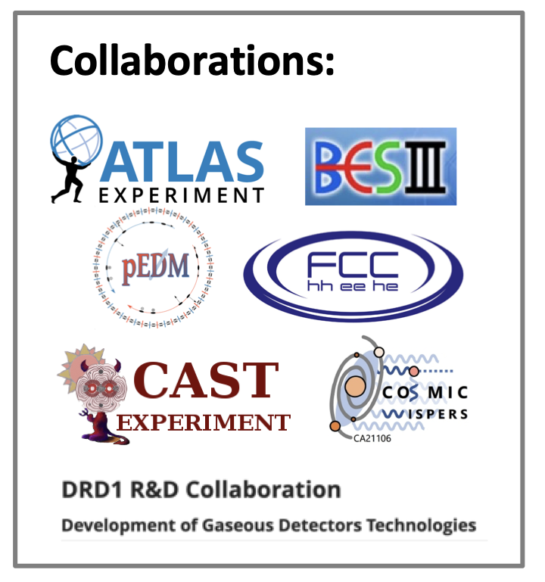
About ISU High Energy Particle Physics (HEPP) Research Group
ISU prioritized HEPP among its R&D fields and initiated establishment of a research group by Sept. 2021. The competent academic and technical staff of the HEPP Research Group are involved in advanced studies on High Energy Physics, Particle Physics, Particle Detectors and Particle Accelerators.
The local laboratory infrastructure to conduct R&D in these fields together with various externally funded projects (TÜBİTAK, TENMAK, TÜSEB) and memberships in world-class international research collaborations offer unique opportunities to PhD students as well.
ISU is a member of four (ATLAS, CAST, DRD1, FCC) collaborations at CERN, the European Particle Physics Laboratory, one (BESIII) experiment at the Institute of High Energy Physics of the Chinese Academy of Sciences, and one (sr-EDM) experiment under preparation at the US Brookhaven National Laboratory as well as the COST action CosmicWISPers.

Slide 4
ISU High Energy Particle Physics (HEPP) Research Group / Projects
PRINCIPLE:
Measurement of average magnetic field along the particle accelerator beam line using K-modulation technique TÜBİTAK (1001)
Development of Gamma Probe with Active Shielding TÜBİTAK (1005)
Production and Characterization of Plastic Scintallors doped with Lithium Tetraborate Nanoparticles
TÜBİTAK (1005)
Construction of a Novel Cosmic Ray Neutron Sensor Prototype for Measuring Soil Moisture over Large Areas
TÜBİTAK (1512)
Ecological Improvement of Gases in Gaseous Particle Detectors
TÜBİTAK (1002)
Development of a new generation hybrid gamma probe by integrating directional count and emission functions
TÜSEB (B)
Data Taking, Data Analysis and Operation, Maintenance and Upgrade of Detector Systems at the CERN-ATLAS Experiment
TENMAK (CERN)
PARTICIPANT:
Virtual Physics Laboratory Applications (Anadolu U.) Erasmus+ KA220-SCH
Cosmic WISPers in the Dark Universe (Bari U., Italy)
COST Action CA21106
Study of the Potential of Scintillation Powders and Optical Media for Cosmic Neutron Detection (Yildiz Technical U.)
TÜBİTAK (1001)
Development of Neutron Interaction Model with Gadolinium Doped Water Cherenkov Detector (Erciyes U.)
TÜBİTAK (1001)
Customized Scintillator Production for Particle Accelerators and Detectors (Bogazici U.)
TÜBİTAK (1005)
Jet Physics Analysis and HCAL-HGCAL Detector R&D at CERN's CMS Experiment (Yildiz Technical U.)
TENMAK (CERN)

Slide 5
ISU High Energy Particle Physics (HEPP) Research Group / Members
Serkant Ali Çetin
Professor
Sertaç Öztürk
Professor
Andrew J. Beddall
Associate Professor
Selçuk Hacıömeroğlu
Associate Professor
Onur Buğra Kolcu
Assistant Professor
Candan Dözen Altuntaş
Postdoctoral Researcher
Emre Çelebi
Postdoctoral Researcher
Sinem Şimşek
Postdoctoral Researcher
Zekeriya Uysal
Postdoctoral Researcher
Ahmet Renklioğlu
Technical Specialist
Orhan Seyrek
Technical Assistant Specialist
Neslihan Sözeri
Administrative Assistant
Anatoli Romaniouk
Adjunct Professor
Sezen Sekmen
Adjunct Professor
& 10 PhD students

Slide 6
ISU HEPP Group Leader / Serkant Ali Çetin / Highlights on project relevant experience
Local Organizer and Lecturer, ICFA Instrumentation School (International Committee for Future Accelerators), 1999, Istanbul/Turkiye
Local Organizer, International School of Theory and Analysis in Particle Physics (ISTAPP), 2011, Istanbul/Turkiye
National Contact, Beamline for Schools Competition by CERN, since 2016
Event Organizer, CERN-Turkey Knowledge Transfer Summit, 2016, Istanbul/Turkiye
Event Organizer, CERN Accelerating Science Exhibition, 2017, Istanbul/Turkiye
Event Organizer, Beamline for Schools Info Days, 2024, 2023, 2022, 2021, 2020, Istanbul/Turkiye (initiated this info day series in 2020)
Event Organizer, Local Infrastructure and R&D Workshop on Particle Accelerators and Detectors, 2024, 2023, 2022, 2021, 2020, Istanbul/Turkiye (initiated this annual workshop series in 2020)
Event Organizer, Public Launch: “Istinye University Joins ATLAS”, 2023, Istanbul/Turkiye
Coordinator of Science and Technology Communication at ISU
…

Slide 7
ISU HEPP Group Leader / Serkant Ali Çetin / SCIENCE COMMUNICATION & OUTREACH
Public Events and Talks
Through various events and organizations, I've been able to reach out to a variety of audience and have had the chance to address subjects like "science & society", "particle physics", "science & technology", "generic technologies & their applications". Below are some diverse examples:
  Public Talk / during the “CosmicWISPers General Meeting” (2024)
      Cosmic Whispers that we can not hear: Dark Side of the Universe
  Betül Mardin Seminars / "Science Communication" (2023)
      A Vectorial Approach to Science Communication
  Brandweek Istanbul / "Designing the Future" (2019)
      Today for tomorrow, tomorrow for yesterday
  TEDx / "Uncharted Lands" (2018)
      Question first, know later
  TEGEP Training and Development Summit / "Collision" (2018)
      From Physics Laws to Organizations
  Istanbul European Cultural Capital Events / "Choreographers' Day”, (2010)
      Performance: Body & Physics - Interaction & Collision
~100 public, high school or student club talks in the last 20 years.

Slide 8
ISU HEPP Group Leader / Serkant Ali Çetin / MENTORSHIP AND SUPERVISION
High school level
  Lectured high school students at training events like "High Energy Physics for High Schools", and, school teachers at the Turkish Teachers Programs at CERN.
  Engaged ~1000 high school students to work on proposals or literature search in physics and engineering through the "Beamline for Schools Info Days”.
University / Academic level
  Lectured physics or engineering students at various extra-curricular summer/winter Accelerator & Detector schools.
  Acting as scientific consultant to various student clubs and one NGO to disseminate further passion for physics
  Supervised and/or mentored around 15 senior undergraduate students, 20 graduate students and 5 postdocs.
  Since 2020, running a TUBİTAK mentorship project, where assigned undergraduate physics students receive consultancy on their academic performance and career planning until they graduate; so far, I've been working with more than 10 students.

Slide 9
ISU HEPP Group / VPCLApps
Message by Hakan:
… We will all decide on the e-book and related experiment content together. I suggested a series of topics below as a first step. These contents were determined according to high school textbooks. We will clarify 6 of these or other topics. I would like you to know that these units do not have to be the ones I suggested. ESMEM and APEL participating institutions are especially expected to do preliminary work on the unit titles.
  1.Pendulum Experiment
  2. Movement in the Horizontal Plane
  3. Movement on an Inclined Plane
  4. Oblique Shot -> (Projectile Motion)
  5. Friction
  6. Collision
  7. Centripetal Force
  8. Electric field
  9. Ohm's Law
  10. Inspection of Capacitors
  11. Examination of Transformers
  1.Pendulum Experiment
  2. Movement in the Horizontal Plane
  3. Movement on an Inclined Plane
  4. Oblique Shot -> (Projectile Motion)
  5. Friction
  6. Collision
  7. Centripetal Force
  8. Electric field
  9. Ohm's Law
  10. Inspection of Capacitors
  11. Examination of Transformers

Slide 10
ISU HEPP Group / VPCLApps
  1.Pendulum Experiment
  2. Movement in the Horizontal Plane
  3. Movement on an Inclined Plane
  4. Oblique Shot -> (Projectile Motion)
  5. Friction
  6. Collision
  7. Centripetal Force
  8. Electric field
  9. Ohm's Law
  10. Inspection of Capacitors
  11. Examination of Transformers
  Pendulum Experiment (Simple Harmonic Motion)
  1D & 2D Motion with friction
  Projectile Motion
  Collision (Linear momentum & energy)
  Centripetal Force (Circular motion)
  Electric field
  Ohm's Law
  Inspection of Capacitors

Slide 11
11.
1. Ünite: Force and Motion
Vectors
Relative motion
Newton’ın Hareket Yasaları
1D Motion with constant acceleration
  Sabit İvmeli Hareket
  Serbest Düşme
  Limit Hız
  Düşey Doğrultuda Atış Hareketi
2D Motion
  Yatay Atış Hareketi
  Düşey Atış Hareketi
Energy & Motion
Impact and Linear Momentum
  İtme
  Çizgisel Momentum
  Çizgisel Momentumun Korunumu
  Çarpışmalar ve Çizgisel Momentumun Korunumu
Torque
Equilibrium and Equilibrium conditions
  Cisimlerin Denge Şartı
  Ağırlık Merkezi ve Kütle Merkezi
2. Ünite: Electricity & Magnetism
Elektriksel Kuvvet ve Elektrik Alan
Elektriksel Potansiyel
Düzgün Elektrik Alan ve Sığa
Manyetizma ve Elektromanyetik İndüklenme
Alternatif Akım
Transformatörler
ISU HEPP Group / VPCLApps
12.
1. ÜNİTE: Uniform circular motion
Düzgün Çembersel Hareket
Dönerek Öteleme Hareketi
Açısal Momentum
Kütle Çekim Kuvveti
Kepler Kanunları
2. ÜNİTE: Simple Harmonic motion
Basit Harmonik Hareket
3. ÜNİTE: Wave mechanics
Dalgalarda Kırınım, Girişim ve Doppler Olayı
Elektromanyetik Dalgalar
4. ÜNİTE: Intro to Atomic Physics and Radioactivity
Atom Kavramının Tarihsel Gelişimi
Büyük Patlama ve Evrenin Oluşumu
Radyoaktivite
5. ÜNİTE: Modern Physics
Özel Görelilik
Kuantum Fiziğine Giriş
Fotoelektrik Olayı
Compton Saçılması ve De Broglie Dalga Boyu
6. ÜNİTE: Technological applications of Modern Physics
Görüntüleme Teknolojileri
Yarı İletken Teknolojisi
Süper İletkenler
Nanoteknoloji
9.
1. Ünite: Physcis and Career Search
Fizik Bilimi
Fizik Biliminin Alt Dalları
Fizik Bilimine Yön Verenler
Fizik Bilimi İle İlgili Kariyer Keşfi
2. Ünite: Force and Motion
Temel ve Türetilmiş Nicelikler
Skaler ve Vektörel Nicelikler
Vektörler
Doğadaki Temel Kuvvetler
Hareket ve Hareket Türleri
3. Ünite: Fluids
Basınç
Sıvılarda Basınç
Açık Hava Basıncı
Kaldırma Kuvveti
Bernoulli İlkesi
4. Ünite: Energy
Enerji, Isı ve Sıcaklık Arasındaki İlişki
Isı, Öz Isı, Isı Sığası ve Sıcaklık Farkı Arasındaki İlişki
Hâl Değişimi
Isıl Denge
Isı Aktarım Yolları
Isı İletim Hızı
10.
1. Ünite: Electricity & Magnetism
Elektrik Akımı
Potansiyel Farkı, Direnç
Elektrik Devreleri
Elektrik Enerjisi, Elektriksel Güç
Mıknatıs ve Manyetik Alan
Akım ve Manyetik Alan
2. Ünite: Pressure & upthrust
Basınç
Kaldırma Kuvveti
3. Ünite: Waves
Yay Dalgası, Su Dalgası, Ses Dalgası, Deprem Dalgası
4. Ünite: Optics
Aydınlanma
Gölge
Yansıma
Düzlem Ayna
Küresel Aynalar
Kırılma
Mercekler
Prizmalar
Renk

Slide 12
ISU HEPP Group / VPCLApps
10.
1. Ünite: Electricity & Magnetism
Current, Potential difference, Resistance
Electrcal energy and power
Magnets and magnetic fields
Current and magnetic field
3. Ünite: Waves
Yay Dalgası, Su Dalgası, Ses Dalgası, Deprem Dalgası
4. Ünite: Optics
Aydınlanma
Gölge
Yansıma
Düzlem Ayna
Küresel Aynalar
Kırılma
Mercekler
Prizmalar
Renk
11.
1. Ünite: Force and Motion
Vectors
Relative motion
Newton’ın Hareket Yasaları
1D Motion with constant acceleration
2D Motion
Energy & Motion
Impact and Linear Momentum
Torque
Equilibrium and Equilibrium conditions
2. Ünite: Electricity & Magnetism
Elektriksel Kuvvet ve Elektrik Alan
Elektriksel Potansiyel
Düzgün Elektrik Alan ve Sığa
Manyetizma ve Elektromanyetik İndüklenme
Alternatif Akım
Transformatörler
12.
1. ÜNİTE: Uniform circular motion
Düzgün Çembersel Hareket
Dönerek Öteleme Hareketi
Açısal Momentum
Kütle Çekim Kuvveti
Kepler Kanunları
2. ÜNİTE: Simple Harmonic motion
Basit Harmonik Hareket
3. ÜNİTE: Wave mechanics
Dalgalarda Kırınım, Girişim ve Doppler Olayı
Elektromanyetik Dalgalar
4. ÜNİTE: Intro to Atomic Physics and Radioactivity
Atom Kavramının Tarihsel Gelişimi
Büyük Patlama ve Evrenin Oluşumu
Radyoaktivite
5. ÜNİTE: Modern Physics
Özel Görelilik
Kuantum Fiziğine Giriş
Fotoelektrik Olayı
Compton Saçılması ve De Broglie Dalga Boyu
Pendulum Experiment (Simple Harmonic Motion)
1D & 2D Motion with friction
Projectile Motion
Collision (Linear momentum & energy)
Centripetal Force (Circular motion)
Electric field
Ohm's Law
Inspection of Capacitors

Slide 13
ISU HEPP Group / VPCLApps
10.
1. Ünite: Electricity & Magnetism
Current, Potential difference, Resistance
Electrical energy and power
Magnets and magnetic fields
Current and magnetic field
3. Ünite: Waves
Yay Dalgası, Su Dalgası, Ses Dalgası, Deprem Dalgası
4. Ünite: Optics
Aydınlanma
Gölge
Yansıma
Düzlem Ayna
Küresel Aynalar
Kırılma
Mercekler
Prizmalar
Renk
11.
1. Ünite: Force and Motion
Vectors
Relative motion
Newton’s Laws of Motion
1D Motion with constant acceleration
2D Motion
Energy & Motion
Impact and Linear Momentum
Torque
Equilibrium and Equilibrium conditions
2. Ünite: Electricity & Magnetism
Elektriksel Kuvvet
Electric Field
Elektriksel Potansiyel
Uniform Electric fields and capacitors
Manyetizma ve Elektromanyetik İndüklenme
Alternatif Akım
Transformatörler
12.
1. ÜNİTE: Uniform circular motion
Uniform circular motion
Dönerek Öteleme Hareketi
Açısal Momentum
Kütle Çekim Kuvveti
Kepler Kanunları
2. ÜNİTE: Simple Harmonic motion
Basit Harmonik Hareket
3. ÜNİTE: Wave mechanics
Dalgalarda Kırınım, Girişim ve Doppler Olayı
Elektromanyetik Dalgalar
4. ÜNİTE: Intro to Atomic Physics and Radioactivity
Atom Kavramının Tarihsel Gelişimi
Büyük Patlama ve Evrenin Oluşumu
Radyoaktivite
5. ÜNİTE: Modern Physics
Özel Görelilik
Kuantum Fiziğine Giriş
Photoelectric effect
Compton Saçılması ve De Broglie Dalga Boyu
Pendulum Experiment (Simple Harmonic Motion)
1D & 2D Motion with friction
Projectile Motion
Collision (Linear momentum & energy)
Centripetal Force (Circular motion)
Electric field
Ohm's Law
Inspection of Capacitors

Slide 14
ISU HEPP Group / VPCLApps
10.
1. Ünite: Electricity & Magnetism
Current, Potential difference, Resistance
Electrical energy and power
Magnets and magnetic fields
Current and magnetic field
12.
1. ÜNİTE: Uniform circular motion
Uniform circular motion
Dönerek Öteleme Hareketi
Açısal Momentum
Kütle Çekim Kuvveti
Kepler Kanunları
2. ÜNİTE: Simple Harmonic motion
Basit Harmonik Hareket
5. ÜNİTE: Modern Physics
Özel Görelilik
Kuantum Fiziğine Giriş
Photoelectric effect
1D Motion (horizontal plane)
2D Motion (inclined plane)
Projectile Motion
Collision (Linear momentum & energy)
Simple Pendulum (Simple Harmonic Motion)
Uniform Circular Motion
Ohm’s Law
Capacitors
Motion of Charged Particle in Uniform Magnetic Field
Photoelectric Effect
11.
1. Ünite: Force and Motion
Vectors
Relative motion
Newton’s Laws of Motion
1D Motion with constant acceleration
2D Motion
Energy & Motion
Impact and Linear Momentum
Torque
Equilibrium and Equilibrium conditions
2. Ünite: Electricity & Magnetism
Elektriksel Kuvvet
Electric Field
Elektriksel Potansiyel
Uniform Electric fields and capacitors
Pendulum Experiment
(Simple Harmonic Motion)
1D & 2D Motion with friction
Projectile Motion
Collision (Linear momentum & energy)
Centripetal Force (Circular motion)
Electric field
Ohm's Law
Inspection of Capacitors

Slide 15
ISU HEPP Group / VPCLApps
1D Motion (horizontal plane)
2D Motion (inclined plane)
Projectile Motion
Collision (Linear momentum & energy)
Simple Pendulum (Simple Harmonic Motion)
Uniform Circular Motion
Ohm’s Law
Capacitors
Motion of Charged Particle in Uniform Magnetic Field
Photoelectric Effect
1D Motion (horizontal plane)
2D Motion (inclined plane)
Collision (Linear momentum & energy)
Ohm’s Law
Motion of Charged Particle in Uniform Magnetic Field
Photoelectric Effect

Slide 16
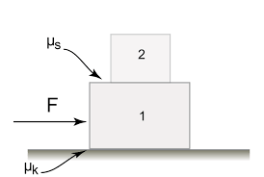
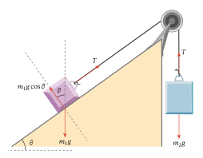
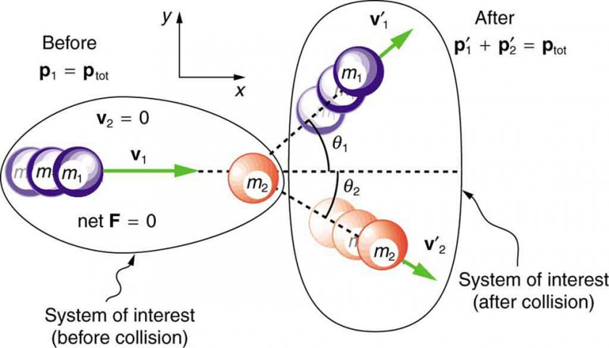
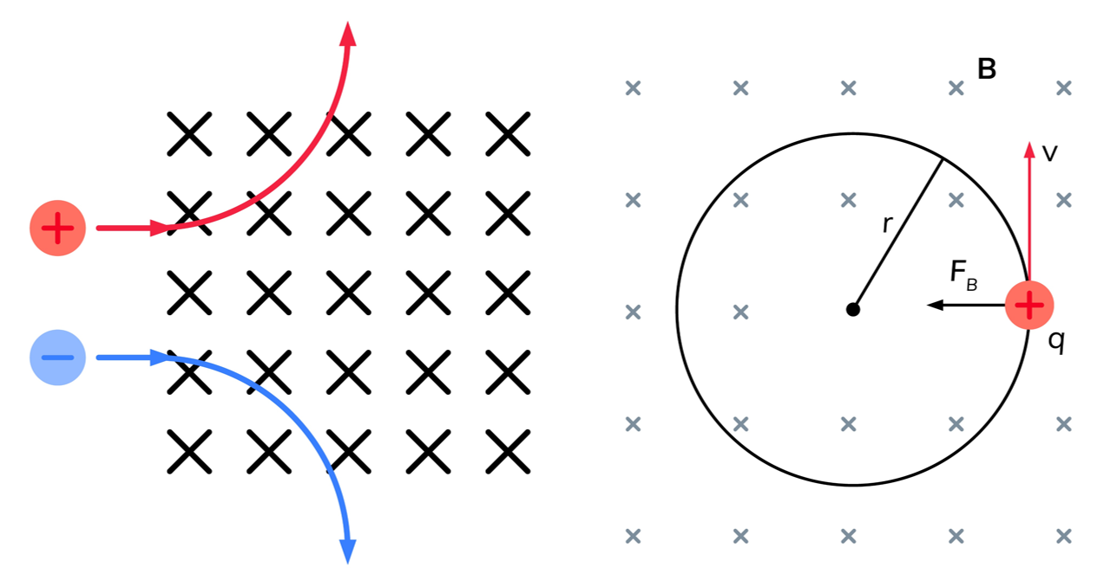
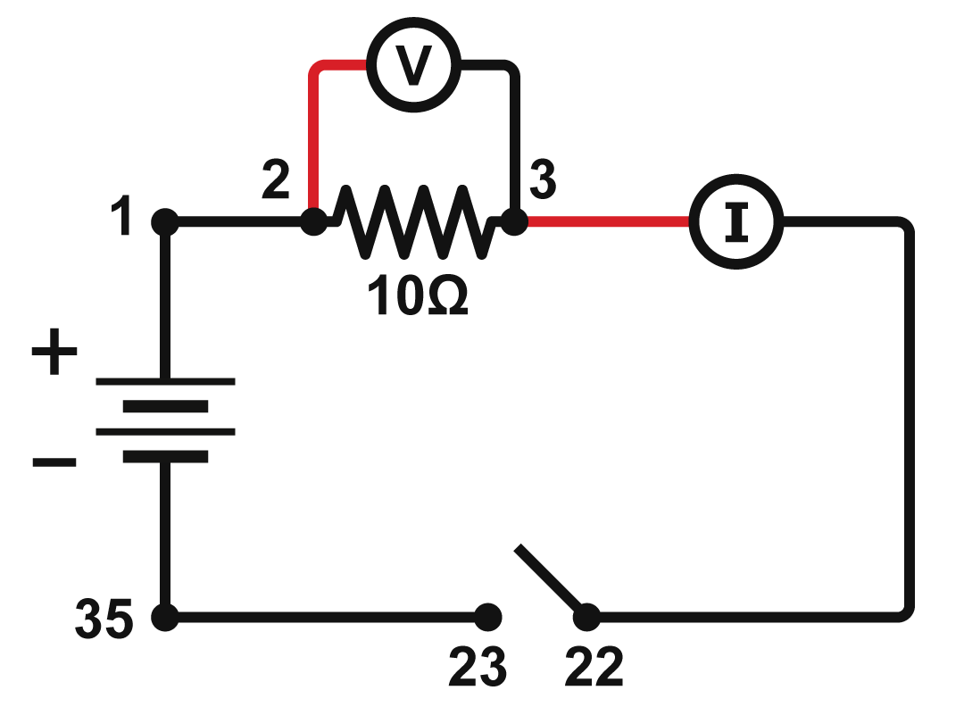
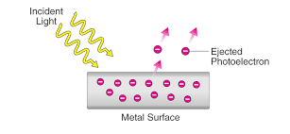
ISU HEPP Group / VPCLApps / Proposal of Experiments
1D Motion (horizontal plane)
2D Motion (inclined plane)
Collisions
Ohm’s Law
Motion of Charged Particle in Uniform Magnetic Field
Photoelectric Effect

