Slide 1



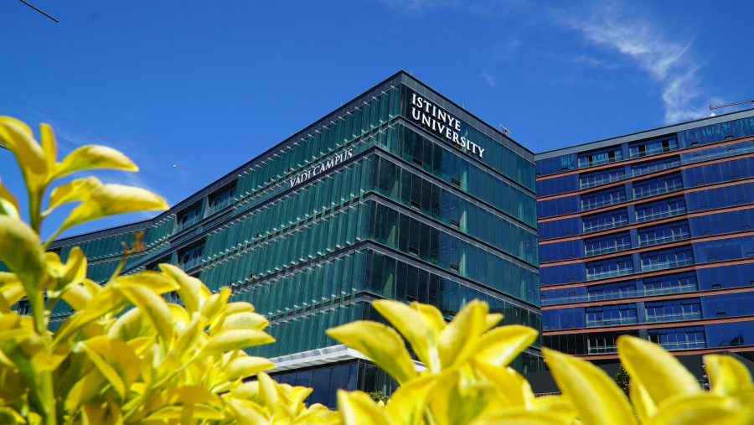
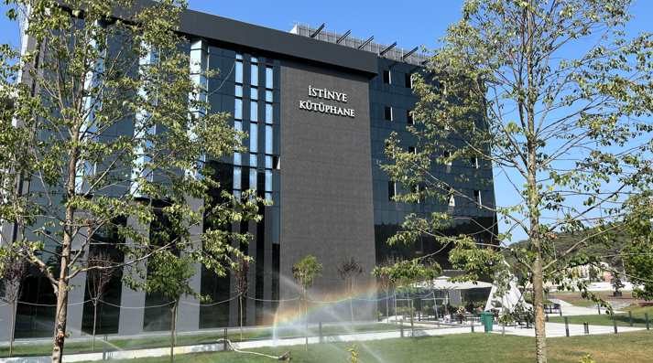



ISTINYE UNIVERSITY
INSTITUTION INTRODUCTION
2024
www.istinye.edu.tr
Modified; 07.09.2024
Prepared by Istinye University | All rights reserved.
.

Slide 2


CONTENTS
3
About Istinye University
11
Academic Units
4
Istinye University Campuses
12
Istinye University in Numbers
5
History
13
Research
6
Campus and Physical Infrastructure
16
Collaborations and International Cooperations
7
University Management
17
Istinye University - National
8
Mission and Vision
18
Istinye University - International
9
What does ISU do?
19
ISU Projects
10
From Istinye
20
Istinye University at ${10}^{TH}$ Anniversary

Slide 3





ABOUT ISTINYE UNIVERSITY
Istinye University was founded in 2015 by the 21st Century Anatolia Foundation based on the experience of the MLPCare Group. Adopting a student-oriented education approach, the university encourages the research of its faculty members in line with its goal of becoming a center of science and research. It also aims to contribute to the welfare of society and provide high quality healthcare services. It offers students a learning environment that includes a wide range of knowledge, technology and art, and focuses on developing leadership skills, raising them as individuals who believe in the power of science, think critically, and have humanitarian and ethical values. Istinye University aims to contribute to the development of society and support the progress of humanity.
Medical Park, Liv Hospital, VM Medical Park,
https://www.mlpcare.com
28 hospitals in 14 provinces across Turkey,
1 Hospital in Baku, Azerbaijan
1 Hospital in Budapest Hungary
MLP Care Group is a member of the group.
JCI accreditation SRC (Surgical Review Corporation) "Center Of Excellence" certificate
23 April 2015
Istinye Unıversity

Slide 4

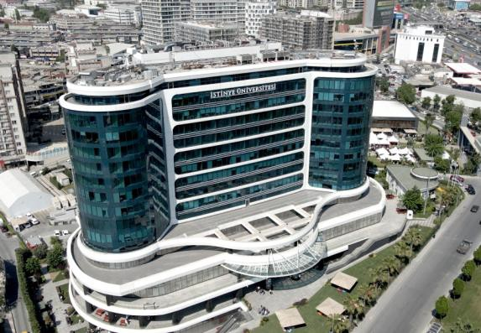
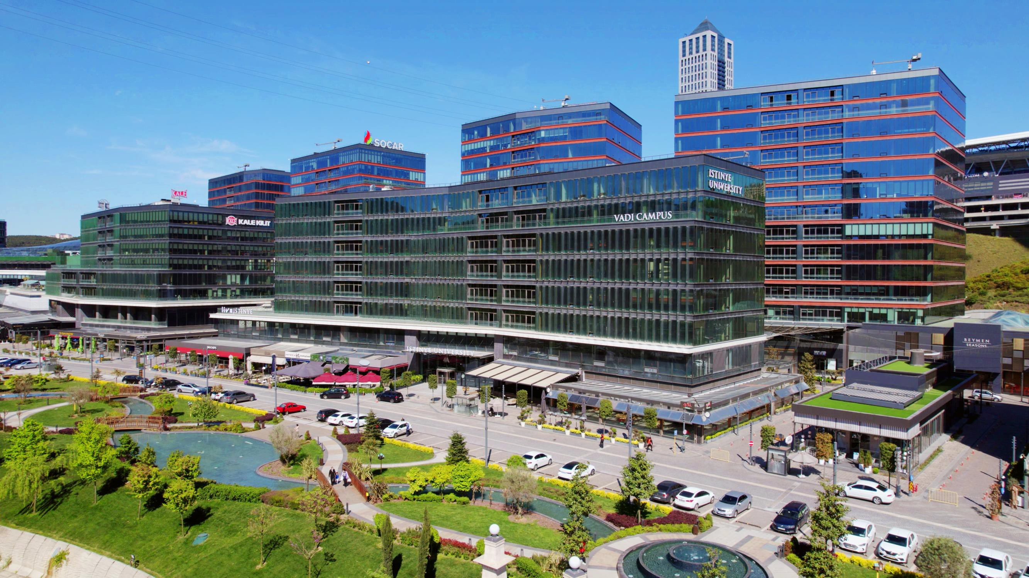
ISTINYE UNIVERSITY CAMPUSES
Istinye University, which started education with Topkapı Campus, opened the Vadi Campus in 2021.
Topkapı Campus
Vadi Campus
Topkapı Kampüsü
• xx
Founded in 2016
Istinye University Topkapı Health Sciences Campus
Istinye University Topkapı Hospital Campus
Founded in 2021
Istinye University Vadi Main Campus (All Faculties)
Istinye University Vadi AB Campus (All Faculties)
Istinye University Vadi C Campus (Administrative Offices)
Istinye University Vadi D Campus (FLED HALL - Department of Foreign Languages)
Istinye University Vadi H Campus (All Faculties)
Istinye University Vadi Dentistry Hospital Campus

Slide 5



HISTORY
Established in 2015, Istinye University currently serves with 9 faculties and 2 campuses.
ENTREPRENEURSHIP AND INCUBATION CENTER
GRADUATE INSTITUTE ORGANISATION
FIRST BACHELOR’S DEGREE GRADUATE
START OF THE EDUCATION
2015
2016
2018
2020
2021
2022
2023
23 APRIL 2015
FOUNDATION OF ISTINYE UNIVERSITY
VADİ CAMPUS WAS ESTABLISHED, 4 FACULTIES MOVED
TOPKAPI AND VADİ CAMPUSES ARE BEING DEVELOPED
ESTABLISHMENT OF THE TECHNOLOGY TRANSFER OFFICE (TTO)

Slide 6

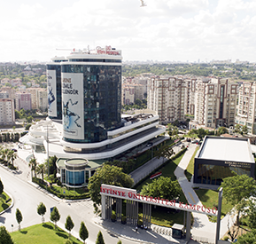
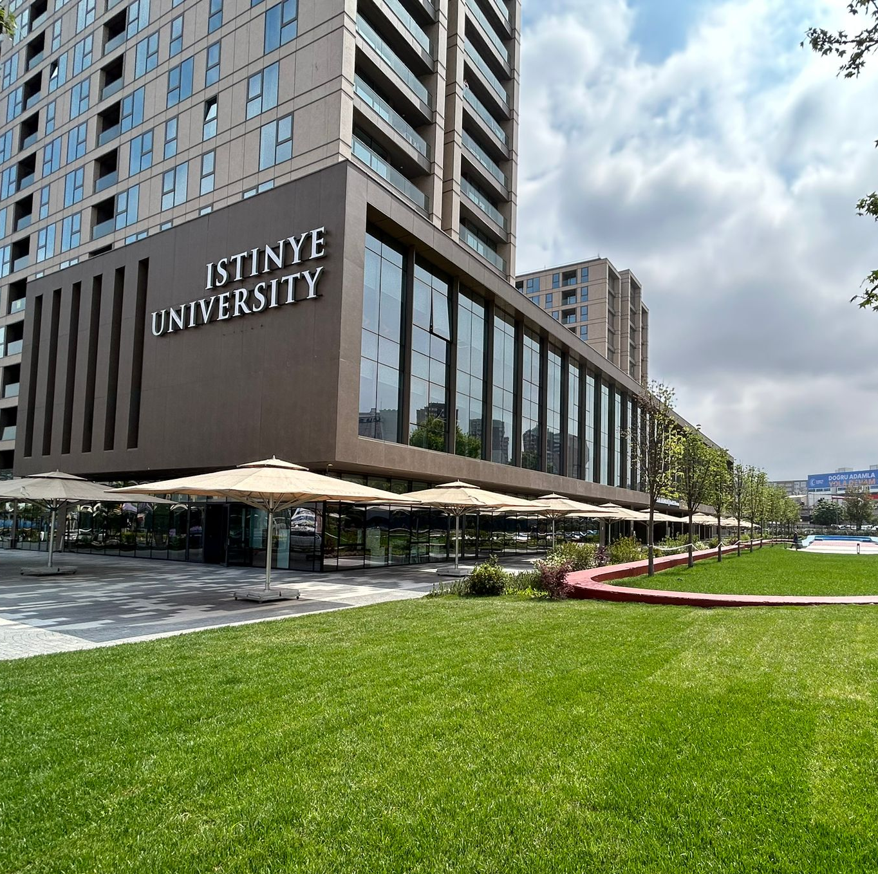
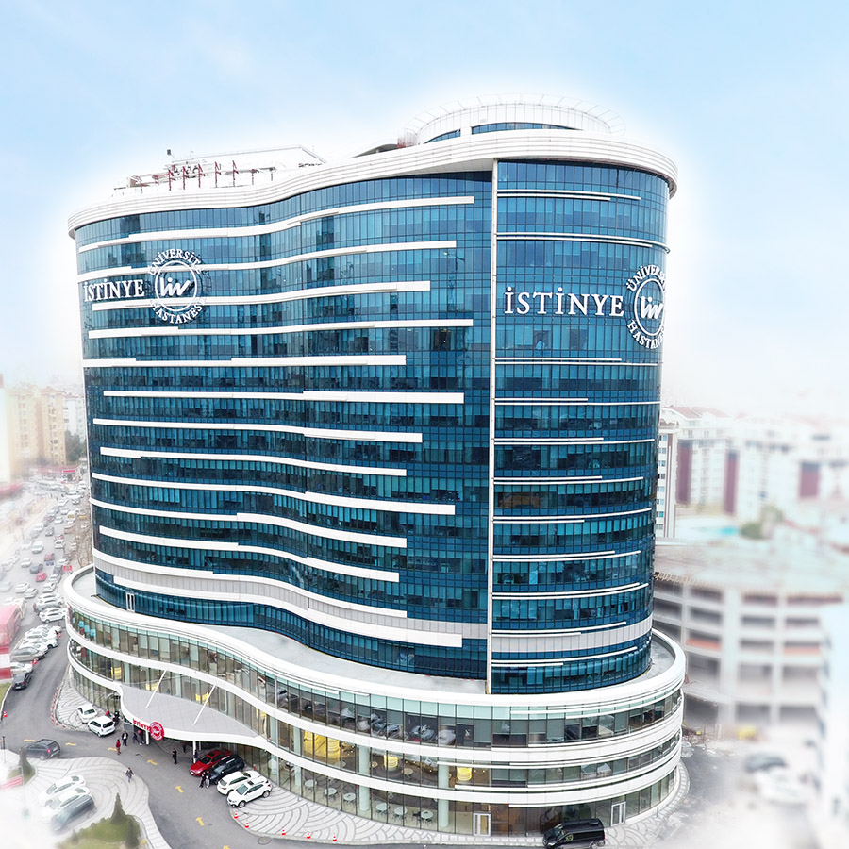
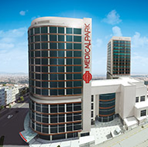
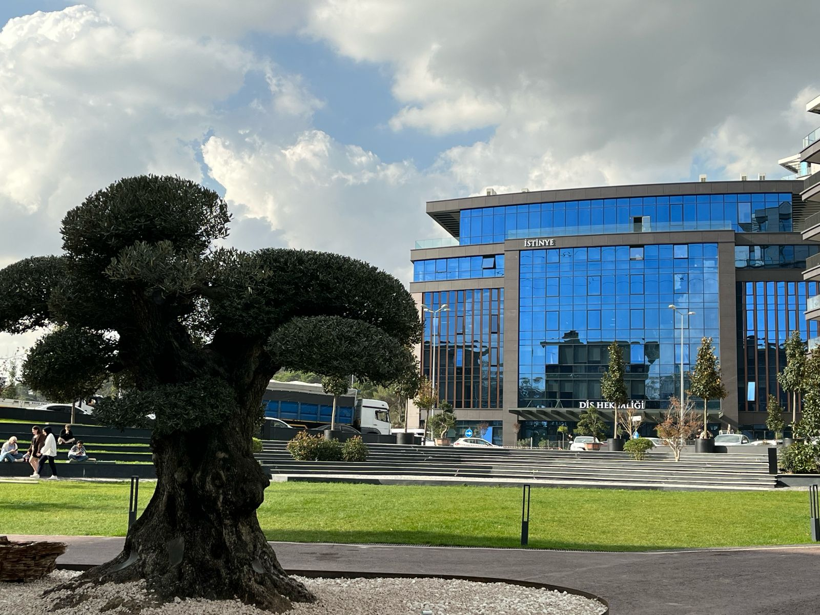
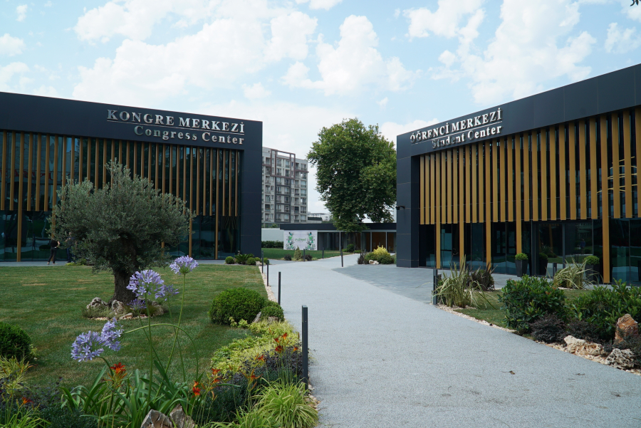
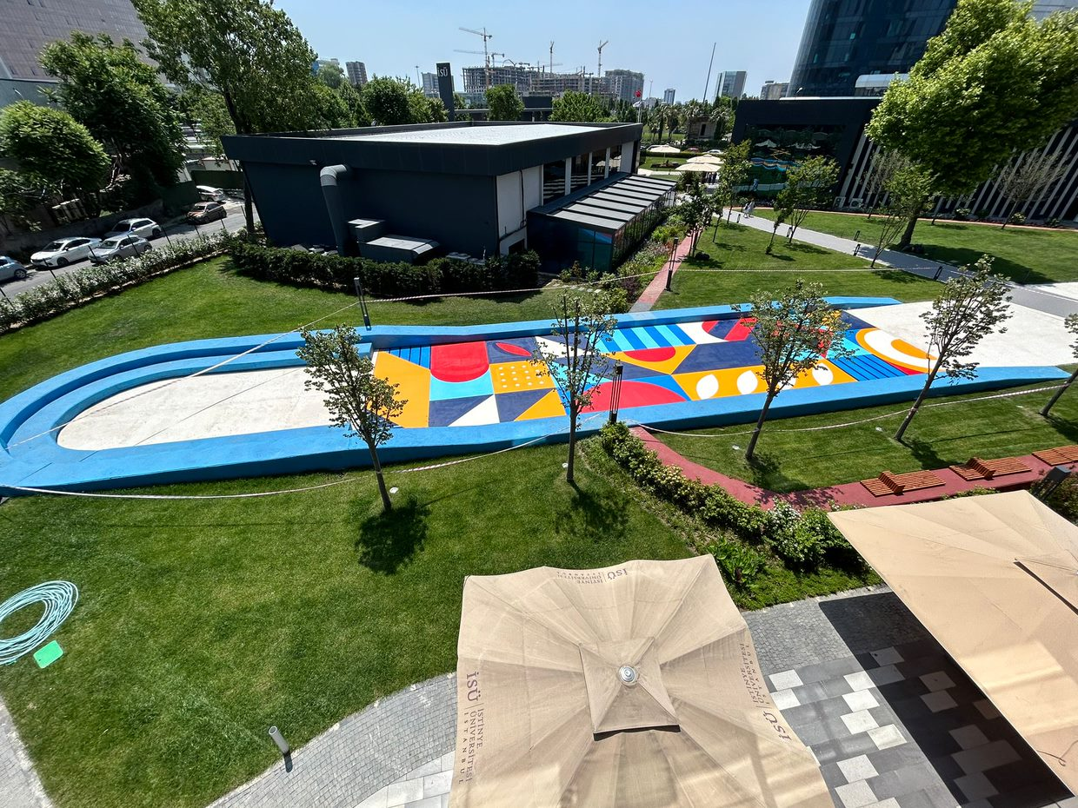
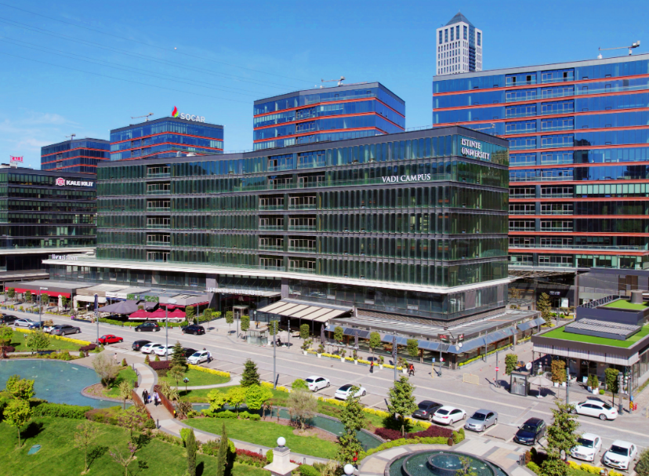
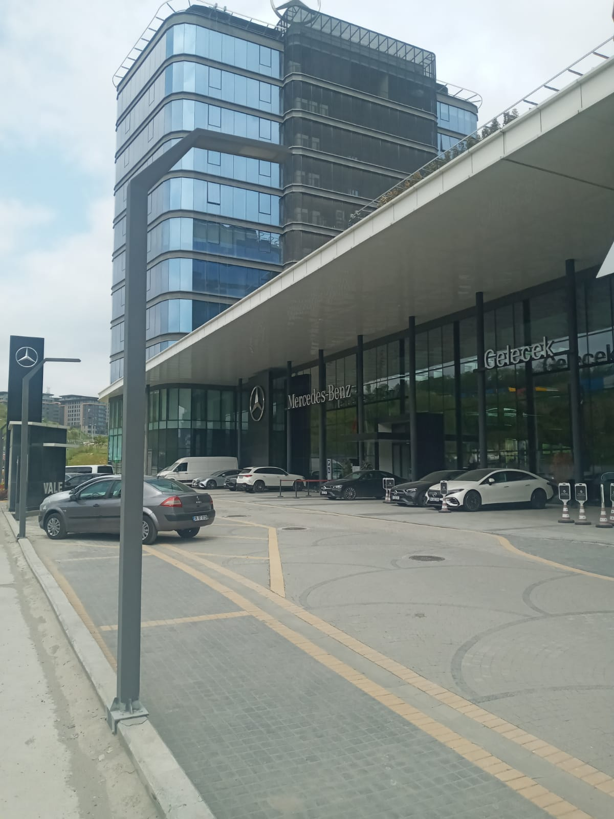
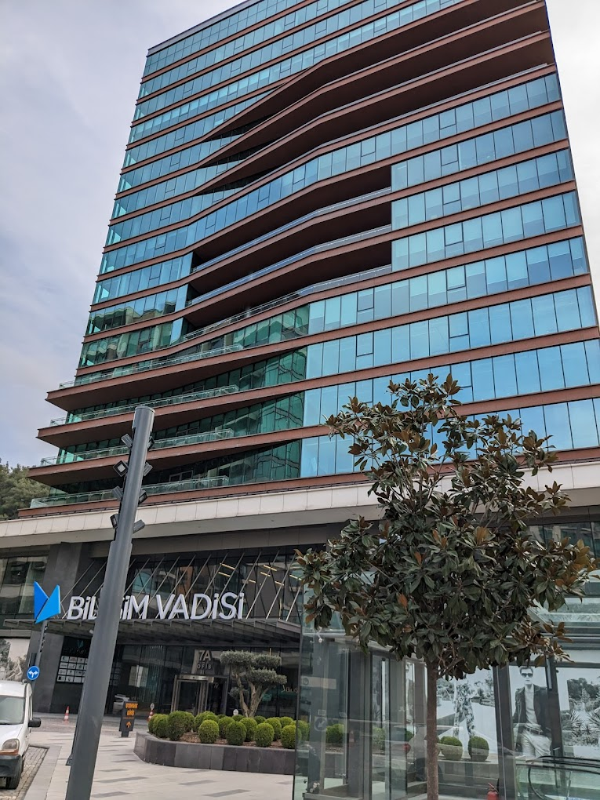
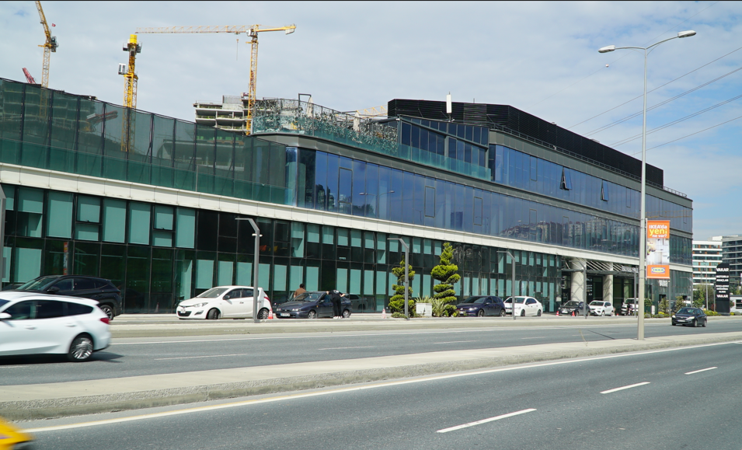
CAMPUS AND PHYSICAL INFRASTRUCTURE
TOPKAPI CAMPUS
ISTINYE HOSPITALS
LİV HOSPİTAL BAHÇEŞEHİR
60.000 M2
200 BED CAPACITY
MEDİCAL PARK GAZİOSMANPAŞA
55.000 M2
200 BED CAPACITY
İSÜ DENTAL HOSPITAL
9.800 M2
70.000 M2 in-door + 15.000 M2 out-door
VADI CAMPUS
27.500 M2
VADİPARK
9.150 M2
VADISTANBUL
ENTREPRENEURSHIP AND INCUBATION CENTER
1600 M2
İSÜ FLED HALL
4.500 M2
VADİ MAIN CAMPUS
40.000 M2

Slide 7

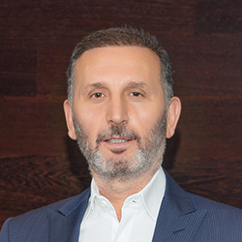
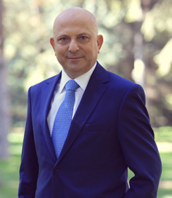
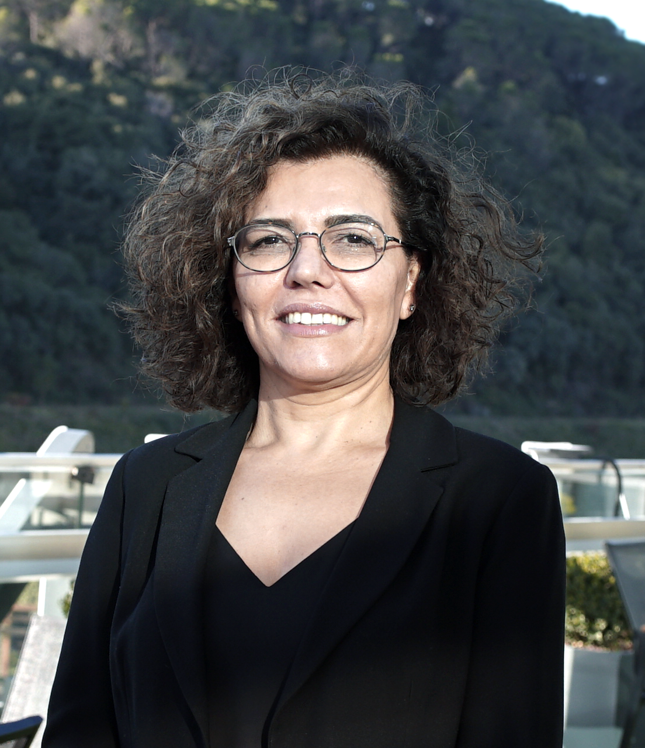
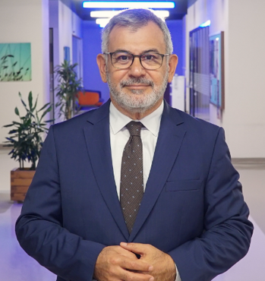
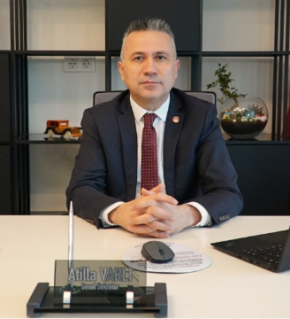
UNIVERSITY MANAGEMENT
Prof. Dr. Erkan İBİŞ
Rector
Dr. Muharrem USTA
CHAIR OF THE BOARD OF TRUSTEES
BOARD OF TRUSTEES
Dr. Muharrem USTA, Chairman
  Prof. Dr. Erkan İBİŞ, Rector
  Prof. Dr. İbrahim DİNÇER
  Dr. Ahmet ÖZDEMİR
  Haydar SANCAK
  Yaşar KARAYEL
  Mustafa NİMETOĞLU
Prof. Dr. Hatice GÜLEN
Prof. Dr. Peyami ÇELİKCAN
Vice Rector
Vice Rector
Atilla VARLI
Secretary General

Slide 8




MISSION AND VISION
Mission
Vision
Student-centred and close cooperation
with the sector
Innovative and sustainable education
Advanced technology based investments
Generation of new knowledge and technology
Contribution to the development of society
Artificial Intelligence
Digitalisation
Excellence in education, training, innovation and technology development
To be one of the world’s leading universities

Slide 9
WHAT DOES ISU DO ?
EDUCATION
RESEARCH-DEVELOPMENT AND APPLICATION
SOCIAL RESPONSIBILITY AND CONTRIBUTION TO SOCIETY
ISU

Slide 10






FROM ISTINYE…
700 Academic ; 200 Administrative
Social Responsibility
Justice
Innovation
Team Spirit
Competitivism
Leadership

Slide 11









ACADEMIC UNITS
Istinye University, which has left behind 9 years in the sector, serves with 9 faculties.
Faculty of
Dentistry
Faculty of
Pharmacy
Fine Arts Faculty of
Design and
Architecture
Faculty of Economics,
Administrative and
Social Sciences
Faculty of
Communication
Founded in 2021
In Vadi Campus.
Founded in 2017
In Vadi Campus.
Founded in 2017.
In Vadi Campus.
Founded in 2017.
In Vadi Campus.
Founded in 2021.
In Vadi Campus.
Faculty of
Humanities and
Social Sciences
Faculty of Engineering and Natural Sciences
Faculty of
Health Sciences
Faculty of
Medicine
Founded in 2018.
In Vadi Campus.
Founded in 2018.
In Vadi Campus.
Founded in 2016.
In Vadi Campus.
Founded in 2016.
In Vadi Campus.

Slide 12
ISTINYE UNIVERSITY BY NUMBERS
Istinye University serves more than 17 thousand students from more than 100 countries.
2015 29 4 %24
Year of Establishment
Research Center
Campus
International Student Ratio
2
17K 9
1
Student
Faculty Institute
Vocational School
4K+ 32 55
International Student VS Programmme
63
Undergraduate Programme
Graduate Programme
11K
4K
11,5K
1,5K
Graduate
VS Student
Undergraduate Students
Graduate Student

Slide 13
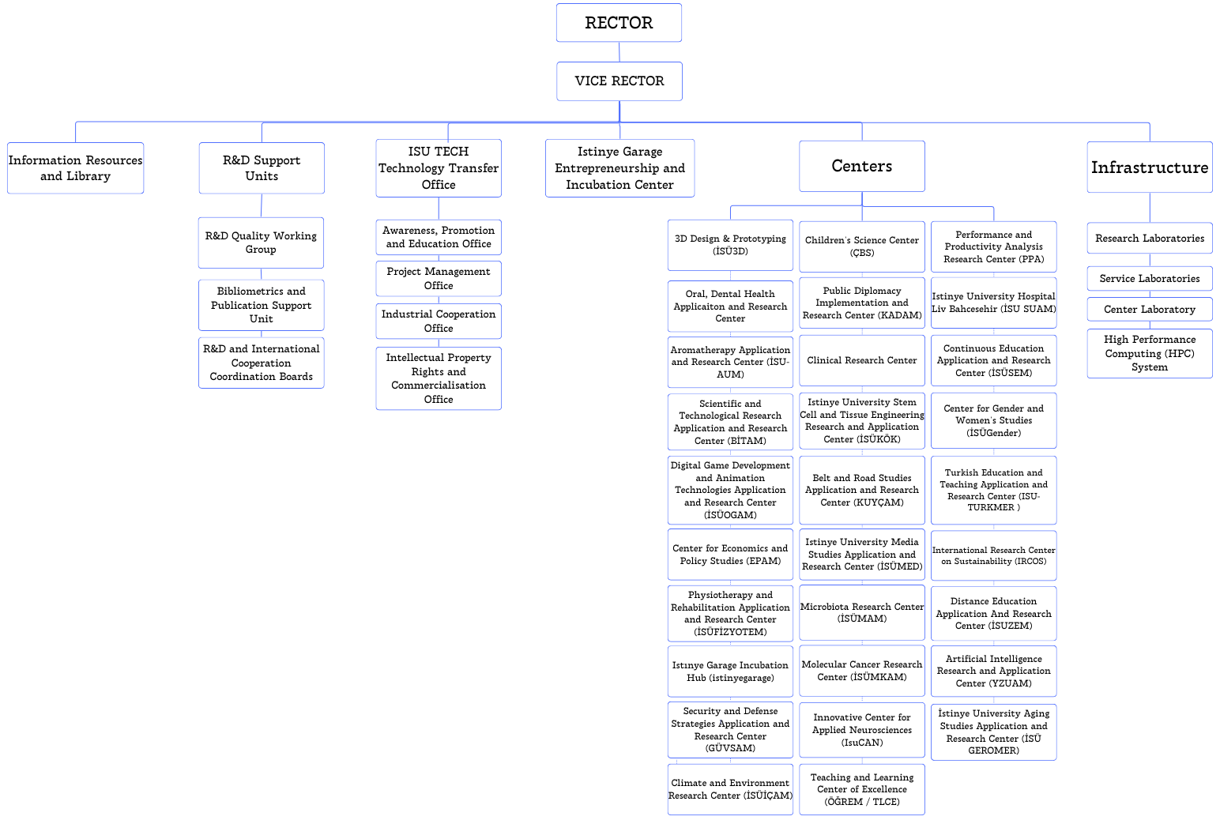
RESEARCH / ORGANISATION CHART

Slide 14
RESEARCH / RESEARCH CENTRES
Health and Science Centres
3D Design & Prototyping (İSÜ3D)
Oral, Dental Health Applicaiton and Research Center
Aromatherapy Application and Research Center (İSU-AUM)
Digital Game Development and Animation Technologies Application and Research Center (İSÜOGAM)
Physiotherapy and Rehabilitation Application and Research Center (İSÜFİZYOTEM)
Clinical Research Center
Istinye University Stem Cell and Tissue Engineering Research and Application Center (İSÜKÖK)
Molecular Cancer Research Center (İSÜMKAM)
Microbiota Research Center (İSÜMAM)
Innovative Center for Applied Neurosciences (IsuCAN)
Istinye University Hospital Liv Bahcesehir (İSU SUAM)
Artificial Intelligence Research and Application Center (YZUAM)
Climate and Environment Research Center (İSÜİÇAM)
Centres in Social Sciences
Center for Economics and Policy Studies (EPAM)
Security and Defense Strategies Application and Research Center (GÜVSAM)
Public Diplomacy Implementation and Research Center (KADAM)
Belt and Road Studies Application and Research Center (KUYÇAM)
Public Diplomacy Implementation and Research Center (KADAM)
Istinye University Media Studies Application and Research Center (İSÜMED)
Performance and Productivity Analysis Research Center (PPA)
Continuous Education Application and Research Center (İSÜSEM)
Turkish Education and Teaching Application and Research Center (ISU-TURKMER )
International Research Center on Sustainability (IRCOS)
Distance Education Application And Research Center (İSUZEM)
İstinye University Aging Studies Application and Research Center (İSÜ GEROMER)
Teaching and Learning Center of Excellence (ÖĞREM / TLCE)
Center for Gender and Women's Studies (İSÜGender)
Istınye Garage Incubation Hub (istinyegarage)
Children's Science Center (ÇBM)

Slide 15
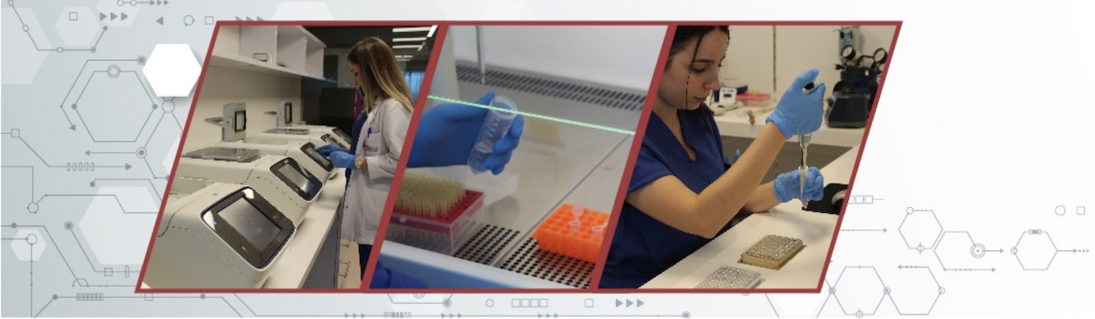
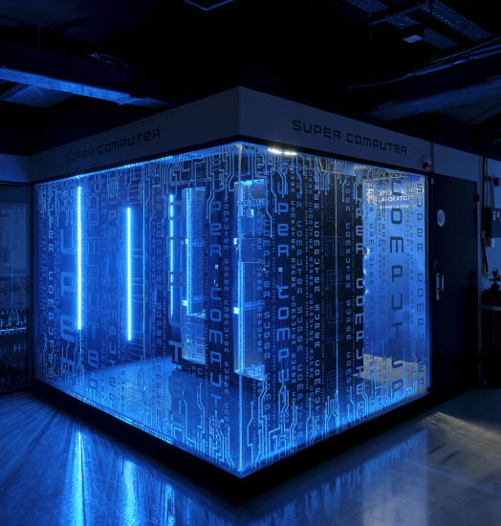
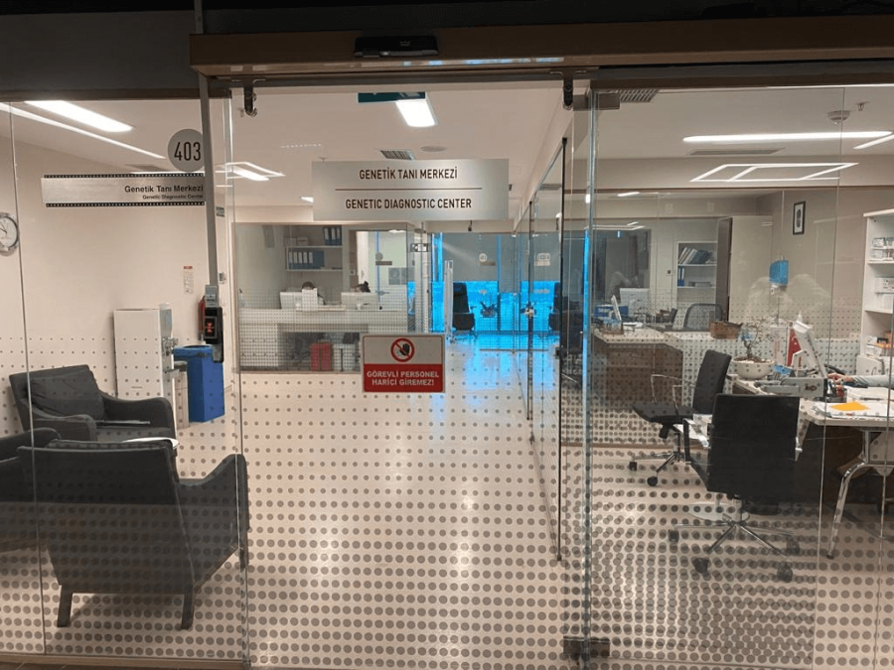
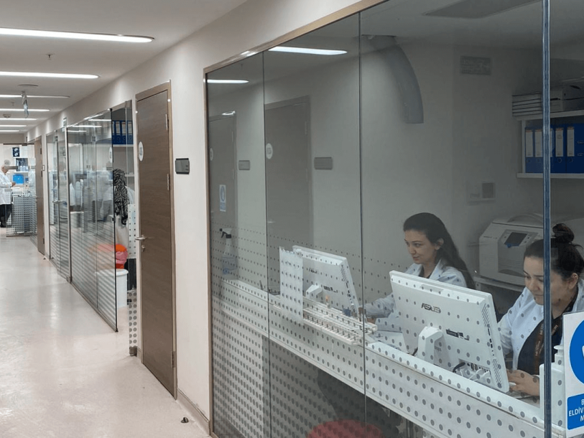
RESEARCH / SERVICE LABORATORIES
Tissue Typing and Immunology Laboratory
Genetic Diseases Assessment Center
High Performance Computing (HPC) System

Slide 16

COLLABORATIONS AND INTERNATIONAL COOPERATIONS
Cooperation with municipalities, universities and other public institutions
332 Erasmus agreements
85 MoU agreements
International memberships
  European University Association (EUA)
  Balkan Universities Association
  International Association of Universities (IAU)
  UNPRME
  UN-Academic Impact
  SDSN Turkey
  CERN – ATLAS
  Magna Charta
Istinye University

Slide 17
ISTINYE UNİVERSITY- NATIONAL
Istinye University
57
2015
163 University
56 Foundation University
2023
206 University
77 Foundation University
11

Slide 18


ISTINYE UNIVERSITY - INTERNATIONAL
Universty Ranking By Academic Performance (URAP) World Rankings (2023-2024)
More than 30,000 Universities are evaluated worldwide.
3000 universities are being announced.
Istinye University is at the
2104
In 2024 the overall ranking among more than 1,500 universities in THE Impact Ranking
800-1000
Health and Quality Life
101-200
3rd place among the Foundation Universities ranked from Turkey.
Istinye University

Slide 19

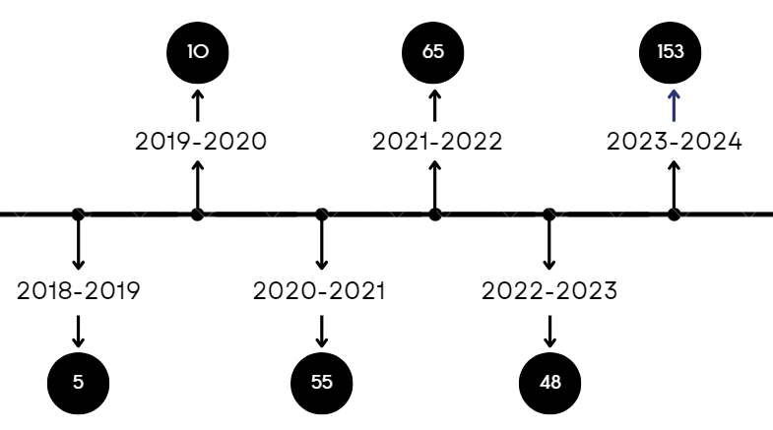

ISU PROJECTS / EXTERNALLY FUNDED PROJECTS
100+
Projects led by Istinye University
20+
78
8
Number of Total Projects (Leader + Partner)
Number of Running Clinical Research
National (Leader)
International (Leader)
50
6
20
2
Number of Running Projects
National (Leader)
Number of Running Projects
International (Leader)
Number of Compleated Projects
National (Leader)
Number of Compleated Projects
International (Leader)
Student Projects
Total:336

Slide 20

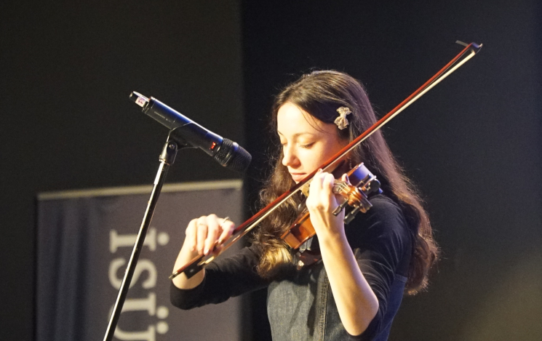
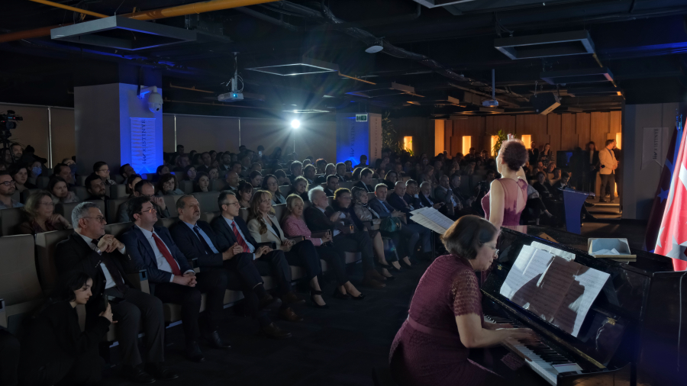
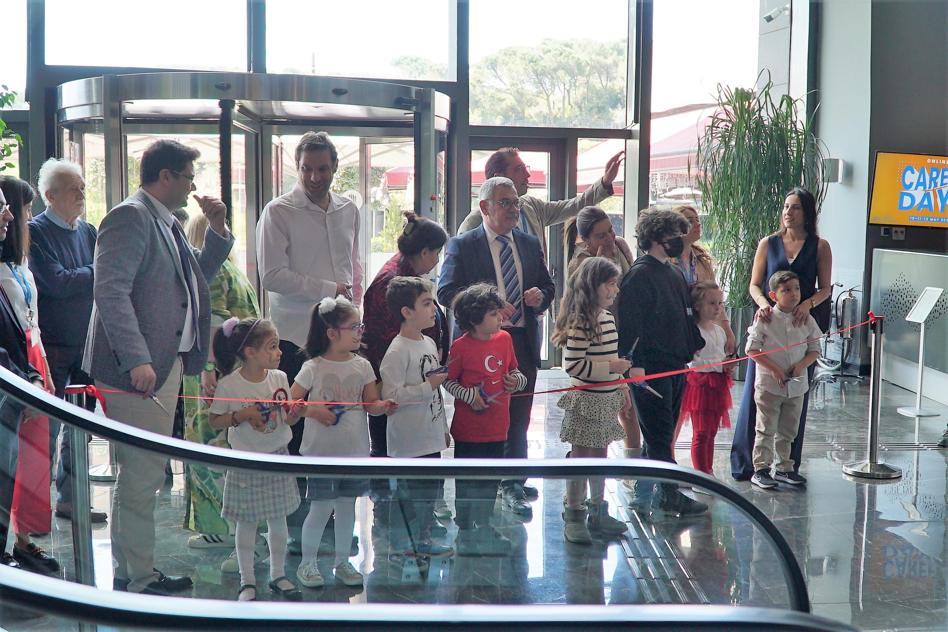

$$ISTINYE UNIVERSITY AT {10}^{th.}ANNIVERSARY$$
QUALITY
INTERNATIONAL STUDENT
ENTREPRENEURSHIP
Accreditation of Education Programmes
%50
%30
Entrepreneurial and Innovative University Index (EIUI)
In top 50
${10}^{th.}$ ANNIVERSARY OF ISU
2025
Universty Ranking By Academic Performance (URAP) World Ranking
TOTAL
NUMBER OF STUDENTS
NUMBER OF GRADUATE PROGRAMMES
+ 20.000
In top 1000
+ 70

Slide 21
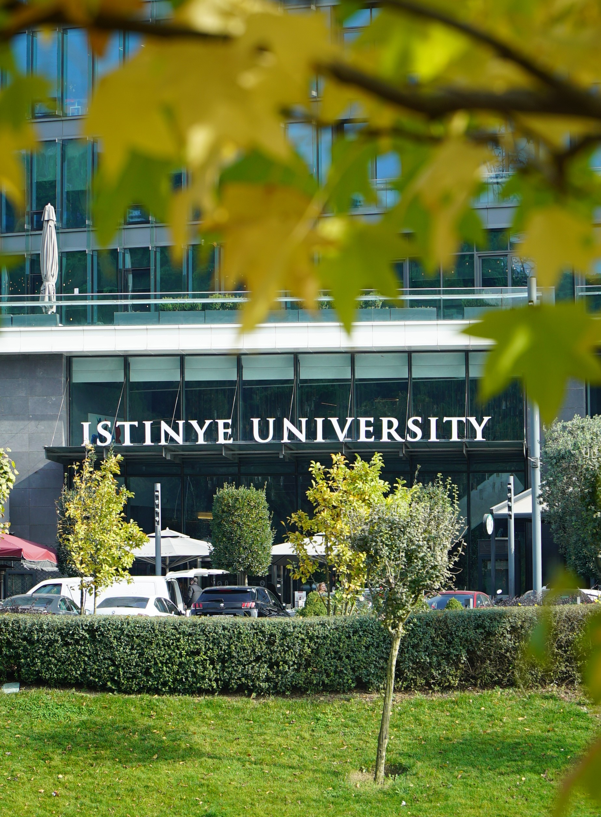
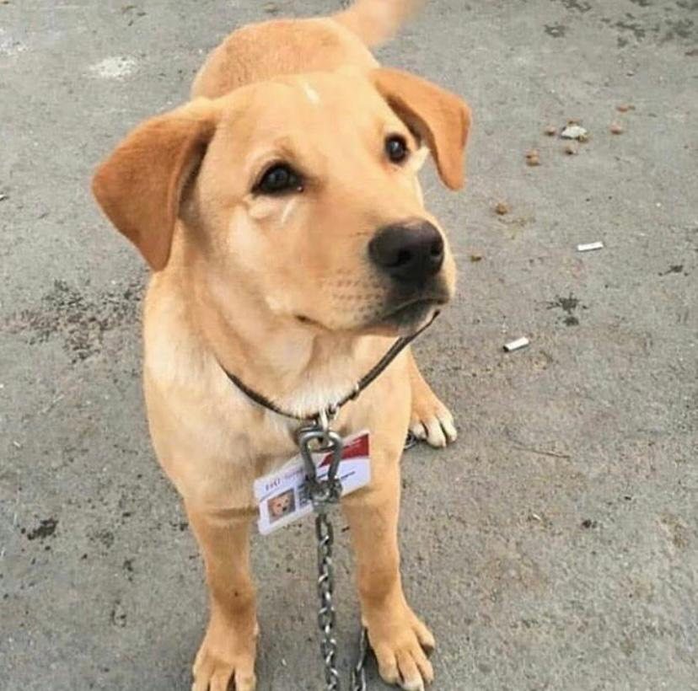
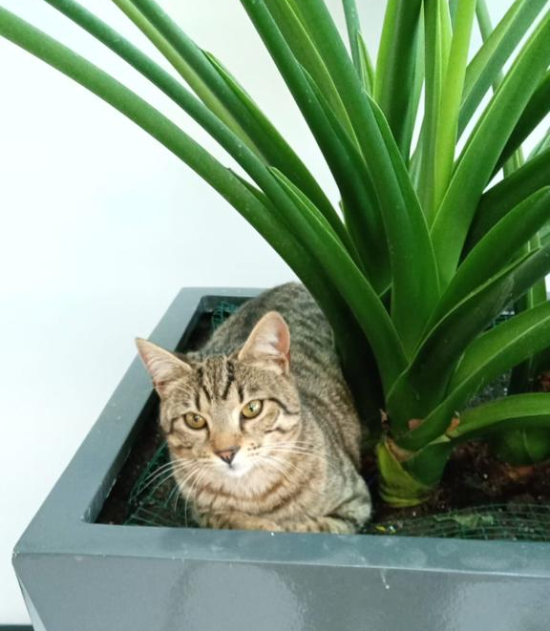
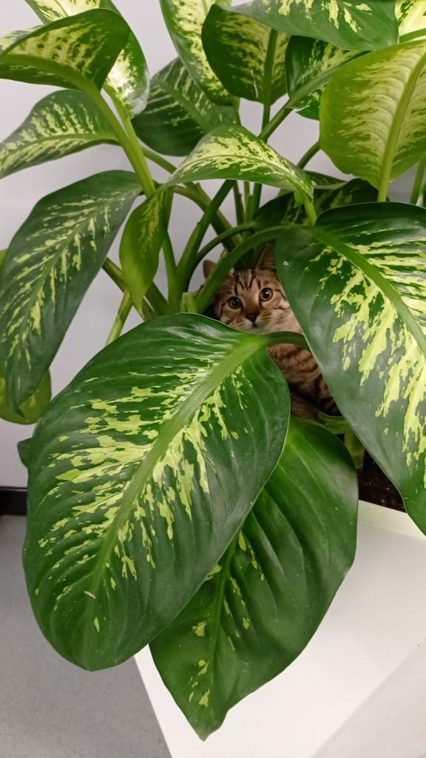
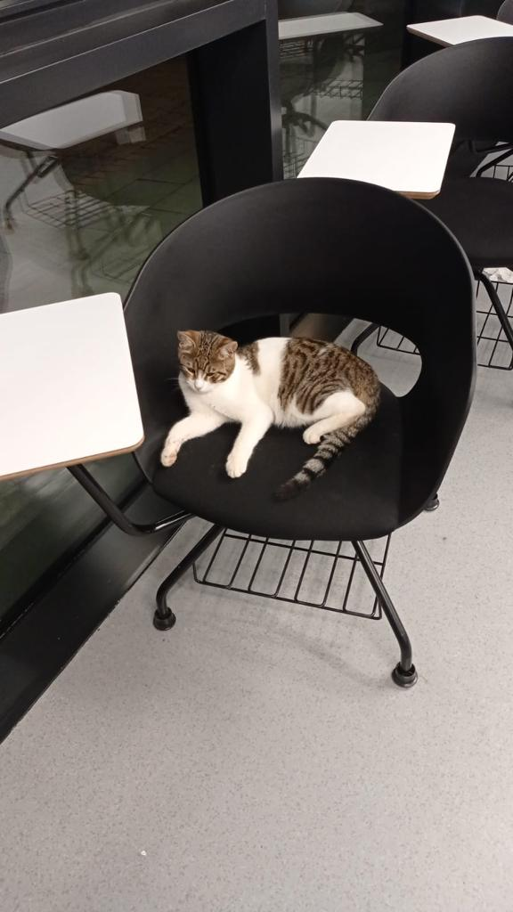
THANKS…

