Slide 1



What project results and other outcomes do you expect your project to have?
Project Results:
Virtual Physics Course Laboratory Applications (6 Experiments)
e-Book (6 Units)
e-Learning Toolkit (1 set)
Dissemination Materials: 1 Web page, 3 Social media platforms, 9 e-Brochures and 3 e-News
Documentation and Reports: 4 interim reports, 1 final report
Transnational Cooperation: 3 Transnational Meetings, 2 Implementation Meetings
Online Training: 6 Tutorials
Digital promotion: 30 short videos
Congress: 1 national congress organization, presentation at 1 different congress

Slide 2
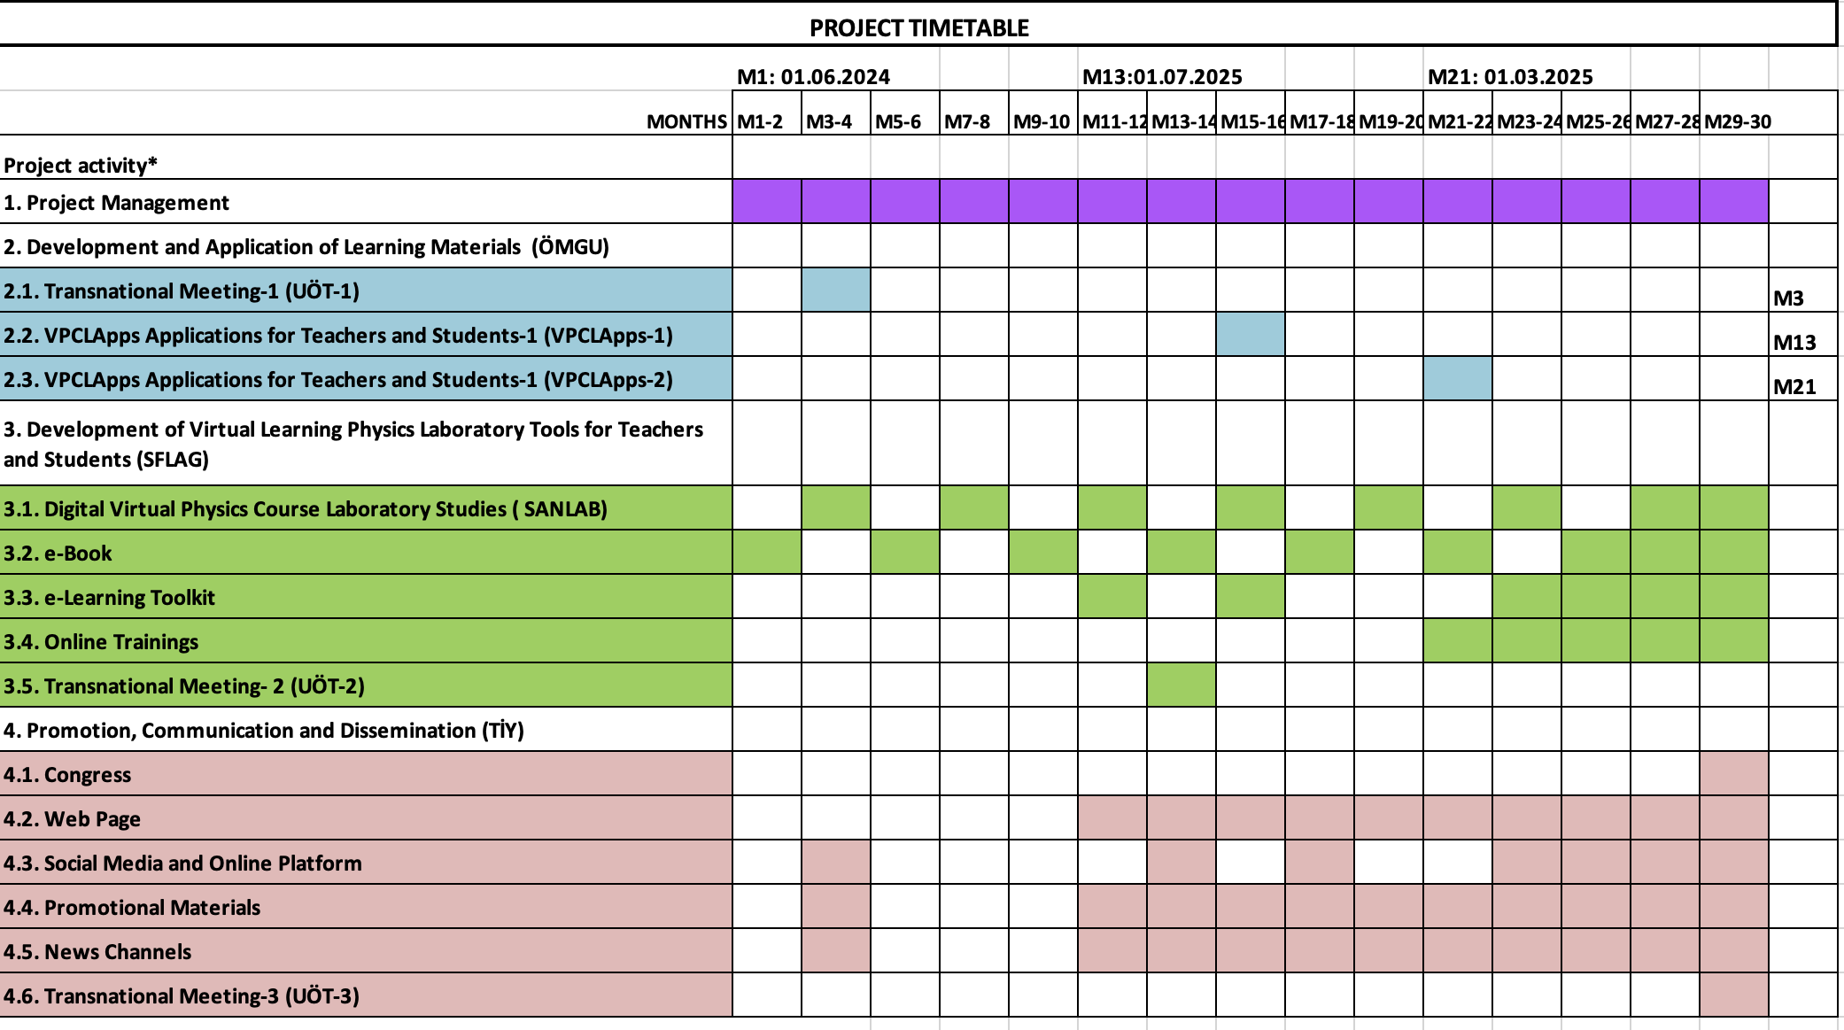

M3
M15
M21
M13
M29

Slide 3
2.1. Transnational Meeting-1 (UÖT-1)
TPM 1 : 11.09.2024 ( M3 )
2.2. VPCLApps Applications for Teachers and Students-1 (VPCLApps-1)
LTT 1 : 20.09.2025 ( M15 )*
2.3. VPCLApps Applications for Teachers and Students-1 (VPCLApps-2)
LTT 2 : 10.03.2026 ( M21 )**
3.5. Transnational Meeting- 2 (UÖT-2)
TPM 2 : 10.07.2025 ( M13 )
4.6. Transnational Meeting-3 (UÖT-3)
TPM 3 : 10.11.2026 ( M29 )
*VPCLApss 1 work package (APEL) will be carried out in the 15 th month with 40 students, 10 teachers,
**VPCLApss 2 (ESMEM) will be carried out in the 21rd month with 60 students, 30 teachers.

Slide 4
1. Pendulum Experiment
2. Movement in the Horizontal Plane
3. Movement on an Inclined Plane
4. Oblique Shot
5. Friction
6. Collision
7. Centripetal Force
8. Electric field
9. Ohm's Law
10. Inspection of Capacitors
11. Examination of Transformers

Slide 5
Documentation and Reports:
4 Interim reports,
10.12.2024 ( M6 )
10.06.2025 ( M12 )
10.12.2025 ( M18 )
10.06.2026 ( M24 )
1 Final report, 10.12.2026 ( M30 )
TPM 1 : 11.09.2024 ( M3 ) İSÜ
TPM 2 : 10.07.2025 ( M13 ) AIJU
LTT 1 : 20.09.2025 ( M15 ) APEL
LTT 2 : 10.03.2026 ( M21 ) ESMEM
TPM 3 : 10.11.2026 ( M29 ) AU

