Slide 1


The nucleons generalized form factors and Mellin moments up to fourth order
Christian Kummer
with: C. Alexandrou, S. Bacchio, M. Constantinou, G. Spanoudes
The AQTIVATE project receives funding from the European Union’s HORIZON MSCA Doctoral Networks programme, under Grant Agreement No. 101072344.

Slide 2
Overview
Motivation
Definitions
Methods
Results
Outlook

Slide 3
Motivation
GFFs are directly calculable in LQCD, no need for inverse transformations
Interpolation between form factors and moments of GPDs, forming a bridge between elastic and inelastic processes
They serve as inputs to sum rules
They provide a systematic way to study the QCD evolution of GPDs via the operator product expansion

Slide 4

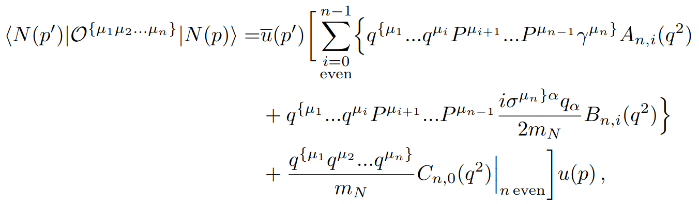
Definitions
Twist-two operator
Matrix elements
GFFs
X.D. Ji, J. Phys. G 24 (1998), 1181-1205

Slide 5
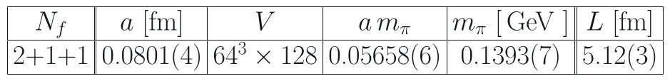
Methods
Ensemble
Calculate two-and three point functions
Construct appropriate matrix elements
Use Weighted Least Squares to determine the GFFs
Fit using a two-state fit or summation method approach
Dipole fit over Q²
C. Alexandrou et al., Phys. Rev. D 98.5 (2018), 05418

Slide 6
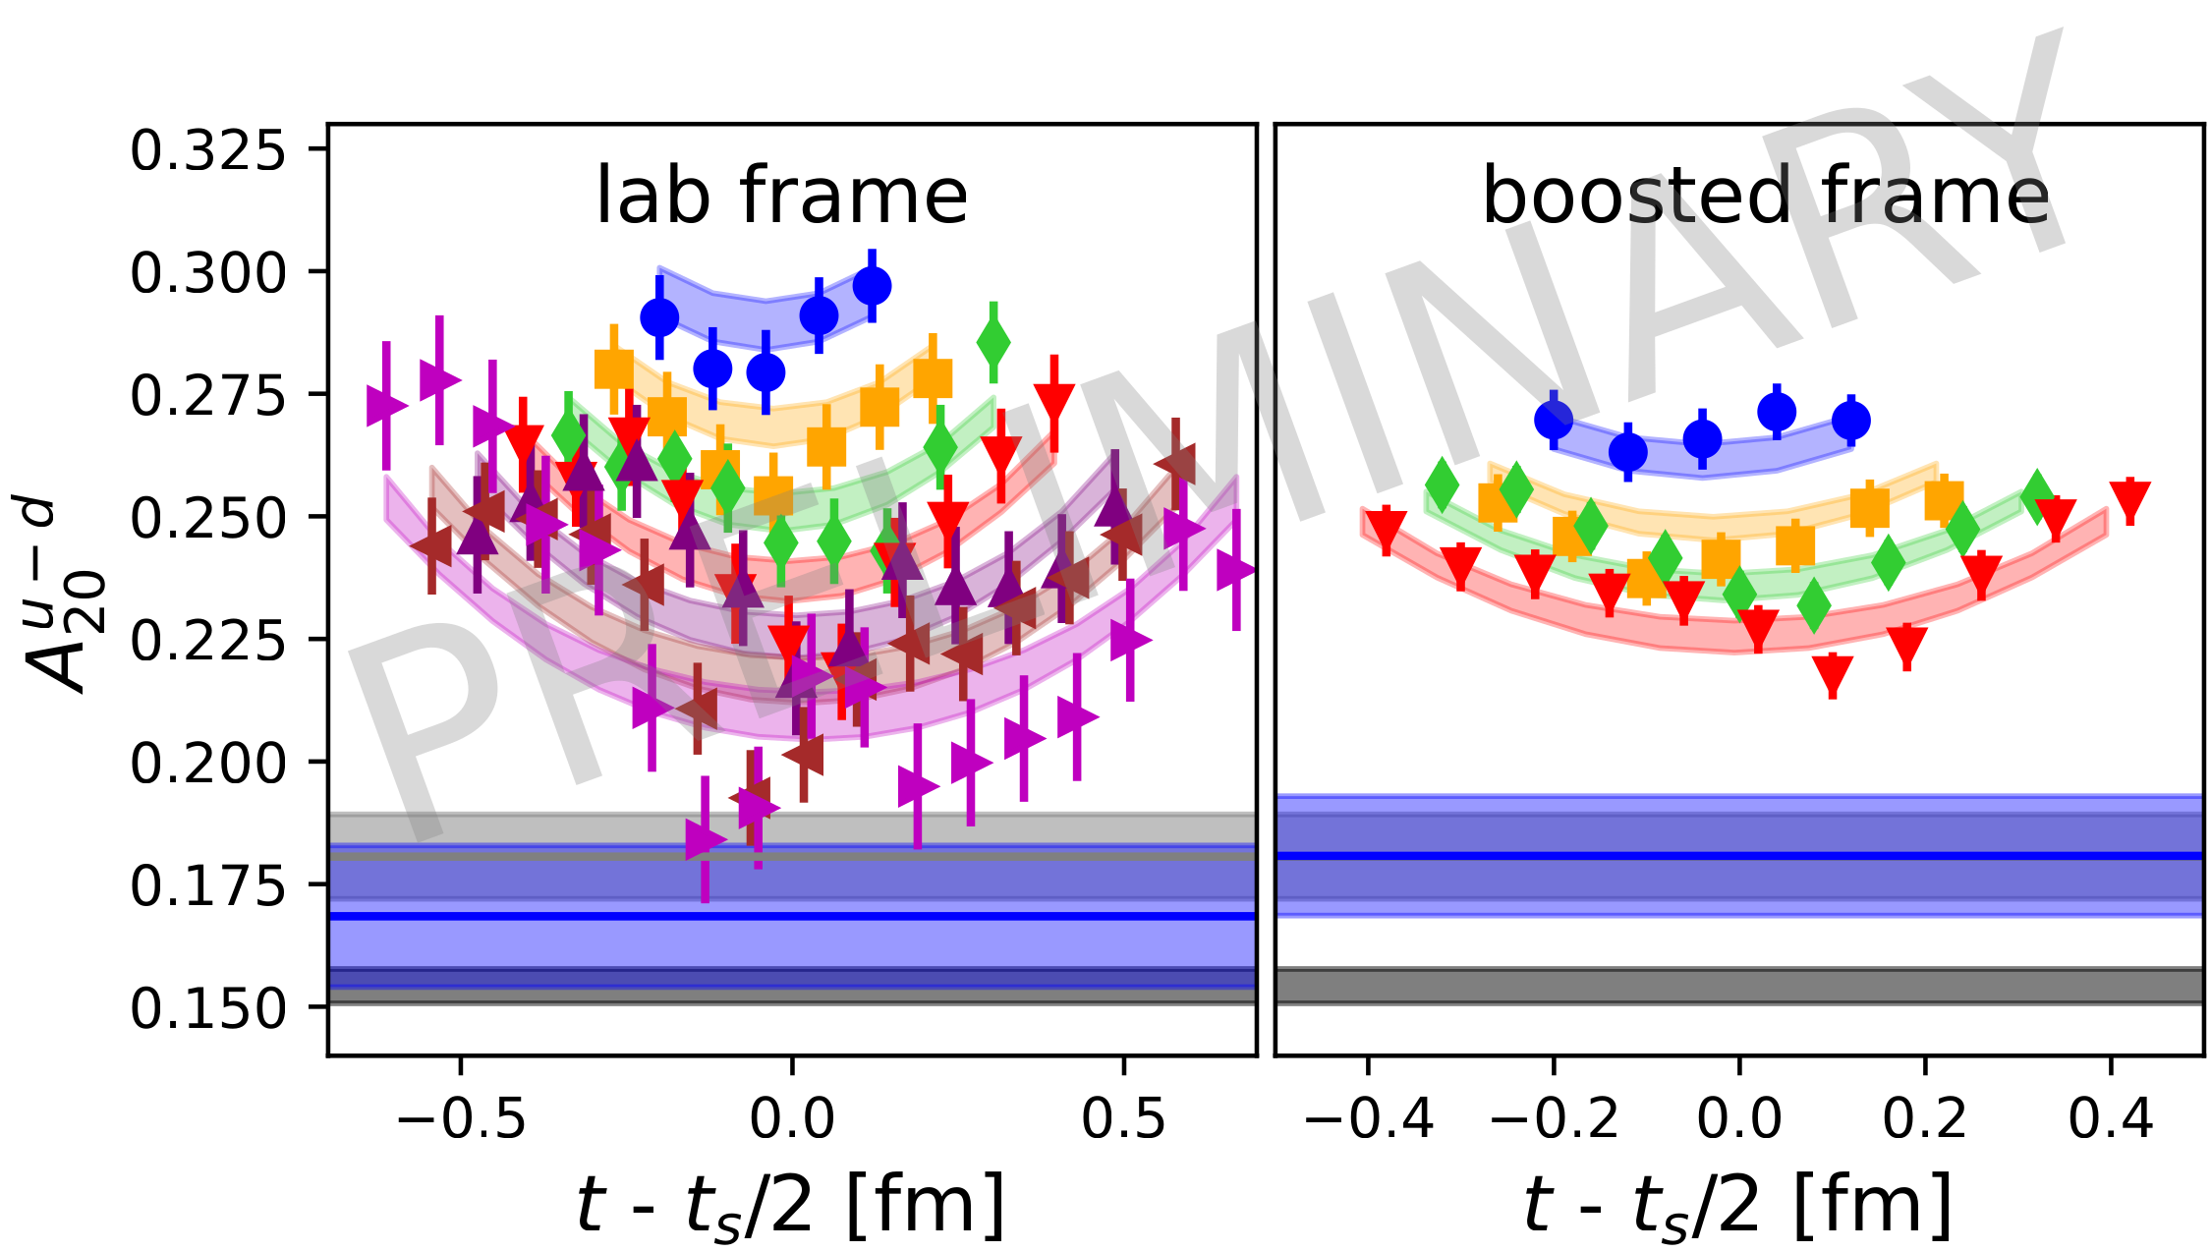
Results
Crosschecking the boosted frame and comparing with JAM
Combined two-state fit describes data well
C. Cocuzza et al., Phys. Rev. D 106.3 (2022), L031502

Slide 7
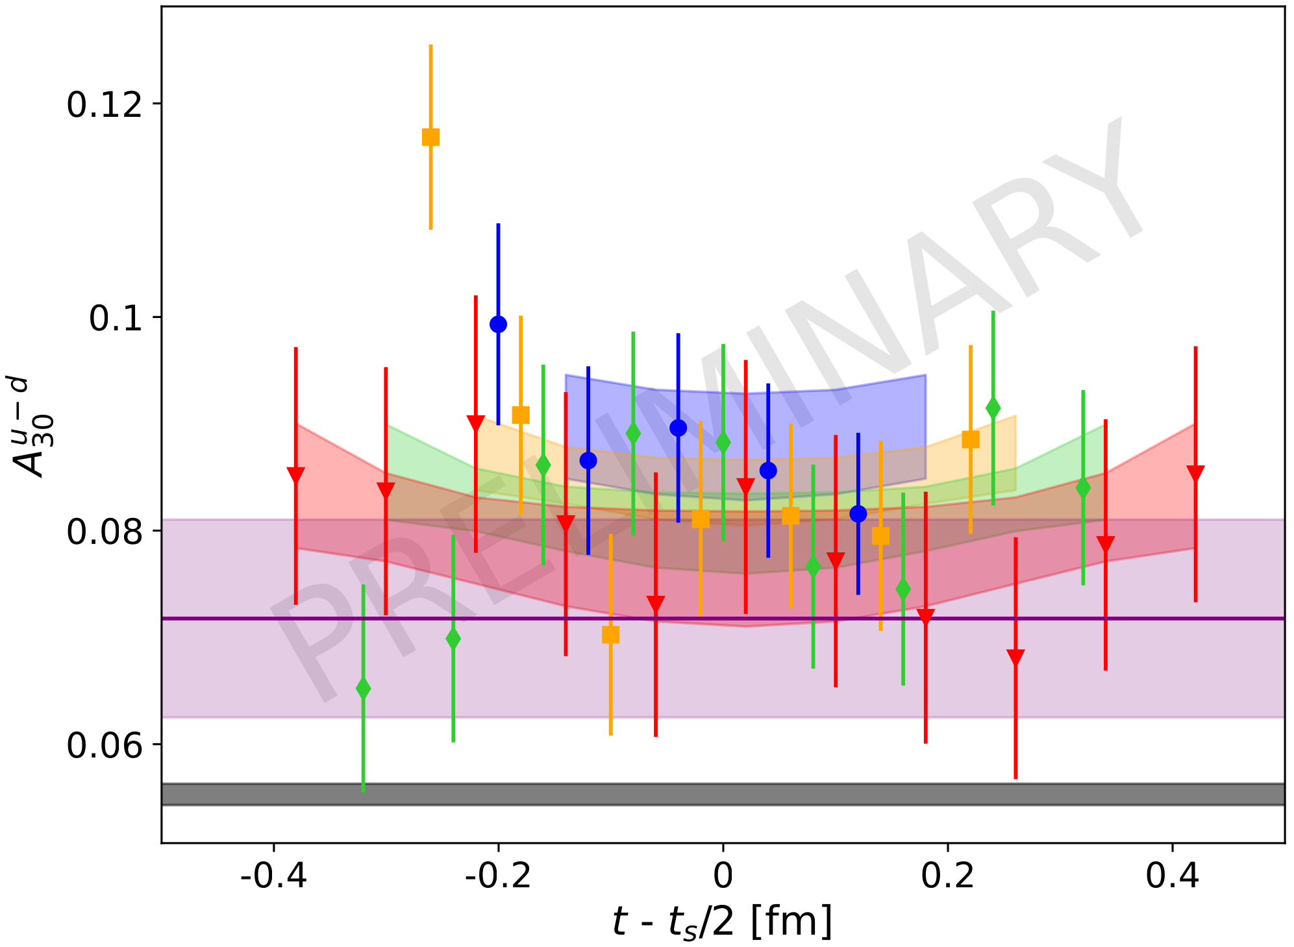
Results
Two-Derivative operator
Direct calculation of <x²>
Two-state fit and summation method are compatible
C. Cocuzza et al., Phys. Rev. D 106.3 (2022), L031502

Slide 8
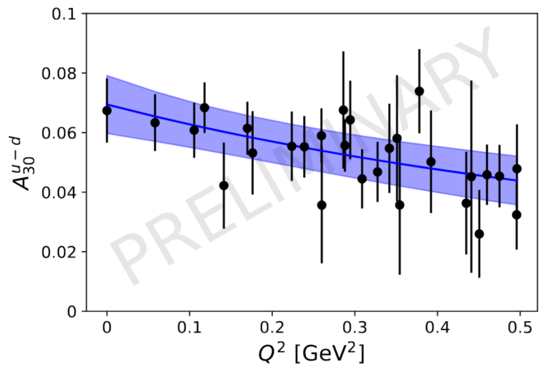
Results
Fitting the ratio for all Q²
Dipole fit over Q²
Dipole compatible with fit at Q² = 0
Also applicable for other GFFs

Slide 9
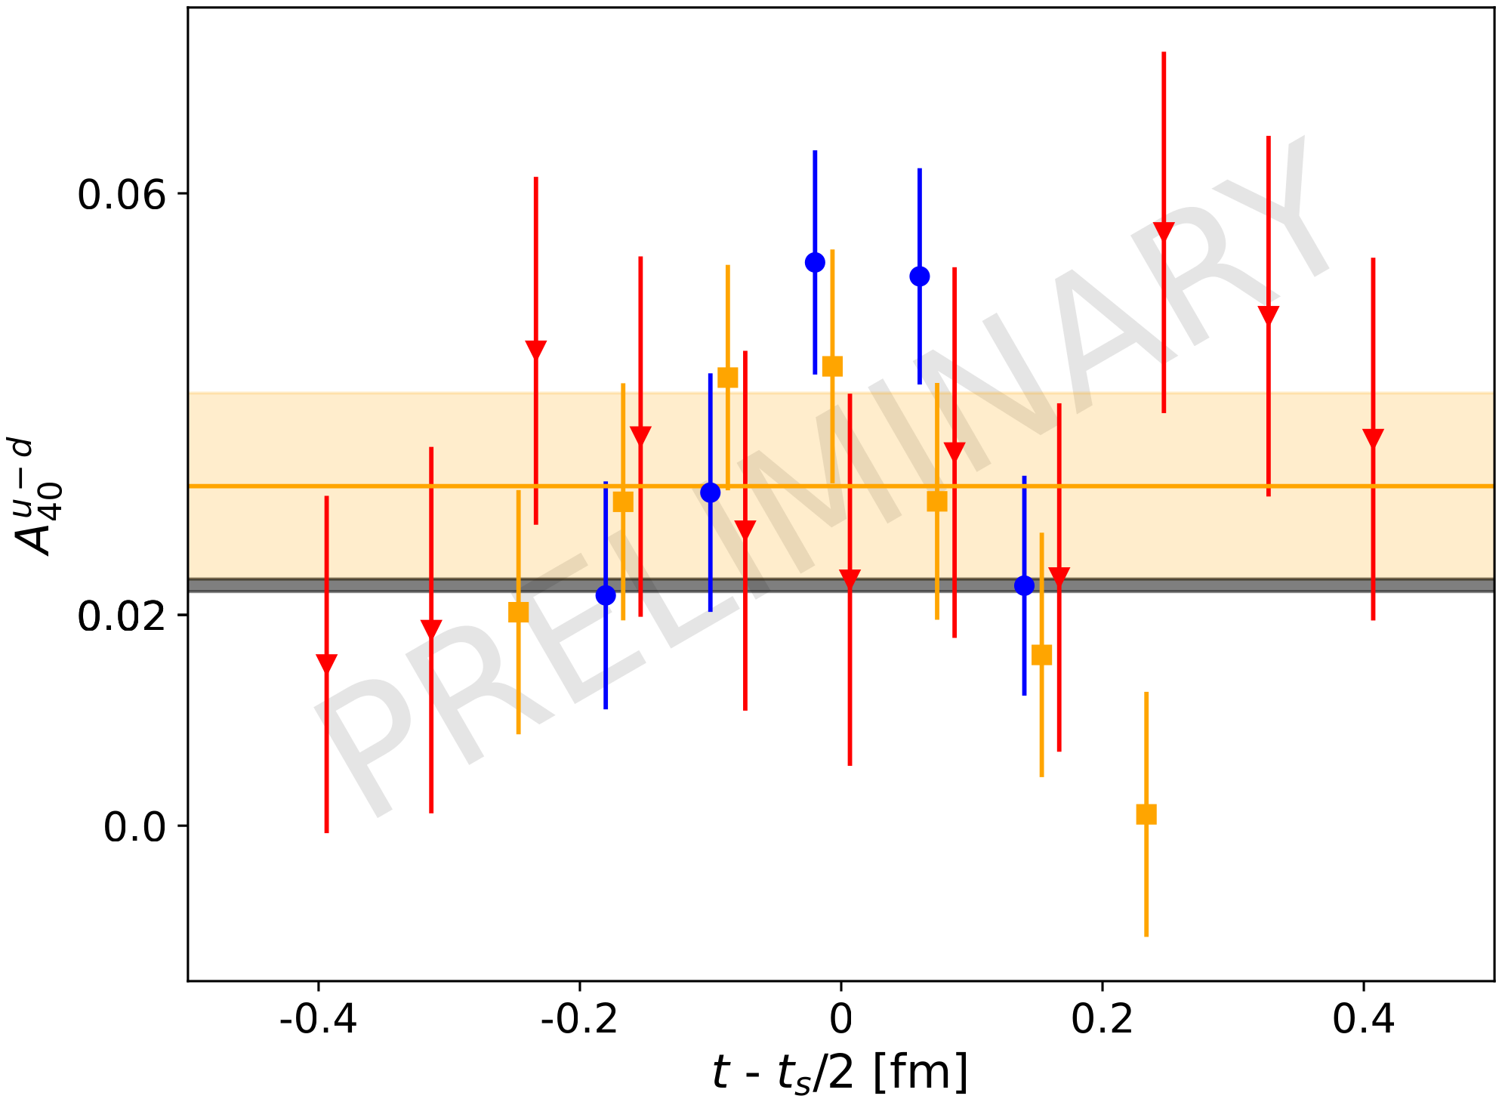
Results
Three-derivative operator
Direct calculation of <x³>
Plateau fit and summation method compatible to each other
C. Cocuzza et al., Phys. Rev. D 106.3 (2022), L031502

Slide 10
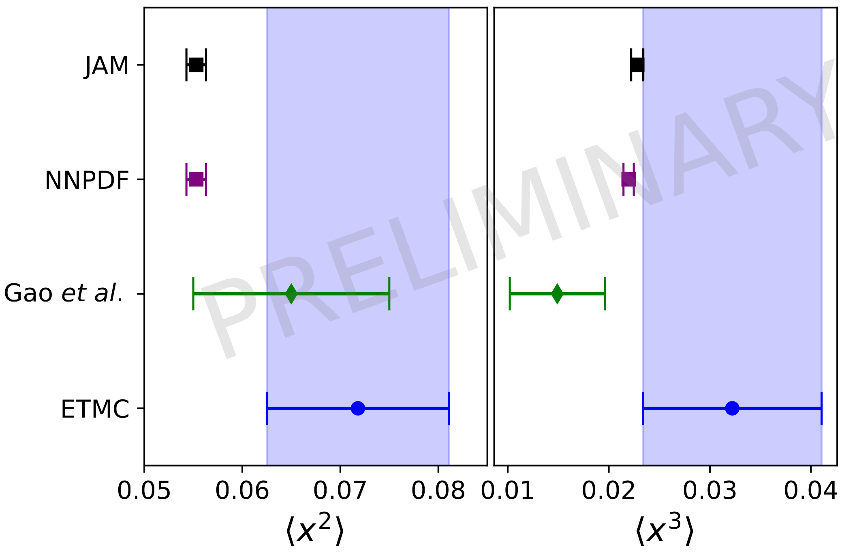
Results
NNPDF4.0 is another phenomenological approach
Gao et al. are a lattice group
R. Ball et al., Eur. Phys. J C 82.5 (2018), 054518
X. Gao et al., Phys.Rev. D. 107.7 (2023), 074509

Slide 11
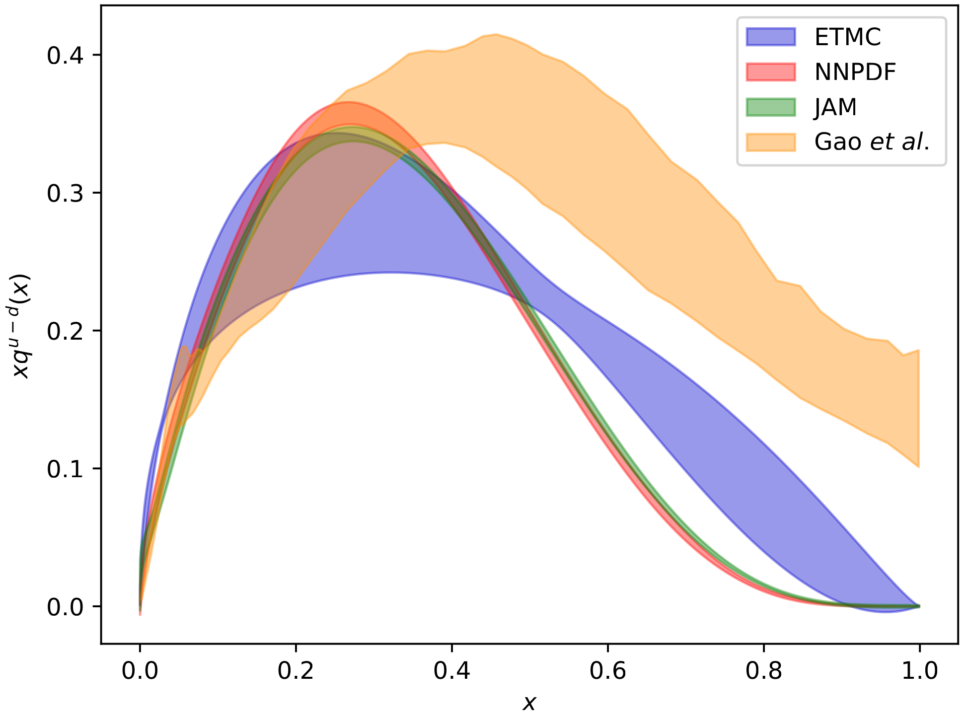
Results
Reconstructing PDF out of the moments
DNN and x-space are two approaches by Gao et al.
NNPDF is the NN approach by NNPDF4.0
Ansatz: q(x) = A xª (1-x)^{b}

Slide 12
Outlook
Moments of axial- and tensor GPDs
Smaller lattice spacing
Higher moments

Slide 13
Thank you

