Slide 1
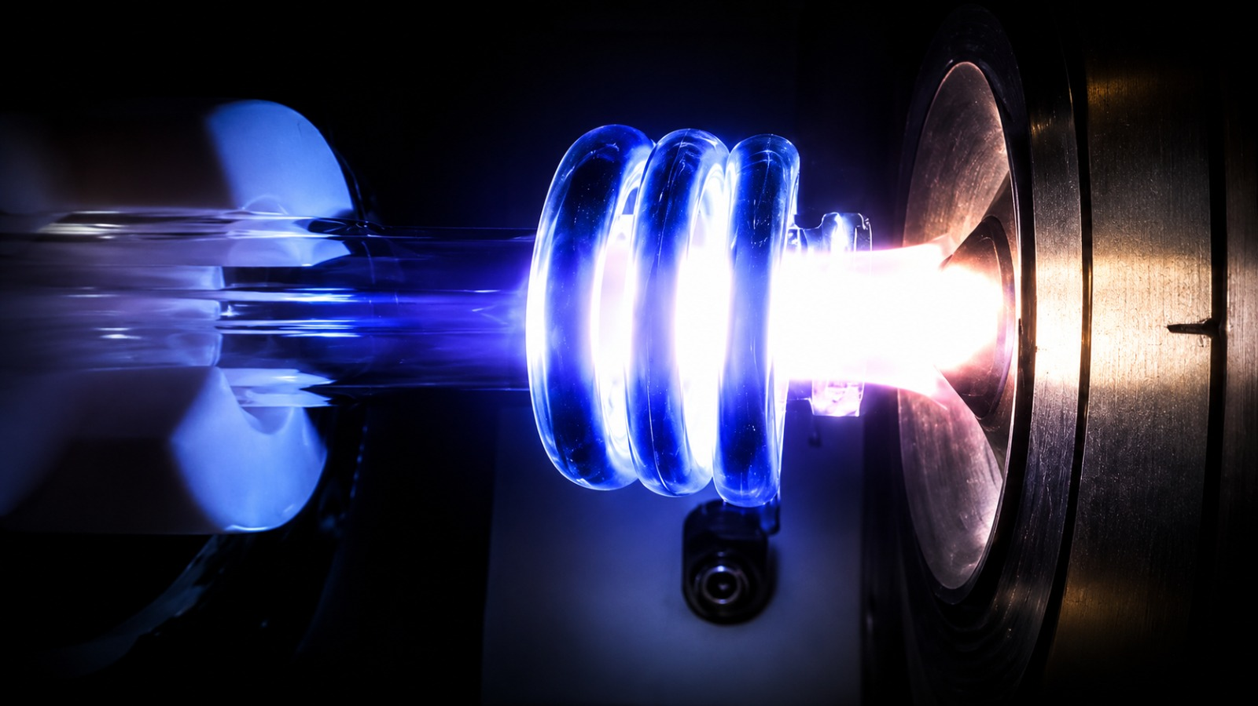


Materials radiopurity and radioactive assays
Roberto Santorelli
CIEMAT – Madrid
roberto.santorelli@ciemat.es
TIDPAN 2026 - Taller de Instrumentación y Detectores en Física de Particulas, Astropartículas y Nuclear

Slide 2
Objectives of this lecture
Figure out the importance of material assays and radiopurity-related aspects for low-background techniques
Know the most important sources of natural radioactivity for rare event search experiments
  Identify the main primordial radionuclides relevant for low-background experiments
  Grasp the principles of the cosmogenic production of radionuclides
  Anthropogenic contaminants
Understand the general framework of the problems posed by Radon
Know the principle of the most commonly used assay techniques

Slide 3
Suggested references
Heusser "Low-Radioactivity Background Techniques"
Ann. Rev. Nucl. Part. Sci. 45: 543 (1995).
Formaggio J. A., Martoff C. J., “Backgrounds to sensitive experiments underground”, Ann. Rev. Nucl. Part. Sci. 54, 361-412 (2004).
S. Cebrián, “Cosmogenic Activation in Double Beta Decay Experiments”, Universe 6 (2020) 10, 162 .
M. Wojcik, G. Zuzel, “Review of high-sensitivity Radon studies”, Int.J.Mod.Phys.A 32 (2017) 30, 1743004.
M. F. L'Annunziata, “Handbook of Radioactivity Analysis”, Elsevier.
G.R. Gilmore, “Practical gamma-ray spectrometry by Gordon Gilmore”, John Wiley & Sons.
Several “material-assay” papers from different low-background experiments (DarkSide, XENON, EXO, LZ, LEGEND, NEXT, etc) .

Slide 4


What you are expected to know:
Principles of radioactive decay
Principles of nuclear radiation
Principles of radiation interaction with matter
Rare events searches: No worries!... We are going to quickly summarize together some general aspects related to the rare-events searches and low-background techniques

Slide 5
Rare-event searches: solar and SN neutrinos, double-beta decay, Dark Matter particles…
LBL ν
Atmospheric ν
Solar & SN ν
Reactor & Geo ν
0νββ
Dark Matter
eV
Typical signal energy scale

Slide 6
Rare-event searches: solar and SN neutrinos, double-beta decay, Dark Matter particles…
Rates as low as a few events per year are predicted
Improved detector technology
Optimized detector design
Improved techniques to extract weak signals over background and noise (e.g. machine learning)
Improved detector modeling, etc…

Slide 7

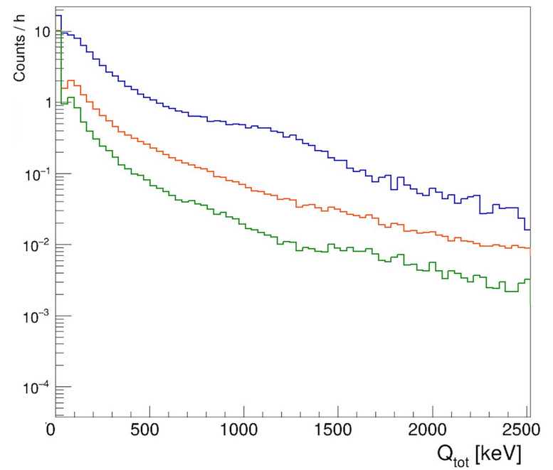
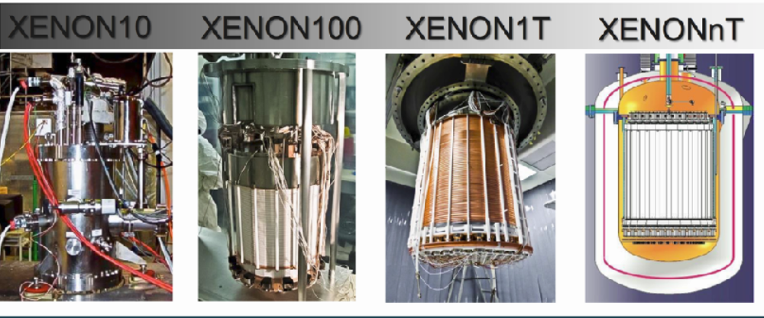
Rare-event searches: solar and SN neutrinos, double-beta decay, Dark Matter particles…
Two fundamental strategies:
Increase the target mass
10⁻¹
10³
Reduce the bkg level
10²
10⁻²
10¹
10⁻³

Slide 8
Backgrounds
Although the background sources in rare-event search experiments depend on the specific experiment, the main sources are generally:
  cosmic rays
  radiation from the materials surrounding the detector
radon in the experimental hall
  These backgrounds can be shielded and vetoed
  (more or less efficiently)
Notes:
School topics related to underground physics.

Slide 9

Setting the stage: material-induced backgrounds
α, β, γ, from the detector materials, especially those surrounding the active volume, can produce the ultimate background for the UG experiments
It is very difficult to mitigate this type of background
Limited impact of active/passive shielding, rock overburden ineffective…
A simple and extremely effective strategy (to some extent) is to minimize the amount of material used to build the detector
The radiopurity of the detector assembly is crucial for achieving the sensitivity required for rare-event searches
https://me.me/i/this-seems-likea-decent-amountof-pasta-what-the-okay-im-19124040

Slide 10
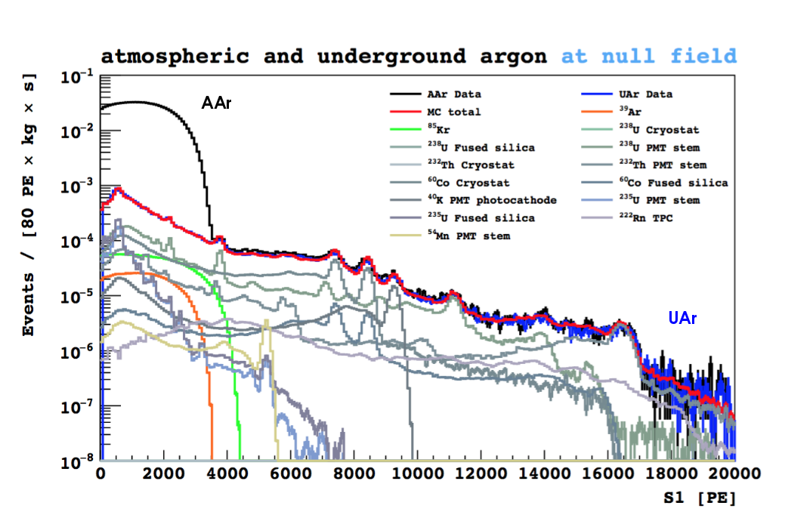
Material radiopurity: general aspects
In rare-event searches, the background must be carefully assessed: all detector components have to be assayed
DS-50 @ LNGS
Cryostat, sensors, support structure, Ar…

Slide 11
Radiopurity assessment strategy
Dedicated measurements to ensure the radiopurity of the materials used in the detector’s construction:
Quantify the content of radionuclides
Multiple assays methods and facilities: gamma counting, ICPMS, radiochemistry…
Simulation and calculation of radiation emission
quantify their impact on detector background
Calculation of the yields of primary and secondary particles, particle tracking …
Notes:
Extremely low-background features are more and more required: steady progress in material sourcing, manufacturing and assaying

Slide 12
Sample, vendor, manufacturing, storage history
The radiopurity of commercial raw materials from different suppliers can vary by orders of magnitude
The contamination level can differ, even in batches of the same material with different geological or chemical histories because of differences in the chemical composition of ores
Clean manufactoring: materials can be contaminated during manufacturing or synthesis through the intentional or unintentional use of radioactively contaminated catalysts, molds, lubricants, or additives.
Prevent recontamination through appropriate storage and handling of clean materials
Notes:
Extremely low-background features are more and more required: steady progress in material sourcing, manufacturing and assaying

Slide 13
Art?
“Selecting candidate low-radioactivity materials is as much an art
as it is a science”
(Nucl.Instrum.Meth.A 839 (2016) 6-11)

Slide 14
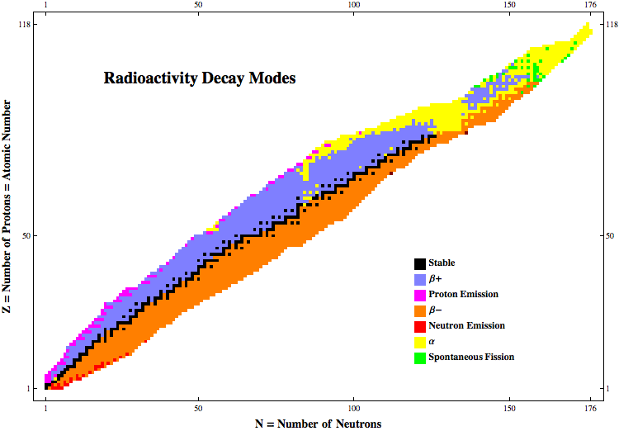
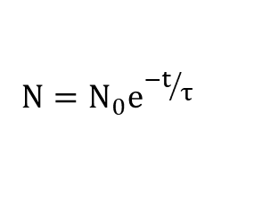
Radionuclides
https://www-nds.iaea.org/relnsd/vcharthtml/VChartHTML.html
For light stable nuclei, the number of neutrons is approximately equal to the number of protons (This reflects the structure of nuclear energy levels, in loose analogy with electron shells)
For light stable nuclei, N≈Z up to about calcium, (Z=20). For heavier stable nuclei, neutron excess increases with Z
Above Z = 82 (or 83), no stable isotopes of the elements discovered so far
N of parent atoms decreases exponentially with time
$$N=N_{0}e^{{−t}/τ}$$
λ is the decay constant of a given radionuclide → A = N λ = N/τ
The half-life t_{1/2} is the time required for half of the radioactive nuclei in a sample to decay
t_{1/2}= (ln2)/λ = 0.693 ⋅ τ

Slide 15
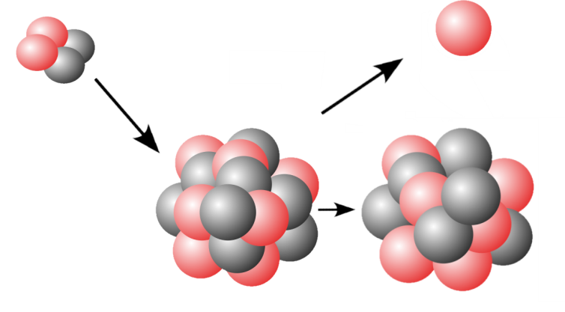
α,β,γ,….and neutrons
α-emitters produce secondary neutrons mainly through
(α, n) reactions
+
S.F.

Slide 16
What we have to measure?
How can we measure it?

Slide 17
What we have to measure?
How can we measure it?

Slide 18
Naturally occurring radionuclides
Primordial
Found on the Earth and existing in their current form since before Earth was formed
Cosmogenic
Production of unstable nuclei by cosmic rays entering the Earth’s atmosphere
Artificial radionuclides
Anthropogenic
Nuclear tests, nuclear waste, accelerators…

Slide 19
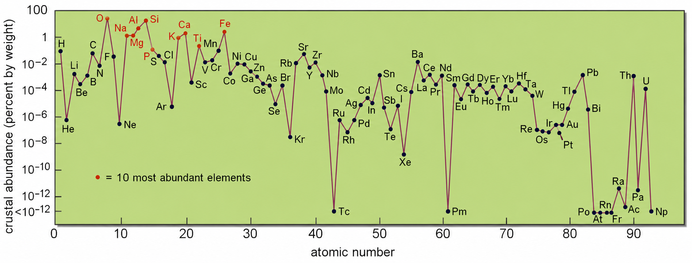
Relevant primordial radionuclides
For low-background experiments, the relevance of primordial radionuclides is driven by:
Abundance of the chemical element in the Earth’s crust
Isotopic abundance of the radioactive isotope
Abundance of the chemical elements in the Earth's upper continental crust

Slide 20
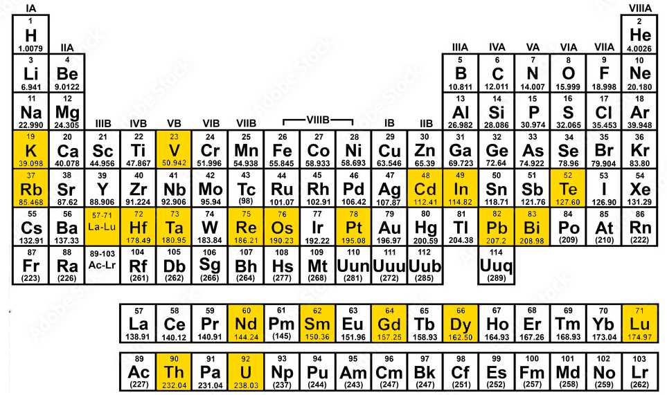
Primordial radionuclides
There are ≈252 stable nuclides (it depends on the definition of “stability”…)
On Earth, ∼ 4.5 × 10⁹ yr after its formation, most of the original unstable nuclei have decayed leaving only those with t_{1/2} > 10⁸ yr
≈34 radionuclides that have half-lives long enough to have survived since the formation of the Earth 4.5×10⁹ years (isotopes of 28 separate elements)
These long-lived nuclei undergo either highly forbidden β decays, involving large spin changes, or α decays with Q-values that lead to half-lives in this range
Most of them have half-lives significantly longer than the age of the Universe
(they are practically stable, with an abundance similar to the one of the stable isotopes of their respective elements)
There are only a handful of nuclides with half-lives comparable to the age of the Earth
Notes:
Our galaxy’s stock of heavy elements was mostly produced in earlier generations of stars and dispersed into the interstellar medium by various processes (e.g. supernovae explosions can eject stable and unstable nuclei into the interstellar medium)
This cloud later condensed to form the stellar systems

Slide 21
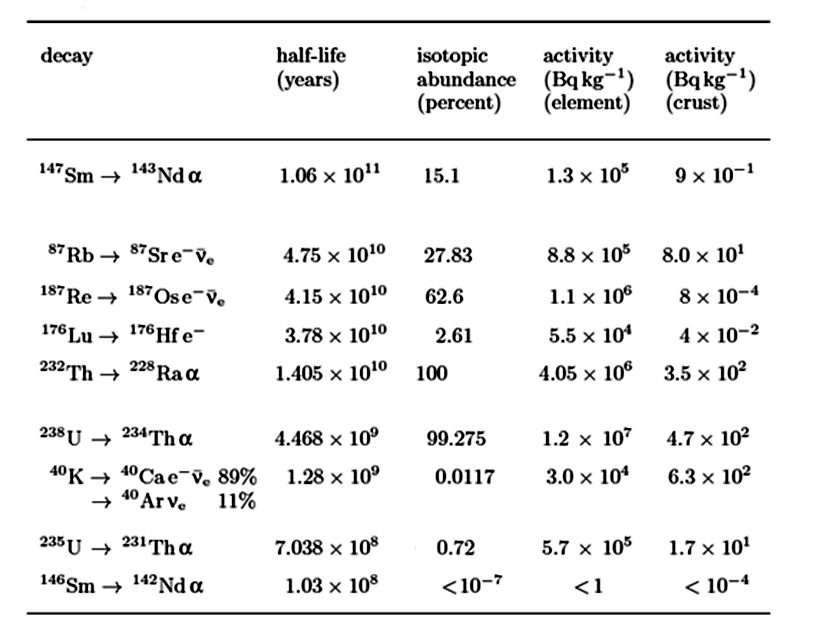
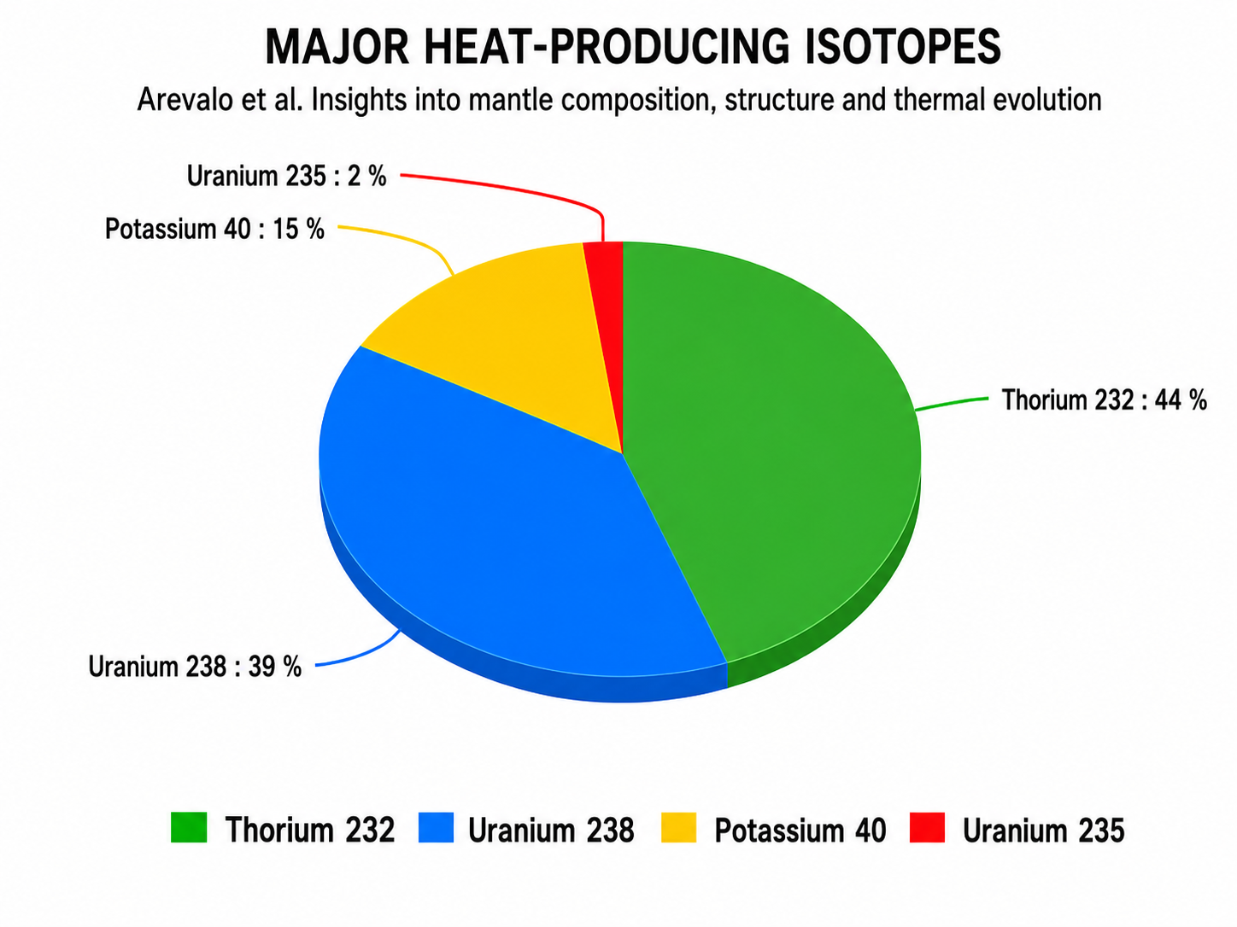
Relevant primordial radionuclides
For low-background experiments, the relevance of primordial radionuclides is driven by:
Abundance of the chemical element in the Earth’s crust
Isotopic abundance of the radioactive isotope
Half-life: long enough to survive since Earth formation, but short enough to produce measurable activity
“Fundamentals In Nuclear Physics From Nuclear Structure to Cosmology” - Springer
t_{1/2}
Radiogenic heat in the Earth
∼10¹¹y
∼10¹⁰y
∼10⁹y
∼10⁸y

Slide 22
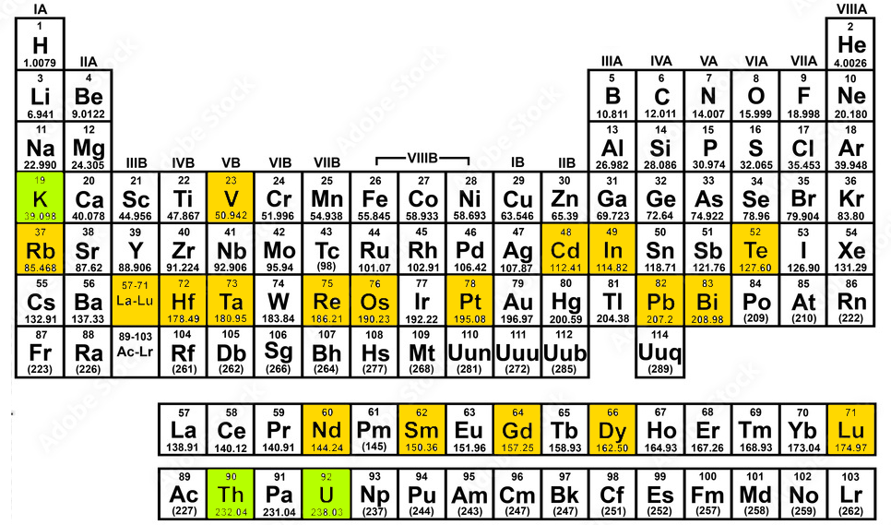
U, Th, and K dominate because they combine natural abundance, suitable half-lives, and radiologically relevant decay emissions.

Slide 23
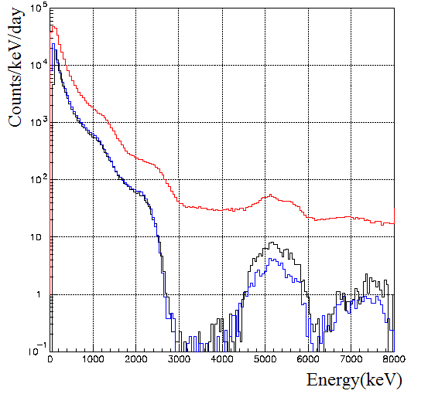
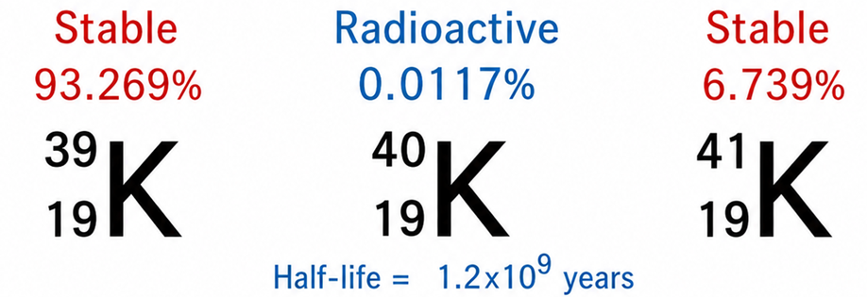
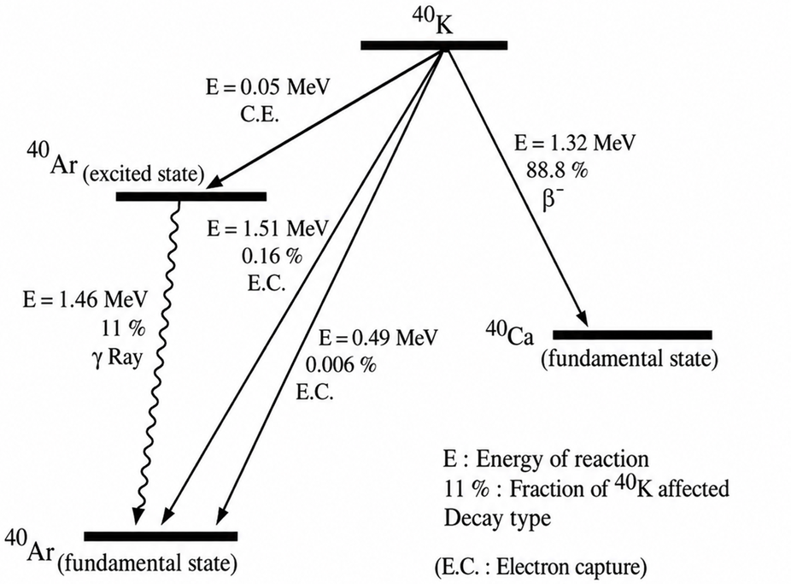
⁴⁰K
Potassium is one of the most common elements on the Earth’s crust
⁴⁰K emits detectable gamma rays
1.46 MeV
from ⁴⁰K
Surface
UG
In 10.72% of events, it decays to ⁴⁰Ar by electron capture (EC)
K content of the body is 0.2 %
⁴⁰K in humans → primary source of radiation from our body
(practically constant)
For a 70-kg person, the amount of ⁴⁰K will be about 4.26 kBq

Slide 24
²³⁸U, ²³⁵U, ²³²Th
They do not decay directly to a stable state: each initiates a decay chain
Altogether, these chains include ≈42 radionuclides
The mass number of the members may be expressed as four times an appropriate integer (n) plus the constant for that series. Three naturally occurring series are:
Thorium series (4n): ²³²Th (t_{1/2} =1.4·10¹⁰ y) → 10 radionuclides → ²⁰⁸Pb (²³²Th ≈100% ^{nat}Th)
Uranium series (4n+2) : ²³⁸U (t_{1/2}= 4.5·10⁹ y) → 17 radionuclides → ²⁰⁶Pb (²³⁸U ≈99.3% ^{nat}U)
Actinium series (4n+3): ²³⁵U (t_{1/2}= 7·10⁸ y) → 15 radionuclides → ²⁰⁷Pb (²³⁵U ≈0.7% ^{nat}U)
The neptunium series with Np-237 (with a half-life of 2 million years) 4n+1 series do not occur naturally, because the half-life of the longest lived isotope in the series is short compared to the age of the Earth.
The Np decay chain has no long-lived nuclei heavier than ²⁰⁹Bi.
→ The chain thus consists of a single decay ²⁰⁹Bi → ²⁰⁵Tl_{(stable)} (t_{1/2} = 1.9 × 10¹⁹ y)

Slide 25
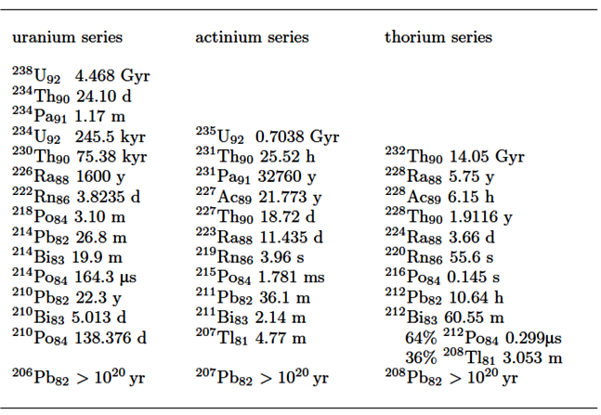
²³⁸U, ²³⁵U, ²³²Th
α decay
β decay
α or β decay

Slide 26
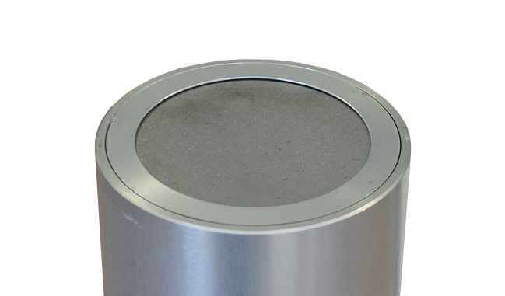
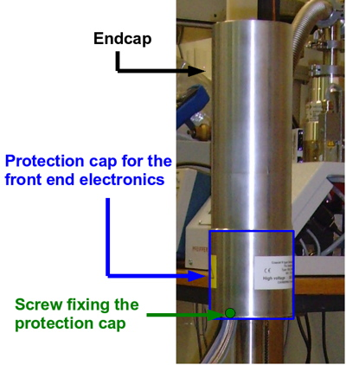
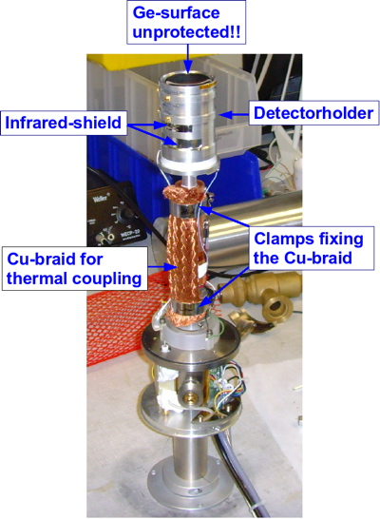
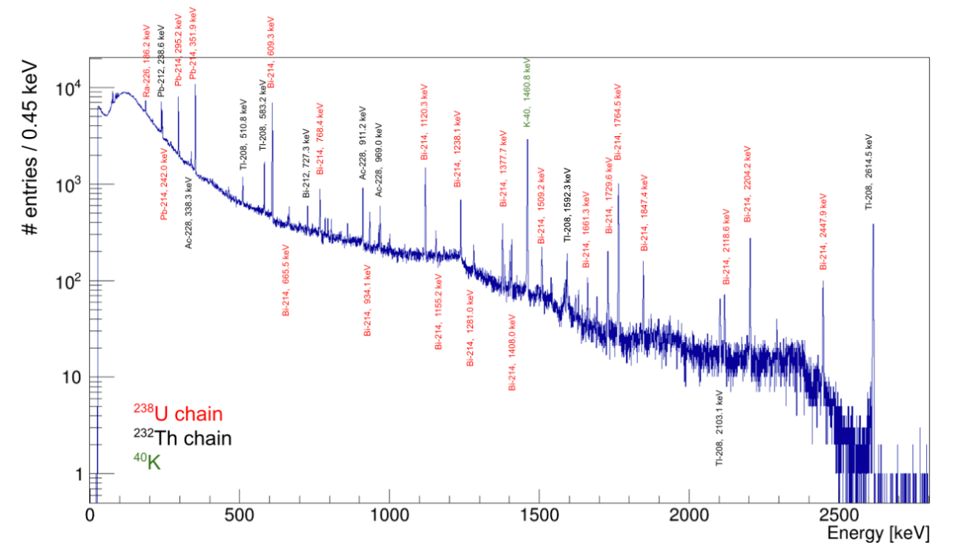
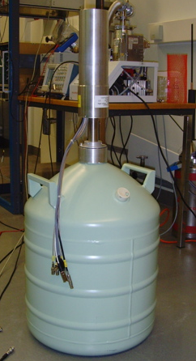
γ-spectroscopy with HPGe detectors

Slide 27
^{However….}
In these chains there are alpha and beta emitters, most of which do not emit detectable gamma rays:
Gamma spectroscopy alone is not sufficient

Slide 28


Equilibrium in the chain
Equilibrium means that the activities of the parent and daughter nuclides are the same
If no progeny atoms are present at time t = 0, the number of progeny atoms, N₂, at any later time t is:
Bateman equation
N₀ is the number of parent atoms present at time N₁(t = 0)
λ₁ is the decay constant of the parent,
λ₂ is the decay constant of the progeny
If (N₂)₀ progeny atoms are present at time t = 0, the expression for N2 is written
The apparent half-life of the progeny reflects the simultaneous production and decay of the progeny.
The ratio of activities A1/A2 for X and Y, respectively, is
Notes:
Secular does not mean eternal. Looking at a very long-term all secular equilibria are transient.
At the equilibrium the # of atoms Is maximum

Slide 29
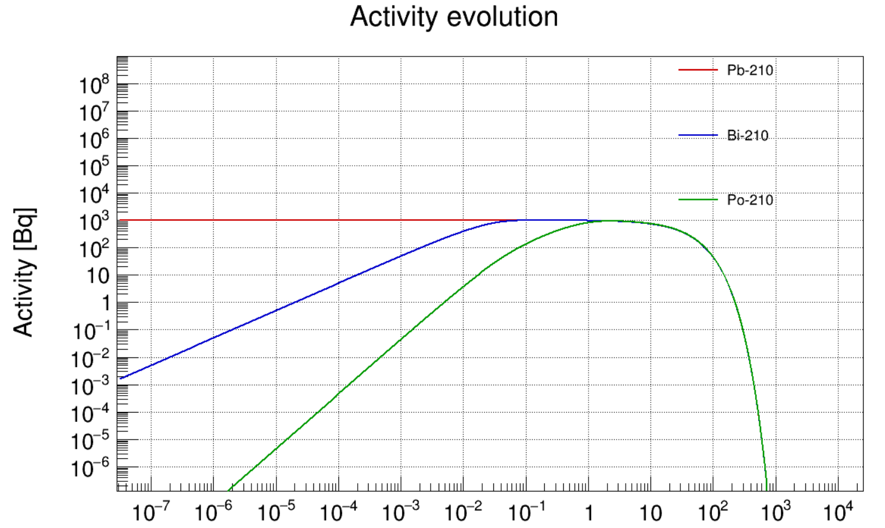
Example: Activity Evolution
Time [y]

Slide 30
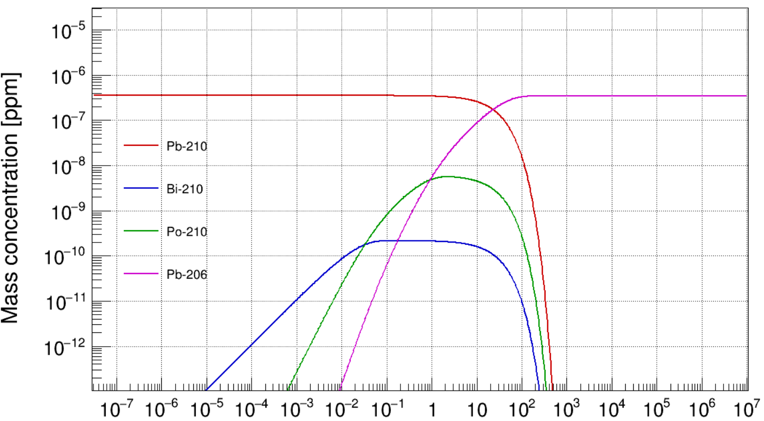
Example: Abundance Evolution
Time [y]

Slide 31
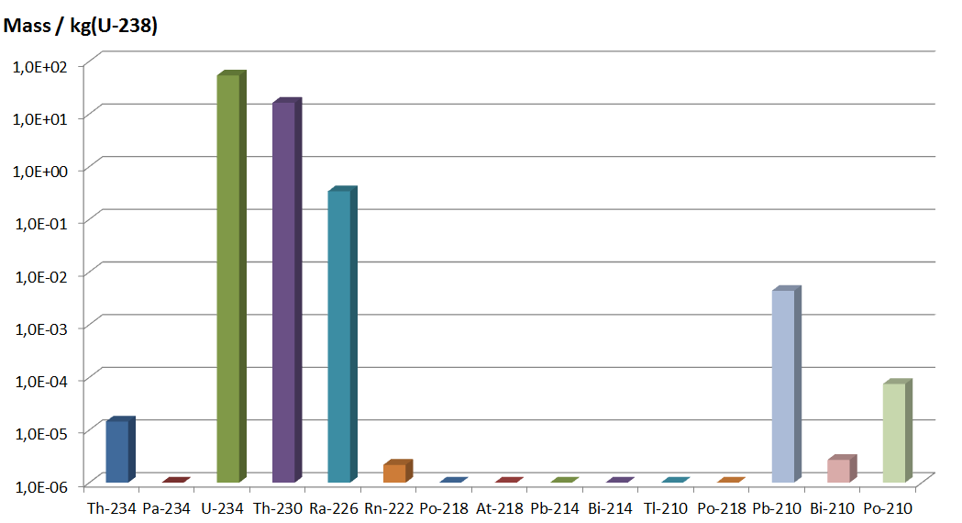
Secular equilibrium
“Secular equilibrium”: the half-life of the parent nuclide is very long and the half-life of the daughter nuclide is considerably shorter than that of the parent
A radioactive nuclide decays at the same rate at which it is being produced:
→ the number of atoms present remains constant (over a certain period of time)
Over the 4.5 billion years of the Earth’s history, all U and Th decay chains have reached equilibria between the parent nucleus and the various descendants (assuming that the system has been closed for millions of years)
Mass / tonne (U-238)
16 g Th-230
Minerals that contain uranium and thorium also contain virtually all daughter nuclides in their decay chains, provided the system has remained closed for a sufficiently long time
In secular equilibrium, all nuclides in the chain have the same activity
The mass of each daughter nuclide present in the mineral is proportional to its half-life
54 g U-234
0.3 g Ra-226
4.4 mg Pb-210

Slide 32
Disequilibrium in natural decay chains
Equilibrium in the decay series is rarely maintained in most surface and near-surface geological environments, as a result of physical or chemical processes:
chemical, artificial or natural processes (e.g. dissolution into groundwater) can remove one or more members of the chain.
If, for example, uranium is dissolved from a primary uranium-bearing mineral by oxidation, the remaining radionuclides in the ²³⁸U series will be supported by its most long-lived radionuclide which is ²³⁰Th. If the dissolved uranium is then precipitated somewhere out of the system a new equilibrium will begin to develop.
The time required to attain the equilibrium is governed by the most long-lived daughter radionuclide in the series, ²³⁰Th in the case of ²³⁸U series. The half-life of ²³⁰Th is 75000 years and this time is required to reach 50% of equilibrium.
The disequilibria can be utilized in dating geological events.

Slide 33
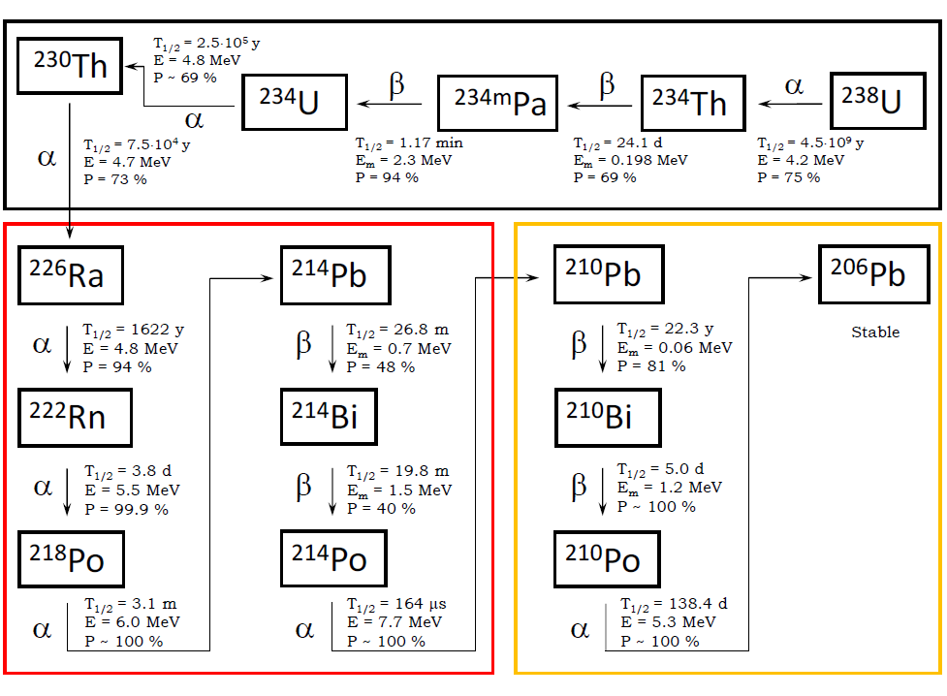
²³⁸U chain

Slide 34
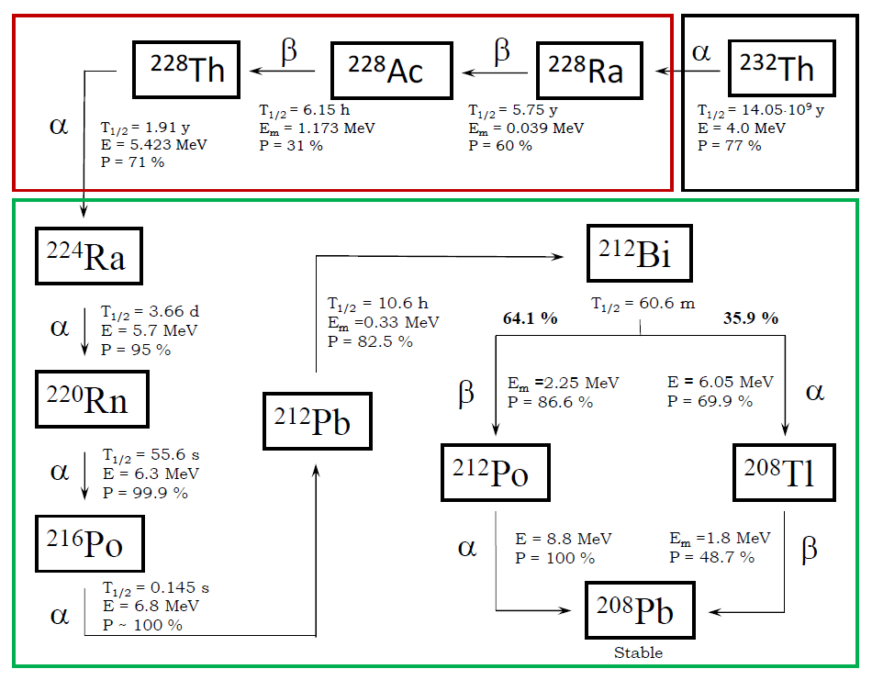
²³²Th chain

Slide 35
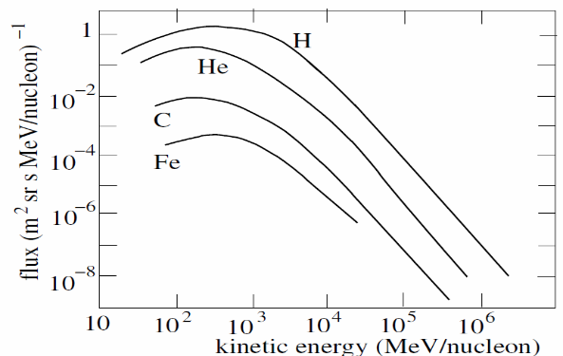
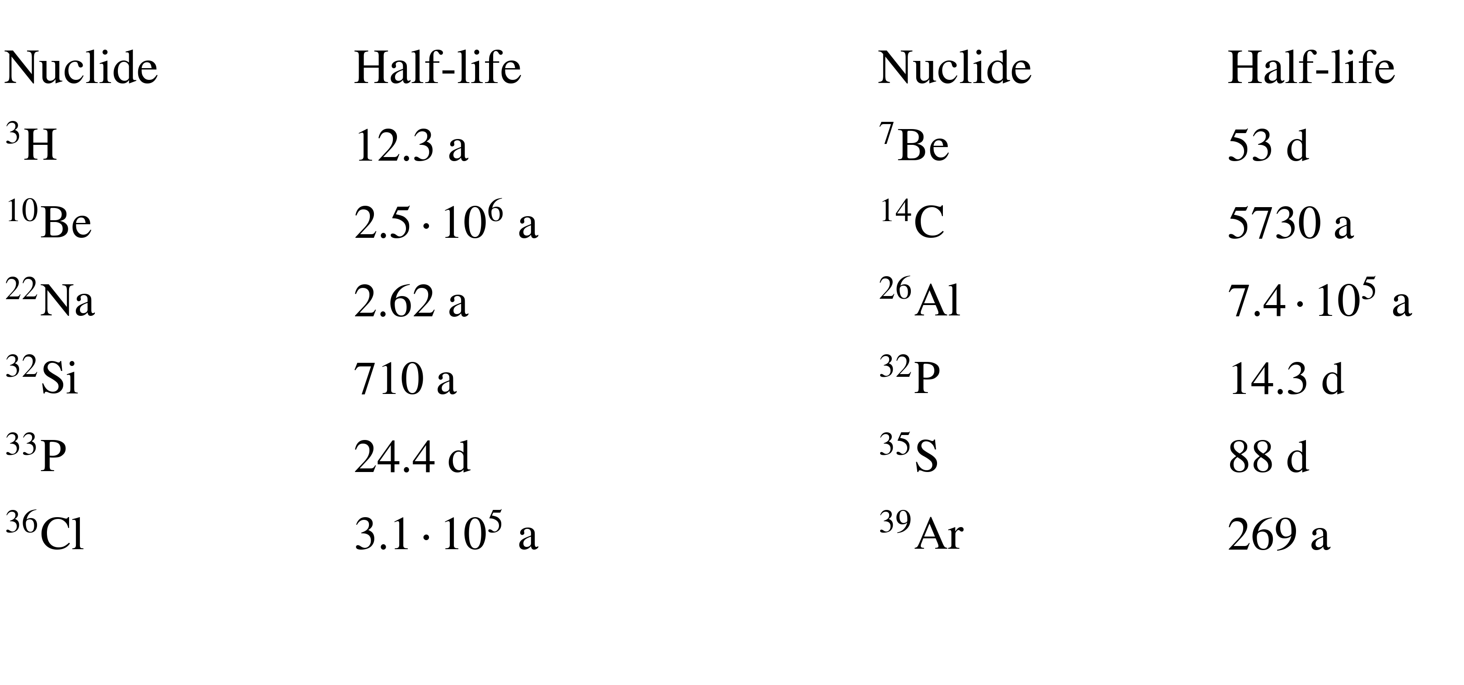
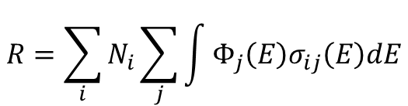
Cosmogenic radionuclides
Cosmic rays produce radioactive nuclei via their interactions with nuclei in the atmosphere and in the Earth’s crust
The primary components of cosmic radiation are high-energy alpha particles and protons, which induce nuclear reactions when they impact on the nuclei of the atmospheric atoms (especially oxygen, nitrogen and argon)
¹⁴N + n → ¹⁴C + p
¹⁴N + n → ¹²C + ³H
In the atmosphere, the most common radioactivity produced is that of ¹⁴C
¹⁴C is mixed throughout the atmosphere and enters the food chain through CO₂ ingesting plants
These radionuclides are isotopes of lighter elements, and their half-lives vary widely
The total production rate R of a radioisotope is obtained by summing over all target nuclei i and over all cosmic-ray particle components j:
N_{i}​ is the number of target nuclei
ϕ_{j}(E) is the energy-dependent cosmic-ray flux
σ_{ij}​(E) is the production cross section for isotope i induced by particle j
(integral accounts for the contribution of all incident particle energies)
$$R=\sum_{i}{N_{i}}\sum_{j}{\int{Φ_{j}\left(E\right)σ_{ij}\left(E\right)dE}}$$
Notes:
In rare circumstances, nucleons removed in spallation reactions can combine to form nuclei. For example the radioactive tritium isotope of hydrogen can be produced by cosmic rays by (for example) the reaction n 16O → H14N t1/2(3H) = 12.35 yr . (5.14) The atmospheric tritium combines with oxygen to form water that rains down on the Earth. Prior to the atmospheric testing of nuclear weapons and the Chernobyl reactor accident, this was he primary source of naturally occurring tritium. Because of its short half-life, tritium is absent in water from deep water reserves and also in crude oil
Primary cosmic ray particles hit the earth atmosphere producing a variety of particles
Cosmic muons can
create neutrons, β and γ backgrounds without leaving any traces in the detector
increase detector dead-time (if overhead burden is inadequate)
produce unwanted radioisotopes (even UG)

Slide 36
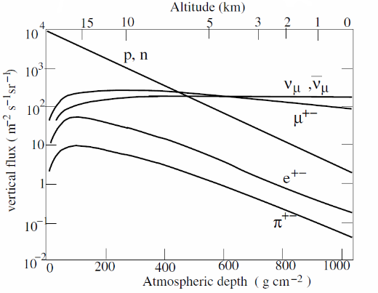
Cosmogenic radionuclides
There is, however, great variation at different heights of the atmosphere and at different latitudes.
The total intensity of these secondary's reaches a maximum at an atmospheric depth of about 150 g/cm (∼13.7 km altitude) and then falls off gradually
Most of the cosmogenic radionuclides are attached to aerosol particles and are deposited on the ground. Some, however, are gaseous, such as ³⁹Ar (a noble gas), and thus stay in the atmosphere.
At sea level (and obviously U.G) the muon flux dominates
Fundamentals in Nuclear Physics - From Nuclear Structure to Cosmology – Basdevant, Rich, Spiro
Muon-induced spallation: a high-energy muon emits a hard photon (virtual or real), which interacts photonuclearly with the nucleus and fragments it, producing radioactive residual isotopes
Electromagnetic/photonuclear showers: muon-induced bremsstrahlung photons and e± cascades generate hard photons that activate nuclei through photonuclear reactions such as (γ,n)
Muon-induced neutrons: secondary neutrons produced as by-products of muon-induced spallation or photonuclear reactions in electromagnetic showers, which then activate nuclei via reactions such as (n,γ), (n,p), or (n,2n)
Negative-muon capture: stopped μ⁻ are captured by nuclei, converting a proton into a neutron and leaving the nucleus excited, possibly producing radioactive isotopes
Notes:
This nucleus is a secondary product of neutrons who are themselves produced by high-energy cosmic-ray protons that breakup nuclei in the atmosphere. The neutrons then either decay or are absorbed. The most common absorption process is the exothermic (n,p) reaction on abundant atmospheric nitrogen
In rare circumstances, nucleons removed in spallation reactions can combine to form nuclei. For example the radioactive tritium isotope of hydrogen can be produced by cosmic rays by (for example) the reaction n 16O → H14N t1/2(3H) = 12.35 yr . (5.14) The atmospheric tritium combines with oxygen to form water that rains down on the Earth. Prior to the atmospheric testing of nuclear weapons and the Chernobyl reactor accident, this was he primary source of naturally occurring tritium. Because of its short half-life, tritium is absent in water from deep water reserves and also in crude oil
Primary cosmic ray particles hit the earth atmosphere producing a variety of particles
The total intensity of these secondary's reaches a maximum at an atmospheric depth of about 150 g/cm (∼13.7 km altitude) and then falls off gradually
At sea level, the muon flux dominates
Cosmic muons can
create neutrons, β and γ backgrounds without leaving any traces in the detector
increase detector dead-time (if overhead burden is inadequate)
produce unwanted radioisotopes (even UG)

Slide 37
Cosmogenic radionuclides
For example neutron “spallation” reactions:
A neutron with kinetic energy greater than ∼20 MeV can remove two neutrons for a germanium nucleus,
e.g. n + ⁷⁰Ge → 3n + ⁶⁸Ge t_{1/2}(⁶⁸Ge) = 270.7day
This reaction results in an activity of ∼0.3 mBq kg⁻¹ in Ge crystals produced at the Earth’s surface
This is the most important source of intrinsic radioactivity in the HPGe crystals
A fast neutron with kinetic energy above the (n,2n) threshold can remove one neutron from atmospheric argon,
e.g. n + ⁴⁰Ar → 2n + ³⁹Ar t_{1/2} (³⁹Ar) = 269 yr
This cosmogenic production leads to an activity of ~1 Bq kg⁻¹ in atmospheric argon
This is the dominant intrinsic radioactive background of Ar_{Atm} in low-background LAr detectors

Slide 38
Cosmogenic radionuclides
The activation by the hadronic component can reach specific radioactivity levels higher than the residual contamination from primordial nuclides.
Since the intensity of cosmic radiation is constant over the long-term, the production of cosmogenic radionuclides is rather constant.
Materials have to be stored underground (the production of cosmogenic radionuclides stops and the activity decays away).
Materials extracted UG should be largely depleted in cosmogenic isotopes.
Notes:
tritium is absent in water from deep water reserves and also in crude oil

Slide 39
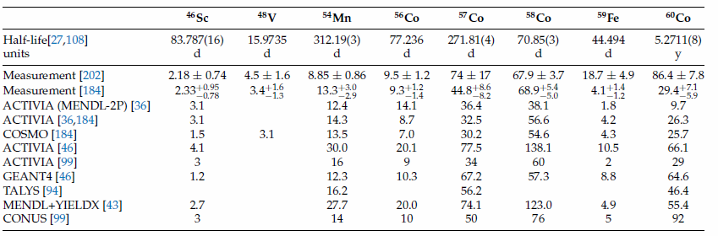
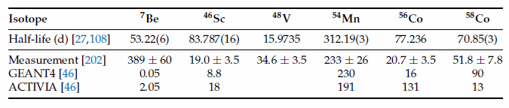
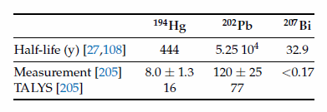
Rates of production of long-lived radionuclides
at sea level (atoms/kg/day)
Copper
SS
Lead
(Universe 6 (2020) 10, 162)

Slide 40
Artificial radionuclides
Sources of artificial radionuclides:
nuclear weapons production and explosions;
nuclear energy production;
radionuclide production by reactors and accelerators (medical application etc…)
Artificial radionuclides form the largest group of radionuclides, comprising more than two thousand nuclides.
The explosion clouds of the most powerful tests entered the upper part of the atmosphere, the stratosphere, from where the radioactive pollutants have deposited on a global scale.
Cs-137 (T_{1/2}=30.2 y), along with iodine-131, xenon-133, and strontium-90, has been released into the environment by nuclear weapons tests and major nuclear accidents.
The mean Cs-137 contamination in Eastern Europe following the Chernobyl disaster was several kBq/m².
Notes:
since the 1930s
Assieme al cesio-134, allo iodio-131 e allo stronzio-90, il cesio-137 era uno dei radioisotopi che ponevano il maggiore rischio per la salute tra quelli dispersi dall'esplosione della bolla d'idrogeno del reattore e il successivo incendio della grafite.
Dal momento che il cesio-137 è un sottoprodotto della fissione nucleare dell'uranio, un tipo di reazione nucleare attualmente per la maggior parte di origine artificiale, esso non si presentava in natura in modo significativo prima che cominciasse l'era atomica
Cs simile al potassio

Slide 41
Artificial radionuclides
Kr-85 (T_{1/2}=10.8 y) is one of the seven common medium-lived fission products
Kr-85 is produced in small quantities by cosmic rays interactions with stable Kr-84 in the atmosphere. Natural sources maintain a steady-state inventory of about 0.09 PBq in the atmosphere.
The Fukushima accident released an estimated 44–84 PBq of Kr-85 in the atmosphere

Slide 42


Slide 43
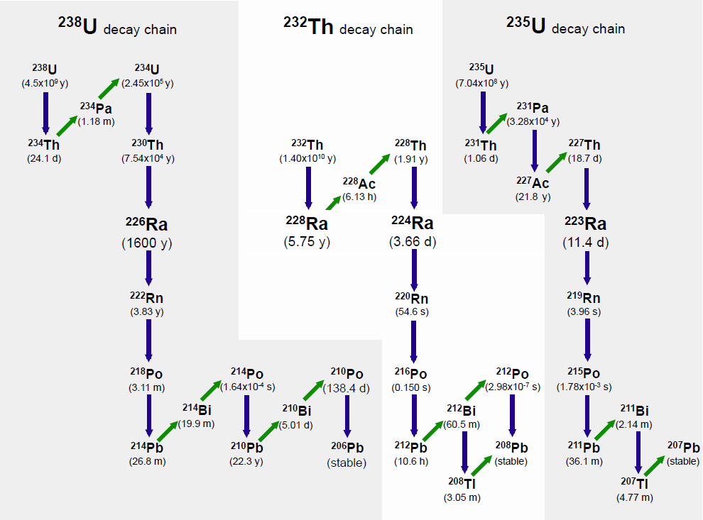

Slide 44
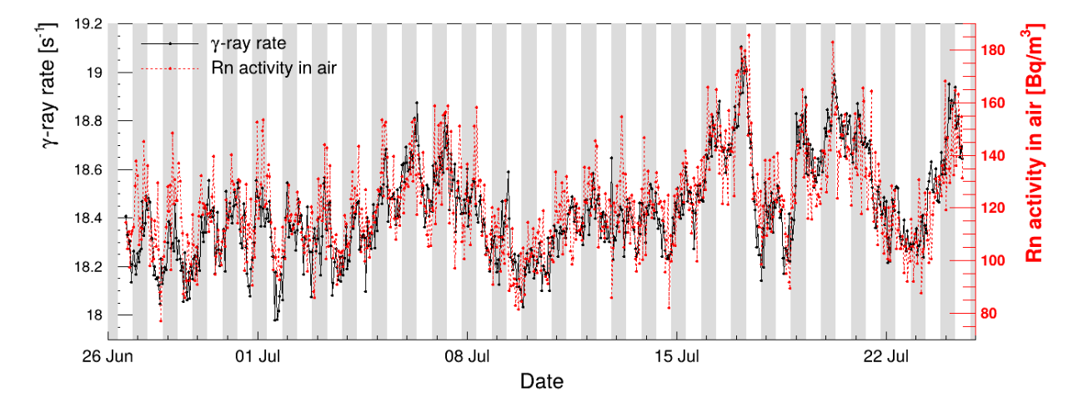
²²²Rn problem
Why is Rn a problem?
Radon is a noble gas and can escape both solid and liquid materials.
²²⁰Rn, ²¹⁹Rn, and especially ²²²Rn (together with their daughters) emit several high-energy gammas
Rn daughters plate out electrostatically onto surfaces. This effect is strongly enhanced on statically charged surfaces such as plastics or glass
²²²Rn feeds the long-lived isotope ²¹⁰Pb (T_{1/2}​=22 y)
Techniques based on charcoal adsorption have been used which suppress Radon (by about a factor of 10⁴-10⁵).
Rn emanates constantly from the rock.
²²²Rn concentration is significantly higher in an underground facility than on surface.
It is mandatory to protect a the material surface against Rn (particularly UG)

Slide 45
What we have to measure?
U, Th, K, Cs, Co…
How can we measure it?

Slide 46
How radiopure?
1 Bq ²³⁸U /kg ≅ 81 × 10⁻⁹ g_{U}/g (81 ppb U)
1 Bq ²³²Th /kg ≅ 246 × 10⁻⁹ g_{Th}/g (246 ppb Th)
1 Bq ⁴⁰K /kg ≅ 32.3 × 10⁻⁶ g_{K}/g (32.3 ppm K)
One banana is a source of about ≈ 20 Bq of ⁴⁰K → ≈ 100 Bq/kg
⁴⁰K in humans → primary source of radiation from our body (practically constant)
    K content of the body is 0.2 %
    Natural abundance of 0.0117 % of K_{Nat}
    K-40 specific activity ≈2.6e5 Bq g⁻¹
For a 70-kg person, the amount of ⁴⁰K will be about 4.26 kBq (≈ 60 Bq/kg)
¹⁴C for a 70-kg person would be about 3.08 kBq (≈44 Bq/kg)
For a low-background detector, a human body is a radioactive object: per kilogram, we are about one hundred thousand times hotter than the materials we are trying to select.

Slide 47
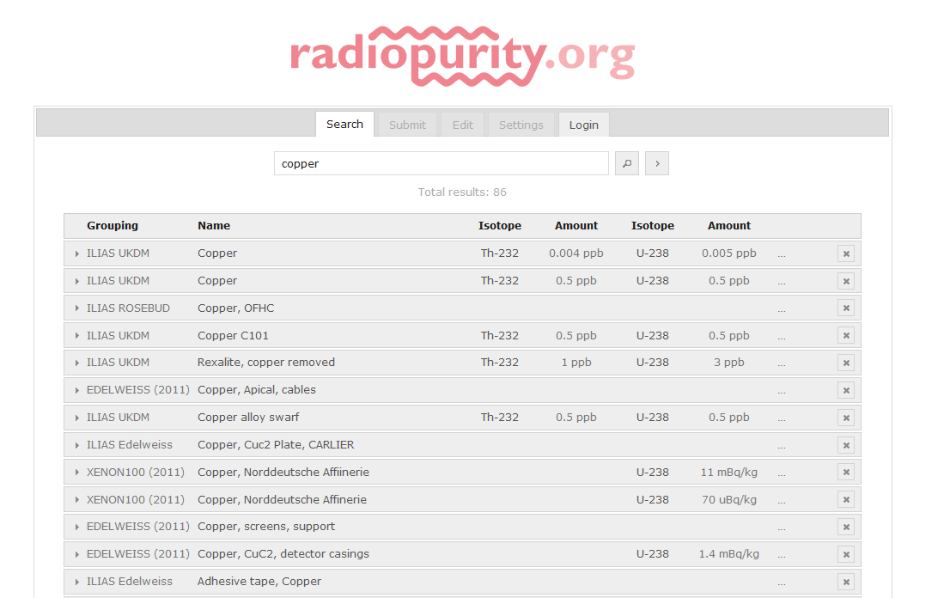

Slide 48
Common assay techniques
Gamma counting with HPGe crystals
Mass spectroscopy
    ICP-MS
    GD-MS
    LA-ICP-MS
Neutron Activation Analysis
Emission spectroscopy
    XRF
    ICP-AES
Radio-chemical methods (²¹⁰Po extraction)

Slide 49
Gamma spectroscopy with HPGe
Gamma rays produced by the great majority of radionuclides
The typical range for γ-rays emitted by nuclei is 50 keV - 10 MeV (endcap - size of the crystals)
Gamma spectrometry is a non-destructive technique
Gamma spectrometry using HPGe semi-conductor detectors is one of the best techniques to identify and quantify radionuclides: very good energy resolution
Operating Ge detectors not possible at room temperature (leakage current due to the small bandgap energy)
The germanium detector preamp is normally included as part of the cryostat package.
All of the cryostat materials around the detector should be as low Z as possible to reduce photon scatter. Hence, aluminum, magnesium, beryllium, Teflon, and Mylar are used whenever possible.
Notes:
Germanium is by far the most common gamma-ray
detector material. High atomic number small band gap

Slide 50

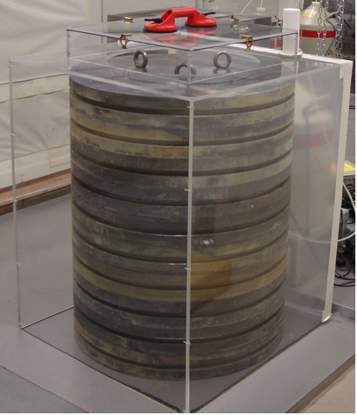
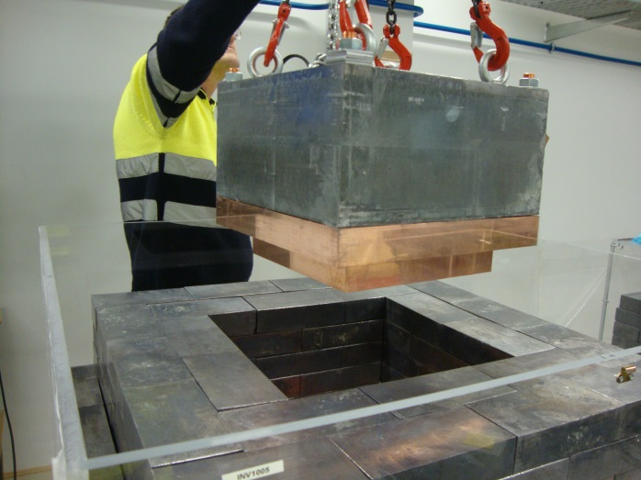
Courtesy of LSC
HPGe shielding
10 cm Cu-OF
20 cm Pb (~660 bricks or “donuts”)
Methacrylate Rn box.
Door

Slide 51
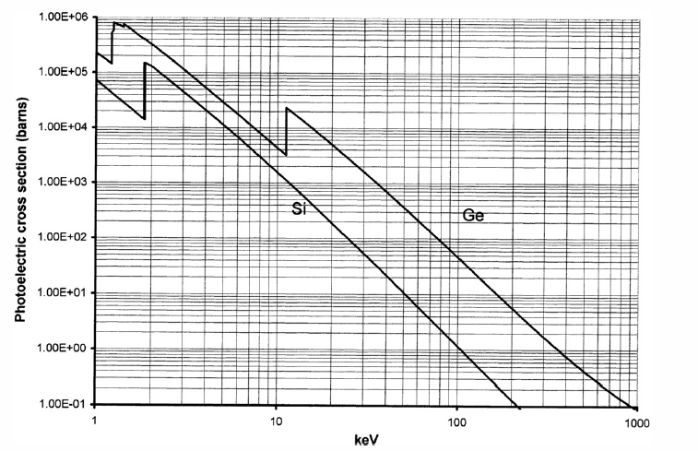
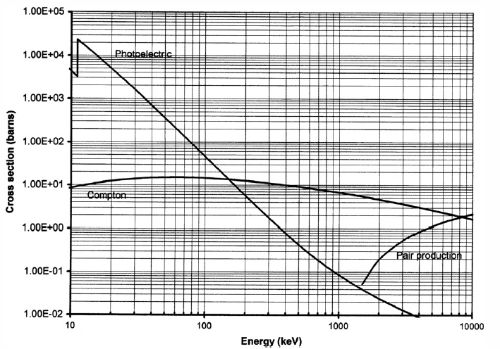
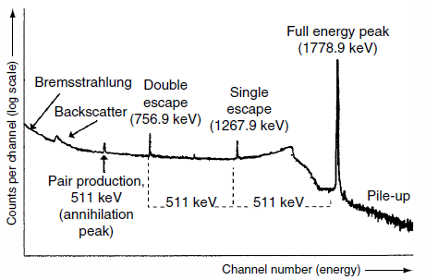

Gamma spectroscopy with HPGe
Photoelectric cross section (barns) of Si (lower curve) and Ge (higher curve) as a function of energy (keV).
Compton, photoelectric, and pair production cross section of Ge for high-energy g-rays.
Notes:
photoelectric cross section depends roughly on the fifth power
of the atomic number

Slide 52
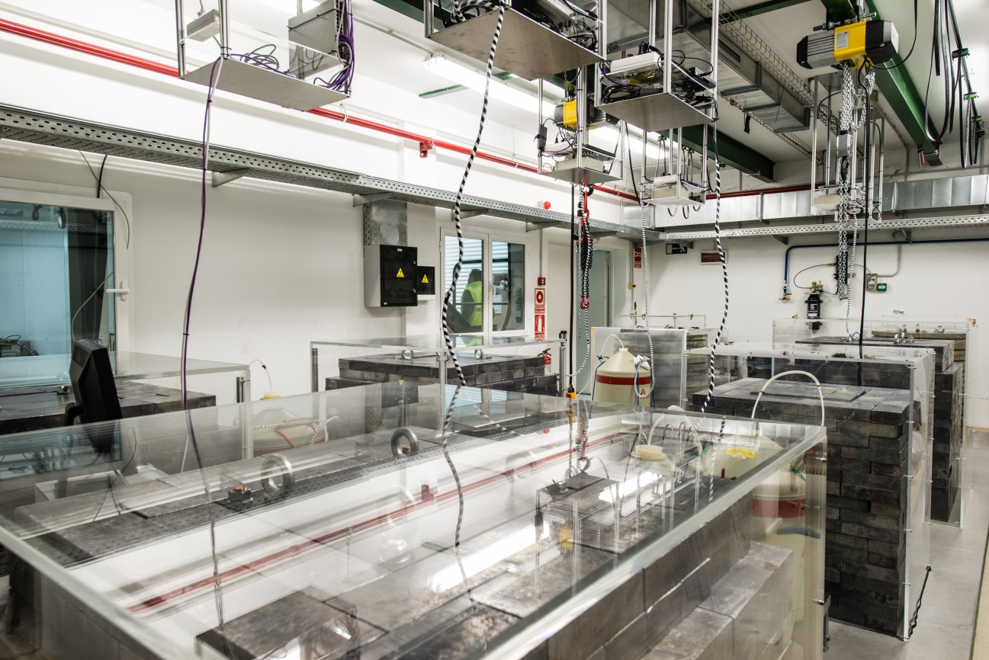
Courtesy of LSC
Ultra-Low Background Measurements Service- Hall C
7 HPGe p-type coaxial (2 kg)-LSC
1 SAGe Well model GSW275L-LSC
1SAGe Well model GSW400-Poland
7 mounted and taking data: Asterix, GeLatuca, GeOroel, GeTobazo, GeAnayet, GeAspe, GeRysy.
Obelix and GeLaraca (SAGe)-no shielding

Slide 53

HPGe: Figure of Merit
Advantages:
The best technique to assay the γ-emitters: K-40, middle primordial decay chains, cosmogenics … etc
Relatively simple sample preparation
Non-destructive technique
Very good sensitivity achievable (<< mBq/kg)
Limitations:
Actual sensitivity strongly depends on the mass of the sample (not suitable for small samples)
Stringent detector stability and background requirements
Only sensitive to γ-emitters
Several weeks are typically necessary to assay clean samples
Detailed Monte Carlo simulation to calculate the efficiency as a function of E

Slide 54
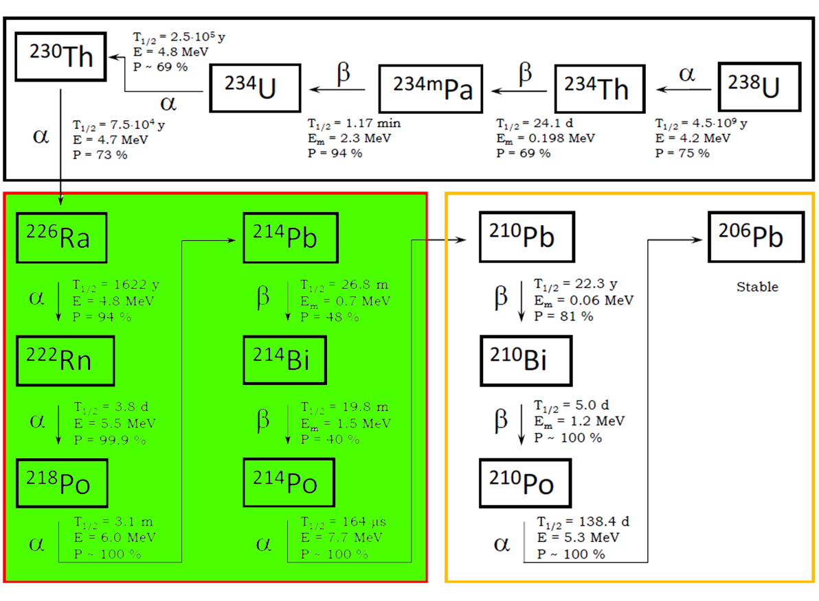
Middle Chain
HPGe

Slide 55
MASS SPECTROMETRY (MS)
Inductively coupled plasma mass spectrometry (ICP-MS)
Glow discharge mass spectrometry (GD-MS)
Laser ablation mass spectrometry (LA-ICP-MS)
Secondary ion mass spectrometry (SIMS),
Resonance ionization mass spectrometry (RIMS),
Accelerator mass spectrometry (AMS)

Slide 56
MASS SPECTROMETRY (MS)
Inductively coupled plasma mass spectrometry (ICP-MS)
Glow discharge mass spectrometry (GD-MS)
Laser ablation mass spectrometry (LA-ICP-MS)
Secondary ion mass spectrometry (SIMS),
Resonance ionization mass spectrometry (RIMS),
Accelerator mass spectrometry (AMS)

Slide 57
INDUCTIVELY COUPLED PLASMA MASS SPECTROMETRY (ICP-MS)
It allows the determination of elements with atomic mass ranges 7 to 250 (Li to U)
Concentration at very low level in a wide variety of samples
High resolution ICP-MS (HR-ICP-MS), uses a magnetic field and electrostatic analyzer, providing very low detection limits, in the pg⋅L⁻¹ range
Destructive analysis: a previous sample digestion is required in order to obtain a liquid solution:
  Acid digestion uses a combination of different acids in order to obtain a total simple digestion (strong mineral acids: Nitric Acid, Hydrochloric Acid, Hydrofluoric Acid, Perchloryc Acid…)
  Dry ashing: Especially suitable for samples with a high organic matter content (organic matter can be completely eliminated)
  Need to avoid contamination during sample processing (acids, tools, crucible…)
Major advantage of ICP-MS: In comparison to other alternative solid-state mass spectrometric techniques is advantageous because liquid solutions can be easily and rapidly analyzed

Slide 58
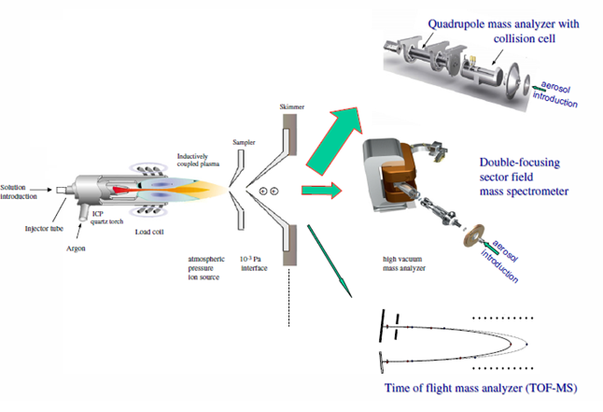
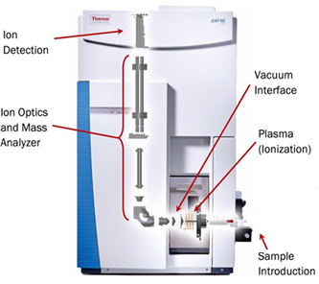
INDUCTIVELY COUPLED PLASMA MASS SPECTROMETRY (ICP-MS)
Sample introduction: the liquid sample is nebulized into a fine aerosol and transported by argon gas into the plasma.
Perkin, Agilent, Bruker….
ICP source: the inductively coupled argon plasma atomizes and ionizes the elements in the sample, producing mostly positive ions.
Interface region: sampler and skimmer cones extract ions from the atmospheric-pressure plasma into the low-pressure region.
Ion optics: electrostatic lenses focus and guide the ion beam, while removing photons, neutrals and unwanted particles.
Mass analyzer: ions are separated according to their mass-to-charge ratio, using quadrupole, sector-field or time-of-flight analyzers.
Detector: the selected ions are counted, giving elemental concentrations down to sub ppt levels for U, Th and other trace contaminants.
Notes:
plasma source in which the energy is supplied by electric currents which are produced by electromagnetic induction, that is, by time-varying magnetic fields.^{[2]}

Slide 59
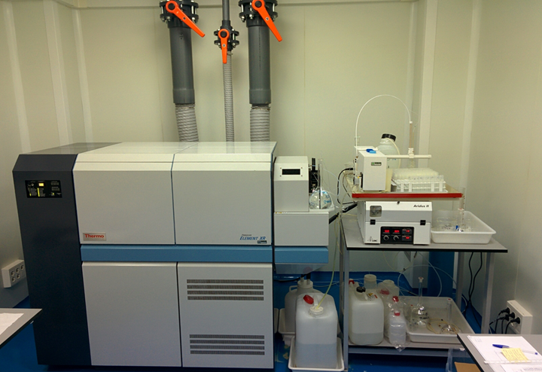
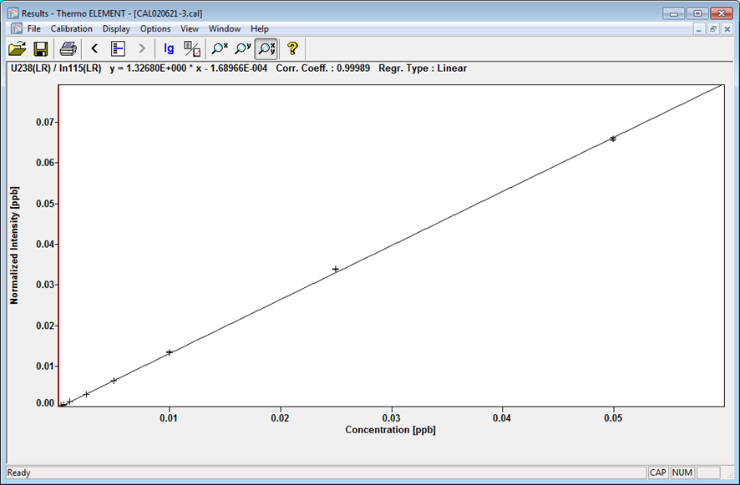
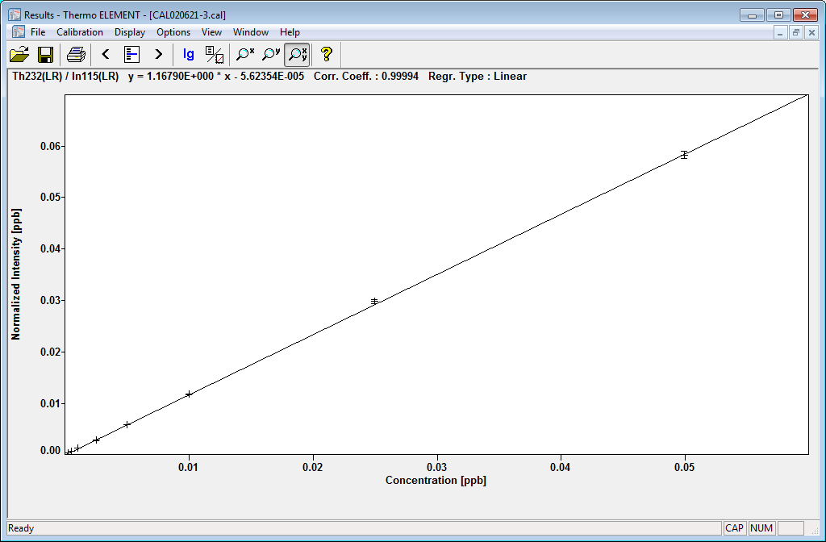
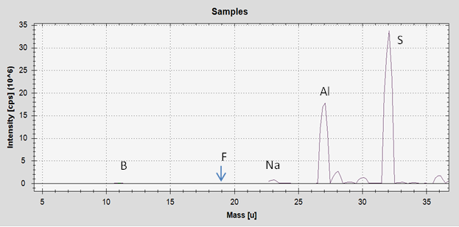
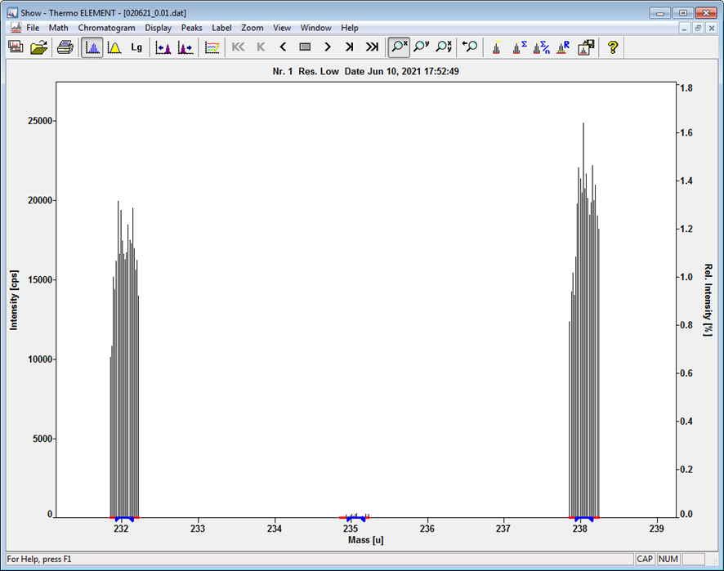
ICP-MS
HR-ICP-MS Thermo Element
²³⁸U AND ²³²Th CALIBRATION
Th (ng/g) U (ng/g)
LOQ 0.052 0.580
HR-ICP-MS U AND Th SPECTRA
²³²Th
²³⁸U
Spectroscopic interferences (molecular ion formation) can be decreased or overcome by the use of a collision cell.
²³⁵U

Slide 60




Concentration of the daughters too low for MS

Slide 61



SS sample

Slide 62
ICP-MS: Figure of Merit
Advantages:
Fast analytical technique for simultaneous determination of trace and ultra-trace elements in liquid solution (≈ 1 d)
Excellent sensitivity, accuracy and very low det. limits: ∼ 0.1 pg/mL
Little amount of materials needed (small sample)
Isotope ratio measurements
Limitations:
Destructive analysis
Sample preparation for solid samples (full digestion, recuperation, contamination..)
It only measures the upper chain (It cannot measure K-40)
Molecular ions interferences with atomic ions (e.g. ²³⁸UH⁺ and ²³⁹Pu⁺)

Slide 63

Radio-chemical methods (²¹⁰Po extraction)
Background component:
Surface contamination
Bulk contamination
(α,n) reaction
Radioanalytical/Radiochemical
problems:
measurement can be done only by alpha spec
High volatility of Po – only wet ashing in boiling concentrated acids and acid mixtures (problems with some polymers materials)

Slide 64

Chemical separation of ²¹⁰Po
Separation method of ²¹⁰Po:
Sample etch and dissolution
Sample pre-concentration and purification (if needed) by co-precipitaion or ion-exchange chromatography (e.g. measurement of bulk ²¹⁰Po in Cu samples)
Source preparation by spontaneous deposition
Laboratory equipment:
Glass beakers (250 ml)
Watch glasses
Stirring rods with PTFE coating
Hotplate with stirrer
Pipette 10-100 μl+ tips
Protective equipment (glasses, gloves etc.)
Radiochemical tracers:
²⁰⁸Po (5.115 MeV alphas)
²⁰⁹Po (4.883 MeV alphas)
Reagents:
HNO₃
HCl
H₂O₂ 30%
N₂H₄•2HCl
Silver discs
Courtesy of T. Mróz
Jagiellonian University in Cracow, Poland

Slide 65

Detection of ²¹⁰Po – semiconductor alpha spectrometer
Very good energy resolution (20-30 keV FWHM)
Detection limits for activity lower than for XiA
Requires radiochemical separation of ²¹⁰Po
Efficiency determined with tracer
Spectrum resolution depends on the source quality
Blank runs required to control the background for each procedure

Slide 66


Source preparation
Spontaneous deposition of Po on Ag from diluted HCl solution

Slide 67
Alpha spectrometry sources
Thick layer deposited
on source
Thin source
(~20 keV FWHM)

Slide 68
Radio-chemical methods : Figure of Merit
Advantages:
Is the only technique able to measure the lower chain
Limitations:
Sample preparation

Slide 69
OBJECTIVES of this lecture
After this class, you should be able to:
Know the most important sources of natural radioactivity.
Understand the principles of secular equilibrium and disequilibrium of the decay chains.
Grasp the principles of the cosmogenic production of radionuclides.
Understand the general framework of the problems posed by the Rn-222.
Figure out the importance of material assays and radiopurity related aspects for low-background techniques.
Know the principle of the most used techniques for the assays.
Thank you for
your kind attention!
Roberto Santorelli TIDPAN 2026 69

Slide 70
Backup

