Slide 1
Espectroscopía de rayos γ por reconstrucción de la trayectoria de los fotones: AGATA, the advanced γ-ray tracking array
Begoña Quintana Arnés
Catedrática de Física Atómica, Molecular y Nuclear
Universidad de Salamanca

Slide 2
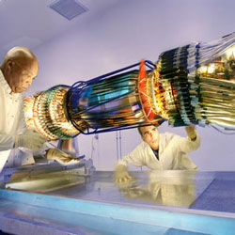
What will this talk be about?
High resolution γ-ray spectroscopy with highly-segmented HPGe detectors

Slide 3
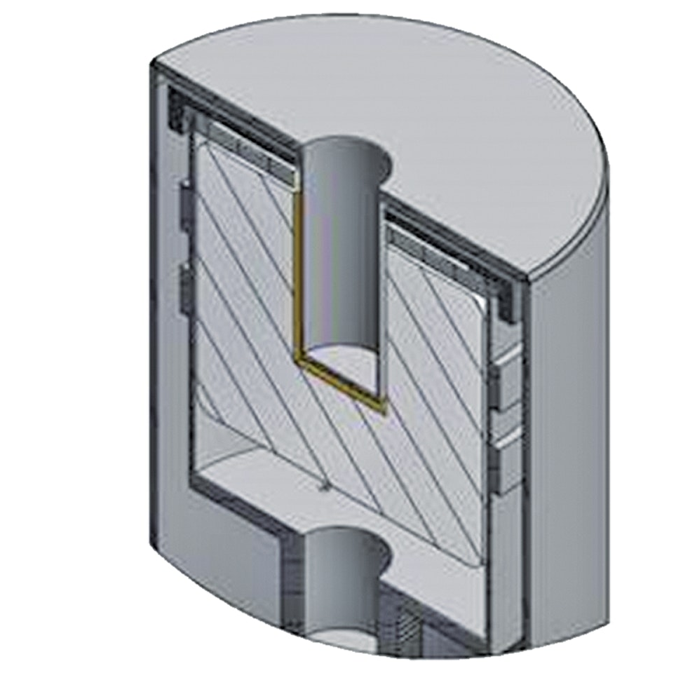
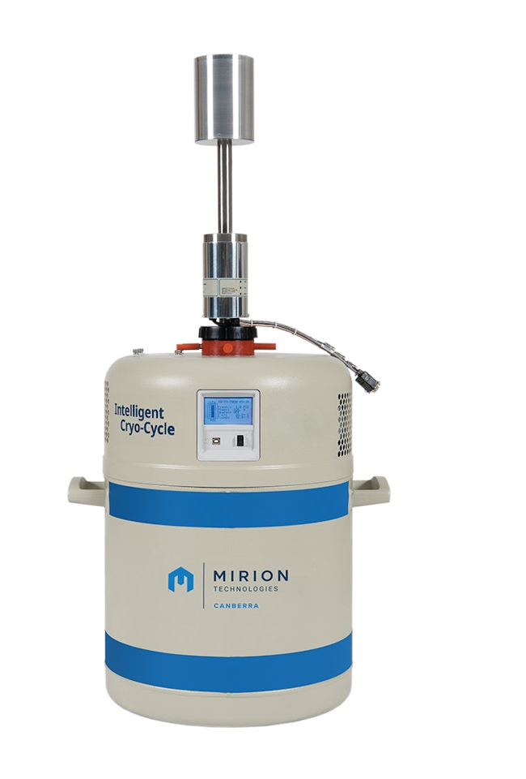
The before….
n-type coaxial
HPGe crystal
Li-difused contact (n⁺)
ΔV
B-implanted
contact (p⁺)
Ge semiconductors band gap = 3 eV
Working T = T( LN₂) = -195,8 °C
Detector + preamplifier = RC circuit
e⁻
V_{max} = Q/C
E
V(t)
t

Slide 4
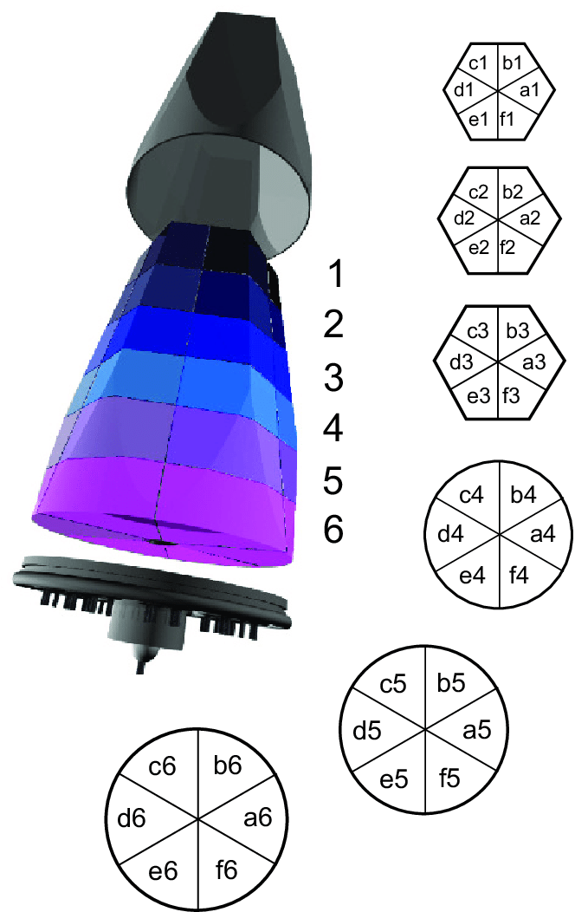

and now…
With n-type HPGe crystals with highly-segmented B contact
Not only E, but also (r,θ,z)
Position-sensitive HPGe detectors

Slide 5
How can it be?

Slide 6
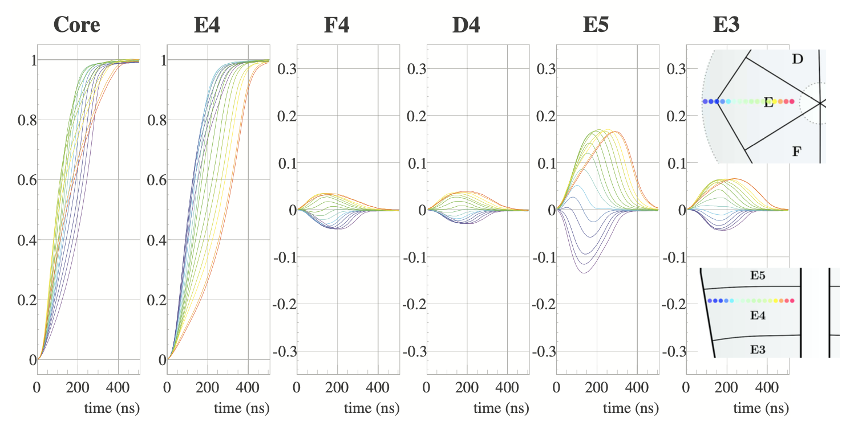
Position sensitive HPGe detectors…
Net signal shape provides the coordinate r
r

Slide 7
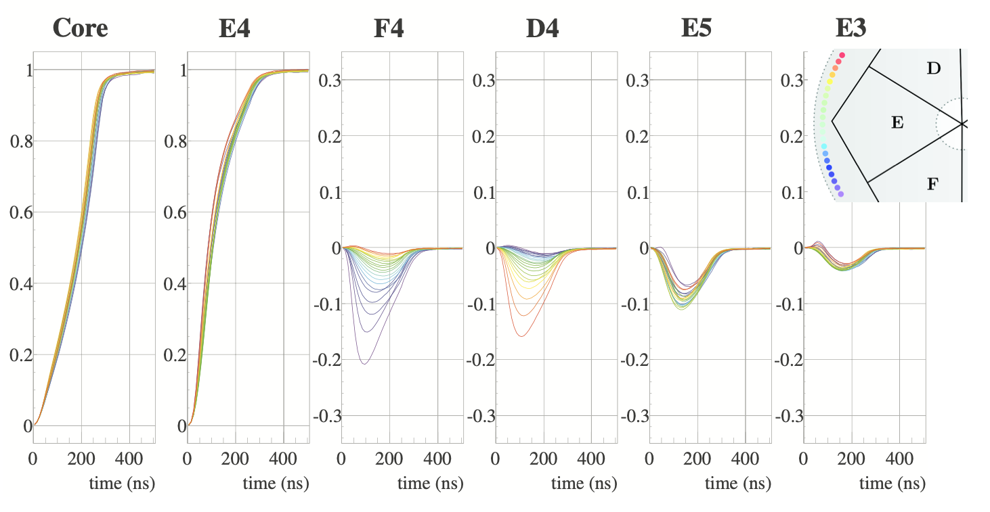
Position sensitive HPGe detectors…
Transient signal shapes in the neighbor segments provide coordinates θ and z
θ

Slide 8
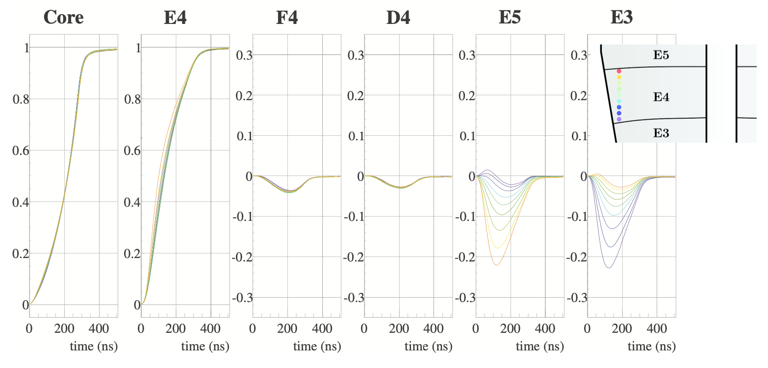
Position sensitive HPGe detectors…
Transient signal shapes in the neighbor segments provide coordinates θ and z
z

Slide 9
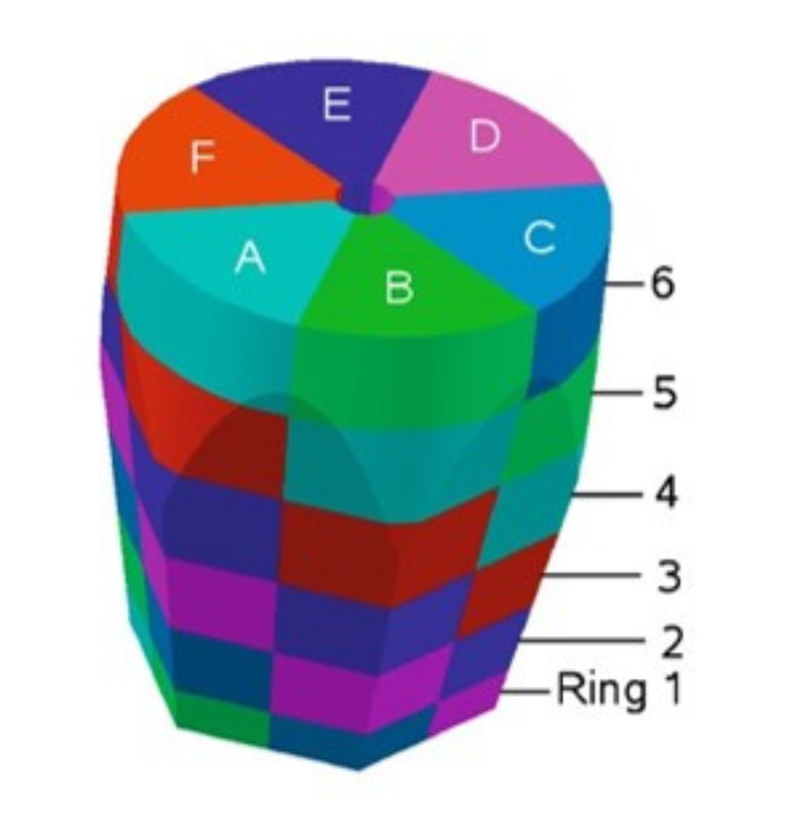
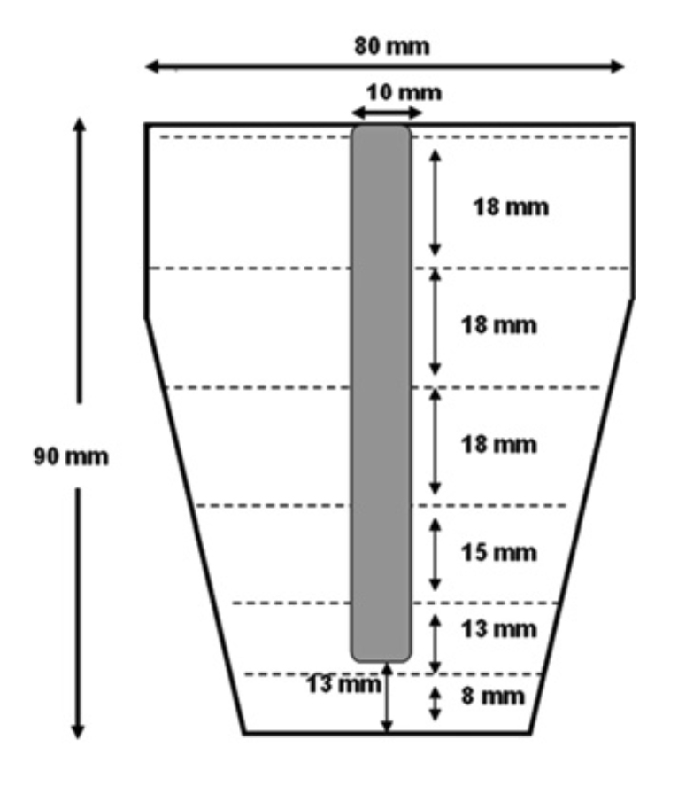

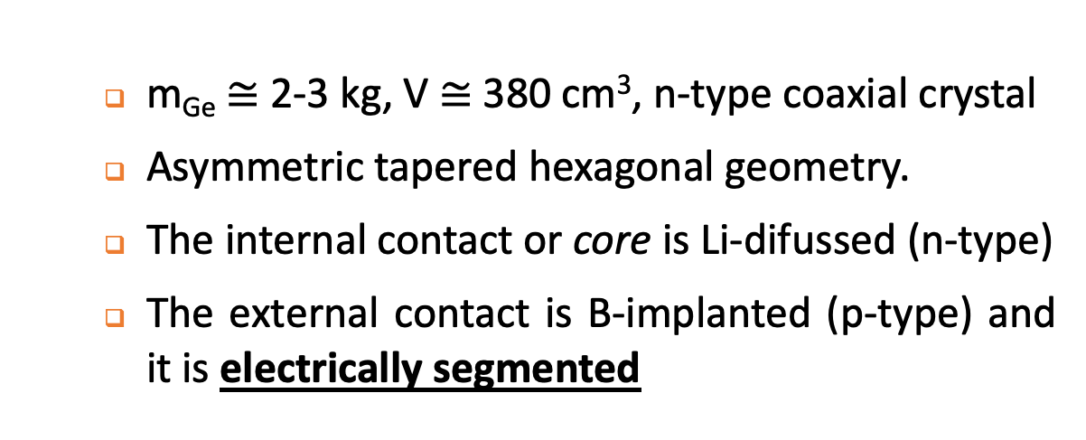
A particular case: the AGATA detectors
  m_{Ge} ≅ 2-3 kg, V $≅$ 380 cm³, n-type coaxial crystal
  Asymmetric tapered hexagonal geometry.
  The internal contact or core is Li-difussed (n-type)
  The external contact is B-implanted (p-type) and it is electrically segmented
Volume subdivided in 36 segments + central core

Slide 10
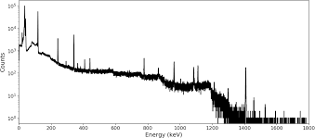
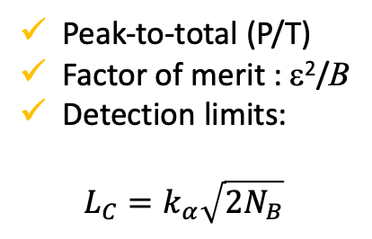
What to do with the interaction position?
First, some basics of γ-ray spectroscopy
E_{γ}
Full-energy absorption peaks:
position, area -> E_{γ} ,p_{γ}
σ
FWHM
SENSITIVITY LIMITED BY THE BACKGROUND UNDER THE PEAK
N → ε
N_{B} → B
Peak-to-total (P/T)
Factor of merit : ε²/B
Detection limits:
$$L_{C}=k_{α}\sqrt{2N_{B}}$$
Spectral continuum: Compton effect of photons from the source not absorbed in the detector and bremsstrahlung of charge particles

Slide 11
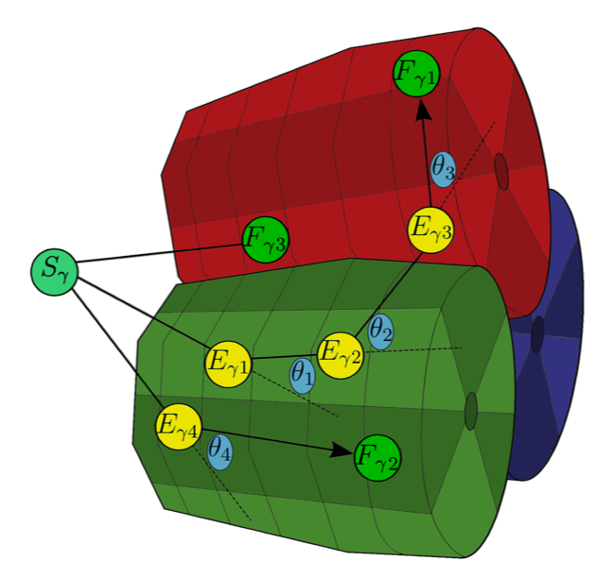
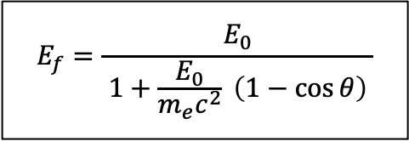
What to do with the interaction position?
Second, how to reduce the Compton background?
The “classical” method: the Compton suppression
But, with the interaction position…TRACKING!!!
E_{γ2}
$$E_{f}=\frac{E_{0}}{ 1+\frac{E_{0}}{m_{e}c^{2}} \left(1−\cos{θ}\right) }$$
HPGe
detector
E_{γ1}
S_{γ}
AC-detector

Slide 12
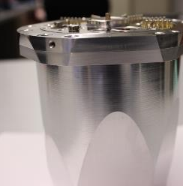
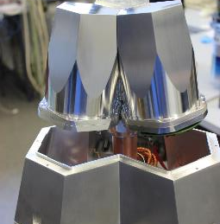
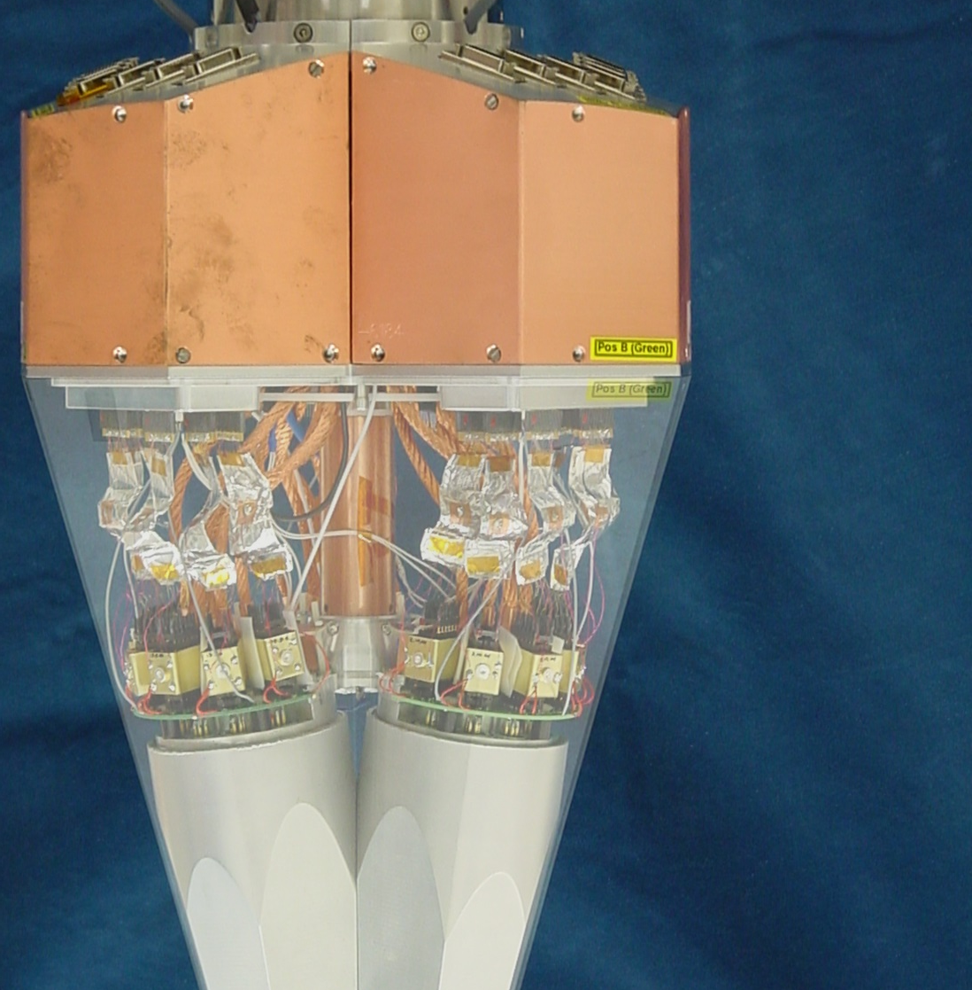

The development of clusters of highly segmented HPGe detectors
Compound or cluster detectors were developed in Europe in the nineties and used for first time in Euroball. This is the starting point up to reach the development of highly-segmented HPGe detectors…

Slide 13
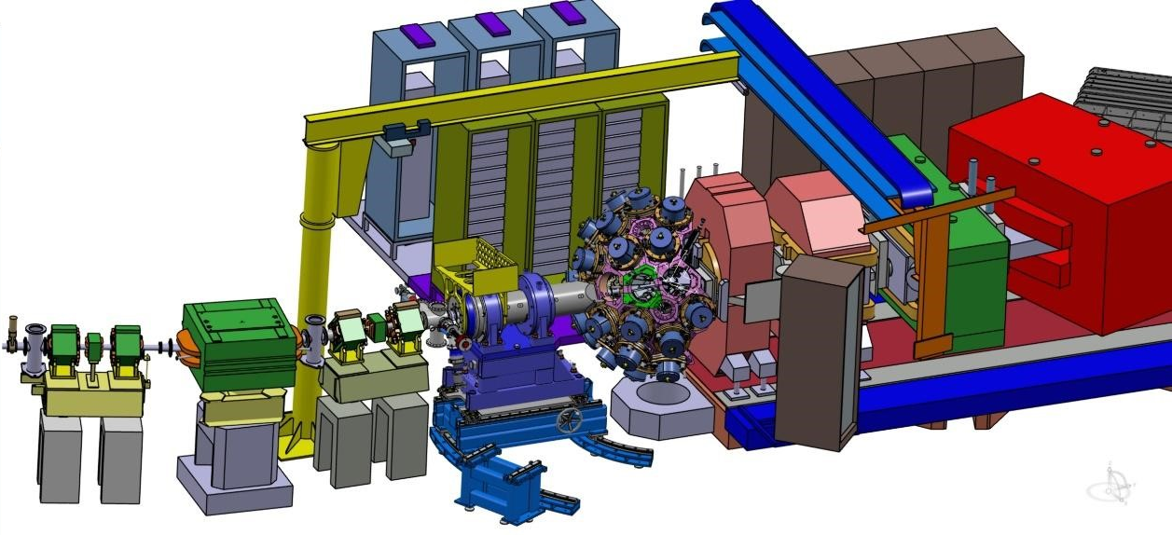

Why?...
Experiments with stable and radioactive beams to study nuclear structure at the frontier of knowledge

Slide 14
But, why to study the atomic nucleus?
To reveal fully the characteristics of the nuclear forces, which are the glue of matter in the Universe
Nucleus properties determine the stability of matter.
Non stable nucleus are used in many applications so useful for the society as nuclear medicine and nuclear energy.
To create new nucleus leads to discover new nuclear properties and then, new matter…

Slide 15
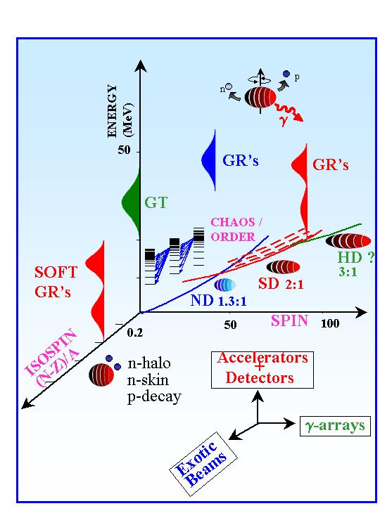
Some topics…
Evolution of shells and collectivity
Magic number evolution in highly excited nucleus
Very heavy nucleus towards new magic numbers
Disintegration modes of exotic nuclei
Cross sections of nuclear reactions for new nuclei
Neutron-halo (proton-halo?)
Neutron skin
Unbound systems…
Large
γ-arrays

Slide 16
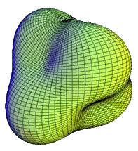
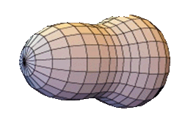


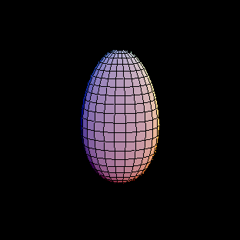
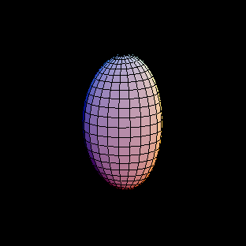
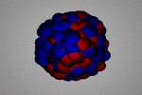
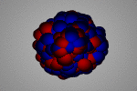
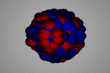
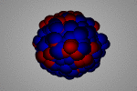
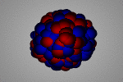
Evolution of nuclear shells and collectivity
Examples of nuclear shapes
Spherical
Prolate
Oblate
Octupole
Tetrahedric
Y₂₀
Y₂₂
Y₃₀
Y₃₁
…
Examples of nuclear shape vibrations
Examples of vibrational collective nuclei
GMR (Isoscalar)
GMR (isovector)
GDR (isovector)
GQR (isoscalar)
GQR (isovector)

Slide 17
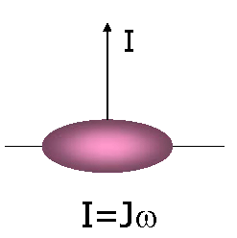
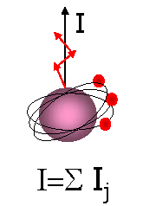
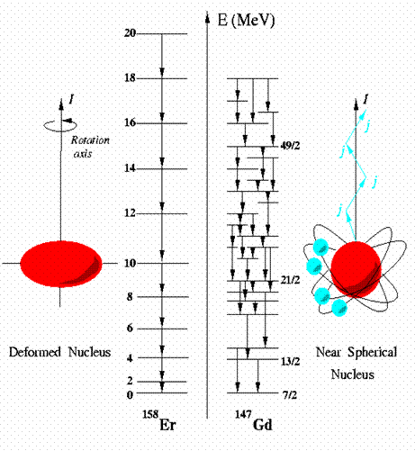
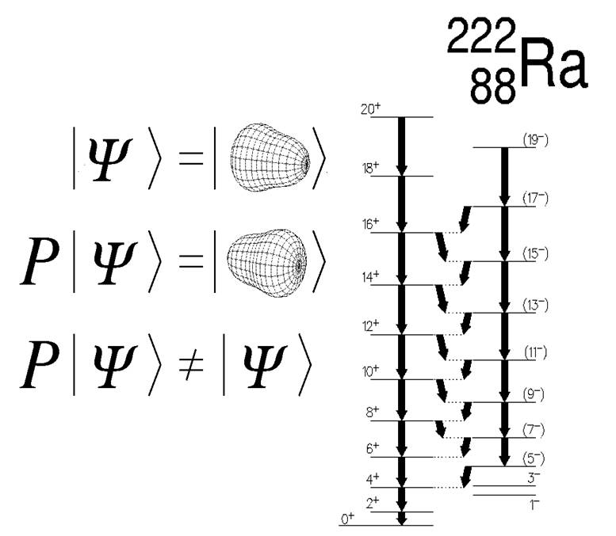
Where to look at into the nucleus ?
J
β₃ ≠ 0
β₂ ≠ 0
β₂ = 0
¹⁵⁸Er
¹⁴⁷Gd

Slide 18
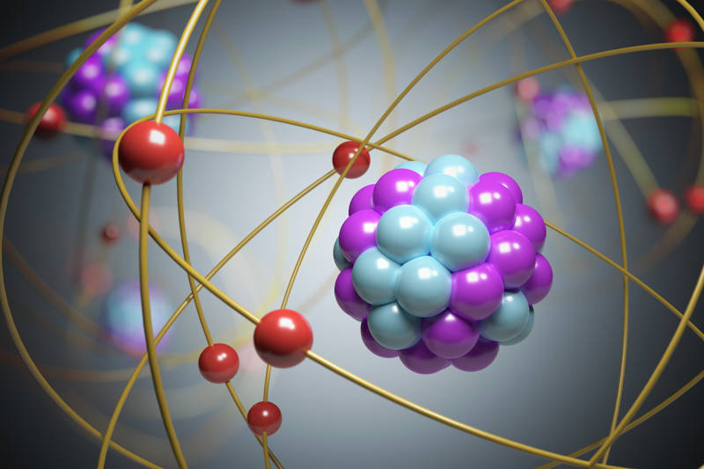
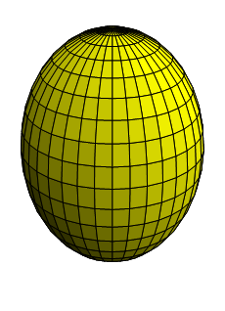
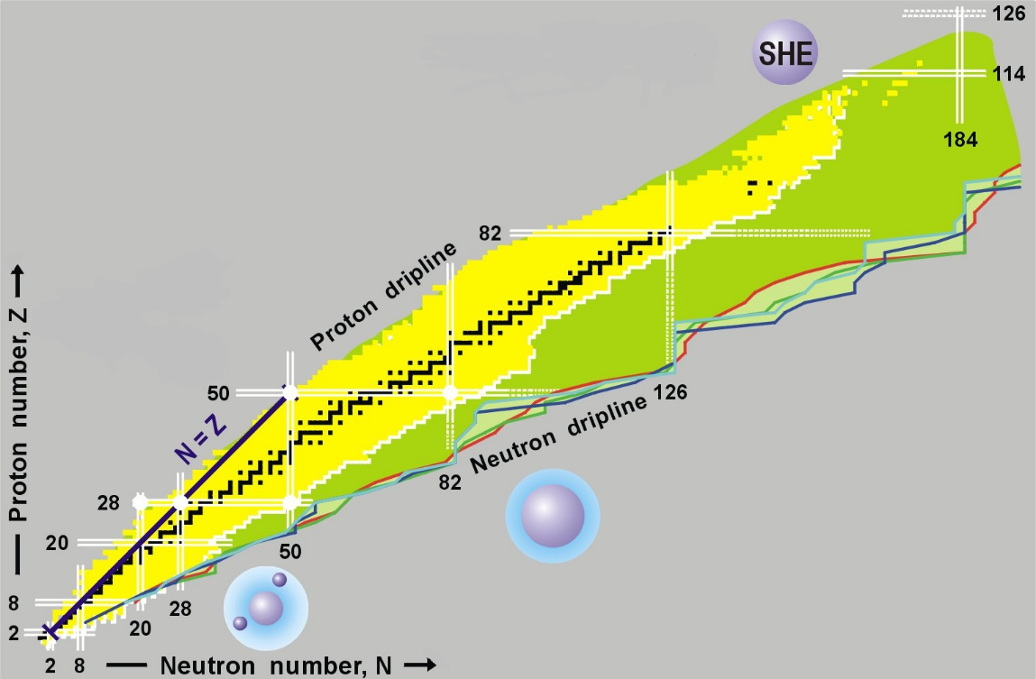
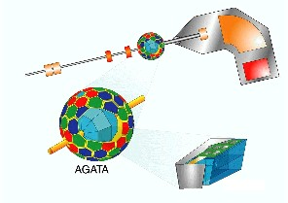



How to generate and measure exotic nuclei? …
ION BEAM
${}_{Z}^{A}{X+{}_{Z´}^{A´}{Y→{}_{Z´´}^{A´´}{W+{}_{Z´´´}^{A´´´}{V+mp^{+}+jn+iα+…(delayed β^{±}}}}}$)
REACTION CHAMBER
T ∝ 3-10 MeV/nucleon
COULEX
$${}_{Z}^{A}{X+{}_{Z´}^{A´}Y→{{}_{Z}^{A}X}^{∗}+{{}_{Z´}^{A´}Y}^{∗}}$$
σ₁ ∝ 1 bar
TARGET
MNT+Ev
$${}_{Z}^{A}{X+{}_{Z´}^{A´}Y→{{}_{Z−1}^{A+1}V}^{∗}+{{}_{Z´}^{A´−2}Y}^{∗}+p^{+}}$$
σ₂ ∝ 1 mbar
Fu-Ev
$${}_{Z}^{A}{X+{}_{Z´}^{A´}Y→{{}_{Z+Z´}^{A+A´−2}W}^{∗}+2n}$$
σ₃ ∝ 10⁻² mbar
σ₁>> σ₂ >> σ₃
CHARGED PARTICLE AND MASS SPECTROMETERS

Slide 19
How to generate and measure exotic nuclei? …
Key aspects
The nucleus to be studied “must” be in an excited state
Direct detection of the “prompt” de-excitation γ-rays emitted by the nucleus of interest
The detection system needs to be installed around the reaction point
In addition to the γ-ray detector, frequently, complementary detectors and ancillary devices are necessary to improve selectivity or to perform a particular measurement.
REACTION products
n
p⁺
*
*
*
*
Nuclear reaction production rates ∝ 10⁻¹⁵ s !!
*
*
CHARGED PARTICLE AND MASS SPECTROMETERS

Slide 20
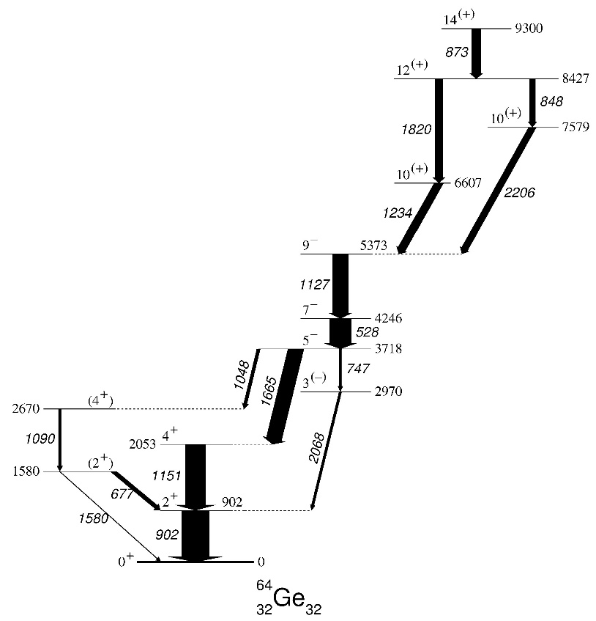
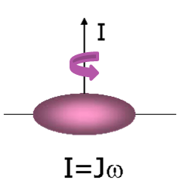
High-resolution in-beam γ-ray spectroscopy to study the nuclear structure far from stability
In-coincidence measurements: TRIGGER with conditions
Time window:
10 ns →500 ns
The excited nuclear state produced in a given nuclear reaction de-excites through electromagnetic transitions among the existing nuclear states, emitting a γ ray per transition in a time around 10⁻¹² s.
HPGe
EUROBALL
HPGe
HPGe
HPGe
E_{γ1}
10⁻¹² s
HPGe
HPGe
E_{γ2}
HPGe
HPGe
HPGe
  Selectivity and multiplicity
  Factors that matters are ε and P/T, i.e. signal-to-noise ratios

Slide 21
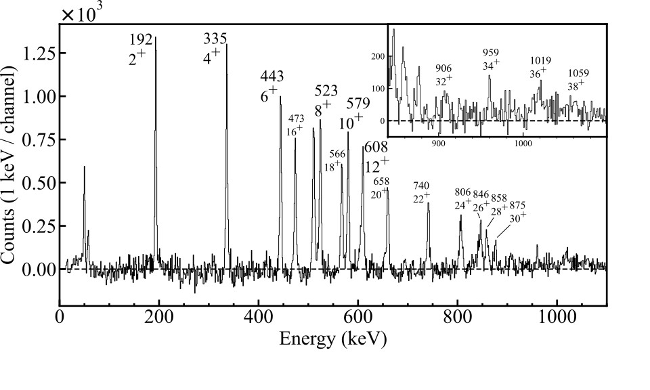
What could we expect from a “clean” γ-ray spectrum?
E_{γ}, I_{γ} and even decay times from peak shapes

Slide 22
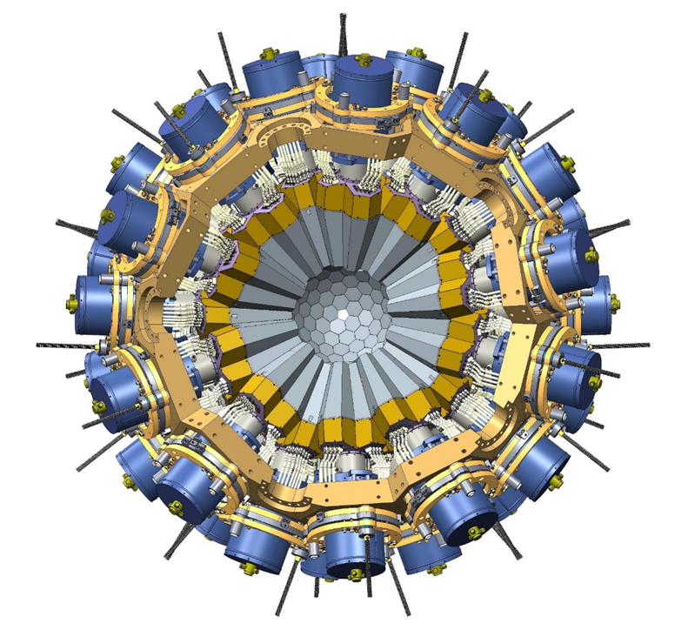
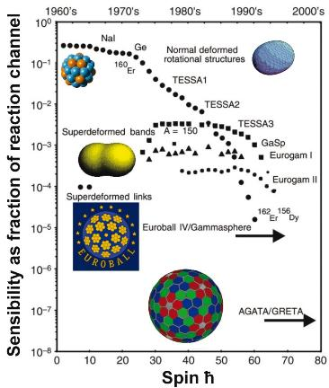
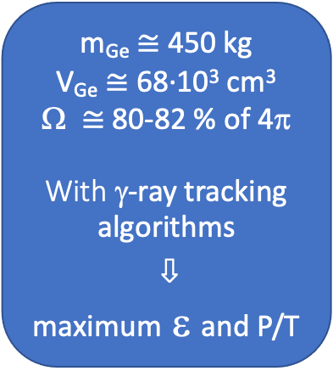
AGATA
(the Advanced GAmma Tracking Array)
m_{Ge} $≅$450 kg
V_{Ge} $≅$ 68·10³ cm³
$≅$ 80-82 % of 4π
With γ-ray tracking algorithms
⇩
maximum ε and P/T
Number of encapsulated 36-fold segmented HPGe = 180
Number of high-resolution digital electronics channels = 6660
High throughput DAQ
Position sensitive operational mode

Slide 23
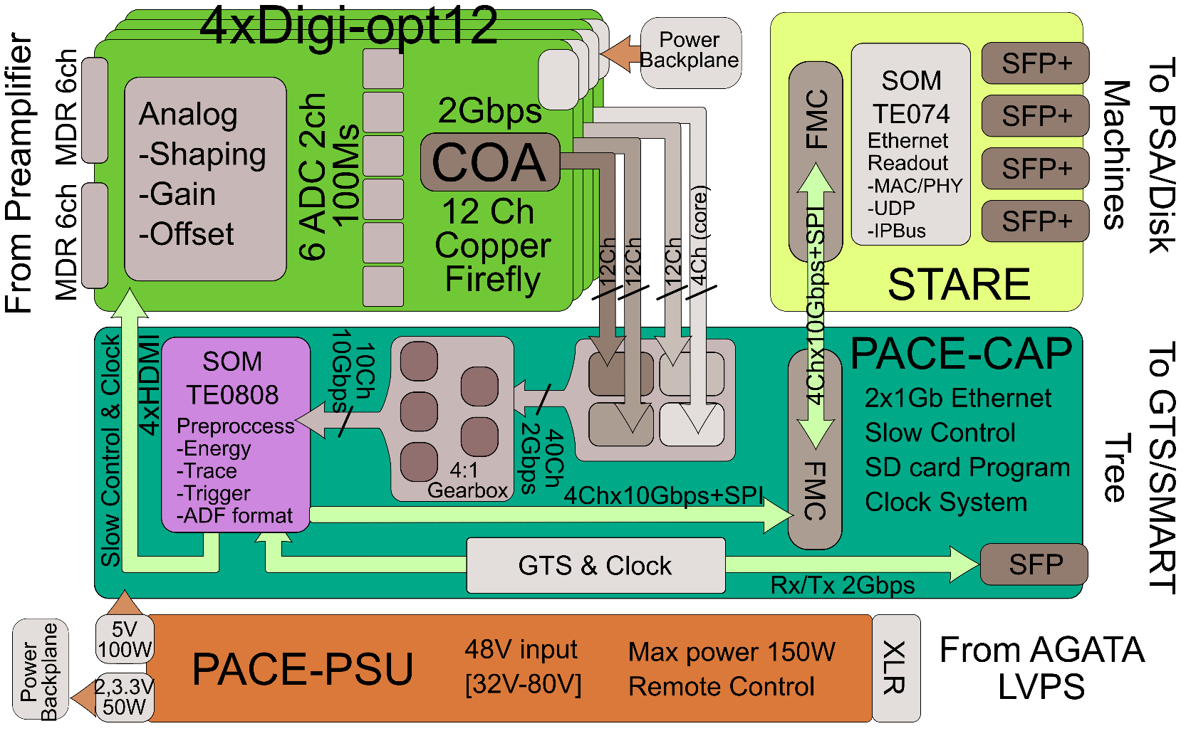
Signal readout and processing: digitisation
Digitiser (DIGOPT12) and pre-processing specifications:
Analog electronics of very low noise to obtain signal with spectroscopic quality.
Analog-to-digital conversor: effective number of bits (ENOB) = 11,5 -12 ∿ SIGNAL AMPLITUDE PRECISSION= 1/4096
Sampling frecuency: 100 MHz, band width = 30 MHz ∿ τ = 10 ns, (Teorema de muestreo de Nyquist )
PSA uses the first μs
INFN-Milano, CSNSM-Orsay, IPHC-Strasbourg, STFC-Daresbury, IFIC & ETSE-Valencia

Slide 24
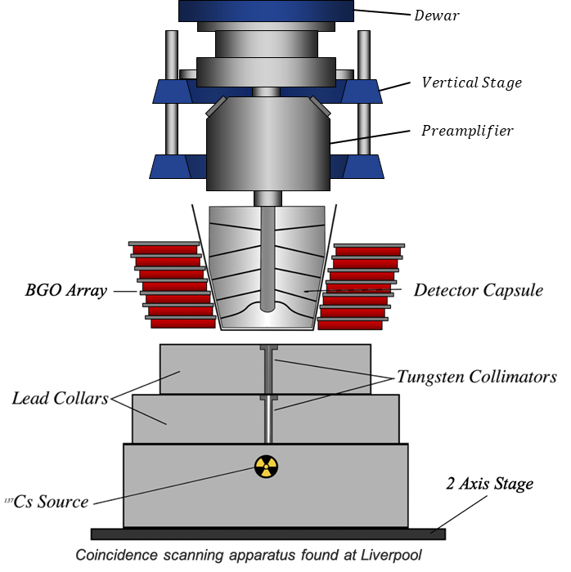
But, what to do with the pulse shapes?
First step…
Characterization of the highly-segmented detector electrical response versus interaction position
DATABASE:
pulse shapes
⇩
interaction position (r,θ,z)
Liverpool´s mechanical
scanning table
See Gala’s poster to know SALSA, the R&D characterisation system under development in Salamanca
DB built from simulated pulse shapes is the current method used in AGATA

Slide 25
And, what’s next?
Pulse Shape Comparison (PSC)
PSC algorithms use statistical criteria to compare between the experimental signals and the DB ones (χ², Wilcoxon test,…)
Signals corresponding to an experimental event in a given detector
TRACKING
From a set of interaction positions corresponding to a given in-coincidence event, the most probable trajectory is evaluated through tracking algorithms that are based on the Compton Scattering formula
OUTPUT
Interaction position coordinates corresponding to the pulses recorded:
(r, θ, z)

Slide 26
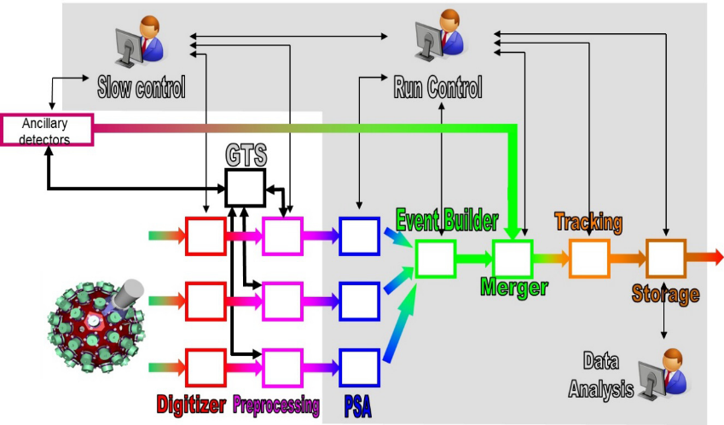

Signal readout and processing: PSA farms and data storage
Data flow, control and storage

Slide 27
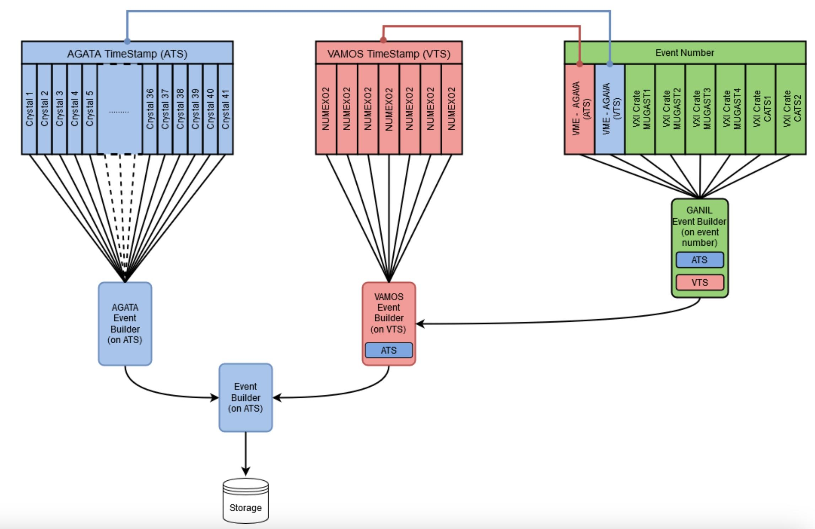
Data merging process at
l
SMART
Mesytec
FASTER V3
AGATA V2
AGAPRO
GAna
nptool
RootFile
RootFile
RootFile
(
TS Branch
)
(
TS Branch
)
(
TS Branch
)
Merged
RootFile
D. Ramos from Ganil adapted

Slide 28
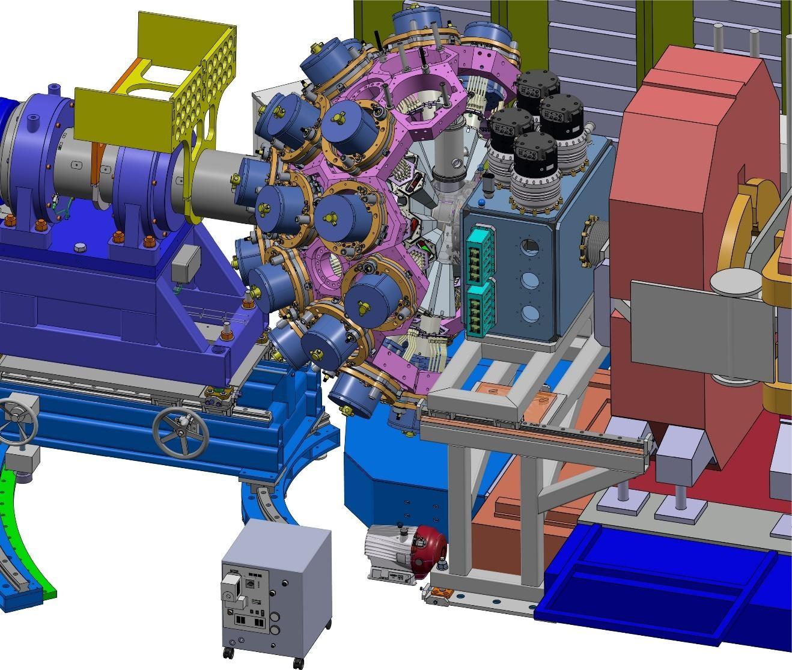
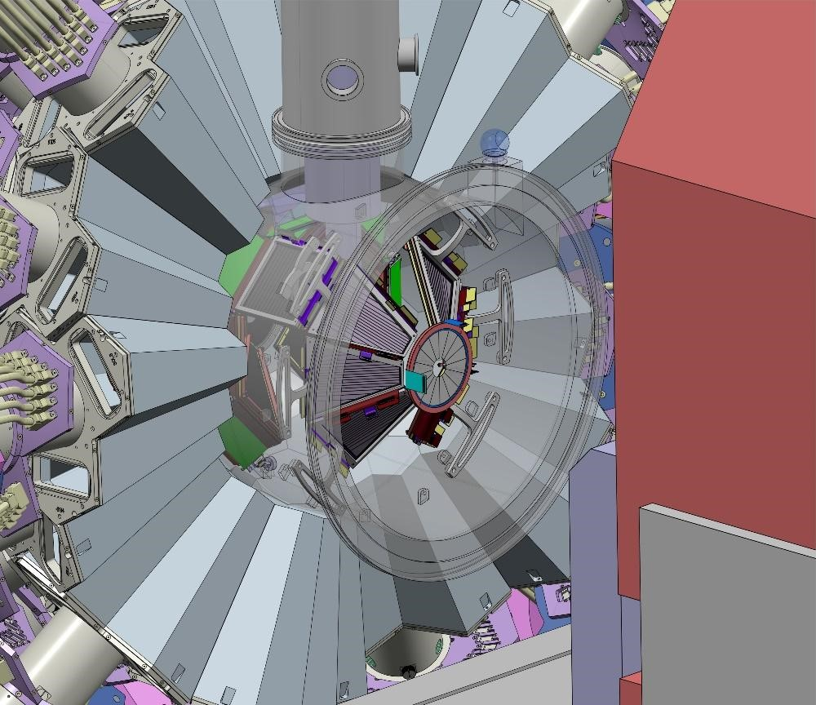

Infrastructures
General view

Slide 29
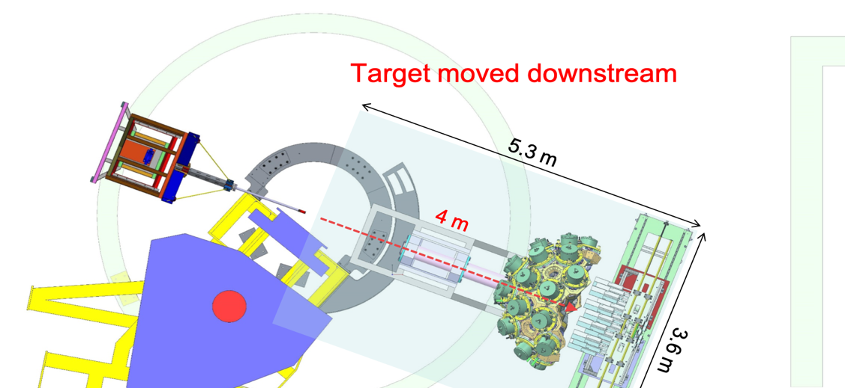
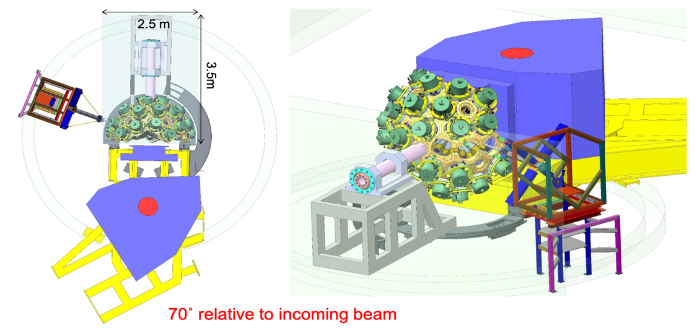
Infrastructure: hall and rooms
Experimental hall
AGATA array + front-end electronics area + pre-processing electronics and GTS Tree
DAQ area
Pre-processing GGP
(optical links of usual lengths = 60 m)
Control room
  An area of ~25m² to install all workstations required for the experiment control, data taking and on-line analysis with fast access to the GRID network for data archive
Maintenance: Detector Laboratory and Repository area

Slide 30




Mechanical Infrastructures
3 m
STFC-Daresbury, GANIL, INFN-Milano, INFN-Padova

Slide 31

Basic infrastructures
Uninterruptible Power Supply (UPS)
Detector high-voltage (HV) power supply and its control system
Digitizer and detector low-voltage power supply (LVPS), water cooling system for the electronics
LN₂ autofill system for Ge cooling:
  Water-free LN₂ at 1.5 bar
  ATC with 4.5 L Dewar vessel needs four filling cycles per day, 5.2 L cycle ⇨ 90 ATCs needs 1,25 m³ a day
  Additional LN₂ (about 7 L, in the GANIL configuration) is used at every filling cycle to purge the unwanted N₂ gas and cool the transfer line
  Total LN2 volume per week = 10 – 11 m³
  Detector Support System (DSS) to control detector temperatures

Slide 32














The AGATA Collaboration
Bulgaria: Univ. Sofia
Denmark: NBI Copenhagen
Finland: Univ. Jyväskylä
France: GANIL Caen, IPN Lyon, CSNSM Orsay, IPN Orsay,
CEA-DSM-DAPNIA Saclay, IPHC Strasbourg, LPSC Grenoble
Germany: GSI Darmstadt, TU Darmstadt, Univ. zu Köln, TU München
Hungary: ATOMKI Debrecen
Italy: INFN-LNL, INFN and Univ. Padova, Milano, Firenze, Genova, Napoli,
Poland: NINP and IFJ Krakow, SINS Swierk, HIL & IEP Warsaw
Romania: NIPNE & PU Bucharest
Sweden: Univ. Göteborg, Lund Univ., KTH Stockholm, Uppsala Univ.
Turkey: Univ. Ankara, Univ. Istanbul, Technical Univ. Istanbul
UK: Univ. Brighton, CLRC Daresbury, Univ. Edinburgh, Univ. Liverpool,
Univ. Manchester, Univ. West of Scotland, Univ. Surrey, Univ. York
Spain: IFIC-CSIC, IEM-CSIC Madrid, LRI-USAL
Countries > 12
Institutions > 40

Slide 33

Thank you for your attention

