Slide 1
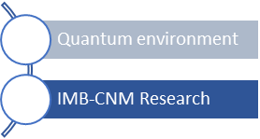




TIDPAN
Taller de Instrumentación y Detectores en
Física de Partículas, Astropartículas y Nuclear
Quantum Sensors
Gemma Rius
Institute of Microelectronics of Barcelona
IMB-CNM-CSIC
gemma.rius@csic.es
1
qchip.csic.es (Under construction)

Slide 2
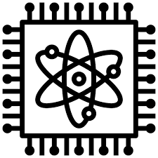
TIDPAN. Taller de Instrumentación y Detectores en Física de Partículas, Astropartículas y Nuclear
Detector and instrumentation categories
Radiation detection and spectroscopy
Imaging techniques
Scintillation and photodetector technologies
Semiconductor detectors and characterisation
Gaseous detector technologies
Calorimetric detection
Low-rate and ultra-low-background event detection
Electronics, trigger and data acquisition systems
Simulation and advanced data analysis
Quantum Chips
2
gemma.rius@imb-cnm.csic.es qchip.csic.es

Slide 3

TIDPAN. Taller de Instrumentación y Detectores en Física de Partículas, Astropartículas y Nuclear
of
in
for
Quantum
PAN
3
gemma.rius@imb-cnm.csic.es qchip.csic.es

Slide 4

Quantum of PAN
Smallest indivisible unit of energy, matter, or interaction - Discrete amount of a physical quantity
Quantum Particles:
all particles described as quanta of underlying fields
- Photons - quanta of the electromagnetic field.
- Gluons - quanta of the strong interaction field (Quantum Chromodynamics, QCD).
- W and Z bosons - quanta of the weak interaction field.
- Gravitons - quanta of the gravitational field (hypothetical)
Quantum of Energy & Energy Levels:
quantized energy, which becomes important in view of:
- When particles interact or collide, as in particle accelerators, energy is transferred in discrete amounts - e.g. in the creation or exchange of particles.
- The term quantum of energy refers to the smallest possible packet of energy that can be transferred in a given interaction.
- Discretization of atomic or particle interaction energies
4
gemma.rius@imb-cnm.csic.es qchip.csic.es

Slide 5
Quantum Science in PAN
Theoretical frameworks for HEP
Describe and understand the fundamental forces and particles
that make of the universe at all scales, from subatomic to cosmic scale
Quantum Mechanics: branch of physics that deals with the behavior of particles at microscopic scales
(atoms and subatomic particles) - crucial for describing phenomena such as:
- Particle-wave duality: Particles like electrons and photons exhibit both wave-like and particle-like behavior.
Superposition and entanglement: Particles can exist in multiple states simultaneously, and pairs of particles can be entangled, meaning the state of one particle is linked to the other.
2. Quantum Field Theory (QFT) : theoretical framework that combines quantum mechanics with special relativity – e.g. foundation for understanding how particles interact in HEP, such as LHC.
A central idea in QFT is that particles are excitations or quanta of underlying fields that permeate space.
3. The Standard Model of Particle Physics: QFT describes three of the four known fundamental forces (electromagnetic, weak, and strong forces) and classifies all known elementary particles (quarks, leptons, bosons).
The Higgs boson, discovered in 2012, is part of this model.
5
gemma.rius@imb-cnm.csic.es qchip.csic.es

Slide 6
Quantum Science in PAN
Theoretical frameworks for PAN
Describe and understand the fundamental forces and particles
that make of the universe at all scales, from subatomic to cosmic scale
4. Quantum Chromodynamics (QCD) and Quantum Electrodynamics (QED):
- Quantum Chromodynamics (QCD) is the QFT that describes the strong interaction, which binds quarks together inside protons and neutrons via the exchange of gluons.
Quantum Electrodynamics (QED) deals with the electromagnetic force between charged particles via photon exchange.
5. High-Energy Phenomena: Quantum effects dominate because at high energies/colliders (or equivalently, small scales), the classical (non-quantum) descriptions of particles and forces fail to explain, including:
Particle creation and annihilation - particle-antiparticle pairs; Renormalization: dealing with infinities that arise in calculations by adjusting the values of physical quantities; mass and charge; Tunneling...
6. Beyond the Standard Model: Quantum theories are also being explored to explain phenomena that the Standard Model doesn’t account for, such as:
- Dark matter and dark energy - Supersymmetry; Gravity at quantum scales - Quantum Gravity, including theories like String Theory, to explain black holes or the early Universe
6
gemma.rius@imb-cnm.csic.es qchip.csic.es

Slide 7
Quantum Tech for PAN
Application of Quantum Mechanics and Quantum Field Theory
Understand and describe response / behavior of particles and forces at their fundamental level
Useful in experiments in particle accelerators, cosmic events, …
How quantum principles, especially those from quantum mechanics and quantum field theory, are applied to study and explain fundamental particles and forces, e.g. at the highest energy scales.
It is essential for understanding the behavior of the universe at the smallest, e.g. most fundamental energy levels, and for advancing our knowledge in areas such as particle physics, cosmology, and nuclear. Nonetheless, one most established QTech is NMR.
Quantum State(s) = Quantum Information
7
gemma.rius@imb-cnm.csic.es qchip.csic.es

Slide 8
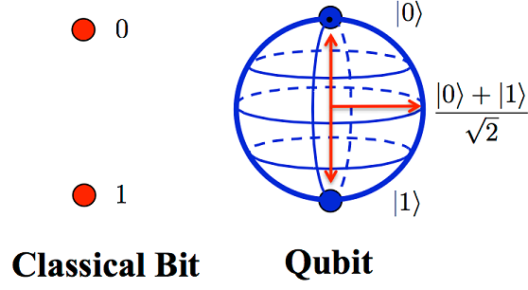
Quantum Technologies
Types of Quantum States in a Quantum System
To accurately describe a quantum system, physicists categorize states into two primary types depending on how much information is known about the system.
Pure States: A pure state describes a system where we have perfect knowledge of its quantum wavefunction. It is typically represented by a "ket" vector (e.g., $|\psi\rangle$) in Dirac notation. In quantum computing, ideal operations assume we are manipulating pure states.
Mixed States: In the real world, systems interact with their environment (noise), leading to a loss of information. A mixed state represents a statistical ensemble of pure states—essentially, we know the system is in one of several states, but we don't know which one. Mixed states are described using a density matrix rather than a simple vector.
Entangled States: When two or more qubits are linked such that the state of one cannot be described independently of the other, they form an entangled state. This correlation is stronger than anything possible in classical physics and is a key resource for quantum algorithms. (See also: Entanglement)
Quantum State(s) = Quantum Information
A quantum state is the fundamental mathematical description of a physical system in quantum mechanics.
It holds of all the information that can potentially be known about that system:
energy, position, momentum, spin...
Different from classical states or computing units, a quantum state is probabilistic.
Until it is measured, it exists as a superposition of potential outcomes.
Analogy of coin spinning in mid-air: embodiment of the potential (in this case, for both) outcomes simultaneously, defined by a precise probability distribution.
8
gemma.rius@imb-cnm.csic.es qchip.csic.es

Slide 9
QuantHEP
Quantum Computing Solutions for High-Energy Physics – QuantERA project
Investigate and assess the potential of quantum computation for experimental particle physics challenges.
Specifically, quantum algorithms as a solution to the increasingly challenging, and soon intractable, problem of analysing and simulating events from large particle-physics experiments.
To develop quantum algorithms for event selection and event reconstruction
To use them to perform proof-of-principle analysis of real data from CERN
Benchmarking the potential advantage of this novel quantum-enhanced processing
Deliverables:
Development of software libraries to simulate particle physics’ objects
(elementary particles, composite particles, jets…)
- Using them as building blocks to develop the quantum simulation of scattering processes
Proof-of-principle scattering quantum simulation
By combining classical and freely-available quantum processors - benchmarking against CERN classical simulations to characterize a quantum advantage threshold for HEP processes.
9
gemma.rius@imb-cnm.csic.es qchip.csic.es

Slide 10

Feynman Vision(s)
“What I want to talk about is the problem of manipulating and controlling things on a small scale. (…)
Why cannot we write the entire 24 volumes of the Encyclopedia Brittanica on the head of a pin?”
“Nature isn't classical, dammit, and if you want to make a simulation of nature, you'd better make it quantum mechanical, and by golly it's a wonderful problem, because it doesn't look so easy.”
10
gemma.rius@imb-cnm.csic.es qchip.csic.es

Slide 11
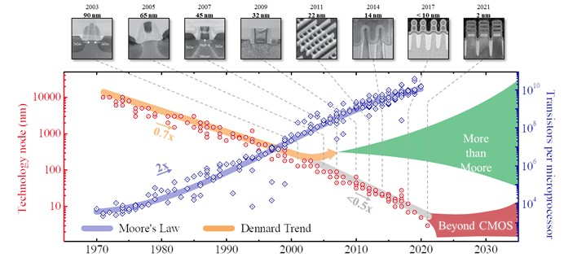
Quantum Chips
Not only geometrical scaling
11
gemma.rius@imb-cnm.csic.es qchip.csic.es

Slide 12
Nano to Quantum
Quantum Technology allows us to organise and control the components of a complex system governed by the laws of quantum physics, instead of exploiting classical physics as in conventional technology.
Two essential drivers in quantum technology:
- Miniaturization, as the dominant trend in last decades: to build devices on a smaller and smaller scale.
Ultimately this will deliver devices at length scales of nanometres and action scales approaching Planck's constant.
At that point design must be based on quantum principles.
- Principles of quantum mechanics: the promise of a vastly improved performance over what can be achieved within a classical framework.
12
gemma.rius@imb-cnm.csic.es qchip.csic.es

Slide 13
13
gemma.rius@imb-cnm.csic.es qchip.csic.es
gemma.rius@imb-cnm.csic.es qchip.csic.es

Slide 14
14
gemma.rius@imb-cnm.csic.es qchip.csic.es

Slide 15
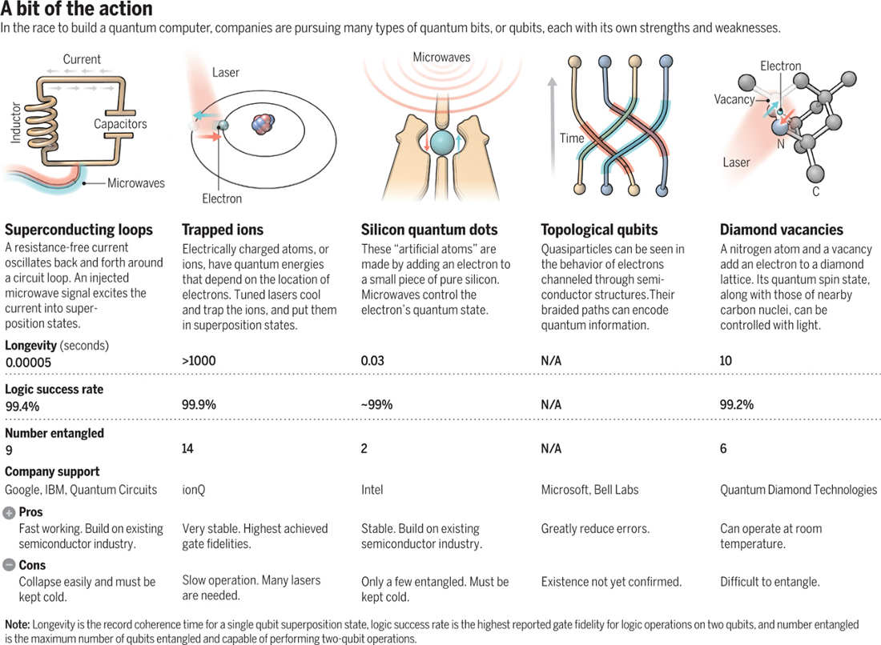
Quantum State – Quantum Information - Qubit
G. Popkin. The Quest for Qubits Science (2016)
15
gemma.rius@imb-cnm.csic.es qchip.csic.es

Slide 16
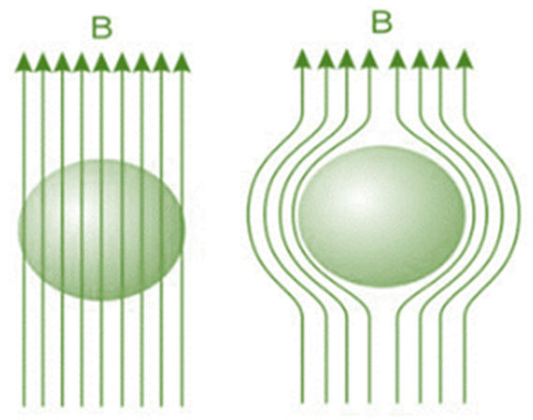
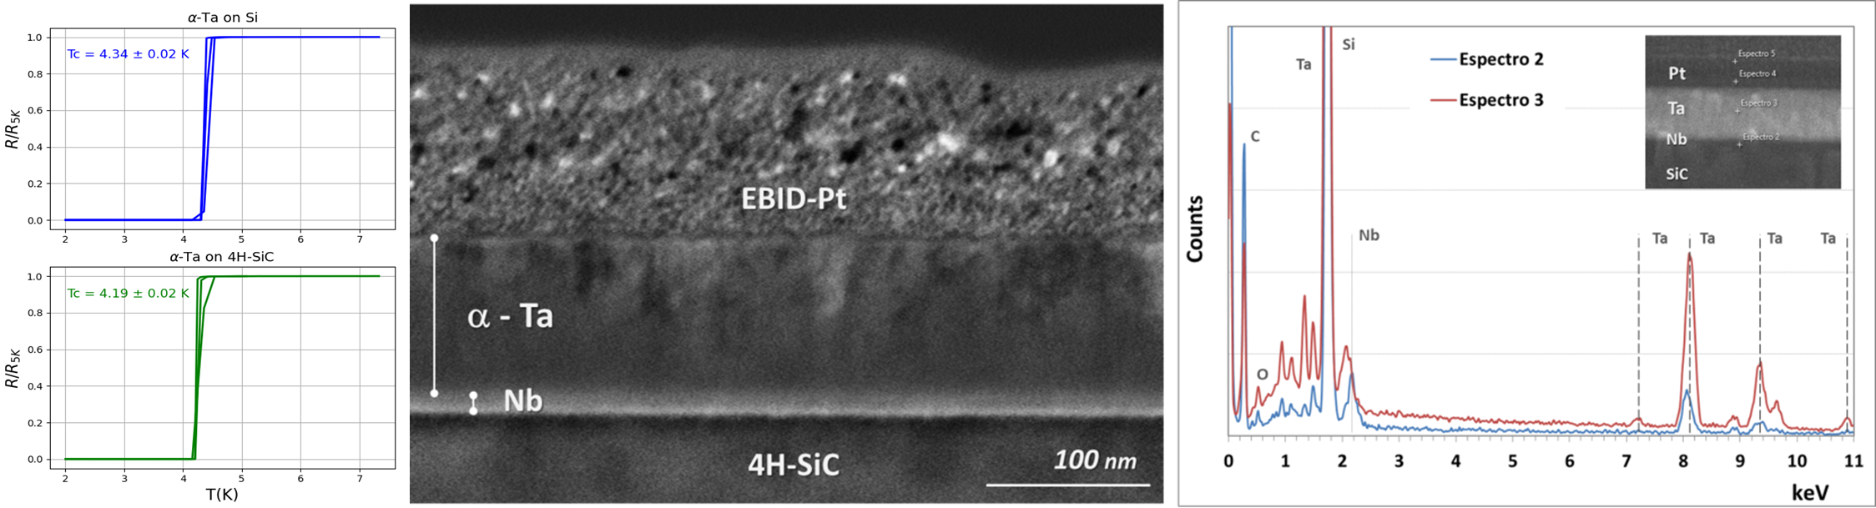
Superconducting thin films are nanoscale to microscale layers of materials that exhibit zero electrical resistance and expel magnetic fields (the Meissner effect) when cooled below a specific critical temperature (Tc).
They are foundational for quantum computing,
advanced sensing, and power electronics
16
gemma.rius@imb-cnm.csic.es qchip.csic.es

Slide 17
From Quantum principles to cQED*
*Nobel of Physics 2025!
1920
1950
2020
QED
Cavity QED
Circuit QED
17
gemma.rius@imb-cnm.csic.es qchip.csic.es

Slide 18
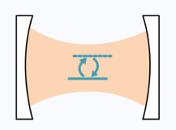
Cavity QED. Study of how light and matter interact at the single-photon and single-atom level.
By trapping photons in a highly reflective resonator, the electromagnetic field is enhanced so strongly that a single atom or particle can coherently exchange energy with the light.
Strong coupling regime of two-level system to a photon field in a resonator
Circuit QED. Instead of traditional mirrors, this method uses superconducting transmission lines and artificial atoms, like transmon qubits, to replicate cavity QED physics on a microchip
18
gemma.rius@imb-cnm.csic.es qchip.csic.es

Slide 19

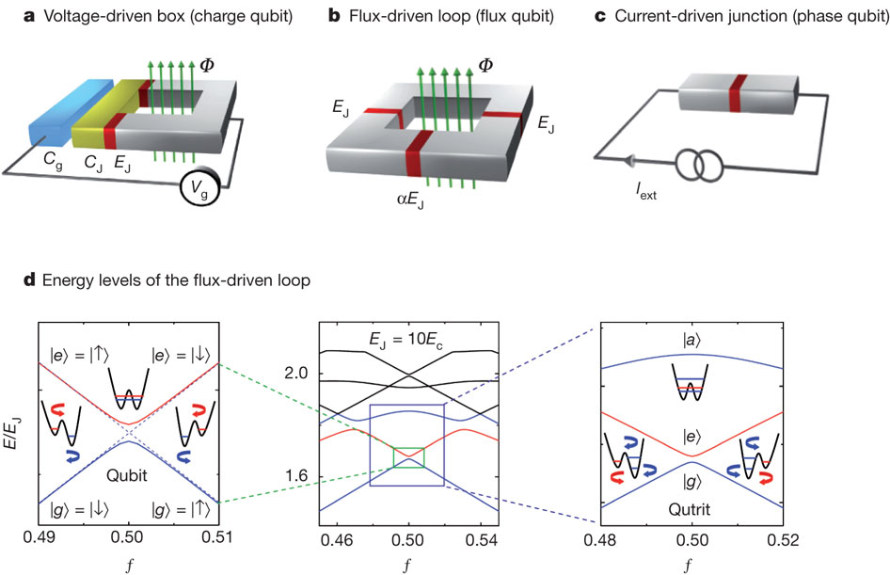



Circuit QED.
N. Crescini
You, J., Nori, F. Atomic physics and quantum optics using superconducting circuits.
Nature 474, 589–597 (2011). Doi:10.1038/nature10122
19
gemma.rius@imb-cnm.csic.es qchip.csic.es

Slide 20
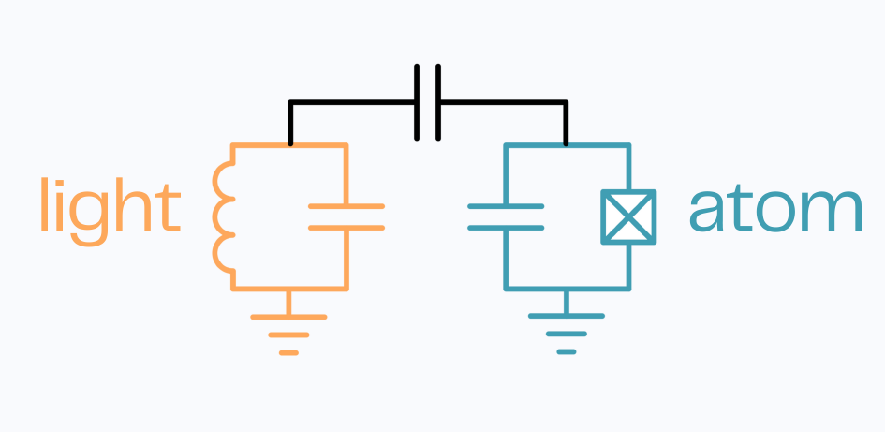

N. Crescini
20
gemma.rius@imb-cnm.csic.es qchip.csic.es

Slide 21
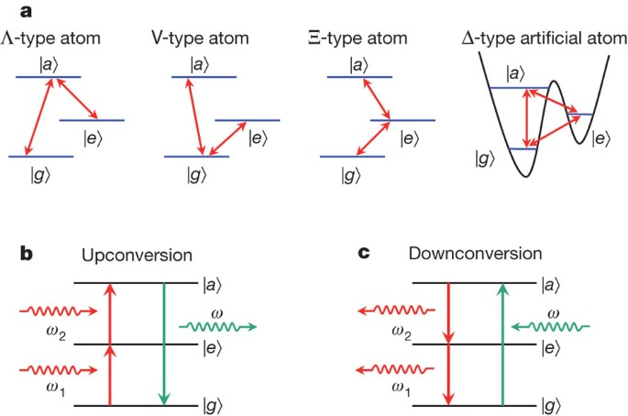
You, J., Nori, F. Atomic physics and quantum optics using SC circuits.
Nature 474, 589–597 (2011) 10.1038/nature10122
21
gemma.rius@imb-cnm.csic.es qchip.csic.es

Slide 22
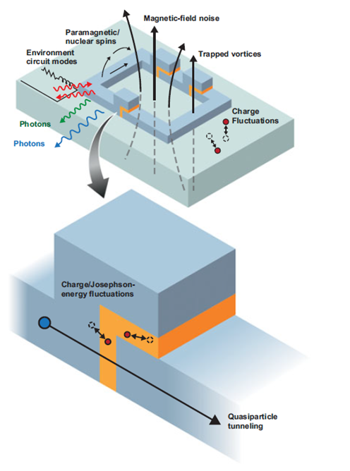
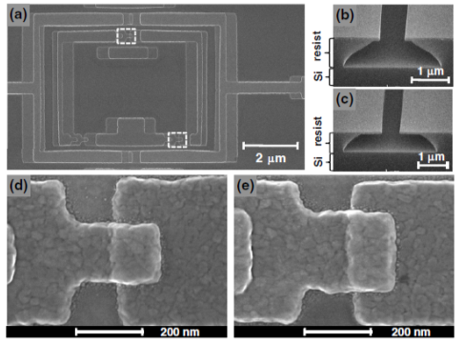
Nb CPW resonator
Dolan bridge processing qubits
22
gemma.rius@imb-cnm.csic.es qchip.csic.es

Slide 23
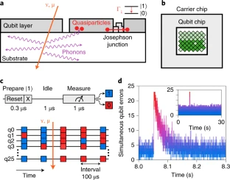
Superconducting Qbits are vulnerable to external factors and noise
Leading to decoherence o variability.
Exploration of new or engineered materials, resilient design and improving fabrication processing of devices, circuits or addition of mitigation elements.
Approaches for mitigation
Off-chip issues
On-chip solutions
Materials: Selection and combination of materials or substrate
Fabrication of structures or architectures:
- Locally suspended - membranes
- Periodical structures – vortex mitigation
Components: passive (quasiparticle traps, on chip-grounding), active (QEC redundancy…)
McEwen, M., Faoro, L., Arya, K. et al. Resolving catastrophic error bursts from cosmic rays in large arrays of superconducting qubits. Nat. Phys. 18, 107–111 (2022). https://doi.org/10.1038/s41567-021-01432-8
23
gemma.rius@imb-cnm.csic.es qchip.csic.es

Slide 24
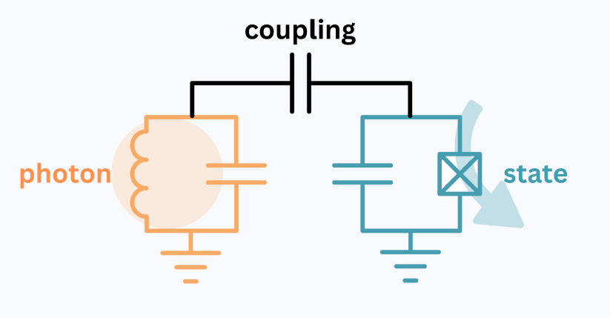
N. Crescini
24
gemma.rius@imb-cnm.csic.es qchip.csic.es

Slide 25
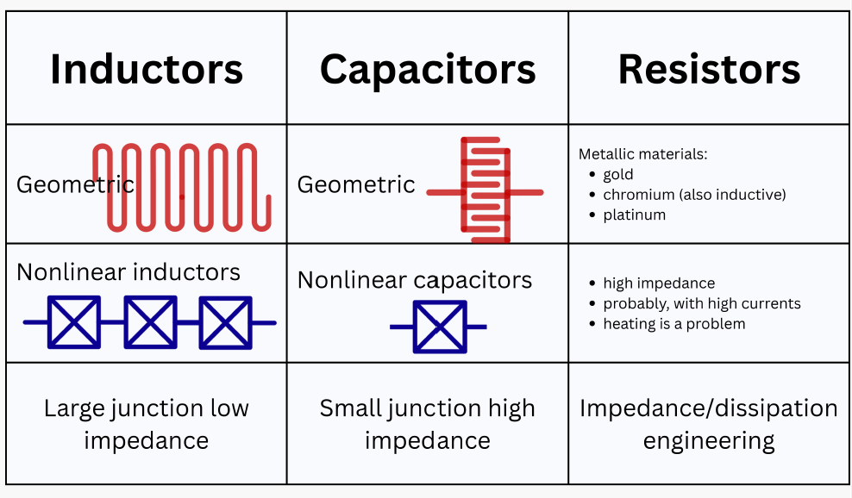
Atomic physics, quantum optics, nanoscience and condensed matter physics are partly merging as new interdisciplinary areas form to involve all of these traditionally separate subfields, Quantum Tech.
Superconducting circuits can be engineered to exhibit quantum phenomena that are normally associated with atomic systems, and so provide a platform for testing various ideas in atomic physics and quantum optics.
N. Crescini
25
gemma.rius@imb-cnm.csic.es qchip.csic.es

Slide 26
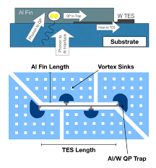
Quantum Sensing in Specific Substrates
Substrate as target for phonon sensing
Calorimeters and Bolometers
Transduction to quantum electronic signal
Hf, Ta, alloys …
Evaporation, Sputtering, …
TES, QET in W, Al, Nb… Sapphire, SiC or more exotic e.g. polar single crystal materials…
Design and characterization of a phonon-mediated cryogenic particle detector with an eV-scale threshold and 100 keV-scale dynamic range (2021) R. Ren et al. Phys. Rev. D 104, 032010 https://journals.aps.org/prd/abstract/10.1103/PhysRevD.104.032010
https://link.springer.com/chapter/10.1007/978-3-319-24091-6_2
gemma.rius@imb-cnm.csic.es qchip.csic.es

Slide 27
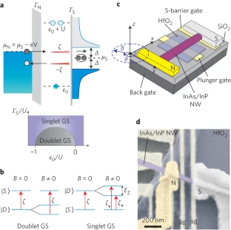
Trends
Other Quantum Sensing devices for photon detection
Engineering very thin films and their properties or characteristics
Hybrid integration in Quantum Sensors, e.g. semiconducting or magnetic with superconducting devices or microwave circuits Challenging principles of oporation, interfaces
SNSPD, nanoTES…
Superconducting alloys, amorphous
Nanowire - Thin Films
Semiconductor-Superconductor
Lee, E. et al. Spin-resolved Andreev levels and parity crossings in hybrid superconductor–semiconductor nanostructures. Nature Nanotech 9, 79–84 (2014). https://www.nature.com/articles/nnano.2013.267
Superconducting nanowire single-photon detectors (…) Appl. Phys. Lett. 118, 190502 (2021) https://doi.org/10.1063/5.0045990
gemma.rius@imb-cnm.csic.es qchip.csic.es

Slide 28
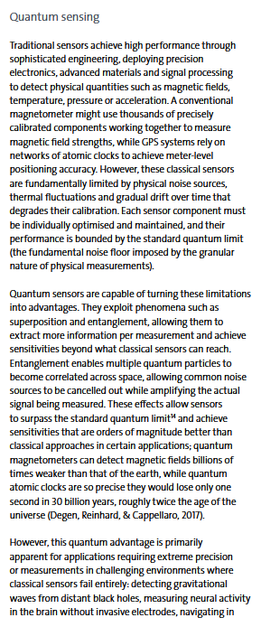
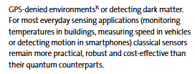
Synergies and Vision of Quantum Technologies - PAN
Connecting quantum information, quantum field theory, gravity, …
Tradition of HEP theory as asset and contribution
Quantum Computing intrinsically fitting HEP fundamental physics problems
Quantum Metrology bridging theory and sensing
HEP as early adopter of new technologies
Single qubit ≠ computer,
but it can be an ideal sensor
Both discrete and collective Quantum states as crucial information of energy and matter
Learn from previous success on micro/nanochip development:
HEP-Microelectronics
  - Solid State detectors
  - DAQs
28
gemma.rius@imb-cnm.csic.es qchip.csic.es

Slide 29
29
gemma.rius@imb-cnm.csic.es qchip.csic.es

Slide 30
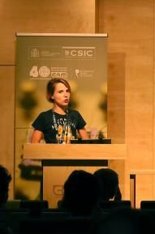
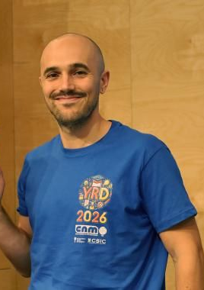
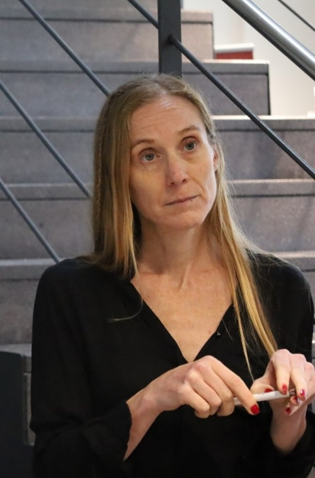
Superconducting and Hybrid Quantum Chips Research Line at IMB-CNM-CSIC
On-going QTech related Funded Projects QUTE - CNS2023-145234 Resonant –IKUR2025-QT11 KICK-IN – Internal IMB-MdM - Trigger Call SUHY – Intramurales CSIC Previous or Recent QTech-related Funded Projects QS4DM - QTP2021-03-014 HYFAB – TED2021-13029B-C44 MINARE – PID2021-122140NB-C32
Current Team Members
María Benito – PreDoc
Carlo Pepe – PostDoc
Gemma Rius – Tenured Scientist
plus two Master Students
30
Micro – Nano Technologies for the realization of Quantum Materials and Devices qchip.csic.es

Slide 31
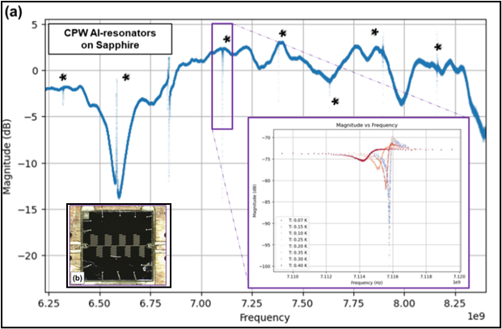
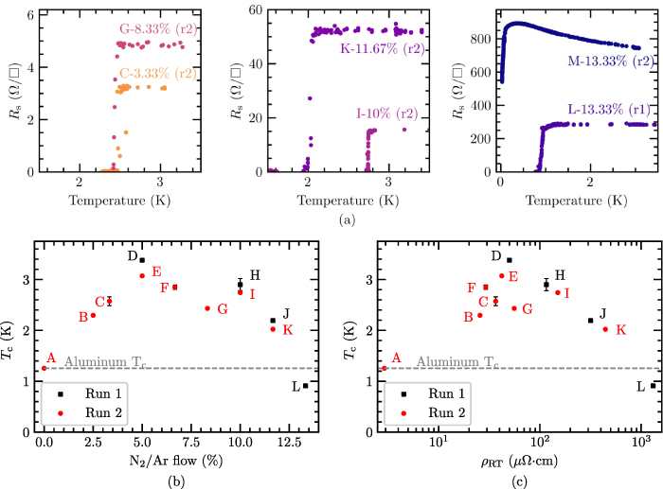
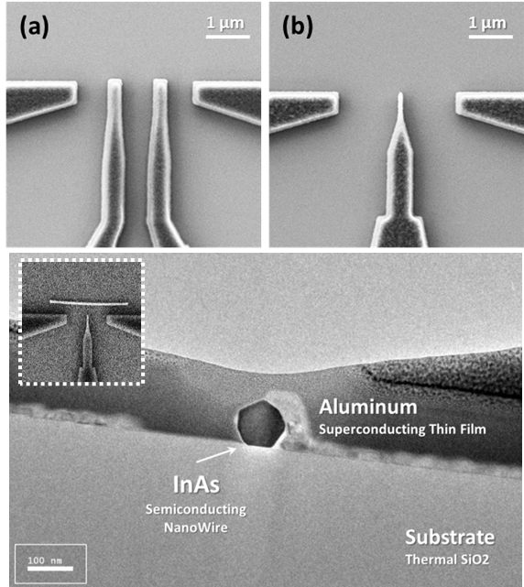
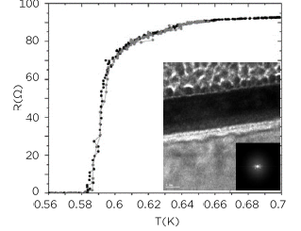
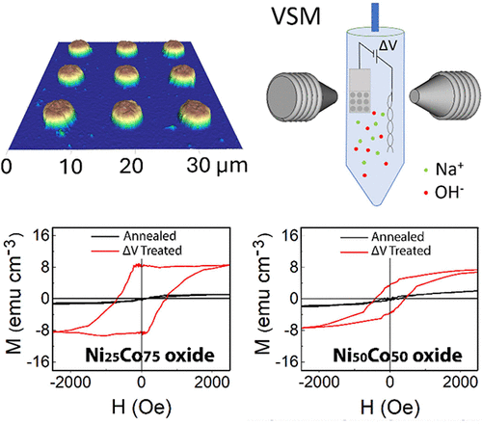
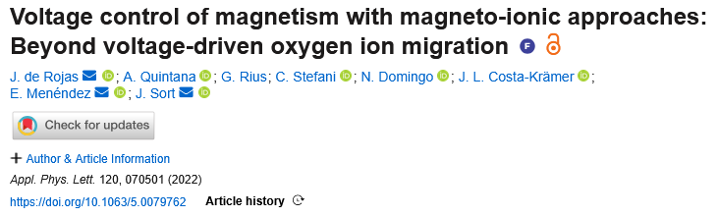
Superconducting & Hybrid Quantum Chips Research Line
Baseline Superconducting Devices.
Design, Fabrication and Testing
Customized or Advanced
Superconducting Thin films
Hybrid Devices and Unconventional Systems
Microwave Resonators, e.g. Al and Ta
Nitridized Aluminum
Semiconductor-Superconductor
2024 Supercond. Sci. Technol. 37 035017
2026 J Low Temp Phys 222, 55 doi.org/10.1007/s10909-026-03390-y
2 Manuscripts in Prep.
Ultrathin Amorphous WSix
Manuscript in Prep.
Baseline Supercond. Thin films & Devices
Material | Tc
Aluminum | 1.2
Tantalum | 4.2-4.4
Niobium | ∼ 4.5
α-Tungsten | < 100mK
Quantum Materials Integration
2025 Supercond. Sci. Technol. 38 095004
Paper on Ta-Nb to be submitted
2026 IEEE Trans. Appl. Superconductivity 36, 5, 1-5 doi.org/10.1109/TASC.2026.3673788
31
Micro – Nano Technologies for the realization of Quantum Materials and Devices gemma.rius@csic.es

Slide 32
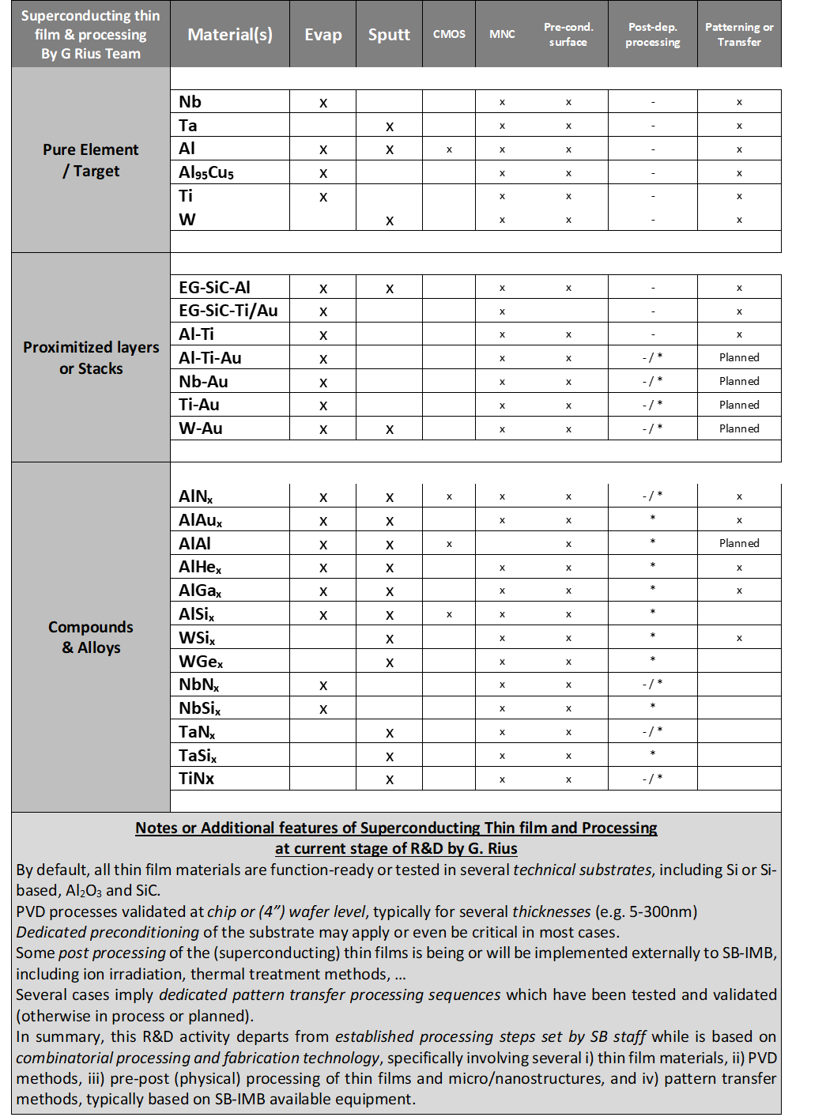
Superconducting & Hybrid Quantum Chips Research Line
Baseline Superconducting Devices.
Design, Fabrication and Testing
Material | Tc
Aluminum | 1.2 K
Tantalum | 4.2-4.4 K
Niobium | ∼ 4.5-6 K
α-Tungsten | < 100mK
Titanium | 400 mK
Proximitized films | Tunable
Layer stacks | Tunable
Baseline Supercond. Thin films & Devices
Qualifying existing (metal) thin films
Developing deposition conditions
Fabrication of devices – based on available equipment
and target materials at the ICTS IMB-Clean Room
Basic Methods:
Sputtering
Evaporation
Micro and Nano Patterning
Intended for both cryogenic electronics and quantum devices
Design fabrication and testing of DC and MW devices & circuits
Resilience of materials and devices to operation, such as B
2025 Supercond. Sci. Technol. 38 095004
32
Micro – Nano Technologies for the realization of Quantum Materials and Devices gemma.rius@csic.es

Slide 33
Superconducting & Hybrid Quantum Chips Research Line
Baseline Superconducting Devices.
Design, Fabrication and Testing
MINARE Project
LSC-LNGS / IFAE / IMB-CNM
Microwave Resonators, e.g. Al and Ta
Designs of circuits, including arrays of multiplexed resonators
Fabrication of devices and external interfacing (pcbs and sample box)
Analysis of performances upon testing in dilution fridge
(cryo-characterization not on-site)
Modelling and simulations for device and chip design and evaluation:
Sonnet
COMSOL
Parametric comprehension of actual characteristics and performances: freq, Ql, power, T, SPR…
Optimization by layout design and fabrication processing
Diagnostic and mitigation of effects and sensitivity or resilience
to environment /off-chip experimental conditions, e.g. ionizing radiation
APL Quantum 3, 020901 (2026)
doi.org/10.1063/5.0319835
Micro – Nano Technologies for the realization of Quantum Materials and Devices gemma.rius@csic.es

Slide 34
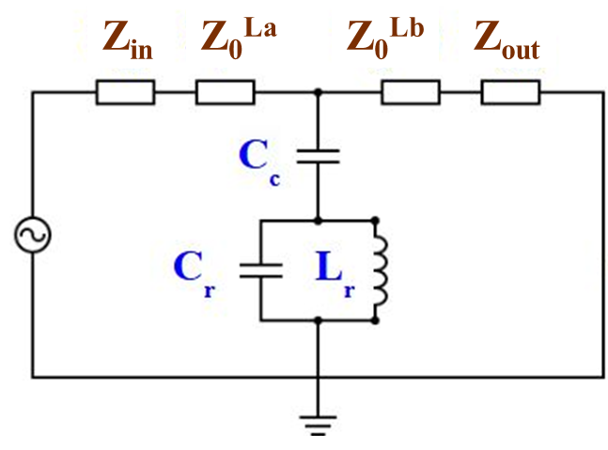
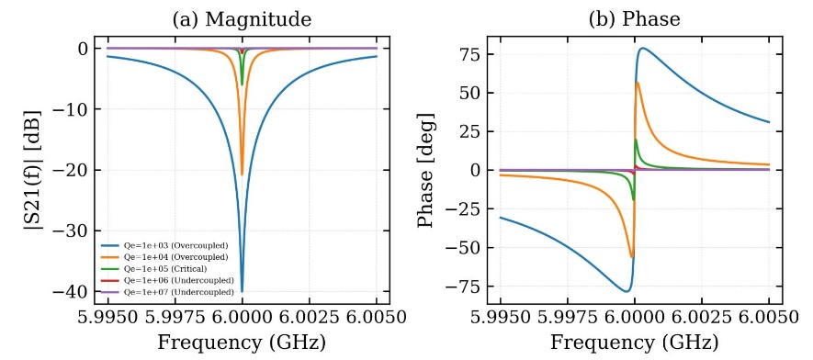
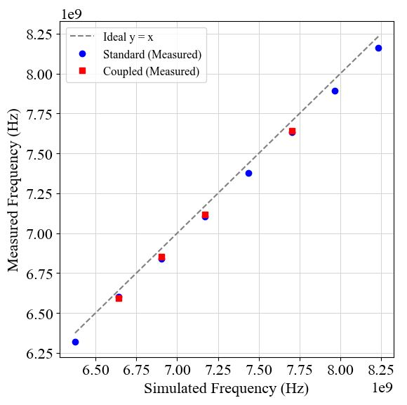
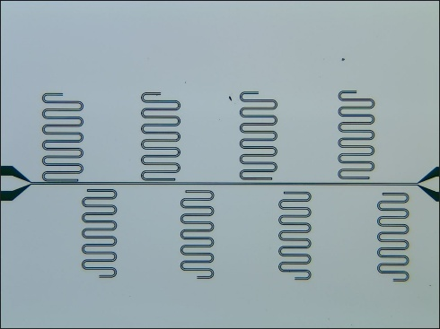
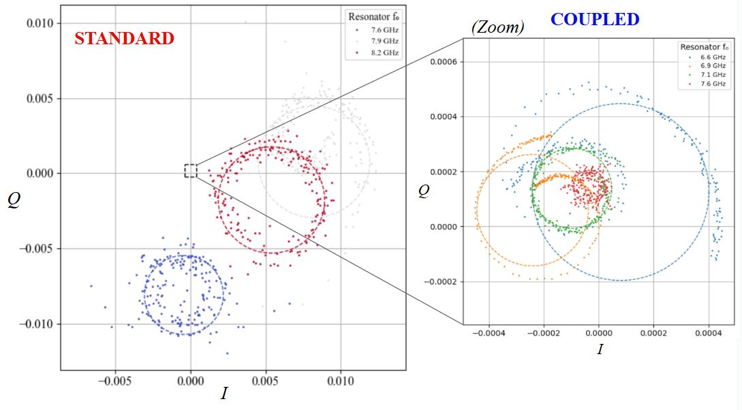
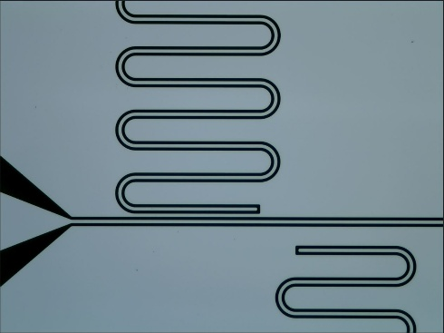
Superconducting & Hybrid Quantum Chips Research Line
Baseline Superconducting Devices.
Design, Fabrication and Testing
Microwave Resonators, e.g. Al on Sapphire
34
Micro – Nano Technologies for the realization of Quantum Materials and Devices gemma.rius@csic.es

Slide 35
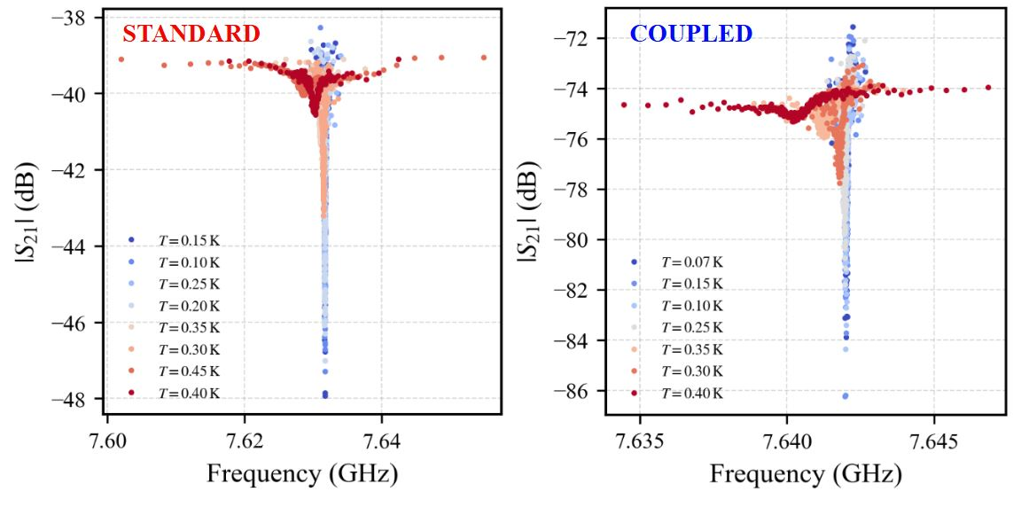
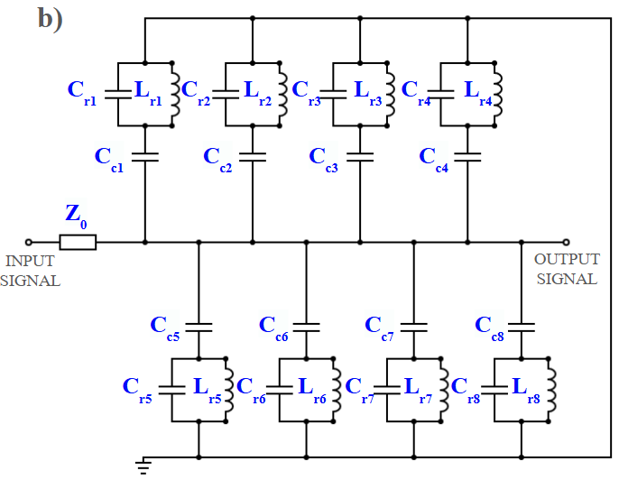
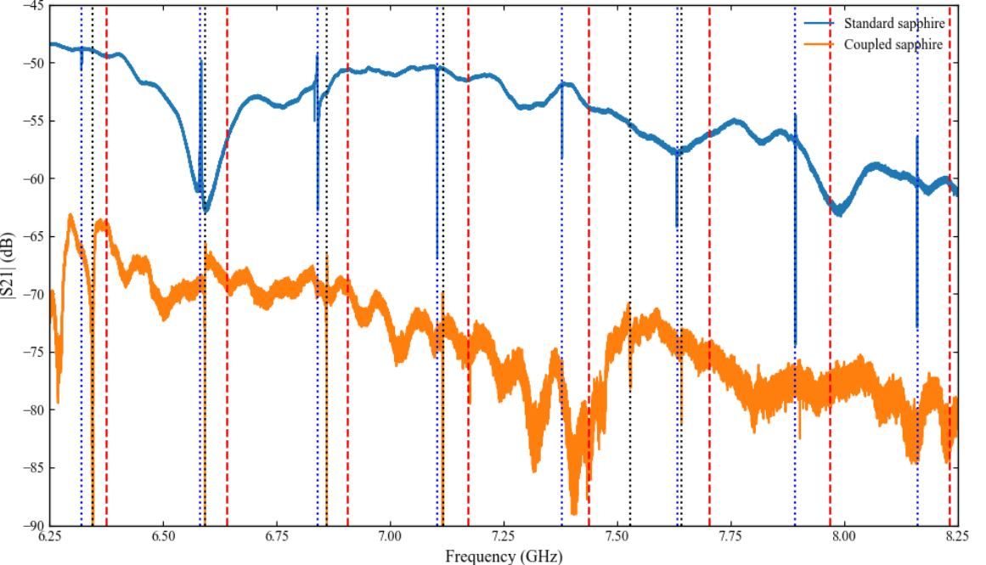
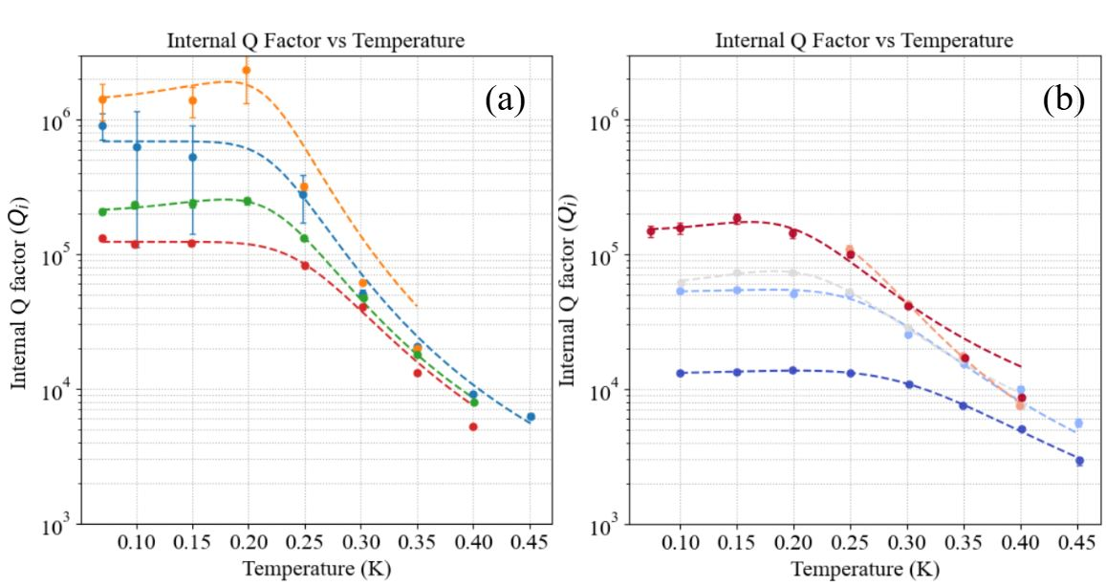

Superconducting & Hybrid Quantum Chips Research Line
Baseline Superconducting Devices.
Design, Fabrication and Testing
Arrays of CPW Microwave Resonators, e.g. Al on Sapphire
35
Micro – Nano Technologies for the realization of Quantum Materials and Devices gemma.rius@csic.es

Slide 36
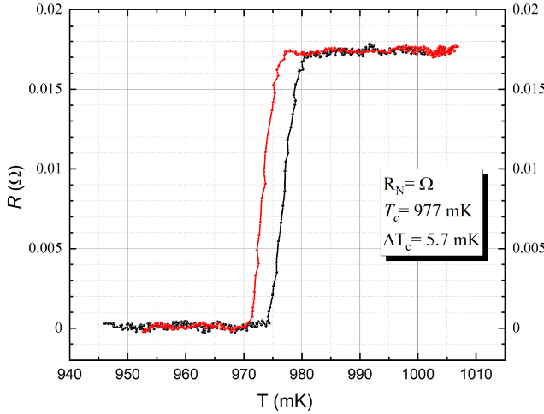
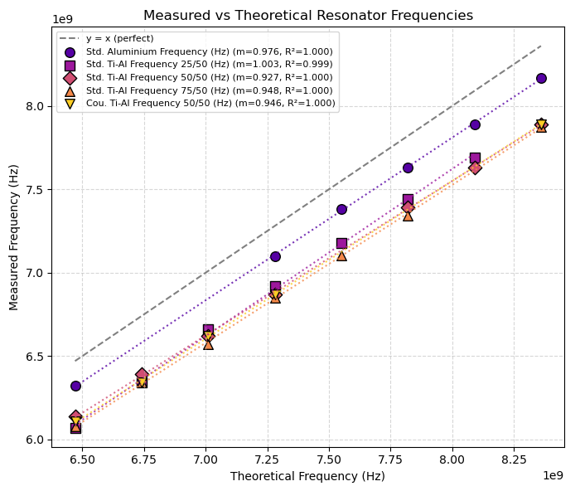
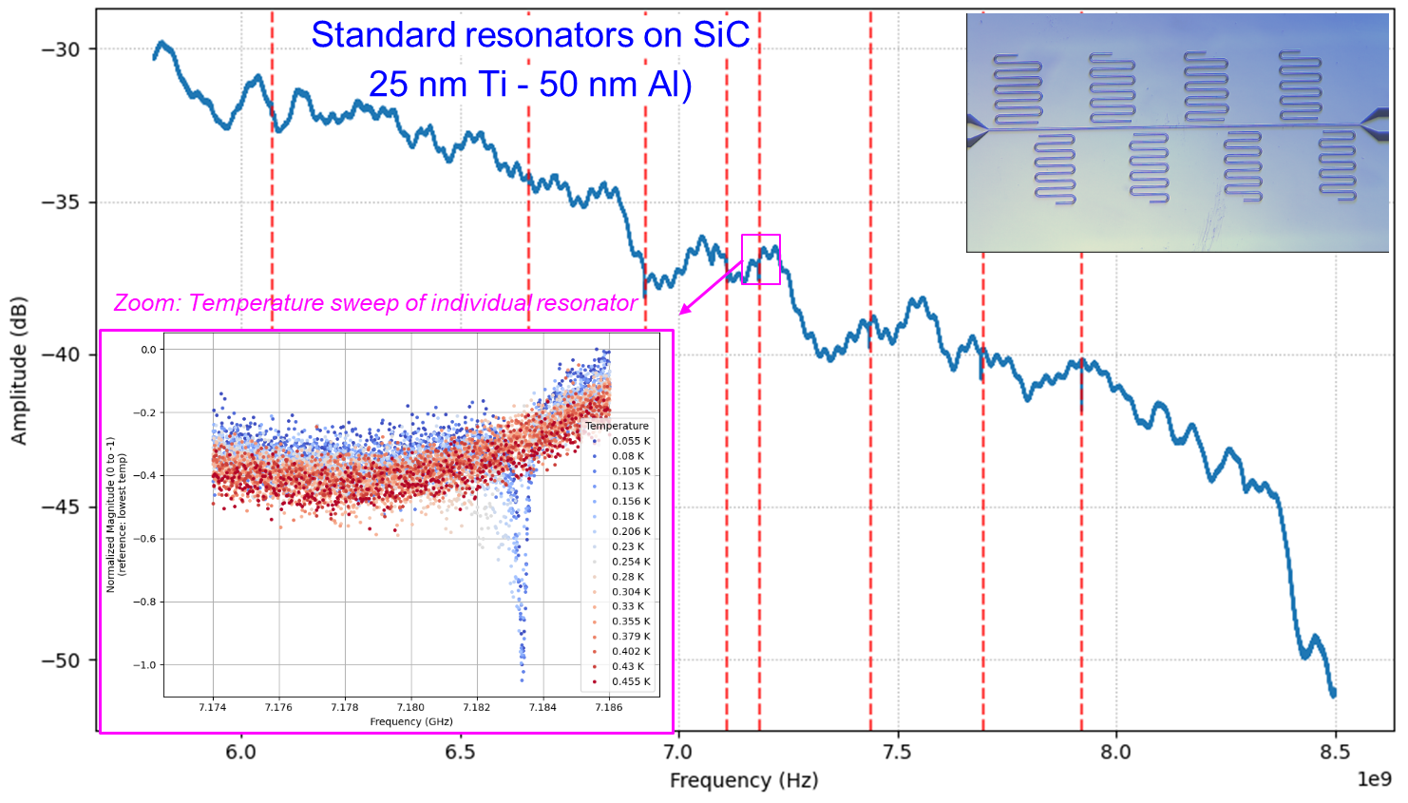
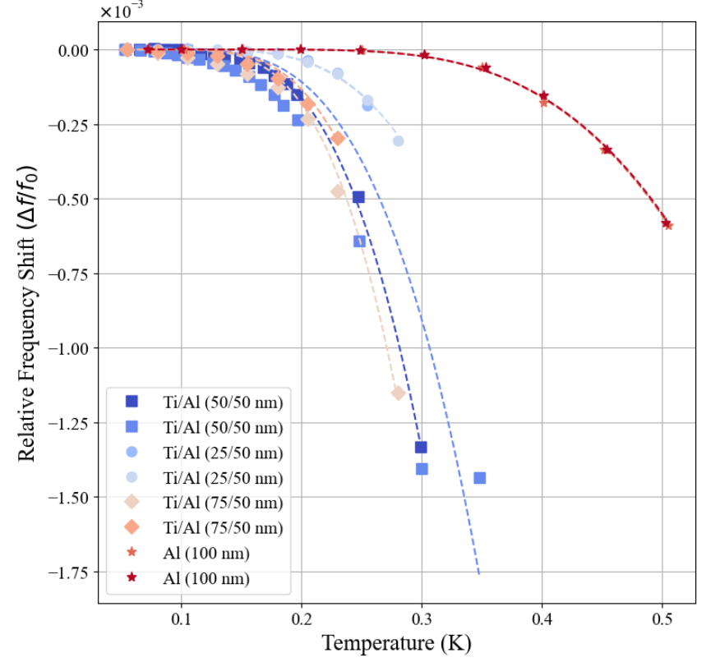
Superconducting & Hybrid Quantum Chips Research Line
Baseline Superconducting Devices.
Design, Fabrication and Testing
+
Enginnering or Advanced Superconducting Thin Films
Microwave Resonator Technology, single metals vs Stacks of Thin films. Ex. substrate/Ti/Al
36
Micro – Nano Technologies for the realization of Quantum Materials and Devices gemma.rius@csic.es

Slide 37
Superconducting & Hybrid Quantum Chips Team - Overview
Baseline Superconducting Devices.
Design, Fabrication and Testing
Customized or Advanced
Superconducting Thin films
Hybrid and Emerging Systems.
Novel Fabrication Methods
Applications
TES
KICS
SQUIDs
Qubits
SNSPD
KID
Features
Multiplexing
Readout
Control
Operation
Range
Methods
Design
Fabrication
Simulation
Integration
Scalability
Collaborations
Characterization
Testing
Theory and Software
PTOLEMY experiment
Microwave Resonators. Arrays on Al or Ta
Nitridized Aluminum
Junctions: SIS, SNS, SScS…
2024 Supercond. Sci. Technol. 37 035017
Quantum-grade Sc-S junctions
Manuscript in Prep.
2026 J Low Temp Phys 222, 55 doi.org/10.1007/s10909-026-03390-y
2 Manuscripts in Prep.
Ion Irradiation for Thin Film Tuning
Superconductor Thin films & Test Structures
Material | Tc
Aluminum | 1.2
Tantalum | 4.2-4.4
Niobium | ∼ 4.5
α-Tungsten | < 100mK
2025 Supercond. Sci. Technol. 38 095004
Tuning Tc in ultrathin W
Molecular or Quantum Materials Integration
Alpha-Ta Sc thin films TBS
2026 IEEE Trans. Appl. Superconductivity 36, 5, 1-5 doi.org/10.1109/TASC.2026.3673788
37
Micro – Nano Technologies for the realization of Quantum Materials and Devices gemma.rius@csic.es

Slide 38
Superconducting & Hybrid Quantum Chips Research Line
Customized or Advanced
Superconducting Thin films
Nitridized Aluminum
2024 Supercond. Sci. Technol. 37 035017
Design of tuned or novel superconductivity features
Developing methods and deposition conditions
Fabrication, morphostructural characterization
and functional/operational testing
Tools and Methods:
Sputtering & Evaporation, Ion irradiation
(std implantation or FIB)
Micro and Nano Patterning of devices
SRIM/TRIM, Tridyn
Intended for Quantum sensing applications, e.g. direct DM detection
Realization of (ultra) thin films and devices or circuits with specifics in Tc, Lk
Application-oriented design of materials and devices
2026 J Low Temp Phys 222, 55 doi.org/10.1007/s10909-026-03390-y
Ultrathin Amorphous WSix
2026 IEEE Trans. Appl. Superconductivity 36, 5, 1-5 doi.org/10.1109/TASC.2026.3673788
38
Micro – Nano Technologies for the realization of Quantum Materials and Devices gemma.rius@csic.es

Slide 39
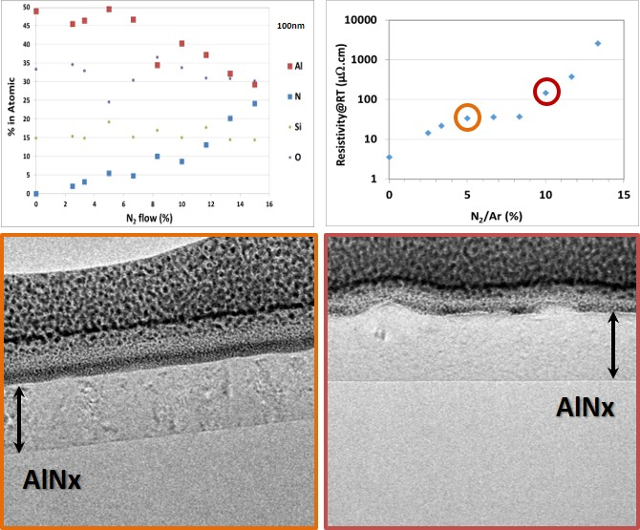
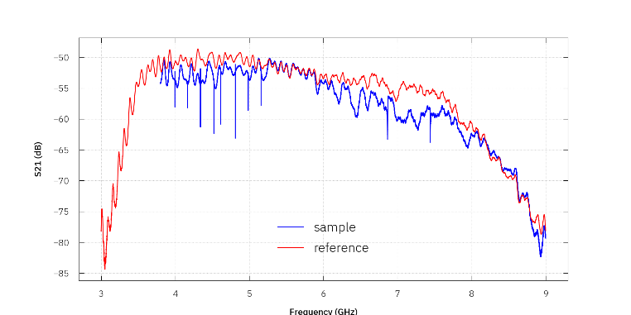
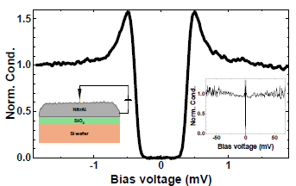
Superconducting & Hybrid Quantum Chips Team - Overview
Customized or Advanced Superconducting Thin films
Nitridized Aluminum
First array of Microwave Resonators made out of nitridized Al
2024 Supercond. Sci. Technol. 37 035017
2026 J Low Temp Phys 222, 55 doi.org/10.1007/s10909-026-03390-y
39
Micro – Nano Technologies for the realization of Quantum Materials and Devices gemma.rius@csic.es

Slide 40
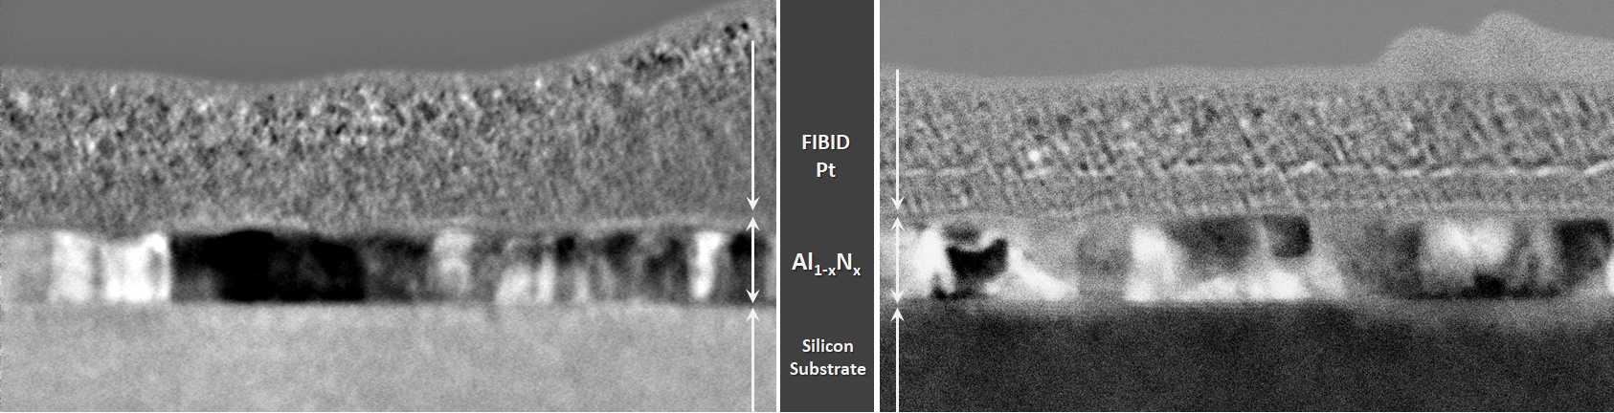
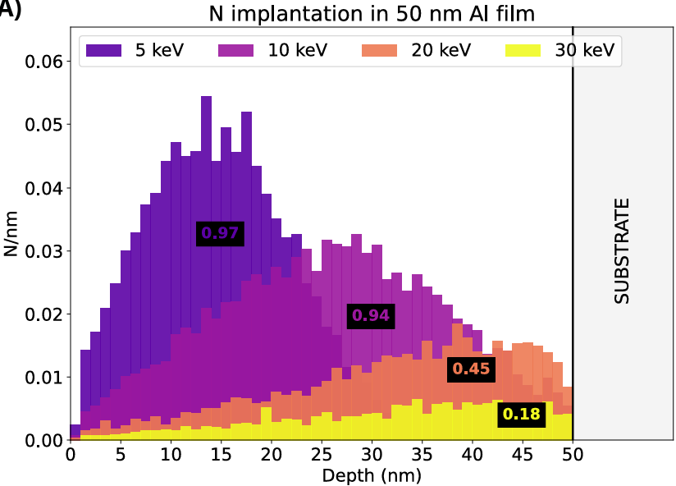
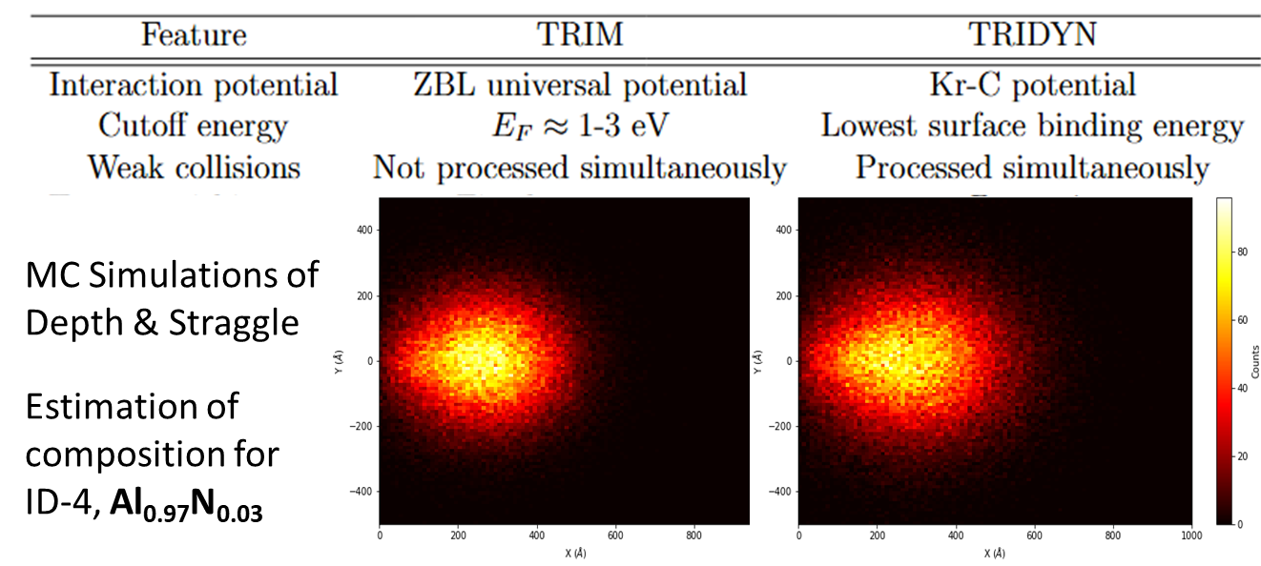


Superconducting & Hybrid Quantum Chips Team - Overview
Customized or Advanced Superconducting Thin films
Ion Irradiation for Thin Film Tuning
AlNx
40
Micro – Nano Technologies for the realization of Quantum Materials and Devices gemma.rius@csic.es

Slide 41

QUTE Project Ref. CNS2023-145234
Ion Irradiation for Advanced Control of Superconductivity in Thin Films
2023 Appl. Phys. Rev. 10, 041311
https://doi.org/10.1063/5.0162597
41
Micro – Nano Technologies for the realization of Quantum Materials and Devices gemma.rius@csic.es

Slide 42

Application of Ion-based SC Thin Films - Transition Edge Sensor
Wiring
TES
area
Tc~0.1 K
Wiring
Tc~ 2 K
3 Metals
3 Patterning levels
Single metal Fully Coplanar
INRiM Carlo Pepe’s software tes.inrim.it/
TES Area | Tc
α-Tungsten | 200mK
Titanium | 400 mK
Titanium + gold | Thickness-ratio tunable
Selection of superconducting material(s)
Functional and operational requirements
Wiring | Tc (K)
Aluminum | 1.2
Tantalum | 4.2-4.4
Niobium | ∼ 4.5
Tungsten implanted | > 1.5
42
Micro – Nano Technologies for the realization of Quantum Materials and Devices gemma.rius@csic.es

Slide 43


Application of Ion-based SC Thin Films - TES
Ion Irradiation for Advanced Control of Superconductivity in Thin Films
Ultra thin W Tc Tuning via Ion irradiation with Si ions
2026 IEEE Trans. Appl. Superconductivity 36, 5, 1-5 doi.org/10.1109/TASC.2026.3673788
43
Micro – Nano Technologies for the realization of Quantum Materials and Devices gemma.rius@csic.es

Slide 44



Ongoing Developments and Achievements on Customized superconducting Thin films & Operational Devices
Local/area selective Ion Irradiation (FIB)
Au++ on Al thin films
Test structures:
VdPauw
Strips
Design and Fab Preliminary Trials. DC and TES Test structures
New test structures mask tested
Quantum-grade interfaces and junctions
Design for experimental validation and callibration
44
Micro – Nano Technologies for the realization of Quantum Materials and Devices gemma.rius@csic.es
Notes:
Compact this and correct grammar

Slide 45






Materials and Devices Design and Technology Developments
GDS Mask v.2 MINARE-QUTE
Multiple possibilities on micro/nanofab processing, thin films, device architectures
Micro – Nano Technologies for the realization of Quantum Materials and Devices gemma.rius@csic.es

Slide 46

Possible Contributions to PTOLEMY working packages
PTOLEMY detection principle:
Cosmic Neutrino Background captured on a beta-unstable target.
Emission of mono-energetic e-
46
Micro – Nano Technologies for the realization of Quantum Materials and Devices gemma.rius@csic.es

Slide 47


Proposed Contribution of IMB to PTOLEMY
If PTOLEMY were to ultimately adopt a TES array, where do we currently stand?
TES energy resolution → ✓ Achieved for photon
Single-electron detection → ✓ Demonstrated
Combining 1 and 2 → Ongoing
Large TES optical arrays → Critical bottleneck
SQUID Multiplexing Limits
Bandwidth: 10-100 kHz/channel
Scalable to tens of pixels only
Possible Solution: KINETIC INDUCTANCE CURRENT SENSORs
Demonstrated by:
Szypryt, Paul, et al. "Kinetic inductance current sensor for visible to near-infrared wavelength transition-edge sensor readout." Communications Engineering 3.1 (2024): 160.
47
Micro – Nano Technologies for the realization of Quantum Materials and Devices gemma.rius@csic.es

Slide 48


Conceptual Proposition
QUTE approach
[1]
[1] Szypryt, Paul, et al. "Kinetic inductance current sensor for visible to near-infrared wavelength transition-edge sensor readout." Communications Engineering 3.1 (2024): 160
Platform evolution
48
Micro – Nano Technologies for the realization of Quantum Materials and Devices gemma.rius@csic.es
Notes:
Compact this and correct grammar

Slide 49
Hybrid Devices and Unconventional Systems
HyFab and IKUR Projects
HyBound and I-QUMA Proposals
Semiconductor-Superconductor
Magnetic-Superconductor
Innovative developments of fabrication technology/sequences
Realization of quantum grade interfaces and hybrid integration
Fabrication, morphostructural characterization and functional testing
Methodologies:
Shadow Wall patterning, e.g. single step EBL
Epitaxial NWs, selective materials growth, local patterning, mix and match
Coordinated processing and characterization in multiple sites
Assessment and demonstrators of compatible fabrication sequences and device operation
Realization of (ultra) thin films and devices or circuits with specifics in Tc, Lk
Oriented to quantum physics studies and novel quantum computing/sensing applications
Manuscript in Prep.
NeuroQ: Quantum Inspired Brain emulation
Biomimetics 2025, 10(8), 516; https://doi.org/10.3390/biomimetics10080516
Unconventional Approaches and Research on Quantum Technologies
49
Micro – Nano Technologies for the realization of Quantum Materials and Devices gemma.rius@csic.es

Slide 50
50
gemma.rius@imb-cnm.csic.es qchip.csic.es

Slide 51

Quantum Principles push/pull Quantum Techmologies
Framework: to deliver useful devices and processes that are based on quantum principles
51
gemma.rius@imb-cnm.csic.es qchip.csic.es

Slide 52

Quantum Principles push/pull Quantum Techmologies
Framework: to deliver useful devices and processes that are based on quantum principles
52
gemma.rius@imb-cnm.csic.es qchip.csic.es

Slide 53


Overview of most important Hardware Platforms for Quantum Technologies
53
gemma.rius@imb-cnm.csic.es qchip.csic.es

Slide 54



Integrated Clean Room for Micro/Nanotechnologies
www.imb-cnm.csic.es/en/sala-blanca-de-micro-y-nanofabricacion
54

Slide 55


Thank you
CONTACT:
Dr. Gemma Rius gemma.rius@csic.es
Funding Acknowledgements:
QTP2021-03-014; PID2021-122140NB-C32;
TED2021-130292B-C44; CNS2023-145234;
IKUR2025-QT11; Trigger KICKIN
Main Collaborators and Support:
INRiM, LNGS, CERN, FBK, HZDR, INL
INMA, UAM, CFM-EHU, UV, IFCA-DCOM, ALBA-CELLS, LSC
kiutra, TESCAN

