Slide 1

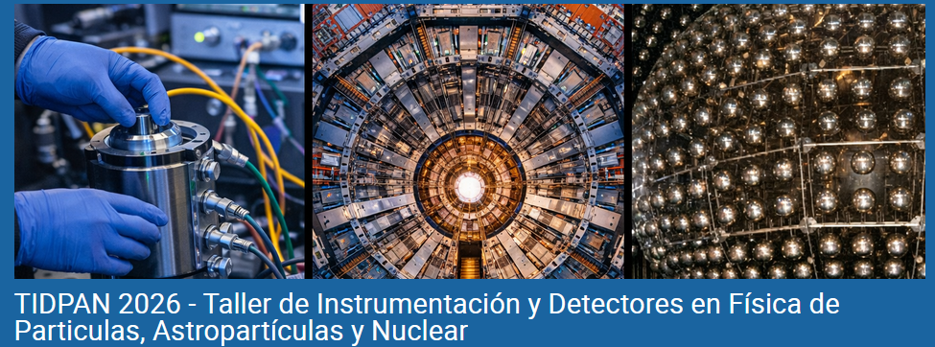


Muon Detectors
Cristina F. Bedoya
TIDPAN 2026
Valencia, June 18th, 2026

Slide 2


What is a muon?
and why do I want to detect it?
C. F. Bedoya
Muon Detectors – TIDPAN 2026 - June 18th, 2026
2

Slide 3
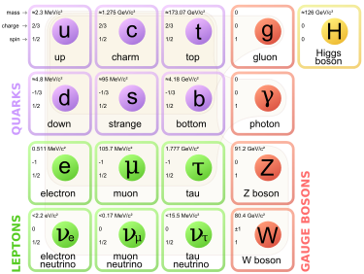
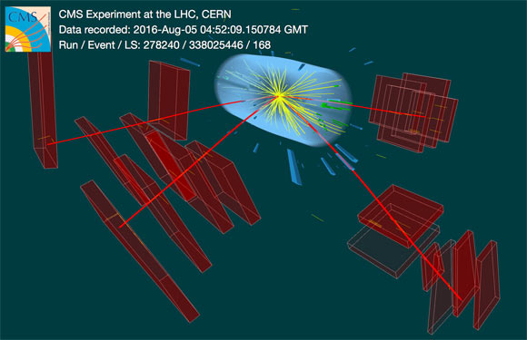
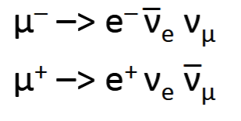
MUON
Their clean experimental signature makes them one of the most valuable particles in modern physics experiments.
Leptons:
No strong force
ELECTRON
Charge -1
Spin ½
Mass ~ 0,511 MeV/c²
MUON
Charge -1
Spin ½
Mass ~ 105,66 MeV/c²
Life-time τ = 2.2 μs
x 207
Highly penetrating
Travel macroscopic distances
Decay:
C. F. Bedoya
Muon Detectors – TIDPAN 2026 - June 18th, 2026
3

Slide 4
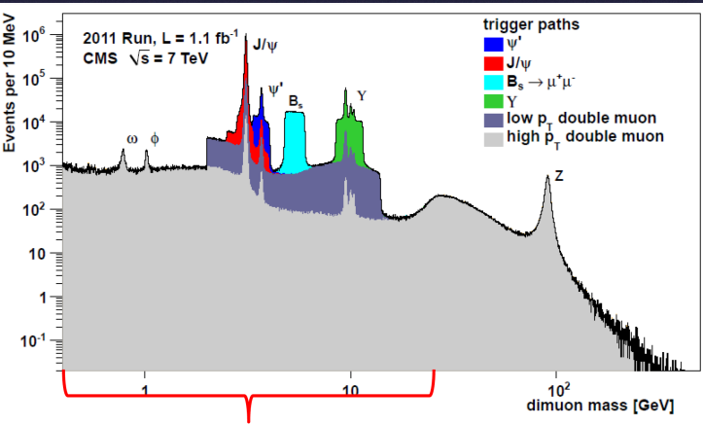
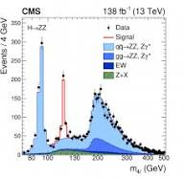
Muons as key observables
1974 → J/ψ → μμ (3.1 GeV)
1977 → Υ → μμ (9.46 GeV)
1983 → W → μν (80.4 GeV)
1983 → Z → μμ (91.2 GeV)
2012 → H → ZZ* → 4μ (125 GeV)
2021-2022 → B_{s} → μμ precision era
2023-2024 → H → μμ observation
The physics became visible because the muons could be reconstructed precisely
They may be rare decays, but the topology is easy to reconstruct and the background is small
Clean final states
C. F. Bedoya
Muon Detectors – TIDPAN 2026 - June 18th, 2026
4

Slide 5
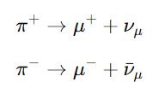
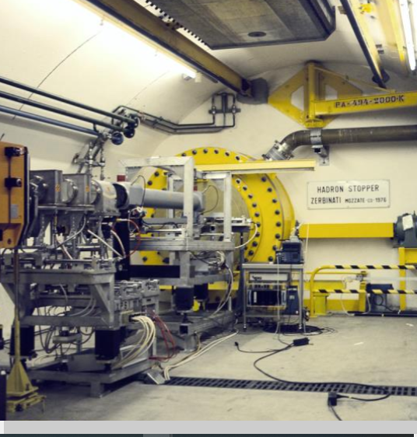
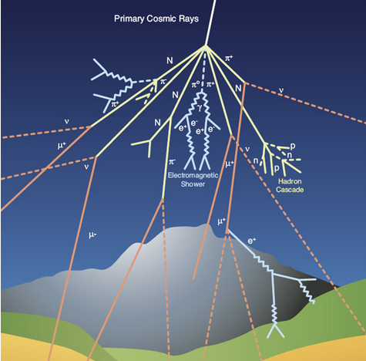


Muon Production
Atmosphere is a gigantic muon source:
Primary cosmic rays (90% protons, 9% Helium, 1% heavier, e, etc)
Secondary: collision with N₂ or O₂ (15-20 km) => pions, kaons => muons
Same way we produce muon beams:
Proton beam + target+ decay+ concrete
PSI, Fermilab, J-PARC and CERN.
(ud)
µ⁺/µ⁻ ~1.3
p(uud)
(du)
At sea level:
~1 muon/cm² min⁻¹
τ ~ 2.2 µs
c·τ ~ 660 m
????
Close to speed of light, their time is slower
C. F. Bedoya
Muon Detectors – TIDPAN 2026 - June 18th, 2026
5

Slide 6
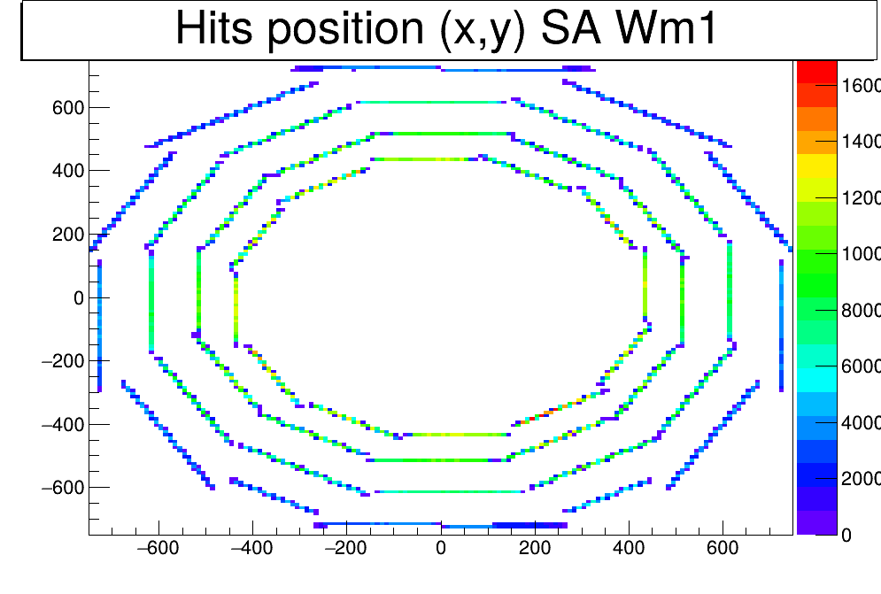
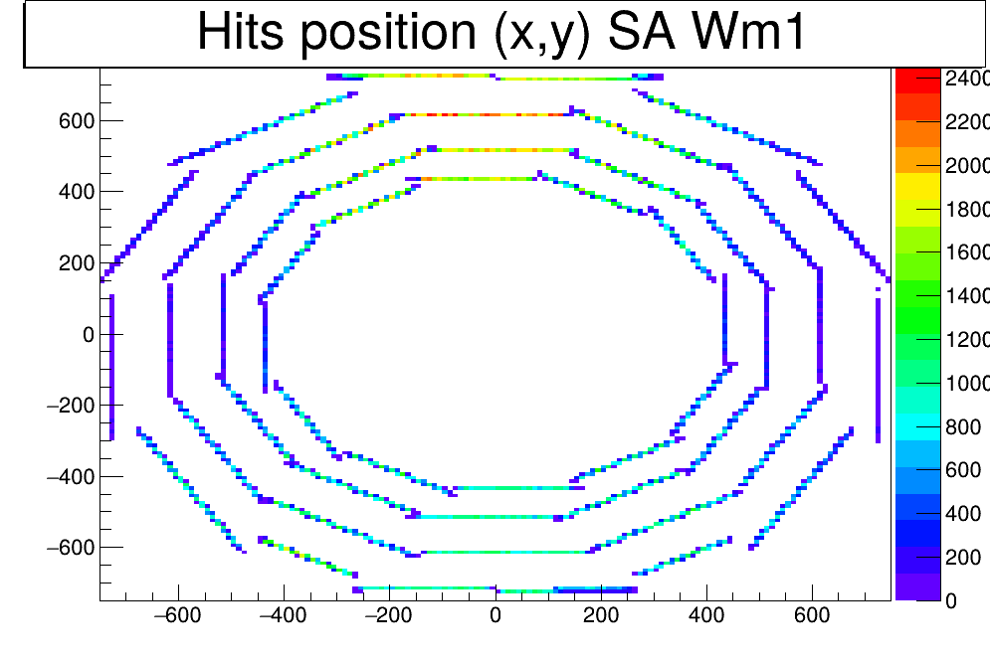
Muons for calibration
Muons can be:
Calibration source (cosmic ray data taking routinely at CMS, LHC)
LHC COLLISIONS at CMS
COSMICS at CMS
C. F. Bedoya
Muon Detectors – TIDPAN 2026 - June 18th, 2026
6

Slide 7
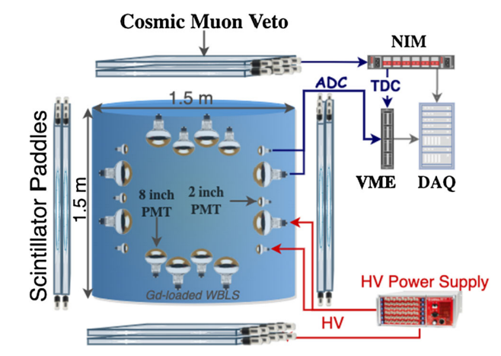
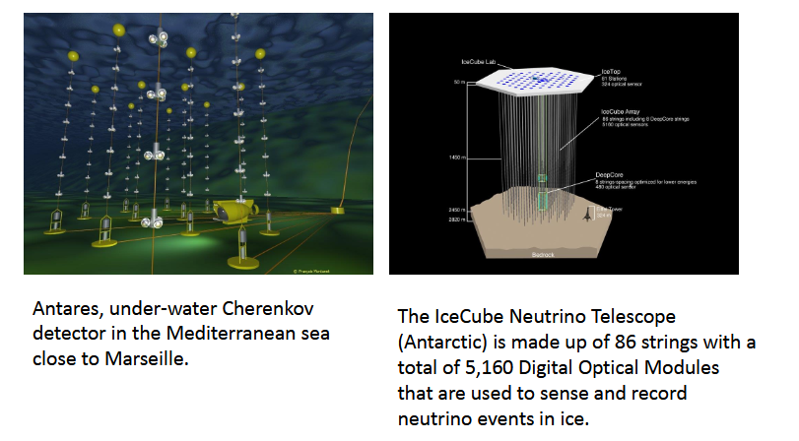
Muons as signal and as background
Muons can be:
Calibration source (cosmic ray data taking routinely at CMS, LHC)
Background in dark matter experiments and others => underground
      Even if the muon is detected and vetoed, its by-products mimic rare physics signals.
https://scoap3-prod-backend.s3.cern.ch/media/files/72139/10.1140/epjc/s10052-022-10658-6_a.pdf
Muons in underground neutrino detectors play a dual role:
unwanted background: few thousand meters water equivalent
signature: Muon neutrinos will most of the time interact via charge-current reactions
      ν N –> μ + X
energetic muon in the final state
(muon detected by Cherenkov radiation)
C. F. Bedoya
Muon Detectors – TIDPAN 2026 - June 18th, 2026
7

Slide 8
How Muons loose their energy?
i.e., how to detect them?
C. F. Bedoya
Muon Detectors – TIDPAN 2026 - June 18th, 2026
8

Slide 9
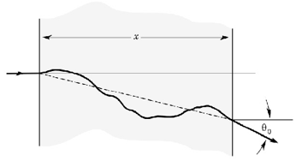
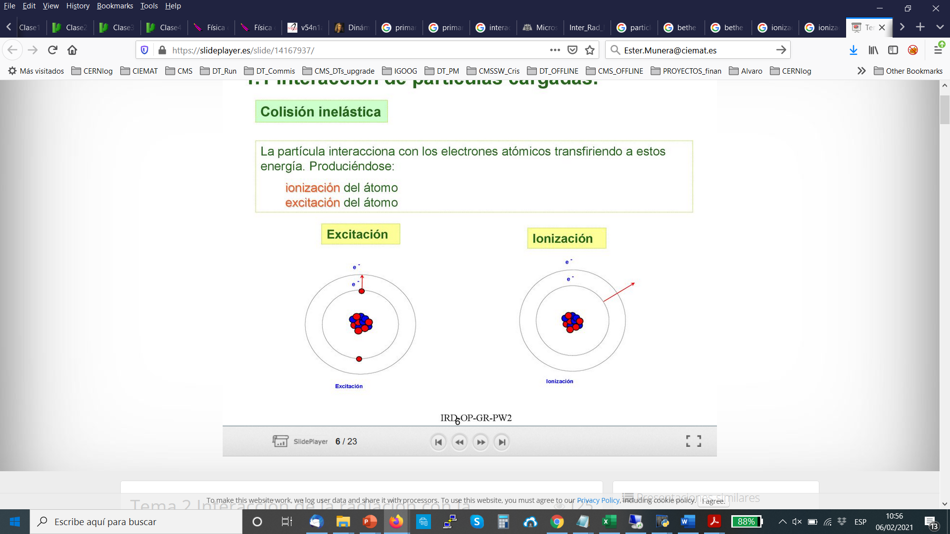
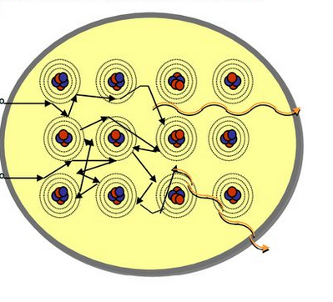
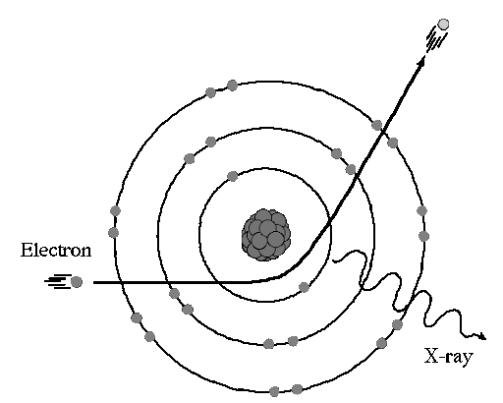
Charged particles: electromagnetic interaction
  interaction with the atomic electrons
  (Inelastic collisions)
Interaction with atomic nuclei
Elastic collisions:
- Multiple scattering: elastic collisions with atomic nucleus.
  Higher Z, larger dispersion
  Higher p_{t}, smaller dispersion
Excitation
Ionization
e⁻
e⁻
Excitation: Electrons are excited to higher energy states when they absorb energy and subsequently emit photons as they return to lower energy states.
Ionization: the atom looses electrons
Radiative effects: Photon emission (Bremsstrahlung)
- The particle is slowed down or deflected as it interacts with the nucleus, and it may emit a photon, thereby losing energy.
e⁻
photon
C. F. Bedoya
Muon Detectors – TIDPAN 2026 - June 18th, 2026
9

Slide 10
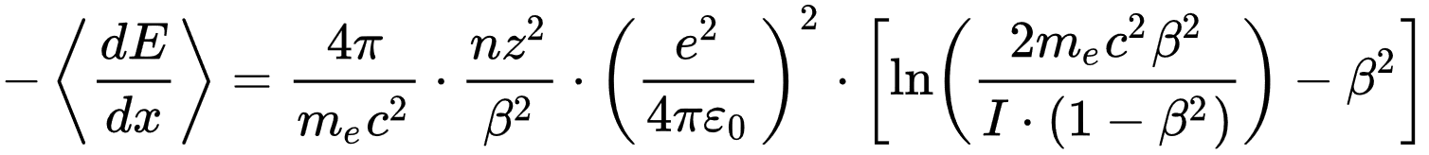
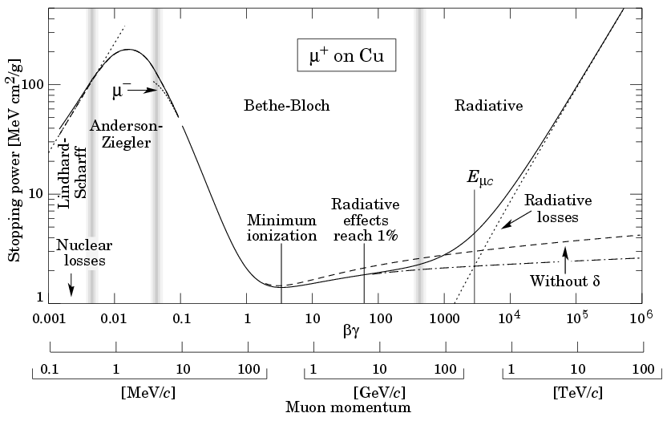
Energy loss in a material by a charged particle
Bethe & Bloch formula -dE/dx Stopping power
Average energy lost per unit path length in a material due to collisions with atomic electrons, resulting in ionization and excitation of the medium.
Particle charge and speed: z² / β²
Medium properties: Z / A, I(ionization pot), densidad
Relativistic effects : β·γ and médium polarization (δ)
Radiative region: Energy loss through bremsstrahlung radiation caused by the particle's deceleration or deflection.
↑ β => ↓ Energy loss
Polarization of the medium reduces the ionization energy loss (polarization depends on medium density)
MIP (minimum ionizing particle)
C. F. Bedoya
Muon Detectors – TIDPAN 2026 - June 18th, 2026
10

Slide 11
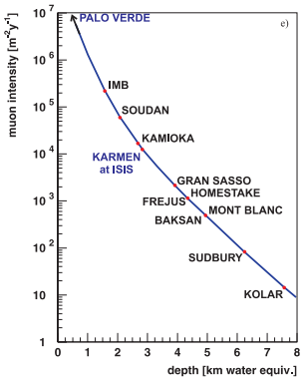
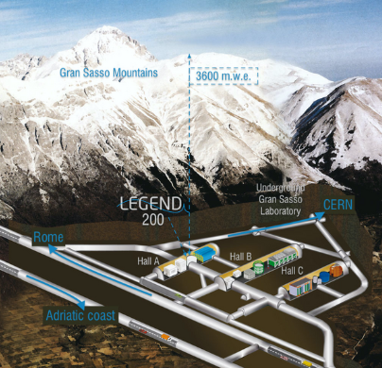
Muons loose little energy
Muons are often considered Minimum Ionizing Particles (MIPs) because, over a wide range of energies, their energy loss in matter is close to the minimum of the Bethe–Bloch curve.
Differently from electrons, bremsstrahlung becomes only
important above a few 100 GeV
They are the most penetrating charged particles :
in one meter of iron they lose only ≈1.5 GeV
(for muons in few GeV to a few tens of GeV)
Surface => 1
100 m rock => 10⁻¹
1000 m rock => 10⁻³ - 10⁻⁴
LNGS, Canfranc => 10⁻⁶
Heavy enough not to shower, light enough to be produced abundantly, and long-lived enough to cross entire detectors.
C. F. Bedoya
Muon Detectors – TIDPAN 2026 - June 18th, 2026
11

Slide 12
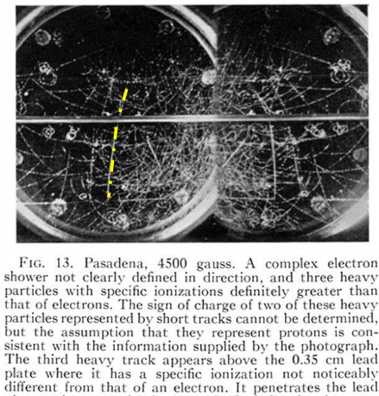
A Little bit of history…
Muons were discovered by Carl D. Anderson and Seth Neddermeyer in a cloud chamber experiment at CalTech in 1936
(Nobel prize for positron discovery in 1936)
Phys. Rev. 50 (1936) 263
Cloud chamber
Ionizing particle → creates ions (condensation nuclei) → supersaturated vapor condenses on the ions → droplets form along the particle track
Wilson received the 1927 Nobel Prize for the invention of the cloud chamber.
From cloud chambers to modern muon detectors, the underlying principle remains the same: charged particles ionize matter and leave measurable signatures.
C. F. Bedoya
Muon Detectors – TIDPAN 2026 - June 18th, 2026
12

Slide 13
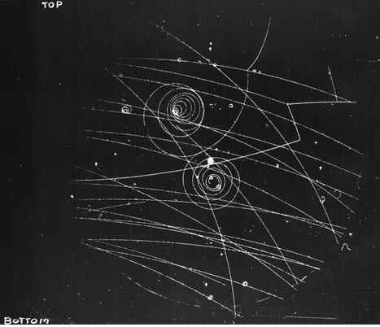
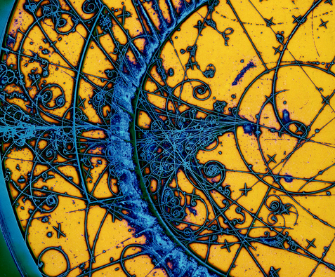
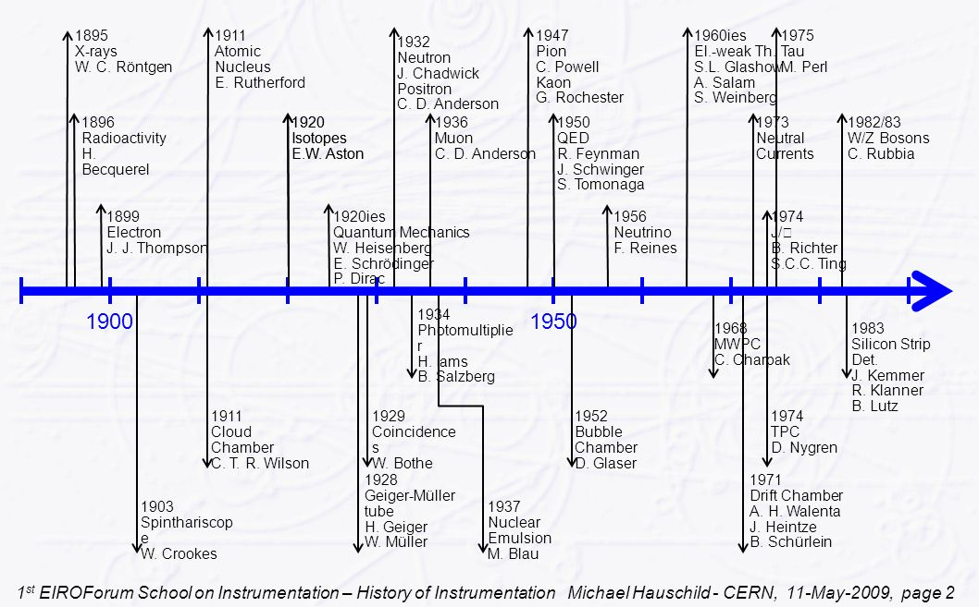
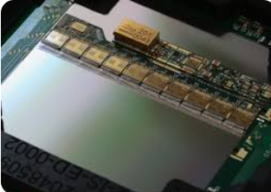
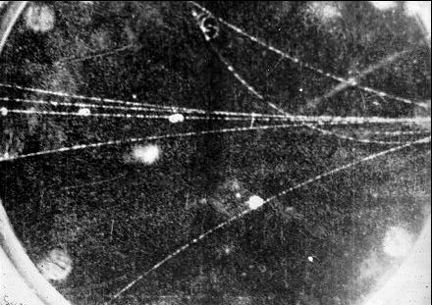
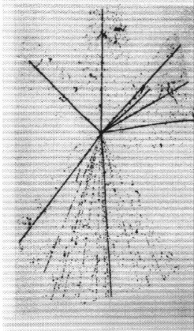
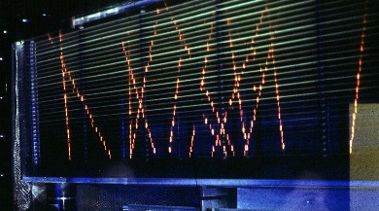
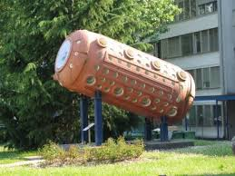
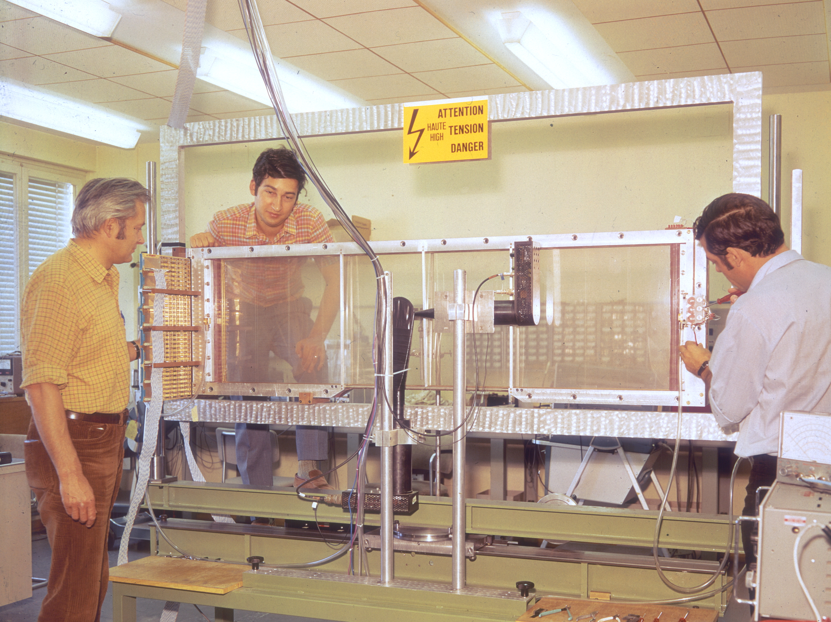
A Brief History of Particle Physics and Detector Instrumentation
Bubble chamber ‘61
~1930:
Photomultipliers, Geiger-Müller tubes, emulsions
1960-1985: Bubble chambers (liquid instead of gas, vapor instead of drops)
>1980: Solid state detectors (Silica, Ge, etc)
1960: Spark and streamer chambers (trigger)
~1910:
cloud chambers
>1970: Multiwire chambers (MWPCs and drift chambers)
C. F. Bedoya
Muon Detectors – TIDPAN 2026 - June 18th, 2026
13

Slide 14
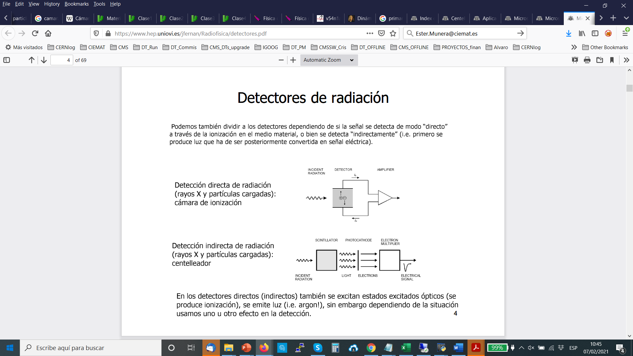
Radiation detectors
Muons can be detected by all of them!!!
Ionization
Excitation
Ionization/excitation typical energies:
1-5 eV semiconductors
10 eV scintillation
30 eV gaseous
Semiconductors
Scintillation
Gas/Liquid
  Electron- ion pair (gas/liquids)
  Electron- hole (semiconductors, metals)
Indirect detection of radiation :
Radiation generates light that in turns, generates electricity through a photosensor
Direct detection of radiation :
Radiation generates electrons that are sent to an electronics system
C. F. Bedoya
Muon Detectors – TIDPAN 2026 - June 18th, 2026
14

Slide 15
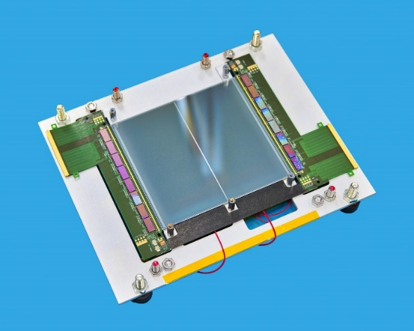
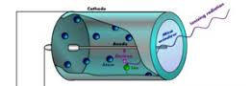
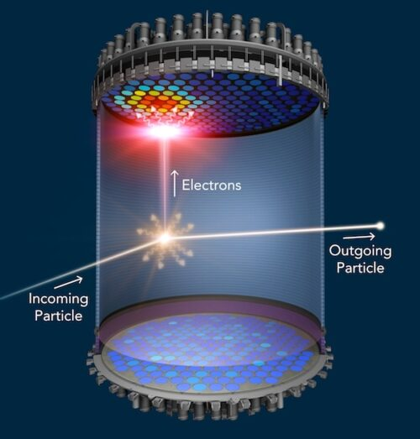
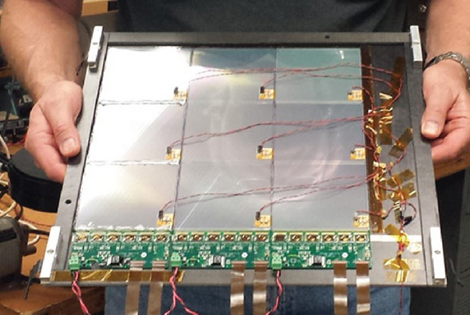
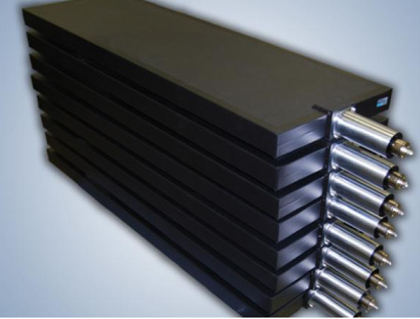
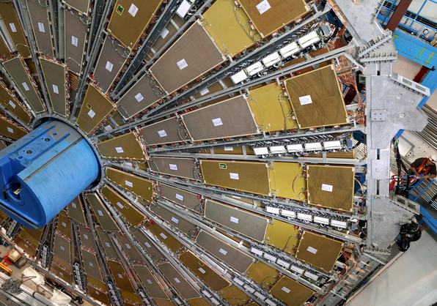
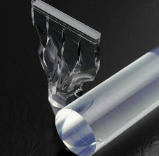
Radiation detectors
Muons can be detected by all of them!!!
Solid state
Gaseous
Liquid scintillator
Plastic scintillators
Gaseous
C. F. Bedoya
Muon Detectors – TIDPAN 2026 - June 18th, 2026
15

Slide 16
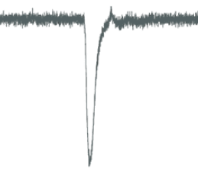
How to detect a muon?
Usually you want to make sure the signal from your detector is not noise.
This is usually granted by the coincidence of signals from neighbouring detectors
Muon detection
layer
Muon detection
layer
C. F. Bedoya
Muon Detectors – TIDPAN 2026 - June 18th, 2026
16

Slide 17

How to identify a muon?
To ensure it is a muon, you need to make sure it is the only particle left.
Enough absorber that will stop all particles except muons and neutrinos (but you will not detect them…)
Interaction length (λ_{I}):
distance over which a high-energy hadron (proton, pion, kaon, neutron, etc.) travels in a material before undergoing a strong nuclear interaction.
  After 1 λ_{I} => 37% survive
  After 2 λ_{I} => 14% survive
  …
  After 6 λ_{I} => 0.25% survive
Usually 12 λ_{I} calorimeters at LHC energies
Iron = 16.8 cm, copper = 15 cm..
Absorber
Muon detection
layer
Muon detection
layer
High Z materials
Usually instrumented (calorimeter)
C. F. Bedoya
Muon Detectors – TIDPAN 2026 - June 18th, 2026
17

Slide 18
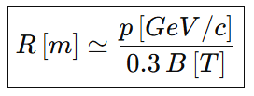
How to measure a muon?
Now you are sure you have a muon, but likely you want to say something about its energy…
Curvature of the muon in the magnetic field is proportional to the momentum of the muon
Curvature in a magnetic field:
100 GeV muon in 1T field, 333 m….
Large fields, large muon systems
Positive and negative muons bend in opposite direction
Absorber
Muon detection
layer
Muon detection
layer
Muon detection
layer
High Z materials
Usually instrumented (calorimeter)
C. F. Bedoya
Muon Detectors – TIDPAN 2026 - June 18th, 2026
18

Slide 19
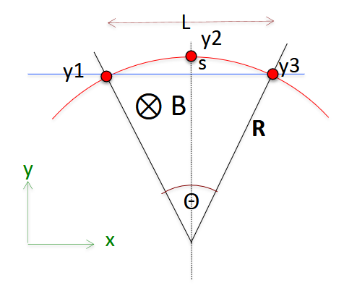


How to measure a muon?
Sagitta
s = R - R cos(θ/2) = R ( 1 - cos(θ/2))
For small angles:
cos(x) ≈ 1 - x²/2
s ≈ R θ²/8
s ≈ L²/ 8 R
s ≈ 0.3 B L²/8 p_{T}
Bending in an homogeneous field
Difficult to measure high energy muons with precision, they bend little
Large muon detectors, and ALIGN LARGE ESTRUCTURES (civil engineering problem)
The momentum resolution is directly determined by how accurately the sagitta can be measured.
C. F. Bedoya
Muon Detectors – TIDPAN 2026 - June 18th, 2026
19

Slide 20
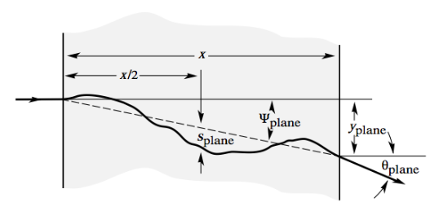
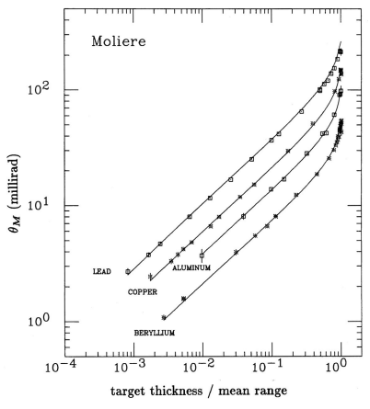

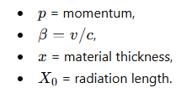

Multiple scattering
Charged particles: large number of small
scattering processes when traversing matter
They are small, but many, they accumulate
They result in a change of the particle’s direction (Θ) and a displacement of its position (or exit point)
Highland formula
Lower momentum => More scattering
Greater thickness and density of material => More scattering
C. F. Bedoya
Muon Detectors – TIDPAN 2026 - June 18th, 2026
20

Slide 21
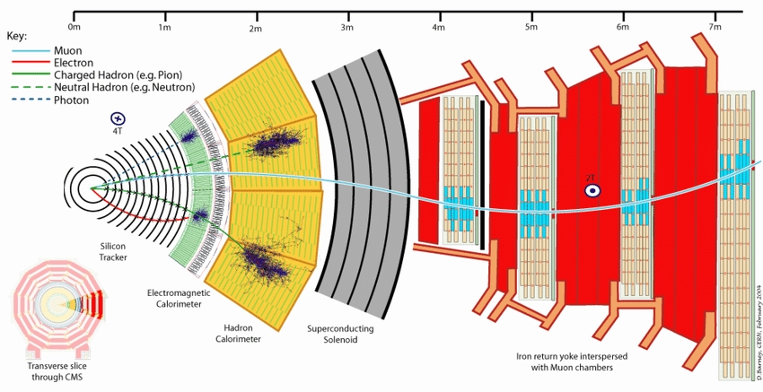
How to measure a muon?
Muon systems: large, external part of the detector, embedded or after enough absorber, inside a B field
Muon systems: type of magnet (iron-core, air-core, …) , precision requirements, area to be covered, cost & maintenance
Price usually determines technology (gaseous detectors)
C. F. Bedoya
Muon Detectors – TIDPAN 2026 - June 18th, 2026
21

Slide 22
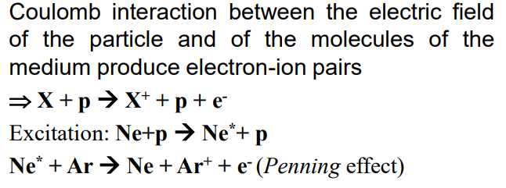
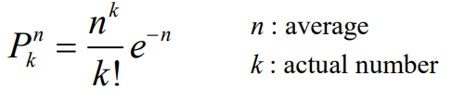
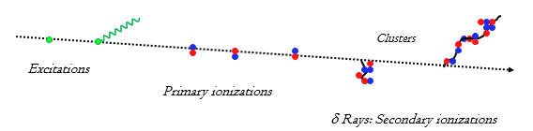
Gaseous detectors
A charged particle ionizes the gas molecules, creating ion–electron pairs.
They move in all directions and lose their energy through collisions with the gas molecules (thermalization).
If an electric field is applied to the gas, ions and electrons experience forces in opposite directions and drift along the field lines: ion→cathode electron→anode
Multiple ionizing collisions follow Poisson distribution
A second ionization process can occur with δ ray electrons: primary electrons with enough energy to ionize the gas: effects on the total number of ionization electrons !! (and spatial resolution as well )
Anode (+)
-
-
electrons
-
-
+
E field
+
ions
+
+
Cathode (-)
C. F. Bedoya
Muon Detectors – TIDPAN 2026 - June 18th, 2026
22

Slide 23

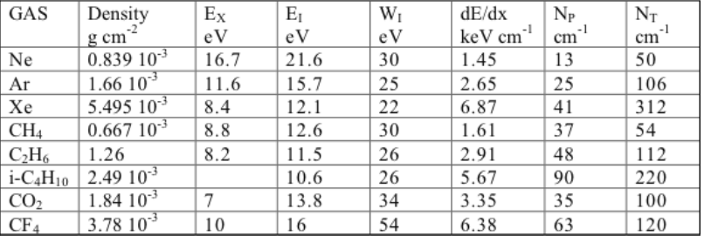
Gaseous detectors: Ionization
W≈25−35 eV/pair
MIP in Argon => ~100 electrons/cm
E_{x} , E_{i} : first excitation and ionization potentials
W_{i} : average energy per ion pair
N_{P} , N_{T} : primary and total ion pairs per cm for 1 proton
In gaseous detectors typically ~100 ion/electron pairs are produced by a MIP in 1 cm of gas
To be compared to ≈24.000 hole/electron pairs produced in 300 μm of Si.
The typical noise level of a signal amplifier is ~1000 e⁻
We need amplification!!
C. F. Bedoya
Muon Detectors – TIDPAN 2026 - June 18th, 2026
23

Slide 24






Gaseous detectors: Avalanche Multiplication and Gas Gain
Townsend Avalanche
Near thin anode wires, GEM holes or Micromegas meshes:
E∼50−100 kV/cm
Electrons acquire enough energy to ionize new atoms.
First Townsend coefficient (α)
If the electric field is sufficiently high, an electron is accelerated and gains enough energy to ionize a gas molecule, producing a new electron. The process repeats itself, giving rise to an electron avalanche.
        Electron avalanche
(a measurable charge pulse is induced on the readout electronics).
The gain (G), or gas amplification factor, is defined as
G=n/n_{o} n= total number of electrons after multiplication
n₀=number of primary electrons in the absence of multiplication
Thus, the gain represents the factor by which the initial ionization charge is amplified within the detector.
C. F. Bedoya
Muon Detectors – TIDPAN 2026 - June 18th, 2026
24

Slide 25


Gaseous detectors: discharges
Avalanche growth is not unlimited.
Raether limit:
N_{crit}∼10⁷−10⁸ electrons.
Beyond this:
Space charge builds up.
Streamer formation occurs.
Full discharge (spark) may develop.
MSGC (1994)
Micro-Strip Gas Chambers
Consequences
Dead time
Electronics damage
Detector ageing
Mitigation
Resistive electrodes (RPCs)
Segmented GEMs
Resistive Micromegas
Optimized gas mixtures
Multi-stage amplification
C. F. Bedoya
Muon Detectors – TIDPAN 2026 - June 18th, 2026
25

Slide 26




Gaseous detectors: Operation modes
Depending on the applied voltage, different operating regimes can be identified:
Recombination region
  Electrons recombine with positive ions before reaching the anode.
Ionization region
  Electrons reach the anode, but no gas multiplication occurs.
Proportional region
  The number of electrons produced in the avalanche is proportional to the initial ionization.
  As a result, the deposited energy can be measured.
Limited proportionality region
  Saturation effects become significant.
  Strong photoemission leads to the development of secondary avalanches.
Geiger region
  Massive photoemission occurs throughout the detector volume.
  The pulse amplitude is no longer related to the initial ionization, so energy measurements are not possible.
Continuous discharge region
  The detector enters a self-sustained discharge state and can no longer operate properly.
Ionization chamber
Proportional counter
Geiger-Müller counter
C. F. Bedoya
Muon Detectors – TIDPAN 2026 - June 18th, 2026
26

Slide 27


Gaseous detectors: Choice of gas
Gaseous detectors typically use noble gases because they require the lowest electric fields to initiate electron avalanches.
Argon is widely used due to its low cost and favorable operating characteristics.
Pure noble gases: unsuitable for proportional operation because excited atoms emit UV that can trigger secondary avalanches and discharges.
Noble gases are mixed with molecular additives such as CO₂ or iC₄H₁₀. They act as quenchers by absorbing excitation energy through non-radiative processes (vibrational, rotational), suppressing UV photon emission.
Also, some gases exhibit electron attachment and vibrational excitation channels, which reduce the probability of secondary avalanche formation (electronegative)
The combined effect of photon quenching and electron moderation allows gaseous detectors to operate stably at high gains, typically up to ∼ 10⁴ - 10⁵.
Light
Abundant, cheap
Expensive, rare
C. F. Bedoya
Muon Detectors – TIDPAN 2026 - June 18th, 2026
27

Slide 28

GWP in Muon Detectors
Mixture cost can range from 1 CHF/m³ (Ar/CO₂) to more than 100 CHF/m³ (Ar/CO₂/CF₄).
Typical flow 10 m³/h for about 300 days/year
Gas cost can range from 72 kCHF (Ar/CO₂) up to 7.2 MCHF for (Ar/CO₂/CF₄)
GWP: Global Warming Potential
Several of the gases used in experiments have a very large GWP
The new EU Regulation (2023) calls for the total elimination of HFCs by 2050
C. F. Bedoya
Muon Detectors – TIDPAN 2026 - June 18th, 2026
28

Slide 29

Gaseous detectors: Electron drift and diffusion
Drift velocities computed by Magboltz at Ar/CO2 at 3 bar
Drift
Electrons and ions move under electric field (μ mobility) v_{d}= μ E
TYPYCAL DRIFT VELOCITY
  electrons (v_{d}∼ cm/µs)
  ions (v_{d}∼ cm/ms) (~1000 slower)
Diffusion
Thermal collisions broaden the cloud:
σ=2Dt​
Transversal diffusion related, typically, to spatial resolution
Longitudinal diffusion related, sometimes, to time resolution
Gas mixtures are often selected as much for their diffusion properties as for their gain characteristics.
Consequences
Spatial resolution degradation.
Limits maximum drift length.
Critical for TPCs and large drift chambers.
C. F. Bedoya
Muon Detectors – TIDPAN 2026 - June 18th, 2026
29

Slide 30

Aging in Gaseous Detectors
Aging refers to the gradual degradation of detector performance caused by prolonged exposure to radiation and accumulated charge. Typical effects:
  Gain loss
  Increased dark current
  Reduced efficiency
  Higher discharge probability
  Mechanical and chemical damage
Aging Parameter
Detector lifetime is usually characterized by:
Q_{int}=∫I dt
Integrated charge per unit length or area
GEMs: >100 mC/cm²
Main Aging Mechanisms
Polymer Deposition
Avalanche-induced dissociation of gas molecules:
CF₄, CH₄, iC₄H₁₀ → free radicals
Development of deposits in the form of tiny whiskers (polymerization of chemical elements in the gas)
anode wires , GEM foils , Micromegas meshes
Mitigation Strategies
✓ Highest purity gas mixtures
✓ Careful material selection (low outgassing)
✓ Gas purification and recirculation
✓ Resistive protection layers, low currents
✓ Distributed amplification (GEMs)
✓ Extensive irradiation qualification tests
✓ Fluorinated gas additives (e.g. CF₄) to suppress polymer deposition (careful…)
Cathode Damage
Surface modification
Increased resistivity
Secondary electron emission changes
Can lead to Malter currents and self-sustained discharges:
  Positive ion accumulation → charging of insulating layer → field emission → self-sustained avalanches
C. F. Bedoya
Muon Detectors – TIDPAN 2026 - June 18th, 2026
30

Slide 31
Some examples of gaseous detectors
C. F. Bedoya
Muon Detectors – TIDPAN 2026 - June 18th, 2026
31

Slide 32



MWPC: Multiwire Proportional Chamber
-HV
FIRST LARGE MWPC (CERN 1970)
Ionization
e⁻
+
Drift
Georges Charpak (Nobel Prize in 1992)
Multiplication
GND
Nucl. Instr. Meth. 62(1968)282
Major breakthrough in gaseous detectors:
Signal can be connected to the electronics chain and into the computer
Photography scanning could be abandoned
-HV
C. F. Bedoya
Muon Detectors – TIDPAN 2026 - June 18th, 2026
32

Slide 33




From MWPC to CSC, TGCs
Several approaches to extract the
2nd coordinate from MWPCs were used:
Crossed wire planes
Charge division: resistive wires read
out from the two sides
Time division: comparing the signal
arrival time at the two wire ends
Segmented cathode planes, picking
up the induced signal, leading to a
number of variants of the MWPCs:
Cathode Strip Chambers (CSCs)
Thin Gap Chambers (TGCs) (triggering)
Fine coordinate → strips
Coarse coordinate → wires
TGCs @ ATLAS
Gas: Ar/CO₂/CF₄
Gap: 5–10 mm
Gain: 10⁵
Resolution: 50–150 μm
Timing: ~5 ns
Rate capability: several kHz/cm²
CSCs @ CMS
Fast, precise and good operation in high-background environments.
C. F. Bedoya
Muon Detectors – TIDPAN 2026 - June 18th, 2026
33

Slide 34


RPC: Resistive Plate Chambers
Capacitive induction
RPCs are composed of two parallel resistive electrodes operated at high voltage (typically ∼9 kV) and separated by a gas gap
The resistive plates limit the current and suppress discharges.
The gas avalanche induces a charge on external readout strips.
Thanks to the fast development of the avalanche, RPCs provide excellent timing performance, with time resolutions of about 1 ns.
They can work in avalanche mode (Gain~10⁷) or streamer mode (Gain~10⁹)
Readout strip
Isolation (Mylar)
GND
GAS
Spacer
Resistive plane
HV
Graphite
Advantages
Excellent timing (~1 ns)
Used in the trigger
Cost-effective
Limitations
Moderate spatial resolution (~0.1-1 cm)
Rate capability limited by electrode resistivity (~700 Hz/cm²)
RPCs @ CMS
CMS RPC system.
ATLAS RPC barrel trigger.
BELLE and many neutrino experiments.
C. F. Bedoya
Muon Detectors – TIDPAN 2026 - June 18th, 2026
34

Slide 35





DT and MTD: Drift Tubes
Drift chambers allow great precision (~100 µm) with few channels (very cost effective).
They measure the drift time between the primary ionization and the arrival of the electrons at the anode.
The electron drift velocity depends on the reduced electric field E/p and the gas mixture.
Advantages
Very precise tracking.
Reliable long-term operation.
Ideal for low-background environments.
Limitations
Slow response.
Not suitable for extremely high particle rates.
Gas: Ar/CO₂ (85/15) CMS – (93/7) ATLAS
Voltage: ~3600 V (CMS) 3080 V (ATLAS)
Gain: 10⁴−10⁵
Max drift: ~400 ns (CMS) – 700 ns (ATLAS)
Single tube spatial resolution: 85 μm (ATLAS) –250 μm (CMS)
V_{D}=Drift velocity (~50 µm/ns)
DTs @ CMS
MDTs @ ATLAS
C. F. Bedoya
Muon Detectors – TIDPAN 2026 - June 18th, 2026
35

Slide 36

MPGD: Micropattern Gas Detectors
Extremely thin amplification gap (~50–100 μm, compared to 2 mm in RPC)
Produced using PCB-like photolithographic manufacturing techniques, enabling high precision and excellent reproducibility.
Excellent spatial and time resolution, with high radiation tolerance.
Common features
Micro-fabricated amplification structures
Gain ~10⁴
High electric fields (40–100 kV/cm)
Spatial resolution ~50–100 μm
Rate capability >10 MHz/cm²
Excellent radiation tolerance
Low ion backflow
Main technologies
GEM: amplification inside microscopic holes
Micromegas: amplification in a thin mesh-anode gap
Conductive metallic mesh suspended above the readout plane
Amplification gap 50–150 μm
Insulating pillars defining and maintaining the gap
50 μm Kapton foil
Copper on both sides
Perforated with ~70 μm diameter holes
Pile up GEMs
MPGDs represent the state-of-the-art gaseous detector technology for high-rate environments at the HL-LHC.
C. F. Bedoya
Muon Detectors – TIDPAN 2026 - June 18th, 2026
36

Slide 37

Emerging MPGD: uRWELL
µRWELL
Single-amplification-stage MPGD derived from GEM technology.
Amplification in WELL structures etched on a Kapton foil.
Resistive layer provides intrinsic spark protection.
Simpler construction than multi-GEM detectors.
Spatial resolution: ~100 μm.
Rate capability: O(100 kHz/cm²–MHz/cm²).
Candidate technology for large-area tracking and timing applications.
Combines GEM-like amplification with Micromegas-like spark protection in a compact and cost-effective design.
C. F. Bedoya
Muon Detectors – TIDPAN 2026 - June 18th, 2026
37

Slide 38





Summary of Muon detectors comparison
+trigger!
MWPC @ LHCb
+GEMs
RPCs @ ALICE
C. F. Bedoya
Muon Detectors – TIDPAN 2026 - June 18th, 2026
38

Slide 39




Muography
Muon radiography uses cosmic-ray muons to obtain images of structures that would otherwise be inaccessible.
First applied by Luis Alvarez in 1970 search for hidden chambers inside the Egyptian pyramids.
http://lappweb.in2p3.fr/~chefdevi/Work_LAPP/Arche/alvarez_70.pdf
Arqueology
November 2017
Discovery of a big void in Khufu’s Pyramid by observation of cosmic-ray muons
https://www.nature.com/articles/nature24647
Civil infrastructure
Search for hidden tunnels and cavities beneath Mount Echia (Naples).
https://doi.org/10.1098/rsta.2018.0057
Scintillator bars + SiPMs.
Structural stability of the dome of Santa Maria del Fiore in Florence.
https://doi.org/10.1098/rsta.2018.0136
The system employed two drift-chamber detectors placed on opposite sides of the dome
C. F. Bedoya
Muon Detectors – TIDPAN 2026 - June 18th, 2026
39

Slide 40





Muography
Vulcanology & Mining
Monitoring of Mount Vesuvius using muon radiography.
https://doi.org/10.1098/rsta.2018.0050
plastic scintillators + SiPMs.
Uranium and lead ore exploration in the McArthur River (Canada) and Pend Oreille (USA) mines.
https://doi.org/10.1098/rsta.2018.0061
Nuclear industry, borders security
Border security and cargo inspection
Muon tomography, X-ray imaging, gamma-ray imaging, and combined techniques are used to inspect trucks and shipping containers.
https://doi.org/10.1098/rsta.2018.0051
Fukushima reactors inspection
https://arxiv.org/abs/1209.2761
Nuclear waste inspection
https://doi.org/10.1098/rsta.2018.0048
C. F. Bedoya
Muon Detectors – TIDPAN 2026 - June 18th, 2026
40

Slide 41
Muon Detectors: Summary
Muon systems are a fundamental component of modern particle physics experiments and, due to their large dimensions and cost constraints, gaseous detectors remain the preferred technology for their instrumentation.
The operation of gaseous detectors is based on ionization, electron transport and avalanche multiplication, with detector performance strongly influenced by the gas mixture and electric-field configuration.
Over decades, gaseous detector technologies have evolved from wire chambers to modern micro-pattern detectors, providing continuous improvements in spatial resolution, timing performance and rate capability.
Detector operation is limited by phenomena such as discharges and ageing, which require dedicated mitigation strategies and careful detector design.
Modern GEM, Micromegas and emerging µRWELL detectors technologies have extended the capabilities of gaseous detectors into the HL-LHC era, and future muon systems will combine high precision, fast timing and operation in extreme radiation environments.
C. F. Bedoya
Muon Detectors – TIDPAN 2026 - June 18th, 2026
41

Slide 42
Questions?
C. F. Bedoya
Muon Detectors – TIDPAN 2026 - June 18th, 2026
42

