Slide 1
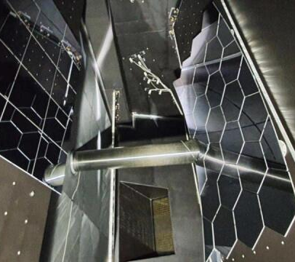
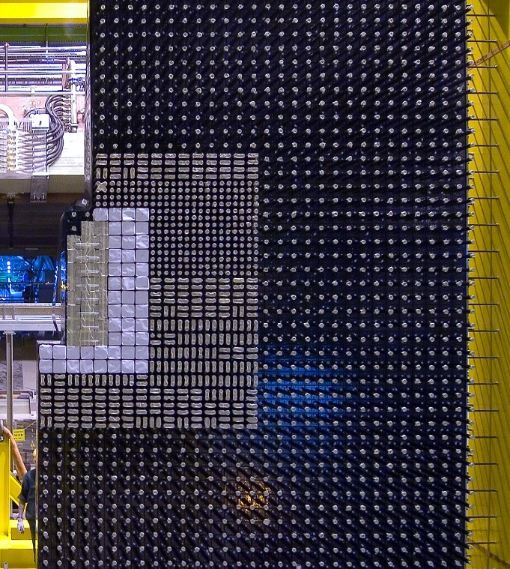
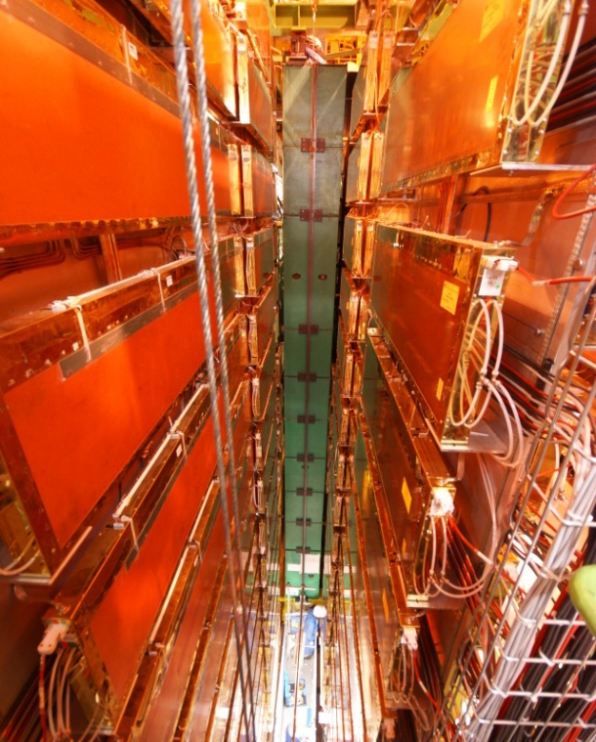
Instrumentation for PID in the HL-LHC LHCb
E. Picatoste
TIDPAN 2026
Taller de instrumentación y Detectores en Física de Partículas, Astropartículas y Nuclear
ICCUB – Universitat de Barcelona
16/06/2026
Notes:
on behalf of the PRESSEC design group

Slide 2
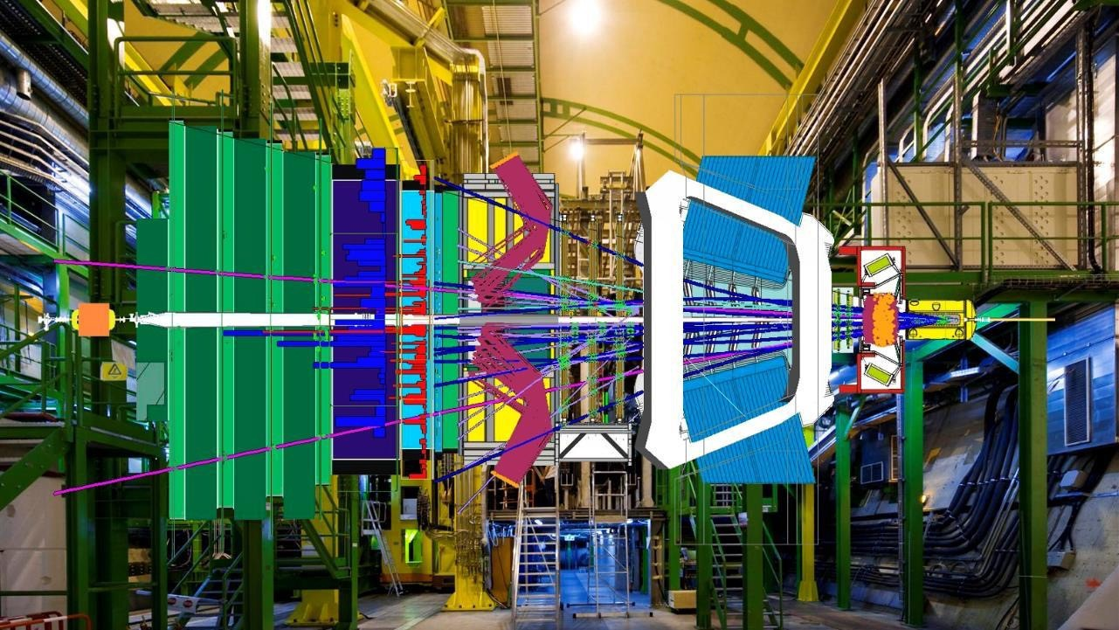
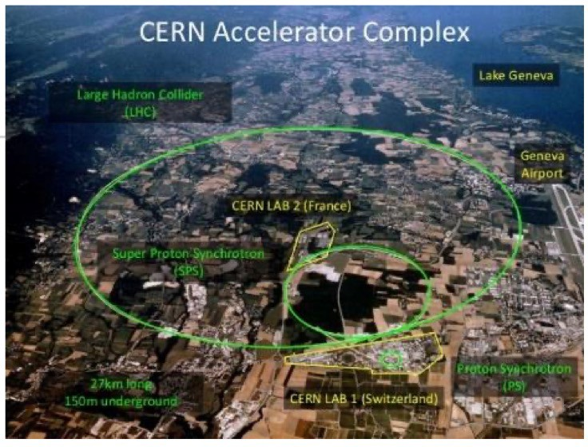

LHCb: a forward spectrometer @ LHC
JINST 3 (2008) S08005
250/300 mrad
Int. J. Mod. Phys. A 30, 1530022
TT→UT
after U1
LHCb
Velo
10 mrad
beam
CALOs
Muon
pp collisions
Magnet
Trackers
Main physics goal
To study 𝑏 & 𝑐 sectors on CPV, rare decays, new physics...
Detector before 2019
RICHs
Notes:
2
2
CTAO the objective is to extracting in real-time the single photon signature out of a continuous waveform.
Despite a reduction of the angular pixel size with respect to PMTs, SiPM pixels are still large compared to standard and must be divided into several channels.
It requires an active summation scheme to process the readout channels and generate a single output.
DR at 250 pe and SNR of about 5 is not going to be posible in this technology, we should study an strategy to cover this range:
Allow saturation and correct in postprocessing
Use dual gain system
A Dynamic dual gain system seems difficult due to the rate is large and pulses too short.
An output buffer capable of driving cables seams hard to be achieved with a reasonable power consumption while keeping a good linearity and SNR.
Implement a capacitive driver and use an external amplifier (PACTA or similar) to drive a cable. First ASIC to test the summation performance with the sensor
Plan to develop the second ASIC with an ADC or an analog memory and thus the driver capable of attaking a cable is not needed anymore.

Slide 3




The Ring Imaging Cherenkov detectors
Excellent PID for charge hadrons by using the Cherenkov effect
RICH 1: 1 to 60 GeV using C₄F₁₀
RICH 2: 15 to 100 GeV using CF₄
RICH 1
RICH 2
Photon Detectors
Magnetic Shield
250 mrad
Quartz
Window
Aerogel
Spherical Mirror
Beam pipe
^{C}4^{F}10
VELO
exit window
Track
Carbon Fibre Exit Window
Plane Mirror
0
100
200
z (cm)
[Int. J. Mod. Phys. A 30 (2015) 15300223]

Slide 4
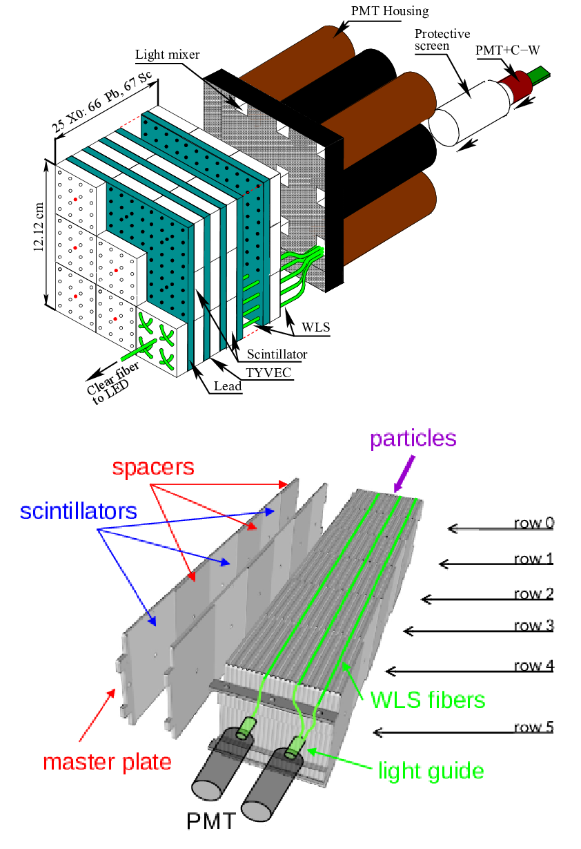
The Calorimeters
Sampling calorimeters with scintillator tiles alternated to Pb/Fe spacers
Measurement of energies and position of the e.m. and hadronic showers
PID for photons, electrons and hadrons (neutral and charged)
[LHCb-DP-2020-001]

Slide 5
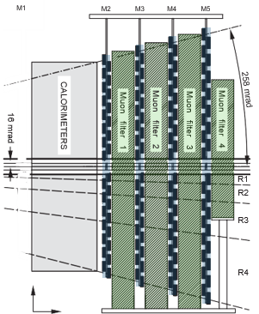
The Muon System
Four stations with Multi-Wire Proportional Chambers (MWPC) interleaved by thick iron ”filters”
Hits around the track extrapolation provide performant muon ID criteria (IsMuon)
[JINST 3 (2008) S08005]

Slide 6
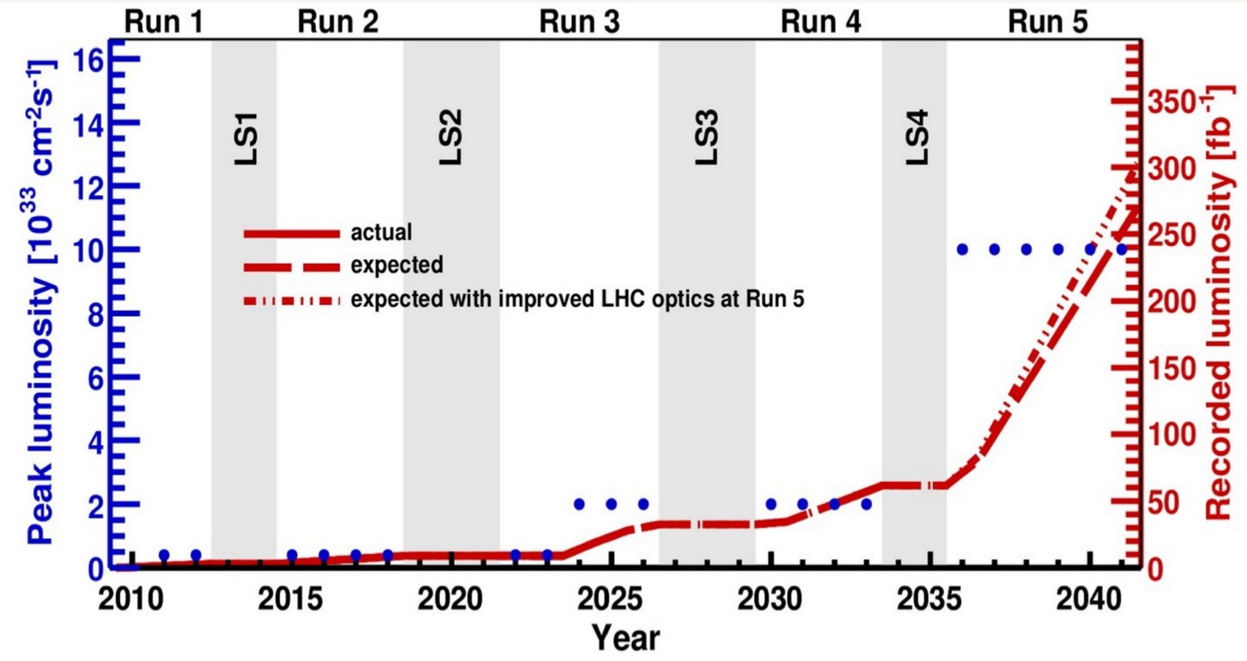
LHCb Upgrades
Upgrade I (U1), started in LS2
ℒ_{max}~ 2x10³³ cm⁻²s⁻¹
ℒ_{int}~ 50 fb⁻¹
Upgrade II (U2), starts in LS4
ℒ_{max}~ 1x10³⁴ cm⁻²s⁻¹
ℒ_{int}~ 250 - 300 fb⁻¹
Upgrade I
Upgrade II
Run3&4
Some smaller detector consolidation and enhancements in LS3 (2026)
x5 ℒ
x5 ^{ℒ}Run1&2
LHCC-2021-021
Major upgrade of ATLAS/CMS LHCb also plan enhancements
Notes:
6
6
CTAO the objective is to extracting in real-time the single photon signature out of a continuous waveform.
Despite a reduction of the angular pixel size with respect to PMTs, SiPM pixels are still large compared to standard and must be divided into several channels.
It requires an active summation scheme to process the readout channels and generate a single output.
DR at 250 pe and SNR of about 5 is not going to be posible in this technology, we should study an strategy to cover this range:
Allow saturation and correct in postprocessing
Use dual gain system
A Dynamic dual gain system seems difficult due to the rate is large and pulses too short.
An output buffer capable of driving cables seams hard to be achieved with a reasonable power consumption while keeping a good linearity and SNR.
Implement a capacitive driver and use an external amplifier (PACTA or similar) to drive a cable. First ASIC to test the summation performance with the sensor
Plan to develop the second ASIC with an ADC or an analog memory and thus the driver capable of attaking a cable is not needed anymore.

Slide 7
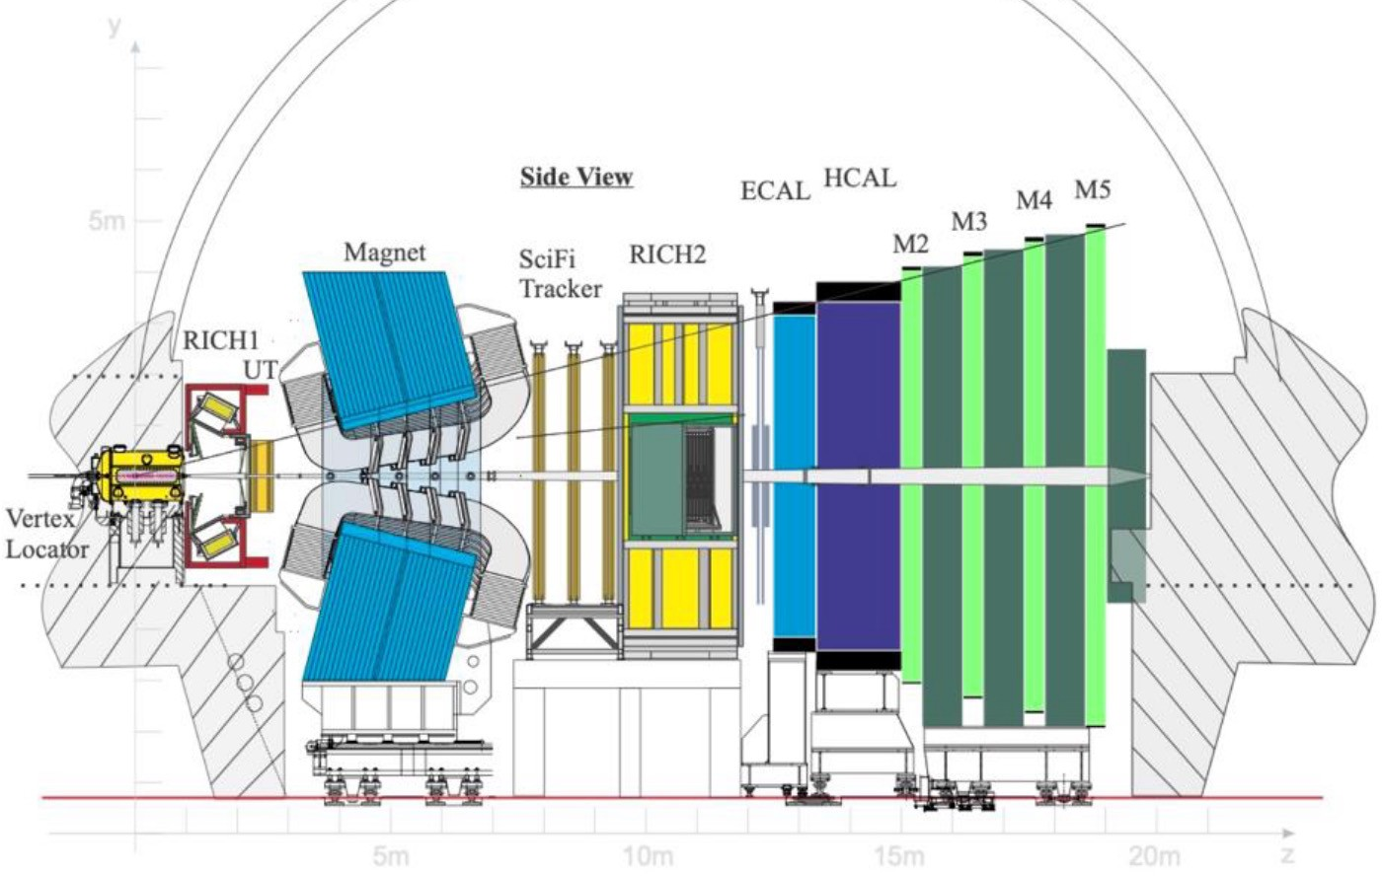
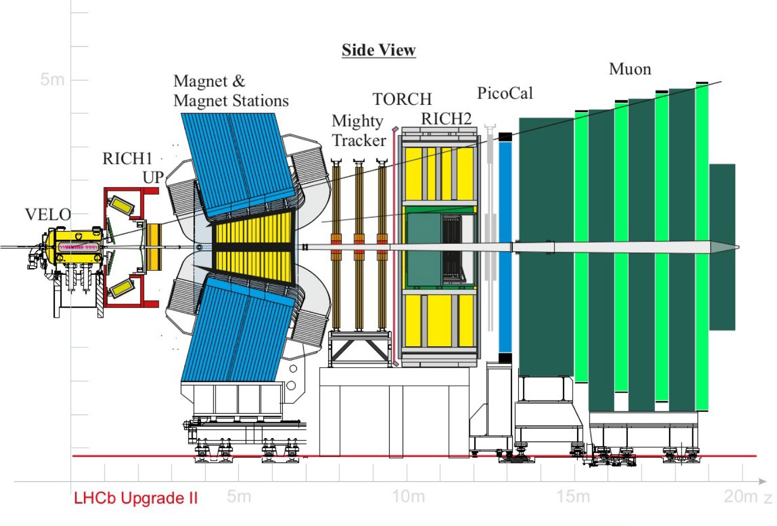
LHCb in Upgrade II
Same performances as Run 3, with a pile-up of 40 instead of 5
[JINST19 (2024) P05065]
Run 3
Run 5
Same geometry for the detector with innovative technologies for sub-detectors and data processing
Main elements:
  Increase granularity
  Add timing measurement (resolutions up to 10-50 ps, in VELO, RICH, ECAL)
  Radiation hardness (up to 10¹⁶ neq/cm²)
  Data rate: 200 Tbit/s

Slide 8
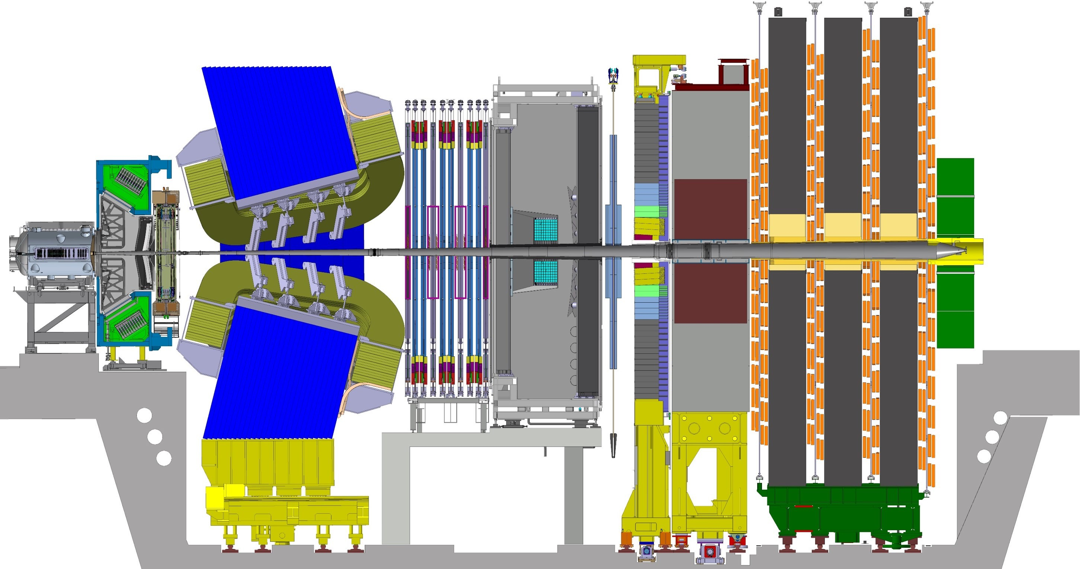



LHCb PID system in Upgrade II
RICH 1, RICH2:
Reduced pixel size
Add timing information
SiPM, MCP, LAPPD
Muon:
New MPGD (inner)
Keep MWPC (outer)
PicoCal (ECAL)
Timing, longitudinal segmentation
SPACAL with radiation hard crystals
Shashlik technology for outer region

Slide 9
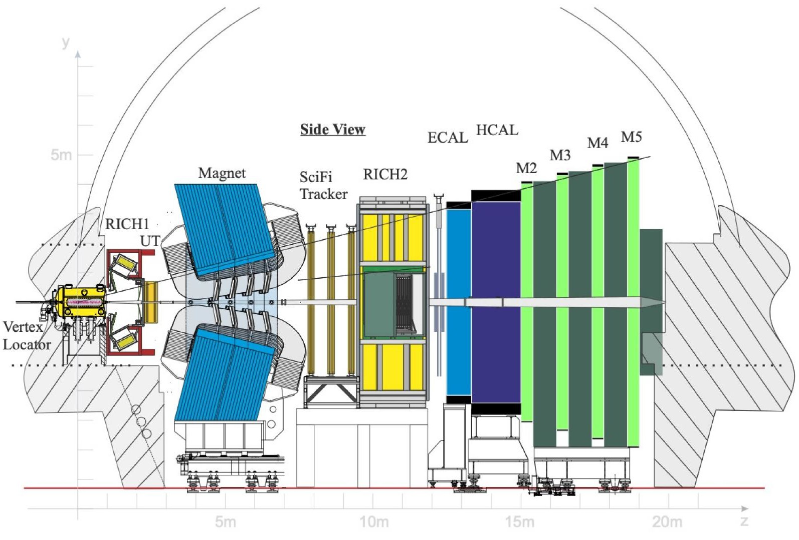
The RICH System

Slide 10
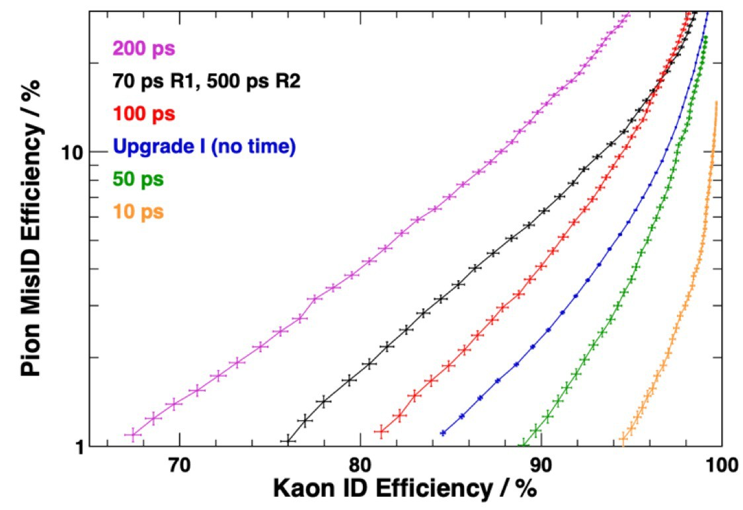
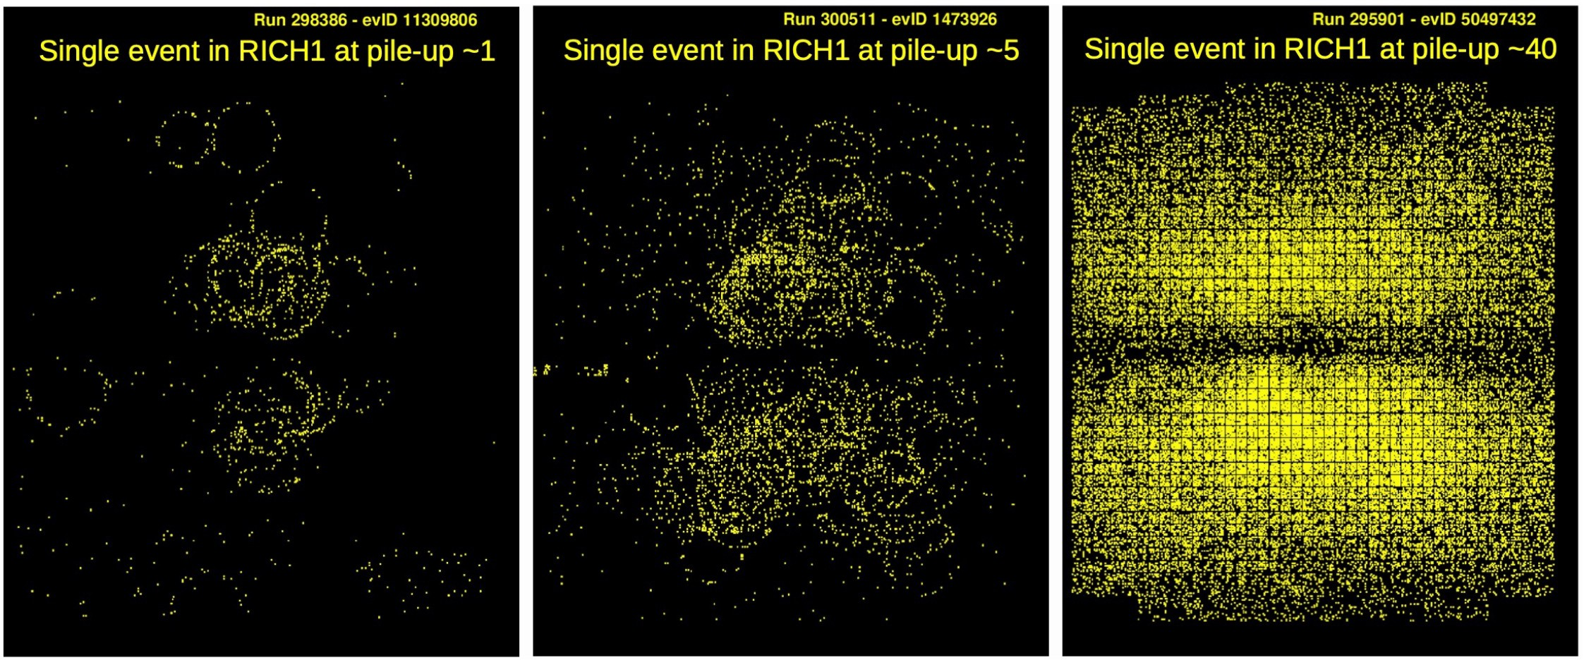
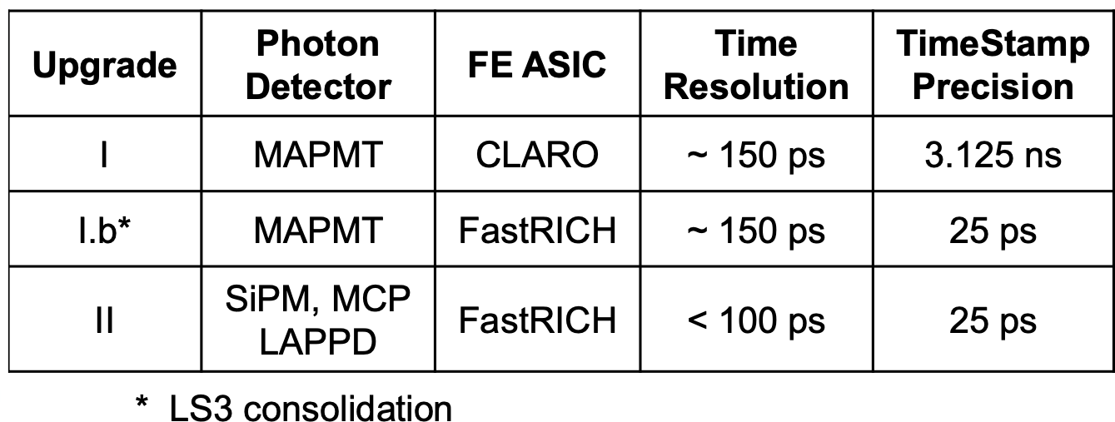
RICH detectors with better timing
High-Lumi RICH occupancy increase by an order of magnitude
RICH 1&2 will maintain same geometry, reduce pixel size
Photon detector options: SiPM, MCP, LAPPD. MAPMT may be backup for low occupancy area
100ps required resolution to maintain Run 3 PID performance
LS3 Enhancements for Run 4: Readout upgrade (FastRICH) with same detector technology
Upgrade II for Run 5: New detector technology compatible with FastRICH readout
LHCC-2021-012
arXiv:2511.03857
* LS3 enhancement

Slide 11
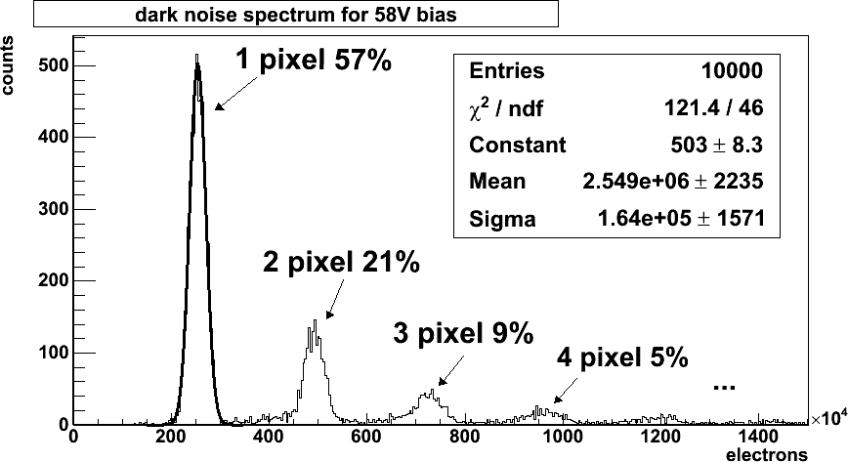
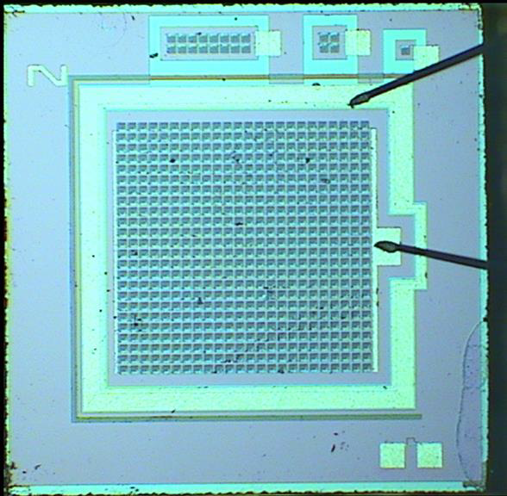
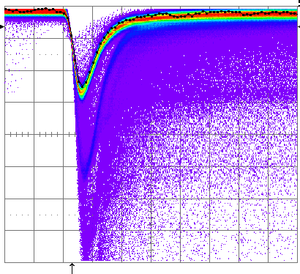
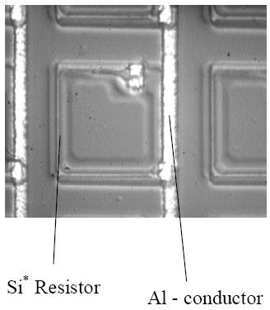
SiPM sensors
A SiPM is a matrix of Geiger-mode APD pixels connected in parallel
The gain is in the range of 10⁵ to 10⁷
  Single photoelectrons produce a signal of several mV on a 50 Ω load
  An amplifier is needed
Dark count rates of 100 kHz to 10 MHz/mm2 @25°C
  Increased by defect states due to production
  Strong function of overbias voltage (trigger probability)

Slide 12
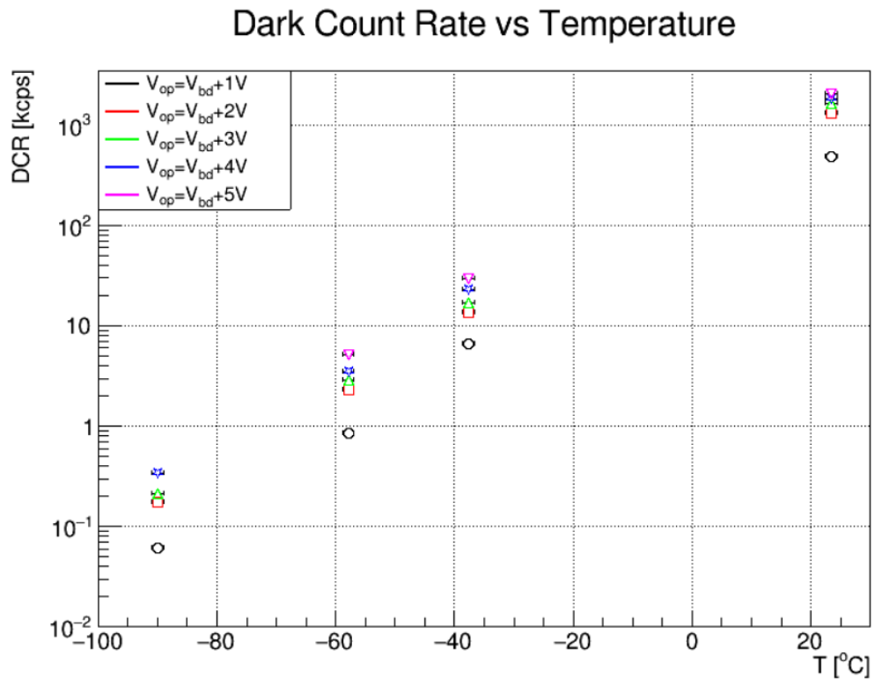
SiPM Advantages and DCR Mitigation
Advantages of SiPMs:
  Smaller pixel size than current MaPMTs
  (3mm × 3mm)
  Very good time resolution
  Higher photon detection efficiency
High Dark Count Rate (DCR) mitigation strategies:
  Cooling: can reduce DCR, which is temperature dependent
  Annealing: heating the SiPMs can partially recover radiation-induced damage in the silicon lattice and thus reduce the DCR
  Measurement of photon arrival time: the introduction of time bins, in addition to the spatial pixel bins, contributes significantly to suppressing the DCR contribution.

Slide 13
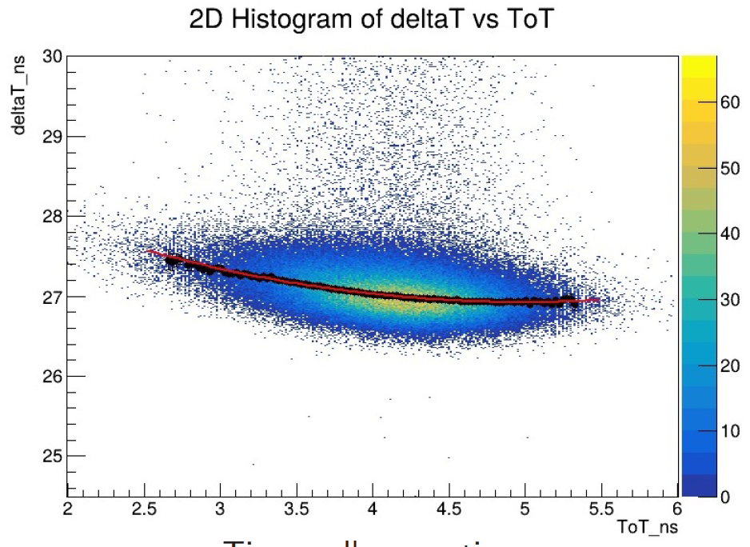
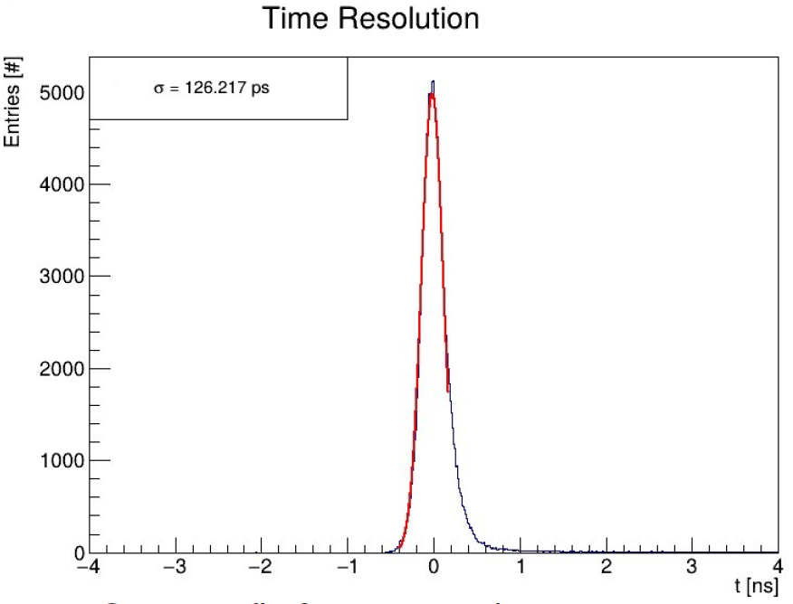
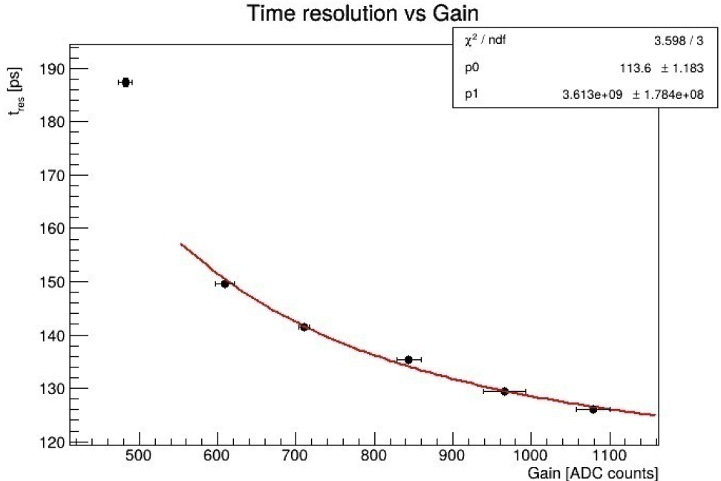
SiPM Time Resolution
SiPM characterization: the device is illuminated with a pulsed laser in a light-tight environment.
Two quantities are recorded:
  The Time of Arrival (ToA) of the SiPM signal, relative to the laser trigger.
  The Time over Threshold (ToT) of the SiPM, with respect to the threshold of the measurement instrument.
A time walk correction is applied to the 2D ToA vs ToT plot
The peak in the ToA projection is fitted with a Gaussian
[PD 2025 poster]
Time walk correction
Gaussian fit for time resolution estimation

Slide 14


RICH Upgrade II Electronics Chain
Sensor MAPMT |  | FE ASIC CLARO |  | FPGA Kintex 7 | NDC | Optical link GBT Versatile Link
NDC
Back-end
PCIe40
LHC Run 3
Sensor MAPMT |  | FastRICH | DC | Optical link lpGBT / VL+
DC
Back-end
PCIe40 / PCIe40++
LHC Run 4
2029-2032
Sensor SiPM / MAPMT / MCP |  | FastRICH | DC | Optical link lpGBT / VL+
DC
Back-end
PCIe40++
HL-LHC Run 5
> 2035
New FastRICH ASIC by CERN-EP-ESE and the University of Barcelona with strong input from the RICH group.
The ASIC is tailored for high flexibility and compatible with MAPMTs (LS3 enhancements) and Upgrade II photon sensors.
Time resolution: TDC with ~ 25 ps time bins.
Power consumption: ~ 8 mW per channel in 16-channel ASIC.
Radiation hardness for ~ 10¹³ n_{eq}/cm² and ~ 5 kGy
Readout rate: 40 MHz

Slide 15
RICH Upgrade II: FastRICH ASIC
FastRICH Die
16 Channels, triggerless readout, with Time of Arrival (ToA) acquisition via Leading Edge (LED) or Constant Fraction (CFD) discriminators, configurable hardware shutter, 40MHz readout
ToA: 24.41ps (gate) or 97.64ps (no gate) bins, ToT: 390.625ps bins
Sensor Coupling: MaPMT, SiPM and MCP
Data encoding: AURORA 64b/66b
Radiation hard design: triple modular redundancy (TMR) for configuration and enclosed layout transistors (ELT) for analogue blocks.

Slide 16





















RICH Upgrade II: FastRICH architecture
Input network with high dynamic range: 50 µA to few mA for MAPMT, SiPM or MCP coupling.
Test pulse DAC for testing purposes.
Positive or negative polarity signal processing.
Novel Constant-Fraction Discrimination (CFD) to reduce throughput (no ToT information).
Optional leading-edge path without recovery time (~15 ns for CFD).
Logic blocks can be switched on/off for optimal power consumption.
INPUT NETWORK (R. BALLABRIGA)
POSITIVE POLARITY FRONT-END (COMPLEMENTARY) (R. MANERA) THRESHOLD
OUTPUT STAGE [0:1]
SIGNAL DC BRANCH BRANCH
THRESHOLD
^{I}BIAS
CFD PATH
DIFFERENTIAL TO SINGLE ENDED
AND
- +
CFD FILTER
- +
- +
- +
- +
+
+ -
+ -
+ -
+ -
+ -
-
R₂
LEADING EDGE PATH
DIFFERENTIAL TO SINGLE ENDED
PULSE STRETCHER
HYST
C_{ADJ}[2:0]
- +
+ -
- +
+ -
- +
+ -
- +
+ -
- +
+ -
+
-
INPUT PAD
R₁
NEGATIVE POLARITY FRONT-END (R. BALLABRIGA)
THRESHOLD
CFD PATH
DIFFERENTIAL TO SINGLE ENDED
AND
C_{TEST}=320fF
OUTPUT STAGE [0:1]
^{V}TEST1
R
SIGNAL BRANCH
DC BRANCH
- +
CFD FILTER
- +
- +
- +
- +
+
V
0
3
+ -
+ -
+ -
+ -
+ -
-
TEST2
1
TEST PULSE
THRESHOLD
LEADING EDGE PATH
DIFFERENTIAL TO SINGLE ENDED
PULSE STRETCHER
DIGITAL TO ANALOG CONVERTER
^{I}BIAS
HYST
- +
- +
- +
- +
- +
+
+ -
+ -
+ -
+ -
+ -
-

Slide 17
RICH Upgrade II: FastRICH ASIC time meaqsurement
Front-end configurable between Constant-Fraction Discrimination (CFD) or Leading-Edge Discrimination (LED) with 390 ps LSB Time-over-Threshold (ToT) measurement.
Simulated residual time walk of the CFD
  with a worst-case residual of ~ 80 ps
  For SiPMs, the (residual) time walk is expected to be negligible.
Example of two different signal traces
CFD – ToA (1)
CFD – ToA (2)
LED
Threshold
Signal traces
(1) and (2)
LED ToA (1)
LED ToA (2)
CFD corrects Time of Arrival (ToA) timewalk

Slide 18
The Electronic Calorimeter (PicoCal)

Slide 19
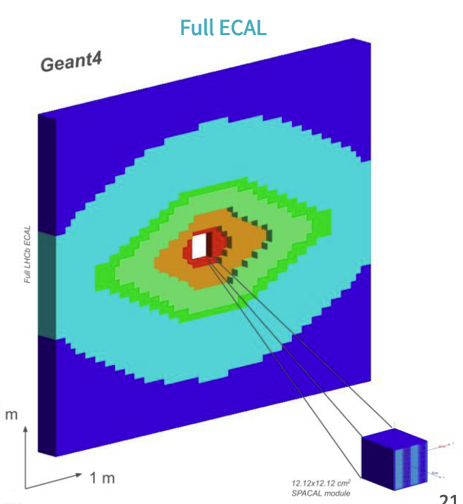
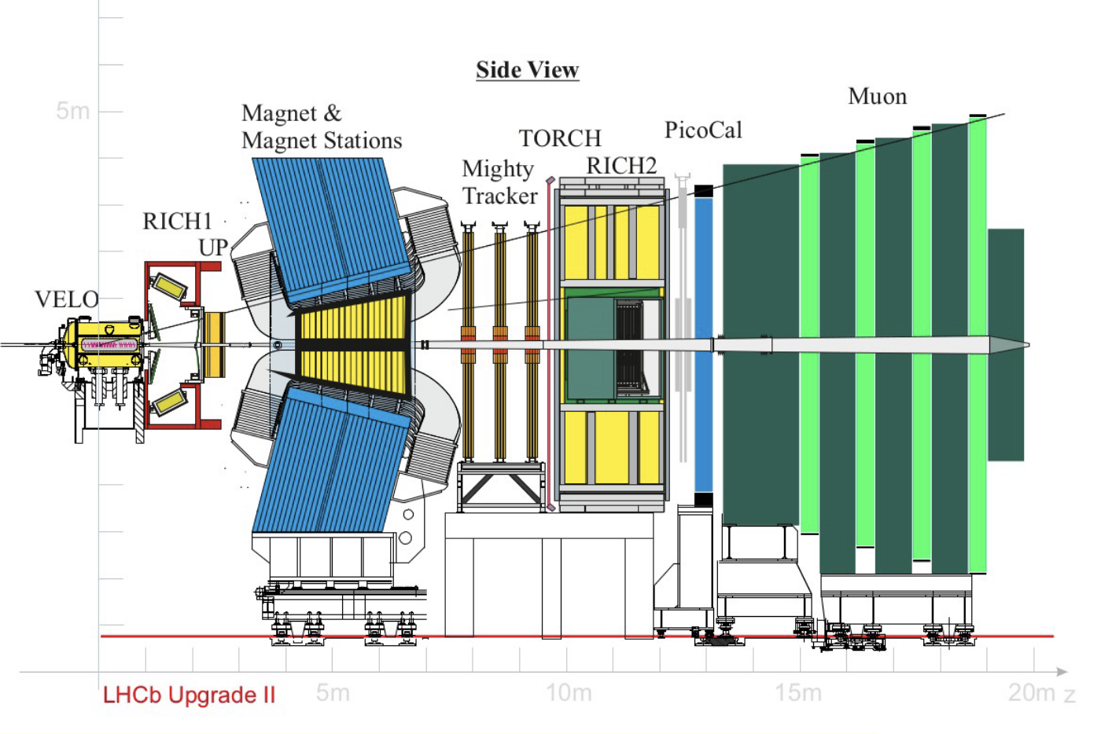
The Calorimeter System in Upgrade II (PicoCal)
Ongoing R&D to produce modules that allow
  Precise time measurement
  Energy resolution of σ(E) / E ≈ 10% / √E ⊕ 1%
Reorganize the ECAL zones in rhombic shapes to follow better radiation and cell occupancies
  Increased granularity in the central region with denser absorber
Add longitudinal segmentation at shower maximum to improve time resolution
  Useful also for particle identification: separation electron/hadron

Slide 20
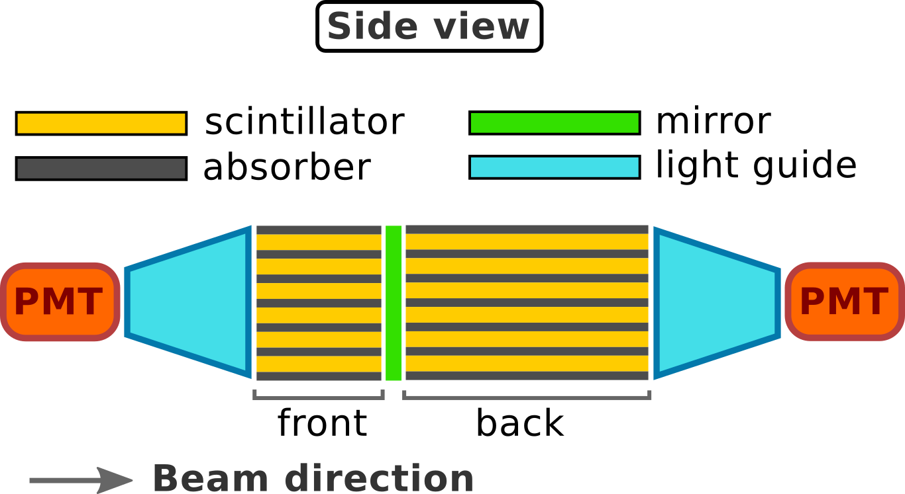
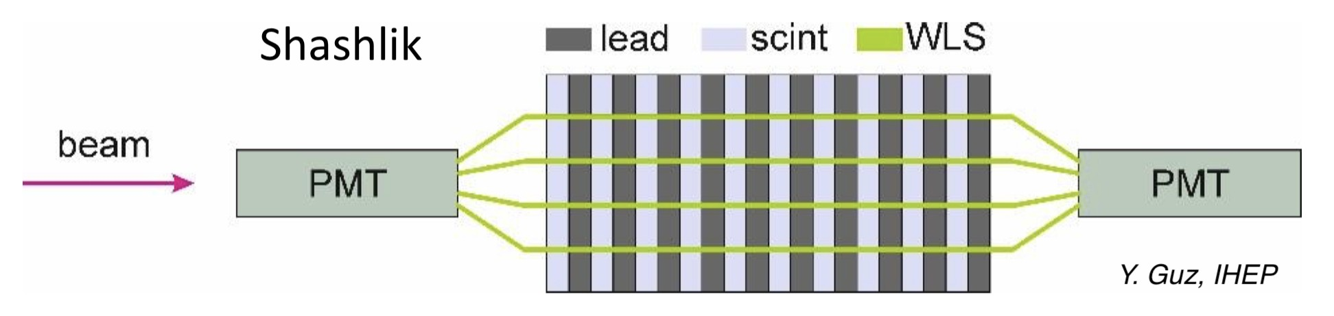
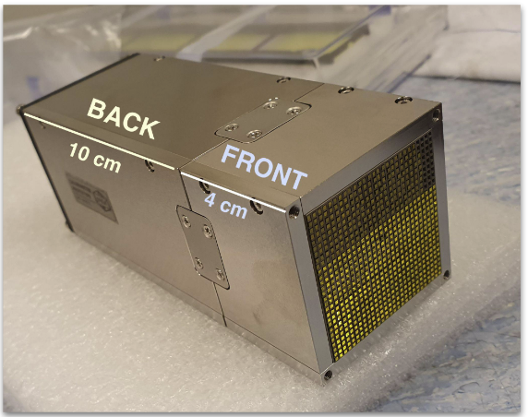
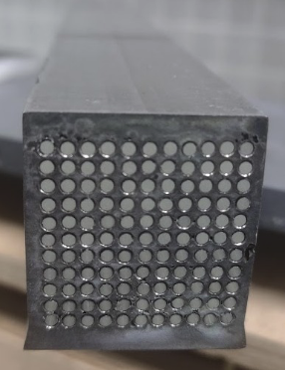
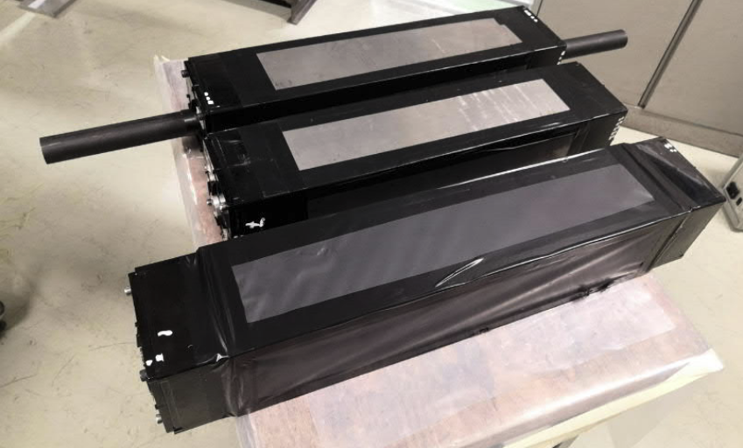
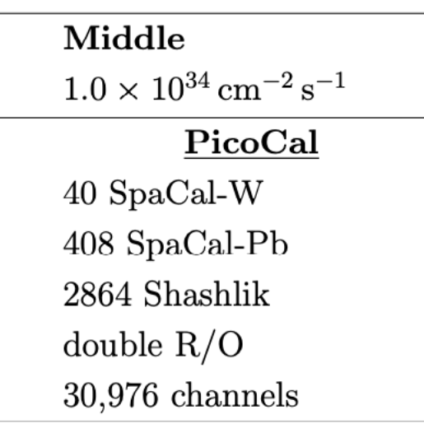
Electronic Calorimeter: SpaCal Technology
SPACAL
SHASHLIK
SPACAL-W
W absorber, crystal fibers (GAGG, gadolinium aluminum gallium garnet)
Large tolerance to radiations and small Molière radius
Cell size 1.5x1.5 cm²
SPACAL-Pb
Pb absorber, polystyrene fibres
Cell sizes
  3x3 cm²
  4x4 cm²
SHASHLIK
Pb absorber, scintillator, YS4 fibres
Current modules: outer region
Cell sizes
  4x4 cm²
  6x6 cm²
  12x12 cm²

Slide 21
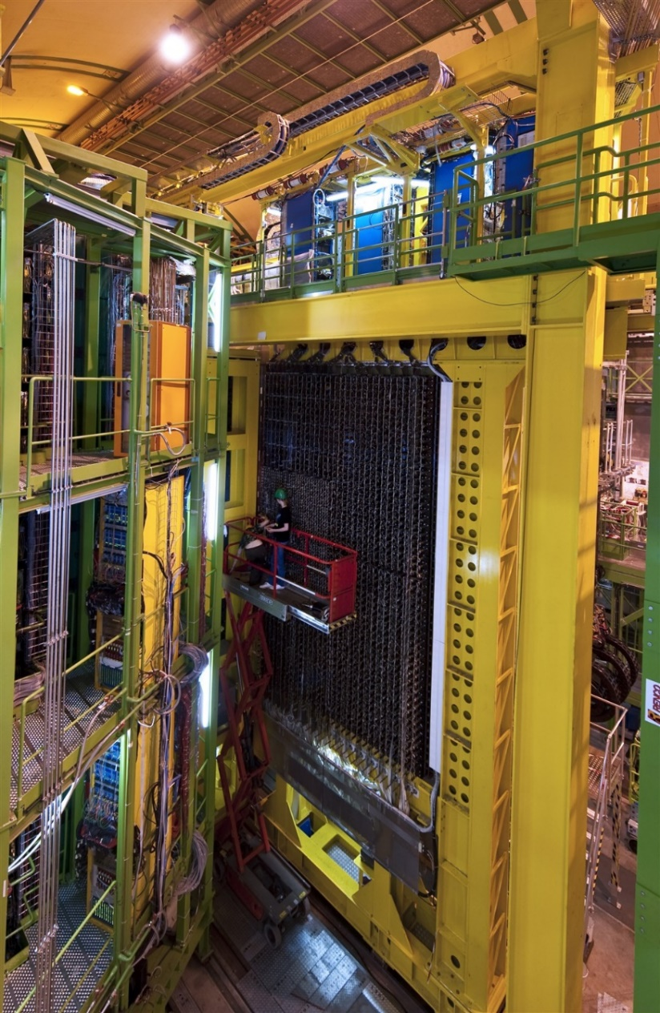
PicoCal readout architecture
Front-End ASIC
Energy
ASIC
ADC
Digital
Back-End
Detector cells
Optical Link
FPGA
GBT
50Ω
I
FRONT-END
CRATES
12-20m cable
PMT
PAC
(COTS)
Time
ASIC
Front End Board
ECAL
Photodetectors readout solution follows the same scheme as in current ECAL:
  PMT sensors near modules
Signal conditioner circuit (COTS) to compensate cable attenuation, improve SNR, and reduce spill-over effort designed by IFIC
ASIC/chipset in TSMC 65 nm with separate energy and timing paths.
  Energy ASIC (ICECAL65) designed by UB, UPC and IFIC.
  Timing ASIC (SPIDER) designed by IJCLab, LPC and IP2I and SUBATECH.

Slide 22
Photomultiplier Tubes
A Photomultiplier Tube (PMT) light into a measurable electrical signal.
  Gain <10⁸
Main Applications: Particle Physics, Medical Imaging (PET), Spectroscopy and Radiation Security.

Slide 23
PMT: magnetic field effects
Dependence of the relative output pulse amplitude of the PMT HAMAMATSU R7899-20
The PMTs operate in proximity to the LHCb's powerful dipole magnet
Strong magnetic fields → degrade PMT electron collection efficiency and gain
Use of shielding
  Steel screen
  Permalloy
No shielding
Shielding
Steel + permalloy
OZ
Permalloy
OY
OX
steel
[Paper]

Slide 24
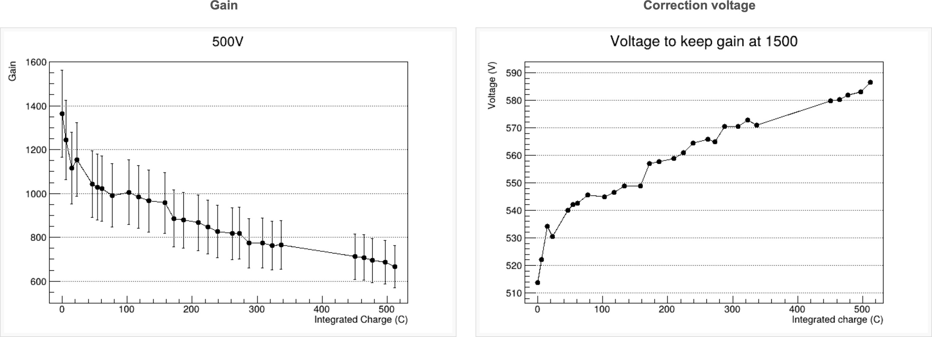
PMT ageing
Extended operation and accumulated anode charge → decrease in gain and quantum efficiency
  Gain Fatigue: The amplification factor of the dynode chain drops over time
  Photocathode Degradation
  Anode Charge: ageing is directly tied to the total integrated charge
How we can cope with it
  Pre-ageing or burn-in
  Increase HV
  Partially recovered
  after stop time

Slide 25
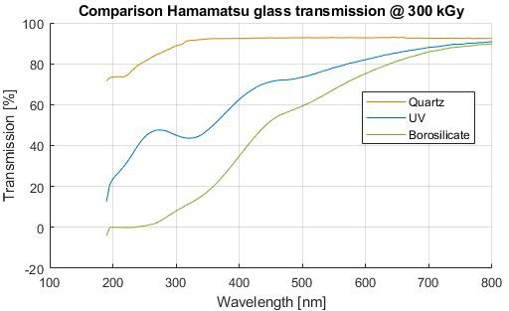
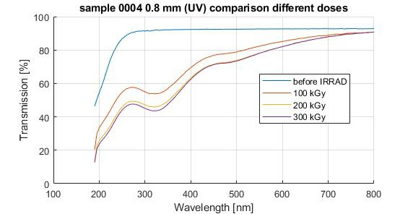
PMT radiation effects
Irradiated PMTs present problems with the entrance window transparency
Proposed PMTs for PicoCal could use quartz, UV or borosilicate windows
Quartz transparency degrades the least, but it is more expensive
Borosilicate

Slide 26
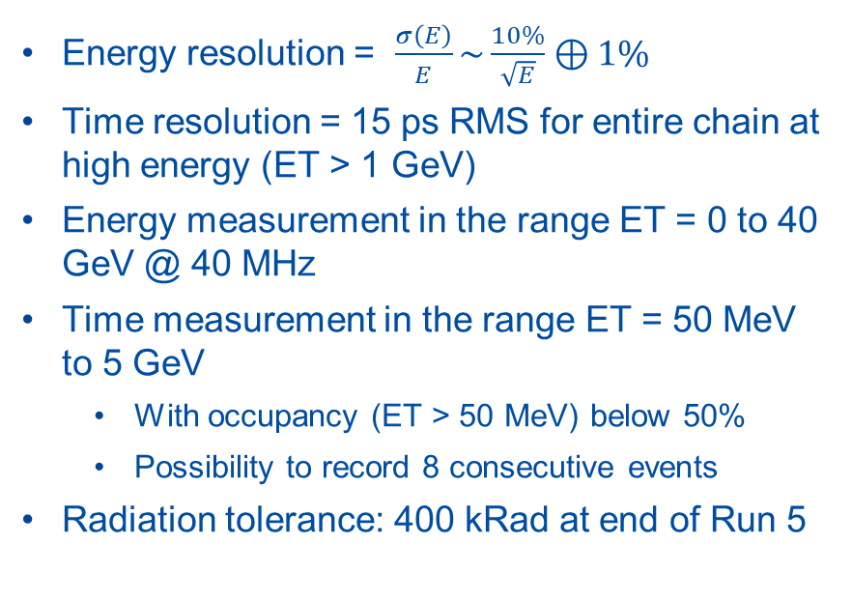
PicoCal Electronics Requirements
Normalized PMT pulse shapes for SpaCal and Shashlik channels
Energy resolution = $\frac{σ\left(E\right)}{E}\sim \frac{10\%}{\sqrt{E}}⊕1\%$
Time resolution = 15 ps RMS for entire chain at high energy (ET > 1 GeV)
Energy measurement in the range ET = 0 to 40 GeV @ 40 MHz
Time measurement in the range ET = 50 MeV to 5 GeV
  With occupancy (ET > 50 MeV) below 50%
  Possibility to record 8 consecutive events
Radiation tolerance: 400 kRad at end of Run 5

Slide 27
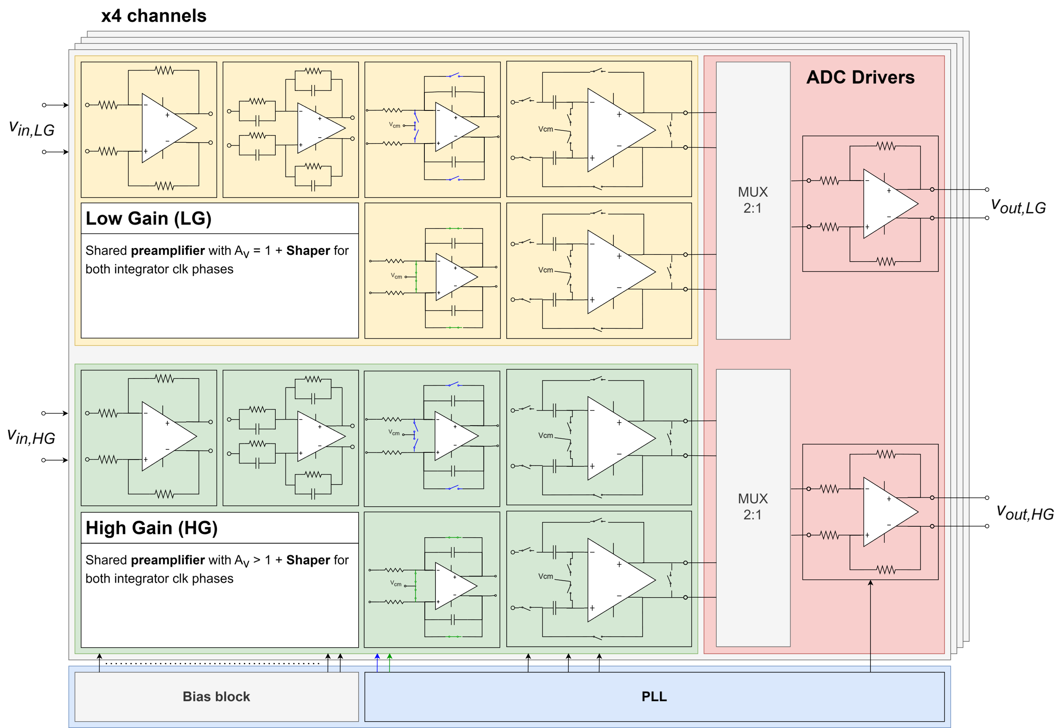
PicoCal Energy Measurement ASIC: ICECAL65
TSMC 65nm 4- or 8-channel ASIC
Dynamic range 1 V
  Noise/1LSB at ~ 500 μV
  Two-gain system and 11-bit resolution for optimal SNR
Continuous readout at 40 MHz
  No deadtime
  Time-interleaved double channel scheme for integrator recovery
  Fully differential to improve noise rejection.
  Clocks individually generated per channel using a PLL.
Power consumption < 50 mW/channel.
Measure digitized with an external ADC. On-chip ADC is under development for the second run.

Slide 28
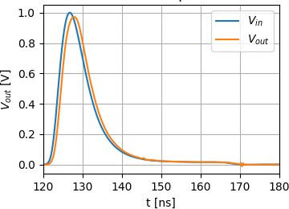
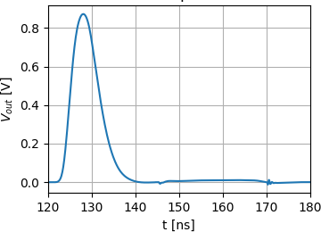
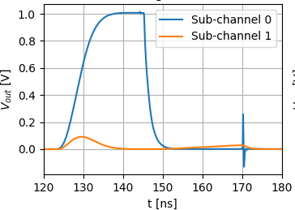
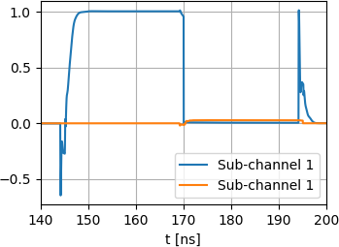
PicoCal Energy Measurement ASIC: ICECAL65
Analog channel stages based in a fully differential operational amplifier
4 channels
External ADCs
Channel independent syncronization
MUX
Select correct sub-channel
Debug mode
ADC Driver
ADC driver needed to cope with the I/C parasitics and the ADC input capacitance
Pre-Amp
Shaper
Integrator
T&H
HG and LG adjustment
Two-gain system for 11+1 bits precision.
Integration error < 1 %
Reshape input signal within 25ns window
Adjustable RC to cope with channel technology and PVT variations
Continuous readout with no deadtime.
Tunable C for gain adjustment.
Bottom-sampling technique.
Transient noise < 500 µV.
Linearity error < 1% for input signals up to 1V
25 ns

Slide 29
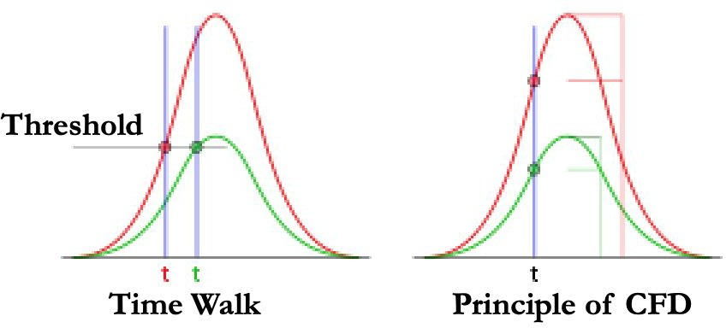
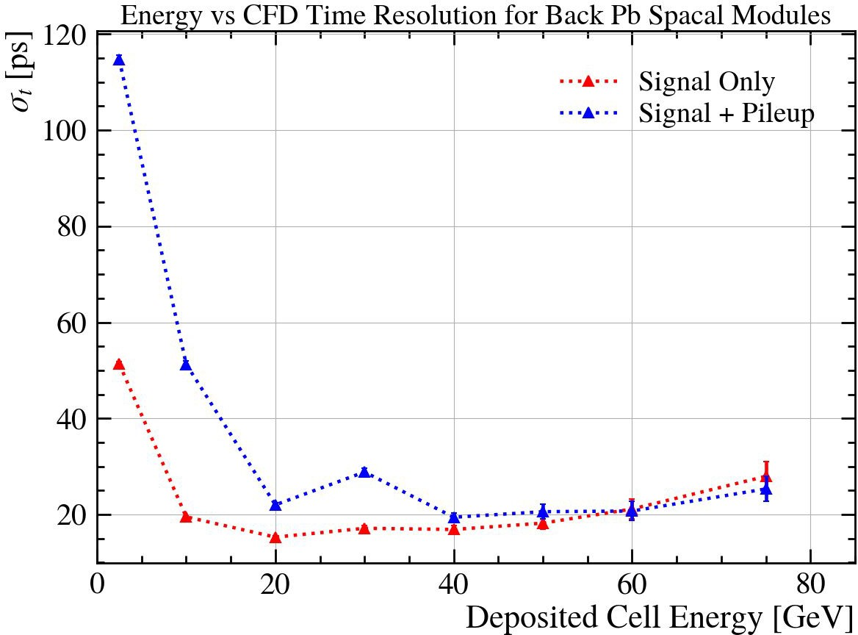
PicoCal Time Measurement ASIC: Timestamping
Timestamping is a regularized determination of the time of arrival of a pulse with respect to a standard time reference
Primary goal is to determine the timestamp of signals with tens of picoseconds of resolution
Several methods exist for timestamping analog signals
  Fixed threshold, ﬁtting, template matching, optimal ﬁltering, analog/digital constant fraction discrimination (CFD), machine learning
Jitter is the time variation of an individual measurement from the expected value
Timewalk is the dependence of the timestamp on the amplitude of a pulse
  Can be corrected

Slide 30
















PicoCal Time Measurement ASIC: SPIDER architecture
TSMC 65nm, VDD 1.2V
8 self-triggering channels
Clock distribution & DLLs
Memory cell
Multi-bank system
  Derandomization buffer
  8 banks of 32 cells, sequencing logic
10-bit Wilkinson ADC @5 GHz
  Fast counter to limit conversion time (max 200 ns for 10 bits i-e 8 LHC periods, for 800 mV signals)
PLL and DAC + buffer for calibrations
Serial readout interface
  Digital buffers
  Up to 2.56 Gb/s on each channel
SPIDER v1
ASIC for timing measurement
Upgrade Phase 2 Ecal LHCb
DLL bin=200ps
PFD & CP
Clock
1
^{V}cp
Bunch Crossing Counter
<0>
<1>
Clock
10-bit Gray Counter
@ 40MHz
<0> <1> <2> <3>
<124> <125> <126 <127>
Phase Pulse Builder
S1
^{S0} S1
X 8
10
reg_out0_phase_select<6:0> reg_out7_phase_select<6:0>
Slow Control
Config_data_bus
^{ϕ}sampling
S0
ϕ
window
DLL2out
DLL₂
Adjustable <31>
PFD & CP
One channel
Frequency
^{V}cp
PLL
Clock @ 640MHz
<0>
<1>
<30>
<31>
@ 1.28GHz
Clock @ 640MHz
wr<0>
dll<0> dll<1>
Bank Mux
dll<30>
dll<31>
hit
Writing & ADC
Controller
Calibration generator
wr<1>
wr<15>
Ramp generator
start
bk_toRead<7:0>
bank_clear<7:0>
+
Reading
serial_data
-
trig
output
V_{in}<7:0>
Controller
ch0
32-cell
bank
- +
- +
- +
Ck D
Q
threshold
Internal 10-bit DAC
ch7
Ck D
Q
Ck
D
Ck
D
10
10 -bit Gray Counter
Ring oscillator
@5GHz
10
10
Q
10
Q
10
10
bx_cpt<9:0> data_conv<9:0>
10
X 8 banks
10
Reading Decoder
readout_select<8:0>
X 8 channels

Slide 31
PicoCal Time Measurement ASIC: Waveform Sampling
Swift Pipelined Digitizer for Electromagnetic Readout (SPIDER)
  8-channel* sampler-digitizer ASIC for synchronous signals in high-rate conditions
Analog signal sampling in a conﬁgurable time window, adjustable by 200ps steps
  Sampling period adjustable from 50ps to 600ps
Sampling region of 32 samples -readout typically restricted to 8 samples
Self-triggered digitization on 10 bits
  Voltage range 0 - 800mV
  Time resolution target: <15ps on 160 - 800mV

Slide 32
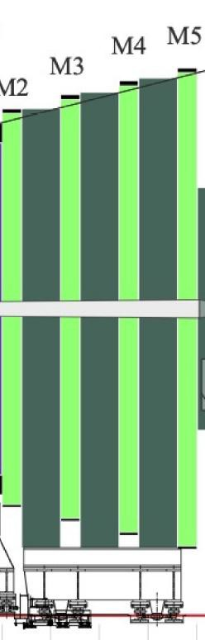
The Muon System

Slide 33
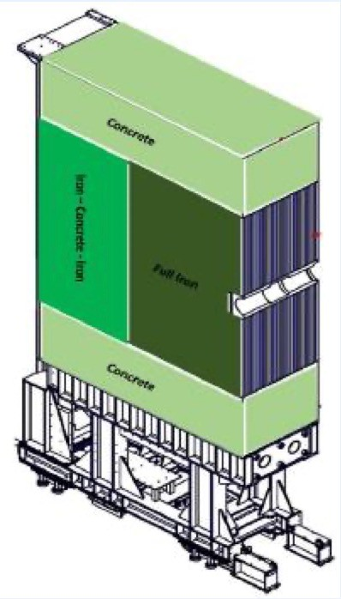
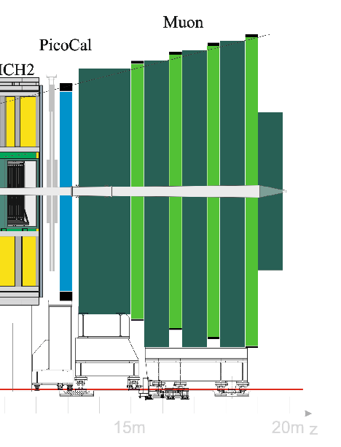
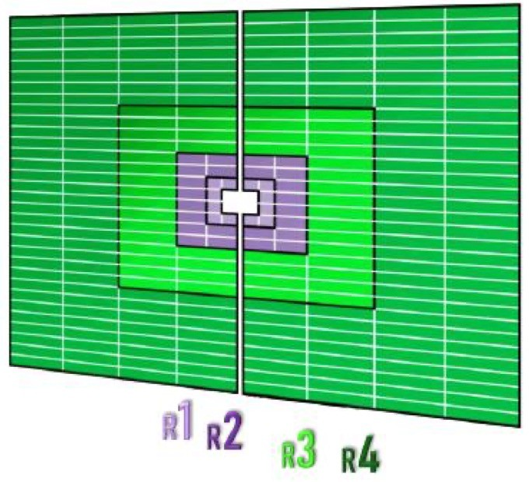


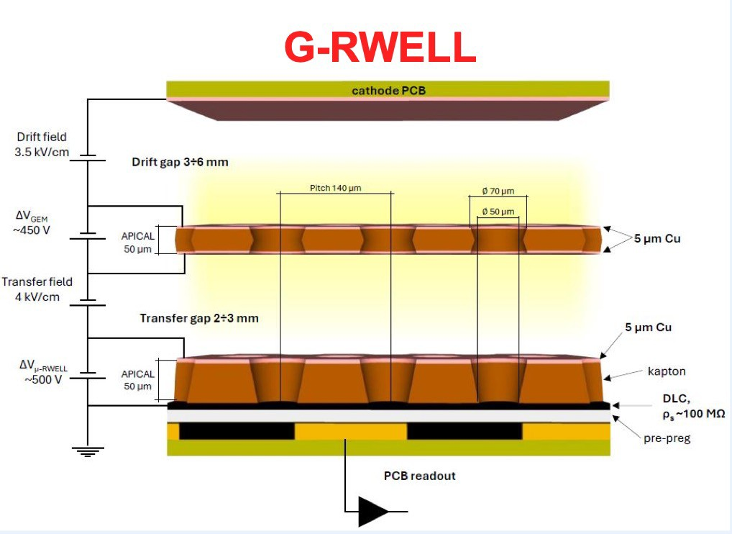
Muon Detector
HCAL replaced with Iron/concrete shield
SPD/PS/M1 already removed in Upgrade I
Shielding to protect electronics against slow neutrons
Novel G-RWELL for inner-most region (R1, R2)
Reuse existing MWPC in outer region (R3, R4)
New readout scheme in all regions, for background reduction and a new FE electronics
Additional shielding (4 λ_{I} → 10 λ_{I}) to be installed in front of Muon detector

Slide 34
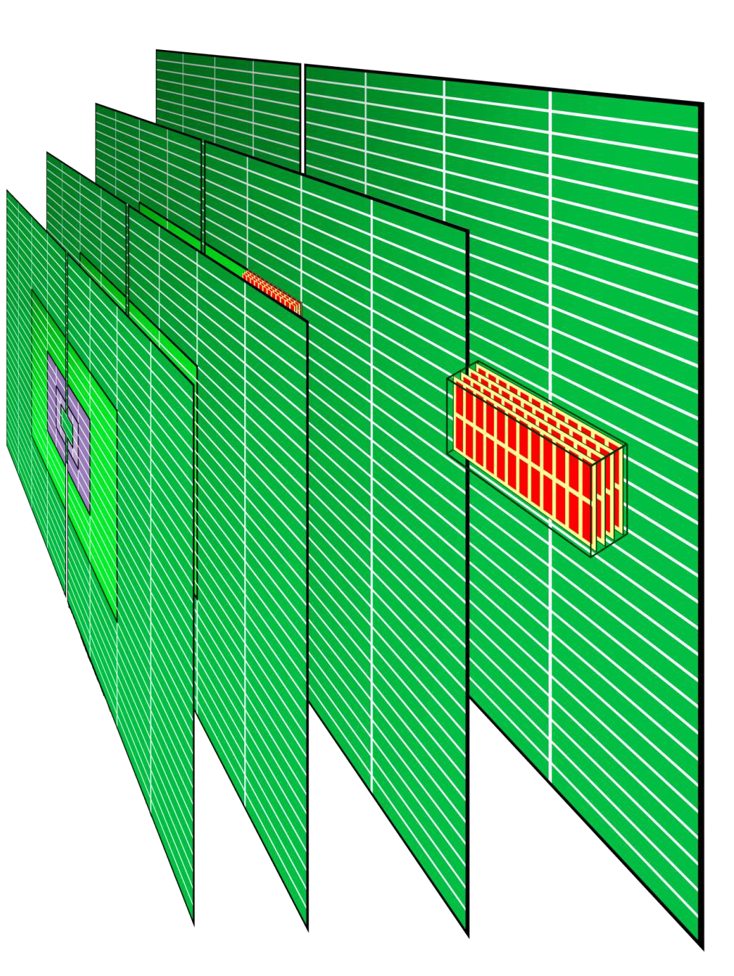

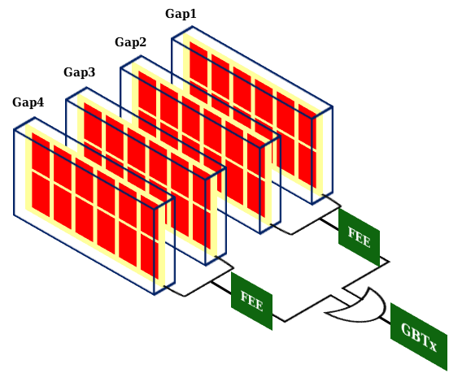













The Muon Detector
4 stations (M2-M4) of 4 gaps MWPCs, defining 4 regions (R1-R4).
Iron absorbers, 80 cm thick, between the stations.
Readout scheme of
chambers
Logical OR of bi-gap, again implemented at FEE level
For each gap, logical pads (red) from logical AND of grouped wires and cathodic pads
M1
removed
(Upgrade I)

Slide 35









Muon Identification
IsMuon, for the muons identification in Run3 at HLT1:
Open a Field of Interest (FoI) around the extrapolated track, depending on the momentum
Hit search in each FoI in each station
Check fired stations according to the track momentum:
FoI on M2
𝒑 [𝑮𝒆𝑽/𝒄] | Track is a muon (isMuon)
𝒑 < 𝟑 | false
𝟑 < 𝒑 < 𝟔 | M2 & M3
𝟔 < 𝒑 < 𝟏𝟎 | M2 & M3 & (M4 || M5)
𝒑 > 𝟏𝟎 | M2 & M3 & M4 & M5
extrapolated
track

Slide 36
The Muon Detector Upgrade II
Challenges of the present detector in the future high luminosity (rates) era:
  Efficiency loss ← FEE dead time pads granularity very low for the expected rates (~1 MHz/cm2)
  misID enhanced ← High pile-up from background limited reduction of background hits
Targeting same performance as in Runs 1 to 3
Necessary ‘‘solutions’’:
  Reduction of hit rates in the detector
  Increase pads granularity
  Background hits discrimination from signals (𝝁)
Appropriate shielding, in place of HCAL calorimeter, for background rate reduction
In R1-R2 (~1 MHz/cm² at Run 5):
  New high performance detectors with granularity and rate capability improvement
In R3-R4 (rates ≤ 50 kHz/cm²):
  Reuse of most of the present MWPCs
A new readout scheme in all regions, for background reduction and a new FE electronics
[LHCb-U2-FTDR]

Slide 37


The Muon Detector UII: Shielding
A shielding in place of the HCAL system is proposed
at Upgrade II.
Shielding effects on the background rate, according to simulation:
[LHCB-INT-2019-008]
 |  | rates reduction
 | R1 | −30%
 | R2 | −40%
M2
 | R3 | −60%
 | R4 | −40%
M3 | ~ | −10%
iron-concrete-iron-NeutronAbsorber (6.2 𝜆_{I}), acting on M2M3R4
Iron-NeutronAbsorber (10.1 𝜆_{I}), acting on M2M3R1-R3
concrete-NeutronAbsorber (4 𝜆_{I}), acting on M2M3R4
Further studies are ongoing, optimising materials choice, in order to maintain the HCAL
148+5 cm

Slide 38



The Muon Detector UII: inner regions R1-R2
𝝁RWELL technology:
MicroPattern Gas detector (MPGD) consisting of:
  cathodic plane
  Gaseous drift region
  𝜇RWELL:
    well foil (copper + kapton)
    resistive layer
  Pad readout
Ionization from drift region is amplified in wells, generating an avalanche. Discharges are suppressed by the resistive layer.
G. Bencivenni et al., The micro-Resistive WELL detector: a compact spark-protected single amplification-stage MPGD, 2015 JINST 10 P02008
cathode PCB
Drift field
3.5 kV/cm
Drift gap 3÷6 mm
∅ 70 µm
5 µm Cu
∅ 50 µm
^{∆V}µ-RWELL
~500 V
APICAL
kapton
DLC,
ρ_{s} ~100 MΩ/☐
pre-preg
50 µm
𝜇
avalanche
PCB readout

Slide 39



The Muon Detector UII: inner regions R1-R2
G-RWELL technology:
a GEM foil added in the 𝝁RWELL drift region
The G-RWELL consists of:
  Cathodic plane
  Gaseous drift region
  GEM foil
  Gaseous transfer region
  𝜇RWELL
Two amplification stages in very stable operation:
  Pre-amplification at GEM stage
  Amplification at 𝜇RWELL stage
  Gas gains significanly greater than 104.
cathode PCB
Drift field
3.5 kV/cm
Drift gap 3÷6 mm
∅ 70 µm
^{∆V}GEM
~450 V
∅ 50 µm
APICAL
5 µm Cu
50 µm
Transfer field
avalanche 1
4 kV/cm
Transfer gap 2÷3 mm
5 µm Cu
^{∆V}µ-RWELL
~500 V
APICAL
kapton
DLC,
ρ_{s} ~100 MΩ/☐
pre-preg
50 µm
avalanche 2
PCB readout
𝜇

Slide 40

The Muon Detector UII: inner regions R1-R2
G-RWELL technology:
a GEM foil added in the 𝝁RWELL drift region
The G-RWELL consists of:
  Cathodic plane
  Gaseous drift region
  GEM foil
  Gaseous transfer region
  𝜇RWELL
Two amplification stages in very stable operation:
  Pre-amplification at GEM stage
  Amplification at 𝜇RWELL stage
  Gas gains significanly greater than 104.
An efficiency of 90% within 25 ns for a single gas gap is achieved at a gas gain of 10⁴, which is to be considered well within safe detector operational limits.

Slide 41

The Muon Detector UII: outer regions R3-R4
In R3-R4 (rates ≤ 50 kHz/cm²):
Reuse of most of the present MWPCs
Keep all of the R4 MWPCs (~768) and a large fraction of R3: aging effects not expected during Run 5-6 in outer regions, based on M1R2 chambers, showing no sign of efficiency loss at the end of Run 2 [JINST 14 (2019) P11031]
Readout of MWPCs at their full granularity

Slide 42






















The Muon Detector UII: background reduction
hits from background
not penetrating more than one gas gap represent the
largest bkg component
Present readout scheme
Gap1
Gap2
Gap3
Gap4
If one charged particle crosses one single gap, the chamber signal is generated
New readout scheme
Logic pads
Gap1
Projective pads of Gaps 4-3 and Gaps 2-1
Gap2
Gap3
Gap4
NO projectivity
A new readout scheme in all regions, for background reduction and a new FE electronics
Separate readout per gap, requiring:
  signal in at least 2 gaps at the same bunch crossing
  At least two projective pads fired in the gaps
First studies show a factor 2 to 4 of background reduction
𝜇
Physical pads

Slide 43


The Muon Detector UII: the FATIC FEE
The FATIC is a new FEE under development at INFN-Bari, aiming to sustain the high rates (~1 MHz/cm²) expected at Run 5-6, in innermost regions.
The latest version, the FATIC3:
  successfully used to readout all the chambers in the test beam (November 2024) for G-RWELL technology performance study.
  Main features:
    32 channels with programmable polarity, gain and peaking time
    Charge and time measurements
    dead time of ~1 usec
A new specific version for LHCb (FATIC4) is under development in order to reduce the dead time to ~100 nsec.

Slide 44
Summary
LHCb PID:
  RICH → charge hadrons by using the Cherenkov effect
  Calo → photons, electrons and hadrons (neutral and charged)
  Muon → track extrapolation provide performant muon ID
HL-LHC conditions require an increase of granularity, timing and radiation hardness
The RICH plan to use SiPM and FastRICH with time stamping
The Calo is developing a new SpaCal channels with increased granularity for energy and timing measurements with ICECAL65 and SPIDER
The Muon detector will update the MicroPattern Gas detector with a new FATIC and add a new shielding

Slide 45


Thanks for your attention
Grant PID2022-138172NB-C43 funded by MICIU/AEI/ 10.13039/501100011033, as appropriate, by the “European Union NextGenerationEU/PRTR” and by Generalitat de Catalunya.
15 June 2026
LST General Meeting Madrid

Slide 46
Radiation damage mechanisms on electronics
Cumulative effects: relatively low dose rate or flux in a long time
  Ionization damage (TID)
    Charge carriers released by the energy absorbed in the insulating layers (mostly Silicon oxide); build-up parasitic electric field changing electrical characteristic of the devices
  Displacement damage
    Incident particle transfer enough energy to the Si atom to displace it from its site in the crystal lattice; change of electrical property of the Si

Slide 47
Radiation damage mechanisms on electronics
Single Event Effects (SEE): Huge amount of charge deposited in the very short time by heavy ion (hadronic interaction induced by protons, pions or neutrons) or alpha particle
  Single event upset (SEU)
    The deposited charge is sufficient to flip the value of a digital signal
    Normally refer to bit flips in memory circuits ( RAM, Latch, flip-flop)
  Single event latchup (SEL)
    Parasitic bipolar transistors that can be triggered by a locally deposited charge to generate a kind of short circuit between the power supply and ground
    SEL may be limited to a small local region or may propagate to affect large parts of the chip
  Single event gate rupture (SEGR) or burnout (SEB): important for power transistors
    Destructive failures of power MOSFET transistors in high power applications

Slide 48


Radiation damage mitigation techniques
Guard rings to prevent SEL at layout level
Mitigate SEU with Triple Modular Redundancy (TMR)
Parasitic bipolars

Slide 49


The Calorimeters
Solid angle coverage 300x250 mrad
Distance from interaction point ~12.5 m
Four sub-detectors: SPD, PS, ECAL, HCAL
Based on scintillator/WLS (with PMTs)
beam
ECAL
PS/SPD
HCAL
MUON SYSTEM
L0 trigger on high p_{T}, e±, π⁰, γ, hadron
Precise energy measurement for e± and γ
Particle identification: e±/γ/hadron, and contributes to Muon ID (HCAL)
[LHCb-DP-2020-001]

Slide 50




Calorimetry with precision timing
Improve efficiently the performance at high luminosity
Re-organize ECAL zones to follow radiation & occupancy map
Baseline: combination of technologies for different regions starting from inner-most
  SpaCal W/ GAGG fibers
  SpaCal Pb / Plastic fibers
  Shashlik / WLS fibers

Slide 51




The Muon Detector Expected rates at Upgrade II
LHC Run 3 data
(𝐿 = 2.0 × 10³³ 𝑐𝑚⁻²𝑠⁻¹) are used for particle rates extrapolation at Run 5 luminosity:
𝑳 = 𝟏. 𝟎 × 𝟏𝟎^{𝟑𝟒} 𝒄𝒎^{−𝟐}𝒔^{−𝟏}
Strong non-uniformity in the
same chamber.
Pads occupancy at Run 5 of M2 R1-R2, most irradiated
R1 pads occupancy
a.u.
Maximum per region of the average rates in chambers
kHz/cm² | R1 | R2 | R3 | R4
M2 | 660.9 | 153.5 | 25.9 | 9.3
M3 | 219.8 | 38.2 | 4.7 | 1.6
M4 | 184.4 | 22.6 | 3.2 | 0.8
M5 | 155.6 | 13.2 | 2.9 | 2.2
Maximum rates (M2) in Run 3: L = 2.0x10³³ cm⁻² s⁻¹
R1_{max}: | 91 | kHz/cm²
R2_{max}: | 30 | kHz/cm²
R3_{max}: | 4.8 | kHz/cm²
R4_{max}: | 1.7 | kHz/cm²
Maximum rate value: ≅ 𝟏. 𝟑 𝐌𝐇𝐳/𝐜𝐦^{𝟐}
≅ 𝟐 times the maximum average measured rates in M2R1 chamber.

Slide 52

Online and Offline
Novel trigger system for Upgrade I
□ Fully software trigger
□ HLT1 based on GPUs, HLT2 on CPUs
Event builders in UX85
in LS3 enhancement
Similar concept planned for Upgrade II
□ Expected data throughput for real time analysis is ~ 200 Tb/s, (~ 5x ATLAS or CMS after L0 at HL-LHC)
□ Further exploitation of hybrid architectures: CPU, GPU, FPGA …
Offline computing requirements are significant
  Software R&D match requirement to prospective resources
□ Issues in Run 5 are similar to ATLAS & CMS Run 4
  Coordination with WLCG and the HEP

Slide 53



PID performances
Electron ID (PicoCal): mis-id rate of B⁰➝K^{*0}ν⁺ν⁻ as a function of
B⁰➝K^{*0}e⁺e⁻ selection efficiency
Kaon ID (RICH)
Muon ID (Muon)
[LHCb Upgrade II Scoping Document]
RICH PID close to Run 3 efficiencies, low momentum region affected in Low scenario
Electron ID is affected by removal of PicoCal longitudinal segmentation in Low scenario
Muon ID not yet at Run 2 performances: optimization of shielding in front of detector will improve performances

