Slide 1


Basic Principles of Silicon Microstrip Detectors
C. García y C. Escobar

Slide 2


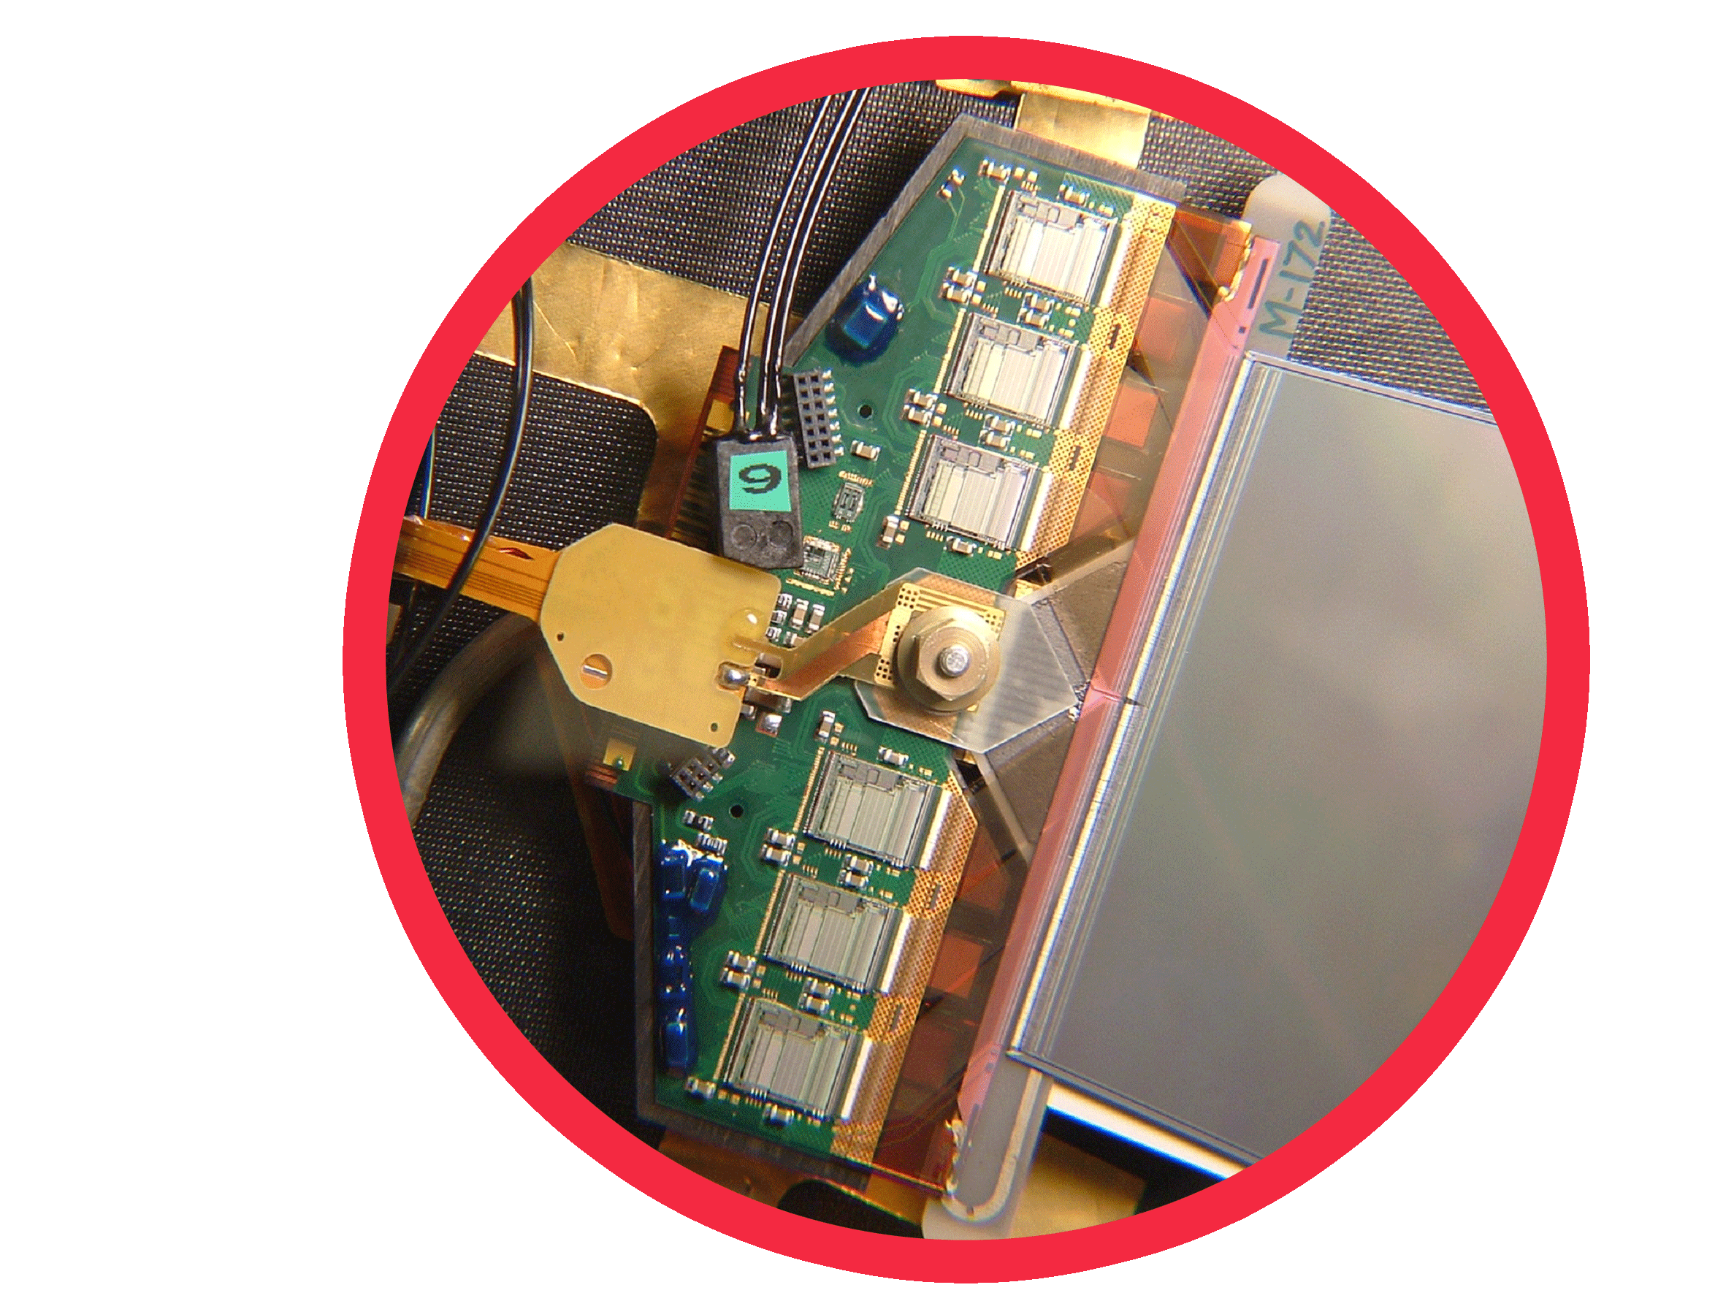
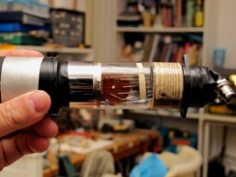
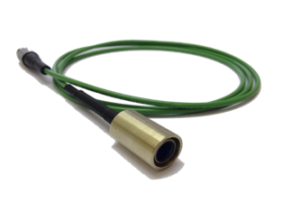

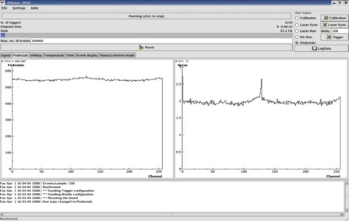

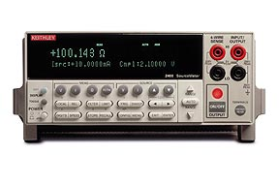
EASY
Setup components @ Lab.
Components of a silicon microstrip detectors
Source of particle
Trigger
Laser
Sensor + ASIC
Radioactive source
Control unit
Data acquisition and monitoring
HV power supply
ASIC: application-specific integrated circuit

Slide 3
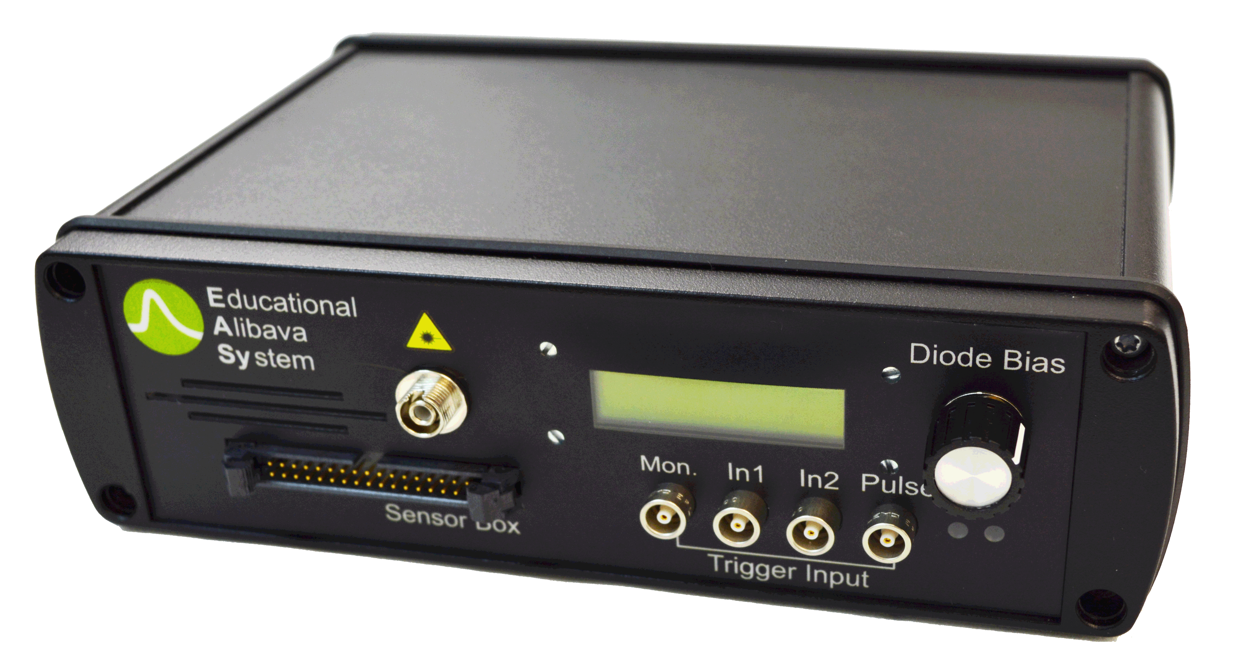
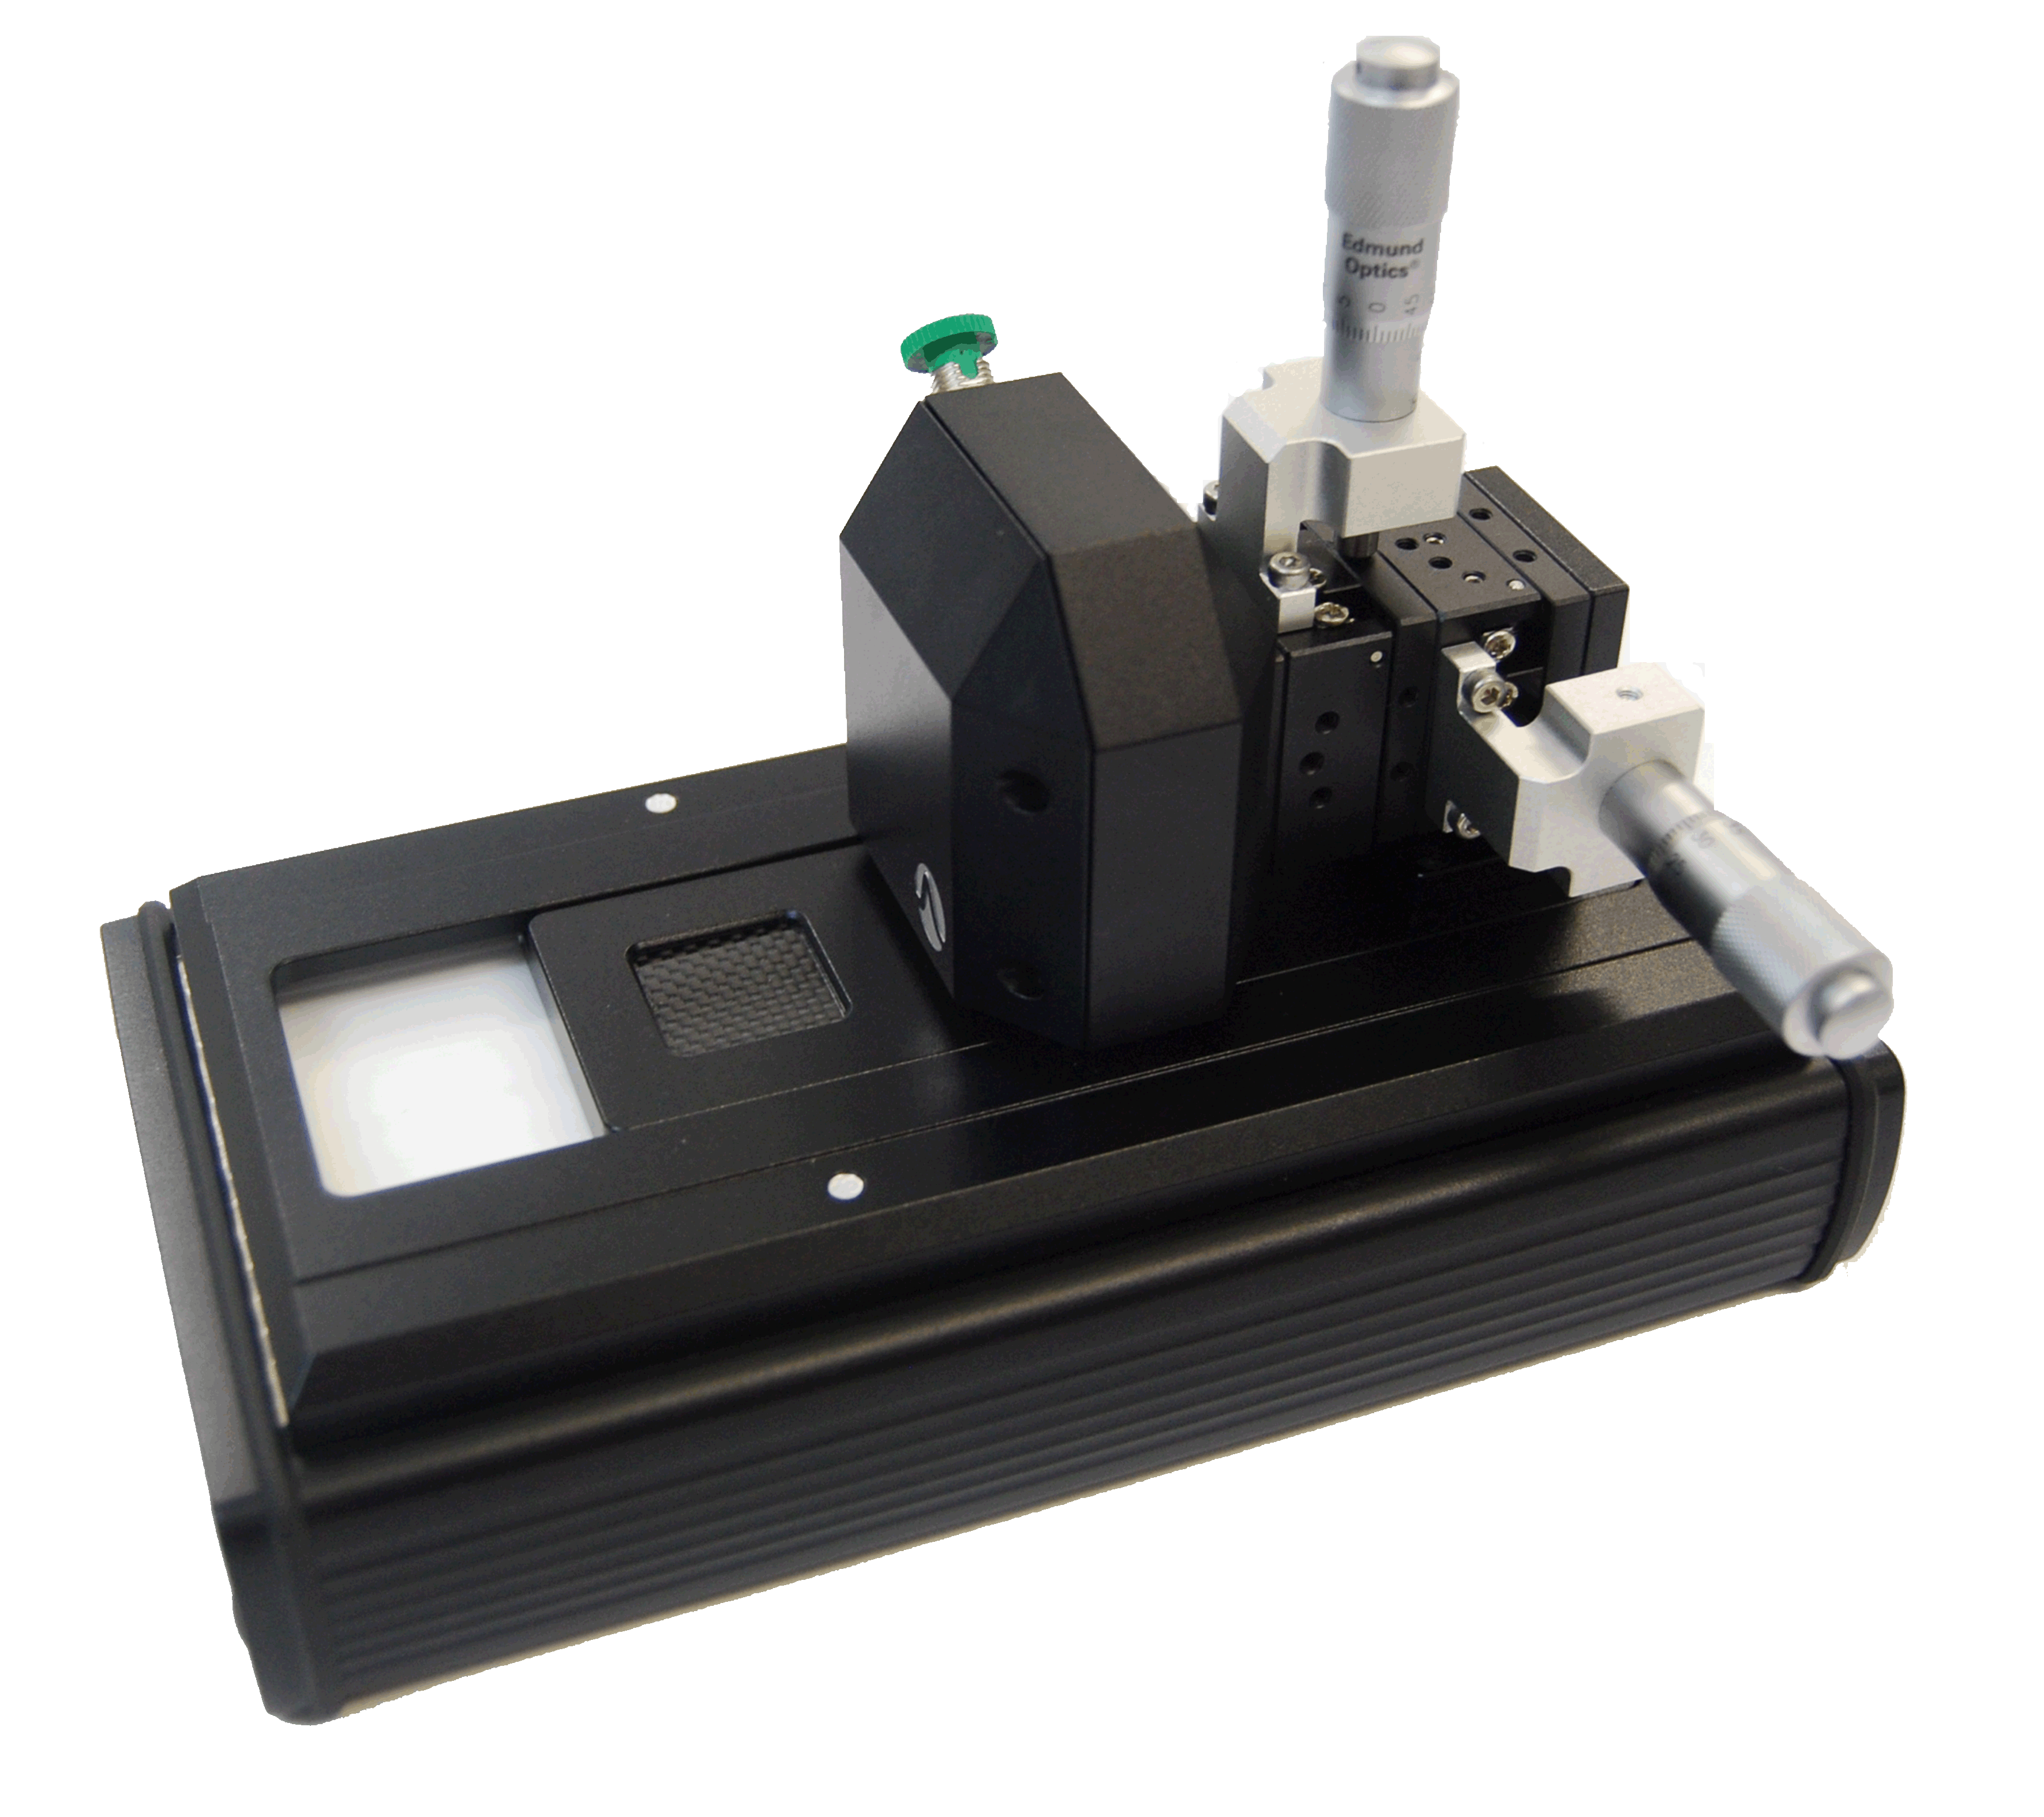
EASY
EASY system
Control unit
Data Acquisition Control.
Processing of the sensor and trigger data
Adjustable HV unit for microstrip sensor bias, with voltage and current display.
Include the laser source
Communication with computer software via USB
Sensor unit
Silicon microstrip sensor and the Beetle chip.
Opaque carbon fibre window to place radioactive source.
Laser micropositioner and focus system.
A diode placed under the detector provides a trigger signal.

Slide 4
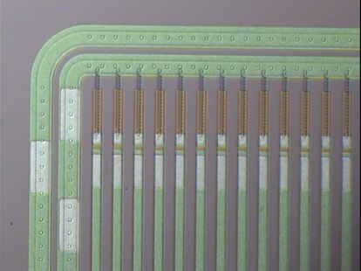
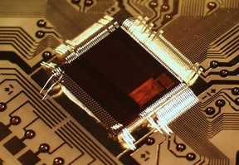
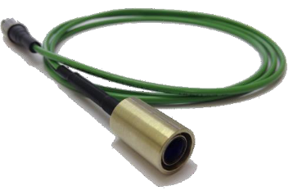

EASY
EASY system
Silicon microstrip
P-on-N Detector
Size: 20x20 mm2
Thickness: 300 µm
Channels: 128
Interstrip pitch: ??? μm
Beetle Characteristics
Low noise ASIC developed for CERN/LHC experiments
128 channels
Laser source
Wavelength: 980nm
Pulse width: 5 ns
Laser Spot: 20 μm
Micropositioner resolution: 10 μm

Slide 5
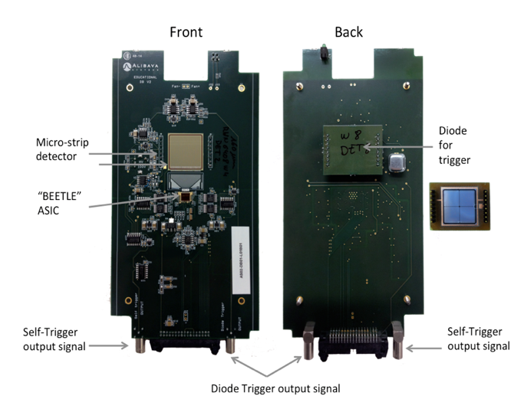
EASY
Trigger

Slide 6
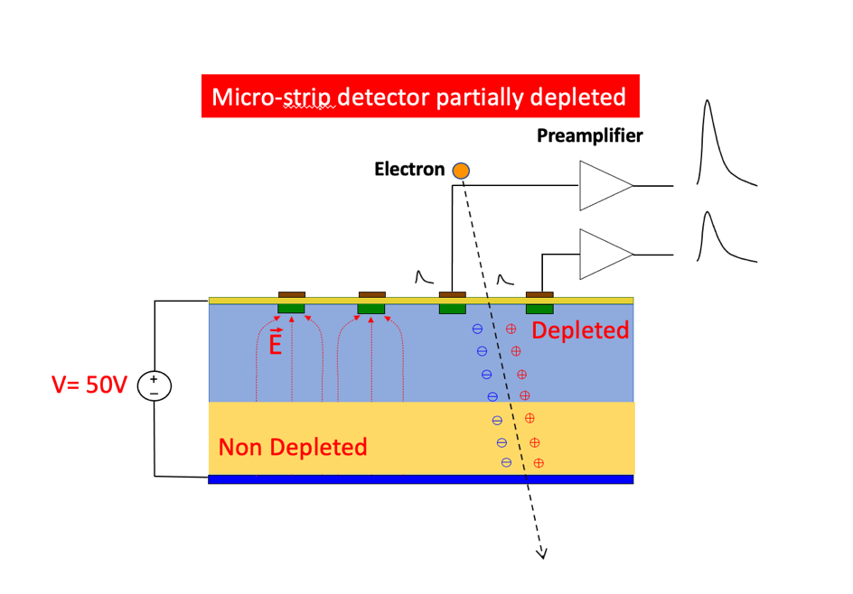
EASY
Basic principle
Exercise 1
Drift
Recombination
Charge collected is proportional to the depletion area
Strips of p-type silicon on a n-type substrate.
Each strip creates a p-n juntion
Notes:
Our divice consist of an 300 microns thick n type bulk. and thin layer of strips of p type silicon,. The abrupt junctions are formed between the strips and the bulk silicon. The depletion zone grows from the strips to the backplane so that, the device can operate partially depleted.
We nned amplification and shaping for full processing

Slide 7
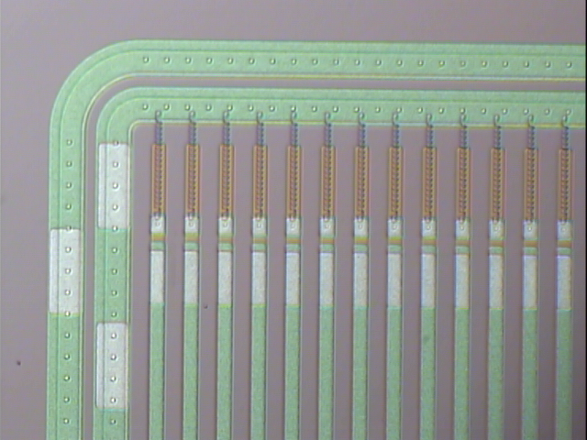
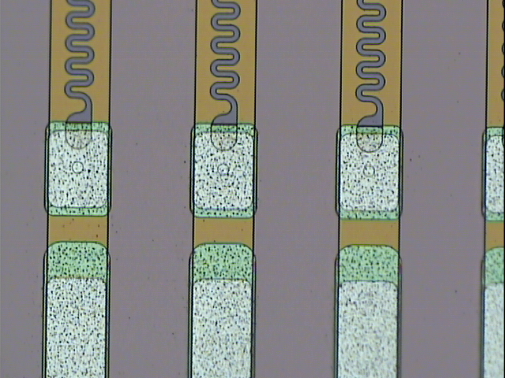
EASY
Basic principle
EASY sensor
Notes:
Our divice consist of an 300 microns thick n type bulk. and thin layer of strips of p type silicon,. The abrupt junctions are formed between the strips and the bulk silicon. The depletion zone grows from the strips to the backplane so that, the device can operate partially depleted.
We nned amplification and shaping for full processing

Slide 8
EASY
Basic principle
Steps of 10µm
Laser
Exercise 2
Notes:
Our divice consist of an 300 microns thick n type bulk. and thin layer of strips of p type silicon,. The abrupt junctions are formed between the strips and the bulk silicon. The depletion zone grows from the strips to the backplane so that, the device can operate partially depleted.
We nned amplification and shaping for full processing

Slide 9
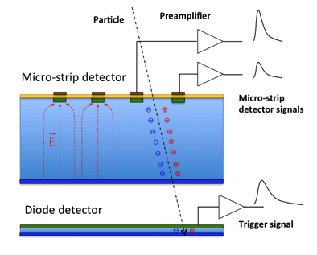
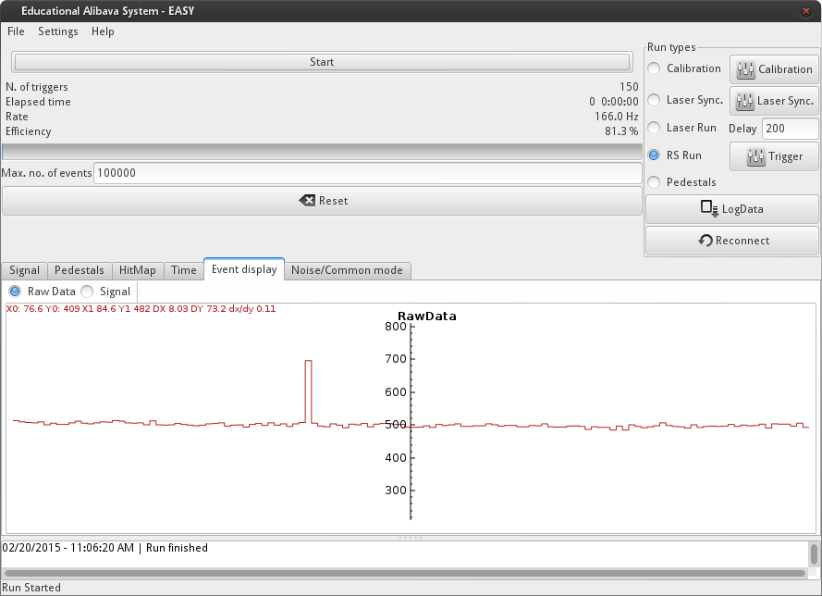
EASY
Charge collection
Strip i , Event k
ADC (i,k)
TDC (i,k)
Beetle chip
Sampling
Charge
time

Slide 10
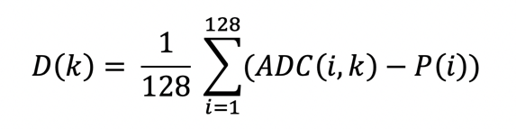
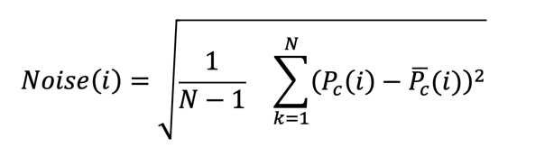
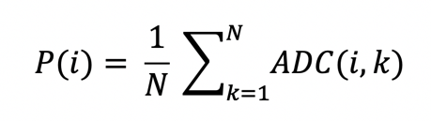
EASY
Charge collection
Strip i , Event k
ADC(i,k)= Offset (i)+ Common Noise (k)+ Electronic Noise (i) + Charge (i,k)
N events
128 channels

Slide 11
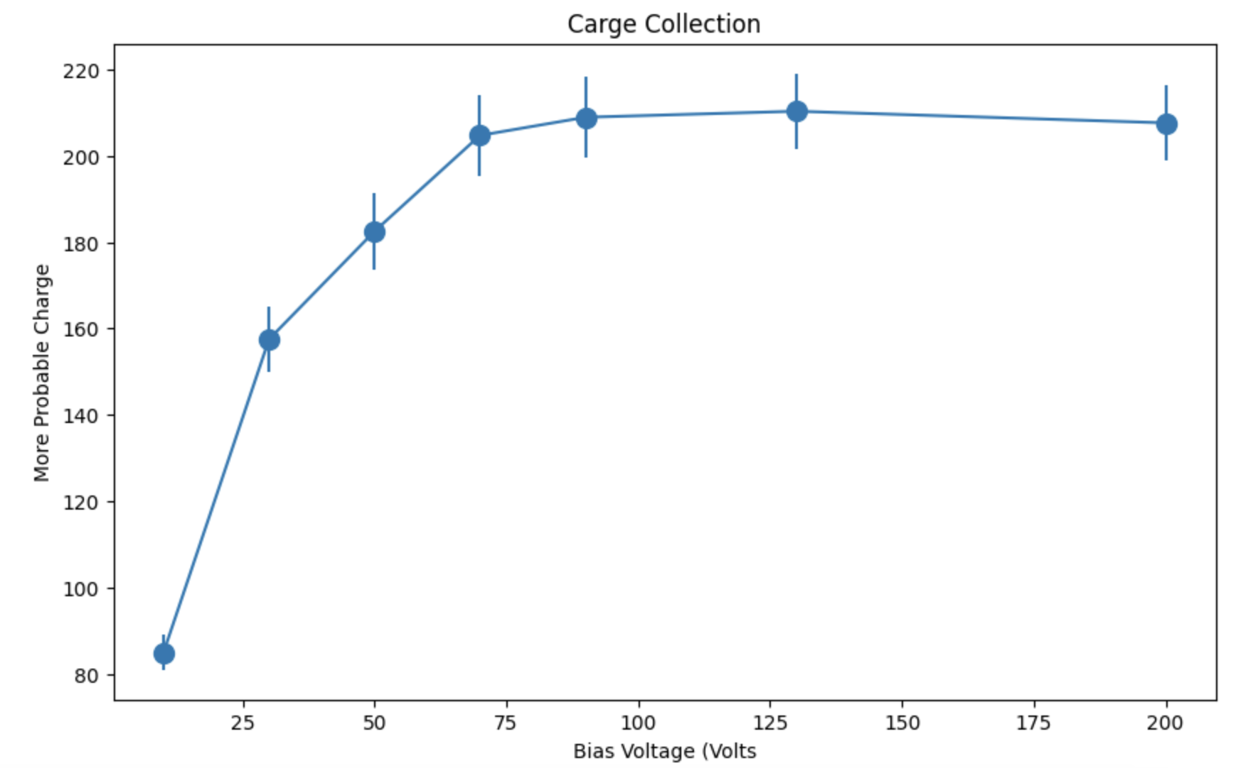
EASY
Depletion Voltage
Exercise 1

Slide 12
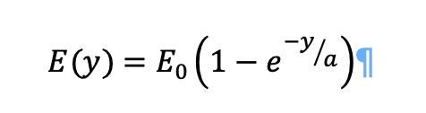
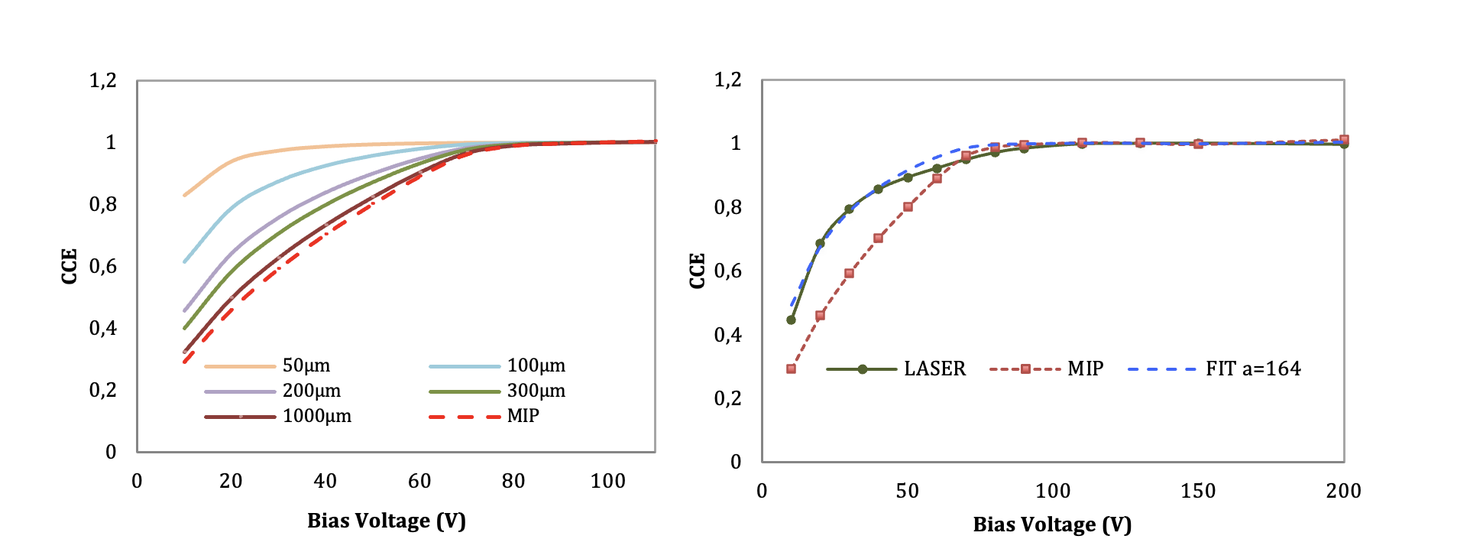
EASY
CCE mip vs Laser
Exercise 1
1000μm sensor

Slide 13
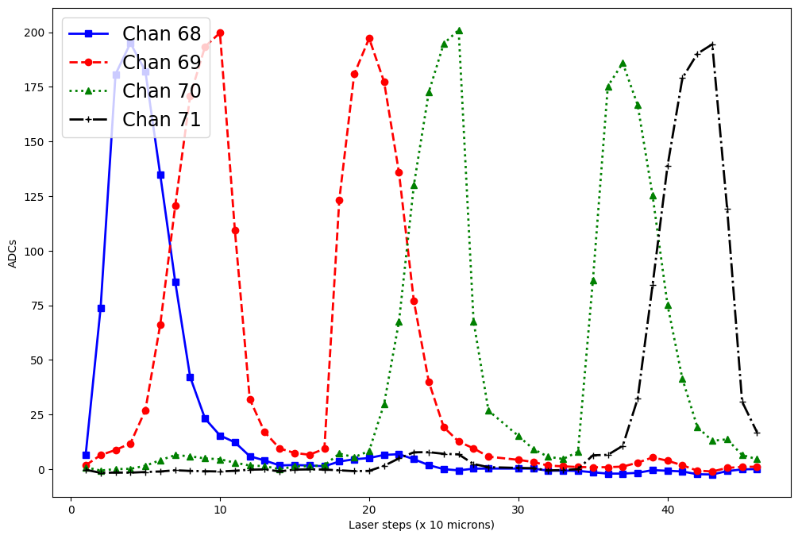
EASY
Charge Sharing
LASER
Exercise 2
Exercise 2

Slide 14
EASY
Charge Sharing
LASER
Exercise 2

Slide 15
EASY
Charge Sharing
LASER
Exercise 2

Slide 16
EASY
Charge Sharing
LASER
Laser beam Spot
Pich
Strip width

Slide 17
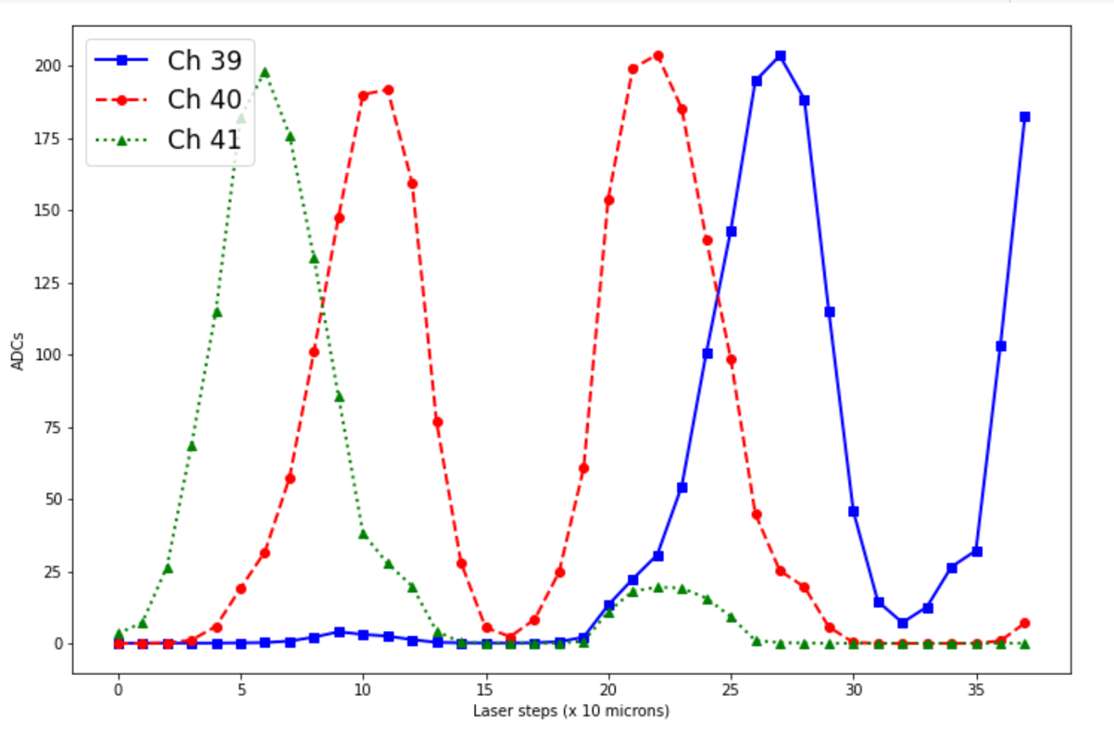
EASY
Charge Sharing
LASER
Laser beam Spot
Pich
Strip width

Slide 18
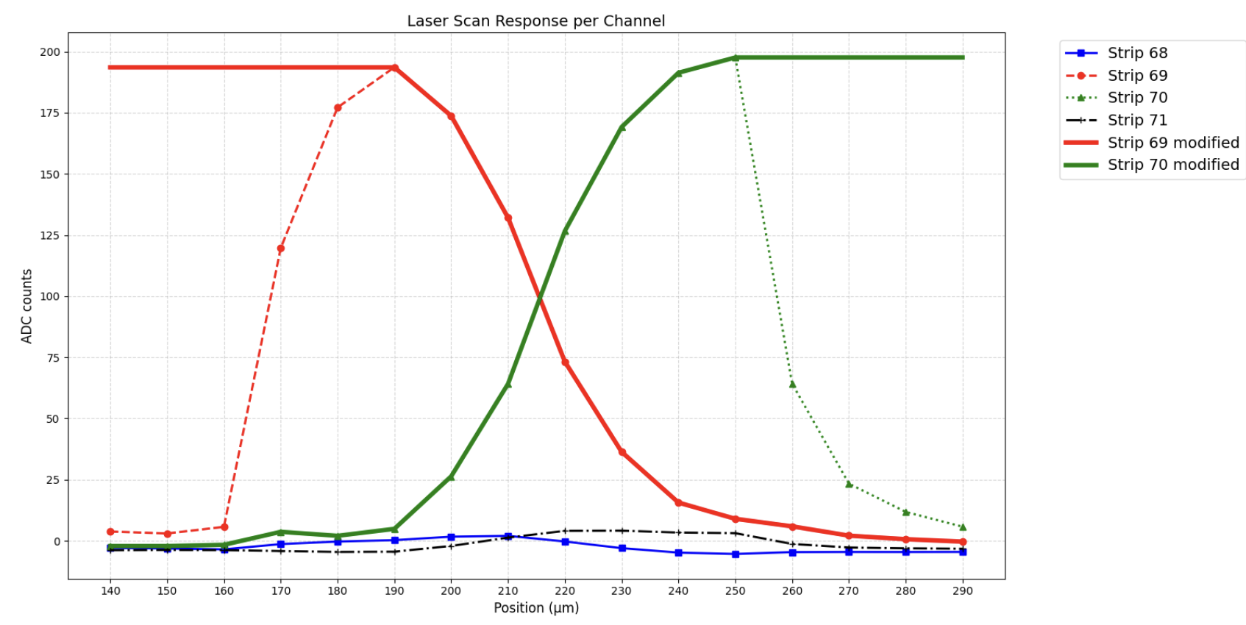
EASY
Spatial resolution

Slide 19
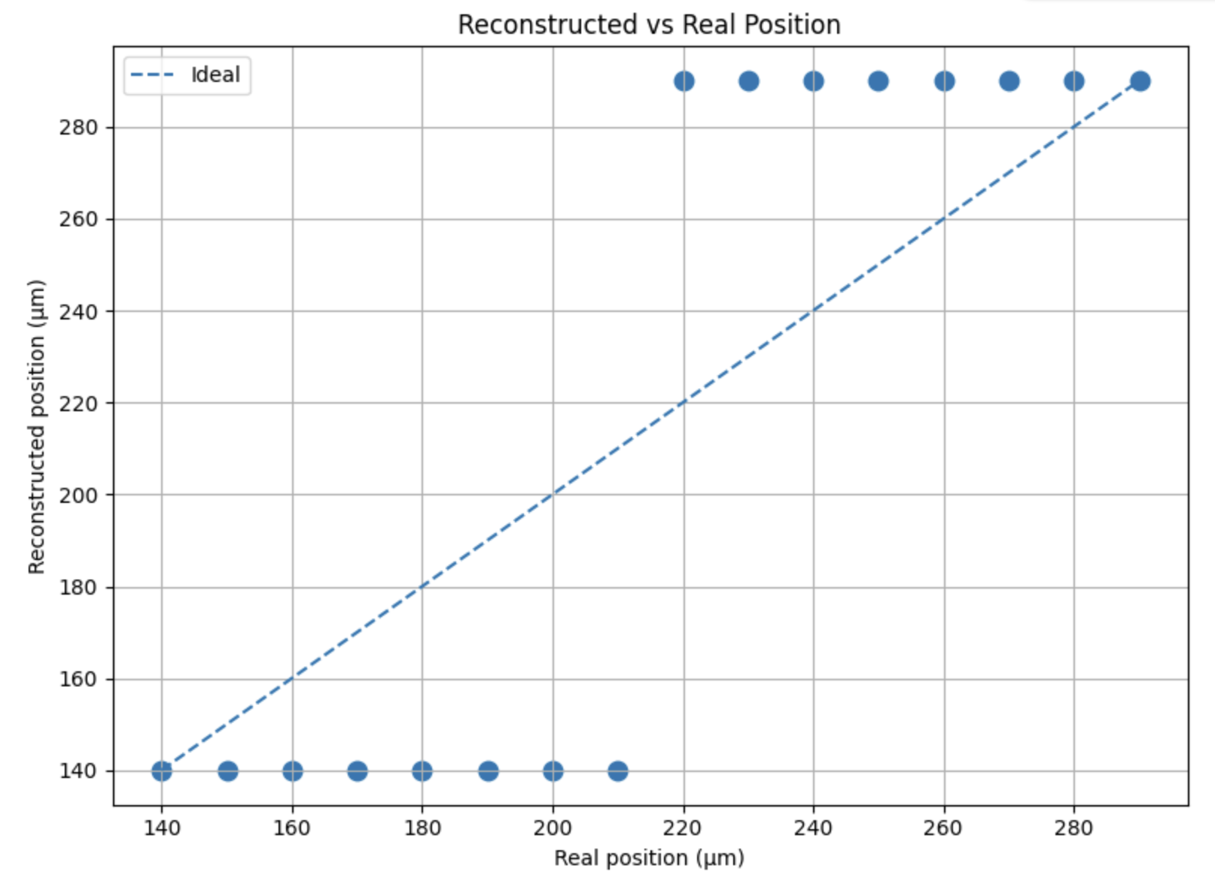
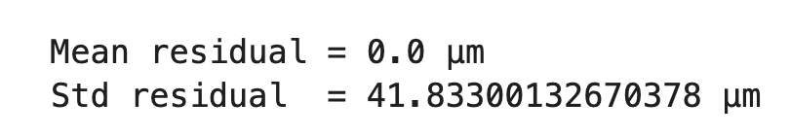
EASY
Spatial resolution

Slide 20
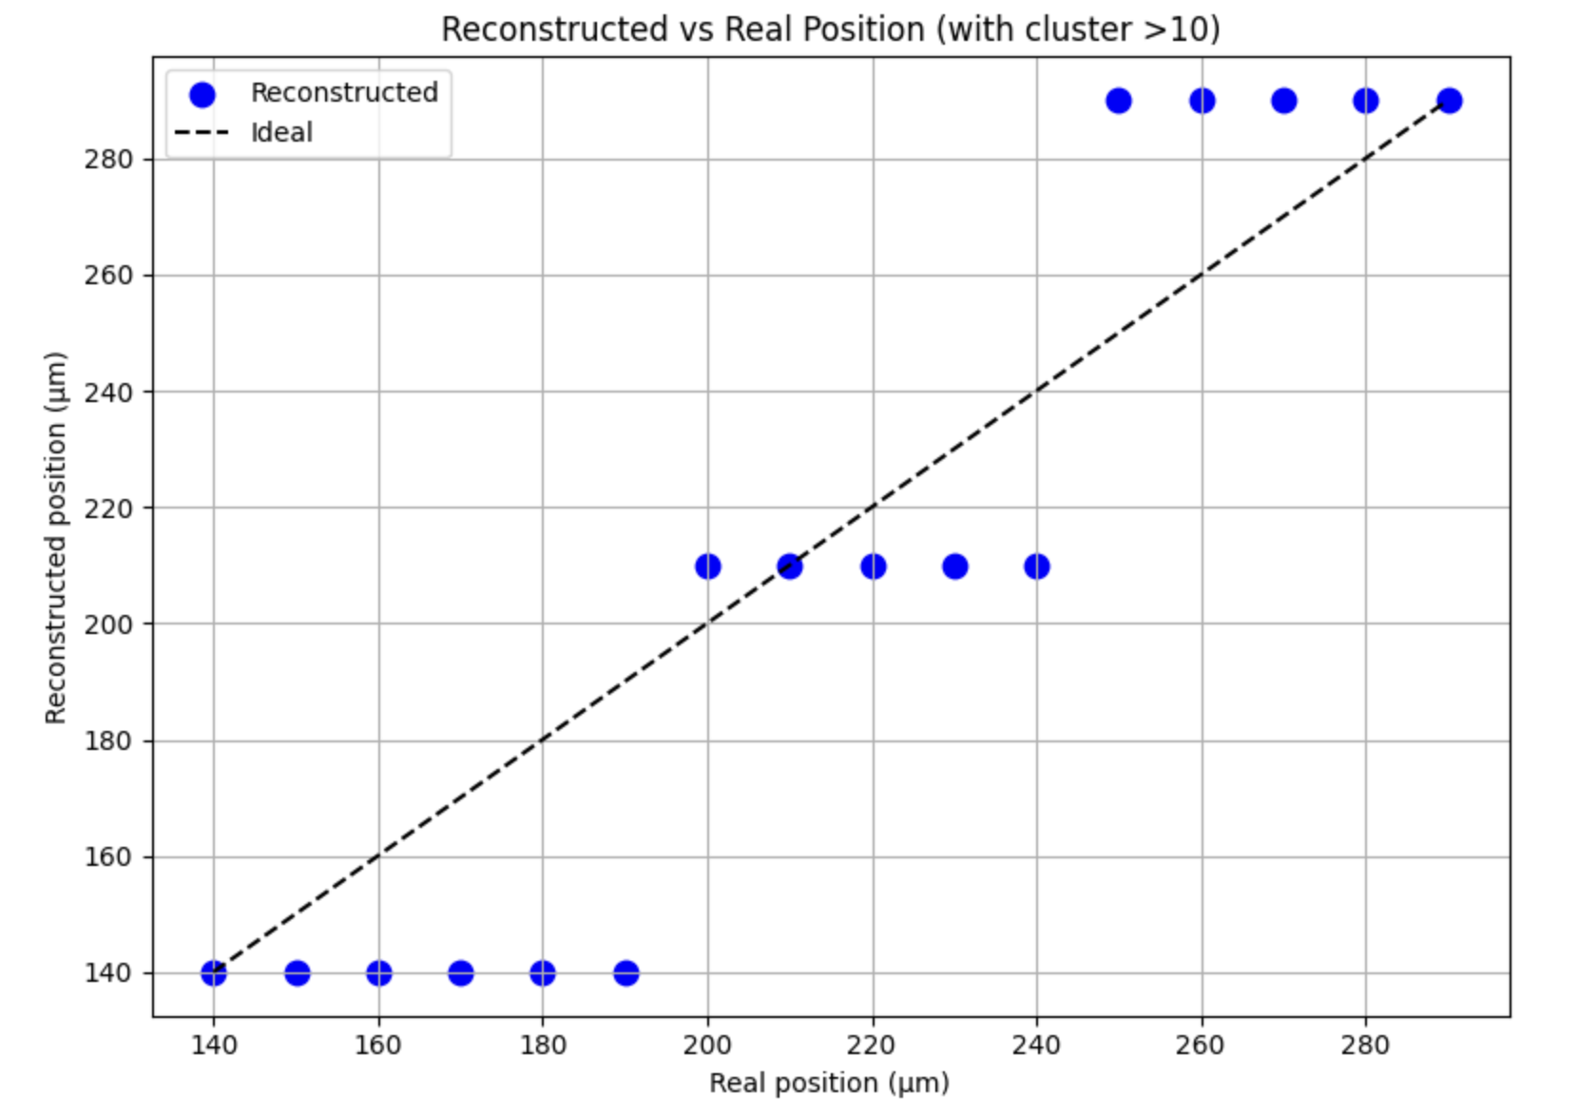
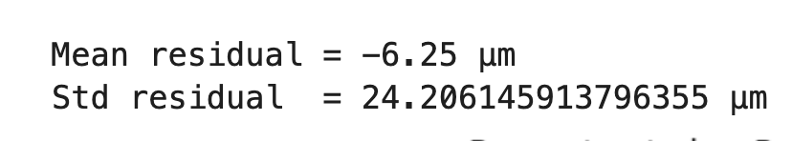
EASY
Spatial resolution

Slide 21
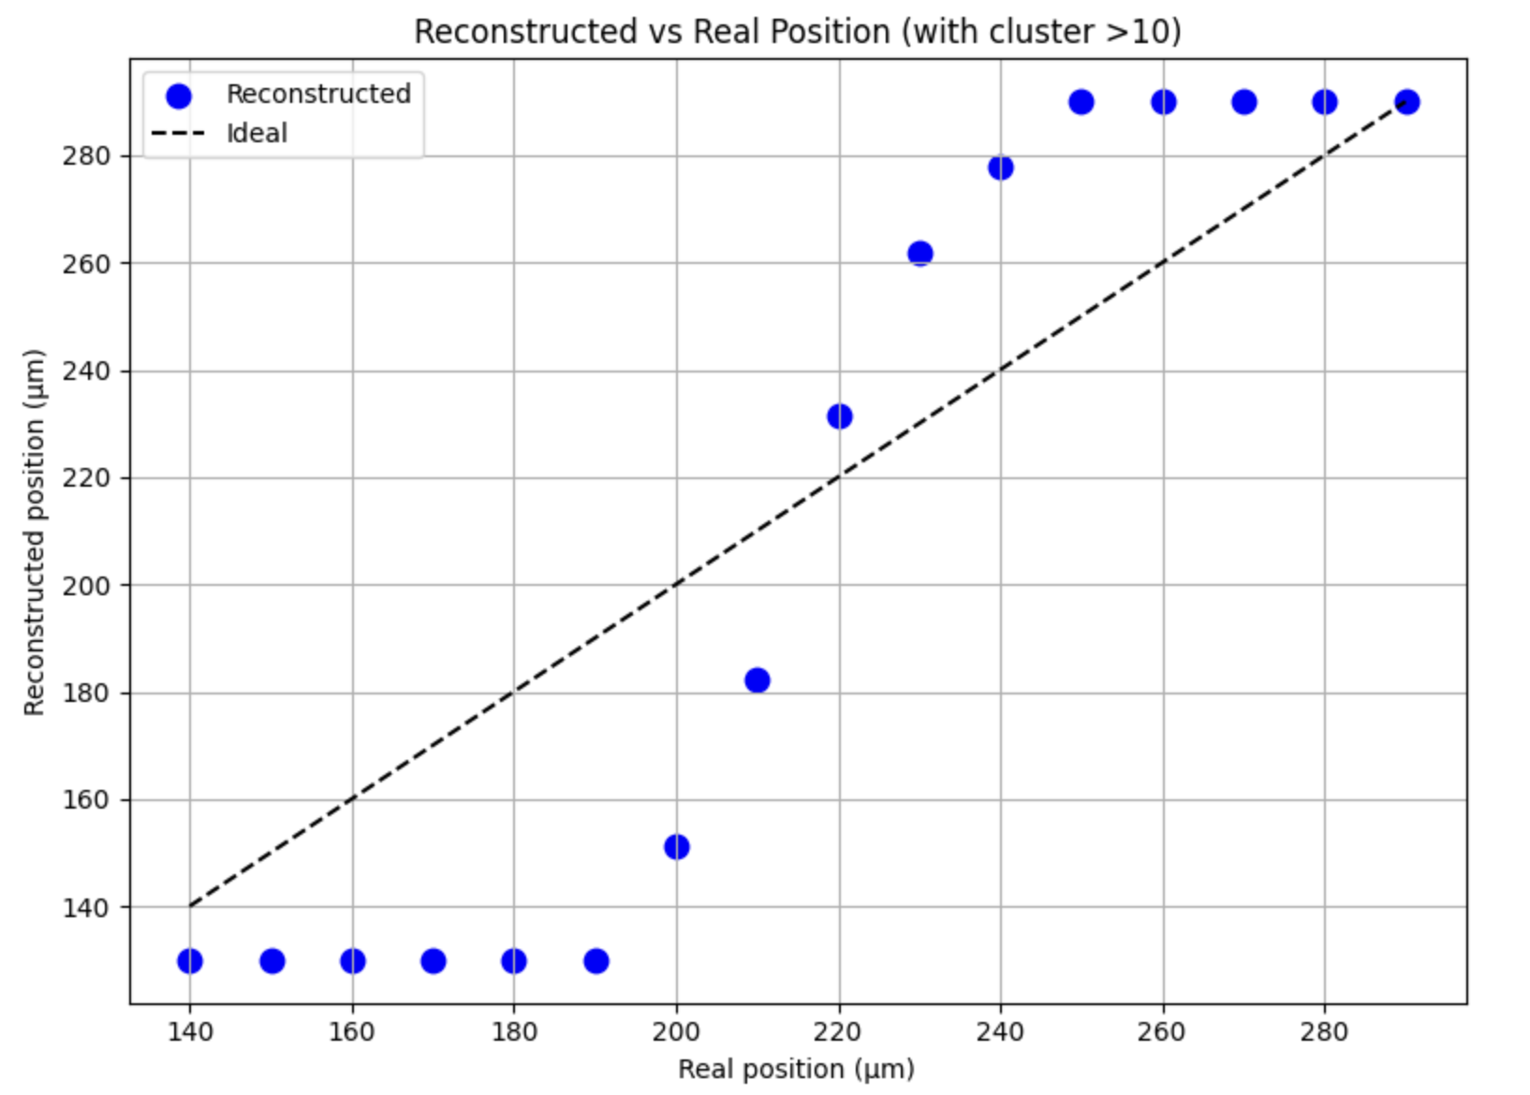
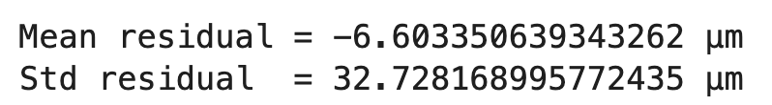

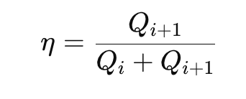
EASY
Spatial resolution
η-algorithm

