Slide 1
Beyond Task-Specific Models
Foundation Models as a New Paradigm
for Experimental Physics
TREASURE: Tokenizing HEP Collider Data for AI Discovery
Yi Huang
04-27-2026

Slide 2





MOTIVATION
Foundation vs Task-Specific Human
Pattern recognition and rule reasoning
Logical and critical thinking
Basic math and language skills
Communication and collaboration

Slide 3
MOTIVATION
What is Wrong of Task-Specific ML
Expensive Labels
Unreusable Algorithm
This is NOT how understanding works
Every task demands its own labeled dataset. The labels can be expensive and slow to produce. Example: Particle accelerators produce hundred and thousand particles at each collision. Annotate them would be a tremendous amount of work.
We will have to design a deep learning algorithm for each task. Each model must be trained, tuned, maintained individually. Overfitting may also happen easily for task-specific algorithms if the complexity of the algorithm and that of the problem do not match.
If humans first learn more general concepts before specialize in tasks, why should artificial intelligent do the opposite. An AI model that understands physics can be trained to specialize in any task with physics as the underlying rule, but the opposite is not true.

Slide 4
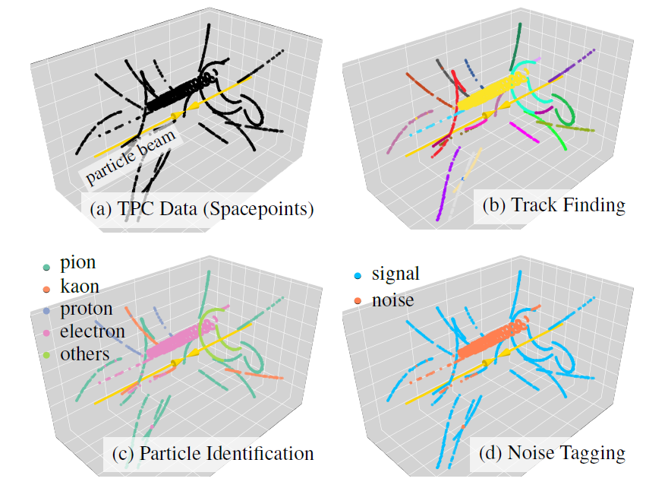
MOTIVATION
Foundation vs Task-Specific ML

Slide 5
CONCEPT
What Is a Foundation Model?
Analogy
Training in logic & critical thinking sharpens reasoning across mathematics, economics, and political science alike — the general capability lifts all specific applications.
An ML model is a foundation model if it is trained to develop a holistic understanding of data that is transferable across many downstream tasks.
Key mechanism:
Self-supervised learning (SSL) — withhold or distort part of the data, challenge the model to reason about what is missing from what remains.

Slide 6
METHODS
A Landscape of Self-Supervised Strategies
Masked Reconstruction
Contrastive Learning
Hide tokens/patches; predict missing content.
BERT, MAE.
Pull augmented views of same sample together,
push different samples apart.
SimCLR, MoCo.
Prototype Distillation
Forecasting
Teacher assigns target representation on full data;
student predicts them on masked/augmented views.
DINO, Panda.
Predict future or context states
from partial observations.
GPT-style, FM4NPP
All share the same philosophy: structure in the data is rich enough to be learned from context alone.

Slide 7
STRATEGY 1 · MASKED RECONSTRUCTION
Masked Reconstruction — Learn by Filling in the Blanks
Core idea
The ______ cat secretly ordered a pizza at 3 a.m. and blamed the ______.
Randomly mask (hide) a portion of the input. Train the model to reconstruct the missing content from the visible context alone.
T1
???
T6
Why it works
To predict the missing parts, the model must build a deep understanding of structure, context, and relationships in the data.
Examples ML Models
BERT — mask tokens in text
MAE — mask patches in images

Slide 8












STRATEGY 2 · CONTRASTIVE LEARNING
Contrastive Learning — Similar Together, Different Apart
Core idea
But can you still recognize me if I look different?
Create augmented views of the same sample. Train the model so these views land close together in embedding space, while views of different samples are pushed apart.
raw
Why it works
Positive pair
The model learns invariances — representations that are stable under noise, rotation, masking — which are precisely the features that matter for physics.
augmented
Examples ML Models
Negative pair
SimCLR — image augmentation pairs
MoCo — momentum encoder + queue
augmented

Slide 9







STRATEGY 3 · PROTOTYPE DISTILLATION
Prototype Distillation — Learn by Agreeing with Yourself
Core idea
A young tabby cat with white chest sitting on the ground in the Sphinx pose. Its eyes are widely open with narrow pupils…
A teacher model that learns and generates representation from full data. A student model learn to produce similar data representation from a masked or distorted view.
Teacher model
Why it works
If a model can still produce correct and detailed understand from partial and/or distorted data, it must understand the hidden correlation in data well.
Student model
A cat with white chest sitting on the ground. Its eyes are widely open.
Examples ML Models
DINO / DINOv2 — vision transformers
SwAV — clustering with prototypes
Panda — particle trajectory prototypes in LArTPC
Teacher model at time step $i$
Student model at time step $i$
Student model at time step $i−1$

Slide 10
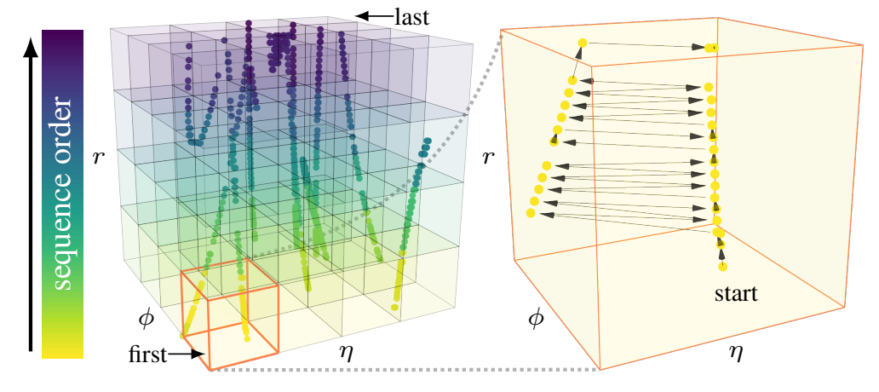
STRATEGY 4 · PREDICTIVE CODING
Forecasting — Learn by Predicting What Comes Next
Core idea
I finally taught my goldfish how to code, but now it only writes programs in _______.
The penguin built an AI model to catch fish, but it kept crashing whenever it saw a _______.
Process a sequence of tokens left-to-right (or in some causal order). At each step, predict the next token from all previous context — no labels needed, just the data itself.
Why it works
Every position in the sequence becomes both an input and a prediction target. Long-range dependencies, local patterns, and global structure all emerge from the same objective.
Examples ML Models
GPT / LLMs — next token prediction
FM4NPP — predict location of the next detector hit
Notes:
Bubble sort. Leopard Seal.

Slide 11
SUMMARY
Four Strategies, One Philosophy
Masked
Reconstruction
Contrastive
Learning
Prototype
Distillation
Predictive
Coding
Signal
Signal
Signal
Signal
Predict
hidden tokens
Align augmented
views
Match teacher
cluster labels
Predict next
in sequence
Captures
Captures
Captures
Captures
Local structure &
correlations
Invariance to
transformations
Emergent semantic
categories
Long-range
dependencies
e.g.
e.g.
e.g.
e.g.
BERT · MAE
SimCLR · MoCo
DINO · Panda
GPT · FM4NPP
All four: withhold part of the data · challenge the model to reason from what remains · no labels required

Slide 12
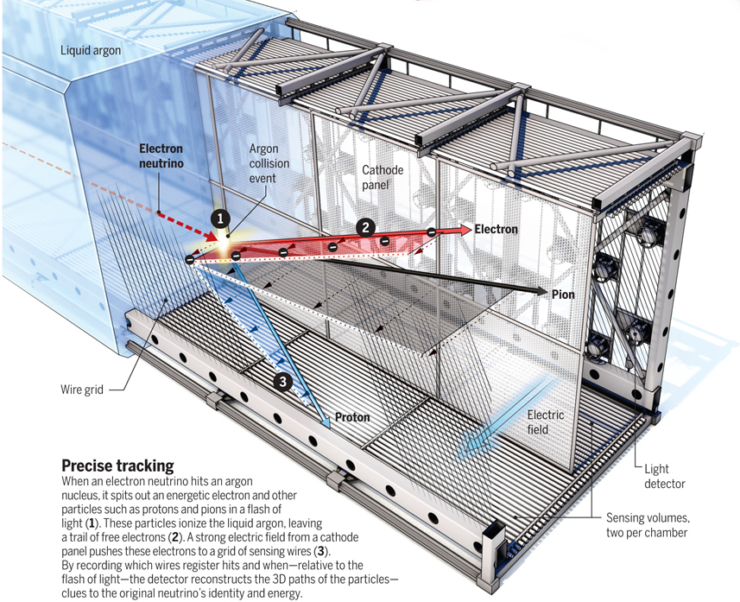
CASE STUDY I
Panda — Self-Distillation for LArTPC Data
The challenge
Key Result
LArTPCs produce sparse 3D charge clouds of particle trajectories. Traditional pipelines rely on dozens of hand-engineered algorithms and large labeled simulations.
1,000×
The approach
fewer labels to match
state-of-the-art segmentation
Hierarchical sparse 3D encoder
Multi-view prototype-based self-distillation
Single backbone → semantic seg · particle clustering · interaction clustering
Young & Terao, arXiv:2512.01324

Slide 13
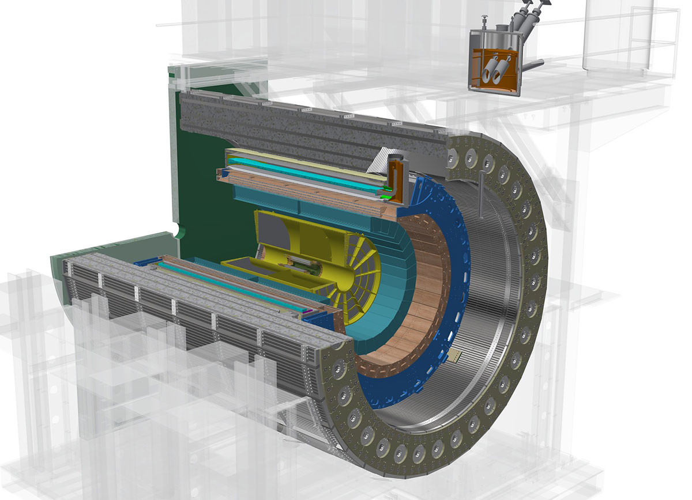
CASE STUDY II
FM4NPP — Scaling Laws for Nuclear & Particle Physics (more details to come)
The challenge
Neural Scaling
sPHENIX detector at RHIC produces sparse, high-dimensional collision events. Do scaling laws — proven in NLP — carry over to physics data?
log(loss)
The approach
11M+ particle collision events;
Models up to 188M parameters; scaling evaluated across size, data & compute
Forecasting self-supervised training method
Frozen backbone + task adapter → track finding, particle ID, noise tagging
Power-law ✓
log(params)
FM consistently outperforms task-specific baselines across all downstream tasks — with frozen weights.
Park et al., arXiv:2508.14087

Slide 14
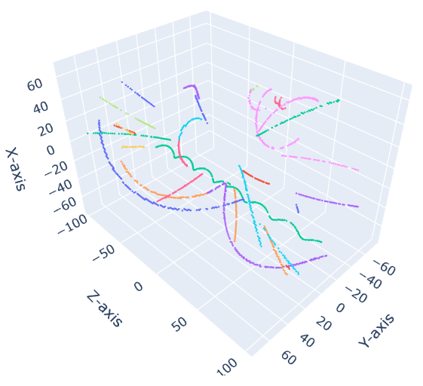
How Do We Do Forecasting for Spatial Data?
In order to do forecasting on spatial data, we first need to serialize them.
An example input point cloud from p + p collision. The input is a list of points in (E, x, y, z).

Slide 15



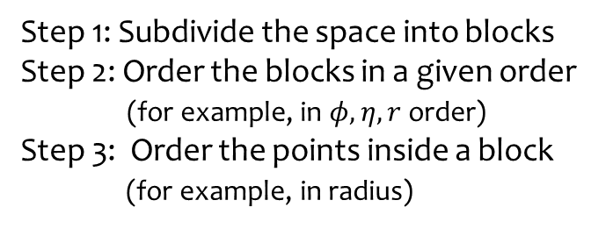
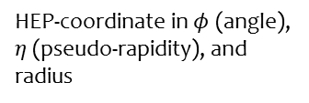

How Do We Do Forecasting for Spatial Data?
$$r$$
Step 1: Subdivide the space into blocks
Step 2: Order the blocks in a given order (for example, in $φ,η, r$ order)
Step 3: Order the points inside a block (for example, in radius)
$$φ$$
$$r$$
$$η$$
HEP-coordinate in $φ$ (angle), $η$ (pseudo-rapidity), and radius

Slide 16
Forecasting Spatial Data
After this serialization process, all space points get a unique index in input, just like a word in a sentence.
With this ordering, we can then apply any forecasting algorithms, such as Transformer-based algorithm, Mamba (a state-space model), to do forecasting.
What have encouraged the model to learn useful tokenization of the points?
A point’s position could only be predicted accurately if points on the same track can be recognized by the model. This force the model to assign similar tokenization (representation/embedding) to points from the same track.

Slide 17
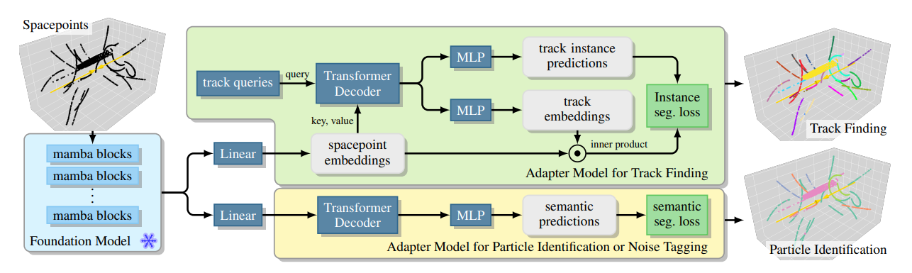
Fine-tuning for Downstream Tasks
forecasting
pretraining
Fine-tuning: Train adapter models for downstream tasks

Slide 18
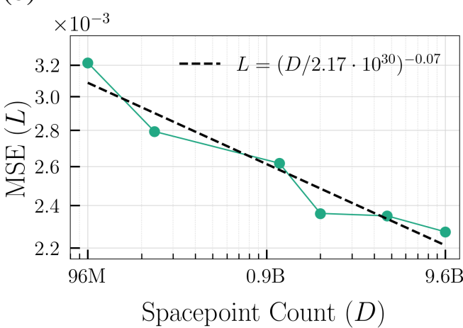
The More the Better?
Forecasting performance a function of input number of space points

Slide 19
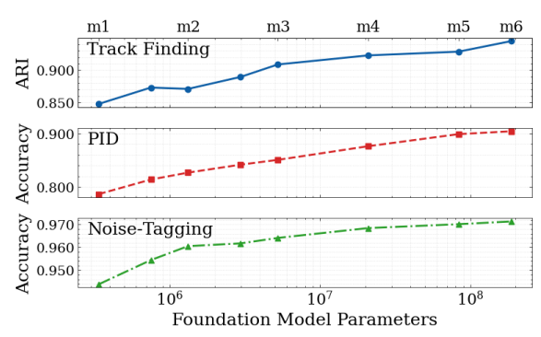
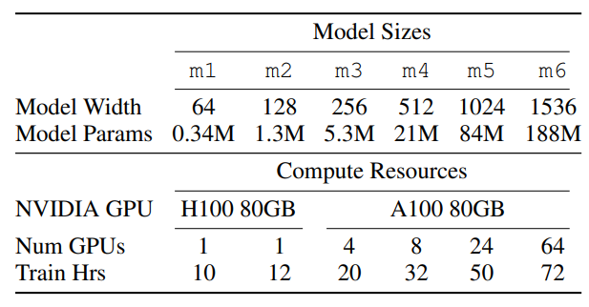
The Larger the Better?
Downstream task performance a function of model size

Slide 20
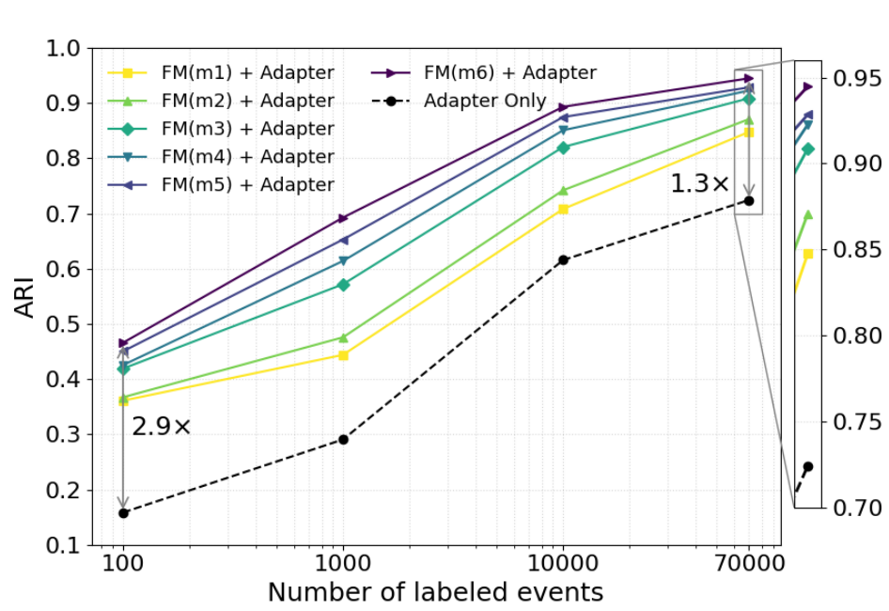
Label efficiency (can we survive on few labeled data)
High label regime
Track finding performance as function of labeled events
Low label regime

Slide 21
A Vision for Physics with Foundation Models
🔬
Shared and reusable backbone across multiple detectors and experiments
🏷️
Labels become optional — self-supervised pretraining carries the weight.
🚀
Scaling laws suggest: more data + larger models = better physics, automatically.
The world is structured enough to be learned from context alone.

Slide 22
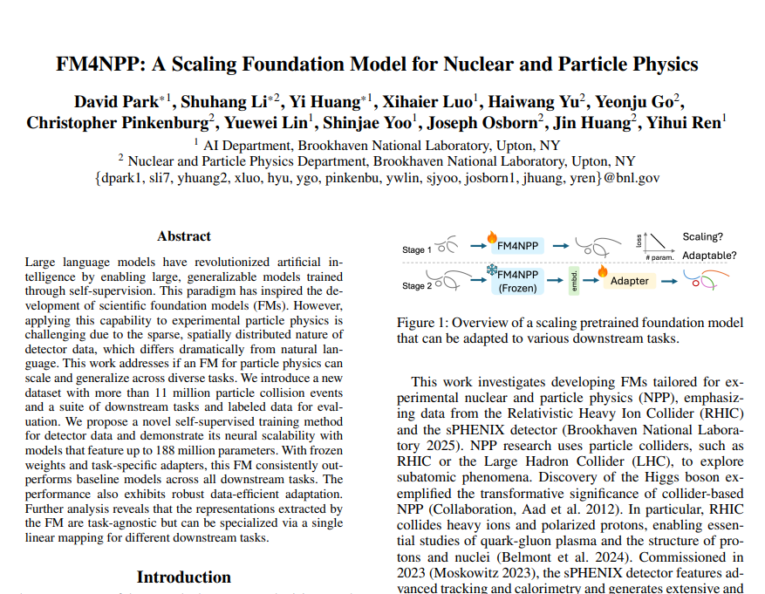
Thank You
FM4NPP BNL and Columbia
Park, Li et al.
arXiv:2508.14087 · Aug 2025
Scaling FM for nuclear & particle physics
Questions & Discussion
yhuang2@bnl.gov

