Slide 1
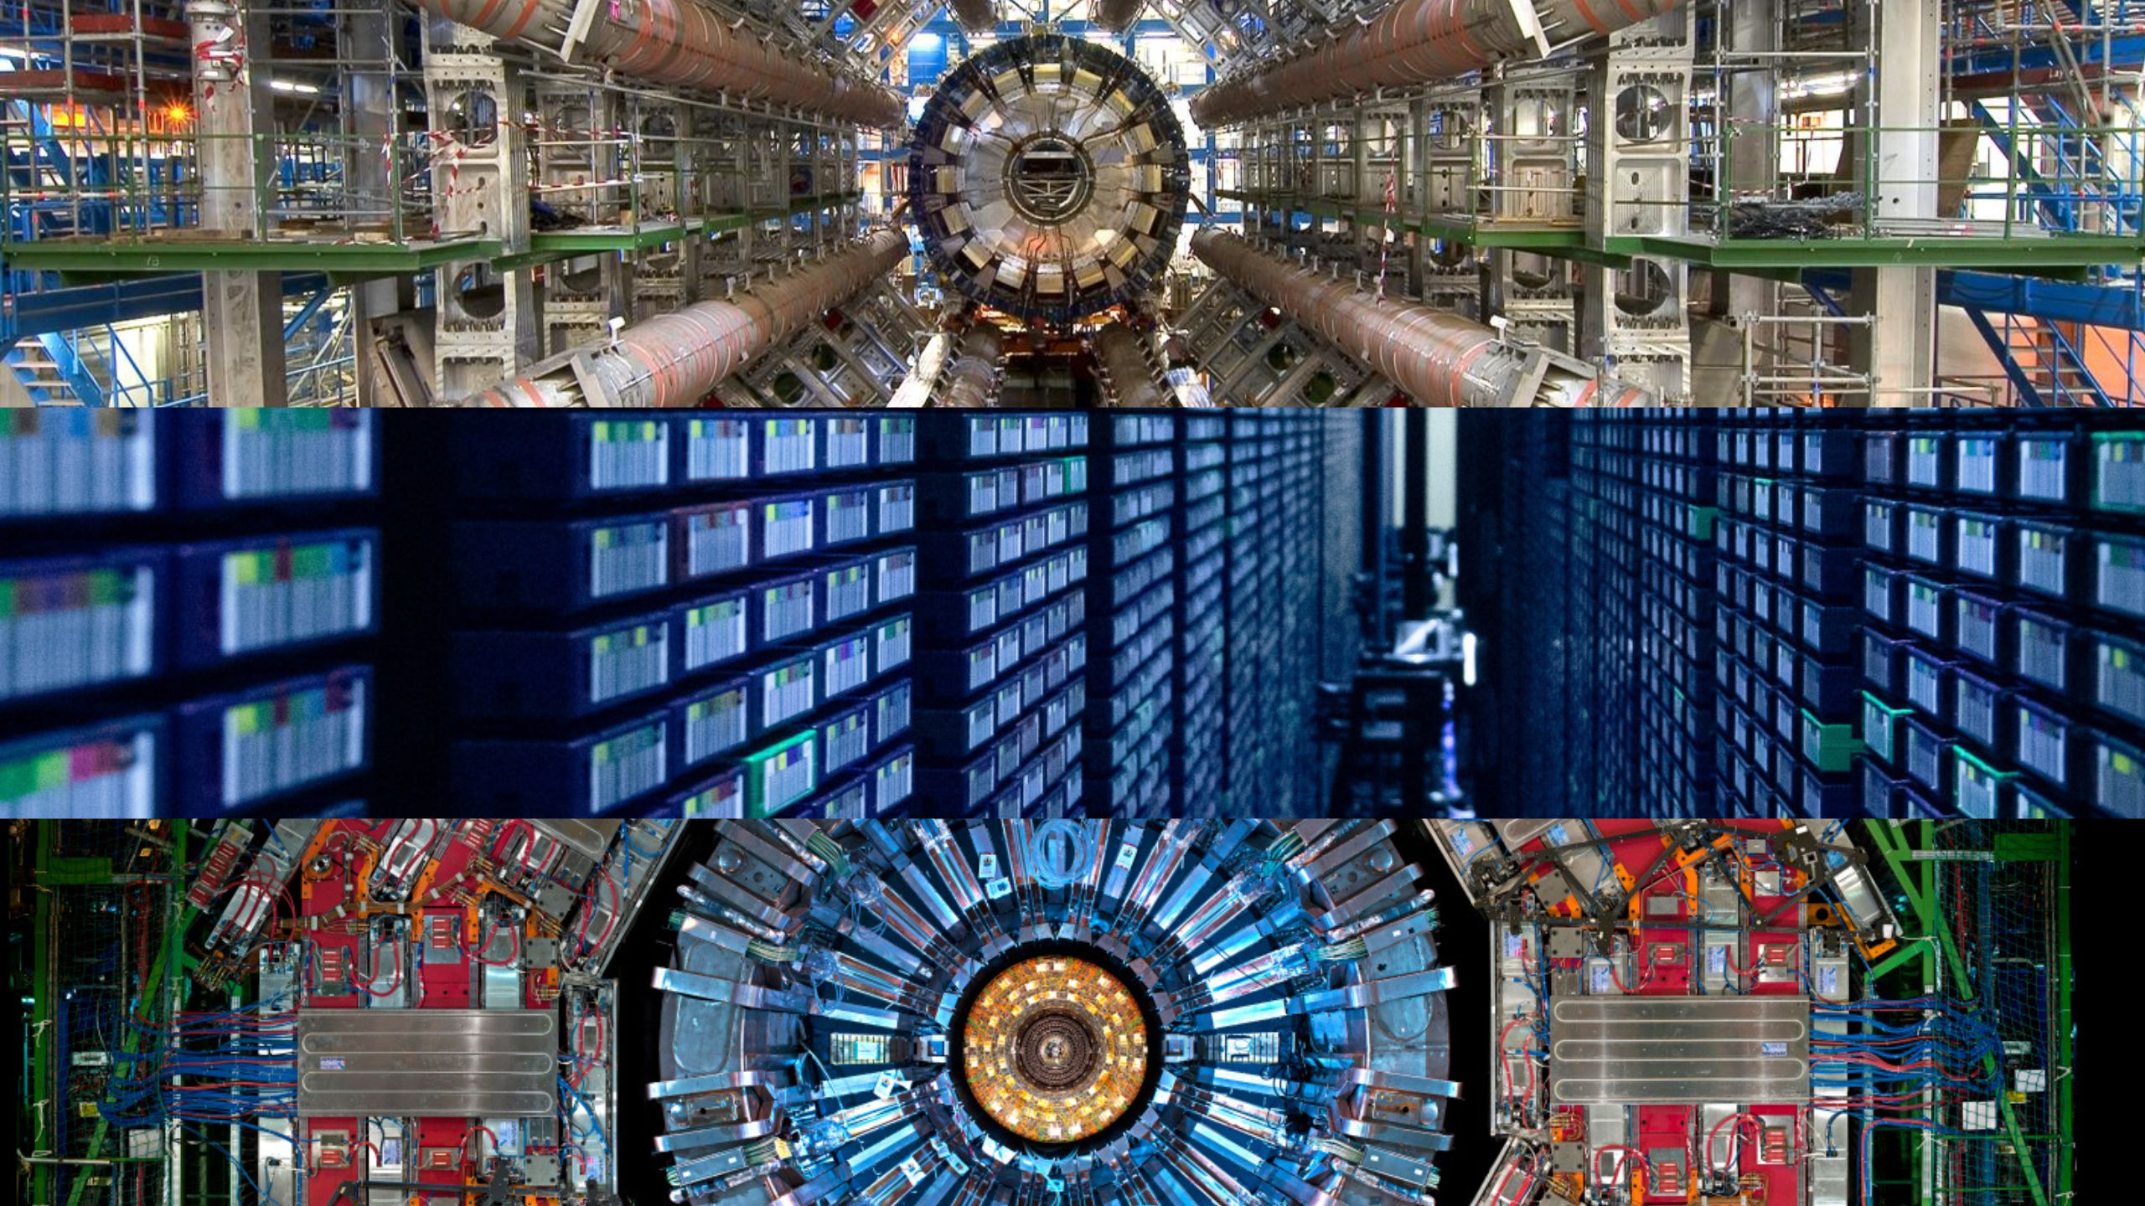
Highlights from LHC
R. Demina
University of Rochester
05/12/2026

Slide 2
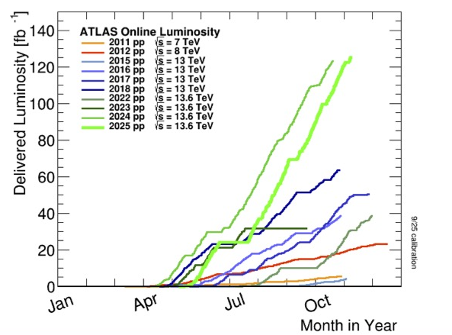
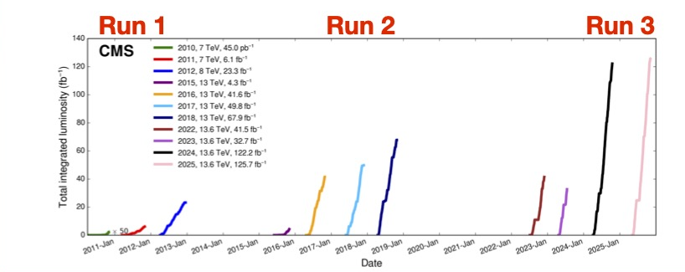
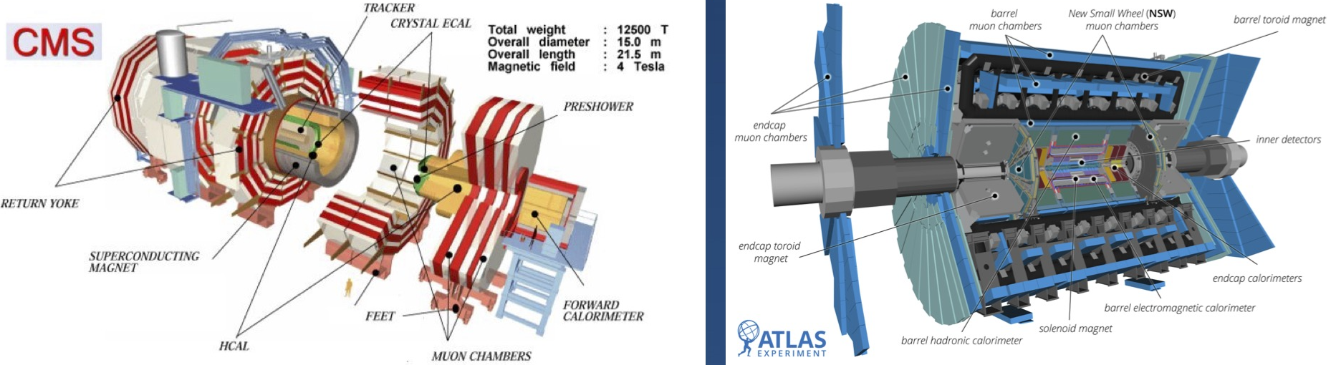
Performance →new strategies
With energy increase the search concentrates on new (rare) signatures
  E-μ channel for top quark discovery at the Tevatron
  ZZ→4l for Higgs boson discovery at LHC
  3-lepton golden channel for SUSY
With increase luminosity shift to kinematic characteristics
  Bump-hunting
  Tails of distributions
Further increase – angular correlations – physics of spin

Slide 3
Outline
CP and polarization of Higgs boson
  Atlas: VBF production, H→𝛾𝛾 decay
  CMS: H→ττ
  CMS: H→Z*Z→4l
Entanglement in Higgs decay
  CMS and Atlas: H→Z*Z→4l
Entanglement and quantum observables in top-antitop system
  Atlas and CMS – dilepton channel
  CMS – lepton+jets channel
“Toponium” – quasi-bound state production
  Atlas and CMS – dilepton channel
  CMS – lepton+jets channel
Conclusions

Slide 4
Higgs boson properties

Slide 5
CP and polarization of Higgs boson
Current experimental sensitivity still allows for possible CP-violating contributions
VBF Higgs production with H→𝛾𝛾 decay, using 164 fb⁻¹ of Run3 data

Slide 6
CP and polarization of Higgs boson
CP: SMEFT Warsaw basis
OO=2Re(M*_{SM} M_{BSM})/| M_{SM}|²

Slide 7
CP and polarization of Higgs boson
Sensitive to polarization – Δφ between VBF jets
Polarization:
α_{L}=g(HV_{L}V_{L})/g(HVV)
α_{T}=g(HV_{T}V_{T})/g(HVV)
In the SM: α_{L} = α_{T} =1 ,
anomalous couplings predicted by BSM models,
e.g., composite Higgs

Slide 8
CP structure of Higgs-τ Yukawa coupling
Use τ◊ e, μ, or π, ρ, a^{1pr}, a^{3pr} decays, with P – the charged decay product momentum, R – their Impact parameter vector from PV
Reconstruction of φ_{CP}
CMS-PAS-HIG-25-012

Slide 9
CP structure of Higgs-τ Yukawa coupling
Use H→ττ channel to constrain the effective CP mixing angle α^{Hττ}, of the admixture of scalar and pseudoscalar couplings
α^{Hττ} =7 ± 16∘ , SM expected value of 0 ± 14∘.
CP-odd
CP-even

Slide 10
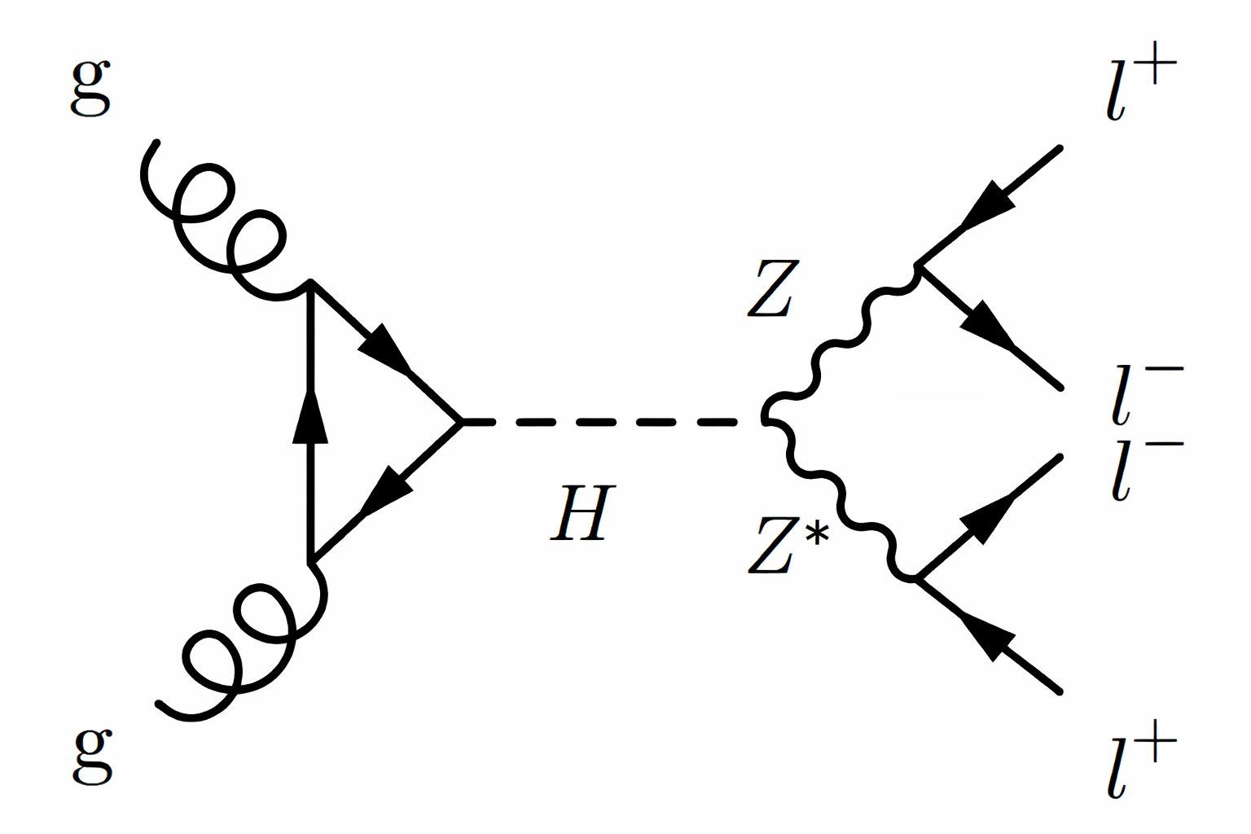
Spin correlations in H→ZZ→4l (Atlas)
The golden channel of Higgs discovery continues to deliver stunning results
Very clean channel, rich angular correlations
Negative leptons – spin analyzers
S=1 Z bosons – 2 qutrit system ➔ 9x9=81 spin correlation coefficients;
Only 9 are non-zero (s(H)=0)
6 off-diagonal are related to two parameters:
C₂₁₂₋₁ and C₂₂₂₋₂ , estimated on event-by-event basis from angles of the spin analyzers
System is entangled if at least one is non-zero.
entangled hypothesis (blue solid line)
separable non-QE hypothesis |00> (orange dashed line)

Slide 11
Entanglement in H→ZZ→4l (Atlas)
Combined results on C₂₁₂₋₁ and C₂₂₂₋₂ are consistent with the SM prediction, but do not exclude separable scenario (both=0)
An alternative approach: Use full angular distributions to construct the test statistic q for the entangled (blue solid line) and non-entangled (orange dashed line) hypotheses.
Distributions for 10 millions of pseudo-experiments.
Data (solid black line disfavor the separable-state hypothesis at a significance of 4.7 (expected 4.9) standard deviations

Slide 12
CP structure of Higgs
CMS: H→Z*Z→4l
Hypothesis testing:
Purely longitudinal polarization f_{L}=1 (dashed blue)
Purely transverse polarization f_{L}=0 (dot-dashed green)
weight =sign of (cosθ₁⋅cosθ₂)
CMS-PAS-HIG-25-011

Slide 13
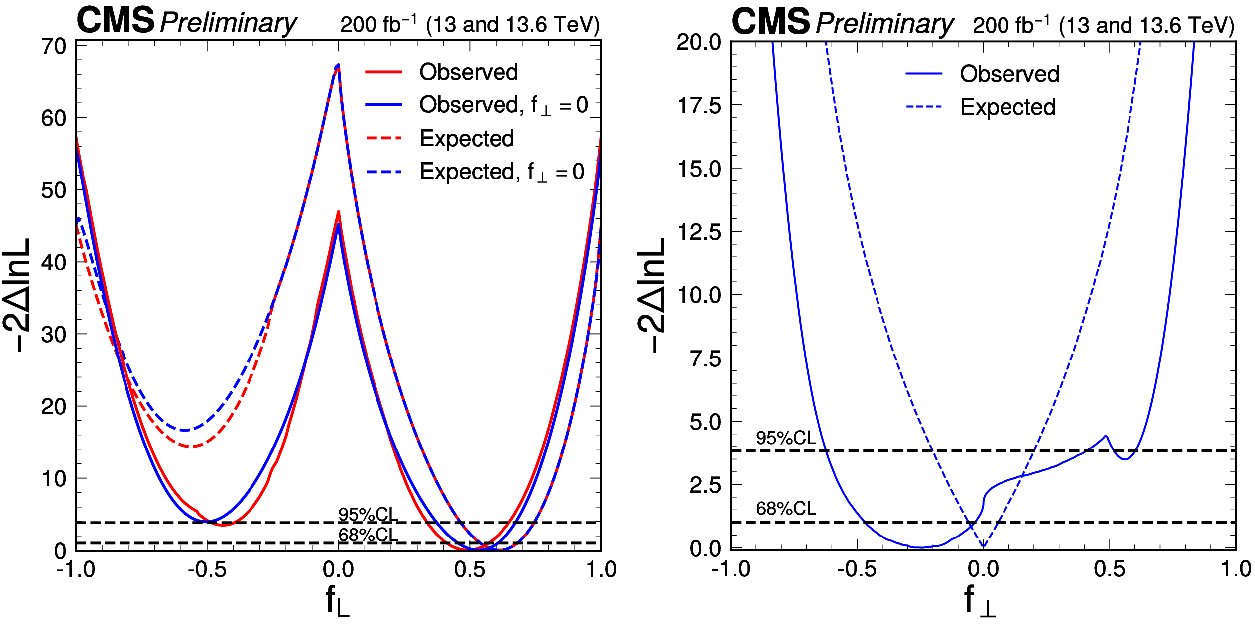
CP structure of Higgs and entanglement of Z bosons
Dashed blue line - f_{Λ1}= 0.5
D_{CP}
D _{int}
D^{Zγ}_{CP}
D^{Zγ}_{int}
Bonus: The model with no permutation of leptons is excluded at 2.7 σ level – muons are identical particles!
D^{γγ}_{CP}
D^{γγ}_{int}
The fully longitudinal (f_{L}) and fully transverse (f_{T}) Z boson polarizations are excluded at >6σ.
➔ entangled state of qutrits (assuming Quantum Mechanics and CP conservation)
conditions exist for measuring violation of the Bell-type inequality in the H→ZZ decays
(assuming large coherence of the transverse and longitudinal amplitudes)
CMS-PAS-HIG-25-011

Slide 14
EFT analysis of HVV couplings
Dashed blue line - f_{Λ1}= 0.5
D_{CP}
D _{int}
D^{Zγ}_{CP}
D^{Zγ}_{int}
D^{γγ}_{CP}
D^{γγ}_{int}
Observed and expected constraints on fractional contribution in the EFT framework.
A simultaneous measurement of eight Higgs boson couplings to electroweak vector bosons is carried out within the frameworks of anomalous couplings and effective field theory.
CMS-PAS-HIG-25-011

Slide 15
Top quark-antiquark pair at LHC

Slide 16
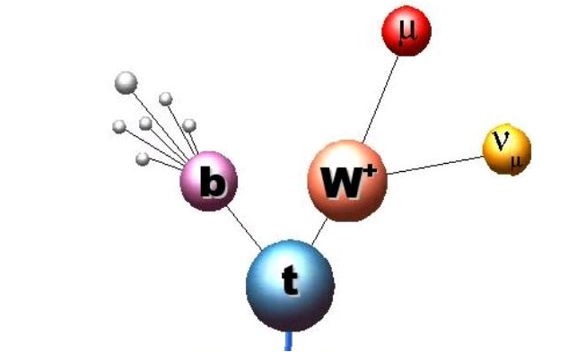
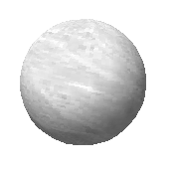
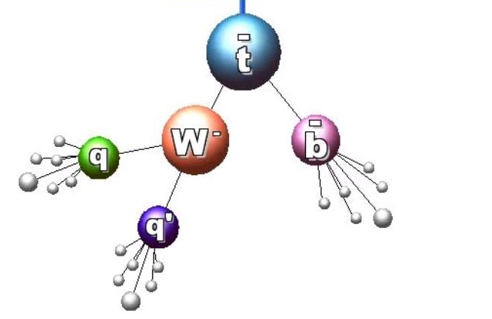
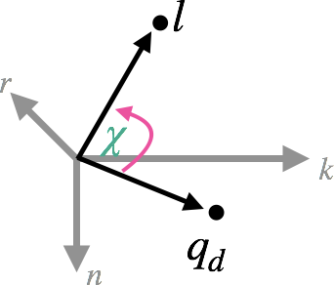
Spin correlation in top-antitop system
Polarization, P and spin correlation matrix, C determines the angular distribution of the decay products in the helicity basis as in [1212.4888]
- spin analyzing power of top/antitop decay products – max for charged leptons and d-type quarks (d or s)
Ω – unit vector in the direction of the decay product
2^{X}3(P)+3^{X}3(C) =15 coefficients Q_{m}
There is a shortcut: use χ –opening angle between the two decay products in rotated tt frame (a.k.a helicity angle)
and χ, where the sign of n-component in one of the decay products is inverted:
~

Slide 17
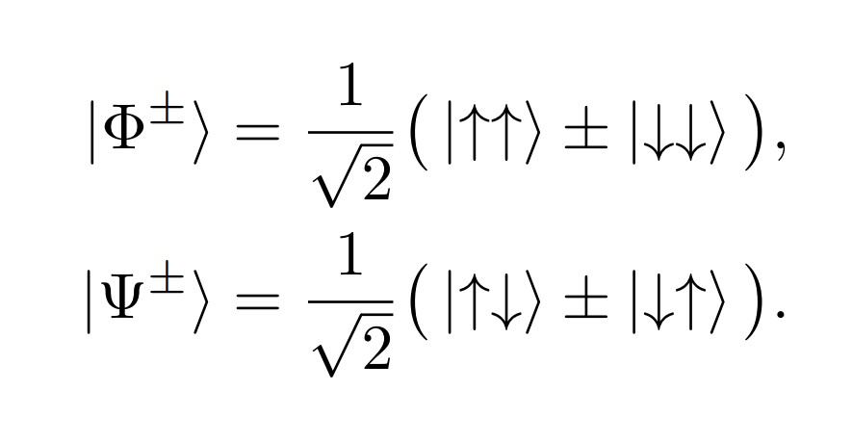
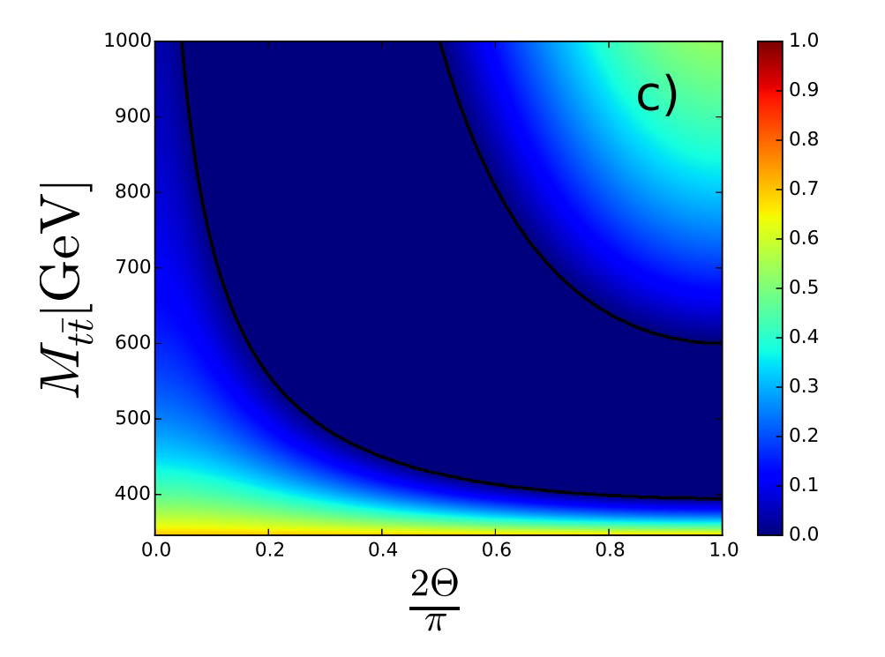
Spin correlation and entanglement in ttbar system
Top quark has s=1/2, it is a qubit → Top-antitop quark pair is a two-qubit system
The system is considered separable if its density matrix can be factored into individual states
Otherwise, it is considered entangled → Peres-Horodecki criterion
There are four pure maximally entangled (Bell) states:
A. Peres, Phys. Rev. Lett. 77, 1413 (1996).
P. Horodecki, Physics Letters A 232, 333 (1997)
at low singlet pseudoscalar state Ψ⁻
Peres-Horodecki criterion
at high triplet vector state
(Φ⁺-Φ⁻, Ψ⁺, Φ⁺+Φ⁻)
Peres-Horodecki criterion
Plot from Afik, De Nova
EPJP136(2021)9,907
hep-ph:2003.02280
Top angle with the beam axis

Slide 18
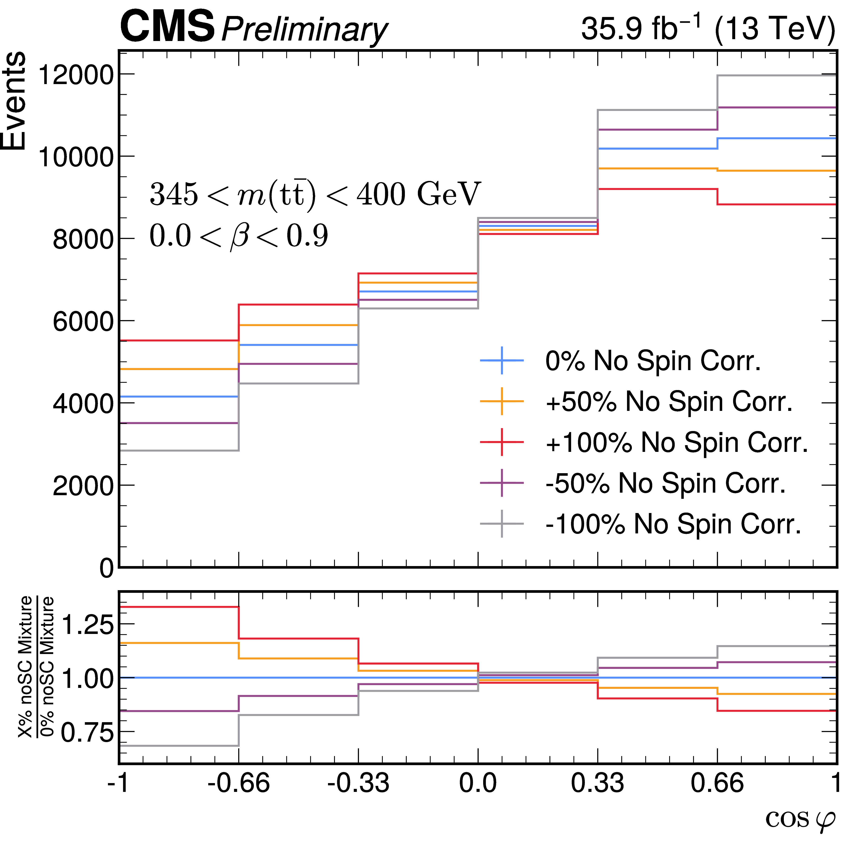
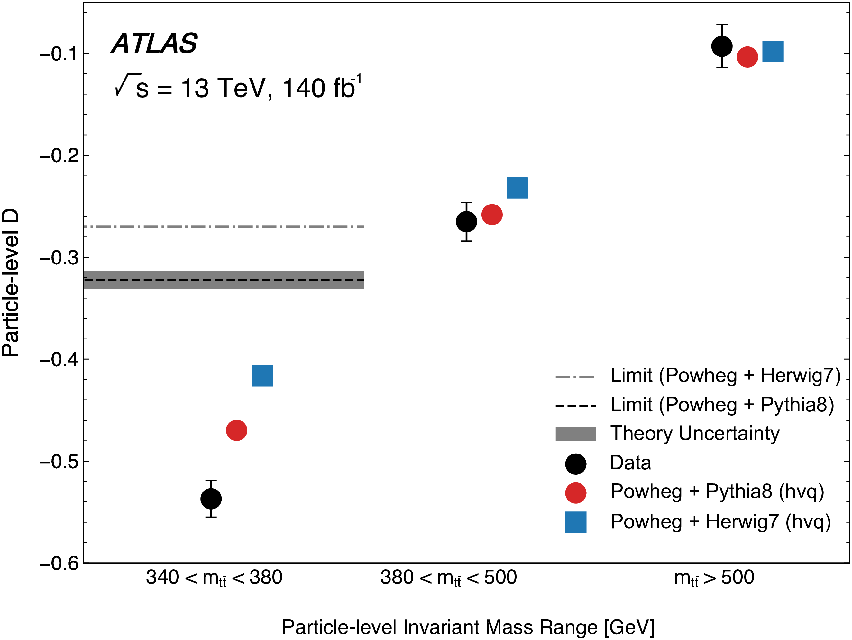
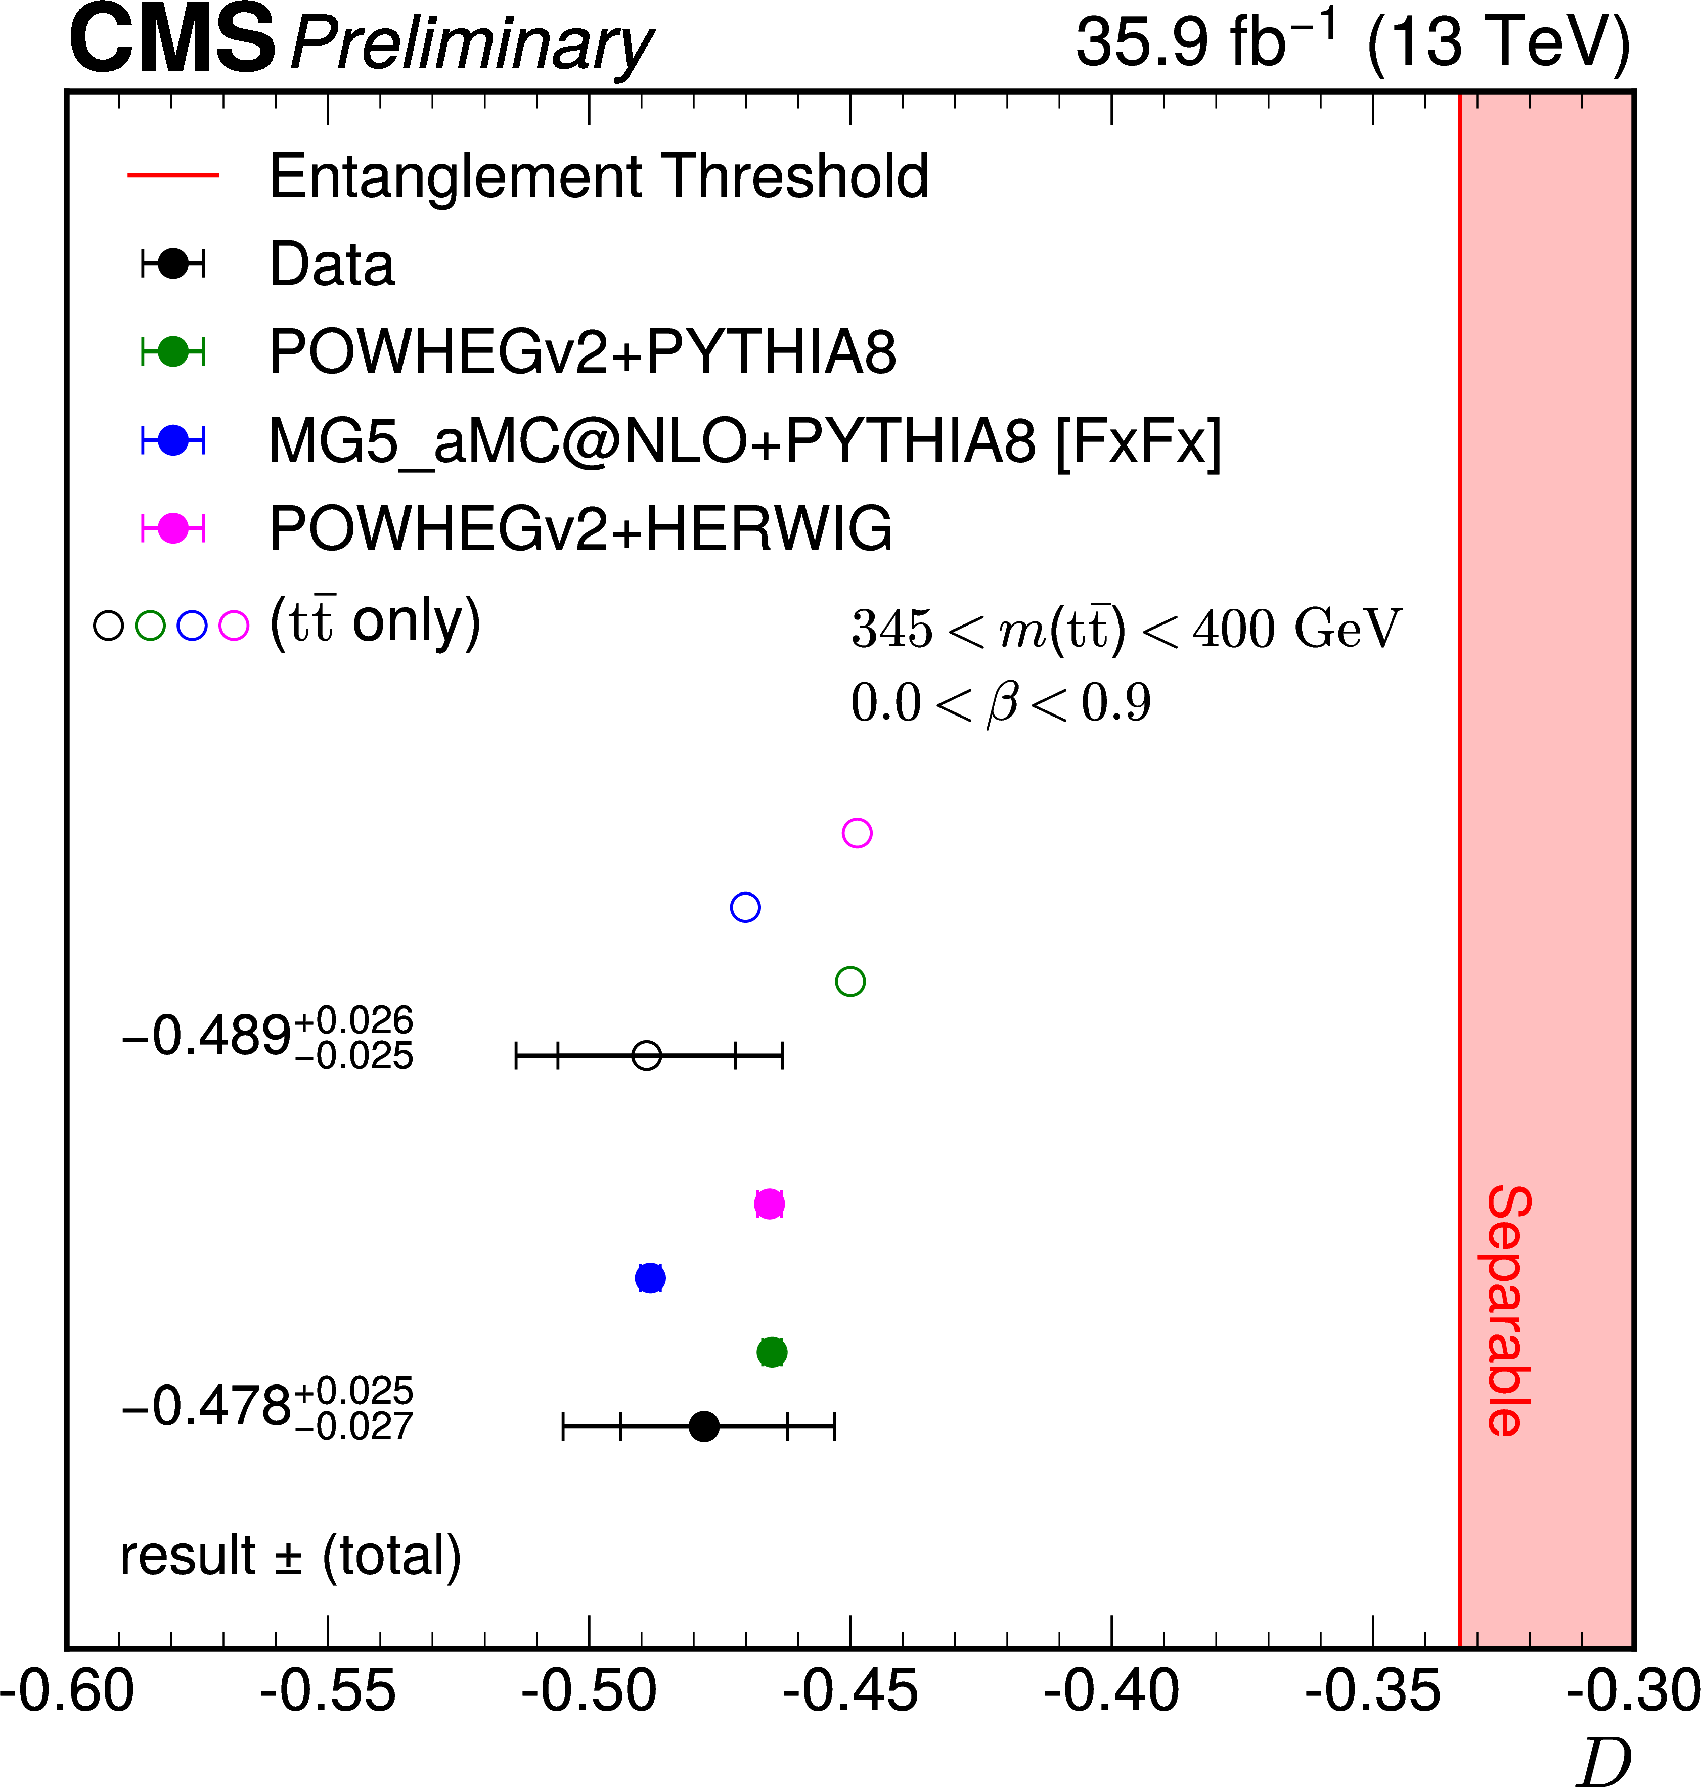
Dilepton channel
Advantages of dilepton channel: clean, have 2 charged leptons(max spin analyzing power)
To extract D we measure the distribution in the sensitive variable – cos χ – fit for the slope
The ttbar entanglement is observed (expected) at the 5.0(4.7)𝜎 level for 345<Mtt<400 GeV, β<0.9
Nature 633, 542–547 (2024)
ROPP 87 (2024) 117801

Slide 19
L+jets channel
We pursue both strategies – evaluation of the full correlation matrix C and polarization vectors P as well as D and D~ measurements
The measurements are done inclusively and differentially in bins of M_{tt}, cosθ and top quark p_{T}
Event reconstruction (jet-parton assignment) is performed using NN
Lepton+jets have higher statistics and better Mtt resolution, but
Major challenge – identify d-type jets from W boson decay
Divide events into categories based on lepton flavor, number of b-tags, and NN score
Fraction of tt events with correctly assigned jets to partons including d-type quark
PRD 110 (2024) 112016

Slide 20
Extraction of spin correlation
We observe the distribution over top quark decay products:
Full measurement of the vectors P and matrix C is performed using templates defined based on the functions of angles of top and antitop decay products
The total cross section is a linear combination of these templates with coefficients Q_{m} components of P and C
Σ_{m} Theoretically predicted distributions in angles of decay products
T_{m} Reconstruction level distributions, which take into the account selection criteria, efficiency and resolution of the detector.
Data distribution is fit the sum of T_{m} with free coefficients – P_{i} and C_{ij}
PRD 110 (2024) 112016

Slide 21
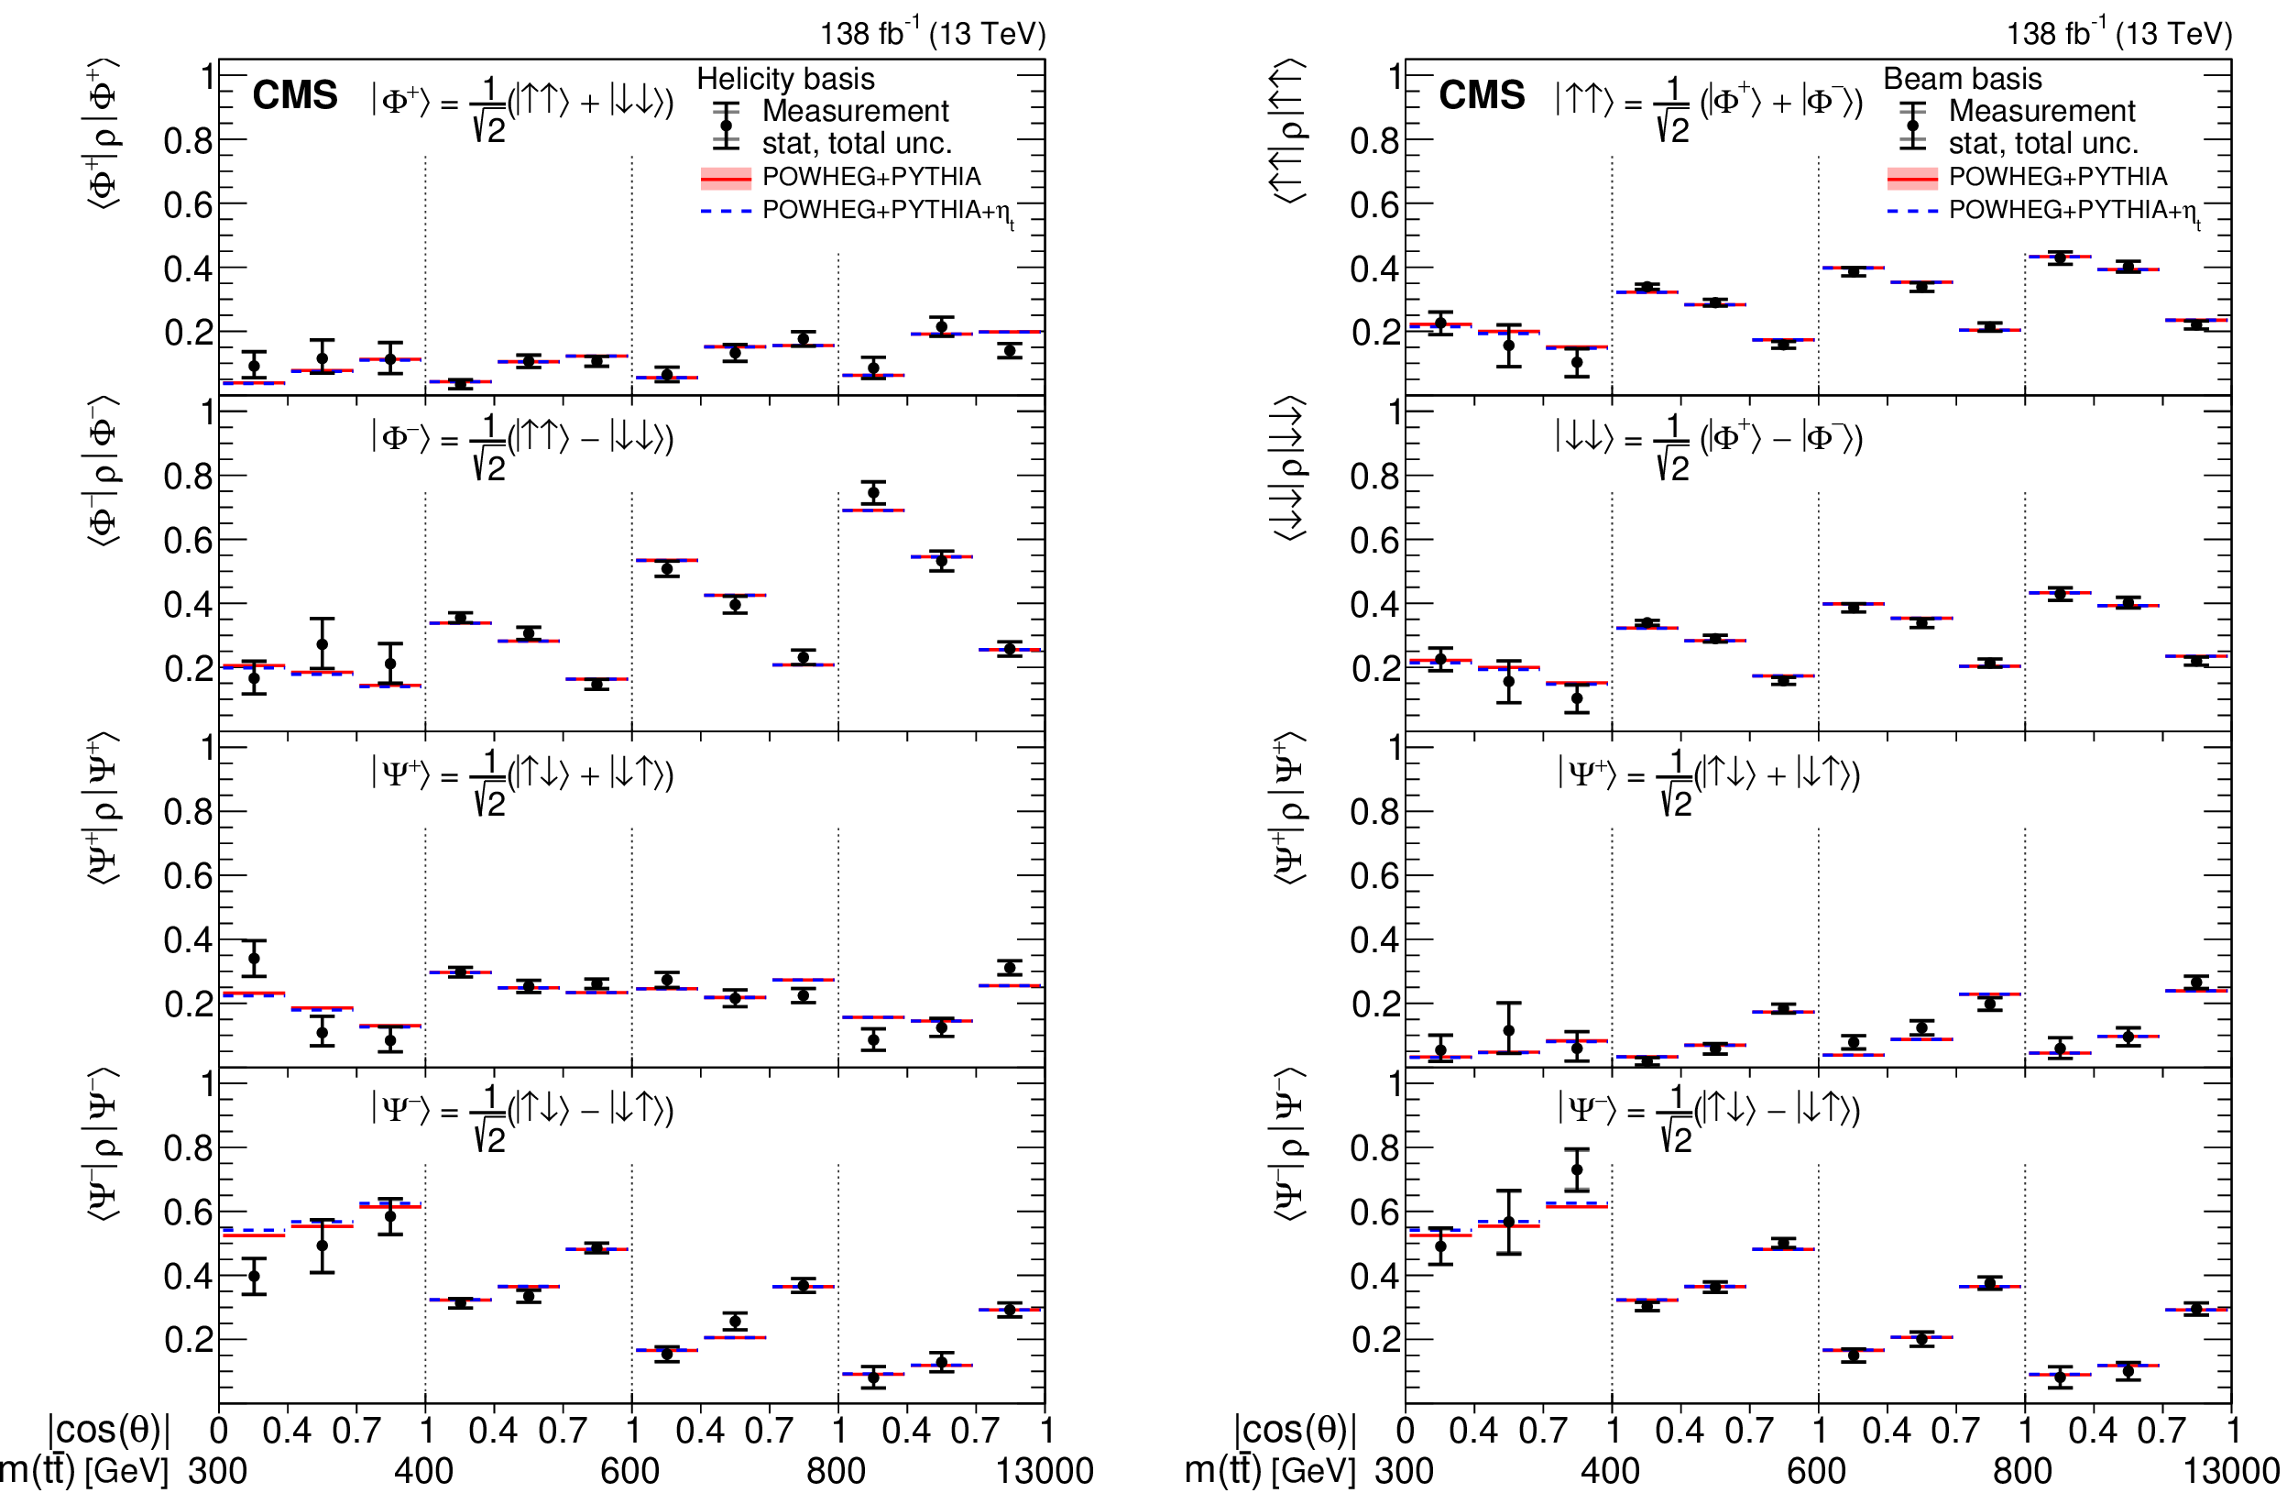
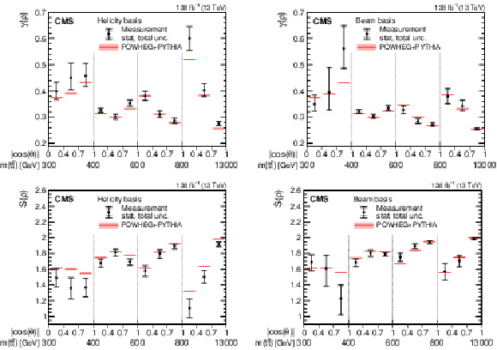
Decomposition into eigenstates
Based on the measured polarizations and full spin correlation matrix we can construct the probability density matrix and decompose it into its eigenstates, evaluate properties like purity and von Neumann entropy Phys. Rev. D 113, L051101 – DOI: https://doi.org/10.1103/hkgw-dztk
At the threshold – mostly pseudoscalar
At high Mtt – mostly vector, highest purity and lowest entropy

Slide 22
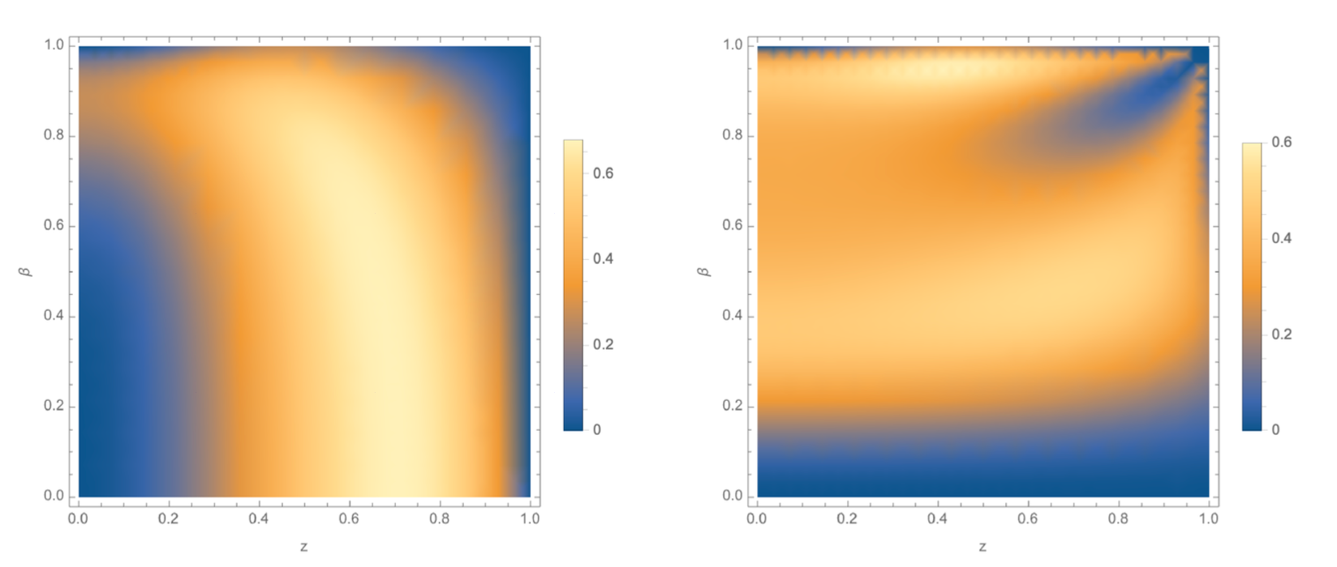
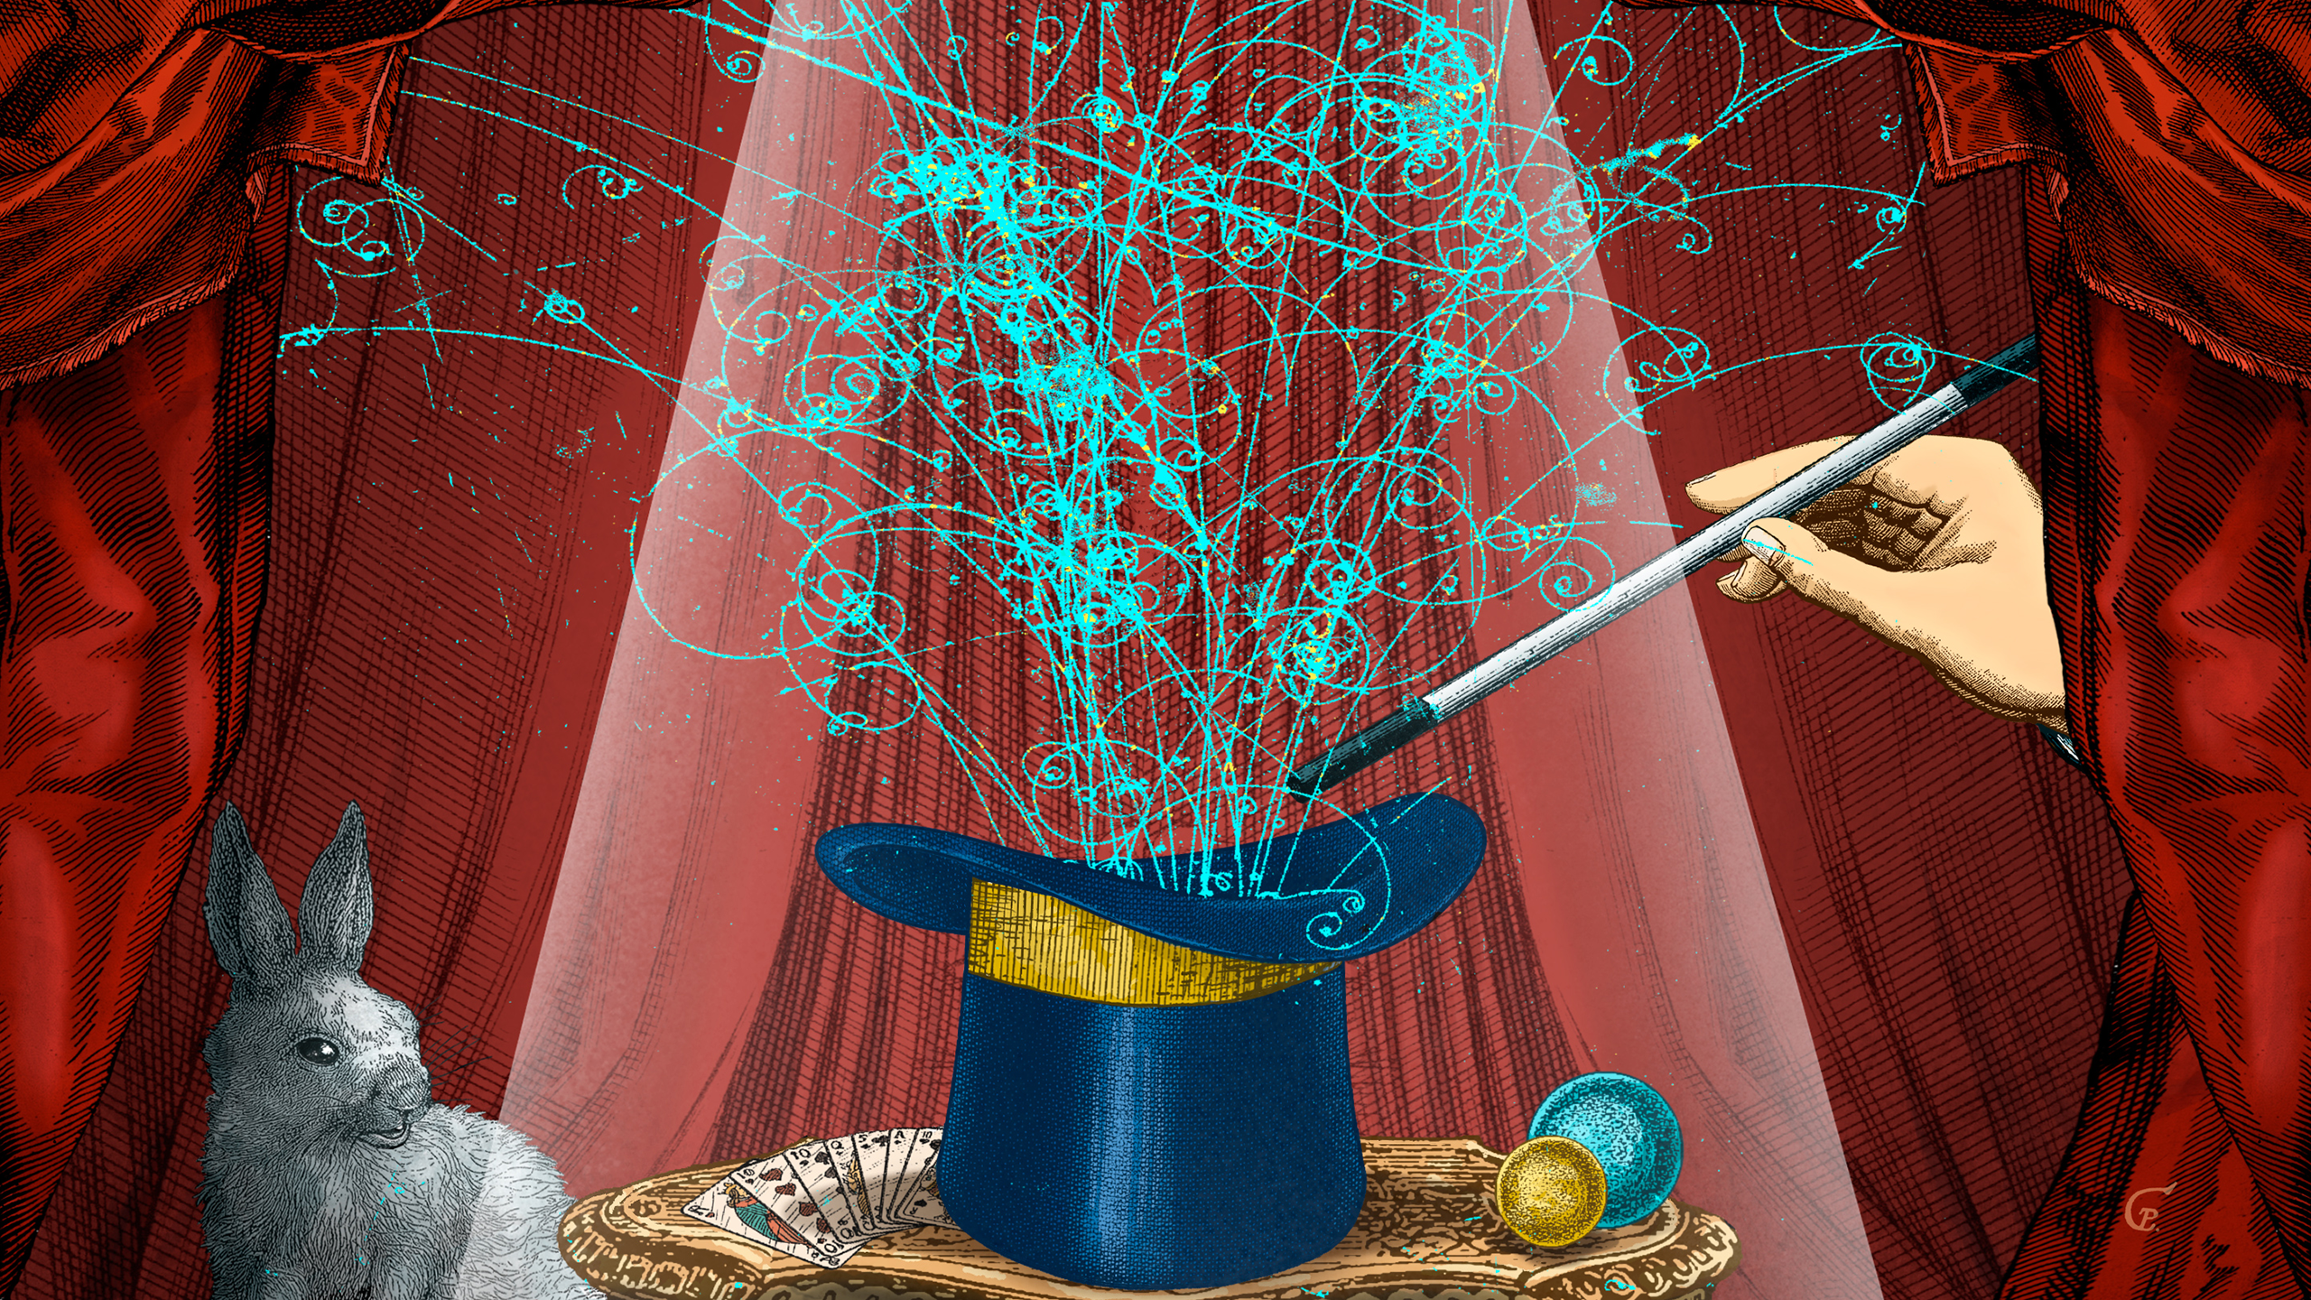
Quantum magic
Knowing the full spin correlation matrix allows to evaluate many quantum information properties of the system
Quantum computers are expected to vastly outperform classical computers.
Naïvely, this is due to quantum superposition and entanglement.
However, this not quite true.
To see why, we need the concept of a stabiliser state
Gottesman-Knill theorem: For every quantum computer containing stabiliser states only, there is a classical computer that is just as efficient!
Need quantum magic - Stabilizer Rényi Entropies
Phys.Rev.D 110 (2024) 11, 116016
β
qq gg
Cos θ
2602.15115
Magic – story got picked up by Quanta Magazine

Slide 23
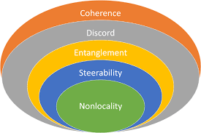
More QIS from ttbar
Discord – a measure of correlation beyond classical mutual information
Entanglement =non-separability
Steerability – ability to influence (or steer) the result of the measurement on the “Bob” (top antiquark) part of the system by observing “Alice” (top)
Bell inequality violation marker – if > 1 BIV can be observed in this region of phase space
Discord Entanglement Steering Bell inequality
2602.15115
Observed steering
with >3σ significance

Slide 24
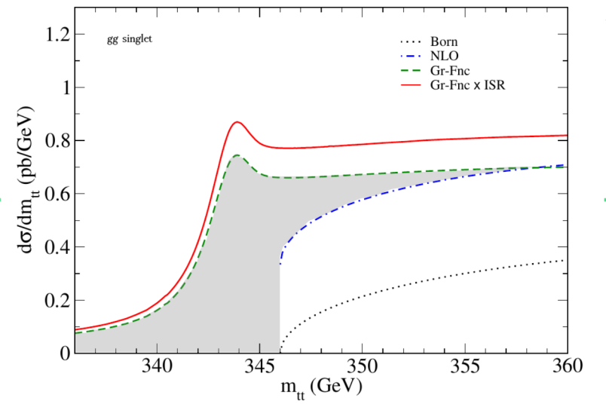
Toponium predictions
Top quark is very short-lived O(10⁻²⁵s)< hadronization time O(10⁻²⁴s)
It is not expected to form bound states, but, in quantum mechanics what is not forbidden is allowed
A small contribution from the ttbar bound state (pseudoscalar color singlet)
[Z. Phys. C 48 (1990) 613] hypothesized before top quark discovery
Expected just below the production threshold K. Hagiwara et al. PLB 666 (2008) 71
More recent works: B. Fuks et al Phys.Rev.D 104 (2021) 3, 034023 – Green function reweighting, Wan-Li Ju et al. [2004.03088] use NR-QCD
Small and narrow color-singlet pseudoscalar resonance with a mass of 343 GeV and a width of 2Γ_{t,} σ=7 pb.
ttbar +toponium resonance
For 14 TeV: total effect 336–346 GeV is about 6.5 pb [K. Hagiwara et al. PLB 666 (2008) 71] with gg singlet Green-function about 4.2 pb (grey area)

Slide 25
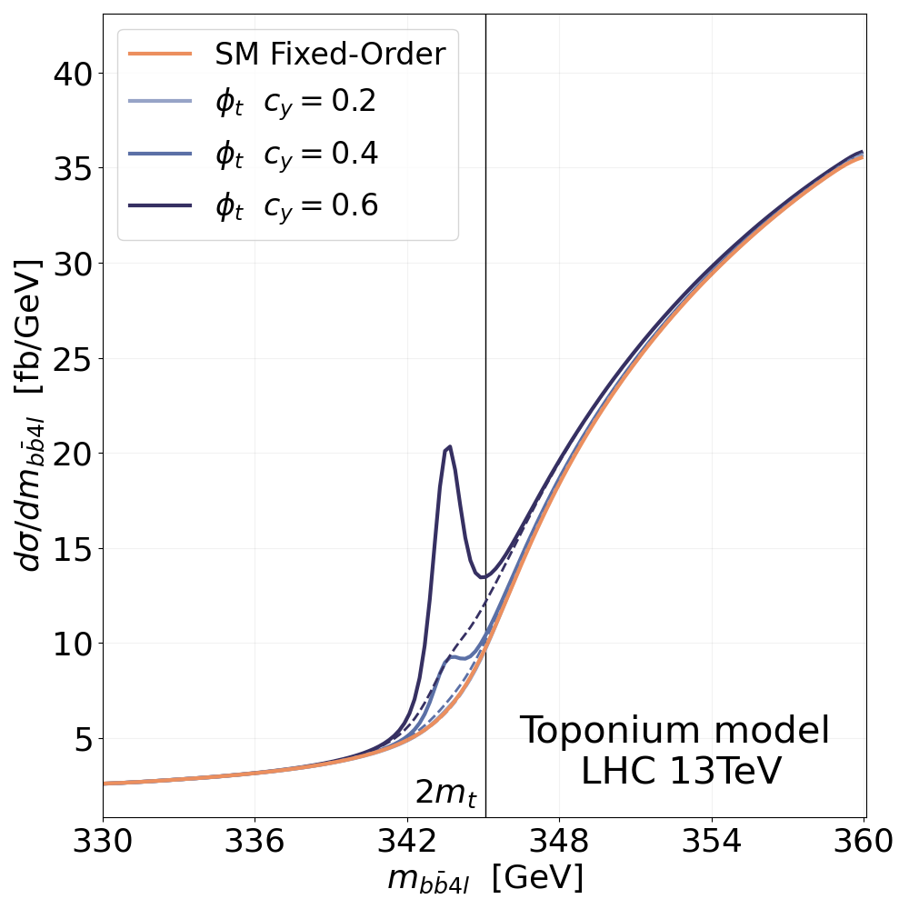
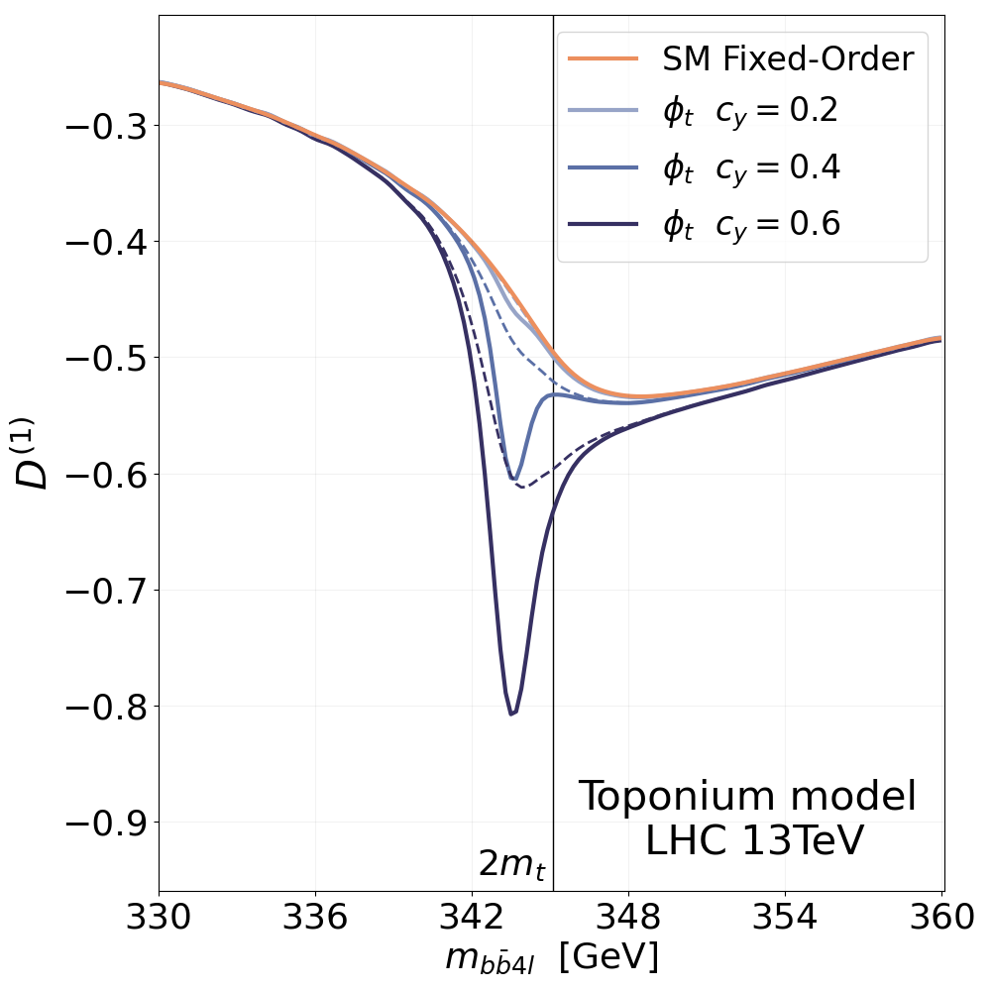
Toponium and entanglement
Toponium (pseudo-scalar color singlet predicted by non-relativistic QCD)
  M(toponium)-344 GeV, σ=~6.5pb
    Sumino, Fujii, Hagiwara, Murayama & Ng (PRD`93)
    Jezabek, Kuhn & Teubner (Z.Phys.C`92)
    B. Fuks et al. (PRD 104 (2021) 034023)
  Toponium affects both the invariant mass distribution and entanglement at the threshold, but
  Full spin correlations provide better sensitivity, than one compound property – entanglement
c_{y} – coefficient in Lagrangian
F. Maltoni et al. JHEP03(2024)099

Slide 26
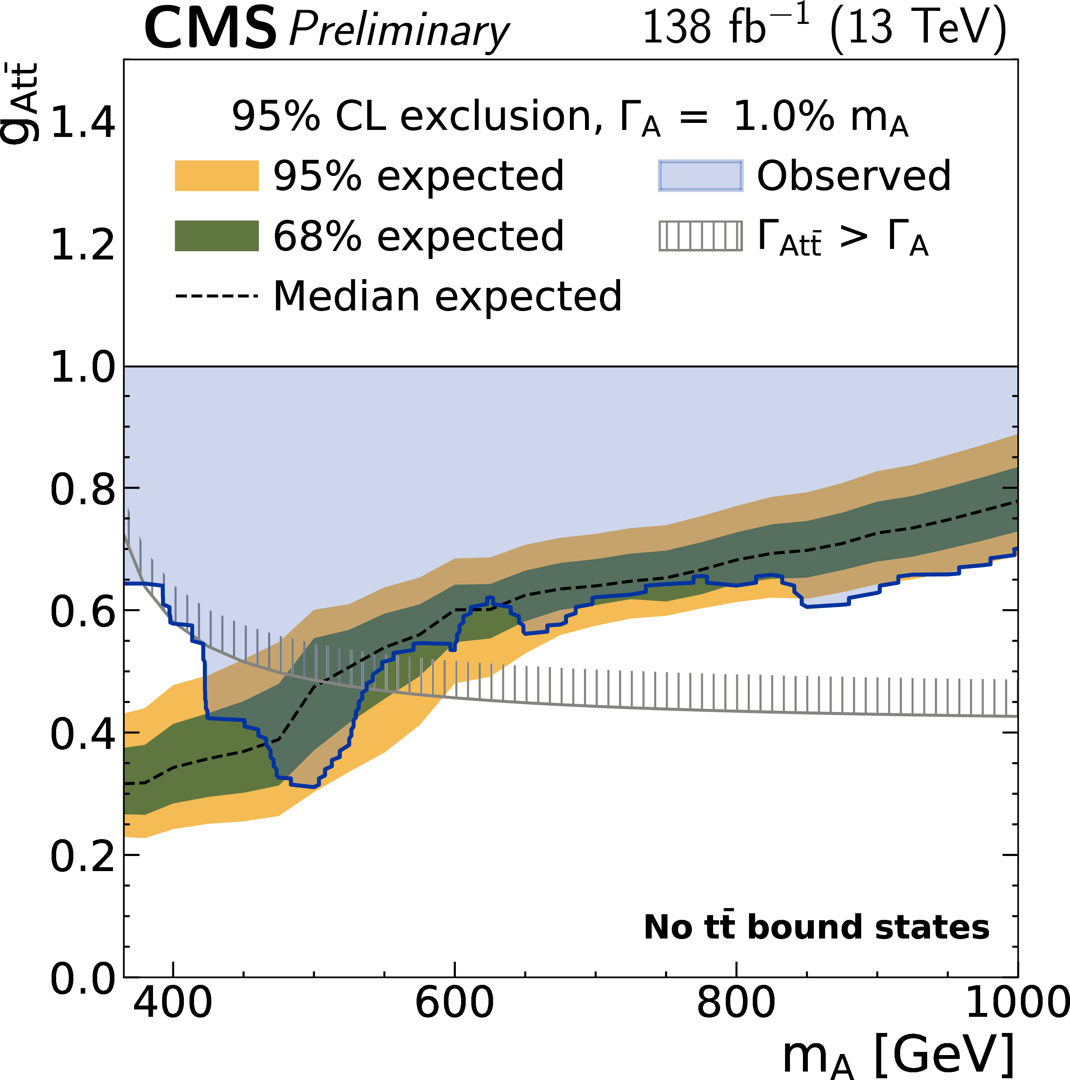
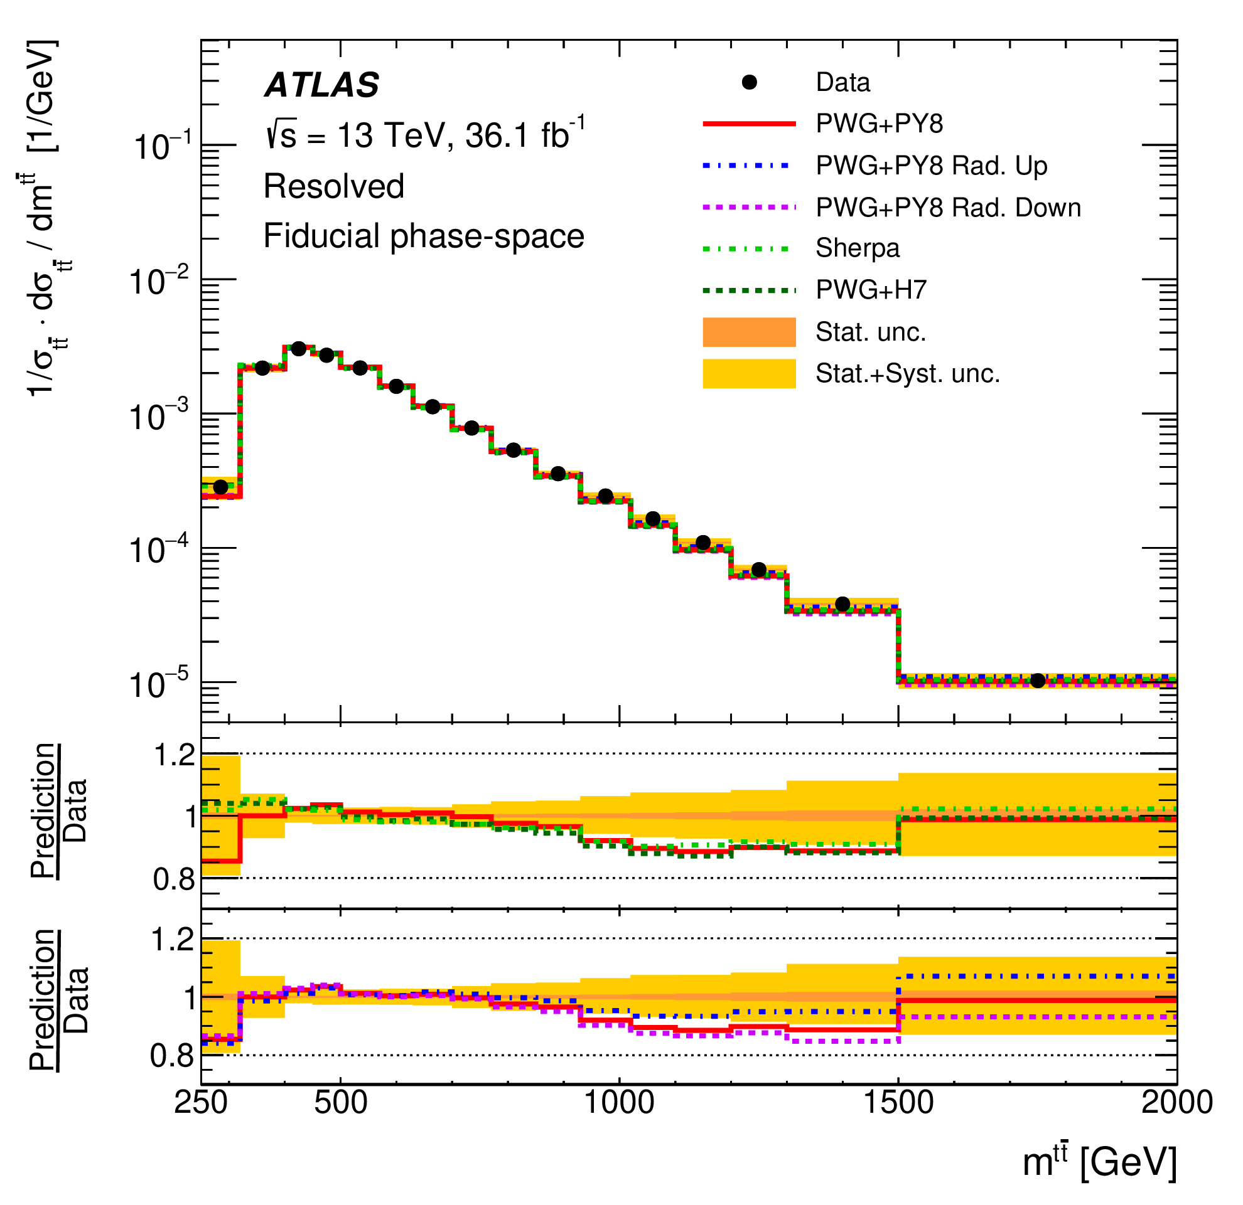
Nature’s hints
w/out Toponium
w/ Toponium
~1.5𝜎 tension with the expectation if toponium is not included – one of many hints (differential cross section, weakened limits in A/H→tt)
Eur. Phys. J. C 79 (2019) 1028
CMS-PAS-HIG-22-013
Submitted to ROPP

Slide 27
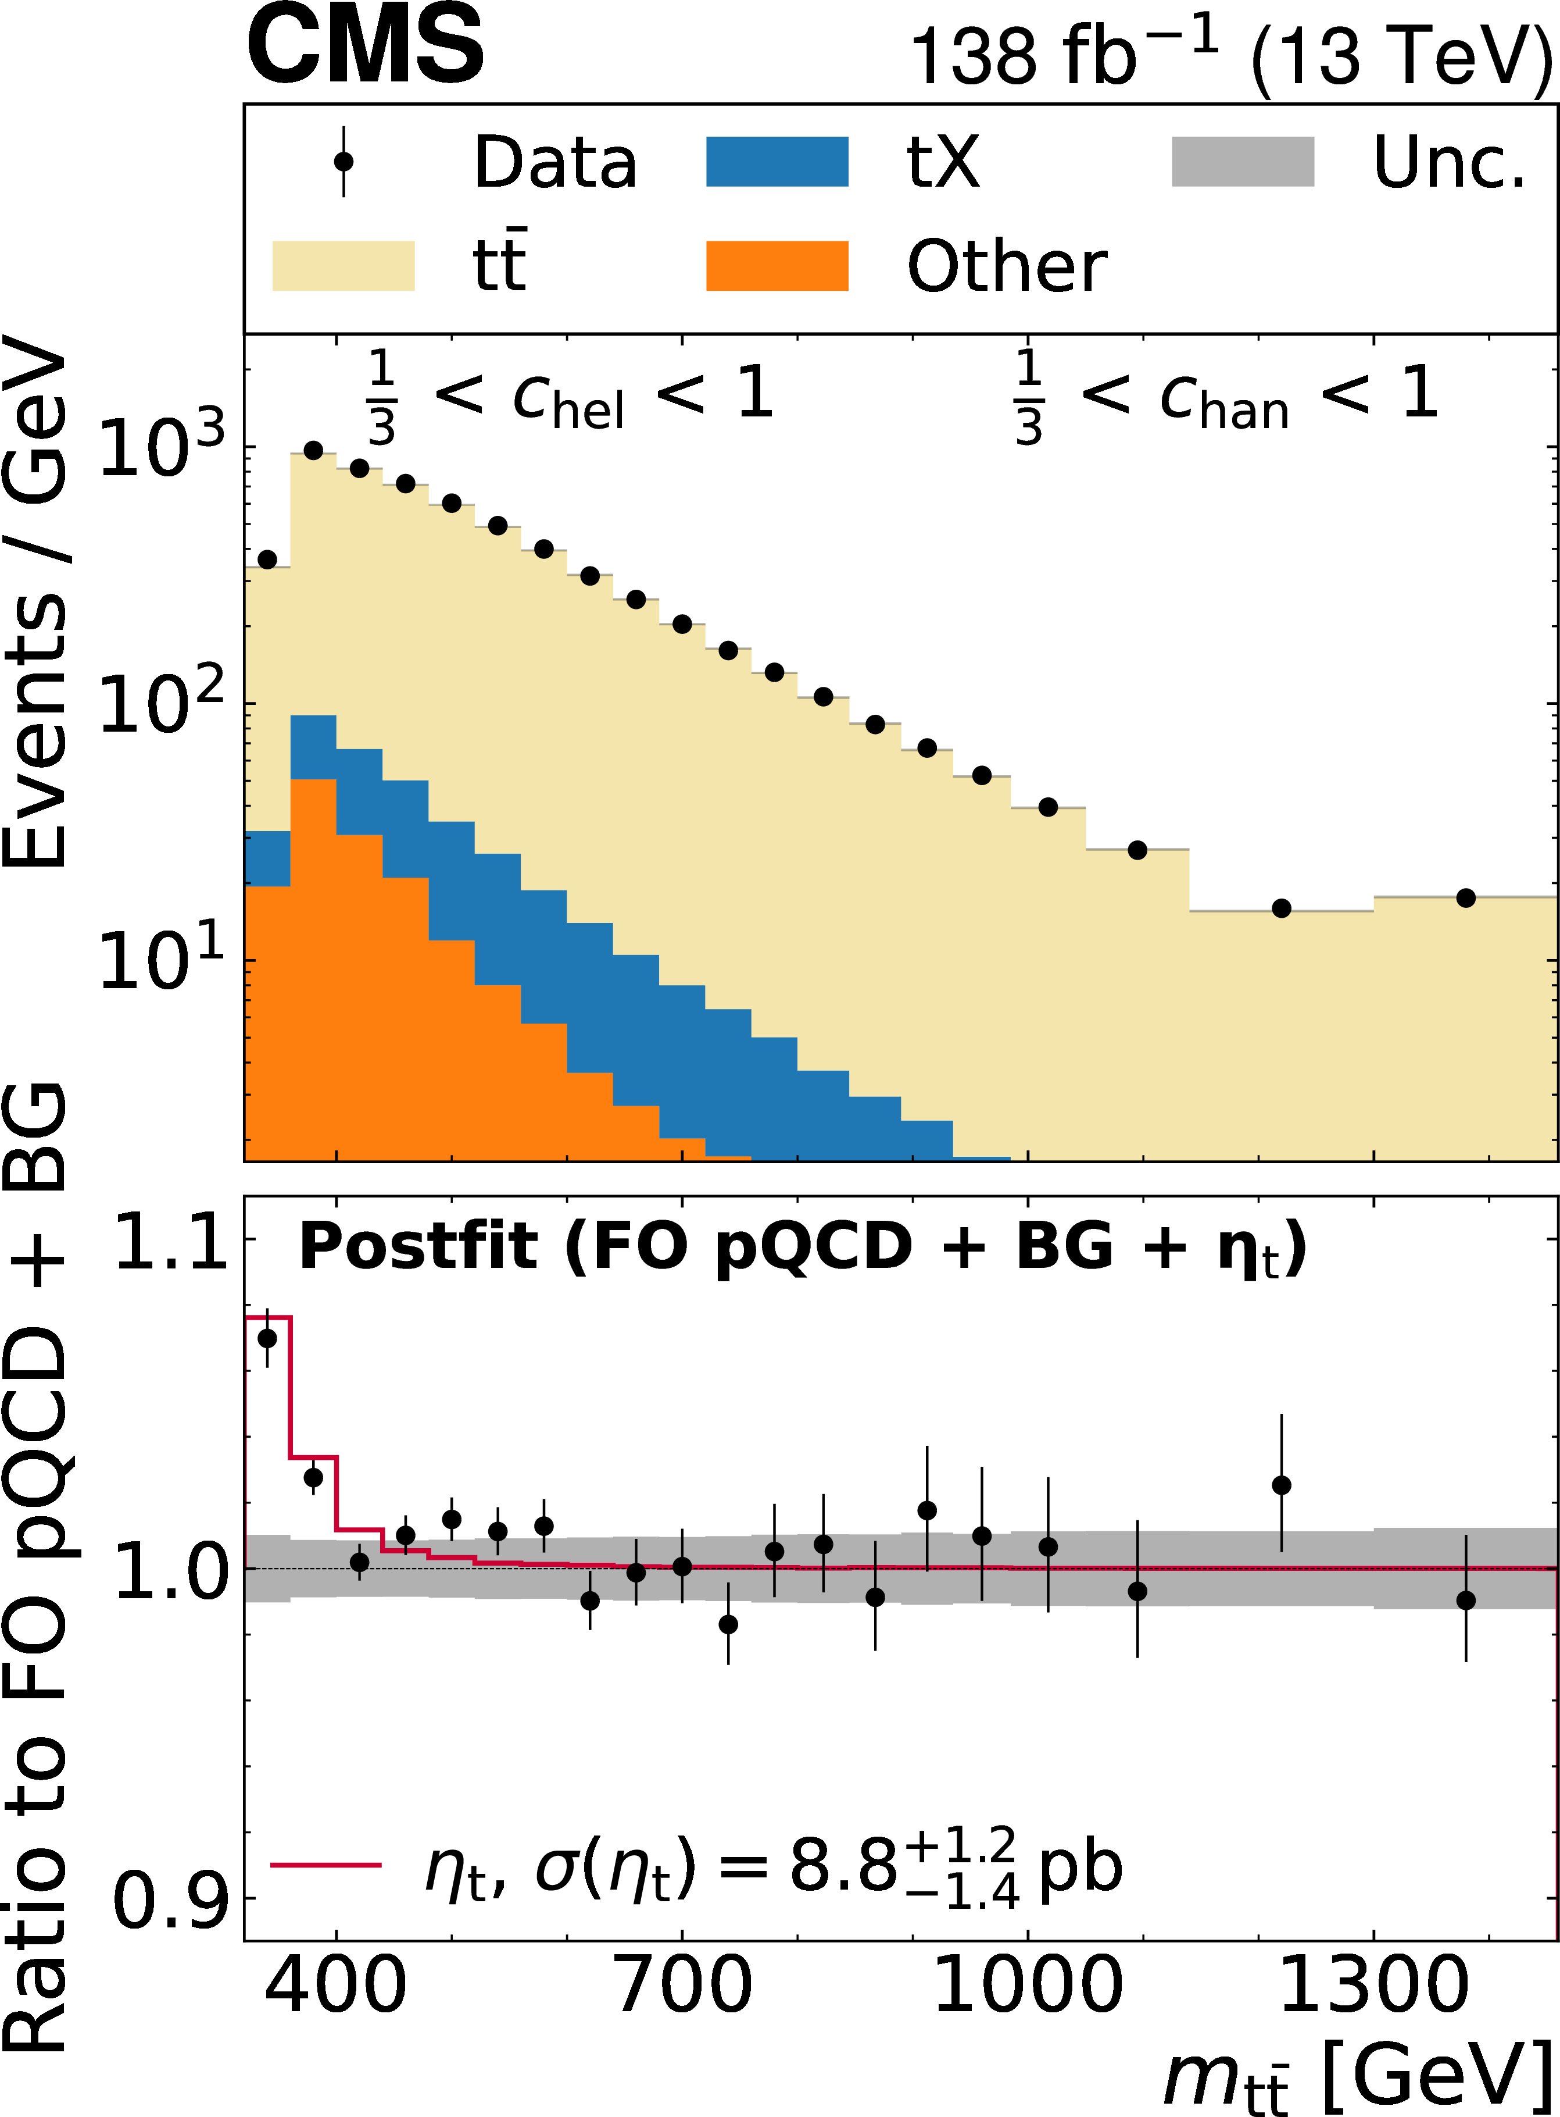
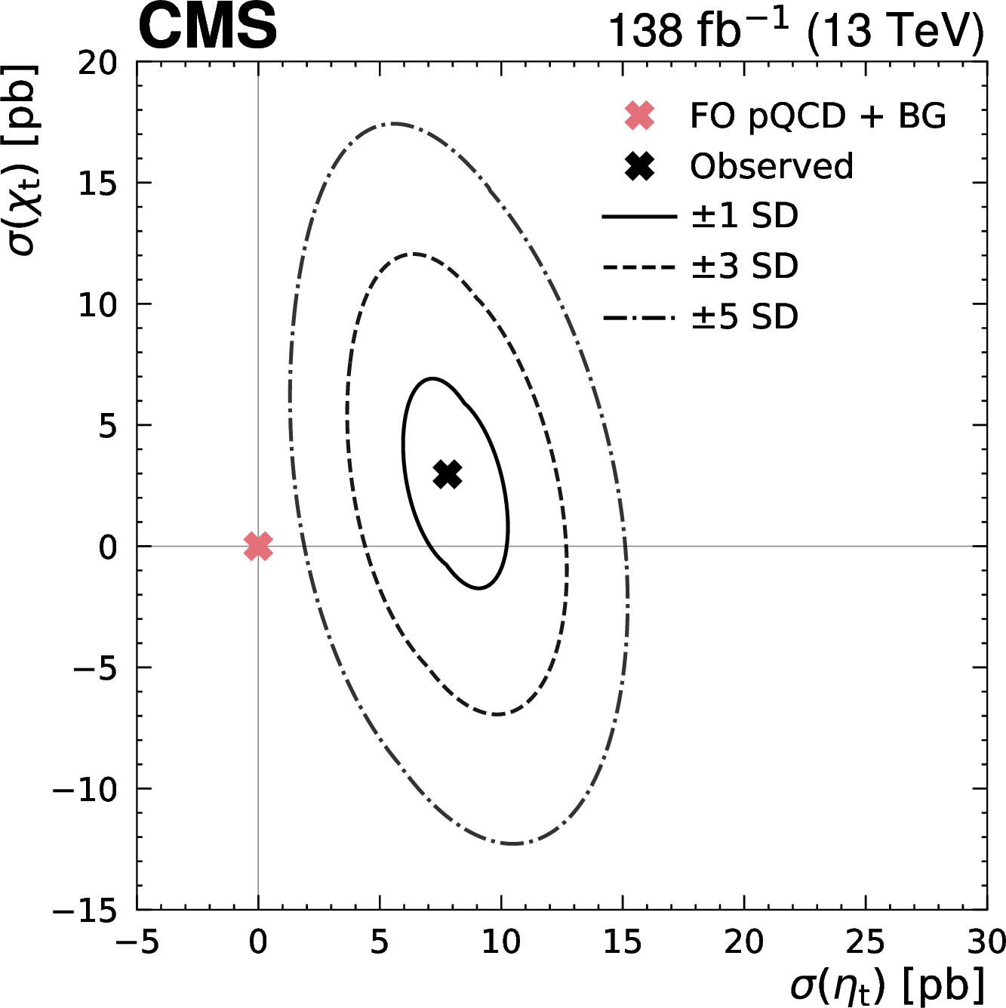
Dilepton channel - CMS
Dilepton channel: Rep. Prog. Phys, 88 (2025) 087801 A significant excess is observed near the t¯t threshold compared to the non-resonant production (pQCD), consistent with the production of a color-singlet pseudoscalar quasi-bound toponium state, predicted by NRQCD.
σ=8.8 +1.2−1.4 pb.

Slide 28
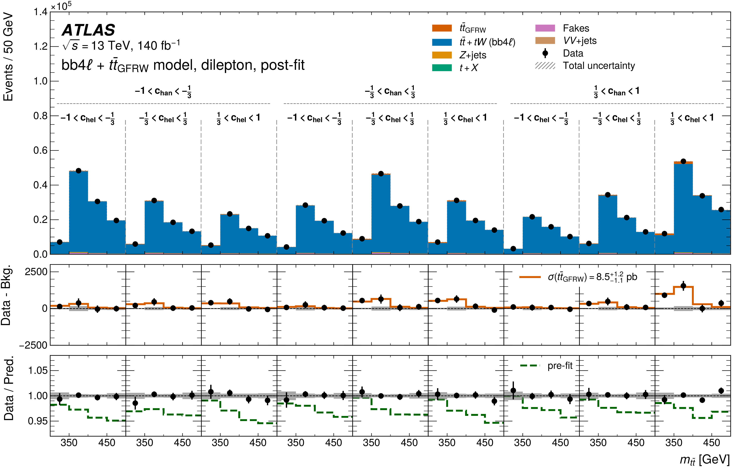
Dilepton channel – Atlas
This excess is consistent with the formation of colour-singlet and spin-singlet quasi-bound states, as predicted by non-relativistic QCD, and corresponds to an observed cross-section of 9.3+1.4-1.3pb.
arXiv:2601.11780

Slide 29
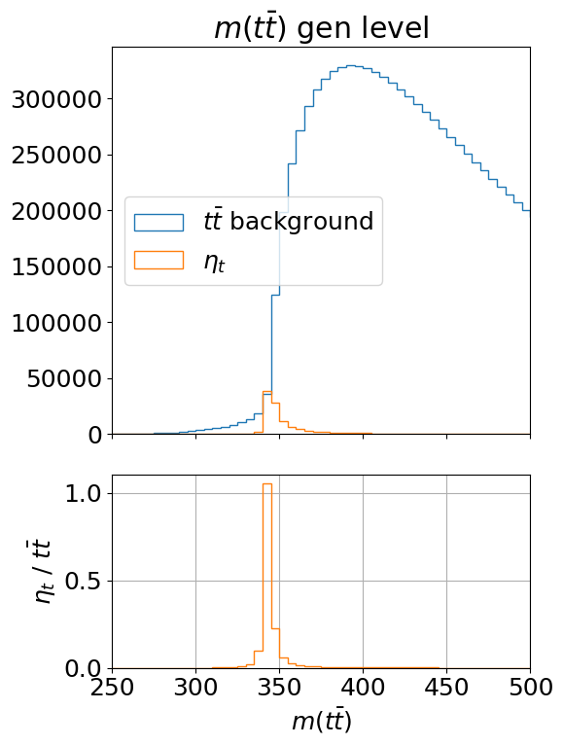
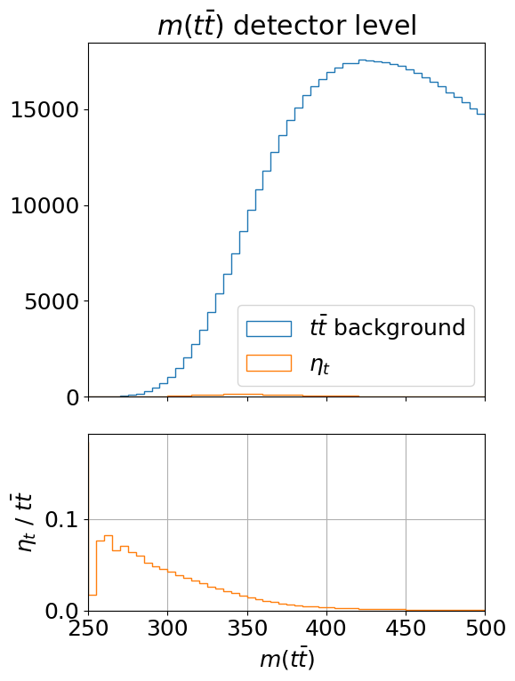
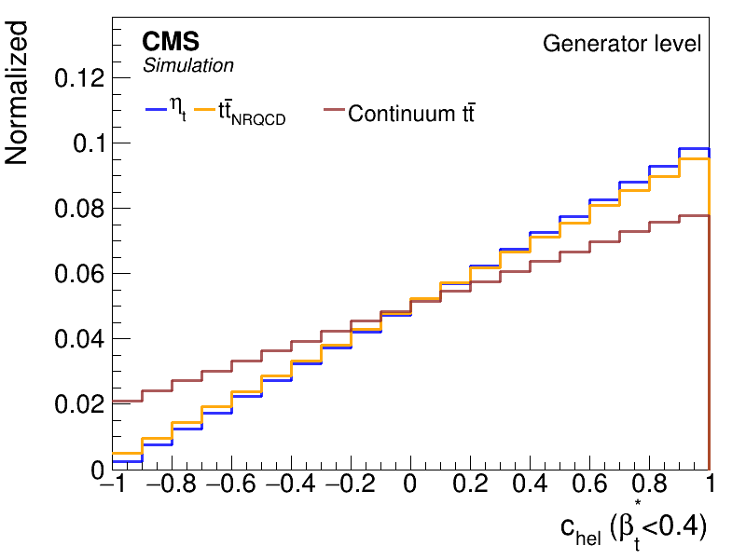
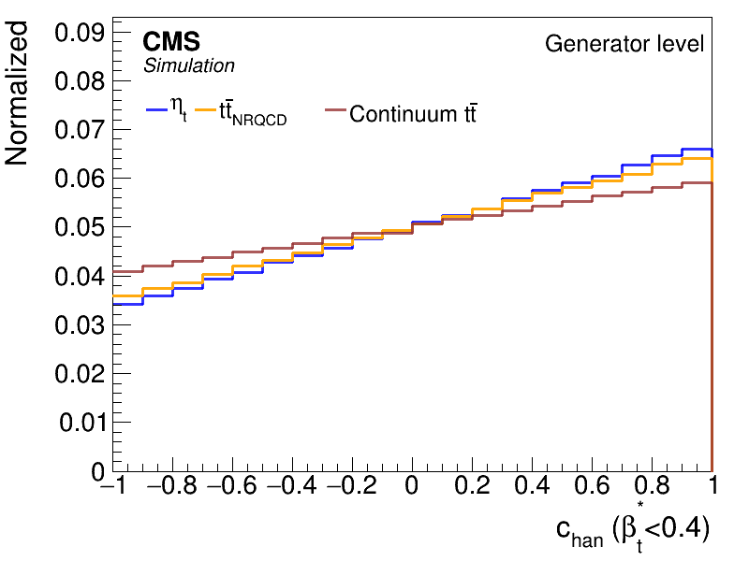
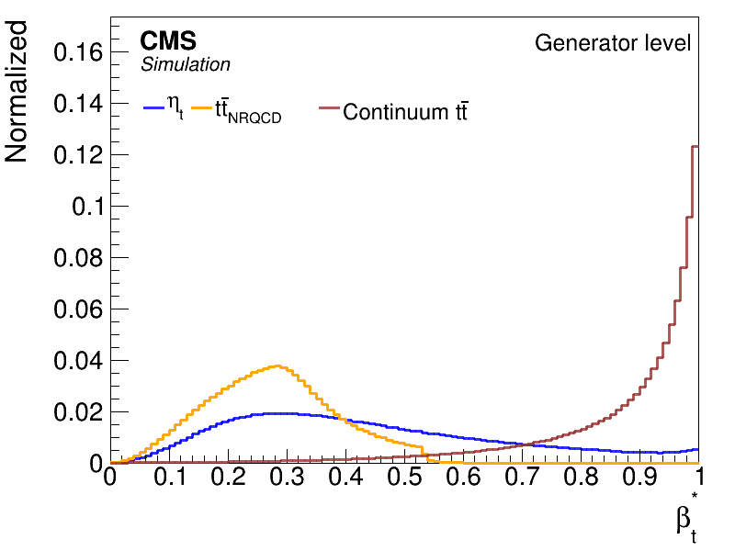
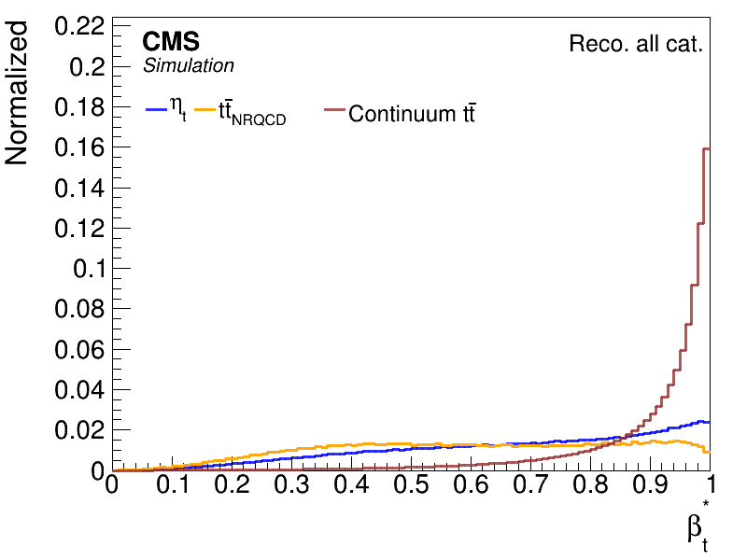
CMS: lepton+jets channel
Mtt, the ttbar invariant mass → β*, the velocity of the top relative to antitop
Several systematic uncertainties (mt, JES, JER) are minimized, if not cancelled
CMS-PAS-Top-25-002

Slide 30
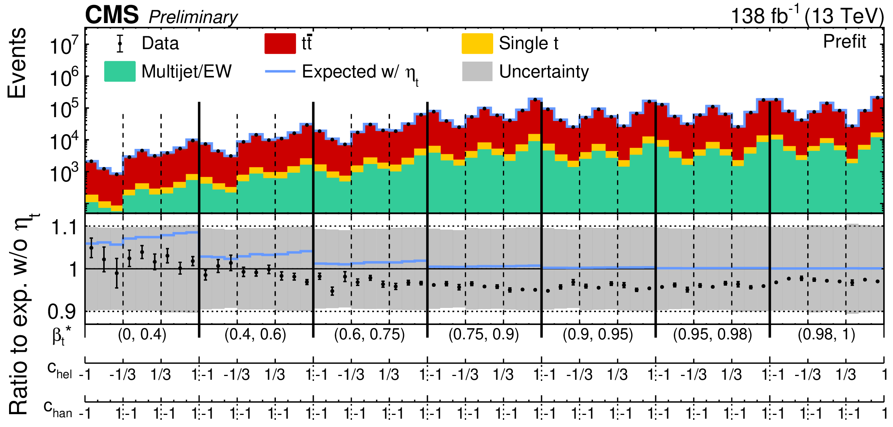
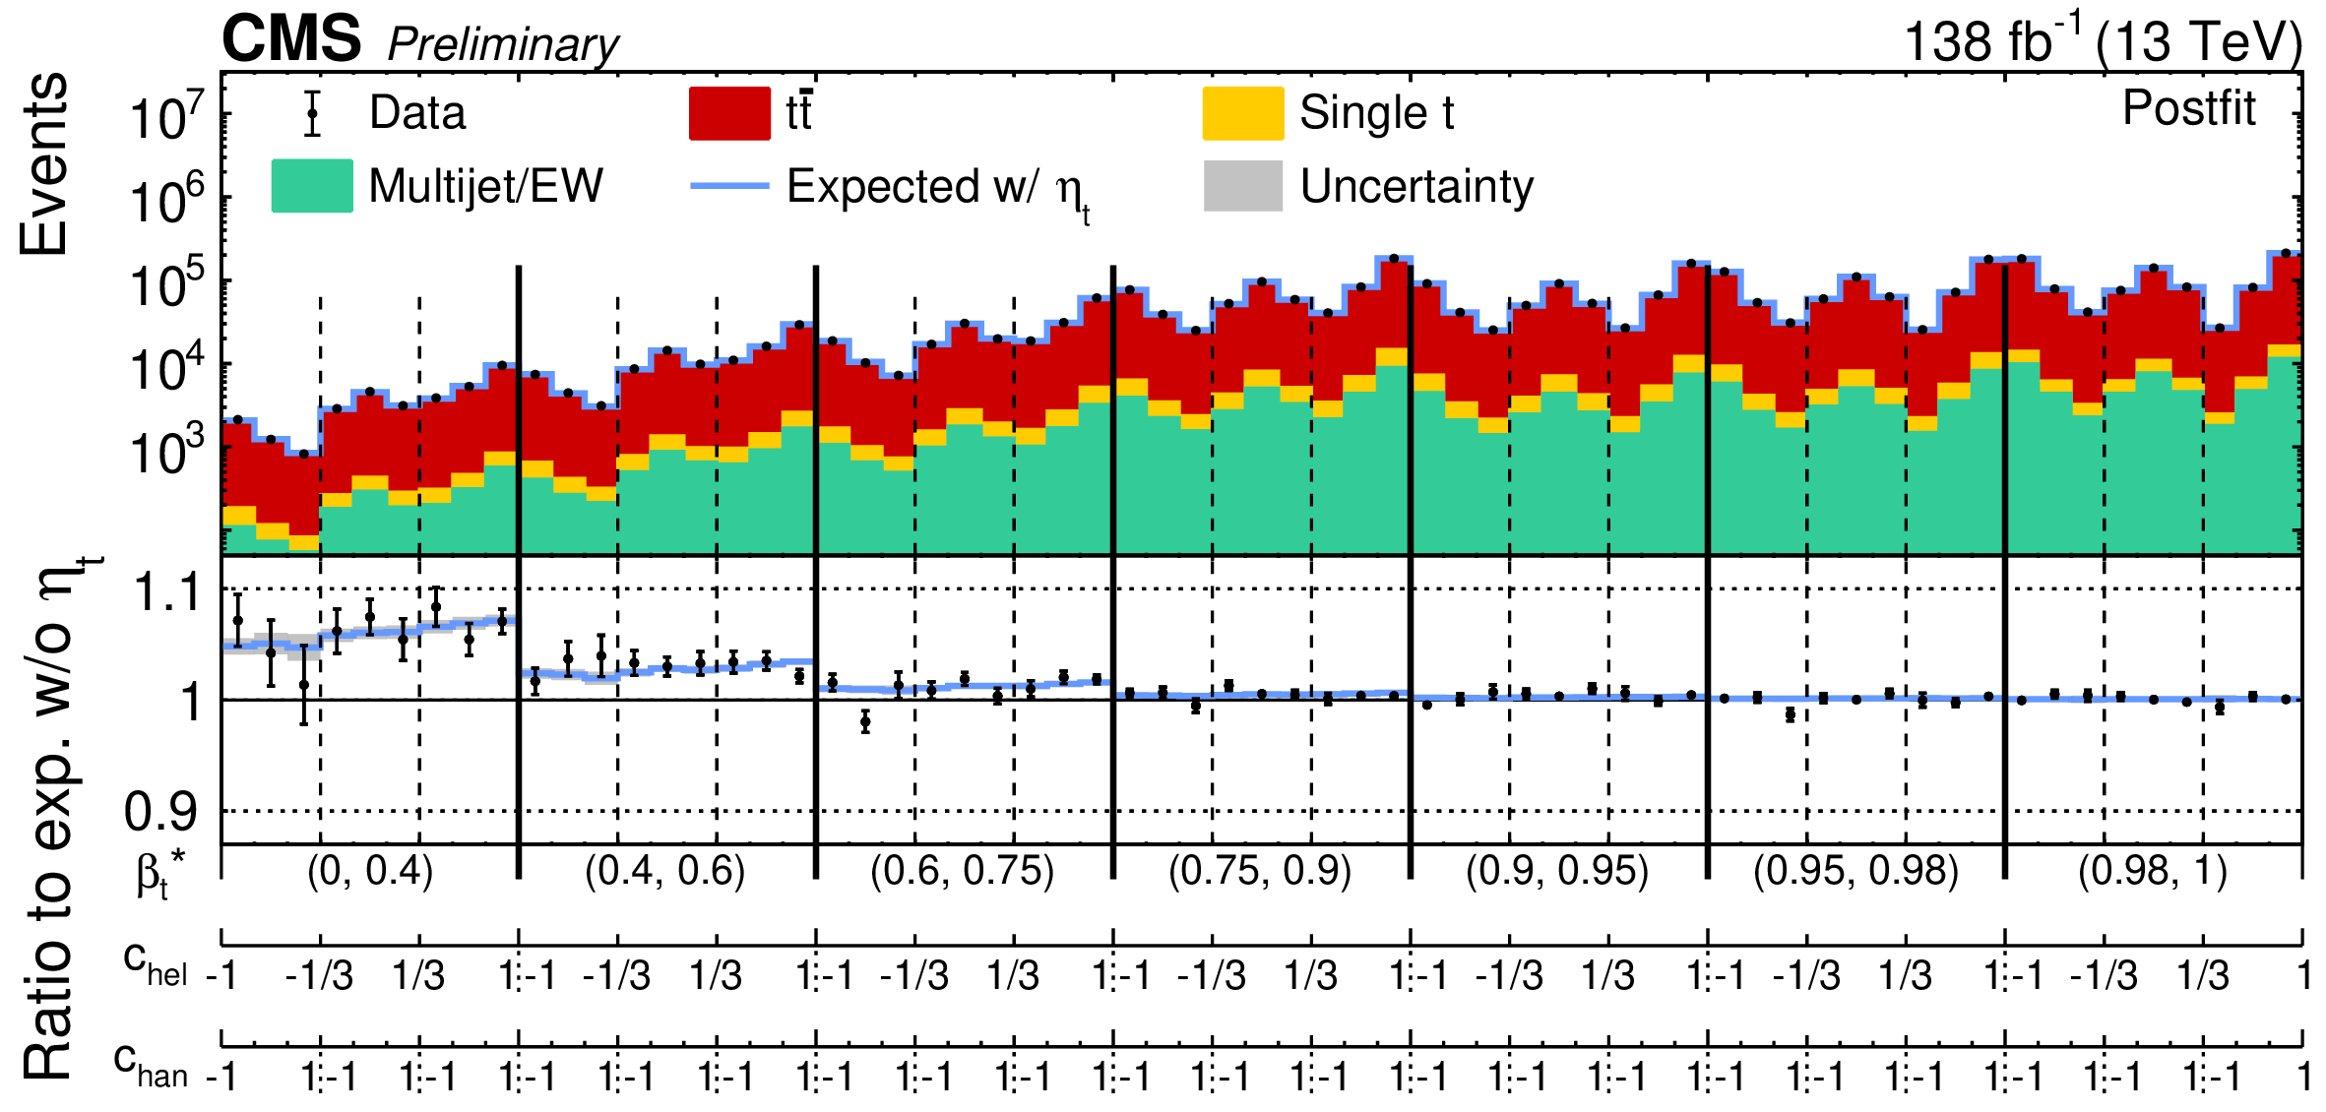
Pseudo scalar excess in lepton+jets
Pre and post-fit “rolled out” distributions in β*, chel, chan
For the baseline use theoretical top pair production σ _{NNLO} =832+40-46 pb
Measured in l+jets σ _{CMS} = 791+-25 pb
Excess of events over the continuum tt production is observed with low β* (~2 first large bins)
σ _{obs}(η_{t}) =5.14+0.85-87 pb
Consistent with predicted
_{exp}(η_{t}) =6.43 pb
[2102.11281, 2401.08751]
Significance 6.07

Slide 31
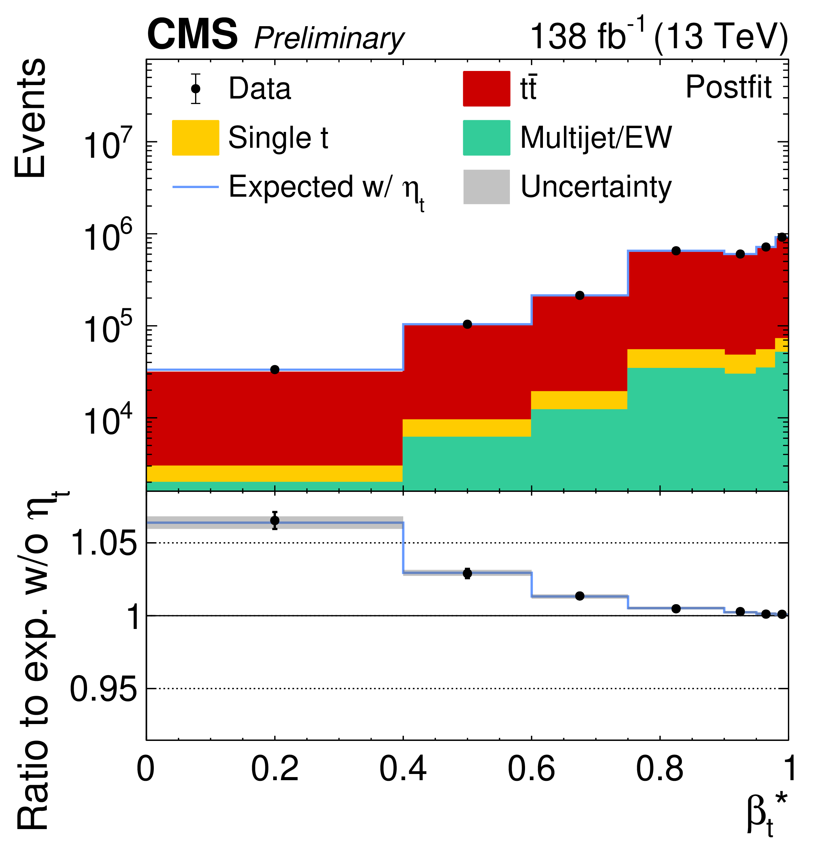
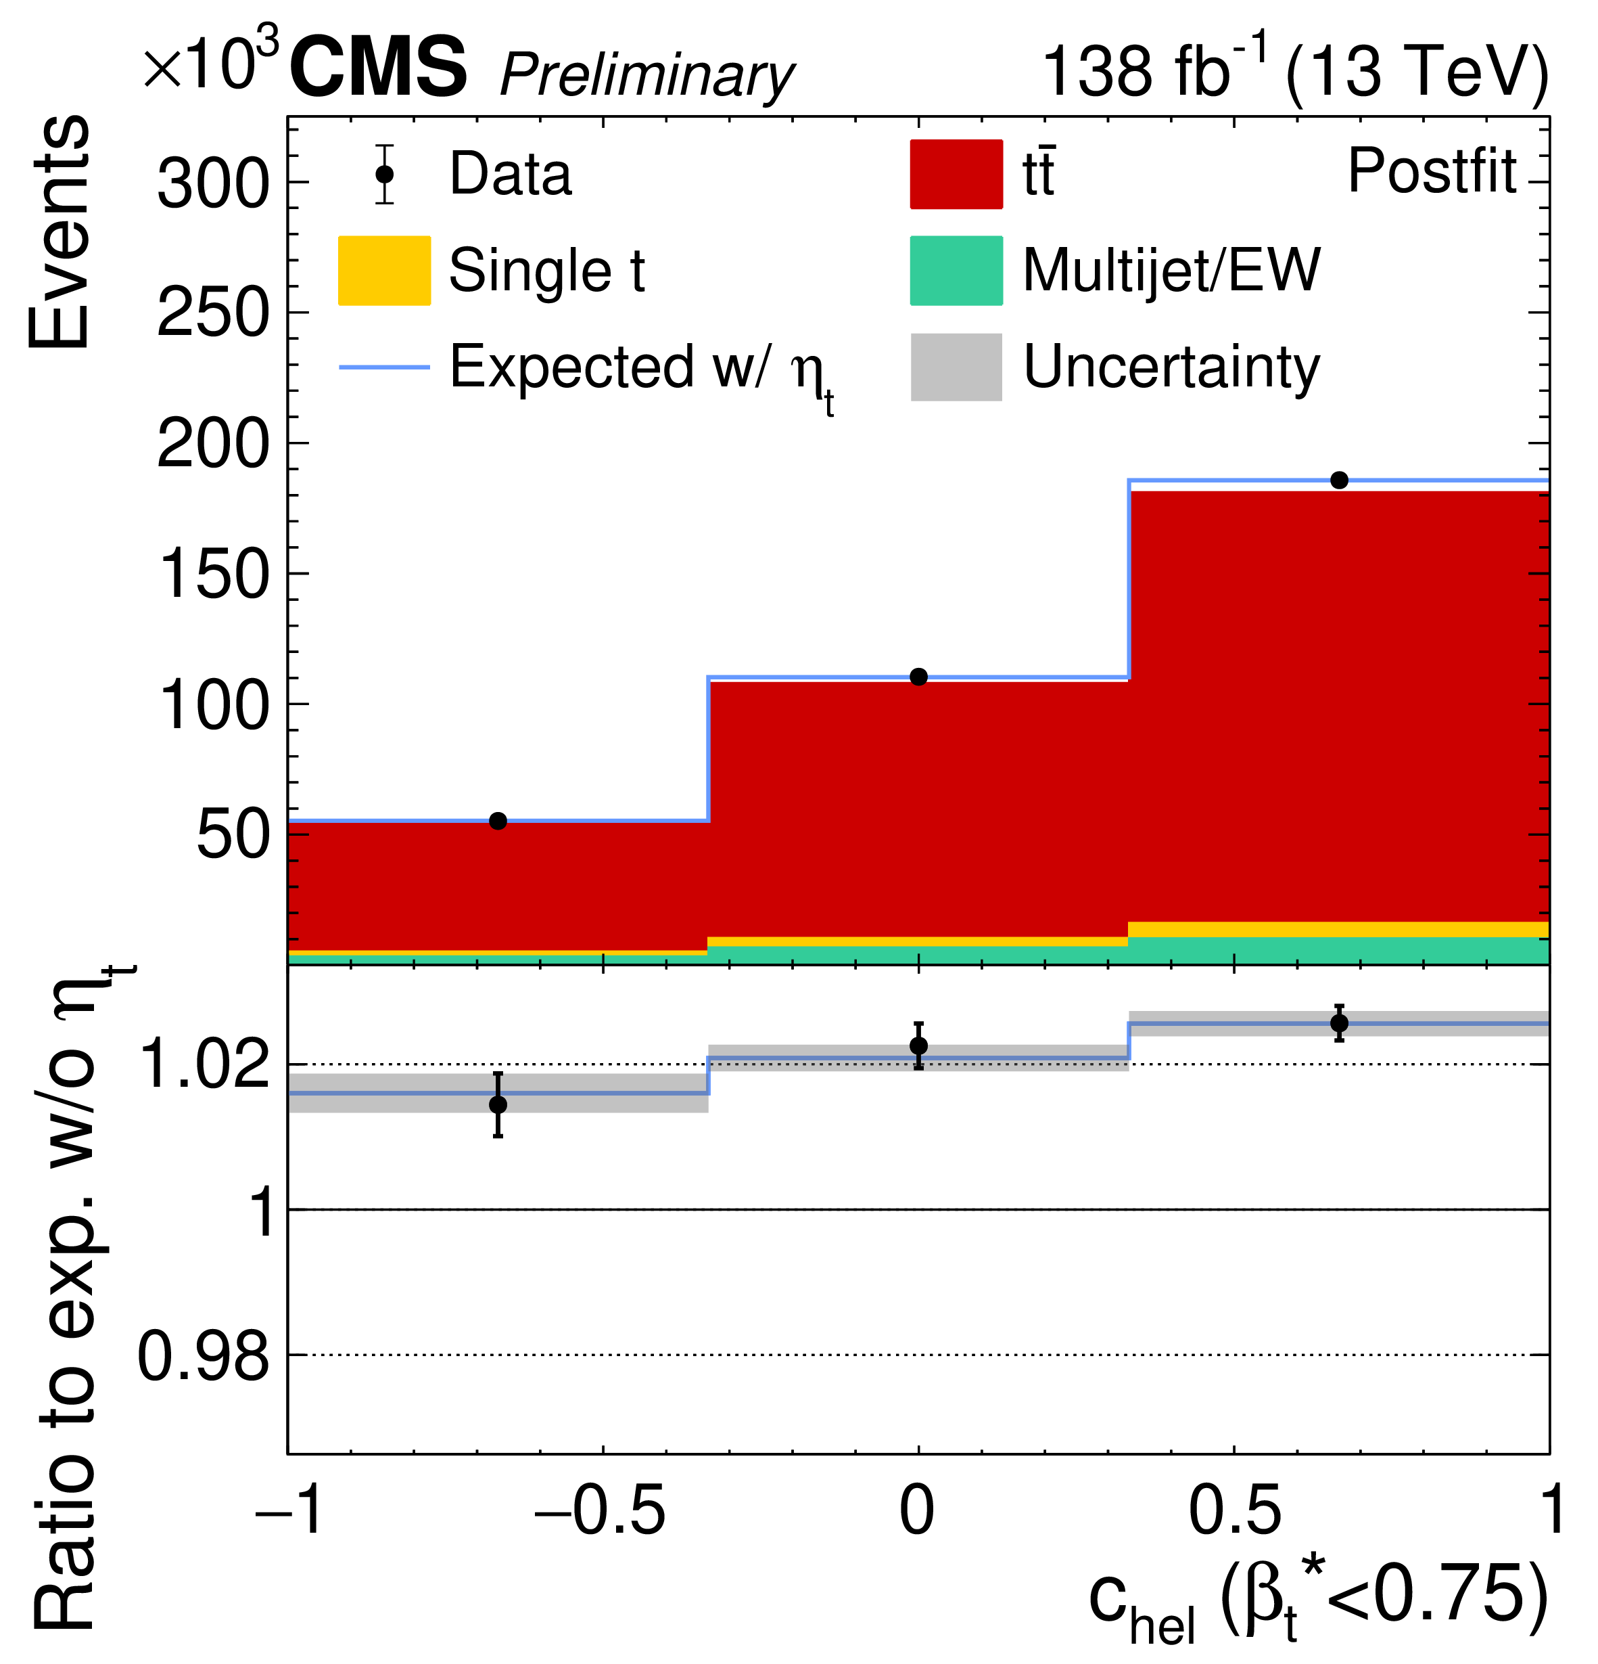
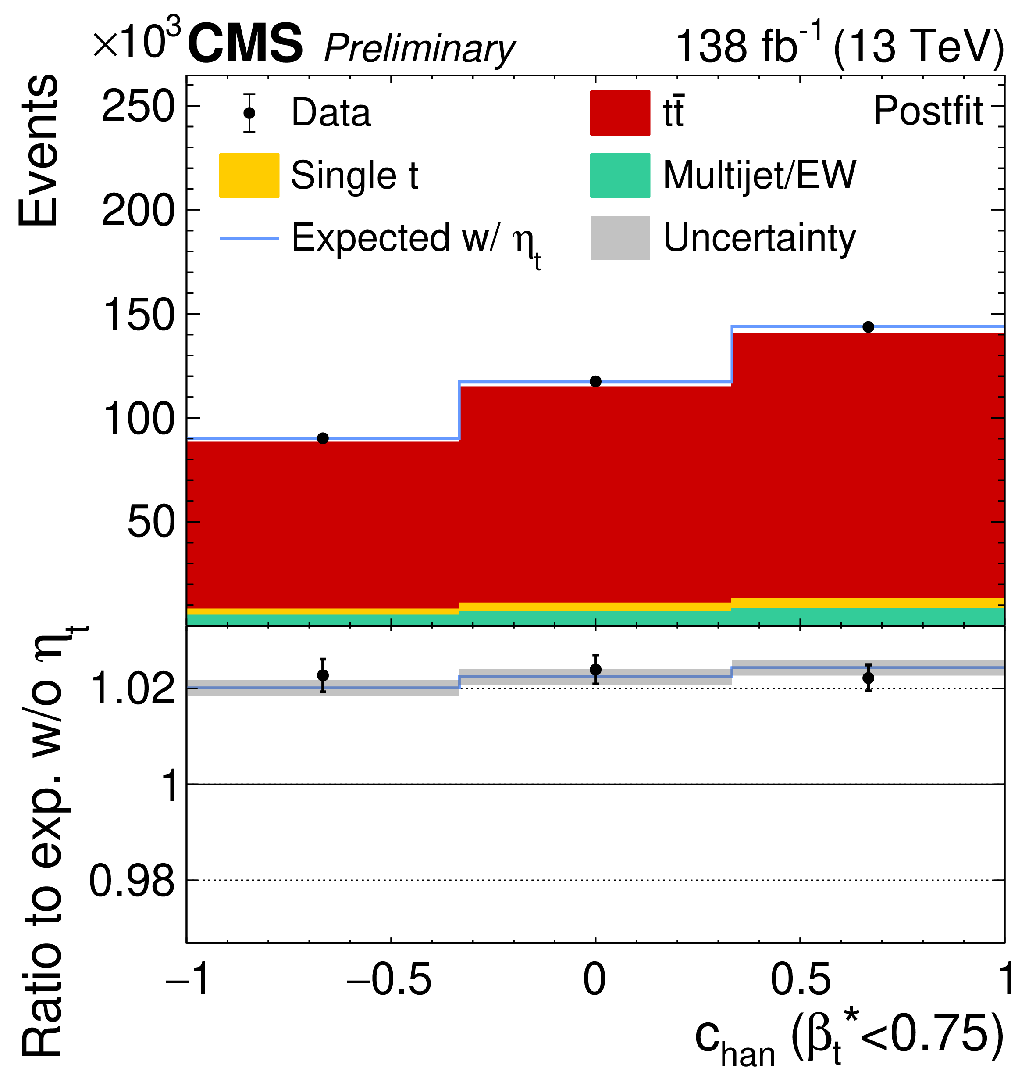
Pseudoscalar excess in lepton+jets
Distributions in β*, chel, chan
  integrated over other variables
  Not used to the fit, just an illustration
Agreement with the pseudoscalar nature of excess
Excess of events at low β* Angular distributions consistent with pseudoscalar

Slide 32
Have we discovered toponium?
Toponium – a pseudoscalar ttbar bound state, a.k.a η_{t} is predicted by non-relativistic QCD with a mass of 343 GeV – It would be nice to discover η_{t}
In 2002, a team of Russian and American scientists created the first ever atom of oganesson (Og), which is the heaviest chemical element ever recorded to date. This nucleus, which consists of 118 protons and 161 neutrons, has a mass number of 279
If confirmed toponium would be the heaviest particle ever observed
The existing evidence is tantalizing
Entanglement and spin correlations played an important role in this observation
More studies are needed to confirm the nature of the excess

Slide 33
Conclusion
Excellent performance of LHC accelerator complex and Atlas and CMS detectors produced high quality, high statistics data, and enabled exploration of subtle new signatures and phenomena
Probe CP structure of Higgs boson
Establish quantum entanglement in the system of Z bosons and top-antitop quark pairs
Quantum tomography opens new possibilities to study new effects (e.g. toponium) and explore the foundations of quantum mechanics in systems of unstable relativistic particles

Slide 34
CP structure of Higgs
CMS: H→Z*Z→4l
Purely longitudinal polarization f_{L}=1 (dashed blue)
Purely transverse polarization f_{L}=0 (dot-dashed green)
D_{bkg}>0.6
weight =sign of (cosθ₁⋅cosθ₂)
CMS-PAS-HIG-25-011

Slide 35
CP structure of Higgs and entanglement of Z bosons
Dashed blue line - f_{Λ1}= 0.5
D_{CP}
D _{int}
D^{Zγ}_{CP}
D^{Zγ}_{int}
Bonus: The model with no permutation of leptons is excluded – muons are identical particles!
D^{γγ}_{CP}
D^{γγ}_{int}
The fully longitudinal (f_{L}) and fully transverse (f_{T}) Z boson polarizations are excluded at >6σ.
➔ entangled state of qutrits (assuming Quantum Mechanics and CP conservation)
conditions exist for measuring violation of the Bell-type inequality in the H→ZZ decays
(assuming large coherence of the transverse and longitudinal amplitudes)
CMS-PAS-HIG-25-011

