Slide 1

⚛ COSMIC RAY PHYSICS · PARTICLE DETECTORS · PUBLIC OUTREACH
Seeing The Invisible
Mini-CoRTEx
Real-Time 3D Visualization of Cosmic-Ray Muons
Building & operating a portable muon detector — from sky to signal
Yuvaraj Elangovan · Kyle Mo · Sean Maloney · Brent Clelland · Tae Min Hong · Pranava Teja Surukuchi
Department of Physics and Astronomy · University of Pittsburgh
[ Phenomenology 2026 Symposium / Pittsburgh / 05/11/26 ]

Slide 2
00
OUTLINE
01
Motivation
02
Detector Overview
Why we built Mini-CoRTEx
Architecture and principal subsystems
03
Detector Fabrication, Testing, Interface & Assembly
04
Trigger & DAQ
Scintillator, SiPM, frontend, assembly
FPGA backend, coincidence logic, software stack
05
Results
06
Key Advantages
Calibration, rates, stability
ready for outreach
07
Next
08
Acknowledgment
Future work

Slide 3
01
MOTIVATION — WHY WE BUILT MINI-CORTEx?
Mini-CoRTEx (Mini Cosmic Ray Tracking Experiment)
Turn cosmic-ray muons passing through us every second into something you can watch happen, in real time, on a glowing 3D LED cube
A portable, tabletop detector built for classrooms, exhibitions, and public outreach not a control room
18 scintillator tiles arranged in a 3 × 3 × 3 orthogonal geometry reconstructs the direction of each muon, not just whether one passed
Same hardware that drives the LED display also delivers quantitative measurements of muon flux across different sites
Make the invisible visible
Bring particle physics out of the lab
Track muons in three dimensions
Do real science alongside the demo
Why build our own? Existing setups are expensive, fragile, lab-bound, and rely on gases or high voltages. Mini-CoRTEx is portable, robust, plug-and-play designed for outreach and education while still doing real science.

Slide 4
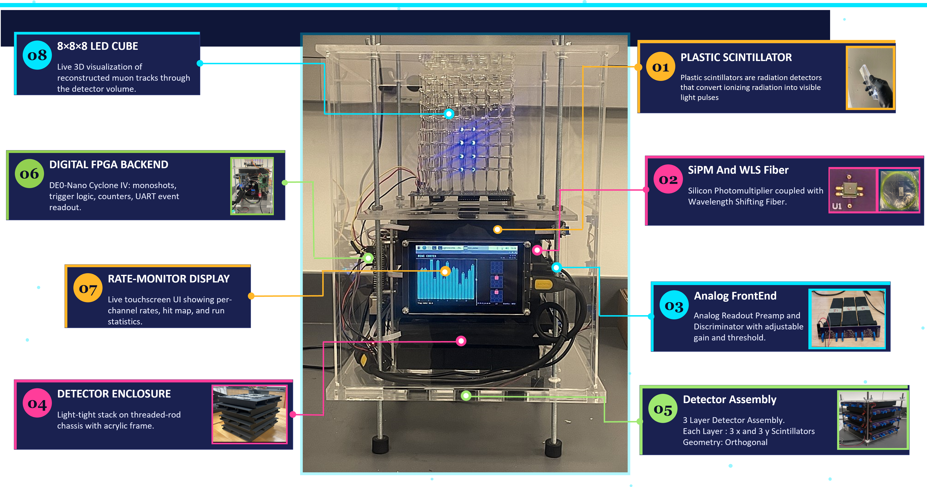
02
DETECTOR OVERVIEW

Slide 5
02
ARCHITECTURE — SIGNAL CHAIN
MUON
SCINTILLATOR
SiPM
FRONTEND
FPGA
RASPBERRY PI
Cosmic ray
Plastic + WLS fiber
Photon → charge
Amp + discriminator
Trigger & counting
Track Fitting + LED cube + Display
KEY COMPONENTS
Component | Specification
Detector type | Plastic scintillator (15 cm × 5 cm × 1 cm)
Photo-detector | Hamamatsu SiPM S13360-2050VE
Front-end | Amplifier, discriminator
Coincidence | Any 2 layers(Pixel)
DAQ | DE0-Nano FPGA module (Cyclone IV)
Power supply | DC 5V 2A and 54 V custom HV bias
Software / host | Python on Raspberry Pi 4

Slide 6
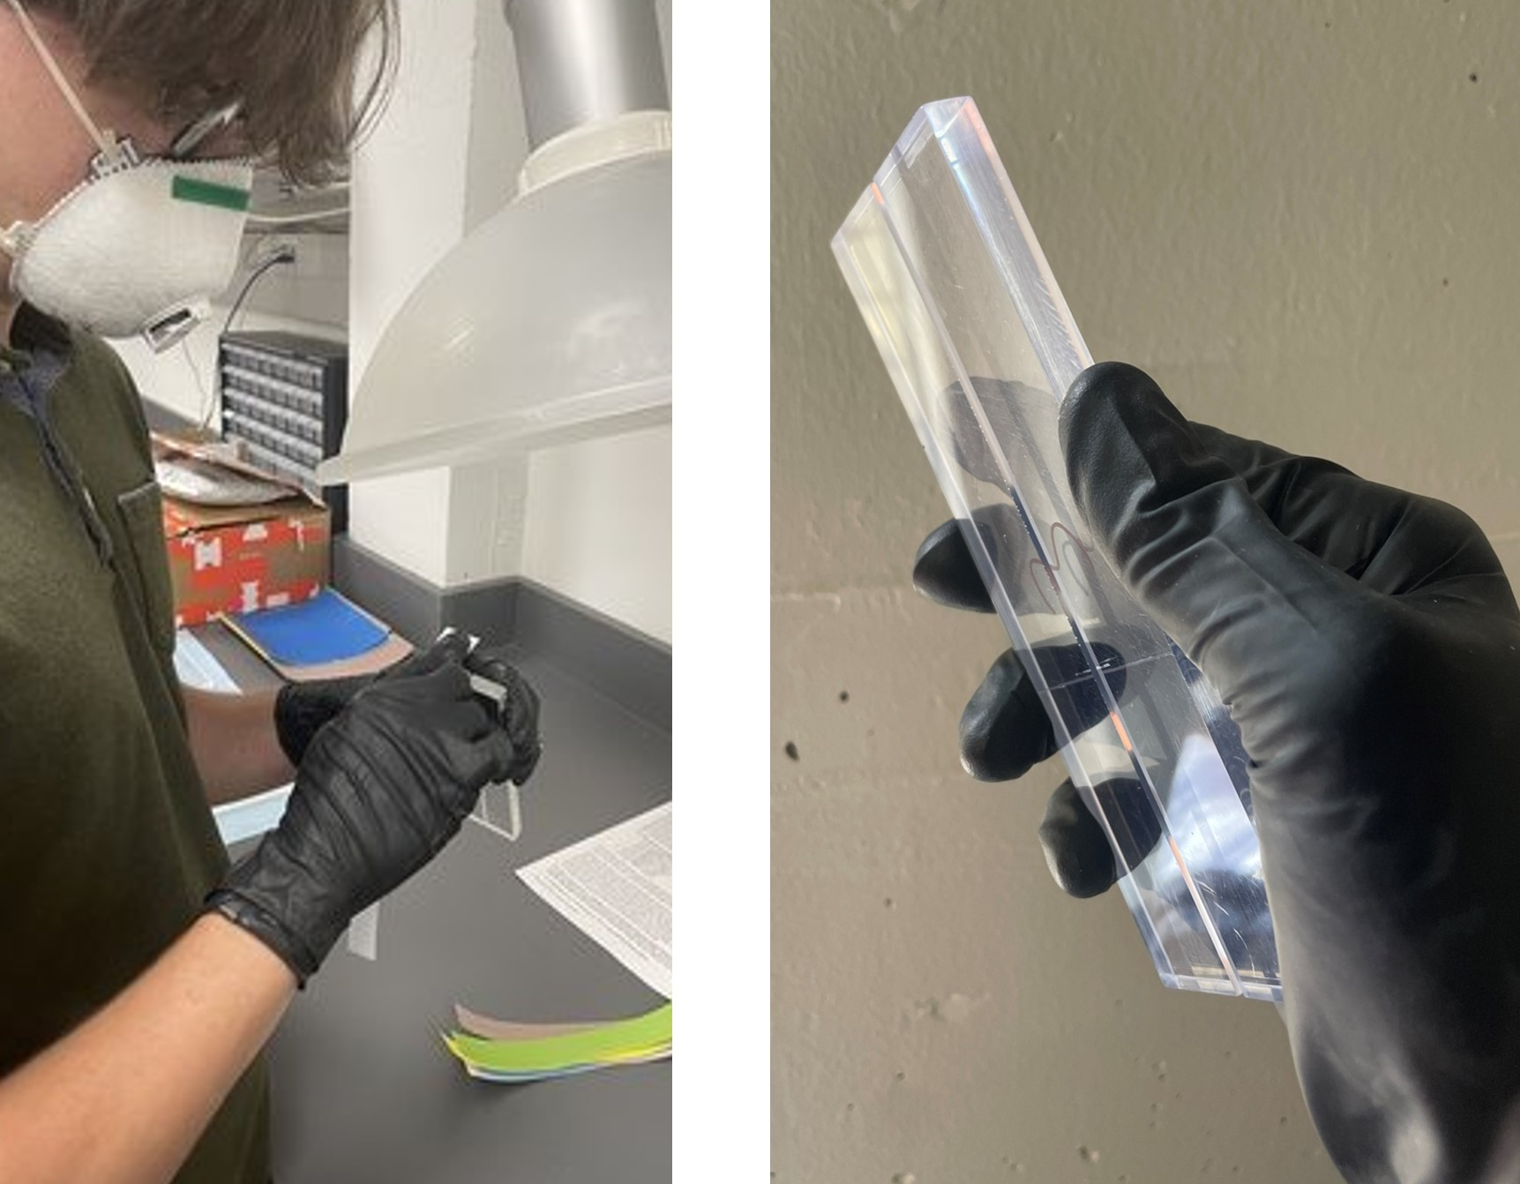
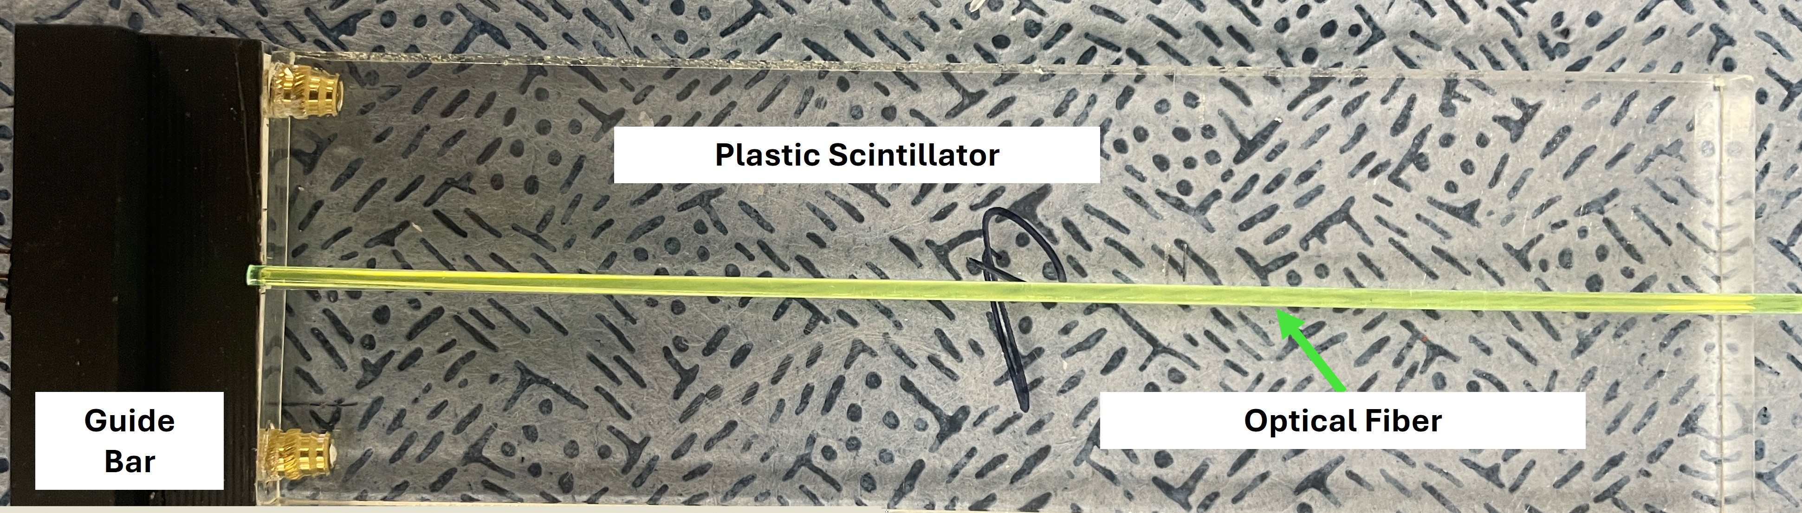
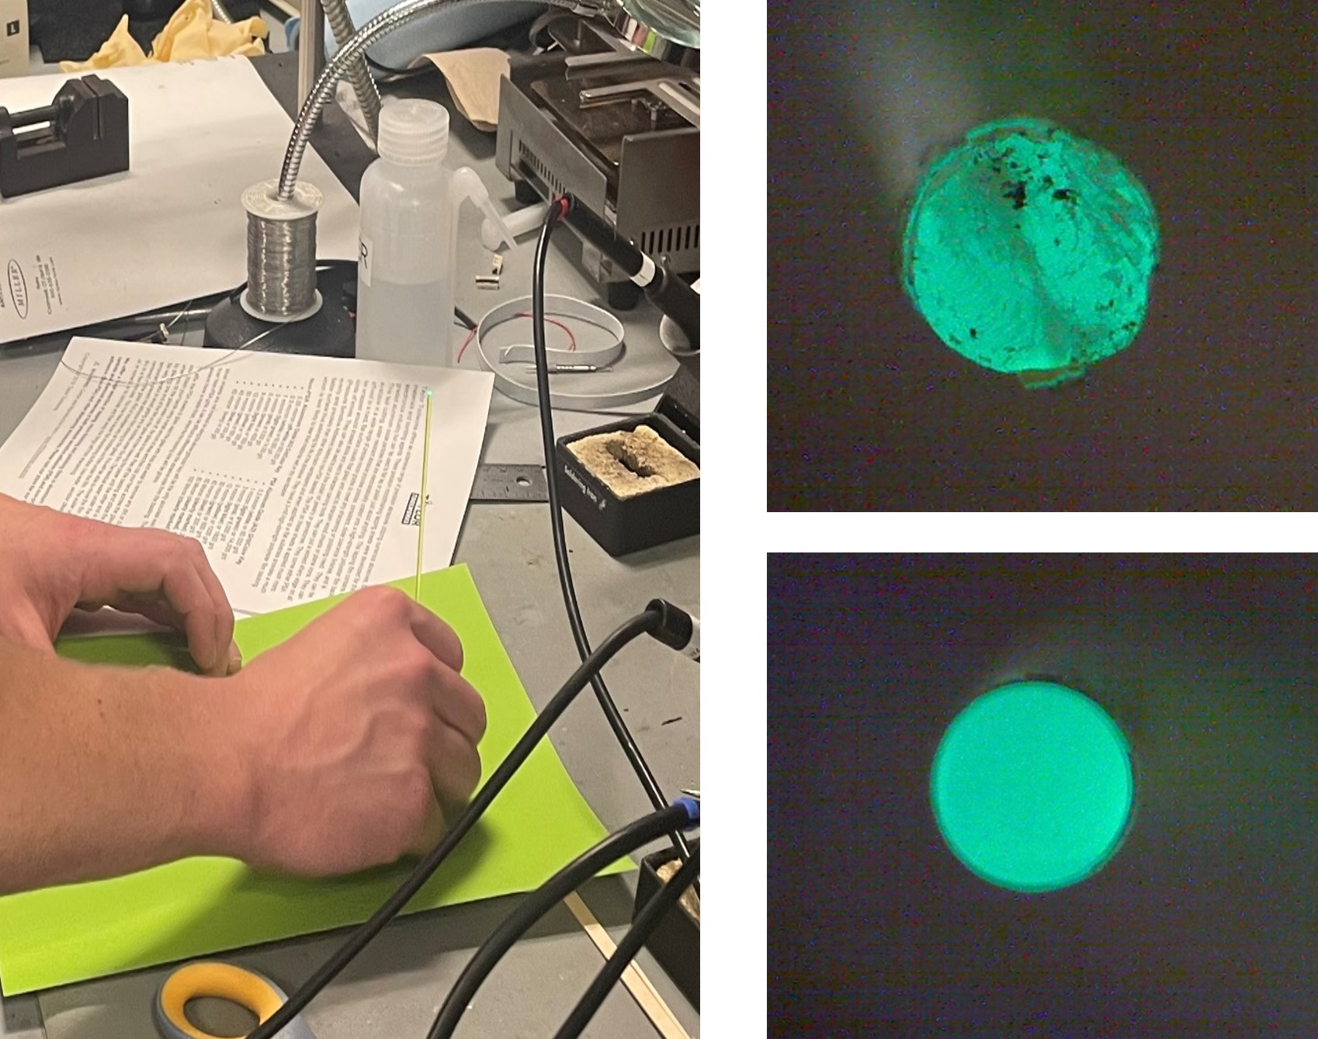
03
DETECTOR FABRICATION
PLASTIC SCINTILLATOR + WLS FIBER
When a muon enters the plastic scintillator, it excites the electrons to a higher energy state. When these electrons deexcite, they emit a photon (the blue light we see)
Plastic scintillators with embedded wavelength-shifting (WLS) optical fibers. Charged muons produce blue light captured by the fiber.
Scintillators and Fibers are Polished using low cost Grit sheets with Micro finishing Fine Sanding Paper
All Adapter modules are 3D Printed Locally
All detectors are fabricated, assembled and tested by student groups.

Slide 7
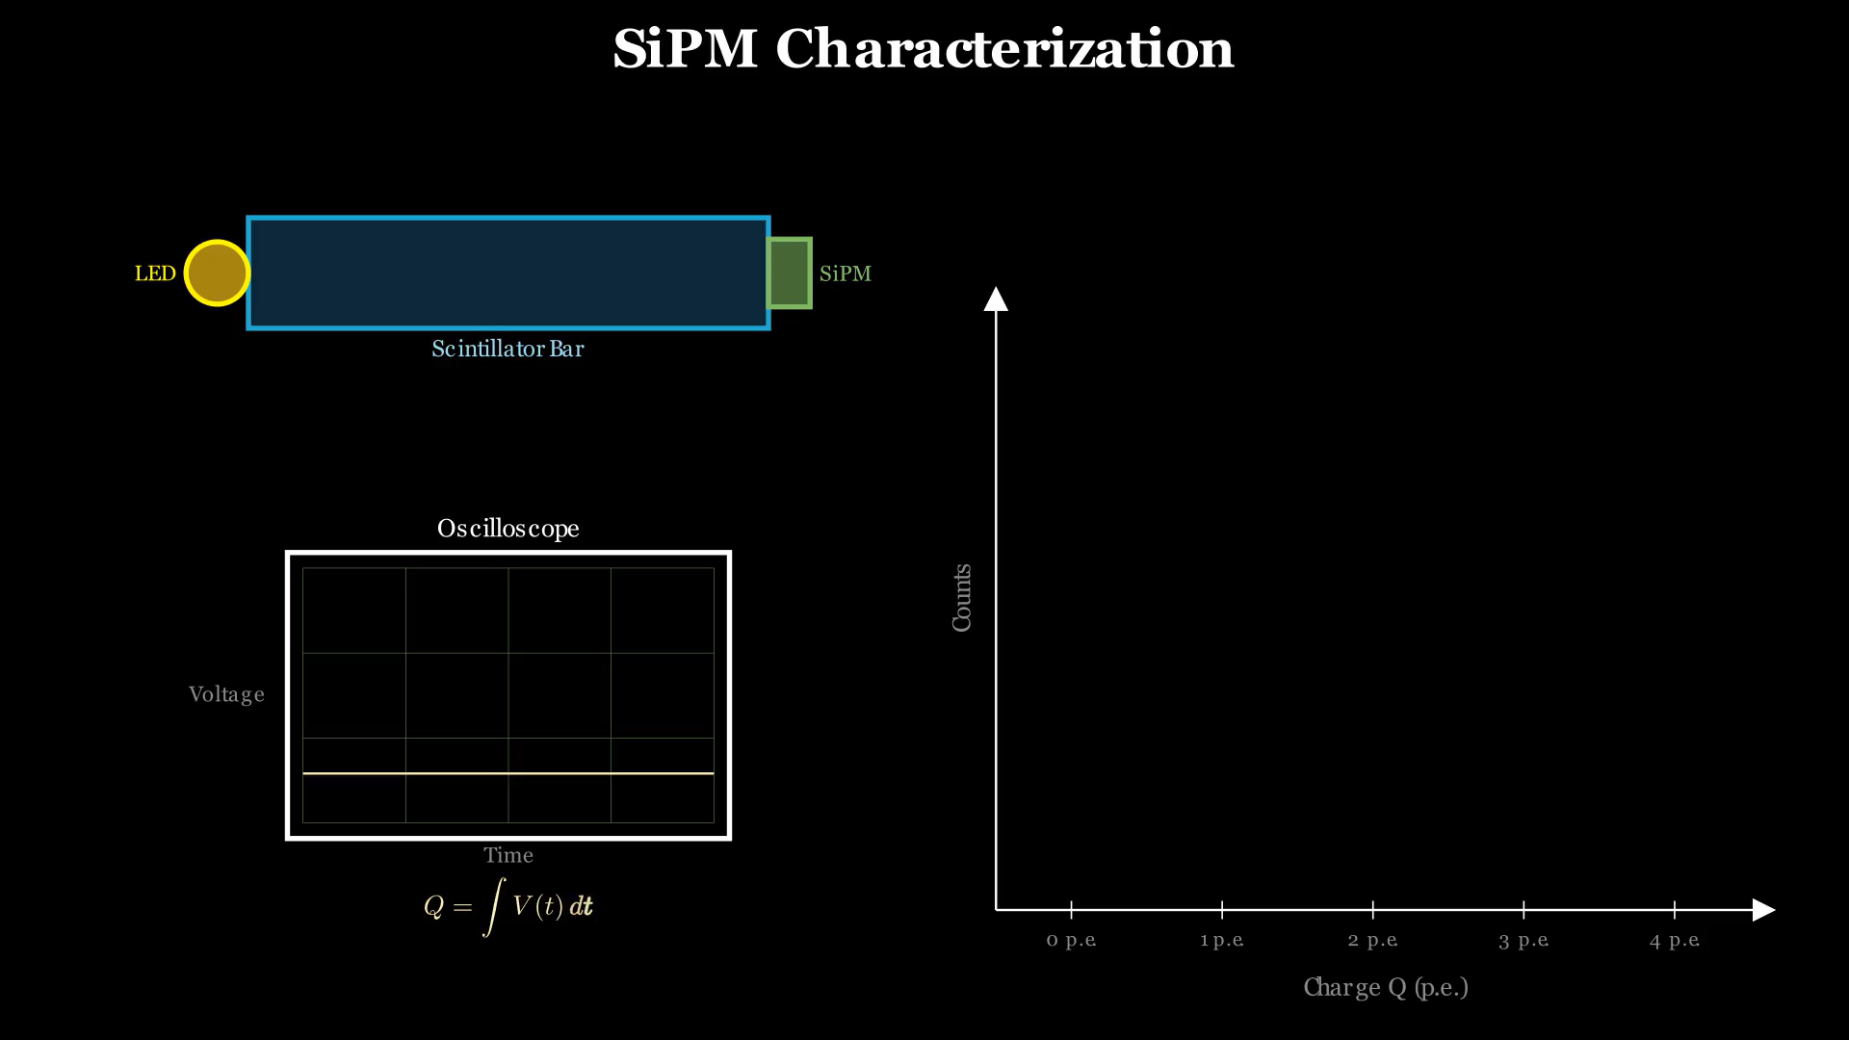
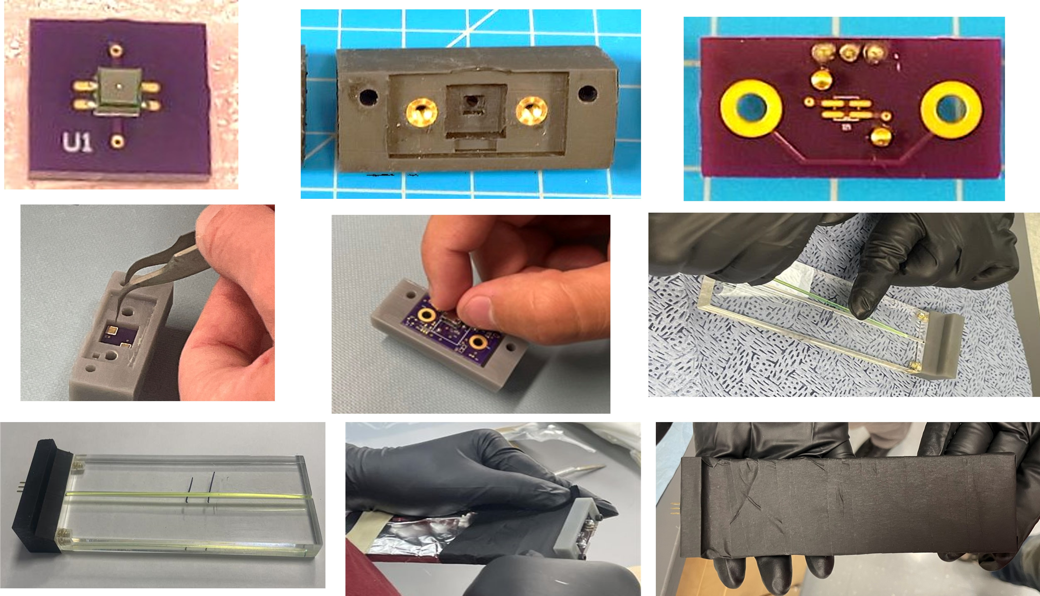
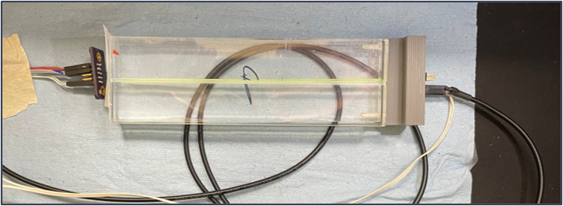
SiPM
SiPM LED Characterization Test Setup

Slide 8
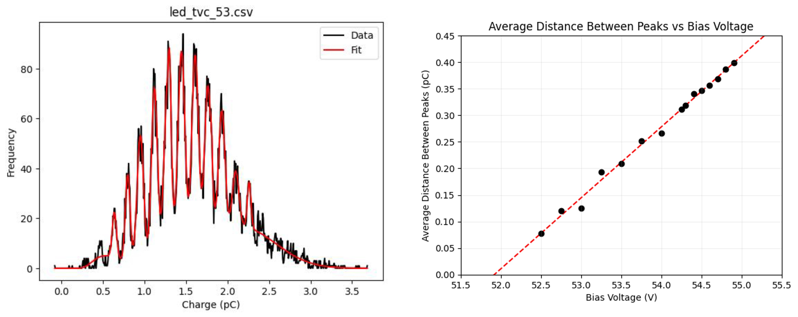
03
SiPM CHARACTERIZATION
Single-photon spectrum (left) and gain linearity vs. bias voltage (right)
Clean photon-counting peaks
Resolvable 1‑p.e. spacing confirms low noise & correct gain.
Linear gain vs. bias
Linear above breakdown — nominal operating point ~54 V.

Slide 9
03
DETECTOR INTERFACE
SiPM Carrier PCB
SiPM Detector Adapter
Readout PCB
Place Carrier PCB
Place Readout PCB
Place WLS Fiber
Tightly Coupled Interface
Reflector and Black Tape
Fully Packed Detector
Custom mechanical coupling and PCBs are made to tightly couple the SiPM photodetector to the fiber end with low optical loss.

Slide 10
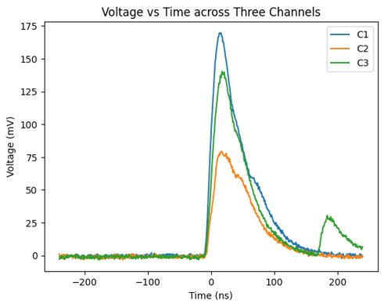
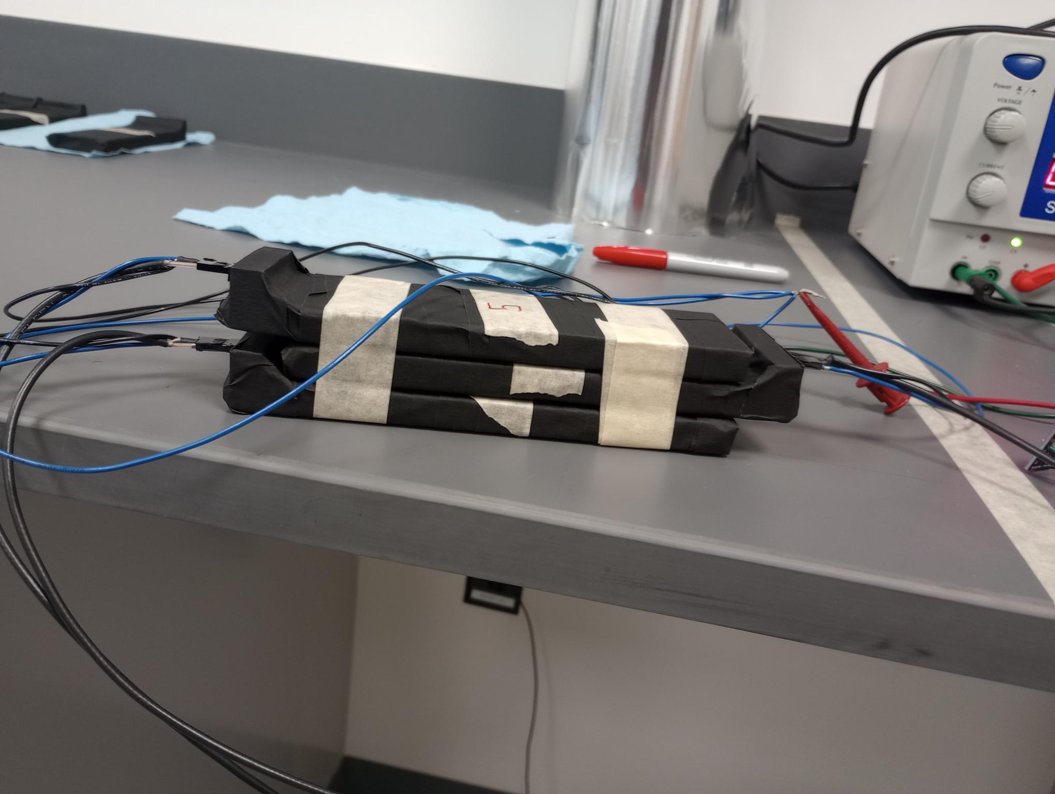
03
DETECTOR EFFICIENCY

Slide 11
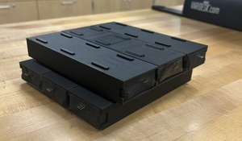
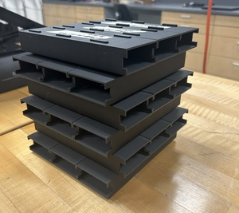
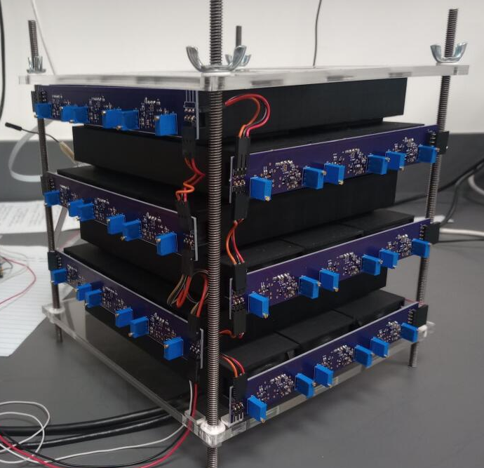
04
DETECTOR ASSEMBLY
3S Printed Enclosures
Enclosure Stack 3 Layer Assembly
Enclosure with Detectors &
Front-End Electronics

Slide 12
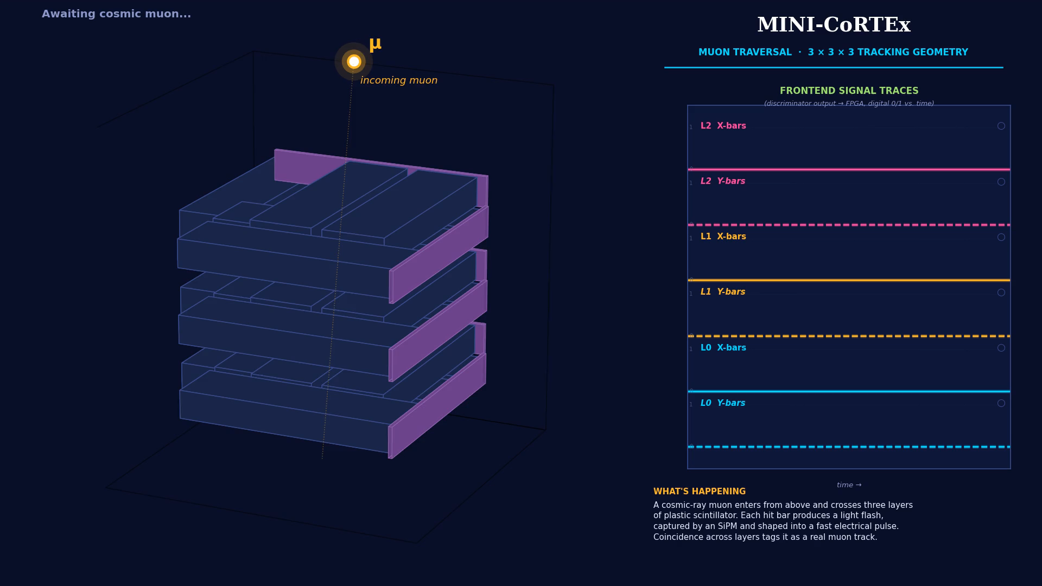
04
TRIGGER, DAQ & SOFTWARE

Slide 13
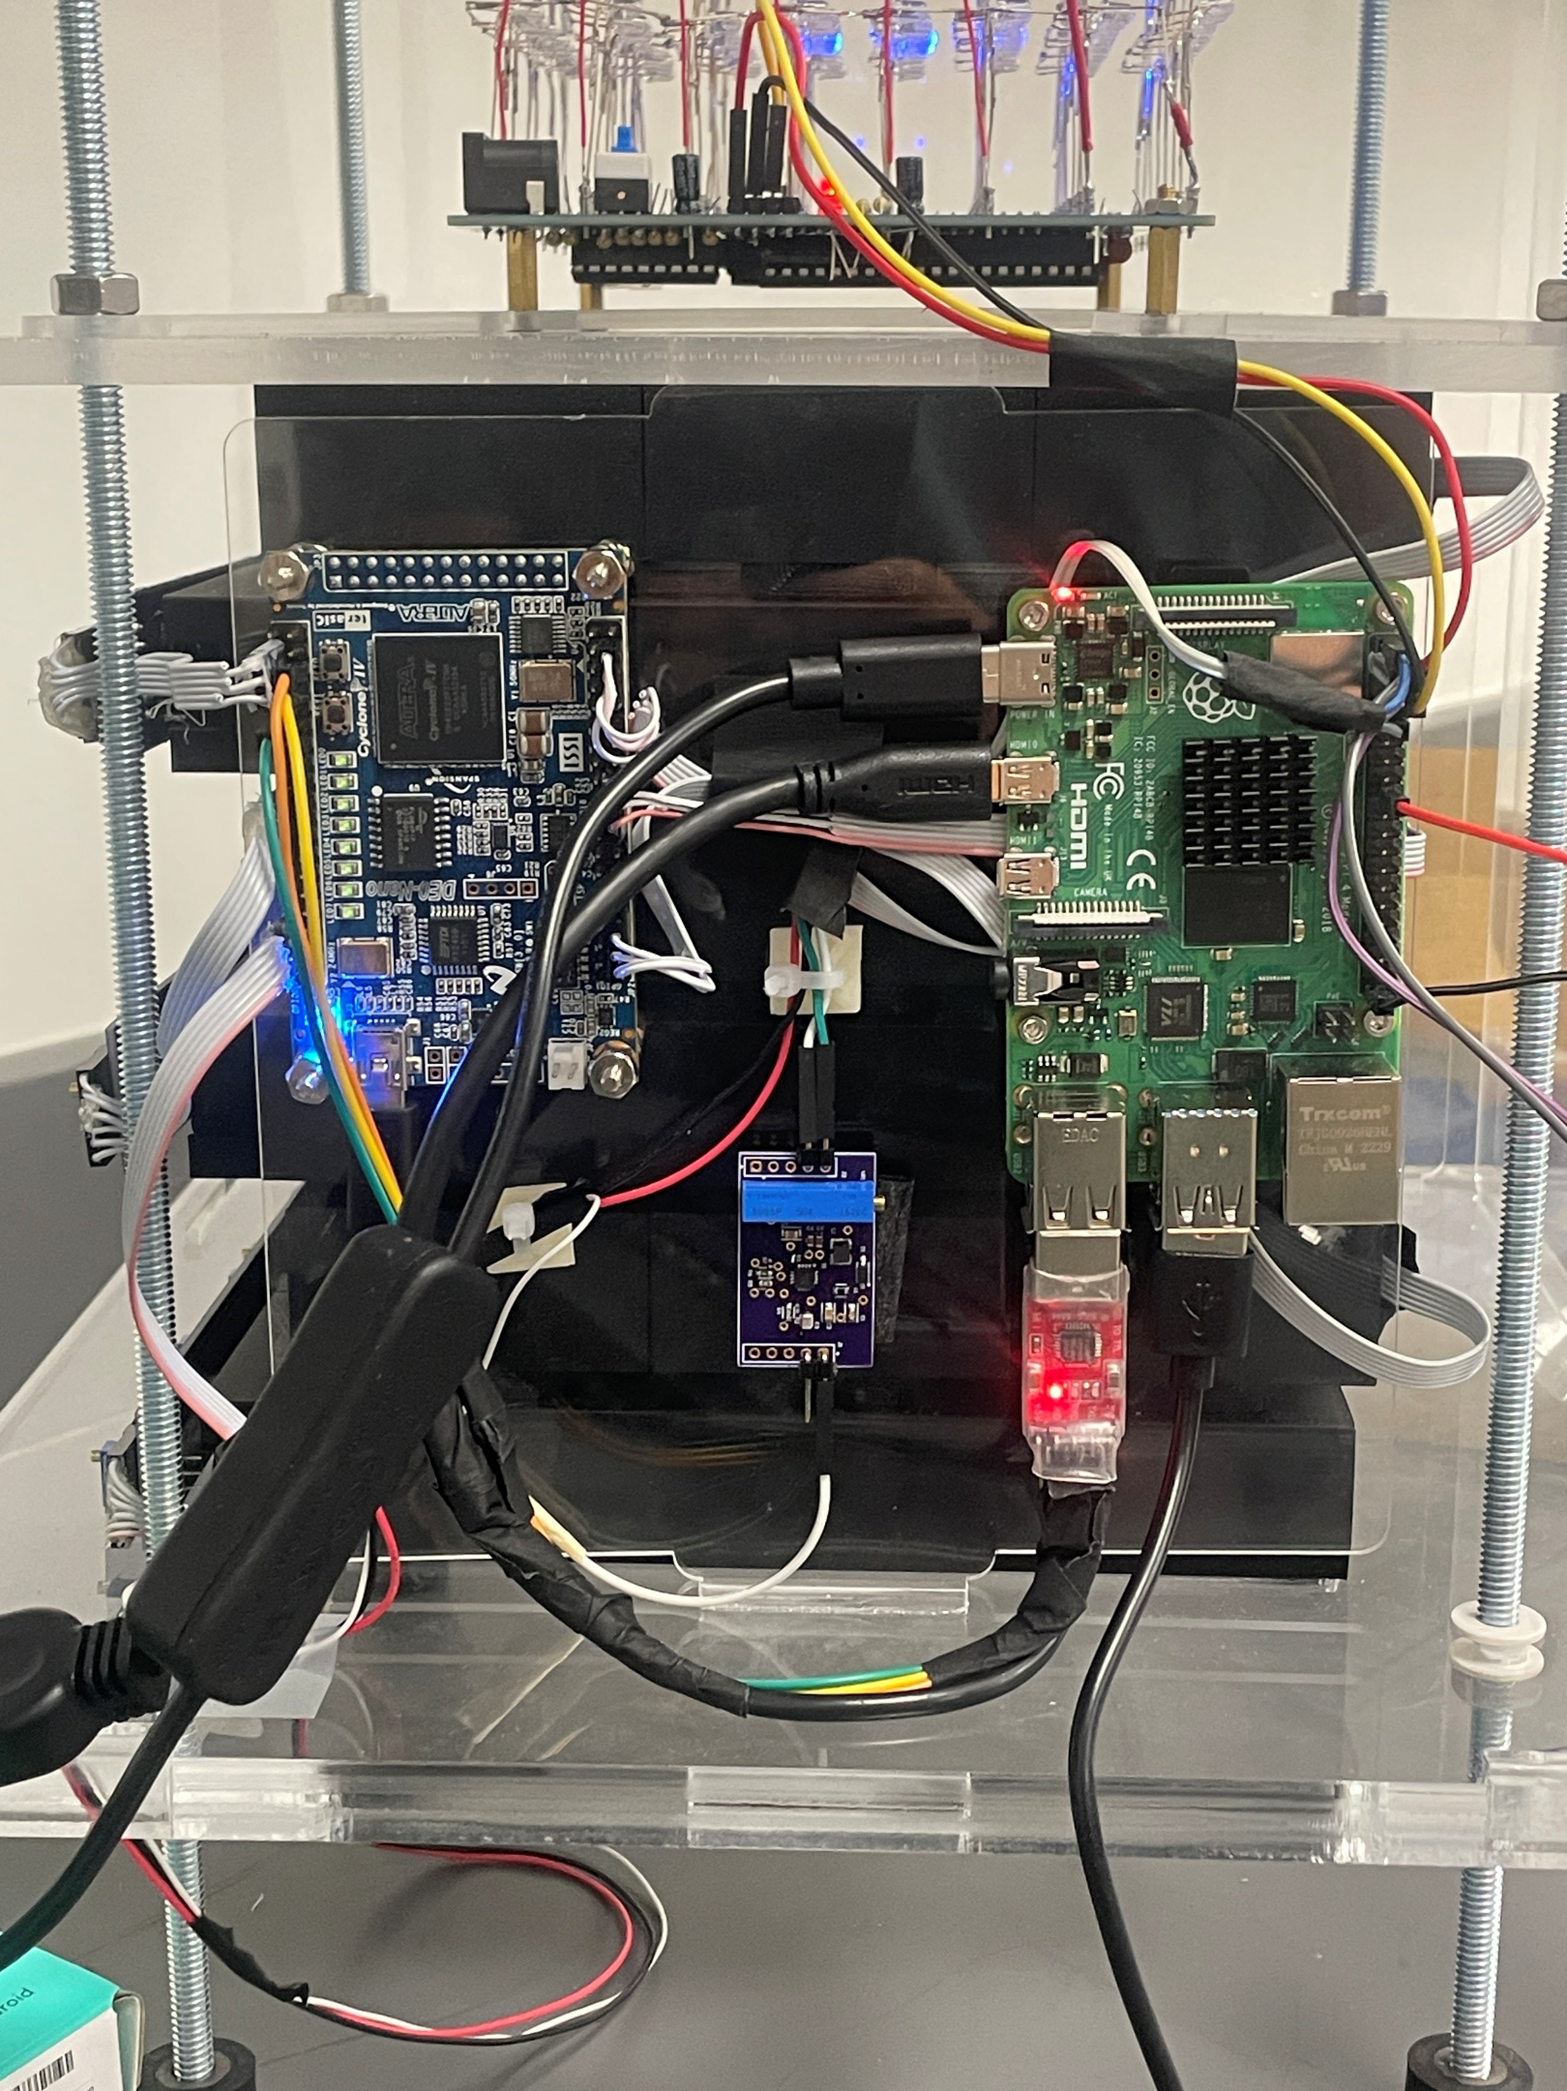
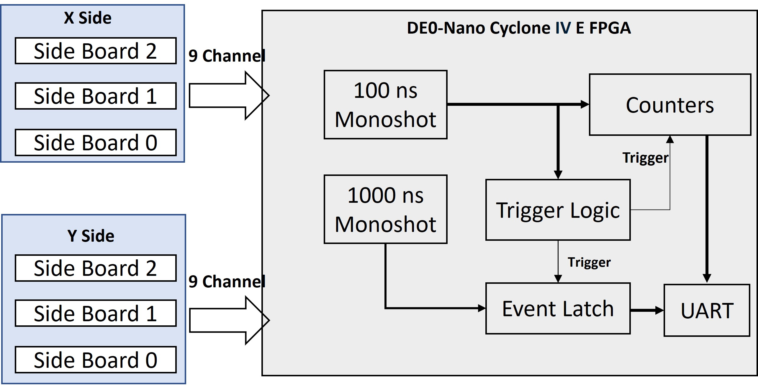
04
TRIGGER, DAQ & SOFTWARE
FPGA DAQ LOGIC
FPGA
Raspberry Pi
100 ns + 1000 ns monoshots shape each channel pulse into a clean digital window.
Trigger logic requires a coincidence across any two layers
Counters accumulate per-channel rates in real time.
Event latch snapshots the X/Y bit pattern at each trigger.
UART readout streams events to a Raspberry Pi for fitting & display.
HV
USB-UART

Slide 14
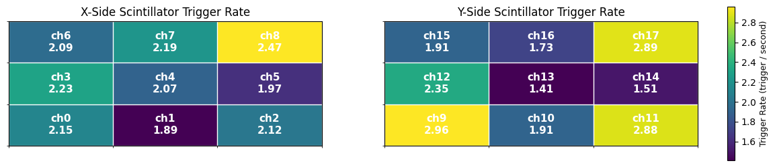
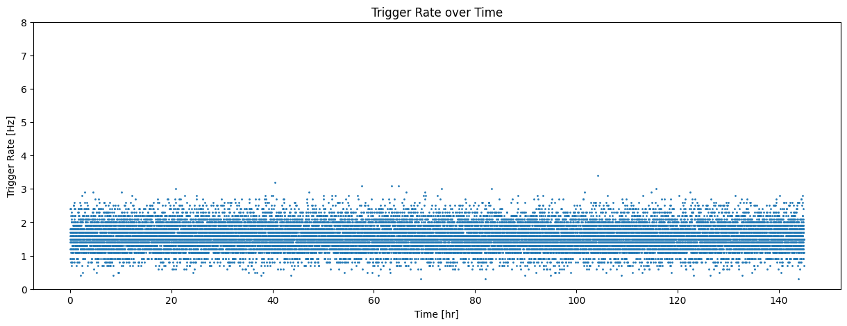
05
RESULTS — RATE & STABILITY
Per-channel trigger-rate heat map
~ 2
Hz total trigger rate
Stable over a 6-day run
Trigger rate over 145 hours

Slide 15
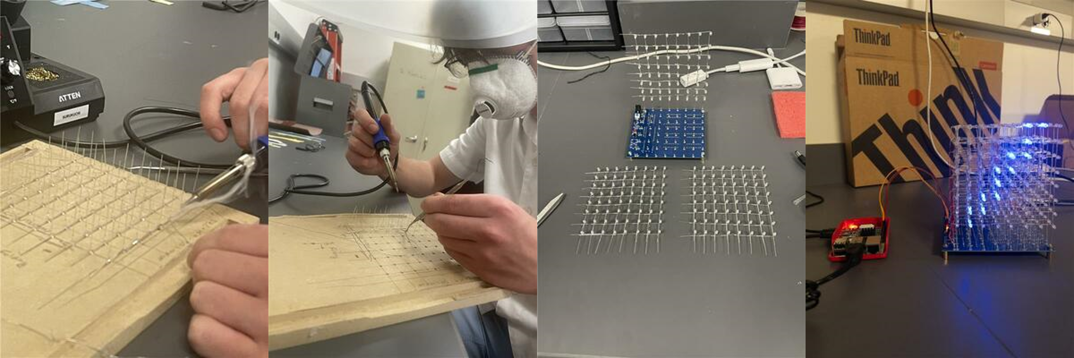
05
LED CUBE FABRICATION
From individual LEDs to a glowing 8×8×8 cube
1
Wire frame
2
Hand-built
3
Stacked
4
Powered up
LEDs soldered into rigid 8×8 grids on a paper template.
Each joint placed and tested manually by the student team.
8 layers assembled, aligned, and electrically combined.
Microcontroller drives 512 LEDs to render 3D muon tracks.

Slide 16
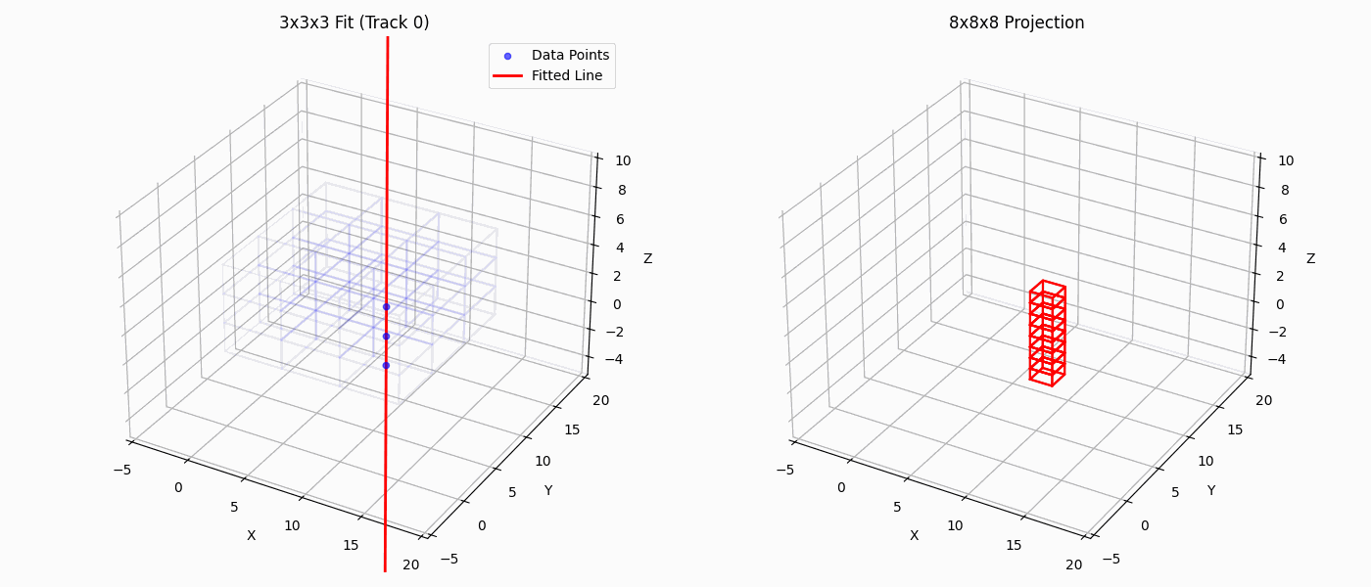
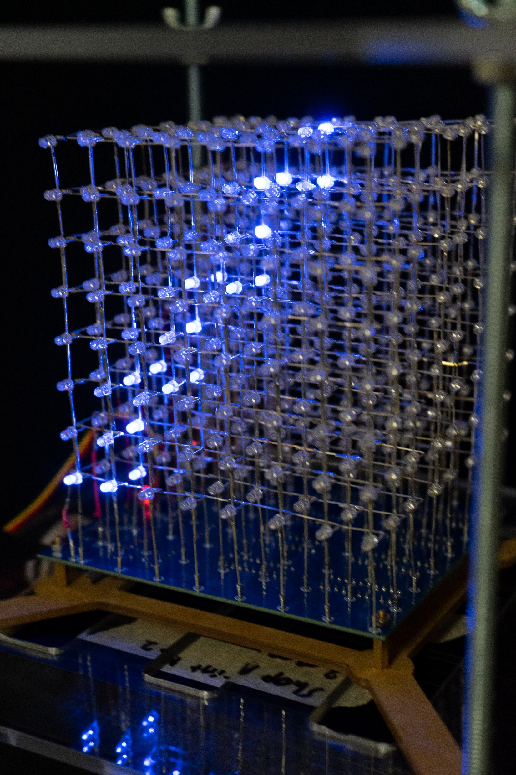
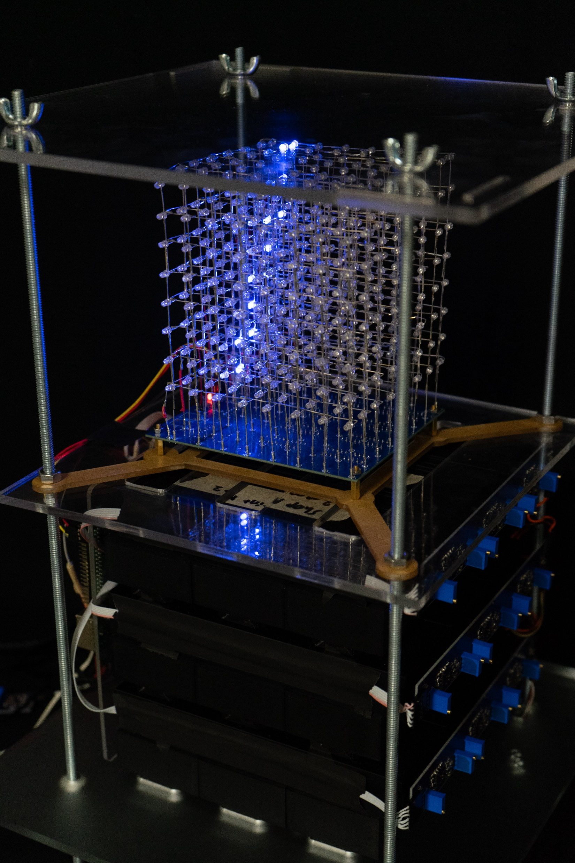
05
TRACK FITTING & LED CUBE DISPLAY
We developed a python-based simulation script which can simulate muons with defined rectangular detector geometry
Uses:
  Allows us to simulate a muon track in a higher resolution detector, so we can extrapolate the 3 x 3 x 3 data to our 8 x 8 x 8 LED Cube
  Creates synthetic data to test post-data scripts (i.e. running the LED cube)
    Also provides comparison data
We currently track fit using Singular Value Decomposition (SVD)

Slide 17
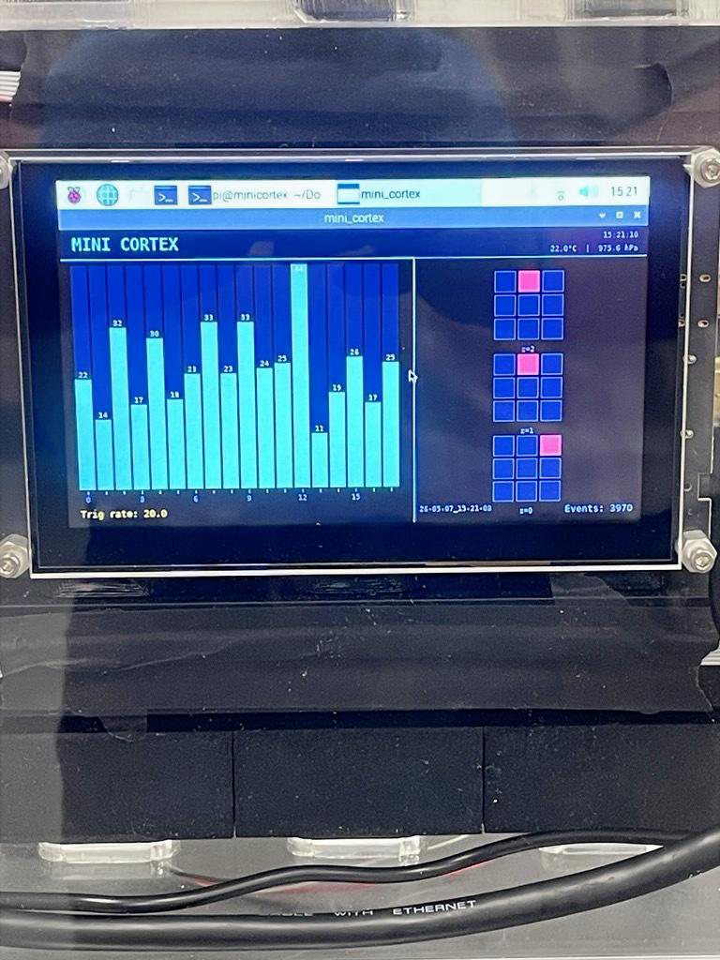
05
LIVE RATE-MONITOR DISPLAY
What you see on the screen
Per-channel rate bars — 18 scintillators, live counts updated every 10 seconds.
Hit map — 3 stacked layers (z = 0, 1, 2) with X×Y overlap.
Trigger rate (Hz), event count, timestamp.
Environmental readout (temperature, pressure) for systematic checks.

Slide 18
06
KEY ADVANTAGES
Once assembled, Mini-CoRTEx is a fully functional cosmic-ray muon display.
⚡
EASY SETUP
□
PORTABLE
↻
SWAPPABLE
Just plug it in — no calibration ritual.
Tabletop size; fits in a backpack.
Easily swap out scintillator modules.
✕
NO GASES, NO LIQUIDS
◉
RECORDS DATA
⊙
POWER-BANK READY
Little maintenance; tolerant to temperature & pressure.
All events logged for later analysis.
Demo it anywhere.

Slide 19
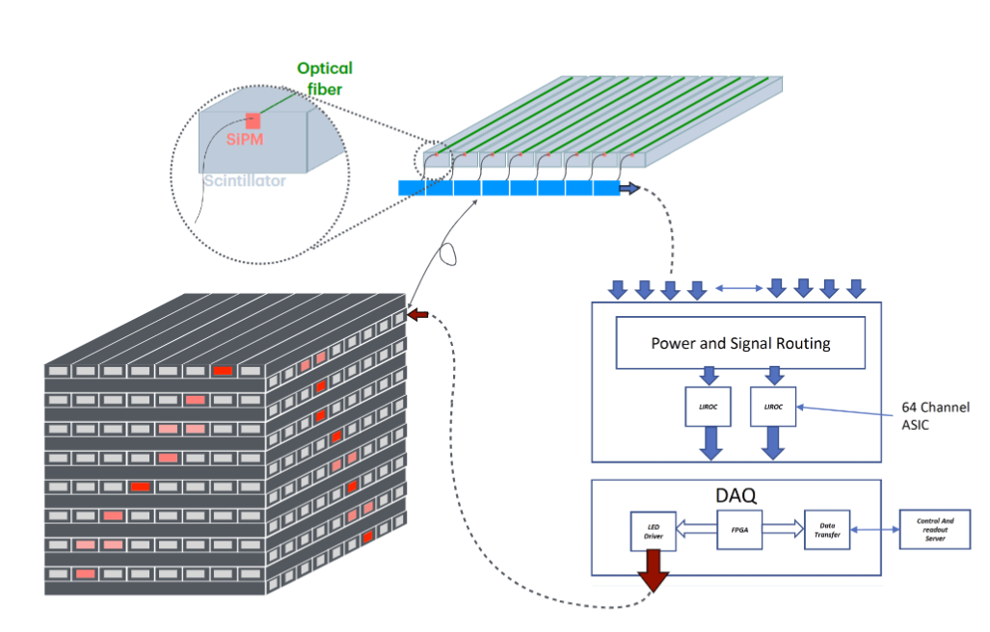
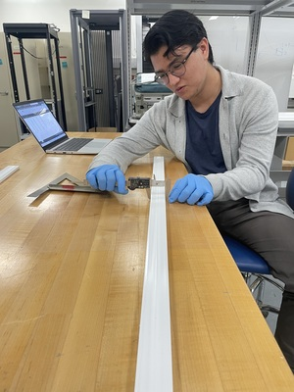
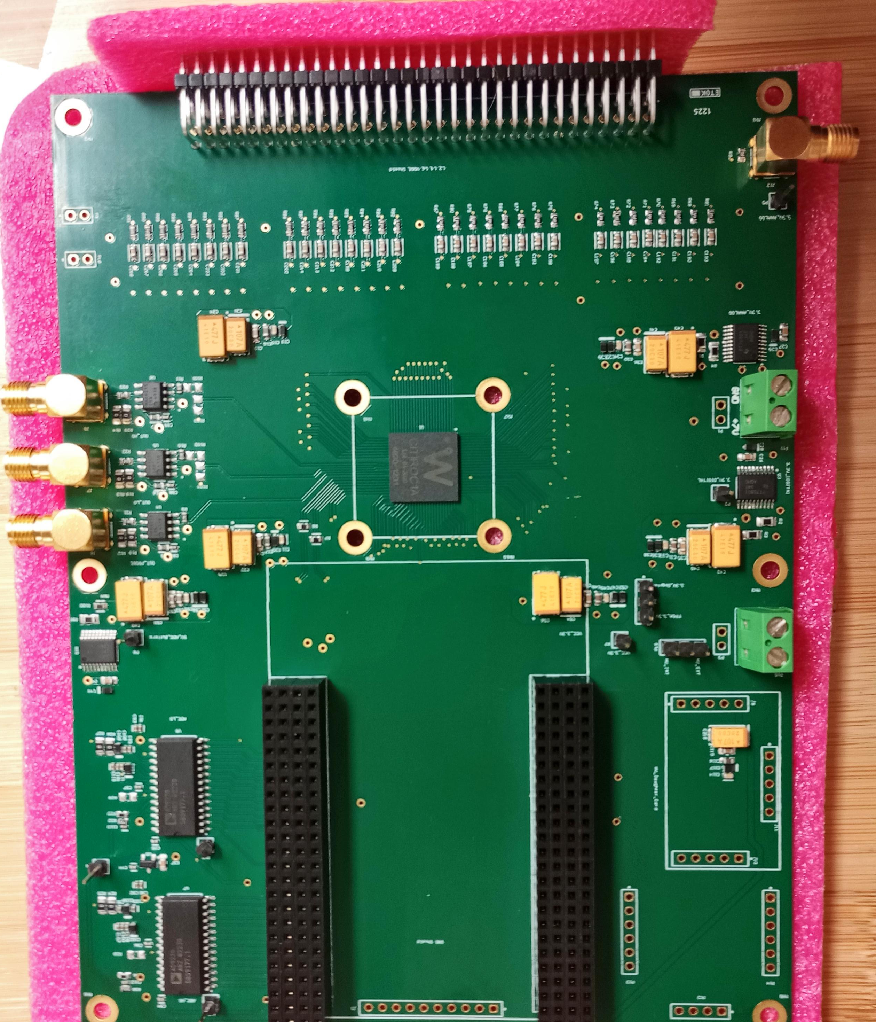
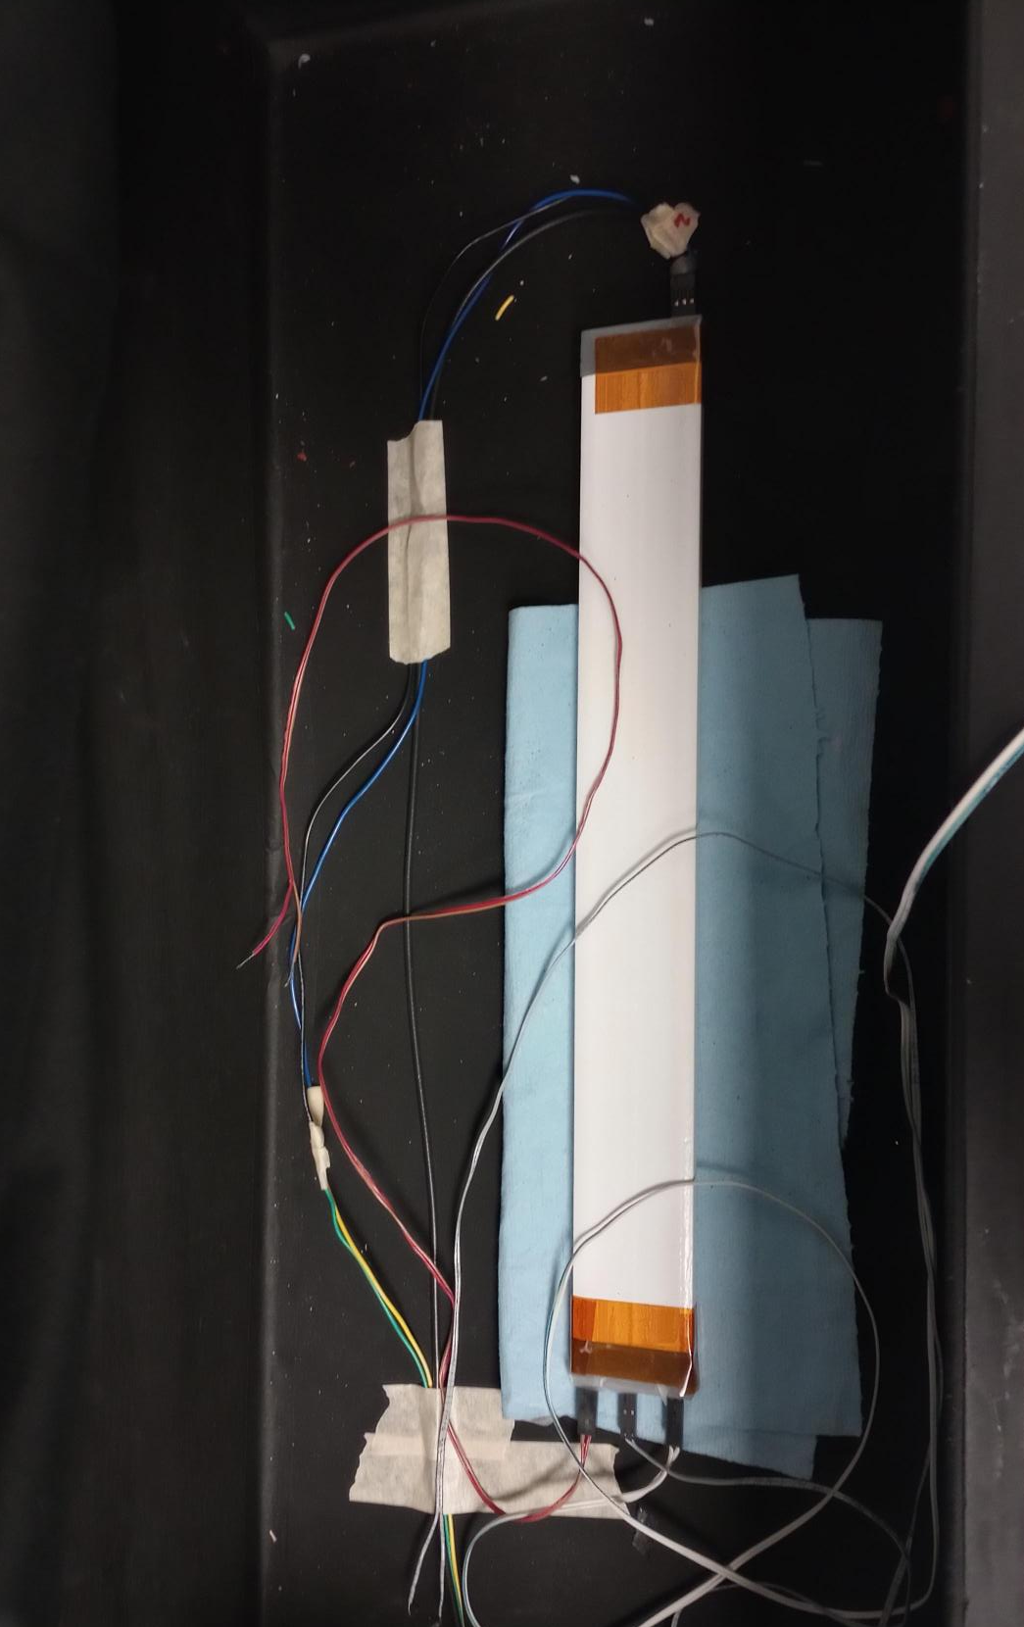
07
NEXT: PITT-CoRTEx
WHAT'S NEXT
Mini-CoRTEx is just a prototype for a larger detector (CoRTEx)
CoRTEx will have:
  Bars about twice the length (32 cm vs 15 cm)
  LEDs on the sides
  Charge and timing information
We are currently on:
  Detector Fabrication and Testing
  CITIROC ASIC based DAQ Development
Detector unit size | 32 cm x 4 cm x 1 cm
Detector type | Extruded Plastic Scintillator
Layer & Channels | 8 x 16 = 128
Orientation | Orthogonal and Stacked
Trigger | Programmable Trigger
Track Fitting | May be
Visualization | LED Panel and LED Cube

Slide 20
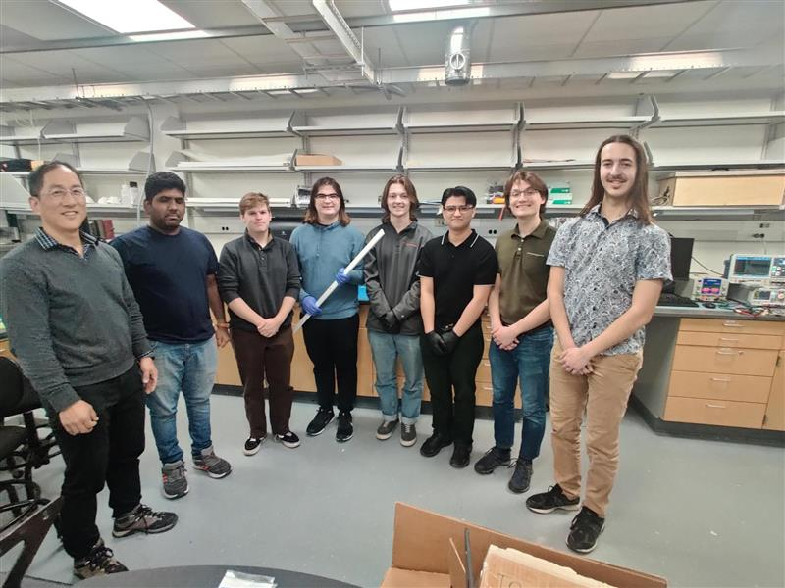
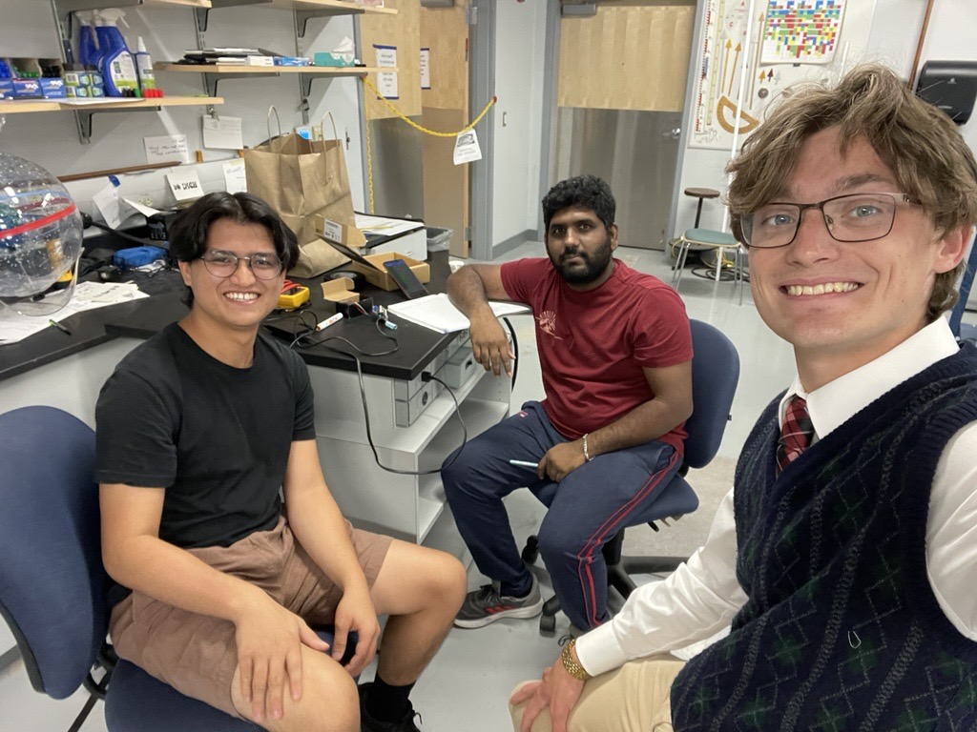

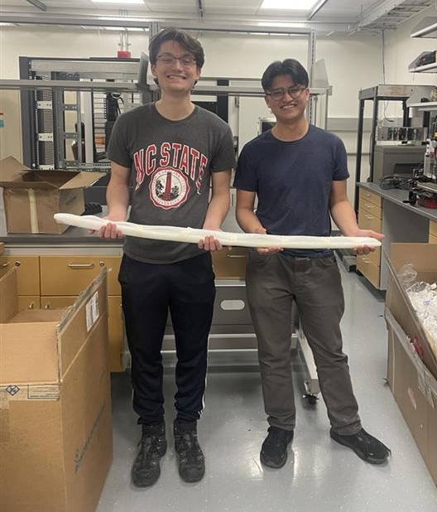
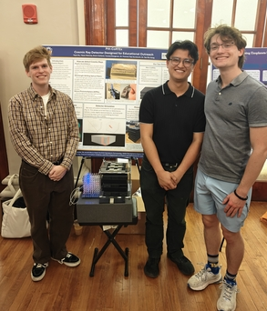
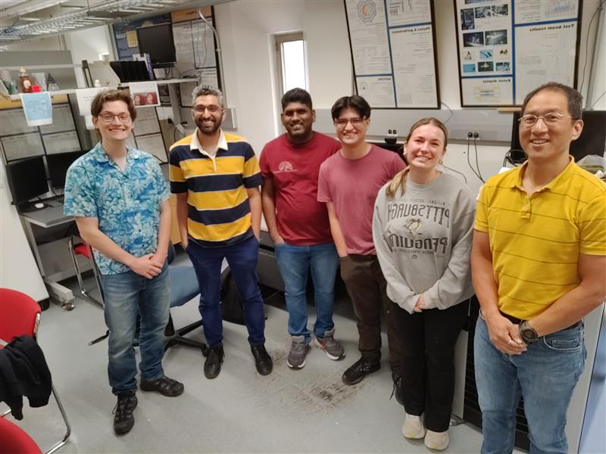
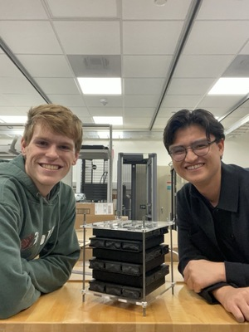
08
ACKNOWLEDGEMENT

Slide 21
08
ACKNOWLEDGEMENT
Supported by
Kenneth P. Dietrich School of Arts & Sciences
Department of Physics & Astronomy
NASA Pennsylvania Space Grant
2025 Emil Sanielevici Scholarship
Department of Energy
National Science Foundation
Electronics Shop(SRSS) : PCB Board Design, Fabrication, Testing and Integration
Machine Shop(SRSS) : Blackbox, 3D Printed Parts and Enclosers and Scintillator Machining

Slide 22
THANK YOU
Questions?
✉ yue8@pitt.edu · University of Pittsburgh
Acknowledgments: SRSS Electronics Shop & Machine Shop · Dietrich School of Arts and Science

