Slide 1
The Geometric
Scattering Algebra
of Physical Space
Moab Croft—Illinois State University—Dr. Christensen

Slide 2
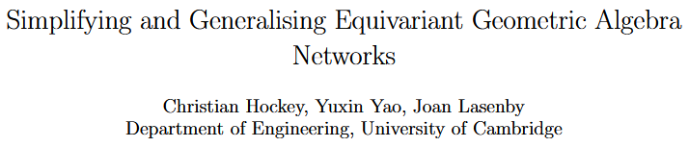

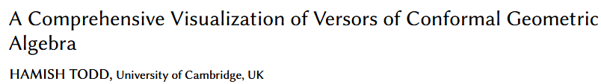
The Many Applications of Geometric Algebra
Computer Graphics
Machine Learning
Physics
Publications from Adv. in Geo. Alg. in Comp. Sci. and Eng. 2024

Slide 3
Constructive SM?
Lorentz Spinors
Lightray Structure
Ongoing Work

Slide 4
CONSTRUCTIVE STANDARD MODEL

Slide 5
Feynman Standard Model
(FSM)
Constructive Standard Model
(CSM)
Observables come from Gauge Invariance
Gauge Invariance introduces unphysical degrees of freedom (DOF)
Unphysical DOF make for lengthy and difficult scattering calculations
Observables are constructed
Construction forgoes unphysical degrees of freedom (DOF)
No unphysical DOF means simpler scattering calculations

Slide 6
Gauge Invariance Example

Slide 7
Gauge Invariance Example

Slide 8
Gauge Invariance Example

Slide 9
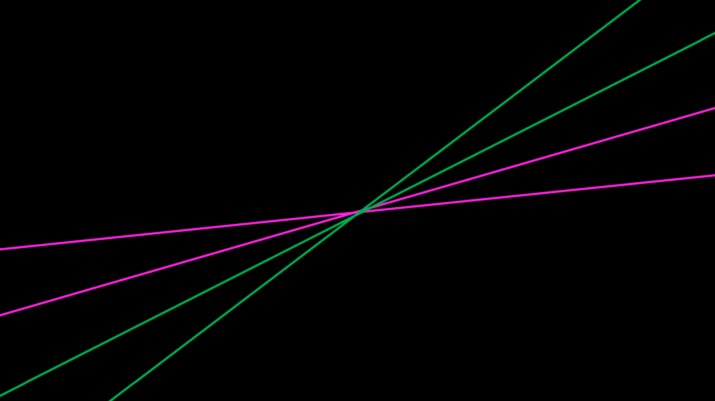
Gauge Invariance Example

Slide 10
Gauge Invariance Example

Slide 11
Gauge Invariance Example
Direct rotation
Unphysical DOF

Slide 12
LORENTZ SPINORS

Slide 13

$${\left|j\right\rangle }_{α}^{ J}=\left[\begin{matrix}\sqrt{E+|\overset{⃑}{p}|}\cos{\frac{θ}{2}} & −\sqrt{E−|\overset{⃑}{p}|}\sin{\frac{θ}{2}}e^{−iω} \\ \sqrt{E+|\overset{⃑}{p}|}\sin{\frac{θ}{2}}e^{iω} & \sqrt{E−|\overset{⃑}{p}|}\cos{\frac{θ}{2}}\end{matrix}\right]$$

Slide 14
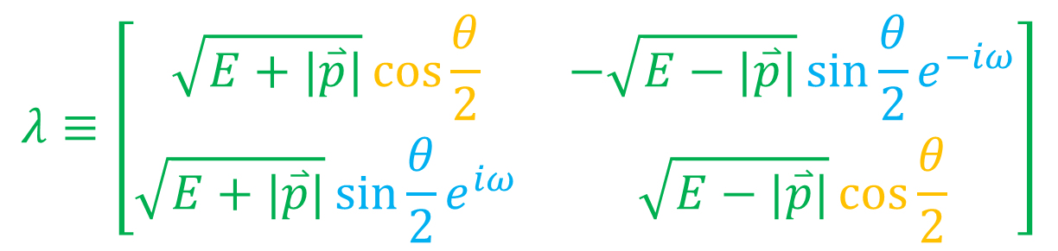
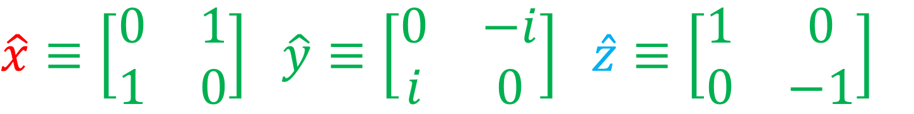
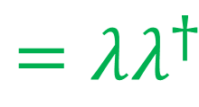
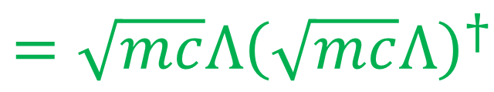
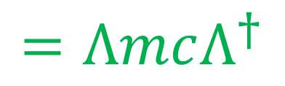
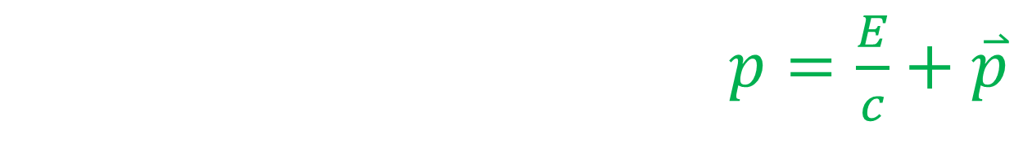
Matrix Representation of the APS
$\hat{x}≡\left[\begin{matrix}0 & 1 \\ 1 & 0\end{matrix}\right]$, $\hat{y}≡\left[\begin{matrix}0 & −i \\ i & 0\end{matrix}\right]$, $\hat{z}≡\left[\begin{matrix}1 & 0 \\ 0 & −1\end{matrix}\right]$
Spacetime momentum: $p=\frac{E}{c}+\overset{⃑}{p}$
$$=ΛmcΛ^{†}$$
$$=\sqrt{mc}Λ{\left(\sqrt{mc}Λ\right)}^{†}$$
$$λ≡\left[\begin{matrix}\sqrt{E+|\overset{⃑}{p}|}\cos{\frac{θ}{2}} & −\sqrt{E−|\overset{⃑}{p}|}\sin{\frac{θ}{2}}e^{−iω} \\ \sqrt{E+|\overset{⃑}{p}|}\sin{\frac{θ}{2}}e^{iω} & \sqrt{E−|\overset{⃑}{p}|}\cos{\frac{θ}{2}}\end{matrix}\right]$$
$$=λλ^{†}$$

Slide 15

$${\left|j\right\rangle }_{α}^{ J}=\left[\begin{matrix}\sqrt{E+|\overset{⃑}{p}|}\cos{\frac{θ}{2}} & −\sqrt{E−|\overset{⃑}{p}|}\sin{\frac{θ}{2}}e^{−iω} \\ \sqrt{E+|\overset{⃑}{p}|}\sin{\frac{θ}{2}}e^{iω} & \sqrt{E−|\overset{⃑}{p}|}\cos{\frac{θ}{2}}\end{matrix}\right]$$
$$λ≡\left[\begin{matrix}\sqrt{E+|\overset{⃑}{p}|}\cos{\frac{θ}{2}} & −\sqrt{E−|\overset{⃑}{p}|}\sin{\frac{θ}{2}}e^{−iω} \\ \sqrt{E+|\overset{⃑}{p}|}\sin{\frac{θ}{2}}e^{iω} & \sqrt{E−|\overset{⃑}{p}|}\cos{\frac{θ}{2}}\end{matrix}\right]$$

Slide 16



Table of Concurrence
${\left|j\right\rangle }_{α}^{ J} ↔ λ=\sqrt{mc}Λ$
${\left([j{\left.​\right|}_{\dot{β}J}\right)}^{T} ↔ λ^{†}$
${\left(⟨j{\left.​\right|}^{αJ}\right)}^{T}↔ \hat{B}\tilde{λ}$
${\left|j\right]}_{ J}^{\dot{β}} ↔ λ^{−}{\hat{B}}^{†}$
For appropriate bivector $\hat{B}$
(usually $\hat{B}=\hat{x}\hat{z}$)

Slide 17
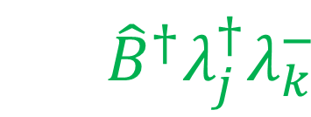
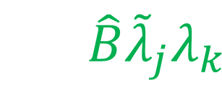
Lorentz Products
$$↔ \hat{B}{\tilde{λ}}_{j}λ_{k}$$
Left-Chiral Product: ${⟨j{\left.​\right|}^{αJ}\left|k\right\rangle }_{α}^{ K}={\left\langle jk\right\rangle }^{JK}$
Right-Chiral Product: ${[j{\left.​\right|}_{\dot{β}}^{ J}|k]}^{\dot{β}K}={\left[jk\right]}^{JK}$
$$↔ {\hat{B}}^{†}λ_{j}^{†}λ_{k}^{−}$$
Still not fully equivalent!

Slide 18
LIGHTRAY STRUCTURE

Slide 19

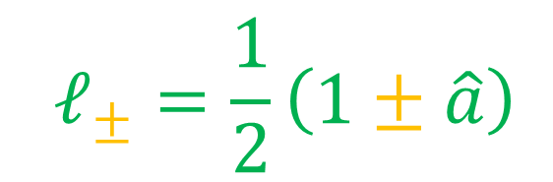
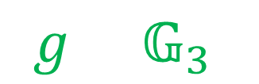
Ray Spinor Structure
Lightrays
$$ℓ_{±}=\frac{1}{2}\left(1±\hat{a}\right)$$
Partition time (complementary): $ℓ_{+}+ℓ_{−}=1$
$$g∈{\text{𝔾}}_{3}$$
Forward-oriented ray spinor: $gℓ_{+}=α_{F}$
Backward-oriented ray spinor: $gℓ_{−}=β_{B}$
$$g=α_{F}+β_{B}$$

Slide 20
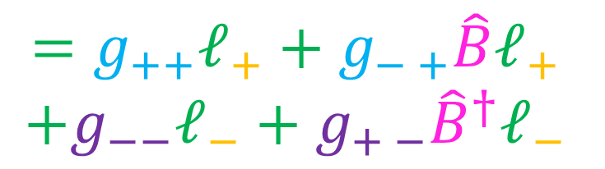
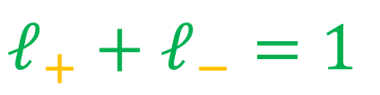

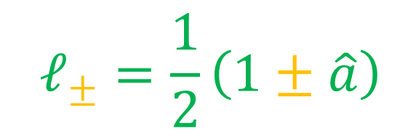



Ray Spinor Structure
$$1$$
$$ℓ_{±}=\frac{1}{2}\left(1±\hat{a}\right)$$
$$ℓ_{−}$$
$$ℓ_{+}$$
$$ℓ_{+}+ℓ_{−}=1$$
$$g=α_{F}+β_{B}$$
$$=g_{++}ℓ_{+}+g_{− +}\hat{B}ℓ_{+}$$
$$+g_{−−}ℓ_{−}+g_{+ −}{\hat{B}}^{†}ℓ_{−}$$

Slide 21




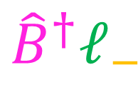
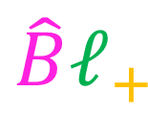
Ray Spinor Structure
$$ℓ_{±}=\frac{1}{2}\left(1±\hat{a}\right)$$
$${\hat{B}}^{†}ℓ_{−}$$
$$\hat{B}ℓ_{+}$$
$$ℓ_{+}+ℓ_{−}=1$$
$$g=α_{F}+β_{B}$$
$$ℓ_{−}$$
$$ℓ_{+}$$
$$=g_{++}ℓ_{+}+g_{− +}\hat{B}ℓ_{+}$$
$$+g_{−−}ℓ_{−}+g_{+ −}{\hat{B}}^{†}ℓ_{−}$$
$$1$$
Recall ${\left\langle jk\right\rangle }^{JK}$ selects components using $JK$

Slide 22

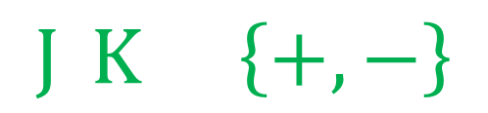
Lightray Filter
For appropriate bivector $\hat{B}=\hat{b}\hat{a}=\hat{b}∧\hat{a}$ :
$${\left[g\right]}^{JK}=ℓ_{J}gℓ_{K}+\hat{b}ℓ_{J}gℓ_{K}\hat{b}$$
$$J,K∈\left\{+,−\right\}$$

Slide 23

Lightray Filter
Scattering Algebra Bracket of $g∈{\text{𝔾}}_{3}$
$${\left[g\right]}^{JK}=ℓ_{J}gℓ_{K}+\hat{b}ℓ_{J}gℓ_{K}\hat{b}$$
$$J,K∈\left\{+,−\right\}$$

Slide 24
Lorentz Products
$$↔ \hat{B}{\tilde{λ}}_{j}λ_{k}$$
Left-Chiral Product: ${⟨j{\left.​\right|}^{αJ}\left|k\right\rangle }_{α}^{ K}={\left\langle jk\right\rangle }^{JK}$
Right-Chiral Product: ${[j{\left.​\right|}_{\dot{β}}^{ J}|k]}^{\dot{β}K}={\left[jk\right]}^{JK}$
$$↔ {\hat{B}}^{†}λ_{j}^{†}λ_{k}^{−}$$
Still not fully equivalent!

Slide 25
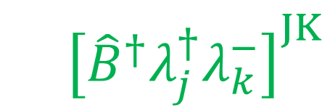
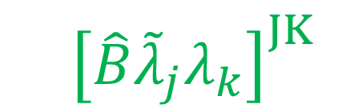
Lorentz Products
$=$ ${\left[\hat{B}{\tilde{λ}}_{j}λ_{k}\right]}^{JK}$
Left-Chiral Product: ${⟨j{\left.​\right|}^{αJ}\left|k\right\rangle }_{α}^{ K}={\left\langle jk\right\rangle }^{JK}$
$$={\left[{\hat{B}}^{†}λ_{j}^{†}λ_{k}^{−}\right]}^{JK}$$
Right-Chiral Product: ${[j{\left.​\right|}_{\dot{β}}^{ J}|k]}^{\dot{β}K}={\left[jk\right]}^{JK}$
Now fully equivalent!

Slide 26
END

Slide 27
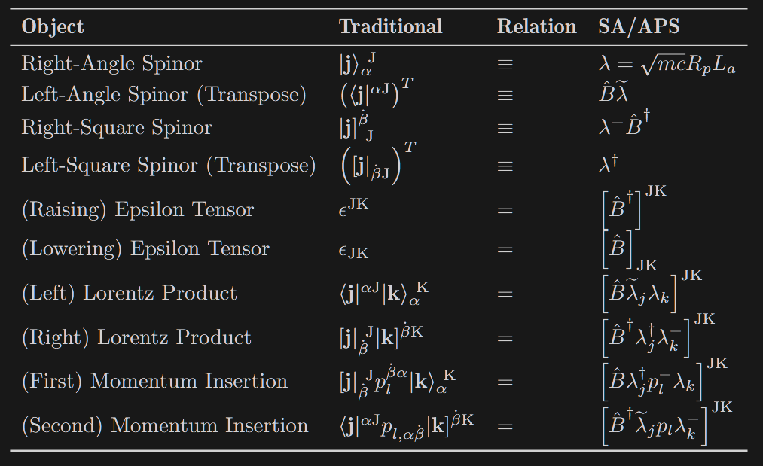

Slide 28
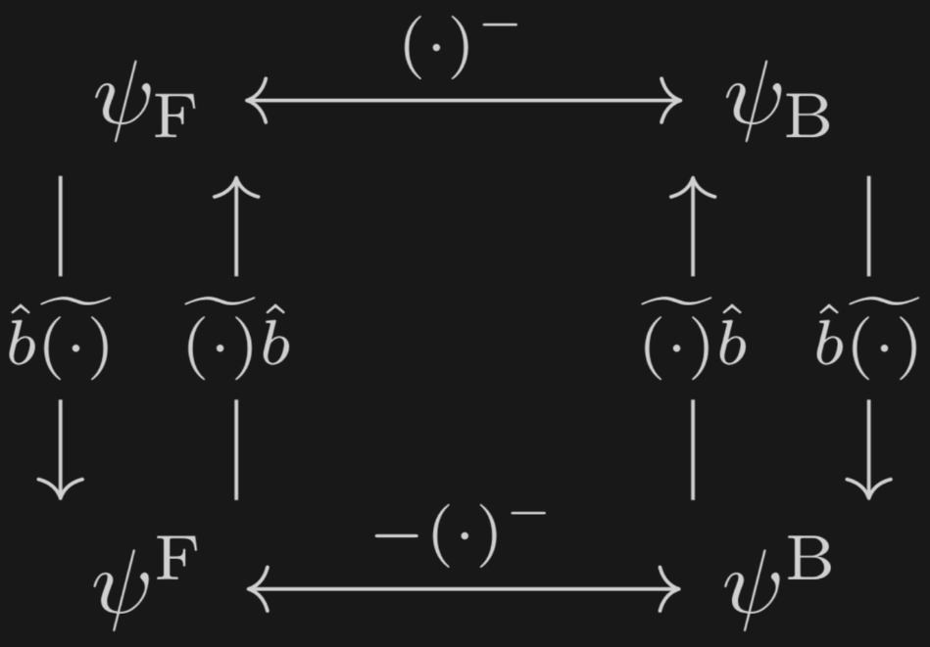

Slide 29
