Slide 1
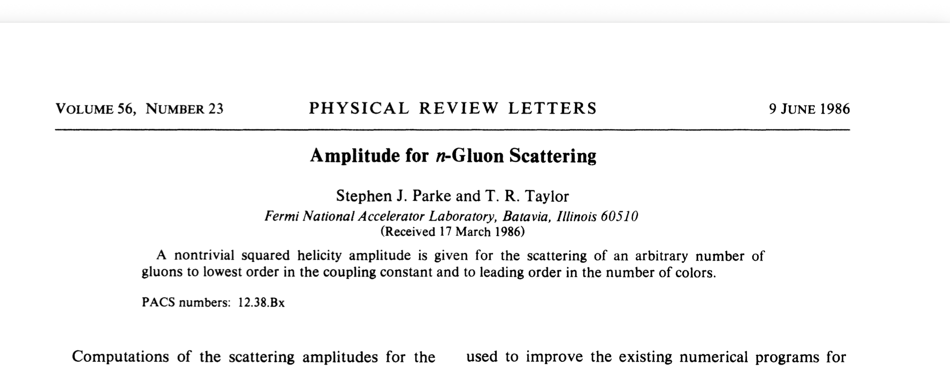
Parke & Taylor

Slide 2
QCD Amplitudes from String Theory

Slide 3
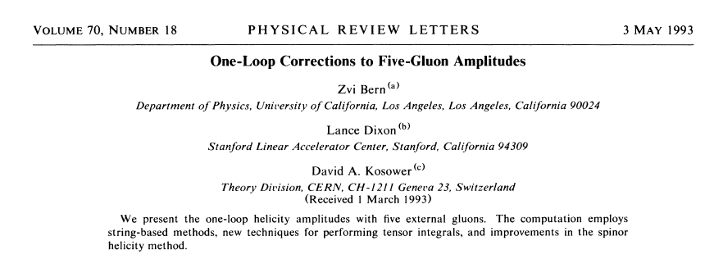
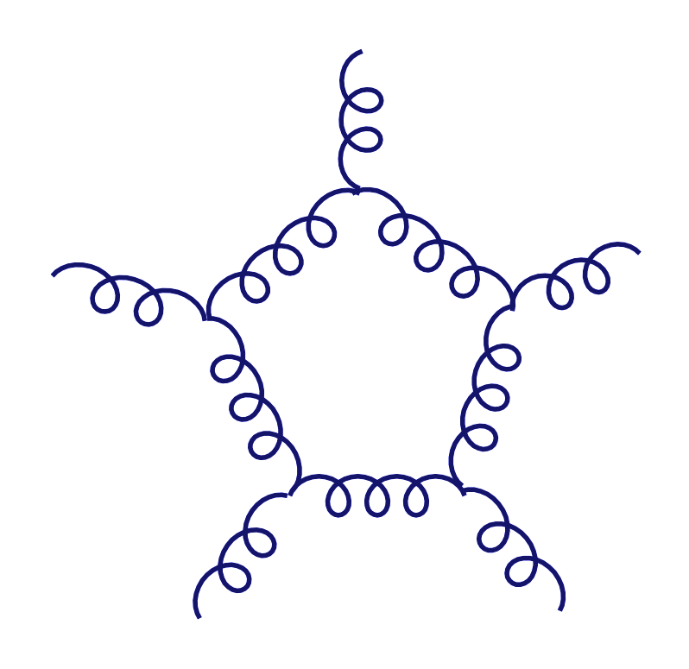
Precursor Paper
5 gluon loop amplitude is simple!

Slide 4

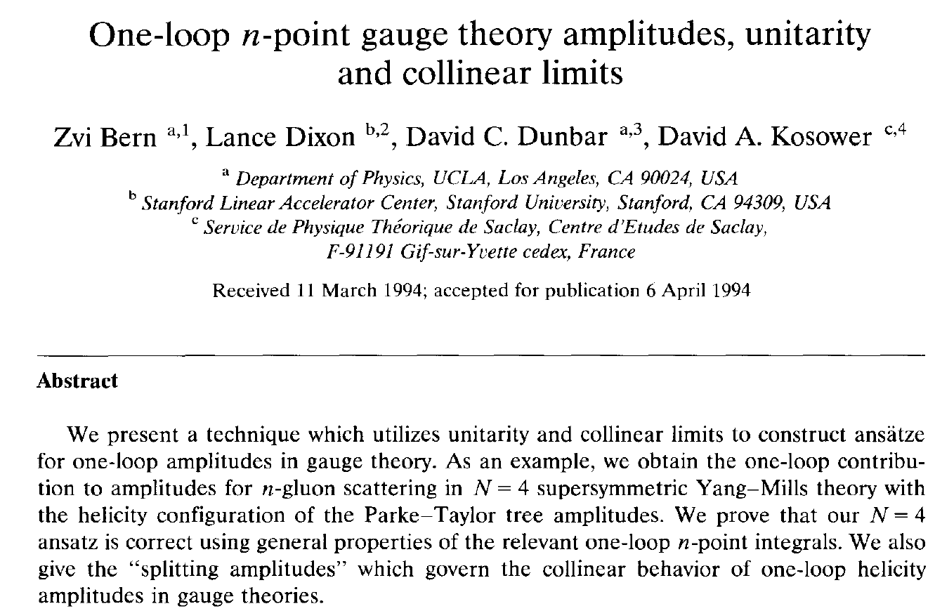
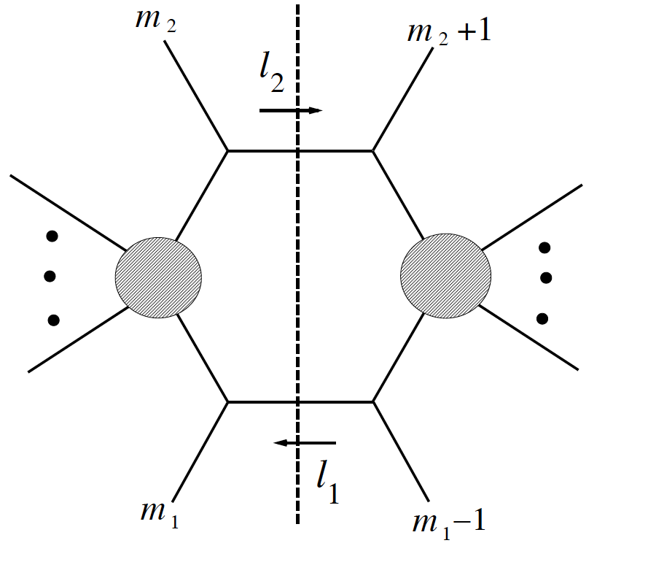
Simplicity at one-loop in gauge theory.
Notes:
Add 5 gluon amplitudes

Slide 5
Simplicity at one-loop in gauge theory.
Notes:
Add 5 gluon amplitudes

Slide 6
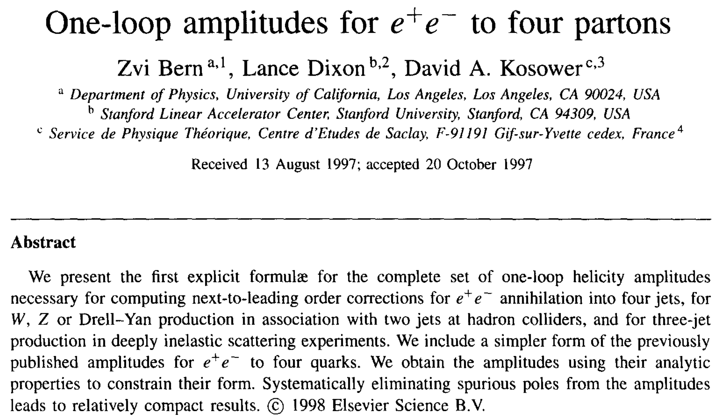
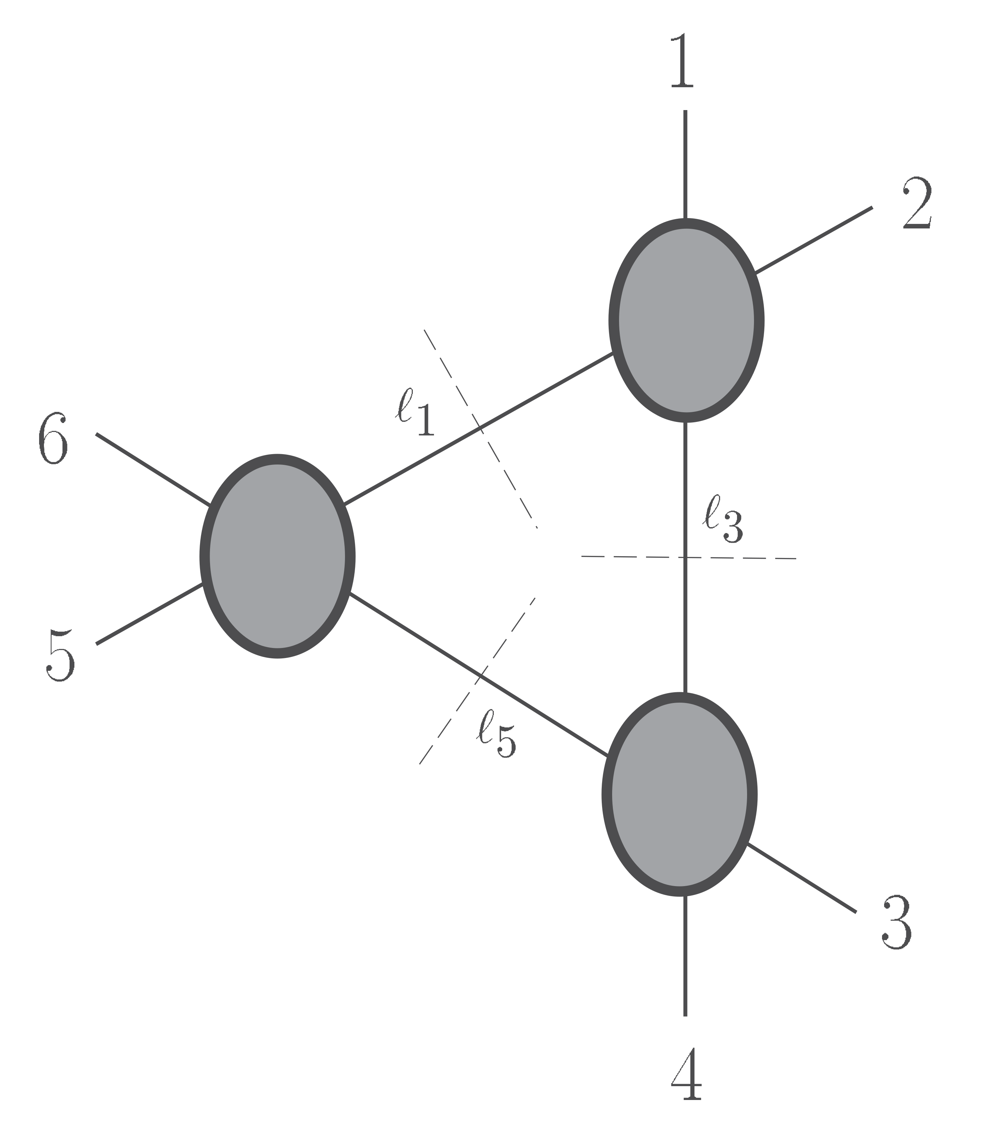
Simplicity at one-loop in gauge theory.
Notes:
Add 5 gluon amplitudes

Slide 7
Two-loops
Notes:
Add 5 gluon amplitudes

Slide 8
Our First Paper on Gravity, N = 8 Supergravity at 2 Loops
We had KLT

Slide 9

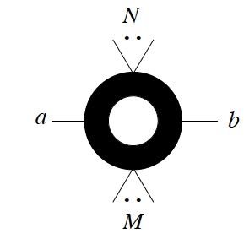
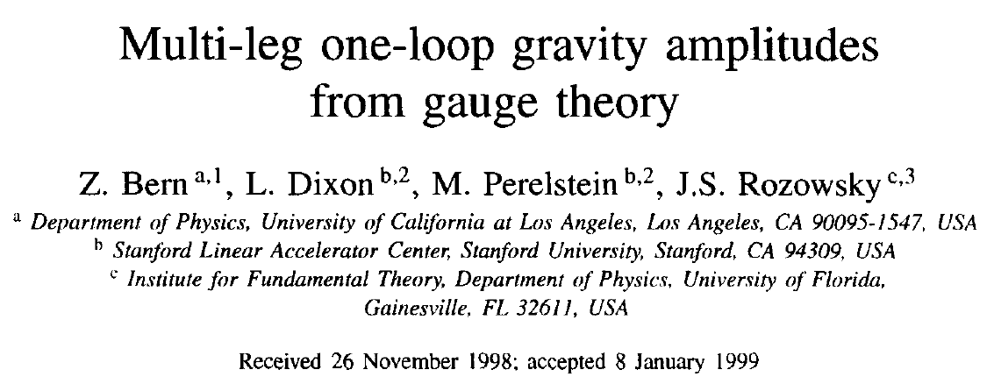
2nd Paper: MHV One-Loop Gravity Amplitudes

Slide 10
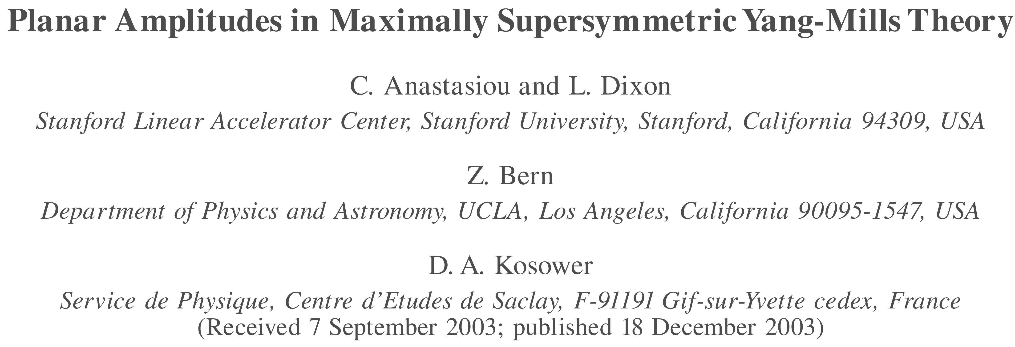
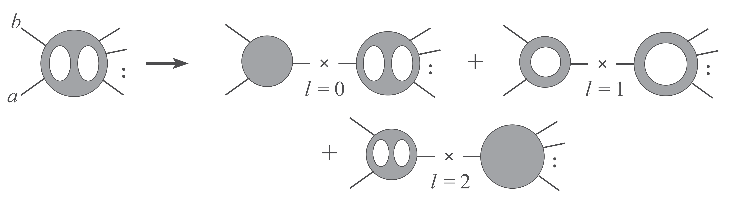
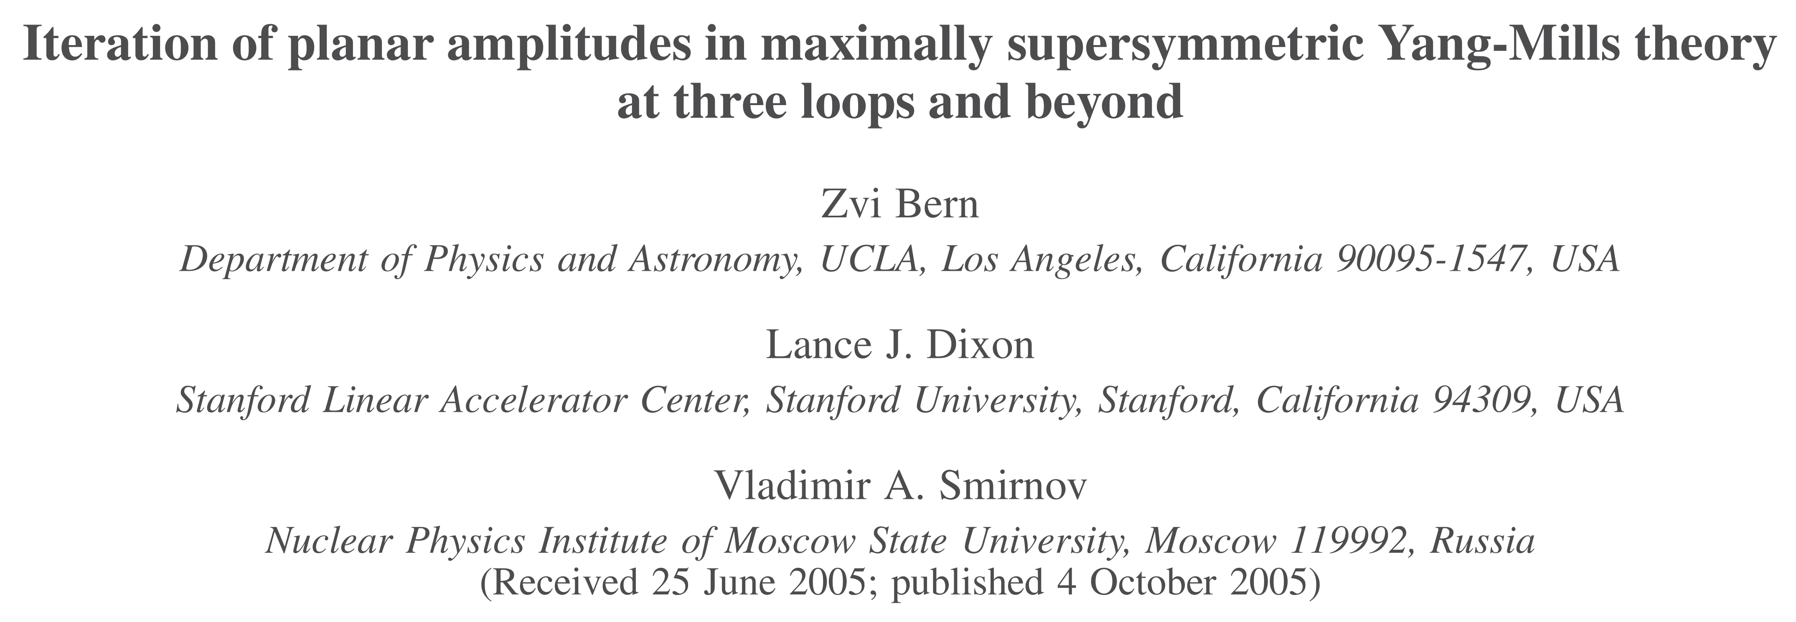
ABDK/BDS

Slide 11
“amplitudes” became “Amplitudes” in 2004
Notes:
CHECK SPELLING OF HEInemann

Slide 12
The 2nd Era of Studying UV in Sugra
No real calculations!
Abstract says: “We comment on calculations needed …” not “We calculate …”

Slide 13
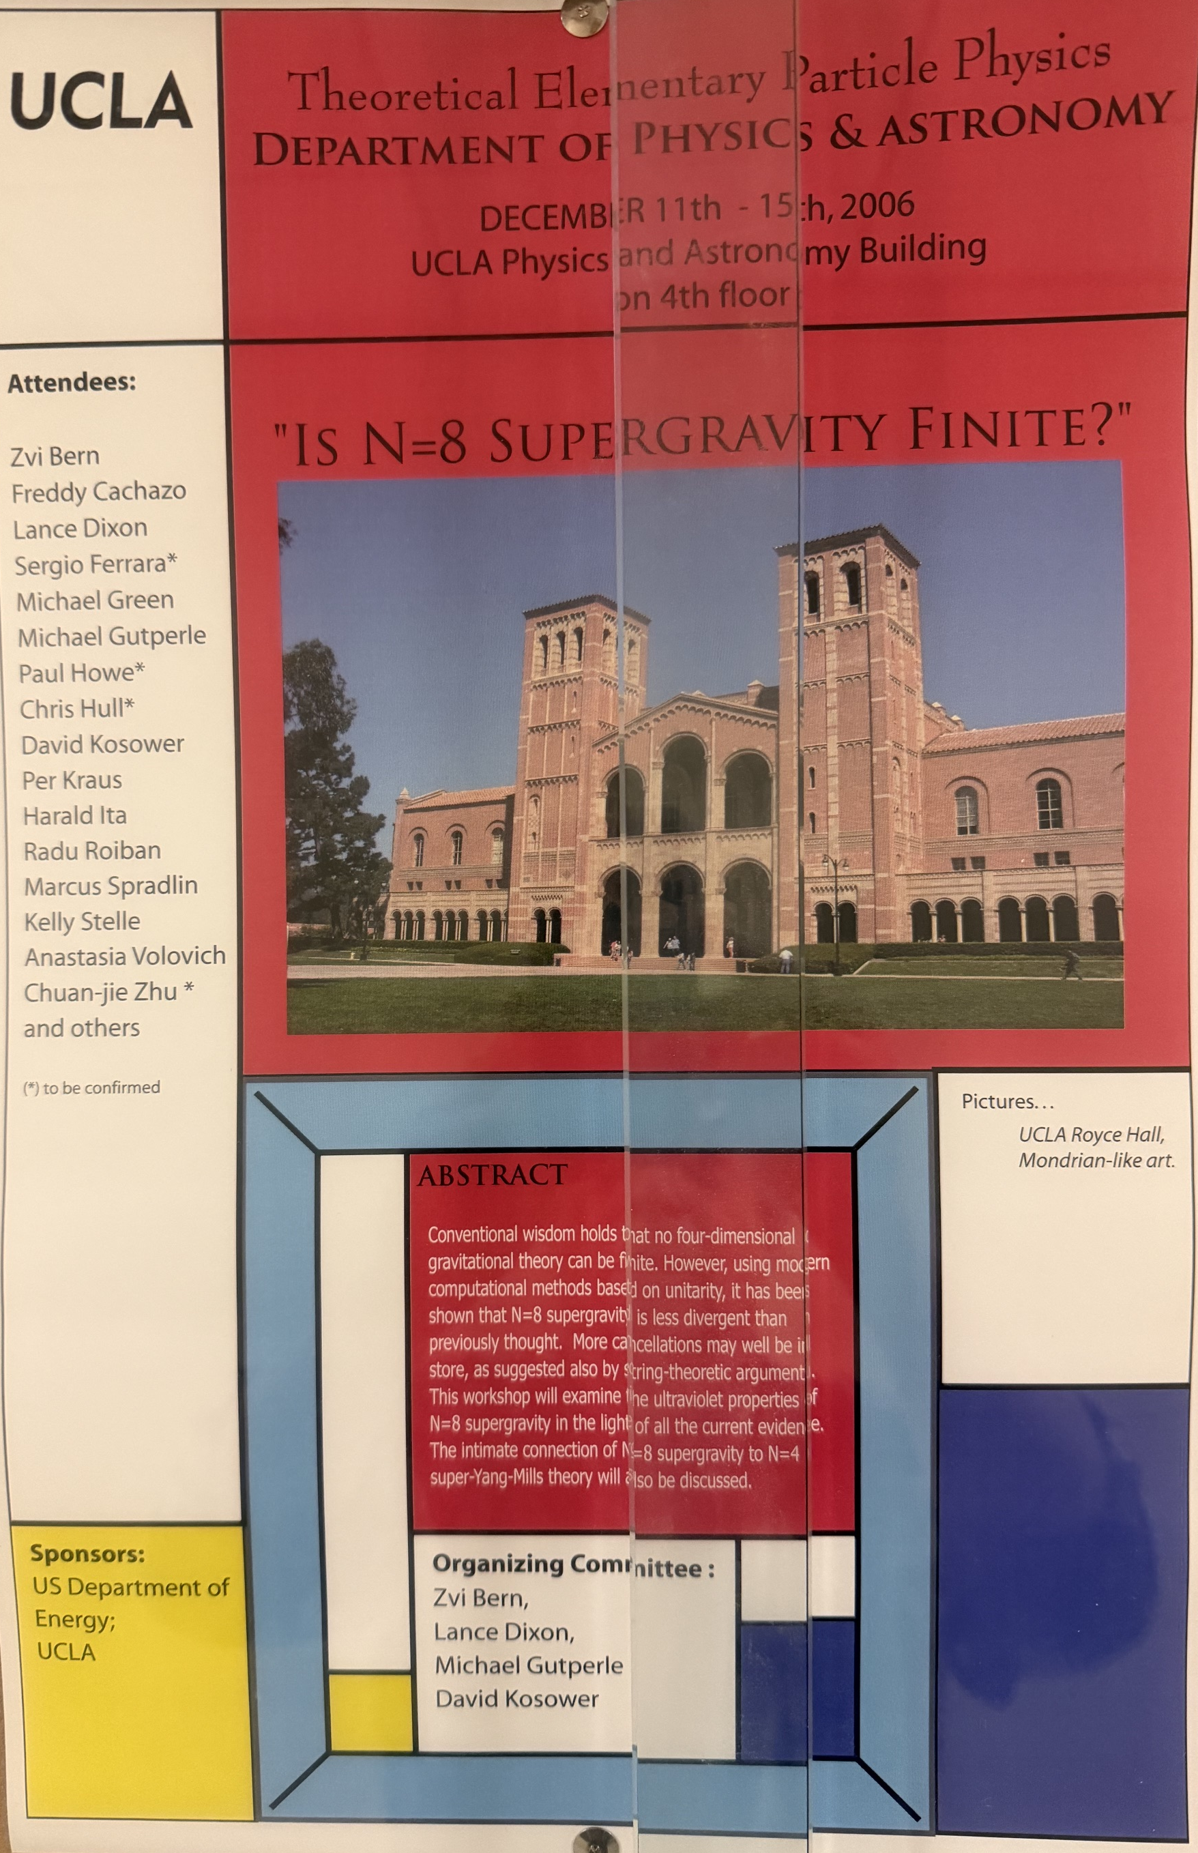
Study of Supergravity Divergences Came Back to Life.
Notes:
CHECK SPELLING OF HEInemann

