Slide 1
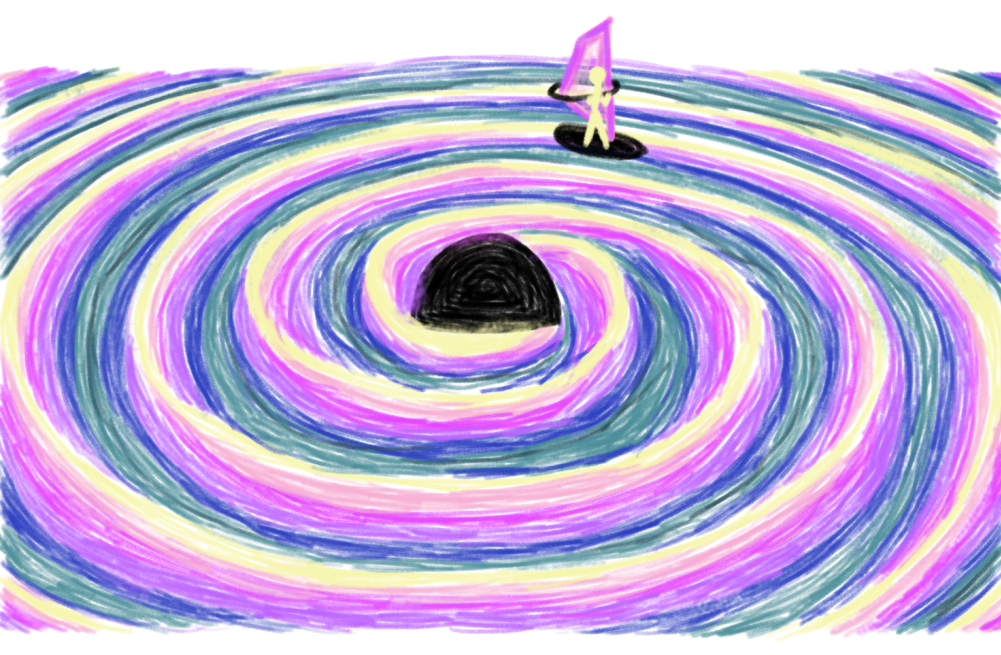


Black Hole Response Theory
and its Shockwave Limit
Based on [2604.22009] & upcoming work with Carl Jordan Eriksen, Jitze Hoogeveen, Gustav Uhre Jakobsen and Jan Plefka
Amplitudes, Queen Mary University of London
Lara Bohnenblust
29. June 2026

Slide 2
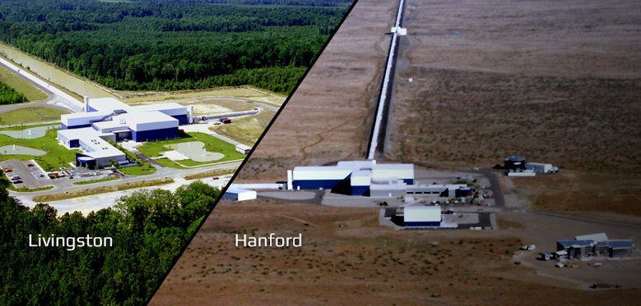
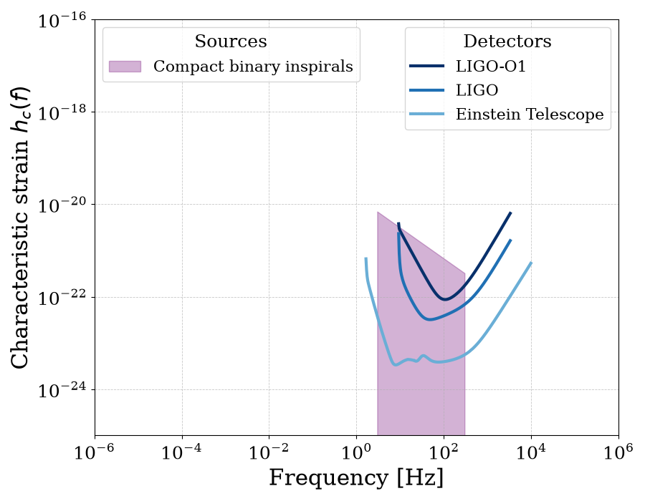
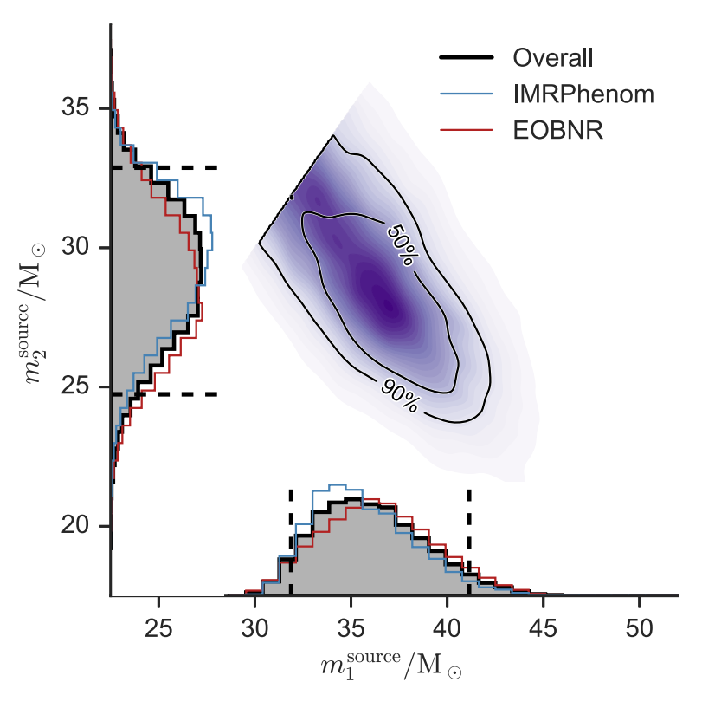
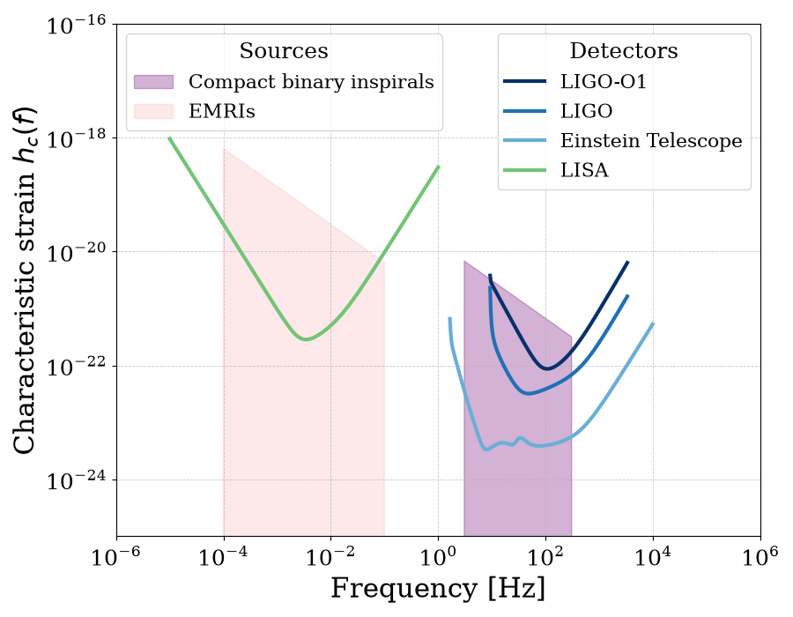
Gravitational wave modeling
Currently detectable
(template 1)
Precise and accurate models are crucial!
(template 2)
Quasi-circular waveform model
Inspiral
Merger
Ringdown
LVK Collaboration [1602.03840]

Slide 3
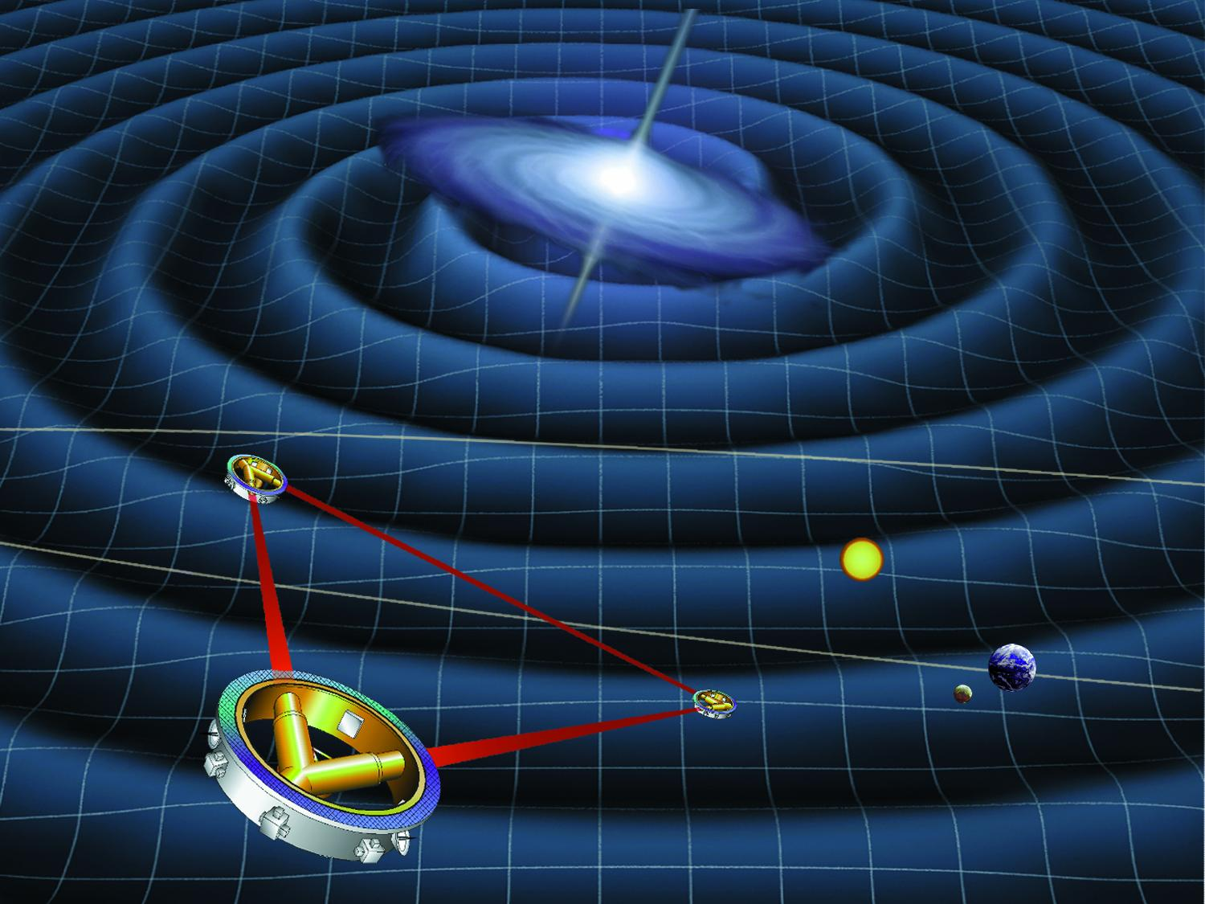
Gravitational wave modeling
Currently detectable
Detectable in the future!
(template 1)
Precise and accurate models are crucial but do not exist for generic EMRIs!
(template 2)
Quasi-circular waveform model
Inspiral
Merger
Ringdown
LVK Collaboration [1602.03840]

Slide 4
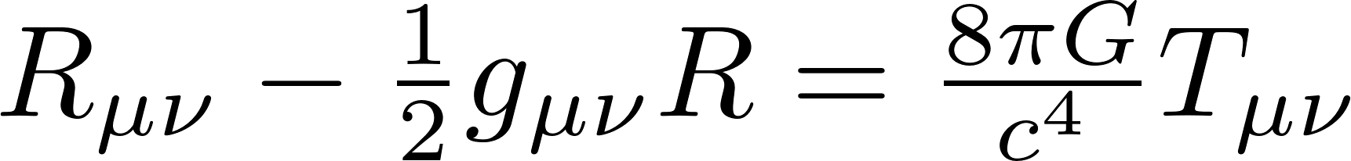
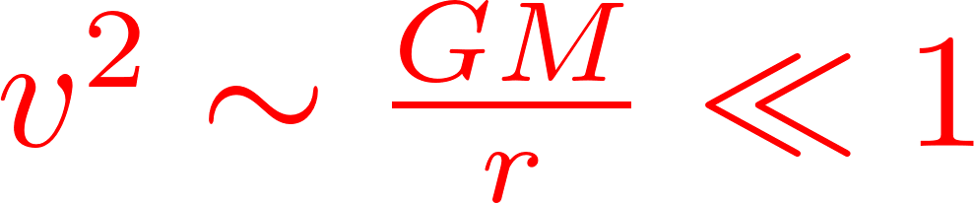
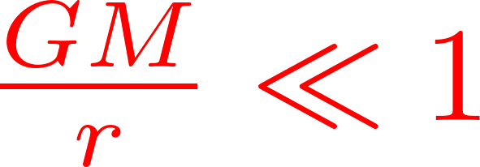
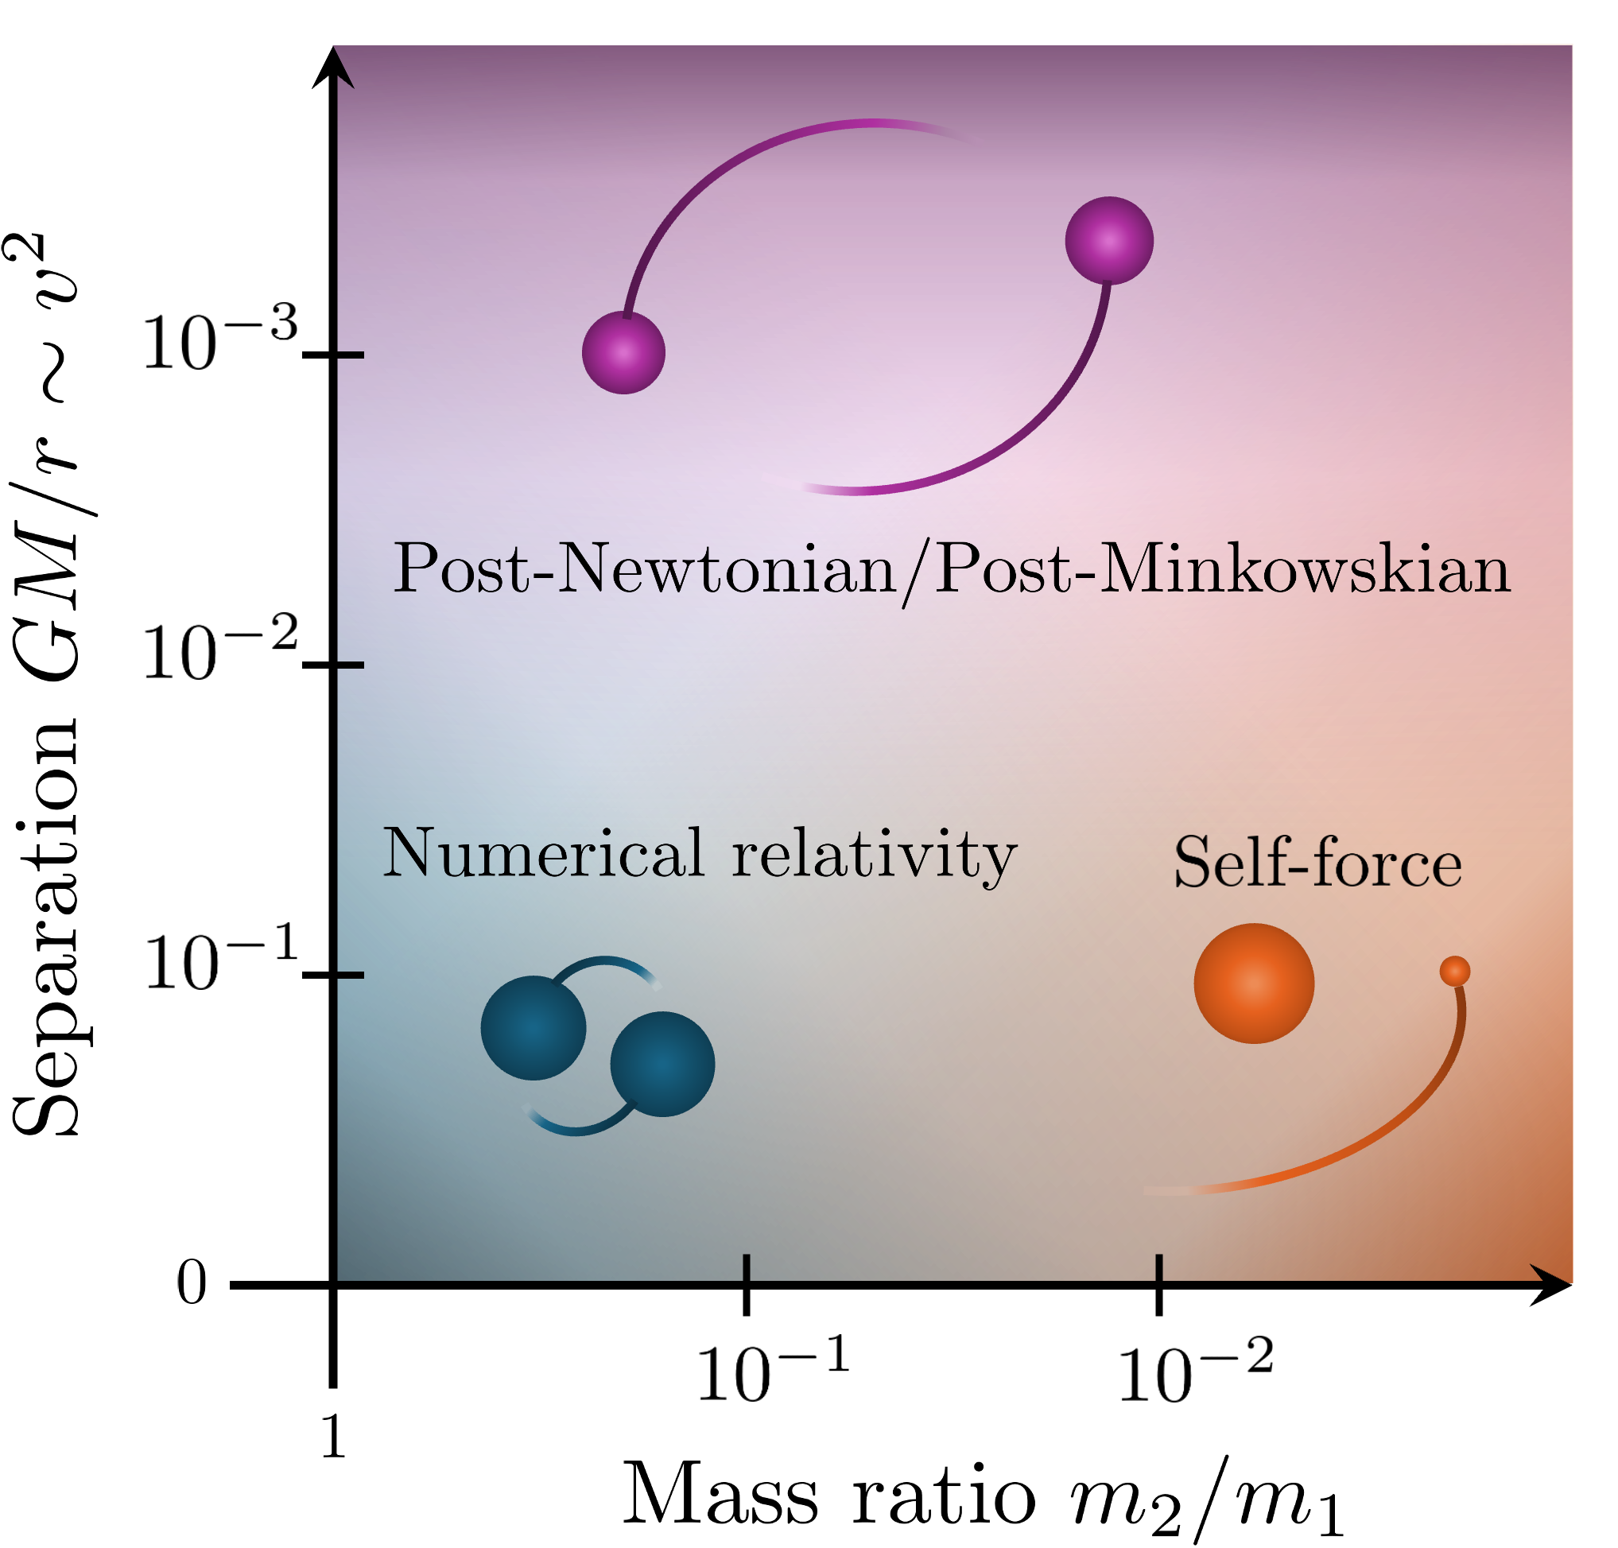
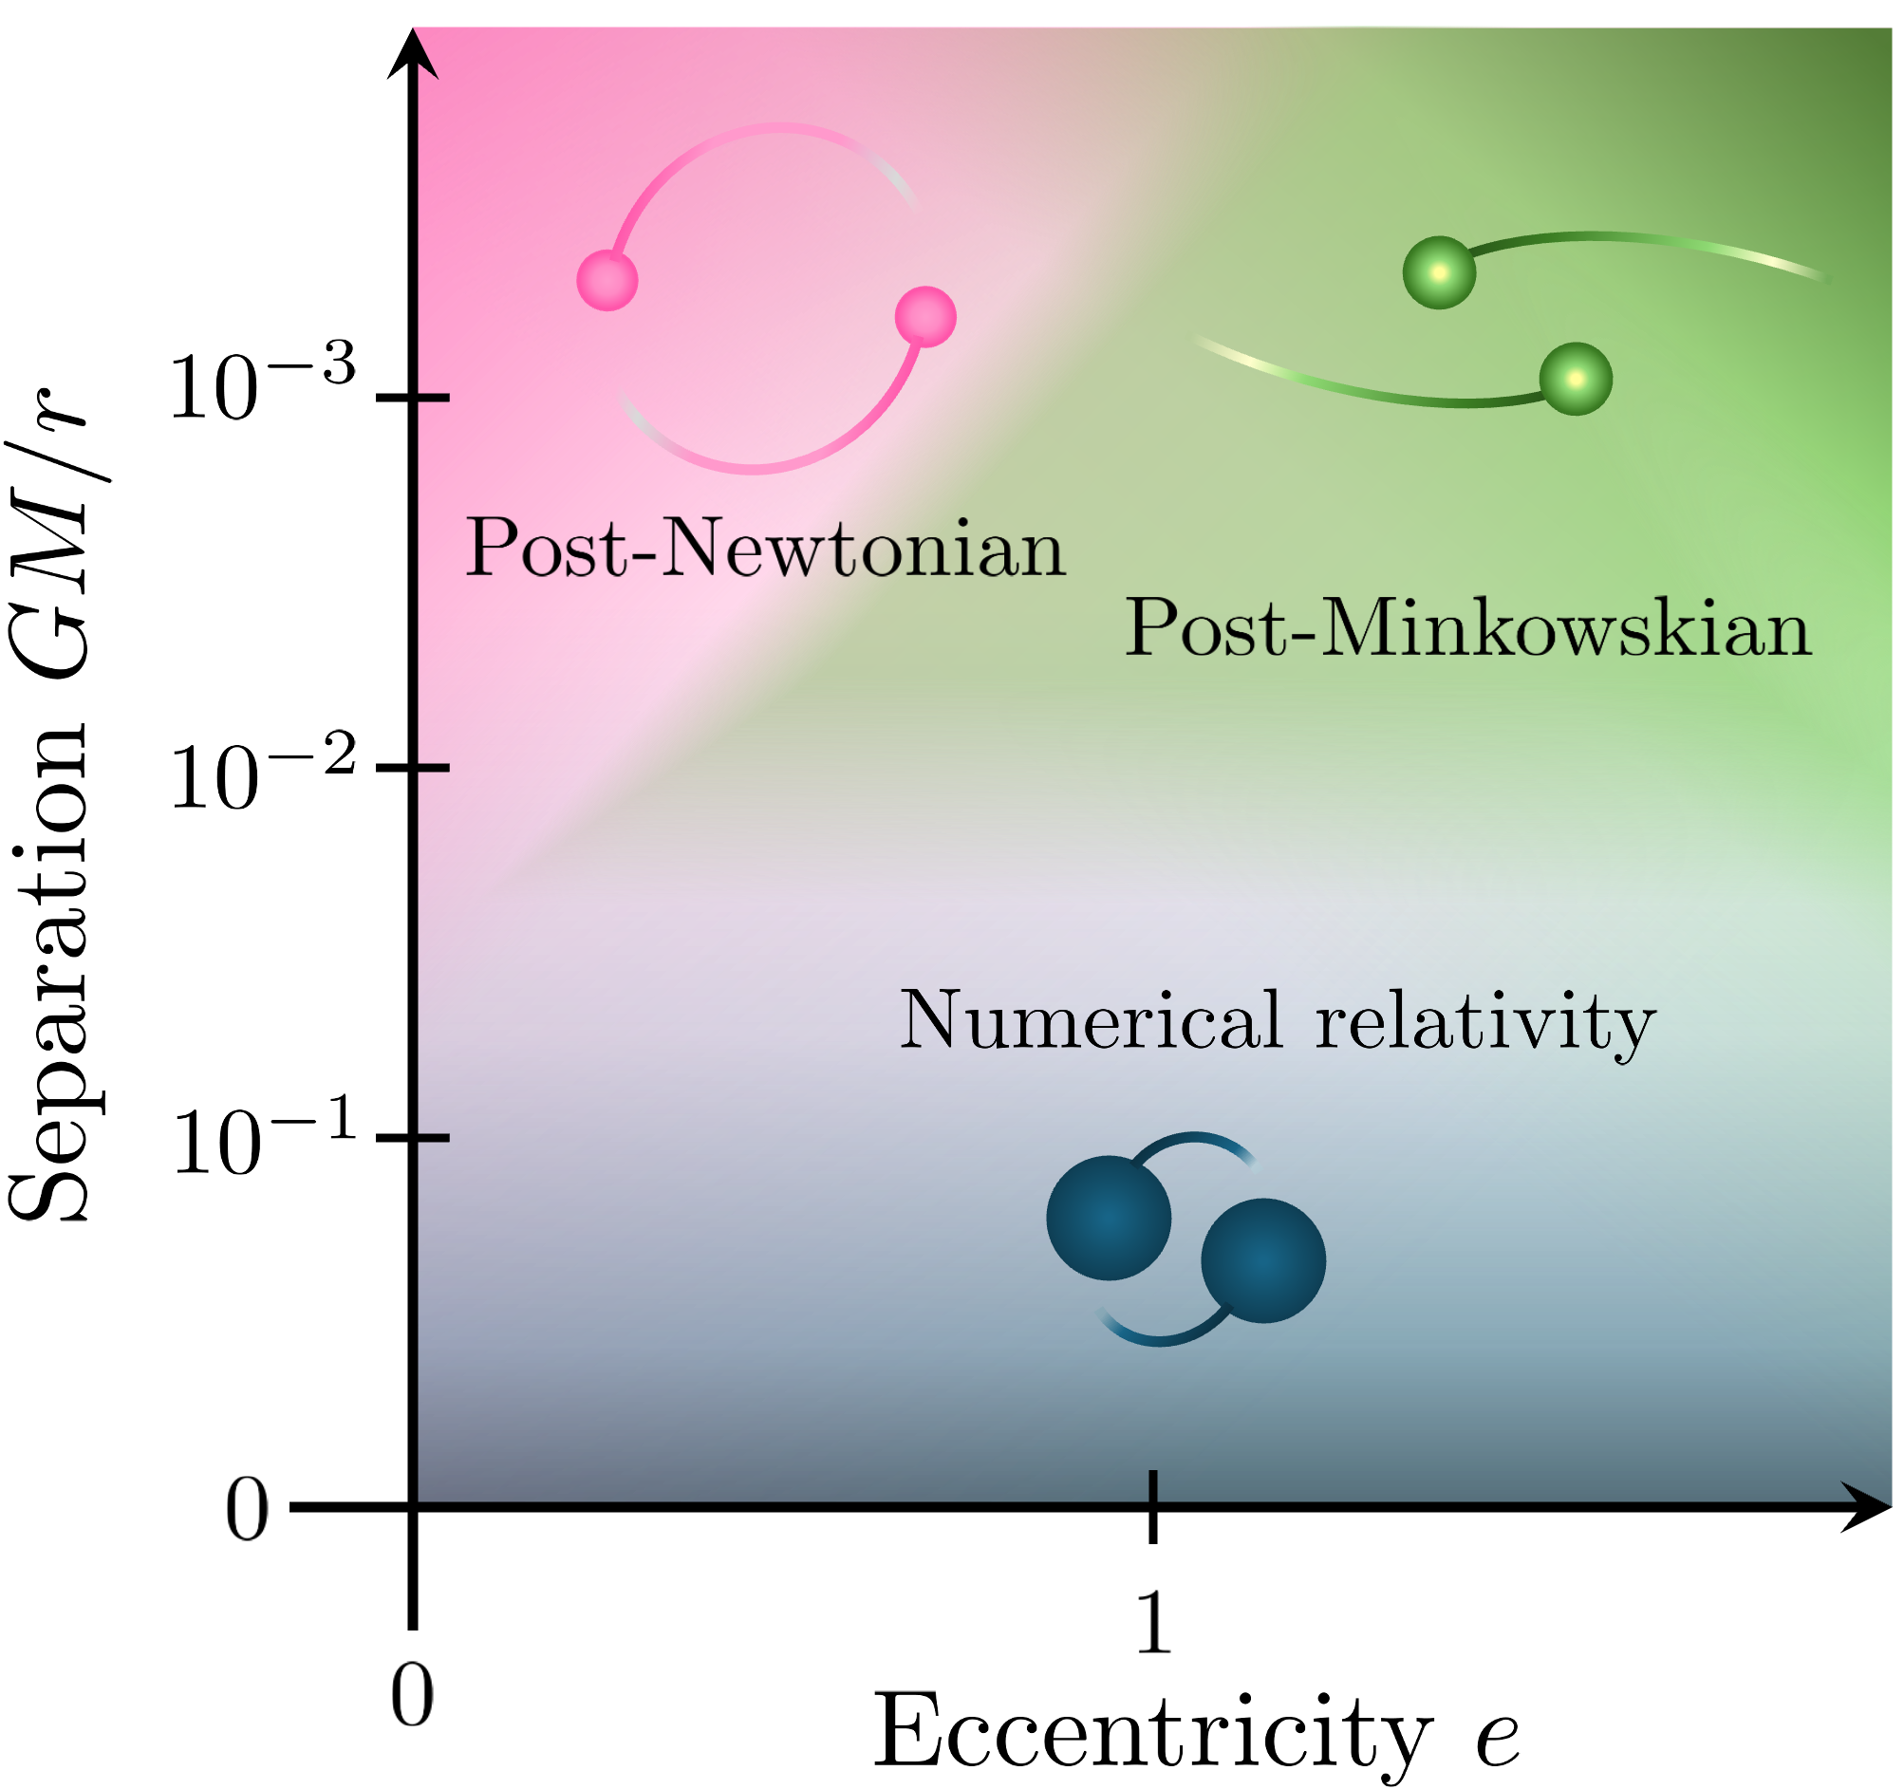
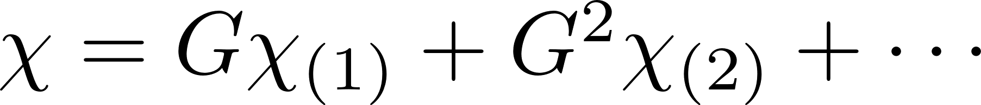
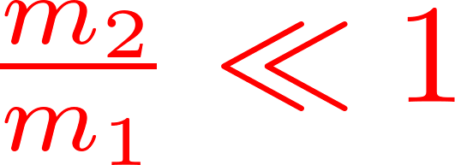
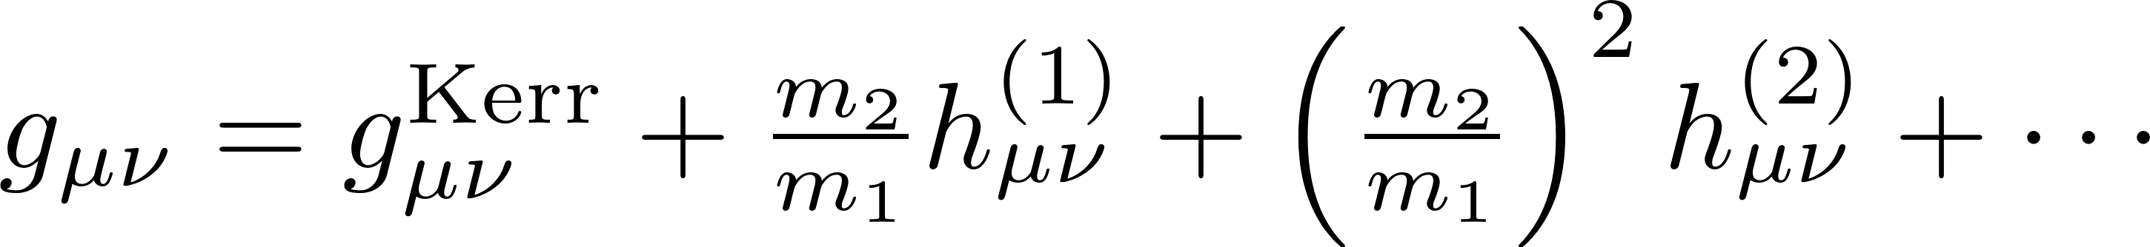
Gravitational wave modeling
Solving non-linear Einstein field equations → approximate in small parameter
From amplitudes:
Post-Minkowskian (PM)
Weak coupling expansion
Classical worldline QFT amplitudes
For EMRIs: self-force (SF)
see Gustav Jakobsen’s talk
Expansion around background metric and geodesic
Black hole response theory
Organize amplitudes and resum to obtain results in the strong field!

Slide 5
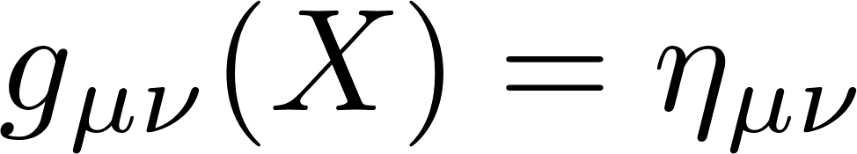

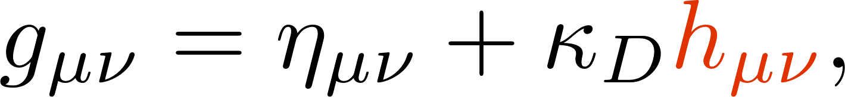
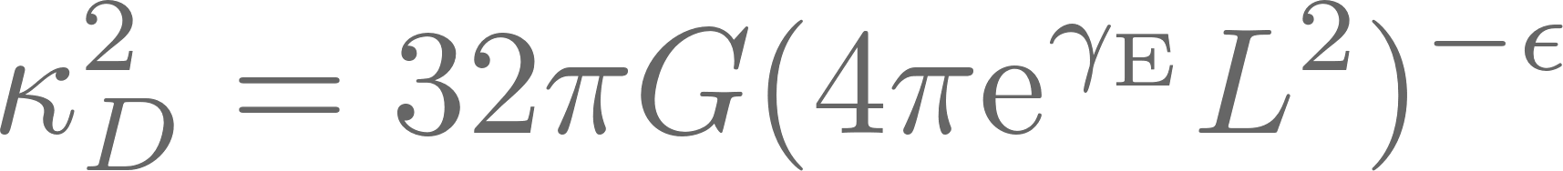
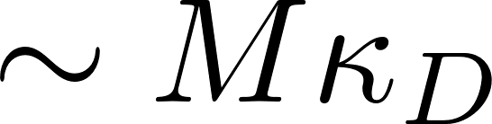

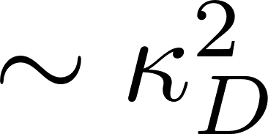
WQFT of a single black hole
Mogull, Plefka, Steinhoff [2010.02865]
Cheung, Parra-Martinez, Rothstein, Shah, Wilson-Gerow [2406.14770]
Fiducial length scale
Quantize deviation from background solution → Classical solution to EOM are tree-level diagrams
Feynman rules for “in-in” (Schwinger-Keldysh) prescription:

Slide 6

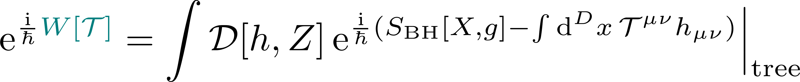

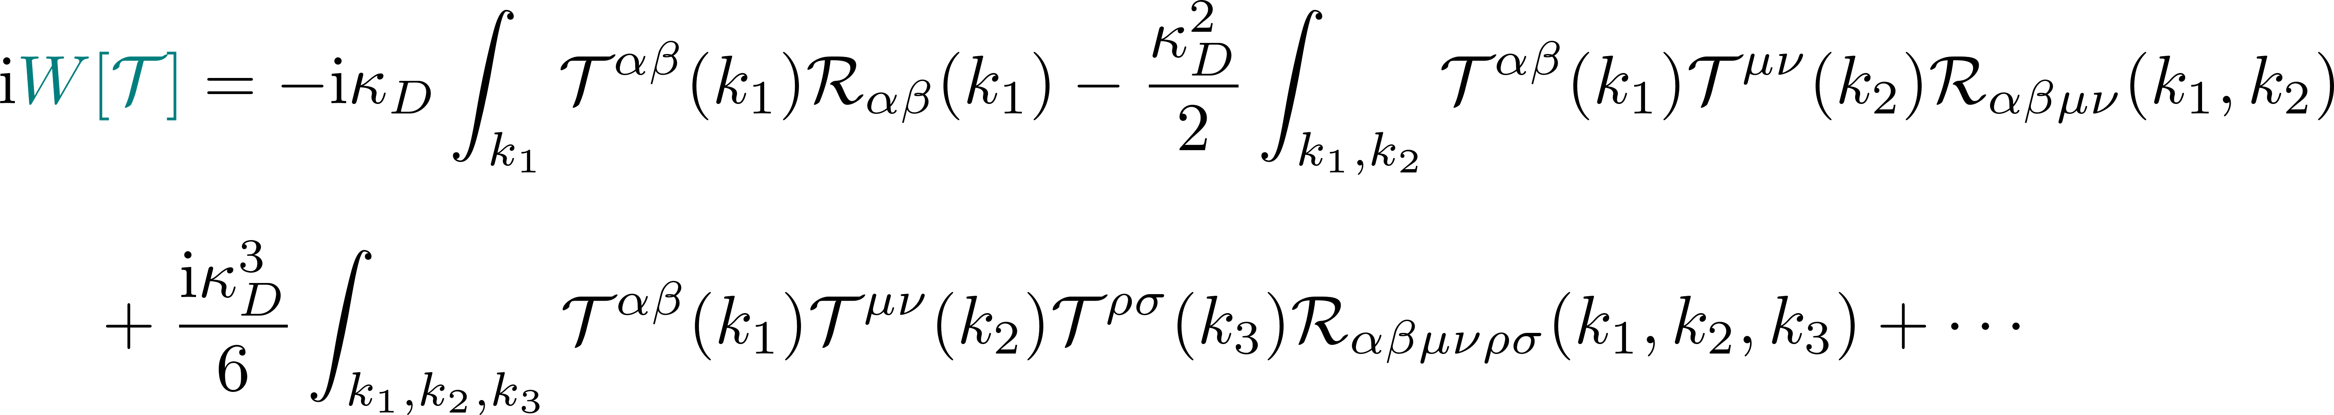



Black hole response theory
Integrate out worldline and graviton fluctuation
Black hole response (BHR) effective action encoding response to arbitrary source
Expansion in source yields response functions:

Slide 7



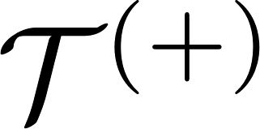
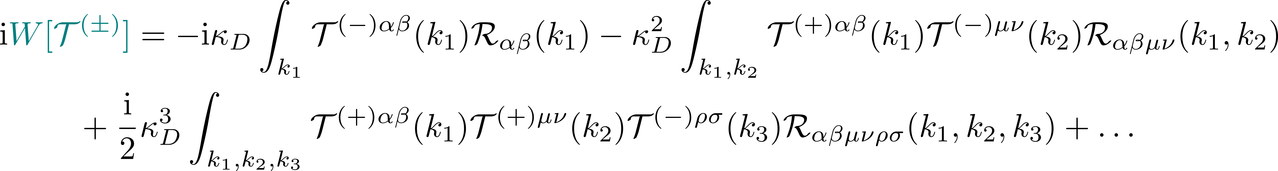
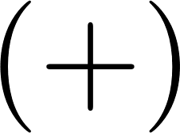
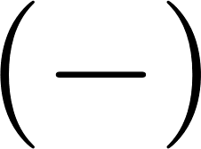












Black hole response theory with “in-in”
Integrate out worldline and graviton fluctuation (Keldysh-Schwinger)
Black hole response (BHR) effective action encoding response to arbitrary source in Keldysh basis
Expansion in source yields response functions:
Many incoming legs and one outgoing leg

Slide 8
Black hole response theory with “in-in”
Integrate out worldline and graviton fluctuation (Keldysh-Schwinger)
Black hole response (BHR) effective action encoding response to arbitrary source in Keldysh basis
Expansion in source yields response functions:
Many incoming legs and one outgoing leg

Slide 9
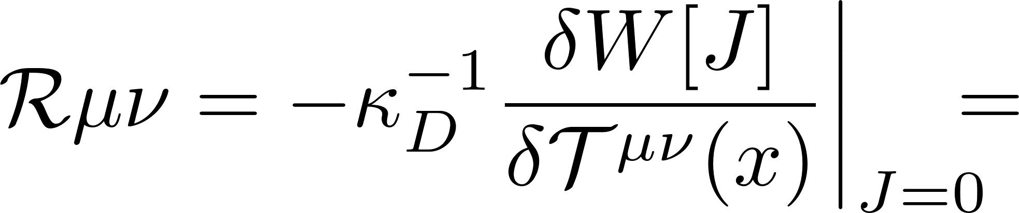
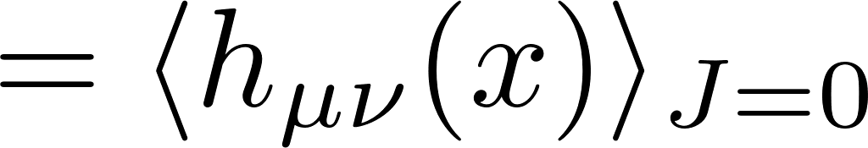
Response functions
One-point response is equivalent to background metric

Slide 10
Response functions
One-point response is equivalent to background metric

Slide 11
Response functions
One-point response is equivalent to background metric
Two-point response acts as propagator on curved spacetime
Three-point response (and higher) can be recovered from lower-point responses
With vertex rule

Slide 12
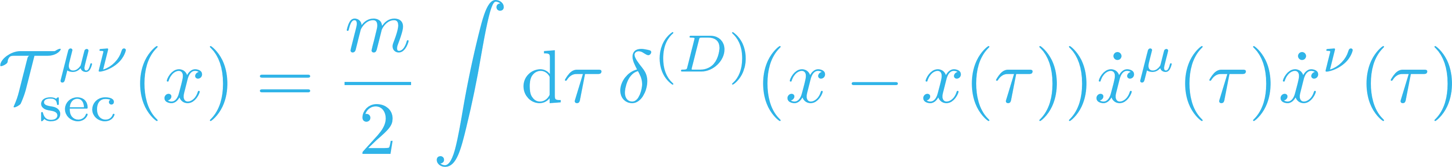
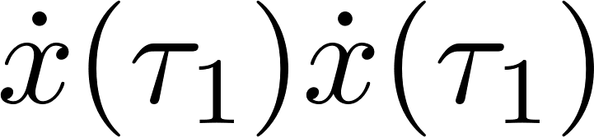
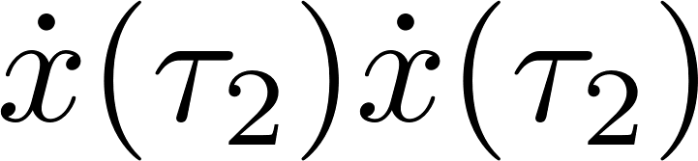

Self-force expansion in black hole response theory
Couple to light secondary black hole
natural self-force expansion
Expand around 0SF dynamics
Geodesic on background metric

Slide 13


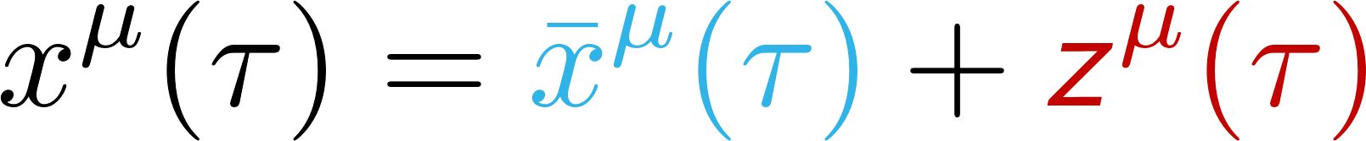
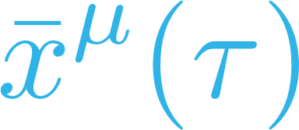
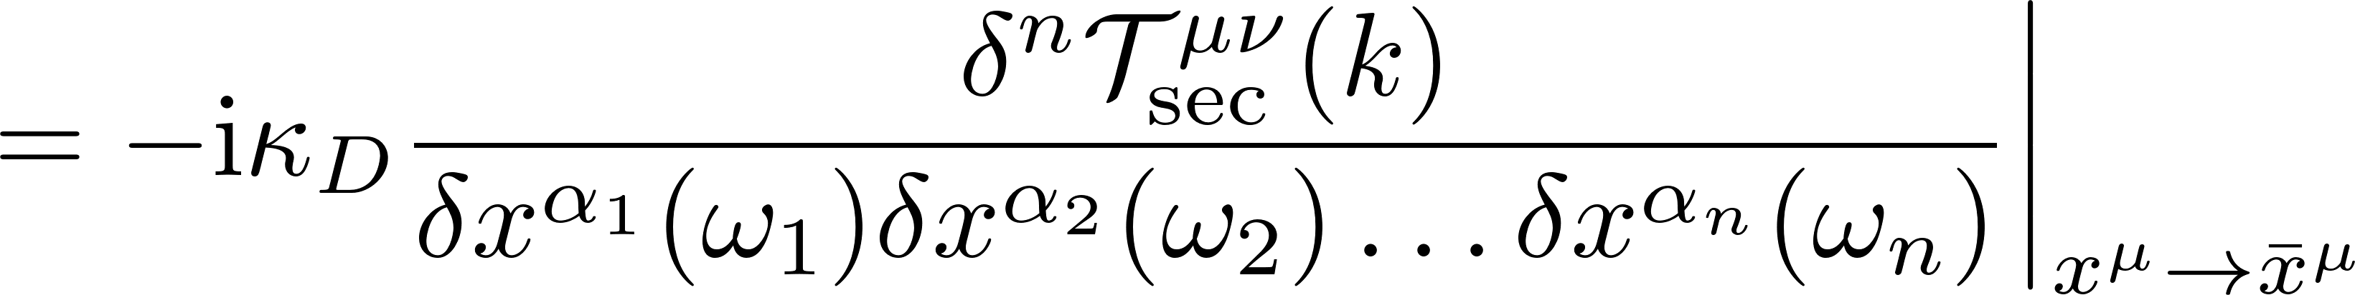
Self-force expansion in black hole response theory
Couple to light secondary black hole
natural self-force expansion
0SF solved by geodesic
Expand around 0SF
Feynman vertices resumming background motion
Geodesic on background metric

Slide 14
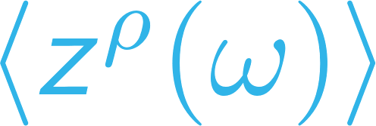
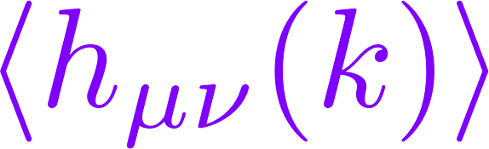
Observables in the self-force expansion
Trajectory/Impulse
Waveform
Ingredients:
Background metric
Geodesics and cross vertices
n-point response function for
(n-1) self-force observable

Slide 15
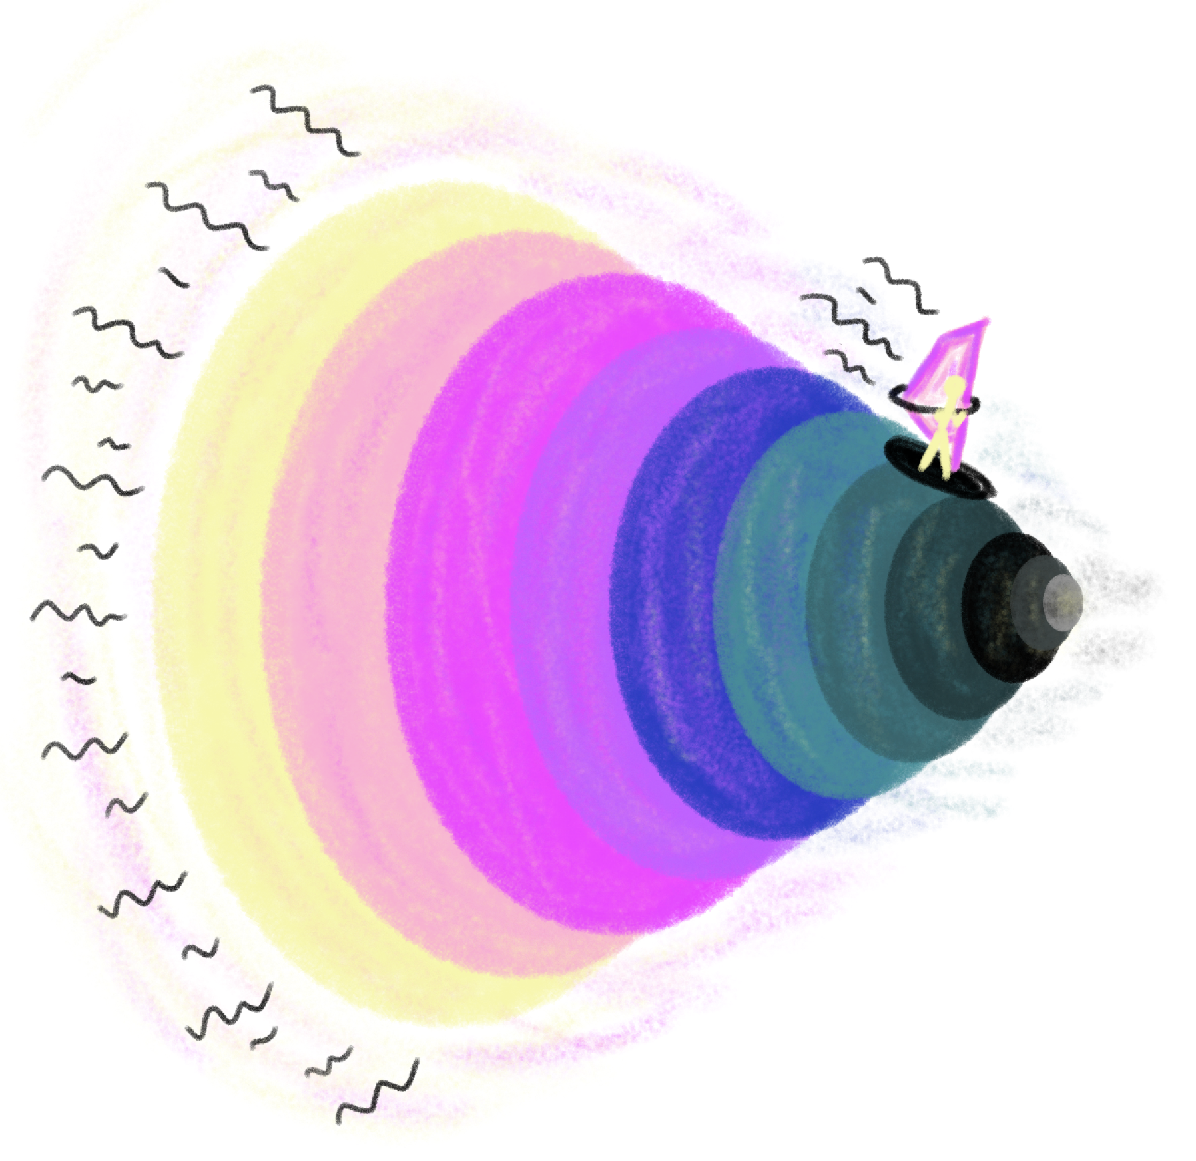
Application of black hole response theory to the shockwave background

Slide 16

Massless WQFT
Brink-Di Vecchia-Howe or Polyakov form for massless limit
Infinitely boosted black hole with energy

Slide 17

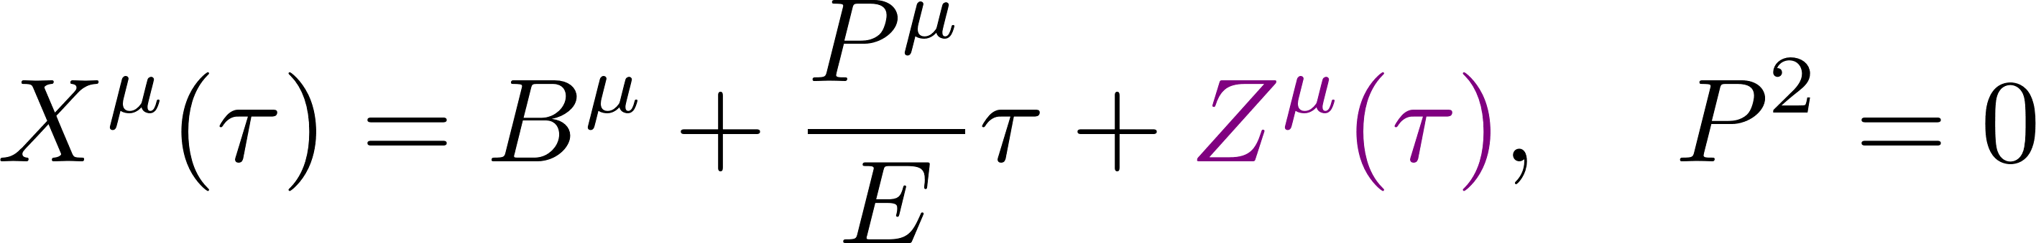
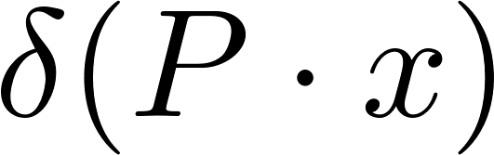
Massless WQFT
Brink-Di Vecchia-Howe or Polyakov form for massless limit
Infinitely boosted black hole with energy

Slide 18
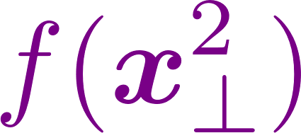
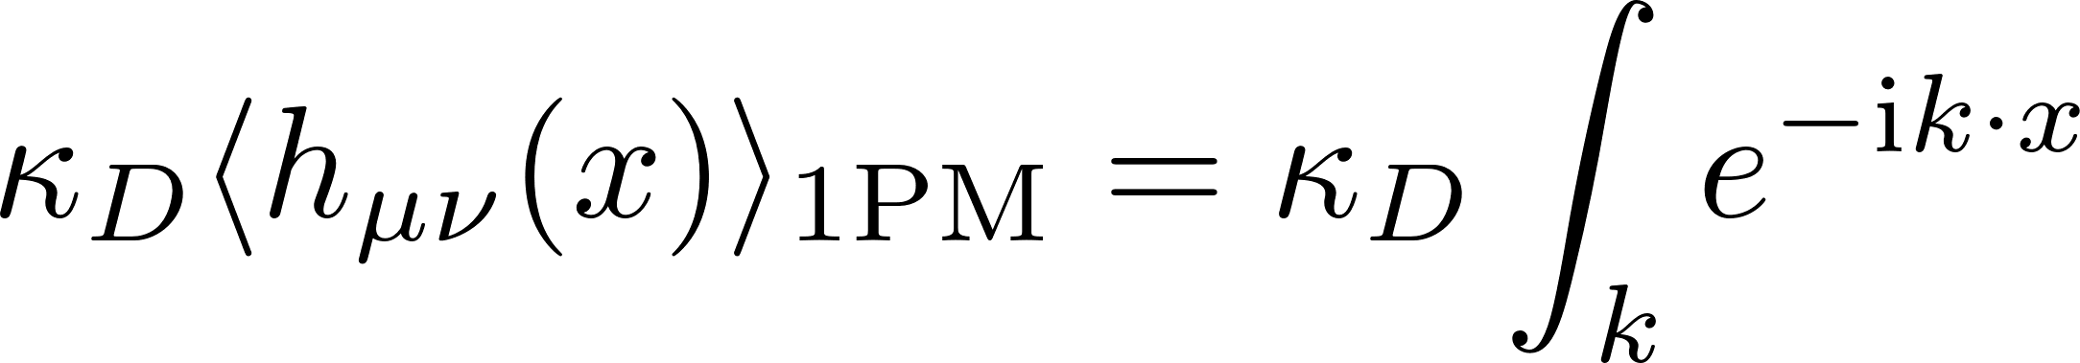
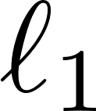
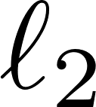

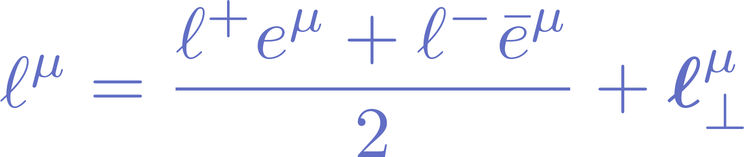
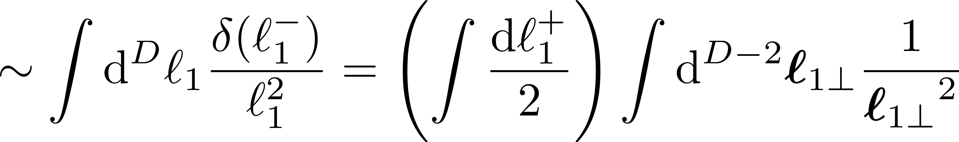
The shockwave metric
1PM contribution
2PM contribution
Light-cone decomposition
Non-regularised divergence

Slide 19
Regularizing massless WQFT

Slide 20
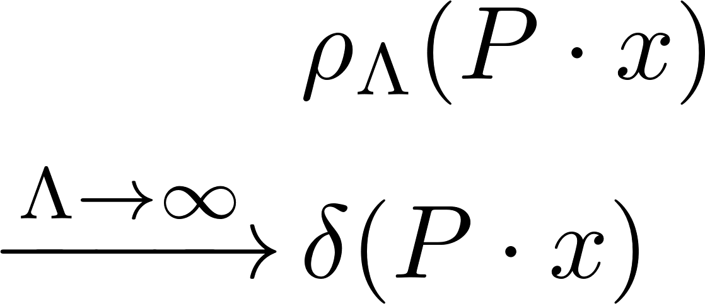
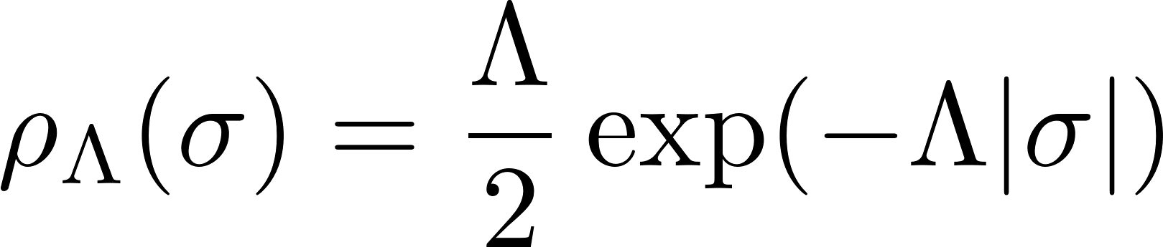
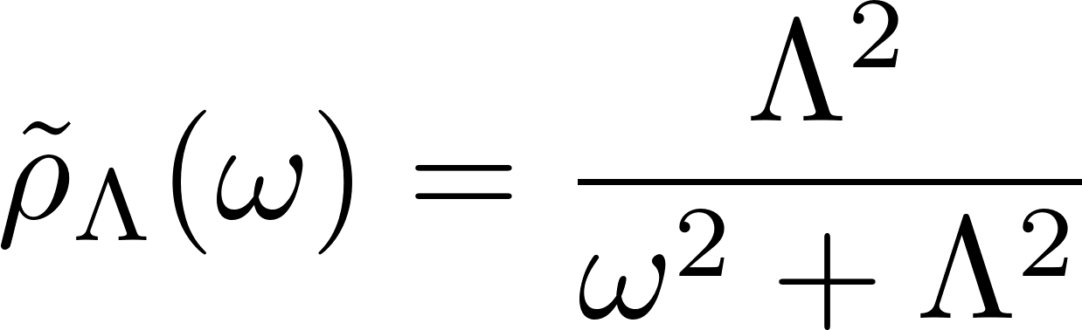
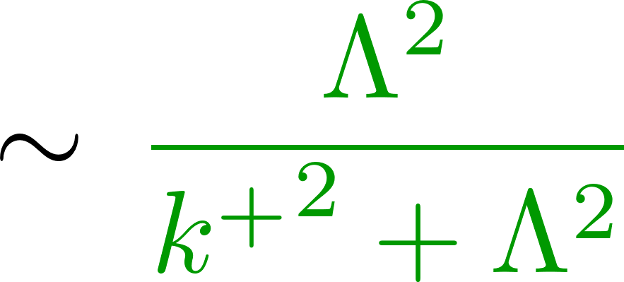

Regularizing massless WQFT
Choose
with Fourier transformation

Slide 21
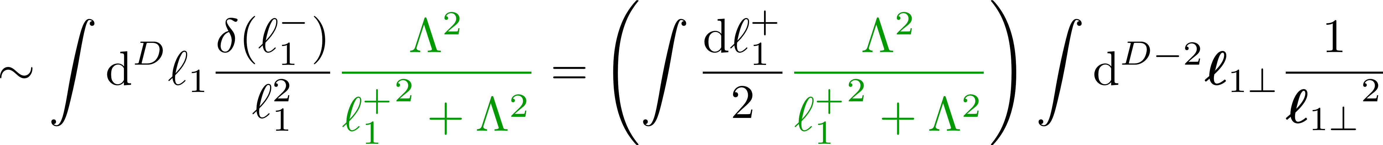
The shockwave metric
1PM contribution
2PM contribution
Light-cone decomposition
Regularised!
Aichelburg, Sexl, 1971

Slide 22
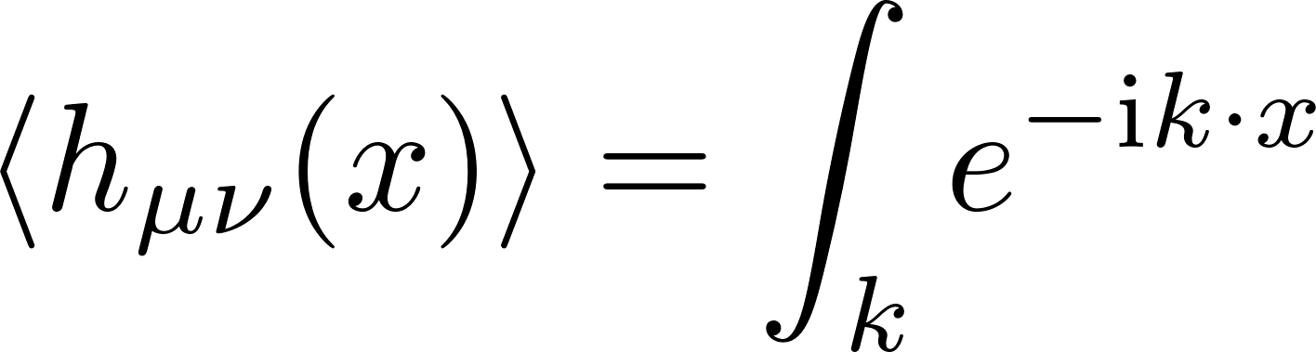



The shockwave metric
Higher-point contributions vanish
Truncation at 1PM
4D limit recovers Aichelburg-Sexl shockwave background
Aichelburg, Sexl, 1971

Slide 23
Goal: Exact in G waveform at 1SF
Ingredients:
Background metric
Geodesics and cross vertices
n-point response function for
(n-1) self-force observable

Slide 24
Goal: Exact in G waveform at 1SF
Ingredients:
Background metric
Geodesics and cross vertices
n-point response function for
(n-1) self-force observable

Slide 25


Shockwave geodesic and geodesic vertices
Trajectory is recursively defined

Slide 26








Shockwave geodesic and geodesic vertices
Trajectory is recursively defined … but truncates at 2PM
supressed for
before crossing
Expand action around geodesic motion and derive vertices
after crossing
during crossing

Slide 27
Goal: Exact in G waveform at 1SF
Ingredients:
Background metric
Geodesics and cross vertices
n-point response function for
(n-1) self-force observable

Slide 28
Goal: Exact in G waveform at 1SF
Ingredients:
Background metric
Geodesics and cross vertices
n-point response function for
(n-1) self-force observable

Slide 29

Two-point shockwave response
Shockwave self-energy vertices truncate:

Slide 30

Two-point shockwave response
Shockwave self-energy vertices truncate:
Large class of vanishing diagrams

Slide 31


Two-point shockwave response
All-order expansion in PM
3PM exact
remainder
Resum to

Slide 32



Two-point shockwave response
231 terms
Simplification at 4PM and beyond!
(using de Donder gauge)
→ Independent of loop momentum
Only scalar integrals
Computed with method of regions
With the TT-projector
and the transverse metric
… simplifies at 4PM and beyond
with TT projector
and transverse metric

Slide 33

Two-point shockwave response
All-order expansion in PM
3PM exact
remainder
Can low orders fix this?
Notes:
Sum over ladders!

Slide 34
Two-point shockwave response
All-order expansion in PM
3PM exact
remainder
Can low orders fix this?
Notes:
Sum over ladders!

Slide 35




Two-point shockwave response
3PM and below, ladders do not follow the pattern observed at higher orders …
… but the sum of all 3PM diagrams does!
Same pattern as high-orders!
Summing low PM order:
Vanishes on-shell
Follows high-PM pattern
2PM exact Remainder
Include in resummed response

Slide 36


Two-point shockwave response
Sum up …
High-order ladder pattern
… into an expanded form
… into an resummed form
Weinberg factor
Same structure as calculation in eikonal approximation
Raj, Venugopalan [2406.10483]
4-dimensional limit
Equivalent structure observed by ‘t Hooft, 1987 for scalar ultra-high energy amplitude
Pure phase factor

Slide 37
Goal: Exact in G waveform at 1SF
Ingredients:
Background metric
Geodesics and cross vertices
n-point response function for
(n-1) self-force observable

Slide 38
Goal: Exact in G waveform at 1SF
Ingredients:
Background metric
Geodesics and cross vertices
n-point response function for
(n-1) self-force observable
Assemble and integrate!

Slide 39
















Two-point shockwave response
Purely memory
No memory
Observer
Shockwave
Probe

Slide 40
Summary and Outlook
In this talk
Novel way of obtaining SF expansion with WQFT!
Proof of concept by applying the formalism to the shockwave
Obtained the first exact in G two-point response function and waveform
Outlook
Compute more observables, such as impulse for the shockwave metric
Connection to high-energy limit of massive particle?
Response functions of massive WQFT?
?
Thanks!

Slide 41
Backup slides

Slide 42







Generating functional, background fields and vertices
Generalize to generic sources
Classical action as functional
generates response fuction
Background metric
generates Feyman vertices on curved spacetime

Slide 43

Propagator and higher-point response functions
Two-point response acts as propagator on curved spacetime due to Green’s function-like relation
Two-point vertex on curved background
Response Function
Solved by a geometric series:
Three-point response (and higher) can be recovered from lower-point response functions

Slide 44




The on-shell limit and N-operator
On-shell response function (Compton amplitude)
Double copy
with the linearised field-strength tensor .
Magnus, 1954
Damgaard, Planté, Vanhove [2107.12891]
Matrix element of Magnus operator
1PM exact and - finite!

