Slide 1


Amplitudes for Gravitational Waves
David A. Kosower
Institut de Physique Théorique, CEA–Saclay
Amplitudes 2026
Queen Mary University of London
June 29–July 3, 2026

Slide 2
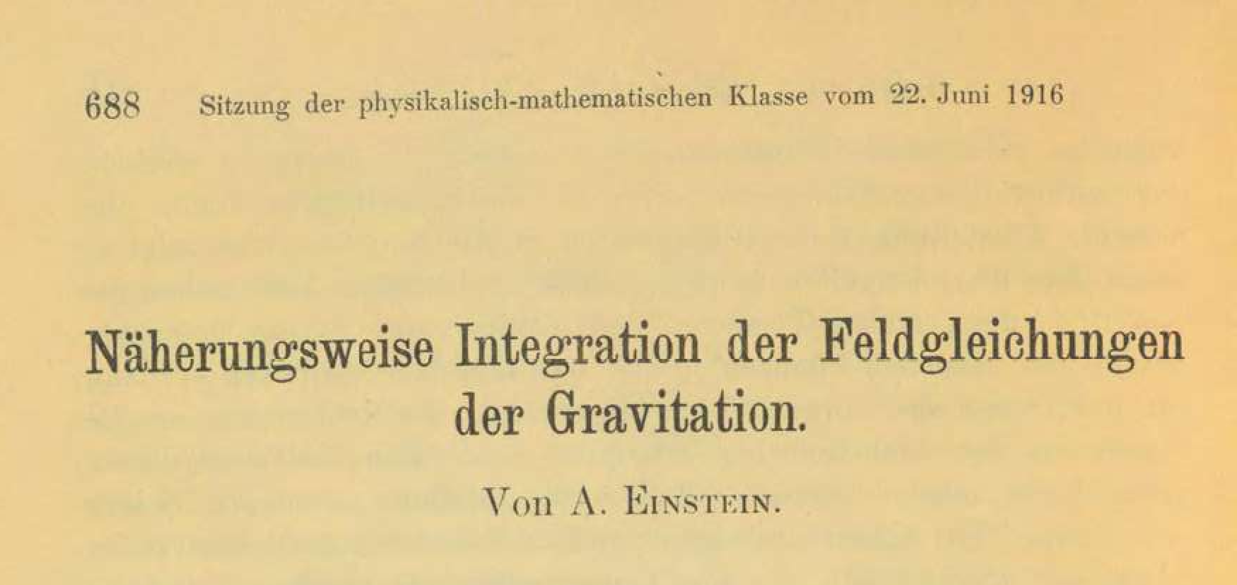
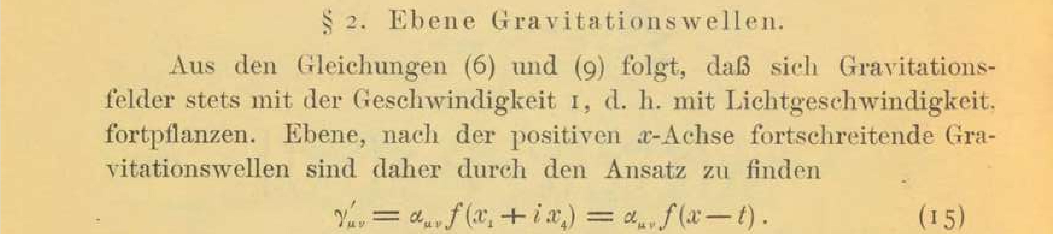

Gravitational Waves
are a very old field
$$⋮$$

Slide 3
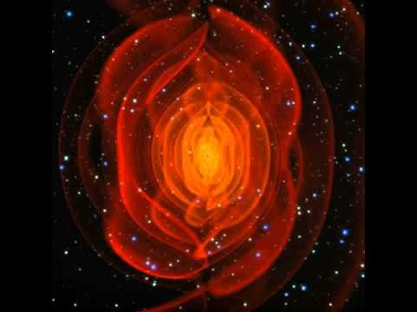
but also a very young one

Slide 4
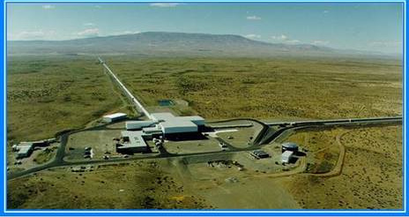
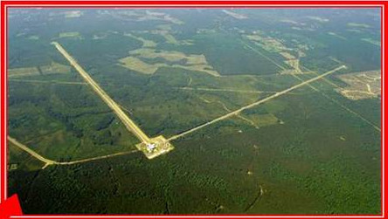
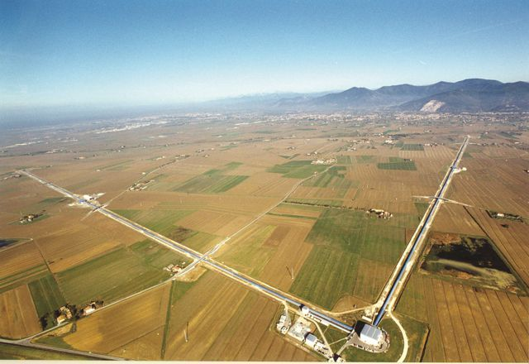
But also a very young field observationally

Slide 5
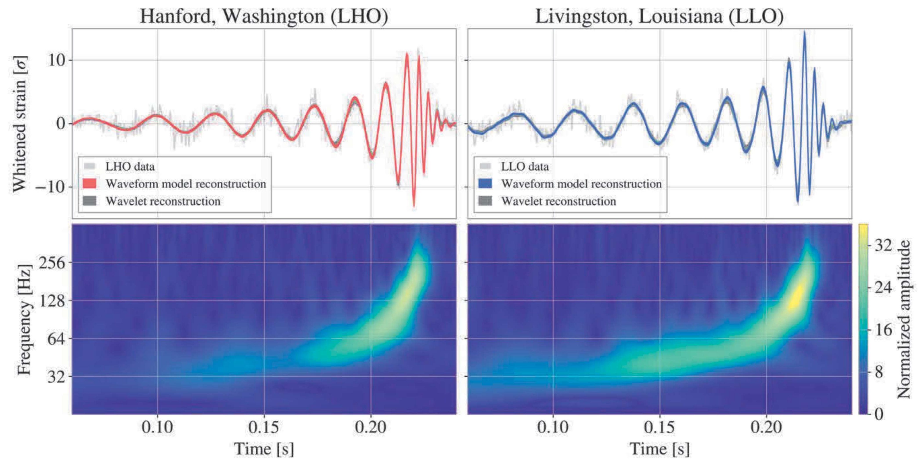
Have you seen these traces before?
LVK/G. Losurdo

Slide 6
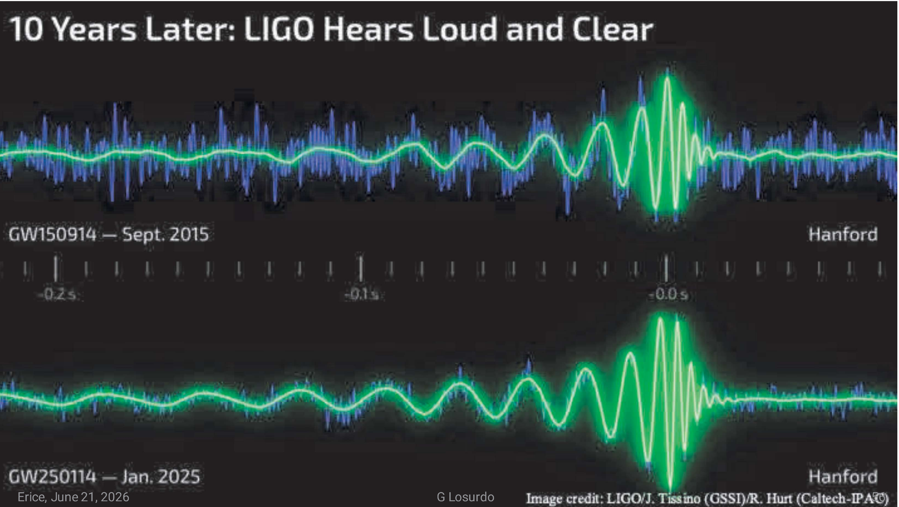
Continuous Improvement
courtesy LVK/G. Losurdo

Slide 7
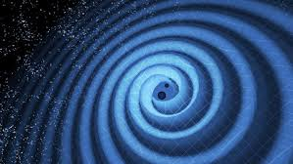
Gravitational Waves
LIGO

Slide 8
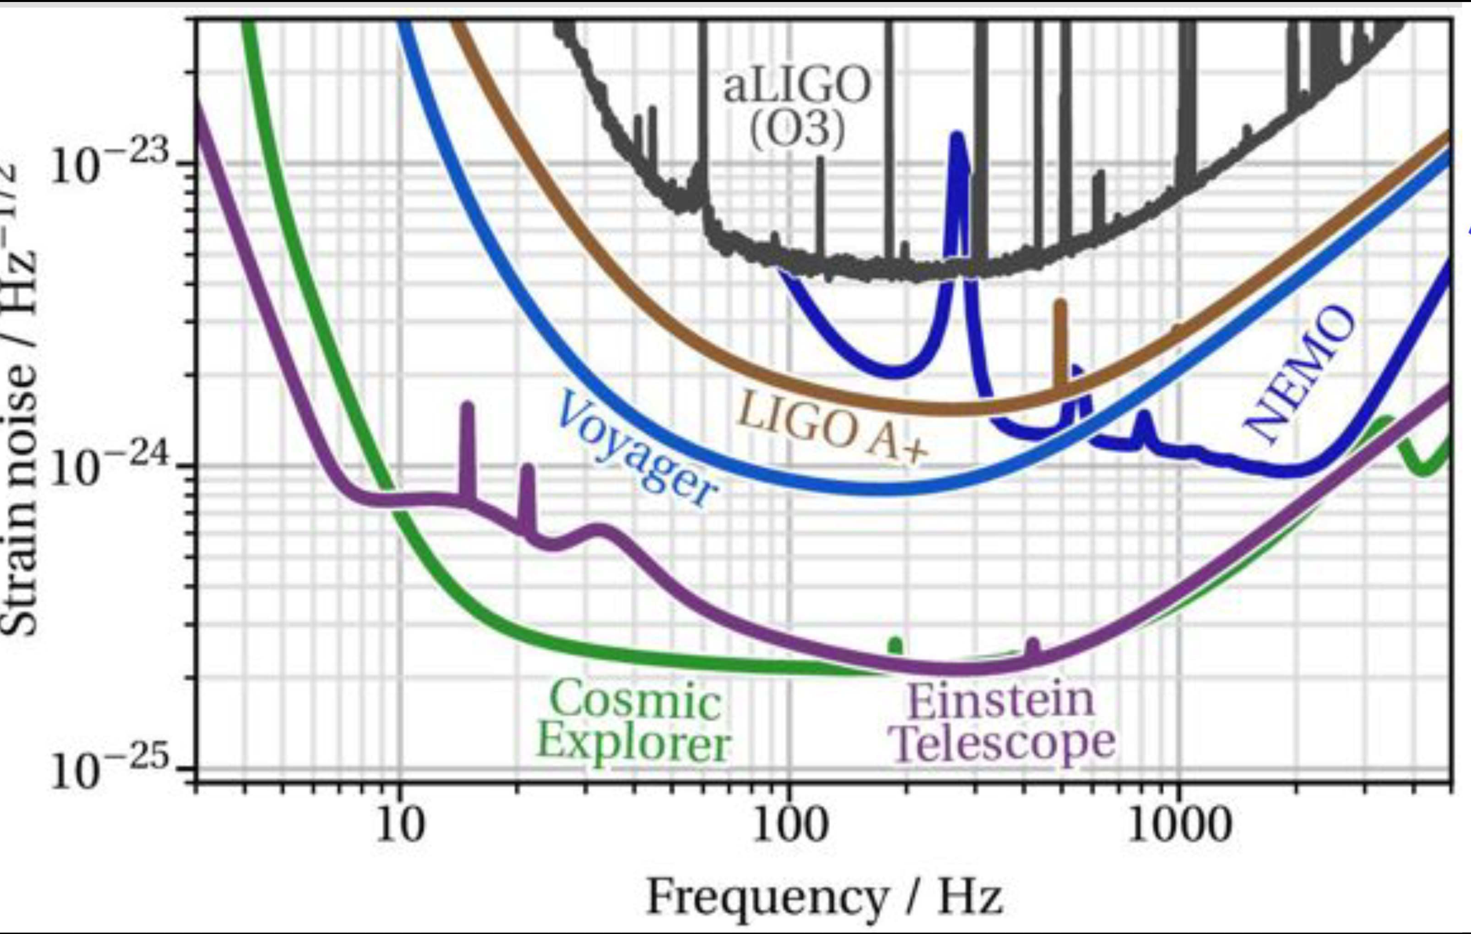
Future Terrestrial GWOs
Path to higher precision
Barsotti
Notes:
Left to right: geophysics / mixed/ thermodynamics /quantum noise

Slide 9
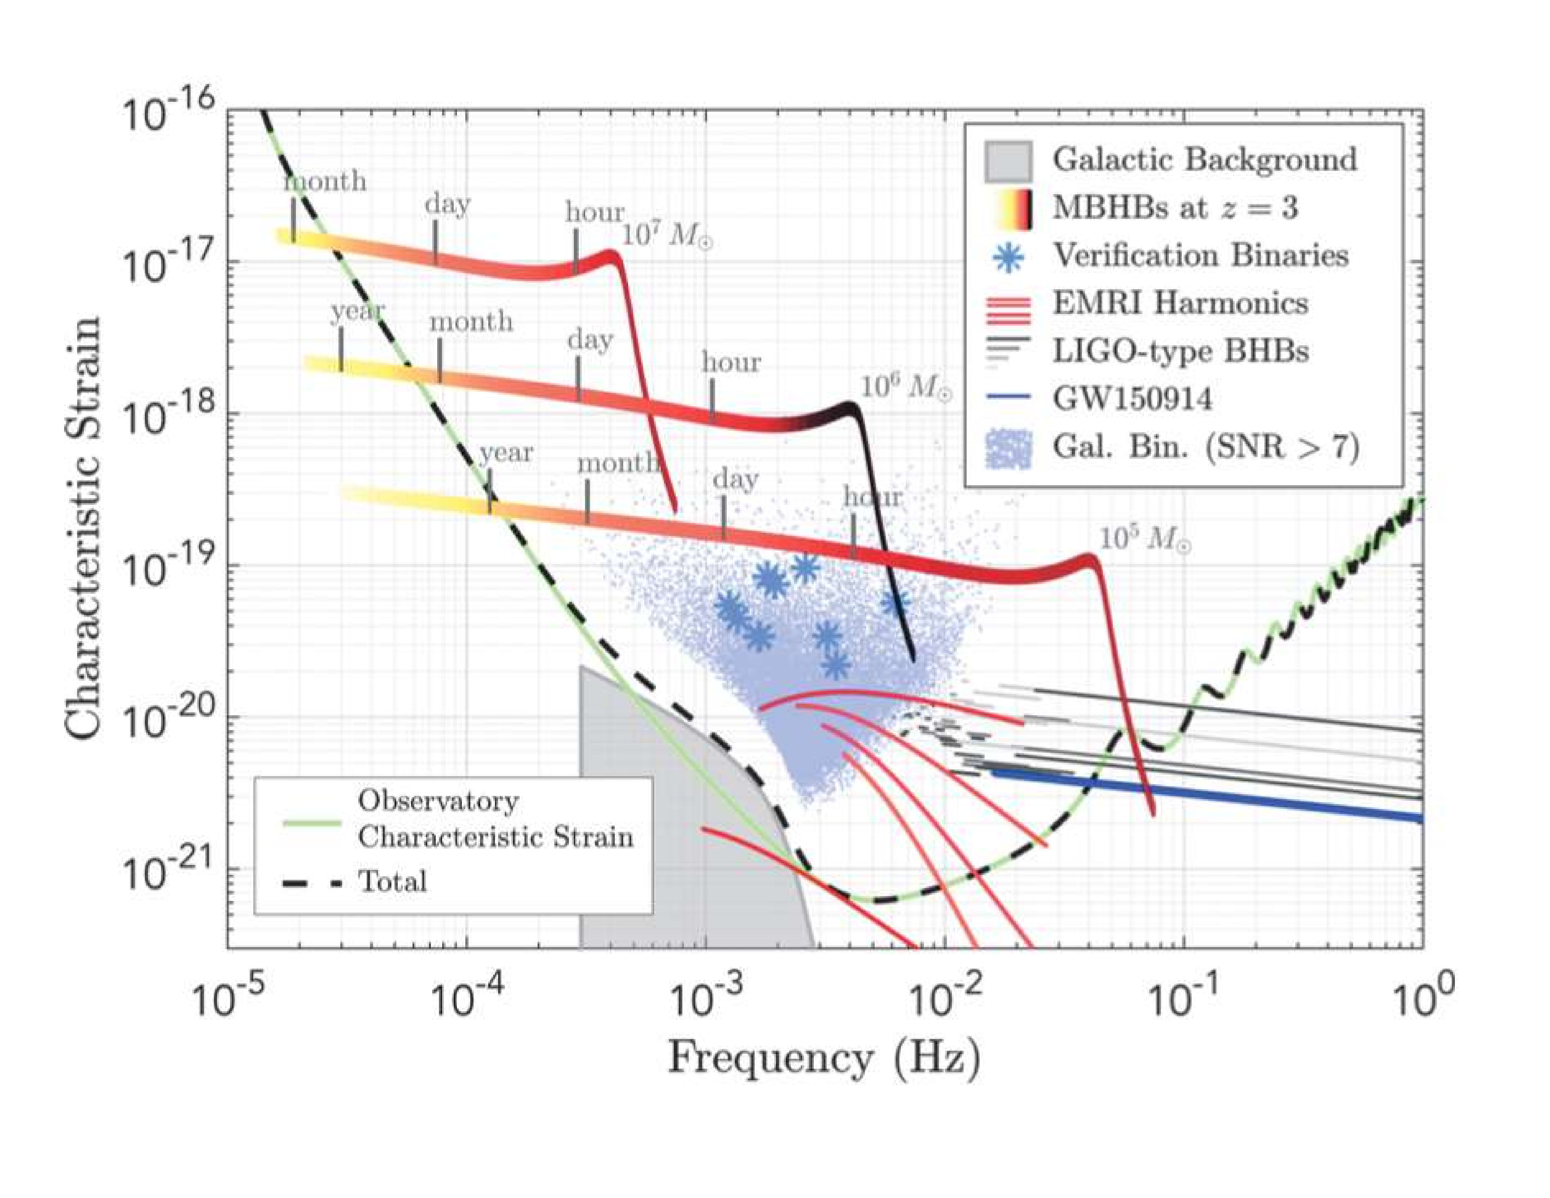
LISA
From LISA L3 Mission proposal (via Robson–Cornish–Liu [1803.01944])

Slide 10
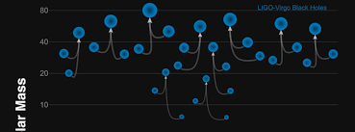
Science Goals
Determine presence and distribution of heavy compact objects
  Already discovered unexpected class of black hole binaries
  More surprises?
Neutron stars
  Determine equation of state
  Contribution to transferric element production
  Insights into Gamma-Ray Bursters
Measure Hubble constant
  Bright candles as individual events
  Dark candles statistically
Limits on exotic compact objects
Precision strong-field tests of Einstein gravity

Slide 11
Science Goals
Insight into galactic evolution through mergers of supermassive black holes
Insight into quantum gravity?
  with exotic black hole models
  with cosmological gravitational waves

Slide 12
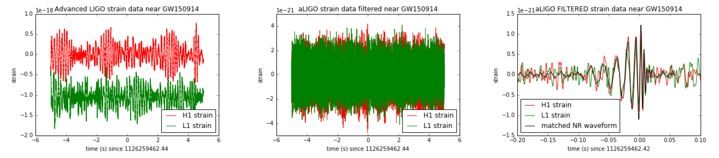
Theorists’ Role
One aspect of detection & analysis
High noise level: 400 times larger than signal! Rehman [1711.07421]
To extract the signal, we need theoretical templates
That’s where theorists come into the picture

Slide 13
Theorists
Waveform Templates
Detection
  Extended mass/spin range for standard events
  Fainter events
  New classes of events (IMRIs, EMRIs)
  Exotic events (capture, early phase, supernovae, …)
Measurement
  Parameter extraction
  Avoid biases in population-level estimates

Slide 14
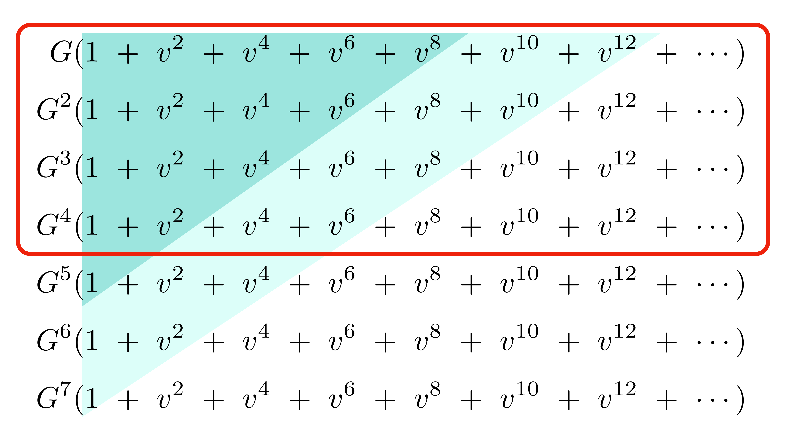
What Do We Need?
Snowmass White Paper: Buonanno, Khalil, O’Connell, Roiban, Solon, Zeng (2022)
I've been rich and I've been poor. Believe me, honey, rich is better!
—Sophie Tucker
More is better

Slide 15
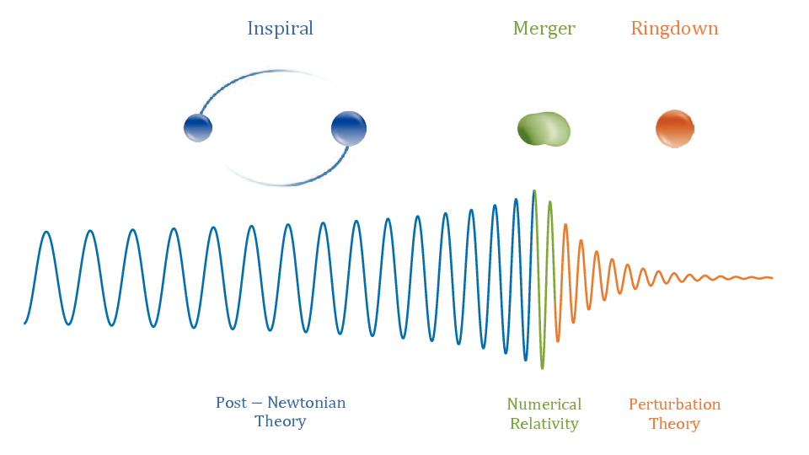
Basic Setup in Mergers
Two slowly inspiralling
compact objects
  Ringdown
  Merger
Inspiral
  Weak-field perturbation theory
Relativistic perturbative expansion in the scattering domain
“Post-Minkowskian Expansion”
Relativistic Perturbation Theory (RPT)
Antelis et al

Slide 16
Numerical Relativity
Key tool for merger phase
Tool for cross-checking other calculations
Computationally expensive
  Not realistic for 100Ks of templates needed
Accumulates errors over long inspirals
Hard to do large mass ratios
Can’t be the only tool

Slide 17
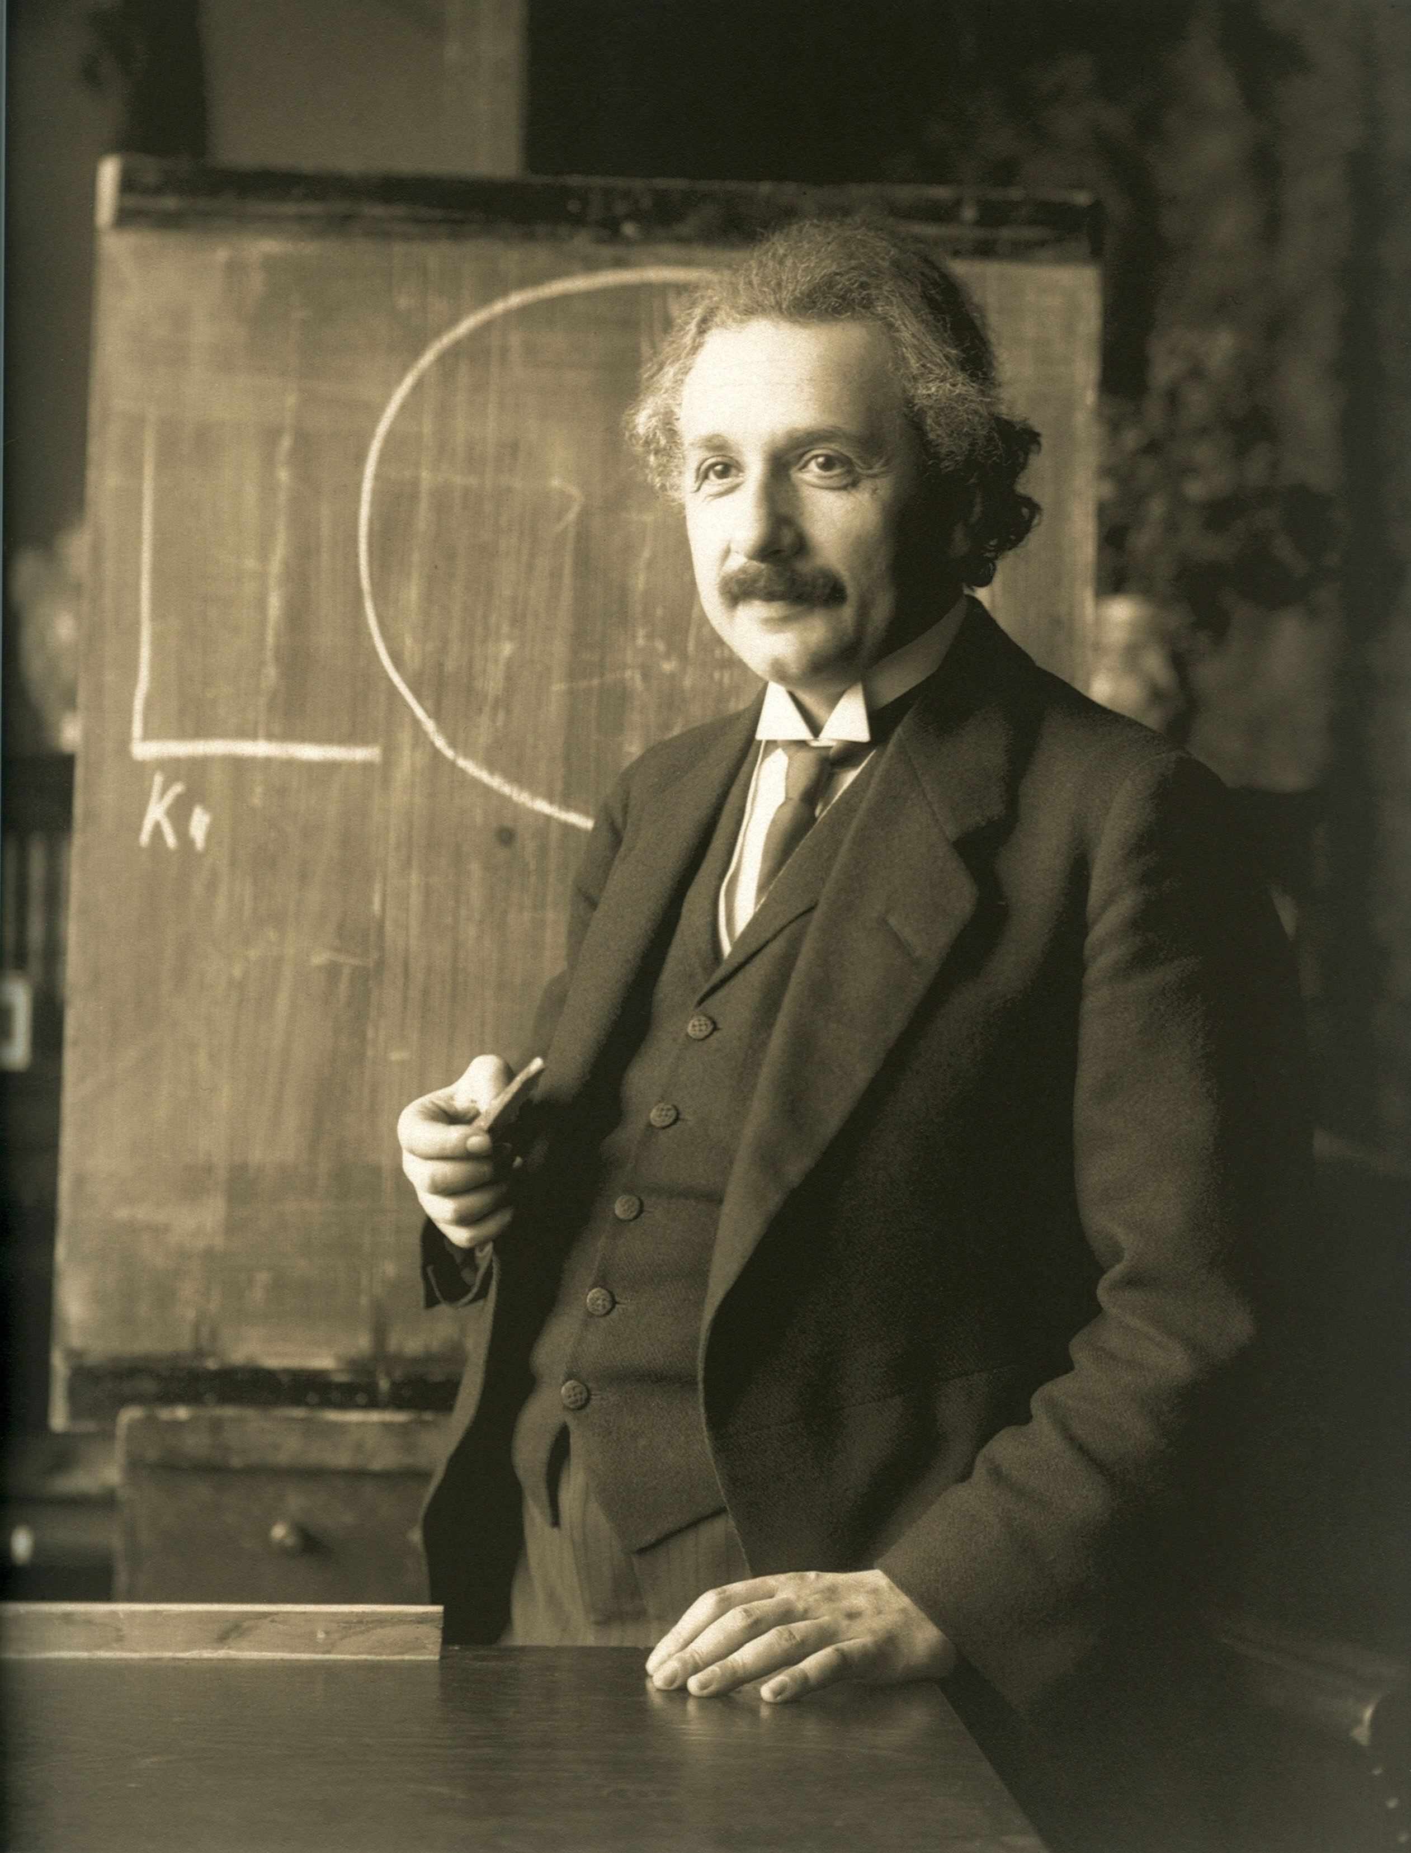
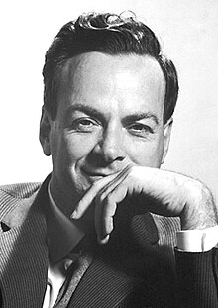
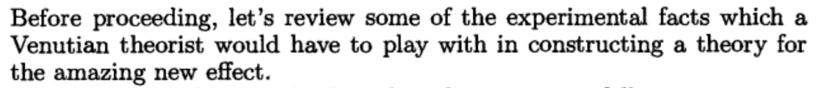
Scattering Amplitudes Approach
Gravitation = General Relativity ← geometry
Inspiration from Feynman
Gravitation = spin-2 field theory

Slide 18
Analysis Pipelines
Vallisneri
Three dominant pipelines
  Phenomenological: post-Newtonian (PN) based, Numerical Relativity (NR) calibrated; fast, mass ratios up to 1:10
  Effective One-Body (EOB): resummed PN, NR calibrated, self-force (SF) matched; slow
  Surrogate: interpolated NR; slowest, limited mass ratios
EOB only one (so far) to use relativistic perturbative (RPT) information

Slide 19
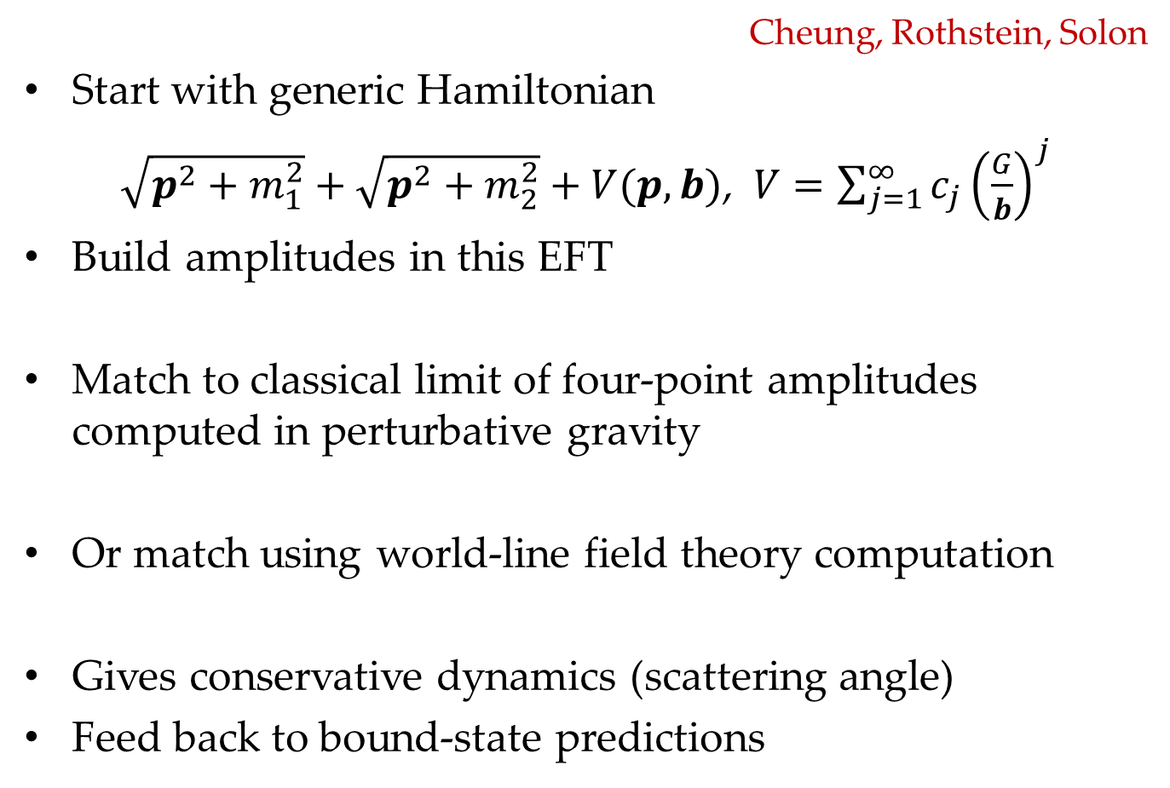
EFT Matching
Cheung, Rothstein, Solon
Start with generic Hamiltonian
$\sqrt{p^{2}+m_{1}^{2}}+\sqrt{p^{2}+m_{2}^{2}}+V(p,b)$, $V=\sum_{j=1}^{∞}{c_{j}{\left(\frac{G}{b}\right)}^{j}}$
Build amplitudes in this EFT
Match to classical limit of four-point amplitudes computed in perturbative gravity
Or match using world-line field theory computation
Gives conservative dynamics (scattering angle)
Feed back to bound-state predictions

Slide 20
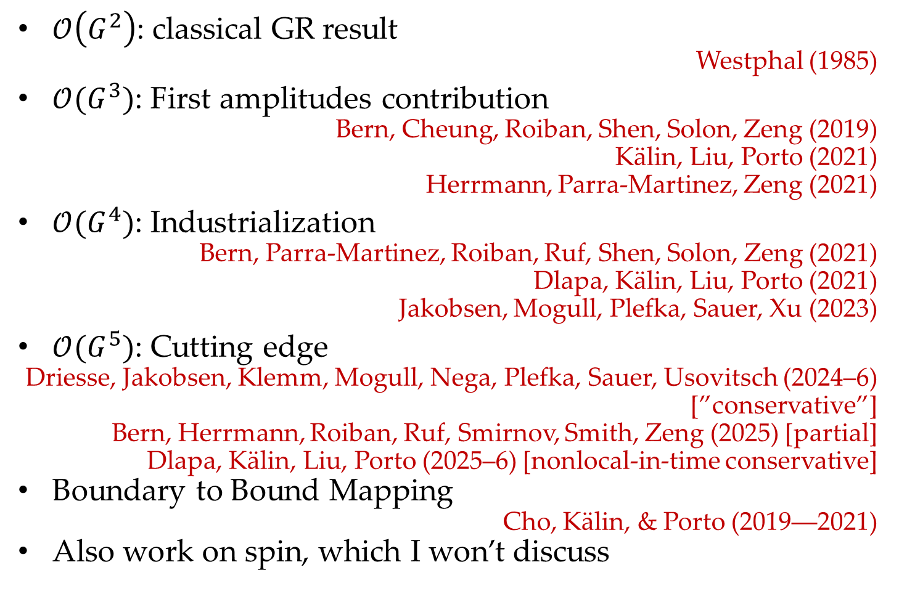
Progress
$𝒪\left(G^{2}\right)$: classical GR result
Westphal (1985)
$𝒪(G^{3})$: First amplitudes contribution
Bern, Cheung, Roiban, Shen, Solon, Zeng (2019)
Kälin, Liu, Porto (2021)
Herrmann, Parra-Martinez, Zeng (2021)
$𝒪(G^{4})$: Industrialization
Bern, Parra-Martinez, Roiban, Ruf, Shen, Solon, Zeng (2021)
Dlapa, Kälin, Liu, Porto (2021)
Jakobsen, Mogull, Plefka, Sauer, Xu (2023)
$𝒪(G^{5})$: Cutting edge
Driesse, Jakobsen, Klemm, Mogull, Nega, Plefka, Sauer, Usovitsch (2024–6)
[”conservative”]
Bern, Herrmann, Roiban, Ruf, Smirnov, Smith, Zeng (2025) [partial]
Dlapa, Kälin, Liu, Porto (2025–6) [nonlocal-in-time conservative]
Boundary to Bound Mapping
Cho, Kälin, & Porto (2019––2021)
Also work on spin, which I won’t discuss

Slide 21
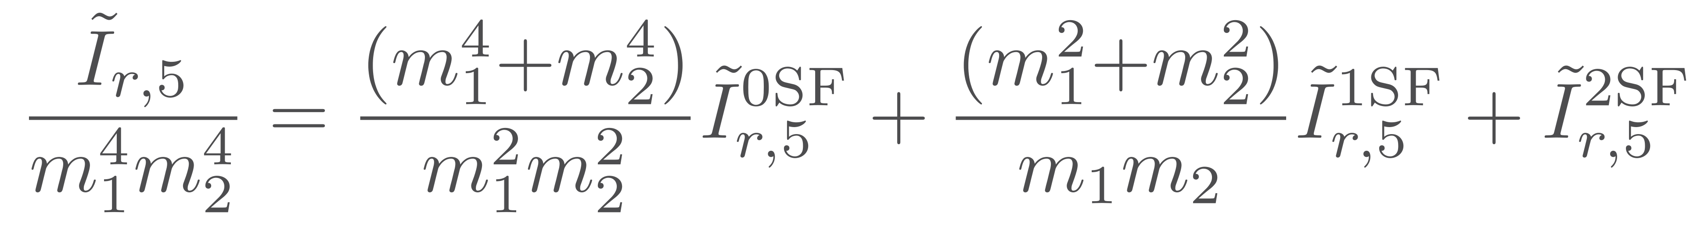
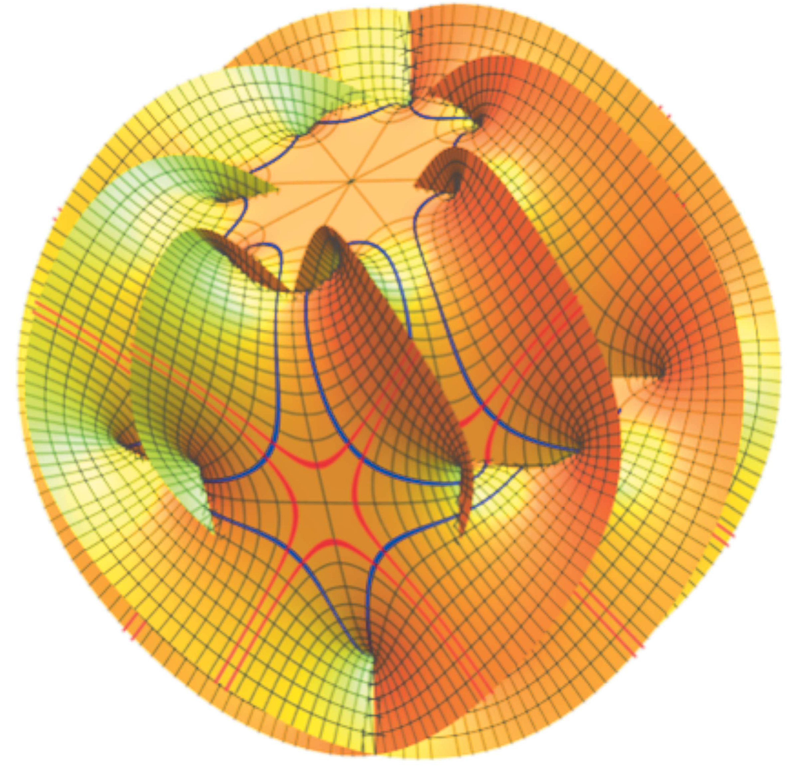
Organize in self-force orders
Bern, Herrmann, Roiban, Ruf, Smirnov, Smith, & Zeng (2025)
Calabi-Yau integrals make an appearance
Driesse, Jakobsen,
Klemm, & Mogull (2024)

Slide 22
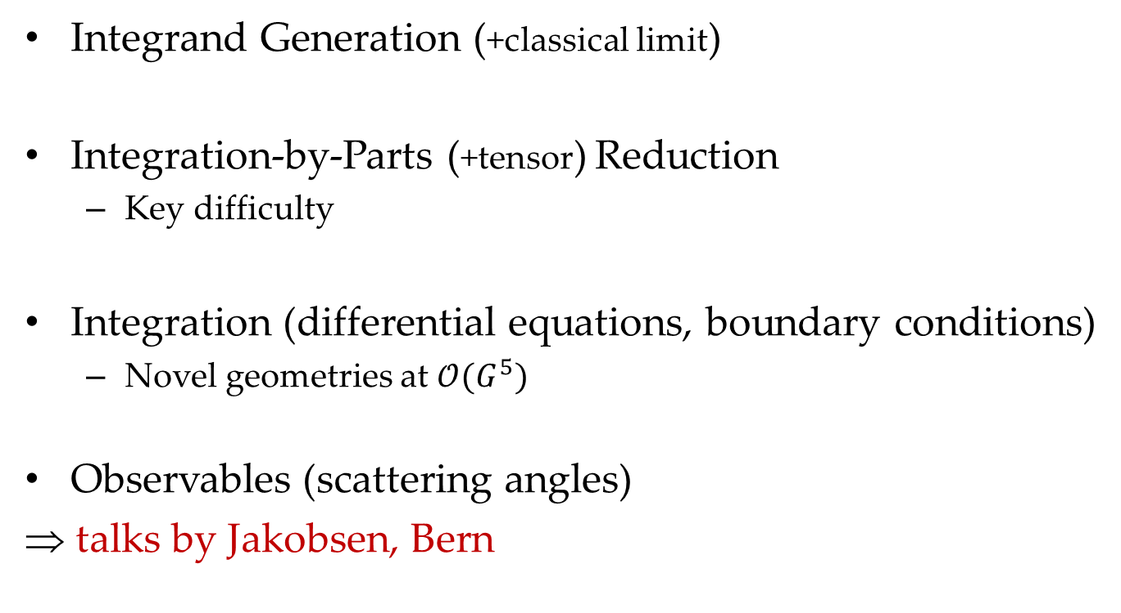
Workflow
Integrand Generation (+classical limit)
Integration-by-Parts (+tensor) Reduction
  Key difficulty
Integration (differential equations, boundary conditions)
  Novel geometries at $𝒪(G^{5})$
Observables (scattering angles)
⇒ talks by Jakobsen, Bern

Slide 23
Progress in IBPs
Many different ideas explored: improvements to existing codes and new directions
Wu, Boehm, Ma, Xu, & Zhang; Hu, Feng, Shen, & Zhang; Liao; Wang & Yang; von Hippel & Wilhelm; Liu & Mitov; Wu, Böhm, Ma, Usovitsch, Xu, & Zhang; Bree, Gasparotto, Matijašić, Mazloumi, Melnichenkod, Pögel, Teschke, Wang, Weinzierl, Wu, & Xu; Wu & Xu; Song; Smirnov & Zeng; Belitsky, Kokosinskaya, Smirnov, Voevodin, & Zeng; Song, Yang, Cao, Luo, & Zhu; Zeng; Ma, Qin, Tan, & Yan; Smith & Zeng; Chen; Feng, Li, Liu, Ma, & Zhang; Coro, Novichkov, Page, & Song; de la Cruz & DAK; Huang, Ma, Wang, & Yang; von Gersdorff & Lessa; Britto, Grimm, & Hoefnagels; Berman, Charton, Luna, Wilhelm, & Zeng
Same problem and same codes for QCD/EW and gravitational waves
Most intense and sensible use of machine learning and AI

Slide 24
Topics I Won’t Be Discussing
All have seen important progress in the last few years
Post-Newtonian calculations
Narikawa; Mandal, Mastrolia, Silva, Patil, & Steinhoff; Georgoudis, Heissenberg, & Russo; Siddhant, Grant, & Nichols; Skoupý & Witzany; Bini, Damour, & Geralico; Placidi, Rettegno, & Nagar; Blanchet, Faye, & Trestini; Bautista, Khalil, Sergola, Kavanagh, & Vines; Cunningham, Kavanagh, Pound, Trestini, Warburton, & Neef; Witzany, Skoupý, Stein, Tanay; Sridhar, Bhattacharyya, Paul, & Mishra; Gamboa, Khalil, & Buonanno; Dones, Henry, Bernard; Islam & Venumadhav; Morras, Pratten, & Schmidt; Fumagalli, Loutrel, Gerosa, & Boschini; Trestini; Brunello, Mandal, Mastrolia, Patil, Pegorin
Self-Force calculations & formalism
Honet, Pound, Compère; Honet, Mathews, Compère, Pound, Wardell; Brunello, Mandal, Mastrolia, Patil, Pegorin, Ronca, Smith, Steinhoff, & Torres Bobadilla; Castillo, Evans, Kavanagh, Neef, Wardell; Liu & Cao; Bini, Geralico, & Rufrano Aliberti; De Falco & Gallo; Yoo, Boyle, & Deppe; Placidi, Sebastiani, & Grignani; Henry & Heffernan; Aykroyd & Bourgoin; Henry; Blanchet, Faye, Seraille, & Trestini; Laxman, Fujita, & Mishra; Colin, Tanay, & Bernard; Bini & Di Russo; Porto & Riva; Morras, Pratten, Schmidt, & Buonanno; Brunello, Mandal, Mastrolia, Patil, & Pegorin; Sun, Bonga, Stein, & Da Re; Cheung, Parra-Martinez, Rothstein, Shah, & Wilson-Gerow

Slide 25
Topics I Won’t Be Discussing
Eikonal, Resummation, Tidal, & Other
Heissenberg & Russo; Fernandes & Lin; Georgoudis, Heissenberg, & Russo; Cipriani, Di Russo, Fucito, Francisco Morales, Poghosyan, & Poghossian; Ivanov, Li, Parra-Martinez, & Zhou; Parra-Martinez & Podo; Schulze, Bernuzzi, Rettegno, Fontbuté, Placidi, & Damour; Caron-Huot, Correia, Isabella, & Solon

Slide 26
Set-up
Scatter two massive objects, treated as point particles
impact parameter b
distinguishable particles

Slide 27
Numerical Relativity Meets Scattering
Numerical relativists have taken up serious interest in scattering & in comparing to perturbative calculations
  Rettegno, Pratten, Thomas, Schmidt, & Damour (2023), using Einstein Toolkit
  Kankani & McWilliams (2024), B2B doesn’t work nonperturbatively
  Swain, Pratten, & Schmidt (2024), using Einstein Toolkit
  Long, Pfeiffer, Buonanno, Jakobsen, Mogull, Ramos-Buades, Rüter, Kidder, & Scheel (2025), using SpEC
  Long, Pfeiffer, Kidder, & Scheel (2025), using SpEC
In some ways observables are cleaner in scattering than in bound state

Slide 28
What About the Bound Domain?
Towards waveform mapping
Gonzo and Mogull
More to come in the next 6–12 months…
Some steps in D. O’Connell’s talk later today

Slide 29
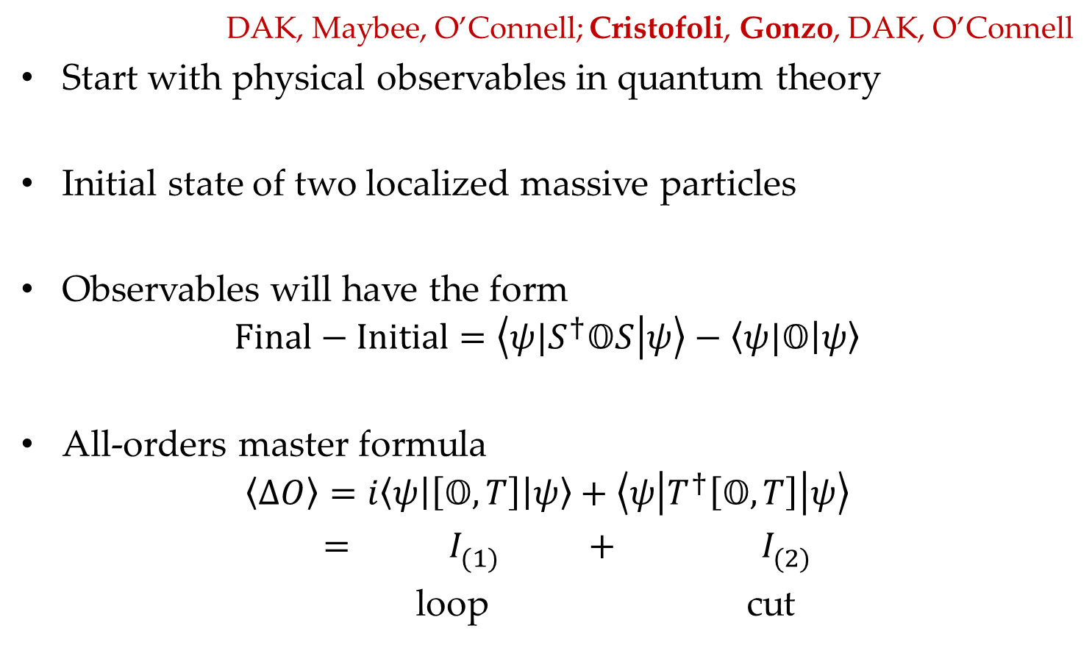
KMOC Approach
DAK, Maybee, O’Connell; Cristofoli, Gonzo, DAK, O’Connell
Start with physical observables in quantum theory
Initial state of two localized massive particles
Observables will have the form
$$Final−Initial=\left\langle {ψ|S}^{†}𝕆S | ψ\right\rangle −\left\langle ψ|𝕆 | ψ\right\rangle$$
All-orders master formula
$$\left\langle ΔO\right\rangle =i\left\langle ψ\left|\left[𝕆, T\right]\right|ψ\right\rangle +\left\langle ψ\left|T^{†}\left[𝕆, T\right]\right|ψ\right\rangle$$
$$= I_{(1)}^{} + I_{(2)}^{}$$
loop cut

Slide 30
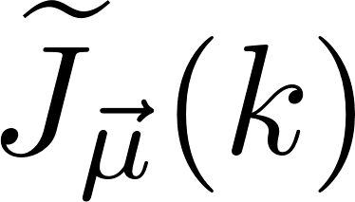
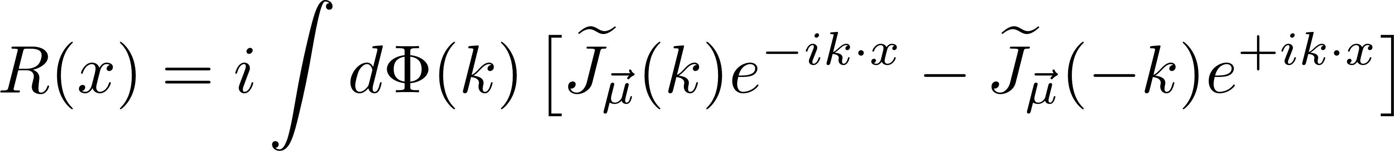
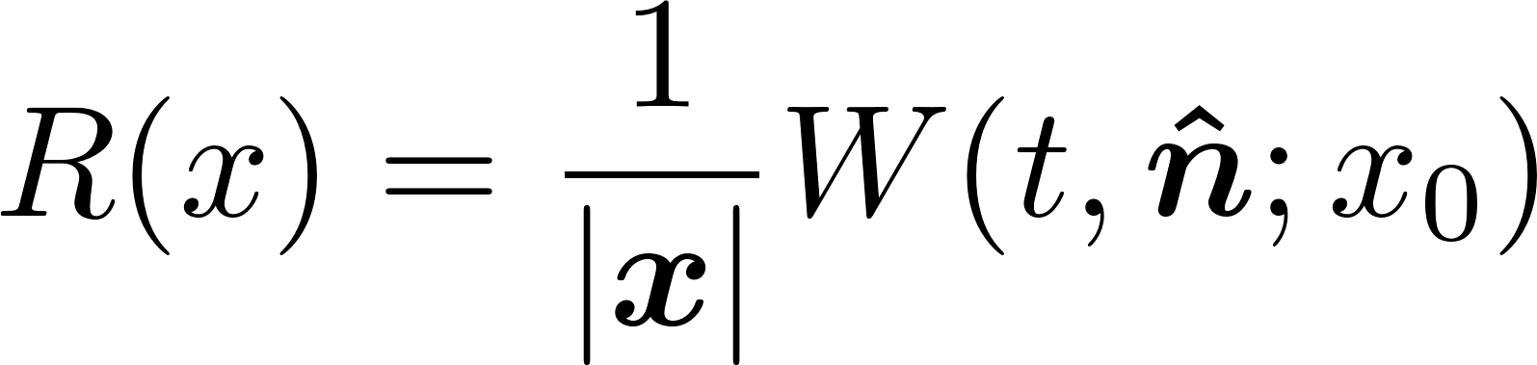
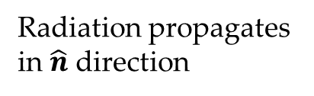
Local Observables
Local radiation observable
Waveform is leading large-distance behavior
Radiation propagates in $\hat{n}$ direction
Scattering region

Slide 31
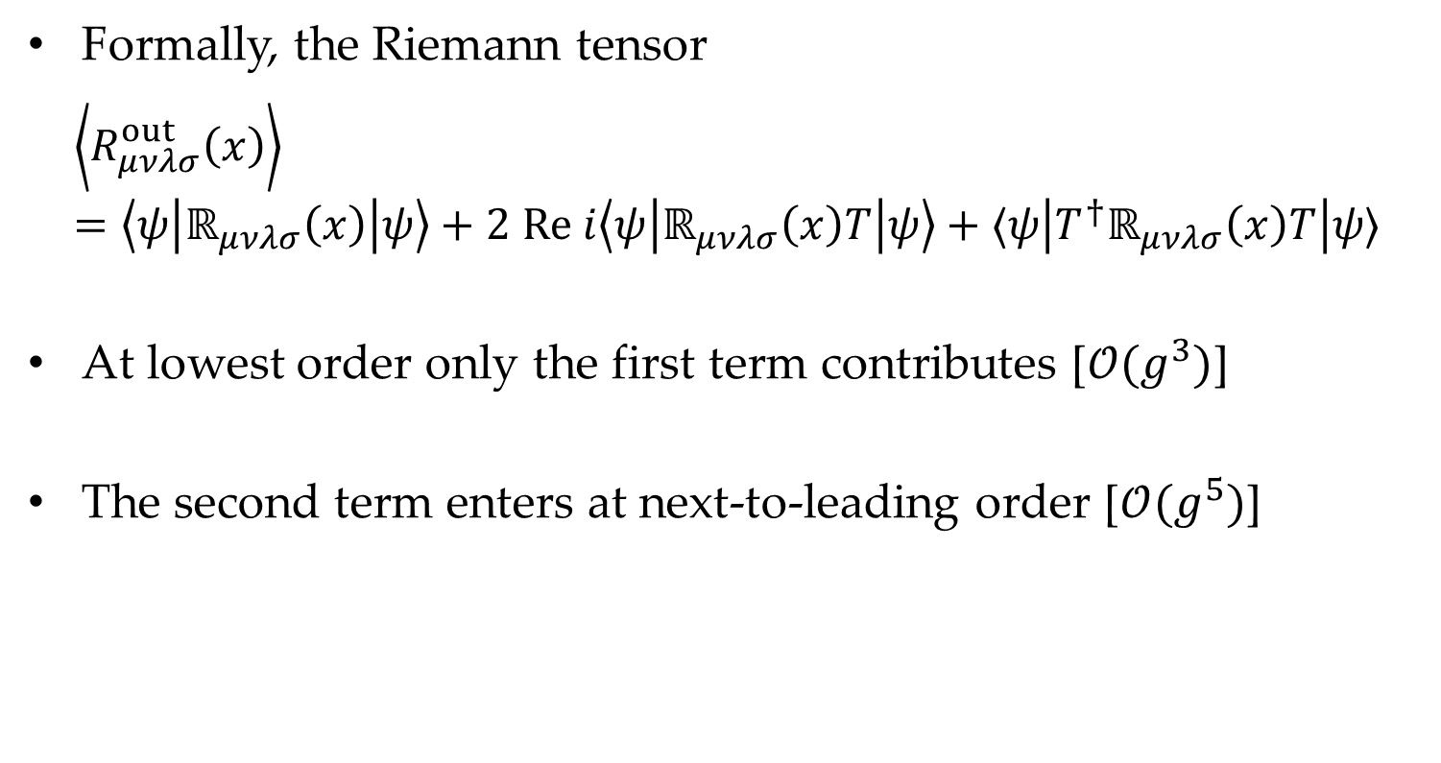
Waveform
Formally, the Riemann tensor
$$\left\langle R_{μνλσ}^{out}\left(x\right)\right\rangle =\left\langle ψ\left|ℝ_{μνλσ}\left(x\right)\right|ψ\right\rangle +2 Re i\left\langle ψ\left|ℝ_{μνλσ}\left(x\right)T\right|ψ\right\rangle +⟨ψ\left|T^{†}ℝ_{μνλσ}\left(x\right)T\right|ψ⟩$$
At lowest order only the first term contributes [$𝒪(g^{3})$]
The second term enters at next-to-leading order [$𝒪(g^{5})$]

Slide 32
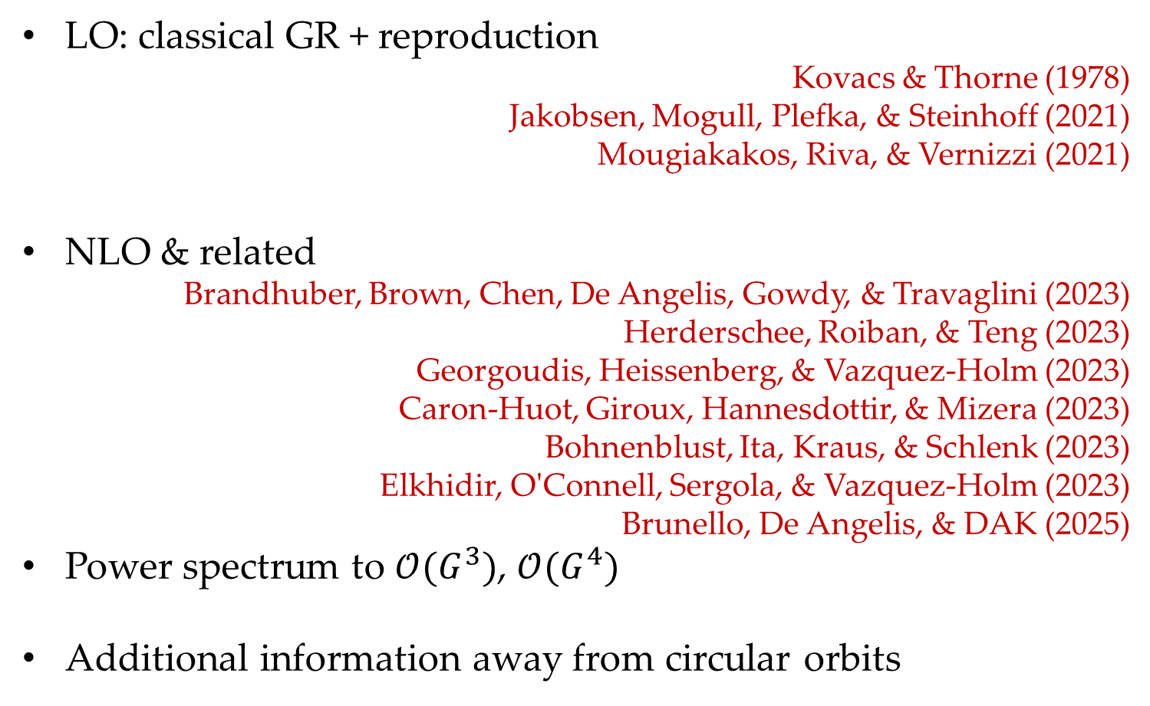
Waveform
LO: classical GR + reproduction
Kovacs & Thorne (1978)
Jakobsen, Mogull, Plefka, & Steinhoff (2021)
Mougiakakos, Riva, & Vernizzi (2021)
NLO & related
Brandhuber, Brown, Chen, De Angelis, Gowdy, & Travaglini (2023)
Herderschee, Roiban, & Teng (2023)
Georgoudis, Heissenberg, & Vazquez-Holm (2023)
Caron-Huot, Giroux, Hannesdottir, & Mizera (2023)
Bohnenblust, Ita, Kraus, & Schlenk (2023)
Elkhidir, O'Connell, Sergola, & Vazquez-Holm (2023)
Brunello, De Angelis, & DAK (2025)
Power spectrum to $𝒪(G^{3})$, $𝒪(G^{4})$
Additional information away from circular orbits

Slide 33
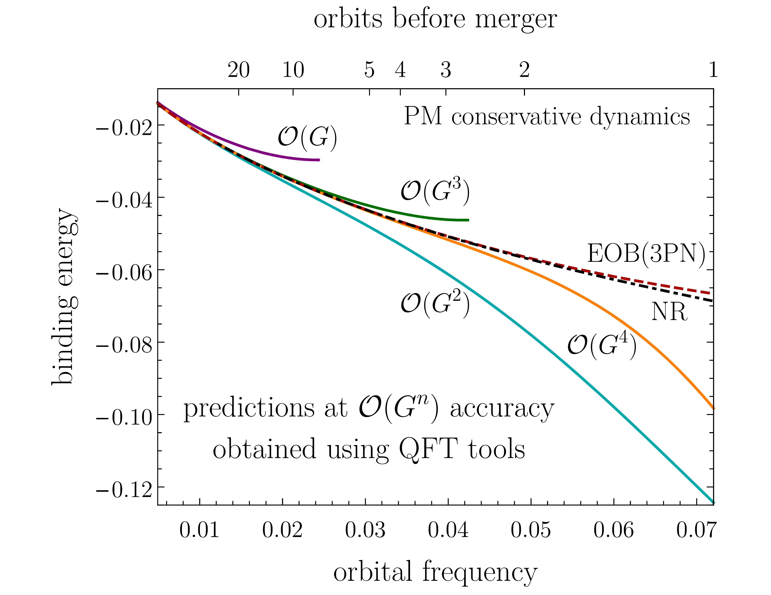
Proof of the Pudding
Incorporating input from RPT gets binding energy predictions closer to the “gold standard” (NR)
Buonanno, Khalil, O’Connell, Roiban, Solon, Zeng (2022)

Slide 34
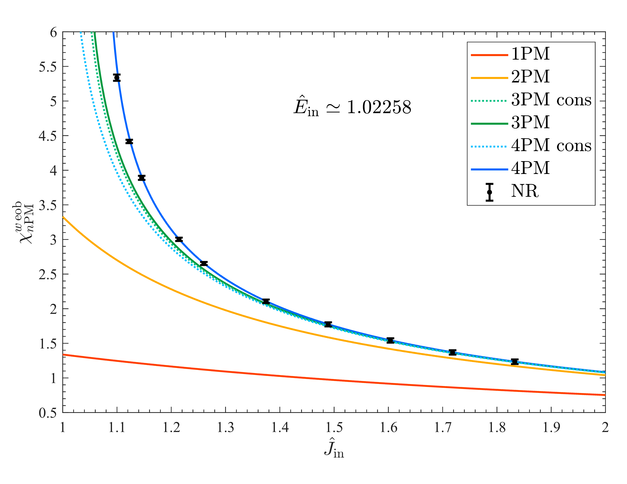
Proof of the Pudding
Gets EOB resummation closer to the “gold standard” in scattering
Damour, Rettegno (2022)

Slide 35
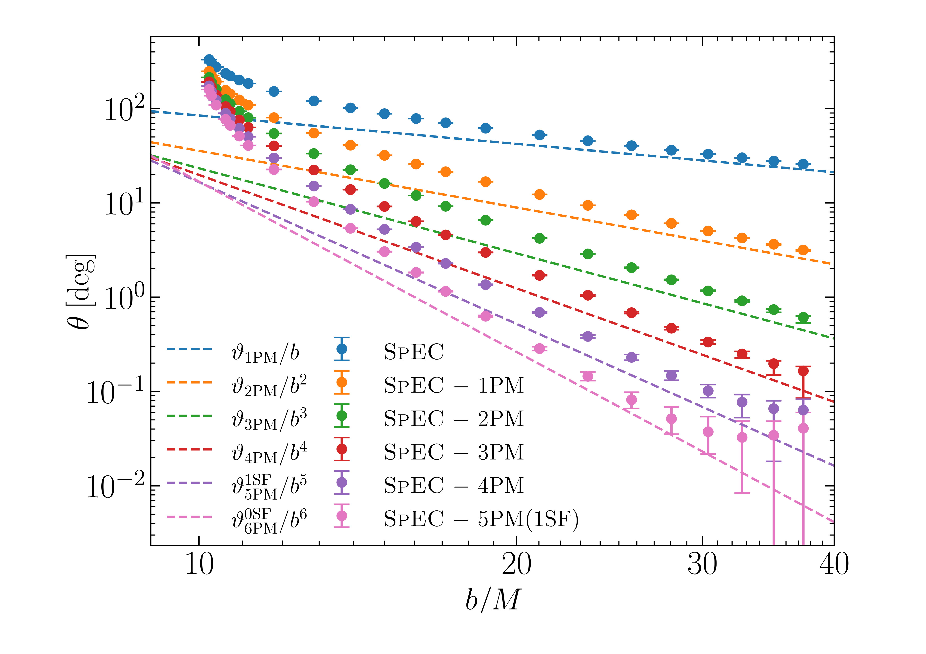
Proof of the Pudding
Scattering angle residuals
Long, Pfeiffer, Kidder, & Scheel (2025)

Slide 36
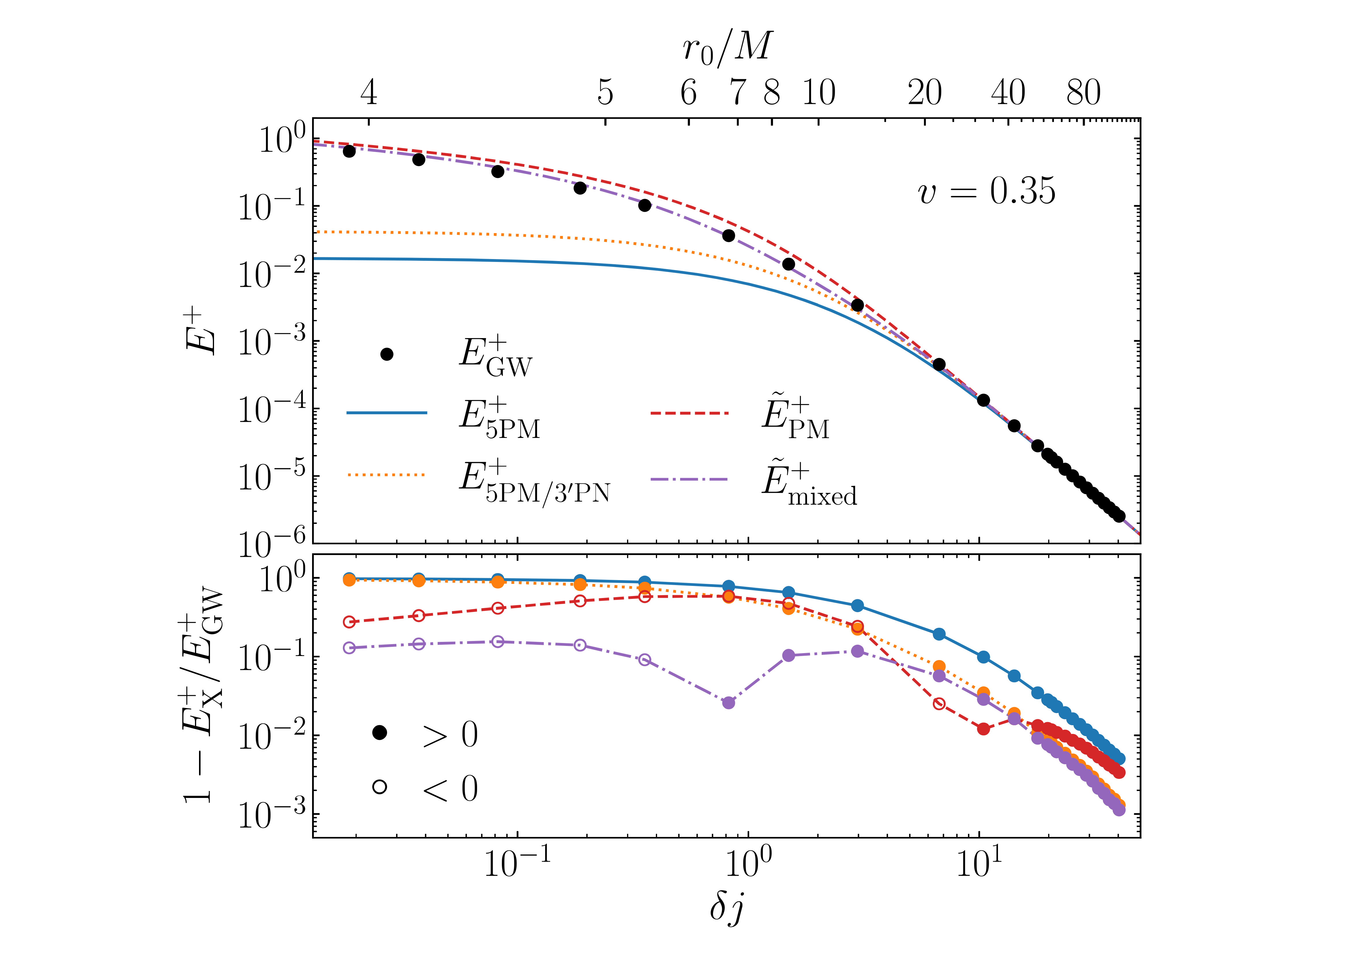
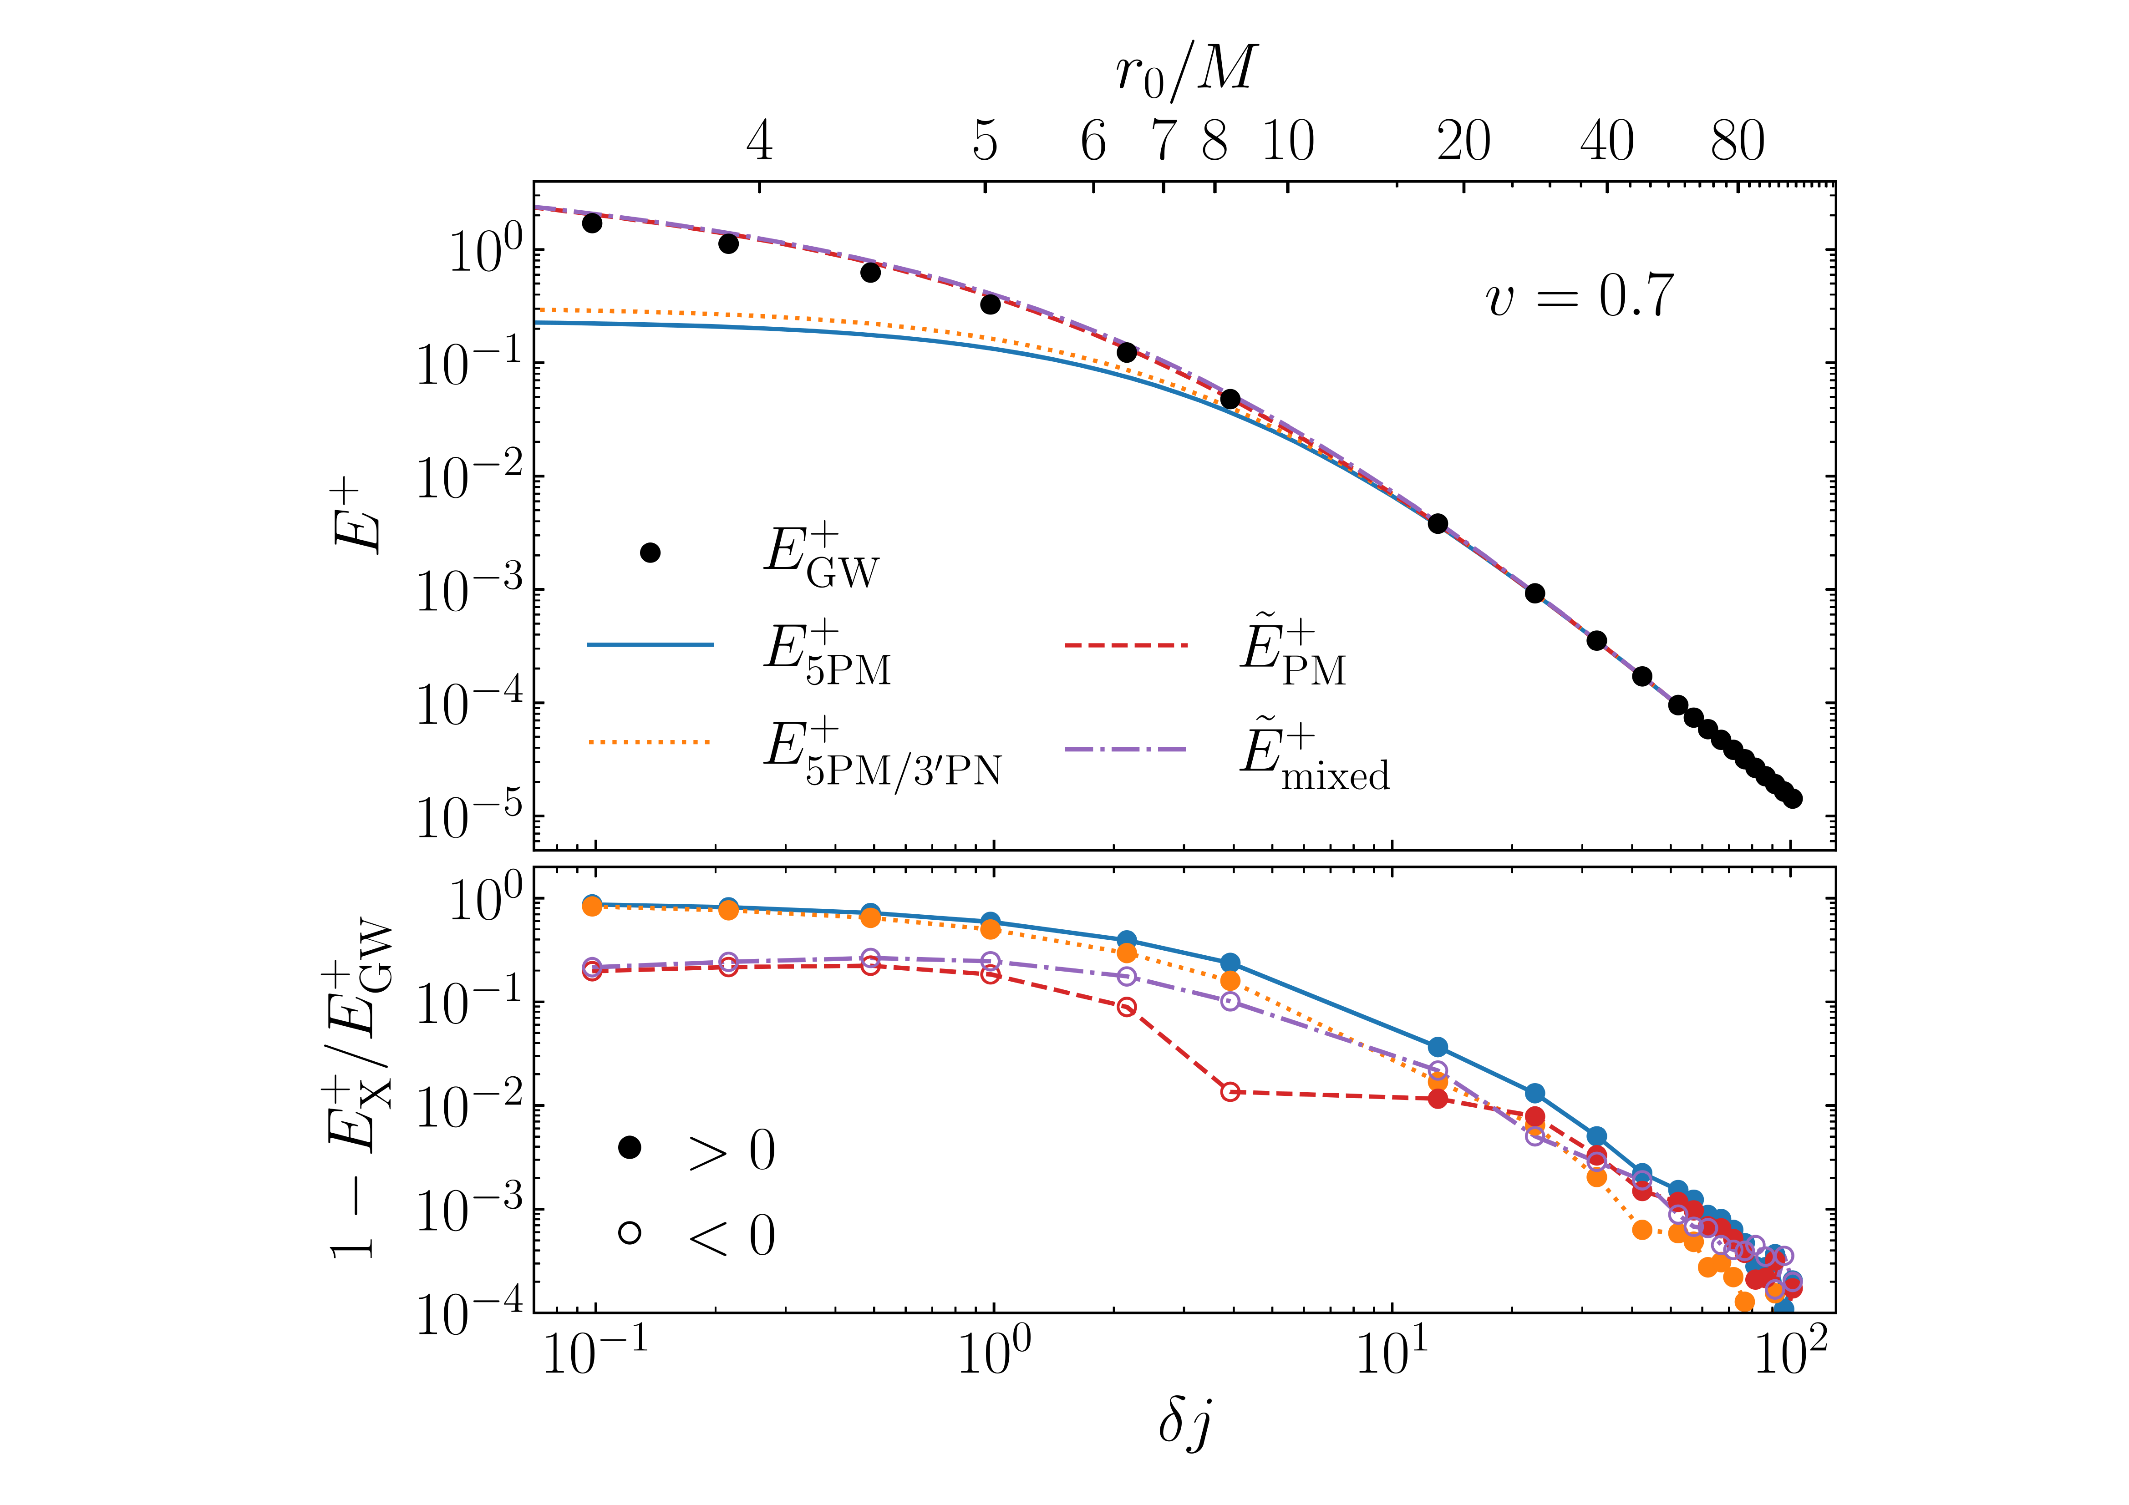
Proof of the Pudding
Emitted energy in scattering with (non-EOB) resummation
Barack, Gonzo, Leather, Long, & Warburton

Slide 37
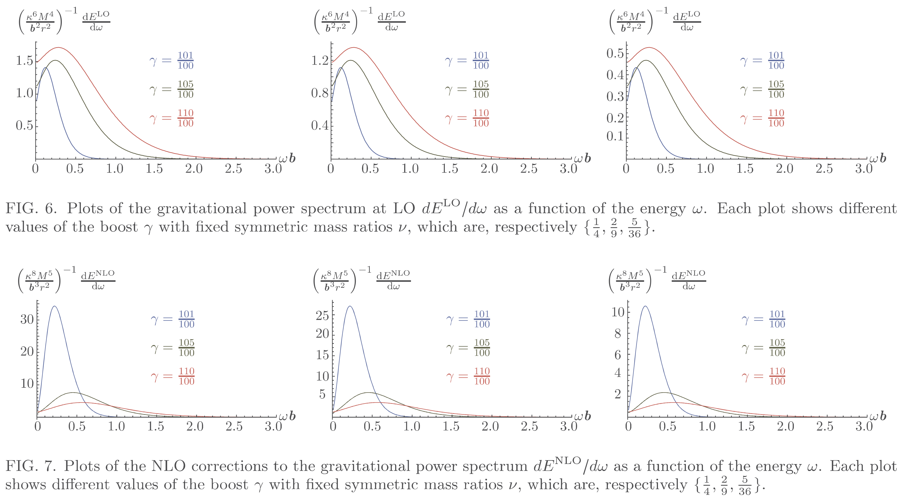

Power Spectra
LO vs NLO power spectra $\frac{dE}{dω}=\frac{2}{κ^{2}}∫dΩ \sum_{h}{{\left|ω 𝒲_{h}\left(ω,Ω\right)\right|}^{2}}$
w/G. Brunello and S. De Angelis

Slide 38
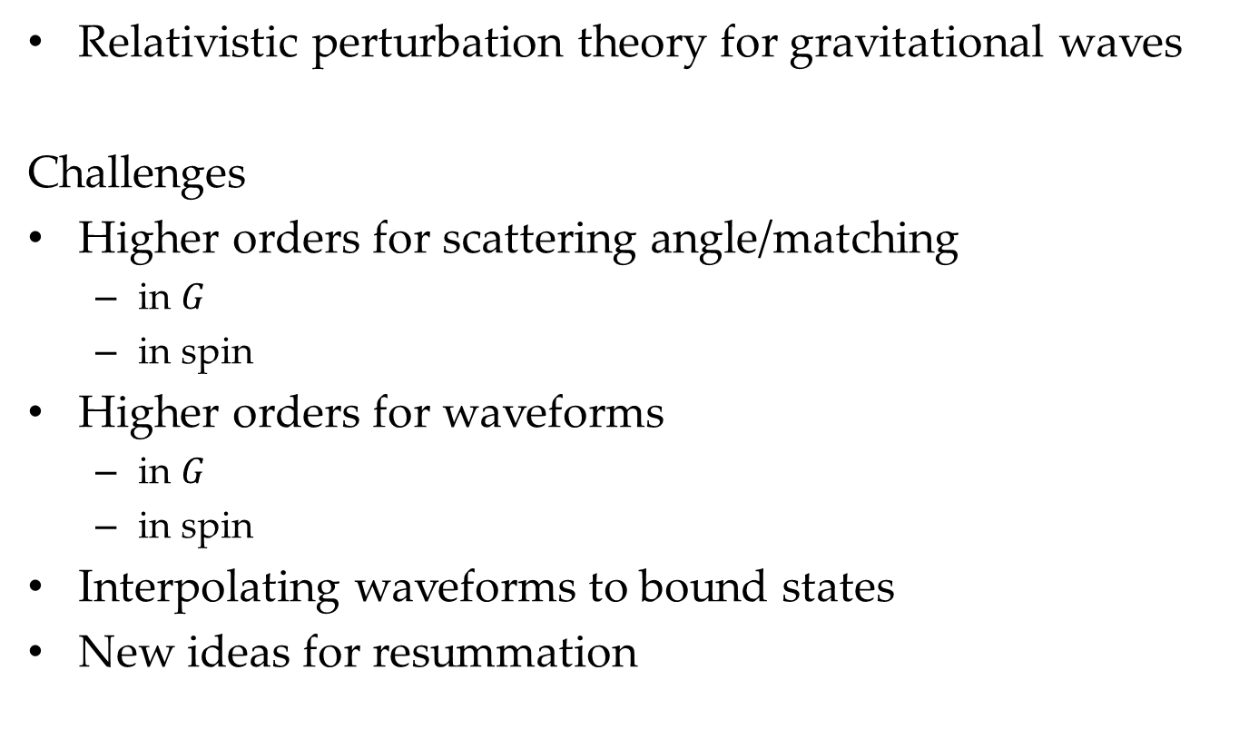
Summary & Outlook
Relativistic perturbation theory for gravitational waves
Challenges
Higher orders for scattering angle/matching
  in $G$
  in spin
Higher orders for waveforms
  in $G$
  in spin
Interpolating waveforms to bound states
New ideas for resummation

