Slide 1
IPAC2026 Preparation
IUPAP WG14 Meeting#23
17 February 2026

Slide 2
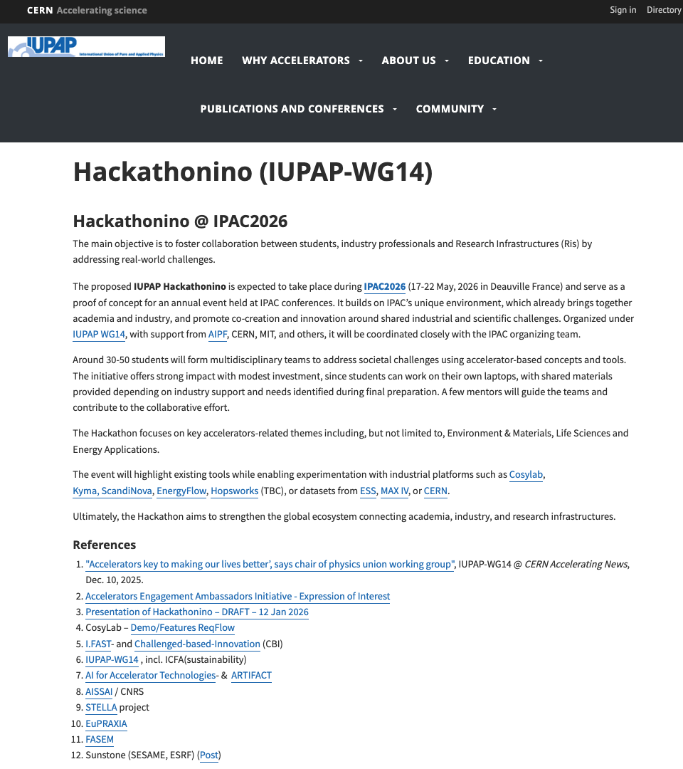
Intro & Interfaces
IUPAP/WG14 Exec. meeting scheduled Wed. 20/05 from 16-18h
Hackathonino preparation: webpage →
Presentation of Hackathonino – DRAFT – 17 Feb. 2026
Preliminary Working Breakdown Structure (WBS)
Google Drive available Here
References:
AISSAI / CNRS
Email: Call for challenges & case studies, AISSAI Hackathon on AI for Accelerators
AI for Accelerator Technologies- & ARTIFACT
I.FAST- and Challenged-based-Innovation (CBI)

Slide 3
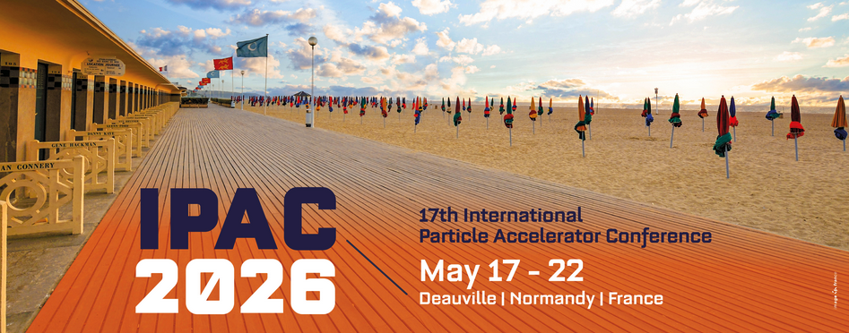
Admin IUPAP-WG14 Hackathonino Prepa
Incl. announcement on page IPAC’26, IUPAP/WG14 LinkedIn, IUPAP WG14 → CD to Provide text/images/link
Add a link to a registration formula IPAC’26 → Hanna Frånberg (IPAC Organizer)
IPAC’26 to provide mails of registered a)Exhibitors and b)Students by end of March (early bird) so that we can send the information
Current status:
ScandiNova can finance Lunch-boxes (30-50 participants - IPAC meal info)
Support one student registration ? 475 Euro (Early bird by March 15) – WG14 member to vote
More financial Support to find:
RI – German Physical Society ?
Via Accelerators Engagement Ambassadors Initiative - Expression of Interest

Slide 4
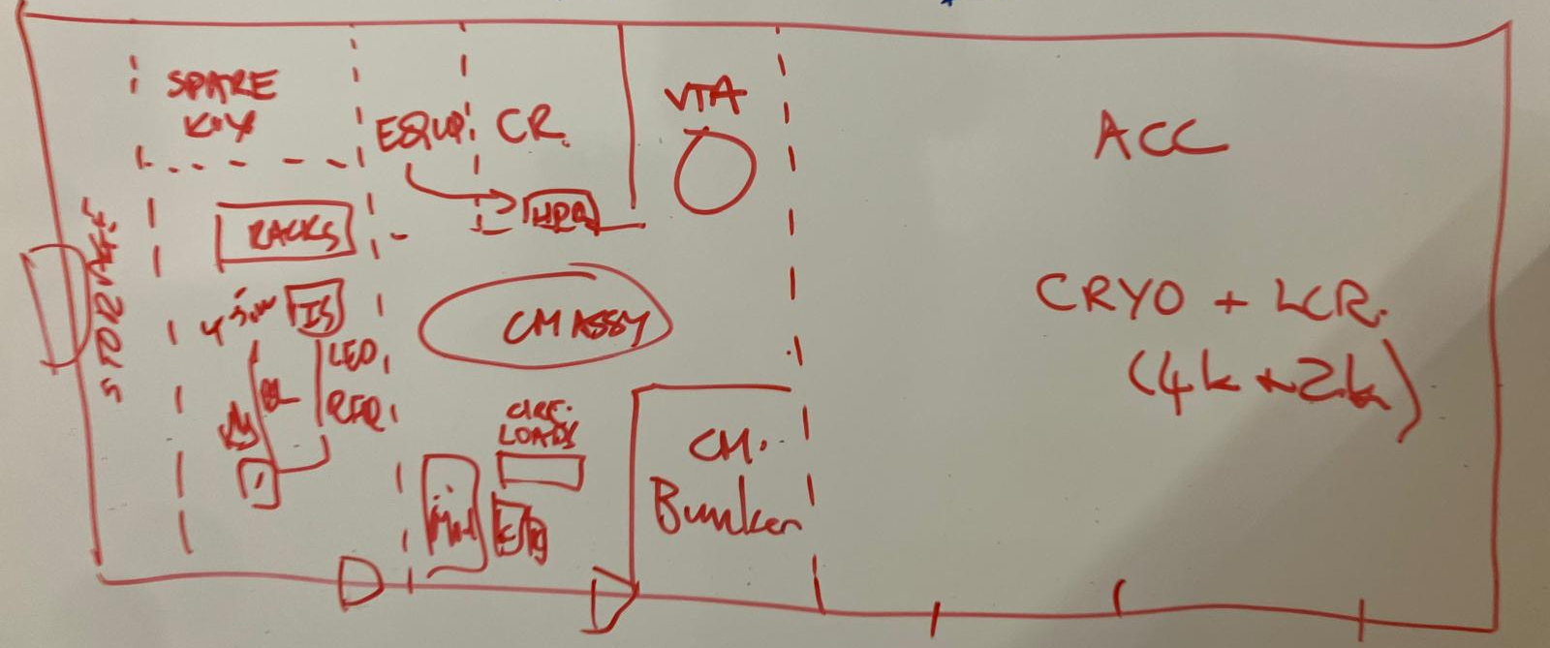
Call for case studies
Synergies ESS & SNS
LogBook ML tools (Fulvia?)
Test stands for Accelerator components (e.g. Kevin Jones’s sketch)
Use ReqFlow (CosyLab)
Build from scratch or improve any accelerator systems
FCC, CANS, Test stand, beam test stand, etc..
➔ Please send your suggestions of challenge descriptions
- Send one-page with clear requirement to christine.darve@ess.eu
Example: Email-Call for challenges and case studies – AISSAI Hackathon on AI for Accelerators

Slide 5
Call for case studies
Thibault’s examples:”
Something that’s really “trendy” at the moment is Stellarator optimization. To give you an idea, I found this recent article, which provides a pretty good overview of the different approaches if you scroll through it: https://arxiv.org/pdf/2506.19583. In Europe, Proxima Fusion (two of whose alumni are from PSFC) is quite active and interesting in this area.
ITER and UKAEA are developing large fusion shot databases (UKAEA: https://www.ukaea.org/service/fair-mast/), which could serve as a basis for machine learning in fusion. At PSFC, Cristina Réa is the lead on these topics. One could also explore synthetic disruption models.
A more “low-level” topic is the confinement of alpha particles in tokamaks, which is becoming relevant again in the context of stellarators. More generally, one could work on “bathtub models” to study fusion, energy yields, the need to confine alpha particles, tritium breeding issues, etc.
I could prepare a mini-project on these topics based on my Fusion course. The idea would be to revisit and deepen some parts of this reference: https://assets.cambridge.org/97805217/33175/copyright/9780521733175_copyright_info.pdf.”

