Slide 1
IUPAP WG14 – Meeting #23
Approval of earlier Minutes
Christine Darve
February 2026
Tuesday Feb. 17 at 10 am CET – Prepa: https://indico.global/event/16400/
Tuesday Feb. 17 at 5 pm CET : https://indico.global/event/16401/

Slide 2
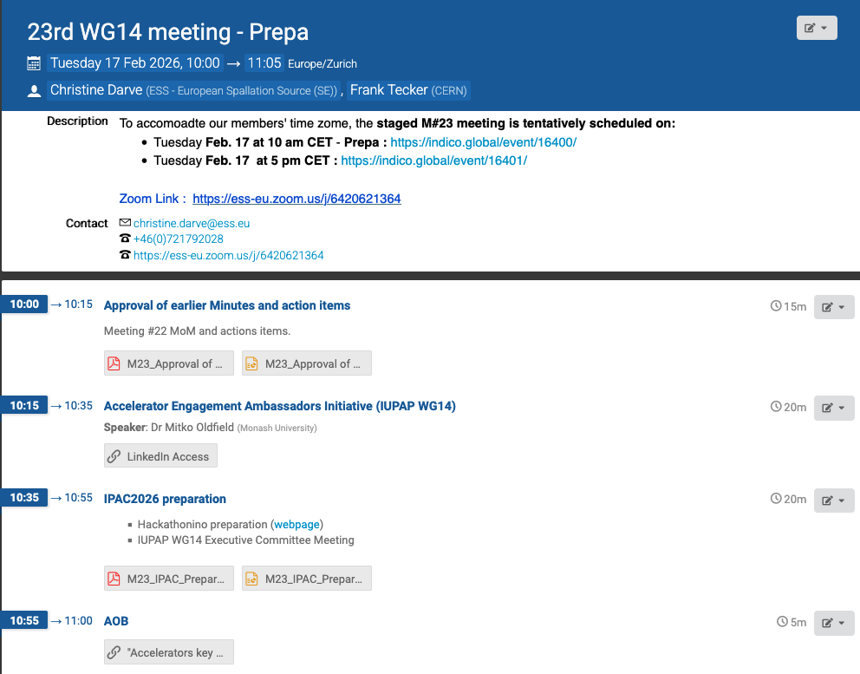
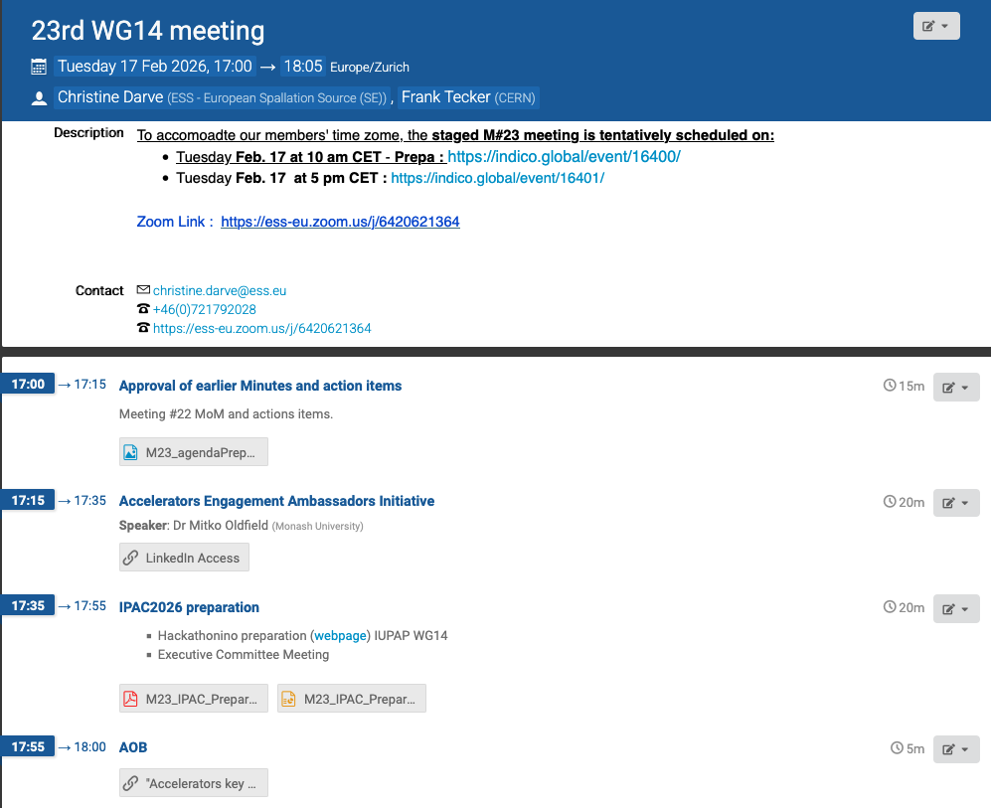
https://indico.global/event/16401/
https://indico.global/event/16400
Prepa

Slide 3
Pending actions – from Meeting #22 (December 2025): https://indico.global/event/15869/
Action Item 1→ CERNBox: GUIDELINE FOR ACCELERATOR DEVELOPERS TO SUPPORT RADIATION THERAPY: REPORT FROM IUPAP WG-14 and Google
“Tasks for report preparation:
1. Ask for volunteers / assign people to write or complete various sections. Authors should initially copy their section, append and edit, and send back the edited section for inclusion into the master document.
2. Decide where is the best place to submit the report for distribution to reach the appropriate audience (e.g. publish a journal paper?, load to a website?)”

Slide 4
Pending actions – from Meeting #22 (December 2025): https://indico.global/event/15869/
Action Item 3 – Ongoing : The IUPAP Rejuvenation. Proposal from 2025 discussions Proposed text to summarize WG14 Scope and Mandate:
Knowledge exchange: Foster collaboration among scientists and accelerator lab directors worldwide to advance particle accelerator innovation.
Talent development: Verify feasibility to train early-career scientists through lab-university collaborations, providing access to leading experts, equipment, and techniques.
Promote applications: Support accelerator use in industrial, medical, energy, and environmental sectors.
Resources & communication: Develop networks (e.g., Ambassadors), webpages, and conference presence to share scientific advancements and societal impacts.
Sustainability alignment: Map and review accelerator applications supporting SDGs, including life sciences, healthcare, research, and technology.
Community cohesion: Organize conferences, workshops, and forums to unify the global accelerator community.
Accelerate progress: Facilitate information sharing, joint procurement, and exchange of equipment, ideas, and personnel among labs globally.”

Slide 5

Pending actions – from Meeting #22 (December 2025): https://indico.global/event/15869/
Action Item 4 – Completed Mitko will create a LinkedIn Ambassador Page to support dissemination of professional news and community engagement.
IUPAP Accelerator Science Communication
LIVE since January 28, 2026!
More than 121 followers (Feb 15) and growing community
Presentation of Accelerator Ambassadors
A portail for all of us !
Jade Fischer & Olivia Masella (Canada)
Dr Maria Paula Rey-Barrera (Colombia / Switzerland)
Dr Hannah Wakeling (United Kingdom)
Annabella Zamora (Switzerland)
Dr Sanae Samsam (Morocco / Italy)

Slide 6

Open questions to complete ToR w.r.t. IUPAP restructure ?
→ Add Associated member: C13 interface by Joe Niemela or Thierry d’Almeida (Benin) ?
(to replace Sekazi Mtingwa/LAAAMP)
where feasible, WG14 aims to organize or support the awarding of medals (award ) or other recognitions of excellence in the field of accelerator science. These initiatives may be developed in collaboration with other IUPAP Working Groups and Commissions to ensure broad engagement and alignment with the Union’s values.
Current proposal : IAEA AccConf. and IUPAP stand – https://nucleus.iaea.org/sites/accelerators/AccConf2026/SitePages/Home.aspx
Support one award: 500 Euro – WG14 member to vote

Slide 7
Storing data
WG14 - webpage
International Union of Pure and Applied Physics (IUPAP) WG14 - Accelerator Science
WG14 Documents storage:
CERNBox : Access : https://cernbox.cern.ch/s/fzIlZ8y2Immi9vD
Google drive: https://drive.google.com/drive/folders/1gWm8WDKYApnhECyCRrLoi9Akq9KfveFa

