Slide 1

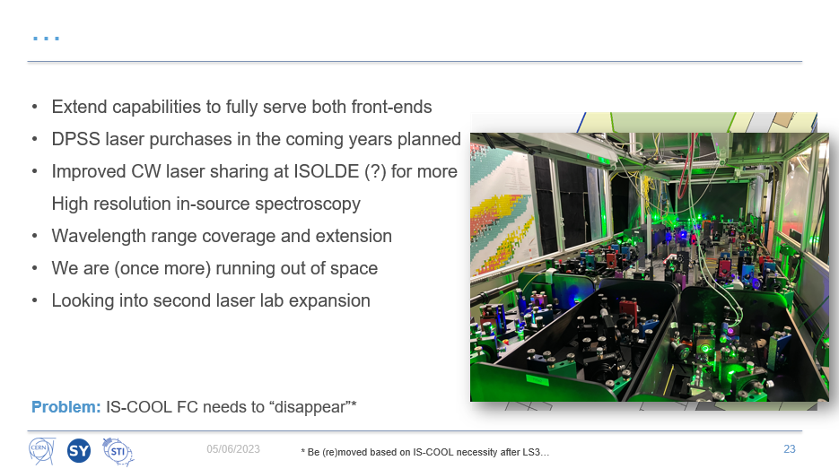

Slide 2
ISCOOL in LS3 and other low-energy beamline upgrades
Lukas Nies (SY-STI-LP)
03 / 02 / 2026

Slide 3
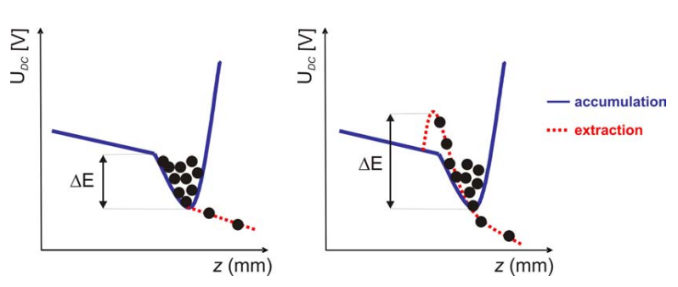
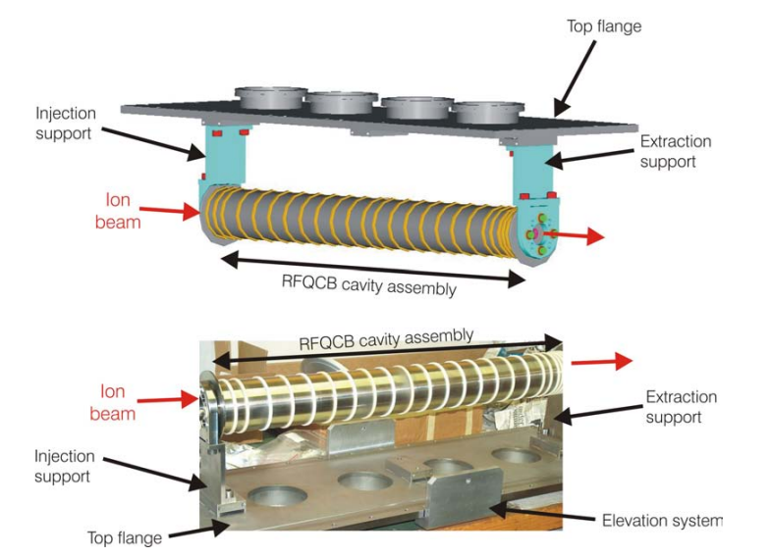
ISCOOL: The ISOLDE Ion Beam Cooler-Buncher primary hardware: remains unchanged
Receives ion beams from HRS frontend
Accumulation, cooling and bunching through He buffer-gas collisions
Either DC or bunched beam mode
Ivan Podadera – Thesis (2007) – EDMS 1072182

Slide 4
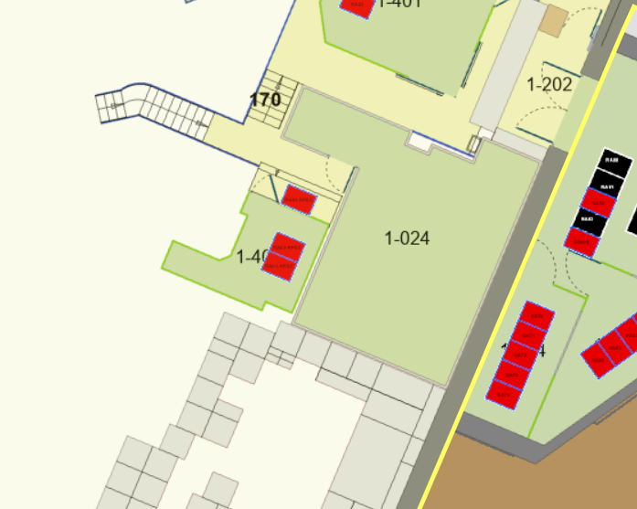
ISCOOL: The ISOLDE Ion Beam Cooler-Buncher secondary hardware: to be relocated
Green HT cage including the two racks + access rack
Decabling of all machine side cables (between HT cage and primary hardware)
Recabling/Extension of cables from EN/EL and EPC
ACC-CONS request for consolidation of some of the PLCs and RF drivers (more later)

Slide 5
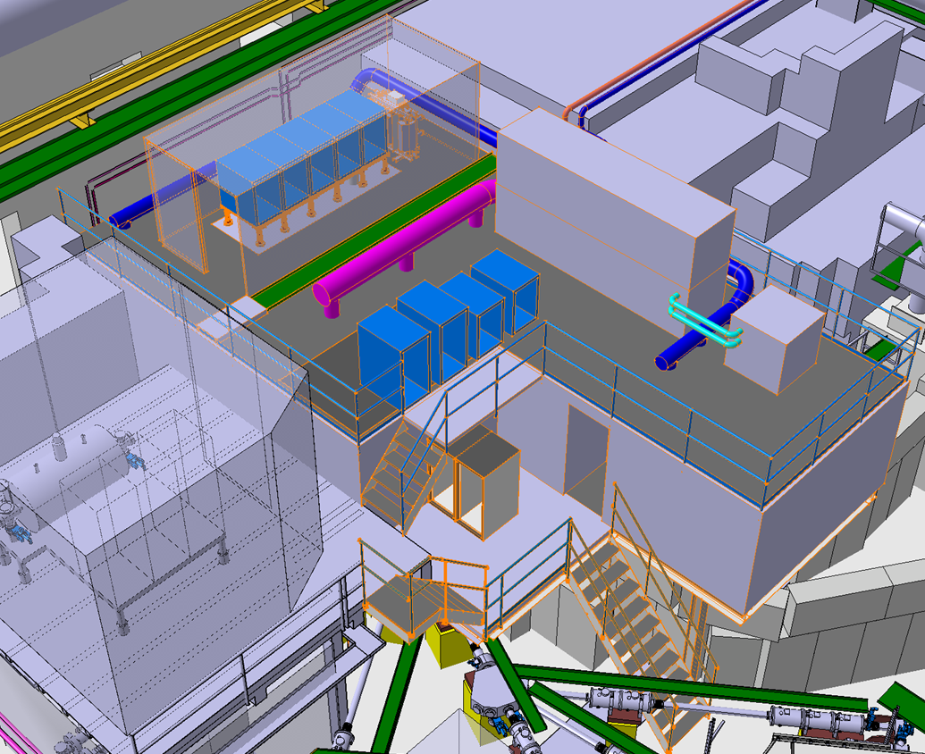
Secondary hardware relocation
HV Cage
HV Rack will move on top of RILIS cabin
EPC and EP racks (HT power supply, interlock and access, user hardware) will be located also on top of cabin
New RILIS cabin

Slide 6
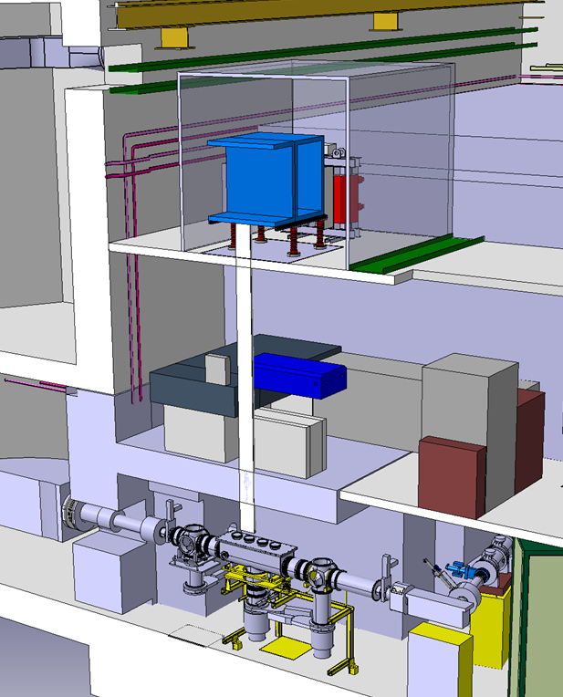
Secondary hardware relocation
HV Cage
HV Rack will move on top of RILIS cabin
EPC and EP racks (HT power supply, interlock and access, user hardware) will be located also on top of cabin
Extra distance to be compensated by new “HT tube” design
HT tube through RILIS cabin
Primary hardware

Slide 7
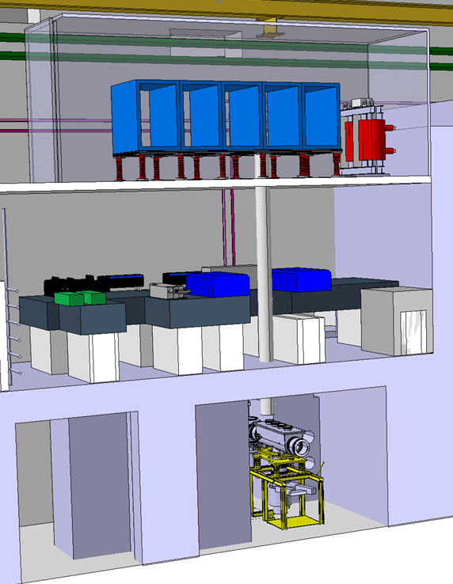
Secondary hardware relocation
HV Cage
HV Rack will move on top of RILIS cabin
EPC and EP racks (HT power supply, interlock and access, user hardware) will be located also on top of cabin
Extra distance to be compensated by new “HT tube” design
HT tube through RILIS cabin
Primary hardware

Slide 8
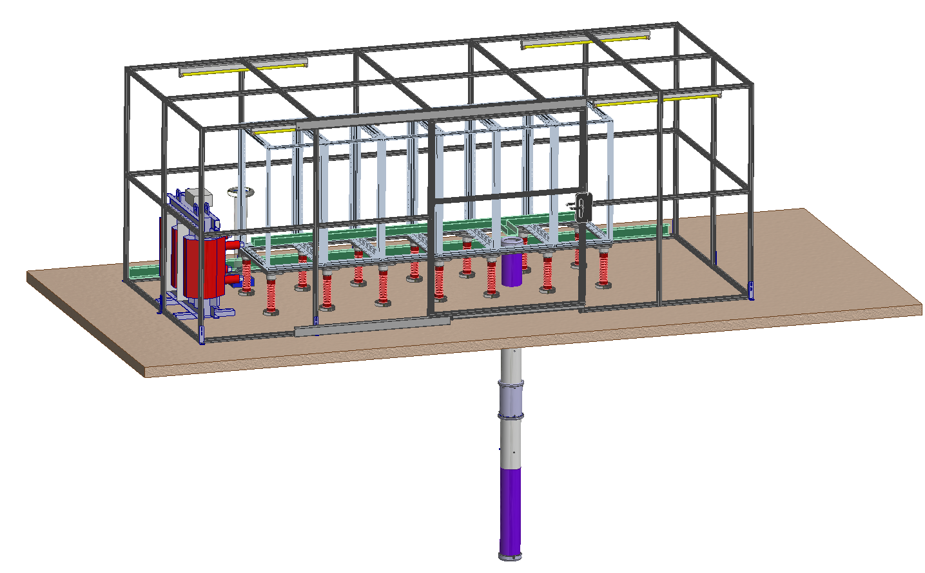
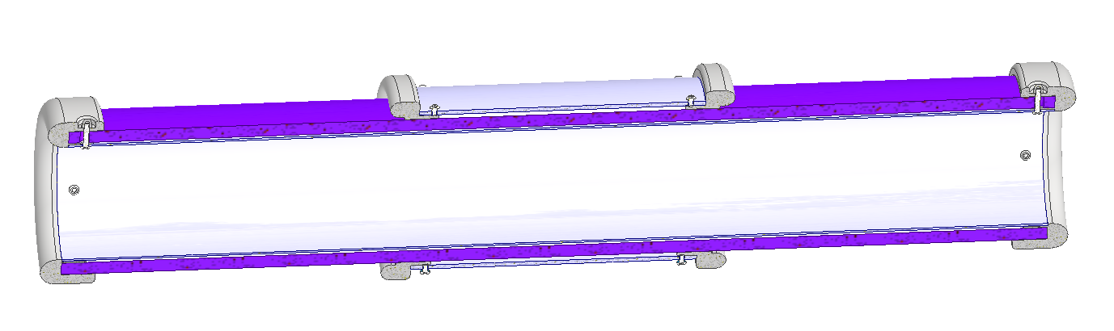
High-voltage cage and tube design
Maximize cage volume and rack space with the given roof constraints
Use lightweight extruded aluminium profiles, reuse PUMA-RC6 design
Reusing Boris tube design from IBDRS project
Expanding racks space: more space for services
Transformer
Insulators
Boris tube through RILIS cabin

Slide 9
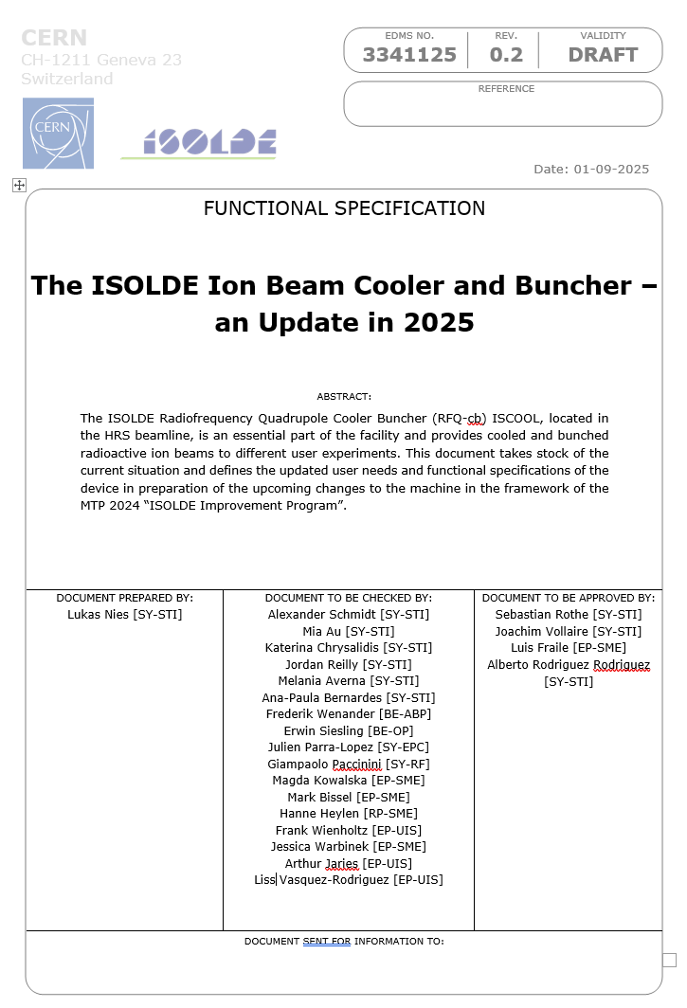
Updated Functional Specifications and CONS
User requirements and new insights into device operation after 15 years motivate update
New functional specs. submitted
Information from equipment owners required: estimation of rack space and power consumption on-platform
Basis for ACC-CONS request submitted this round

Slide 10
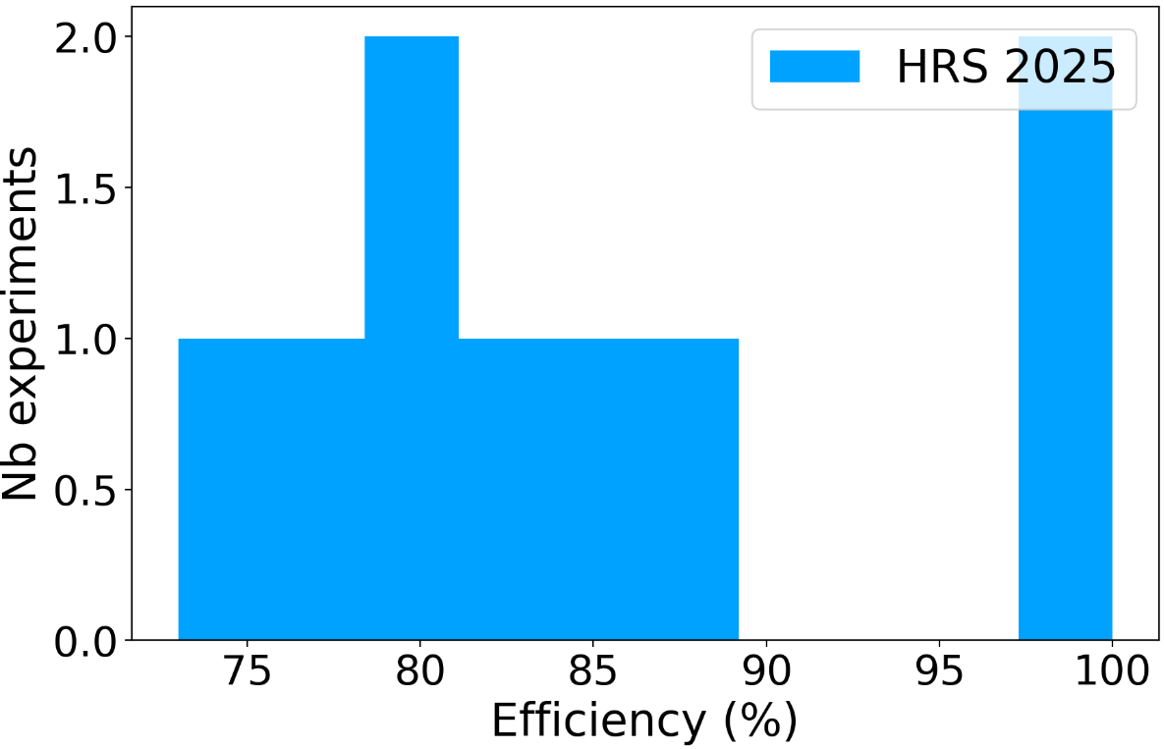
Updated Functional Specifications and CONS
User requirements and new insights into device operation after 15 years motivate update
New functional specs. submitted
Information from equipment owners required: estimation of rack space and power consumption on-platform
Basis for ACC-CONS request submitted this round
*Transmission*

Slide 11
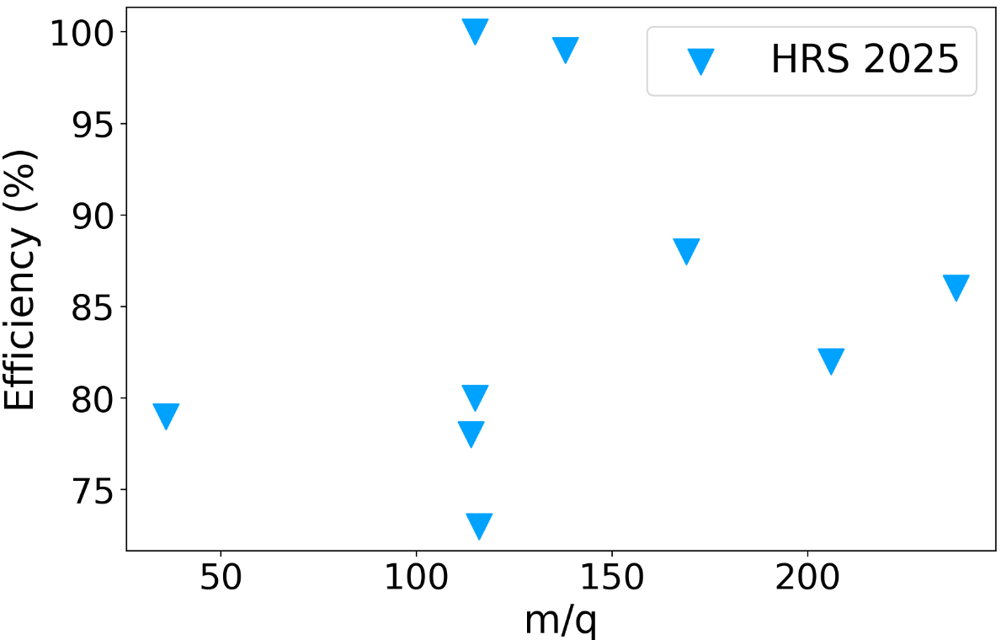
Updated Functional Specifications and CONS
User requirements and new insights into device operation after 15 years motivate update
New functional specs. submitted
Information from equipment owners required: estimation of rack space and power consumption on-platform
Basis for ACC-CONS request submitted this round

Slide 12
User Feedback between LS2 – LS3
Since 2014, efficiency has consistently improved from 30% to up to 80%, but temporal widths also increased from a reported 500ns to more than 2us
From a molecular spectroscopy experiment it was deduced, that only 50% of the ion beam was cooled to room temperature
The way how the readout of the HT platform potential using EP-UIS hardware is done may need to be revised as for some experiments significantly more noise was observed than through others
The temporal width of the bunches is too long for certain users to efficiently recapture the bunches in their experiments
It was observed that, when switching between LIST and PI-LIST modes, frequent retuning of the downstream beamlines after ISCOOL were necessary, even though the emittance of the delivered bunches from the device should be independent from the ion source mode
The observed performance for low atomic masses, especially on Li and Be was poor, attributed to inefficient trapping, as well as charge exchange and molecular formation due to buffer gas impurities
During high-sensitivity measurements, i.e. with extremely low rates and single-ion detection, it was observed that ISCOOL serves as a constant source of ions (in a low particles per second rate) with a memory of previously transmitted beam. The mechanism behind this is not understood but likely poses no issue to user experiments.

Slide 13
Consolidation request for LS3
 | Model (Suggestion) // Comments | Quantity | Estimated Price (kCHF) |  | 2025 |  |  |  | 2026 |  |  |  | 2027 |  |  |  | 2028
 |  |  |  |  | Q1 | Q2 | Q3 | Q4 | Q1 | Q2 | Q3 | Q4 | Q1 | Q2 | Q3 | Q4 | Q1 | Q2 | Q3 | Q4
HV CAGE RELOCATION AND PRIMARY INFRASTRUCTURE
Cabling work off-platform | EN-EL | 1 | 10 |  |  |  |  |  |  |  |  | 9 | 3
Cabling work on-platform | EN-EL, SY-STI | 1 | 5 |  |  |  |  |  |  |  |  |  | 1 | 1 | 1
HV Cage | SY-STI | 1 | 10 |  |  |  |  |  |  |  | 4 | 4 | 1
Racks and insulators | SY-STI | 1 | 5 |  |  |  |  |  |  |  |  | 3 | 2 | 1
Misc |  | 1 | 5 |  |  |  |  |  |  |  |  |  | 1 | 1 | 1 |  | 2
Total |  |  | 35
Total per year |  |  |  |  |  |  |  |  | 20 |  |  |  | 13 |  |  |  | 2
RF DRIVER SYSYEM
400W RF Amplifiers | online + offline (spares), commercial | 6 | 110 |  |  |  |  |  |  |  |  |  | 50 | 60
Transducer box | online + offline (spares), in-house (SY-RF) | 6 | 15 |  |  |  |  |  |  |  | 5 | 5 | 5
RF generators and digital scop | offline (spare) | 1 | 5 |  |  |  |  |  |  |  |  | 2 | 2 | 2
Misc |  | 1 | 5 |  |  |  |  |  |  |  |  |  | 1 | 1 |  |  | 2
Total |  |  | 135
Total per year |  |  |  |  |  |  |  |  | 12 |  |  |  | 121 |  |  |  | 2
POWERLINE CONVERTERS AND FAST SWITCHES
Transformer and interfaces | online + offline (spare) | 2 | 35 |  |  |  |  |  |  |  | 2.5 | 5 | 12 | 12 | 3.5
Switches | online + offline (spare) | 6 | 4 |  |  |  |  |  |  |  |  |  | 2 | 2
ISEG -20kV module | ISEG EHS-42-200n | 1 | 6 |  |  |  |  |  |  |  |  |  | 3 | 3
Fast voltage amplifiers | EDA-01892, online + offline (spare) | 6 | 6 |  |  |  |  |  |  |  |  |  |  |  |  |  | 3 | 3
Fast voltage amplifiers, crate | online + offline (spare) | 2 | 3 |  |  |  |  |  |  |  |  |  |  |  |  |  | 3
DSS Ressources, 4 weeks |  |  | 10 |  |  |  |  |  |  |  |  | 2.5 | 7.5
Misc |  |  | 3 |  |  |  |  |  |  |  |  |  | 1 | 1 |  |  | 1
Total |  |  | 67
Total per year |  |  |  |  |  |  |  |  | 10 |  |  |  | 47 |  |  |  | 10
Total per Q
Total per year |  |  |  |  |  |  |  |  | 42 |  |  |  | 181 |  |  |  | 14
FULL TOTAL |  |  | 237 kCHF
35 kCHF
If funded would relief some stress on the RILIS budget

Slide 14
Proposed improvements funded through IIP
TOTAL IIP GRANTED BUDGET | 100 kCHF
RF system improvements | 10
Alignment of extraction orifices | 5
Investigate if vacuum can be merged with normal hall recuperation line | 0
Move gas system outside the cage (i.e. proper gas system) | 20
Refurbish gas injection system (hysteresis) | 15
Investigate electrode crosstalk | 5
MagneToF after RFQ-cb | 30
Perform beam bunching studies on low-mass beams (Li) | 0
OL2 RFQ R&D | 15
TOTAL COST ESTIMATE | 100
Other ideas?

Slide 15
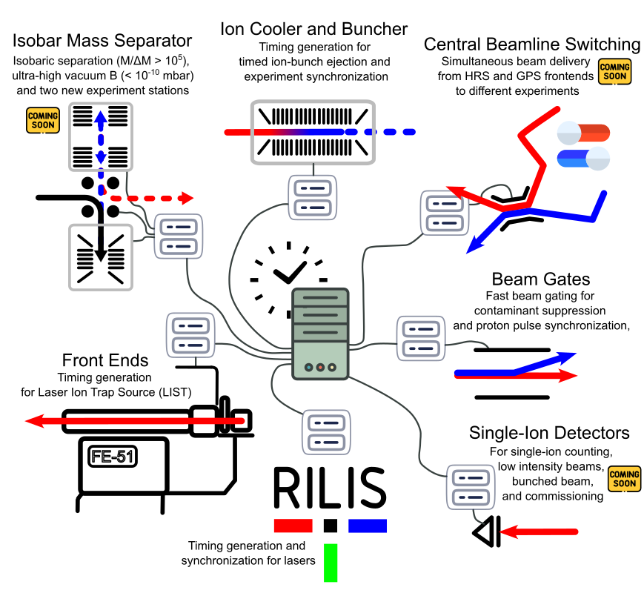
Central ISOLDE Timing
New and existing projects will benefit from the (proposed) implementation of a centralized timing server
Central beamline switching: potential for more (CRIS) beamtime
Easier control and better diagnostics over ISCOOL
Online beam composition checks with ISOLDE MR-ToF MS

